Slide 1
320: Understanding place value and division
Notes:
Overview
This is a suggested presentation/workshop to support a short PD session focusing on an element of mathematics that students find challenging.
This presentation accompanies Video 5 (https://vimeo.com/437769539) from the NCETM’s Mathematical Prompts for Deeper Thinking pages and focuses on students’ understanding of place value and division.
This workshop might be a part of an input at a department meeting, at a PD meeting across a Maths Hub or for a group of interested teachers to work on together.
Timing
A minimum suggested time for this workshop is 30 minutes, including the video (which is 5 minutes and 55 seconds long)
Adaptation
You might choose to adapt these slides to fit the context in which you are leading the PD.
There are three key components to this workshop which we suggest should be included
Participants should have an opportunity to work on the task and predict what students will do (Slide 2)
Participants should watch the video and have a time for focused reflection on their predictions and other observations (Slides 3, 4 and 5)
Participants consider next steps in addressing issues raised in the workshop. To support this we suggest tasks from the NCETM’s Secondary Mastery PD Materials (Slide 9)
There are optional slides (Slides 6, 7 and 8) that offer prompts to focus and catalyse discussion and conversation around some of the points that are likely to have been raised by the video.
Slide 6 and Slide 7 show the outcomes of tests carried out to explore students understanding of place value within calculations.
Slide 8 compares some questions used for research and gives an opportunity to compare these with the task in the video. This comparison may be useful in identifying the important features of the task.
Unless otherwise stated, all of the tasks offered in this video are taken from Core Concept 1.3 Ordering and comparing from the Secondary PD Materials
https://www.ncetm.org.uk/media/xp2m3gio/ncetm_ks3_cc_1_3.pdf

Slide 2
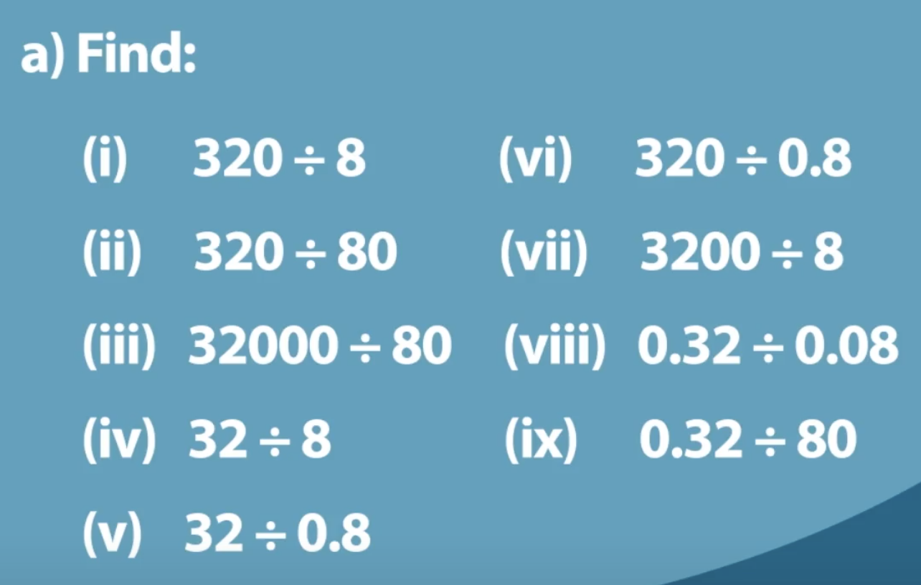
Work on this task for yourself and think about how you’d find the answer to each question.
Once you’ve made your decisions, think about some KS3 students you teach.
How do you think they would work through the questions?
Link to Core Concept 1.3
Notes:
NOTE TO SESSION FACILITATOR
Make sure that sufficient time is given for participants to explore the task themselves.
It is important that time is given to discussing what students might do, what their reasoning might be and to predicting some of the related misconceptions that might be revealed so that participants are able to watch the video with these aspects as a focus.
This task is taken from Page 14 of the NCETM’s Secondary PD Materials Core Concept 1.3 Ordering and comparing. There is a link to this document on the slide.

Slide 3
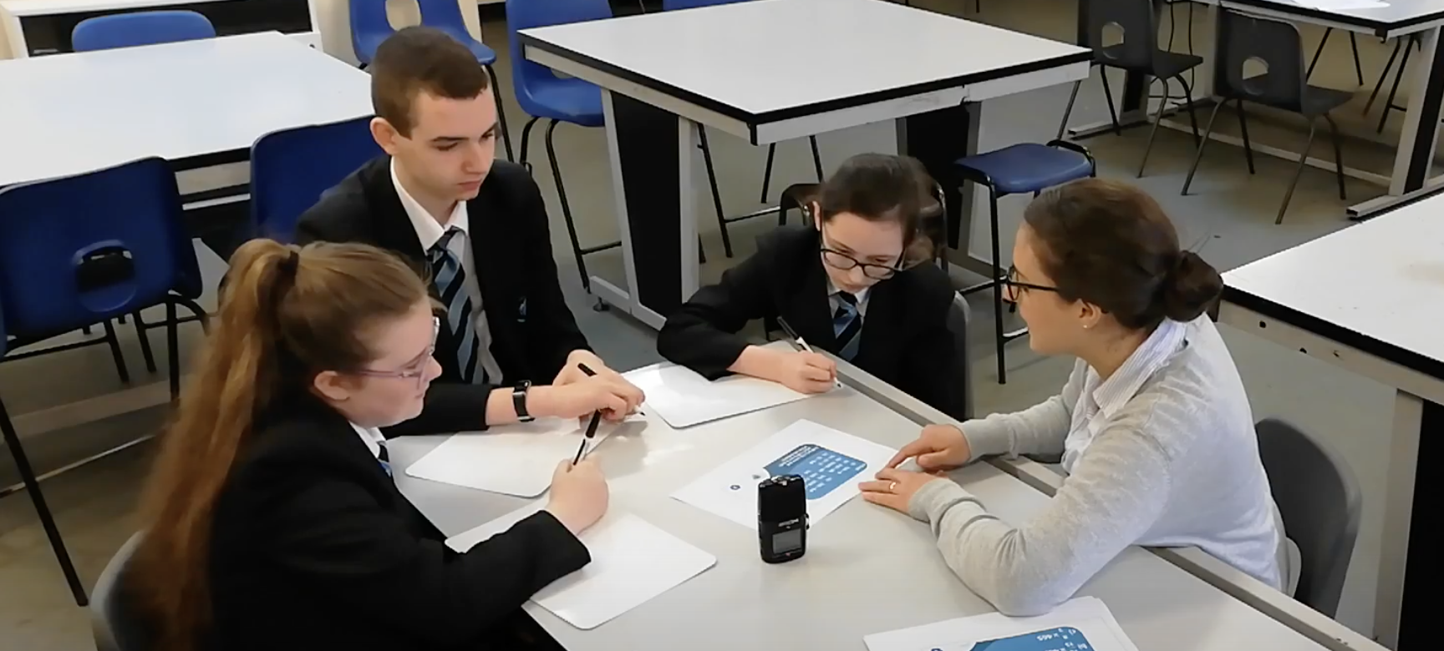
Watch the video in which three Year 8 students discuss this prompt with their teacher.
While watching, keep in mind the predictions that you made.
Do these students show the same thinking that you expected?
What strikes you about the responses and reasoning from these students?
Notes:
The slide text Watch the video is hyperlinked to the video

Slide 4
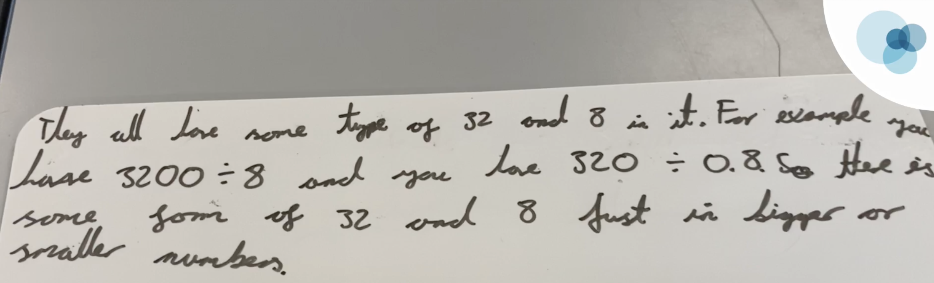
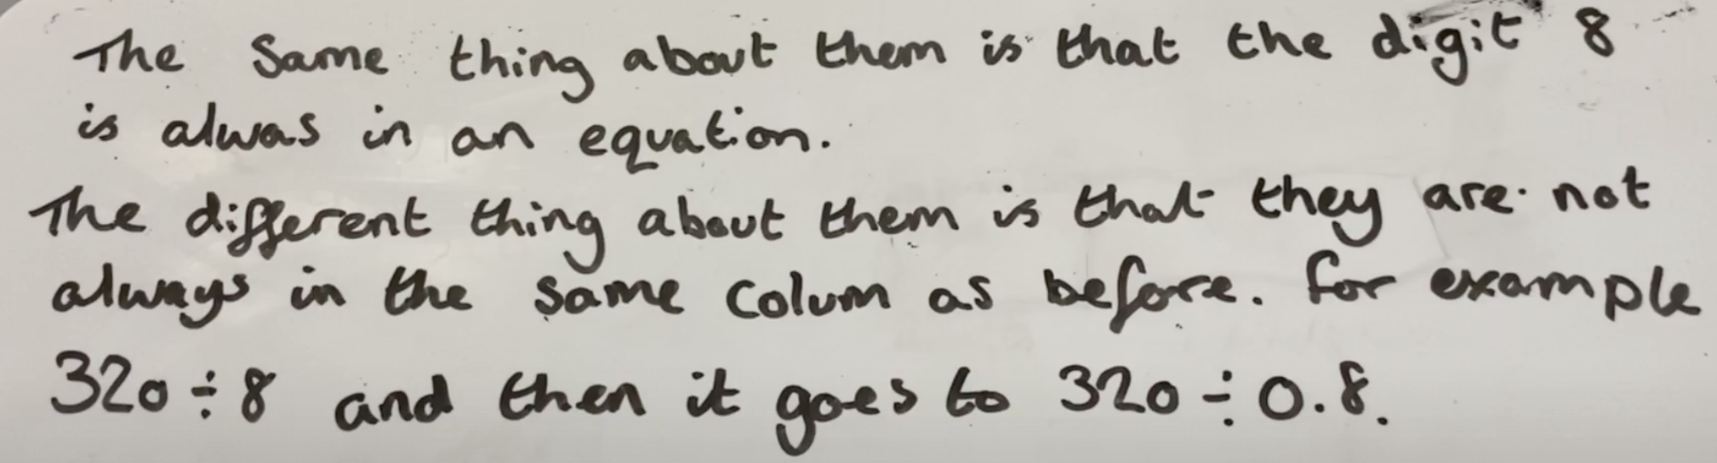
Sophia and Jasmine both identify that the digits are the same in all of the calculations, but the value of the digits changes as they change position.

Slide 5
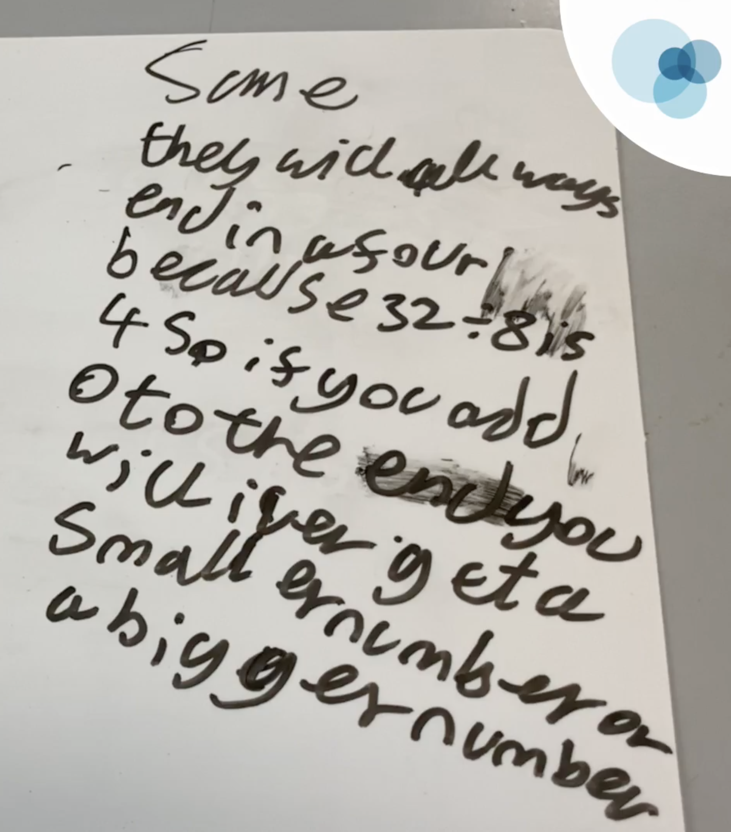
While John notices that the different values of the digits will impact on the value of the quotient, but not the digits that form it.
In what ways might this be a significant difference?
Battista (2012) suggests that there are ‘two interrelated components of students’ understanding of place value’, namely:
understanding place value in individual numbers, and
understanding place value in computational algorithms for arithmetic.
Do you recognise this distinction in the video?
Notes:
NOTE TO SESSION FACILITATOR
This slide is animated so the second paragraph appears on a click.
You might like to suggest that in the video Sophia and Jasmine show an example of the first of Battista’s ‘components’, while John demonstrates both.
It may be fruitful to consider whether this would be the case if, rather than division, multiplication had been used (this is explored further on the next two slides).
It may also be fruitful to consider with the participants what line of questioning might a teacher pursue in order to draw out this distinction and prompt some further thinking from the students?
You might like to have tried the task with some students so that you can share your experience with the participants at this point.
The distinction described is taken from Battista, Michael T. (2012) Cognition-based assessment and teaching of place value: building on students’ reasoning.

Slide 6
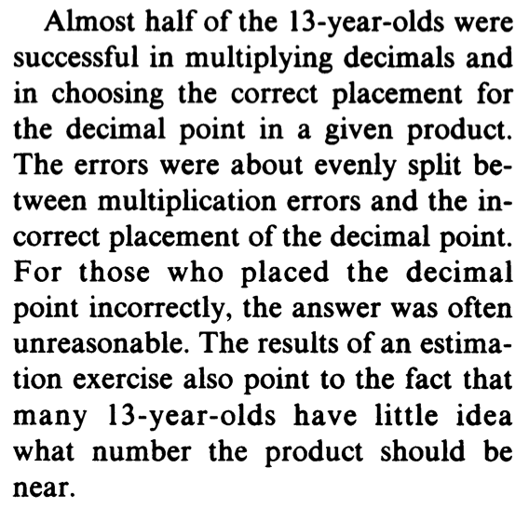
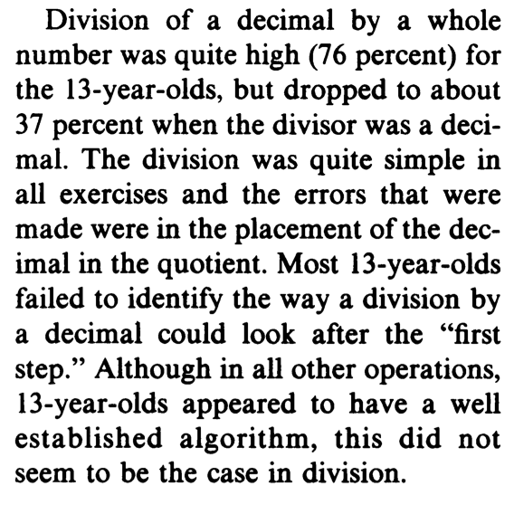
Reviewing the mathematics assessment of the National Assessment of Education Progress in the US, Carpenter et al. (1981) write
Do you think that these percentages would be different if repeated with students now?
Do you think that discussing place value tasks as in the video would support students in understanding the structures and relationships (and so answering the questions correctly)? What other tasks might help?
Notes:
NOTE TO SESSION FACILITATOR
This is an optional slide which discusses the results of a national progress test in the US.
Note that ‘division of a decimal by a whole number was quite high (76%)… but dropped to about 37% when the divisor was a decimal’.
You might like to ask the participants whether they recognise this description
You might like to have asked your class some questions to see whether your students show the same shifts in understanding.
You might also like to raise as a discussion point with participants that, comparing the attainment of students of different ages Carpenter et al noted that, ‘although performance increased about 20 percentage points from age 13 to age 17, many areas of difficulty for 13-year-olds were still problem areas for the 17-year-olds’
The extract is taken from Carpenter, Thomas P., et al. “Decimals: Results and Implications from National Assessment.” The Arithmetic Teacher, vol. 28, no. 8, 1981, pp. 34–37. JSTOR, www.jstor.org/stable/41191870.

Slide 7
Hart et al (1981) asked students to;
Ring the one which gives the BIGGER answer:
8 ✕ 4 or 8 ÷ 4
8 ✕ 0.4 or 8 ÷ 0.4
0.8 ✕ 0.4 or 0.8 ÷ 0.4
And found that the responses were as follows:
 | 12yrs old | 13yrs old | 14yrs old | 15yrs old
✕ ÷ ÷ | 13% | 8% | 15% | 18%
✕ ✕ ✕ | 50% | 58% | 47% | 30%
Do you think that these percentages would be different if repeated with students now?
What do you think accounts for the fact that the majority of students in the study stated that the multiplications were bigger and the divisions were smaller?
What other tasks might help students address these misconceptions and think about the structures involved?
Link to test paper
Notes:
NOTE TO SESSION FACILITATOR
This is an optional slide that again offers outcomes from an assessment.
This is from the CSMS Tests carried out in the UK in the late 70s and designed to assess students’ understanding of key topics.
The results from the tests were discussed in Kath Hart’s book, Children’s Understanding of Mathematics: 11-16
(There is a link to the test papers that the question is taken from on the slide).
You might like to have tried this task with some students so that you can share your experience with the participants at this point.

Slide 8
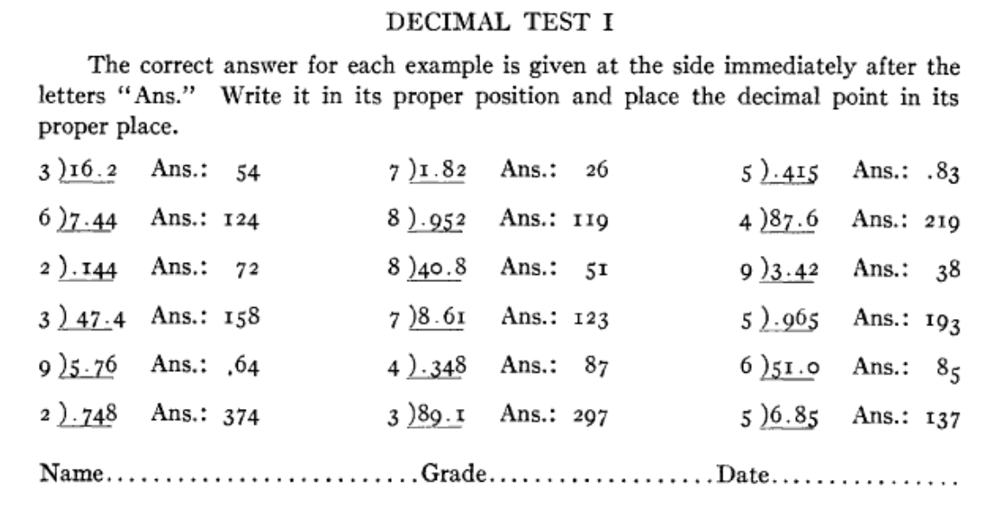
A 1917 paper called The Ability to Place the Decimal Point in Division used tests, including this one, to explore students understanding.
Link to paper
Compare the 1917 questions with those used in the video.
Which set of questions challenges students understanding of place value and division more?
Which would you use with your class and how might you use them?
Link to Core Concept 1.3
Notes:
NOTE TO SESSION FACILITATOR
This is an optional slide that offers a task from a paper by Walter S. Monroe from 1917 as a contrast and comparison to the task featured in the video.
MAKE CLEAR TO PARTICIPANTS THAT THE CALCULATIONS SHOWN ARE DIVISIONS. THE HISTORICAL ALIGNMENT OF THE VINCULUM MEANS THAT THIS MAY NOT BE CLEAR TO ALL!
In comparing these two tasks, participants may clarify their understanding of their key features, and the intended object of learning for the tasks.
A key difference is that the digits used in the NCETM task remain the same throughout, while those in Monroe’s task change (although the digits of the quotient are given).
You might like to explore whether keeping the digits the same leads students to following a ‘pattern’ or whether it gives access to the ‘structure’ of place value and division.
(There is a link to Monroe’s paper on the slide, as well as a link to the NCETM task)
The slide is animated so that, on a click the Decimal test is enlarged to make the text more readable. A second click will return the slide to its original layout.
You might like to have tried both tasks with some students so that you can share your experience with the participants at this point.

Slide 9
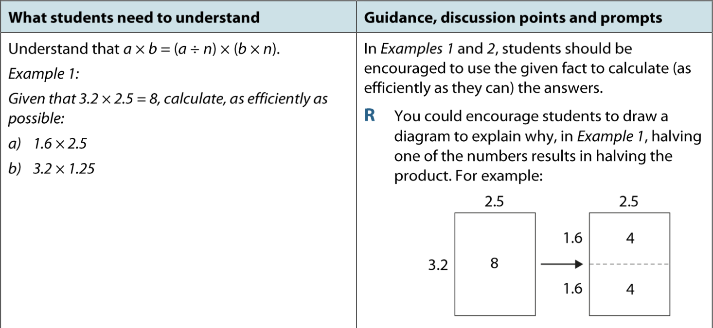
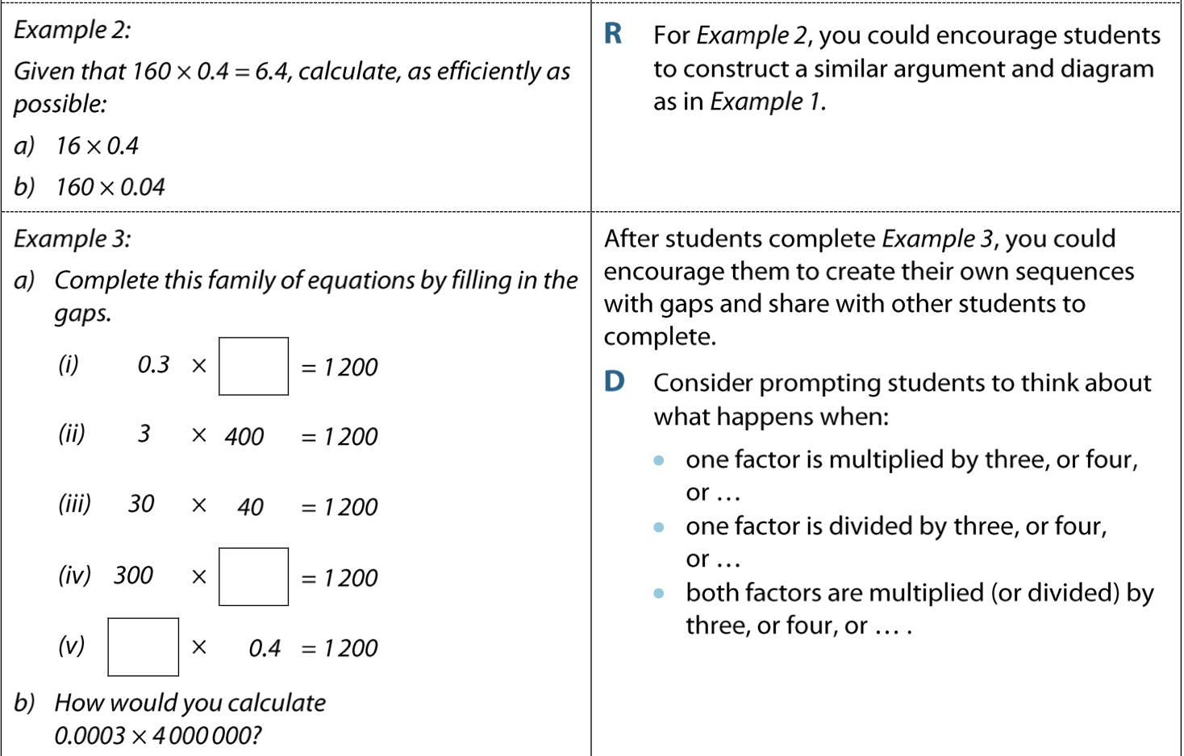
These tasks are taken from the NCETM’s PD Materials.
Do you think that working on these tasks might support students in building a deeper understanding of place value and its role in calculation?
You might like to consider how you would offer these tasks to your students.
The teacher in the video asked students to write down their thoughts before discussing them. What might be the advantages and disadvantages of this approach?
Link to Core Concept 1.3
Notes:
NOTE TO SESSION FACILITATOR
It may be useful to direct participants to the Secondary PD Materials Core Concept 1.3: Ordering and comparing, pages 15 to 18, or to have those pages printed so that participants are able to work on these tasks.
A link to the Core Concept document is on the slide.
You might like to have tried some of these tasks with some students so that you can share your experience with the participants at this point

