Slide 1
Half of a third: understanding operations on fractions
Notes:
Overview
This is a suggested presentation/workshop to support a short CPD session focusing on an element of mathematics that students find challenging.
This presentation accompanies Video 6 (https://vimeo.com/437148887) from the NCETM’s Mathematical Prompts for Deeper Thinking pages, and focuses on students’ understanding of fractions.
This workshop might be a part of an input at a department meeting, at a CPD meeting across a Maths Hub or for a group of interested teachers to work on together.
Timing
A minimum suggested time for this workshop is 40 minutes, including the video (which is 5 minutes and 22 seconds long)
Adaptation
You might choose to adapt these slides to fit the context in which you are leading the CPD.
There are three key components to this workshop which we suggest should be included:
Participants should have an opportunity to work on the task and predict what students will do (Slide 2)
Participants should watch the video and have a time for focused reflection on their predictions and other observations (Slides 3 to 6)
Participants consider next steps in addressing issues raised in the workshop. To support this we suggest tasks from the NCETM’s Secondary Mastery PD Materials (Slide 9).
There are optional slides (Slides 7 and 8) which offer prompts to focus and catalyse discussion and conversation around some of the points that are likely to have been raised by the video.
Slide 7 offers an extract from Nunes and Bryant’s 2009 review of research into students understanding of rational numbers and intensive quantities. This extract considers the challenges of conceptual understanding and procedural fluency.
Slide 8 gives an extract from a 1981 article by Kath Hart, which reflects on students’ reluctance to multiply with fractions and offers a task from the PD Materials to discuss.
Unless otherwise stated, all of the tasks offered in this video are taken from Core Concept 2.1 Arithmetic procedures from the Secondary Mastery PD Materials

Slide 2
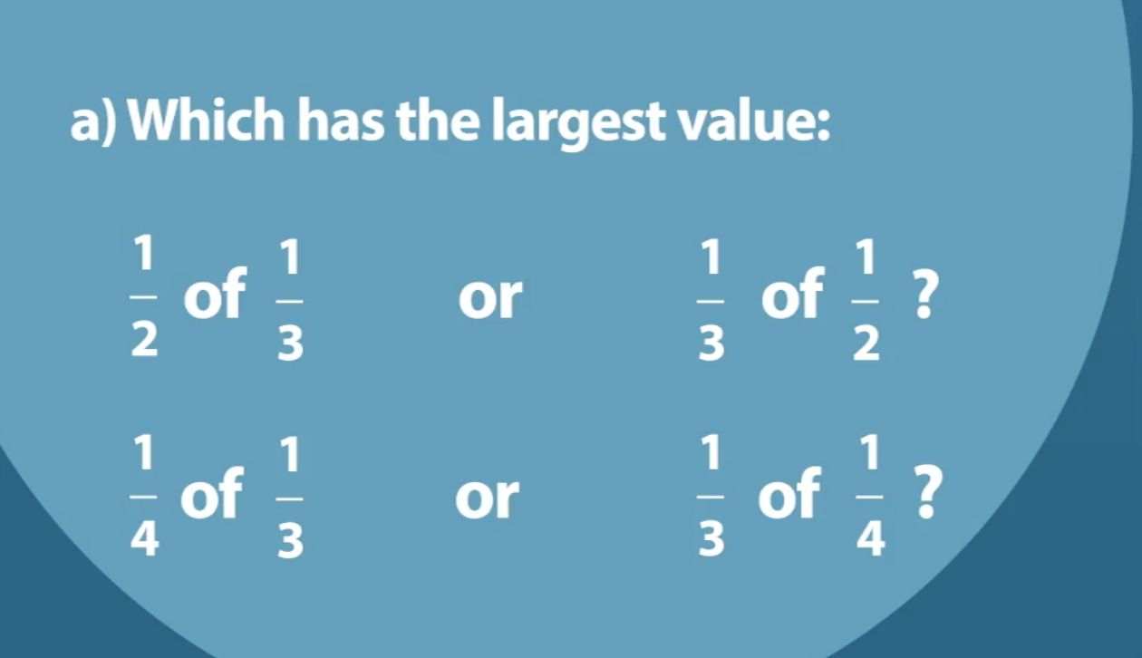
Work on this task for yourself and think about how you’d explain the answer to each question.
Once you’ve made your decisions, think about some KS3 students you teach:
How do you think they would work on the questions?
What misconceptions might be evident?
Link to Core Concept 2.1
Notes:
NOTE TO SESSION FACILITATOR
Make sure that sufficient time is given for participants to explore the task themselves.
It is important that time is given to discussing what students might do, what their reasoning might be, and to predicting some of the related misconceptions that might be revealed so that participants are able to watch the video with these aspects as a focus.
This task is taken from Page 25 of the NCETM’s Secondary Mastery PD Materials Core Concept 2.1 Arithmetic procedures. There is a link to this document on the slide.

Slide 3
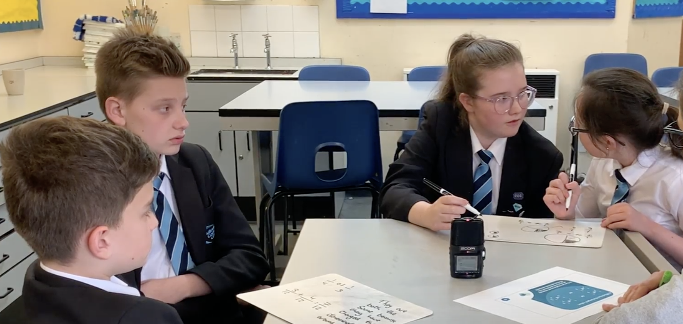
Watch the video in which three Year 8 students discuss this prompt with their teacher.
While watching, keep in mind the predictions that you made.
Do these students show the same thinking that you expected?
What strikes you about the responses and reasoning from these students?
Notes:
The slide text Watch the video is hyperlinked to the video

Slide 4
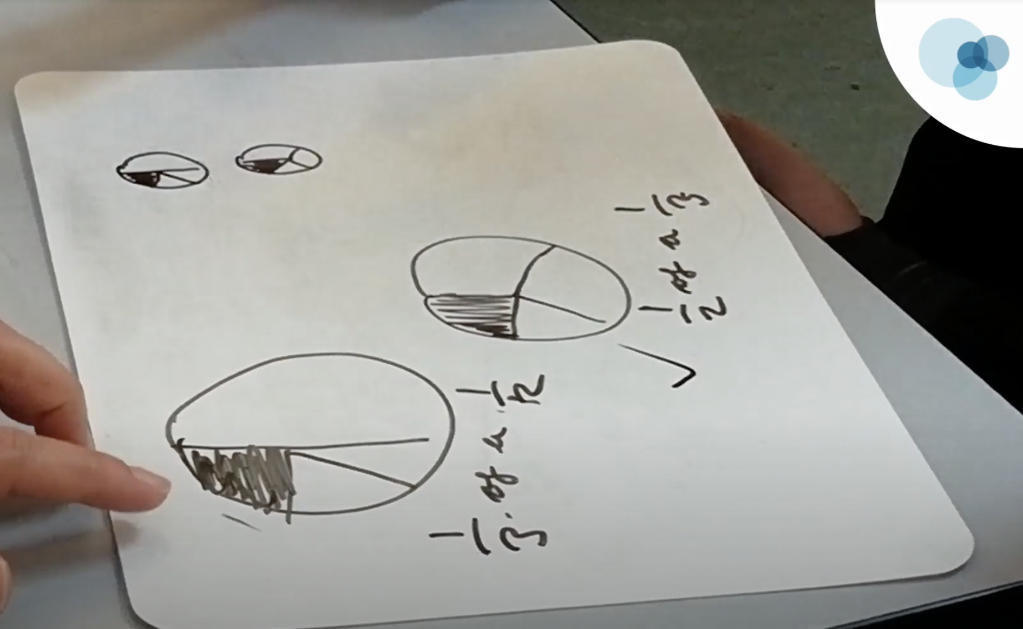
Sophia and Jasmine drew a picture to help them understand the situation.

Slide 5
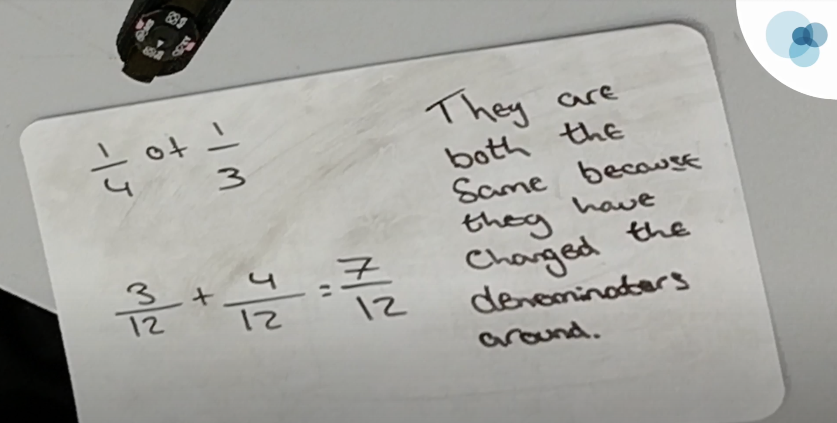
Toby and H used numerical representation to work on their problem.
Toby explains that they know addition works in any order but says, “We don’t know if you can do that with fractions”.
Does this prompt any thoughts about Toby and H’s understanding of commutativity?
Do the two groups’ different approaches suggest any difference in their understanding of fractions?
Notes:
NOTE TO SESSION FACILITATOR
This slide is animated so that the second bullet pointed prompt is revealed on a click.
Note that Toby and H have written an addition rather than a multiplication.
Toby explains this by saying (around 3:00) that he knows that addition works in any order (the commutative property), but says “We don’t really know if you can do that with fractions”.
A discussion prompt understanding of commutativity is offered on the slide. It’s interesting to note that Toby doesn’t question whether commutativity works for multiplication, but for fractions.
It might catalyse the discussion between participants to suggest that Toby doesn’t understand that fractions can be interpreted as numbers.

Slide 6






The notation used when writing fractions describes multiple possible interpretations and relationships.
You might like to take a moment to think about what is meant by the notation $\frac{2}{3}.$
The same notation might be interpreted as
An operator
Find $\frac{2}{3}$ of 9
A part to whole comparison
$\frac{2}{3}$ of the shape is red
A quotient
$$\frac{2}{3}=2÷3$$
A ratio
There are $\frac{2}{3}$ as many yellow as red
$\frac{2}{3}$
A measure of continuous or discrete quantities
0
1
2
3
Link to Behr et al
Notes:
NOTE TO SESSION FACILITATOR
This slide is animated to allow time for participants to think and discuss how they might interpret two thirds, before showing some possible different ways of seeing them (the different ways of interpreting a concept like this are known as ‘subconstructs’).
You might then like to discuss with participants:
Which of these subconstructs were evident in the video?
Which of these subconstructs do you explicitly teach to your classes?
The subconstructs in this slide are taken from:
Silver, Edward & Behr, Merlyn & Post, Thomas & Lesh, Richard. (1983). Rational number concepts.
There is a link to this paper on the slide.

Slide 7
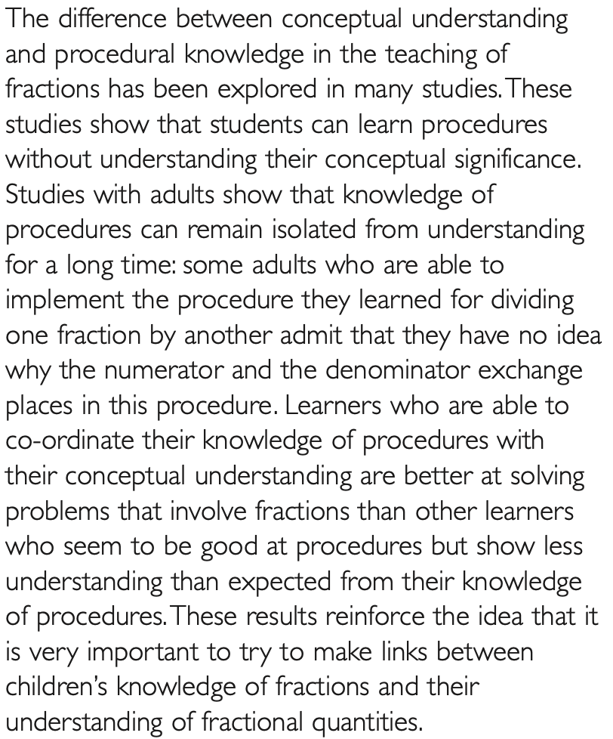
Around four minutes into the video, Jasmine stops drawing and says:
I think they’re equivalent because if you’ve done the multiplication for the first one; one times one is one and then two times three is six and then, for the second one; one times one is one and three times two is six so I think they’re equivalent.
Might this shift in approach suggest that she’s moved from a conceptual to a procedural approach? Do you think the students in the video have linked their conceptual understanding and procedural knowledge?
Link to research review
Notes:
NOTE TO SESSION FACILITATOR
This is an optional slide
You might note that the students’ strategy to solve the problems shifts after a while.
The two pairs of students started to reason in different ways about their problem but, (at about 4:00) when Jasmine calculates the two products and sees that they are the same, it might be suggested that their thinking moves from conceptual to procedural in order to reach an answer.
The above text is taken from a 2009 review of research around students understanding of rational numbers by Nunes and Bryant. There is a link to the research review on the slide.

Slide 8
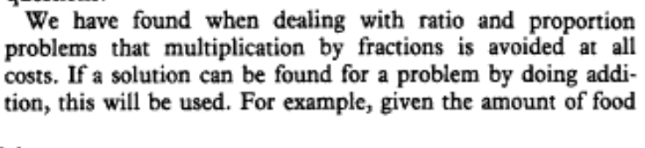
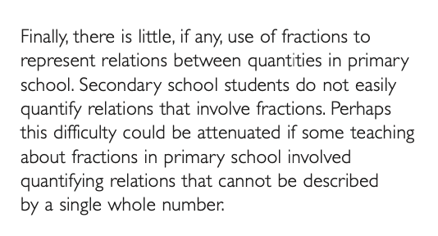
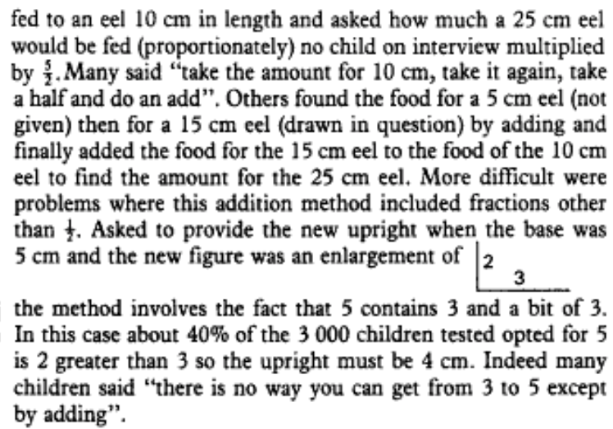
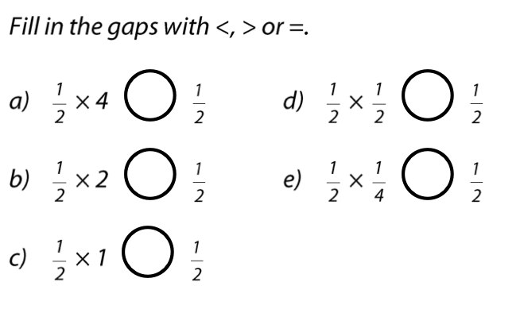
Link to research review
Link to article
It might be suggested that students’ reluctance to multiply with fractions is a consequence of a lack of experience of using ‘fractions to represent relations between quantities’.
Would spending time discussing a task such as this one, support students in building this understanding?
Notes:
NOTE TO SESSION FACILITATOR
This is an optional slide offering some research conclusions for discussion.
This slide is animated so the example from the NCETM’s Secondary Mastery PD Materials will fly in on a click.
The extract on the left is taken from a 1981 article in the MA Journal, Maths in School, and is written by Kath Hart about her work using the CSMS tests – a study designed to explore students understanding of different mathematical ideas.
The extract on the right is again from the 2009 research review by Nunes and Bryant that featured on the previous slide. There is a link to both the article and the research review on the slide.
Note the distinction being used here between calculating a multiplier using an additive strategy (the amount of food for a 10cm eel + food for a 10cm eel + food for a 5cm eel, rather than multiplying by a factor of 5/2 or 2.5).
The text gives an interpretation of the article extracts to catalyse discussion and exploration with participants, rather than a firm conclusion from the research, so it should be treated as nothing more than a discussion prompt.

Slide 9
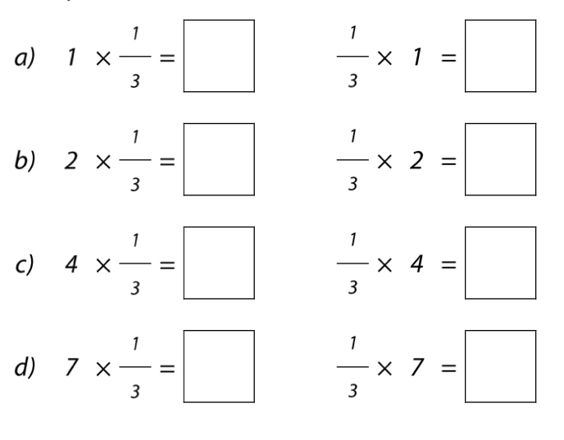
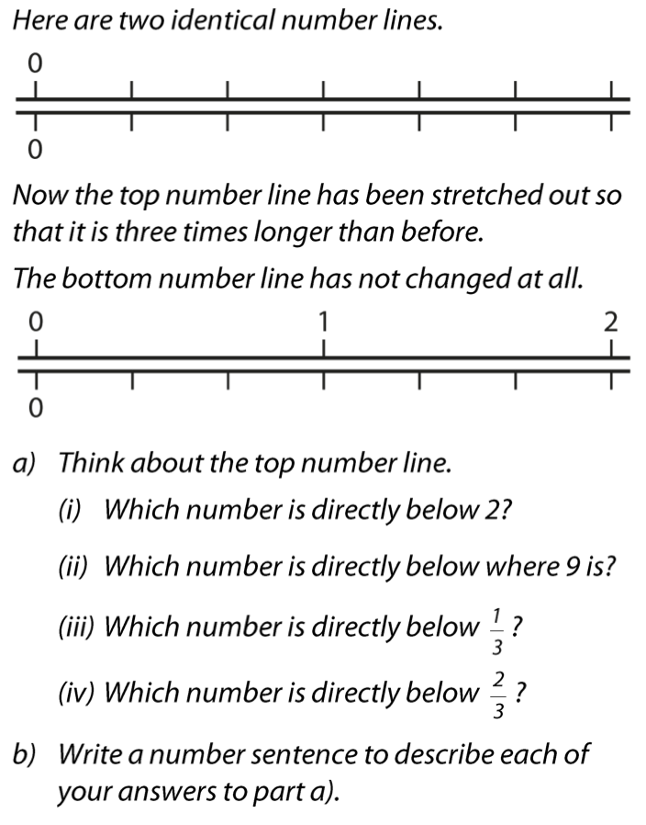
These tasks are taken from the NCETM’s Secondary Mastery PD Materials.
Do you think that working on these tasks, and others like them, might support students in building a deeper understanding of fractions and multiplication?
Link to Core Concept 2.1
Notes:
NOTE TO SESSION FACILITATOR
It may be useful to direct participants to the Secondary Mastery PD Materials Core Concept 2.1: Operating on number, pages 24 to 30, or to have those pages printed so that participants are able to work on these tasks.
A link to the Core Concept document is on the slide.
You might like to have tried some of these tasks with some students so that you can share your experience with the participants at this point.

