Slide 1
Sequences: working with structure
Notes:
Overview
This is a suggested presentation/workshop to support a short CPD session focusing on an element of mathematics that students find challenging.
This presentation accompanies Video 7 (https://vimeo.com/440706621) from the NCETM’s Mathematical Prompts for Deeper Thinking pages and focuses on linear sequences.
This workshop might be a part of an input at a department meeting, at a CPD meeting across a Maths Hub or for a group of interested teachers to work on together.
Timing
A minimum suggested time for this workshop is 30 minutes, including the video (which is 6 minutes and 17 seconds long).
Adaptation
You might choose to adapt these slides to fit the context in which you are leading the CPD.
There are three key components to this workshop which we suggest should be included:
Participants should have an opportunity to work on the task and predict what students will do (Slide 2)
Participants should watch the video and have a time for focused reflection on their predictions and other observations (Slides 3, 4 and 5)
Participants consider next steps in addressing issues raised in the workshop. To support this we suggest tasks from the NCETM’s Secondary Mastery PD Materials (Slides 7 and 8).
There is an optional slide (Slide 6) which offers an extract from Project Update, an Open University publication. This publication might be of interest to explore the role of generalising more deeply. There is a link to the Project Update materials on the slide.
Unless otherwise stated, all of the tasks offered in this video are taken from Core Concept 4.1 Sequences from the Secondary Mastery PD Materials.

Slide 2
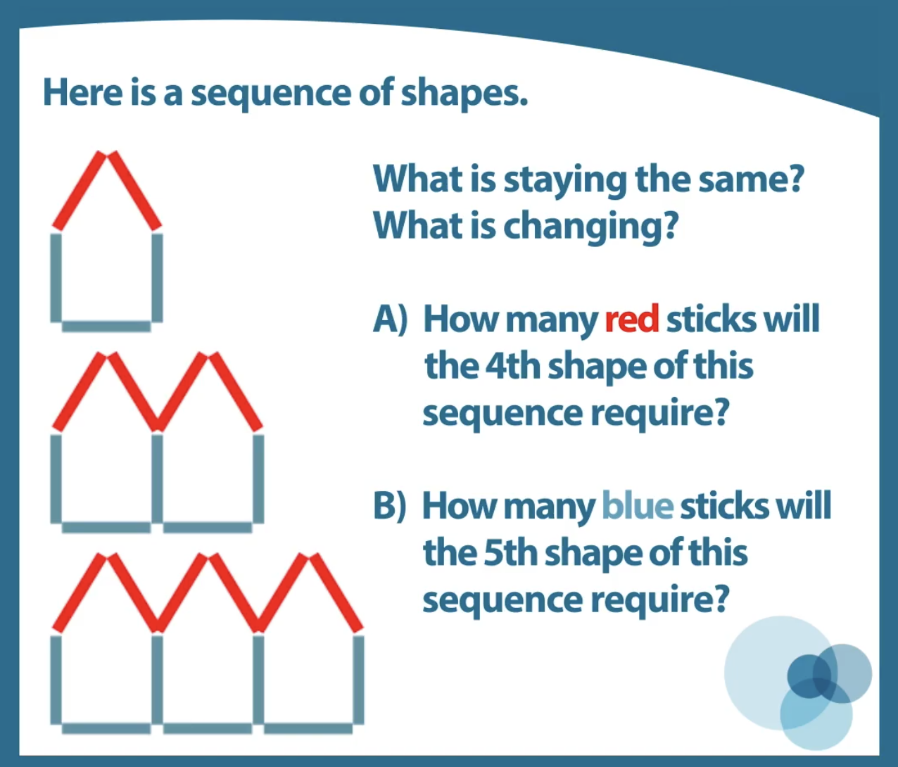
Work on this task for yourself and think about how you’d explain the answer to each question.
Once you’ve made your decisions, think about some KS3 students you teach.
How do you think they would work on the questions?
What misconceptions might be evident?
Link to Core Concept 4.1
Notes:
NOTE TO SESSION FACILITATOR
Make sure that sufficient time is given for participants to work on the task themselves.
It is important that time is given to discussing what students might do, what their reasoning might be, and to predicting some of the related misconceptions that might be revealed so that participants are able to watch the video with these aspects as a focus.
The title of this CPD session is ‘working with structure’ and you might like to ask participants to consider what ‘structure’ refers to in the context of this task.
This task is taken from Page 9 of the NCETM’s Secondary Mastery PD Materials Core Concept 4.1 Sequences. There is a link to this document on the slide.

Slide 3
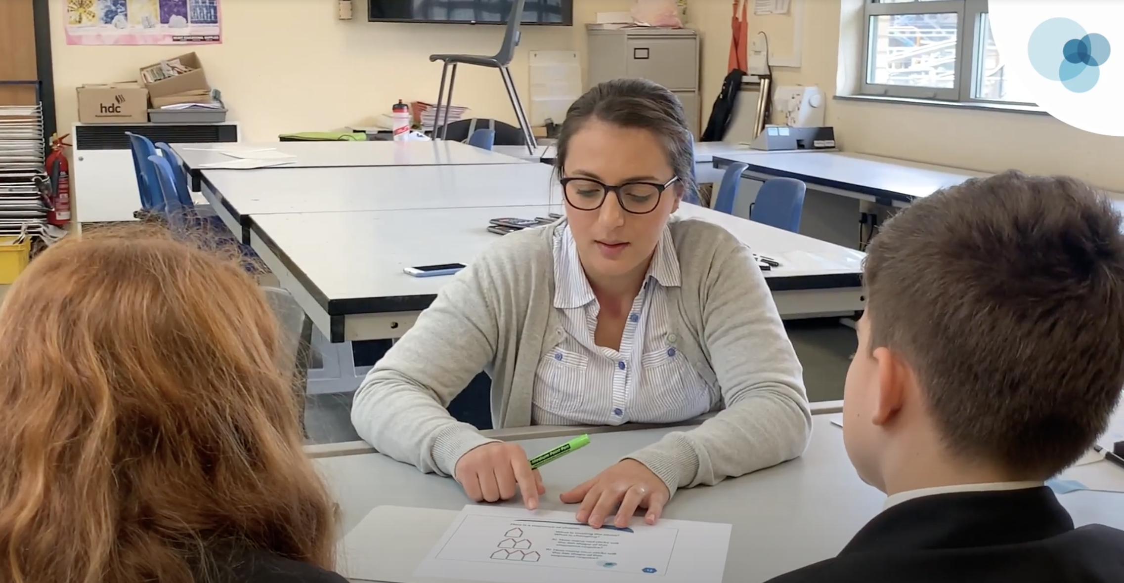
Watch the video in which two Year 8 students discuss this prompt with their teacher.
While watching, keep in mind the predictions that you made.
Do these students show the same thinking that you expected?
What strikes you about the responses and reasoning from these students?
Notes:
The slide text Watch the video is hyperlinked to the video

Slide 4
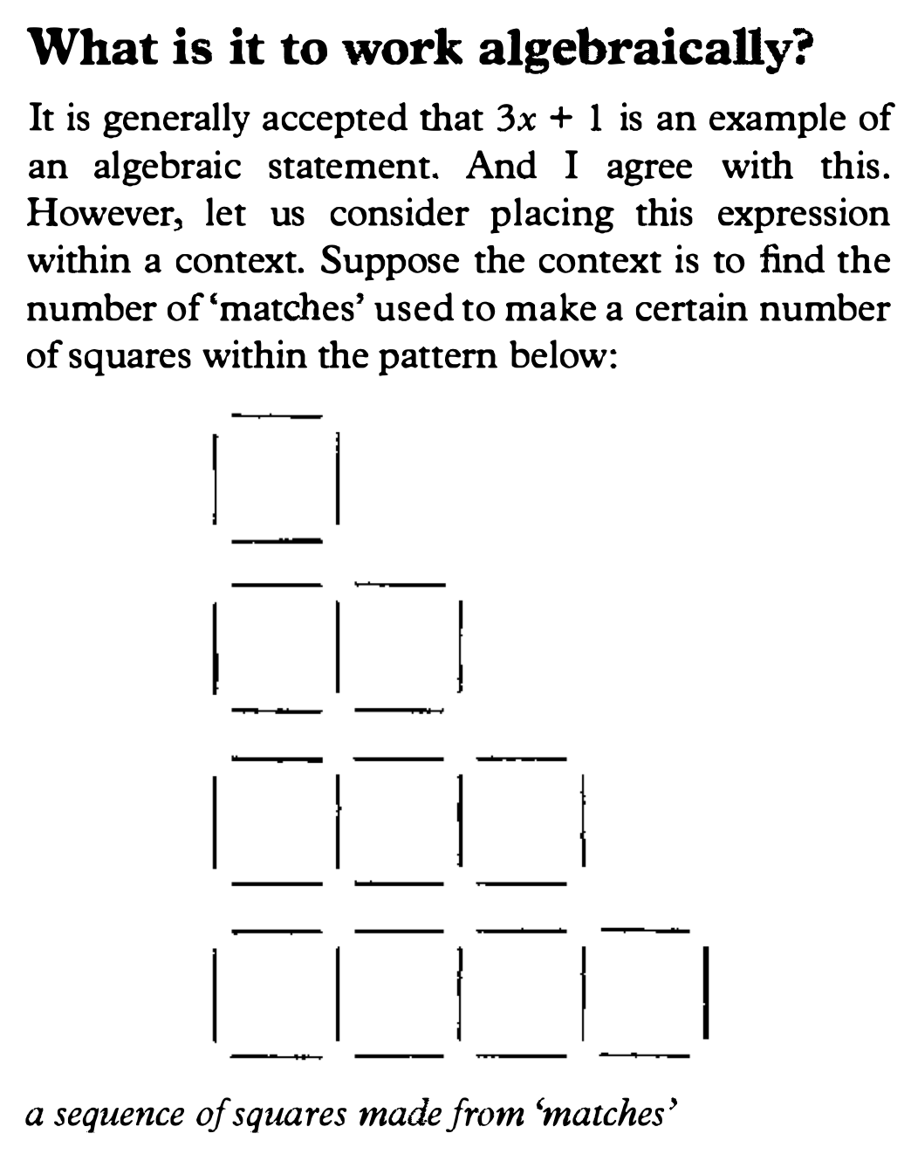
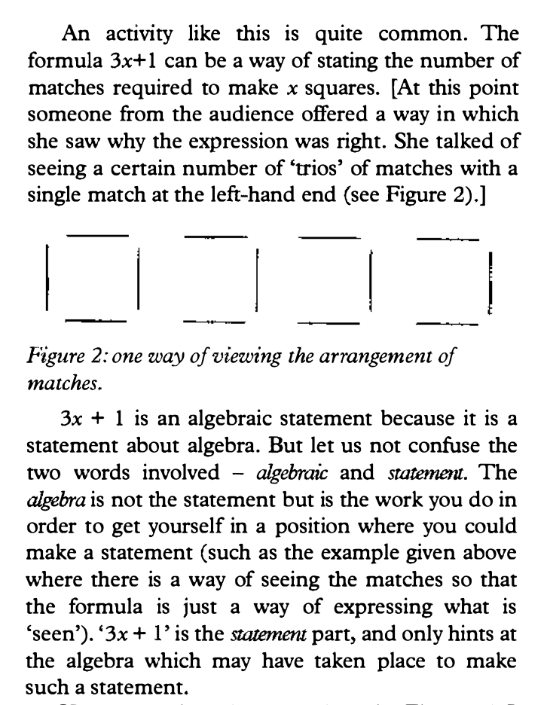
Link to Behr et al
Notes:
NOTE TO SESSION FACILITATOR
This slide shows an extract from an article by Dave Hewitt and is used to set a context for discussion on the next slide.
Before moving on, you might like to encourage participants to think about…
“The algebra is not the statement but the work you do in order to get yourself in a position where you could make a statement. ‘3x + 1’ is the statement part and only hints at the algebra which may have taken place to make such a statement.”
…and to reflect on how much they agree or disagree with it.
It might be useful to discuss what makes 3x + 1 ‘algebraic’? Is it algebraic because it has a letter symbol?

Slide 5


Towards the end of the video, B-May describes how she would find the number of blue sticks in the 999th shape saying, “You times it by two and then plus one”.
An interpretation of Dave Hewitt’s article might be that she has identified the structure that generates the sequence, and so has carried out some of the algebra without recording it as an algebraic statement.
To what extent do you agree with this interpretation?
How different is B-May’s statement “you times it by two and then plus one” to an algebraic way of recording this such as 2n + 1? In what ways is it different?
Notes:
NOTE TO SESSION FACILITATOR
In the video the teacher uses a task structure that is sometimes described as particular, peculiar, general.
She asks students to find a solution in a particular case (working with the 4th or 5th pattern) then a peculiar situation (in this case the 999th pattern) as a step towards a general rule, which (in the video) is described in words.
A discussion point here could be about the importance of both identifying the structure and recording it symbolically.
It might be argued that a student who constructs a table of values and uses the differences in consecutive terms to write down that the n^{th} term of the sequence is 2n + 1, but can’t describe how that rule relates to the features of the houses, does not understand the structure that the algebraic symbolism is generalising.
It might also be argued that, by not being able to record a generalisation of the structure using standard symbolic algebra, a student is unable to manipulate and compare any generalisations.
Do participants agree that both elements are equally important, or should one be stressed over the other?
Are there other considerations that haven’t been discussed?
You might like to have tried some of these tasks with some students so that you can share your experience with the participants at this point.

Slide 6
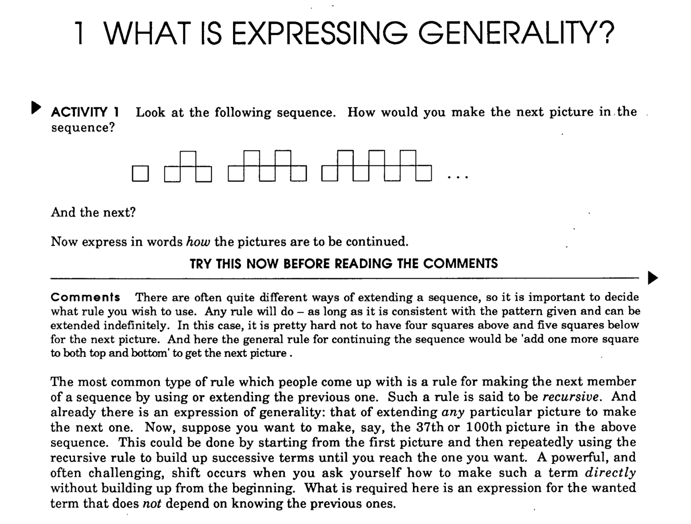
When working with linear sequences, students commonly identify the term-to-term rule rather than the ‘functional’ position-to-term rule.
The functional rule is an expression of generality, a description of a structure that fits every term in a sequence.
How long do you typically spend with students exploring and describing structures in words, before expressing them symbolically?
Link to Expressing Generality
Notes:
NOTE TO SESSION FACILITATOR
This is an optional slide that acts as a place holder for deeper thinking about generalisation and expressing generality.
The slide is animated so that, on a click, the article text is enlarged to enable it to be read more easily (the title goes off the screen) and, on a second click, it shrinks back to show the full slide.
There is a link on the slide to Expressing Generality, an Open University publication and part of the Project Update suite of materials, designed to explore and challenge understanding of generality and structure. (The suite of Project Update materials can be found at https://www.open.edu/openlearncreate/mod/oucontent/view.php?id=19072&printable=1).
If you’re able to explore more deeply than a 30-minute meeting allows, you might like to have hard copies of pages 7 to 10 of the document to work on with participants.
There is a prompt on the slide and you might like to explore with participants any strategies they have to explore and understand generality and structures with their students, or whether they quickly move on to recording these structures symbolically.

Slide 7
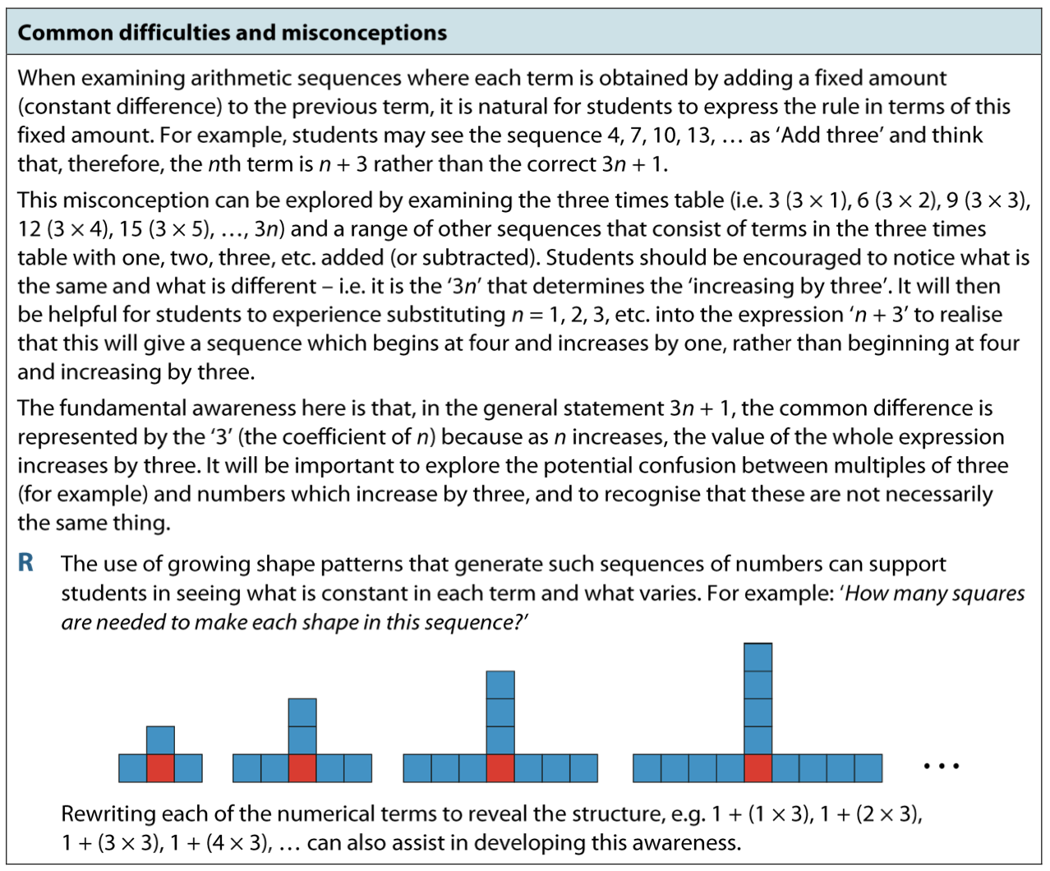
Link to Core Concept 4.1
Notes:
NOTE TO SESSION FACILITATOR
This is an optional slide that raises some of the challenges students and teachers experience when using linear sequences as a context to explore and record generalisations.
The slide is animated to highlight a strategy described in the last two lines of the extract (the box highlighting these lines will appear on a click). Here, an expanded version of an expression is written out for each term of a sequence in order to make the structure more apparent (for example when considering 1 + (4 ✕ 3) and the related pattern, a teacher prompt might be to ask students, ‘Where are the three fours?’, ‘Where is the add one?’).
You might like to discuss this strategy and explore other strategies that participants use to encourage their students to access the structure of arithmetic sequences.
The content of this slide is taken from Page 13 of Core Concept 4.1 of the NCETM Secondary Mastery PD Materials. There is a link to the document on the slide.

Slide 8
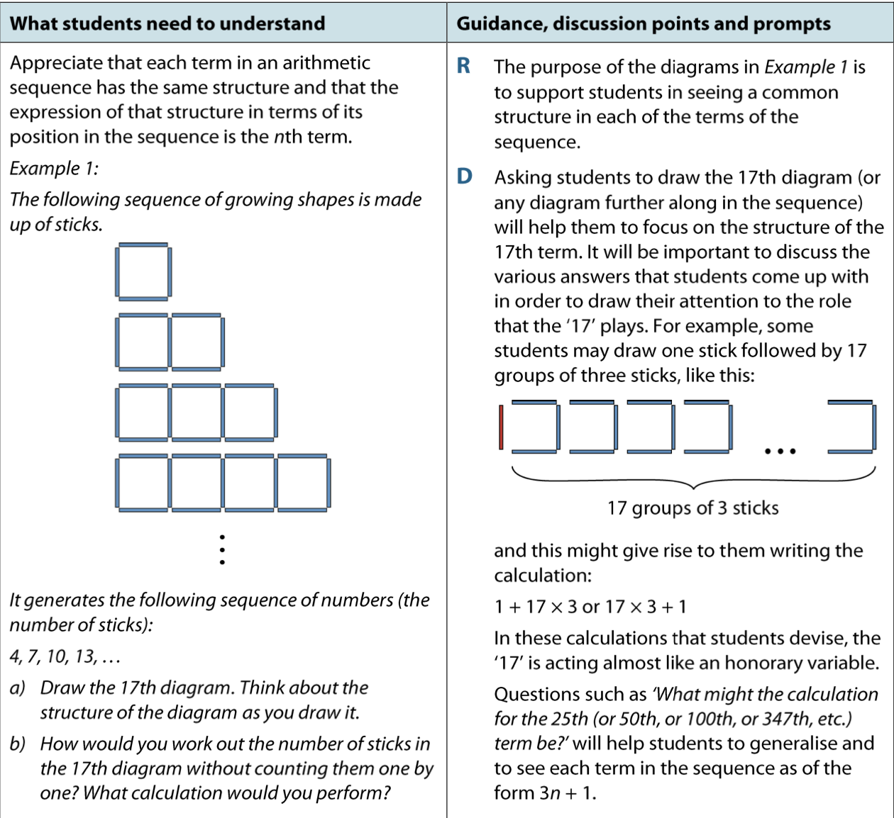
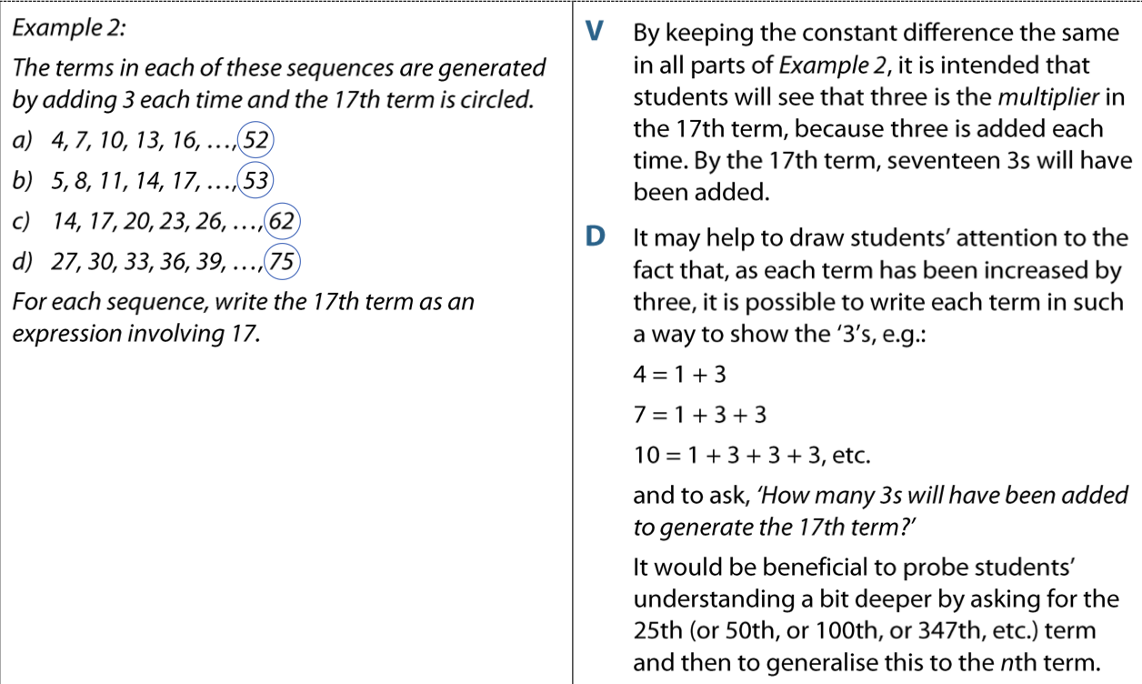
These tasks are taken from the NCETM’s Secondary PD Materials.
Do you think that working on these tasks, and others like them, might support your students in understanding the structures and generalisation used when working on linear sequences?
Link to Core Concept 4.1
Notes:
NOTE TO SESSION FACILITATOR
It may be useful to direct participants to the Secondary Mastery PD Materials Core Concept 4.1: Sequences, pages 8 to 19, or to have those pages printed so that participants are able to work on these tasks.
A link to the Core Concept document is on the slide.
You might like to have tried some of these tasks with some students so that you can share your experience with the participants at this point.

