Slide 1
Angles in parallel lines: deducing unknown facts from known facts
Notes:
Overview
This is a suggested presentation/workshop to support a short professional development session focusing on an element of mathematics that students find challenging.
This presentation accompanies Video 8 (https://vimeo.com/440909743) from the NCETM’s Mathematical Prompts for Deeper Thinking pages and focuses on deducing unknown facts from known facts.
This workshop might be a part of an input at a department meeting, at a professional development meeting across a Maths Hub, or for a group of interested teachers to work on together.
Before the session
This session uses the article Arbitrary and Necessary Part 1: A Way of Viewing the Mathematics Curriculum by Dave Hewitt as a lens through which the mathematics in the video is considered. Some slides have a lot of text from this article. Key parts of the text are highlighted but the surrounding text is offered to give context.
For this professional development session you might like to have hard copies of the article available to participants and/or to have set the article as pre-reading.
Timing
A minimum suggested time for this workshop is 30 minutes, including the video (which is 4 minutes and 48 seconds long).
Adaptation
You might choose to adapt these slides to fit the context in which you are leading the professional development.
There are three key components to this workshop which we suggest should be included
Participants should have an opportunity to work on the task and predict what students will do (Slide 2)
Participants should watch the video and have a time for focused reflection on their predictions and other observations (Slide 3) and discussion of the article in the context of the video (slides 4 and 5)
Participants consider next steps in working on thoughts provoked in the workshop. To support this we suggest tasks from the NCETM’s Secondary Mastery Professional Development Materials (Slide 7).
There are optional slides
Slide 6 considers pedagogical issues around the distinctions made in the article
Slide 8 offers a proposition for discussion.
Unless otherwise stated, all of the tasks offered in this video are taken from Core Concept 6.1 Geometrical Properties from the Secondary Professional Development Materials.

Slide 2
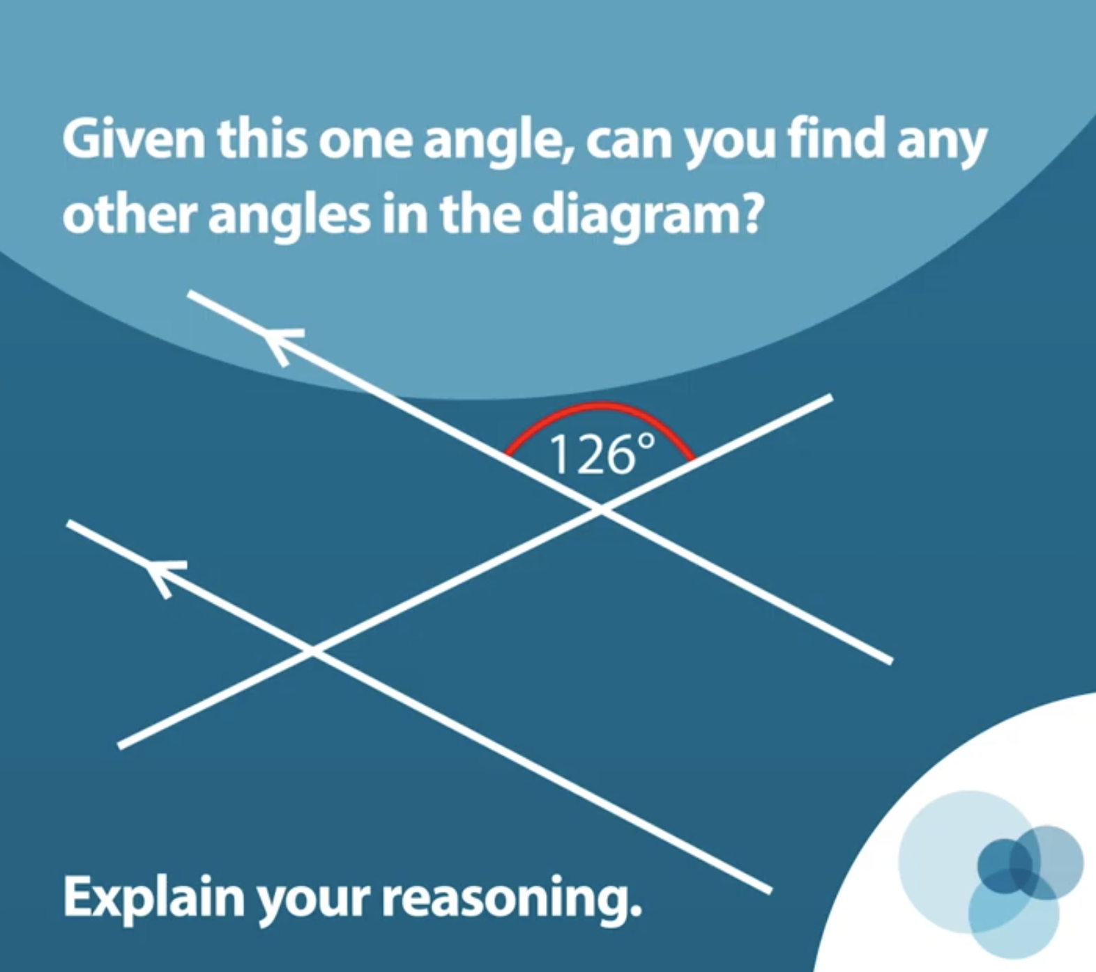
Work on this task for yourself and think about how you’d tackle it.
Once you’ve made your decisions, think about some KS3 students you teach.
How do you think they would work on this task?
Link to Core Concept 6.1
Notes:
NOTE TO SESSION FACILITATOR
Make sure that sufficient time is given for participants to work on the task themselves.
It is important that time is given to discussing what students might do, what their reasoning might be and to predicting some of the related misconceptions that might be revealed so that participants are able to watch the video with these aspects as a focus.
This task is taken from Page 14 of the NCETM’s Secondary Professional Development Materials Core Concept 6.1: Geometrical Properties. There is a link to this document on the slide.

Slide 3
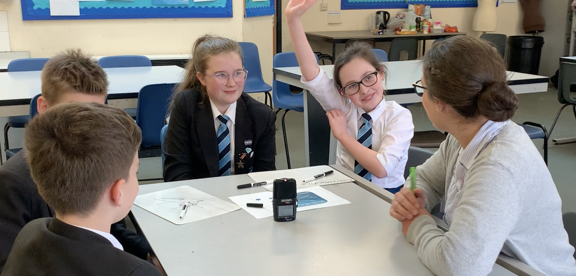
Watch the video in which four Year 8 students work on this prompt with their teacher.
While watching, keep in mind the predictions that you made.
Do these students show the same thinking that you expected?
What strikes you about the responses and reasoning from these students?
Notes:
The slide text Watch the video is hyperlinked to the video

Slide 4
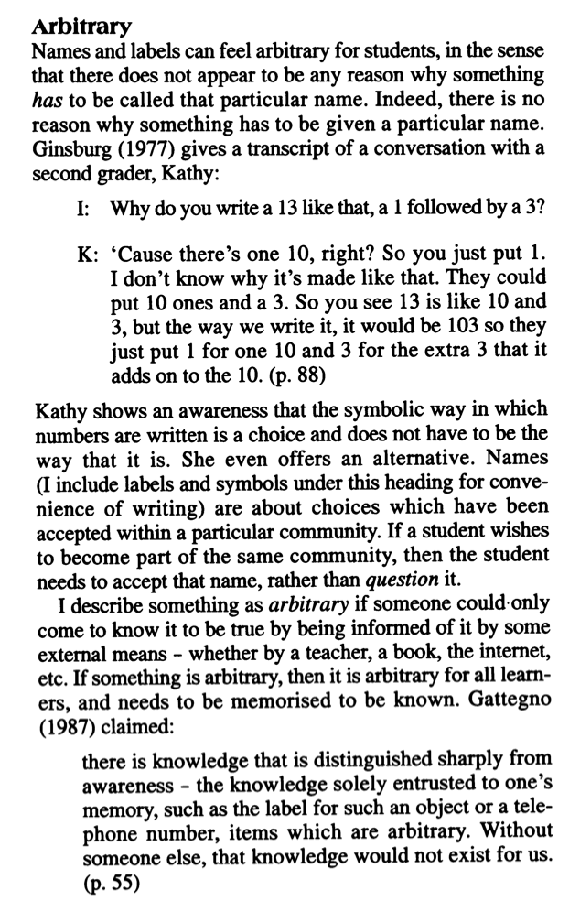
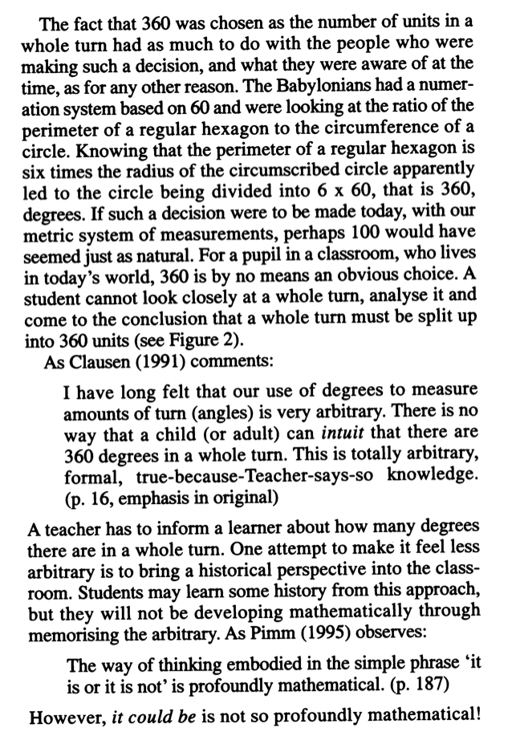
In a series of three articles, Dave Hewitt discusses the ‘arbitrary and necessary’ elements of the maths curriculum…
…and offers the use of 360º as the unit of a full turn as an example
Link to the article
Notes:
NOTE TO SESSION FACILITATOR
This slide is animated so that the text can be read at a distance (you might like to have hard copies of the article as handouts). On a click the first section of text shrinks back and an example of ‘arbitrary’ maths is offered.
There is a lot of text on this slide – the key text for participants to read is highlighted.
The article is Hewitt, D. (1999). Arbitrary and Necessary Part 1: A Way of Viewing the Mathematics Curriculum. For the Learning of Mathematics, 19(3),
There is a link to the article on the slide

Slide 5
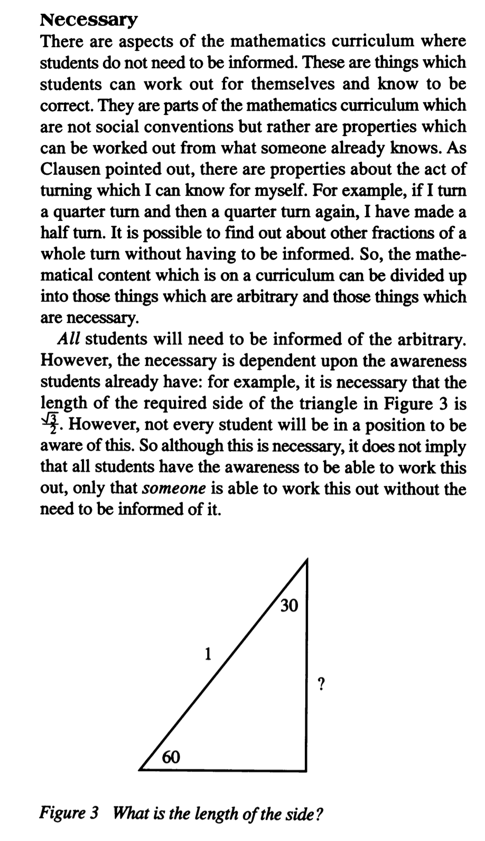
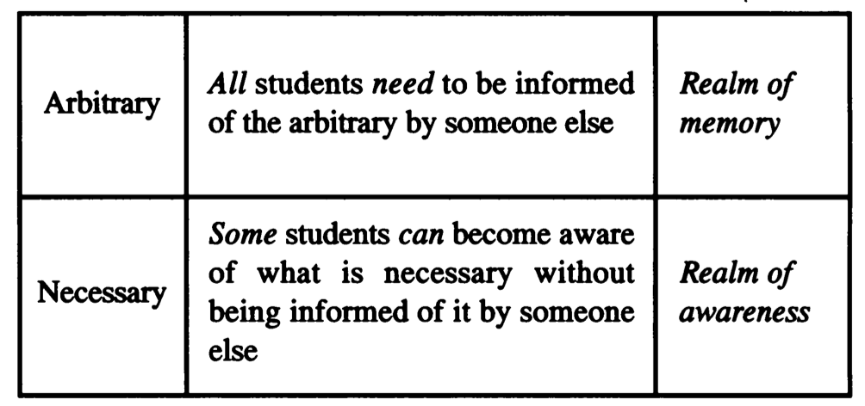
In contrast to the ‘arbitrary’, Hewitt also identifies areas of the maths curriculum that are ‘necessary’
Think about the students working in the video.
Which elements of the task might be described as arbitrary and which are necessary?
The article continues…
What is necessary is in the realm of awareness, whereas the arbitrary is in the realm of memory.
and offers this table…
Link to the article
Notes:
NOTE TO SESSION FACILITATOR
This slide is animated so that the text can be read at a distance (you might like to have hard copies of the article as handouts). On the first click additional text is revealed, offering a quote from the article for discussion, and on the second click participants are invited to make sense of arbitrary and necessary using the video as a shared experience and exemplification of this distinction.
There is a lot of text on this slide – the key text for participants to read is highlighted.
The article is Hewitt, D. (1999). Arbitrary and Necessary Part 1: A Way of Viewing the Mathematics Curriculum. For the Learning of Mathematics, 19(3).
There is a link to the article on the slide.

Slide 6
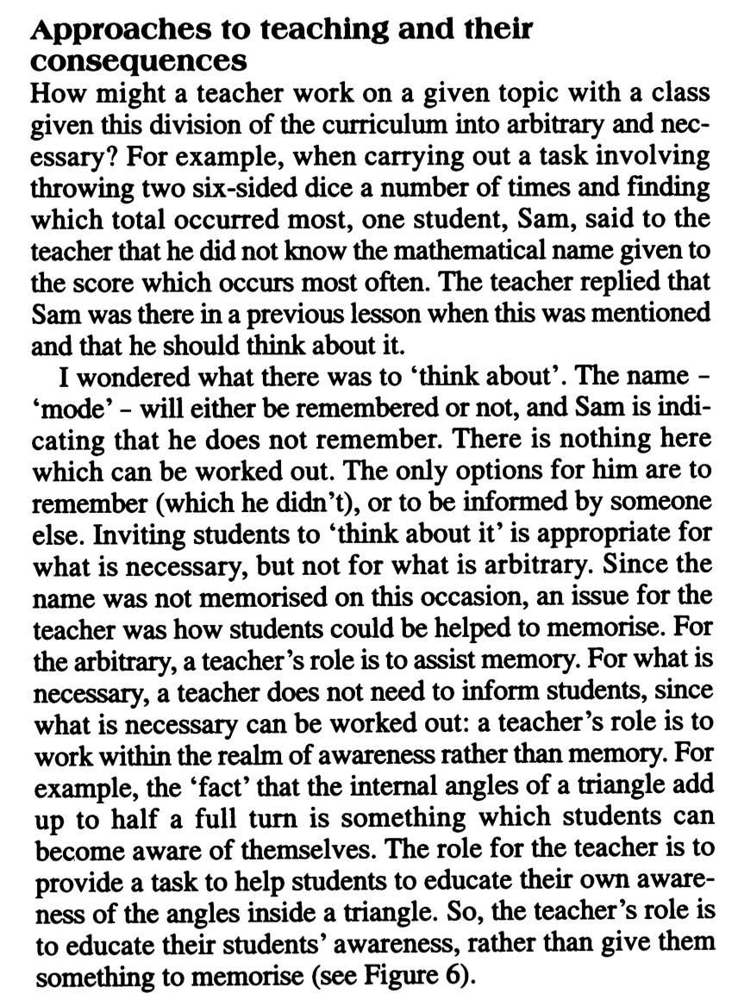
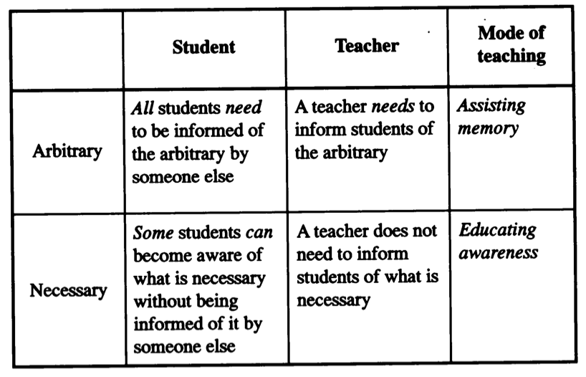
Hewitt suggests that a teacher takes different roles depending on whether the mathematics being worked on is arbitrary or necessary.
Consider the teacher in the video – are there times when this distinction is evident?
Link to the article
Notes:
This is an optional slide
The slide gives an opportunity to think about different ways that a teacher might act in the class, given the distinction being made between arbitrary and necessary mathematics.
When watching the video it is likely that participants were focused on the students and their actions, you might like to show the video again here and watch the teacher’s reactions and responses to the students’ answers.

Slide 7
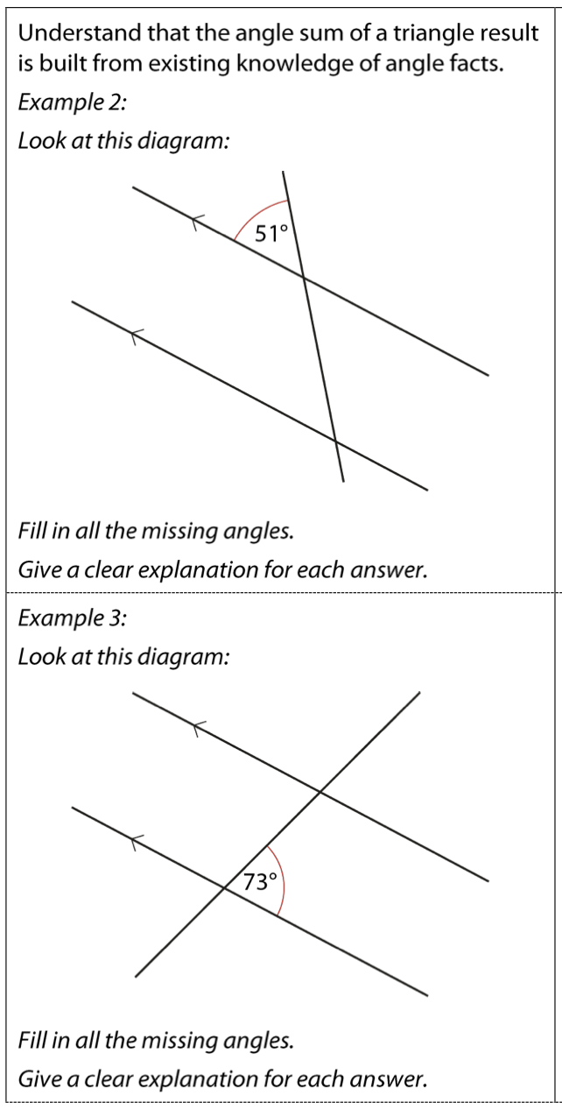
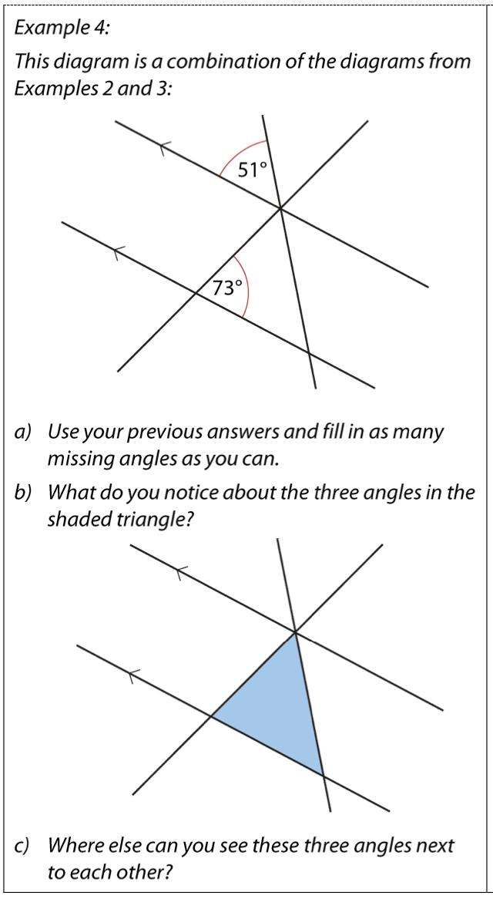
It might be suggested that these examples from the NCETM’s Secondary PD Materials offer an opportunity to focus students’ awareness in such a way that the sum of the interior angles of a triangle is understood as a necessary fact.
To what extend do you agree with this?
Link to Core Concept 6.1
Notes:
NOTE TO SESSION FACILITATOR
This slide offers some tasks from pages 19 and 20 of the NCETM’s Secondary Professional Development Materials 6.1 Geometric Properties. There is a link to the document on the slide.
Participants are likely to have their own methods for teaching students about the angle sum of a triangle (for example, by tearing the corners off a paper triangle). You might like to discuss these and consider their approaches through the lens of the arbitrary and necessary distinction.
You might like to have tried these items with your own students and share the results

Slide 8
Dave Hewitt’s article begins and ends with the proposition:
If I’m having to remember …, then I’m not working on mathematics.
To what extent do you agree with this?
Can you offer some examples from your classroom to support your argument?
Link to the article
Notes:
NOTE TO SESSION FACILITATOR
This is an optional slide, offering a proposition from the article.
The proposition might be seen as controversial and is offered here as a catalyst to generate discussion within your group.
You might like to start your session by offering this statement for discussion, conclude with it, or both. Or maybe not offer it if time doesn’t allow.
The intention of this slide is to support and focus discussion around what mathematics is and the intention of the mathematics curriculum in your school.

