Slide 1
Partitioning 12.653: understanding place value
Notes:
Overview
This is a suggested presentation/workshop to support a short professional development session focusing on an element of mathematics that students find challenging.
This presentation accompanies Video 9 (https://vimeo.com/440988872) from the NCETM’s Mathematical Prompts for Deeper Thinking pages and focuses on decimals and place value.
This workshop might be a part of an input at a department meeting, at a professional development meeting across a Maths Hub, or for a group of interested teachers to work on together.
Timing
A minimum suggested time for this workshop is 45 minutes, including the video (which is 5 minutes and 54 seconds long).
Adaptation
You might choose to adapt these slides to fit the context in which you are leading the session.
There are three key components to this workshop which we suggest should be included
Participants should have an opportunity to work on the task and predict what students will do (Slide 2)
Participants should watch the video and have a time for focused reflection on their predictions and other observations (Slides 3 and 4) and discussion of research around students’ difficulties with decimals (slides 5 and 6)
Participants consider next steps in addressing issues raised in the workshop. To support this we suggest tasks from the NCETM’s Secondary Mastery Professional Development Materials (Slide 11).
There are optional slides (Slides 7, 8, 9 and 10) that offer more details from the Assessment of Performance Unit (APU) research introduced in slides 5 and 6.
There is also an additional slide (Slide 12) that shows the Gattegno Place Value Chart in more detail, should this be an unfamiliar representation to your participants.
Unless otherwise stated, all of the tasks offered in this video are taken from Core Concept 2.1 Arithmetic Procedures from the NCETM Secondary Professional Development Materials

Slide 2
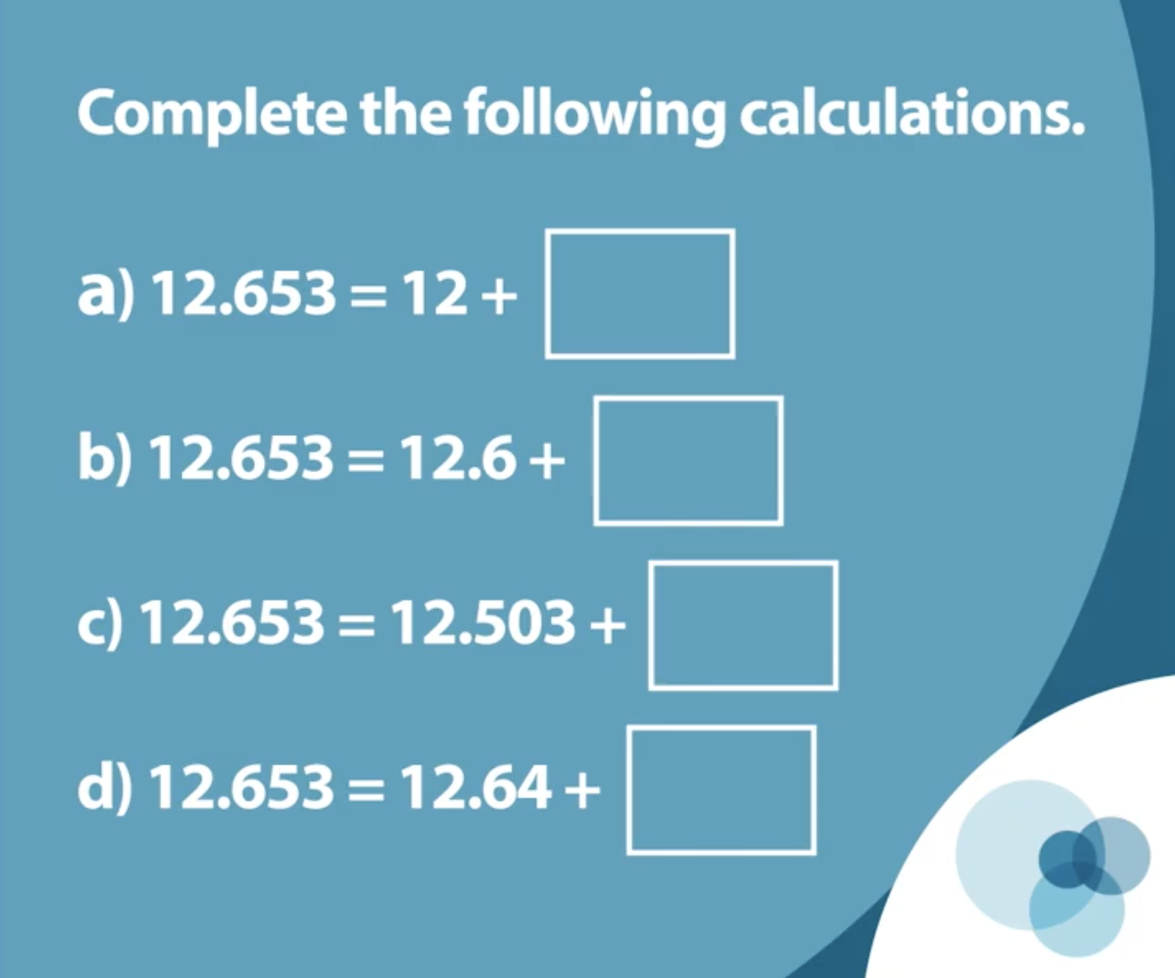
Work on this task for yourself and think about how you’d explain the answer to each question.
Once you’ve made your decisions, think about some KS3 students you teach
How do you think they would work on the questions?
What misconceptions might be evident?
Link to Core Concept 2.1
Notes:
NOTE TO SESSION FACILITATOR
Make sure that sufficient time is given for participants to work on the task themselves.
It is important that time is given to discussing what students might do, what their reasoning might be and to predicting some of the related misconceptions that might be revealed, so that participants are able to watch the video with these aspects as a focus.
This task is taken from Page 19 of the NCETM’s Secondary Professional Development Materials Core Concept 2.1: Arithmetic Procedures. There is a link to this document on the slide.

Slide 3
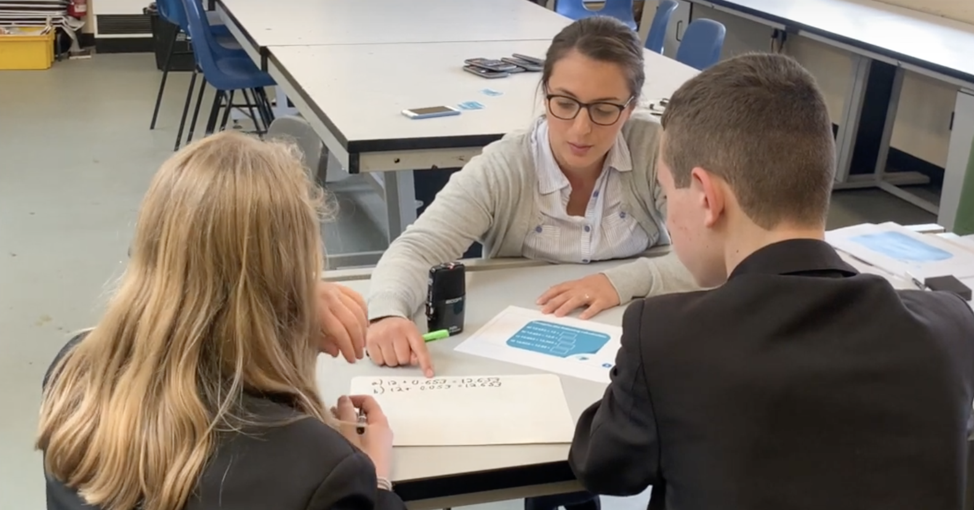
Watch the video in which two Year 8 students work on this prompt with their teacher.
While watching, keep in mind the predictions that you made.
Do these students show the same thinking that you expected?
What strikes you about the responses and reasoning from these students?
Notes:
The slide text Watch the video is hyperlinked to the video

Slide 4
Initially John says that the answer to part d is 0.09 “because if you did 0.1 you wouldn’t be able to get to 3 in the hundredths column because 4 is already over 3 so you’re going to have to carry it over to start back at 0 to get back up to 3.”
What do you think John might be thinking here? Is this a mistake or an error indicating a misconception?
Notes:
NOTE TO FACILITATOR
This slide gives an opportunity to focus on the participants’ reflections and consider whether John’s response was a mistake or an error that might suggest a misconception.
You might like to consider what common misconceptions participants have come across in their students when working with decimal numbers.

Slide 5
A 1984 article reporting on the work of the APU identified some common errors students demonstrated when working with decimals.
The APU asked these questions to samples of around 1000 11-year-olds.
The percentage shows the proportion giving each answer.
Put these numbers in order of size, smallest first
Put these numbers in order of size, smallest first
0.3 | 0.1 | 0.7 | 0.6
0.07 | 0.23 | 0.1
?
0.1 | 0.3 | 0.6 | 0.7 | 75%
0.7 | 0.6 | 0.3 | 0.1 | 18%
 |  |  | other | 4%
 |  |  | omit | 3%
0.07 | 0.1 | 0.23 | 23%
0.1 | 0.07 | 0.23 | 31%
0.23 | 0.07 | 0.1 | 20%
0.23 | 0.1 | 0.07 | 2%
 |  | other | 21%
 |  | omit | 3%
What reasoning might be behind the wrong answers in the second question?
What percentage of students do you think gave each answer?
Link to article
Notes:
NOTE TO FACILITATOR
This slide is animated so that, on a click the percentage of students giving each response is revealed (the correct response is already highlighted in yellow).
The Assessment of Performance Unit (APU) explored and compared UK students’ understanding of maths at ages 11 and 15, reporting on changes from 1984 to 1988.
The article from the APU authors Graham Ruddock, Keith Mason and Derek Foxman was published in the Mathematical Association’s journal, Mathematics in School, Jan, 1984, Vol. 13, No. 1.
There is a link to the article on the slide.
You might like to have tried some of these tasks with some students so that you can share your experience with the participants at this point

Slide 6
At the same time, the APU asked these questions to 15-year-olds
Which of the numbers below has
the greatest value?
Which of the numbers below has the smallest value?
A | 0.625 | 34%
B | 0.25 | 3%
C | 0.375 | 2%
D | 0.125 | 38%
E | 0.5 | 22%
other |  | 1%
omit |  | 1%
?
?
A | 0.075 | 1%
B | 0.09 | 1%
C | 0.1 | 82%
D | 0.089 | 14%
other |  | 1%
omit |  | 1%
The researchers suggested that there were two common errors when students compared decimals;
Decimal Point Ignored (DPI) in which the comparison would be correct if whole numbers, rather than decimals, had been used.
Largest is Smallest (LS) in which the number of decimal places is used to decide on the greatest value.
What reasoning might be behind the wrong answers?
What percentage of students do you think gave each answer?
Link to article
Notes:
NOTE TO SESSION FACILITATOR
This slide is animated so that, on the first click the percentage of students giving each response to the first question is revealed (the correct response is already highlighted in yellow) and on the second click the percentages for the second question are revealed.
A third click brings in text describing two common errors identified by the APU.
Do participants recognise these errors in their own students? Were these errors among those listed when discussing John’s error on Slide 4?
The APU carried out this research during the 1980s. You might like to ask participants to what extent they think these errors are still evident? What do they think would happen if they asked their KS4 classes these questions?
It’s worth noting that the researchers adapted the questions with these two errors in mind and predicted common incorrect answers. Using these tests confirmed that the errors were as expected. More details about this can be found in the article.
You might like to have tried some of these tasks with some students so that you can share your experience with the participants at this point

Slide 7
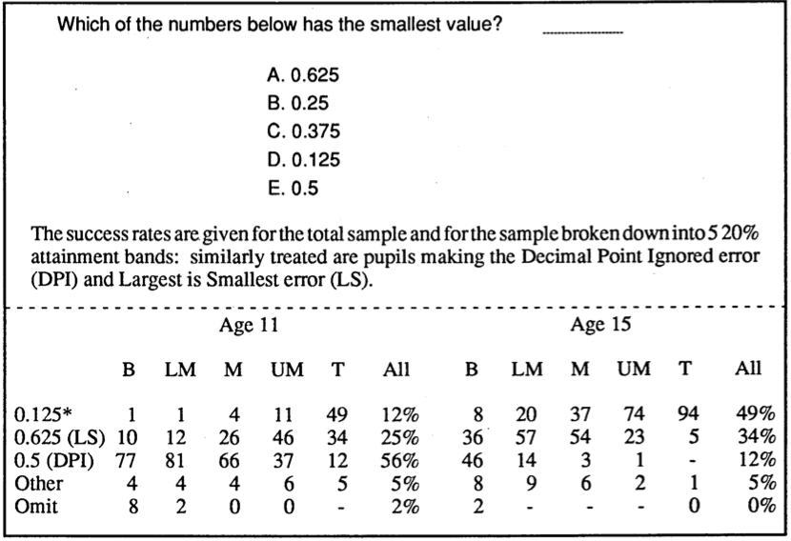
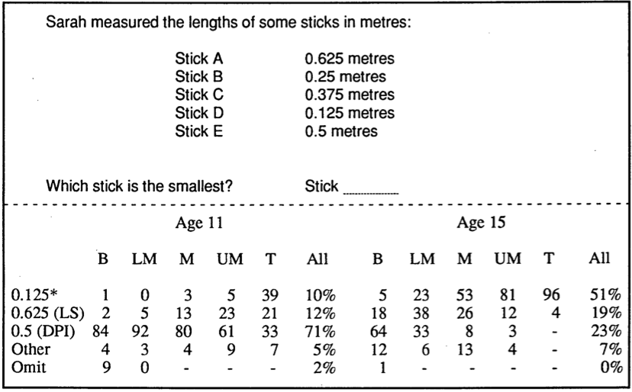
To explore whether context reduced student errors with decimals, the same question was asked both with and without the context of length. The APU authors conclude that:
Success rates for both age groups are not affected by the provision of a context, in this case length, but the pattern of incorrect responses is considerably altered. The LS error is given less frequently, and the attainment band analyses show that this is true across the attainment range for both age groups. The younger pupils and lower attaining 15-year-olds give DPI type answers more frequently when the length context is used.
Link to report
Notes:
NOTE TO SESSION FACILITATOR
This is an optional slide that continues to explore the identified errors in a little more detail.
It might be suggested that a context supports students in making sense of decimal numbers.
The APU authors explored this by adapting one of the items already considered (item D) so that the numbers represented the lengths of sticks.
As can be seen, students made different errors within this context, but the overall percentage of correct responses was around the same.
(The authors used the assessment outcomes to compare success in individual items across different attainment groupings for the assessment as a whole. The categories go from Bottom (B) to Top (T), with 20% of the students in each group).
This adaptation is taken from Chapter 3 Page 48 of the APU’s Mathematics Monitoring Phase 2 report. A link to the report (on the STEM Learning website) is available on the slide.

Slide 8
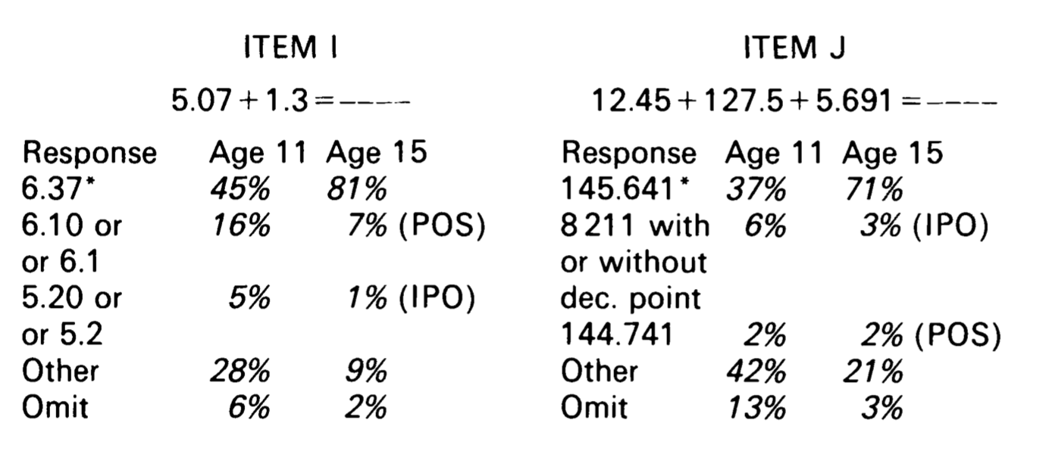
The APU also identified two common errors when students calculated with decimal numbers.
These were characterised as:
Ignore Points and Perform Operation (IPO) which is closely related to the DPI error described earlier. Students carrying out this error ignore the decimal points and carry out the operation, then re-insert the decimal point in the resulting answer.
Considers Points but Performs Operations Separately (POS) describes students who considered the digits before and after the decimal points as separate values and calculated each accordingly.
Examples of these errors can be seen in these results for both 11 and 15-year-olds
Link to article
Notes:
NOTE TO SESSION FACILITATOR
This is an optional slide that explores results from the APU when calculating with decimals.
It might be conjectured that students currently in school will have greater fluency with decimal numbers, and this offers an opportunity for participants to take these tasks back to their classes to see whether the results are similar (or whether they’re similar with younger students?).
The key here is to consider the types of errors which students might make when working with decimal numbers.
You might like to have tried these items with your own students and share the results

Slide 9
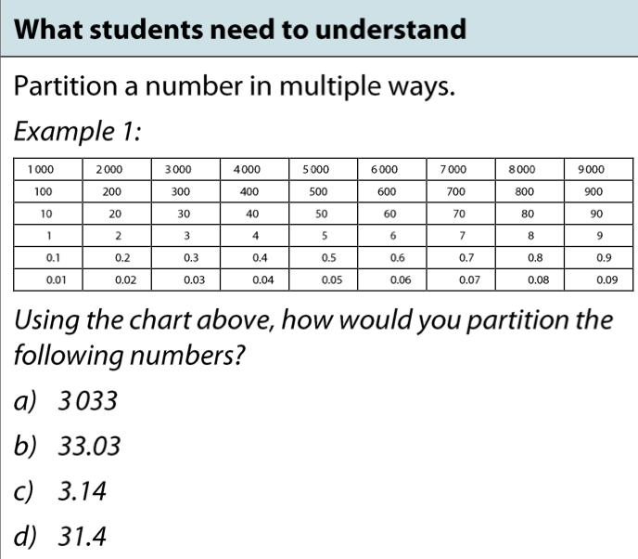
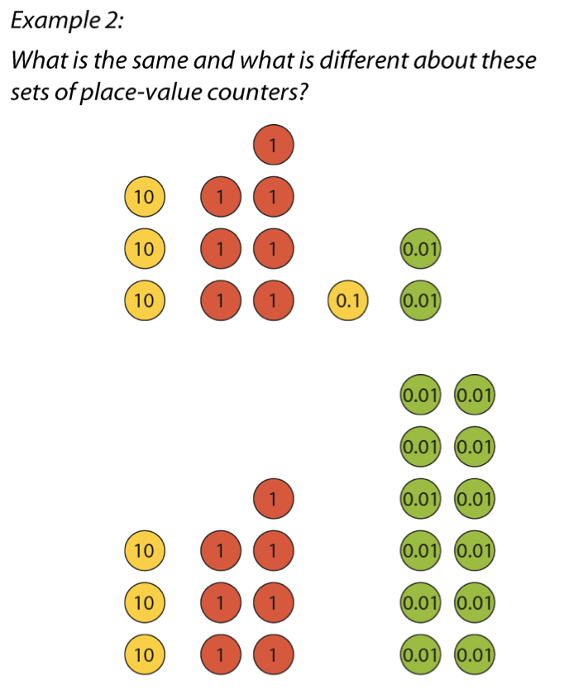
These tasks are taken from the The The NCETM’s Secondary Professional Development Materials show different representations that might be used to support an understanding of place value.
Consider the benefits and disadvantages of these and other representations
Link to Gattegno Chart
Link to place value counters
Link to Core Concept 2.1
Notes:
NOTE TO SESSION FACILITATOR
These tasks are taken from pages 18 and 19 of Core Concept 2.1 Arithmetic Procedures from the NCETM Secondary Professional Development Materials.
The intention of this slide is to give a context in which to discuss the use of different representations to support understanding of place value. A larger version of the Gattegno Place Value Chart (shown in Example 1) is offered on the next slide if you’d like to further explore its use.
Both representations used here are explored in detail in the Representations section of the NCETM’s Secondary Professional Development Materials and are linked to on the slide.
You might like to have tried the tasks with some students so that you can share your experience with the participants at this point

Slide 10
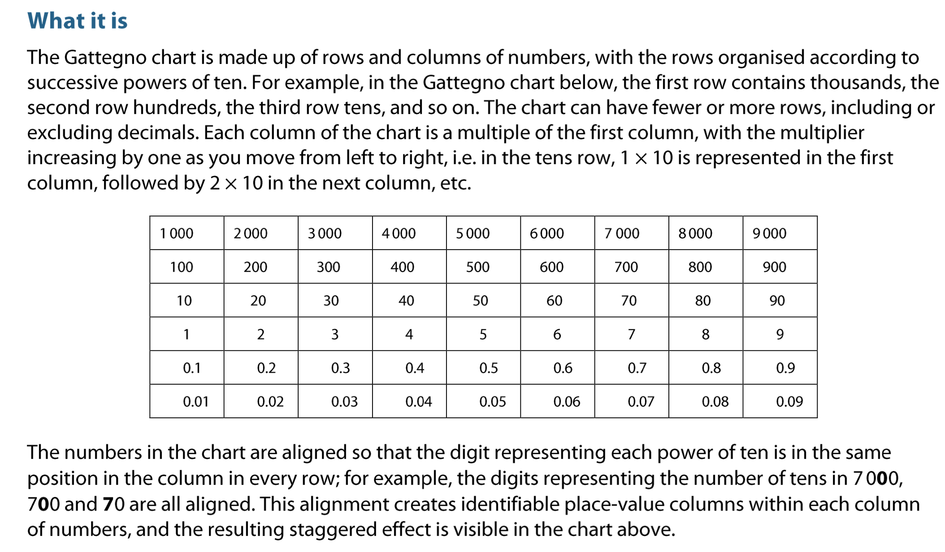
Link to representations section of PD Materials
Notes:
NOTE TO FACILITATOR
This is an optional slide that gives more detail about the Gattegno Place Value Chart introduced on the previous slide.
The Gattegno (pronounced Gat – ten – yo) Chart was developed by the maths educator Caleb Gattegno (1911 – 1988).
It might be an unfamiliar representation to the participants. If so, you might like to spend time exploring it further.
More details about using the chart can be found in the Representations section of the NCETM’s Secondary Professional Development Materials which is linked to on the slide.

