Slide 1
Using experimental probability to determine likelihood
KS3 Mastery PD Materials: Exemplified Key Ideas
Materials for use in the classroom or to support professional development discussions
(from 5.3 Probability)
Summer 2021

Slide 2
About this resource
These slides are designed to complement the 5.3 Probability Core Concept document and its associated Theme Overview document 5 Statistics and probability, both found in the Secondary Mastery Professional Development pages.
These slides re-present the key examples from the Core Concept document so that the examples can be used either directly in the classroom or with a group of teachers. There are prompt questions alongside the examples, and further clarification in the notes.
These slides do not fully replicate the Core Concept document, so should be used alongside it. Reference to specific page numbers, and to other useful NCETM resources, can be found in the notes for each slide.
This slide deck is not designed to be a complete PD session, rather it is a selection of resources that you can adapt and use as needed when planning a session with a group of teachers.

Slide 3


About this resource
The slides are structured as follows:
  The big picture:
    Where does this fit in?
    What do students need to understand?
    Why is this key idea important?
  Prior learning
  Misconceptions
  Exemplified key ideas
  Reflection questions
  Appendices:
    Key vocabulary
    Representations and structure
    Previous and Future learning
    Useful links
The exemplified key idea slides have the following symbols to indicate how they have been designed to be used:
Into the classroom
The examples are presented on these slides so that they could be used in PD, but also directly in the classroom. The notes feature suggested questions and things teachers might consider when using with students.
PD discussion prompts
These slides look at the examples in more detail, with question prompts to promote discussion among maths teachers. The notes feature reference to further information and guidance within the Core Concepts document.

Slide 4
Where does this fit in?
The NCETM has identified a set of six ‘mathematical themes’ within Key Stage 3 mathematics that bring together a group of ‘core concepts’.
The fifth of these themes is Statistics and probability, which covers the following interconnected core concepts:
    5.1 Statistical representations and measures
    5.2 Statistical analysis
    5.3 Probability
Notes:
Linked on this slide is the Theme Overview document of Statistics and probability. This document includes why it is important, the key underpinning knowledge and links to prior and future learning. There is also guidance about how the five big ideas of Teaching for Mastery relate specifically to this theme.

Slide 5
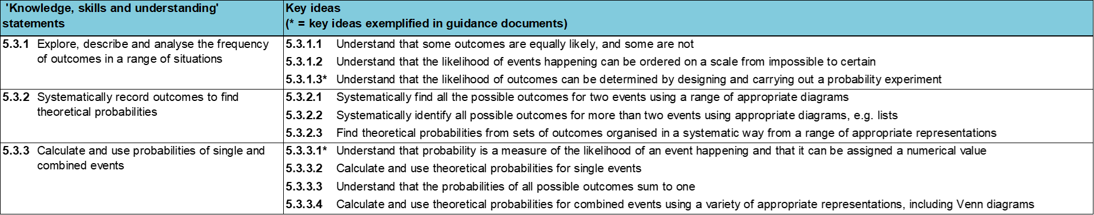
Where does this fit in?
Within this core concept, 5.3 Probability, there are three statements of knowledge, skills and understanding.
These, in turn, are broken down into ten key ideas. The highlighted key idea is exemplified in this slide deck.
Notes:
For key ideas marked with an asterisk, we exemplified the common difficulties and misconceptions that students might have and included elements of what teaching for mastery may look like. We have provided examples of possible student tasks and teaching approaches.
Within these slides are ‘classroom-ready’ versions of the examples for the key idea that has been highlighted. There are also slides that may be useful for discussion in a professional development session.

Slide 6
What do students need to understand?
5.3.1.3 Understand that the likelihood of outcomes can be determined by designing and carrying out a probability experiment
Recognise events in which outcomes are random.
Understand that previous outcomes can be used to make predictions about behaviour over a large number of trials.
Recognise when prior outcomes can be used to make predictions.
  What prior knowledge might your students already have?
  What language might they use to describe this key idea?
  What questions might you want to ask to assess their prior learning?

Slide 7
Why is this key idea important? (1)
Students will encounter probability in many aspects of their daily lives, from sporting events to weather reports. However, probability is an area of mathematics that students can find perplexing. Students may feel that their lived experiences do not reflect calculated mathematical likelihoods. For example, rolling a six on a dice in order to win a board game often ‘feels’ far less likely than any of the other outcomes.
The introduction of probability at Key Stage 3 will offer students a way to quantify, explore and explain likelihood and coincidence, and to reason about uncertainty.
Students should have the opportunity to engage in experiments and develop a feel for likely, unlikely, even, certain and impossible chances, before starting to quantify probabilities and the likelihood of different outcomes.
Furthermore, students need to appreciate that predictions of likelihood do not predict individual events. Rather, experimental data will tend towards this theoretical value (for example, knowing that flipping a head or a tail on a coin has an even chance of occurring does not mean these outcomes will occur an equal number of times).
Notes:
A more detailed overview of the core concept of probability can be found on page 2 of the 5.3 Core Concept document.
The background to each key idea is also explored in more detail on the following pages:
5.3.1 Explore, describe and analyse the frequency of outcomes in a range of situations – page 5
5.3.2 Systematically record outcomes to find theoretical probabilities – pages 5-6
5.3.3 Calculate and use probabilities of single and combined events – pages 6-7

Slide 8
Why is this key idea important? (2)
Before they quantify probabilities, students need to appreciate that, where an event has different possible outcomes, some of these outcomes may be more or less likely than others for different possible reasons.
One factor that underpins uncertainty is that of randomness: students should understand that although an individual event might be random, reasoning about uncertain events can be fruitful when they are repeated many times. Given enough time, trends in apparently random behaviour can become predictable by analysing the frequency of outcomes.
Specific and precise language is key to working with probability. For example, students should understand the distinctions between an event (for example, flipping a coin) and an outcome (for example, a coin landing on heads) or between probability and possibility (for example, it is possible that it will snow in summer, but not probable).
Students will learn that the total chance of all the outcomes of an event will sum to one and should understand how this can be illustrated on a number line, and subsequently link this knowledge to the relationship:
[the chance of an outcome not happening] = 100% − [the chance of it happening]
Notes:
A more detailed overview of the core concept of probability can be found on page 2 of the 5.3 Core Concept document.
The background to each key idea is also explored in more detail on the following pages:
5.3.1 Explore, describe and analyse the frequency of outcomes in a range of situations – page 5
5.3.2 Systematically record outcomes to find theoretical probabilities – pages 5-6
5.3.3 Calculate and use probabilities of single and combined events – pages 6-7

Slide 9
Prior learning
Key Stage 3 Learning Outcome
3.1.3 Understand that fractions are an example of a multiplicative relationship and apply this understanding to a range of contexts
3.1.4 Understand that ratios are an example of a multiplicative relationship and apply this understanding to a range of contexts
Please note: Numerical codes refer to statements of knowledge, skills and understanding in the NCETM breakdown of Key Stage 3 mathematics.
  What representations might your students already be familiar with?
  What language might they use?
  How does this fit in with your curriculum progression?
Notes:
You may find it useful to speak to your partner schools to see how fractions, ratios and multiplicative relationships have been covered and the language used.
You can find further details regarding prior learning in the following segments of the NCETM primary mastery professional development materials (linked on last slide):
• Year 3: 3.2 Unit fractions: identifying, representing and comparing
• Year 3: 3.3 Non-unit fractions: identifying, representing and comparing
• Year 6: 2.27 Scale factors, ratio and proportional reasoning
Within the Statistics and probability Theme Overview document, you can also find a broader description of students’ potential previous learning (page 3), alongside further information about key underpinning knowledge (page 2).

Slide 10
Checking prior learning
The following slides contain questions for checking prior learning.
  What representations might students use to support their understanding of these questions?
  What variation might you put in place for these questions to fully assess students’ understanding of the concept?
  How might changing the language of each question change the difficulty?
  Why are these such crucial pre-requisites for this key idea?

Slide 11
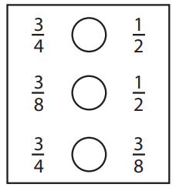
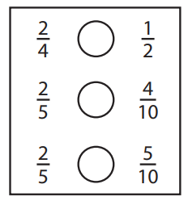
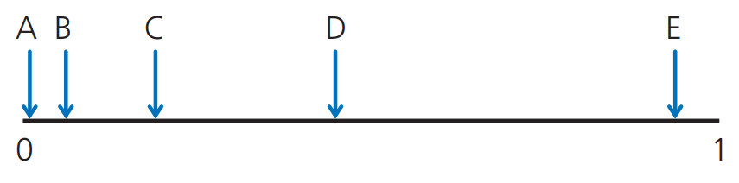
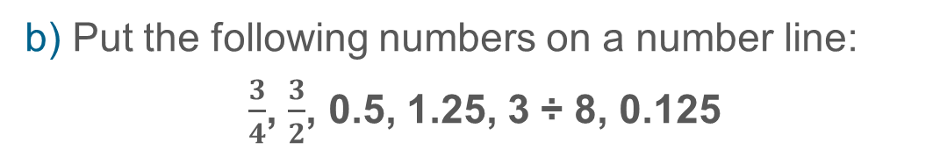
Checking prior learning (1)
a) Make each number sentence correct using =, > or <.
b) Put the following numbers on a number line:
$\frac{3}{4}$, $\frac{3}{2}$, 0.5, 1.25, 3 ÷ 8, 0.125
c) Some events are marked on a probability scale.
What might each event be? Explain your thinking.
Notes:
References to the questions (links on final slide):
a) NCETM primary assessment materials, Year 5 page 17
b) NCETM primary assessment materials, Year 6 page 20
c) NCETM secondary assessment materials, page 49

Slide 12
Checking prior learning (2)
d) Which of these statements is correct? Explain your thinking for each statement.
  When flipping a coin there are two possible outcomes (heads or tails) and only one of them can happen. Each of them has a probability of one half.
  In a football match there are three possible outcomes (win, lose or draw) and only one of them can happen. Each of them has a probability of one third.
  When sitting at a table there are four possible seats (one is red, one yellow, one red and one green). You can only sit in one seat. The probability you sit in the green seat is one quarter.
  A 100m race has five runners (Adam, Max, Grace, Emily and Tilly). Each of them has a probability of one fifth of winning.
  When rolling a die there are six numbers. The probability of rolling each of the numbers is one sixth.
Notes:
References to the questions (links on final slide):
d) NCETM secondary assessment materials, page 48

Slide 13
Common difficulties and misconceptions
What aspects of this key idea might students find challenging?
What misconceptions might students have?
When teaching this topic, you may find students encounter difficulties with…
The concept of randomness
More information, and some suggestions for overcoming these challenges, can be found on the following slides

Slide 14
Common difficulties and misconceptions (1)
In order to understand a probability experiment, students must understand that outcomes should be the result of a random process, but randomness is not necessarily a well-understood concept.
A study from Pratt and Noss (2002) showed that students might, for example, view a non-uniform spinner as not being random because it was ‘not fair’, even though it was seen to fit other features of randomness, while a uniform spinner was perceived to be random.
Giving students an opportunity to explore the same mathematical ideas in different contexts can draw attention to the key structures that underpin the mathematics, and so support students in developing a deeper understanding of randomness.
Within the context of independent events, a common misconception is that having flipped a coin and obtained a head, the next flip ‘should’ give tails because it is an equal probability. Allowing students the opportunity to experience such situations and analyse the possible outcomes will help address the misconception.
Notes:
D. Pratt and R. Noss, 2002, The microevolution of mathematical knowledge: the case of randomness, journal of the learning sciences, 11(4), 453-488, Philadelphia, Taylor and Frances
This can be found on page 8 of the 5.3 Core Concept document.

Slide 15
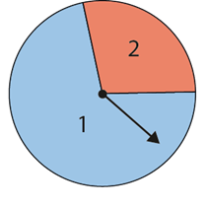
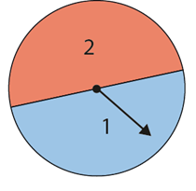
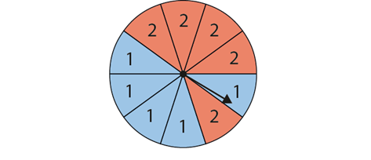
Recognise events in which outcomes are random
Example 1
a) Which of these events do you think will select a number at random?
(i) Rolling a six-sided dice numbered 1 to 6.
(ii) Rolling a nine-sided dice numbered 1 to 9.
(iii) Rolling a nine-sided dice numbered with four 1s and five 2s.
(iv) Spinning
this spinner.
(vii) Asking the person sitting next to you to pick a whole number between 1 and 10.
(v) Spinning this spinner.
(vi) Spinning this spinner.
b) Do you think that any of the above are ‘more random’ than the others? Explain why.
c) Which of the above do you think is a ‘fair’ way to select a random number? Explain why the other ones are not fair.
Notes:
Suggested questioning:
If you wanted to score (e.g.) a 2, which of the methods would you choose?
What is the same and different about each of the spinners?
What is the same and different about each of the dice?
What do we mean by ‘random’?
Things for you to think about:
Example 1 provides an opportunity to explore students’ understanding of randomness and to support them in developing a deeper understanding of the ideas.
Increasing the number of options, moving from part (i) to (ii), allows students to discuss whether this increases the randomness of the situation. Similarly, in parts (iv), (v) and (vi), students may identify spinner (vi) as generating more random results because there are more options than in spinner (v) and they are arranged differently.
Parts b) and c) are prompts to give students an opportunity to think in a different way about their answers to part a). Research suggests that students can hold contradictory opinions about randomness and fairness, which these prompts may expose.

Slide 16
Recognise events in which outcomes are random
Example 1
a) Which of these events do you think will select a number at random?
  What language will you encourage students to use to discuss their ideas?
  What misconceptions around randomness and fairness might these examples expose?
(i) Rolling a six-sided dice numbered 1 to 6.
(ii) Rolling a nine-sided dice numbered 1 to 9.
(iii) Rolling a nine-sided dice numbered with four 1s and five 2s.
(iv) Spinning this spinner.
(vii) Asking the person sitting next to you to pick a whole number between 1 and 10.
(v) Spinning this spinner.
(vi) Spinning this spinner.
b) Do you think that any of the above are ‘more random’ than the others? Explain why.
c) Which of the above do you think is a ‘fair’ way to select a random number? Explain why the other ones are not fair.
Notes:
More detail about the sequencing of this example can be found on pages 8-9 of the 5.3 Core Concept document.

Slide 17
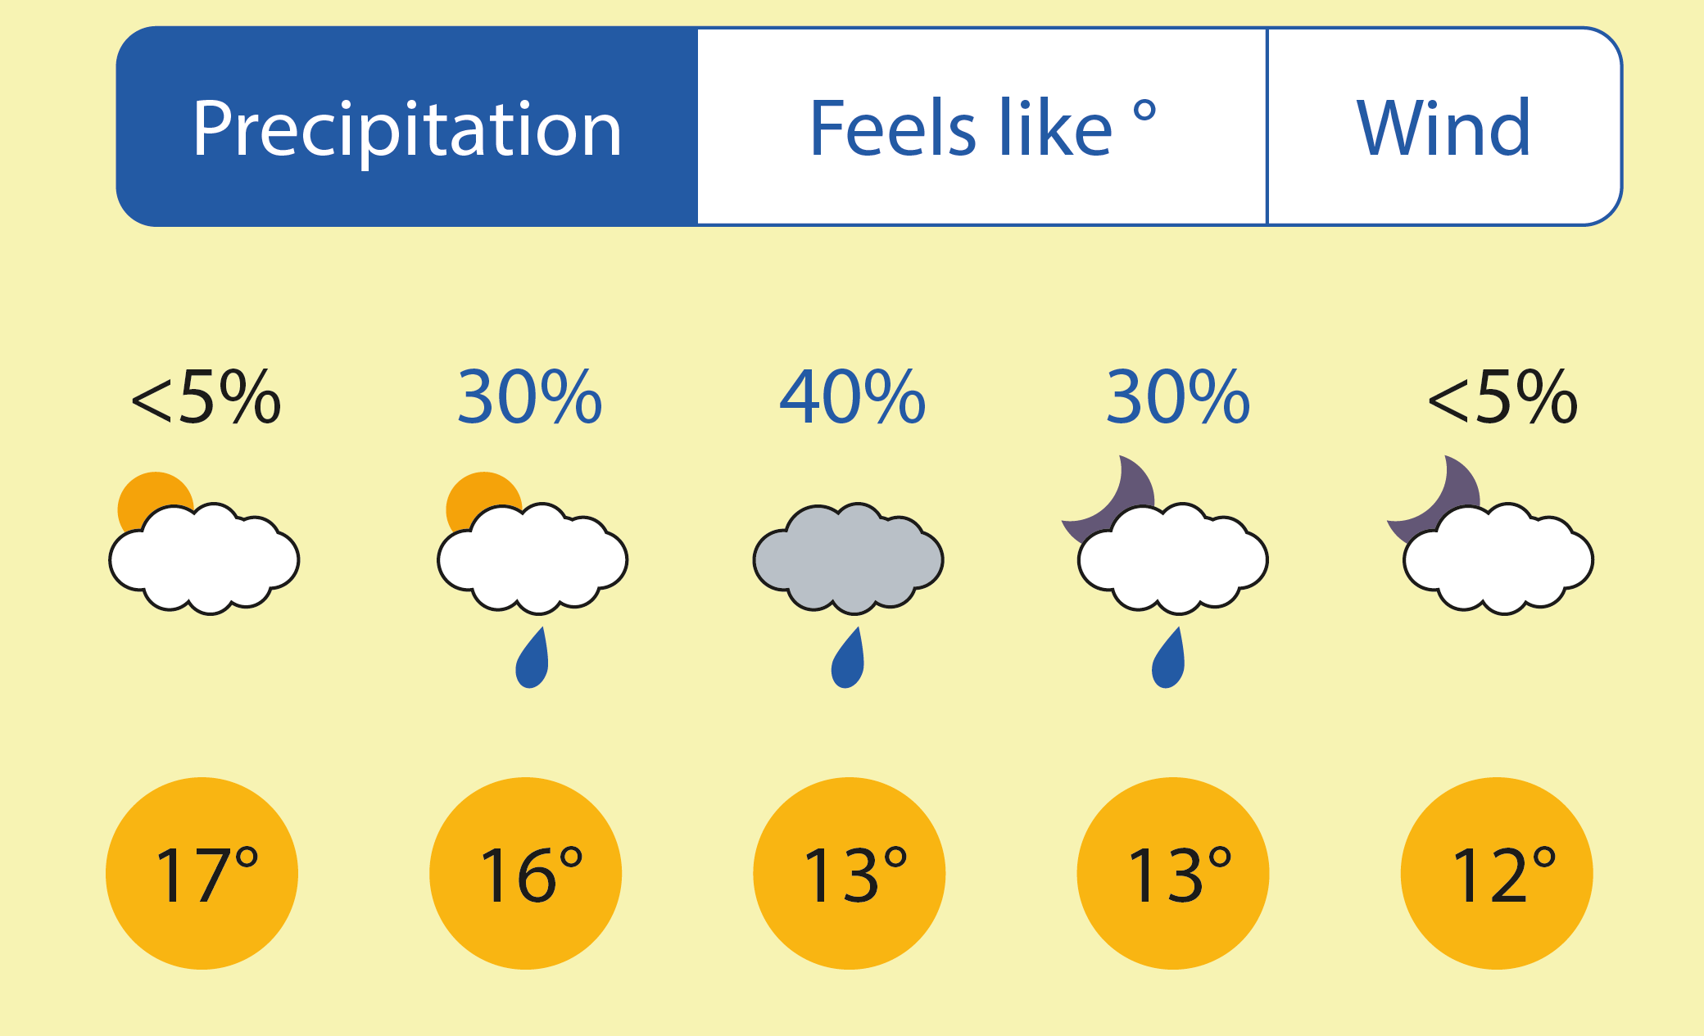
Recognise events in which outcomes are random
Example 2
The weather forecast says that there is a 40% chance of rain.
Ella says, ‘That’s quite likely – I’ll take an umbrella.’
Gavin says, ‘I don’t think it’s going to rain.’
Raj says, ‘It’s just random – it might rain, it might not.’
Who do you most agree with?
Explain why you think the others are wrong.
Notes:
Suggested questioning:
Can we use information from previous occurrences to predict the likelihood of a future event?
Is the weather random?
What do we mean by ‘likely’?
Things for you to think about:
Example 2 allows for discussion of randomness and what it means to assign a probability to an outcome of an event. This example gives students an opportunity to consider what it means to make a prediction about the likelihood of a future event, based on information gathered from previous occurrences.

Slide 18
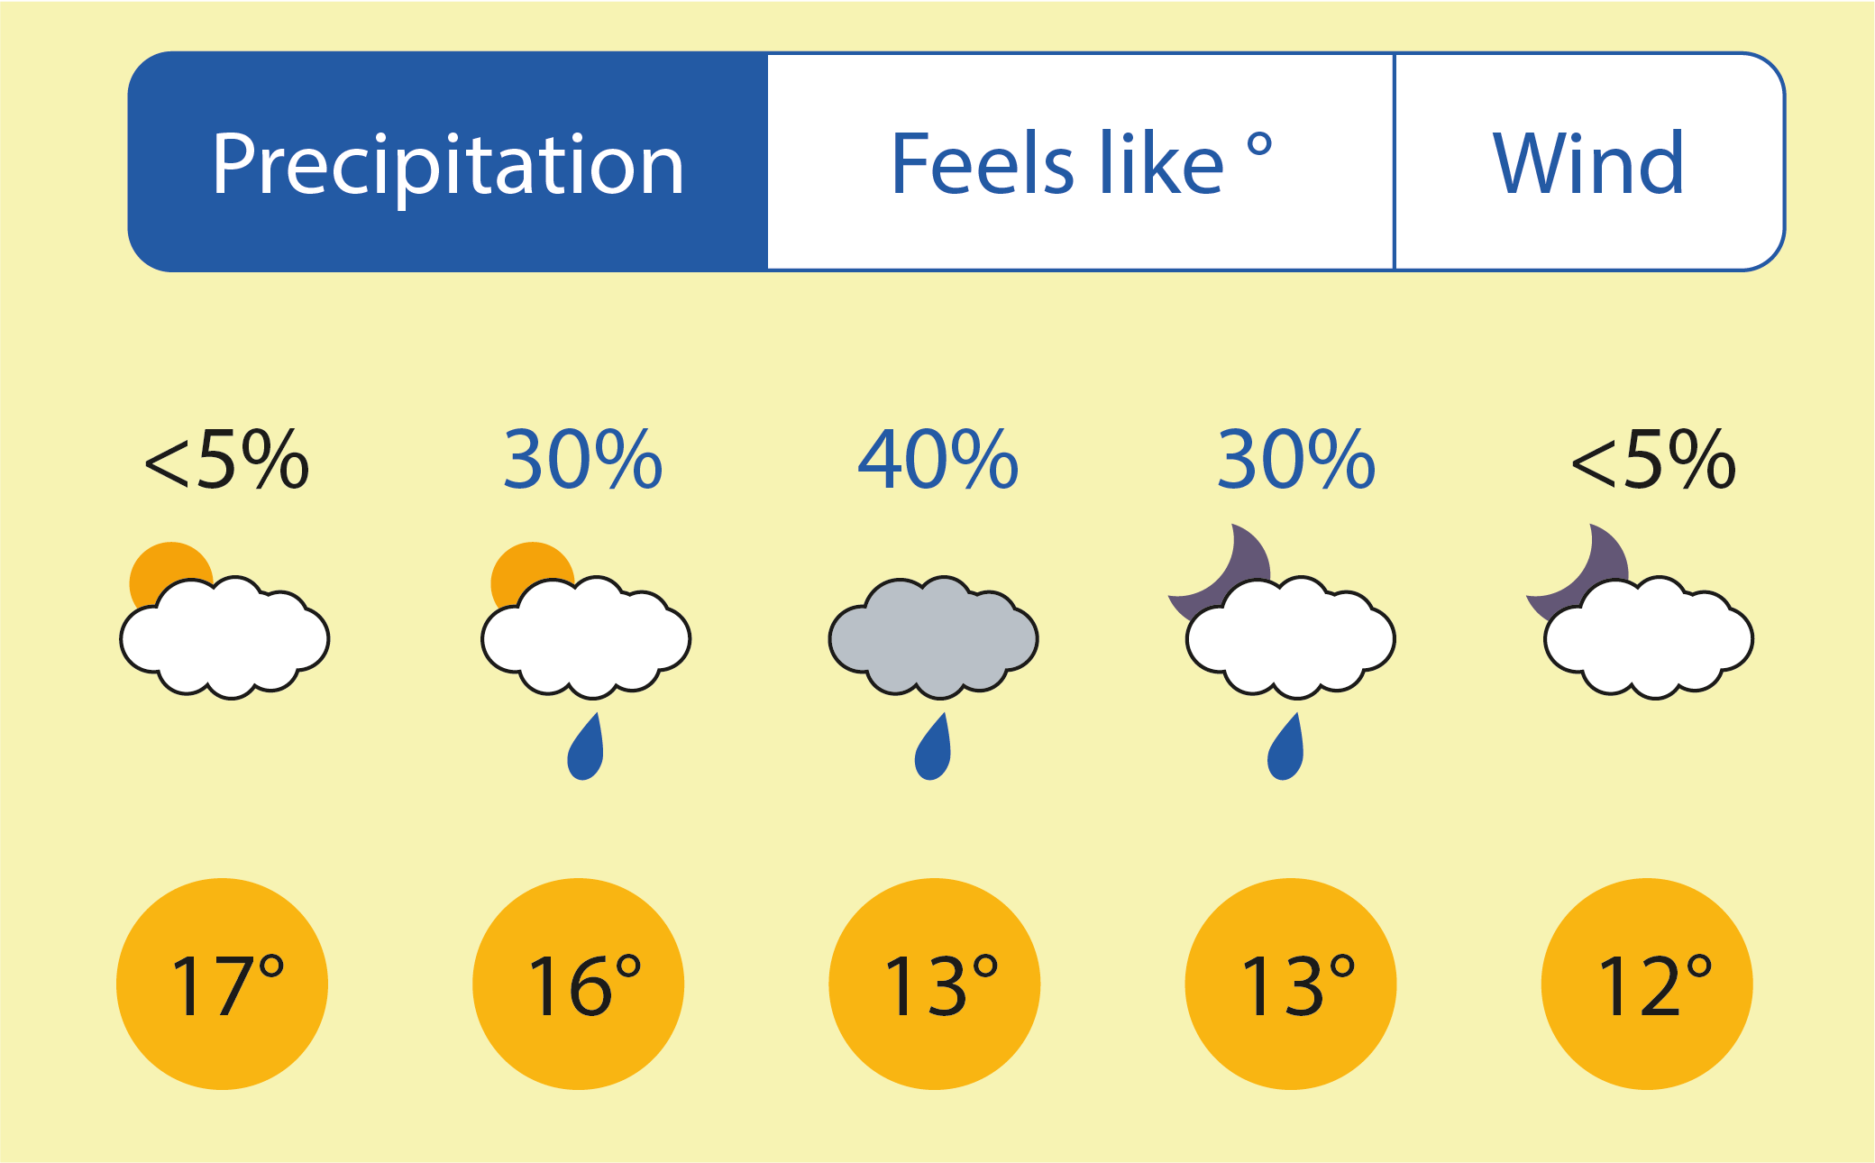
Recognise events in which outcomes are random
Example 2
The weather forecast says that there is a 40% chance of rain.
Ella says, ‘That’s quite likely – I’ll take an umbrella.’
Gavin says, ‘I don’t think it’s going to rain.’
Raj says, ‘It’s just random – it might rain, it might not.’
Who do you most agree with?
Explain why you think the others are wrong.
  What misconceptions about randomness and likelihood might students bring to this discussion?
  What language would you encourage them to use in their explanations?
Notes:
Due to space constraints, the image on this PD discussion slide is very small. PD Leads might like to use or print the ‘in the classroom’ version of this slide for teachers to access during discussions.
More detail about the decisions behind the choice of statements can be found on page 9 of the 5.2 Core Concept document.

Slide 19
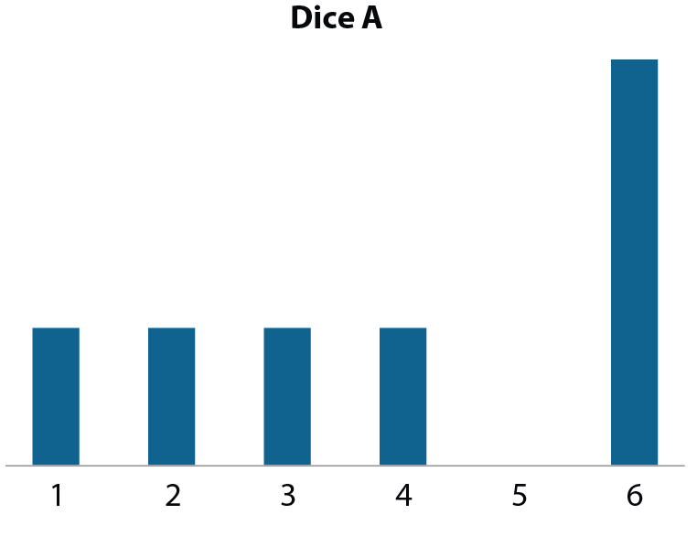
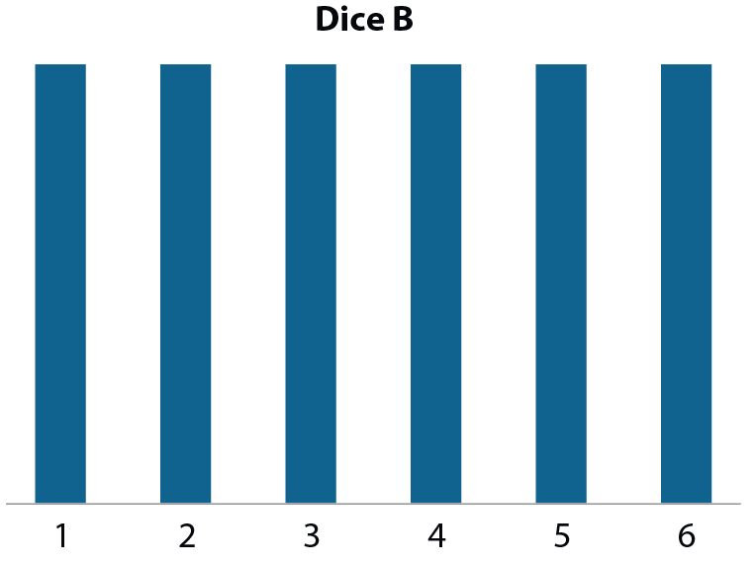
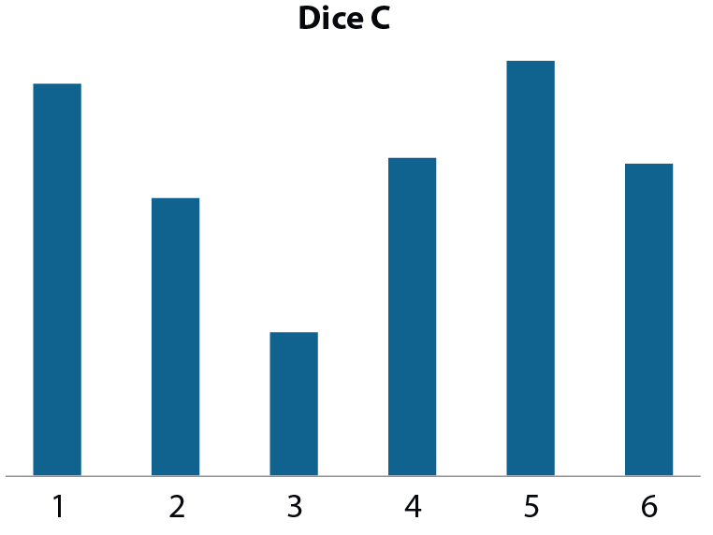
Understand that previous outcomes can be used to make predictions about behaviour over a large number of trials
Example 3
Libby rolled each of three dice over 200 times.
These bar charts show the frequency of each score.
Which dice would you use if you were one step away from finishing a game and needed to roll a 5 to win? Explain why.
Notes:
Suggested questioning:
Which of these dice do you think is fairest? Why?
How would your answer change if you had to roll a 6 to win?
Is it impossible to roll a 5 on dice A? How do you know?
Things for you to think about:
In Example 3, care has been taken to not offer specific values to the number of outcomes, in order to focus students’ attention on the way in which the frequency of events is distributed. The intention here is for students to understand that the frequency of each outcome over time can be used to make a prediction about future outcomes.

Slide 20
Understand that previous outcomes can be used to make predictions about behaviour over a large number of trials.
Example 3
Libby rolled each of three dice over 200 times.
These bar charts show the frequency of each score.
Which dice would you use if you were one step away from finishing a game and needed to roll a 5 to win? Explain why.
  How might you use these examples to introduce the concepts of ‘fairness’ and ‘impossibility’?
  As a result of this discussion, what would you want students to understand about predicting future outcomes?
Notes:
Due to space constraints, the image on this PD discussion slide is very small. PD Leads might like to use or print the ‘in the classroom’ version of this slide for teachers to access during discussions.
More detail about the variation of this example can be found on pages 10-11 of the 5.3 Core Concept document.

Slide 21
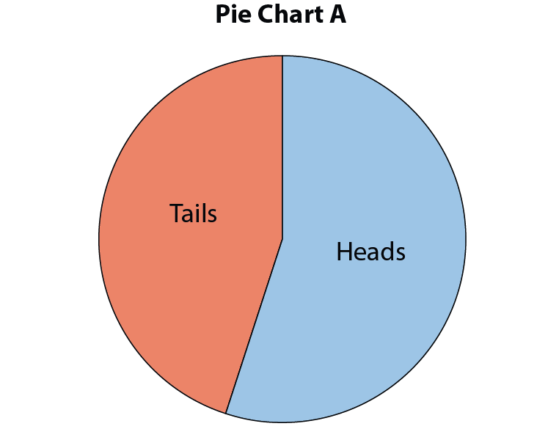
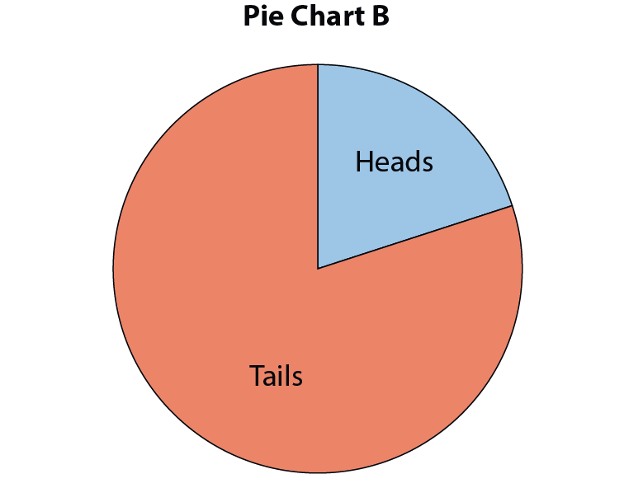
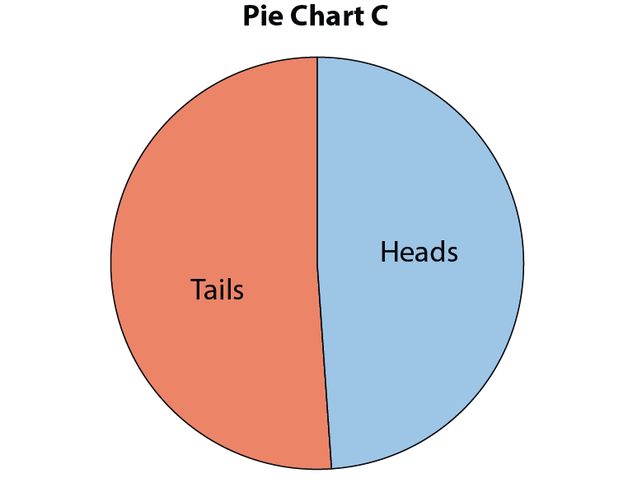
Understand that previous outcomes can be used to make predictions about behaviour over a large number of trials
Example 4
Matilda flipped a fair coin 200 times.
She drew a pie chart to show the results after 10 flips, after 50 flips and after 200 flips.
Which of these pie charts do you think shows the results after each number of flips?
Explain how you know.
Notes:
Suggested questioning:
Which pie chart shows the outcome after 10 flips? How do you know?
There are more heads in Pie Chart A – does this mean that this is the pie chart for the most flips too? Why or why not?
What would you expect the pie chart to look like after 500 flips? How about 1000?
Things for you to think about:
Example 4 is designed to explore students’ understanding of the way that outcomes of an experiment will tend towards expectations as the number of trials increases. The intention is that students appreciate the greater the number of trials, the greater the accuracy of the prediction (i.e. the closer to a 50 : 50 split of heads and tails).

Slide 22
Understand that previous outcomes can be used to make predictions about behaviour over a large number of trials
Example 4
Matilda flipped a fair coin 200 times.
She drew a pie chart to show the results after 10 flips, after 50 flips and after 200 flips.
Which of these pie charts do you think shows the results after each number of flips?
Explain how you know.
  What misconceptions might students have about expected outcomes?
  What questions or examples might you introduce to students next?
Notes:
Due to space constraints, the image on this PD discussion slide is very small. PD Leads might like to use or print the ‘in the classroom’ version of this slide for teachers to access during discussions.
More detail about the misconceptions that might be raised by this example can be found on pages 11-12 of the 5.3 Core Concept document.

Slide 23
Understand that previous outcomes can be used to make predictions about behaviour over a large number of trials
Example 5
Which of these tables do you think might be the results of flipping a coin that has been tampered with so that it is weighted to one side?
Table 1
Heads | 3
Tails | 5
Table 2
Heads | 203
Tails | 189
Table 3
Heads | 21
Tails | 34
Table 4
Heads | 18
Tails | 11
Notes:
Suggested questioning:
What would you expect the outcomes to be with a fair coin? Why?
How many trials have there been each time? Is this enough to determine if the coin is biased? Why or why not?
Things for you to think about:
As with Example 4, Example 5 offers the results of flipping a coin after a different number of trials, with a focus on developing understanding that the greater the number of trials, the more accurate the prediction. The addition of the biased coin in this example is intended to give the opportunity to discuss the outcomes that may be expected with a fair coin and those that exceed those expectations as the number of trials increases.

Slide 24
Understand that previous outcomes can be used to make predictions about behaviour over a large number of trials
Example 5
Which of these tables do you think might be the results of flipping a coin that has been tampered with so that it is weighted to one side?
  How might this example give you an opportunity to discuss the following concepts with students…
    Bias/fairness
    Expected outcomes
    The impact of the number of trials on the accuracy of a prediction
  What misconceptions might students have?
Table 1
Heads | 3
Tails | 5
Table 2
Heads | 203
Tails | 189
Table 3
Heads | 21
Tails | 34
Table 4
Heads | 18
Tails | 11
Notes:
Due to space constraints, the image on this PD discussion slide is very small. PD Leads might like to use or print the ‘in the classroom’ version of this slide for teachers to access during discussions.
More detail about this example can be found on page 12 of the 5.2 Core Concept document.

Slide 25
Recognise when prior outcomes can be used to make predictions
Example 6a
Gianmarco flipped a fair coin 10 times.
His results were:
T H H H H H H H H H
Gabriel says, ‘You’ve got to get tails next time! It’s the law of averages.’
Gianmarco says, ‘No, it could be either heads or tails. It’s an equal chance.’
Who do you agree with? Explain your answer.
Notes:
Suggested questioning:
What does the word ‘fair’ mean here?
Can we predict the 11th outcome, based on the previous 10? Why or why not?
Things for you to think about:
Example 6 offers situations with the same mathematical structure presented in three different contexts. Here, students need to focus on the difference that the context makes, considering issues around randomness, independent events and the number of trials that are being considered. Each example is presented on a different slide; the final slide presents all three examples together, without the imagined statements, giving students a chance to compare and contrast the different contexts.

Slide 26
Recognise when prior outcomes can be used to make predictions
Example 6b
Jack runs a café – for lunch he sells two different types of soup.
In half an hour he sells 10 cups of soup:
Tomato Chicken Chicken Chicken Chicken
Chicken Chicken Chicken Chicken Chicken
Willow says, ‘You’d better make more chicken than tomato soup tomorrow! People love it!’
Jack says, ‘No, they can choose either tomato or chicken. I’ll make the same amount of both.’
Who do you agree with? Explain your answer.
Notes:
Suggested questioning:
Is this situation random?
Can we predict the 11th outcome, based on the previous 10? Why or why not?
Things for you to think about:
Example 6 offers situations with the same mathematical structure presented in three different contexts. Here, students need to focus on the difference that the context makes, considering issues around randomness, independent events and the number of trials that are being considered. Each example is presented on a different slide; the final slide presents all three examples together, without the imagined statements, giving students a chance to compare and contrast the different contexts.

Slide 27
Recognise when prior outcomes can be used to make predictions
Example 6c
A rugby team’s results over 10 weeks are:
L W W W W W W W W W
Louis says, ‘We’re bound to win the next match! We’re on a winning streak!’
Sasha says, ‘We could win or lose. It can go either way.’
Who do you agree with? Explain your answer.
Notes:
Suggested questioning:
Is this situation random?
Can we predict the 11th outcome, based on the previous 10? Why or why not?
Things for you to think about:
Example 6 offers situations with the same mathematical structure presented in three different contexts. Here, students need to focus on the difference that the context makes, considering issues around randomness, independent events and the number of trials that are being considered. Each example is presented on a different slide; the final slide presents all three examples together, without the imagined statements, giving students a chance to compare and contrast the different contexts.

Slide 28
Recognise when prior outcomes can be used to make predictions
Example 6
a) Gianmarco flipped a fair coin 10 times. His results were:
T H H H H H H H H H
b) Jack runs a café – for lunch he sells two different types of soup. In half an hour he sells 10 cups of soup:
Tomato Chicken Chicken Chicken Chicken Chicken Chicken Chicken Chicken Chicken
c) A rugby team’s results over 10 weeks are:
L W W W W W W W W W
What is the same and different about each example?
Notes:
Suggested questioning:
Which of these are random? Which are not?
When can you use prior outcomes to predict future outcomes? Why?
Things for you to think about:
This slide presents the three examples together so that students can compare and contrast them. They should recognise that, although the structure is the same, that prior outcomes cannot be used to make predictions in all three contexts.

Slide 29
Recognise when prior outcomes can be used to make predictions
Example 6
a)
Gianmarco flipped a fair coin 10 times.
His results were:
T H H H H H H H H H
  What is the effect of presenting the same mathematical structure in different contexts?
  What structures and strategies might be successful in allowing you to hear students’ current understanding as they express it, and then move them forward?
b)
Jack runs a café – for lunch he sells two different types of soup.
In half an hour he sells 10 cups of soup:
Tomato Chicken Chicken Chicken Chicken
Chicken Chicken Chicken Chicken Chicken
c)
A rugby team’s results over 10 weeks are:
L W W W W W W W W W
Notes:
Each of these examples is intended to be presented to students with pairs of statements to agree/disagree with; these can be found on page 13 of the 5.3 Core Concept document, as well as on their respective ‘into the classroom’ slides.

Slide 30
Reflection questions
What other mathematical concepts will be supported by students’ stronger understanding of this key idea?
What mathematical language will you continue to use to support pupils to make connections with other areas?
Which representations might you continue to use to further develop students’ understanding?

Slide 32
Appendices
You may choose to use the following slides when planning or delivering a PD session. They cover:
  Key vocabulary
  Representations and structure
  Previous learning
  Future learning
  Library of links

Slide 33
Key vocabulary (1)
Term | Definition
combined event | A combined (or compound) event is an event that includes several outcomes. Example: In selecting people at random for a survey, a combined event could be ‘girl with brown eyes’.
conditional probability | The conditional probability of an event B is the probability that the event will occur, given the knowledge that an event A has already occurred. This probability is written P(B|A) (‘the probability of B given A’). In the case where events A and B are independent, P(B|A) = P(B). If events A and B are dependent, then the probability that both events occur is P(A and B) = P(A) × P(B|A).
dependent and independent events | Two events are said to be dependent when the outcome of one has an influence on the outcome of the other. Example: Picking two balls from a bag of balls when the first one is not replaced; the probability of choosing the second ball will be influenced by which ball is chosen first. When there is no such influence, the events are said to be independent. Example: Picking two balls from a bag of balls when the first ball is replaced before picking the second.

Slide 34
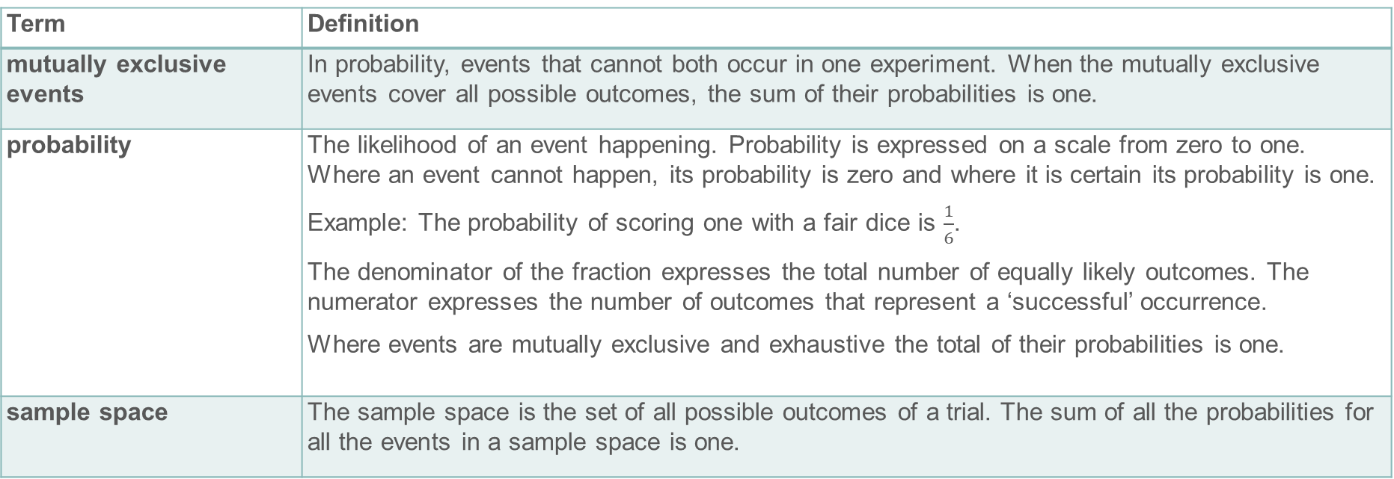
Key vocabulary (2)
Term | Definition
mutually exclusive events | In probability, events that cannot both occur in one experiment. When the mutually exclusive events cover all possible outcomes, the sum of their probabilities is one.
probability | The likelihood of an event happening. Probability is expressed on a scale from zero to one. Where an event cannot happen, its probability is zero and where it is certain its probability is one. Example: The probability of scoring one with a fair dice is $\frac{1}{6}$. The denominator of the fraction expresses the total number of equally likely outcomes. The numerator expresses the number of outcomes that represent a ‘successful’ occurrence. Where events are mutually exclusive and exhaustive the total of their probabilities is one.
sample space | The sample space is the set of all possible outcomes of a trial. The sum of all the probabilities for all the events in a sample space is one.

Slide 35

Representations and structure
There are a number of different representations that you may wish to use to support students’ understanding of this key idea. These might include:
Probability scale
Probability space
  A probability space is a useful representation to identify all outcomes where events are being combined.
Tree diagrams
  Although not a requirement of the national curriculum Key Stage 3 programme of study, students may find a tree diagram helpful in identifying and classifying outcomes of more than one event.
  A probability scale supports students in quantifying between everyday terms such as ‘likely’, ‘impossible’ and ‘certain’.
Notes:
More information about representations can be found on pages 5-7 of the Theme Overview document 5 Statistics and probability.

Slide 36
Previous learning
From Upper Key Stage 2, students will bring experience of:
interpreting and presenting discrete and continuous data using appropriate graphical methods, including bar charts, pictograms and time graphs
solving comparison, sum and difference problems using information presented in bar charts, pictograms, tables and other graphs
interpreting and constructing pie charts and line graphs, and using these to solve problems
encountering and drawing graphs relating two variables, arising from their own enquiry and in other subjects (non-statutory guidance)
calculating and interpreting the mean as an average
knowing when it is appropriate to find the mean of a data set (non-statutory guidance).
Notes:
Theme 5 Statistics and probability

Slide 37
Future Learning (1)
In KS4, students will build on the core concepts in this mathematical theme to:
infer properties of populations or distributions from a sample, whilst knowing the limitations of sampling
interpret and construct tables and line graphs for time series data
{construct and interpret diagrams for grouped discrete data and continuous data, i.e. histograms with equal and unequal class intervals and cumulative frequency graphs, and know their appropriate use}
Please note: Braces { } indicate additional mathematical content to be taught to more highly attaining students.
Notes:
Theme 5 Statistics and probability

Slide 38
Future learning (2)
In KS4, students will build on the core concepts in this mathematical theme to:
interpret, analyse and compare the distributions of data sets from univariate empirical distributions through:
  appropriate graphical representation involving discrete, continuous and grouped data, {including box plots}
  appropriate measures of central tendency (including modal class) and spread {including quartiles and inter-quartile range}
apply statistics to describe a population
use and interpret scatter graphs of bivariate data; recognise correlation and know that it does not indicate causation; draw estimated lines of best fit; make predictions; interpolate and extrapolate apparent trends whilst knowing the dangers of so doing
Please note: Braces { } indicate additional mathematical content to be taught to more highly attaining students.
Notes:
Theme 5 Statistics and probability

Slide 39
Library of links
The following resources from the NCETM website have been referred to within this slide deck:
  NCETM Secondary Mastery Professional Development
    Statistics and probability theme overview document
    5.3 Probability core concept guidance document
    3.1 Understanding multiplicative relationships Core Concept Document
  Using mathematical representations at KS3 | NCETM
  NCETM primary mastery professional development materials
  NCETM primary assessment materials
  NCETM secondary assessment materials
References are also made to the following:
  D. Pratt and R. Noss, 2002, The microevolution of mathematical knowledge: the case of randomness, journal of the learning sciences, 11(4), 453-488, Philadelphia, Taylor and Frances

