Slide 1

Checkpoints
Year 7 diagnostic mathematics activities
Place value
Seven Checkpoint activities
Seven additional activities
Published in 2021/22

Slide 2
About this resource
This resource is designed to be used in the classroom with Year 7 students, although it may be useful for other students.
The Checkpoints are grouped around the key ideas in the core concept document 1.1 Place Value, Estimation and Rounding, part of the NCETM Secondary Mastery Professional Development materials.
Before each set of Checkpoints, context is explored, to help secondary teachers to understand where students may have encountered concepts in primary school.
The 10-minute Checkpoint tasks might be used as assessment activities, ahead of introducing concepts, to help teachers to both explore what students already know and identify gaps and misconceptions.
Each Checkpoint has an optional question marked . This will provide further thinking for those students who have completed the rest of the activities on the slide.
The notes for each Checkpoint give answers (if appropriate), some suggested questions and things to consider.
After each Checkpoint, a guidance slide explores suggested adaptations, potential misconceptions and follow-up tasks. These may include the additional activities at the end of this deck.

Slide 3
Checkpoints
Checkpoint | Underpins | Code
1: Arranging digits | Understanding the value of digits in decimals, measures and integers | 1.1.1*
2: All the 3s
3: Comparing representations
4: Calculations in colour | Understand place value in decimals, including recognising exponent and fractional representations of the column headings | 1.1.1.2
5: Many-step calculations
6: Comparing lengths
7: Understanding inequalities
*This three-digit code refers to the statement of knowledge, skills and understanding in the NCETM’s Sample Key Stage 3 Curriculum Framework (see notes below for more information).
Notes:
In the Sample Key Stage 3 Curriculum Framework, statements of knowledge, skills and understanding are arranged to give an example teaching order. The three-digit code for each statement in the framework is a clickable hyperlink to documents with more detailed information, including the key ideas contained within that statement. These key ideas are also shown on the next slide in this deck.

Slide 4
Key ideas
Key idea | Code
Understand place value in integers | 1.1.1.1
Understand place value in decimals, including recognising exponent and fractional representations of the column headings | 1.1.1.2
Understand place value in the context of measure | 1.1.1.3
Order and compare numbers and measures using <, >, = | 1.1.1.4

Slide 5
Understand place value in integers
Checkpoints 1–2

Slide 6
Understand place value in integers
Previous learning | In Key Stage 3 students need to
Key Stage 2 curriculum: Year 4: numbers greater than 1 000 Year 5: numbers up to 1 000 000. Further information about how students may have experienced this key idea in Key Stages 1 and 2: Primary Mastery Professional Development, Spine 1 Number, Addition and Subtraction Teaching mathematics in primary schools, 6NPV–2 Place value in numbers up to 10 000 000 (pp 286–88)*; 6NPV–3 Numbers up to 10 million in the linear number system (pages 289–93)* * Page numbers reference the complete Years 1–6 document. | Be able to say any number and understand where it fits in the number system, i.e. an ordered list of numbers and on a number line. Know the general structure of the place-value system is based on powers of ten and begin to see how this naturally extends to decimals. Progress beyond recalling place-value column headings when answering questions, such as, ‘What does the 8 represent in 43 872?’, appreciating that 43 872 has 438 hundreds and, later, that 43 872 is, in fact, 438.72 hundreds or 438.72 × 100. Have a deep understanding of place value to understand two further ideas developed in Key Stage 3 which require rounding to a number of decimal places or significant figures and interpreting and writing numbers in standard form.

Slide 7
Checkpoint 1: Arranging digits
9
7
6
0
8
Use the digit cards to create:
the largest possible 5-digit number
the smallest possible 5-digit number
the 5-digit number that is closest to 60 000
the 5-digit number that is closest to 90 000
a number with 76 tens
a number with 76 hundreds
Using these cards, how many different 5-digit numbers can you create between 50 000 and 70 000? How do you know?
Notes:
This slide is animated. Each question will appear separately so you can choose the pace at which to work with your class. You may wish to use the printable 0–9 digit cards (on slides 37–46).
Answers
98 760
60 789
60 789
89 760
XX76X, e.g. 90 768
X76XX, e.g. 97 680
24
Suggested questioning
Which digit did you put in the __ position? Why? Is your strategy the same each time?
How do you know your number fits the criteria? How would you explain this to your teacher?
Things to think about
Students may find it challenging to read larger values. Ensure that you build time into this activity to practise reading their 5-digit numbers aloud.

Slide 8
Checkpoint 1: Guidance
Adaptations | Assessing understanding
Support Remove one or two digit cards to work with smaller numbers and focus on the key concept of the position of the digits. It is important to then build on this by working on the task in its original form, so that students have exposure to numbers with five digits or more. Challenge If your students need more challenge, you can add additional criteria, such as ‘even or odd’, ‘multiple of __’, and/or ‘has a __ in the __s column’. Representations Use a place-value grid or Gattegno chart to explore what is the same and what is different in each part. Guidance on using representations can be found here: Using mathematical representations at KS3 | NCETM. | Do students know to place the digits in descending order for part a)? Do they appreciate where the ‘0’ needs to be placed to create the smallest number in part b)? Parts c) and d) offer an opportunity to discuss the order of the digits and why the number closest to 90 000 doesn’t have 9 in the ten thousands column. The digits given in e) and f) are the same so that students can focus on what is different: the position.
Additional resources 6NPV–2 and 6NPV–3 in the Exemplification of ready-to-progress criteria NCETM. Download as part of the Year 6 deck or the complete Number and Place Value deck. Additional activities A, B and C in this deck offer alternative contexts to explore place value.

Slide 9
Checkpoint 2: All the 3s
Write these numbers in digits:
three hundred and thirty thousand and thirty-three
thirty thousand three hundred and thirty-three
three hundred thousand and thirty-three
thirty three thousand and thirty-three
three hundred and thirty thousand, three hundred and thirty-three
thirty three thousand three hundred and thirty-three
three hundred and thirty three thousand three hundred and thirty-three
three million and thirty-three
Write your set of numbers in ascending order. Can you think of any other numbers that use only the digits 3 and 0? Where would they fit in your set?
Notes:
This slide is animated. Each question will appear separately so you can choose the pace at which to work with your class.
Answers
330 033
30 333
300 033
33 033
330 333
33 333
333 333
3 000 033
Suggested questioning
What is the same and what is different about number _ and number _?
Which is the biggest and which is the smallest number in this set?
What would happen if I multiplied one of these numbers by 10?
Things to think about
This activity has been designed make students think about how the position of the digits changes the value of the number. A single digit, 3, has been used to focus students’ attention on the language associated with place value – the different ways we say a digit depending on its position.

Slide 10
Checkpoint 2: Guidance
Adaptations | Assessing understanding
Support If students find it challenging to unpick so many similar numbers at once, provide place-value grids, or only show one or two parts at a time. For more practice, repeat this task with a different digit, or with two digits. You may wish to start with a number where the language doesn’t change in the 10s column, such as eight (eighty). Challenge Students who are more confident may start to think more logically about the different 5-, 6- and 7-digit numbers that can be generated with just 3 and 0, and which are missing from the set given. Representations Use a place-value grid with counters or a Gattegno chart alongside this activity. Guidance on using representations can be found here: Using mathematical representations at KS3 | NCETM. | Students are often very familiar with numbers up to 4 digits but may struggle to place the digits in numbers larger than this. A common misconception is that ‘one million’ has 5 zeros. Assess understanding the repeating pattern of ones, tens and hundreds. A place-value chart could be used. Focus on what is the same and what is different about two similar numbers to draw attention to the language that denotes place value – for example, parts c) and h).
Additional resources On p9 of the Year 5 Primary Assessment Materials | NCETM there is an activity exploring place value around 1 million. Further questions exploring numbers over 1 million can be found on p5 of the Secondary Assessment Materials | NCETM.

Slide 11
Understand place value in decimals
Checkpoints 3–5

Slide 12
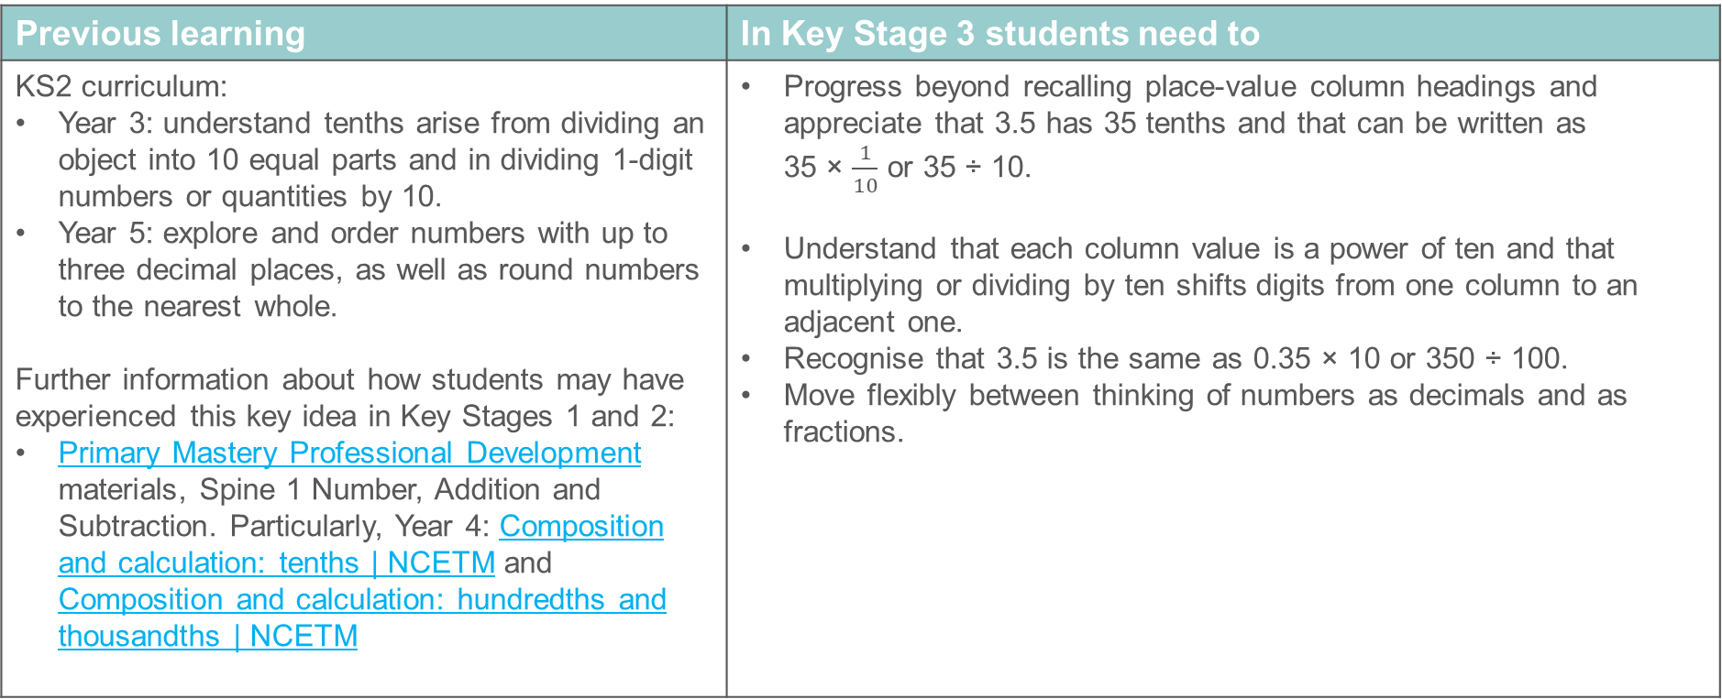
Understand place value in decimals, including recognising exponent and fractional representations of the column headings
Previous learning | In Key Stage 3 students need to
KS2 curriculum: Year 3: understand tenths arise from dividing an object into 10 equal parts and in dividing 1-digit numbers or quantities by 10. Year 5: explore and order numbers with up to three decimal places, as well as round numbers to the nearest whole. Further information about how students may have experienced this key idea in Key Stages 1 and 2: Primary Mastery Professional Development materials, Spine 1 Number, Addition and Subtraction. Particularly, Year 4: Composition and calculation: tenths | NCETM and Composition and calculation: hundredths and thousandths | NCETM | Progress beyond recalling place-value column headings and appreciate that 3.5 has 35 tenths and that can be written as 35 × $\frac{1}{10}$ or 35 ÷ 10. Understand that each column value is a power of ten and that multiplying or dividing by ten shifts digits from one column to an adjacent one. Recognise that 3.5 is the same as 0.35 × 10 or 350 ÷ 100. Move flexibly between thinking of numbers as decimals and as fractions.

Slide 13
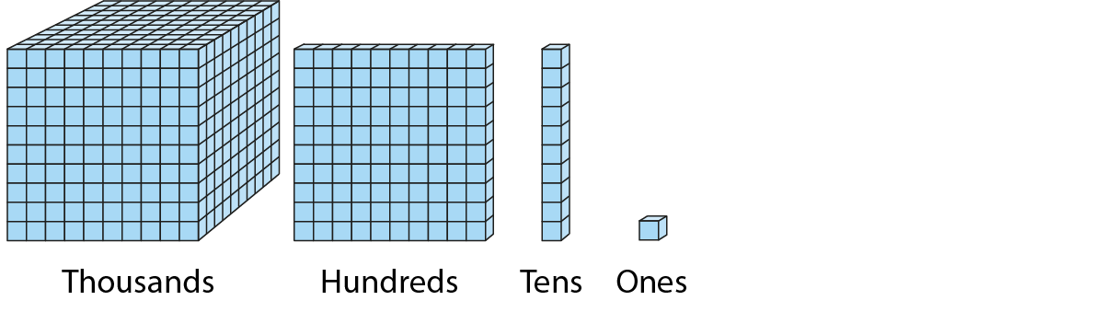
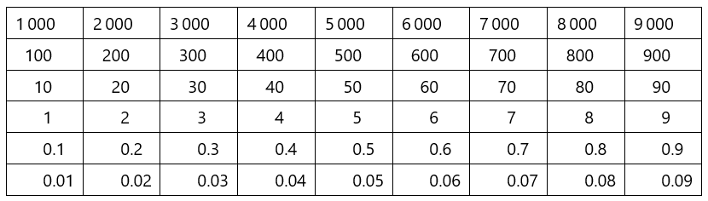
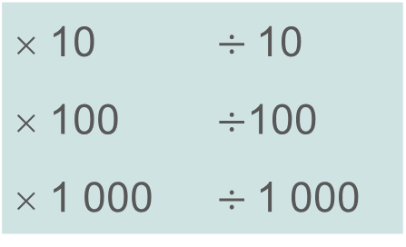
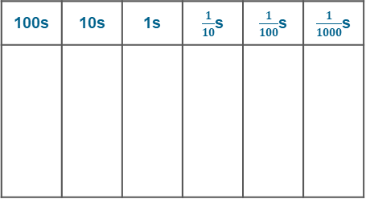
Checkpoint 3: Comparing representations
Amina, Beth and Cameron each use a representation to show a different number.
Amina
Beth
Cameron
100s | 10s | 1s | $\frac{1}{10}$s | $\frac{1}{100}$s | $\frac{1}{1000}$s
What number is represented by each student?
What is the same and what is different about their numbers?
Can you write a calculation using one or more of the operations from the box on the right to connect their numbers? Why or why not?
× 10 | $÷$10
× 100 | $÷$100
× 1 000 | $÷$1 000
What would you need to change to write a calculation connecting all three numbers? Is there more than one way to do this?
Notes:
This slide is animated. Each question will appear separately so you can choose the pace at which to work with your class.
Answers
a) Amina: 1 063; Beth: 0.163; Cameron: 10.63
b) The digits of each number are the same, but have different values because of their position.
c) Examples for Amina and Cameron’s numbers: 1 063$÷$ 100 = 10.63, 10.63 × 100 = 1 063, 10.63 × 10 × 10 = 1 063
It is not possible to include Beth’s number in this calculation since the digits are placed differently and, when multiplying or dividing by a power of 10, the order of the digits remains unchanged.
? You would need to change Beth’s number so that there was a place holder between the 1 digit and the 6 digit. Alternatively, you could remove the placeholder 0 from both Amina and Cameron’s numbers so that their numbers just used the digits 163 in that order.
Suggested questioning
Why do we need to use a zero to show there are no hundreds in Amina’s number, but not in Beth’s or Cameron’s number?
What operation could we make to Beth’s number so that we could multiply by 10 or 100 or 1000 to get Amina’s number?
What would happen if Beth’s number was multiplied by 10? What would that look like using Amina’s representation? Using Cameron’s representation?
Things to think about
This activity focuses students’ attention on the position of the digits, the effect of multiplication or division by powers of 10 and the importance of the use of zero as a place holder.

Slide 14
Checkpoint 3: Guidance
Adaptations | Assessing understanding
Support Give students manipulatives so that they can physically recreate the representations. First show the same number using each representation, so that students can identify the similar and different features. Challenge Ask students to create their own numbers using the different representations, with various parameters, such as the number using the Dienes blocks must be 100 times greater than number on the Gattegno chart. Representations This activity makes reference to Dienes blocks, place-value counters and a Gattegno chart. Guidance on using representations can be found here: Using mathematical representations at KS3 | NCETM. | Part a) checks students’ understanding of the different representations, and their awareness of the importance of position in place value. Check that students use language accurately, such as ‘placeholder’ to describe 0. It could also be a good opportunity to touch upon the language of ‘significance’ ahead of future learning on rounding. Part b) links students’ understanding of place value to multiplication and division by powers of 10. Students should recognise that Beth’s number cannot be connected to the other numbers in this way, and be able to explain why.
Additional resources The Gattegno chart, place-value chart and number line are used in the context of hundredths and thousandths in Spine 1 of the Primary Mastery PD Materials (particularly in topic 1.24, found here: Composition and calculation: hundredths and thousandths | NCETM.) Additional activity D uses the hundred square to represent integers and decimals, by assigning a value other than 100 to the whole square. This offers students the opportunity to think more deeply about representations and place value.

Slide 15
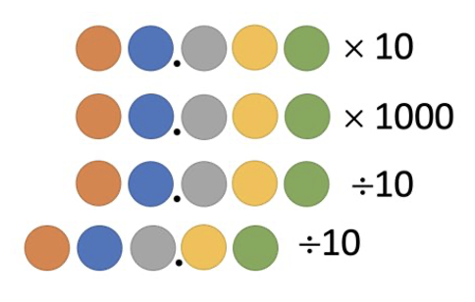
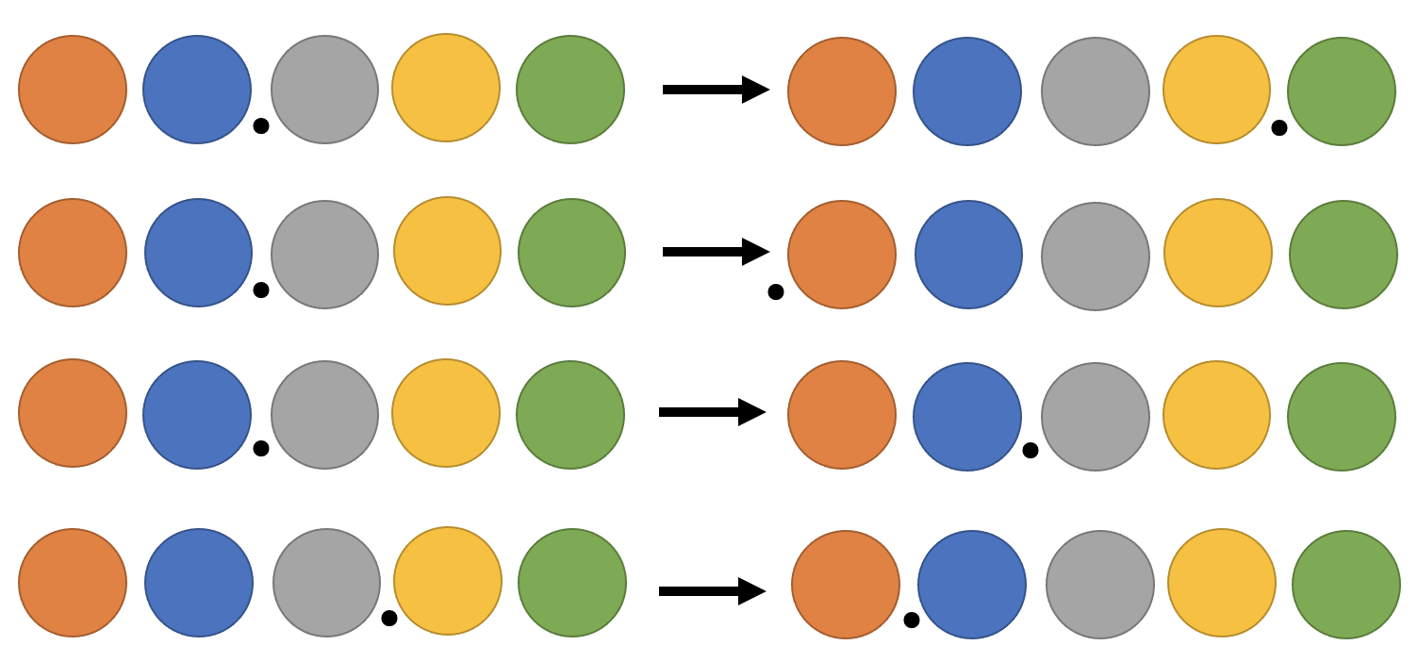
Checkpoint 4: Calculations in colour
In these calculations, coloured dots have replaced digits.
Describe how the dots and decimal points will be arranged after the calculation has been carried out.
What mathematical operations will result in the digits making these movements?
Create your own questions using coloured dots. Can you think of four different examples showing × 100? How about ÷ 100?
Notes:
This slide is animated. The second set of dots will appear separately to allow you to choose whether your class works on one set or both sets.
Answers
Orange Blue Grey . Yellow Green
Orange Blue Grey Yellow Green
Orange . Blue Grey Yellow Green
Orange Blue . Grey Yellow Green
× 100
÷ 100
× 1 or ÷ 1
÷ 100
Suggested questioning
What is the same? What is different?
Which calculation results in the biggest product/quotient? How do you know?
How would you write Orange Blue Grey Yellow Green × 1000?
Things to think about
This activity focuses students’ attention on the position of the digits and the effect of multiplication and division by powers of 10. It is designed as a discussion task, so you might wish to set your class up into pairs or small groups.

Slide 16
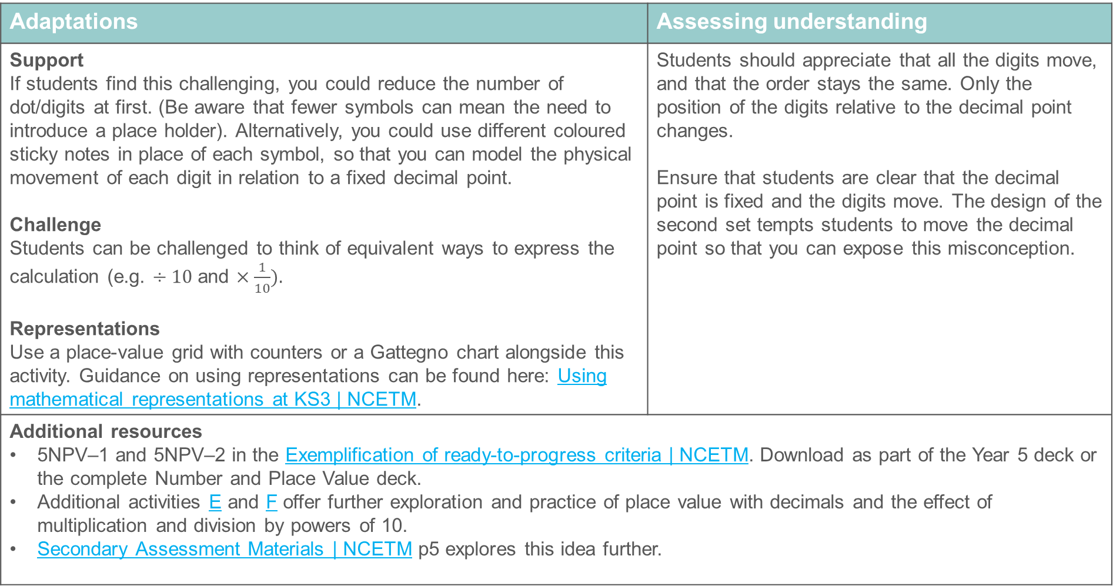
Checkpoint 4: Guidance
Adaptations | Assessing understanding
Support If students find this challenging, you could reduce the number of dot/digits at first. (Be aware that fewer symbols can mean the need to introduce a place holder). Alternatively, you could use different coloured sticky notes in place of each symbol, so that you can model the physical movement of each digit in relation to a fixed decimal point. Challenge Students can be challenged to think of equivalent ways to express the calculation (e.g. $÷10$and $×\frac{1}{10}).$ Representations Use a place-value grid with counters or a Gattegno chart alongside this activity. Guidance on using representations can be found here: Using mathematical representations at KS3 | NCETM. | Students should appreciate that all the digits move, and that the order stays the same. Only the position of the digits relative to the decimal point changes. Ensure that students are clear that the decimal point is fixed and the digits move. The design of the second set tempts students to move the decimal point so that you can expose this misconception.
Additional resources 5NPV–1 and 5NPV–2 in the Exemplification of ready-to-progress criteria | NCETM. Download as part of the Year 5 deck or the complete Number and Place Value deck. Additional activities E and F offer further exploration and practice of place value with decimals and the effect of multiplication and division by powers of 10. Secondary Assessment Materials | NCETM p5 explores this idea further.

Slide 17
Checkpoint 5: Many-step calculations
9.81 × 10 = 98.1
This is a one-step calculation to move from 9.81 to 98.1
9.81 × 100 ÷ 10 = 98.1
This is a two-step calculation to move from 9.81 to 98.1
Write at least two three-step calculations to move from 9.81 to 98.1
Write as many four-step calculations to move from 9.81 to 98.1 as you can
Can you write a ‘10-step’ calculation to get from 9.81 to 98.1?
Notes:
This slide is animated. Each question will appear separately so you can choose the pace at which to work with your class.
Answers
a) Examples might include (but would not be limited to): 9.81 × 10 × 10 ÷ 10 = 98.1 or 9.81 ÷ 10 × 1 000 ÷ 10 = 98.1
b) Examples might include (but would not be limited to): 9.81 × 10 × 10 × 10 ÷ 100 = 98.1 or 9.81 ÷ 100 × 1 000 ÷ 10 × 10 = 98.1
It may be interesting to discuss the strategies that students use here. Do they have pairs of calculations that cancel out? Do they aim for a higher/lower number and then adjust?
Suggested questioning
Is there more than one way to do this?
What do you notice about two-step calculations? What is the difference between your multiplier and divisor each time?
How many different three-step calculations can you create? Can you create one with more multiplications than divisions? How about more divisions than multiplications?
Things to think about
This activity allows students to demonstrate their fluency with place value and multiplying and dividing by powers of 10. You might like to ask students to use some creative licence to create examples that no one else in their class has thought of. Can they generalise their strategy?

Slide 18
Checkpoint 5: Guidance
Adaptations | Assessing understanding
Support A precursor to this task might involve just one digit, but it is important that students build up to numbers with more than one digit to prevent misconceptions where not all digits move. Challenge If students are confident with the effect of multiplying and dividing by powers of 10, then they should be able to generate chains of calculation where the overall effect is the same as ×10. Some students may be able to reason about the combination of operations they perform without imagining the digits moving. Representations Use a place-value grid with counters or a Gattegno chart. Guidance on using representations can be found here: Using mathematical representations at KS3 | NCETM. | Students will be writing multiple operations – you will need to consider how you will model a ‘multi-step’ calculation and how you will address inaccurate notation. Students may, for example, use the equals sign inaccurately and create incorrect chains of reasoning, such as 9.81 × 10 = 98.1 × 10 = 981 Emphasise the ‘equality’ of each part of an equation and the role of the equals sign in connecting mathematical statements that have the same value. As with Checkpoint 4, this is also an opportunity to assess students’ understanding of multiplication and division by powers of 10.
Additional resources Teaching mathematics in primary schools (pp 212-9)*. Additional activity F also looks at connecting numbers through multiplication and division by multiples of 10, but takes a step back to spend more time on column names. * Page numbers reference the complete Years 1–6 document.

Slide 19
Understand place value in the context of measure
Checkpoint 6

Slide 20
Understand place value in the context of measure
Previous learning | In Key Stage 3 students need to
Key Stages 1 and 2 curriculum: Year 1: record measurements Year 2: units of length, mass, temperature and capacity Year 4: convert units of measure Further information about how students may have experienced this key idea in Key Stages 1 and 2: Teaching mathematics in primary schools: 5NPV–5 Convert between units of measure using common decimals and fractions (pp229– 33); 6NPV–4 Divide powers of 10 into 2, 4, 5 and 10 equal parts and read scales with labelled intervals divided into 2, 4, 5 and 10 equal parts (pp294–95) * Page numbers reference the complete Years 1–6 document | Use their knowledge of place value, and of multiplying and dividing by powers of 10, in the context of measures. Flexibly and efficiently convert between different metric units for length, volume or mass.

Slide 21
Checkpoint 6: Comparing lengths
Fill in the blanks.
a) cm > 2 m e) mm > 20 cm > m
b) m < 400 cm f) mm < 40 cm < m
c) 200 cm < m g) 20 cm > mm > m
d) 4 m > cm h) 40 km < m < cm
km < m < cm < mm
Notes:
Answers
a) Any value greater than 200cm
b) Any value less than 4m
c) Any value greater than 2m
d) Any value less than 400cm
e) Any value greater than 200mm and less than 0.2m
f) Any value less than 400mm and greater than 0.4m
g) Any value less than 200mm and less than 0.2m
h) Any value greater than 40000m and 4000000cm
? (for example): 2 km < 3 000 m < 400 000 cm < 5 000 000mm or 0.1 km < 101 m < 10101 cm < 101011 mm
Suggested questioning
Which measurement needs to be bigger? What does this mean for the value?
What might your answer be if the units were the same? How can you change it?
Things to think about
This activity makes students think about conversions of length – there are deliberate similarities to provide opportunities to discuss the inequality and the conversion.

Slide 22
Checkpoint 6: Guidance
Adaptations | Assessing understanding
Support Students may find ‘chains’ of multiple inequalities confusing. They need to understand that each value along the chain will be greater or less than the one before, but you could cover one part of the inequality to build up this understanding. Challenge Place extra constraints, such as finding the smallest or largest possible answer. Representations Present the two equivalent measurements on a double number line. Guidance on using representations can be found here: Using mathematical representations at KS3 | NCETM. | Discuss what is the same and different a) and b), or a) and c). The values chosen make students think. Some uncover misconceptions underneath seemingly correct answers to previous parts. In part a), for example, a correct answer of 250 may be chosen as 250 > 2, without considering the conversion. In part c), students will not be able to rely on the values as a number bigger than 200 would be incorrect. Listen to the language students use when describing inequalities. Do they understand which is greater and less than? Can they read them in both directions?
Additional resources Primary Assessment Materials | NCETM Year 4 pp23–24; Year 5 pp22–24. If students struggle with the inequality aspect of this task, Checkpoint 7 looks at inequalities in more depth.

Slide 23
Order and compare numbers and measures using <, >, =
Checkpoint 7

Slide 24
Order and compare numbers and measures using <, >, =
Previous learning | In Key Stage 3 students need to
Key Stage 1 curriculum: Year 1: = symbol Year 2: symbols for inequality < and > Further information about how students may have experienced this key idea in Key Stages 1 and 2: Teaching mathematics in primary schools: Reasoning about the location of numbers appears in all year groups but the inequality symbols are mentioned specifically in Year 1, 1NPV–2 Reason about the location of numbers within the linear number system including comparing using < > and = (pp20-23). * Page numbers reference the complete Years 1–6 document. | Be confident using the inequality symbols to compare values or make statements. Appreciate that a mathematical statement may use one or more equality/inequality symbols and be able to interpret what these statements mean.

Slide 25
Checkpoint 7: Understanding inequalities
In each set of numbers, which is the bigger value?
Write a statement using < or > to compare your values.
1 900 fourteen thousand
0.4 0.09
a)
d)
109 000 140 000
1.09 1.4
b)
e)
190 000 1.4 million
0.04 0.019
c)
f)
Write your own inequalities statements using the digits 0, 1, 4 and 9. Can you write a statement that no one else will have thought of?
Notes:
This slide is animated. Each question will appear separately so you can choose the pace at which to work with your class.
Answers
1 900 < Fourteen thousand
109 000 < 140 000
190 000 < 1.4 million
0.4 > 0.09
1.09 < 1.4
0.04 > 0.019
Students may create statements such as 0.14 < 0.9 or 1 090 000 < 1 400 000. You may wish to think ahead about how you will facilitate students sharing and discussing their answers.
Suggested questioning
Which is bigger in each set? Is the number on the left greater than or less than the number on the right?
Can you read your inequality from left to right? Can you read your inequality from right to left?
Things to think about:
This activity unpicks some common misconceptions around place value, while putting the emphasis on correct usage of the inequality symbol.

Slide 26
Checkpoint 7: Guidance
Adaptations | Assessing understanding
Support You could encourage students to write the worded values in digits before comparing. Challenge If students are confident, you could encourage them to ‘change one thing’ to make the inequality untrue. Representations Representations such as a place value chart or Gattegno chart might help students to visualise the pairs of numbers. Guidance on using representations can be found here: Using mathematical representations at KS3 | NCETM. | Discuss what is the same and different a) and b), or a) and c). The values chosen make students think. Some uncover misconceptions underneath seemingly correct answers to previous parts. In part a), for example, a correct answer of 250 may be chosen as 250 > 2, without considering the conversion. In part c), students will not be able to rely on the values as a number bigger than 200 would be incorrect. Listen to the language students use when describing inequalities. Do they understand which is greater and less than? Can they read them in both directions?
Additional resources Additional activity G looks at some examples and non-examples with inequalities. Additional activities C and E also use inequalities to explore place value.

Slide 27
Additional activities
Activities A–G

Slide 28
Activity A: Partition table
The number 3 254 can be written as 3 × 1 000 + 2 × 100 + 5 × 10 + 4 × 1.
Complete the table so that each row has a number and its partitioned form.
a) | 32 054
b) |  | 3 × 100 000 + 2 × 100 + 5 × 10 + 4 × 1
c) |  | 3 × 100 000 + 2 × 1 000 + 5 × 100 + 4 × 1
d) | 3 200 540
e) |  | a × 10 000 + b × 100 + c × 10
Given that 100 = 10² and 100 = 10³, can you rewrite the partitioned numbers using powers?
Notes:
Answers
a) 3 × 10 000 + 2 × 1 000 + 5 × 10 + 4 × 1
b) 300 254
c) 302 504
d) 3 × 1 000 000 + 2 × 100 000 + 5 × 100 + 4 ×10
e) a0bc0
Suggested questioning
What is the same and what is different between rows _ and _?
Can you write an example where 3 254 has been multiplied by a power of 10?
Things to think about
This activity focuses students’ attention on the position of the digits and the value of the column. To partition successfully, students need to understand the value of the column and how 0 acts as a placeholder. The same digits are used throughout to offer opportunities to compare parts of numbers and how the different position has changed the place value.

Slide 29
Activity B: Strategising with place value
William and Vicky take it in turns to pick a digit card from 0–9 and write that number anywhere on the grid. The winner is the person with the biggest number at the end.
Vicky picks a 4 next. Where should she place it on the grid to stand the best chance of winning?
 | Ten thousands | Thousands | Hundreds | Tens | Ones
William | 4 |  | 9
Vicky |  |  | 2 | 9
How would Vicky’s strategy change if the rules changed to be:
The winner is closest to 5 000?
The winner is the smallest number?
Notes:
Suggested questioning
If Vicky places the 4 in the __ column, what might happen next? How could she still win? How could William still win?
Things to think about:
This activity has multiple possible answers. Think about what discussions you might want to have if students choose each of the remaining five spaces. For example:
If Vicky chooses to place the 4 in her ten thousands column, then what will the game rely upon? What might happen next?
If Vicky places the 4 in William’s thousands column, then she would win if she ended up with a digit greater than 4 in her ten thousands column. Could she still win if she ended up with a 4 in her ten thousands column?
If Vicky places the 4 on the ones column, does this have any impact on the outcome of the game?
You might wish to use the printable 0-9 digit cards (found on slides 37-46) to model the game ‘live’ to your class. In the example modelled here, we have chosen to replace the digit cards back in the deck after selection. You may wish to explore how the game changes if you don’t replace the digit cards and so are better able to predict what remains in the deck.

Slide 30
Activity C: Comparing place value in integers
Use <, > or = to complete these statements.
a) 310
31 tens
d) 31 thousands
301 hundreds
b) 120 tens
13 hundreds
e) 120 000 ones
130 hundreds
c) 5 005
505 tens
f) 12 hundreds and 35 tens
1 235
Where you used < or >, change one number so that you could use = instead. Is there more than one way to do this?
Notes:
This slide is animated. Each question will appear separately so you can choose the pace at which to work with your class.
Answers
310 = 31 tens
120 tens < 13 hundreds
5 005 < 505 tens
31 thousands > 301 hundreds
120 000 ones > 130 hundreds
12 hundreds and 35 tens > 1 235 (since 1 200 + 350 = 1 550)
Students may make changes such as:
b) 120 tens = 12 hundreds or 130 tens = 13 hundreds
c) 5 050 = 505 tens or 5005 = 50.5 tens
d) 31 thousands = 310 hundreds or 30.1 thousands = 301 hundreds
e) 120 000 ones = 1200 hundreds or 13000 ones = 130 hundreds
f) 13 hundreds and 3.5 tens = 1235 or 12 hundreds and 35 tens = 1550
Suggested questioning
How else can you write each number?
Things to think about
This activity can be used both to assess students’ understanding of the inequality and equality symbols, as well as their understanding of place value. The pairs of numbers have been deliberately selected to promote discussion or expose common misconceptions. This makes students really focus on the place value; some of the examples may catch students out. Think about what representations you could use to model each pair of numbers. Is the same representation suited to each example?

Slide 31
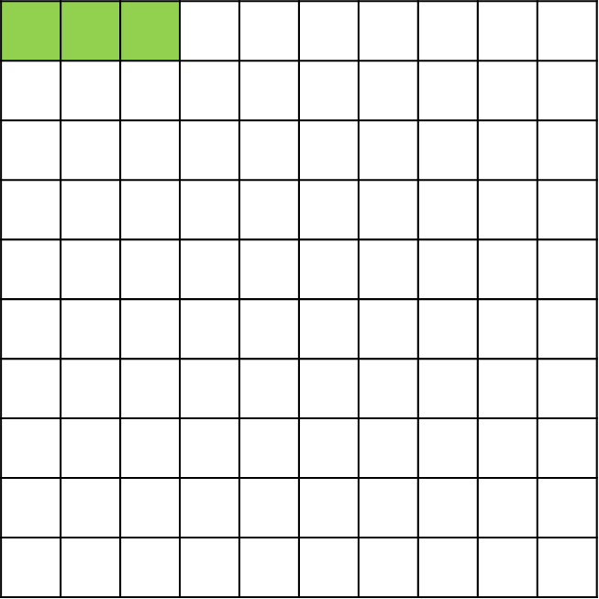
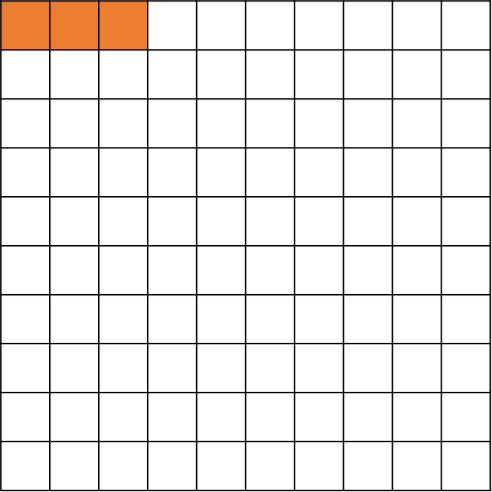
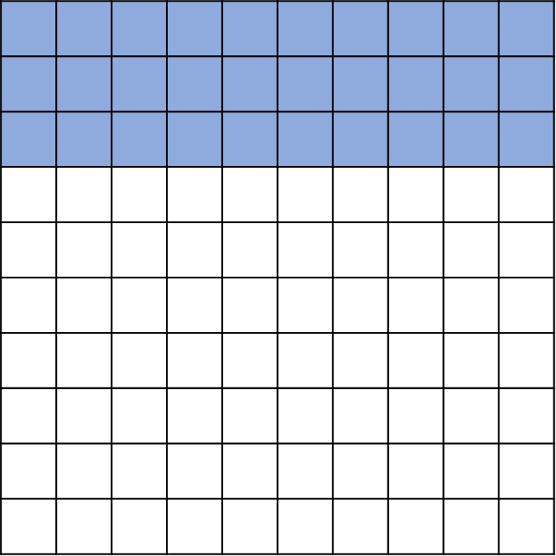
Activity D: Non-hundred squares
What value is shaded?
How could this be true?
A
B
The whole of this square is worth 1 000. How much is the green section worth?
>
The whole of this square is worth 10. How much is the orange section worth?
What might squares A and B be worth? Is there more than one possible answer?
Using pairs of hundred squares, can you write:
A statement where two squares look different but are equal?
A statement where two squares look the same but are not equal?
Notes:
This slide is animated. Each question will appear separately so you can choose the pace at which to work with your class.
Answers
Green – 30; Orange – 0.3
For example, if the whole of square A was worth 100, but the whole of square B was worth 1, since 3 > 0.3. There are multiple other answers that would work. Discuss the special case where Orange = Blue (for example, if A represented 100 and B represented 10).
Suggested questioning
What is the whole square worth? What is one square worth?
What would the whole square be worth if one square represented 10? 0.1? 10 000?
In part b), is there more than one way to make Orange > Blue?
Things to think about
This task takes a familiar representation – the hundred square – and places it in a potentially unfamiliar context, where the value of the whole square is not 100. The purpose is to get students to think about the relationship between numbers with the same digits, and the base 10 nature of our number system.

Slide 32
Activity E: Comparing place value in decimals
Use <, > or = to complete these statements.
a) 3.1
31 tenths
d) 9 hundredths
0.9
b) 120 thousandths
12 hundredths
e) 0.012
120 hundredths
c) 50.05
f) 12 tenths and 35 hundredths
1.235
505 tenths
Where you used < or >, change one number so that you could use = instead. Is there more than one way to do this?
Notes:
This slide is animated. Each question will appear separately so you can choose the pace at which to work with your class.
Answers
3.1 = 31 tenths
120 thousandths = 12 hundredths
50.05 < 505 tenths
9 hundredths < 0.9
0.12 < 120 hundredths
12 tenths and 35 hundredths > 1.235 (as 1.2 + 0.35 = 1.55)
Students may make changes such as:
c) 50.05 = 500.5 tenths or 50.5 = 505 tenths
d) 9 hundredths = 0.09 or 90 hundredths = 0.9
e) 0.012 = 1.2 hundredths or 1.2 = 120 hundredths
f) 12 tenths and 35 thousandths = 1.235 or 12 tenths and 35 hundredths = 1.55
Suggested questioning
How else can you write each number?
How could you represent each number to help you decide which is bigger?
Things to think about
This activity can be used both to assess students’ understanding of the inequality and equality symbols, as well as their understanding of place value. The pairs of numbers have been deliberately selected to promote discussion or expose common misconceptions. This makes students really focus on the place value; some of the examples may catch students out. In part a, for example, students may be confident describing 3.1 as having ‘3 ones and 1 tenth’ but less familiar with expressing this as ‘31 tenths. Think about what representations you could use to model each pair of numbers. Is the same representation suited to each example?

Slide 33
Activity F: Place value with 4.32
What is the value of the bold red digit in each number?
0.432
4.32
43.2
4.32
4320
4.32
0.0432
4.32
432
4.32
0.00432
4.32
b) What do you notice about each pair of numbers?
c) Can you write a calculation involving both numbers? The first one has been done for you.
0.432 × 10 = 4.32
Can you write all of your calculations another way?
Notes:
This slide is animated. Each question will appear separately so you can choose the pace at which to work with your class.
Answers
In each of the questions, the value of the red digit bottom number (4.32) is 3 tenths.
The values of the top numbers are, left to right, 0.432: three hundredths, 43.2: three (ones), 4320: three hundreds,
0.0432: three thousandths, 432: three tens/thirty, 0.00432: three ten thousandths.
b) Students should recognise that, although the place value is different, the digits and order of the digits is the same. This means that the two numbers can be connected by multiplying/dividing by power of 10.
c) Students may have written one or more of the following calculations – some may also choose to be creative, and include multiple operations (such as in the third example given each time).
0.432 × 10 = 4.32 or 4.32 ÷ 10 = 0.432 or 4.32 ÷ 1000 × 100 = 0.432 etc.
43.2 ÷ 10 = 4.32 or 4.32 × 10 = 43.2 or 43.2 × 100 ÷ 1000 = 4.32 etc.
4320 ÷ 1000 = 4.32 or 4.32 × 1000 = 4320 or 4320 ÷ 10 ÷ 100 = 4.32 etc.
0.0432 ×100 = 4.32 or 4.32 ÷ 100 = 0.0432 or 4.32 ÷ 1000 × 10 = 0.0432 etc.
432 ÷ 100 = 4.32 or 4.32 × 100 = 432 or 4.32 × 10 × 10 = 0.432 etc.
0.00432 × 1000 = 4.32 or 4.32 ÷ 1000 = 0.00432 or 0.0432 × 100 ×10 = 4.32 etc
Suggested questioning
What is the same and what is different about each pair of numbers?
How has the value of the 3 digit changed each time?
What is the relationship between each pair of numbers? Can you express this another way?
Things to think about
In this activity, the digits remain the same throughout to allow students to really focus on what has changed: the values. Comparing the numbers in pairs may support conversations about multiplying and dividing by powers of 10, so that you can assess students’ prior knowledge in this area. Think carefully about the language you will use to describe the relationship between the two numbers – will students use phrases such as ‘ten times bigger’ and ‘ten times smaller’? How about ‘one tenth as big’? There are lots of opportunities to assess students’ confidence with performing operations that change place value mentally, as well as whether they are familiar with representations such as place-value grids and Gattegno charts.

Slide 34
Activity G: True or false?
Which of these statements are correct? How do you know?
100 × 0.7 = 7
0.70 = 0.7 x 10
0.70 > 0.7
70 ÷ 100 < 0.07 × 10
10 × 0.7 = 0.07 × 100
0.70 < 0.07 × 100
0.7 × 10 < 70 ÷ 100
0.07 × 10 > 0.7 × 100
Change one thing about the statements that are incorrect to make them correct. Is there more than one way to do this?
Notes:
This slide is animated. Each question will appear separately so you can choose the pace at which to work with your class.
Answers
a) False
b) False
c) False
d) False
e) True
f) True
g) False
h) False
Changes to incorrect statements could include:
a) 10 x 0.7 = 7 or 100 x 0.7 = 70
b) 0.70 = 0.7 x 1 or 7.0 = 0.7 x 10
c) 0.70 = 0.7 or 7.0 > 0.7
d) 70 ÷ 100 = 0.07 × 10 or 70 ÷ 1000 < 0.07 × 10 or 70 ÷ 100 < 0.07 × 100
g) 0.7 x 10 > 70 ÷ 100 or 0.7 x 10 < 70 ÷ 1
h) 0.07 x 10 < 0.7 x 100 or 0.07 x 10 000 > 0.7 x 100
Suggested questioning
What is the value of the left hand side of your equation/inequality? What is the value of the right hand side of your equation/inequality?
How could you rewrite each statement? Is there more than one way to rewrite it?
Things to think about
The activities throughout this set of key ideas have relied upon use of the <, >, = symbols. This activity focuses more explicitly on the symbols and ensuring students fully understand them.
Listen carefully to the language that students use around the equality and inequality symbols. Do they understand that = means ‘the same value as…’? Some students may use words like ‘makes’ when reading calculations aloud, which suggests an understanding of = as a process rather than a statement of equality.

Slide 35
Printable resources

Slide 36
Printable 0–9 digit cards
You may wish to print slides 37–46 to create sets of 0–9 digit cards. Stack and clip the set of 10 pages and cut along the lines to produce eight sets.

Slide 37
0 | 0 | 0 | 0
0 | 0 | 0 | 0

Slide 38
1 | 1 | 1 | 1
1 | 1 | 1 | 1

Slide 39
2 | 2 | 2 | 2
2 | 2 | 2 | 2

Slide 40
3 | 3 | 3 | 3
3 | 3 | 3 | 3

Slide 41
4 | 4 | 4 | 4
4 | 4 | 4 | 4

Slide 42
5 | 5 | 5 | 5
5 | 5 | 5 | 5

Slide 43
6 | 6 | 6 | 6
6 | 6 | 6 | 6

Slide 44
7 | 7 | 7 | 7
7 | 7 | 7 | 7

Slide 45
8 | 8 | 8 | 8
8 | 8 | 8 | 8

Slide 46
9 | 9 | 9 | 9
9 | 9 | 9 | 9

