Slide 1
Interpreting Line Graphs
Year 6

Slide 2
Introduction
This document contains:
an introduction to the lesson
points to consider as you watch each video clip.

Slide 3
Introduction
The lesson reviews and builds the skills the understanding necessary to read and interpret line graphs.
The teacher describes the learning journey as small/microscopic steps.

Slide 4
The journey through the lesson
Review of perpendicular lines
Review of important numbers involved in reading time
Review of time represented on a time line
Consideration of the features of line graphs
Reading and interpreting line graphs, using the skills explored during the lesson

Slide 5
Precise mathematical vocabulary
Notice throughout the lesson how the teacher models precise mathematical vocabulary and the children’s developing use of correct mathematical terms.

Slide 6
Interpreting Line Graphs
Right angles and
perpendicular lines
Year 6 Lesson Clip 1

Slide 7
Right angles, what are they?
Consider how this questions provides the children with the opportunity to recall previous learning and talk together, using mathematical vocabulary.

Slide 8

Which are right angles?
Consider the importance of presenting the angles in a variety of orientations. This is an aspect of variation. Also note ideally the angles should be marked. The assumption in the lesson was that the focus was the interior angles

Slide 9
The “why” question
The teacher asks:
Why are they the odd ones out?
Asking why is an important aspect of teaching for mastery, it engages children in a deeper level of thinking.

Slide 10
Scaffolding and support
Consider how the teacher supports the learning of individual children to enable them to keep up with the pace of learning in the lesson.
Another strategy used by the teacher is same day intervention, which happens after the lesson, but before the next lesson.

Slide 11
Interpreting Line Graphs
Key numbers within
the context of time
Year 6 Lesson Clip 2

Slide 12
True or false activities
The children identify which numbers are important within the context of time using a true or false activity.
True or false activities are a useful tool in teaching for mastery as they focus on analysing and thinking about the mathematics, providing the opportunity to go deeper.
Consider how you might integrate true or false activities into your teaching.

Slide 13
The “why” question
Notice that this question is asked again, and indeed is common throughout the lesson, providing the opportunity for the children to think more deeply about the mathematics.

Slide 14
Interpreting Line Graphs
Exploring a timeline
Year 6 Lesson Clip 3

Slide 15
True or False?
This time the true/false activity is focused on whether the time marked on each time line is correct.
Notice the carefully chosen numbers that the teacher uses. Within the context of teaching for mastery, the questions are designed with care to maximise learning.

Slide 16
Peer Support
Notice how the children support each other. This is particularly important in this Year 6 class at this time, due to the wide range of prior attainment.
Notice how the children have become particularly skilled at not just telling their partner the answer, but instead scaffolding learning through explanation and questioning.

Slide 17
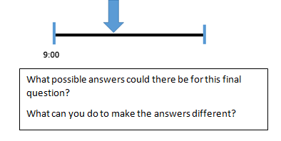
The Challenge Questions
Notice how there are challenge questions that provide sufficient challenge for all.

Slide 18
Interpreting Line Graphs
Introduction to Line Graphs
Year 6 Lesson Clip 4

Slide 19
Interactive Teaching
Notice how the teacher involves children in discussion and contributing ideas, whist at the same time providing sufficient support and scaffold to move the learning forward.

Slide 20
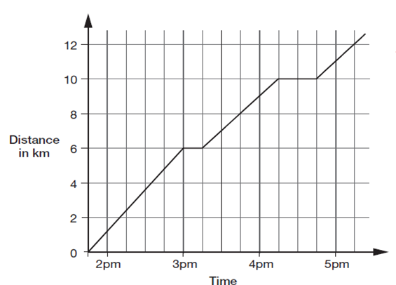
Whole Class Discussion
Having looked at, compared, and begun to draw out some features of line graphs, the next small step is to look at a graph together where the teacher uses questioning to draw out the key features of a line graph.

Slide 21
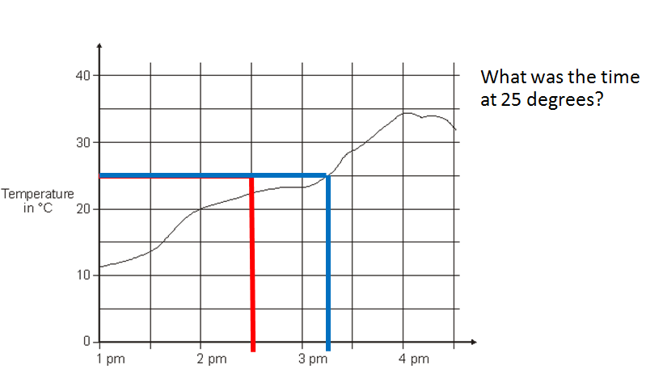
Have I done it correctly?
Notice how the teacher’s deliberate errors and true/false questions highlight key skills required in reading line graphs.

Slide 22
Pupil Commentator
Notice that a child demonstrates on the white board whilst another child commentates and explains what he is doing.
This can be a useful technique to hand over responsibilities to the children.
In China they call this the little teacher.

Slide 23
Interpreting Line Graphs
Independent work on line graphs
Year 6 Lesson Clip 5

Slide 24
Peer Support
Notice how the children reason and support each other. In teaching for mastery, fostering this type of behaviour is important and it is developed through a continuous diet of:
Asking the children to reason and explain
Carefully designed questions and activities which prompt the children to think more deeply.

Slide 25
Interpreting Line Graphs
Reflecting on the lesson
Year 6 Lesson Clip 6

Slide 26
Reflection
In the class children’s reflection on and identification of key points of learning are regular and important activities. The potential benefits are:
Clarification of key points of learning to take forward into the next lesson
Provision of assessment information for the teacher.
Consider how such reflections might support pupils’ learning.

