Slide 1
1.1 Comparisons of quantities and measures
Representations | Year 1
Number, Addition and Subtraction

Slide 2
How to use this presentation
You can find the teacher guide 1.1 Comparisons of quantities and measures by following the link below.

Slide 3
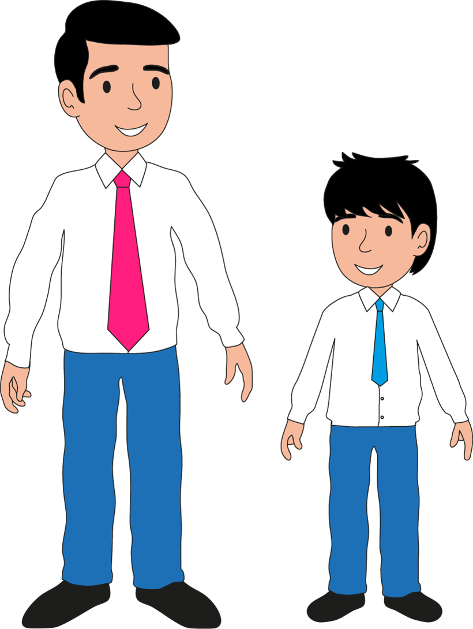
1.1 Comparisons of quantities and measures – step 1:1

Slide 4
1.1 Comparisons of quantities and measures – step 1:2

Slide 5
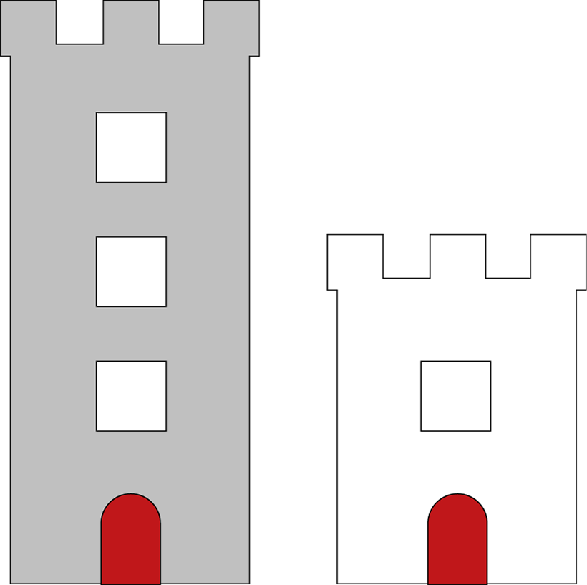
1.1 Comparisons of quantities and measures – step 1:2

Slide 6
1.1 Comparisons of quantities and measures – step 1:2

Slide 7
1.1 Comparisons of quantities and measures – step 1:3

Slide 8
1.1 Comparisons of quantities and measures – step 1:3

Slide 9
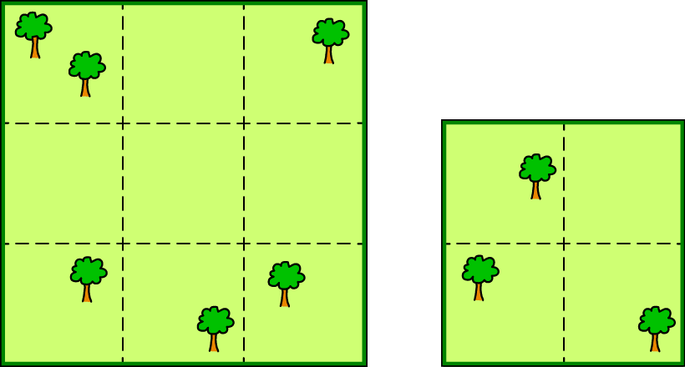
1.1 Comparisons of quantities and measures – step 1:4

Slide 10
1.1 Comparisons of quantities and measures – step 1:5

Slide 11
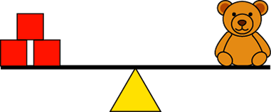
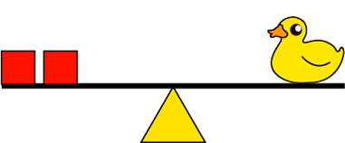
1.1 Comparisons of quantities and measures – step 1:5

Slide 12
1.1 Comparisons of quantities and measures – step 2:1
Images © 2017 Alphablocks Ltd. All Rights Reserved.

Slide 13
1.1 Comparisons of quantities and measures – step 2:1
1
2
3
4
5
6
7
8
9
10

Slide 14
1.1 Comparisons of quantities and measures – step 2:1

Slide 15
1.1 Comparisons of quantities and measures – step 2:2
5
2
1
4
3
7
6

Slide 16
1.1 Comparisons of quantities and measures – step 2:3
seven
three
eight
one
two
four
five
six

Slide 17
1.1 Comparisons of quantities and measures – step 2:3

Slide 18
1.1 Comparisons of quantities and measures – step 2:4
1
2
3
4

Slide 19
1.1 Comparisons of quantities and measures – step 2:4
4
3
2
1

Slide 20
1.1 Comparisons of quantities and measures – step 2:4

Slide 21
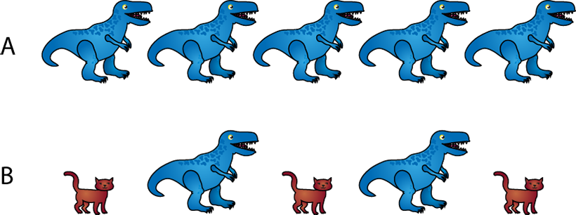
1.1 Comparisons of quantities and measures – step 2:4

Slide 22
1.1 Comparisons of quantities and measures – step 2:4

Slide 23
1.1 Comparisons of quantities and measures – step 2:5

Slide 24
1.1 Comparisons of quantities and measures – step 2:6

Slide 25
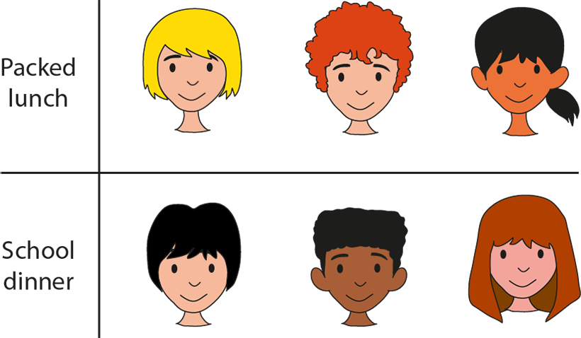
1.1 Comparisons of quantities and measures – step 2:6

Slide 26
1.1 Comparisons of quantities and measures – step 2:7

Slide 27
1.1 Comparisons of quantities and measures – step 2:7

Slide 28
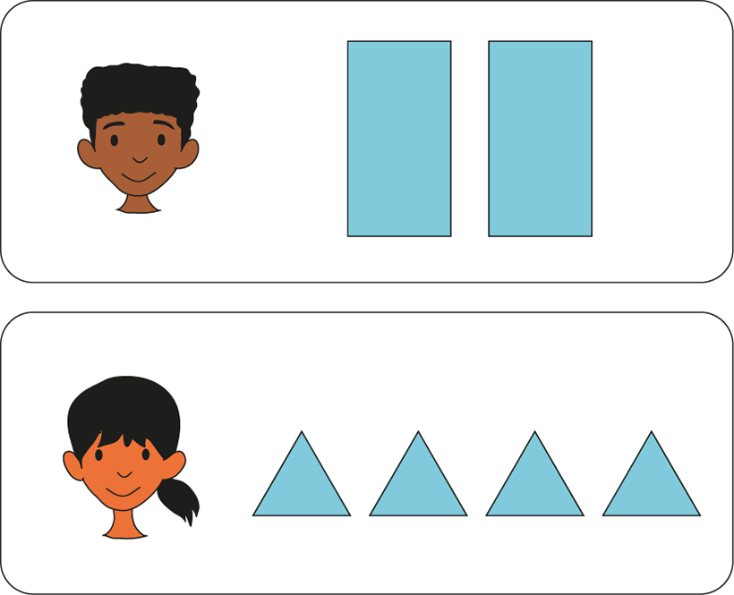
1.1 Comparisons of quantities and measures – step 2:8

Slide 29
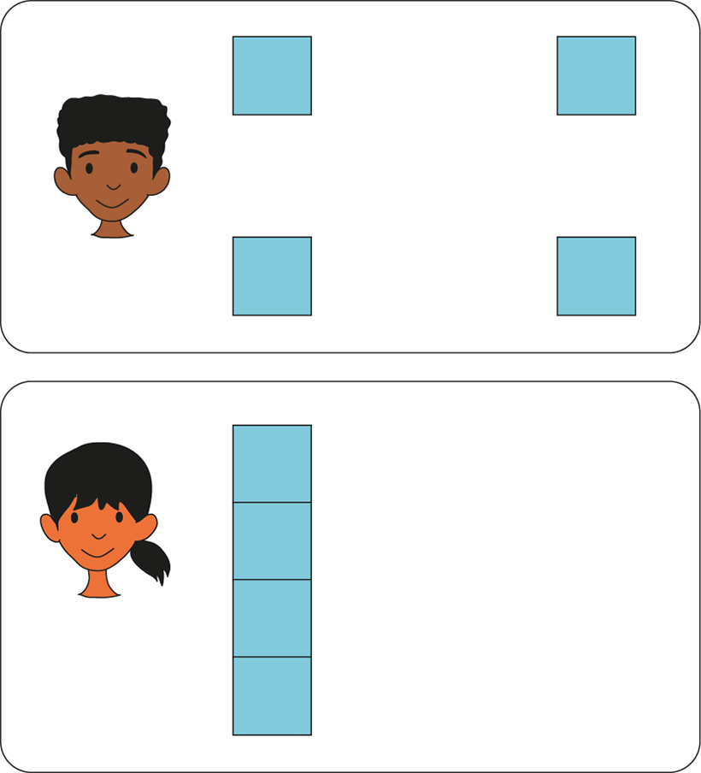
1.1 Comparisons of quantities and measures – step 2:8

Slide 30
1.1 Comparisons of quantities and measures – step 2:9
Adam
Nick
Tom

Slide 31
1.1 Comparisons of quantities and measures – step 2:9
Clare
Joe
Aisha
?

Slide 32
1.1 Comparisons of quantities and measures – step 3:1
1
<
3
2
=
2
3
>
1

Slide 33
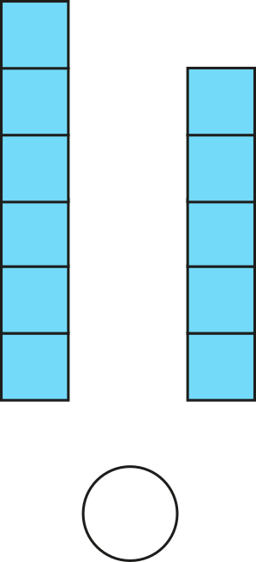
1.1 Comparisons of quantities and measures – step 3:2
6
>
5

Slide 34
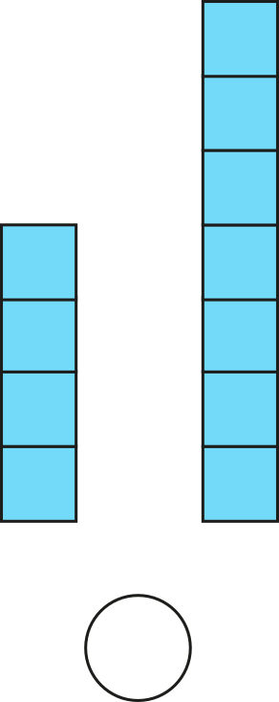
1.1 Comparisons of quantities and measures – step 3:2
4
<
7

Slide 35
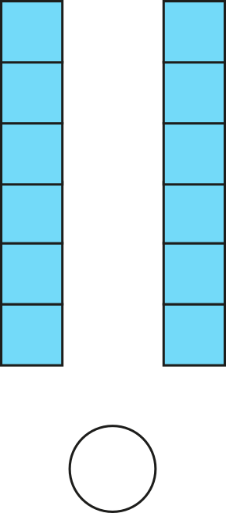
1.1 Comparisons of quantities and measures – step 3:2
6
=
6

Slide 36
1.1 Comparisons of quantities and measures – step 3:3
6
>
5
5
<
6

Slide 37
1.1 Comparisons of quantities and measures – step 3:3
5

Slide 38
1.1 Comparisons of quantities and measures – step 3:3
5
7
increase
decrease
5
<
7

Slide 39
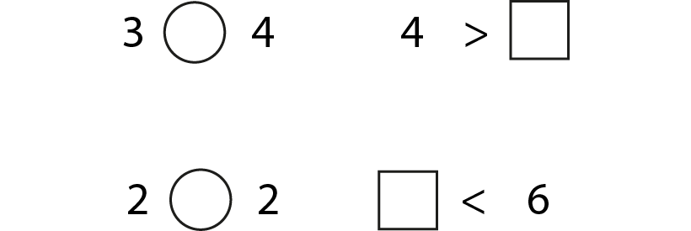
1.1 Comparisons of quantities and measures – step 3:4

