Slide 1
Series 3 Episode 1
Once Upon a Time

Slide 2
Practitioner Notes

Slide 3
Episode Description
Let’s have a bedtime story with Five all about the first five Numberblocks. Learn all about the numbers 1, 2, 3, 4 and 5 with Numberblocks One to Five and how they relate to one another.

Slide 4
Maths in the Episode
Composition of numbers 1 to 5
In this episode the Numberblocks from One to Five are revised. Each Numberblock is made from the Numberblock before it along with Another One. Each block counts up to itself and introduces its numeral (they call it their numberling).

Slide 5
Using Mathematical Language
Use these stem sentences to rehearse the mathematical ideas in the programme:
“I am <4>, I am made from <1,2,3,4> … <4> blocks.”
“I am <4>, I am 1 more than <3>.”
“<4> and 1 more is <5>.”
“<4> plus <1> equals <5>.”
Notes:
< > indicates what can be changed in the stem sentence.

Slide 6
Talk and Discuss Together

Slide 7
Talk and Discuss Together
Watch the episode of Numberblocks. Use the following picture as a stimulus. Which is your favourite Numberblock in this episode? Why?
The following slides are designed to stimulate children and adults to talk about the episode and draw out some key aspects of the mathematics.

Slide 8
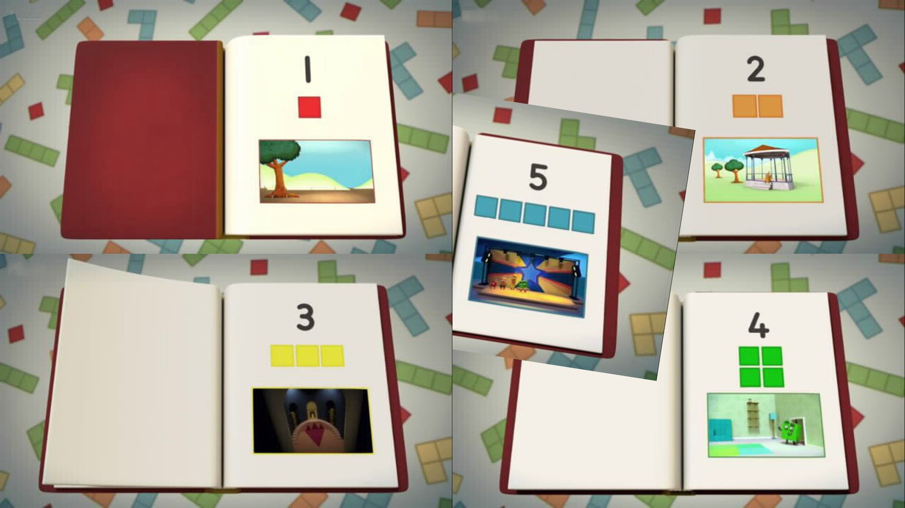
Images © 2017 Alphablocks Ltd. All Rights Reserved.
Notes:
Use this picture as the stimulus for discussion (slide 7).

Slide 9
Enabling Environments in Reception

Slide 10
Enabling Environments
Playing and Exploring
Use shoeboxes to make a small-world space for different Numberblocks 1-5. In each shoebox, put the correct number of things for that Numberblock.
Choose a subitising card for arrangements of 1-5. Encourage children to do a given action (e.g. jumping or patting their head) the number of times shown on the card, counting as they perform each action.
Active Learning
When children are involved in their own play, notice when they describe the quantity of something. Model the use of naming amounts using ‘everyday’ language, e.g. “Oh, we’ve only got four plates out and we need six”.
Creating and Thinking Critically
Play ‘I spy …’ as a number game. Go round in a circle saying, “I spy one whiteboard”, the next in turn says “I spy two …” etc. Go on an ‘I spy’ hunt outside and take photos of quantities (1-5) in the natural environment. Share the pictures with other children in an
‘I spy…’ game.

Slide 11
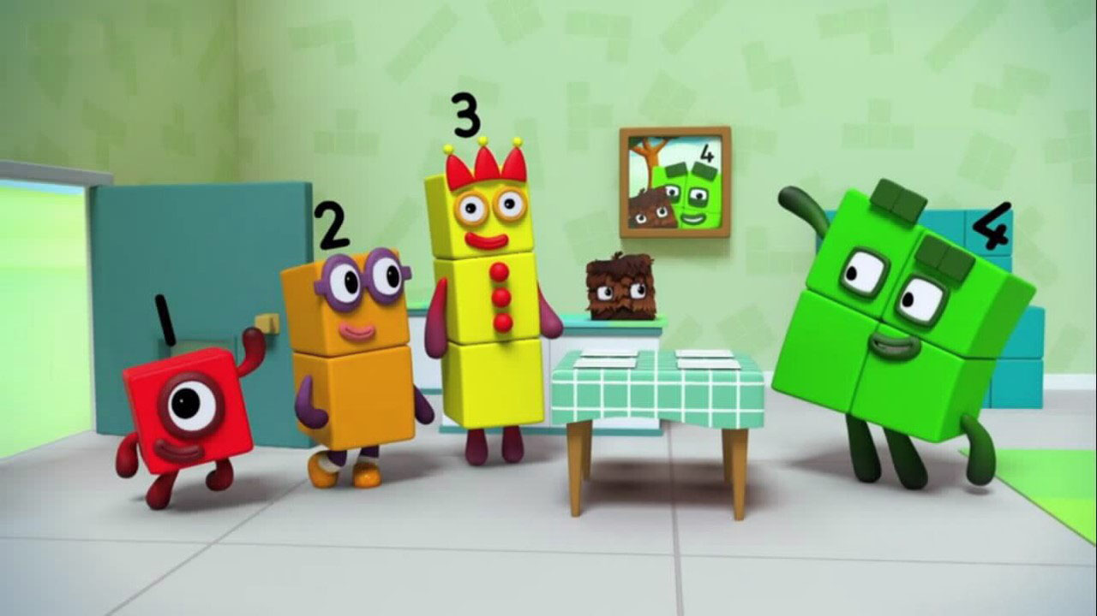
Images © 2017 Alphablocks Ltd. All Rights Reserved.
Notes:
Use this picture to play, ‘I spy four…’.

Slide 12
Learning Together in Y1

Slide 13
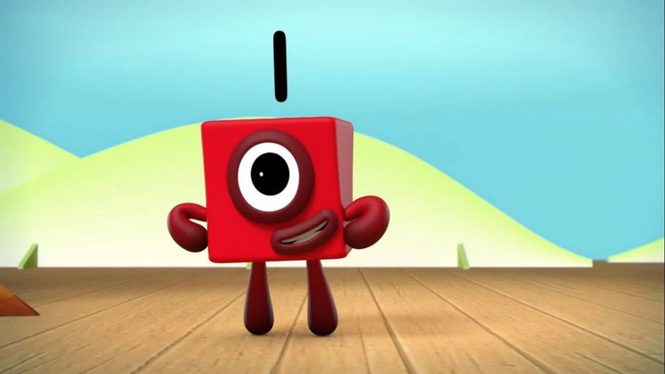
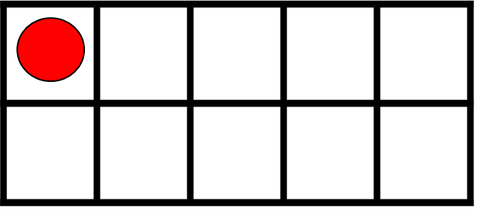

I am One.
Images © 2017 Alphablocks Ltd. All Rights Reserved.
Notes:
Read together “I am one.”
What is special about One?
One is used to make all the other Numberblocks.
How does One make Two?

Slide 14
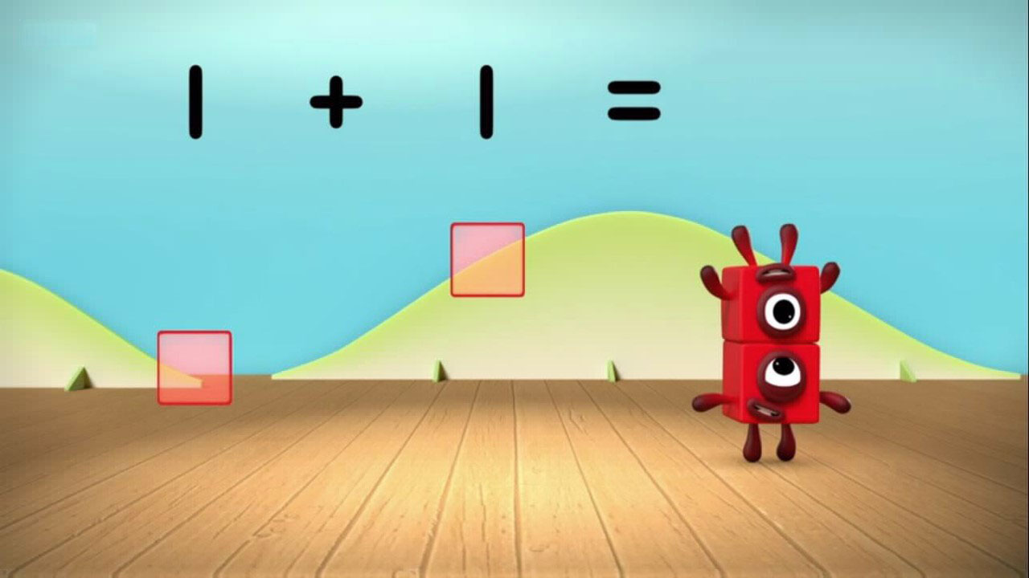
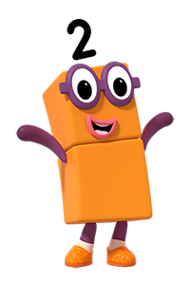
I am One and Another One.
Images © 2017 Alphablocks Ltd. All Rights Reserved.
Notes:
What do you notice?
One and another one is two.
How does the tens frame show that one and another one is two?
Read the equation: “1 plus 1 equals 2.”
What does each number in the equation mean?

Slide 15
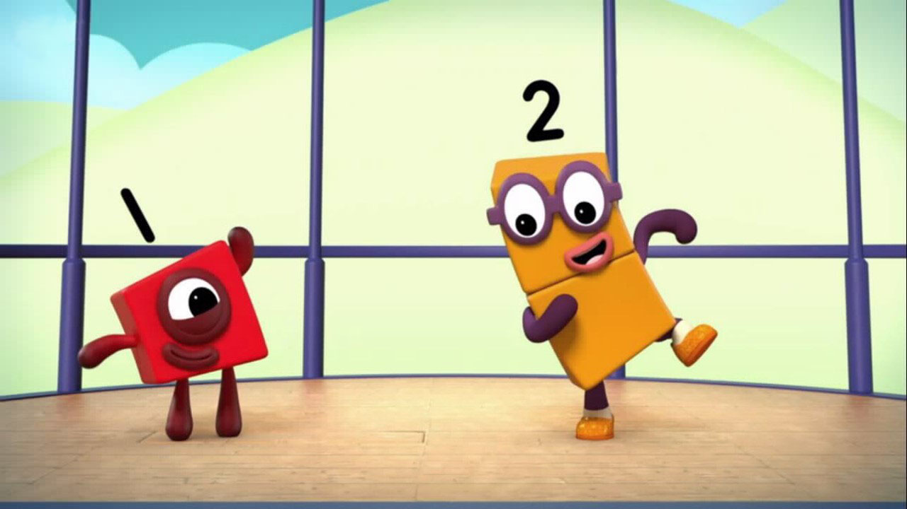
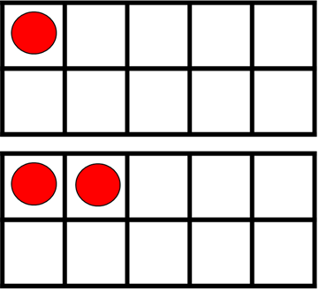

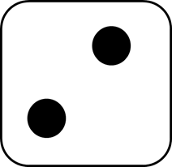
I am Two.
Images © 2017 Alphablocks Ltd. All Rights Reserved.
Notes:
What do you notice?
Two can be arranged as two tall or two wide.
Two is one more than one.
Two comes after one.

Slide 16
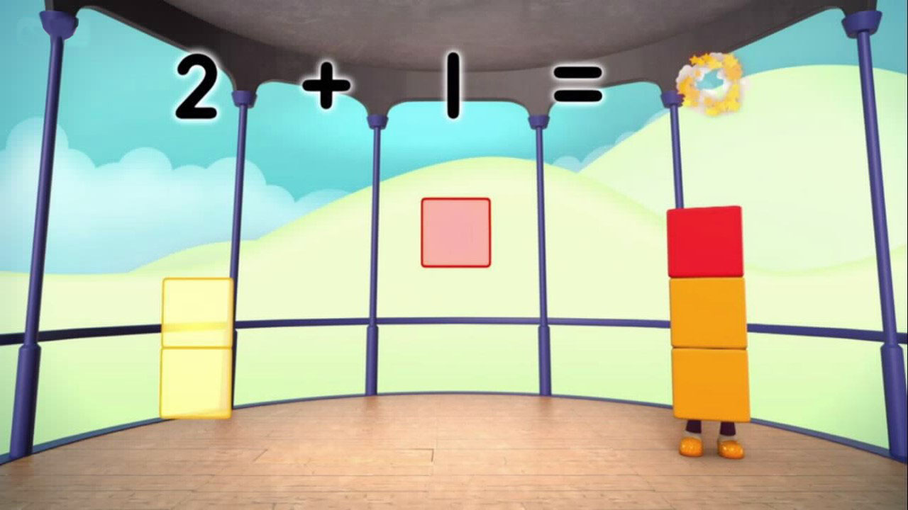
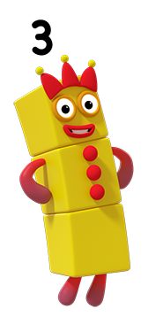
I am Two and Another One.
Images © 2017 Alphablocks Ltd. All Rights Reserved.
Notes:
What do you notice?
“Two and another one is three.” “Three is one more than two.”
How does the tens frame show that two and another one is three?
Read the equation. “2 plus 1 equals 3.”
What does each number in the equation mean?

Slide 17
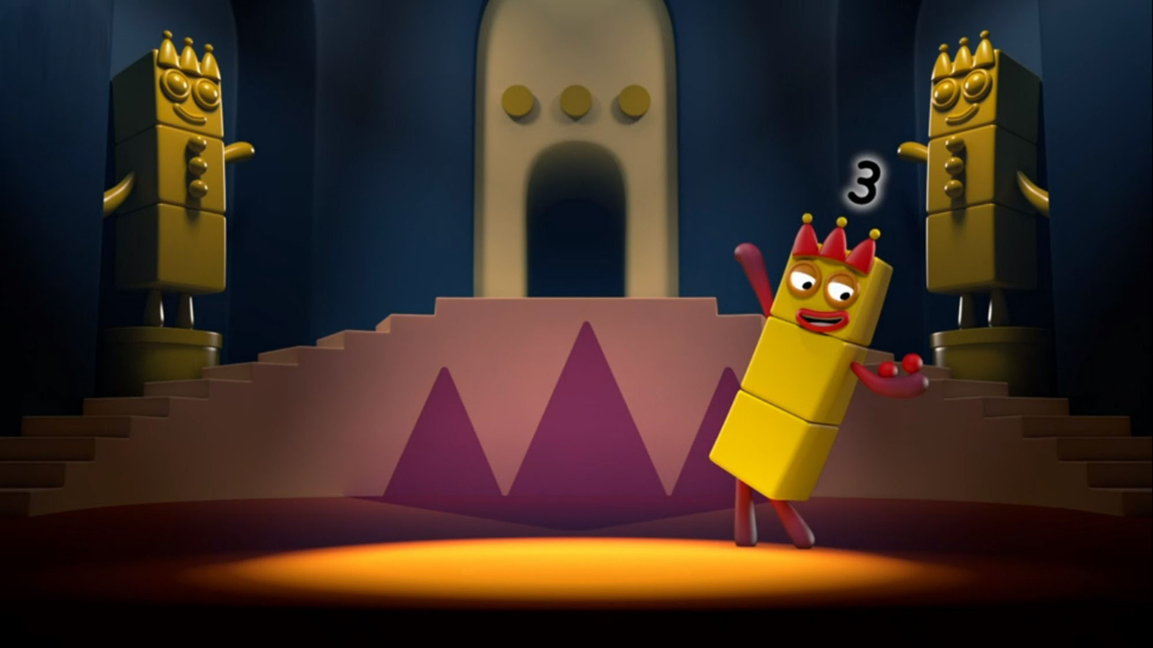
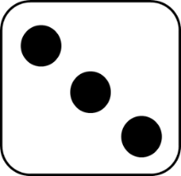

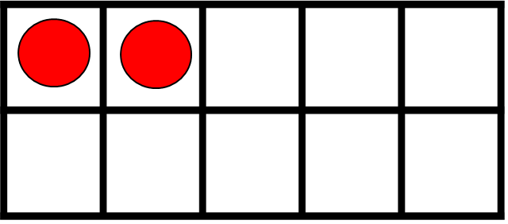
I am Three.
Images © 2017 Alphablocks Ltd. All Rights Reserved.
Notes:
What do you notice?
“Two and another one is three.” “Three is one more than two.”
How many ways can you find to arrange three blocks?
Allow time for children to explore how to make three with connecting blocks. Children could record on paper by drawing around their blocks.
Compare children’s arrangements with the shapes that Three has made.
Discuss the children’s shapes and compare them with the shapes on the slide.
Were your shapes the same? If you turn them around can you make them look the same?

Slide 18
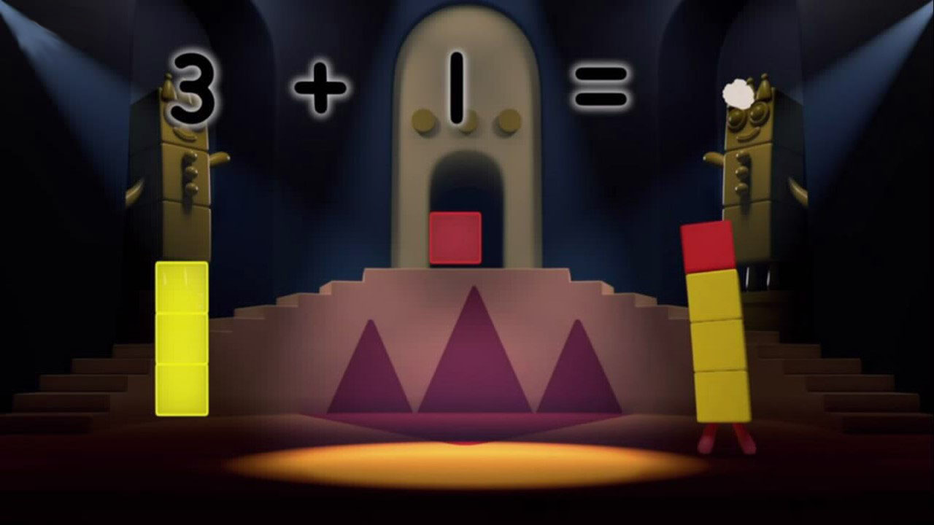
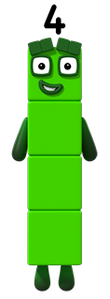
I am Three and Another One.
Images © 2017 Alphablocks Ltd. All Rights Reserved.
Notes:
What do you notice?
“Three and another one is four.” “Four is one more than three.”
How does the tens frame show that three and another one is four?
Read the equation: “3 plus one equals 4.”
What does each number in the equation mean?

Slide 19
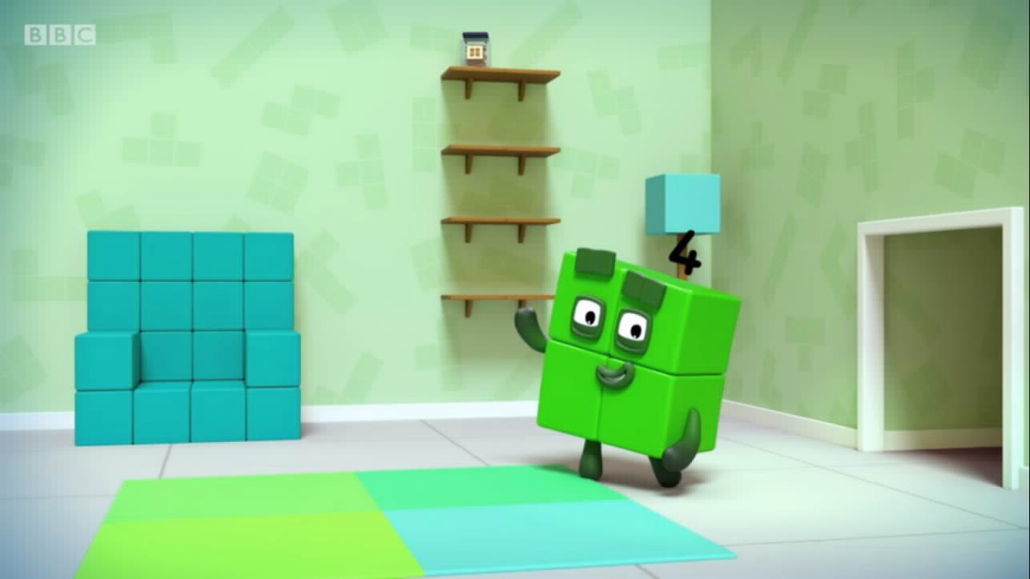
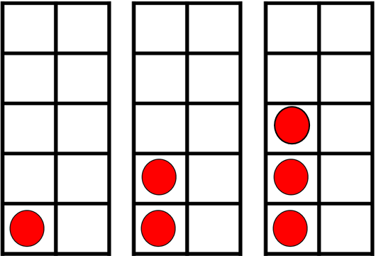

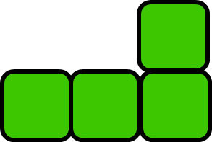
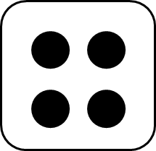
I am Four.
Images © 2017 Alphablocks Ltd. All Rights Reserved.
Notes:
What do you notice?
Four loves to be in a square shape but can make other shapes.
How many ways can you find to arrange four blocks?
Explore ways to make four with connecting blocks. Record shapes on paper by drawing around them.
Compare shapes with images of four blocks.
Are yours the same? Can you make them look the same by turning them around?

Slide 20
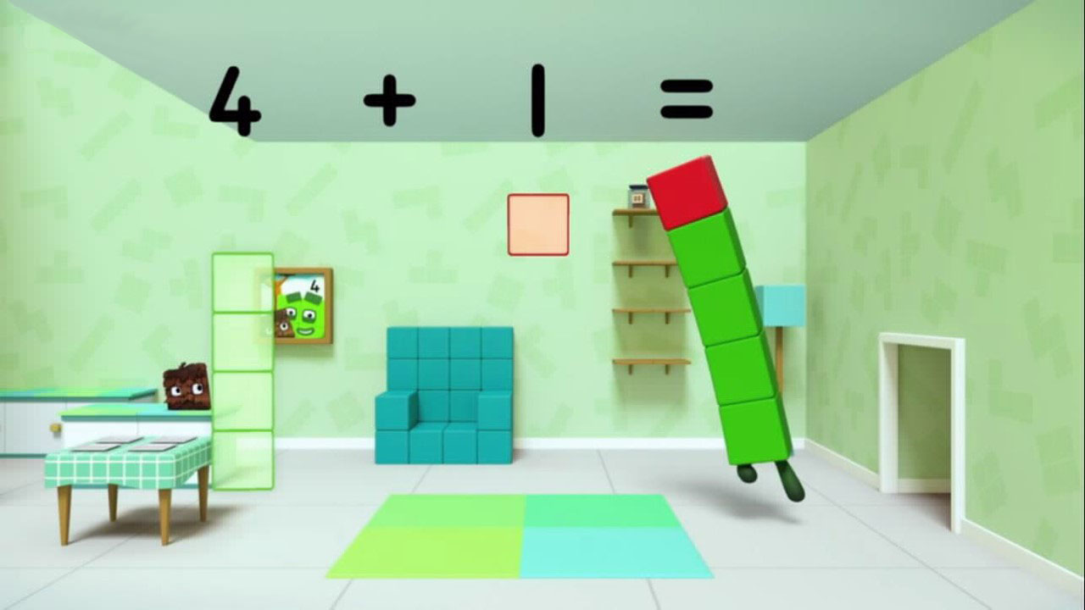
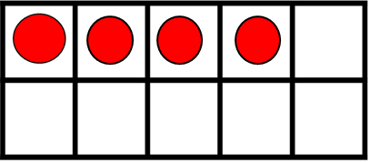
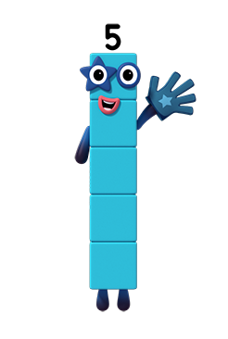
I am Four and Another One.
Images © 2017 Alphablocks Ltd. All Rights Reserved.
Notes:
What do you notice?
“Four and another one is five.” “Five is one more than four.”
How does the tens frame show that four and another one is five?
Read the equation: “4 plus 1 equals 5.”
What does each number in the equation mean?

Slide 21
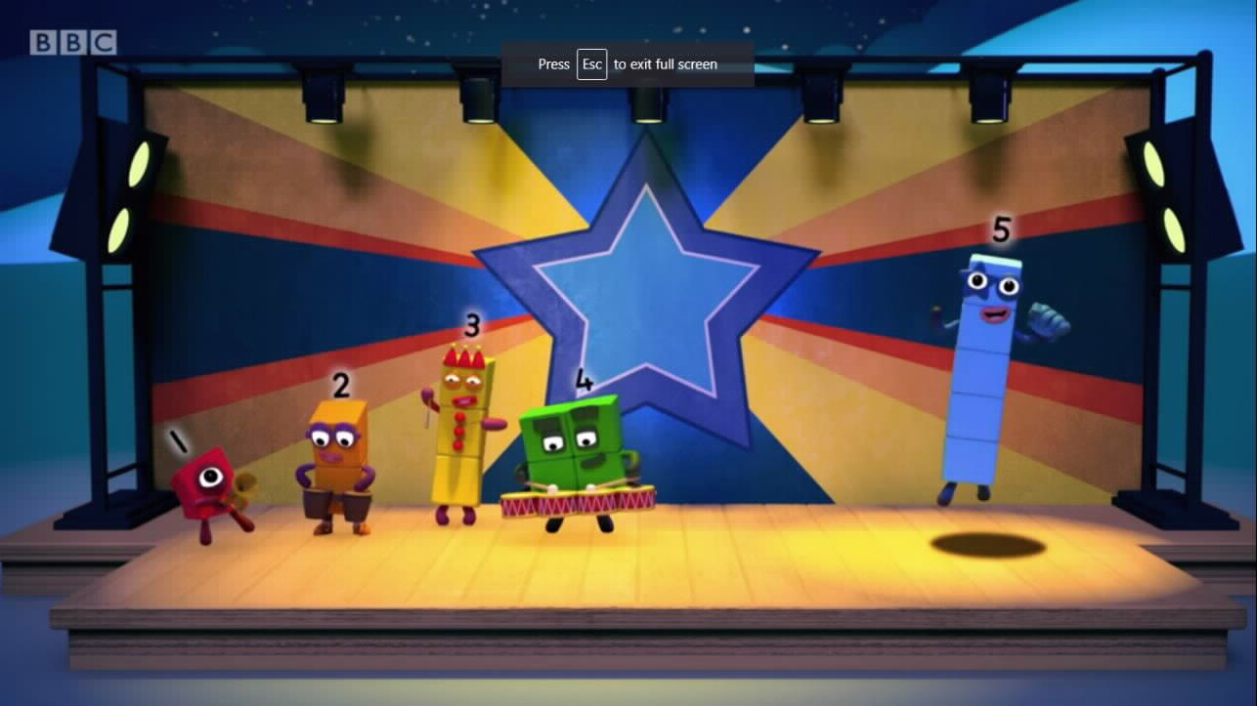

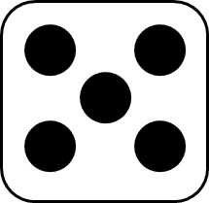
I am Five.
Images © 2017 Alphablocks Ltd. All Rights Reserved.
Notes:
What do you notice about the tens frames?
Each number is one more than the previous one. Five has a full column of counters.
Five often stands tall like the counters in the tens frames but she can make lots of shapes.
Explore shapes which can be made with five connecting blocks.

Slide 22
Further activities for Y1
Explore ways of arranging interlocking cubes to make the numbers 1 to 5.
Focussing on the number 5, see how many different shapes you can make with 5 cubes. Encourage children to compare and describe shapes which are the same but placed in different orientations, e.g. ‘standing up’ shapes and ‘lying down’ shapes. Ask children to explain how they ‘see 5’ in each arrangement.
Complete missing information sentences to describe the numbers 1 to 5.
  E.g. I am o more than 2
Match ten frames to Numberblocks without counting (subitising arrangements).
Identify missing numbers on a number line 1 – 5.
Relate geometric shapes to the Numberblocks. Starting with some dots on a piece of paper, join 2 dots to make a line, join 3 dots to make a triangle, 4 dots to make a square/ rectangle, 5 dots to make a pentagon.

Slide 23
Learning Together in Y2

Slide 24
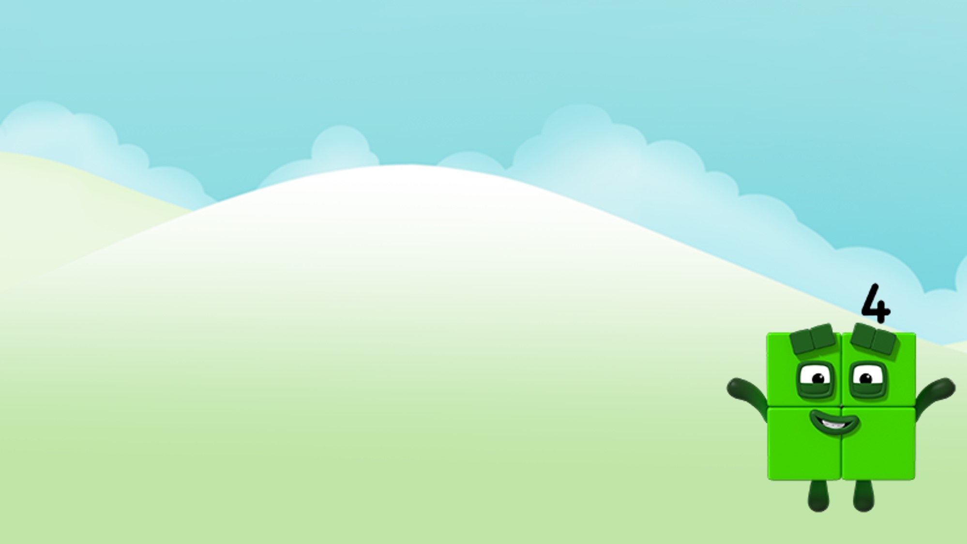
How many ways can you make Four using the 1, 2 and 3 blocks?
Images © 2017 Alphablocks Ltd. All Rights Reserved.
Notes:
Discuss challenge set by Four. Read together: “How many ways can you make Four using the 1, 2 and 3 blocks?”
Use towers of cubes ready prepared in ones, twos and threes (all the same colour for each tower of two/ three) and see how many ways can be found to make Four.
Children could record on large-squared paper.

Slide 25







There are ___ ways to make Four from the 1, 2 and 3 blocks.
Images © 2017 Alphablocks Ltd. All Rights Reserved.
Notes:
Use this slide to model how to work systematically to find all the ways to make four using the blocks.
How does each equation represent the blocks? What does each number mean? Why did we need more than one addition sign?

Slide 26



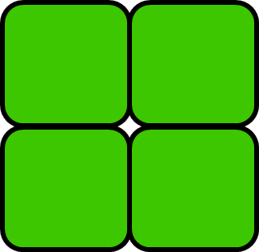

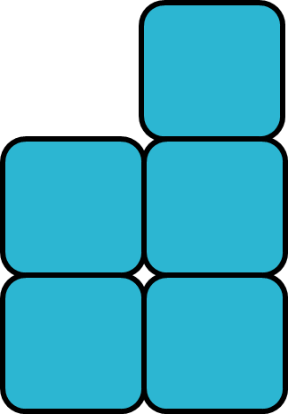

How many ways can you make the numbers 1-5 from the 1-5 blocks?
Number | How many ways?
 | 1
 | 2
 | 2
 | 4
 | 6
Images © 2017 Alphablocks Ltd. All Rights Reserved.
Notes:
What does the table show us?
The table represents the information that we have already investigated.
How can we find out the number to put in the last row?
Discuss the challenge together.
Make predictions which can be tested by using cubes to explore ways to make 5.

Slide 27
Further activities for Y2
Record the combinations using equations. Look for duplicates (same numbers different order).
Continue the sequence for 6.
Represent equations as images of combined blocks.
Represent the combinations using part-part-whole model.
Find the missing number in an equation:
  E.g. 5 = 2 + o + 1

