Slide 1
Year 4, Unit 6
Understanding and manipulating multiplicative relationships

Slide 2
Year 4, Unit 6
These materials heavily reflect the prioritisation approach of the ready-to-progress criteria in the DfE Primary Mathematics Guidance 2020 and on the PPTs that exemplify them on the NCETM website. They also include other relevant National Curriculum content. Related sections of the NCETM Primary Mastery Professional Development Materials provide small-step teaching guidance.
Ready-to-progress criteria addressed by this unit
Teaching of this unit supports the following criteria from the ‘DfE Mathematics Guidance: key stages 1 & 2’ (the 335-page document available as a download)
4MD-1 Page 170
4MD-2 Page 173
4MD-3 Page 178
4NF-3 Page 166
Prior learning
If the following ready-to-progress criteria, contained in the same DfE guidance document as above, were secured in Year 3, children will be ready to start on this unit.
3NF-3 Page 103

Slide 3
Contents
The links below take you to the starting slide of each learning outcome.
1 | Pupils explain what each factor represents in a multiplication equation
2 | Pupils explain how each part of a multiplication and division equation relates to a story
3 | Pupils explain where zero can be part of a multiplication or division expression and the impact it has
4 | Pupils partition one of the factors in a multiplication equation in different ways using representations (I)
5 | Pupils partition one of the factors in a multiplication equation in different ways using representations (II)
Click the arrow button to return to this Contents slide.

Slide 4
Contents
The links below take you to the starting slide of each learning outcome.
6 | Pupils explain which is the most efficient factor to partition to solve a multiplication problem
7 | Pupils use knowledge of distributive law to solve two part addition and subtraction problems, efficiently
8 | Pupils use knowledge of distributive law to calculate products beyond known times tables facts
9 | Pupils explain the relationship between multiplying a number by 10 and multiples of 10
10 | Pupils explain why a zero can be placed after the final digit of a single-digit number when we multiply it by 10
Click the arrow button to return to this Contents slide.

Slide 5
Contents
The links below take you to the starting slide of each learning outcome.
11 | Pupils explain why a zero can be placed after the final digit of a two-digit number when we multiply it by 10
12 | Pupils explain why the final digit zero can be removed from a two-digit multiple of 10, when we divide by 10
13 | Pupils explain why the final digit zero can be removed from a three-digit multiple of 10, when we divide by 10
14 | Pupils explain the relationship between multiplying a number by 100 and multiples of 100
15 | Pupils explain why two zeros can be placed after the final digit of a single digit number when we multiply it by 100
Click the arrow button to return to this Contents slide.

Slide 6
Contents
The links below take you to the starting slide of each learning outcome.
16 | Pupils explain why two zeros can be placed after the final digit of a two digit number when we multiply it by 100
17 | Pupils explain why the last two zeros can be removed from a three-digit multiple of 100 when we divide it by 100
18 | Pupils explain why the last two zeros can be removed from a four-digit multiple of 100 when we divide it by 100
19 | Pupils use knowledge of the composition of 100 to multiply by 100 in different ways
20 | Pupils use knowledge of the composition of 100 to divide by 100 in different ways
Click the arrow button to return to this Contents slide.

Slide 7
Contents
The links below take you to the starting slide of each learning outcome.
21 | Pupils explain how making a factor 10 times the size affects the product
22 | Pupils explain how making the dividend 10 times the size affects the quotient
23 | Pupils explain how making a factor 100 times the size affects the product
24 | Pupils explain how making the dividend 100 times the size affects the quotient
25 | Pupils scale known multiplication facts by 10
26 | Pupils scale division derived from multiplication facts by 100
Click the arrow button to return to this Contents slide.

Slide 8
Year 4, Unit 6, Learning Outcome 1
Learning Outcome 1
Pupils explain what each factor represents in a multiplication equation
The following slides have been collated to support the teaching of this learning outcome.

Slide 9
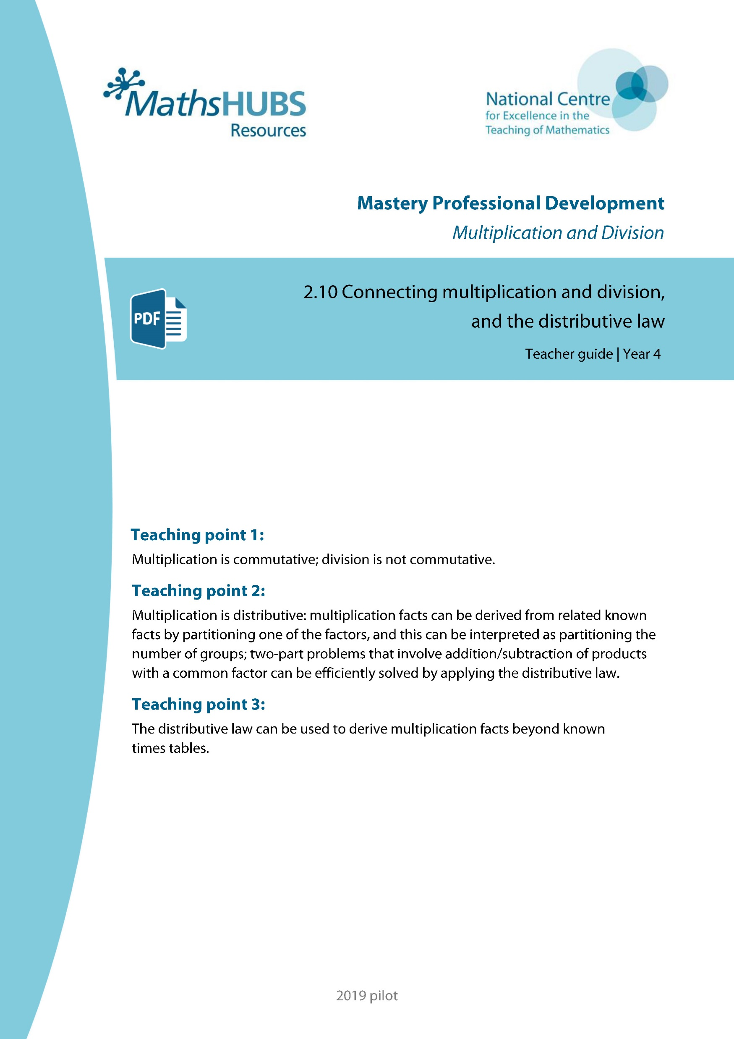
Year 4, Unit 6, Learning Outcome 1
Additional teacher guidance for this outcome should be read first and can be found in this segment of the NCETM Primary Mastery Professional Development Materials:
2.10 Connecting multiplication and division, and the distributive law
The spine materials are divided into ‘teaching points’ and ‘steps in learning’.
Teaching point | Steps in learning | Pages
1 | 1:1 | 3-5

Slide 10
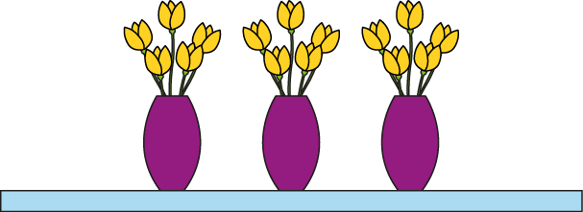
2.10 Making connections; the distributive law Step 1:1
Two multiplication equations?
3 × 5 = 15
5 × 3 = 15
3 groups of 5 are equal to 15.
Five, 3 times, is equal to 15.
3 × 5 = 5 × 3
Notes:
Write two multiplication equations to represent this picture.
What’s the same? In both equations, three and five are factors and fifteen is the product.
What’s different? The factors are written in a different order.

Slide 11
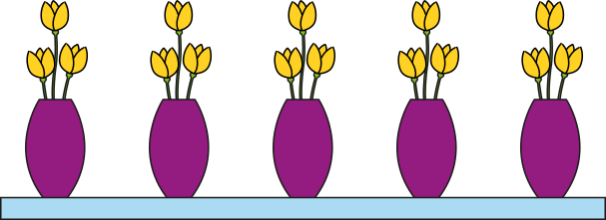
2.10 Making connections; the distributive law Step 1:1
3 × 5 = 15
A
B
3 groups of 5 are equal to 15.
5 groups of 3 are equal to 15.
Three, 5 times, is equal to 15.
3 groups of 5 is equal to 5 groups of 3.
Notes:
What’s the same? Both pictures show fifteen flowers.
What’s different?
Picture A shows three groups of five flowers.
Picture B shows five groups of three flowers (or three, five times).

Slide 12
2.10 Making connections; the distributive law Step 1:1
5 × 3 = 15
A
B
3 groups of 5 are equal to 15.
5 groups of 3 are equal to 15.
Five, 3 times, is equal to 15.
3 groups of 5 is equal to 5 groups of 3.

Slide 13
2.10 Making connections; the distributive law Step 1:1
 | Products equal?
2 × 3 and 3 × 2
5 × 4 and 4 × 5
5 × 5 and 6 × 5
12 × 3 and 13 × 2
3 × 22 and 23 × 2
✓
✓
✗
✗
✗

Slide 14
Year 4, Unit 6, Learning Outcome 2
Learning Outcome 2
Pupils explain how each part of a multiplication and division equation relates to a story
The following slides have been collated to support the teaching of this learning outcome.

Slide 15
Year 4, Unit 6, Learning Outcome 2
Additional teacher guidance for this outcome should be read first and can be found in this segment of the NCETM Primary Mastery Professional Development Materials:
2.10 Connecting multiplication and division, and the distributive law
The spine materials are divided into ‘teaching points’ and ‘steps in learning’.
Teaching point | Steps in learning | Pages
1 | 1:2-1:5 | 5-8

Slide 16
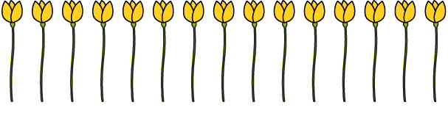
2.10 Making connections; the distributive law Step 1:2
15 flowers, 5 in each vase. How many vases?
3
× 5 = 15
3
5 × = 15
Which calculation?
15 ÷ 5 =
3
✓
5 ÷ 15 =
✗

Slide 17
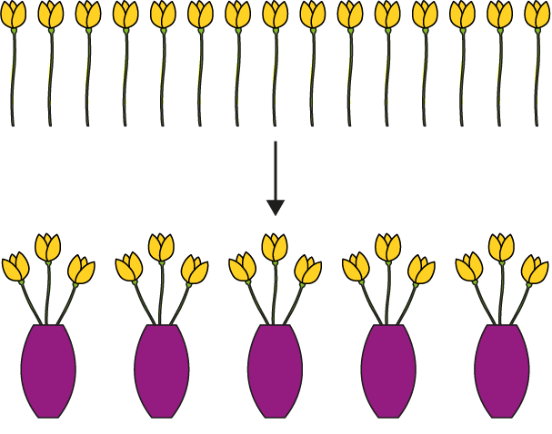
2.10 Making connections; the distributive law Step 1:3
15 flowers, 3 in each vase. How many vases?
5
× 3 = 15
5
3 × = 15
Which calculation?
15 ÷ 3 = 5
✓
15 ÷ 5 = 3
✗
Notes:
15 ÷ 3 Equation is correct; does represent the problem.
15 ÷ 5 Equation is correct; but 15 ÷ 5 is not the calculation we need to perform.

Slide 18
2.10 Making connections; the distributive law Step 1:4
15 flowers
5 in each vase, how many vases? | 3 in each vase, how many vases?
3
× 5 = 15
5 × = 15
3
5
× 3 = 15
3 × = 15
5
15 ÷ 5 =
3
15 ÷ 3 =
5
factor × ? = product
? × factor = product
↓
dividend ÷ divisor = quotient

Slide 19
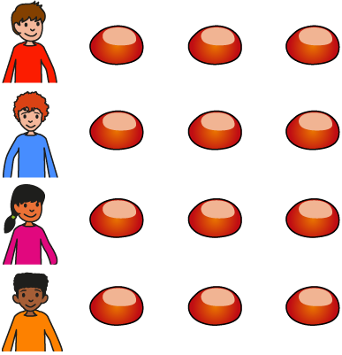
2.10 Making connections; the distributive law Step 1:5
12 conkers shared between 4 children. How many conkers each?
3
× 4 = 12
3
4 × = 12
12 ÷ 4 =
3

Slide 20
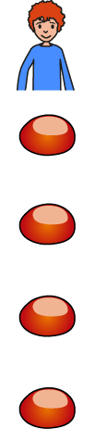
2.10 Making connections; the distributive law Step 1:5
12 conkers shared between 3 children. How many conkers each?
4
× 3 = 12
4
3 × = 12
12 ÷ 3 =
4

Slide 21
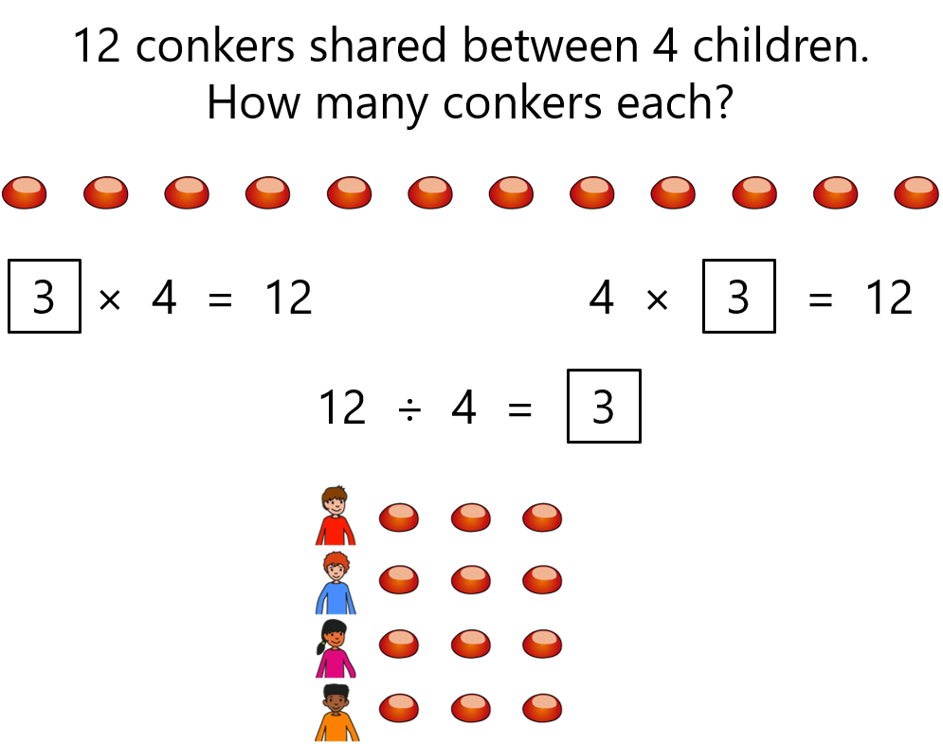
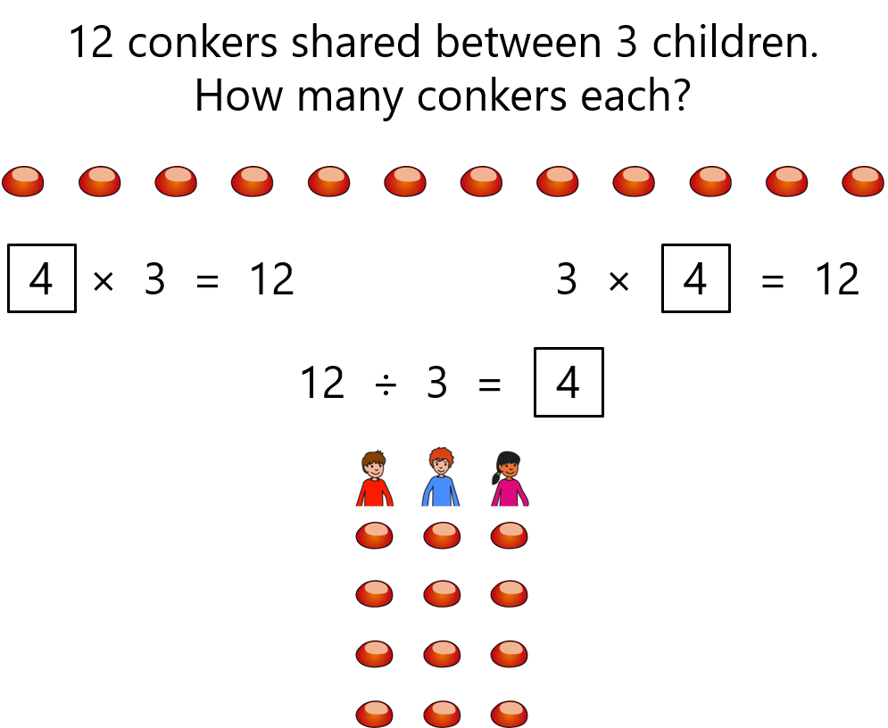
2.10 Making connections; the distributive law Step 1:5

Slide 22

4MD-2 Manipulating the multiplicative relationship
What do you see? Can you see 2 groups of 7? What do you see now? Can you see 7 groups of 2?
What is the same/different? Can you write two different equations? What do you notice about this equation?
Provide different arrays for pupils to work with and ask them to orally apply the commutative property.
2 × 7 = 7 × 2
2 groups of 7 is equal to 14.
2, 7 times is equal to 14.
2 groups of 7 is equal to 7, two times.

Slide 23

4MD-2 Manipulating the multiplicative relationship
Can you write two multiplication equations to represent this picture? What does the 2 represent? The 7? The 14?
What is the same/different?
Which are the factors in your equation? What is the product? Does the order of the factors affect the product?
Repeat using other images and real-life contexts.
2 × 7 = 14
7 × 2 = 14
The product of __ and __ is equal to the product of __ and __.
__ times __ is equal to __ times __.

Slide 24
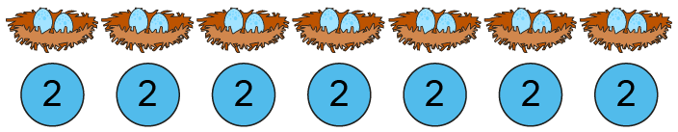
4MD-2 Manipulating the multiplicative relationship
What do you see? Can you write two multiplication equations to represent this picture? What does each number in your equation represent?
How does this compare with the last slide? What do you notice about the equations you have written?
Provide children with similar equations and ask them to draw two pictures to represent them.
2 × 7 = 14
7 × 2 = 14

Slide 25


4MD-2 Manipulating the multiplicative relationship
What is the same/different?
Provide similar cards with different equations and ask children to match these.
Can you write another equation that is equal to 3 x 6? Now can you draw or use counters to represent each of your equations? Repeat for other equations.
2 groups of 7
2 × 7 = 14
7 groups of 2
7 × 2 = 14
2 groups of 7 is equal to 7 groups of 2.

Slide 26
4MD-2 Manipulating the multiplicative relationship
If we know these two equations have the same product, can you write a corresponding division statement? And another? What do you notice?
Return to arrays and ask children to write 2 multiplication and 2 division statements for each.
2 × 7 = 14
7 × 2 = 14
14 ÷ 7 = 2
14 ÷ 2 = 7
Exchange the factors and the product remains the same.
Exchange the divisor and quotient and the dividend remains the same.

Slide 27
4MD-2 Manipulating the multiplicative relationship
What is the same/different?
Provide similar cards with different division equations and ask children to match these.
Can you write another equation that is equal to 15 ÷ 3? Now can you draw or use counters to represent each of your equations? Repeat for other equations.
2 groups of 7
14 ÷ 7 = 2
7 groups of 2
14 ÷ 2 = 7

Slide 28
Year 4, Unit 6, Learning Outcome 3
Learning Outcome 3
Pupils explain where zero can be part of a multiplication or division expression and the impact it has
The following slides have been collated to support the teaching of this learning outcome.

Slide 29
Year 4, Unit 6, Learning Outcome 3
Additional teacher guidance for this outcome should be read first and can be found in this segment of the NCETM Primary Mastery Professional Development Materials:
2.10 Connecting multiplication and division, and the distributive law
The spine materials are divided into ‘teaching points’ and ‘steps in learning’.
Teaching point | Steps in learning | Pages
1 | 1:6-1:8 | 8-10

Slide 30
2.10 Making connections; the distributive law Step 1:7
0 × 1 = 0 | 0 ÷ 1 = 0
0 × 2 = 0 | 0 ÷ 2 = 0
0 × 3 = 0 | 0 ÷ 3 = 0
0 × 4 = 0 | 0 ÷ 4 = 0
0 × 5 = 0 | 0 ÷ 5 = 0
0 × 10 = 0 | 0 ÷ 10 = 0
Notes:
When the dividend is zero, the quotient is zero.

Slide 31
2.10 Making connections; the distributive law Step 1:8
Connect matching multiplication and division equations.
15 = 3 × 5 |  | 24 ÷ 6 = 4
24 = 8 × 3 |  | 0 ÷ 7 = 0
22 = 2 × 11 |  | 15 ÷ 3 = 5
0 = 7 × 0 |  | 7 ÷ 7 = 1
24 = 12 × 2 |  | 11 = 22 ÷ 2
7 = 7 × 1 |  | 24 ÷ 8 = 3
4 × 6 = 24 |  | 2 = 24 ÷ 12

Slide 32
Year 4, Unit 6, Learning Outcome 4
Learning Outcome 4
Pupils partition one of the factors in a multiplication equation in different ways using representations (I)
The following slides have been collated to support the teaching of this learning outcome.

Slide 33
Year 4, Unit 6, Learning Outcome 4
Additional teacher guidance for this outcome should be read first and can be found in this segment of the NCETM Primary Mastery Professional Development Materials:
2.10 Connecting multiplication and division, and the distributive law
The spine materials are divided into ‘teaching points’ and ‘steps in learning’.
Teaching point | Steps in learning | Pages
2 | 2:1-2:3 | 11-14

Slide 34

2.10 Making connections; the distributive law Step 2:1
5 × 8
= 4 × 8 + 8
= 40
4 × 8 = 32
+ 8

Slide 35
2.10 Making connections; the distributive law Step 2:1
4 × 8
= 5 × 8 − 8
= 32
− 8

Slide 36

2.10 Making connections; the distributive law Step 2:2
5 × 8
8
8
8
8
8
5 = 4 + 1
5 × 8 = 4 × 8 + 1 × 8
= 32 + 8
= 40
Notes:
Five is equal to four plus one, so
five times eight is equal to
four times eight plus one times eight.

Slide 37
2.10 Making connections; the distributive law Step 2:2
5 × 8
8
8
8
8
8
4 = 5 − 1
4 × 8 = 5 × 8 − 1 × 8
= 40 − 8
= 32
Notes:
Four is equal to five minus one, so
four times eight is equal to
five times eight minus one times eight.

Slide 38
2.10 Making connections; the distributive law Step 2:2
5 × 8
5 × 8
8
8
8
8
8
8
8
8
8
8
5 = 4 + 1
4 = 5 − 1
5 × 8 = 4 × 8 + 1 × 8
4 × 8 = 5 × 8 − 1 × 8
= 32 + 8
= 40 − 8
= 40
= 32

Slide 39
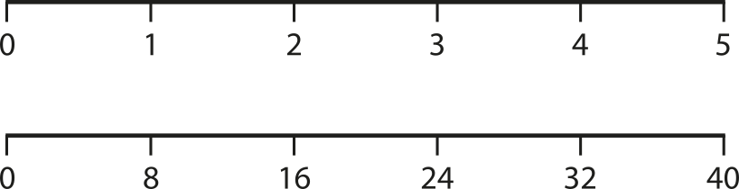
2.10 Making connections; the distributive law Step 2:2
4 + 1 = 5
4 = 5 − 1
5 × 8 = 4 × 8 + 1 × 8
4 × 8 = 5 × 8 − 1 × 8

Slide 40
2.10 Making connections; the distributive law Step 2:3
5 × 8
8
8
8
8
8
5 = 3 + 2
5 × 8 = 3 × 8 + 2 × 8
= 24 + 16
= 40
Notes:
Five is equal to three plus two, so
five times eight is equal to
three times eight plus two times eight.

Slide 41
2.10 Making connections; the distributive law Step 2:3
5 × 8
8
8
8
8
8
3 = 5 − 2
3 × 8 = 5 × 8 − 2 × 8
= 40 − 16
= 24
Notes:
Three is equal to five minus two, so
three times eight is equal to
five times eight minus two times eight.

Slide 42
2.10 Making connections; the distributive law Step 2:3
5 × 8
5 × 8
8
8
8
8
8
8
8
8
8
8
5 = 3 + 2
3 = 5 − 2
5 × 8 = 3 × 8 + 2 × 8
3 × 8 = 5 × 8 − 2 × 8
= 24 + 16
= 40 − 16
= 40
= 24

Slide 43
2.10 Making connections; the distributive law Step 2:3
3 + 2 = 5
3 = 5 − 2
5 × 8 = 3 × 8 + 2 × 8
3 × 8 = 5 × 8 − 2 × 8

Slide 44
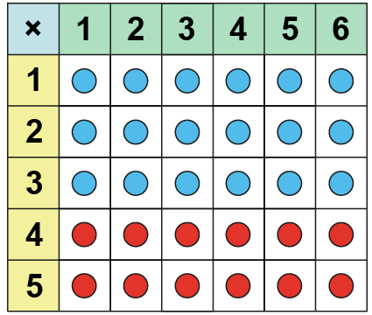
4MD-3 The distributive property of multiplication
If I have four sixes, what would I need to do to find five sixes? Do I need to start from zero and count up in sixes?
Use your counters to make an array to represent 4 x 6. Now change your array to make 5 x 6. Explain what you have done.
Repeat for other multiplications, adding one more multiple. Stop using the array when children are confident.
5 sixes is 4 sixes and one more 6.
5 x 6 = 4 x 6 + 6
4 × 6 + 6 = 5 × 6

Slide 45
4MD-3 The distributive property of multiplication
If I have 3 sixes, what would I need to do to find five sixes?
Use your counters to make an array to represent 3 x 6. Now change your array to make 5 x 6. Explain what you have done.
Can you write a calculation?
Repeat for other multiplications, adding on 2 or more multiples. Stop using the array when children are confident.
3 × 6 + 2 × 6 = 5 × 6

Slide 46
4MD-3 The distributive property of multiplication
Can you see 3 groups of 6 as a part? Can you see 2 groups of 6 as a part? How many groups of 6 do we have in total.
Using part-part-whole representations and counters/jottings, ask children to represent further multiplications, for example:
  4 x 3 + 2 x 3 5 x 2 + 3 x 2
5
5 x 6
5 is equal to 3 plus 2, so 5 sixes is equal to 3 sixes plus 2 sixes.
1
1
6
6
1
1
6
6
1
6
3 + 2 = 5
3 x 6 + 2 x 6 = 5 x 6

Slide 47
Year 4, Unit 6, Learning Outcome 5
Learning Outcome 5
Pupils partition one of the factors in a multiplication equation in different ways using representations (II)
The following slides have been collated to support the teaching of this learning outcome.

Slide 48
Year 4, Unit 6, Learning Outcome 5
Additional teacher guidance for this outcome should be read first and can be found in this segment of the NCETM Primary Mastery Professional Development Materials:
2.10 Connecting multiplication and division, and the distributive law
The spine materials are divided into ‘teaching points’ and ‘steps in learning’.
Teaching point | Steps in learning | Pages
2 | 2:4-2:5 | 15-18

Slide 49
2.10 Making connections; the distributive law Step 2:4
9 × 3
3 × 9
3
3
3
3
3
3
3
3
3
3
3
3
3
3
3
3
3
3
Notes:
Nine is equal to five plus four, so
three times nine is equal to
three times five plus three times four.
Five is equal to nine minus four, so
three times five is equal to
three times nine minus three times four.

Slide 50
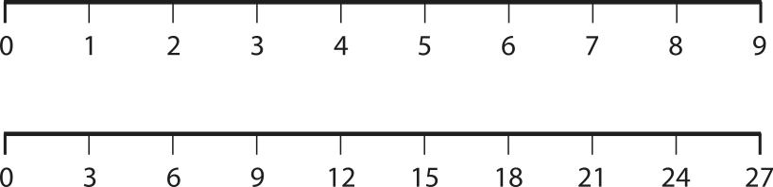
2.10 Making connections; the distributive law Step 2:4

Slide 51
2.10 Making connections; the distributive law Step 2:5
5
× 2
2
2
2
2
2

Slide 52
2.10 Making connections; the distributive law Step 2:5
For each solution write 3 equations.
8 × 2

Slide 53
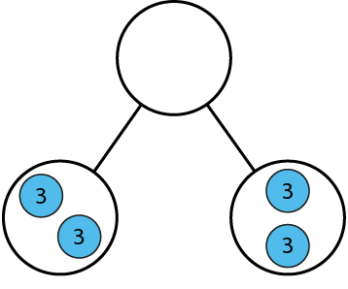
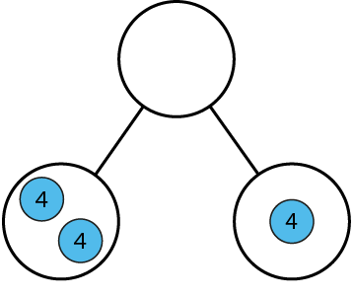
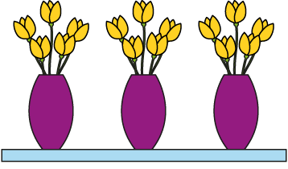
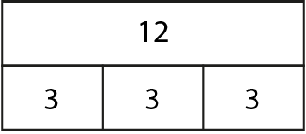
2.10 Making connections; the distributive law Step 2:5
4 × 3 = ?
✗
3 × 3 + 1 × 3
✓
2 × 4 + 4 × 1

Slide 54
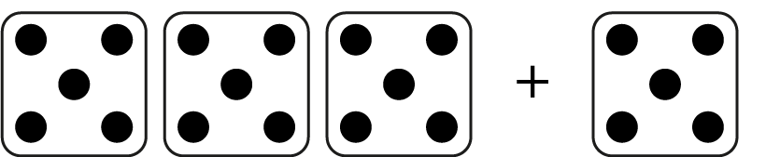
2.10 Making connections; the distributive law Step 2:5
Represent with an equation.
3 × 5 + 1 × 5 = 4 × 5

Slide 55

2.10 Making connections; the distributive law Step 2:5
2 spiders crawl away. How many legs left?
Represent with an equation.
6 × 8 − 2 × 8 = 4 × 8

Slide 56


4MD-3 The distributive property of multiplication
Can you represent this image using a multiplication equation? Point to part of the equation written and ask: What does this part represent?
What if there were 3 more spiders not 2? How will you change your equation?
Can you draw a picture to represent this equation?
  4 x 3 + 2 x 3
Repeat.
3 × 5 + 1 × 5 = 4 × 5
4 × 8 + 2 × 8 = 6 x 8

Slide 57


4MD-3 The distributive property of multiplication
Let’s solve 7 fours using our new partitioning method. What has 7 been partitioned into?
Can you write the equation?
Now try 5 x 8.
Repeat using other calculations, including real-life contexts.
7 is equal to 5 plus 2, so 7 fours is equal to 5 fours plus 2 fours.
7 = 5 + 2
7 × 4 =
5 × 4
+ 2 × 4
= 20 + 8
= 28

Slide 58


4MD-3 The distributive property of multiplication
Let’s solve 9 x 4 by finding 10 x 4 first.
Can you write the equation?
Now solve 9 x 6 by finding 10 x 6 first.
Repeat with similar calculations.
Provide real-life contexts in which children can apply this method.
9 is equal to 10 minus 1, so 9 fours is equal to 10 fours minus 1 4.
9 = 10 − 1
9 × 4 = 10 × 4 − 1 × 4
= 40 − 4
= 36

Slide 59
Year 4, Unit 6, Learning Outcome 6
Learning Outcome 6
Pupils explain which is the most efficient factor to partition to solve a multiplication problem
The following slides have been collated to support the teaching of this learning outcome.

Slide 60
Year 4, Unit 6, Learning Outcome 6
Additional teacher guidance for this outcome should be read first and can be found in this segment of the NCETM Primary Mastery Professional Development Materials:
2.10 Connecting multiplication and division, and the distributive law
The spine materials are divided into ‘teaching points’ and ‘steps in learning’.
Teaching point | Steps in learning | Pages
2 | 2:6-2:8 | 18-22

Slide 61
2.10 Making connections; the distributive law Step 2:6
6 = 5 + 1
6 × 4 = 5 × 4 + 1 × 4
4 × 6 =
4 × 5
+ 4 × 1
= 20 + 4
= 24
Notes:
Six is equal to five plus one, so
four times six is equal to four times five plus
four times one.
Six is equal to five plus one, so
six times four is equal to five times four plus
one times four.

Slide 62
2.10 Making connections; the distributive law Step 2:6
7 = 5 + 2
7 × 4 = 5 × 4 + 2 × 4
4 × 7 =
4 × 5
+ 4 × 2
= 20 + 8
= 28
Notes:
Seven is equal to five plus two, so
four times seven is equal to four times five plus
four times two.
Seven is equal to five plus two, so
seven times four is equal to five times four plus
two times four.

Slide 63
2.10 Making connections; the distributive law Step 2:6
9 = 10 − 1
4 × 9 =
4 × 10
− 4 × 1
9 × 4 = 10 × 4 − 1 × 4
= 40 − 4
= 36
Notes:
Nine is equal to ten minus one, so
four times nine is equal to four times ten minus
four times one.
Nine is equal to ten minus one, so
nine times four is equal to ten times four minus
one times four.

Slide 64
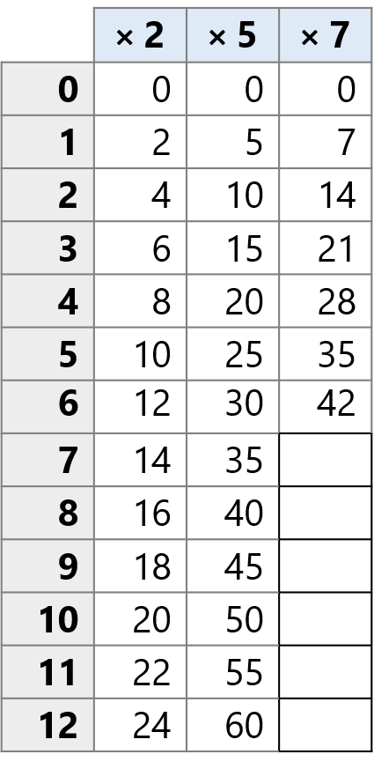
























2.10 Making connections; the distributive law Step 2:8

Slide 65

























2.10 Making connections; the distributive law Step 2:8

Slide 66
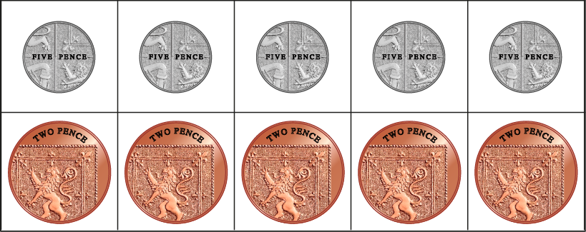
2.10 Making connections; the distributive law Step 2:8
How much money altogether?
= 35 p
5 × 5 + 2 × 5
25 + 10
= 35

Slide 67
Year 4, Unit 6, Learning Outcome 7
Learning Outcome 7
Pupils use knowledge of distributive law to solve two part addition and subtraction problems, efficiently
The following slide supports the teaching of this learning outcome.

Slide 68
Year 4, Unit 6, Learning Outcome 7
Additional teacher guidance for this outcome should be read first and can be found in this segment of the NCETM Primary Mastery Professional Development Materials:
2.10 Connecting multiplication and division, and the distributive law
The spine materials are divided into ‘teaching points’ and ‘steps in learning’.
Teaching point | Steps in learning | Pages
2 | 2:9-2:10 | 22-23

Slide 69
Year 4, Unit 6, Learning Outcome 8
Learning Outcome 8
Pupils use knowledge of distributive law to calculate products beyond known times tables facts
The following slides have been collated to support the teaching of this learning outcome.

Slide 70
Year 4, Unit 6, Learning Outcome 8
Additional teacher guidance for this outcome should be read first and can be found in this segment of the NCETM Primary Mastery Professional Development Materials:
2.10 Connecting multiplication and division, and the distributive law
The spine materials are divided into ‘teaching points’ and ‘steps in learning’.
Teaching point | Steps in learning | Pages
3 | 3:1-3:3 | 24-26

Slide 71
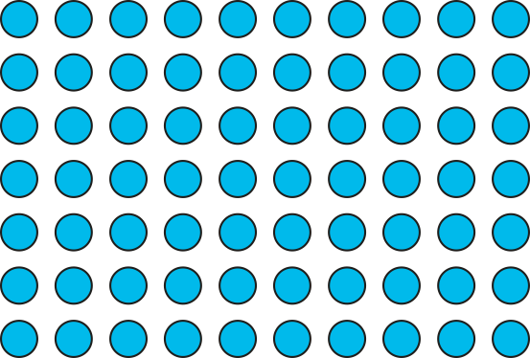

2.10 Making connections; the distributive law Step 3:1
7 × 13
= 91
10
3
7
70
21
7 × 13 = 7 × 10 + 7 × 3
= 70
+
21
= 91

Slide 72
2.10 Making connections; the distributive law Step 3:1
5 × 16
= 80
10
6
5
50
30
5 × 16 = 5 × 10 + 5 × 6
= 50 + 30
= 80

Slide 73
4MD-3 The distributive property of multiplication
13 × 7
= 91
10
3
What is different this time?
Which factor shall we partition?
How should we partition13? Why?
13 sevens is 10 sevens plus 3 sevens.
7
70
21
13 × 7 = 10 × 7 + 3 × 7
= 70
+
21
= 91

Slide 74
4MD-3 The distributive property of multiplication
16 × 5
= 80
Which factor will you partition? Could you represent this using rectangles instead of using your counters?
Can you write the equation?
Repeat using other calculations, multiplying teen numbers by a single digit and varying the order of the factors each time. Ask children to use this rectangular representation, writing the equation beneath.
Can you now solve these without the representation?
10
6
5
50
30
16 × 5 = 10 × 5 + 6 × 5
= 50 + 30
= 80

Slide 75
4MD-3 The distributive property of multiplication
16 × 5
= 80
How else could we partition 16 without thinking of 10 and a bit?
Could we use doubles?
What would this look like as a representation using rectangles.
Can you solve 18 x 3 and 12 x 4 in the same way?
8
8
5
40
40
16 × 5 = 8 × 5 + 8 × 5
= 40 + 40
= 80

Slide 76
Year 4, Unit 6, Learning Outcome 9
Learning Outcome 9
Pupils explain the relationship between multiplying a number by 10 and multiples of 10
The following slides have been collated to support the teaching of this learning outcome.

Slide 77
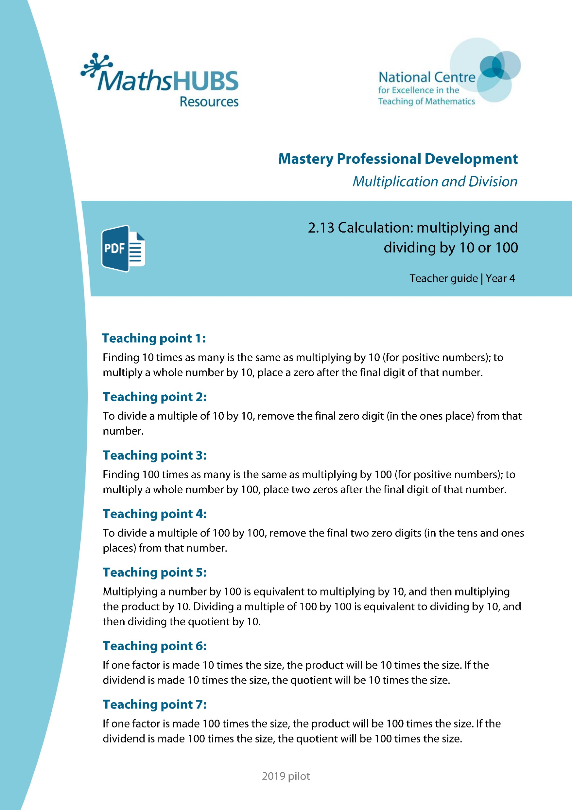
Year 4, Unit 6, Learning Outcome 9
Additional teacher guidance for this outcome should be read first and can be found in this segment of the NCETM Primary Mastery Professional Development Materials:
2.13 Calculation: multiplying and dividing by 10 and 100
The spine materials are divided into ‘teaching points’ and ‘steps in learning’.
Teaching point | Steps in learning | Pages
1 | 1:1-1:3 and 1:9 | 3-7 and 12-13

Slide 78


2.13 Calculation: ×/÷ 10 or 100 Step 1:1
Emily has 1 pencil; Jamie has 10 times as many.
How many pencils does Jamie have?
Notes:
For every one pencil of Emily’s, Jamie has ten.
Think of ‘1’ and make it ten times the size.
Think of ‘1’ and multiply by ten.
1 × 10
One multiplied by ten is equal to ten.
1 × 10 =10
Ten is ten times the size of one.
Ten pencils is ten times as many as one pencil.
Jamie has ten pencils.

Slide 79
2.13 Calculation: ×/÷ 10 or 100 Step 1:1
Emily has 2 pencils; Jamie has 10 times as many.
How many pencils does Jamie have?
Notes:
For every one pencil of Emily’s, Jamie has ten.
Think of ‘2’ and make it ten times the size.
Think of ‘2’ and multiply by ten.
2 × 10
Two multiplied by ten is equal to twenty.
2 × 10 = 20
Twenty is ten times the size of two.
Twenty pencils is ten times as many as two pencils.
Jamie has twenty pencils.

Slide 80
2.13 Calculation: ×/÷ 10 or 100 Step 1:1
Emily has 3 pencils; Jamie has 10 times as many.
How many pencils does Jamie have?
Notes:
For every one pencil of Emily’s, Jamie has ten.
Think of ‘3’ and make it ten times the size.
Think of ‘3’ and multiply by ten.
3 × 10
Three multiplied by ten is equal to thirty.
3 × 10 = 30
Thirty is ten times the size of three.
Thirty pencils is ten times as many as three pencils.
Jamie has thirty pencils.

Slide 81


2.13 Calculation: ×/÷ 10 or 100 Step 1:2

Slide 82
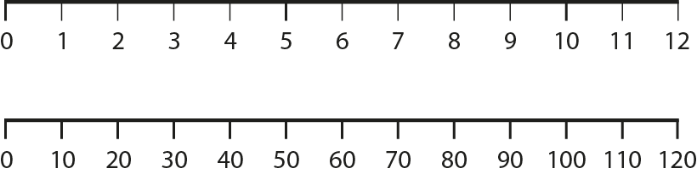
2.13 Calculation: ×/÷ 10 or 100 Step 1:2

Slide 83
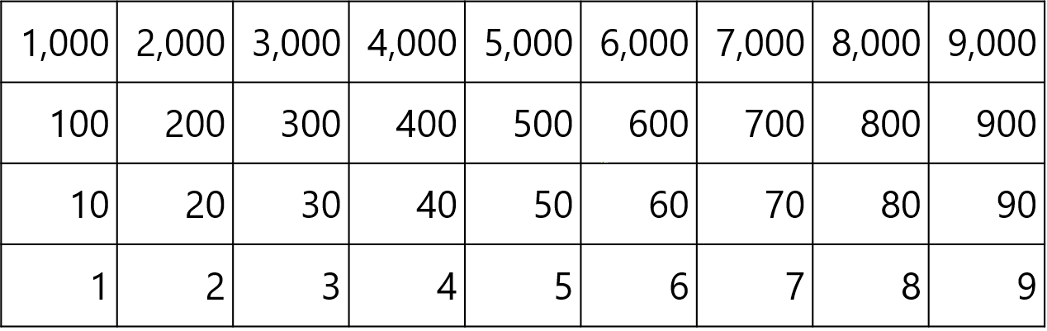

2.13 Calculation: ×/÷ 10 or 100 Step 1:3
1
2
3
4
5
6
7
8
9
× 10
= 10
= 20
= 30
= 40
= 50
= 60
= 70
= 80
= 90

Slide 84
2.13 Calculation: ×/÷ 10 or 100 Step 1:3
× 10

Slide 85
Year 4, Unit 6, Learning Outcome 10
Learning Outcome 10
Pupils explain why a zero can be placed after the final digit of a single-digit number when we multiply it by 10
The following slides have been collated to support the teaching of this learning outcome.

Slide 86
Year 4, Unit 6, Learning Outcome 10
Additional teacher guidance for this outcome should be read first and can be found in this segment of the NCETM Primary Mastery Professional Development Materials:
2.13 Calculation: multiplying and dividing by 10 and 100
The spine materials are divided into ‘teaching points’ and ‘steps in learning’.
Teaching point | Steps in learning | Pages
1 | 1:4-1:5 and 1:9 | 7-9 and 12-13

Slide 87



2.13 Calculation: ×/÷ 10 or 100 Step 1:4
1,000s | 100s | 10s | 1s
10 times
the size
10 times
the size
10 times
the size

Slide 88
2.13 Calculation: ×/÷ 10 or 100 Step 1:4
1,000s | 100s | 10s | 1s
1
1
1
1
1
1
1
10 times
the size
10 times
the size
10 times
the size

Slide 89
2.13 Calculation: ×/÷ 10 or 100 Step 1:4
6 × 10 =
60
1,000s | 100s | 10s | 1s
6
6
↓ × 10
6
0
6
Think of ‘6’ and
make it ten times
the size.
10 times
the size
10 times
the size
10 times
the size

Slide 90

2.13 Calculation: ×/÷ 10 or 100 Step 1:5
× 10

Slide 91

2.13 Calculation: ×/÷ 10 or 100 Step 1:5
0
1
2
3
4
5
6
7
8
9
× 10
0
10
20
30
40
50
60
70
80
90

Slide 92
Year 4, Unit 6, Learning Outcome 11
Learning Outcome 11
Pupils explain why a zero can be placed after the final digit of a two-digit number when we multiply it by 10
The following slides have been collated to support the teaching of this learning outcome.

Slide 93
Year 4, Unit 6, Learning Outcome 11
Additional teacher guidance for this outcome should be read first and can be found in this segment of the NCETM Primary Mastery Professional Development Materials:
2.13 Calculation: multiplying and dividing by 10 and 100
The spine materials are divided into ‘teaching points’ and ‘steps in learning’.
Teaching point | Steps in learning | Pages
1 | 1:6-1:9 | 10-13

Slide 94

2.13 Calculation: ×/÷ 10 or 100 Step 1:6
12 × 10 =
120
Notes:
I have twelve. This is one ten and two ones.
How much will I have if I have ten times this amount?
Think of twelve and make it ten times the size.
Think of twelve and multiply by ten.
12 × 10
We have:
ten tens; that’s one hundred
twenty ones; that’s twenty.
Twelve multiplied by ten is equal to one hundred and twenty.
12 × 10 = 120
One hundred and twenty is ten times the size of twelve.

Slide 95
2.13 Calculation: ×/÷ 10 or 100 Step 1:7
12 × 10 =
120
1,000s | 100s | 10s | 1s
2
1
2
1
↓ × 10
2
0
1
1
2
Think of ‘12’ and
make it ten times
the size.
10 times
the size
10 times
the size
10 times
the size
Notes:
Step 1 – move each of the digits one place to the left.
Step 2 – put a ‘0’ in the ones place.

Slide 96
2.13 Calculation: ×/÷ 10 or 100 Step 1:7
12 | × | 10 |  | = | 120
What is the value of the ‘2’
in ‘12’?
What is the value of the ‘2’
in ‘120’?
‘two’
‘twenty’
2
20
What is the value of the ‘1’
in ‘12’?
What is the value of the ‘1’
in ’120’?
‘ten’
‘one hundred’
10
100
We had 12 ones. We now have 12 tens.
Notes:
Summarise and compare the value of the digits.

Slide 97
2.13 Calculation: ×/÷ 10 or 100 Step 1:8
100
110
120
130
140
150
160
170
180
190
10 × 10 =
200
11 × 10 =
12 × 10 =
13 × 10 =
14 × 10 =
15 × 10 =
16 × 10 =
17 × 10 =
18 × 10 =
19 × 10 =
20 × 10 =

Slide 98
Year 4, Unit 6, Learning Outcome 12
Learning Outcome 12
Pupils explain why the final digit zero can be removed from a two-digit multiple of 10, when we divide by 10
The following slides have been collated to support the teaching of this learning outcome.

Slide 99
Year 4, Unit 6, Learning Outcome 12
Additional teacher guidance for this outcome should be read first and can be found in this segment of the NCETM Primary Mastery Professional Development Materials:
2.13 Calculation: multiplying and dividing by 10 and 100
The spine materials are divided into ‘teaching points’ and ‘steps in learning’.
Teaching point | Steps in learning | Pages
2 | 2:1-2:5 | 14-18

Slide 100
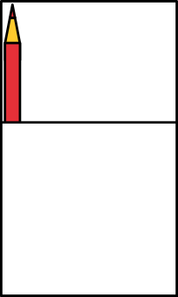
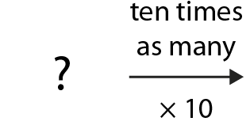
2.13 Calculation: ×/÷ 10 or 100 Step 2:1
Jamie has 10 pencils; he has 10 times as many as Emily.
How many pencils does Emily have?
10 times
as many
× 10
Notes:
One multiplied by ten is equal to ten.
1 × 10 = 10
Ten divided by ten is equal to one.
10 ÷ 10 = 1
Ten is ten times the size of one.
Emily has one pencil.

Slide 101
2.13 Calculation: ×/÷ 10 or 100 Step 2:1
Jamie has 20 pencils; he has 10 times as many as Emily.
How many pencils does Emily have?
10 times
as many
× 10
Notes:
Two multiplied by ten is equal to twenty.
2 × 10 = 20
Twenty divided by ten is equal to two.
20 ÷ 10 = 2
Twenty is ten times the size of two.
Emily has two pencils.

Slide 102
2.13 Calculation: ×/÷ 10 or 100 Step 2:1
Jamie has 30 pencils; he has 10 times as many as Emily.
How many pencils does Emily have?
10 times
as many
× 10
Notes:
Three multiplied by ten is equal to thirty.
3 × 10 = 30
Thirty divided by ten is equal to three.
30 ÷ 10 = 3
Thirty is ten times the size of three.
Emily has three pencils.

Slide 103
2.13 Calculation: ×/÷ 10 or 100 Step 2:2
× 10
÷ 10
1 × 10 = 10
2 × 10 = 20
3 × 10 = 30
4 × 10 = 40
5 × 10 = 50
6 × 10 = 60
7 × 10 = 70
8 × 10 = 80
9 × 10 = 90
10 ÷ 10
20 ÷ 10
30 ÷ 10
40 ÷ 10
50 ÷ 10
60 ÷ 10
70 ÷ 10
80 ÷ 10
90 ÷ 10
= 1
= 2
= 3
= 4
= 5
= 6
= 7
= 8
= 9

Slide 104
2.13 Calculation: ×/÷ 10 or 100 Step 2:2
× 10
÷ 10

Slide 105
2.13 Calculation: ×/÷ 10 or 100 Step 2:2
90 ÷ 10 =
9
1,000s | 100s | 10s | 1s
9
9
9
0
0
↓ ÷ 10
9
0
10 times
the size
10 times
the size
10 times
the size
Notes:
Step 1 – move each of the digits one place to the right.
Step 2 – remove zero.

Slide 106

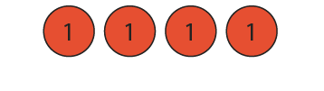
2.13 Calculation: ×/÷ 10 or 100 Step 2:4
40 ÷ 10 =
4
4 tens
40
4 ones
4
Notes:
I have forty. This is four tens.
How much will I have if I divide by ten?
We had four tens. We now have four ones.
Four tens divided by ten is equal to four ones.
Forty divided by ten is equal to four.

Slide 107

2.13 Calculation: ×/÷ 10 or 100 Step 2:5
× 10
÷ 10

Slide 108
2.13 Calculation: ×/÷ 10 or 100 Step 2:5
0
1
2
3
4
5
6
7
8
9
÷ 10
0
10
20
30
40
50
60
70
80
90

Slide 109
Year 4, Unit 6, Learning Outcome 13
Learning Outcome 13
Pupils explain why the final digit zero can be removed from a three-digit multiple of 10, when we divide by 10
The following slides have been collated to support the teaching of this learning outcome.

Slide 110
Year 4, Unit 6, Learning Outcome 13
Additional teacher guidance for this outcome should be read first and can be found in this segment of the NCETM Primary Mastery Professional Development Materials:
2.13 Calculation: multiplying and dividing by 10 and 100
The spine materials are divided into ‘teaching points’ and ‘steps in learning’.
Teaching point | Steps in learning | Pages
2 | 2:6-2:8 | 18-21

Slide 111


2.13 Calculation: ×/÷ 10 or 100 Step 2:6
160 ÷ 10 =
16
1 hundred and 6 tens
160
1 ten and 6 ones
16
Notes:
I have one hundred and sixty.
This is one hundred and six tens.
How much will I have if I divide by ten?

Slide 112
2.13 Calculation: ×/÷ 10 or 100 Step 2:6
160 ÷ 10 =
16
× 10
× 10
× 10
1,000s | 100s | 10s | 1s
6
0
1
1
6
6
0
0
↓ ÷ 10
1
6
0
÷ 10
÷ 10
÷ 10
Notes:
Step 1 – move each of the digits one place to the right.
Step 2 – remove zero.

Slide 113
2.13 Calculation: ×/÷ 10 or 100 Step 2:6
160 | ÷ | 10 |  | = | 16
What is the value of the ‘6’
in ‘160’?
What is the value of the ‘6’
in ‘16’?
‘sixty’
‘six’
60
6
What is the value of the ‘1’
in ‘160’?
What is the value of the ‘1’
in ‘16’?
‘one hundred’
‘ten’
100
10
We had 16 tens. We now have 16 ones.
Notes:
Step 3 - Summarise and compare the value of the digits.

Slide 114
2.13 Calculation: ×/÷ 10 or 100 Step 2:7
÷ 10
10
11
12
13
14
15
16
17
18
19
140 ÷ 10 =
20
100 ÷ 10 =
120 ÷ 10 =
180 ÷ 10 =
190 ÷ 10 =
200 ÷ 10 =
110 ÷ 10 =
130 ÷ 10 =
150 ÷ 10 =
160 ÷ 10 =
170 ÷ 10 =

Slide 115
Year 4, Unit 6, Learning Outcome 14
Learning Outcome 14
Pupils explain the relationship between multiplying a number by 100 and multiples of 100
The following slides have been collated to support the teaching of this learning outcome.

Slide 116
Year 4, Unit 6, Learning Outcome 14
Additional teacher guidance for this outcome should be read first and can be found in this segment of the NCETM Primary Mastery Professional Development Materials:
2.13 Calculation: multiplying and dividing by 10 and 100
The spine materials are divided into ‘teaching points’ and ‘steps in learning’.
Teaching point | Steps in learning | Pages
3 | 3:1-3:3 and 3:8 | 22-25 and 28

Slide 117

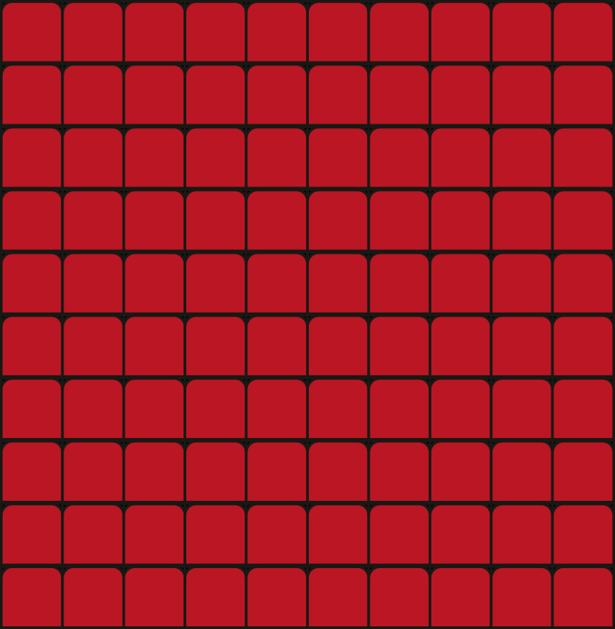
2.13 Calculation: ×/÷ 10 or 100 Step 3:1
This afternoon there was 1 person in the cinema.
This evening there are 100 times as many.
How many people in the cinema this evening?
Notes:
Think of ‘1’ and make it one hundred times the size.
Think of ‘1’ and multiply by one hundred.
1 × 100
One multiplied by one hundred is equal to one hundred.
1 × 100 = 100
One hundred is one hundred times the size of one.
One hundred people is one hundred times as many as one person.
There are one hundred people in the cinema this evening.

Slide 118
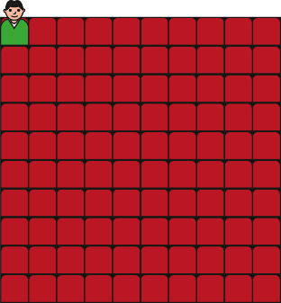
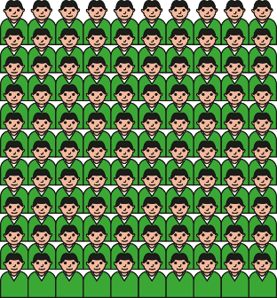
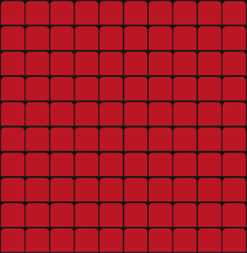
2.13 Calculation: ×/÷ 10 or 100 Step 3:1
This afternoon there were 2 people in the cinema.
This evening there are 100 times as many.
How many people in the cinema this evening?
Notes:
Think of ‘2’ and make it one hundred times the size.
Think of ‘2’ and multiply by one hundred.
2 × 100
Two multiplied by one hundred is equal to two hundred.
2 × 100 = 200
Two hundred is one hundred times the size of two.
Two hundred people is one hundred times as many as two people.
There are two hundred people in the cinema this evening.

Slide 119
2.13 Calculation: ×/÷ 10 or 100 Step 3:1
This afternoon there were 3 people in the cinema.
This evening there are 100 times as many.
How many people in the cinema this evening?
Notes:
Think of ‘3’ and make it one hundred times the size.
Think of ‘3’ and multiply by one hundred.
3 × 100
Three multiplied by one hundred is equal to three hundred.
3 × 100 = 300
Three hundred is one hundred times the size of three.
Three hundred people is one hundred times as many as three people.
There are three hundred people in the cinema this evening.

Slide 120

2.13 Calculation: ×/÷ 10 or 100 Step 3:3
1 × 100
2 × 100
3 × 100
4 × 100
5 × 100
6 × 100
8 × 100
9 × 100
7 × 100
= 100
= 200
= 300
= 400
= 500
= 600
= 700
= 800
= 900

Slide 121
2.13 Calculation: ×/÷ 10 or 100 Step 3:3
× 100

Slide 122
Year 4, Unit 6, Learning Outcome 15
Learning Outcome 15
Pupils explain why two zeros can be placed after the final digit of a single digit number when we multiply it by 100
The following slides have been collated to support the teaching of this learning outcome.

Slide 123
Year 4, Unit 6, Learning Outcome 15
Additional teacher guidance for this outcome should be read first and can be found in this segment of the NCETM Primary Mastery Professional Development Materials:
2.13 Calculation: multiplying and dividing by 10 and 100
The spine materials are divided into ‘teaching points’ and ‘steps in learning’.
Teaching point | Steps in learning | Pages
3 | 3:4-3:5 and 3:8 | 25-26 and 28

Slide 124

2.13 Calculation: ×/÷ 10 or 100 Step 3:4
1,000s | 100s | 10s | 1s
100 times
the size

Slide 125
2.13 Calculation: ×/÷ 10 or 100 Step 3:4
1,000s | 100s | 10s | 1s
1
1
100 times
the size

Slide 126
2.13 Calculation: ×/÷ 10 or 100 Step 3:4
6 × 100 =
600
1,000s | 100s | 10s | 1s
6
6
× 100
0
0
6
Think of ‘6’ and
make it 100 times
the size.

Slide 127

2.13 Calculation: ×/÷ 10 or 100 Step 3:5
× 100

Slide 128

2.13 Calculation: ×/÷ 10 or 100 Step 3:5
0
1
2
3
4
5
6
7
8
9
× 100
0
100
200
300
400
500
600
700
800
900

Slide 129
Year 4, Unit 6, Learning Outcome 16
Learning Outcome 16
Pupils explain why two zeros can be placed after the final digit of a two digit number when we multiply it by 100
The following slides have been collated to support the teaching of this learning outcome.

Slide 130
Year 4, Unit 6, Learning Outcome 16
Additional teacher guidance for this outcome should be read first and can be found in this segment of the NCETM Primary Mastery Professional Development Materials:
2.13 Calculation: multiplying and dividing by 10 and 100
The spine materials are divided into ‘teaching points’ and ‘steps in learning’.
Teaching point | Steps in learning | Pages
3 | 3:6-3:8 | 26-28

Slide 131


2.13 Calculation: ×/÷ 10 or 100 Step 3:6
15 × 100 =
1,500
1 ten and 5 ones
15
1 thousand and 5 hundreds
1,500
Notes:
Fifteen multiplied by one hundred is equal to one thousand five hundred.
15 × 100 = 1,500
One thousand five hundred is one hundred times the size of fifteen.

Slide 132

2.13 Calculation: ×/÷ 10 or 100 Step 3:6
15 × 100 =
1,500
1,000s | 100s | 10s | 1s
1
1
5
5
× 100
0
1
0
5
Think of ‘15’ and
make it 100 times
the size.
100 times
the size
100 times
the size
Notes:
Step 1 – move each of the digits two places to the left.
Step 2 – introduce zeros in the tens and ones places.

Slide 133
2.13 Calculation: ×/÷ 10 or 100 Step 3:6
15 | × | 100 |  | = | 1,500
What is the value of the ‘5’
in ‘15’?
What is the value of the ‘5’
in ‘1,500’?
‘five’
‘five hundred’
5
500
What is the value of the ‘1’
in ‘15’?
What is the value of the ‘1’
in ‘1,500’?
‘ten’
‘one thousand’
10
1,000
We had 15 ones. We now have 15 hundreds.
Notes:
Step 3 - Summarise and compare the value of the digits.

Slide 134
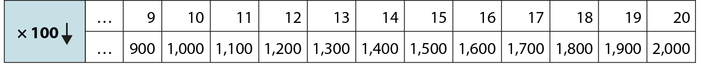
2.13 Calculation: ×/÷ 10 or 100 Step 3:7
11 × 100 =
13 × 100 =
14 × 100 =
15 × 100 =
16 × 100 =
17 × 100 =
18 × 100 =
19 × 100 =
20 × 100 =
12 × 100 =
10 × 100 =
1,000
1,100
1,200
1,300
1,400
1,500
1,600
1,700
1,800
1,900
2,000

Slide 135
Year 4, Unit 6, Learning Outcome 17
Learning Outcome 17
Pupils explain why the last two zeros can be removed from a three-digit multiple of 100 when we divide it by 100
The following slides have been collated to support the teaching of this learning outcome.

Slide 136
Year 4, Unit 6, Learning Outcome 17
Additional teacher guidance for this outcome should be read first and can be found in this segment of the NCETM Primary Mastery Professional Development Materials:
2.13 Calculation: multiplying and dividing by 10 and 100
The spine materials are divided into ‘teaching points’ and ‘steps in learning’.
Teaching point | Steps in learning | Pages
4 | 4:1-4:4 | 29-32

Slide 137
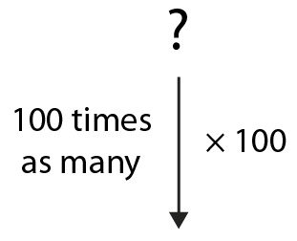
2.13 Calculation: ×/÷ 10 or 100 Step 4:1
This evening there are 100 people in the cinema,
100 times as many as this afternoon.
How many were in the cinema this afternoon?
Notes:
One multiplied by one hundred is equal to one hundred.
1 × 100 = 100
One hundred divided by one hundred is equal to one.
100 ÷ 100 = 1
One hundred is one hundred times the size of one.
There was one person in the cinema.

Slide 138
2.13 Calculation: ×/÷ 10 or 100 Step 4:1
This evening there are 200 people in the cinema,
100 times as many as this afternoon.
How many were in the cinema this afternoon?
Notes:
Two multiplied by one hundred is equal to two hundred.
2 × 100 = 200
Two hundred divided by one hundred is equal to two.
200 ÷ 100 = 2
Two hundred is one hundred times the size of two.
There were two people in the cinema.

Slide 139
2.13 Calculation: ×/÷ 10 or 100 Step 4:1
This evening there are 300 people in the cinema,
100 times as many as this afternoon.
How many were in the cinema this afternoon?
Notes:
Three multiplied by one hundred is equal to three hundred.
3 × 100 = 300
Three hundred divided by one hundred is equal to three.
300 ÷ 100 = 3
Three hundred is one hundred times the size of three.
There were three people in the cinema.

Slide 140
2.13 Calculation: ×/÷ 10 or 100 Step 4:1
× 100
÷ 100
1 × 100 = 100
2 × 100 = 200
3 × 100 = 300
4 × 100 = 400
5 × 100 = 500
6 × 100 = 600
7 × 100 = 700
8 × 100 = 800
9 × 100 = 900
100 ÷ 100
200 ÷ 100
300 ÷ 100
400 ÷ 100
500 ÷ 100
600 ÷ 100
700 ÷ 100
800 ÷ 100
900 ÷ 100
= 1
= 2
= 3
= 4
= 5
= 6
= 7
= 8
= 9

Slide 141
2.13 Calculation: ×/÷ 10 or 100 Step 4:3
900 ÷ 100 =
9
1,000s | 100s | 10s | 1s
9
9
0
0
0
0
÷ 100
9
0
0
0
0
100 times
the size
100 times
the size

Slide 142
2.13 Calculation: ×/÷ 10 or 100 Step 4:3
900 | ÷ | 100 |  | = | 9
What is the value of the ‘9’
in ‘900’?
What is the value of the ‘9’
in ‘9’?
‘nine hundred’
‘nine’
900
9
We had 9 hundreds. We now have 9 ones.
Notes:
Summarise and compare the value of the digits.

Slide 143
2.13 Calculation: ×/÷ 10 or 100 Step 4:4
× 100
÷ 100

Slide 144
2.13 Calculation: ×/÷ 10 or 100 Step 4:4
0
1
2
3
4
5
6
7
8
9
÷ 100
0
100
200
300
400
500
600
700
800
900

Slide 145
Year 4, Unit 6, Learning Outcome 18
Learning Outcome 18
Pupils explain why the last two zeros can be removed from a four-digit multiple of 100 when we divide it by 100
The following slides have been collated to support the teaching of this learning outcome.

Slide 146
Year 4, Unit 6, Learning Outcome 18
Additional teacher guidance for this outcome should be read first and can be found in this segment of the NCETM Primary Mastery Professional Development Materials:
2.13 Calculation: multiplying and dividing by 10 and 100
The spine materials are divided into ‘teaching points’ and ‘steps in learning’.
Teaching point | Steps in learning | Pages
4 | 4:5-4:7 | 32-34

Slide 147


2.13 Calculation: ×/÷ 10 or 100 Step 4:5
1,600 ÷ 100 =
16
1 thousand and 6 hundreds
1,600
1 ten and 6 ones
16

Slide 148
2.13 Calculation: ×/÷ 10 or 100 Step 4:5
1,600 ÷ 100 =
16
× 100
× 100
1,000s | 100s | 10s | 1s
1
1
6
6
0
0
0
0
÷ 100
1
6
0
0
0
0
÷ 100
÷ 100

Slide 149
2.13 Calculation: ×/÷ 10 or 100 Step 4:5
1,600 | ÷ | 100 |  | = | 16
What is the value of the ‘6’
in ‘1,600’?
What is the value of the ‘6’
in ‘16’?
‘six hundred’
‘six’
600
6
What is the value of the ‘1’
in ‘1,600’?
What is the value of the ‘1’
in ‘16’?
‘one thousand’
‘ten’
1000
10
We had 16 hundreds. We now have 16 ones.
Notes:
Summarise and compare the value of the digits.

Slide 150
2.13 Calculation: ×/÷ 10 or 100 Step 4:6
÷ 100
1,300 ÷ 100 =
1,400 ÷ 100 =
1,500 ÷ 100 =
1,600 ÷ 100 =
1,800 ÷ 100 =
1,000 ÷ 100 =
1,200 ÷ 100 =
1,900 ÷ 100 =
2,000 ÷ 100 =
1,700 ÷ 100 =
10
11
12
13
14
15
16
17
18
19
1,100 ÷ 100 =
20

Slide 151
Year 4, Unit 6, Learning Outcome 19
Learning Outcome 19
Pupils use knowledge of the composition of 100 to multiply by 100 in different ways
The following slides have been collated to support the teaching of this learning outcome.

Slide 152
Year 4, Unit 6, Learning Outcome 19
Additional teacher guidance for this outcome should be read first and can be found in this segment of the NCETM Primary Mastery Professional Development Materials:
2.13 Calculation: multiplying and dividing by 10 and 100
The spine materials are divided into ‘teaching points’ and ‘steps in learning’.
Teaching point | Steps in learning | Pages
5 | 5:1-5:3 and 5:7 | 35-38 and 40-41

Slide 153
2.13 Calculation: ×/÷ 10 or 100 Step 5:1
8 × 10 = 80
80 × 10 = 800
8 × 100 = 800
× 10
× 100
× 10
8 × 10 × 10 = 8 × 100

Slide 154
2.13 Calculation: ×/÷ 10 or 100 Step 5:2
× 10
× 10
1,000s | 100s | 10s | 1s
8
× 10
8
0
× 10
8
0
0
× 100

Slide 155
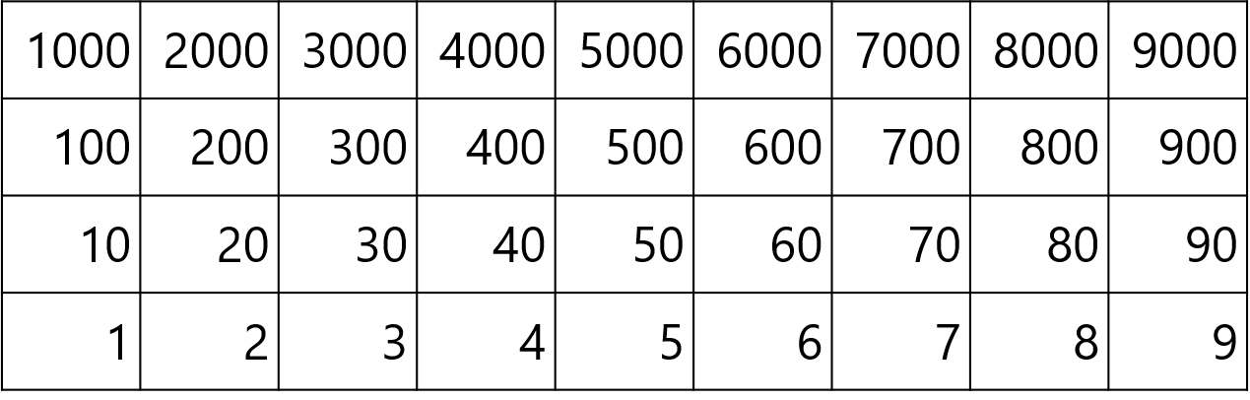
2.13 Calculation: ×/÷ 10 or 100 Step 5:3
13 × 10 = 130
130 × 10 = 1,300
13 × 100 = 1,300
× 10
× 100
× 10
13 × 10 × 10 = 13 × 100

Slide 156
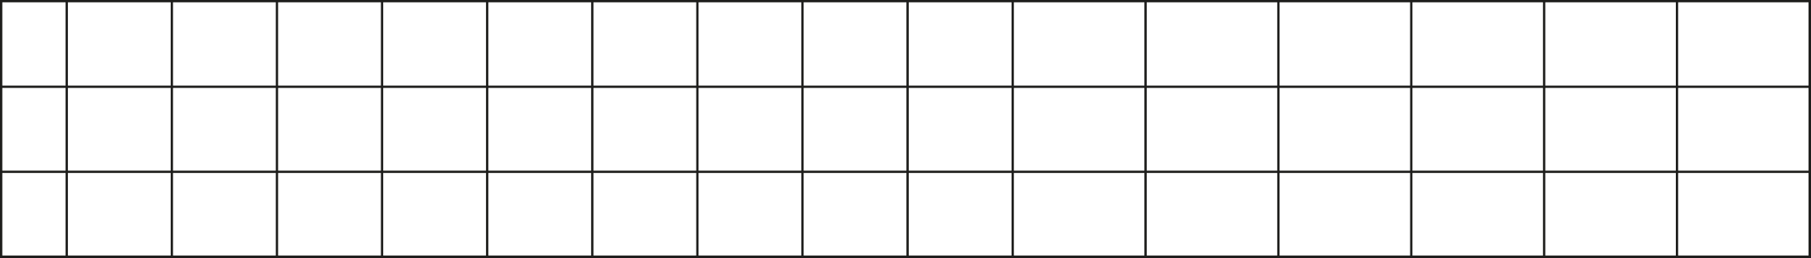


2.13 Calculation: ×/÷ 10 or 100 Step 5:3
0
1
2
3
4
5
6
7
8
9
10
11
12
13
14
15
× 10
0
10
20
30
40
50
60
70
80
90
100
110
120
130
140
150
× 100
× 10
0
100
200
300
400
500
600
700
800
900
1,000
1,100
1,200
1,300
1,400
1,500

Slide 157
Year 4, Unit 6, Learning Outcome 20
Learning Outcome 20
Pupils use knowledge of the composition of 100 to divide by 100 in different ways
The following slides have been collated to support the teaching of this learning outcome.

Slide 158
Year 4, Unit 6, Learning Outcome 20
Additional teacher guidance for this outcome should be read first and can be found in this segment of the NCETM Primary Mastery Professional Development Materials:
2.13 Calculation: multiplying and dividing by 10 and 100
The spine materials are divided into ‘teaching points’ and ‘steps in learning’.
Teaching point | Steps in learning | Pages
5 | 5:4-5:7 | 38-41

Slide 159
2.13 Calculation: ×/÷ 10 or 100 Step 5:4
700 ÷ 10 = 70
70 ÷ 10 = 7
700 ÷ 100 = 7
÷ 10
÷ 100
÷ 10

Slide 160


2.13 Calculation: ×/÷ 10 or 100 Step 5:5
÷ 10
÷ 10
1,000s | 100s | 10s | 1s
7
0
0
$÷$ 10
7
0
$÷$ 10
7
÷ 100

Slide 161
2.13 Calculation: ×/÷ 10 or 100 Step 5:6
1,200 ÷ 10 = 120
120 ÷ 10 = 12
1,200 ÷ 100 = 12
÷ 10
÷ 100
÷ 10

Slide 162
2.13 Calculation: ×/÷ 10 or 100 Step 5:6
0
1
2
3
4
5
6
7
8
9
10
11
14
14
14
15
÷ 10
0
10
20
30
40
50
60
70
80
90
100
110
120
130
140
150
÷ 100
÷ 10
0
100
200
300
400
500
600
700
800
900
1,000
1,100
1,200
1,300
1,400
1,500

Slide 163
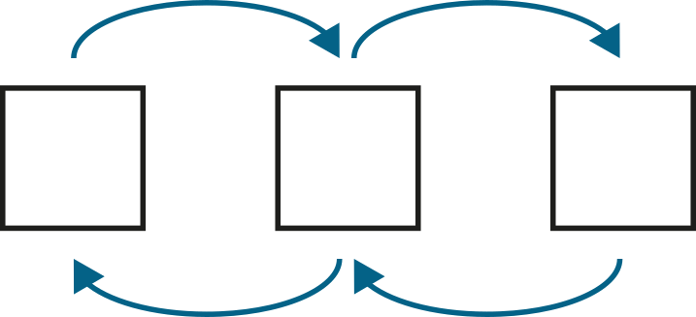
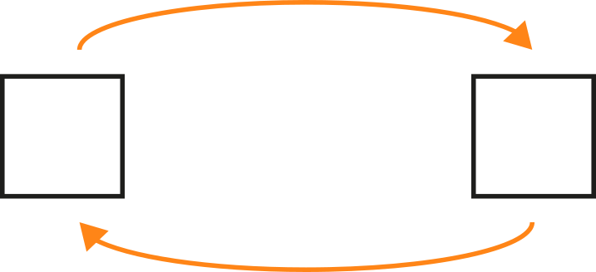








2.13 Calculation: ×/÷ 10 or 100 Step 5:7
Fill in the missing numbers.
× 10
× 10
× 10
× 10
3
600
6
60
30
300
$÷$ 10
$÷$ 10
$÷$ 10
$÷$ 10
$×$ 100
$×$ 100
3
600
6
300
$÷$ 100
$÷$ 100

Slide 164
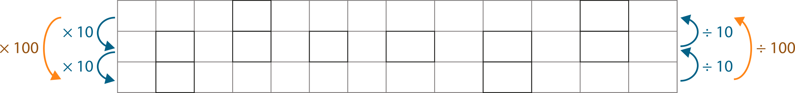

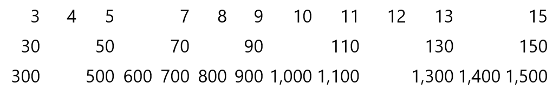









2.13 Calculation: ×/÷ 10 or 100 Step 5:7
Fill in the missing numbers.

Slide 165
Year 4, Unit 6, Learning Outcome 21
Learning Outcome 21
Pupils explain how making a factor 10 times the size affects the product
The following slides have been collated to support the teaching of this learning outcome.

Slide 166
Year 4, Unit 6, Learning Outcome 21
Additional teacher guidance for this outcome should be read first and can be found in this segment of the NCETM Primary Mastery Professional Development Materials:
2.13 Calculation: multiplying and dividing by 10 and 100
The spine materials are divided into ‘teaching points’ and ‘steps in learning’.
Teaching point | Steps in learning | Pages
6 | 6:1-6:4 and 6:7 | 42-45 and 47-48

Slide 167


2.13 Calculation: ×/÷ 10 or 100 Step 6:1
1
×
1
=
1
×
10
×
10
1
×
10
=
10

Slide 168
2.13 Calculation: ×/÷ 10 or 100 Step 6:1
2
×
1
=
2
×
10
×
10
2
×
10
=
20

Slide 169
2.13 Calculation: ×/÷ 10 or 100 Step 6:1
1
×
2
=
2
×
10
×
10
1
×
20
=
20

Slide 170
2.13 Calculation: ×/÷ 10 or 100 Step 6:1
2
×
2
=
4
×
10
×
10
2
×
20
=
40

Slide 171
2.13 Calculation: ×/÷ 10 or 100 Step 6:1
1
×
3
=
3
×
10
×
10
1
×
30
=
30

Slide 172
2.13 Calculation: ×/÷ 10 or 100 Step 6:1
2
×
3
=
6
×
10
×
10
2
×
30
=
60

Slide 173
2.13 Calculation: ×/÷ 10 or 100 Step 6:1
3
×
4
=
12
×
10
×
10
3
×
40
=
120
Notes:
Three times four is equal to twelve, so
three times four tens is equal to twelve tens.

Slide 174
2.13 Calculation: ×/÷ 10 or 100 Step 6:2
4
×
2
=
8
×
10
×
10
40
×
2
=
80
Notes:
Four times two is equal to eight, so
four tens times two is equal to eight tens.

Slide 175
2.13 Calculation: ×/÷ 10 or 100 Step 6:2
3
×
5
=
15
×
10
×
10
30
×
5
=
150
Notes:
Three times four is equal to twelve, so
three times five is equal to fifteen tens.

Slide 176
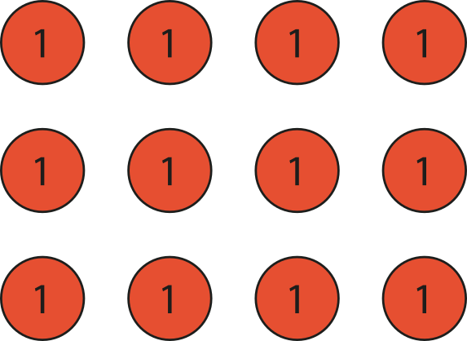
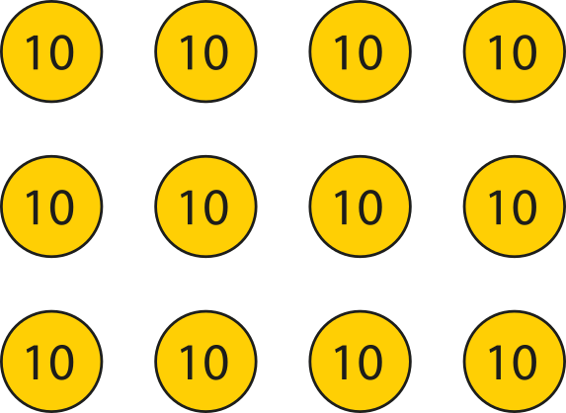

2.13 Calculation: ×/÷ 10 or 100 Step 6:3
4 classes of children. 30 children in each class.
How many children altogether?
4
×
3
=
12
×
10
×
10
4
×
30
=
120
Notes:
If there were four classes of three children, there would be twelve children altogether.
4 × 3 = 12
But there are four classes of thirty children; there are ten times
as many children in each class. So there are ten times as many children altogether.
12 × 10 = 120
4 × 30 = 120

Slide 177
2.13 Calculation: ×/÷ 10 or 100 Step 6:3
5
÷
5
=
1
×
10
×
10
50
÷
5
=
10

Slide 178
Year 4, Unit 6, Learning Outcome 22
Learning Outcome 22
Pupils explain how making the dividend 10 times the size affects the quotient
The following slides have been collated to support the teaching of this learning outcome.

Slide 179
Year 4, Unit 6, Learning Outcome 22
Additional teacher guidance for this outcome should be read first and can be found in this segment of the NCETM Primary Mastery Professional Development Materials:
2.13 Calculation: multiplying and dividing by 10 and 100
The spine materials are divided into ‘teaching points’ and ‘steps in learning’.
Teaching point | Steps in learning | Pages
6 | 6:5-6:7 | 45-48

Slide 180
2.13 Calculation: ×/÷ 10 or 100 Step 6:5
10
÷
5
=
2
×
10
×
10
100
÷
5
=
20

Slide 181
2.13 Calculation: ×/÷ 10 or 100 Step 6:5
15
÷
5
=
3
×
10
×
10
150
÷
5
=
30

Slide 182
2.13 Calculation: ×/÷ 10 or 100 Step 6:5
12
÷
3
=
4
×
10
×
10
120
÷
3
=
40
Notes:
Twelve divided by three is equal to four, so
twelve tens divided by three is equal to four tens.

Slide 183

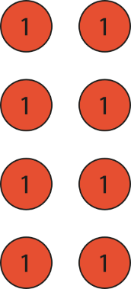
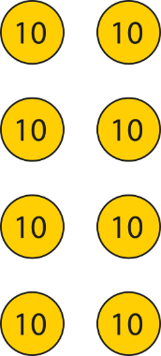
2.13 Calculation: ×/÷ 10 or 100 Step 6:6
80 children are going on a trip. There are 4 coaches.
If the children are divided equally between the 4 coaches,
how many are on each coach?
8
÷
4
=
2
×
10
×
10
80
÷
4
=
20
Notes:
If there were eight children divided between four coaches, there
would be two children on each coach.
8 ÷ 4 = 2
But there are eighty children divided between four coaches; there
are ten times as many children altogether.
So there are ten times as many children on each coach.
2 × 10 = 20
80 ÷ 4 = 20

Slide 184
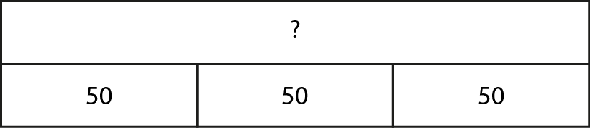
2.13 Calculation: ×/÷ 10 or 100 Step 6:7
Complete the equations to describe the bar model.
50
+
50
+
50
=
150
3 ×
50
=
150
50 ×
3
=
150
150 ÷
3
=
50

Slide 185
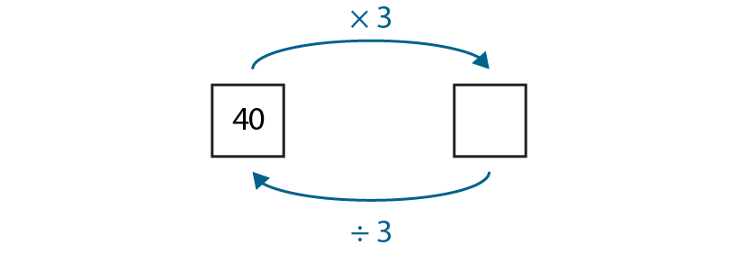
2.13 Calculation: ×/÷ 10 or 100 Step 6:7
Fill in the missing number.
40
120

Slide 186
Year 4, Unit 6, Learning Outcome 23
Learning Outcome 23
Pupils explain how making a factor 100 times the size affects the product
The following slides have been collated to support the teaching of this learning outcome.

Slide 187
Year 4, Unit 6, Learning Outcome 23
Additional teacher guidance for this outcome should be read first and can be found in this segment of the NCETM Primary Mastery Professional Development Materials:
2.13 Calculation: multiplying and dividing by 10 and 100
The spine materials are divided into ‘teaching points’ and ‘steps in learning’.
Teaching point | Steps in learning | Pages
7 | 7:1-7:4 and 7:8 | 49-51 and 55

Slide 188
2.13 Calculation: ×/÷ 10 or 100 Step 7:1
2
×
1
=
2
×
100
×
100
2
×
100
=
200

Slide 189
2.13 Calculation: ×/÷ 10 or 100 Step 7:1
2
×
2
=
4
×
100
×
100
2
×
200
=
400

Slide 190
2.13 Calculation: ×/÷ 10 or 100 Step 7:1
2
×
3
=
6
×
100
×
100
2
×
300
=
600

Slide 191
2.13 Calculation: ×/÷ 10 or 100 Step 7:1
3
×
4
=
12
×
100
×
100
3
×
400
=
1,200
Notes:
Three times four is equal to twelve, so
three times four hundreds is equal to twelve hundreds.

Slide 192
2.13 Calculation: ×/÷ 10 or 100 Step 7:2
3
×
5
=
15
×
100
×
100
300
×
5
=
1,500
Notes:
Three times five is equal to fifteen, so
three hundreds times five is equal to fifteen hundreds.

Slide 193
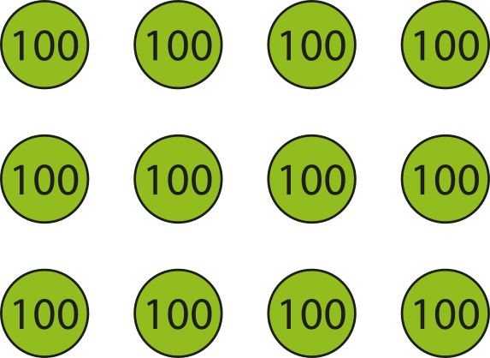
2.13 Calculation: ×/÷ 10 or 100 Step 7:3
4 jars of marbles. 300 marbles in each jar.
How many marbles altogether?
4
×
3
=
12
×
100
×
100
4
×
300
=
1,200
Notes:
If there were four jars of three marbles, there
would be twelve marbles altogether.
But there are four jars of three hundred marbles; there
are one hundred times as many marbles in each jar.
So there are one hundred times as many marbles altogether.
12 × 100 = 1200
4 × 300 = 1200

Slide 194
Year 4, Unit 6, Learning Outcome 24
Learning Outcome 24
Pupils explain how making the dividend 100 times the size affects the quotient
The following slides have been collated to support the teaching of this learning outcome.

Slide 195
Year 4, Unit 6, Learning Outcome 24
Additional teacher guidance for this outcome should be read first and can be found in this segment of the NCETM Primary Mastery Professional Development Materials:
2.13 Calculation: multiplying and dividing by 10 and 100
The spine materials are divided into ‘teaching points’ and ‘steps in learning’.
Teaching point | Steps in learning | Pages
7 | 7:5-7:8 | 52-55

Slide 196
2.13 Calculation: ×/÷ 10 or 100 Step 7:5
3
÷
3
=
1
×
100
×
100
300
÷
3
=
100

Slide 197
2.13 Calculation: ×/÷ 10 or 100 Step 7:5
6
÷
3
=
2
×
100
×
100
600
÷
3
=
200

Slide 198
2.13 Calculation: ×/÷ 10 or 100 Step 7:5
9
÷
3
=
3
×
100
×
100
900
÷
3
=
300

Slide 199
2.13 Calculation: ×/÷ 10 or 100 Step 7:5
12
÷
3
=
4
×
100
×
100
1,200
÷
3
=
400
Notes:
Twelve divided by three is equal to four, so
twelve hundreds divided by three is equal to four hundreds.

Slide 200
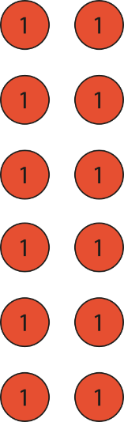
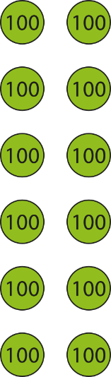
2.13 Calculation: ×/÷ 10 or 100 Step 7:6
1,200 exercise books shared equally between 6 year groups.
How many books does each year group get?
12
÷
6
=
2
×
100
×
100
1,200
÷
6
=
200
Notes:
If there were twelve books divided between six year groups, there
would be two books for each year group.
12 ÷ 6 = 2
But there are twelve hundred books divided between six year groups; there
are one hundred times as many books altogether.
So each year group gets one hundred times as many books.
2 × 100 = 200
1,200 ÷ 6 = 200

Slide 201
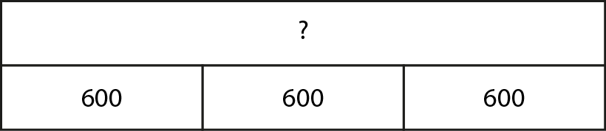
2.13 Calculation: ×/÷ 10 or 100 Step 7:7
Complete the equations to describe the bar model.
600
+
600
+
600
=
1,800
3
×
600
=
1,800
600
×
3
=
1,800
1,800
÷
3
=
600

Slide 202
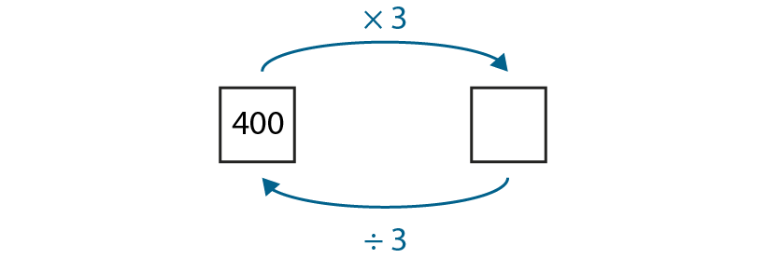
2.13 Calculation: ×/÷ 10 or 100 Step 7:7
Fill in the missing number.
400
1,200

Slide 203
Year 4, Unit 6, Learning Outcome 25
Learning Outcome 25
Pupils scale known multiplication facts by 10
The following slides have been collated to support the teaching of this learning outcome.

Slide 204

Year 4, Unit 6, Learning Outcome 25
Additional teacher guidance for this outcome should be read first and can be found in the DfE Mathematics guidance. Page references relate to the 335-page document available as a download at the bottom of this web page.
Ready to progress criteria | Pages
4NF-3 | 166-169

Slide 205


4NF-3 Scaling number facts by 100
Look at these two representations. What is the same/different?
Explain how you can use place value to use the first calculation to solve the second calculation. How else can we say 12 hundred?
What other calculations using multiplication can you write?
Repeat for other similar calculations.
4 times 3 is equal to 12.
3 times 4 hundreds is equal to 12 hundreds.
12 hundreds is equal to 1,200.
4 × 3 = 12
4 × 3 hundreds = 12 hundreds
4 × 300 = 1,200

Slide 206
Year 4, Unit 6, Learning Outcome 26
Learning Outcome 26
Pupils scale division derived from multiplication facts by 100
The following slides have been collated to support the teaching of this learning outcome.

Slide 207
Year 4, Unit 6, Learning Outcome 26
Additional teacher guidance for this outcome should be read first and can be found in the DfE Mathematics guidance. Page references relate to the 335-page document available as a download at the bottom of this web page.
Ready to progress criteria | Pages
4NF-3 | 166-169

Slide 208
4NF-3 Scaling number facts by 100
Look at these two representations. What is the same/different?
Explain how you can use place value to use the first calculation to solve the second calculation?
What other calculations using division can you write?
Repeat for other similar calculations.
1,200 ÷ 4 = 300
4 times 3 is equal to 12.
3 times 4 hundreds is equal to 12 hundreds.
12 hundreds is equal to 1,200.
1,200 ÷ 300 = 4
xx

