Slide 1
Ratio: determining parts given the part and the ratio
KS3 Mastery PD Materials: Exemplified Key Ideas
Materials for use in the classroom or to support professional development discussions
(from 3.1 Understanding multiplicative relationships)
Summer 2021

Slide 2
About this resource
These slides are designed to complement the 3.1 Understanding Multiplicative Relationships Core Concept document and its associated Theme Overview document 3 Multiplicative Reasoning, both found in the Secondary Mastery Professional Development pages.
These slides re-present the key examples from the Core Concept document so that the examples can be used either directly in the classroom or with a group of teachers. There are prompt questions alongside the examples, and further clarification in the notes.
These slides do not fully replicate the Core Concept document, so should be used alongside it. Reference to specific page numbers, and to other useful NCETM resources, can be found in the notes for each slide.
This slide deck is not designed to be a complete PD session, rather it is a selection of resources that you can adapt and use as needed when planning a session with a group of teachers.

Slide 3


About this resource
The slides are structured as follows:
  The big picture:
    Where does this fit in?
    What do students need to understand?
    Why is this key idea important?
  Prior learning
  Misconceptions
  Exemplified key ideas
  Reflection questions
  Appendices:
    Key vocabulary
    Representations and structure
    Previous and Future learning
    Useful links
The exemplified key idea slides have the following symbols to indicate how they have been designed to be used:
Into the classroom
The examples are presented on these slides so that they could be used in PD, but also directly in the classroom. The notes feature suggested questions and things teachers might consider when using with students.
PD discussion prompts
These slides look at the examples in more detail, with question prompts to promote discussion among maths teachers. The notes feature reference to further information and guidance within the Core Concepts document.

Slide 4
Where does this fit in?
The NCETM has identified a set of six ‘mathematical themes’ within Key Stage 3 mathematics that bring together a group of ‘core concepts’.
The third of these themes is Multiplicative reasoning, which covers the following interconnected core concepts:
    3.1 Understanding multiplicative relationships
    3.2 Trigonometry
Notes:
Linked on this slide is the Theme Overview document of Multiplicative reasoning. This document includes why it is important, the key underpinning knowledge and links to prior and future learning. There is also guidance about how the five big ideas of Teaching for Mastery relate specifically to this theme.

Slide 5
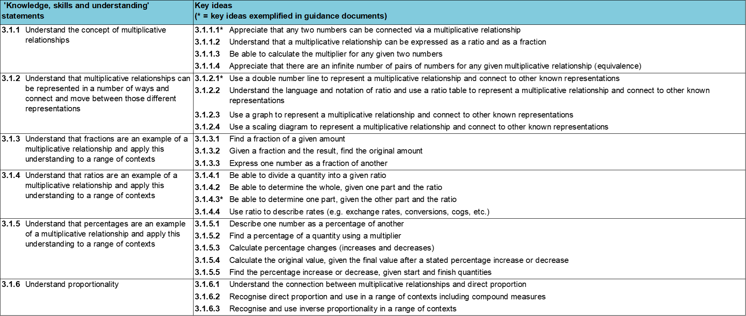
Where does this fit in?
Within this core concept, 3.1 Understanding multiplicative relationships, there are six statements of knowledge, skills and understanding.
These, in turn, are broken down into twenty three key ideas. The highlighted key idea is exemplified in this slide deck.
Notes:
For key ideas marked with an asterisk, we exemplified the common difficulties and misconceptions that students might have and included elements of what teaching for mastery may look like. We have provided examples of possible student tasks and teaching approaches.
Within these slides are ‘classroom-ready’ versions of the examples for the key idea that has been highlighted. There are also slides that may be useful for discussion in a professional development session.

Slide 6
What do students need to understand?
3.1.4.3 Be able to determine one part, given the other part and the ratio
Interpret mathematically a situation involving unequal sharing, using correct notation and relevant diagrams.
Recognise the multiplicative relationship between a and b in the ratio a : b.
Find missing parts when a quantity is divided into more than two unequal parts.
  What prior knowledge might your students already have?
  What language might they use to describe this key idea?
  What questions might you want to ask to assess their prior learning?

Slide 7
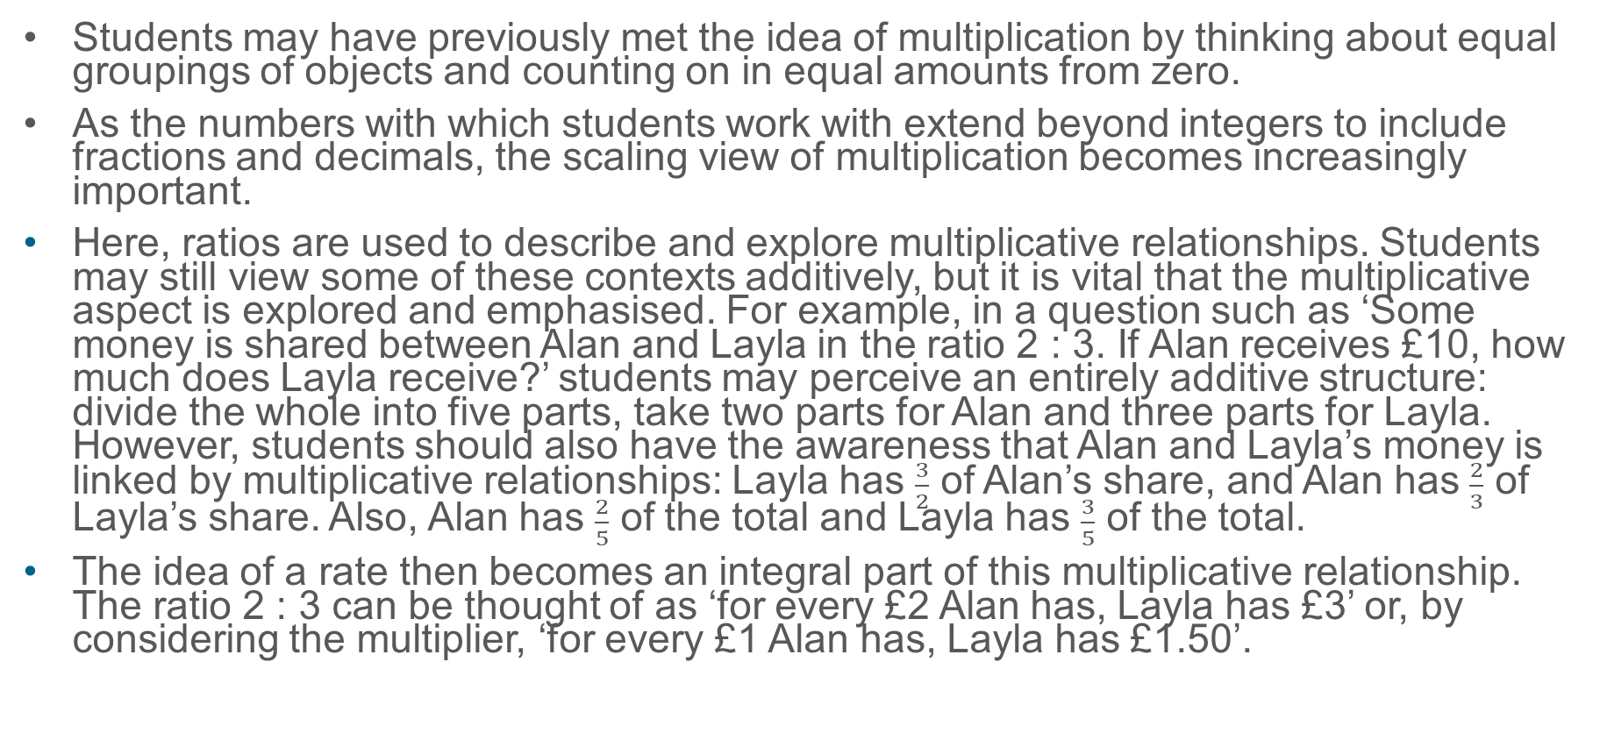
Why is this key idea important?
Students may have previously met the idea of multiplication by thinking about equal groupings of objects and counting on in equal amounts from zero.
As the numbers with which students work with extend beyond integers to include fractions and decimals, the scaling view of multiplication becomes increasingly important.
Here, ratios are used to describe and explore multiplicative relationships. Students may still view some of these contexts additively, but it is vital that the multiplicative aspect is explored and emphasised. For example, in a question such as ‘Some money is shared between Alan and Layla in the ratio 2 : 3. If Alan receives £10, how much does Layla receive?’ students may perceive an entirely additive structure: divide the whole into five parts, take two parts for Alan and three parts for Layla. However, students should also have the awareness that Alan and Layla’s money is linked by multiplicative relationships: Layla has $\frac{3}{2}$ of Alan’s share, and Alan has $\frac{2}{3}$ of Layla’s share. Also, Alan has $\frac{2}{5}$ of the total and Layla has $\frac{3}{5}$ of the total.
The idea of a rate then becomes an integral part of this multiplicative relationship. The ratio 2 : 3 can be thought of as ‘for every £2 Alan has, Layla has £3’ or, by considering the multiplier, ‘for every £1 Alan has, Layla has £1.50’.
Notes:
A more detailed overview of the core concept of Multiplicative reasoning can be found on page 2 of the 3.1 Core Concept document.
The background to each key idea is also explored in more detail on the following pages:
3.1.1 Understand the concept of multiplicative relationships – page 5
3.1.2 Understand that multiplicative relationships can be represented in a number of ways and connect and move between those different representations – page 5
3.1.3 Understand that fractions are an example of a multiplicative relationship and apply this understanding to a range of contexts – pages 5 and 6
3.1.4 Understand that ratios are an example of a multiplicative relationship and apply this understanding to a range of contexts – page 6
3.1.5 Understand that percentages are an example of a multiplicative relationship and apply this understanding to a range of contexts – pages 6 and 7
3.1.6 Understand proportionality – page 7

Slide 8
Prior learning
Upper Key Stage 2 Learning Outcome
Multiply proper fractions and mixed numbers by whole numbers, supported by materials and diagrams
Use all four operations to solve problems involving measure (for example, length, mass, volume, money) using decimal notation, including scaling
Solve problems involving the relative sizes of two quantities where missing values can be found by using integer multiplication and division facts
Solve problems involving the calculation of percentages (for example, of measures, and such as 15% of 360) and the use of percentages for comparison
Solve problems involving similar shapes where the scale factor is known or can be found
Solve problems involving unequal sharing and grouping, using knowledge of fractions and multiples
  What prior knowledge might your students already have?
  What language might they use to describe this key idea?
  What questions might you want to ask to assess their prior learning?
Notes:
You may find it useful to speak to your partner schools to see how the above has been covered and the language used.
You can find further details regarding prior learning in the following segments of the NCETM primary mastery professional development materials (linked on final slide):
Year 4: 2.17 Structures: using measures and comparison to understand scaling
Year 6: 2.27 Scale factors, ratio and proportional reasoning
Year 6: 3.10 Linking fractions, decimals and percentages
Within the Multiplicative reasoning Theme Overview document, you can also find a broader description of students’ potential previous learning (page 3), alongside further information about key underpinning knowledge (page 2).

Slide 9
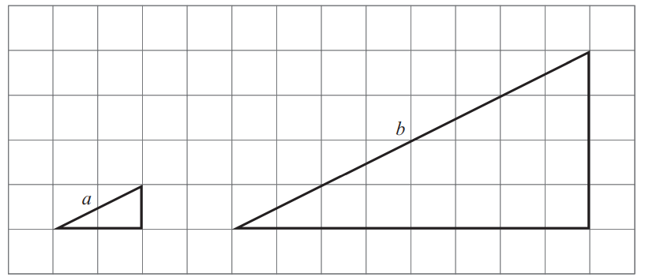
Checking prior learning
a)
Sam and Tom share 45 marbles in the ratio 2 : 3.
How many more marbles does Tom have than Sam?
b)
Here are two similar right-angled triangles.
Write the ratio of side a to side b.
a : b = __ : __
Notes:
References to the questions (links on final slide):
a) NCETM Primary assessment materials: Year 6, page 25
b) 2017 Key Stage 2 Mathematics Paper 2: reasoning, question 22

Slide 10
Common difficulties and misconceptions
What aspects of this key idea might pupils find challenging?
What misconceptions might pupils have?
When teaching this topic, you may find students encounter difficulties with…
Recognising where relationships are multiplicative/additive in a problem
Assuming they need to know or find the total as a first step
More information, and some suggestions for overcoming these challenges, can be found on the following slides.

Slide 11

Common difficulties and misconceptions (1)
When solving problems involving unequal sharing, students may view a problem as a combination of multiplicative and additive processes.
Consider the question ‘Alice and Brenda share some money in the ratio 4 : 3. Alice has £20. How much does Brenda have?’
It is common for students to approach this problem by working multiplicatively: halve Alice’s £20 to give £10, halve this again to give £5, and then additively combine these results to calculate that Brenda has £15. The use of a bar model representation in this situation can reinforce this combination of additive and multiplicative thinking:
Notes:
More detail can be found on page 28 of the 3.1 Core Concept document.

Slide 12
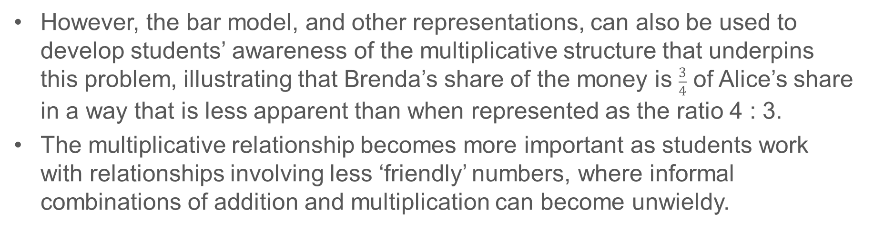
Common difficulties and misconceptions (1 cont’d)
However, the bar model, and other representations, can also be used to develop students’ awareness of the multiplicative structure that underpins this problem, illustrating that Brenda’s share of the money is $\frac{3}{4}$ of Alice’s share in a way that is less apparent than when represented as the ratio 4 : 3.
The multiplicative relationship becomes more important as students work with relationships involving less ‘friendly’ numbers, where informal combinations of addition and multiplication can become unwieldy.
Notes:
More detail can be found on page 28 of the 3.1 Core Concept document.

Slide 13
Common difficulties and misconceptions (2)
Students may assume that it is necessary to know (or to calculate) the total quantity being shared as a first step, and so find problems difficult to access.
The use of different representations to make the relationship between the ratio and the two ‘shared’ parts can give students an opportunity to use more intuitive informal strategies.
Notes:
More detail can be found on page 28 of the 3.1 Core Concept document.

Slide 14
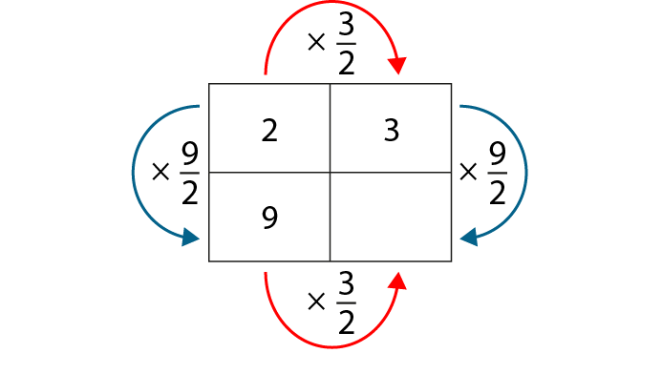
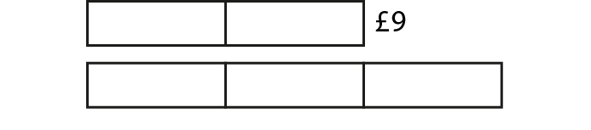
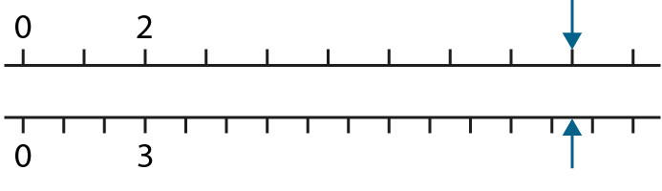
Interpret mathematically a situation involving unequal sharing, using correct notation and relevant diagrams
Example 1
Oscar and Pietro share some money in the ratio 2 : 3.
Oscar’s share is £9.
Explain how each of these diagrams can help to calculate Pietro’s share of the money.
a)
b)
c)
Notes:
Suggested questioning:
Where is the 3? Where is the 2? Where is the 9?
What is the relationship between Oscar and Pietro’s shares? Which diagram makes this most obvious?
Which do you find easiest to use? Which do you find hardest?
After completing Example 1, you could ask students to draw similar representations for a different situation, say, a ratio of 2 : 5.
Things for you to think about:
It is important for students to be able to work between representations. Offering a situation, and asking students to represent it in more than one way, can be productive in making connections between those representations and the mathematical structures they represent.
It is also important to recognise the limitations of different representations. For example, if a question describes some money shared in the ratio 2 : 3 : 4, then a double number line or ratio table may not be as useful as a bar model representation, since the bar model can more obviously be adapted and interpreted to include the three-way split.

Slide 15
Interpret mathematically a situation involving unequal sharing, using correct notation and relevant diagrams
Example 1
  Reflect on the representations that you habitually use when teaching students how to find one part, given the other part and a ratio.
  Why do you use those representations? What are the benefits? What are the drawbacks?
  Reflect on the representations offered in Example 1. What are the benefits of each? What are the drawbacks of each?
Oscar and Pietro share some money in the ratio 2 : 3.
Oscar’s share is £9.
Explain how each of these diagrams can help to calculate Pietro’s share of the money.
a)
c)
b)
Notes:
Due to space constraints, the image on this PD discussion slide is very small. PD Leads might like to use or print the ‘in the classroom’ version of this slide for teachers to access during discussions.
More detail about the sequencing of this example can be found on pages 28 and 29 of the 3.1 Core Concept document.

Slide 16
Interpret mathematically a situation involving unequal sharing, using correct notation and relevant diagrams
Example 2
Mark and Ahmed share some sweets in the ratio 1 : 3.
Ahmed has eight more sweets than Mark.
How many does Mark have?
Notes:
Suggested questioning:
Can you draw a bar model to represent this problem?
Where is the 8 in your bar model? Where is the 1? Where is the 3?
How would this question change if you took out the word ‘more’?
Things for you to think about:
How could a bar model be used to solve this problem? This type of question is encountered in Key Stage 2 and is a good example of when a bar model is particularly efficient because there are additive structures as well as multiplicative structures in use. Useful activities and questions are ones that help students to recognise how the underlying structure of a problem can influence which type of representations are most appropriate.

Slide 17
Interpret mathematically a situation involving unequal sharing, using correct notation and relevant diagrams
Example 2
  Why might a bar model be a particularly useful representation of this problem?
  How many different questions can you pose using the number eight and the same ratio? How does the bar model differ for each? How can you support students to understand and represent the structures in each problem?
Mark and Ahmed share some sweets in the ratio 1 : 3.
Ahmed has eight more sweets than Mark.
How many does Mark have?
Notes:
More detail about the sequencing of this example can be found on page 29 of the 3.1 Core Concept document.

Slide 18
Recognise the multiplicative relationship between a and b in the ratio a : b
Example 3
Richard and Sarah share some money in the ratio 2 : 5.
For every two pounds that Richard has, Sarah has five pounds.
Sarah always has two and a half times as much as Richard.
Louis
Matilda
List some possible amounts that Richard and Sarah could have and explain how they show that both Louis and Matilda are correct.
Notes:
Suggested questioning:
Is there another way of saying this?
Which way do you think about ratios?
Could you represent a different ratio in both of these ways?
Things for you to think about:
The use of ‘for every’, as in Example 3, will link to other elements of multiplicative reasoning. For example, if sweets are shared between Alice and Brenda in the ratio 2 : 1, students should be able to read this as ‘Alice has two sweets for every one sweet that Brenda has’. Students’ attention should be drawn to the two different multiplicative relationships used in Example 3. For any quantities shared in the ratio 2 : 5, one will always be 2.5 times greater than the other (this is often described as the functional multiplier). As students list pairs of quantities that fit this, they will use a second multiplicative relationship to scale up each of the quantities. For example, 2 : 5 can be scaled to 8 : 20 by multiplying by four (this is called the scalar multiplier).

Slide 19
Recognise the multiplicative relationship between a and b in the ratio a : b
Example 3
Richard and Sarah share some money in the ratio 2 : 5.
  Reflect on how you’ve taught ratio in the past. Have you made explicit both the functional and the scalar relationship?
  How might having an understanding of both help students to understand the mathematical structure here?
For every two pounds that Richard has, Sarah has five pounds.
Sarah always has two and a half times as much as Richard.
Louis
Matilda
List some possible amounts that Richard and Sarah could have and explain how they show that both Louis and Matilda are correct.
Notes:
Due to space constraints, the image on this PD discussion slide is very small. PD Leads might like to use or print the ‘in the classroom’ version of this slide for teachers to access during discussions.
More detail about the sequencing of this example can be found on pages 29 and 30 of the 3.1 Core Concept document.

Slide 20
Recognise the multiplicative relationship between a and b in the ratio a : b
Example 3 (cont)
  Imagine a student says, “If the ratio was 3 : 5, then the Sarah would have 3 and a half times as much as Richard.”
  How might this example have lead to this misunderstanding? How would you explain in?
  Can you think of any other examples where number selection can lead to misconceptions?
Richard and Sarah share some money in the ratio 2 : 5.
For every two pounds that Richard has, Sarah has five pounds.
Sarah always has two and a half times as much as Richard.
Louis
Matilda
List some possible amounts that Richard and Sarah could have and explain how they show that both Louis and Matilda are correct.
Notes:
Due to space constraints, the image on this PD discussion slide is very small. PD Leads might like to use or print the ‘in the classroom’ version of this slide for teachers to access during discussions.
More detail about the sequencing of this example can be found on pages 29 and 30 of the 3.1 Core Concept document.

Slide 21
Recognise the multiplicative relationship between a and b in the ratio a : b
Example 4
Erin and Laura share some money.
Laura has £3 more than Erin.
Erin and Laura have shared their money in the ratio 2 : 5.
Emily
Explain why Emily might think this and why she might not be right.
Notes:
Suggested questioning:
Why might Emily think this? When is this true? When is this not true?
How much might Erin and Laura actually each have? What ratio might they actually have shared in? Is there more than one answer to this?
Things for you to think about:
Example 4 offers an example of ‘what it’s not’. A common misconception for students working with ratio is to use additive rather than multiplicative relationships, assuming that a ratio of 2 : 5 means that Laura will always have £3 more than Erin. This question gives students a chance to explore and reason about why this cannot be the case. Students could list other ratios that would also give a difference of £3.

Slide 22
Recognise the multiplicative relationship between a and b in the ratio a : b
Example 4
Erin and Laura share some money.
Laura has £3 more than Erin.
  Why might you want to use this non-example with your students?
  What other non-examples of ratio might you want to discuss with your students?
Erin and Laura have shared their money in the ratio 2 : 5.
Emily
Explain why Emily might think this and why she might not be right.
Notes:
More detail about the sequencing of this example can be found on page 30 of the 3.1 Core Concept document.

Slide 23
Recognise the multiplicative relationship between a and b in the ratio a : b
Example 5
Sam and Cassidy share some money.
James explains: ‘Sam always has four times as much as Cassidy.’
In what ratio have Sam and Cassidy shared the money? Explain how you know.
Notes:
Suggested questioning:
If Sam has _, how much does Cassidy have? If Cassidy has _, how much does Sam have?
What did you do to calculate this each time? Is there another way to do this?
Things for you to think about:
Example 5 builds on Example 4 and brings in another aspect of language, saying that Sam’s share is four times as much (or four times greater) than Cassidy’s. The use of this language, associated with scaling and enlargement, is designed to encourage students to think of the multiplication in another way, not just as repeated addition.

Slide 24
Recognise the multiplicative relationship between a and b in the ratio a : b
Example 5
  What language would you want students to use when answering this question?
  What representations might you use to model this?
Sam and Cassidy share some money.
James explains: ‘Sam always has four times as much as Cassidy.’
In what ratio have Sam and Cassidy shared the money? Explain how you know.
Notes:
More detail about the sequencing of this example can be found on page 30 of the 3.1 Core Concept document.

Slide 25
Recognise the multiplicative relationship between a and b in the ratio a : b
Example 6
The ratio between the base length and the height of a rectangle is 3 : 1.
Describe the rectangle – is it short and fat or tall and thin?
The ratio changes to 3 : 2 – how has the shape of the rectangle changed?
The ratio changes again to 3 : 3 – how has the shape of the rectangle changed?
What is the ratio when the height is double the length of the base?
What is the ratio when the height is ten times the length of the base?
What is the ratio when the height is two and a half times the length of the base?
Notes:
Suggested questioning:
How does the rectangle change each time? How does the ratio change each time?
Can you suggest a different rectangle and the ratio of its sides?
Things for you to think about:
In Example 6, students are asked to use the ratio 3 : 1 to imagine the shape of a rectangle, then imagine how that rectangle changes as the ratio changes – keeping the base length constant while varying the height.
Linger on the visualisation element of this task, only drawing the rectangle once students have had time to work on and understand the context (if at all).
Parts d), e) and f) then continue to use the geometrical context to focus attention on the multiplicative relationship between the base and the height of the rectangle.
A geometric context can be useful when exploring the impact of changing a variable, as it offers a continuous, sliding representation for students to work with. It is worth noting that understanding the multiplicative relationship between the lengths of sides of a triangle is at the heart of GCSE trigonometry and so this is a key understanding for students to develop.

Slide 26
Recognise the multiplicative relationship between a and b in the ratio a : b
Example 6
  What might be the potential benefit of introducing a geometric context for ratio?
  How might you physically model this example in class? At what stage would you draw it?
  What other ratios might you model using this context?
The ratio between the base length and the height of a rectangle is 3 : 1.
Describe the rectangle – is it short and fat or tall and thin?
The ratio changes to 3 : 2 – how has the shape of the rectangle changed?
The ratio changes again to 3 : 3 – how has the shape of the rectangle changed?
What is the ratio when the height is double the length of the base?
What is the ratio when the height is ten times the length of the base?
What is the ratio when the height is two and a half times the length of the base?
Notes:
Due to space constraints, the image on this PD discussion slide is very small. PD Leads might like to use or print the ‘in the classroom’ version of this slide for teachers to access during discussions.
More detail about the sequencing of this example can be found on page 31 of the 3.1 Core Concept document.

Slide 27
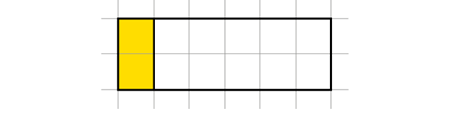
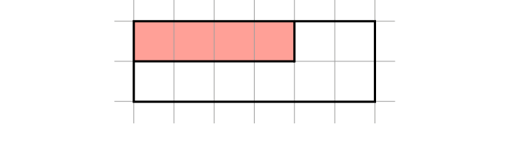
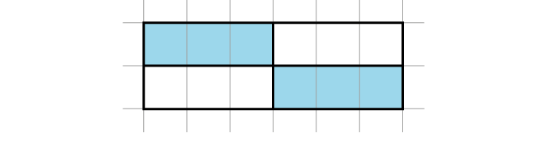
Find missing parts when a quantity is divided into more than two unequal parts
Example 7a
All of these rectangles are to be coloured yellow : red : blue in the ratio 1 : 2 : 3.
Complete the shading on each rectangle.
Notes:
Suggested questioning:
What is the same about your answers? What is different?
Is there more than one way to answer this question?
What would the ratio be if we combined all the rectangles? Why?
What fraction of the whole shape should the _ area be? What fraction of the _ colour should the _ area be?
Things for you to think about:
In Example 7 students will need to be aware that the three rectangles show the same relationship between the yellow : red : blue, although the parts might look different.
A prompt such as ‘What’s the same and what’s different about your answers?’ might be a useful way to initiate students’ reflections.
It should also be noted that the third rectangle in part a) can be considered as two smaller rectangles that are to be shaded in the same ratio. Shading that rectangle in a way that exploits this, might suggest a different understanding than shading the rectangle in a way that doesn’t. This may prove to be an interesting discussion point with students. A visual example of this can be found in the notes for this example on pages 31 and 32 of the 3.1 Core Concept document.
To encourage students to consider the nature of the multiplicative relationships involved, you might like to ask students to consider what the ratio of yellow : red : blue would be if all of the rectangles drawn for part a) were combined.

Slide 28
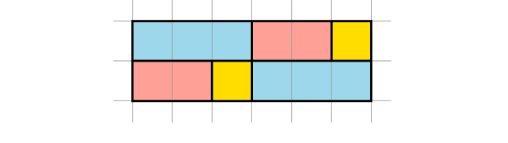
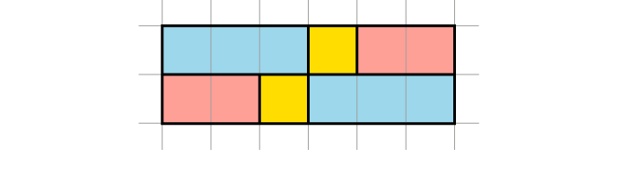
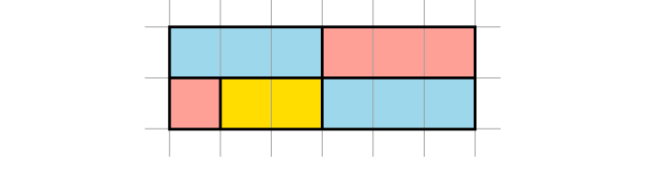
Find missing parts when a quantity is divided into more than two unequal parts
Example 7a
  What different ways might your students approach this problem? What might that reveal about their understanding of the relationships here?
  Here are three potential answers for the rectangle with blue shaded. What differences in understanding might these suggest?
All of these rectangles are to be coloured yellow : red : blue in the ratio 1 : 2 : 3.
Complete the shading on each rectangle.
Notes:
Due to space constraints, the image on this PD discussion slide is very small. PD Leads might like to use or print the ‘in the classroom’ version of this slide for teachers to access during discussions.
More detail about the sequencing of this example can be found on pages 31 and 32 of the 3.1 Core Concept document.

Slide 29
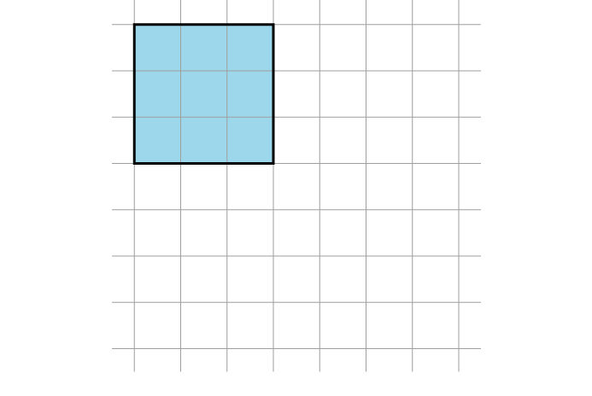
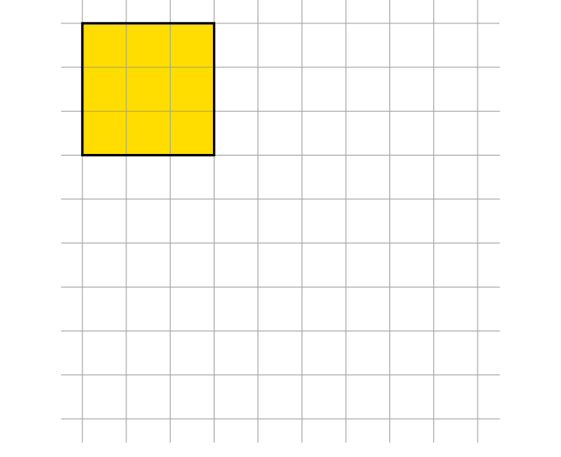
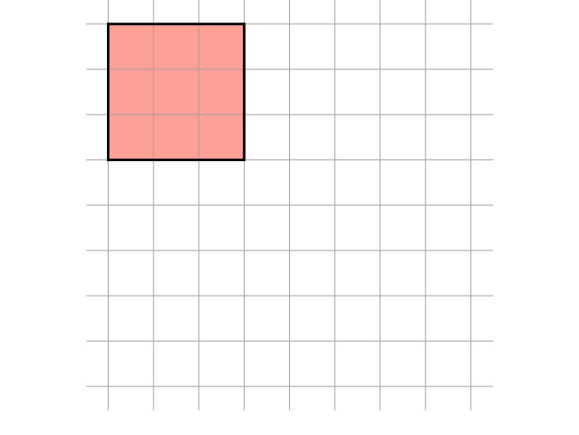
Find missing parts when a quantity is divided into more than two unequal parts
Example 7b
All of these rectangles are to be coloured yellow : red : blue in the ratio 1 : 2 : 3.
Draw the rest of each rectangle, then shade it in the same ratio as above.
Notes:
Suggested questioning:
What is the same about your answers? What is different?
Is there more than one way to answer this question?
What would the ratio be if we combined all the rectangles? Why?
What fraction of the whole shape should the _ area be? What fraction of the _ colour should the _ area be?
Things for you to think about:
In Example 7 students will need to be aware that the three rectangles show the same relationship between the yellow : red : blue, although the parts might look different.
A prompt such as ‘What’s the same and what’s different about your answers?’ might be a useful way to initiate students’ reflections.
In part b) the size of the known section is constant and students have to use this to complete the other two sections, while still maintaining the rectangle. The intention here is that students become aware of the multiplicative nature of the relationships, which might be prompted further using questions such as ’What fraction of the blue area should the yellow area be?’

Slide 30
Find missing parts when a quantity is divided into more than two unequal parts
Example 7b
  What different answers might your students give? What questions might you ask to explore these further?
  What is the effect of varying the colour but keeping the area coloured the same? How does this help expose the mathematical structure of this ratio?
All of these rectangles are to be coloured yellow : red : blue in the ratio 1 : 2 : 3.
Draw the rest of each rectangle, then shade it in the same ratio as above.
Notes:
Due to space constraints, the image on this PD discussion slide is very small. PD Leads might like to use or print the ‘in the classroom’ version of this slide for teachers to access during discussions.
More detail about the sequencing of this example can be found on page 32 of the 3.1 Core Concept document.

Slide 31
Find missing parts when a quantity is divided into more than two unequal parts
Example 8
Yasmine, Rachel and Brenda share some money in the ratio 1 : 2 : 3.
How much do Yasmine and Brenda each have if Rachel has £9?
Brenda always has three times as much money as Yasmine.
  Write a sentence like this about the money that Rachel and Yasmine always have.
  Write a sentence like this about the money that Rachel and Brenda always have.
Notes:
Suggested questioning:
If Brenda always has three times as much money as Yasmine, how could you rephrase that sentence? E.g. Yasmine always has _ as much money as Brenda.
How would your answer change if someone else had £9? How about if the total was £9?
How could you represent this ratio in a diagram? How might that help?
Things for you to think about:
The images from Example 7 can be used to support Example 8 since both examples use the same mathematical structure. You might like to ask students to reflect on whether they preferred to work on the task represented pictorially or whether they preferred the contextualised representation. In part b), writing the required sentences helps students to understand that even with a three-way split, the relationship between the parts is multiplicative.

Slide 32
Find missing parts when a quantity is divided into more than two unequal parts
Example 8
  The images from example 7 have the same mathematical structure. How might you use these two examples in conjunction with each other?
  What might be the potential benefit of providing students with sentence structures to describe ratios? What other sentence structures might you use to explore this relationship?
Yasmine, Rachel and Brenda share some money in the ratio 1 : 2 : 3.
How much do Yasmine and Brenda each have if Rachel has £9?
Brenda always has three times as much money as Yasmine.
  Write a sentence like this about the money that Rachel and Yasmine always have.
  Write a sentence like this about the money that Rachel and Brenda always have.
Notes:
Due to space constraints, the image on this PD discussion slide is very small. PD Leads might like to use or print the ‘in the classroom’ version of this slide for teachers to access during discussions.
More detail about the sequencing of this example can be found on page 33 of the 3.1 Core Concept document.

Slide 33
Reflection questions
What other mathematical concepts will be supported by students’ stronger understanding of this key idea?
What mathematical language will you continue to use to support pupils to make connections with other areas?
Which representations might you continue to use to further develop students’ understanding?

Slide 35
Appendices
You may choose to use the following slides when planning or delivering a PD session. They cover:
  Key vocabulary
  Representations and structure
  Previous learning
  Future learning
  Library of links

Slide 36
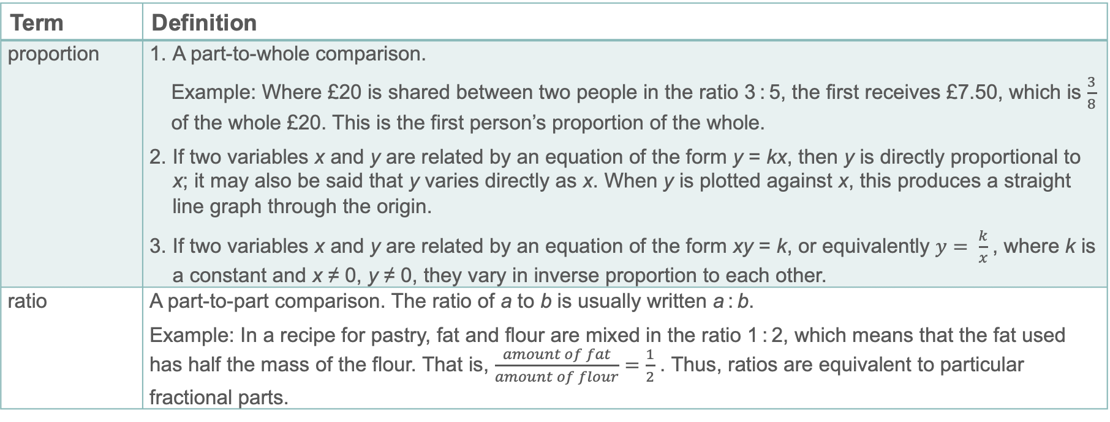
Key vocabulary
Term | Definition
proportion | A part-to-whole comparison. Example: Where £20 is shared between two people in the ratio 3 : 5, the first receives £7.50, which is $\frac{3}{8}$ of the whole £20. This is the first person’s proportion of the whole. If two variables x and y are related by an equation of the form y = kx, then y is directly proportional to x; it may also be said that y varies directly as x. When y is plotted against x, this produces a straight line graph through the origin. If two variables x and y are related by an equation of the form xy = k, or equivalently $y= \frac{k}{x}$, where k is a constant and x ≠ 0, y ≠ 0, they vary in inverse proportion to each other.
ratio | A part-to-part comparison. The ratio of a to b is usually written a : b. Example: In a recipe for pastry, fat and flour are mixed in the ratio 1 : 2, which means that the fat used has half the mass of the flour. That is, $\frac{amount of fat}{amount of flour}=\frac{1}{2}$ . Thus, ratios are equivalent to particular fractional parts.

Slide 37
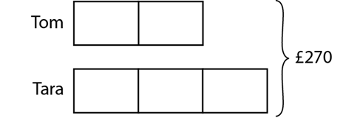
Representations and structure
There are a number of different representations that you may wish to use to support students’ understanding of this key idea. These might include:
Bar models
  Bar models can be very useful to support students in representing (literally, re-presenting) problems in order to reveal multiplicative structures (as appropriate) and thus become aware of how to proceed to a solution.
Ratio tables and double number lines (also known as ‘stacked number lines’)
  The comparison of corresponding entries in two different sets of multiples, such as from a multiplication table, can be a useful context in which to explore multiplicative relationships.
Tom and Tara share £270 between them in the ratio 2 : 3. How much do they each receive?
Notes:
More information about the representations and structure involved in this key idea can be found:
On page 7 of the Multiplicative Reasoning Theme Overview document
Links to all of these can be found on the final slide.

Slide 38
Previous learning
From Upper Key Stage 2, students will bring experience of:
multiplying proper fractions and mixed numbers by whole numbers, supported by materials and diagrams
recognising the per cent symbol (%) and understanding that per cent relates to ‘number of parts per hundred’, and writing percentages as a fraction with denominator 100, and as a decimal
using all four operations to solve problems involving measure (for example, length, mass, volume, money) using decimal notation, including scaling
solving problems involving the relative sizes of two quantities where missing values can be found by using integer multiplication and division facts
solving problems involving the calculation of percentages (for example, of measures, and such as 15% of 360) and the use of percentages for comparison
solving problems involving similar shapes where the scale factor is known or can be found
solving problems involving unequal sharing and grouping, using knowledge of fractions and multiples.
Notes:
Theme 3 Multiplicative reasoning

Slide 39
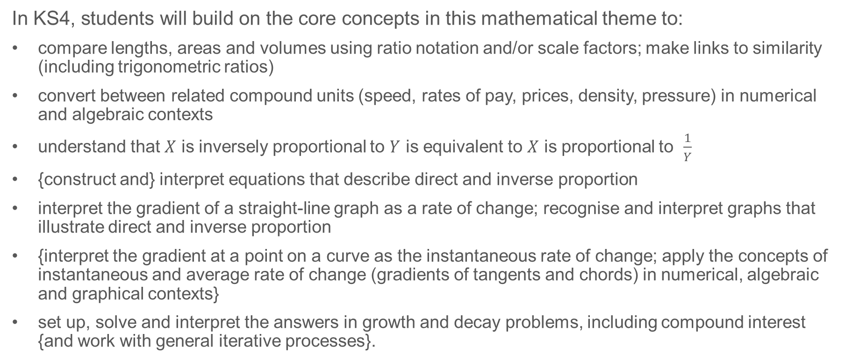
Future learning
In KS4, students will build on the core concepts in this mathematical theme to:
compare lengths, areas and volumes using ratio notation and/or scale factors; make links to similarity (including trigonometric ratios)
convert between related compound units (speed, rates of pay, prices, density, pressure) in numerical and algebraic contexts
understand that $X$ is inversely proportional to $Y$ is equivalent to $X$ is proportional to $\frac{1}{Y}$
{construct and} interpret equations that describe direct and inverse proportion
interpret the gradient of a straight-line graph as a rate of change; recognise and interpret graphs that illustrate direct and inverse proportion
{interpret the gradient at a point on a curve as the instantaneous rate of change; apply the concepts of instantaneous and average rate of change (gradients of tangents and chords) in numerical, algebraic and graphical contexts}
set up, solve and interpret the answers in growth and decay problems, including compound interest {and work with general iterative processes}.
Please note: Braces { } indicate additional mathematical content to be taught to more highly attaining students.
Notes:
Theme 3 Multiplicative reasoning

Slide 40
Library of links
The following resources from the NCETM website have been referred to within this slide deck:
  NCETM Secondary Mastery Professional Development
    3 Multiplicative Reasoning Theme Overview Document
    3.1 Understanding Multiplicative Relationships Core Concept Document
  Using mathematical representations at KS3 | NCETM
  Insights from experienced teachers | NCETM
  NCETM primary mastery professional development materials
  NCETM primary assessment materials
  NCETM secondary assessment materials
There are also references to:
  Standards & Testing Agency’s past mathematics papers

