Slide 1
2.17 Structures: using measures and comparison to understand scaling
Representations | Year 4
Multiplication and Division

Slide 2
How to use this presentation
You can find the teacher guide 2.17 Structures: using measures and comparison to understand scaling by following the link below.

Slide 3
2.17 Scaling: measures and comparison Step 1:1
5 cm
5 cm
5 cm
15 cm
5 cm × 3 = 15 cm
Notes:
The spotty ribbon is shorter than the plain ribbon.
The plain ribbon is longer than the spotty ribbon.
The spotty ribbon is 5 cm long.
The length of three spotty ribbons is equal to the length of the plain ribbon.
The combined length of three spotty ribbons is fifteen centimetres.
Five centimetres times by three is equal to fifteen centimetres.
Five centimetres multiplied by three is equal to fifteen centimetres.
So the plain ribbon is fifteen centimetres long.
The plain ribbon is three times the length of the spotty ribbon.

Slide 4
2.17 Scaling: measures and comparison Step 1:2
Notes:
The stripy ribbon is two times the length of the plain ribbon.
The stripy ribbon is twice the length of the plain ribbon.
The stripy ribbon is double the length of the plain ribbon.

Slide 5

2.17 Scaling: measures and comparison Step 1:3
8 cm
8 cm
8 cm × 1 = 8 cm
Notes:
The patterned ribbon is the same length as the plain ribbon.
The length of one plain ribbon is equal to the length of the patterned ribbon.
The patterned ribbon is one times the length of the plain ribbon.

Slide 6


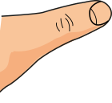
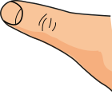
2.17 Scaling: measures and comparison Step 1:4
10 cm × 2
10 cm
20 cm
10 cm × 2 = 20 cm
Notes:
The elastic is ten centimetres long.
We stretch it to two times the original length.
Ten centimetres times/multiplied by two is equal to twenty centimetres.
The elastic is now twenty centimetres long.

Slide 7
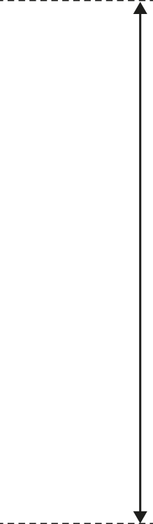



2.17 Scaling: measures and comparison Step 1:5
By June it is 10 times the original height.
12 cm sunflower in April.
12 cm × 10 = 120 cm
120 cm
12 cm
April
June
Notes:
Twelve centimetres times/multiplied by ten is equal to
one hundred and twenty centimetres.

Slide 8
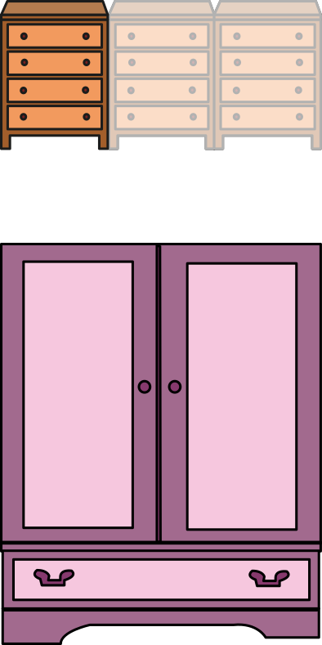
2.17 Scaling: measures and comparison Step 1:7
The wardrobe is 3 times the width of the cabinet. How wide is the wardrobe?
40 cm × 3 = 120 cm
40 cm
40 cm
40 cm
120 cm

Slide 9
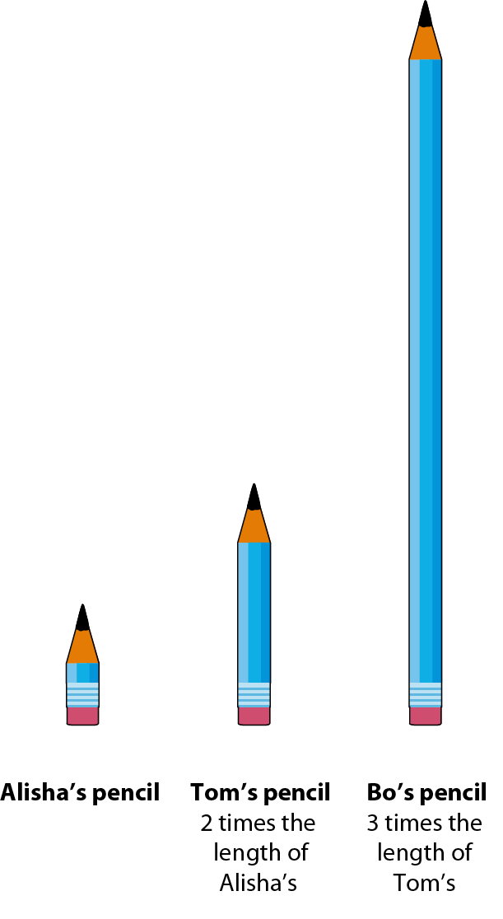
2.17 Scaling: measures and comparison Step 1:7
Bo’s pencil is times
the length of Alisha’s pencil.
6

Slide 10
2.17 Scaling: measures and comparison Step 2:1
Describe the length of the plain ribbon.
5 cm
5 cm
5 cm
15 cm
The plain ribbon is 3 times the length of the spotty ribbon.
5 cm × 3 = 15 cm
Notes:
The plain ribbon is three times the length of the spotty ribbon.

Slide 11
2.17 Scaling: measures and comparison Step 2:1
Describe the length of the spotty ribbon.
5 cm
of the
of the
of the
whole
whole
whole
15 cm
whole
Notes:
The plain ribbon is three times the length of the spotty ribbon.
The spotty ribbon is one-third times the length of the plain ribbon.

Slide 12
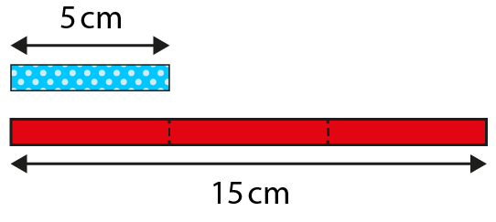
2.17 Scaling: measures and comparison Step 2:2

Slide 13
2.17 Scaling: measures and comparison Step 2:3
Describe the length of the stripy ribbon.
The stripy ribbon is two times the length of the plain ribbon.
Notes:
The stripy ribbon is two times the length of the plain ribbon.
The stripy ribbon is twice the length of the plain ribbon.
The stripy ribbon is double the length of the plain ribbon.

Slide 14
2.17 Scaling: measures and comparison Step 2:3
Describe the length of the plain ribbon.
of the
of the
whole
whole
whole
Notes:
The plain ribbon is one-half times the length of the striped ribbon.

Slide 15
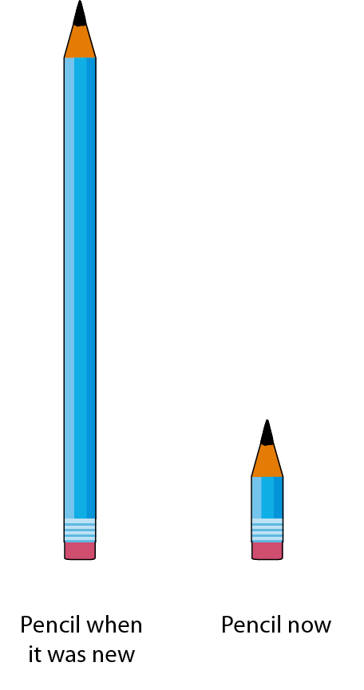
2.17 Scaling: measures and comparison Step 2:4

Slide 16
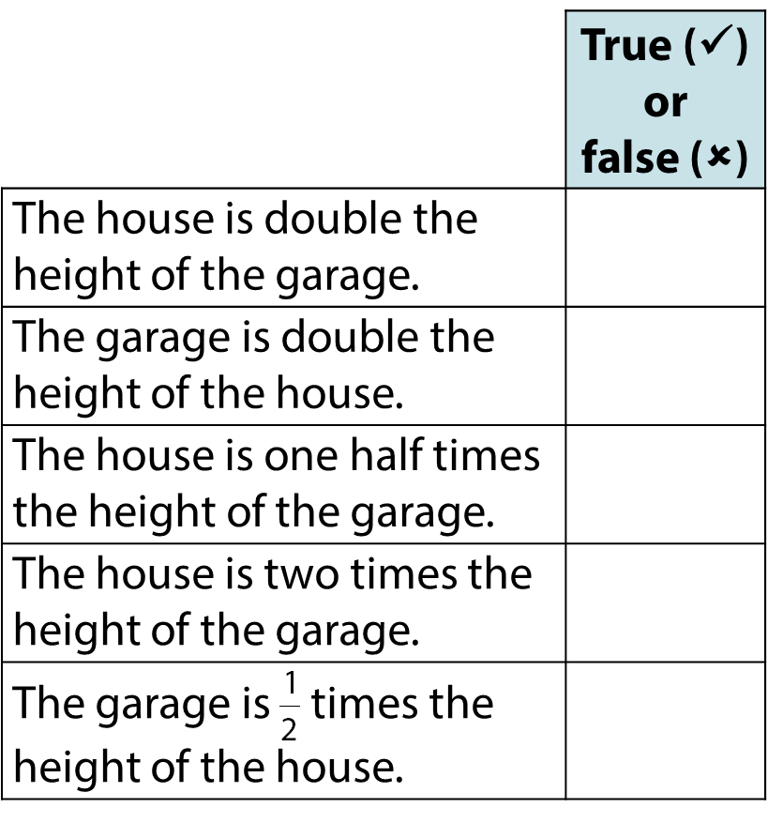

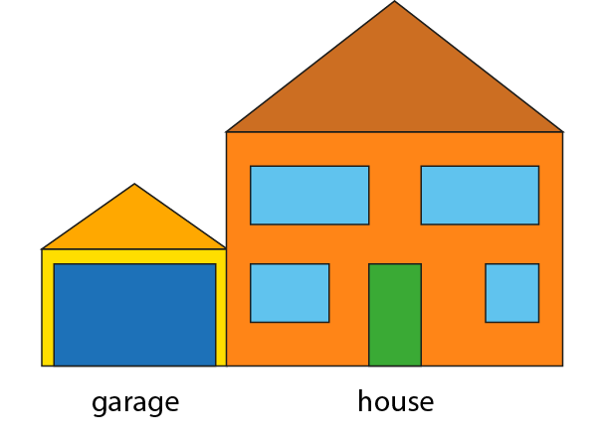

2.17 Scaling: measures and comparison Step 2:6

Slide 17

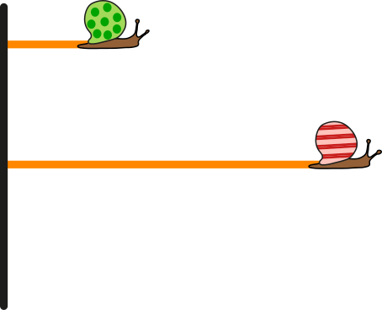


2.17 Scaling: measures and comparison Step 2:6

Slide 18
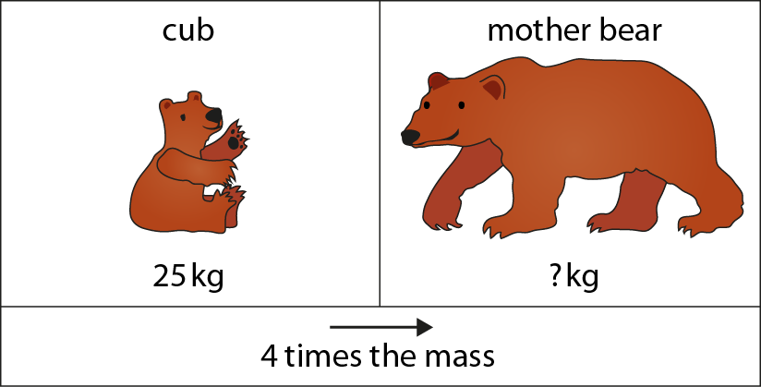

2.17 Scaling: measures and comparison Step 3:1
25 kg × 4 = kg
100
Notes:
The mass of a mother bear is four times the mass of her cub.

Slide 19
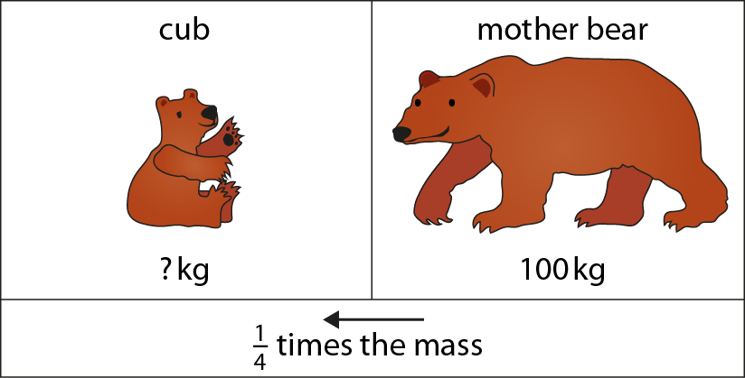

2.17 Scaling: measures and comparison Step 3:1
25
kg
100 kg ÷ 4 = kg
25
Notes:
The mass of a bear cub is one quarter the mass of his mother.

Slide 20
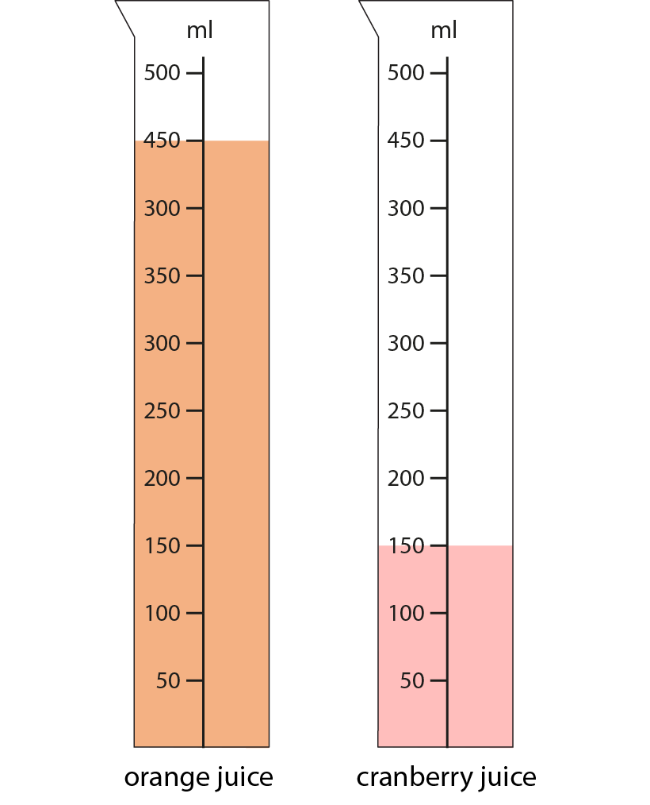
2.17 Scaling: measures and comparison Step 3:2
150 ml × 3 = 450 ml
450 ml ÷ 3 = 150 ml
Notes:
The volume of orange juice is three times the volume of cranberry juice.
The volume of cranberry juice is one third the volume of orange juice.

Slide 21
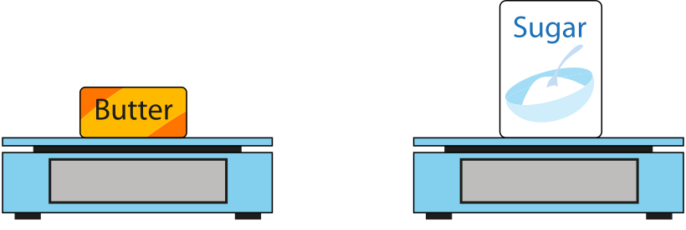
2.17 Scaling: measures and comparison Step 3:2
How much does the sugar weigh?
500 g
1000 g
× 2 =
? g
Notes:
The weight of the sugar is two times/twice/double the weight of the butter.
How much does the sugar weigh?

Slide 22
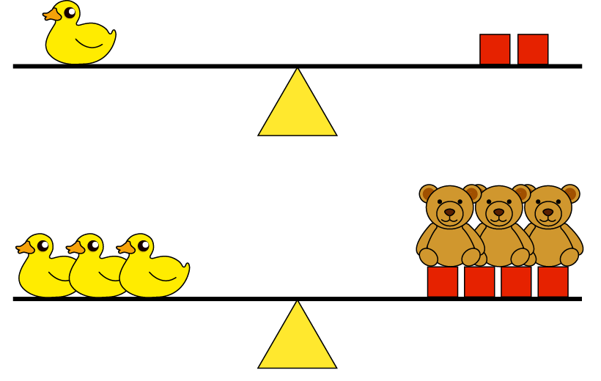
2.17 Scaling: measures and comparison Step 3:3
2
A duck is times as heavy as a brick
3
A duck is times as heavy as a bear
3
bears weigh the same as 2 bricks.

