Slide 1
Numberblocks
Support Materials
Episode 6
Four

Slide 2
Practitioner Notes

Slide 3
Episode Description
One, Two and Three are admiring the clouds, but there is one more than Three can count. So, One hops on top of Three to make Four, who uses the magic mirror to copy himself and make One and Three again. Three wants to be the tallest so Four kindly changes shape to make himself shorter and is delighted to find that he is square. He sings a song about Four being one more than Three, the right number of legs on a table, and so on, and then about the joys of being square.

Slide 4
Maths in the Episode
Introduction to the Number 4
Four appears in lots of contexts, such as four legs on a table. Children should be encouraged to become aware of this and become “4 detectives”. Four has the special property of being a square number and children’s attention can be drawn to this through the arrangement of 4 blocks or squares.
Counting to 4
4 is a small number and counting to 4 provides lots of practice in developing the skills of counting such as one- to- one correspondence and saying the numbers in the correct order.
Recognition of 4 without counting (subitising)
A group of four objects is easy to subitise (recognise without counting) and children should be encouraged to say the number without counting.

Slide 5
Using Mathematical Language
In this episode the children experience the relationship between Four and Three. Use these sentences to describe the relationship.
“Four is made of three and one.”
“Four take away one leaves three.”
Children may be able to describe the relationship using comparative language:
“Four is one more than three.”
“Three is one less than four.”

Slide 6
Talk and Discuss Together

Slide 7
Talk and Discuss Together
Watch the episode of Numberblocks. First ask the children what they noticed and allow them to talk to you and each other. The following slides are designed to stimulate children and adults to talk about the episode and draw out some key aspects of the mathematics.

Slide 8

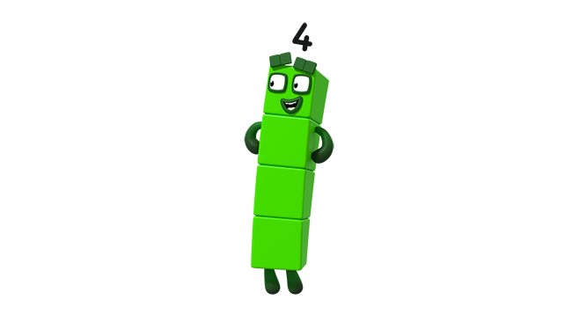
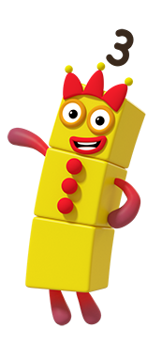
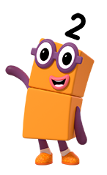
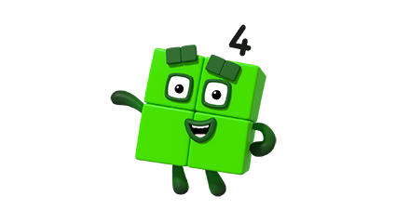
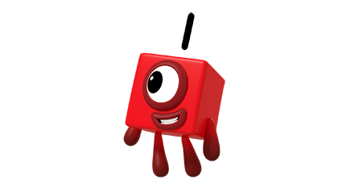
Images © 2017 Alphablocks Ltd. All Rights Reserved.
Notes:
This slide is designed to support the children with recognising Four. At each click a new character will appear.
Ask the children: is this Four?
Click once to appear and once to disappear. The aim is for the children to instantly recognise without having to count (perceptual subitising). Increase the speed of the character appearing and disappearing. Ask the children to explain their answer:
Why is this Four? Why is this not Four?
Focus the responses about the cardinality of the character (e.g. “I can see four blocks” as opposed to “…because he is green”).

Slide 9

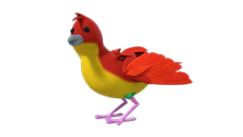

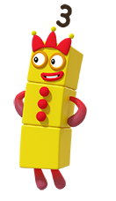
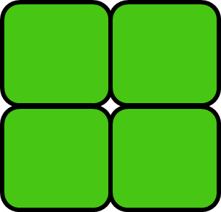
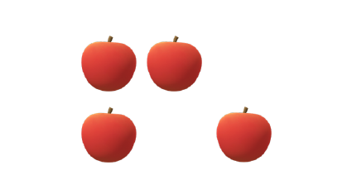
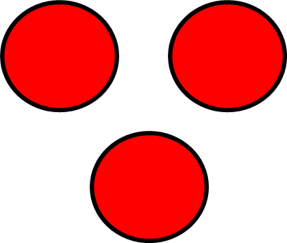
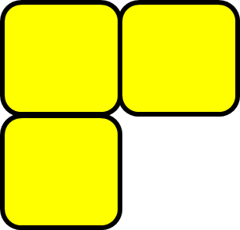
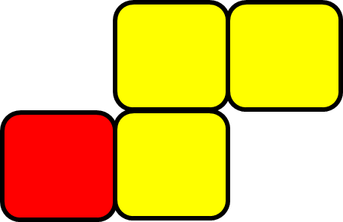
not
Images © 2017 Alphablocks Ltd. All Rights Reserved.
Notes:
Use this slide to discuss which images represent four or do not represent four.
This slide is animated:
Click 1: Image appears between the two sorting boxes.
Where should this go? Why?
Click 2: Image moves to the correct sorting box.
This animation continues for 9 further images.

Slide 10
Enabling Environments

Slide 11
Enabling Environments
Playing and Exploring
Collect sets of objects or photograph examples of four things to tell others about. Include discussions about what we can take / what we have to leave and why. Find some examples of ‘not four’ – children to explain why their artefact/ collection is not four.
Active Learning
Notice whether children can subitise four in their play: e.g. when collecting small world toys to sit on four chairs, do the children pick up the right amount without counting?
Creating and Thinking Critically
Provide square-faced printing sponges to make 2D pictures of Four and other pictures using 4 squares: e.g. a flower with 4 petals.

Slide 12
Learning Together in Y1

Slide 13


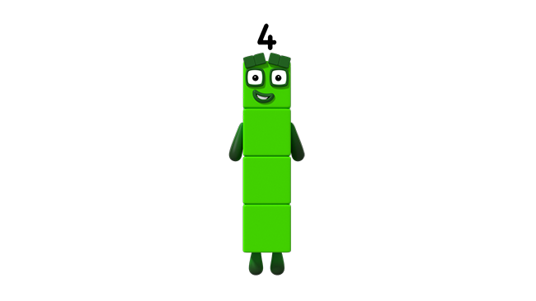


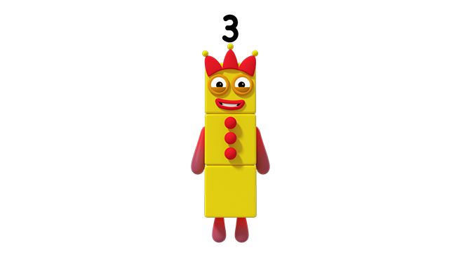
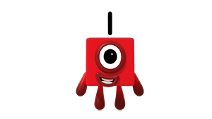
Images © 2017 Alphablocks Ltd. All Rights Reserved.
Notes:
Use this slide to recap how Four is made from One and Three.
This slide is animated:
Click 1: One jumps on Three and then Four appears.
Discuss what is the same and what is different between One and Three and Four.
What number sentence can we use to describe this story?
Click 2: starts an animation to build the equation 1 + 3 = 4 by emphasising the Numberblocks as the equation unfolds.

Slide 14
Images © 2017 Alphablocks Ltd. All Rights Reserved.
Notes:
This slide builds on the previous slide but the arrangement for 1 + 3 is different.
Ask the children to build the representation with their own cubes.
What’s the same? What’s changed? Does it matter how Three is arranged when we add One?
This slide is animated:
Click 1: red cube joins the three yellows to make a green square number.
Click 2: empty equation box appears.
What number sentence could we use to represent this story?
Notice that the equation is the same as before.
Click 3: animates the equation by emphasising the parts of the number sentence in the model.

Slide 15
Images © 2017 Alphablocks Ltd. All Rights Reserved.
Notes:
This slide sets the foundation for slide 17.
Ask the children to build the representation with their own cubes.
This slide is animated:
Click 1: the red square joins the yellow squares to make four; the four slides down to show that they are equivalent.
What do you notice? What's the same? What’s different between this slide and the ones before?
Click 2: empty equation box appears.
What number sentence can we use to tell this story?
Click 3: animates the equation by emphasising the parts of the number sentence in the model.

Slide 16
Images © 2017 Alphablocks Ltd. All Rights Reserved.
Notes:
This slide models how Four is made from Three and One.
This slide is animated:
Click 1: Animates the partitioning of Four into One and Three and at the same time builds the equation.
Ask the children to build the representation with their own cubes.

Slide 17
is more than
Click the blue dot to
reveal the expression.
Images © 2017 Alphablocks Ltd. All Rights Reserved.
Notes:
This slide develops the relationship between 3 and 4, that 4 is 1 more than 3, by using comparison. The comparison model will have been seen in slide 15.
This slide is animated:
Click on the blue dot: the expression “4 is 1 more than 3” is revealed with the model emphasising the sentence.
What do you notice? How does the model help to see the ‘one more’?
Ask the children to build their own model to demonstrate that 4 is 1 more than 3 and practice the stem sentence.

Slide 18

Images © 2017 Alphablocks Ltd. All Rights Reserved.
Notes:
This slide represents the relationship between 4 and 3 using subtraction as reduction.
This slide is animated:
Click 1: models the reduction of 4 by 1.
Ask the children to represent the animation with their own cubes.
What’s the same, what’s different (about this and the other representations)?
What number sentence can we use to describe this number story?
Click 2: reveals the equation: 4 – 1 = 3.

Slide 19
is less than
Click the blue dot to
reveal the expression.
Images © 2017 Alphablocks Ltd. All Rights Reserved.
Notes:
This slide develops the relationship between 3 and 4, that 3 is 1 less than 4, by using comparison. The comparison model will have been seen in slides 15 and 17.
This slide is animated:
Click the blue dot: models the comparison of 3 and 4 to show how “3 is 1 less than 4”. Simultaneously the expression will appear.
Ask the children to represent the animation with their own cubes.
What’s the same, what’s different, (about this and the other representations)? What number sentence can we use to describe this number story?
Click 1: the equation appears. Discuss how the expression is represented in the equation: e.g. ‘one less than four’ is written in a different order in the equation. ‘One less than’ is written as ‘- 1’.

Slide 20
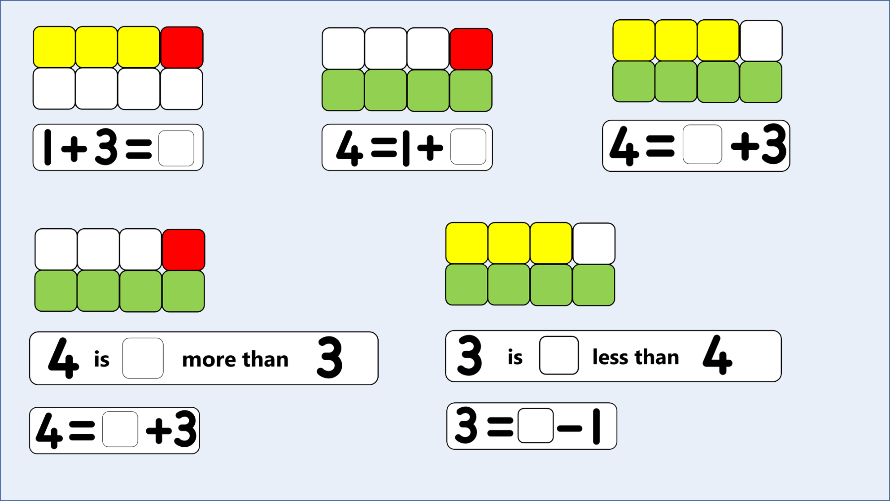
Notes:
Use this as individual practice and then go through the answers to check.

