Slide 1
Series 3 Episode 22
Block Star

Slide 2
Practitioner Notes

Slide 3
Episode Description
Super-rectangle Twelve needs to save the Block Star's battery power before it crashes into Blockworld. One coordinates what needs to be done using Twelve’s different arrays. Thanks to ‘using the Fours’, Block Star's batteries are changed and Blockworld is saved.

Slide 4
Maths in the Episode
Different Arrays of 12
In this episode the children have the opportunity to describe the different array formations for 12, using the term by. The idea of a ‘unit’ is also introduced, for example, 3 ‘fours’, where four is a unit. This concept is known as unitising, that is, naming a quantity as a single ‘unit’.

Slide 5
Using Mathematical Language
Use these stem sentences to rehearse the mathematical ideas in the programme:
“<12> is made from <6> <Twos>.”
“<12> is made from <6> <2s>.”
“<12> is <6> by <2>.”
Notes:
Text inside < > indicates what can be changed in the stem sentence.

Slide 6
Talk and Discuss Together

Slide 7
Talk and Discuss Together
Watch the episode of Numberblocks. First ask the children what they noticed and allow them to talk to you and each other.
Has anyone ever seen any Star Wars films?
The following slides are designed to stimulate children and adults to talk about the episode and draw out some key aspects of the mathematics.

Slide 8
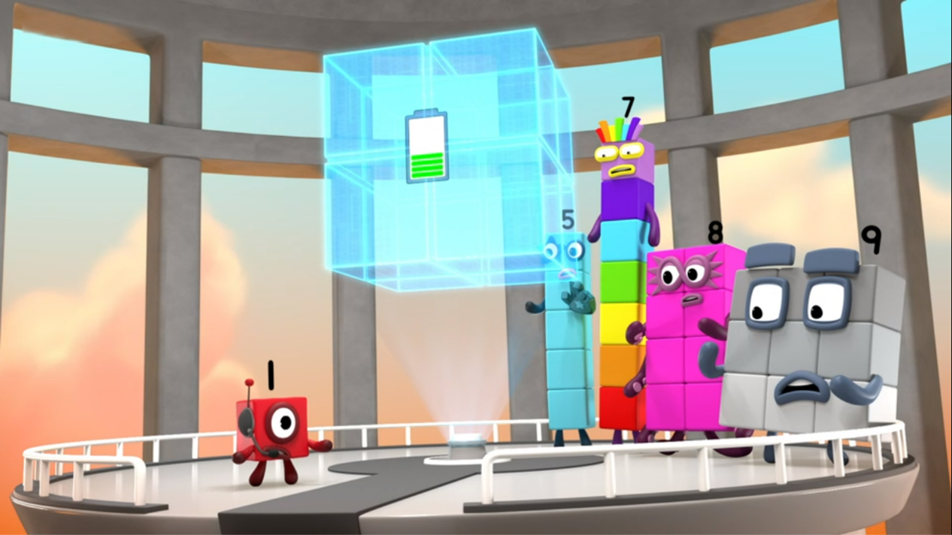
Images © 2017 Alphablocks Ltd. All Rights Reserved.
Notes:
Use this picture as the stimulus for Talk and Discussion (slide 7).

Slide 9
Enabling Environments in Reception

Slide 10
Enabling Environments
Playing and Exploring
Hide ‘units of 4’ and other units (of 2 and 3) in the sand tray, for example, a tower of 4 cubes, a square of 4 cubes, a bead-string of 4 beads, and challenge the children to “Find the Fours”.
Active Learning
Notice when children pick up small quantities whether they count each element or whether they see units in quantities. When playing with children, model saying how many without counting. “I think that looks like 4 buttons”.
Creating and Thinking Critically
Use subitising flash cards and ask the children to “Find the Fours” by shouting it out when four can be seen. (See Slide 16 for an example.)

Slide 11
Notes:
Hidden slide for printing. Example of subitising cards – cut along dotted line

Slide 12
Learning Together in Y1

Slide 13
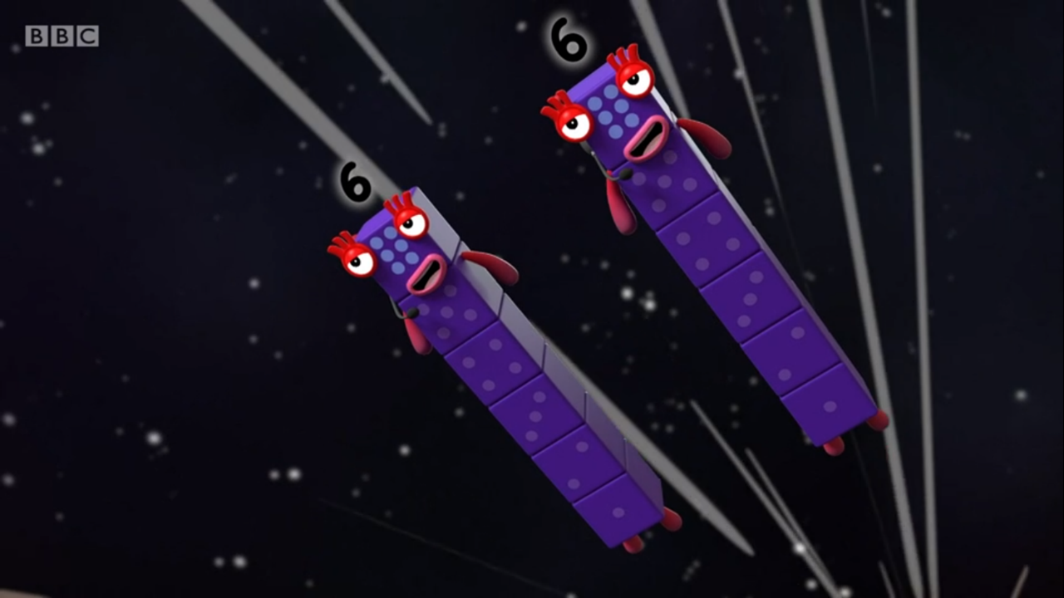


I see _____ sixes.
Images © 2017 Alphablocks Ltd. All Rights Reserved.
Notes:
Use these slide to compare representations of equal groups.
Discuss:
What do you see?
What is the same/what is different about the Numberblocks and the dice? (Both represent six in different ways and there are two Numberblocks and two dice.)
How many sixes can you see? (I see 2 sixes.)

Slide 14
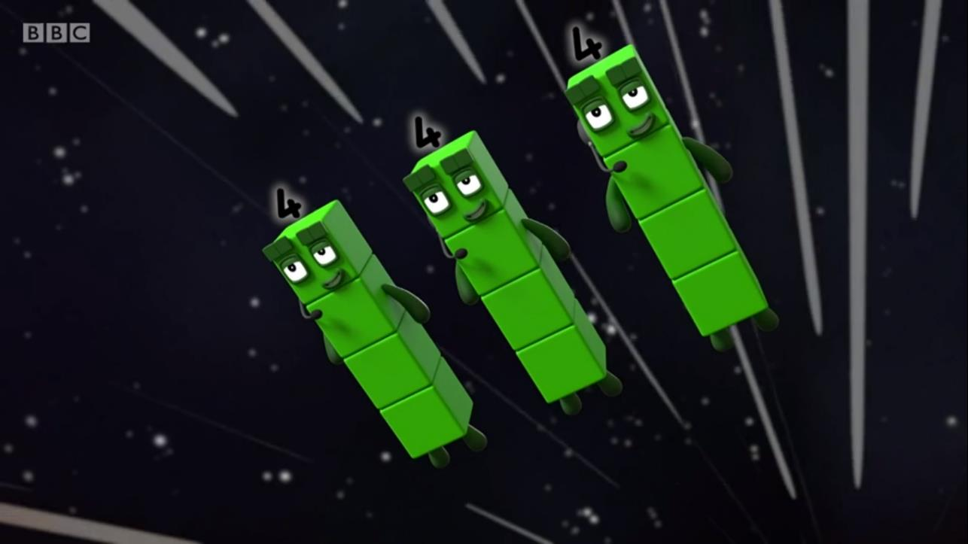


I see _______.
fours
Images © 2017 Alphablocks Ltd. All Rights Reserved.
Notes:
Discuss:
What do you see?
What is the same/what is different about the Numberblocks and the dice? (Both represent four in different ways and there are three Numberblocks and three dice.)
How many fours can you see? (I see 3 fours.)

Slide 15
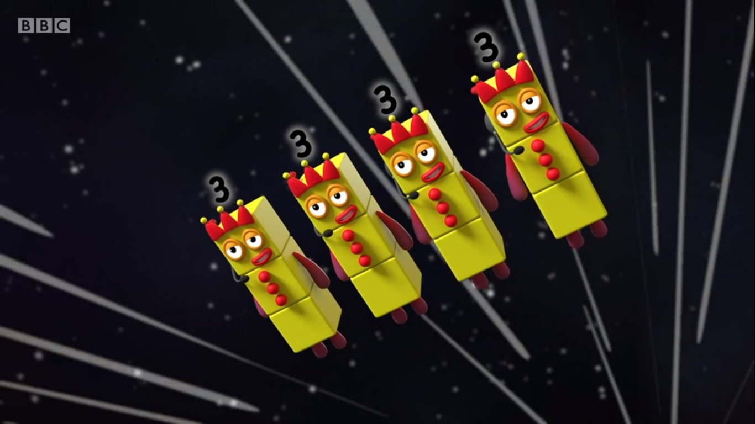


I see ___ _______ .
threes
Images © 2017 Alphablocks Ltd. All Rights Reserved.
Notes:
Discuss:
What do you see?
What is the same/what is different about the Numberblocks and the dice? (Both represent three in different ways and there are four Numberblocks and four dice.)
How many threes can you see? (I see 4 threes.)

Slide 16
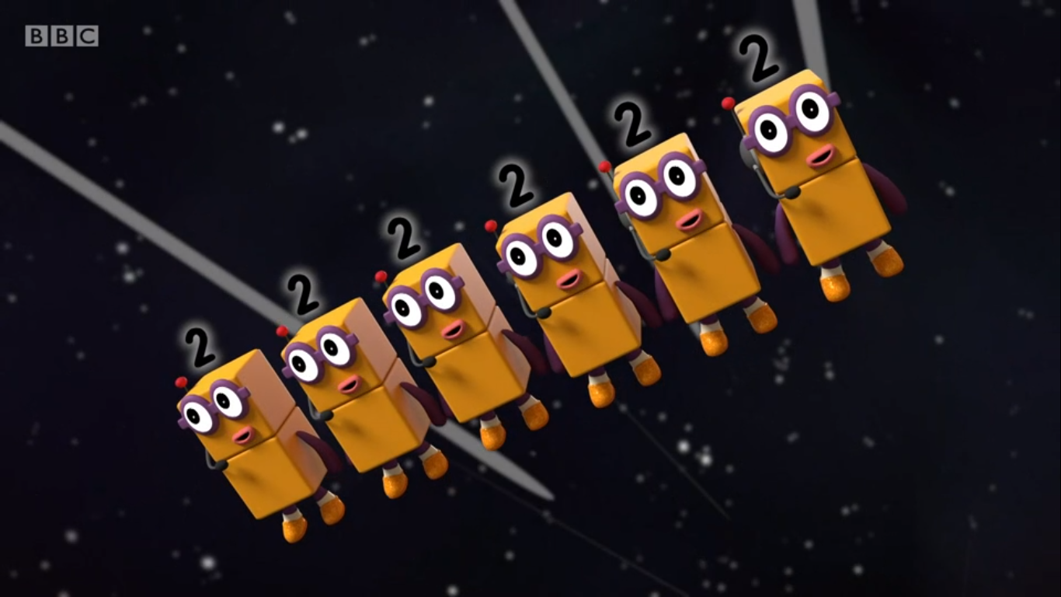


I see _____ _____ .
twos
Images © 2017 Alphablocks Ltd. All Rights Reserved.
Notes:
Discuss:
What do you see?
What is the same/what is different about the Numberblocks and the dice? (Both represent two in different ways and there are six Numberblocks and six dice.)
How many twos can you see? (I see 6 twos.)
Some children may start to notice that as Twelve breaks into smaller and smaller Numberblocks (parts), that there are more Numberblocks (parts).

Slide 17
I see _____ _______ .
threes
Images © 2017 Alphablocks Ltd. All Rights Reserved.
Notes:
Use this and the next slide to start looking for equal groups in arrays and use the language of unitising to describe them (4 threes/3 fours). The colours of the stars help children focus on the groups in columns.
Discuss:
What do you see? Can you use the words we used to describe the Numberblocks? (I see 4 threes.)
Draw around the columns to highlight the 4 threes to help children identify them if necessary.

Slide 18
I see _____ _______ .
fours
Images © 2017 Alphablocks Ltd. All Rights Reserved.
Notes:
Discuss:
What do you see now?
Can you describe how the array has changed?
Can you describe what you see? (We can only see 3 different colours of stars. There are only three columns.)
Draw around the columns to highlight the 3 fours to help children identify them if necessary.

Slide 19
I see _____ _______ .
sixes
Images © 2017 Alphablocks Ltd. All Rights Reserved.
Notes:
Discuss:
Is this an array? (No, it isn’t in rows and columns.)
What do you notice about the number of red stars and orange stars? (There are 6 of each colour.)
Read together: I see 2 sixes. Do you think this is right?
If the stars were in an array, would we be able to see the 2 sixes more easily?
Watch the stars animate to form an array and children discuss what they can see.

Slide 20
Further activities for Y1
Provide further images of organised and randomly-arranged units of quantities to practise finding using crossing off or circling.
Make a matching pairs game to match stem sentence to pictures (use both organised and randomly-arranged quantities).
Given a quantity of counters or cubes, explore ways to arrange in equal groups.

Slide 21
Learning Together in Y2

Slide 22
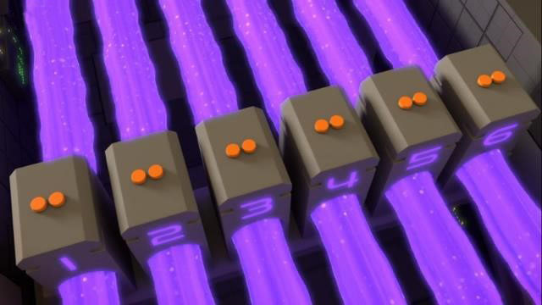
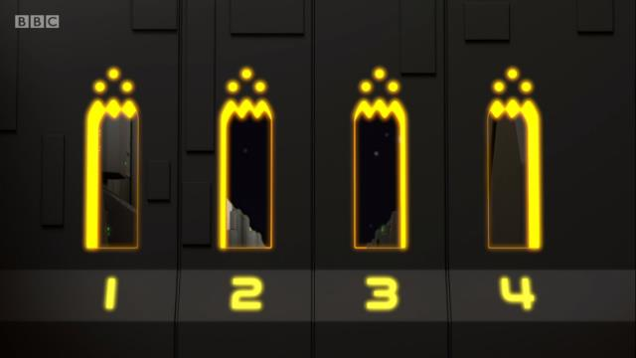
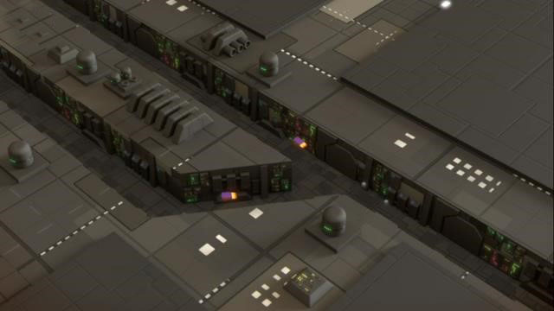
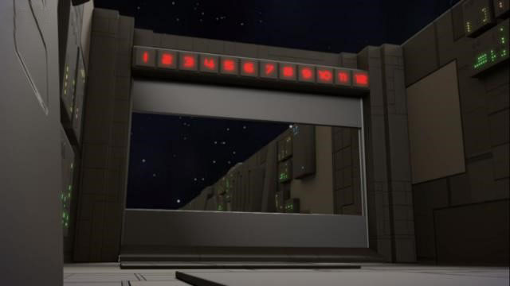
Images © 2017 Alphablocks Ltd. All Rights Reserved.
Notes:
Use this slide to discuss how Twelve solved each challenge. Identify each situation by its star reference.
Red star: Twelve had to switch to 6 twos.
Orange star: Twelve had to switch to 4 threes.
Yellow star: Twelve had to switch to 2 sixes.
Green star: Twelve had to switch to 12 ones.

Slide 23
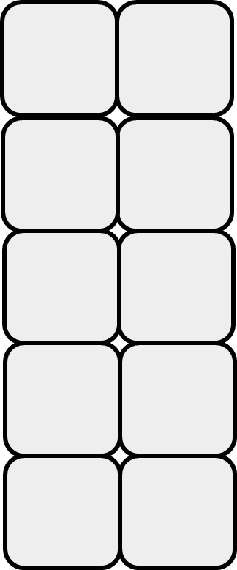
I am 6 twos.
SWITCH!
I am 6 x 2.
Notes:
Use these slides to connect the language of ‘6 twos’ to the multiplication expression.
Discuss:
What number is shown? How do you know? (12 is made of ten and two.)
When the blocks turn orange, can you see how many twos 12 is made from? (12 is made from 6 twos.)
How can this be represented as a multiplication expression? (6 x 2)

Slide 24
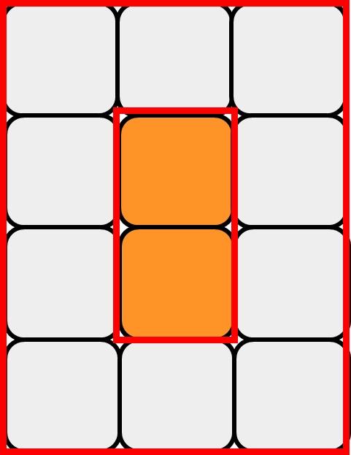
I am ____ fours.
SWITCH!
I am ___ x ___.
Notes:
Discuss:
Now that Twelve has switched, do you think there are still 12 blocks?
When the blocks change to green, can you see how many fours 12 is made from?
How can this be represented as a multiplication expression?
Use cubes to make 12 in this array and rotate the array.
Can you say another sentence about 12 that is different to 6 twos or 3 fours?
How could you write this as a multiplication expression?

Slide 25
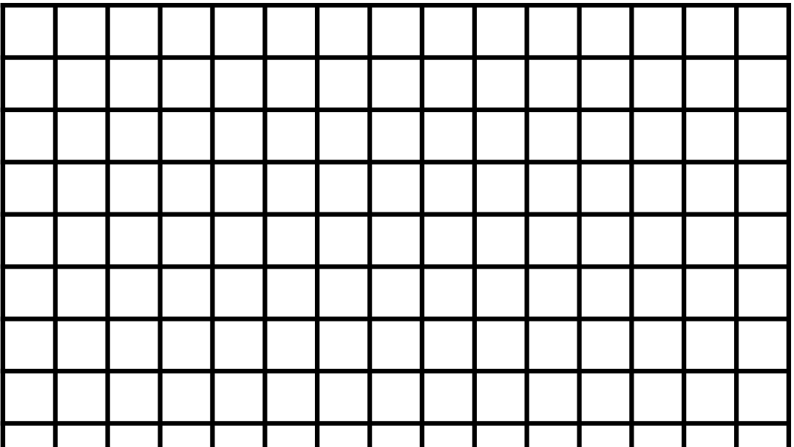
Block Star Challenge
Notes:
How can Twelve arrange her blocks so that she can pass through these spaces?
(If needed, use 12 cubes and make the shapes shown by the spaces.)
Have you managed to make four of the shapes out of 12 cubes? How many are in each shape?
Click to reveal the solution. (12 needs to be in 4 threes.)

Slide 26
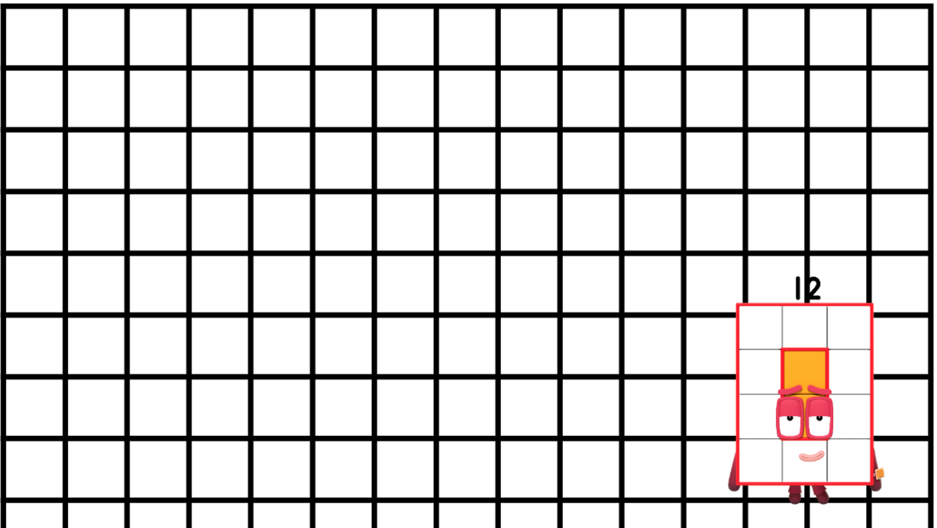
Block Star Challenge
How many of these are needed to challenge Twelve?
Images © 2017 Alphablocks Ltd. All Rights Reserved.
Notes:
Can you make a shape which will fit perfectly through this space?
How many of these shapes will Twelve need to make to complete the challenge? (Twelve needs to become 2 sixes.)

Slide 27
Further activities for Y2
Design different Block Star Challenges for Twelve’s equal groups.
Write stem sentences to describe the challenges.
“Twelve needs to switch to … ” (4 threes, 4 by 3).
Match Block Star Challenge shapes to stem sentences as a matching pairs game.
Design Block Star Challenges for a different rectangular Numberblock.

