Slide 1

Checkpoints
Year 7 diagnostic mathematics activities
Perimeter and area
Fourteen Checkpoint activities
Ten additional activities
Published in 2021/22

Slide 2
About this resource
This resource is designed to be used in the classroom with Year 7 students, although it may be useful for other students.
The Checkpoints are grouped around the key ideas in the core concept document 6.2 Perimeter, area and volume, part of the NCETM Secondary Mastery Professional Development materials.
Before each set of Checkpoints, context is explored, to help secondary teachers to understand where students may have encountered concepts in primary school.
The 10-minute Checkpoint tasks might be used as assessment activities, ahead of introducing concepts, to help teachers explore what students already know and identify gaps and misconceptions.
Each Checkpoint has an optional question marked . This will provide further thinking for those students who have completed the rest of the activities on the slide.
The notes for each Checkpoint give answers (if appropriate), some suggested questions and things to consider.
After each Checkpoint, a guidance slide explores suggested adaptations, potential misconceptions and follow-up tasks. These may include the additional activities at the end of this deck.

Slide 3
Checkpoints 1–6
Checkpoint | Underpins | Code
1: Bigger? | The concepts of perimeter and area | 6.2.1 6.2.2
2: Paper cutting | Identify and explain whether a number is or is not a multiple of a given integer
3: Strange staircases
4: Sticky note patterns
5: Mosaics
6: Tile changes
This three-digit code refers to the statement of knowledge, skills and understanding in the NCETM’s Sample Key Stage 3 Curriculum Framework (see notes below for more information).
Notes:
In the Sample Key Stage 3 Curriculum Framework, statements of knowledge, skills and understanding are arranged to give an example teaching order. The three-digit code for each statement in the framework is a clickable hyperlink to documents with more detailed information, including the key ideas contained within that statement. These key ideas are also shown on slide 5 in this deck.

Slide 4
Checkpoints 7–14
Checkpoint | Underpins | Code
7: Shapes on a grid | Calculating perimeter and area | 6.2.1 6.2.2
8: Building plots | Identify and explain whether a number is or is not a multiple of a given integer
9: Goldilocks and the three rectangles
10: Area or perimeter
11: From one vertex
12: Labels
13: Holes
14: Dozen or doesn’t?
This three-digit code refers to the statement of knowledge, skills and understanding in the NCETM’s Sample Key Stage 3 Curriculum Framework (see notes below for more information).
Notes:
In the Sample Key Stage 3 Curriculum Framework, statements of knowledge, skills and understanding are arranged to give an example teaching order. The three-digit code for each statement in the framework is a clickable hyperlink to documents with more detailed information, including the key ideas contained within that statement. These key ideas are also shown on the next slide in this deck.

Slide 5
Key ideas
Understand the concept of perimeter and use it in a range of problem-solving situations | Code
Use the properties of a range of polygons to deduce their perimeters | 6.2.1.1
Understand the concept of area and use it in a range of problem-solving situations | Code
Derive and use the formula for the area of a trapezium | 6.2.2.1*
Understand that the areas of composite shapes can be found in different ways | 6.2.2.2
*‘There are additional resources exemplifying this key idea in the Secondary Mastery Professional Development | NCETM.

Slide 6
The concepts of perimeter and area
Checkpoints 1–6

Slide 7
The concepts of perimeter and area
Previous learning | In Key Stage 3 students need to
Key Stage 2 curriculum: Year 6: recognise that shapes with the same areas can have different perimeters and vice versa Further information about how students may have experienced this key idea in Key Stages 1 and 2: Teaching mathematics in primary schools, 5G–2: compare and calculate the area of rectangles (including squares) using standard units (pp269–74) * Page numbers reference the complete Years 1–6 document | Understand that perimeter is a one-dimensional measure and be able to distinguish it from area, which is two-dimensional (two ideas that are often confused).
The Checkpoints in this deck have been separated into two sections: The concepts of perimeter and area (Checkpoints 1–6) and Calculating perimeter and area (7–14). There is more detail about how perimeter and area are covered in both Key Stage 2 and Key Stage 3 on the introductory slide to the second section.

Slide 8
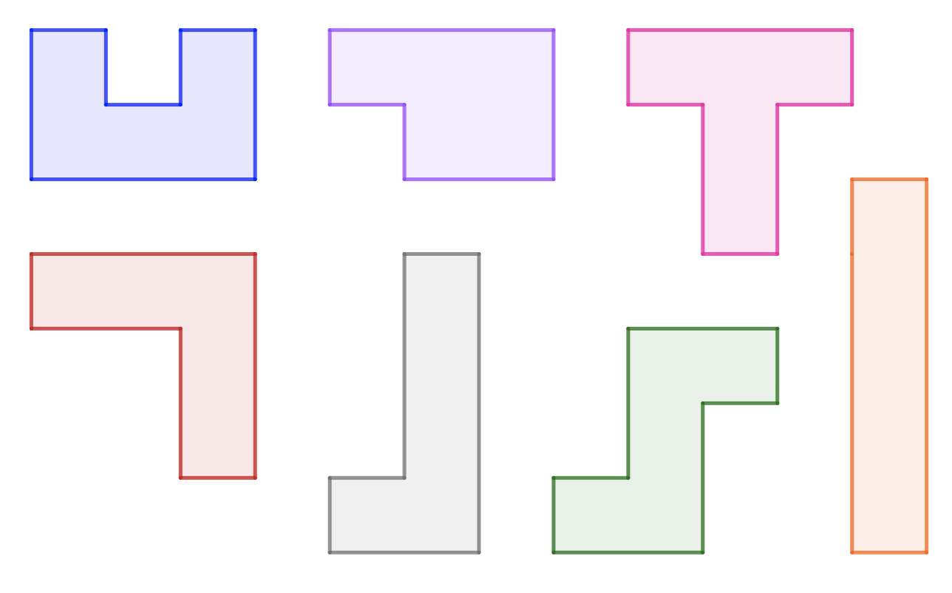
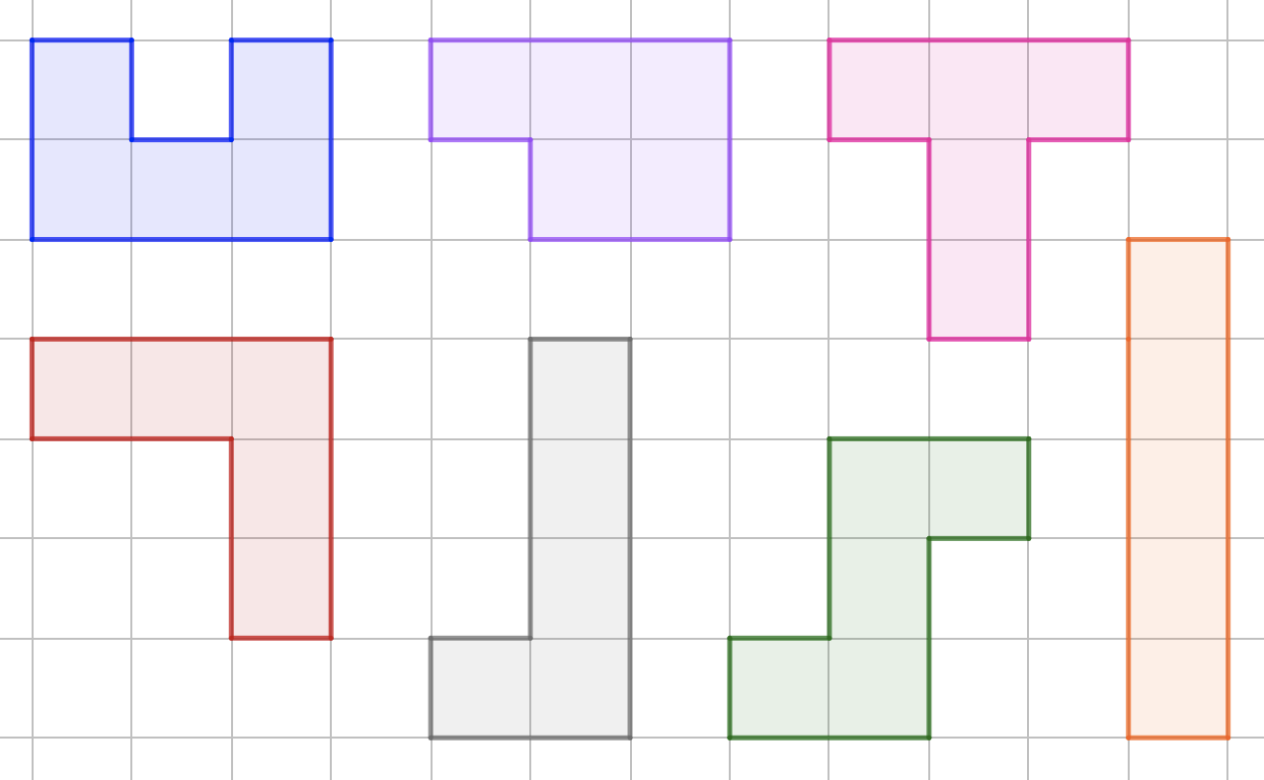
Checkpoint 1: Bigger?
Which of these shapes do you think is the biggest? Why?
Does including a square grid help?
In what way/s is the shape you chose bigger than the others? In what way/s is it the same?
*
*In present mode, the square grid will appear on the image alongside this question.
Can you create shapes with this same area? How many possibilities are there?
Notes:
This slide is animated. Each question will appear separately so you can choose the pace at which to work with your class. In ‘present’ mode, a square grid will also appear for part b.
Answers
a) There is no single correct answer as it will depend on the students' criteria for 'biggest’. The task is designed to be open so that students can suggest their own ideas. If they suggest area and perimeter as measures (or you choose to prompt them to) then:
Area: all of the shapes have the same area (five square units).
Perimeter (left to right from top left and then bottom left): blue 12 units; purple 10 units; pink 12 units; red 12 units; grey 12 units; green 12 units; orange 12 units.
b) The grid may make it easier for students to identify the areas and perimeters listed in the answer to part a.
c) This is designed as an open-ended question, so students can make their own comparisons and suggest their own justifications. An example response might be that the orange rectangle in the bottom right position is bigger because it's the tallest, but it's the same because it has the same area as all of the other shapes, and the same perimeter as most of them. As with part a, students may or may not automatically link to area and perimeter. It is for teachers’ own judgment whether to prompt them.
? Any arrangement of five squares into a shape. These are examples of pentominoes: seven of the twelve possible pentominoes are shown here. Examples of the twelve pentominoes are readily available online.
Suggested questioning
What is the same/different about ___?
I think __ is the biggest because ___, do you agree?
Things to think about
In Checkpoint 1, the first question (“which of these shapes is the biggest?”) is intended to give a context for students to talk about what they know about measures and properties of shapes. The teacher's role in this assessment task is to listen to the ways in which students talk about these properties but, as a part of this, you may like to prompt students to expand on definitions, or to compare one property or measure with another shape

Slide 9
Checkpoint 1: Guidance
Adaptations | Assessing understanding
Support The initial question is intended to be open – the emphasis in the question should be on the ‘you’. Get the ball rolling by stating that you think it’s the pink T-shape because it’s tall and wide, while a colleague thinks that it’s the orange bar because it’s the tallest. On revealing the grid in part b, a prompt such as ‘what’s the same and what’s different’ may support students to identify key properties. Challenge Students might be challenged to explain why a person might describe a given shape as the ‘biggest’. A focus on the perimeter of the shapes will allow them to explore which arrangement has the greatest and least perimeter. Representations The inclusion of the grid at part b allows students to confirm or contradict some of the ideas that they may have been discussing. Understanding what area is can be challenging, and the overlay of a grid allows students to think of it as the space that is covered by a shape. | This task gives a context for teachers to hear what students already know, and to reveal any potential misconceptions. The initial question is open with no language prompts, allowing students to use language and terms which are comfortable and familiar to them. Listen for the terms area and perimeter. Ask students to explain how they know that a given shape has a larger/smaller/equal area or perimeter than another. Students might respond to the prompt in part a by saying that the shapes are all the same size – probe this by asking them to explain this more mathematically, to see if they make reference to area. If students are reluctant to justify their choices, you could prompt them with incorrect statements, such as, ‘The distance around the T-shape is clearly more than the distance around the orange bar’ , and ask for their responses.
Additional resources Additional activity A again uses squares (sticky notes) to work with and between area and perimeter. Additional activity B offers a context to discuss what is meant by area, and different ways to think about it.

Slide 10
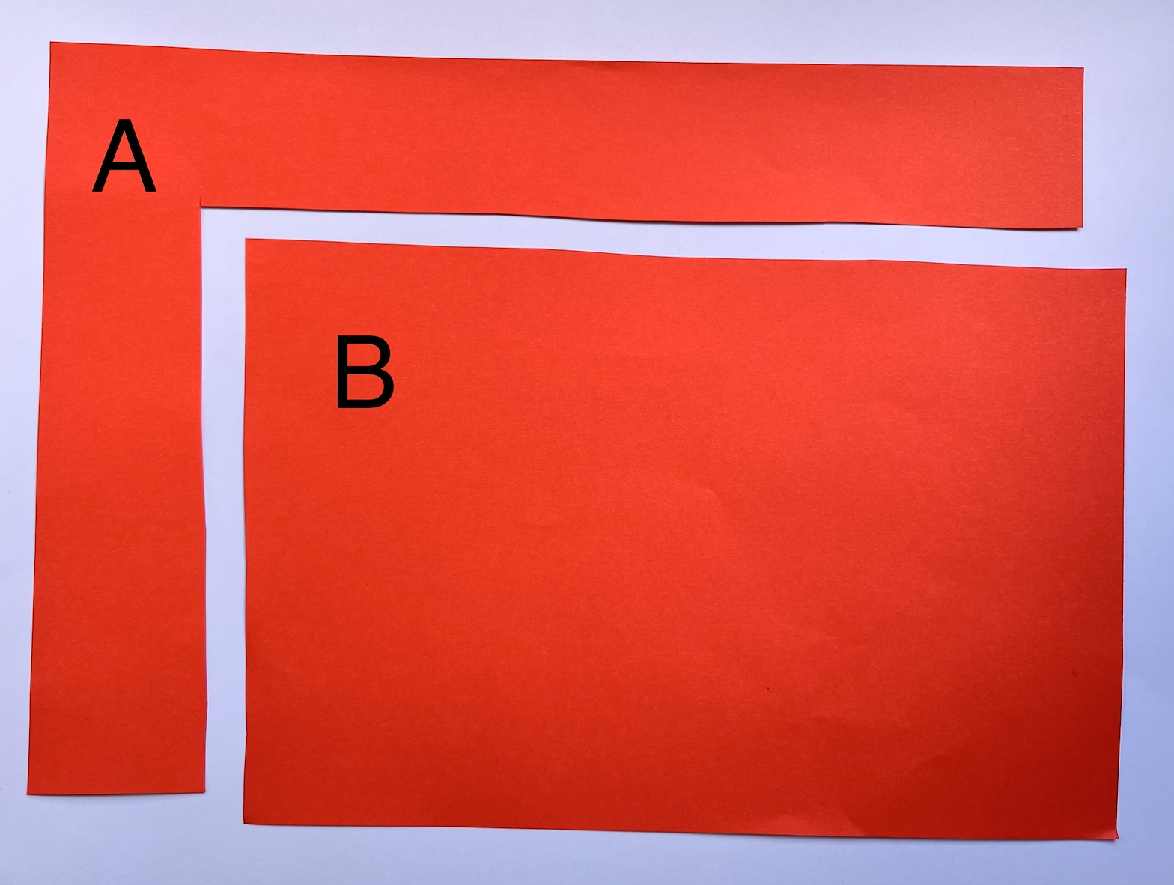
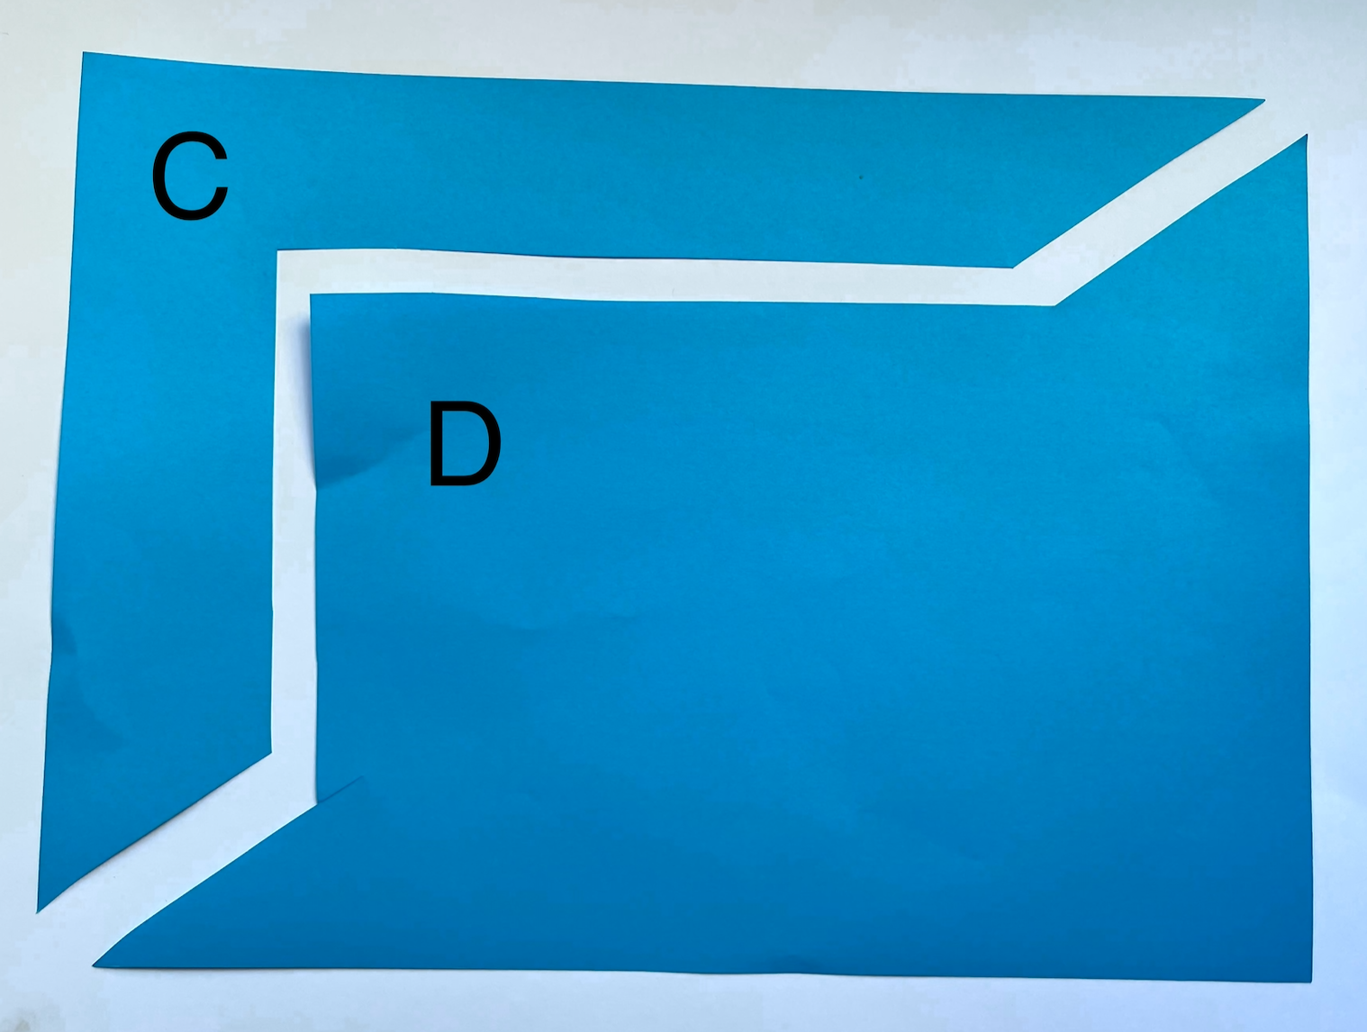
Checkpoint 2: Paper cutting
A sheet of paper is cut in two. Which of the two pieces has the longest perimeter, A or B? Why?
A different sheet of paper of the same size is cut in two. Which of the two pieces has the longest perimeter, C or D? Why?
How would you order the four pieces of paper from shortest to longest perimeter?
Notes:
This slide is animated. Each question will appear separately so you can choose the pace at which to work with your class. An animated exploration of this problem is provided on the next slide.
Answers
a) A has a longer perimeter than B. The corresponding sides from the cut are the same length. B is a rectangle, so the total perimeter is just twice these two lengths, whereas the perimeter of A is the same as the original piece of paper.
b) C and D have equal perimeters. The corresponding sides from the cut are the same length, as are the outer two sides (as they are the edges of the original rectangular paper).
? A is the greatest, C and D are equal, B is the shortest.
Suggested questioning
(How) would your answer change if the cut was in a different place?
Which of the four pieces will always have the same perimeter, no matter where the cut is made?
How does the perimeter of A compare to the perimeter of the sheet before it was cut in two? Explain how you know.
Will any cut that goes corner to corner result in two pieces of paper with equal perimeter?
Things to think about
Checkpoint 2 may provide a real source of debate in the classroom – support this by modelling the cuts ‘live’ or giving students paper to cut themselves. The task specifies that the strips are cut to the same depth, but you might like to consider what relationships must be true, even if the strips are cut to different depths. What are the conditions for the perimeter of B to be greater than that of C and D?

Slide 11
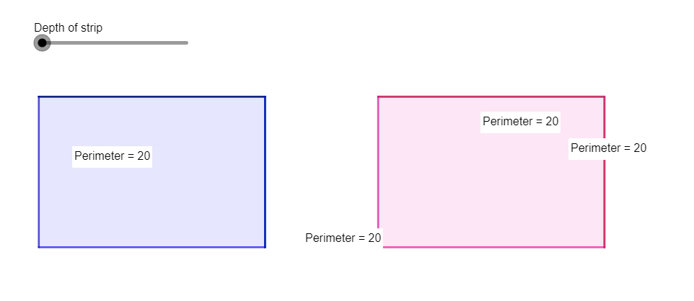
Checkpoint 2: Paper cutting (animated solution)
Notes:
This video offers an animation for changing the depth of the strip that is cut in Checkpoint 2, and may be helpful for exploring why the perimeters are the same for the second shape. It may also support reasoning for the further thinking question.

Slide 12
Checkpoint 2: Guidance
Adaptations | Assessing understanding
Support Ensure that students understand that this task focuses on perimeter rather than area. Consider drawing along each edge of each shape as a ‘ruler’ to create a single line segment that is the same length as the whole perimeter. This might help students to compare the total perimeters more easily. Challenge Ask: if both strips had been cut to a different depth, would the relationship still hold? Can they identify a depth of cut that would change the order for the further thinking question, and mean the perimeter of B is greater than C/D? (This would be the case if, for example, A was cut to be very thin, but C/D were cut so that the majority of the cut was along the diagonal, with just very short lengths making up the right angle.) Representations You might like to have paper to hand for students to cut (or to have prepared some cut sheets) so that they can mark equal lengths and compare other lengths. Dynamic geometry might also be a helpful tool to explore this task further (as modelled on slide 11). | The assessment focus for this task is understanding the concept of perimeter, and comparing perimeters through reasoning rather than measurement. Students should be looking for equal lengths, and reasoning to compare lengths in compound shapes. The task offers plenty of scope to listen to their justifications and language as they discuss and order the four pieces. Some properties might not be intuitive for students. For example, regardless of the depth of the cut, the perimeter of A is fixed – can students explain why this is? Do they recognise that the perimeter of A is the same as the original piece of paper? Students may also struggle to articulate why the perimeters of C and D are the same. Comparing each corresponding part individually may help; consider also cutting a version with longer and shorter diagonals.
Additional resources In Additional activity E students work with perimeters that, perhaps counterintuitively, remain constant as the shape changes. Additional activities C, D and F all ask students to reason about perimeter in different shapes.

Slide 13
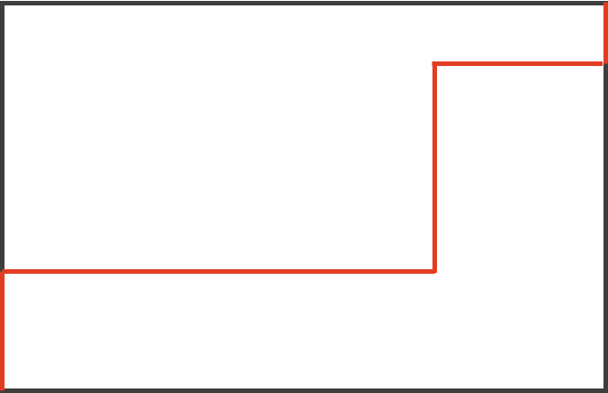
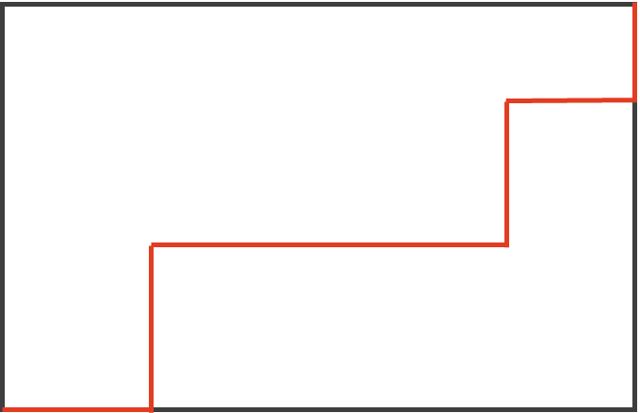
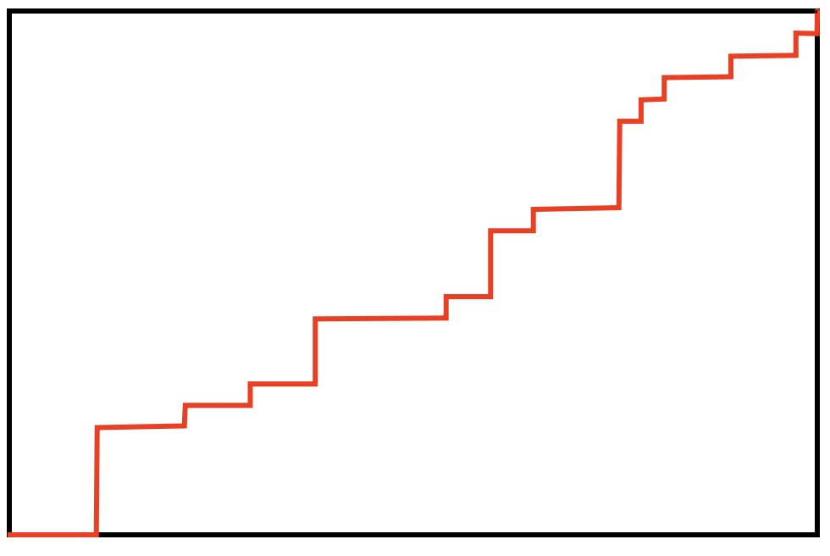
Checkpoint 3: Strange staircases
The perimeter of each rectangle is 26 cm.
How long is the red line each time?
A
B
C
Sketch another line, joining the same corners, that is longer than the one in A. Then sketch one that is shorter and one that is the same length.
Notes:
This slide is animated. Each question will appear separately so you can choose the pace at which to work with your class. An animated exploration of this problem is provided on the next slide.
Answers
The red lines in A, B and C all have a length of 13 cm.
? To sketch a longer line, students will need to ‘go back on themselves’, for example by sketching a ‘dip’ in their lines. To sketch a shorter line, students will need to include a diagonal (either directly from one corner to another, or at a point on their ‘staircase’). Any staircase that includes only vertical lines building up from horizontal lines will be the same length.
Suggested questioning
What would happen if you moved all the vertical lines to the left/right?
What would happen if you moved all the horizontal lines up/down?
What is the same/different about each question?
Things to think about
In Checkpoint 3, students might reason that the more steps there are, the longer the line. Think about how long you might leave students to discuss the task before giving a hint or clue. Once the answer is revealed, challenging students to reason and match the vertical and horizontal parts of the red line should offer useful insight into their understanding of conservation of length, while also preparing them for working with the perimeter of compound rectilinear shapes. Interestingly, teachers’ intuitive response to the staircases is often that the red line 'tends to the hypotenuse’, which is not familiar language for year 7. You may find it helpful to spend time as a department discussing how you might explain this appropriately for early Key Stage 3.

Slide 14
Checkpoint 3: Strange staircases (solution)
The perimeter of each rectangle is 26 cm.
How long is the red line each time?
A
B
C
Notes:
This slide is an animated solution for Checkpoint 3. Each line will move in turn so that you can move through the solution at the pace you choose with your class.

Slide 15

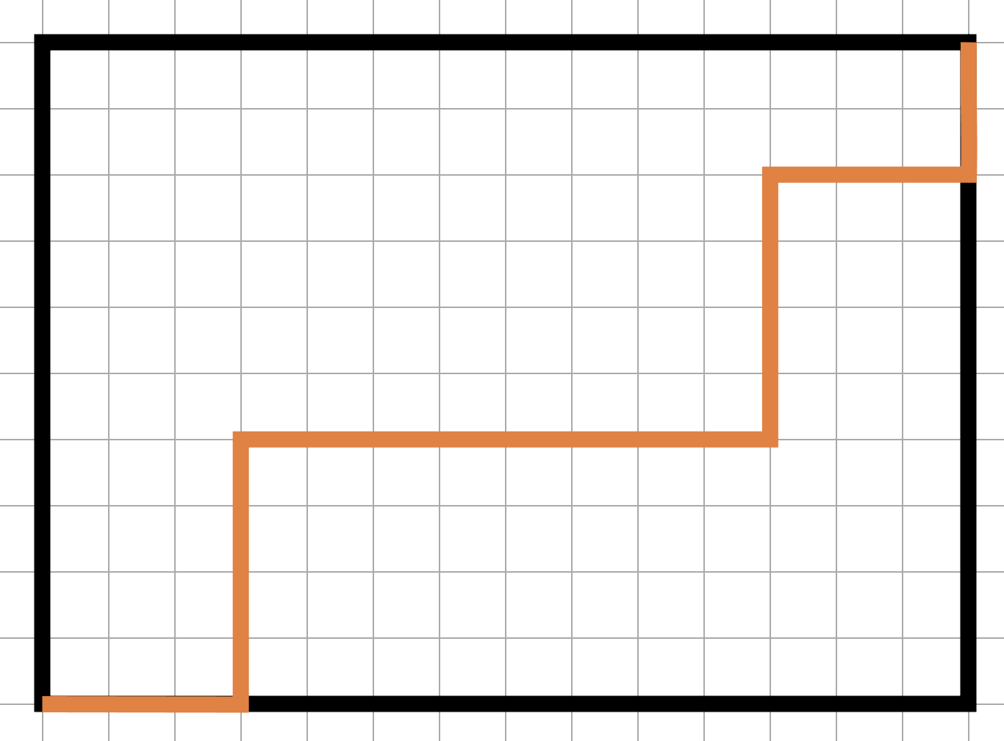
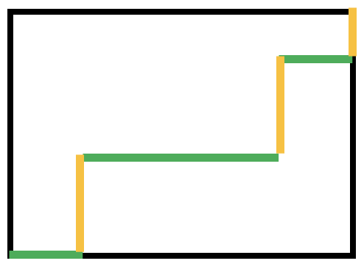
Checkpoint 3: Guidance
Adaptations | Assessing understanding
Support Start with an even simpler example than part a, by drawing a ‘staircase’ with just a single step: Challenge Build on the further thinking question by asking students to draw the longest and shortest lines possible. Can they recognise that the shortest line would be the diagonal? What is their strategy for the longest line? Representations Plotting that shape on a square grid, or shading the vertical and horizontal edges, may support students in reasoning about the length of the coloured line. For example using the staircase in part b: Animated versions, modelling the equivalence to the horizontal and vertical slide, are provided on slide 14. This visualisation may support students' reasoning | The intention of the task is for students to reason with and about the perimeter of a rectilinear shape. Students should notice that the sum of the horizontal lengths of the red line total the horizontal length of the rectangle, and the equivalent for the vertical lines. Look for students to demonstrate their understanding that the distance can be broken into sections without the total length changing. Being able to identify line segments and reason about their length is a key awareness for finding missing lengths when working with the area and perimeter of compound shapes.
Additional resources Additional activity E uses similar reasoning in exploring the perimeter of rectilinear shapes and may be a useful follow on to this Checkpoint.

Slide 16

Checkpoint 4: Sticky note patterns
Some square sticky notes are used to make a pattern of shapes.
One more sticky note is added each time.
A
B
C
D
E
The perimeter of shape A is 4 units.
The perimeter of shape B is 6 units.
Find the perimeters of shapes C to E.
Explain why the perimeter sometimes changes and sometimes stays the same.
Predict the perimeter for shapes F and G. Continue the patterns to draw shapes F and G – were you correct?
Notes:
This slide is animated. The pattern of shapes is revealed one-by-one, and then each question appears separately so you can choose the pace at which to work with your class.
Answers
a) The perimeters are C: 8, D: 8 and E: 10.
b) The perimeter stays the same when moving from an ‘L’ shape to the next rectangle in the sequence (for example, C to D). This is because there are the same number of horizontal and vertical sticky note edges around the outside of the shape.
? The perimeters are F:10 and G: 12.
Suggested questioning
What will the next one arrangement of sticky notes look like?
What is the same/different about each consecutive shape made?
How is the pattern being created?
Is there another arrangement of sticky notes that would have the same perimeter?
When does the perimeter change? When does it stay the same?
Things to think about
In Checkpoint 4, the way that the area increases while the perimeter is constant may be counterintuitive for some students. How do you see the shift in the 'position' of edges that make up the perimeter? How will you know how your students see it? The use of sticky notes on the whiteboard or tables might make the structure of the relationship more apparent.

Slide 17
Checkpoint 4: Guidance
Adaptations | Assessing understanding
Support Although not a key part of the learning, noticing the pattern is an important first step in accessing the task. Providing students with sticky notes to generate the pattern may support with this. Challenge Ask students to predict other parts in the pattern where the perimeter won’t change and reason how they know (i.e. an L shape and the next consecutive rectangle). Can they identify a pair with a really large number of sticky notes, perhaps over 100? Students might also be able to reason about and predict the value of the perimeter for those numbers. Representations Identifying matching edges to justify whether the perimeter does or does not change is key to this task. The use of colour or labelling of matching edges might support students in seeing this structure. | The task is designed to raise the misconception that a greater area means a greater perimeter. Listen for students’ awareness of the difference between these two properties, and for the reasoning about the apparent inconsistencies in the way that the perimeter grows. The intention is that students move beyond the pattern in the values and are able to identify the reason that the pattern exists. Students might reason, for example, that moving between pattern C and pattern D, two of the edges 'pop out' to accommodate the new sticky note so the area increases while the perimeter is unchanged. Probe students’ reasoning and encourage them to generalise if they are confident – do they recognise that the perimeter of an L shape is the same as the perimeter of the smallest rectangle that will contain it?
Additional resources Additional activity A uses the context of sticky notes to explore area and perimeter. Offering just one task from this activity may support students who need scaffolding to access Checkpoint 4, while other students might explore the different tasks in Additional activity A as an opportunity to move beyond the more rigid structure of a given pattern and find creative solutions to the problems.

Slide 18

Checkpoint 5: Mosaics
Marius is making mosaic patterns using these square tiles. Estimate how many tiles he will need to completely cover each different shape.
Estimate how many tiles he will need for this circle.
In present mode, click on each shape to reveal the tiles. Was your estimation correct?
Notes:
This slide is animated. The further thinking (circle) question will appear separately. The grey shapes are each animated to disappear when you click on them, so that students can see the arrangement of mosaic tiles behind.
A printable version of this Checkpoint, showing both blank and tiled shapes, is available on slides 50 and 51. If teachers are copying slides into a format where the animations no longer work, slide 51 may be helpful for showing the solution to students.
Answers
60 tiles are needed to cover each of the rectangles and the square.*
*Students may argue that the area of the square is 64 as there are 8 rows of 8 squares. If they suggest this, draw attention to the fact that the final row and column of tiles are not complete squares.
? Circle: 60 (approx.)
Suggested questioning
How many tiles do you think will fit?
How many tiles would fit along the bottom? How about the left hand edge? How might this help?
What do you notice about the number of tiles along the bottom of the square?
How can you estimate the number of tiles needed for the circle? How might the symmetry of the shape help?
Things to think about
Checkpoint 5 uses mosaic tiles to explore the concept of area and ‘square units’. Estimation can be a powerful tool for assessing students’ conception of area; this checkpoint is designed to promote discussion about the concept of area and how we measure it. All of the shapes on this slide have the same area, which might not be intuitive for students.

Slide 19
Checkpoint 5: Guidance
Adaptations | Assessing understanding
Support Help students to visualise the area: cut out a piece of paper the size of the squares shown when projected and model the counting of this square along one or more lengths. Or use the printable version on slides 50 and 51. Challenge Ask students to imagine and describe how you could change the shapes but maintain the area – for example, if one length were doubled, what would happen to the other length? Students could also be asked to sketch a different shape on the board that has the same approximate area. Representations The square ‘mosaic’ tile is used as a representation for the units of area. Different shapes are used to help students visualise how the same number of ‘square units’ can be arranged in different spaces. | This Checkpoint explicitly explores the concept of area, rather than thinking about calculations. Estimation is used to help teachers assess students’ spatial reasoning and understanding of area as a measure of 2D space. Even when the tiles are visible, there are too many to count easily. Teachers should use the opportunity to see how readily students can estimate – both with and without the support of the tiles. Students may find it hard to visualise that all the shapes have the same area and may be surprised that as many as 60 of the tiles fit within each shape. It is worth asking students if they expected that answer and discussing strategies to count the 60 tiles to prove all the shapes have the same area. The further thinking question introduces a circle. Some students may be able to supply language such as ‘radius’ or ‘diameter’ but, as with the quadrilaterals, the intention is to explore how they use the tiles to estimate, and whether they reach towards a strategy, such as dividing the circle into quarters, or ‘pairing up’ part-tiles.
Additional resources If students find it challenging to articulate what area is and how it is measured, Additional activity B uses another context. Secondary Assessment Materials | NCETM p35 and Year 6 Primary Assessment Materials | NCETM p32 offer more exploration of area, particularly the second questions on both pages.

Slide 20
Checkpoint 6: Tile changes
On the right is a square made up of nine tiles.
By adding, removing or moving tiles, can you change the shape so that:
The area changes, but the perimeter doesn’t?
The perimeter changes, but the area doesn’t?
Is it always, sometimes or never true that:
Increasing the perimeter of a shape will increase the area of that shape?
Increasing the area of a shape will increase the perimeter of that shape?
Explain how you know.
Notes:
This slide is animated. Each question will appear separately so you can choose the pace at which to work with your class.
Answers
a) For example, removing any of the corner squares (red, blue, light green or yellow) would mean that the area decreases but the perimeter stays the same.
b) For example, moving any one square so that it extends one of the sides would mean that the perimeter increases but the area stays the same.
? Increasing the perimeter of a shape sometimes increases the area of the shape. For example, adding more tiles to the shape in this Checkpoint would increase both area and perimeter. However, in the suggested answer to part b above, the perimeter increases whilst the area stays the same.
Increasing the area of a shape sometimes increases the perimeter of that shape. For example, if a tenth tile was added underneath the yellow tile in the bottom left corner of the shape in this Checkpoint, the perimeter and area would both increase. If an eleventh tile was added under the pink tile in the bottom centre of the shape, the area would increase again but the perimeter would not.
Suggested questioning
What would make the area bigger? What would this do to the perimeter?
What would make the area smaller? What would this do to the perimeter?
How would this question be different if the shape was different?
Things to think about
Checkpoint 6 asks students to consider both area and perimeter, allowing teachers to assess if they can work with both concepts without confusing them. There are lots of opportunities for discussion as students can compare their solutions and explore what is the same or different about them.

Slide 21
Checkpoint 6: Guidance
Adaptations | Assessing understanding
Support Give students 9 square tiles, or a printed version of the image (as on slide 52), so that they can physically manipulate or sketch their ideas. Adapt the instructions to smaller steps – for example, specify that the area or perimeter increases. Challenge The further thinking question asks students to generalise using ‘always, sometimes, never’ statements. Students may use the 3 × 3 square from the slide to explore this, or challenge them further by asking them to exemplify their assertions using different shapes, such as one not made up of square tiles. Representations A square made up of coloured tiles is given as a clear visual example to support students to imagine the scenarios. Teachers could also explore the statements with sketches of other shapes. | This Checkpoint asks students to think about area and perimeter simultaneously, and to consider how a change in one affects the other. This will help check that students don’t confuse the two concepts. The focus here is not on finding area and perimeter by calculating, but by reasoning about the changes to the tiles. Teachers should listen out for the language students use to justify their responses. For example, how do they explain that the perimeter is the same when one of the corner tiles is removed? Do they visualise the edges of the tiles ‘moving’? Do they still imagine a rectangle around the new shape? Students may assume that increasing the area will always increase the perimeter. If they draw conclusions from adding just one tile, probe their initial statements by asking what happens if another is added.
Additional resources Additional activity A offers a more structured version of this task, with constraints to encourage students towards specific responses. Primary Assessment Materials | NCETM Year 5, p23 has tasks on a similar theme.

Slide 22
Calculating perimeter and area
Checkpoints 7–14

Slide 23
Calculating perimeter and area
Previous learning | In Key Stage 3 students need to
Key Stage 2 curriculum: Year 5: measure and calculate the perimeter of composite rectilinear shapes in cm and m Year 5: calculate and compare the area of rectangles (including squares) and including using standard units (cm² and m²) and estimate the area of irregular shapes Year 6: recognise when it is possible to use the formulae for area (and volume) of shapes Year 6: calculate the area and perimeter of regular and irregular polygons Year 6: calculate the area of parallelograms and triangles Further information about how students may have experienced this key idea in Key Stage 2: Teaching mathematics in primary schools: 4G–2: find the area and perimeter of regular and irregular polygons (pp197–201); 6G–1: draw, compose and decompose shapes according to given properties including dimensions, angles and area and solve related problems (pp322–26) Primary Mastery Professional Development, Spine 2 Multiplication and Division, Year 4 Segment 2.16: Multiplicative contexts: Area and perimeter 1; Year 5 Segment 2.30: Multiplicative contexts: Area and perimeter 2 * Page numbers reference the complete Years 1–6 document | When calculating perimeter, use the properties of parallelograms, isosceles triangles and trapezia, as well as non-standard shapes, and reason mathematically to deduce missing information. Appreciate the reasoning behind the formula for the perimeter of the rectangle. (i.e. P = 2(l + w) or P = 2l + 2w), and know that it cannot be used for finding the perimeter of other shapes. Be aware that any parallelogram has the same area as a rectangle with the same base and perpendicular height and that any triangle has an area that is half the area of a parallelogram with the same base and perpendicular height. Calculate the area of a triangle, parallelogram and trapezium using the relevant formulae, and understand how these formulae are derived from other known facts.

Slide 24
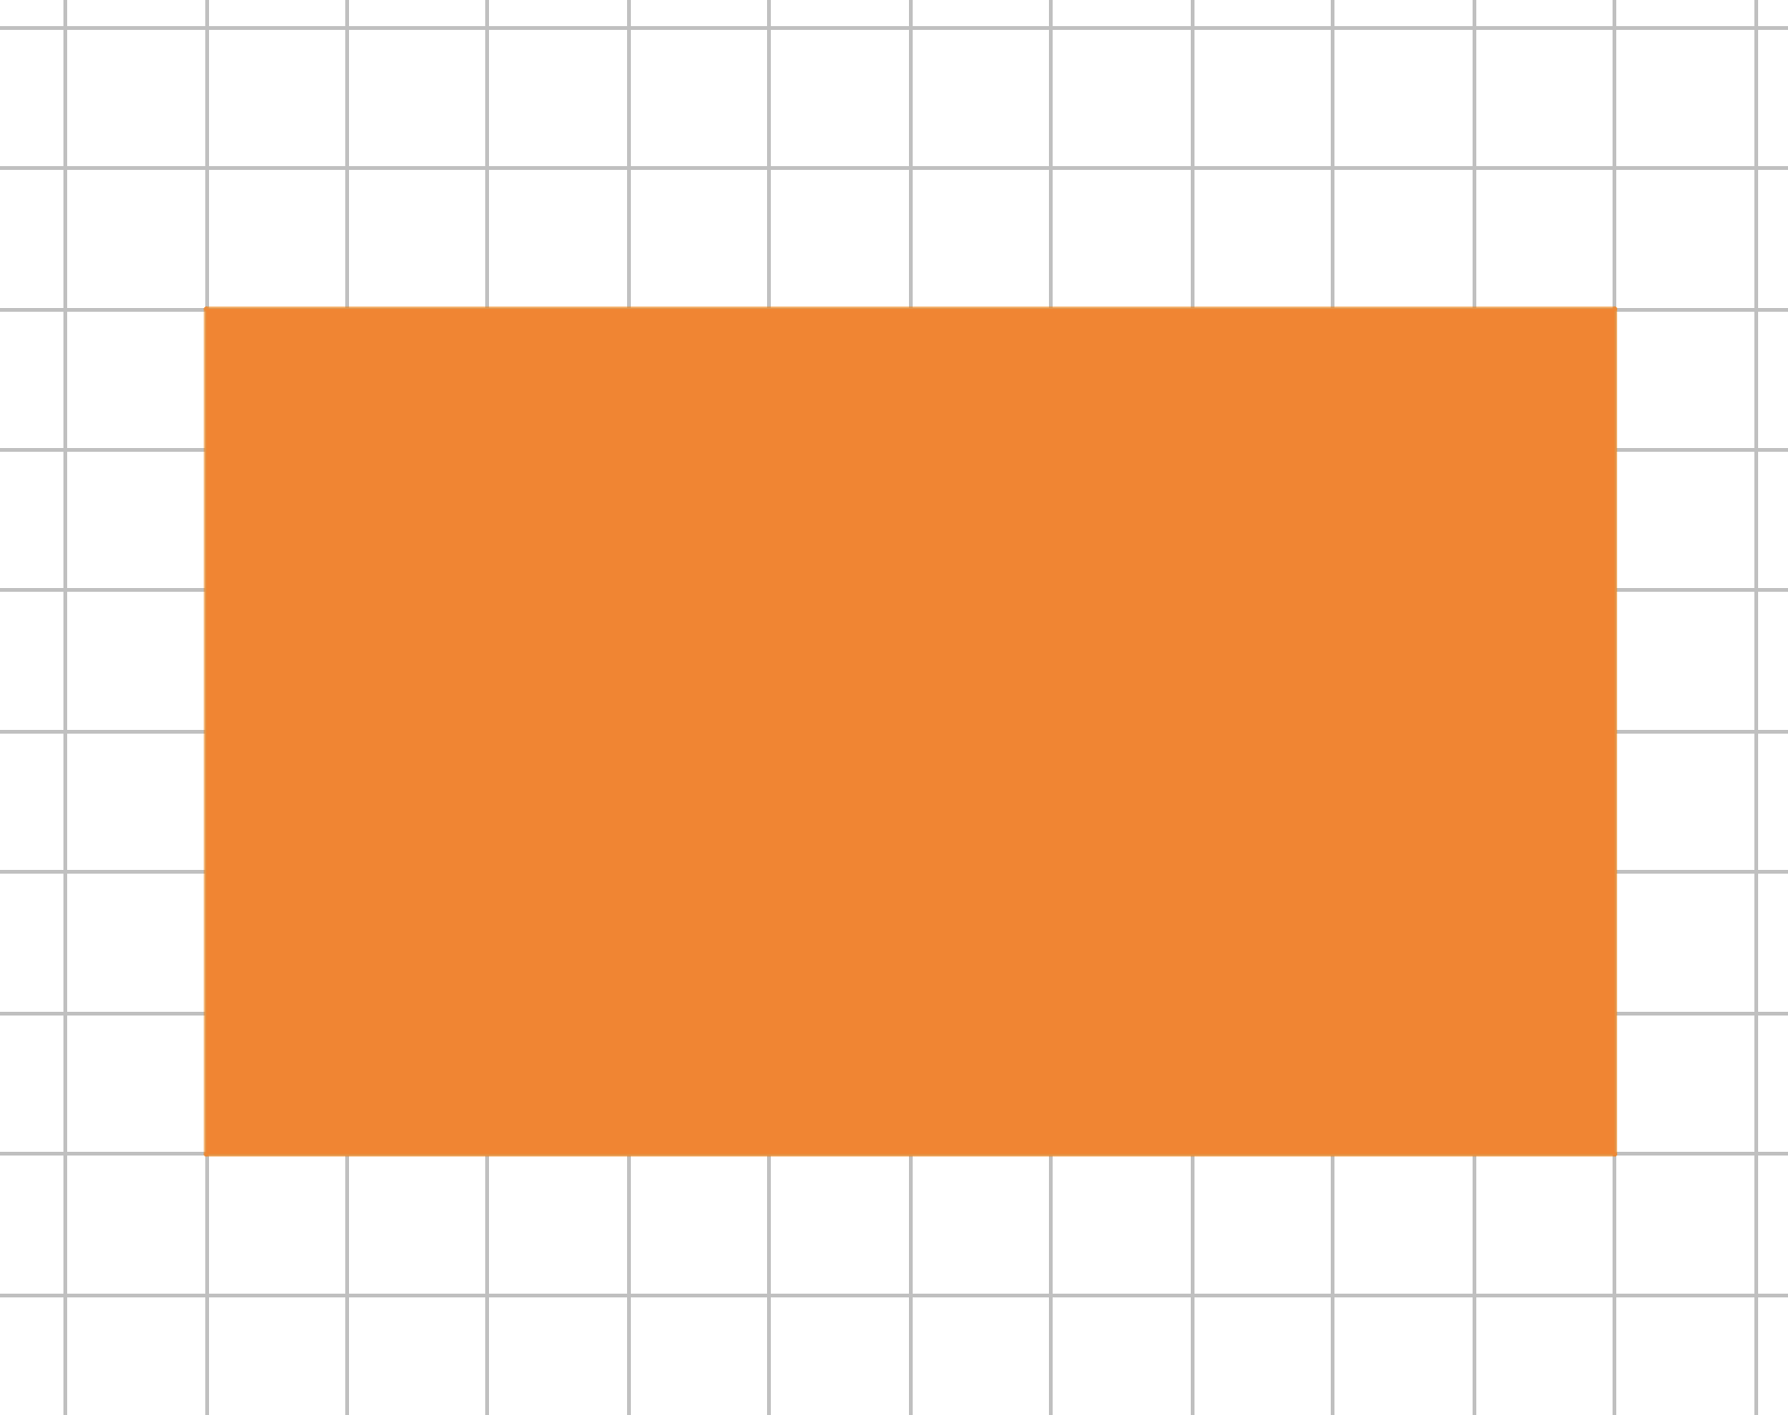
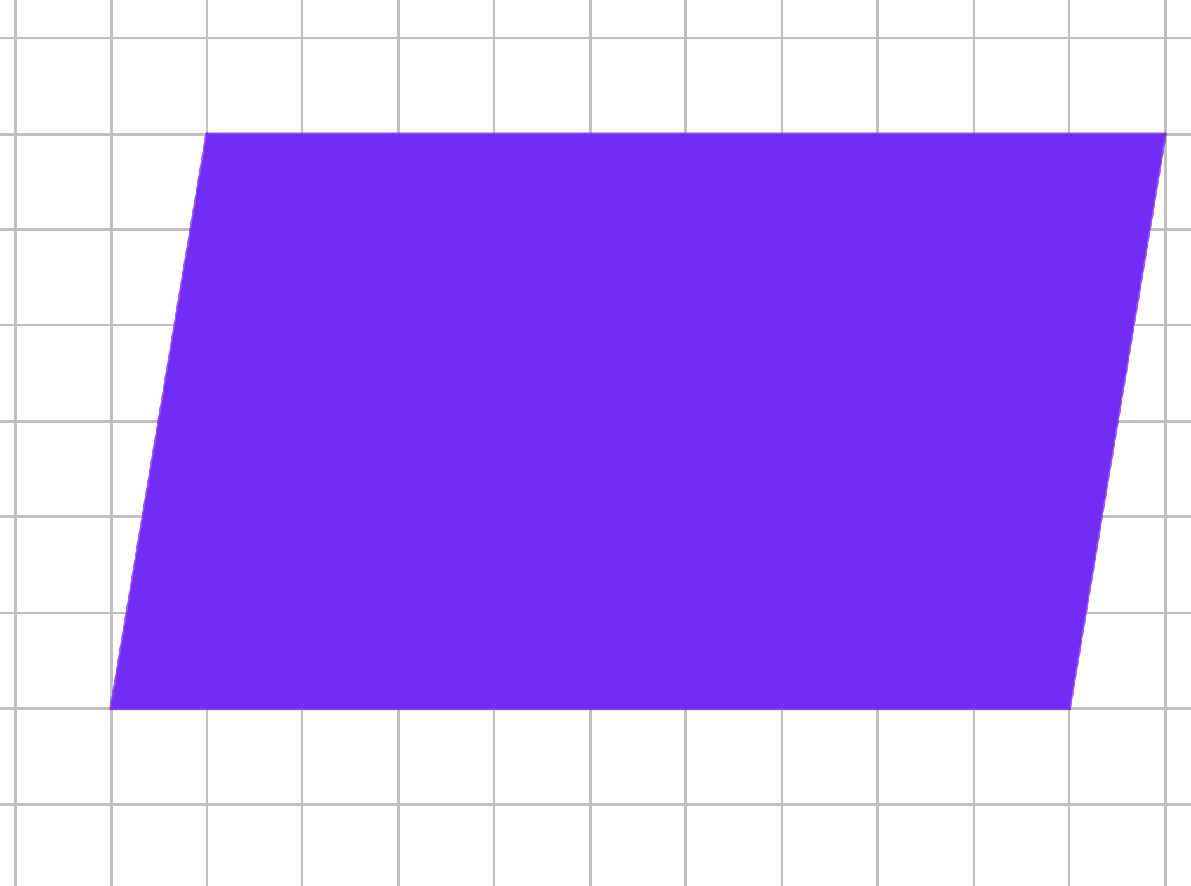
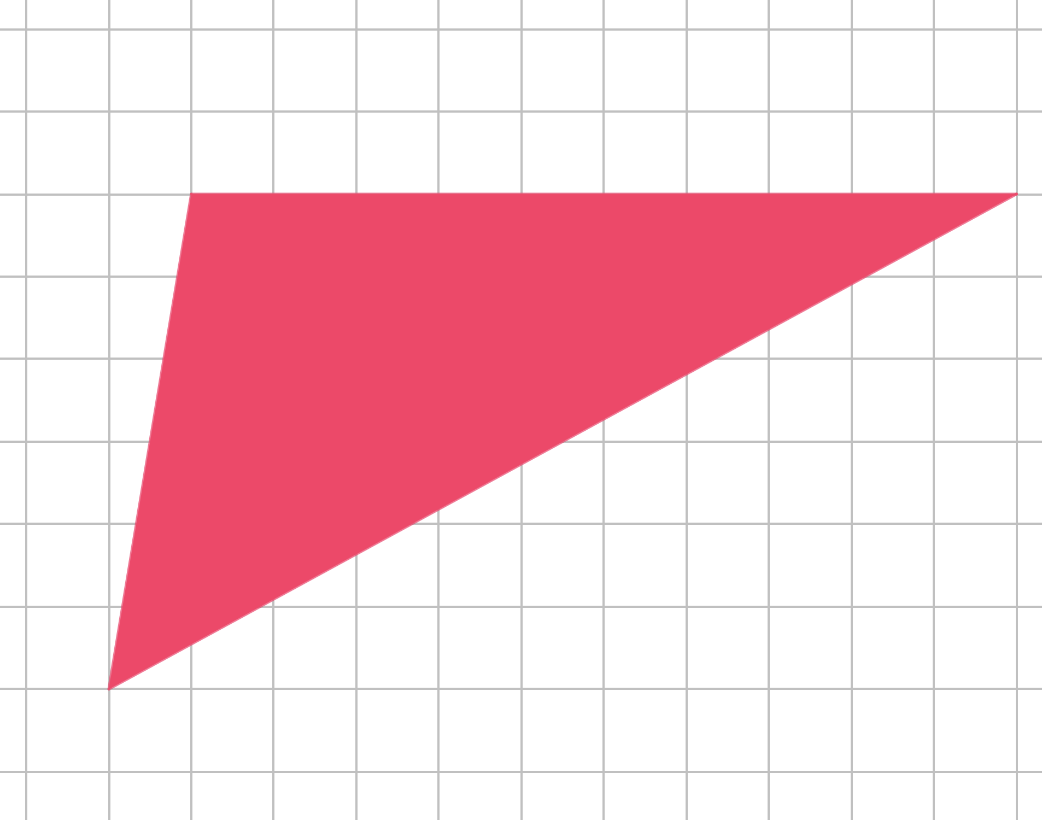
Checkpoint 7: Shapes on a grid
How many squares of the grid below are covered by the rectangle?
Explain how you know.
How many squares of the grid below are covered by the parallelogram?
Explain how you know.
How many squares of the grid below are covered by the triangle?
Explain how you know.
Can you draw a different rectangle, parallelogram and triangle that will cover the same number of squares as each of these?
Notes:
Printable copies of the images in this task are available in ‘Printable resources’, slide 53.
This slide is animated. Each question will appear separately so you can choose the pace at which to work with your class.
Answers
Orange rectangle: 60 squares. Students should say they know because six rows of 10 squares are covered.
Blue parallelogram: 60 squares. Students might describe cutting up the rectangle, or maybe tilting the rectangle as an explanation for their answer.
Red triangle: 30 squares. It is likely that students will say they know because they identify this as half of the parallelogram.
? Any rectangle, parallelogram or triangle with a base and perpendicular height with a product of 60 will cover the same number of squares.
Suggested questioning
How can you work out how many squares are covered?
What is the same/different about each diagram?
Things to think about
In Checkpoint 7, note that the size of the squares in the grids are different in order that students need to reason and justify, rather than state that they 'look about the same’. Think about what justifications for the area of the parallelogram you expect from your students. Is the idea of 'cutting' a triangle from one edge and 'sticking' it on the opposite edge less sophisticated that the idea of 'tipping' the rectangle? Do they suggest different understandings from your students?

Slide 25
Checkpoint 7: Guidance
Adaptations | Assessing understanding
Support A printable resource is provided on slide 53: use this to help students count along the base and height. If this is still challenging, suggest that students extend the grid to draw over the shape to see if it helps them. The focus here is not just on calculating or counting the squares, but also on the way in which they construct the grid and connect that to the number of squares covered. Challenge Encourage students to draw many more rectangles/parallelograms/triangles that covers the same number of squares. By reflecting on their reasoning and their way of drawing each shape, students may begin to generalise the structure, for example that any pair of parallel lines that are 10 squares long and six squares apart will have the required area. Representations The rectangle and parallelogram cover the same number of squares, and the triangle is half of the rectangle, to help students make connections between each shape. The grid is slightly differently sized/aligned each time so students have to count and/or think, rather than just line the shapes up. | The intention here is to explore students’ understanding of area as the amount of space a shape covers on a plane. Students may know the formulae for the area of a rectangle, parallelogram and triangle, but may not appreciate what these formulae are calculating. Or they may not yet have experienced the formulae but can reason about the relationships between the area of each shape. Listen for students whose explanation of how they know shows some understanding of the meaning of area. For example, for the rectangle they might reason that there are 10 columns, each with six squares which leads to the calculation 6 × 10. Students might then use an understanding of conservation of area to reason about the area of the parallelogram and triangle.
Additional resources Pages 35 and 36 of the Secondary Assessment Materials | NCETM offer questions which challenge students’ understanding of what area is as well as how to calculate it efficiently.

Slide 26
Checkpoint 8: Building plots
Bev wants to buy a plot of land to build a house. In the table on the right is some information about the sizes of three plots.
Which plot do you think she should choose?
Plot | Area (m²) | Perimeter (m)
X | 100 | 40
Y | 120 | 242
Z | 120 | 52
Below the table are the plan views of the three plots.
Match each image to a row in the table.
Do you want to change your answer to part a)? Why or why not?
10 m
20 m
GREY
BROWN
10 m
6 m
1 m
GREEN
120 m
Sketch another rectangular plot with the same area as X. Can you make the perimeter larger? How about smaller?
Notes:
This slide is animated. Each question will appear separately so you can choose the pace at which to work with your class.
Answers
a) Students may select any of the plots. Plot X is arguably the most sensible, as it provides the most space to build a house. Students may be tempted to select the biggest value and so choose plot Y, without understanding that this means the plot is very long and thin and so not suitable to build a house on. Plot Z could also be argued to be a sensible plot, as there is space for a house with a long garden. Parts b and c explore potential misconceptions.
b) X: grey (10 × 10); Y: green (120 × 1); Z: brown (20 × 6).
c) Students’ answer to this question will depend upon their choice and reasoning for part a.
? Any pair of numbers with a product of 100, e.g. 25 and 4 or 40 and 2.5. The perimeter will be larger for all combinations; 40 is the smallest possible perimeter for a rectangle with an area of 100.
Suggested questioning
What does ‘plot’ mean here?
Which is the biggest plot? How do you know?
Can you imagine these building plots? What would they look like if they were rectangles?
How about if they were different shapes?
Do the images in part b make you want to change your answer to part a? Why or why not?
Things to think about
Checkpoint 8 introduces values for area and perimeter, and asks students to think about their application in a real-life context. Students are likely to be more used to the reverse scenario (for example, being given lengths and asked to calculate area/perimeter). This explores the depth of their conceptual understanding rather than their confidence with the processes. It is worth spending time on part a and asking students to visualise the possible shapes – particularly discussing what plot Y might look like.

Slide 27
Checkpoint 8: Guidance
Adaptations | Assessing understanding
Support Students may not have experience of what a building plot is or be confident with considering the ‘plan’ view. In this case, show students some images of plan view to support them to understand the scenario. For example, you could show the shape of a familiar building or space (such as the school or playground), when viewed from above. Challenge Ask students to consider other real-life contexts. When might the green plot be the most useful? Representations Part a does not specify that the shapes are rectangles, so that students can consider different shapes with the same area but different perimeters. Students might usefully sketch possible shapes before being shown the three rectangles in part b. | Part a focusses on the concepts of perimeter and area. Students may be tempted to select the biggest value (242) as their preferable plot, without considering what a large perimeter must mean for the shape. The areas have been chosen to be the same or similar to focus students’ attention on the varying perimeters. Give students time to share why they have chosen a particular plot, and to imagine what each plot might look like. Part b introduces three rectangles with dimensions. Comparing the brown and green rectangles (which share the same area) may lead students to make generalisations about what happens to the shape as the perimeter increases. Encourage students to consider the real-life applications and discuss the most useful shape for a building plot. You may also wish to spend some time assessing whether students understand how the lengths relate to the calculations for perimeter and area.
Additional resources Additional activity H similarly explores the relationship between perimeter and area The second question on p33 of the Secondary Assessment Materials | NCETM could offer further exploration for students.

Slide 28
Checkpoint 9: Goldilocks and the three rectangles
Goldilocks wants to work out the area and perimeter of each of these rectangles.
40 mm
13 cm
25 m
Z
6 m
Y
X
40 mm
40 mm
13 cm
40 mm
When is there too much, not enough or just the right amount of information?
Find the area and perimeter of the rectangles where it is possible.
Goldilocks works out the area of Z using the calculation 40 × 40 × 40 × 40. What has she done wrong?
For the rectangle that had not enough information, the perimeter is between 41 and 44. What might the area be?
Notes:
This slide is animated. Each question will appear separately so you can choose the pace at which to work with your class.
Answers
a) X: not enough information is given; both of the parallel sides need not be labelled, but the length of the shorter sides is needed.
Y: the right amount of information is given.
Z: more information is given than is required; the area and perimeter can be calculated with just two perpendicular sides labelled or, if the equal sides of the square were clearly marked, just one.
b) Y: perimeter = (6 × 2) + (25 × 2) = 62 m; area = 6 × 25 = 150 m²
Z: perimeter = 40 × 4 = 160 mm; area = 40 × 40 = 1 600 mm²
c) Goldilocks has wrongly multiplied every side together (possibly because she has misunderstood the rule for area of a rectangle as ‘multiply every side’); she needs to square one side or multiply length by width.
? The missing length is between 7.5 cm and 9 cm, so the area is between 97.5 cm² and 117 cm².
Suggested questioning
Is ‘just enough’ information the same for area and perimeter? Is it the same for all shapes?
What is the same/different about each of these shapes?
Which information could you remove? What information do you need to add?
Things to think about
Checkpoint 9 removes the need to calculate immediately, instead asking students to think about what information they need to calculate area and perimeter. Some common misconceptions may be exposed as a result of these discussions – the aim is to assess what students think they need to do to find the area and perimeter, and uncover if there are any over-simplifications (see Guidance).

Slide 29
Checkpoint 9: Guidance
Adaptations | Assessing understanding
Support To help students grasp the ideas of ‘too much’ and ‘just the right amount’ of information, start with a rectangle with all sides labelled and remove one label at a time. Ask students if they can calculate the area/perimeter at each step and why. Repeat, removing the labels in a different order. Challenge Ask students to apply the questions in this Checkpoint to different shapes, such as triangles and parallelograms, and consider what information is unique to each calculation. Representations The three representations here have been chosen to broaden students’ conceptions of rectangles. An interesting exercise can be to ask students to draw a rectangle and see the images they offer – do they consider different orientations, or squares? Similarly, the different labels have been offered so that students can think about what information is needed rather than just using given values. | This Checkpoint probes some common misconceptions around the calculations for area and perimeter. By asking students about appropriate amounts of information, they have the opportunity to show you if they understand what information is needed for each calculation. Listen out for over-simplified classifications such as ‘add for perimeter’ and ‘multiply for area’. Whilst both area and perimeter are considered together here, you might like to initially focus on just area or perimeter and repeat the task at a later date to compare both. Part c exposes a potential misconception which can occur when students are used to being given only the sides needed to calculate the area. When more sides are labelled, some may be tempted to multiply every value given. Teachers might also like to discus the fact that shape Z is a square and how, if this was clearly marked, we would only need one side to be labelled. Each shape uses a different metric unit, so that teachers have an opportunity to check students awareness of the different units for length and area.
Additional resources Additional activity G uses the context of a coordinate grid to look at finding perimeter from the information given.

Slide 30
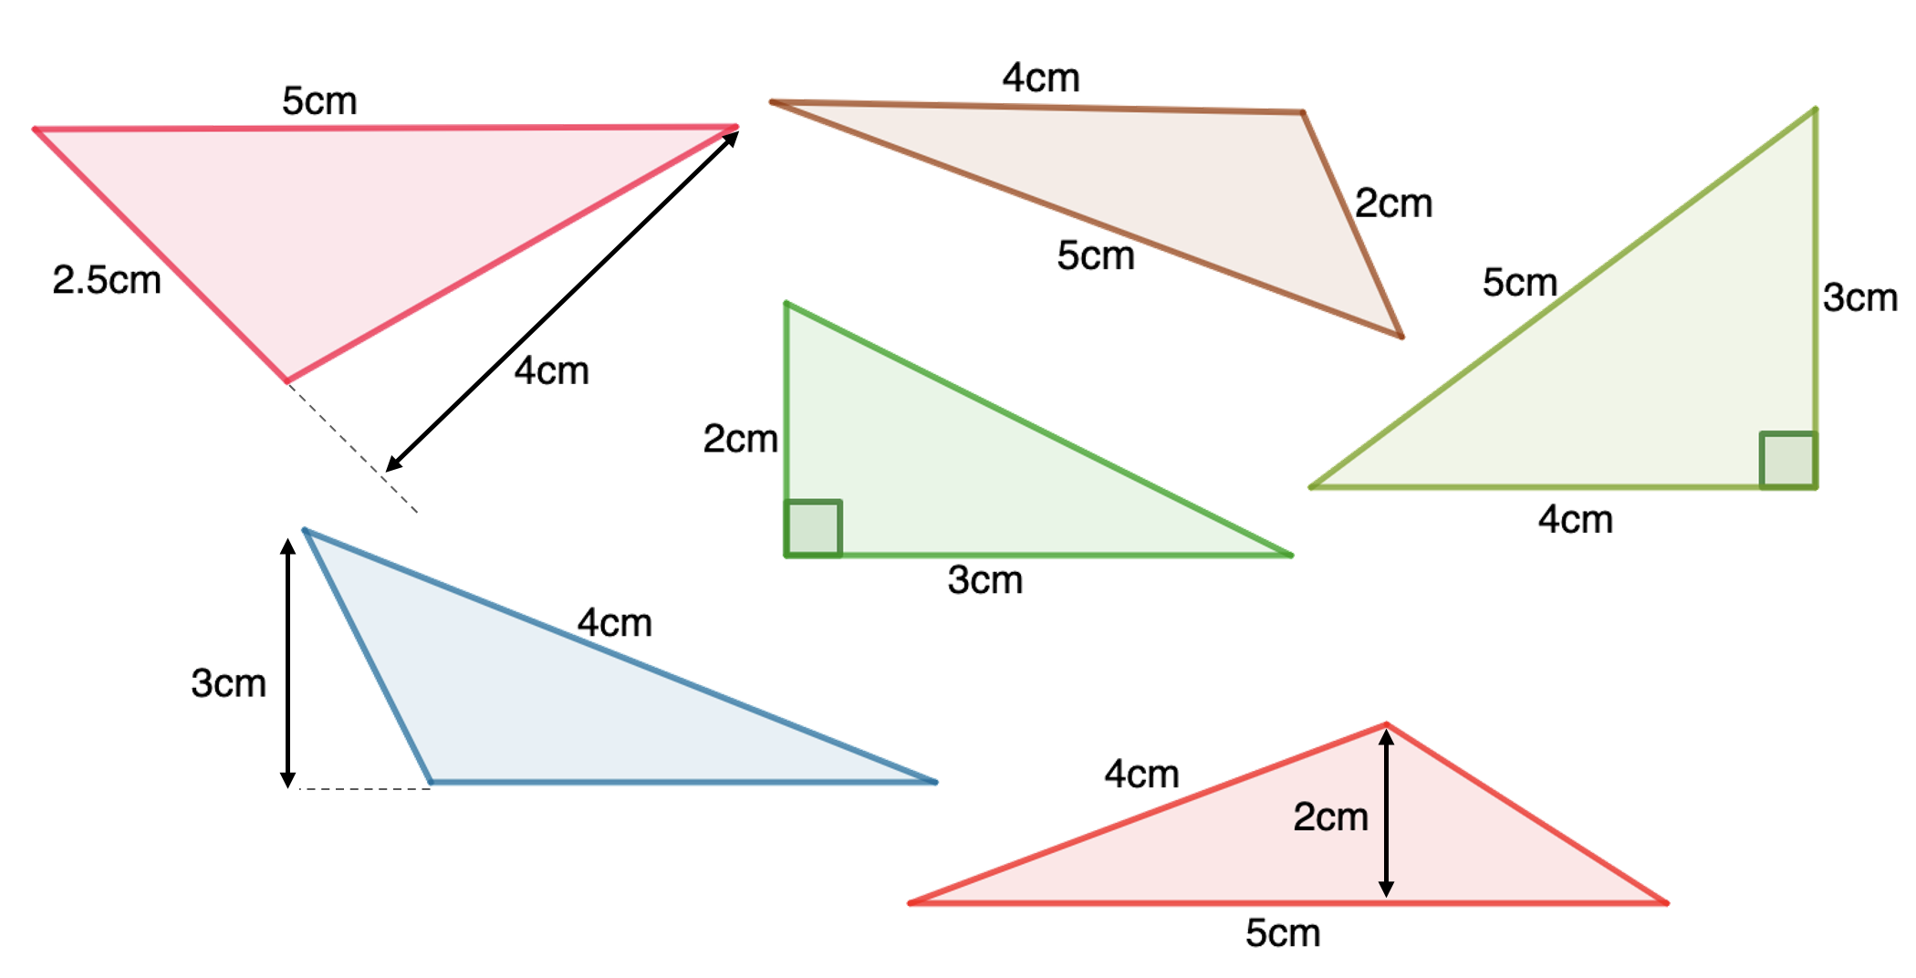
Checkpoint 10: Area or perimeter?
B
A
For each triangle, do you have enough information to calculate the area, the perimeter, both or neither?
Explain how you know.
D
C
E
F
Drawn to scale.
For the ones that are not possible, write the minimum additional information you need. Is there more than one way to do this?
Notes:
This slide is animated. Each question will appear separately so you can choose the pace at which to work with your class.
Answers
A: can calculate area but not perimeter
B: can calculate perimeter but not area
C: can calculate area but not perimeter*
D: can calculate area and perimeter
E: cannot calculate area or perimeter
F: can calculate area but not perimeter
*teachers may wish to mention that, once students have learned Pythagoras’ Theorem, they could calculate both!
? A: the remaining side
B: any perpendicular line from one vertex to a side (or an extension of that side)
C: the remaining side
E: both of the remaining sides (just the base would allow you to calculate area, as would a perpendicular line from the 4cm side to the opposite vertex)
F: the remaining side
Suggested questioning
What's the same and what's different in the labelling of triangle A and triangle E? Triangle C and triangle F? Triangle C and triangle D?
Things to think about
You might like to think about the use of language when discussing Checkpoint 10. Do students specify the perpendicular height for area and understand what this means? Although students may not have enough information to calculate the perimeter or area at this stage, you may like to clarify with them that it is possible to calculate precisely using techniques that they will learn later in KS3. For example, they cannot find the perimeter of triangle C using the mathematics they know now but, by using Pythagoras' Theorem, the problem will become straightforward.

Slide 31
Checkpoint 10: Guidance
Adaptations | Assessing understanding
Support Reduce the number of shapes and the number of properties being worked with, while maintaining the focus on reasoning. For example, ask students to explain why the perimeter of triangle F can’t be found, and follow this by asking why the area can be found. Then reverse this for the triangle B. Challenge Give students a specified area and perimeter and ask them to sketch a triangle that fits these criteria. Is there more than one possible answer? If they accurately draw their suggested triangle, do their values work? Why or why not? Representations A variety of orientations and types of triangle are shown, so that students have experience of more than the ‘classic’ image of a triangle with a base at the bottom. | Students are likely to have met and worked with the formula for the area of a triangle in contexts involving both right-angled and non-right-angled triangles. They are also likely to be familiar with the concept of perimeter – this Checkpoint allows you to assess how much they have retained of this experience. While working on this task students might make errors showing they have not fully understood perimeter – for example, adding three lengths that are not edges such as 4 + 5 + 2 to find the perimeter of triangle F; or multiplying numbers that ‘look’ right such as using the 4 and 3 in the formula to find the area of triangle E. The task is designed particularly to expose misunderstandings around the ‘base’ and ‘height’ of triangles.
Additional resources If students need to take a step back to build their understanding of perpendicular height, the first question on p32 of Year 6 Primary Assessment Materials | NCETM looks at right angles in different orientations. Additional activity I could be a next step to look more deeply at how every side could be defined as the ‘base’ of a triangle.

Slide 32
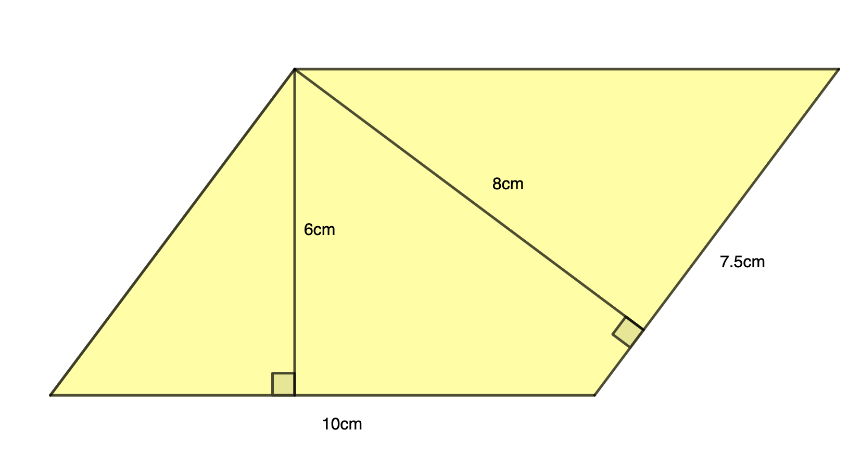
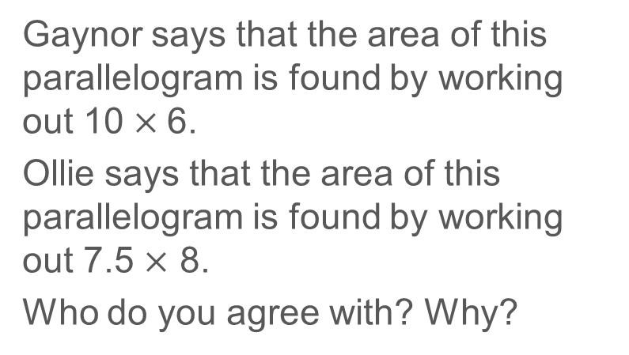
Checkpoint 11: From one vertex
Gaynor says that the area of this parallelogram is found by working out 10 $×$6.
Ollie says that the area of this parallelogram is found by working out 7.5 $×$ 8.
Who do you agree with? Why?
Drawn to scale.
Carefully draw a different parallelogram with a base of 10 cm and a perpendicular height of 6 cm. Measure the other base and perpendicular height. What is the product of these values? Why?
Notes:
This slide is animated. Each question will appear separately so you can choose the pace at which to work with your class. A printable version of the image is provided on slide 54.
Answers
Both Gaynor and Ollie are correct. They have used different lengths as the base, but as they are multiplying by the appropriate perpendicular height each time, they will both find the area of the parallelogram: 10 × 6 = 7.5 × 8 = 60
? The two values would also have a product of 60. Students may find that, due to the accuracy of their drawing, this is not exact!
Suggested questioning
What information is needed to calculate the area of a parallelogram?
What strategies could we use to test Gaynor and Ollie's methods?
Things to think about
The dimensions of the parallelogram have been chosen so that it can be drawn accurately with both vertical heights within the parallelogram and with 'friendly' numbers. What are the benefits of this? Are there disadvantages? You might like to explore the range of possible values that fit within these two constraints.

Slide 33
Checkpoint 11: Guidance
Adaptations | Assessing understanding
Support Rotating an image of the parallelogram so that different edges become the ‘base’ and are aligned horizontally will help students to identify that both possible calculations are correct. A printable version is provided on slide 54. Challenge Give students another pair of values that multiply to 60, and ask them to draw a parallelogram with one ‘base’ of 10 (and height of 6), and one ‘base’ from this pair. Can they identify the other perpendicular height? For example, can they identify the height of 5cm when the side is 12? They might find it helpful to use cm squared paper. Representations Students may be very familiar with a parallelogram in this orientation, with a horizontal base, but may not be used to considering the non-horizontal side as the ‘base’. Part of the challenge of this task comes from the fact that both perpendicular lines converge at a common corner of the parallelogram, maybe making the perpendicular distance less obvious. Students might usefully be asked to mark on lines of 6 cm or 8 cm from other vertices of the parallelogram, extending the edges where necessary, to show these lengths more clearly as perpendicular heights. | Students can be expected to have met the formula for the area of a parallelogram at primary school, but their understanding may vary and they may well only be confident in identifying the base as the horizontal length at the bottom. Listen for students who are confident in identifying the relevant lengths from the four given to spot one correct calculation (which is likely to be Gaynor’s because of the alignment of the ‘base’). Students who understand the area of a parallelogram as ‘height × base’ may not recognise the non-vertical distance as relevant and so not see Ollie’s calculation as a valid approach.
Additional resources Additional activity I and Checkpoint 10 both give an opportunities to identify the base and associated perpendicular height for non-right angled triangles.

Slide 34
Checkpoint 12: Labels
The three shapes are a square, a rectangle and an isosceles triangle.
Choose values for the labels so that:
Each shape has a perimeter of 12 cm.
Each shape has a perimeter of 30 cm.
Each shape has an area of 16 cm².
Each shape has an area of 25 cm².
Which boxes are never filled at the same time? Why?
Notes:
Printable copies of the images in this task are available in ‘Printable resources’, slide 55.
Answers
a) Red square, top left: either or both lengths = 3 cm; blue triangle, top right: any pair of values where the horizontal side + 2 × non-vertical side sums to 12 cm, and the non-vertical sides are greater than 3cm (for example, 2 cm and 5cm); yellow rectangle, bottom: each side labelled with any combination of values that sum to 6 cm.
b) Red square, top left: either or both lengths = 7.5 cm; blue triangle: any pair of values where the horizontal side + 2 × non-vertical side sums to 30 cm, and the non-vertical sides are greater than 7.5cm (for example, 12 cm and 9 cm); yellow rectangle, bottom: each side labelled with any combination of values that sum to 15 cm.
c) Red square, top left: either or both lengths = 4 cm; blue triangle, top right: horizonal side and perpendicular height labelled with any combination of values that have a product of 32 (for example, 8 cm and 4 cm); yellow rectangle, bottom: each side labelled with any combination of values that have a product of 16 (for example, 8 cm and 2 cm)
d) Red square, top left: either or both lengths = 5 cm; blue triangle, top right: horizonal side and perpendicular height labelled with any combination of values that have a product of 50 (for example, 10 cm and 5 cm); yellow rectangle, bottom: each side labelled with any combination of values that have a product of 25 (for example, 12.5 cm and 2 cm)
? The perpendicular height and non-vertical side of the blue triangle, top right, are not filled at the same time.
Suggested questioning
Do you need to label every box each time? Why or why not?
For parts c and d, what do you notice about your values for the blue triangle/yellow rectangle?
Things to think about
A key purpose of this Checkpoint is to assess whether students understand that they don't need all values in order to calculate the different measures. In this case, the perpendicular height and non-perpendicular side of the triangle will not need to be labelled at the same time. You do not need to go beyond this to check understanding at this stage. If the opportunity arises, you could ask students to estimate the possible values of the third measure of the triangle, or mention to them that they will later learn the mathematics they need to be able to label all sides.

Slide 35
Checkpoint 12: Guidance
Adaptations | Assessing understanding
Support Understanding that a range of solutions is possible may be challenging for some students. Reduce the range by fixing one of the dimensions. Ask students which box they'd like to complete for each shape, and use their responses (particularly if they ask for an unnecessary value for the triangle) as a part of your ongoing assessment. A printable resource is on slide 55. Challenge The triangle and rectangle offer a range of possible answers for both the area and perimeter. Ask students to explore the boundaries of this range of possible answers, maybe sketching different possibilities. Representations The rectangle and square are presented in their most ‘classic’ and over-represented form: orientated with horizontal and vertical lines, and exactly two sides labelled. The triangle is presented perhaps more unusually as the ‘base’ is at the ‘top’, but it is still likely to be very familiar. Consider students’ experiences of the examples they work with beyond this checkpoint: do they see different orientations and representations of shapes and their labels? | The task is designed to let students show their understanding and reasoning around perimeter and area. When looking for perimeter, look out for students who, for example, choose two values that sum to 12 and do not reason that this would actually create a perimeter of 24. When working with area, look for students who understand that the product is key, maybe connecting the square root and the length for the square, or noticing that they can use their rectangle lengths for the triangle, if one of them is doubled. Try to draw out whether students understand that the non-horizontal side for the triangle cannot be used to calculate area as we do not know the corresponding height.
Additional resources For students that struggled with identifying which lengths to use when calculating the area of the triangle, Additional activity I offers an opportunity for further practice.

Slide 36
Checkpoint 13: Holes
What is the same about these shapes? What is different?
1
2
3
4
3 mm
3 mm
3 mm
3 mm
8 mm
8 mm
8 mm
8 mm
3 mm
3 mm
10 mm
10 mm
10 mm
10 mm
Which shapes have the same area?
Which have the same perimeter?
Design another shape that has the same area and perimeter as each of your shapes.
Notes:
Printable copies of the images in this task are available in ‘Printable resources’, slide 56.
This slide is animated. Each question will appear separately so you can choose the pace at which to work with your class.
Answers
a) This question is open ended, and so students’ responses may vary. Students may comment that they are all based around the same 8 × 10 rectangle, but that 2, 3 and 4 all have a 3 × 3 ‘hole’ removed. Students may identify shape 2 as the only hexagon or shape 3 as the only octagon. Debate may ensue about whether shape 1 is the only rectangle, or if shape 4 can be classified as a rectangle as well. Students may also supply some of the information about area and perimeter that is specifically asked for in parts b and c; these parts have been included in case they don’t.
b) Shape 1 has an area of 80 mm². Shapes 2, 3 and 4 all have the same area: 8 × 10 − 3 × 3 = 71 mm².
c) Shapes 1 and 2 both have a perimeter of 36 mm.
Shape 3 has a perimeter of 42 mm.
Shape 4 is mathematically ambiguous, and students may supply different answers based upon their definition of perimeter. If students understand perimeter as ‘the distance around the outside’, then they may argue that the perimeter is 36 mm as with shapes 1 and 2. If students understand the perimeter as ‘the sum of the the lengths that bound the area’, then they may argue that the lengths of the hole should also be included, making the perimeter 48 mm. A useful conversation might be had about context, and when each definition is most useful. For example, the rectangle could represent a scale image of a field with a pond in the middle: you would use the value of 36 if you were describing the distance to walk around the outside of the field, but 48 if you were describing the length of fencing needed to border the field and pond.
? Students’ responses to this may vary: some may choose to adapt the existing shapes, for example by moving the ‘hole’ to a different position, whilst others may create entirely new shapes.
Suggested questioning
How did you find the area/perimeter? Are there different ways to find the area/perimeter?
Which two shapes are most similar? Why do you think this?
What does perimeter mean?
For shape 4, when might you want to include the 3 mm square in the perimeter? When might you not want to?
Things to think about
In Checkpoint 13, the same rectangle is used as the basis for four different shapes, to explore area and perimeter. How might you draw attention to the similarities and differences between each shape?

Slide 37
Checkpoint 13: Guidance
Adaptations | Assessing understanding
Support The numbers are straightforward to ensure ease of access to this activity. Provide a printed version (slide 56) if students would benefit from being able to make notes on the shapes to support their reasoning. Challenge Ask students to order the shapes according to area or perimeter, and to create a shape that would fit between each in their order. Representations The variation of these four shapes has been planned carefully, with the same dimensions throughout to help students more readily notice what is different about the area/perimeter. If students need more support to recognise the similarities, teachers could cut out a piece of white paper that is the same size as the hole (when projected) to model how the ‘hole’ has moved each time. | This activity explores compound shapes, but relates them all back to the same rectangle. Therefore the focus is less upon the calculation, and more upon the reasoning around when area and perimeter will change or be the same. When considering perimeter, students may assume that the middle two are the same as the same shape has been cut out. Listen carefully to the language that they use to support their reasoning. Colouring each line segment a different colour may help students to identify they lines they want to describe in their explanations. When calculating area, students often break compound shapes into smaller shapes but this task is designed to lead students towards the idea of ‘cutting out’ the smaller square so subtracting that area from the larger rectangle. How readily students notice and accept this may help teachers plan future content involving compound shapes.
Additional resources If students find it hard to accept that the perimeter is constant between shapes 1 and 2, Additional activity E makes more explicit how perimeter remains constant when a rectangle is cut to become an ‘L’ shape.

Slide 38
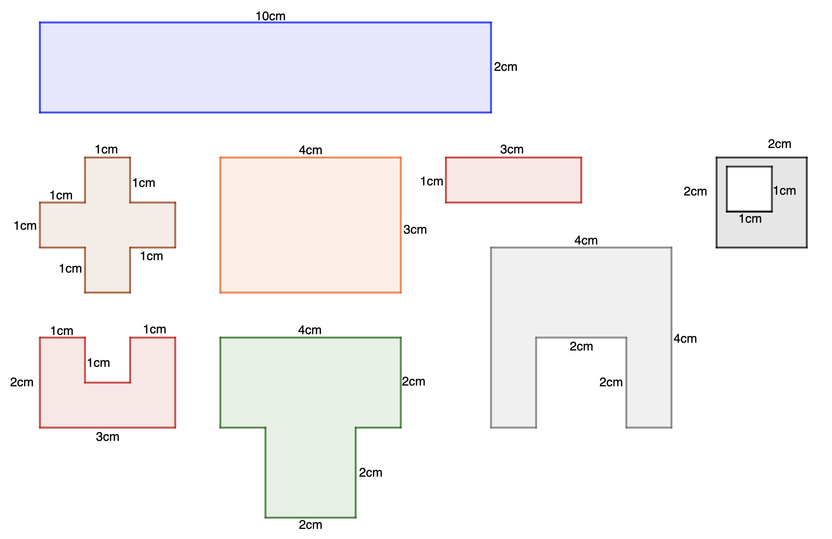
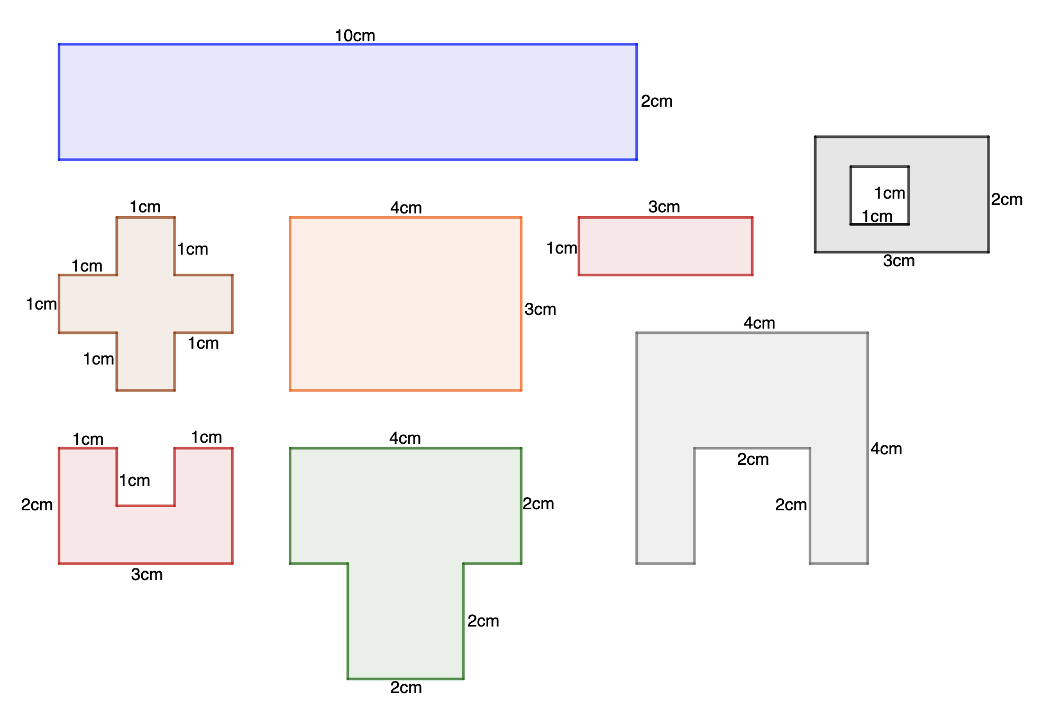
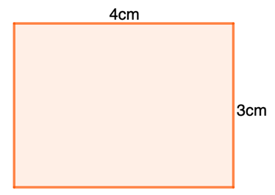
Checkpoint 14: Dozen or doesn’t?
Some of these shapes have an area of 12 cm². Some have a perimeter of 12 cm.
Some have neither.
Decide which shapes are in which category.
G
All angles are right angles.
E
A
B
D
F
C
H
Design your own shapes with an area of 12 cm² or perimeter of 12 cm.
Notes:
Printable copies of the images in this task are available in ‘Printable resources’, slide 57.
This slide is animated. Shapes E–H are hidden and will appear separately so you can choose the pace at which to work with your class.
Answers
Area of 12: D, E and G
Perimeter of 12: B, C and, arguably, H (see notes from previous Checkpoint)
Neither area nor perimeter of 12: A, F
Suggested questioning
Are there any that you can definitely identify as not having 12?
Which were easiest/hardest to reason about?
Things to think about
Checkpoint 14 explores rectangles and other rectilinear shapes, looking both at area and perimeter. A discussion around the ‘hollow rectangle’ (H) may prove more revealing around students; understanding of both area and perimeter and whether they feel that the perimeter of the shape should include or exclude the perimeter of the ‘hole’. (The convention is that the perimeter of a hollow rectangle includes the hole, so the perimeter of the shape shown is 12 cm. However, it is not necessary for students to know this at this stage.)

Slide 39
Checkpoint 14: Guidance
Adaptations | Assessing understanding
Support Keep shapes E–H on the slide hidden to reduce the complexity for students, or reveal the remaining four one at a time and treat each as a discussion point. For example, ask, ‘Why might someone think that the area/perimeter of this one is 12?’ A printable version is on slide 57. Challenge The task includes several shapes where either the area or the perimeter has a numerical value of 12. Challenge students to find the dimensions of a shape where both of these properties have the same numerical value. How close can they get to 12? It is not possible for a simple rectangle to have a perimeter and area equal to 12 units – can students identify this and explain why? Representations The shapes are presented on a blank slide, but offering squared paper for students to reconstruct some of the more challenging shapes may support them in conceptualising the area of each shape. A printable version of this slide is also available; students may find this helpful to annotate or highlight to identify key elements and equal lengths | The task is designed so that students are working simultaneously with both area and perimeter, and so will reveal any mistakes around the two concepts. It also gives an opportunity to discuss units: do students understand that the area and perimeter of a shape might have the same numerical value, but that these numbers represent measures of different physical characteristics? The shapes have been chosen to elicit potential misconceptions. For example, adding just the labelled sides for A or G gives an answer of 12 cm, but this is not the whole perimeter. Shape G does in fact have an area of 12 and so students may be misled into stating ‘both’.
Additional resources Additional activity D provides a context for students to reason about perimeters in rectangles, while Additional activity E allows them to think about area and perimeter of rectilinear shapes.

Slide 40
Additional activities
Activities A–J

Slide 41
Activity A: Shifting sticky notes
Five square sticky notes are used to make a shape with a perimeter of 12 units.
How might you move one of the sticky notes so that the perimeter stays the same?
How might you move one of the sticky notes so that the perimeter decreases by two?
How might you add another sticky note but not change the perimeter?
How might you move one of the sticky notes so that the perimeter increases by two?
Notes:
This slide is animated. Each question will appear separately so you can choose the pace at which to work with your class.
Answers
a) There are many possible correct solutions. The lowest sticky note can be repositioned anywhere on the remaining four and the perimeter will be constant.
b) Move the end sticky note on the right down so that it is directly to the right of the lowest sticky note.
c) Adding another sticky note beside and to the right of the lower square will not change the perimeter.
?) By sliding the third sticky note on the top row down by half a square, the perimeter will increase by two.
Suggested questioning
Which part did you find easiest?
Is there more than one way to do each part?
What other perimeter changes could you make?
Things to think about
Additional activity 7 offers a representation for exploring perimeter and may be most effective if students have physical sticky notes to manipulate. When moving the sticky notes, think about what element of the perimeter is being lost and what's being gained. You might like to consider the further thinking question, and whether it is possible to give an answer with sticky notes being fully aligned, and if not, why not?

Slide 42
Activity B: Decorating
Mia is decorating a wall in her house. It is in the shape shown on the right below, and has an area of 9 m² .
Which of the options below would be easiest to use to decorate the wall? Why?
Wallpaper
2 m² per roll
£24
Tiles 0.25m²
Tiles 0.25m²
Tiles 0.25m²
Tiles
0.25 m²
^{£12 for 4}
Paint
200ml
covers 1.5 m²
^{£21 per tin}
Explain what Mia would need to do to decorate the wall with each option.
Which is the best-value option for Mia? Would your answer change if it had an area of 10 m²? How about 11 m²?
Notes:
This slide is animated. Each question will appear separately so you can choose the pace at which to work with your class.
Answers
a) There is no ‘correct’ answer here, but students may notice that the shape of the wall means that, for both the wallpaper and tiles, some would need to be cut at an angle to cover the space around the non-right-angled corners. Paint would therefore arguably be more straightforward. Students may also notice the cost and coverage of each option, and use this to form the basis of their argument.
b) Mia would need six tins of paint, which she would spread over the wall. She would need at least five rolls of wall-paper, which would need to be cut to the height of the walls, and the shape of the non-right-angled corners. Mia would need 36 tiles, which would need to be cut to the shape of the non-right-angled corners. (Students may recognise that the pieces of 36 tiles could be rearranged to the correct shape, or might suggest that she buys more than 36 tiles for ‘neatness’).
? Wallpaper would cost 5 × £24 = £120. Paint would cost 6 × £21 = £126. Tiles would cost 9 × £12 = £108 (or more if she bought extra tiles to simplify arranging cut pieces). Tiles are therefore the best value.
If the wall had an area of 10 m², then additional tiles and paint would need to be purchased (10 × £12 = £120 for tiles and 7 × £21 = £147 for paint), so tiles and wallpaper would be equal cheapest.
If the wall had an area of 11 m², then additional would need to be purchased for all three options (11 × £12 = £132 for tiles, 8 × £21 = £168 for paint and 6 × £24 = £144 for wallpaper), so tiles are the cheapest again.
Suggested questioning
How can all three options cover the same area?
What does ‘an area of 9 m²’ mean? Can you explain it using the paint? The tiles? The wallpaper?
What is the effect of the ‘cut-off corner’? How would this question be different if the wall was rectangular?
Which is the best-value option? Will this always be the best value?
Things to think about
Additional activity B uses the context of decorating to give students an opportunity to talk about what they understand by ‘area’, without explicitly asking them to define it. It can be hard for students to articulate their understanding of the measurement of 2D space and so three different options for decorating are given. Interesting discussions might be had comparing how, for example, paint and tiles can both be described as ‘covering’ a space. The dimensions of the wallpaper and tiles have not been given so as to keep the focus of discussion on the concept rather than on specific calculations. The shape of the wall has been chosen to not be a rectangle, so teachers can probe students’ understanding of how, for example, 36 tiles will still ‘fit’ in the space. If students find this hard to visualise or describe, teachers may wish to first show a rectangle of 9 m² before showing the wall given here.

Slide 43
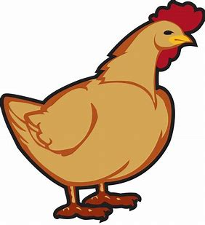
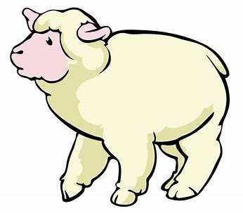
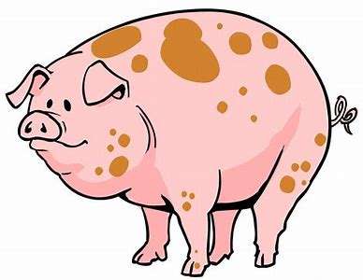
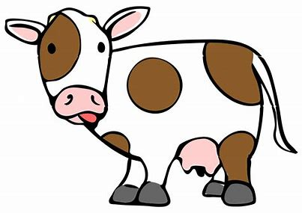
Activity C: Fencing
Farmer Dave has 120 m of fencing. He creates a different-shaped pen for each animal.
What could the length of each of the sides be if the pens have different lengths for each side?
How would your answers change if the pens were regular?
Animal
Pens’ number of sides | 3 | 4 | 5 | 6
How might your answers change if he had 150 m of fencing?
Notes:
This slide is animated. Each question will appear separately so you can choose the pace at which to work with your class.
Answers
a) Any combination of 3, 4, 5 and 6 different numbers that sum to 120 m. For example, chickens: 30 m, 4 0m and 50 m; sheep: 25 m, 35 m, 20 m and 40 m; pigs: 12 m, 24 m, 36 m, 20 m and 28 m; cows: 17 m, 18 m, 19 m, 21 m, 22 m and 23 m.
b) If the pens were regular, the sides would need to be the same length so you could just divide 120 m by the number of sides. Chickens: 3 × 40 m sides; sheep: 4 × 30 m sides; pigs: 5 × 24 m sides; cows 6 × 20 m sides.
? Some students may attempt this from the beginning again, using 150 m as their starting point. Others might try to adapt their existing answers. Probe students’ reasoning to explore the strategies they choose. For example, they may start with their side lengths for part a and add 10 m to each of their values for their chicken pen, or 7.5 m to each of their values for the sheep pen etc. For part b, students may attempt a similar strategy or simply divide 150 m by the number of sides each time.
Suggested questioning
What does ‘pen’ mean here?
What does ‘regular’ mean? What word could we use to describe a shape with different lengths?
What is your strategy?
If one of my lengths is 25 m, what might the others be?
Can you think of a solution where there is only one integer length? How about none?
Things to think about
Additional activity C uses a context for perimeter to assess a wealth of related concepts. There is an opportunity to discuss regular and irregular shapes, as well as shape names and properties, including shapes that are ‘impossible’ (such as a triangle where the sum of two sides was the same or less than the third side). Teachers might be interested in students’ strategies and whether they work logically – for example, by adjusting previous answers to take account of more side lengths. There is also an opportunity to assess fluency with addition and subtraction facts and students’ willingness to reason with them. Do students recognise, for example, that if they introduce an odd length, that they will need to ‘pair’ it up with another odd length? Do they think about ensuring their ones values sum to a multiple of 10? If these conversations do not naturally occur, teachers might prompt them by suggesting one or two lengths.

Slide 44
Activity D: Impossible rectangles
Class 6 were asked to sketch rectangles with a perimeter of 30 cm. Some of their responses are shown – rectangles A to F.
Which of these are possible?
For those that are possible, what must the missing lengths be?
For those that are not possible, what do you need to change?
Diagrams not drawn to scale.
40 mm
16 cm
10 cm
E
A
D
F
A square
20 cm
14 cm
3 cm
B
C
10 cm
How many different perimeters can you find for rectangles with a an area of 30 cm²?
Notes:
This slide is animated. Each question will appear separately so you can choose the pace at which to work with your class.
Answers
a) C, E and F are possible
b) C: 1 cm, 14 cm and 1 cm E: 110 mm, 40 mm and 110 mm; F: 7.5 cm, 7.5 cm, 7.5 cm and 7.5 cm
c) A: the length of 16 cm needs to be less than (but not including) 15 cm.
B: the two lengths need to add up to 15 cm, not 30 cm, so could, for example, both be halved to 10 cm and
5 cm.
D: this has a perimeter of 26 cm (but an area of 30), so the two lengths need to be a total of 2 cm longer. For example, the 10 cm could be increased to 12 cm or the 3 cm could be increased to 5 cm.
Suggested questioning
What must the two lengths add up to? Why is this not 30?
What is the longest that the longest length can be?
What do you need to do to calculate the lengths of the square?
Things to think about
Additional activity D explores the calculation for perimeter in more depth, and has been designed to expose some common misconceptions. For example, the two values for D result in an area of 30, rather than a perimeter. The two values for B add to 30, but are only half of the perimeter, as students sometimes forget to double the sides if they are not labelled. A and C encourage students to think about the limits of the possible answer, and why a length of 15 or more would be impossible. E gives the opportunity to discuss different units of measurement. Checkpoint 6 in the ‘Properties of number’ deck offers a further assessment opportunity for units of measure if this is a challenge for your students.

Slide 45
Activity E: L shapes
Tyrell cuts a section out of a 10 × 10 square to create an L shape.
What is the area of his L? What is the perimeter?
4 cm
4 cm
Below are some more L shapes created from 10 × 10 squares.
What is the area and perimeter of each L shape? What do you notice?
4 cm
4 cm
4 cm
6 cm
2 cm
9 cm
9 cm
1
4
9 cm
2
3
Can you use a 10 × 10 square to create an L shape with an area of 100 m²? How about a perimeter of 36 cm? Why or why not?
Notes:
This slide is animated. Each question will appear separately so you can choose the pace at which to work with your class.
Answers
a) Area = 84 cm², perimeter = 40 cm
b) Shape 1: area = 76 cm², perimeter = 40 cm; shape 2: area = 92 cm², perimeter = 40 cm; shape 3: area = 64 cm², perimeter = 40 cm; shape 4: area = 9 cm², perimeter = 40 cm. The perimeter is the same each time. The area is 100 – the area of the rectangle that has been ‘cut’ out.
? The L shape will always have an area of less than 100 cm², if you start with a 10 × 10 square. If the L shape needs an area of 100 cm², then at least one of the lengths will need to be more than 10. Similarly, the L shape will always have a perimeter of 40 cm. If it needs a perimeter of 36 cm, then the starting rectangle will also need to have a perimeter of 36.
Suggested questioning
What is the same and different each time?
How can you use your previous answers to work out the area for the subsequent answers?
Why do they all have the same perimeter?
Things to think about
Additional activity E follows the theme of holes from Checkpoint 13, but looks more explicitly at the relationship between a rectangle and the L shapes created by cutting a rectangle from one corner. There are two elements to assess here: area and perimeter. If students find this challenging, teachers may like to focus on just one concept at a time, and solely ask about area or perimeter.
The key assessment point for perimeter is whether students understand that the perimeter of any L will be the same as the smallest rectangle that it fits into. Students may find it hard to visualise why all of the shapes on this page have the same perimeter – this can be made more obvious by highlighting the vertical and horizontal lines in two different colours or patterns. Dynamic explanations, where lengths physically move to align with each other, may also be helpful.
The key assessment point for area is whether students understand that the area can be found efficiently by subtracting the area of the ‘cut-out rectangle’ from 100. Students may be more inclined to separate the L into two rectangles and then add, and so may need this more efficient method to be suggested. Some students may notice that four of the five L shapes involve a length of four, and that they can use their previous answers to calculate subsequent ones. For example, the L shape in part a has a 4 × 4 rectangle cut out, but first L shape in part b has a 6 × 4 rectangle cut out – so a further 2 × 4 needs to be subtracted from their answer to part a.

Slide 46
Activity F: Perimeter of 100
Match each of shapes 1 to 4 to a name.
2
Isosceles triangle
4
Equilateral triangle
1
3
Isosceles trapezium
Scalene triangle
All the shapes have a perimeter of 100 m. Their side lengths are integers.
What might the side lengths be? Are they all possible?
How would your answers to change if the side lengths were not specified to be integers?
What is the minimum and maximum each side length can be?
Notes:
This slide is animated. Each question will appear separately so you can choose the pace at which to work with your class.
Answers
a) 1 (green) is a scalene triangle; 2 (purple) is an isosceles triangle; 3 (yellow) is an equilateral triangle; 4 (blue) is an isosceles trapezium.
b) There are multiple combinations of integers that would work for shapes 1, 2 and 4 – explore with students which ones are physically possible. For example, for scalene triangle 1, students could suggest 10, 40 and 50 but this would not be possible, whereas 25, 35 and 45 would. For isosceles triangle 2, 60, 20 and 20 would be an impossible combination, but 20, 40 and 40 would work. For isosceles trapezium 4, 60, 10, 10 and 20 would not be possible, but 40, 15, 15 and 30 would be. An equilateral triangle is not possible with integer lengths as 100 is not a multiple of 3.
c) There would now be an infinite number of possible solutions for shapes 1, 2 and 4. The equilateral triangle is now possible, with lengths of 33⅓ m.
? For triangle 1, the two shorter sides must add up to be longer than the longest side. For triangle 2, the two identical sides must add up to be longer than the third side. There is only one solution for triangle 3 (given above). For trapezium 4, the two equal sides and shortest sides must add up to be longer than the longest side.
Suggested questioning
What is the same and different about, for example, shapes 2 and 3? Or 2 and 4?
What does ‘integer’ mean? Why does this mean one of the shapes is not possible?
Will every combination of numbers that add to 100 work? Why or why not?
Things to think about
Activity F offers another context to explore perimeter and properties of shapes. Students may not have experienced the dash notation for sides of equal length before, and so part a has been included so that teachers can establish the properties of each of the shapes given and check understanding of terms such as ‘isosceles’. At its most simple, part b activity explores if students understand perimeter as the total of each side length, and can suggest some potential values based on shapes’ properties. If students are ready and it is appropriate, teachers can support them to think more deeply about whether their suggested lengths are physically possible for each shape. If students find this activity challenging, removing the trapezium would allow students to focus solely on combinations of three numbers and what properties would make these combinations possible.

Slide 47
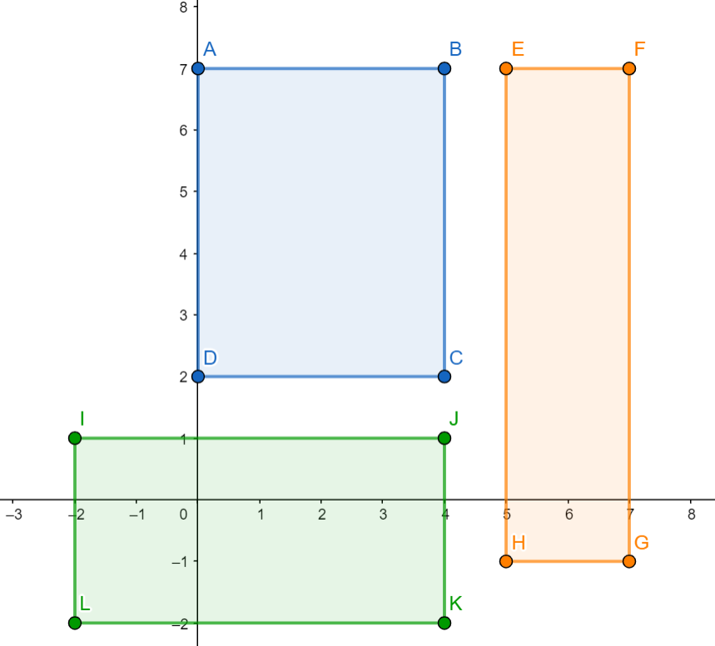
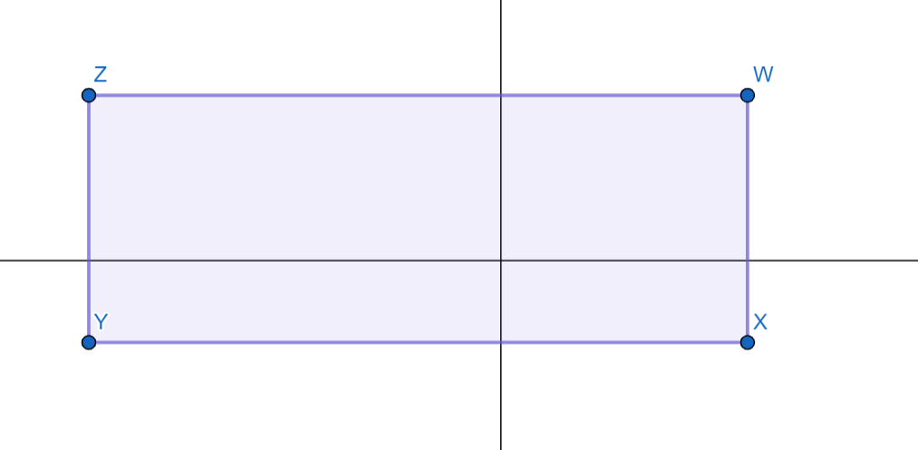
Activity G: Coordinate perimeters
y
Find the perimeter of each of the rectangles on the left .
The rectangle below has a perimeter of 24 units. What could the coordinates be?
y
x
x
Notes:
This slide is animated. The further thinking question will appear separately so you can choose the pace at which to work with your class.
Answers
ABCD (green): 18 units
EFGH (blue): 18 units
IJKL (orange): 20 units
? Any set of four coordinate where the difference between pairs of x-values, and the difference between pairs of y-values, sums to 12, and there is a coordinate in each quadrant. For example: (3, 3), (-5, 3), (-5, -1) and (3, -1).
Suggested questioning
Which looks like the longest perimeter? Why?
How would you work out each length?
Where you have negative coordinates, what is your strategy?
Things to think about
Additional activity G uses the context of coordinates as a further opportunity to explore perimeter. Depending on the order of your scheme of work, the assessment focus might shift to emphasise either the coordinates or the perimeter aspects more heavily.

Slide 48
Activity H: Comparing fields
Three different rectangular fields are for sale.
Area of field | Perimeter of field
1 km² | 4 km
1 km² | 5 km
1 km² | 8.5 km
How is it possible to have three fields with the same area, but such different perimeters?
Jen wants to buy a field for her horse. Which should she choose? Why?
Rani wants to buy a field to build a runway for her plane. Which should she choose? Why?
How many other rectangle perimeters can you find that give an area of 1 km²?
Notes:
This slide is animated. Each question will appear separately so you can choose the pace at which to work with your class.
Answers
a) Shapes can have the same area but different perimeter. The first is a square of length 1 km. The second is a rectangle of lengths 2 km and 0.5 km. The third is a rectangle of lengths 4 km and 0.25 km.
b) Students could argue for all three fields, as there is the same area for the horse to graze and run around. However, if Jen needs to walk to get to her horse from within the field, she would have shorter potential distances to walk in the first field as it has shorter sides.
c) The third field is the most sensible as it is ‘long and thin’, although the second field would be adequately long for smaller planes. Students may be interested to know that the longest active runway in the UK is Heathrow, at 3.9 km × 0.05 km.
? Students will need to calculate the perimeter from pairs of values with a product of 1. Students may further explore the doubling/halving pattern that has been established here (e.g. lengths of 8 and 0.125 would create a perimeter of 16.25).
Suggested questioning
What is the same? What is different?
How is it possible to have the same area but different perimeters?
How would this question be different if the fields were not rectangular?
Why is a square also a rectangle?
Why might you not want a really long field for a horse?
Why might you not want a really short field for an aeroplane?
Things to think about
Activity H uses a similar premise to Checkpoint 8 to explore students’ understanding of the relationship between perimeter and area in rectangles. Sketching the fields may support students to visualise the situation, particularly as one length has been doubled and the other halved each time. If students are really struggling to suggest values for the lengths, then giving one length each time may help. Teachers should also think about students’ varying experiences of these contexts, and whether they have enough understanding to consider what might be important for a horse or runway. We have deliberately included two quite different examples to broaden students’ experiences of contexts for area. Teachers should use questioning to support students to understand the situations described, and might like to supplement these contexts with others – both familiar and unfamiliar to their students.

Slide 49
Activity I: Base and height
Mark on a pair of base and perpendicular height for triangles 1 to 3.
Can you mark on more than one different pair?
1
2
3
4
How about for triangle 4?
Notes:
Printable copies of the images in this task are available in ‘Printable resources’, slide 58. An animated version of the solution is available on slide 50.
This slide is animated. Each question will appear separately so you can choose the pace at which to work with your class.
Answers
The answers for this activity are given as animations on the next slide.
Suggested questioning
Which side do you most naturally ‘see’ as the base?
Could any side be the base?
How do you know the height is perpendicular?
Things to think about
Additional activity I supports understanding of the area of a triangle. At Key Stage 2, students will have had experience of calculating the area of triangles, but this may have been with the support of a formula or grid. Students are also likely to have mainly experienced examples where the base and its related perpendicular height are relatively obvious. This activity might be used as a further assessment of students’ understanding of the information needed to find the area of a triangle, or as a next step to support teaching of area at Key Stage 3. The area of a triangle is deliberately not referenced here in order to ensure students’ focus is on their definitions of base and perpendicular height.

Slide 50
Activity I: Base and Height (animated solutions)
1
2
3
Notes:
This slide is an animated version of additional activity I, showing the approximate perpendicular height where each side is taken to be the base. For simplicity, triangle 2 only has two solutions shown as the base and height are interchangeable when the two perpendicular sides are used.

Slide 51
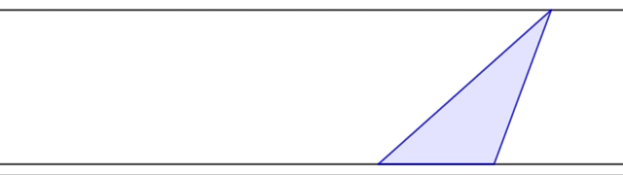
Activity J: Triangle sliding
A triangle is constructed between a pair of parallel lines.
As just the top point of the triangle moves:
When is the perimeter the longest? When is it the shortest?
When is the area the greatest? When is it the least?
How would your answers change if the top point was fixed and one of the bottom points moved?
Notes:
This slide is animated. The top vertex of the triangle is animated to move left and right along the top line segment. Each question will also appear separately so you can choose the pace at which to work with your class.
Answers
a) The perimeter is the longest when the two non-horizontal sides are longest, i.e. when the top point is on the far left of the slide. It is the shortest when the top point is directly above the middle of the base, i.e. when the triangle is isosceles.
b) The base and height are fixed and therefore the area is the same throughout.
? In this case, the area would change as the base was no longer constant – it would be at its greatest if the bottom left point moved to the far left of the slide. The area would be smallest when the base was as small as possible, so the bottom points are as close together as possible.
The perimeter would be longest when the bottom left point was move to the far left of the slide. It would be shortest when the base was as small as possible, so the bottom points are as close together as possible.
Suggested questioning
What
Things to think about
In

Slide 52
Printable resources

Slide 53
Marius is making mosaic patterns using these square tiles. Estimate how many tiles he will need to completely cover each different shape.
Estimate how many tiles he will need for this circle.
Notes:
See slide 51 for explanation.

Slide 54
How many tiles were needed to cover each shape? Check your estimations by counting the tiles.
Estimate how many tiles he will need for this circle.
Notes:
This is a blank printable version of the solution to Checkpoint 5; the previous slide features the blank shapes. You may wish to print them back-to-back so that students can see the ‘reveal’ of the 60 square tiles more easily.

Slide 55
This is a square made up of nine tiles.
By adding, removing or moving tiles, can you change the shape so that:
The area changes, but the perimeter doesn’t?
The perimeter changes, but the area doesn’t?
Notes:
This printable resource could be used with Checkpoint 6 (two per page).

Slide 56
Notes:
This printable resource could be used with Checkpoint 7 (two per page).

Slide 57
Notes:
This printable resource could be used with Checkpoint 11 (four per page).

Slide 58
Notes:
This printable resource could be used with Checkpoint 12.

Slide 59
3 mm
3 mm
3 mm
3 mm
8 mm
8 mm
8 mm
8 mm
3 mm
3 mm
10 mm
10 mm
10 mm
10 mm
3 mm
3 mm
8 mm
3 mm
3 mm
8 mm
8 mm
8 mm
3 mm
3 mm
10 mm
10 mm
10 mm
10 mm
3 mm
3 mm
3 mm
3 mm
8 mm
8 mm
8 mm
8 mm
3 mm
3 mm
10 mm
10 mm
10 mm
10 mm
Notes:
This printable resource could be used with Checkpoint 13 (three per page).

Slide 60
Drawn to scale.
All angles are right angles
Notes:
This printable resource could be used with Checkpoint 14.

Slide 61
Notes:
This printable resource could be used with additional activity I (two per page)

