Slide 1
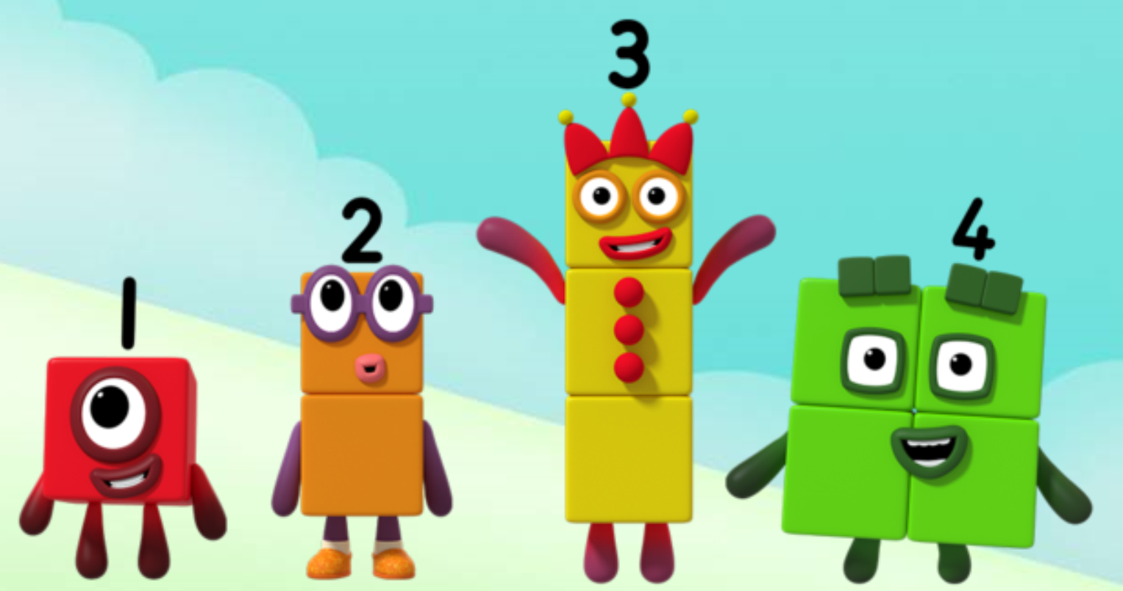
Series 1 Episode 13
The Terrible Twos

Slide 2
Maths in the Episode
To watch this episode, please go to BBC iPlayer – Numberblocks. Look for Series 1: The Terrible Twos
Understanding ‘groups’
In this episode children see Four splitting into Two and Two and hear them described as ‘two twos’. Understanding that a group of objects can be described as ‘one group’, and that there can be many groups, is an important step in maths learning.
Encourage your child to describe what they see using this language
“I see 2 twos”.

Slide 3
Talk and discuss together
Watch the episode together.
Ask your child what they noticed and be interested in anything they have to say.
Use the following pictures and activities to explore and talk about the maths involved.

Slide 4
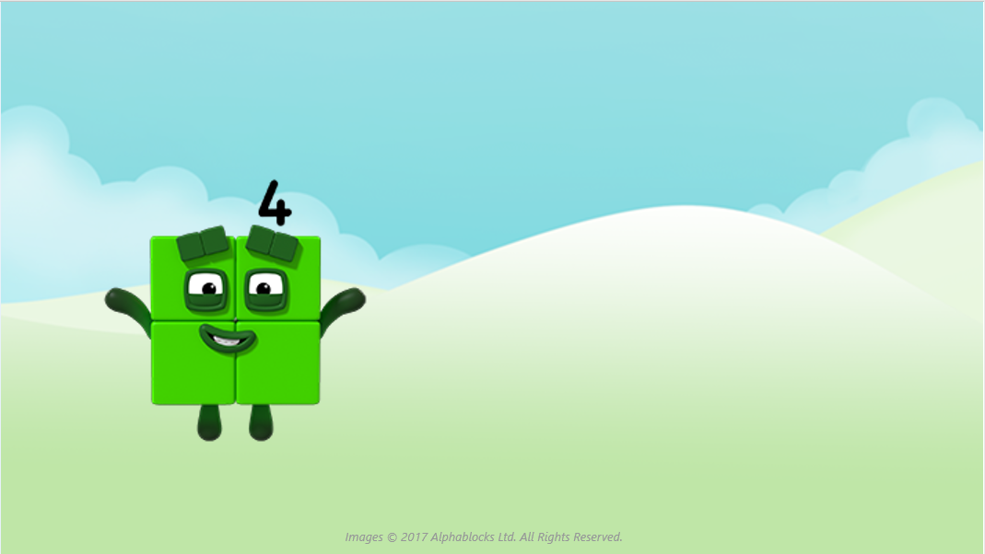
Look at me!
I can turn into some twos!

Slide 5
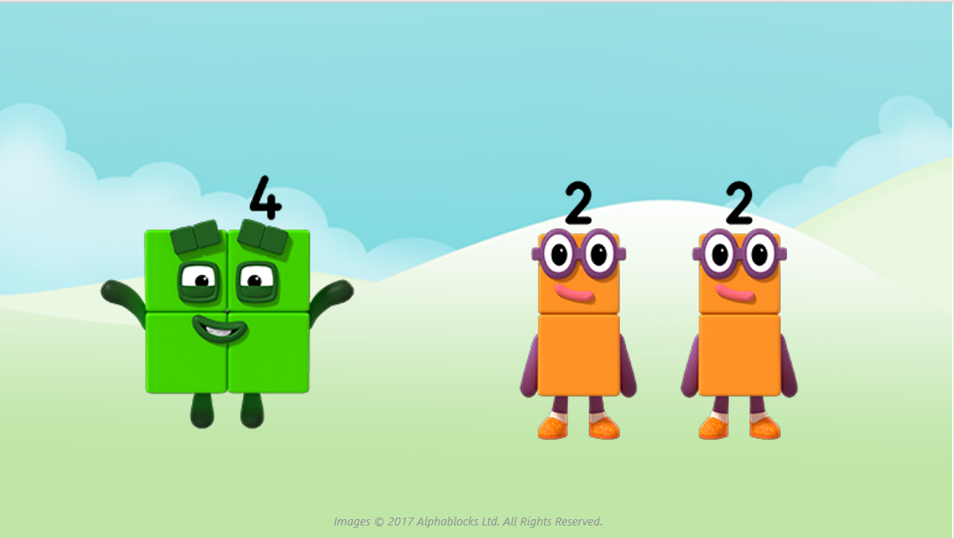
We are two twos!

Slide 6
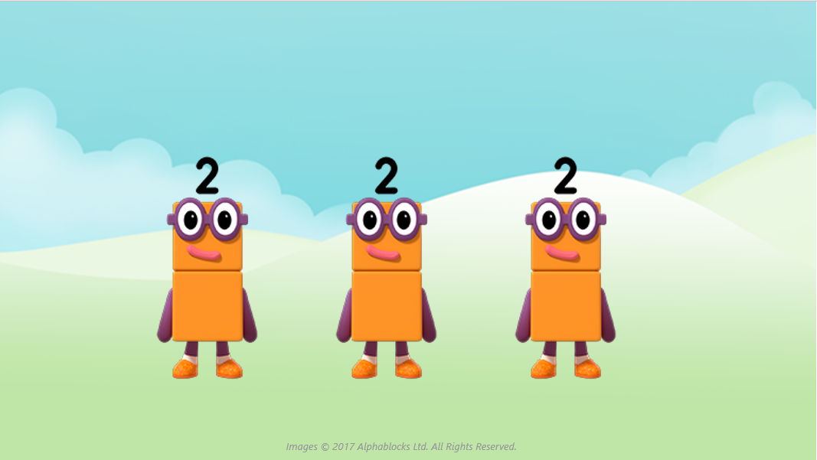
Two and two and two.
We are three twos!

Slide 7
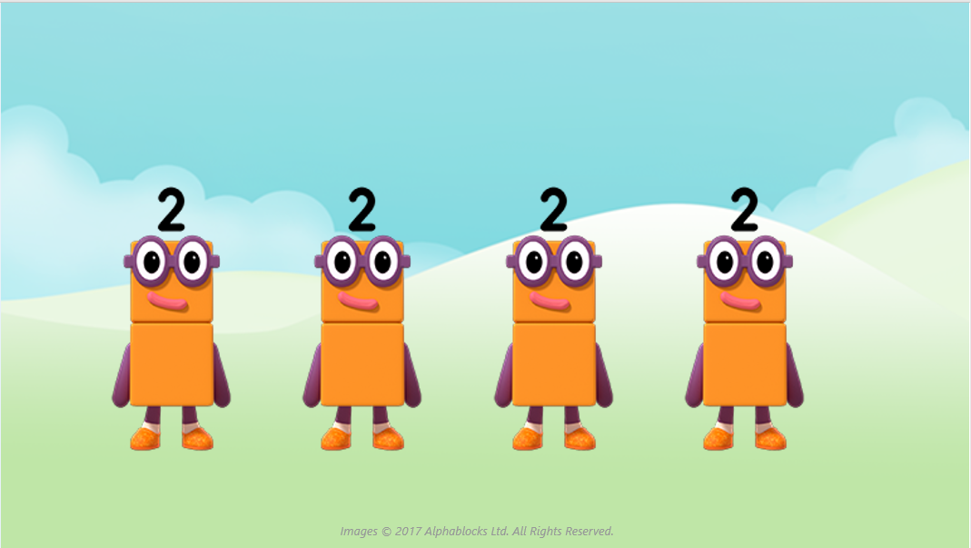
Two and two and two and two.
We are four twos!

Slide 8
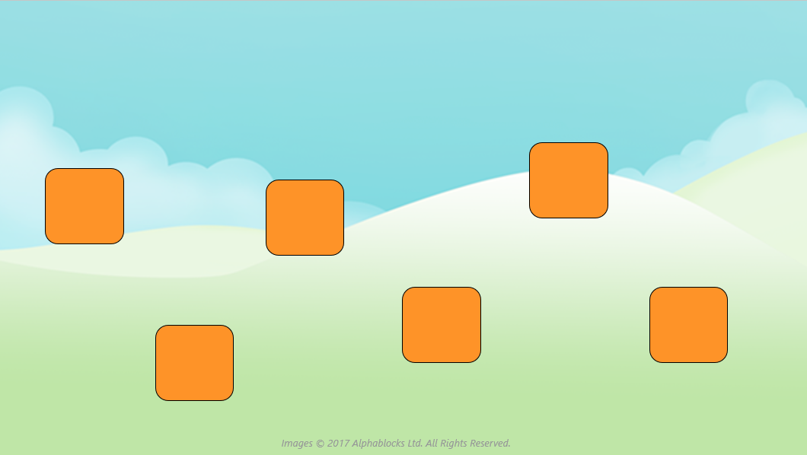
I wonder how many twos we can make from these blocks?

Slide 9
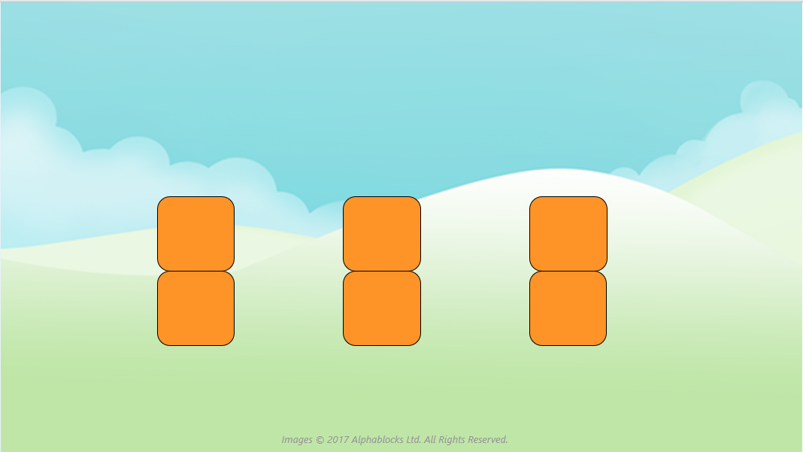
Three twos!

Slide 10
Around the home
Find and talk about things in your home which often come in twos, such as shoes, socks, chopsticks. Talk about ‘pairs of shoes’ and ‘pairs of socks’.
Sort socks into pairs and talk about how many pairs of socks you have.
Pick up a handful of small objects, e.g. pasta or beads. Find some bowls or pots and put two objects in each bowl or pot. See how many pots you can put two objects into. Encourage your child to say how many twos they can see.
Draw a picture for Numberblock Two. You could draw lots of pairs of socks or other things which you can put into twos.

Slide 11
General tips that can make a difference in maths
Provide lots of opportunities to say how many things you can see (up to 5) without counting.
Whenever you talk about a small set of objects, say the number. For example, please pick up those 3 teddies or look at those 2 dogs.
Count up (starting from one) when walking upstairs and count back when walking downstairs.
Count lots of different objects, big and small, and ask ‘How many are there?’ Your child should be able to tell you without going back and re-counting. If they can’t, then tell them: ‘There are 6 altogether’.
Play with fingers, firstly practise counting fingers.
Ask your child to put their fingers down and then say or hold up a number such as 3. Can they do it without counting? Can they do it using different fingers? Can they do it using fingers from two hands?
Play board games with your child which involve moving along numbered tracks, such as ‘Snakes and Ladders’. Check that your child counts along the track correctly, moving one square for each number counted.
Regular use of these simple ideas, whenever the opportunity arises, will improve your child’s maths.

Slide 12
General tips that can make a difference in maths
Notice when there are two amounts and one is more than the other, or they are the same. For example, I have 2 eyes and 2 ears, or I have more chips than peas.
Talk about and describe shapes you can see outside or around your home. For example, count corners, talk about straight/curved edges, flat/curved surfaces. If you have building blocks then talk about and describe the things that are built.
In the bath or at the sink, play with containers, pouring water, counting how many small pots are needed to fill the big container.
Encourage your child to draw a picture of their number work and explain their mark-making to you, for example, how many leaves they find on a walk. This doesn’t necessarily mean writing the numerals (1, 2, 3, 4… etc.).
Sing counting songs and rhymes. You can find some on the internet, but children love it if you join in with them!
Make a deliberate maths mistake from time to time and ask your child to explain why you are wrong. For example, say that 4 is bigger than 5.
Regular use of these simple ideas, whenever the opportunity arises, will improve your child’s maths.

