Slide 1
Developing Decimal Place Value
Working with tenths

Slide 2
Introduction
This document contains:
an introduction to the lesson
points to consider as you watch each video clip.
Note there is also a separate video where
the teacher reflects on the lesson. This is
worth watching either before or after you
watch the video of the lesson.

Slide 3
The Lesson Design:
What the teacher considered
Learning Objective
To recognise and use the unit '0.1‘
Key Difficulty Points
The decimal point – understanding it just indicates the position of the ones/tenths boundary
Pupils seeing tenths as an extension of their knowledge about ones, tens, and hundreds
Partitioning and combining whole numbers and tenths
Recognising additive and multiplicative relationships
Models used to explain concept/address difficulty points
Measures: 1kg and 0.1kg pasta/rice, 1m and 0.1m lengths
Important language structures
One is divided into ten equal parts, and one of these parts is one tenth.
Ten tenths is equivalent to one whole.
The tenths sit on the right hand side of the decimal point.

Slide 4
The journey through the lesson
Combining parts and wholes to express a quantity as a decimal number
Using the language of tenths and wholes
Visualising a quantity of rice and writing it as a decimal
Partitioning a number involving wholes and tenths
Partitioning and combining decimal numbers in different ways
Variation – working with kilograms and other quantities
Moving from additive to multiplicative representations

Slide 5
Small Focus
Note that the first five lessons of this unit address only tenths. This is typical within the context of teaching for mastery.
Concepts are considered for longer and in more detail in order to acquire deep learning which is sustained and readily connected to later learning.

Slide 6
Use of Measures
The lesson uses measures as a context to explore decimal numbers. This enables children to make sense of whole numbers and parts of whole numbers (tenths).

Slide 7
Developing Decimal Place Value
Working with tenths
Y4 Lesson Clip 1

Slide 8
Review of Previous lesson
The children write a quantity of rice as a decimal number.
Consider the use of the visual image to support their understanding.
Note that the previous day they had explored the concept of tenths with real rice.

Slide 9
Stem Sentences
Notice the sentence that is repeated throughout the lesson:
The tenths sit on the right hand side of the decimal point.
One purpose of stem sentences is to highlight key points and remind children of important information.

Slide 10
Children’s Language
Children distinguish between and use the language of wholes and tenths.
Notice the use of the word represents. Consider the purpose of this language.

Slide 11
Representation
Representation is central to mathematics.
Mathematics is abstract and it necessary to represent it in order to understand and work with it. We use a variety of ways to represent mathematics including concrete, pictorial, diagrammatic, geometric, graphical and symbolic. It is crucial that children are able to interpret and make sense of these representations.
Consider developing children’s use of the word representation so it becomes natural to use it as the children do in the video. This will help them to think more deeply about the mathematics.

Slide 12
3.5 kg
Notice that the children are encouraged to visualise what this might look like – a step beyond seeing the pictures.

Slide 13
Speaking in full sentences
Notice how the children respond in full sentences:
The three represents three whole kilograms and the five represents five tenths of a kilogram.
Consider developing the routine of speaking in full sentences. It can support children in thinking about and expressing the mathematics with greater accuracy and is thus supportive to their learning.

Slide 14
Use of the part part whole model
3.5 kg
3 kg
0.5 kg
The children are very familiar with this model for expressing additive relationships and are able to connect the new learning to it.

Slide 15
Writing a number sentence
Notice that the next small step is to write a number sentence to express the relationship between wholes and tenths.
The part part whole model supports children in seeing relationships and writing the sentences.

Slide 16
Developing Decimal Place Value
Working with tenths –
Partitioning in different ways
Y4 Lesson Clip 2

Slide 17
Partitioning in different ways
The next small step is to partition a decimal number in more than one way.
This activity provides variation and develops depth and flexibility through looking at the same quantity in different ways.

Slide 18
Maisie’s Error
Maisie writes 1. kg on the board
Notice how the teacher picks up on this error.
Teaching for mastery demands precision in the mathematics.

Slide 19
Developing Decimal Place Value
Working with tenths –
Exploring place value with other
units
Y4 Lesson Clip 3

Slide 20
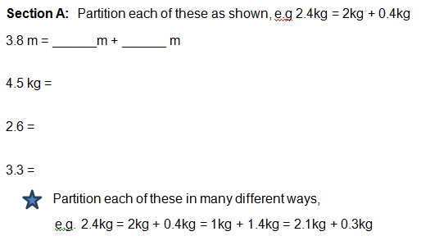
Children consolidate and extend their learning through independent work
Notice the variation between kilograms, metres and the numbers used.

Slide 21
Developing Decimal Place Value
The use of concrete
Representations, leading to multiplicative reasoning
Y4 Lesson Clip 4

Slide 22
Using a concrete representation
Consider the use of the metre ruler to explore tenths.
This represents an aspect of conceptual variation (looking at the same concept in a different way).

Slide 23
Remaining Focused
The teacher says: I’m just going to stick with the metre examples, we are not going to consider centimetres today.
A mastery lesson remains focused in order to master the key point(s) of the lesson.

Slide 24
Representing a length in different ways
1.2 m
1m + 0.2 m
12 x 0.1m
The teacher draws attention to expressing the length in an additive way and a multiplicative way.

Slide 25
Developing Decimal Place Value
Exploring equivalence using the balance model
Y4 Lesson Clip 5

Slide 26
Stem Sentence
Ten tenths are equivalent to one whole.
A key feature of the memorisation of stem sentences is to bring important information to mind to support thinking about the mathematics.

Slide 27
Converting between whole numbers and tenths
The balance scales are used to represent the equivalent relationship between:
3.4 kg and 34 tenths of a kilogram
Notice how the teacher represents it as:
34 x 0.1kg
and: 34
10
These are all aspects of variation.

Slide 28
Continuing to explore equivalence
Express 1.5 as tenths.
Write it as a number sentence.
Notice how the children are becoming familiar with the new way of representing tenths of kilograms:
1.5kg= 15 x 0.5kg

Slide 29
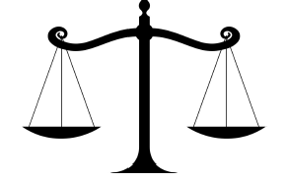



Where are the 15 x 0.1 kg?
Ensuring that children are matching an abstract representation to a visual one.

Slide 30
The next step
This time I want you to imagine……….
2.4 kg = ____ x 0.1kg
We show children images in order that eventually they will be able to visualise their own images.

Slide 31
Developing Decimal Place Value
Y4 Lesson Clip 6
Independent work

Slide 32
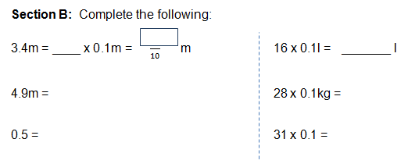
Independent Written Work
Notice the variation: moving from combined to partitioned on the left and from partitioned to combined on the right hand side of the worksheet.

Slide 33
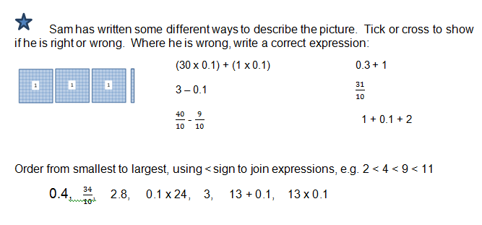
The Star Challenge
The star challenge extends and deepens thinking for the rapid graspers in the lesson. These children however are not labelled and the challenge is open to all.

Slide 34
The Star Challenge
Aims to provide the opportunity for children to:
Slow down, stop, think and
make connections.

Slide 35
Addressing an error
16 x 0.1= 0.16
Notice how the teacher uses the child’s error as a valuable teaching point.
This might be an error that the Chinese teachers would “presuppose” in their lesson design and see it as a valuable opportunity for learning.
The teacher will refer back to it when she introduces hundredths later in the unit of work.

Slide 36
Teacher Reflection
The teacher realised after the lesson that the stem sentence:
The tenths sit on the right hand side of the decimal point
may have been the reason for making the error in writing 16 tenths as 0.16 instead of 1.6
Consider whether the you think it was a helpful stem sentence?

Slide 37
Can you convince me?
This is a key question within the context of teaching for mastery. It provides the opportunity for children to think more deeply about the mathematics and challenges them to give precise mathematical explanations.

