Slide 1
Numberblocks
Support Materials
Series 2, Episode 6
Just Add One

Slide 2
Practitioner Notes

Slide 3
Episode Description
One drops out of the sky to sing a song about adding One. She sings about her idea of fun (being One), then another One falls out of the sky, they combine to make Two, who sings about his idea of fun (a song and dance), before another One falls out of the sky - and it continues all the way to Ten. Along the way, heavy fruit falls on Three’s head, Four bounces on his corners, saying ‘Ouch!’, Five crosses a river on stepping stones, Six rolls dice, Seven paints rainbows of light in the sky, Eight runs several times around the world, Nine sneezes and Ten splits into Ones for the grand finale.

Slide 4
Maths in the Episode
Saying the counting numbers up to 10
Throughout this episode each Numberblock says the counting numbers up to his/her value.
Adding One
The children practise successively adding 1 to a number. The children will experience how a number is related to the adjacent one and how the counting numbers increase by 1. You can make any number by adding 1 to the previous number.

Slide 5
Using Mathematical Language
Practise counting for numbers up to 10, e.g. “I can see 1, 2, 3, 4, 5, 6, 7 (while pointing), 7 colours.”
As children begin to experience the relationship between consecutive numbers encourage them to use this stem sentence:
“Nine is one more than Eight”
Or:
“When you add 1 to a number, the number gets one bigger”.

Slide 6
Talk and Discuss Together

Slide 7
Talk and Discuss Together
Watch the episode of Numberblocks. First ask the children what they noticed and allow them to talk to you and each other. The following slides are designed to stimulate children and adults to talk about the episode and draw out some key aspects of the mathematics.

Slide 8
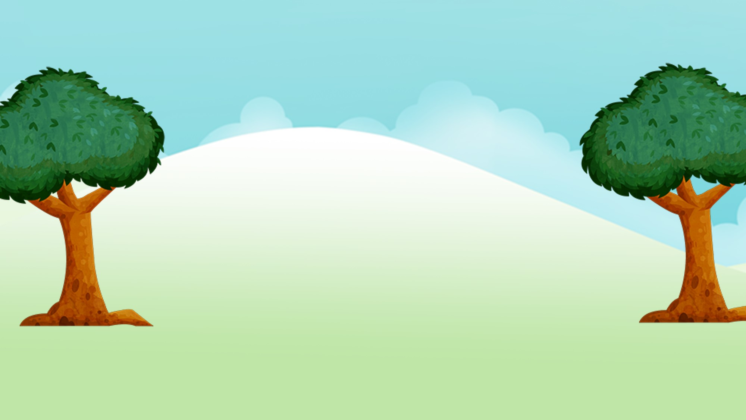
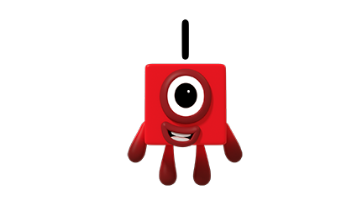
Images © 2017 Alphablocks Ltd. All Rights Reserved.
Notes:
Discuss the programme. What did you like? What happened?
Use slides 8 – 17 like a ‘big book’ to accompany the song from the episode.
Activity with linking cubes: Starting with one cube for One, children build towers to represent each character. Some of the characters on the slides do not appear as towers and children should compare their tower with the character, recognising that the Numberblocks can appear in different shapes but still have the correct number of blocks.

Slide 9

Images © 2017 Alphablocks Ltd. All Rights Reserved.
Notes:
Ask children to hold up One.
I am One and I’m playing in the sun.
Being One is my idea of fun.
One. One little block.
Now let’s add another One.

Slide 10
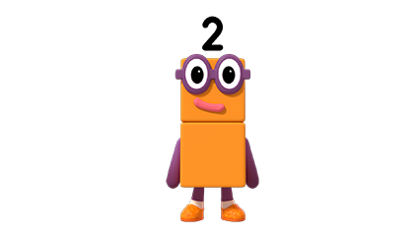
Images © 2017 Alphablocks Ltd. All Rights Reserved.
Notes:
Add another One
Ask the children to hold up Two.
Sing the verse from the song:
I am Two and I’m playing in the sun.
A song and dance is my idea of fun.
One, two, one, two, one, two, one, two. Two dancing shoes.
Now let’s add another One.

Slide 11
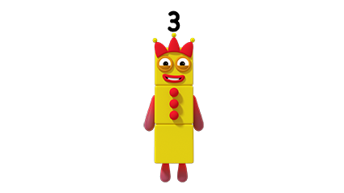
Images © 2017 Alphablocks Ltd. All Rights Reserved.
Notes:
Add another One
Ask the children to hold up Three.
Sing the verse from the song:
I am Three and I’m playing in the sun.
Juggling things is my idea of fun.
One, two, three. Three things.
Now let’s add another One.

Slide 12
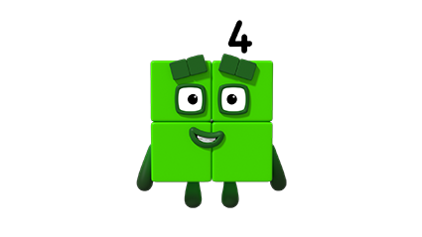
Images © 2017 Alphablocks Ltd. All Rights Reserved.
Notes:
Add another One
Ask the children to hold up Four.
Sing the line from the song:
I am Four and I’m playing in the sun.
Being square is my idea of fun.
One, two, three four. Four sides.
Ouch, Ouch, Ouch, Ouch!
Now let’s add another One.

Slide 13
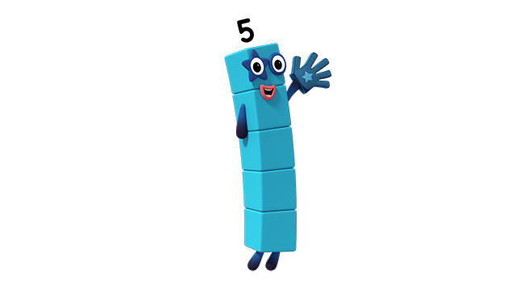
Images © 2017 Alphablocks Ltd. All Rights Reserved.
Notes:
Add another One
Ask the children to hold up Five.
Sing the verse from the song:
I am Five and I’m playing in the sun.
High five, is my idea of fun.
One, two, three, four, five. Five fingers.
Now let’s add another One.

Slide 14
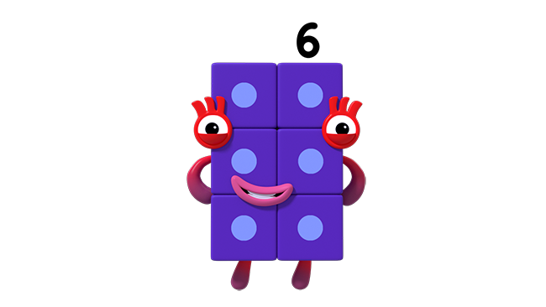
Images © 2017 Alphablocks Ltd. All Rights Reserved.
Notes:
Add another One
Ask the children to hold up Six.
Sing the verse from the song:
I am Six and I’m playing in the sun.
Playing games is my idea of fun.
One, two, three, four, five, six. Six dice.
Now let’s add another One.

Slide 15
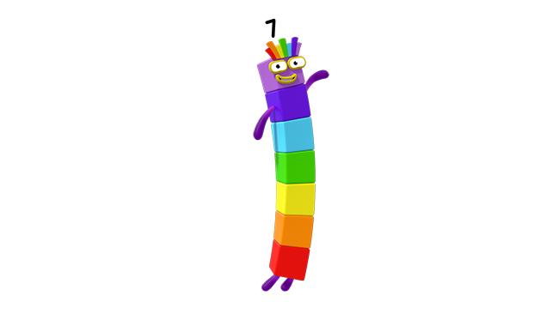
Images © 2017 Alphablocks Ltd. All Rights Reserved.
Notes:
Add another One
Ask the children to hold up Seven.
Sing the verse from the song:
I am Seven and I’m playing in the sun.
Making rainbows, is my idea of fun.
One, two, three, four, five, six, seven. Seven colours.
Now let’s add another One.

Slide 16
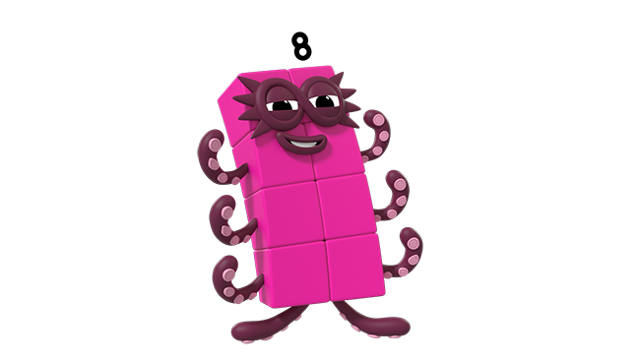
Images © 2017 Alphablocks Ltd. All Rights Reserved.
Notes:
Add another One
Ask the children to hold up Eight.
Sing the verse from the song:
I am Eight and I’m playing in the sun.
Being Octoblock is my idea of fun.
Octoblock run. One, two, three, four, five, six, seven, eight. Run!
Now let’s add another One.

Slide 17
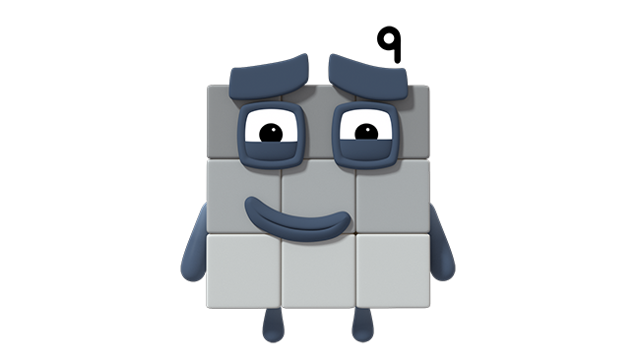
Images © 2017 Alphablocks Ltd. All Rights Reserved.
Notes:
Add another One
Ask the children to hold up Nine.
Sing the verse from the song:
I am Nine and I’m playing in the sun.
Not sneezing is my idea of fun.
One, two, three, four, five, six, seven, eight, nine. Nine hankies.
Now let’s add another One.

Slide 18
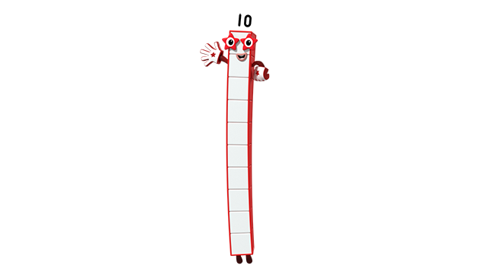
Images © 2017 Alphablocks Ltd. All Rights Reserved.
Notes:
Add another One
Ask the children to hold up Ten.
Sing the verse from the song:
I am Ten and I’m playing in the sun.
Being Ten is my idea of fun.
One, two, three, four, five, six, seven, eight, nine, ten. Ten blocks.

Slide 19
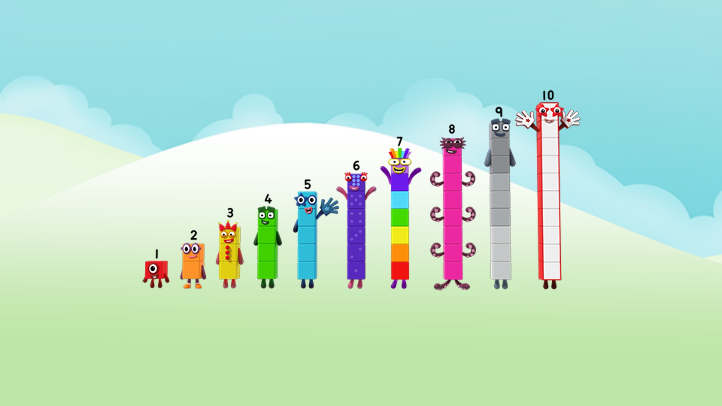
Images © 2017 Alphablocks Ltd. All Rights Reserved.
Notes:
Compare the children’s towers to this image.
What do you notice (each Numberblock gets one block taller)?
Using the Numberblock staircase that was built during the song by the teacher, ask the children to cover their eyes. Ask a child to remove one of the blocks. Ask them to open their eyes. Which Numberblock is missing?
Make this harder by muddling up the Numberblocks so that the children have to re-order.

Slide 20
Enabling Environments

Slide 21
Enabling Environments
Playing and Exploring
Leave out the trays of Numberblocks made with linking cubes. Encourage children to lay them out in order by comparing two blocks. Use conkers or beads of similar sizes to make hanging garlands that represent each number from 1 to 10 when lined up side by side. Build a staircase with big building bricks.
Active Learning
Notice how the children compare two Numberblocks. Model how to compare two Numberblocks by lining them up side by side. Notice when children have counted or subitised the smaller quantity, if they can use this knowledge to identify the second quantity by counting on.
Creating and Thinking Critically
Provide bags of collections of objects, for example, 1 red counter, 2 orange counters, 3 yellow counters, and 5 blue counters. Can the children identify which quantity is missing by arranging the collections in order?

Slide 22
Learning Together in Y1

Slide 23




1 is 1 more than 0.
Images © 2017 Alphablocks Ltd. All Rights Reserved.
Notes:
Discuss the programme. What did you like? What happened?
Use slides 23 – 32 to present the relationship between consecutive numbers.
Provide trays of cubes for the children to make the Numberblocks while watching the slides.
The slides are animated, building each Numberblock by adding one. The focus is placed on the addition of 1, and the comparison between the new number formed and the previous number. Ask children to describe this relationship. There is a sentence to read together to describe the relationship between the two Numberblocks, e.g. “3 is 1 more than 2”.
Ask the children to discuss or record the equation required to represent the addition of one. Then show the equation and ask what each number represents.

Slide 24

2 is 1 more than 1.
Images © 2017 Alphablocks Ltd. All Rights Reserved.

Slide 25
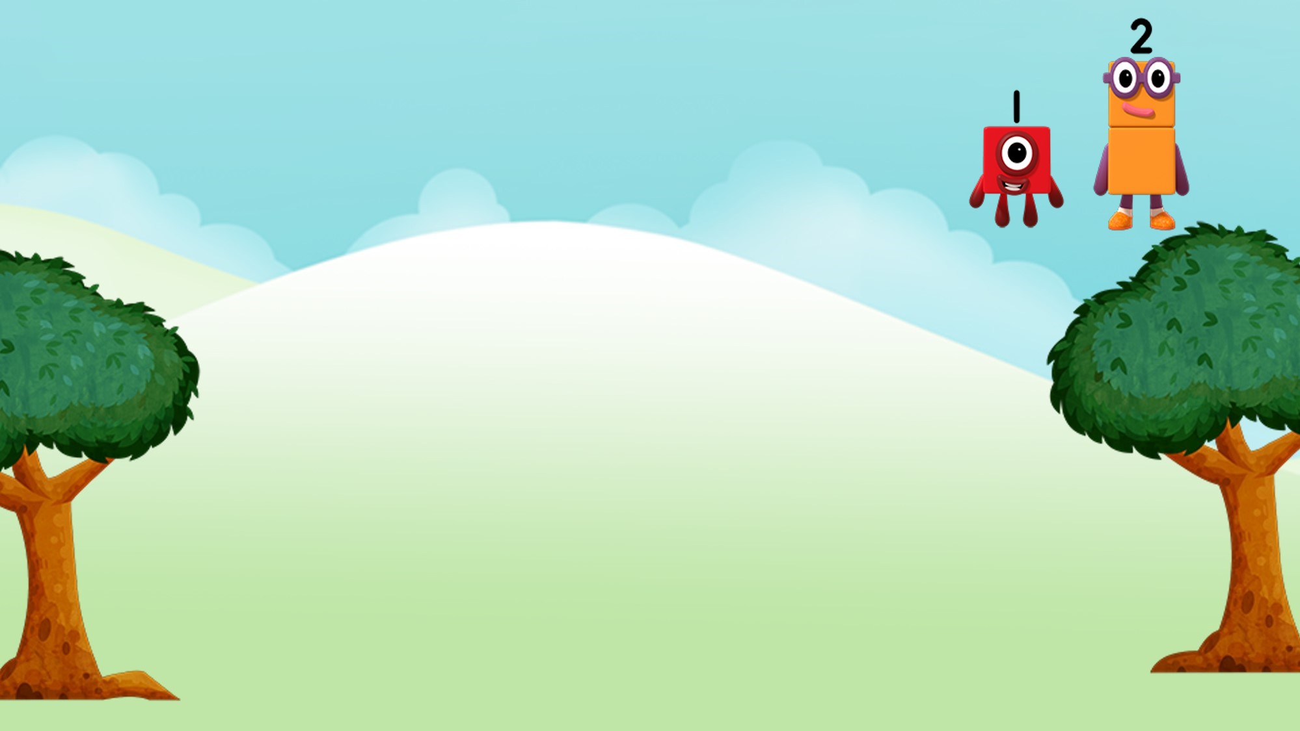

3 is 1 more than 2.
Images © 2017 Alphablocks Ltd. All Rights Reserved.

Slide 26
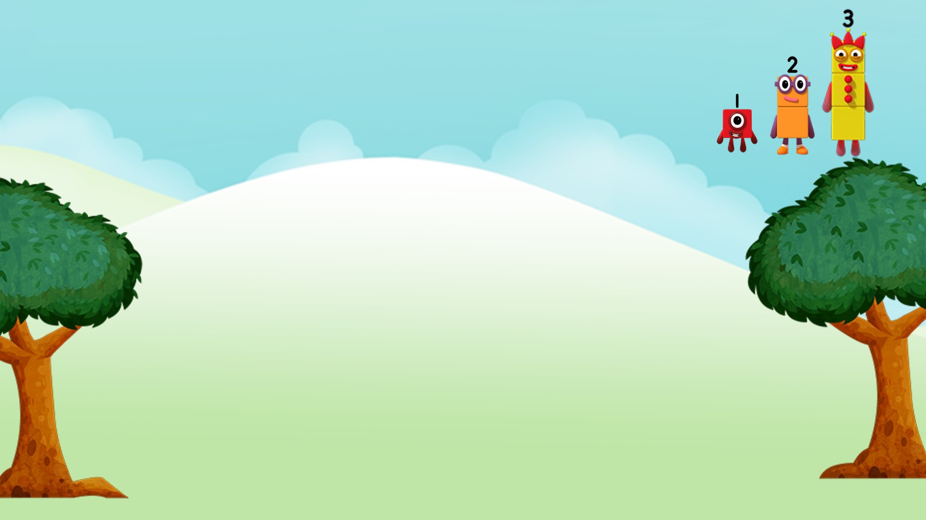

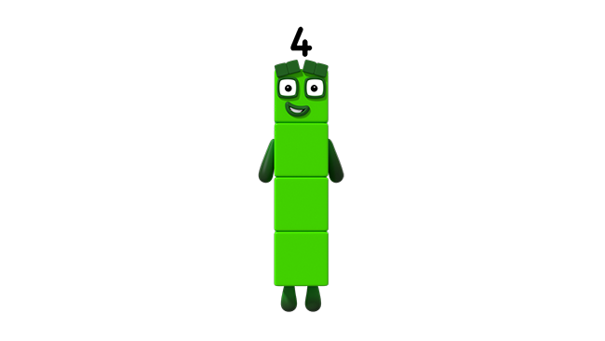
4 is 1 more than 3.
Images © 2017 Alphablocks Ltd. All Rights Reserved.

Slide 27
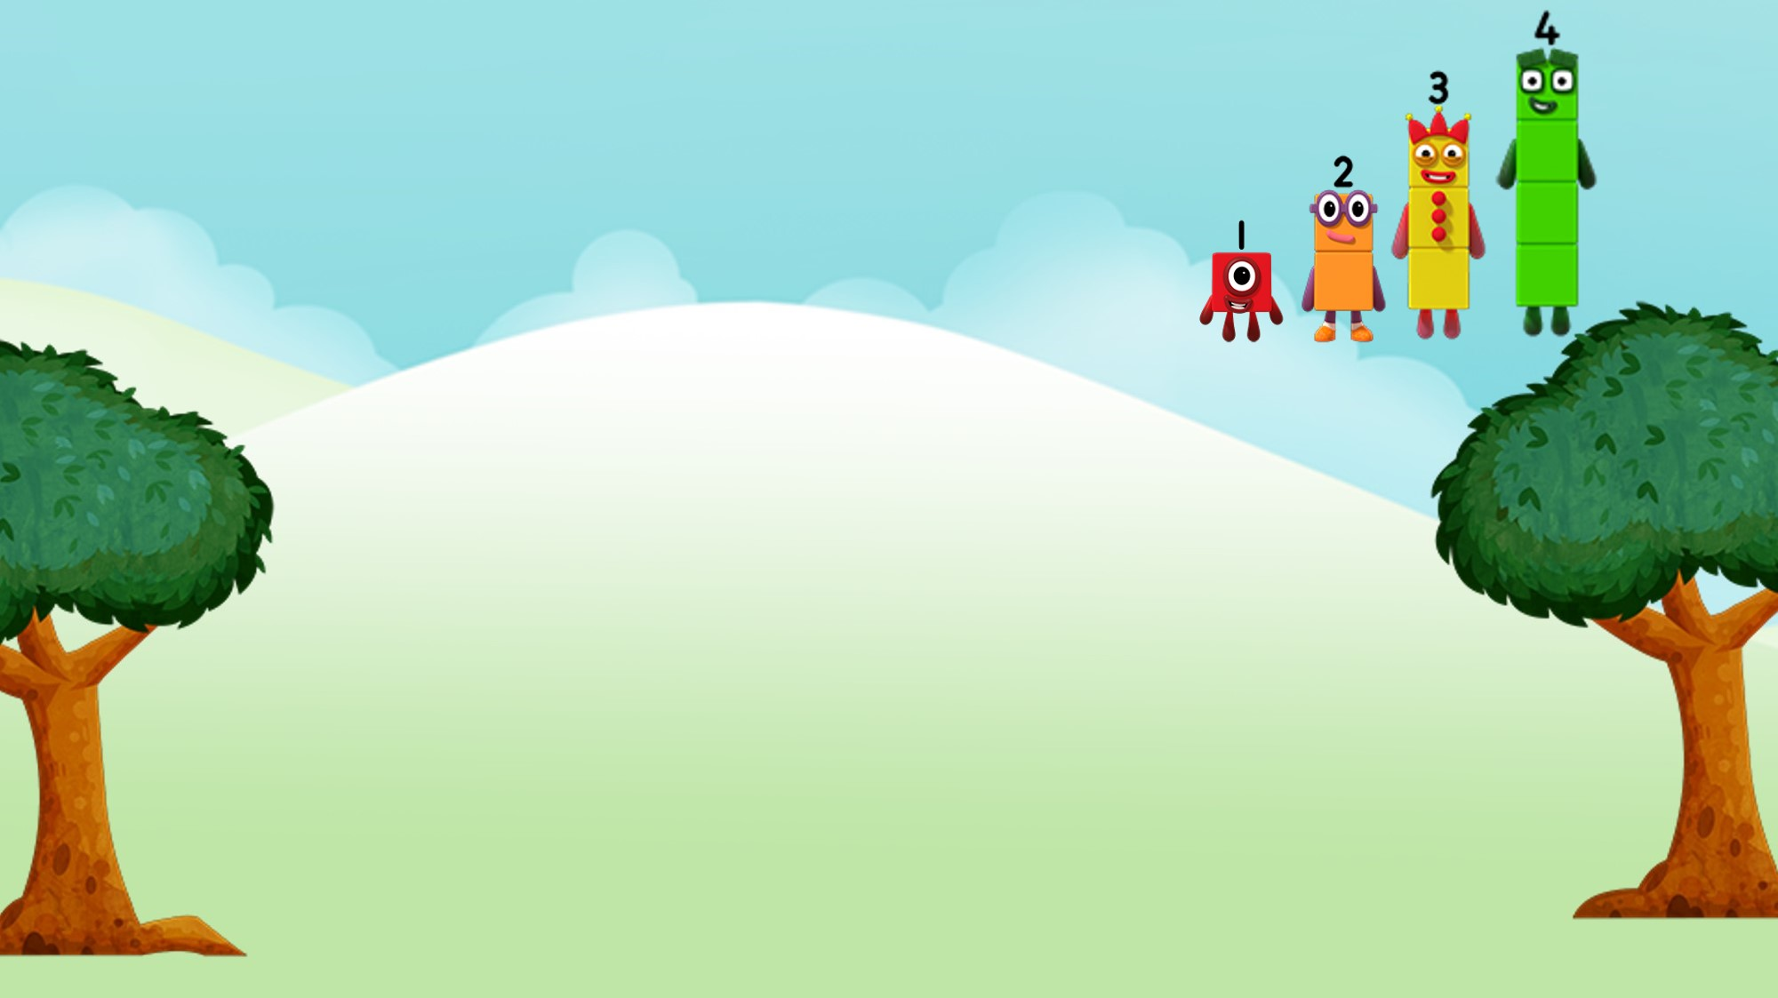

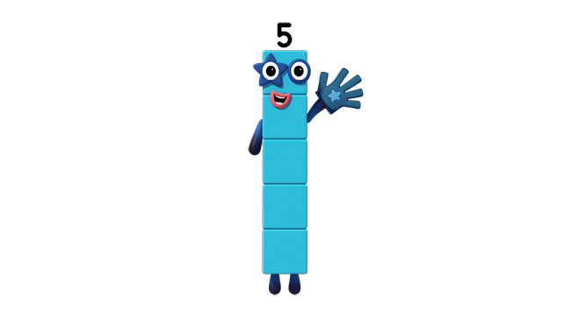
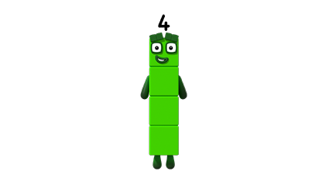
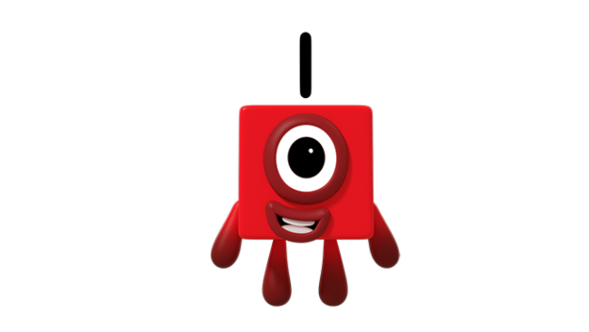
5 is 1 more than 4.
Images © 2017 Alphablocks Ltd. All Rights Reserved.

Slide 28
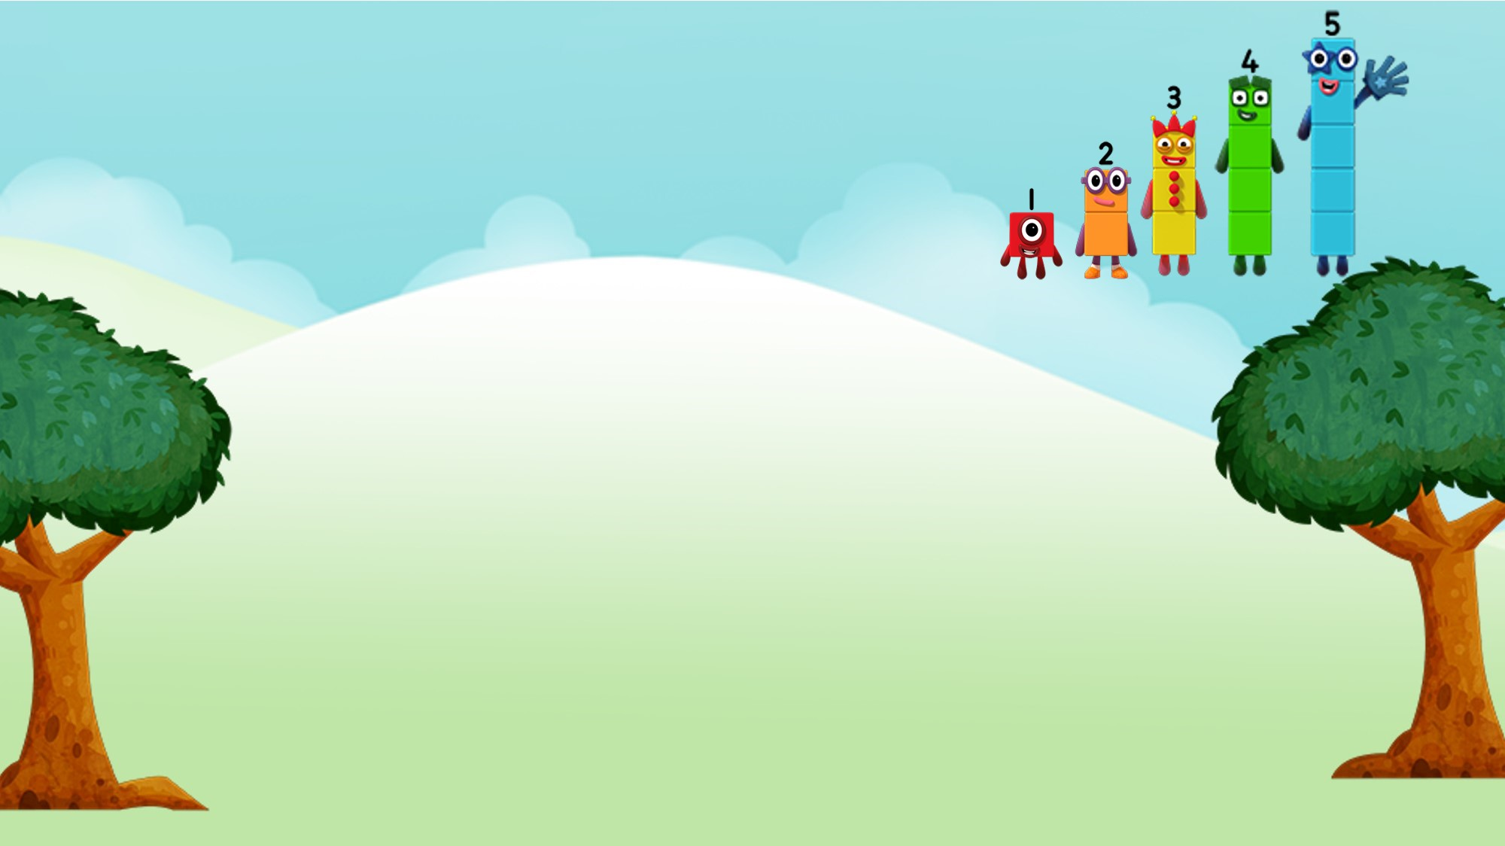

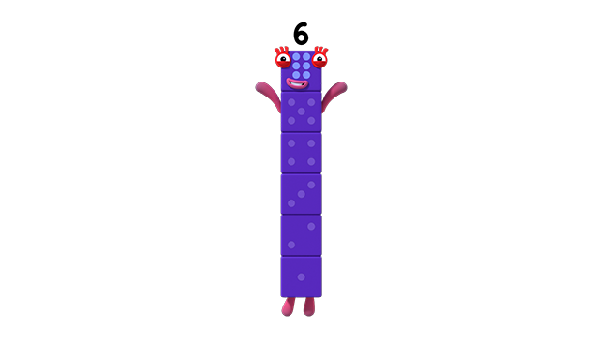
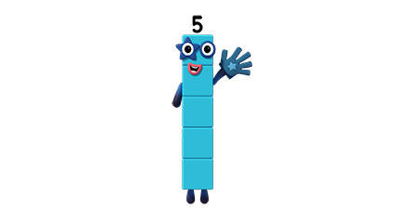
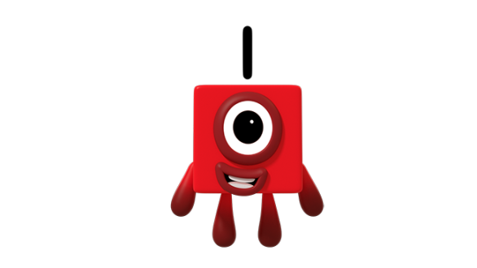
6 is 1 more than 5.
Images © 2017 Alphablocks Ltd. All Rights Reserved.

Slide 29
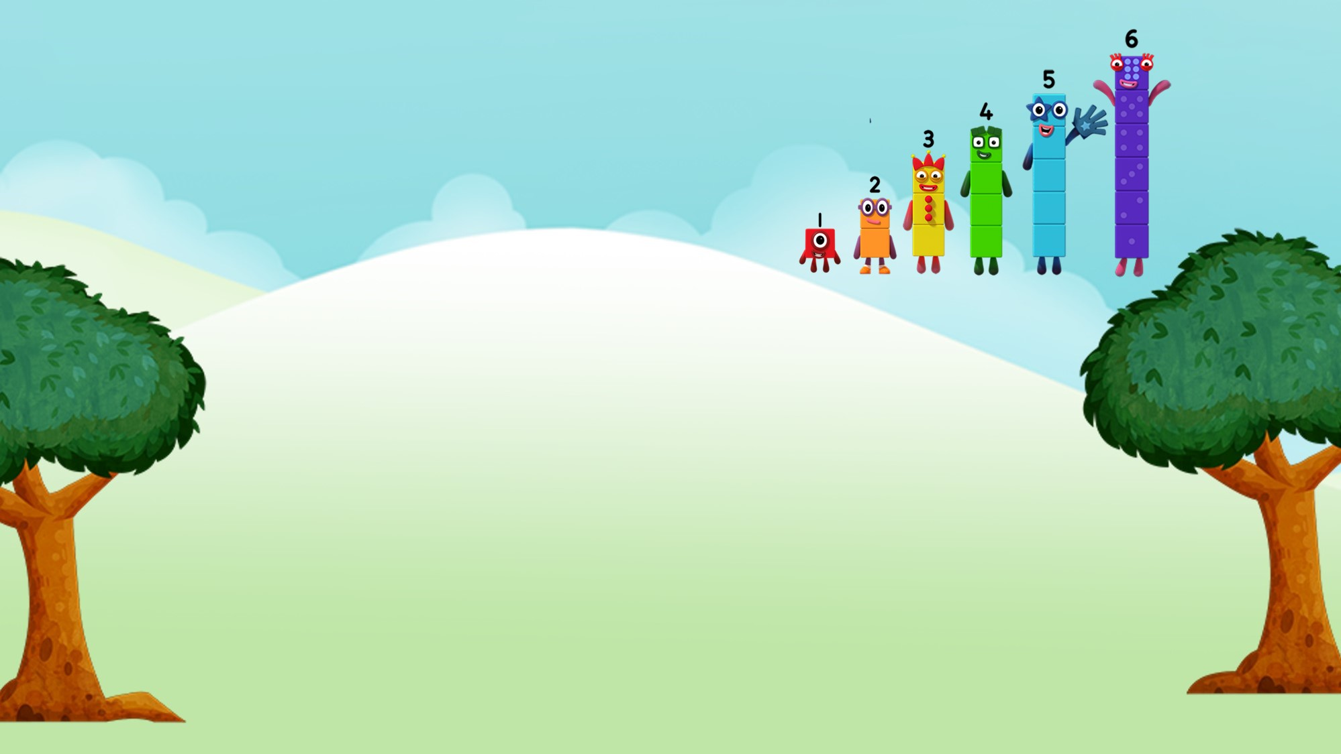

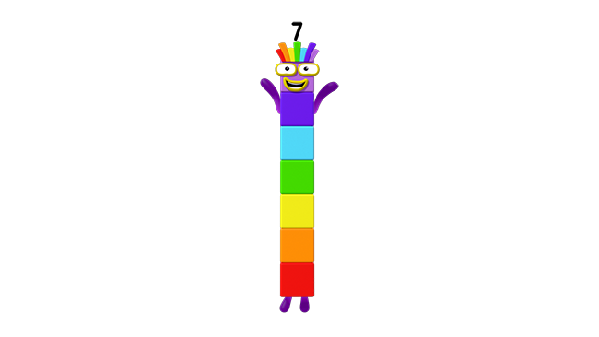
7 is 1 more than 6.
Images © 2017 Alphablocks Ltd. All Rights Reserved.

Slide 30
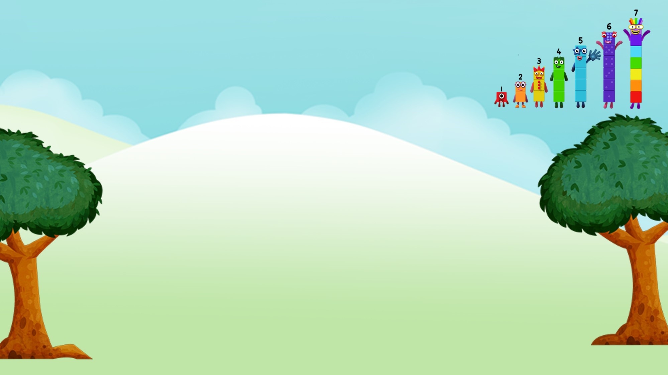

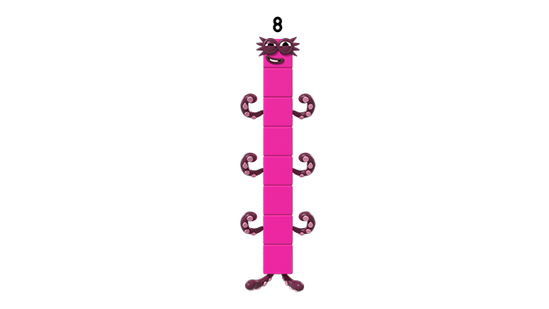
8 is 1 more than 7.
Images © 2017 Alphablocks Ltd. All Rights Reserved.

Slide 31
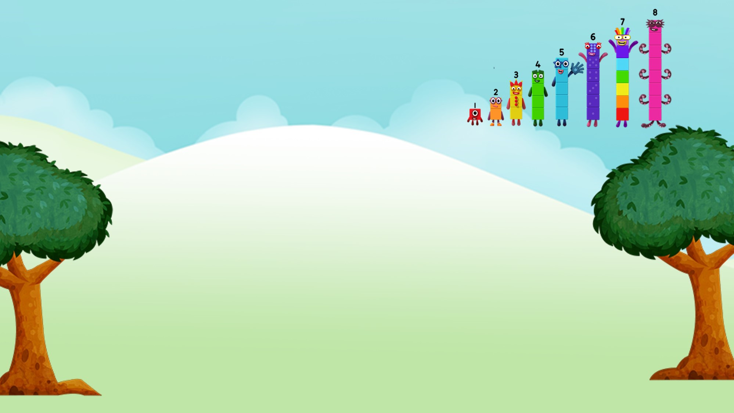

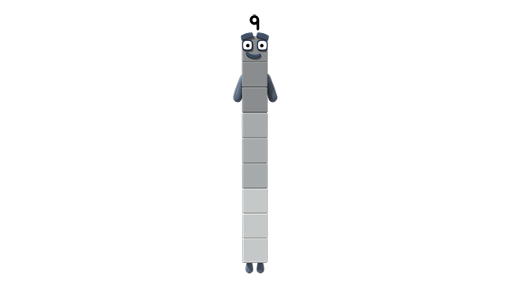

9 is 1 more than 8.
Images © 2017 Alphablocks Ltd. All Rights Reserved.

Slide 32
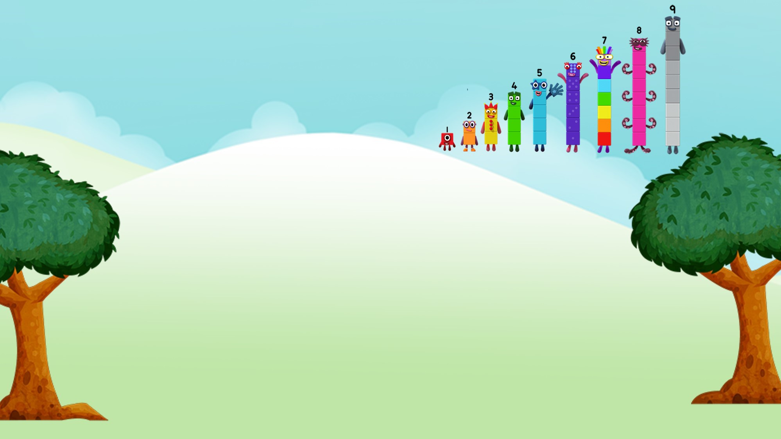

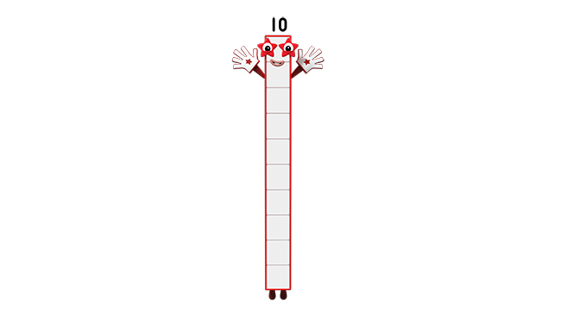
10 is 1 more than 9.
Images © 2017 Alphablocks Ltd. All Rights Reserved.

Slide 33
When you add One to a number, the number gets 1 bigger.
Images © 2017 Alphablocks Ltd. All Rights Reserved.
Notes:
Compare the Numberblocks. What do you notice?
Use the stem sentence:
“When you add 1 to a number, the number gets 1 bigger.”

Slide 34
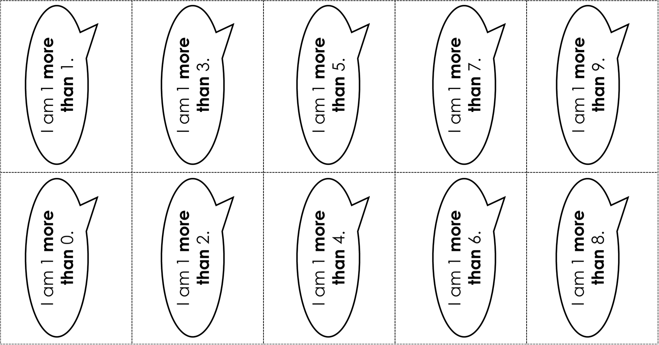
Notes:
Use slides 34 and 35 to make a matching pairs game or a lotto game.

Slide 35
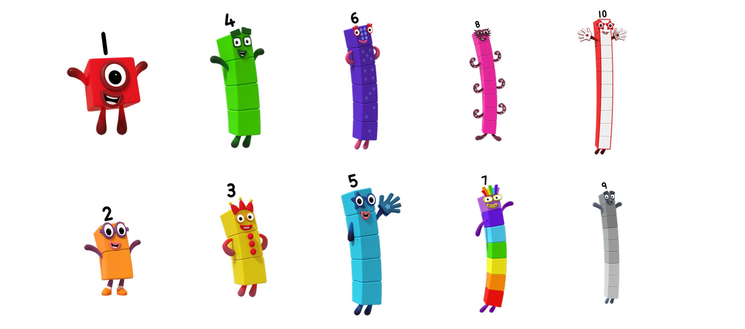
Images © 2017 Alphablocks Ltd. All Rights Reserved.

Slide 36
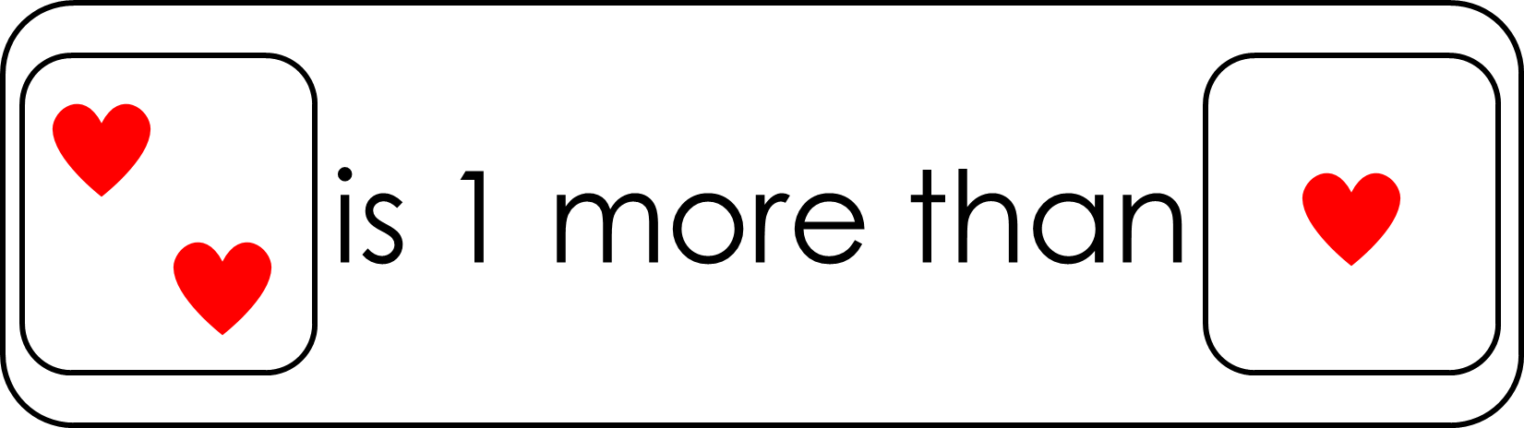
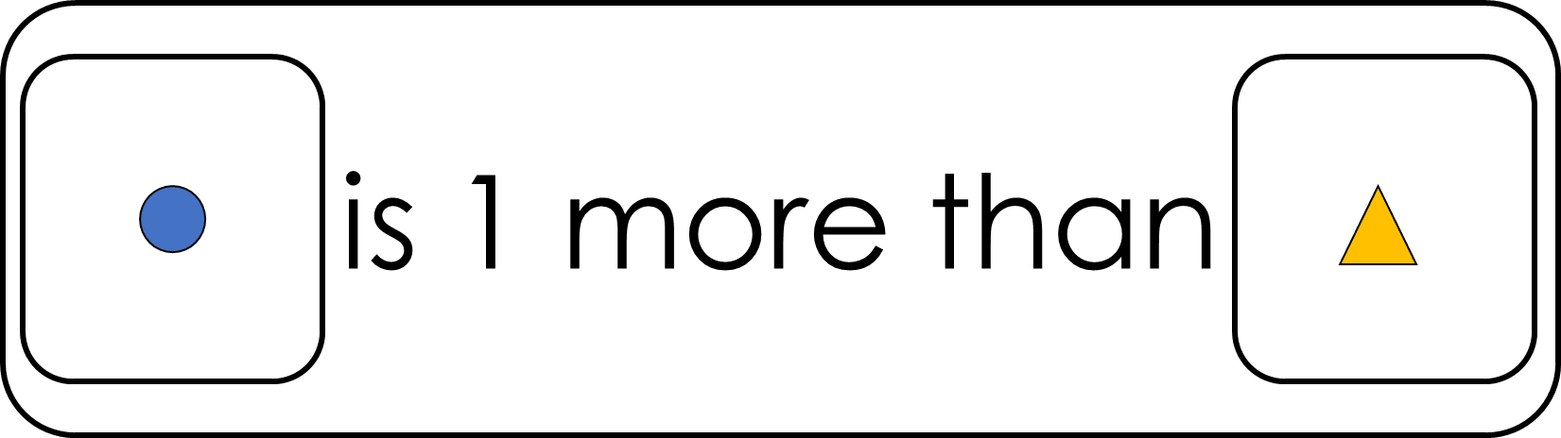


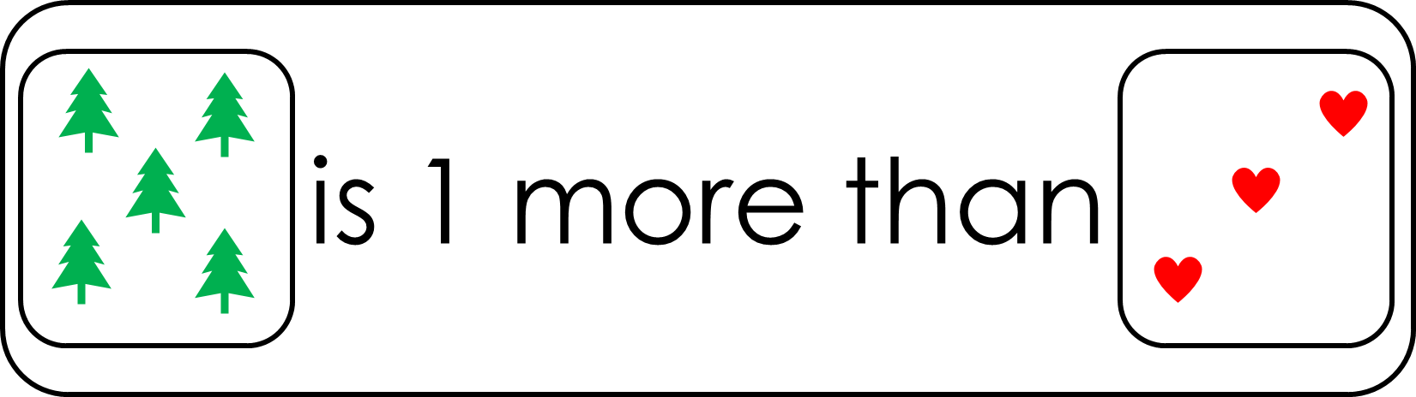

True or false?
Notes:
Use this slide to discuss reasoning.
Click on a statement to reveal a tick or a cross.
Remove the ticks and crosses by clicking on the title.

