Slide 1
Year 6, Unit 2
Multiples of 1,000

Slide 2
Year 6, Unit 2
These materials heavily reflect the prioritisation approach of the ready-to-progress criteria in the DfE Primary Mathematics Guidance 2020 and on the PPTs that exemplify them on the NCETM website. They also include other relevant National Curriculum content. Related sections of the NCETM Primary Mastery Professional Development Materials provide small-step teaching guidance.
There are no specific ready-to-progress criteria supported by this unit.

Slide 3
Contents
The links below take you to the starting slide of each learning outcome.
1 | Pupils explain how ten thousand can be composed
2 | Pupils explain how one hundred thousand can be composed
3 | Pupils read and write numbers up to one million (1)
4 | Pupils read and write numbers up to one million (2)
5 | Pupils identify and place the position of five-digit multiple of one thousand numbers, on a marked, but unlabelled number line
6 | Pupils identify and place the position of six-digit multiple of one thousand numbers, on a marked, but unlabelled number line
Click the arrow button to return to this Contents slide.

Slide 4
Contents
The links below take you to the starting slide of each learning outcome.
7 | Pupils count forwards and backwards in steps of powers of 10, from any multiple of 1,000
8 | Pupils explain that 10,000 is composed of 5,000s 2,500s and 2,000s
9 | Pupils explain that 100,000 is composed of 50,000s 25,000s and 20,000s
10 | Pupils read scales in graphing and measures contexts, by using their knowledge of the composition of 10,000 and 100,000
Click the arrow button to return to this Contents slide.

Slide 5
Year 6, Unit 2, Learning Outcome 1
Learning Outcome 1
Pupils explain how ten thousand can be composed
The following slides have been collated to support the teaching of this learning outcome.

Slide 6
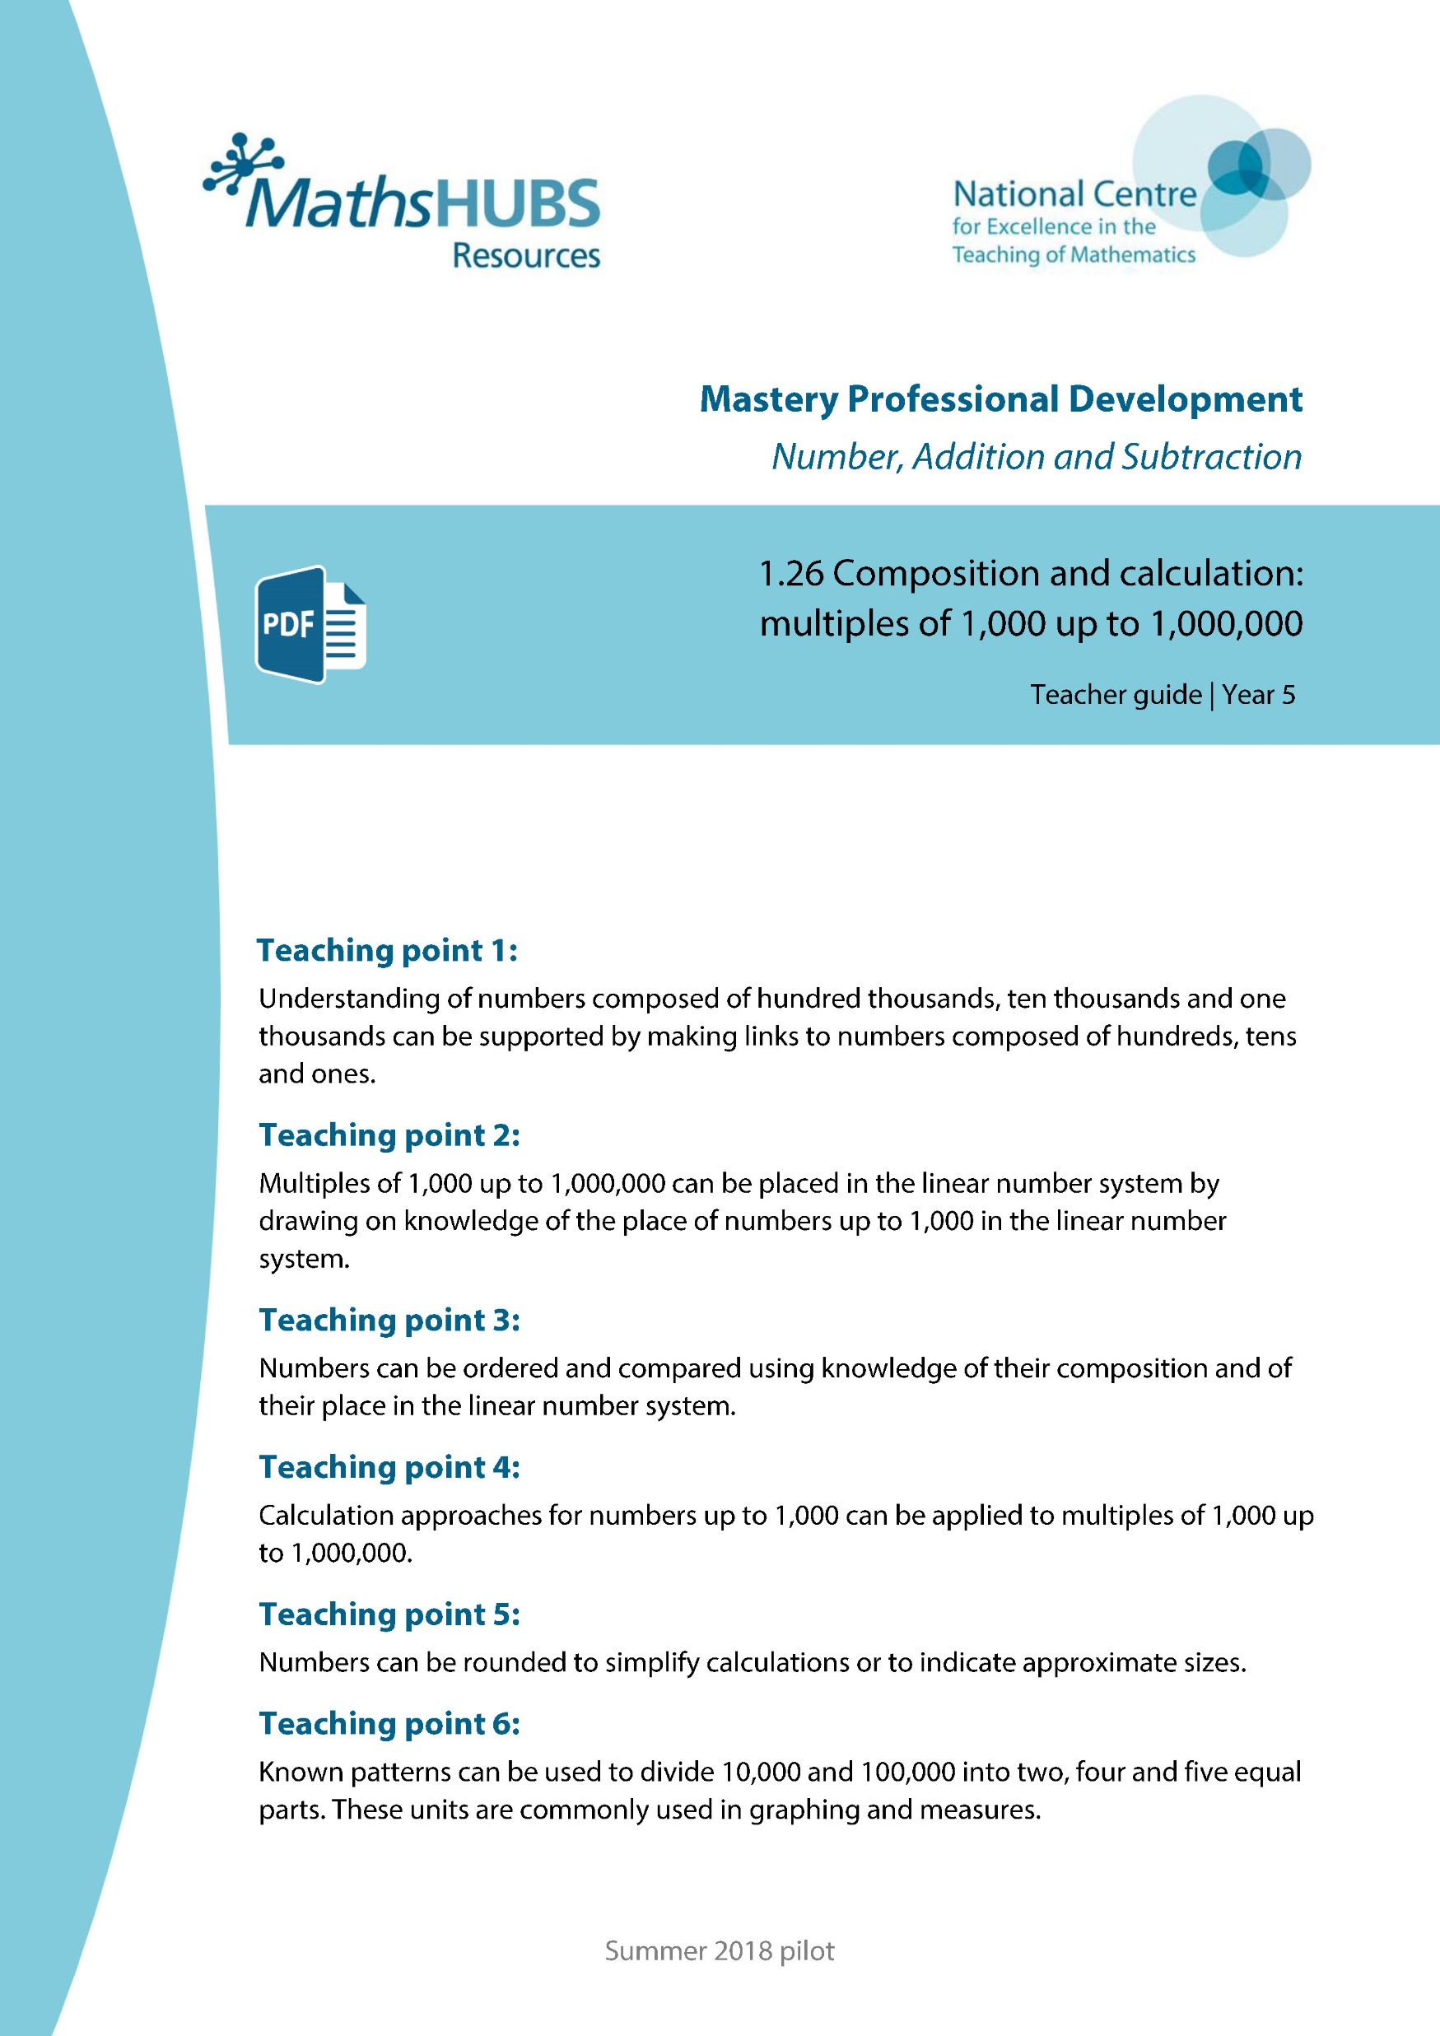
Year 6, Unit 2, Learning Outcome 1
Additional teacher guidance for this outcome should be read first and can be found in this segment of the NCETM Primary Mastery Professional Development Materials:
1.26 Multiples of 1,000 up to 1,000,000
The spine materials are divided into ‘teaching points’ and ‘steps in learning’.
Teaching point | Steps in learning | Pages
1 | 1:1-1:3 & 1:12 | 4-6 & 14-15

Slide 7
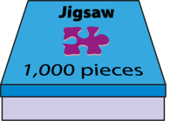
1.26 Multiples of 1,000 up to 1,000,000 – step 1:1
1,000
2,000
3,000
4,000
5,000
6,000
7,000
8,000
9,000
10,000
one thousand
two thousand
three thousand
four thousand
five thousand
six thousand
seven thousand
eight thousand
nine thousand
ten thousand

Slide 8


1.26 Multiples of 1,000 up to 1,000,000 – step 1:2

Slide 9
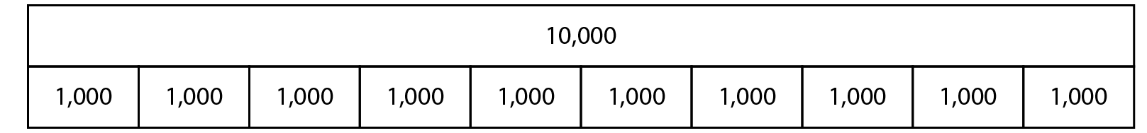
1.26 Multiples of 1,000 up to 1,000,000 – step 1:2

Slide 10

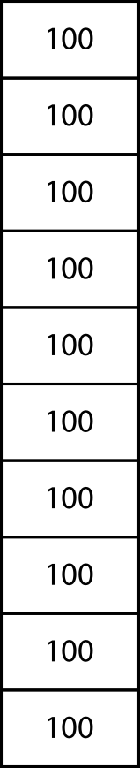
1.26 Multiples of 1,000 up to 1,000,000 – step 1:2

Slide 11
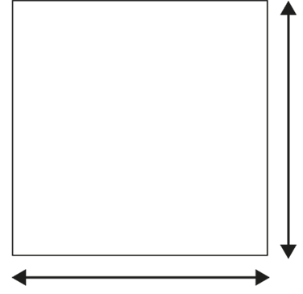
1.26 Multiples of 1,000 up to 1,000,000 – step 1:3
100 cm
1 m
100 cm
1 m
100 cm × 100 cm = 10,000 cm²
1 m × 1 m = 1 m²

Slide 12
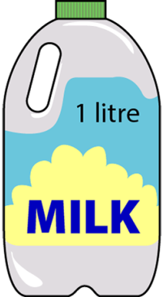
1.26 Multiples of 1,000 up to 1,000,000 – step 1:3
1 litre × 10
= 10 litres
= 10,000 ml

Slide 13
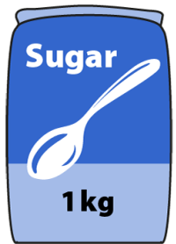
1.26 Multiples of 1,000 up to 1,000,000 – step 1:3
1 kg × 10
= 10 kg
= 10,000 g

Slide 14
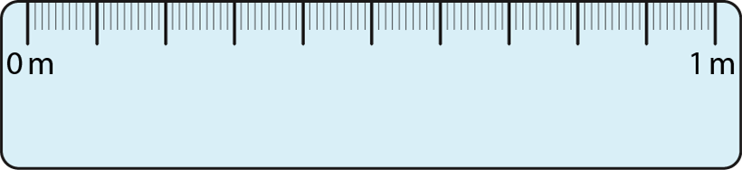
1.26 Multiples of 1,000 up to 1,000,000 – step 1:3
× 100
1 m × 100
= 100 m
= 10,000 cm

Slide 15
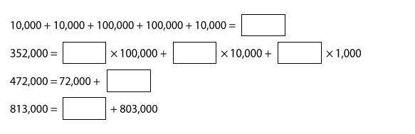
1.26 Multiples of 1,000 up to 1,000,000 – step 1:12
Fill in the missing numbers.

Slide 16
Year 6, Unit 2, Learning Outcome 2
Learning Outcome 2
Pupils explain how one hundred thousand can be composed
The following slides have been collated to support the teaching of this learning outcome.

Slide 17
Year 6, Unit 2, Learning Outcome 2
Additional teacher guidance for this outcome should be read first and can be found in this segment of the NCETM Primary Mastery Professional Development Materials:
1.26 Multiples of 1,000 up to 1,000,000
The spine materials are divided into ‘teaching points’ and ‘steps in learning’.
Teaching point | Steps in learning | Pages
1 | 1:4-1:5 & 1:12 | 7-8 & 14-15

Slide 18

1.26 Multiples of 1,000 up to 1,000,000 – step 1:4

Slide 19
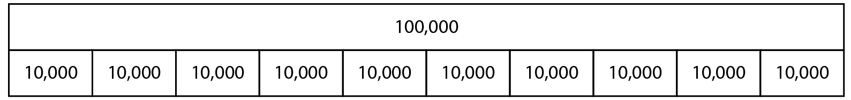
1.26 Multiples of 1,000 up to 1,000,000 – step 1:4

Slide 20

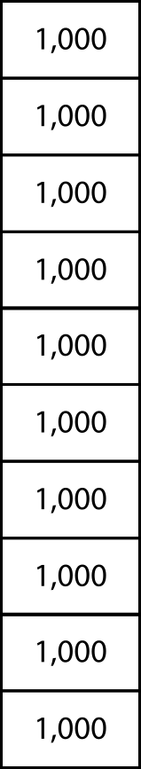
1.26 Multiples of 1,000 up to 1,000,000 – step 1:4

Slide 21
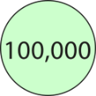


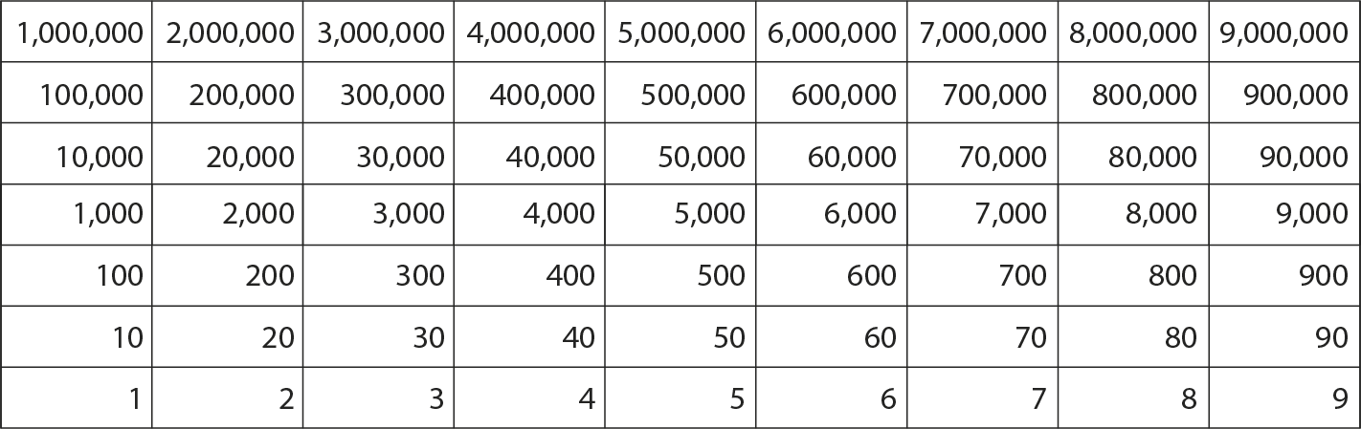


1.26 Multiples of 1,000 up to 1,000,000 – step 1:12
300,000
+
20,000
+
4,000
=
324,000

Slide 22
Year 6, Unit 2, Learning Outcome 3
Learning Outcome 3
Pupils read and write numbers up to one million (1)
The following slides have been collated to support the teaching of this learning outcome.

Slide 23
Year 6, Unit 2, Learning Outcome 3
Additional teacher guidance for this outcome should be read first and can be found in this segment of the NCETM Primary Mastery Professional Development Materials:
1.26 Multiples of 1,000 up to 1,000,000
The spine materials are divided into ‘teaching points’ and ‘steps in learning’.
Teaching point | Steps in learning | Pages
1 | 1:6-1:9 & 1:12 | 8-11 & 14-15

Slide 24
1.26 Multiples of 1,000 up to 1,000,000 – step 1:6
Millions |  |  | Thousands |  |  | Ones
100s | 10s | 1s | 100s | 10s | 1s | 100s | 10s | 1s
 |  |  |  |  |  |  |  | 1
 |  |  |  |  |  |  | 1 | 0
 |  |  |  |  |  | 1 | 0 | 0
 |  |  |  |  | 1 | 0 | 0 | 0
 |  |  |  | 1 | 0 | 0 | 0 | 0
 |  |  | 1 | 0 | 0 | 0 | 0 | 0
 |  | 1 | 0 | 0 | 0 | 0 | 0 | 0

Slide 25
1.26 Multiples of 1,000 up to 1,000,000 – step 1:6
 |  |  |  |  |  |  |  |  | 1 |  |  |  |  | one
 |  |  |  |  |  |  |  | 1 | 0 |  |  |  |  | ten
 |  |  |  |  |  |  | 1 | 0 | 0 |  |  |  |  | one hundred
 |  |  |  |  | 1 | , | 0 | 0 | 0 |  |  |  |  | one thousand
 |  |  |  | 1 | 0 | , | 0 | 0 | 0 |  |  |  |  | ten thousand
 |  |  | 1 | 0 | 0 | , | 0 | 0 | 0 |  |  |  |  | one hundred thousand
 | 1 | , | 0 | 0 | 0 | , | 0 | 0 | 0 |  |  |  |  | one million

Slide 26




1.26 Multiples of 1,000 up to 1,000,000 – step 1:7

Slide 27


1.26 Multiples of 1,000 up to 1,000,000 – step 1:9
400 + 80 + 5 =
485

Slide 28
1.26 Multiples of 1,000 up to 1,000,000 – step 1:9
400,000 + 80,000 + 5,000 =
485,000

Slide 29
1.26 Multiples of 1,000 up to 1,000,000 – step 1:9
400
+
80
+
5
=
485
400 thousand
+
80 thousand
+
5 thousand
=
485 thousand
400,000
+
80,000
+
5,000
=
485,000

Slide 30
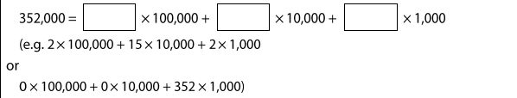
1.26 Multiples of 1,000 up to 1,000,000 – step 1:12
Complete this equation in many different ways.

Slide 31
Year 6, Unit 2, Learning Outcome 4
Learning Outcome 4
Pupils read and write numbers up to one million (2)
The following slides have been collated to support the teaching of this learning outcome.

Slide 32
Year 6, Unit 2, Learning Outcome 4
Additional teacher guidance for this outcome should be read first and can be found in this segment of the NCETM Primary Mastery Professional Development Materials:
1.26 Multiples of 1,000 up to 1,000,000
The spine materials are divided into ‘teaching points’ and ‘steps in learning’.
Teaching point | Steps in learning | Pages
1 | 1:10-1:12 | 12-15

Slide 33
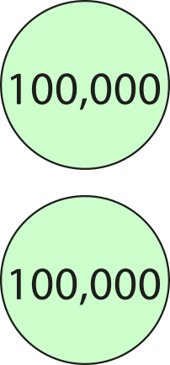
1.26 Multiples of 1,000 up to 1,000,000 – step 1:10
200,000

Slide 34
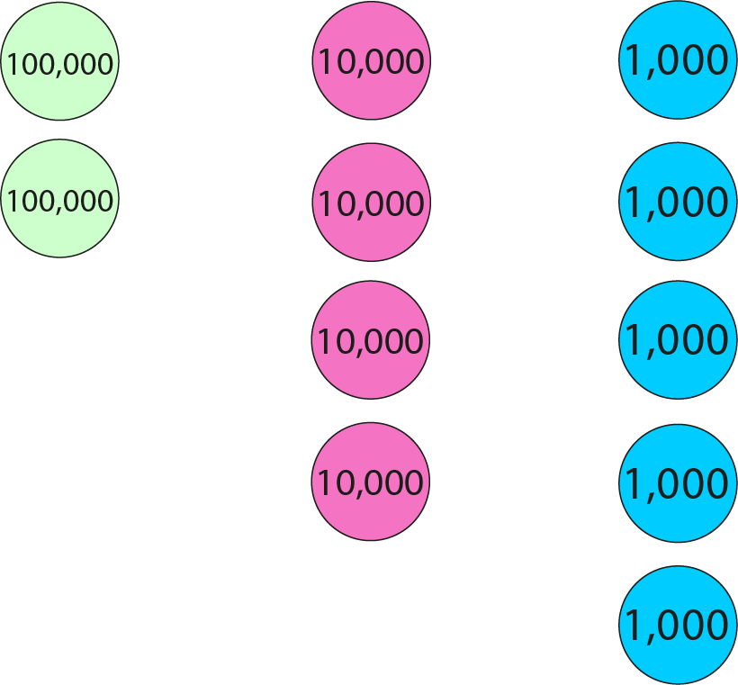
1.26 Multiples of 1,000 up to 1,000,000 – step 1:10
245,000

Slide 35
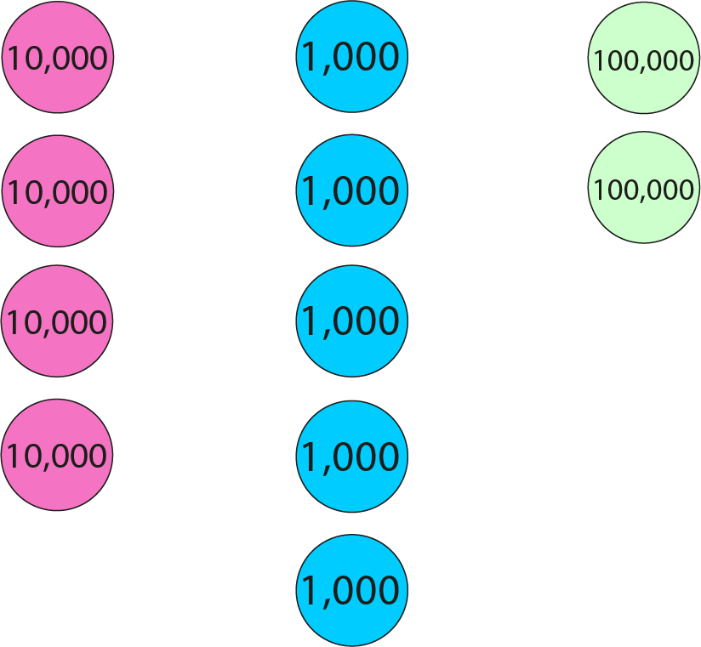
1.26 Multiples of 1,000 up to 1,000,000 – step 1:10
245,000

Slide 36
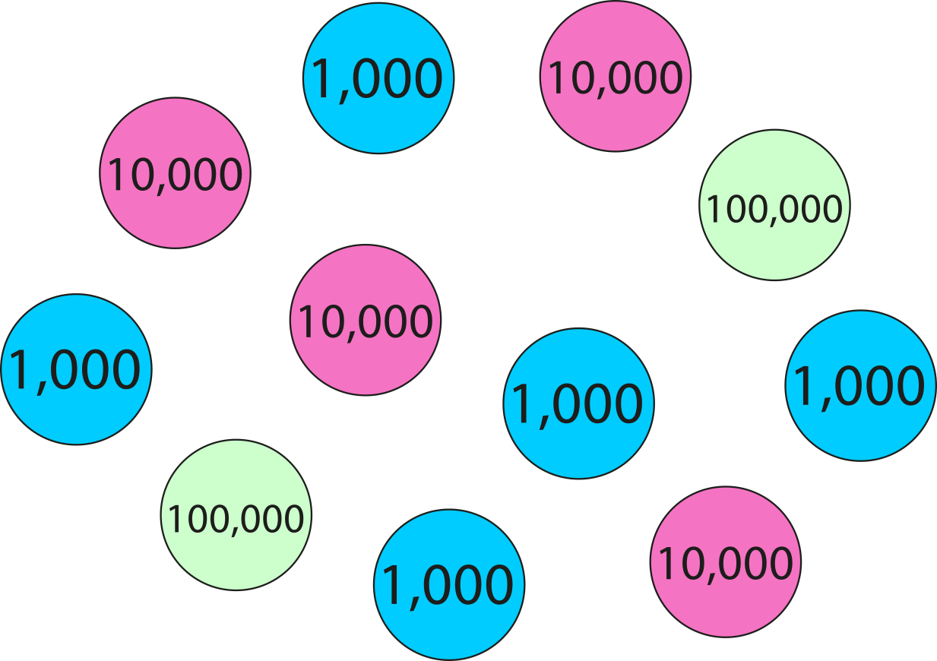
1.26 Multiples of 1,000 up to 1,000,000 – step 1:10
245,000

Slide 37
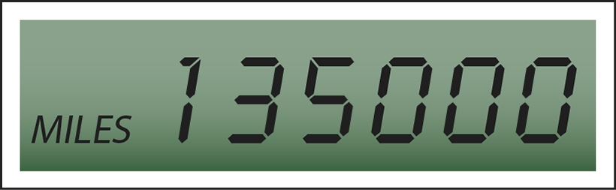
1.26 Multiples of 1,000 up to 1,000,000 – step 1:11
135 000

Slide 38
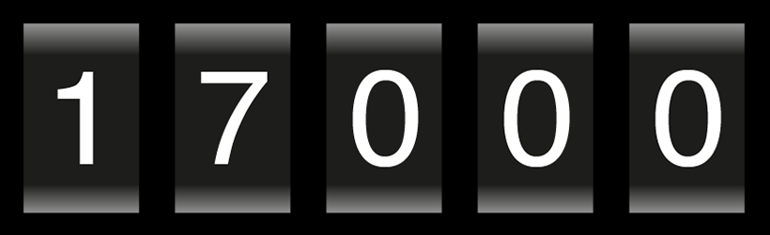
1.26 Multiples of 1,000 up to 1,000,000 – step 1:11
17 000

Slide 39
1.26 Multiples of 1,000 up to 1,000,000 – step 1:12
300,000
+
20,000
+
4,000
=
324,000

Slide 40
Year 6, Unit 2, Learning Outcome 5
Learning Outcome 5
Pupils identify and place the position of five-digit multiple of one thousand numbers, on a marked, but unlabelled number line
The following slides have been collated to support the teaching of this learning outcome.

Slide 41
Year 6, Unit 2, Learning Outcome 5
Additional teacher guidance for this outcome should be read first and can be found in this segment of the NCETM Primary Mastery Professional Development Materials:
1.26 Multiples of 1,000 up to 1,000,000
The spine materials are divided into ‘teaching points’ and ‘steps in learning’.
Teaching point | Steps in learning | Pages
2 | 2:1-2:2 | 16-17

Slide 42




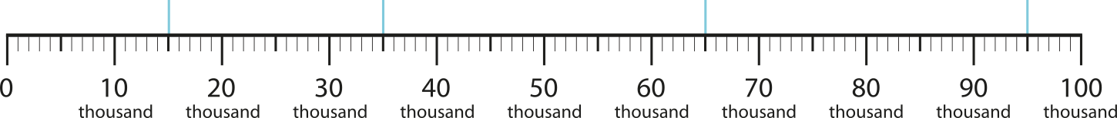
1.26 Multiples of 1,000 up to 1,000,000 – step 2:1
15
35
65
95
15
thousand
35
thousand
65
thousand
95
thousand
15,000
35,000
65,000
95,000

Slide 43






1.26 Multiples of 1,000 up to 1,000,000 – step 2:2
13,000
26,000
38,000
54,000
72,000
89,000

Slide 44
1.26 Multiples of 1,000 up to 1,000,000 – step 2:2
43,000
12,000
98,000
61,000

Slide 45
Year 6, Unit 2, Learning Outcome 6
Learning Outcome 6
Pupils identify and place the position of six-digit multiple of one thousand numbers, on a marked, but unlabelled number line
The following slides have been collated to support the teaching of this learning outcome.

Slide 46
Year 6, Unit 2, Learning Outcome 6
Additional teacher guidance for this outcome should be read first and can be found in this segment of the NCETM Primary Mastery Professional Development Materials:
1.26 Multiples of 1,000 up to 1,000,000
The spine materials are divided into ‘teaching points’ and ‘steps in learning’.
Teaching point | Steps in learning | Pages
2 | 2:3-2:5 | 17-19

Slide 47
1.26 Multiples of 1,000 up to 1,000,000 – step 2:3
450
450 thousand
450,000

Slide 48



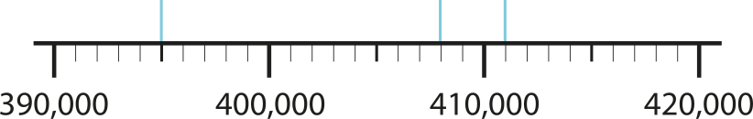
1.26 Multiples of 1,000 up to 1,000,000 – step 2:4
395,000
408,000
411,000

Slide 49
1.26 Multiples of 1,000 up to 1,000,000 – step 2:4
158,000
159,000
160,000
161,000
162,000

Slide 50
1.26 Multiples of 1,000 up to 1,000,000 – step 2:4
780,000
790,000
800,000
810,000
820,000
830,000

Slide 51
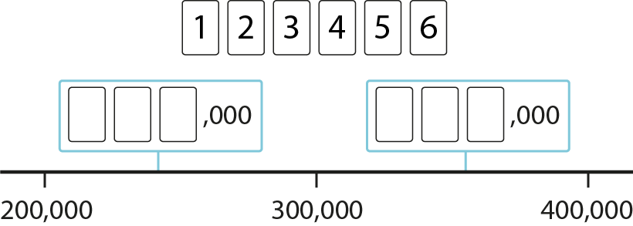






1.26 Multiples of 1,000 up to 1,000,000 – step 2:4
,000
,000
,000
,000
,000
,000
,000
,000
Notes:
‘Use the digit cards 1–6 to complete the missing values on the number line.’

Slide 52


1.26 Multiples of 1,000 up to 1,000,000 – step 2:5
28,000
20,000
30,000
40,000

Slide 53

1.26 Multiples of 1,000 up to 1,000,000 – step 2:5
320,000
0
100
thousand
200
thousand
300
thousand
400
thousand

Slide 54
Year 6, Unit 2, Learning Outcome 7
Learning Outcome 7
Pupils count forwards and backwards in steps of powers of 10, from any multiple of 1,000
The following slides have been collated to support the teaching of this learning outcome.

Slide 55
Year 6, Unit 2, Learning Outcome 7
Additional teacher guidance for this outcome should be read first and can be found in this segment of the NCETM Primary Mastery Professional Development Materials:
1.26 Multiples of 1,000 up to 1,000,000
The spine materials are divided into ‘teaching points’ and ‘steps in learning’.
Teaching point | Steps in learning | Pages
2 | 2:6 | 20-21

Slide 56







1.26 Multiples of 1,000 up to 1,000,000 – step 2:6
Fill in the missing numbers.

Slide 57
Year 6, Unit 2, Learning Outcome 8
Learning Outcome 8
Pupils explain that 10,000 is composed of 5,000s 2,500s and 2,000s
The following slides have been collated to support the teaching of this learning outcome.

Slide 58
Year 6, Unit 2, Learning Outcome 8
Additional teacher guidance for this outcome should be read first and can be found in this segment of the NCETM Primary Mastery Professional Development Materials:
1.26 Multiples of 1,000 up to 1,000,000
The spine materials are divided into ‘teaching points’ and ‘steps in learning’.
Teaching point | Steps in learning | Pages
6 | 6:1 & 6:3 | 43-45 & 47

Slide 59

1.26 Multiples of 1,000 up to 1,000,000 – step 6:1
10,000
5,000
?
5,000
?

Slide 60

1.26 Multiples of 1,000 up to 1,000,000 – step 6:1
10,000
2,500
?
2,500
?
2,500
?
2,500
?

Slide 61
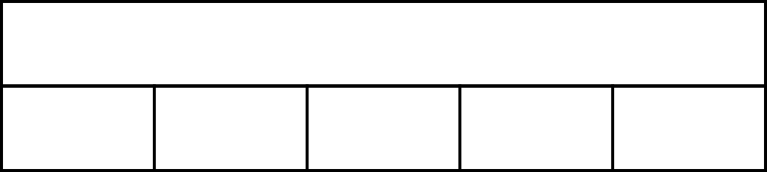
1.26 Multiples of 1,000 up to 1,000,000 – step 6:1
10,000
2,000
?
2,000
?
2,000
?
2,000
?
2,000
?

Slide 62
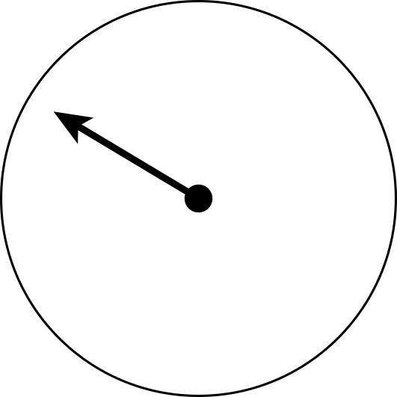
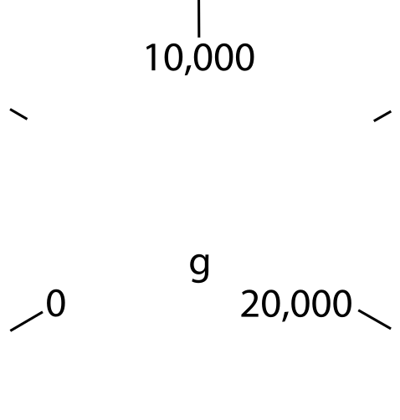
1.26 Multiples of 1,000 up to 1,000,000 – step 6:1
5,000 g

Slide 63
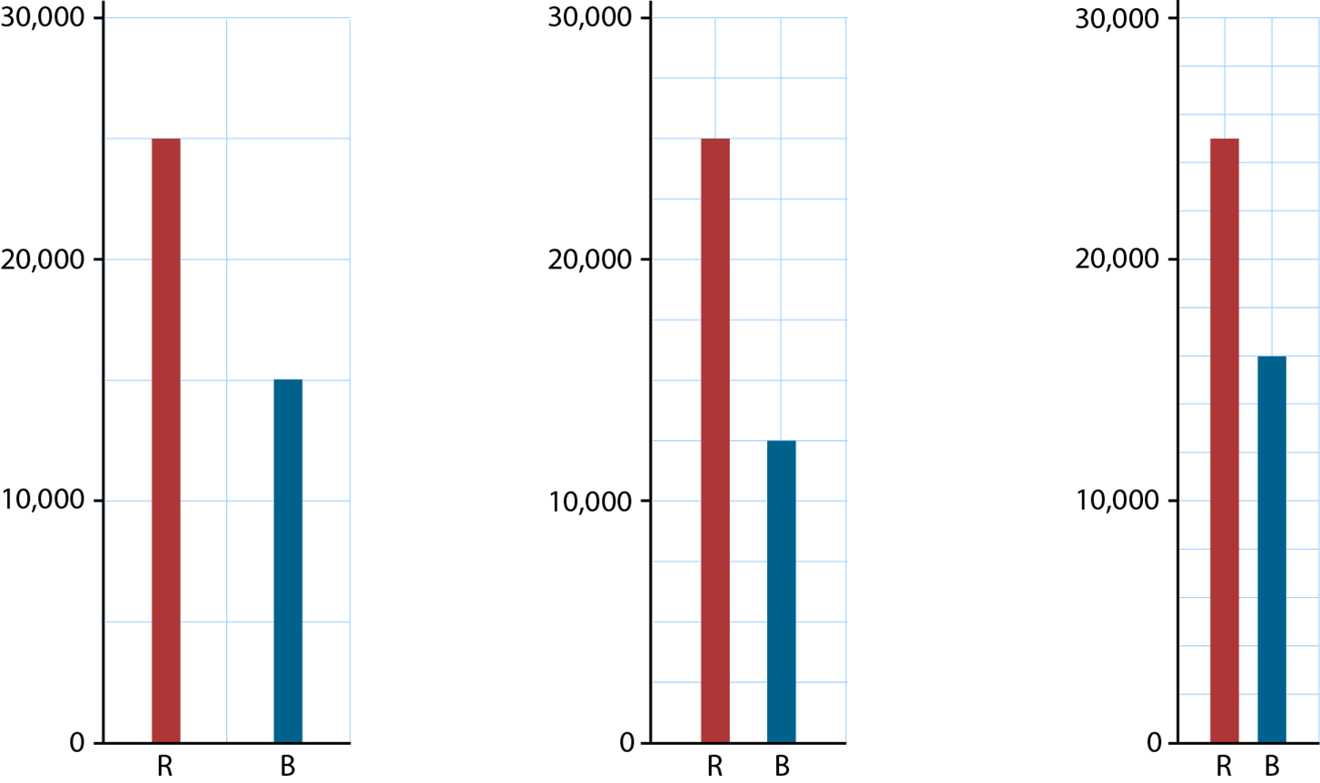
1.26 Multiples of 1,000 up to 1,000,000 – step 6:1

Slide 64
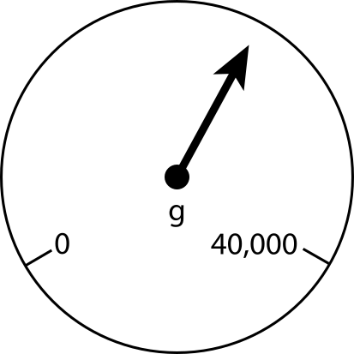
1.26 Multiples of 1,000 up to 1,000,000 – step 6:3

Slide 65
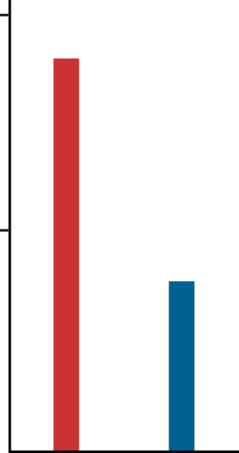
1.26 Multiples of 1,000 up to 1,000,000 – step 6:3
200,000
100,000
0
R
B

Slide 66

1.26 Multiples of 1,000 up to 1,000,000 – step 6:3
R
B

Slide 67
Year 6, Unit 2, Learning Outcome 9
Learning Outcome 9
Pupils explain that 100,000 is composed of 50,000s 25,000s and 20,000s
The following slides have been collated to support the teaching of this learning outcome.

Slide 68
Year 6, Unit 2, Learning Outcome 9
Additional teacher guidance for this outcome should be read first and can be found in this segment of the NCETM Primary Mastery Professional Development Materials:
1.26 Multiples of 1,000 up to 1,000,000
The spine materials are divided into ‘teaching points’ and ‘steps in learning’.
Teaching point | Steps in learning | Pages
6 | 6:2 & 6:3 | 45-47

Slide 69
1.26 Multiples of 1,000 up to 1,000,000 – step 6:2
100,000
50,000
?
50,000
?

Slide 70
1.26 Multiples of 1,000 up to 1,000,000 – step 6:2
100,000
25,000
?
25,000
?
25,000
?
25,000
?

Slide 71
1.26 Multiples of 1,000 up to 1,000,000 – step 6:2
100,000
20,000
?
20,000
?
20,000
?
20,000
?
20,000
?

Slide 72
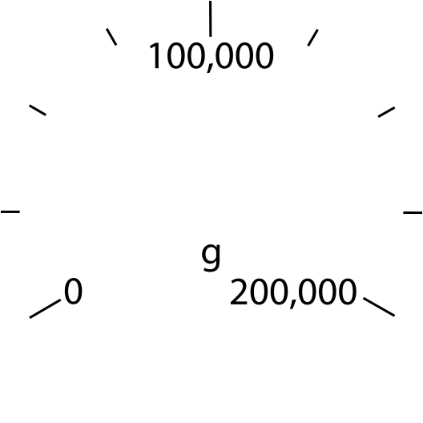
1.26 Multiples of 1,000 up to 1,000,000 – step 6:2
75,000 g

Slide 73
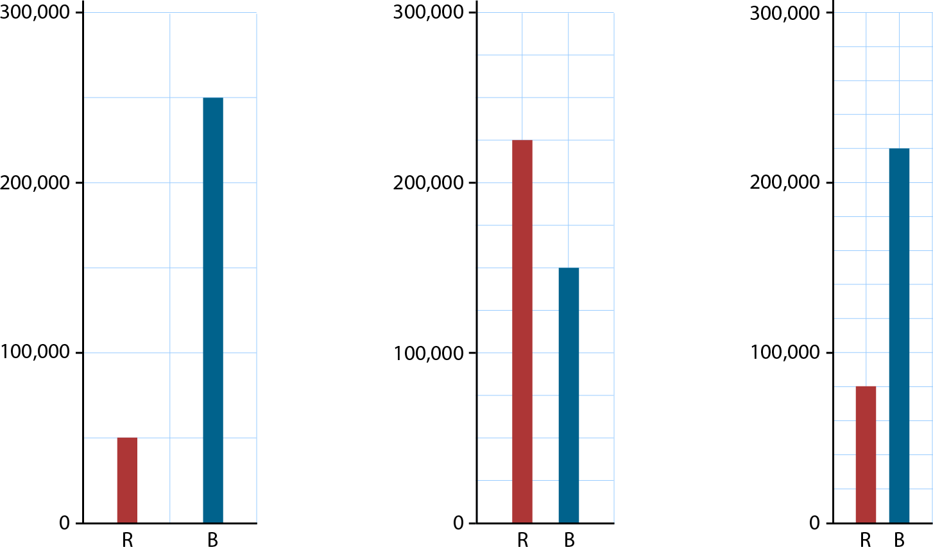
1.26 Multiples of 1,000 up to 1,000,000 – step 6:2

Slide 74
1.26 Multiples of 1,000 up to 1,000,000 – step 6:3

Slide 75
1.26 Multiples of 1,000 up to 1,000,000 – step 6:3
200,000
100,000
0
R
B

Slide 76
1.26 Multiples of 1,000 up to 1,000,000 – step 6:3
R
B

Slide 77
Year 6, Unit 2, Learning Outcome 10
Learning Outcome 10
Pupils read scales in graphing and measures contexts, by using their knowledge of the composition of 10,000 and 100,000
The following slide supports the teaching of this learning outcome.

Slide 78
Year 6, Unit 2, Learning Outcome 10
Additional teacher guidance for this outcome should be read first and can be found in this segment of the NCETM Primary Mastery Professional Development Materials:
1.26 Multiples of 1,000 up to 1,000,000
The spine materials are divided into ‘teaching points’ and ‘steps in learning’.
Teaching point | Steps in learning | Pages
6 | 6:4 | 47-48

