Slide 1
Year 6, Unit 11
Solving problems with two unknowns

Slide 2
Year 6, Unit 11
These materials heavily reflect the prioritisation approach of the ready-to-progress criteria in the DfE Primary Mathematics Guidance 2020 and on the PPTs that exemplify them on the NCETM website. They also include other relevant National Curriculum content. Related sections of the NCETM Primary Mastery Professional Development Materials provide small-step teaching guidance.
Ready-to-progress criteria addressed by this unit
Teaching of this unit supports the following criteria from the ‘DfE Mathematics Guidance: key stages 1 & 2’ (the 335-page document available as a download)
6AS/MD-4 Page 308

Slide 3
Contents
The links below take you to the starting slide of each learning outcome.
1 | Pupils compare the structure of problems with one or two unknowns
2 | Pupils compare the structure of problems with two unknowns
3 | Pupils represent the structure of contextual problems with two unknowns
4 | Pupils represent a problem with two unknowns using a bar model
5 | Pupils explain why sometimes there is only one solution to a sum and difference problem
Click the arrow button to return to this Contents slide.

Slide 4
Contents
The links below take you to the starting slide of each learning outcome.
6 | Pupils explain why sometimes there is only one solution to a sum and multiple problem
7 | Pupils explain the values a part-whole model could represent
8 | Pupils use a bar model to visualise how to solve a problem with two unknowns
9 | Pupils use diagrams to explain how to solve a spatial problem
10 | Pupils explain how to represent an equation with a bar model
Click the arrow button to return to this Contents slide.

Slide 5
Contents
The links below take you to the starting slide of each learning outcome.
11 | Pupils solve problems with two unknowns in a range of contexts
12 | Pupils systematically solve problems with two unknowns using ‘trial and improvement’ (one and several solutions)
13 | Pupils explain how I know I have found all possible solutions to problems with two unknowns
14 | Pupils explain how to balance an equation with two unknowns
15 | Pupils systematically solve problems with two unknowns using ‘trial and improvement’ (one, several and infinite solutions)
Click the arrow button to return to this Contents slide.

Slide 6
Year 6, Unit 11, Learning Outcome 1
Learning Outcome 1
Pupils compare the structure of problems with one or two unknowns
The following slides have been collated to support the teaching of this learning outcome.

Slide 7
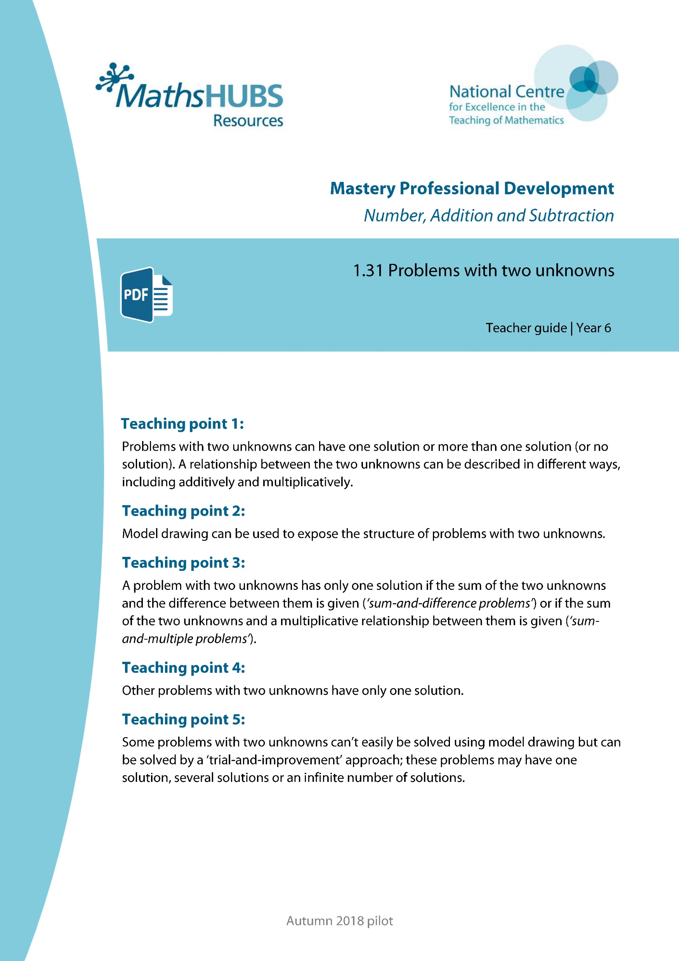
Year 6, Unit 11, Learning Outcome 1
Additional teacher guidance for this outcome should be read first and can be found in this segment of the NCETM Primary Mastery Professional Development Materials:
1.31 Problems with two unknowns
The spine materials are divided into ‘teaching points’ and ‘steps in learning’.
Teaching point | Steps in learning | Pages
1 | 1:1 & 1:4 | 5-6 & 8

Slide 8



1.31 Problems with two unknowns – step 1:1
B = r + b
Notes:
One unknown; one solution:
I am thinking of two rods that are equivalent to blue. One of them is red. What is the other one?

Slide 9







1.31 Problems with two unknowns – step 1:1
B = g + d
B = w + t
B = r + b
B = p + y
Notes:
Two unknowns; several solutions:
I am thinking of two rods that together are equivalent to blue. What are they?

Slide 10
6AS/MD-4 Solve problems with two unknowns
Take out the blue rod.
Place the red and black rods underneath.
Write an addition equation to show that the length of the blue rod is equal to the length of the red and black rod.
For the problem shown is there:
  an infinite number of solutions;
  more than one solution;
  only one solution?
B = r + b
B = p + y
B = +
There is more than one solution to the problem.

Slide 11
Year 6, Unit 11, Learning Outcome 2
Learning Outcome 2
Pupils compare the structure of problems with two unknowns
The following slides have been collated to support the teaching of this learning outcome.

Slide 12
Year 6, Unit 11, Learning Outcome 2
Additional teacher guidance for this outcome should be read first and can be found in this segment of the NCETM Primary Mastery Professional Development Materials:
1.31 Problems with two unknowns
The spine materials are divided into ‘teaching points’ and ‘steps in learning’.
Teaching point | Steps in learning | Pages
1 | 1.2-1.4 | 6-8

Slide 13
1.31 Problems with two unknowns – step 1:2
B = g + d
d = 2 × g
Notes:
Two unknowns: one solution (multiplicative relationship between the unknowns):
I am thinking of two rods that together are equivalent to blue. One is twice as long as the other. What are they?

Slide 14
1.31 Problems with two unknowns – step 1:3
B = p + y
y − p = w
p + w = y
Notes:
Two unknowns; one solution (additive relationship between the unknowns):
I am thinking of two rods that together are equivalent to blue. There is a difference of white between the two rods. What are they?

Slide 15
Year 6, Unit 11, Learning Outcome 3
Learning Outcome 3
Pupils represent the structure of contextual problems with two unknowns
The following slides have been collated to support the teaching of this learning outcome.

Slide 16
Year 6, Unit 11, Learning Outcome 3
Additional teacher guidance for this outcome should be read first and can be found in this segment of the NCETM Primary Mastery Professional Development Materials:
1.31 Problems with two unknowns
The spine materials are divided into ‘teaching points’ and ‘steps in learning’.
Teaching point | Steps in learning | Pages
2 | 2:1-2:3 | 9-13

Slide 17
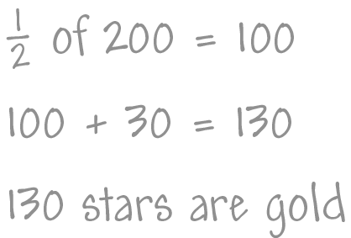
1.31 Problems with two unknowns – step 2:1
Child A
Notes:
Year 6 have earnt 200 stars; the stars are either gold or silver. They have 30 more gold stars than silver. How many are gold?

Slide 18
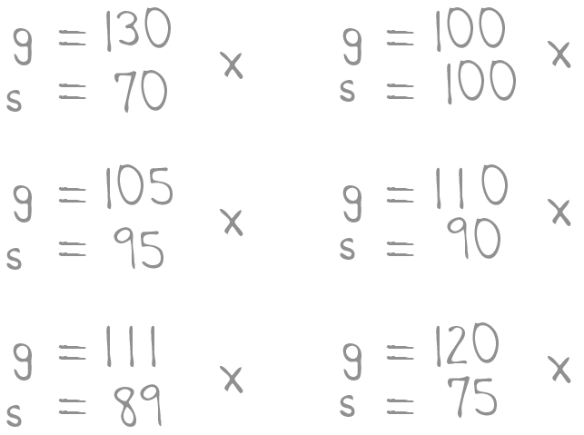
1.31 Problems with two unknowns – step 2:1
Child B
Notes:
Year 6 have earnt 200 stars; the stars are either gold or silver. They have 30 more gold stars than silver. How many are gold?

Slide 19
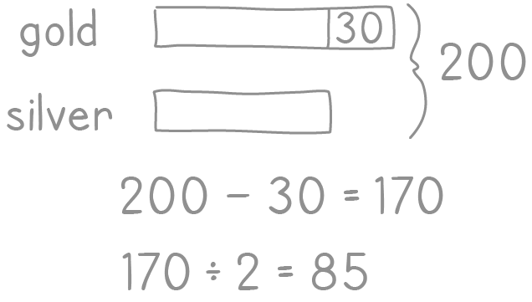
1.31 Problems with two unknowns – step 2:1
Child C
Notes:
Year 6 have earnt 200 stars; the stars are either gold or silver. They have 30 more gold stars than silver. How many are gold?

Slide 20
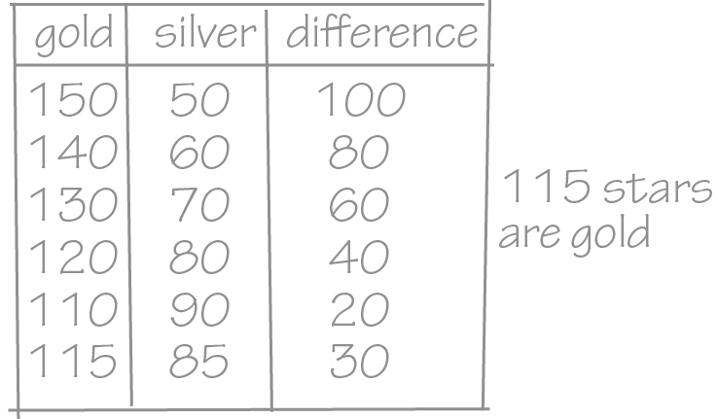
1.31 Problems with two unknowns – step 2:1
Child D
Notes:
Year 6 have earnt 200 stars; the stars are either gold or silver. They have 30 more gold stars than silver. How many are gold?

Slide 21

1.31 Problems with two unknowns – step 2:1
Child E
Notes:
Year 6 have earnt 200 stars; the stars are either gold or silver. They have 30 more gold stars than silver. How many are gold?

Slide 22
1.31 Problems with two unknowns – step 2:1
Child A
Child B
Child C
Child D
Child E
Notes:
Year 6 have earnt 200 stars; the stars are either gold or silver. They have 30 more gold stars than silver. How many are gold?

Slide 23
Year 6, Unit 11, Learning Outcome 4
Learning Outcome 4
Pupils represent a problem with two unknowns using a bar model
The following slides have been collated to support the teaching of this learning outcome.

Slide 24
Year 6, Unit 11, Learning Outcome 4
Additional teacher guidance for this outcome should be read first and can be found in this segment of the NCETM Primary Mastery Professional Development Materials:
1.31 Problems with two unknowns
The spine materials are divided into ‘teaching points’ and ‘steps in learning’.
Teaching point | Steps in learning | Pages
2 | 2:4-2:5 | 13-16

Slide 25
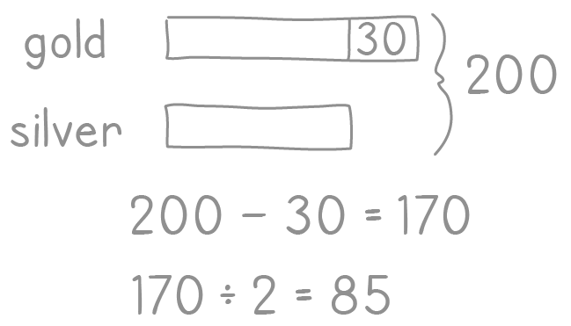


1.31 Problems with two unknowns – step 2:4
Child C
Child D

Slide 26
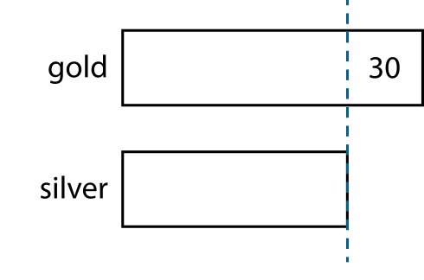


1.31 Problems with two unknowns – step 2:5
Child C
‘So now I know that the number of silver stars is half of 170.’
‘I know that there are 30 more gold stars than silver stars.’
‘I also know that there are 200 stars altogether.’
‘I subtract the “30”.’
170 ÷ 2 = 85
number of silver stars = 85
number of gold stars = 85 + 30 = 115

Slide 27



1.31 Problems with two unknowns – step 2:5
Child E
‘I also know that there are 30 more gold stars than silver stars.’
‘I know that the number of gold stars plus the number
of silver stars is equal to 200.’
‘I can fill in the missing part on the bottom row.’
s + 30 + s = 200
or
2s = 200 − 30 = 170
170 ÷ 2 = 85
number of silver stars = 85
number of gold stars = 85 + 30 = 115

Slide 28
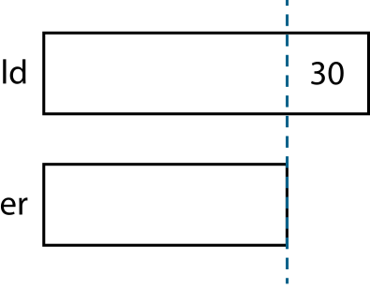
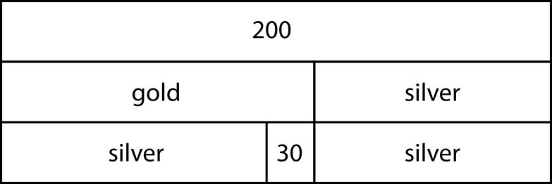
1.31 Problems with two unknowns – step 2:5
Child C
Child E
s + 30 + s = 200
170 ÷ 2 = 85
or
2s = 200 − 30 = 170
number of silver stars = 85
170 ÷ 2 = 85
number of gold stars = 85 + 30 = 115
number of silver stars = 85
number of gold stars = 85 + 30 = 115

Slide 29
Year 6, Unit 11, Learning Outcome 5
Learning Outcome 5
Pupils explain why sometimes there is only one solution to a sum and difference problem
The following slides have been collated to support the teaching of this learning outcome.

Slide 30
Year 6, Unit 11, Learning Outcome 5
Additional teacher guidance for this outcome should be read first and can be found in this segment of the NCETM Primary Mastery Professional Development Materials:
1.31 Problems with two unknowns
The spine materials are divided into ‘teaching points’ and ‘steps in learning’.
Teaching point | Steps in learning | Pages
3 | 3:1-3:2 & 3:7 | 17-19 & 23-25

Slide 31
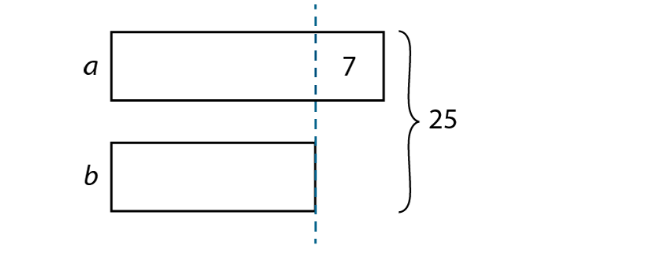
1.31 Problems with two unknowns – step 3:1
b = 18 ÷ 2
= 9
a = 9 + 7
= 16
‘The two numbers are 9 and 16.’
check: 9 + 16 = 25
Notes:
The sum of two numbers, a and b, is 25, and the difference between them is 7. What are the two numbers?

Slide 32
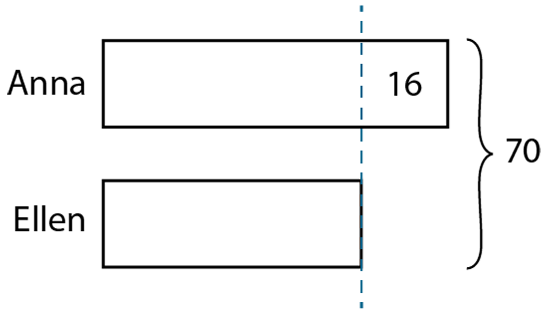
1.31 Problems with two unknowns – step 3:2
this is double Ellen’s
amount of money
70 − 16
= 54
Ellen’s amount = 54 ÷ 2
= 27
Anna’s amount = 27 + 16
= 43
‘Anna has £43 and Ellen has £27.’
check: £43 + £27 = £70
Notes:
Anna and Ellen have £70 in total. Anna has £16 more than Ellen. How much money do they each have?

Slide 33
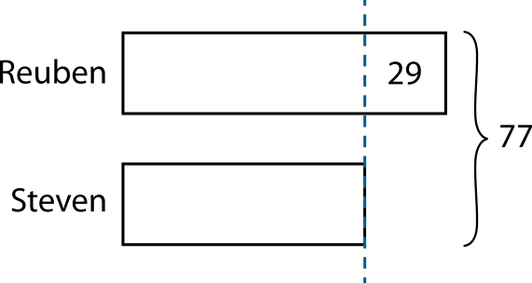
1.31 Problems with two unknowns – step 3:2
77 − 29
= 48
this is double Steven’s age
Steven’s age = 48 ÷ 2
= 24
Reuben’s age = 24 + 29
= 53
‘Steven is 24 years old and Reuben is 53 years old.’
check: 24 + 53 = 77
Notes:
Steven is 29 years younger than Reuben. The sum of their ages is 77 years. How old is each person?

Slide 34
6AS/MD-4 Solve problems with two unknowns
The sum of two numbers, a and b, is 25, and the difference between them is 7. What are the two numbers?
How can we label our representation to shown that the sum is 25?
How can we show that the difference between a and b is 7?
If we subtract 7 from one part, how will this affect the sum?
How can we check that our solutions are correct?
b = 18 ÷ 2
= 9
a = 9 + 7
= 16
The two numbers are 9 and 16.
Check: 9 + 16 = 25

Slide 35
Year 6, Unit 11, Learning Outcome 6
Learning Outcome 6
Pupils explain why sometimes there is only one solution to a sum and multiple problem
The following slides have been collated to support the teaching of this learning outcome.

Slide 36
Year 6, Unit 11, Learning Outcome 6
Additional teacher guidance for this outcome should be read first and can be found in this segment of the NCETM Primary Mastery Professional Development Materials:
1.31 Problems with two unknowns
The spine materials are divided into ‘teaching points’ and ‘steps in learning’.
Teaching point | Steps in learning | Pages
3 | 3:3-3:5 & 3:7 | 19-25

Slide 37


1.31 Problems with two unknowns – step 3:3
‘I know that one number (a) is four times the other number (b).’
‘I also know that the two numbers sum to twenty.’
‘There are five equal parts that sum to twenty.’
a
4
4
4
4
20
b
4
one part = 20 ÷ 5
= 4
b = 4
a = 4 × 4
= 16
‘The two numbers are 16 and 4.’
check: 16 + 4 = 20
Notes:
The sum of two numbers is 20. One number is four times the other number. What are the two numbers?

Slide 38


1.31 Problems with two unknowns – step 3:4
‘There are six equal parts that sum to forty-eight.’
a
8
48
b
8
8
8
8
8
one part = 48 ÷ 6
= 8
a = 8
b = 5 × 8
= 40
‘The two numbers are 8 and 40.’
check: 8 + 40 = 48
Notes:
The sum of two numbers is 48. One number is one-fifth of the other number. What are the two numbers?

Slide 39
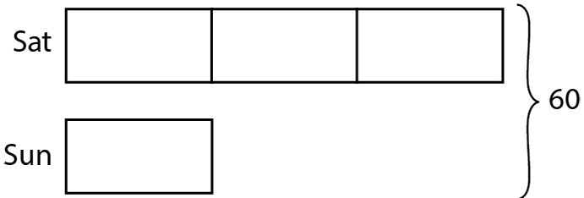
1.31 Problems with two unknowns – step 3:5
‘There are four equal parts that sum to sixty.’
60 ÷ 4
= 15
this is the amount earnt on Sunday
amount earnt on Saturday = 15 × 3
= 45
‘Bill earnt £45 on Saturday and £15 on Sunday.’
check: £45 + £15 = £60
Notes:
Bill earnt £60 doing odd-jobs one weekend. He earnt three times as much on Saturday as he did on Sunday. How much did Bill earn each day?

Slide 40
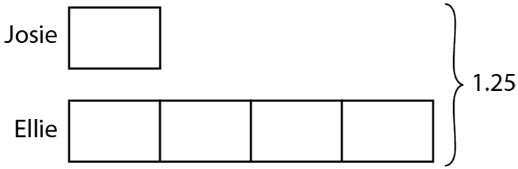
1.31 Problems with two unknowns – step 3:5
‘There are five equal parts that sum to 1.25.’
1.25 ÷ 5
= 0.25
this is the distance Josie swam
distance Ellie swam = 0.25 × 4
= 1
‘Josie swam 0.25 km and Ellie swam 1 km.’
check: 0.25 + 1 = 1.25
Notes:
Between them, Josie and Ellie swam 1.25 km during swimming training. Josie swam ¼ of the distance that Ellie swam. How far did each of them swim?

Slide 41
6AS/MD-4 Solve problems with two unknowns
The sum of two numbers is 20. One number is four times the other number. What are the two numbers?
Use strips of paper to model the problem.
Why are all of the parts equal in size?
Why do we divide by 5 and not 4?
How can we check that our solutions are correct?
a
4
4
4
4
20
b
4
one part = 20 ÷ 5
= 4
One number is four times the size of the other. This can be represented by one part to four parts. There are five equal parts that sum to twenty, so we must divide by five.
b = 4
a = 4 × 4
= 16
The two numbers are 16 and 4.
Check: 16 + 4 = 20

Slide 42


6AS/MD-4 Solve problems with two unknowns
Bill earned some money doing odd-jobs one weekend. He earned 3 times as much on Saturday than he did on Sunday. He earned £30 more on Saturday than on Sunday. How much did Bill earn in total?
Use strips of paper to model the problem.
Why are all of the parts equal in size?
Why have we added 30 to our representation? What does this tell us about the value of each part?
How do we know that our solutions are correct?
Sat
15
15
15
60
Sun
15
30

Slide 43
6AS/MD-4 Solve problems with two unknowns
The sum of two numbers is 48. One number is one-fifth times the size of the other number. What are the two numbers?
What should our starting point be?
Why is the second number five times the size of the first number, but we are dividing by six?
How can we check that our solutions are correct?
a
8
48
b
8
8
8
8
8
one part = 48 ÷ 6
= 8
One number is one-fifth the size of the other. This can be represented by one part to five parts.
There are six equal parts that sum to forty-eight, so we must divide by six.
a = 8
b = 5 × 8
= 40
The two numbers are 8 and 40.
Check: 8 + 40 = 48

Slide 44
6AS/MD-4 Solve problems with two unknowns
Between them, Josie and Ellie swam 1.25 km during swimming training. Josie swam ¼ of the distance that Ellie swam. How far did each of them swim?
Why are all of the parts equal in size? Why is Ellie’s part four times the size of Josie’s?
What should we divide 1.25 by to find the value of each part? Why?
How can we check that our solutions are correct?
0.25
0.25
0.25
0.25
0.25
1.25 ÷ 5
= 0.25
distance Ellie swam = 0.25 × 4
= 1
There are 5 equal parts that sum to 1.25 so we need to divide by five.
Josie swam 0.25 km and Ellie swam 1 km.
Check: 0.25 + 1 = 1.25

Slide 45
Year 6, Unit 11, Learning Outcome 7
Learning Outcome 7
Pupils explain the values a part-whole model could represent
The following slides have been collated to support the teaching of this learning outcome.

Slide 46
Year 6, Unit 11, Learning Outcome 7
Additional teacher guidance for this outcome should be read first and can be found in this segment of the NCETM Primary Mastery Professional Development Materials:
1.31 Problems with two unknowns
The spine materials are divided into ‘teaching points’ and ‘steps in learning’.
Teaching point | Steps in learning | Pages
3 | 3:6-3:7 | 22-25

Slide 47
1.31 Problems with two unknowns – step 3:6
‘Bill earnt three times as much on Saturday as on Sunday, so the bar for Saturday must be made up of three parts each equal in size to the “Sunday” bar.’
‘The question compares the amounts earnt on Saturday and Sunday, so I’ll draw two bars side by side.’
‘The question also tells us that Bill earns £30 more on Saturday than on Sunday, so I’ll add this difference to my model.’
‘I can see that the difference of 30 corresponds to two equal parts of the “Saturday” bar. So each of these parts must be 15.’
‘Because all of the parts in the model are equal, I know that the other parts must be 15 as well.’
‘So the total amount earnt is four multiplied by £15; that’s £60.’
Sat
15
15
15
60
Sun
15
30
Notes:
Bill earnt some money doing odd-jobs one weekend. He earnt 3 times as much on Saturday than he did on Sunday. He earnt £30 more on Saturday than on Sunday. How much did Bill earn in total?

Slide 48
Year 6, Unit 11, Learning Outcome 8
Learning Outcome 8
Pupils use a bar model to visualise how to solve a problem with two unknowns
The following slides have been collated to support the teaching of this learning outcome.

Slide 49
Year 6, Unit 11, Learning Outcome 8
Additional teacher guidance for this outcome should be read first and can be found in this segment of the NCETM Primary Mastery Professional Development Materials:
1.31 Problems with two unknowns
The spine materials are divided into ‘teaching points’ and ‘steps in learning’.
Teaching point | Steps in learning | Pages
4 | 4:1-4:2 | 26-29

Slide 50
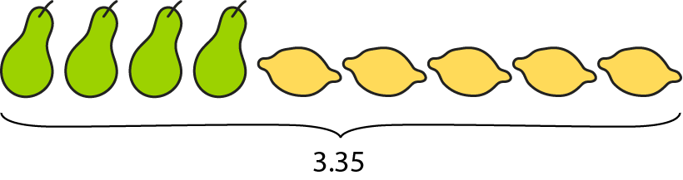

1.31 Problems with two unknowns – step 4:1
‘4 pears and 5 lemons cost £3.35.’
‘4 pears and 2 lemons cost £2.30.’

Slide 51
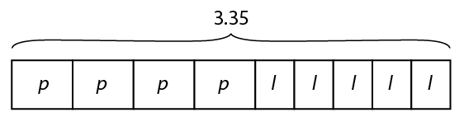
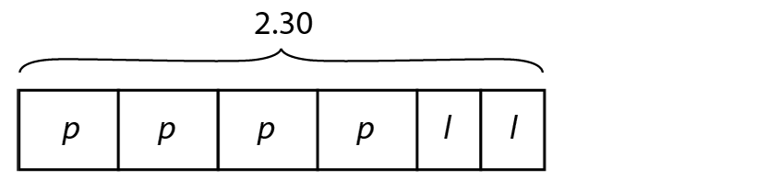
1.31 Problems with two unknowns – step 4:1
‘4 pears and 5 lemons cost £3.35.’
‘4 pears and 2 lemons cost £2.30.’

Slide 52



1.31 Problems with two unknowns – step 4:1
‘4 pears and 5 lemons cost £3.35.’
‘4 pears and 2 lemons cost £2.30.’

Slide 53
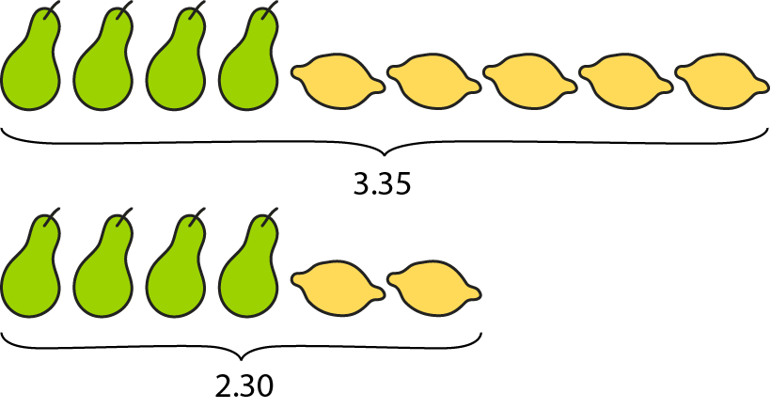
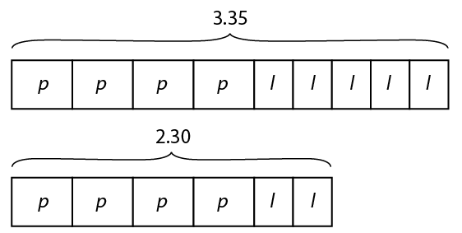
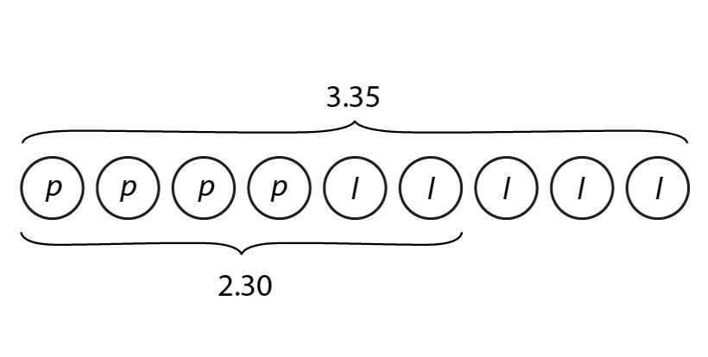
1.31 Problems with two unknowns – step 4:1
‘4 pears and 5 lemons cost £3.35.’
‘4 pears and 2 lemons cost £2.30.’

Slide 54
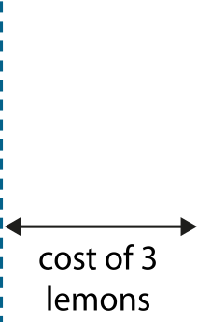
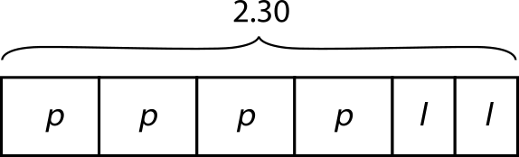
1.31 Problems with two unknowns – step 4:2
‘4 pears and 5 lemons cost £3.35.’
‘4 pears and 2 lemons cost £2.30.’
Step 1 – finding the cost of a lemon
cost of 3 lemons = 3.35 − 2.30
= 1.05
cost of 1 lemon = 1.05 ÷ 3
= 0.35
‘One lemon costs 35 p.’
Notes:
How much does one pear cost? How much does one lemon cost?

Slide 55
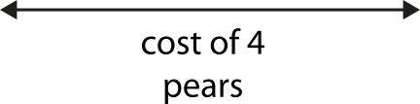

1.31 Problems with two unknowns – step 4:2
‘4 pears and 5 lemons cost £3.35.’
‘4 pears and 2 lemons cost £2.30.’
Step 2 – finding the cost of a pear
35 p
35 p
check: ‘4 pears and 5 lemons cost £3.35.’
cost of 4 pears = 4 × 40 p = £1.60
cost of 4 pears = 2.30 − 0.70
= 1.60
cost of 5 lemons = 5 × 35 p = £1.75
cost of 1 pear = 1.60 ÷ 4
= 0.40
£1.60 + £1.75 = £3.35
‘One pear costs 40 p.’
‘The solution must be correct.’
Notes:
How much does one pear cost? How much does one lemon cost?

Slide 56
6AS/MD-4 Solve problems with two unknowns
4 pears and 5 lemons cost £3.35. 4 pears and 2 lemons cost £2.30.
How much does one pear cost? How much does one lemon cost?
How many unknowns are in the problem?
Draw a picture to represent each statement.
What’s the same/different about each picture?
There are two unknowns, the cost of a pear and the cost of a lemon.
Both pictures have the same number of pears, but a different number of lemons and therefore also a different total price.

Slide 57
6AS/MD-4 Solve problems with two unknowns
4 pears and 5 lemons cost £3.35. 4 pears and 2 lemons cost £2.30.
How much does one pear cost? How much does one lemon cost?
Which unknown can be found first?
How can the cost of one lemon be calculated?
Step 1 – finding the cost of a lemon
The cost of three lemons is equivalent to the difference between both total prices.
This difference can be divided by three to find the cost of one lemon.
Cost of 3 lemons = 3.35 − 2.30
= 1.05
Cost of 1 lemon = 1.05 ÷ 3
= 0.35
One lemon costs 35 p.

Slide 58
6AS/MD-4 Solve problems with two unknowns
4 pears and 5 lemons cost £3.35. 4 pears and 2 lemons cost £2.30.
How much does one pear cost? How much does one lemon cost?
How can the cost of one lemon be used to find the cost of one pear? Is there more than one way?
How can we check that our solutions are correct?
Step 2 – finding the cost of a pear
35 p
35 p
Check: 4 pears and 5 lemons cost £3.35.
The cost of one lemon can replace l in order to calculate the cost of p. Either bar model can be used, but there are fewer parts in the second model.
Cost of 4 pears = 2.30 − 0.70
= 1.60
Cost of 4 pears = 4 × 40 p = £1.60
Cost of 5 lemons = 5 × 35 p = £1.75
Cost of 1 pear = 1.60 ÷ 4
= 0.40
£1.60 + £1.75 = £3.35
One pear costs 40 p.
The solution must be correct.

Slide 59
Year 6, Unit 11, Learning Outcome 9
Learning Outcome 9
Pupils use diagrams to explain how to solve a spatial problem
The following slides have been collated to support the teaching of this learning outcome.

Slide 60
Year 6, Unit 11, Learning Outcome 9
Additional teacher guidance for this outcome should be read first and can be found in this segment of the NCETM Primary Mastery Professional Development Materials:
1.31 Problems with two unknowns
The spine materials are divided into ‘teaching points’ and ‘steps in learning’.
Teaching point | Steps in learning | Pages
4 | 4:3 | 29-31

Slide 61
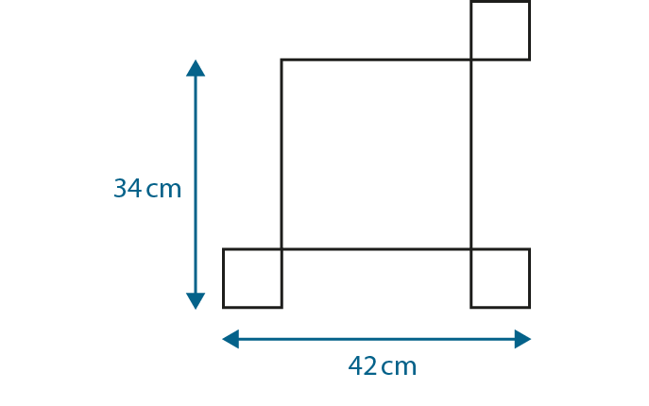
1.31 Problems with two unknowns – step 4:3
Notes:
This pattern is made from two different sized squares. What is the side-length of each type of square?

Slide 62



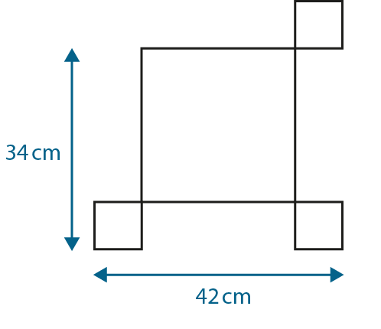
1.31 Problems with two unknowns – step 4:3
42
big
small
small
26
8
8
34
8
big
small
26
8
Notes:
This pattern is made from two different sized squares. What is the side-length of each type of square?

Slide 63
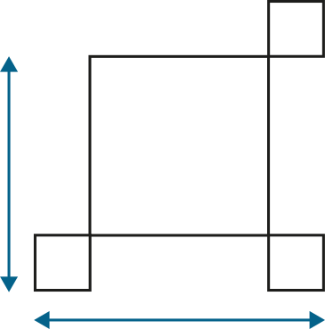
1.31 Problems with two unknowns – step 4:3
8 cm
?
8 cm
?
26 cm
26 cm
42 cm
34 cm
8 cm
8 cm
42 cm
42 cm − 34 cm
= 8 cm
34 cm − 8 cm
= 26 cm
check: 26 cm + 8 cm + 8 cm
= 42 cm
Notes:
This pattern is made from two different sized squares. What is the side-length of each type of square?

Slide 64
Year 6, Unit 11, Learning Outcome 10
Learning Outcome 10
Pupils explain how to represent an equation with a bar model
The following slides have been collated to support the teaching of this learning outcome.

Slide 65
Year 6, Unit 11, Learning Outcome 10
Additional teacher guidance for this outcome should be read first and can be found in this segment of the NCETM Primary Mastery Professional Development Materials:
1.31 Problems with two unknowns
The spine materials are divided into ‘teaching points’ and ‘steps in learning’.
Teaching point | Steps in learning | Pages
4 | 4:4 | 31-33

Slide 66
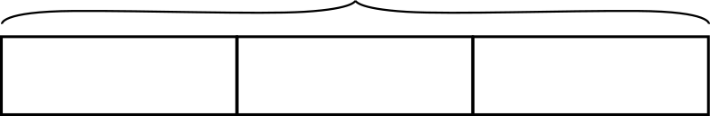
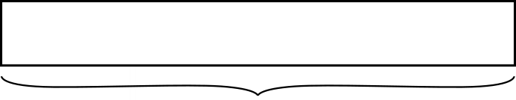
1.31 Problems with two unknowns – step 4:4
3 bananas
£1.30
− 30 p = £1
banana
banana
30 p
2 apples
cost of 5 bananas = £1
cost of 1 banana = £1 ÷ 5
= 20 p
‘An apple costs 15 p more than a banana.’
cost of 1 apple = 20 p + 15 p
= 35 p
Notes:
An apple costs 15 p more than a banana. 2 apples and 3 bananas cost £1.30. How much do apples and bananas cost each?

Slide 67
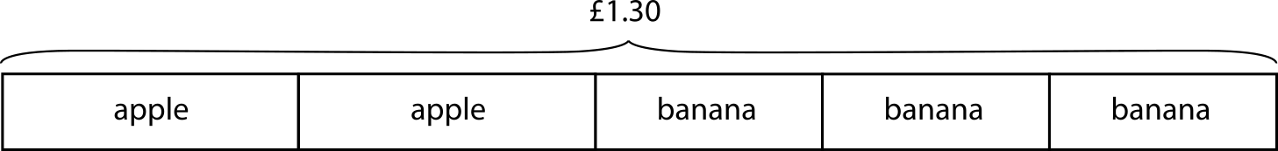


1.31 Problems with two unknowns – step 4:4
check: ‘If a banana costs 20 p and an apple costs 35 p then:’
cost of 2 apples = 2 × 35 p = 70 p
cost of 3 bananas = 3 × 20 p = 60 p
cost of 2 apples and 3 bananas = 70 p + 60 p = £1.30
Notes:
An apple costs 15 p more than a banana. 2 apples and 3 bananas cost £1.30. How much do apples and bananas cost each?

Slide 68
Year 6, Unit 11, Learning Outcome 11
Learning Outcome 11
Pupils solve problems with two unknowns in a range of contexts
The following slides have been collated to support the teaching of this learning outcome.

Slide 69
Year 6, Unit 11, Learning Outcome 11
Additional teacher guidance for this outcome should be read first and can be found in this segment of the NCETM Primary Mastery Professional Development Materials:
1.31 Problems with two unknowns
The spine materials are divided into ‘teaching points’ and ‘steps in learning’.
Teaching point | Steps in learning | Pages
4 | 4:5 | 33-36

Slide 70
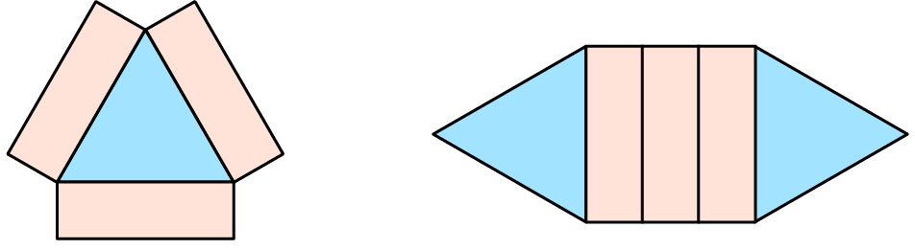
1.31 Problems with two unknowns – step 4:5
total area = 51 cm²
total area = 66 cm²
triangular tile = 15 cm²
rectangular tile = 12 cm²
Notes:
Here are two different designs made with the same rectangular and triangular tiles. What is the area of one triangular tile? What is the area of one rectangular tile?

Slide 71
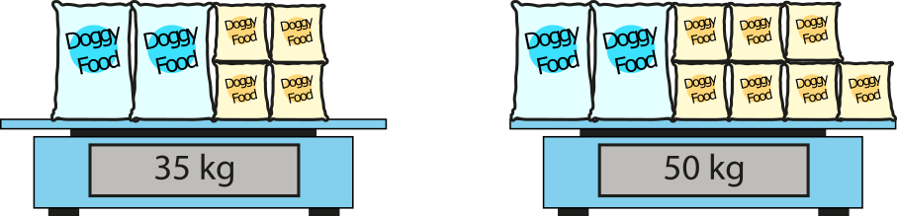
1.31 Problems with two unknowns – step 4:5
large bag = 7.5 kg
small bag = 5 kg
Notes:
The scales show the masses of some large and small bags of dog food. What is the mass of each of the two different sized bags?

Slide 72
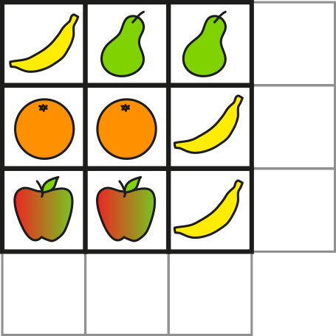
1.31 Problems with two unknowns – step 4:5
£1.15
banana = 25 p
£1.25
pear = 45 p
95 p
orange = 50 p
apple = 35 p
£1.10
£1.30
95 p
Notes:
The diagram shows the total cost of the items in each row and column. Fill in the two missing costs.

Slide 73
1.31 Problems with two unknowns – step 4:5
Menu
Item | Price
Juice | ?
Milk | 50 p more than a juice
Tea | 75 p more than a juice
juice = 80 p
tea = £1.55
milk = £1.30
Notes:
Here is the menu for a very strange café that I visit. I buy two teas and two milks and the price is £5.70. How much does a tea cost? How much does a milk cost?

Slide 74


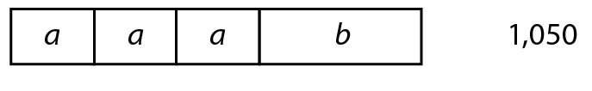
1.31 Problems with two unknowns – step 4:5
a + b + c = 800
2a + b + c = 950
3a + b = 1,050
a = 150
b = 600
c = 50
Notes:
What are the values of a, b and c?

Slide 75



1.31 Problems with two unknowns – step 4:5
‘The mean of r and s is 35.’
‘The mean of t and r is 47.’
r + s + t = 120
r = 44
s = 26
t = 50
Notes:
Calculate the values of r, s and t.

Slide 76
Year 6, Unit 11, Learning Outcome 12
Learning Outcome 12
Pupils systematically solve problems with two unknowns using ‘trial and improvement’ (one and several solutions)
The following slides have been collated to support the teaching of this learning outcome.

Slide 77
Year 6, Unit 11, Learning Outcome 12
Additional teacher guidance for this outcome should be read first and can be found in this segment of the NCETM Primary Mastery Professional Development Materials:
1.31 Problems with two unknowns
The spine materials are divided into ‘teaching points’ and ‘steps in learning’.
Teaching point | Steps in learning | Pages
5 | 5:1-5:2 | 37-39

Slide 78
1.31 Problems with two unknowns – step 5:1
Number of portions | Fish | Chips
1 | £3.20 | £1.50
2 | £6.40 | £3.00
3 | £9.60 | £4.50
4 | £12.80 | £6.00
5 | £16.00
6 | £19.20 | £9.00
7 |  | £10.50
8 | £25.60 | £12.00
9 | £28.80 | £13.50
10 | £32.00 | £15.00
£7.50
£7.50
£22.40
£22.40
£22.40 + £7.50 = £29.90
‘Seven portions of fish and five portions of chips were bought.’
Notes:
I spent £29.90 on fish and chips. One fish costs £3.20 and one portion of chips costs £1.50. How many portions of each did I buy?

Slide 79
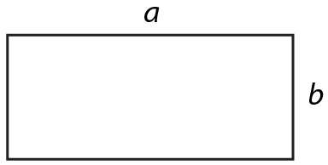
1.31 Problems with two unknowns – step 5:2
a (two-digit) (cm) | b (one-digit) (cm) | a + b (cm)
10
5
15
11
4
15
perimeter = 30 cm
12
3
15
13
2
15
a + b = half of 30 cm
= 15 cm
14
1
15
Notes:
A rectangle with sides a and b has a perimeter of 30 cm. a is a two-digit whole number and b is a one-digit whole number. What are the possible values of a and b?

Slide 80
Year 6, Unit 11, Learning Outcome 13
Learning Outcome 13
Pupils explain how I know I have found all possible solutions to problems with two unknowns
The following slides have been collated to support the teaching of this learning outcome.

Slide 81
Year 6, Unit 11, Learning Outcome 13
Additional teacher guidance for this outcome should be read first and can be found in this segment of the NCETM Primary Mastery Professional Development Materials:
1.31 Problems with two unknowns
The spine materials are divided into ‘teaching points’ and ‘steps in learning’.
Teaching point | Steps in learning | Pages
5 | 5:3-5:4 | 39-41

Slide 82







1.31 Problems with two unknowns – step 5:3
Number of each shape | Squares | Hexagons
0 | 0 | 0
1 | 4 | 6
2 | 8 | 12
3 | 12 | 18
4 | 16 | 24
5 | 20 | 30
6 | 24 | 36
7 | 28 | 42
8 | 32 | 48
9 | 36 | 54
10 | 40 | 60
11 | 44 | 66
12 | 48 | 72
13 | 52
14 | 56
15 | 60
16 | 64
17 | 68
18 | 72
Notes:
Zac has some squares and hexagons. He chooses some of the shapes and when he counts the number of sides, he finds that the total is 72. How many of each shape could he have?
0 squares and 12 hexagons
3 squares and 10 hexagons
6 squares and 8 hexagons
9 squares and 6 hexagons
12 squares and 4 hexagons
15 squares and 2 hexagons
18 squares and 0 hexagons

Slide 83
Year 6, Unit 11, Learning Outcome 14
Learning Outcome 14
Pupils explain how to balance an equation with two unknowns
The following slides have been collated to support the teaching of this learning outcome.

Slide 84
Year 6, Unit 11, Learning Outcome 14
Additional teacher guidance for this outcome should be read first and can be found in this segment of the NCETM Primary Mastery Professional Development Materials:
1.31 Problems with two unknowns
The spine materials are divided into ‘teaching points’ and ‘steps in learning’.
Teaching point | Steps in learning | Pages
5 | 5:5-5:6 | 42-43

Slide 85
Year 6, Unit 11, Learning Outcome 15
Learning Outcome 15
Pupils systematically solve problems with two unknowns using ‘trial and improvement’ (one, several and infinite solutions)
The following slides have been collated to support the teaching of this learning outcome.

Slide 86
Year 6, Unit 11, Learning Outcome 15
Additional teacher guidance for this outcome should be read first and can be found in this segment of the NCETM Primary Mastery Professional Development Materials:
1.31 Problems with two unknowns
The spine materials are divided into ‘teaching points’ and ‘steps in learning’.
Teaching point | Steps in learning | Pages
5 | 5:7 | 43

Slide 87
6AS/MD-4 Solve problems with two unknowns
For the problem shown is there:
  an infinite number of solutions;
  more than one solution;
  only one solution?
If we choose a value of 2 for the first unknown, what will that mean the second unknown must be? Why?
Repeat for other values and other equations with two unknowns.
There is an infinite number of solutions to the problem.
5 x 2 = 10 so 5 x 2 = 10 x 1

