Slide 1
2.7 Times tables: 2, 4 and 8, and the relationship between them
Representations | Year 3
Multiplication and Division

Slide 2
How to use this presentation
You can find the teacher guide Times tables: 2, 4 and 8, and the relationship between them by following the link below.

Slide 3
2.7 The 2, 4 and 8 times tables Step 1:1
0
2
4
6
8
10
12
14
16
18
20
22
24

Slide 4
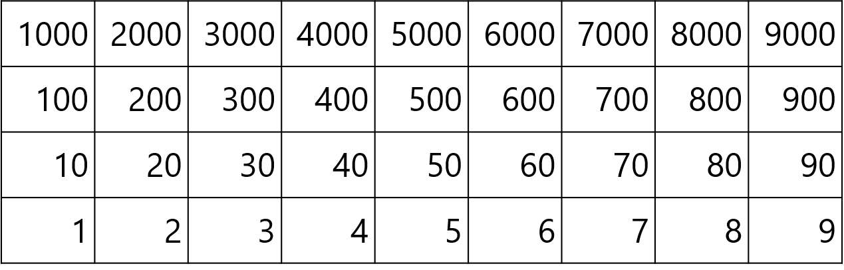
2.7 The 2, 4 and 8 times tables Step 1:1

Slide 5






2.7 The 2, 4 and 8 times tables Step 1:1
10
12
14
16
18
20
22
24
0
2
4
6
8
twenty-four
twenty-two
eighteen
fourteen
sixteen
twenty
twelve
eight
zero
four
two
ten
six

Slide 6
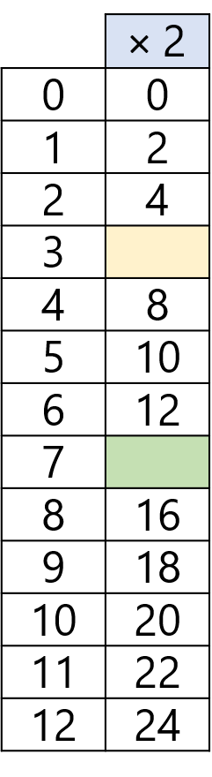
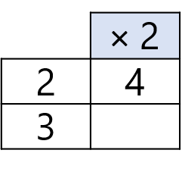
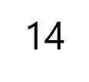

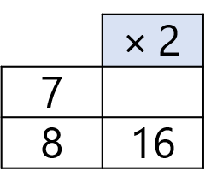


2.7 The 2, 4 and 8 times tables Step 1:1
↑ − 2
↓ + 2
3 × 2 = 2 × 2 + 2
7 × 2 = 8 × 2 − 2
+ 2
− 2
0
2
4
6
8
10
12
14
16
18
20

Slide 7



2.7 The 2, 4 and 8 times tables Step 1:2
How many wheels? Count in groups of 4.
There are 20 wheels.
5 × 4 = 20
4 × 5 = 20
Notes:
There are five groups of four. There are four, five times.
There are twenty altogether.
Five is a factor. Four is a factor.
The product of five and four is twenty.
Twenty is the product of five and four.

Slide 8






2.7 The 2, 4 and 8 times tables Step 1:3
1 × 4 = 4 4 × 1 = 4
3 × 4 = 12 4 × 3 = 12
2 × 4 = 8 4 × 2 = 8
0 × 4 = 0 4 × 0 = 0
Notes:
When zero is a factor, the product is zero.

Slide 9
2.7 The 2, 4 and 8 times tables Step 1:4
0
4
8
12
16
20
24
28
32
36
40
44
48

Slide 10
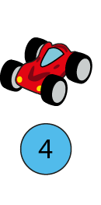
2.7 The 2, 4 and 8 times tables Step 1:5
Number of cars
Total number of wheels
0
1
2
3
4
5
6
0
4
8
12
16
20
24
0
3 × 4 = 12 4 × 3 = 12
4 × 4 = 16 4 × 4 = 16
5 × 4 = 20 4 × 5 = 20
6 × 4 = 24 4 × 6 = 24
0 × 4 = 0 4 × 0 = 0
1 × 4 = 4 4 × 1 = 4
2 × 4 = 8 4 × 2 = 4

Slide 11
2.7 The 2, 4 and 8 times tables Step 1:6
Number of cars | Total number of wheels
0 | 0
1 | 4
2 | 8
3 | 12
4 | 16
5 | 20
6 | 24
7 | 28
8 | 32
9 | 36
10 | 40
11 | 44
12 | 48
0 × 4 = 0 | 4 × 0 = 0
1 × 4 = 4 | 4 × 1 = 4
2 × 4 = 8 | 4 × 2 = 8
3 × 4 = 12 | 4 × 3 = 12
4 × 4 = 16 | 4 × 4 = 16
5 × 4 = 20 | 4 × 5 = 20
6 × 4 = 24 | 4 × 6 = 24
7 × 4 = 28 | 4 × 7 = 28
8 × 4 = 32 | 4 × 8 = 32
9 × 4 = 36 | 4 × 9 = 36
10 × 4 = 40 | 4 × 10 = 40
11 × 4 = 44 | 4 × 11 = 44
12 × 4 = 48 | 4 × 12 = 48

Slide 12
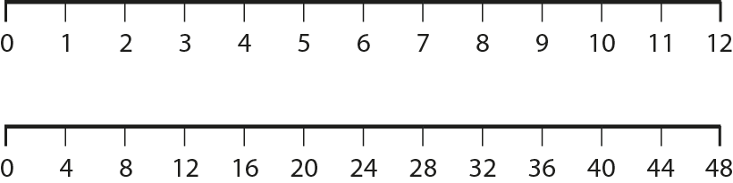
2.7 The 2, 4 and 8 times tables Step 1:7

Slide 13
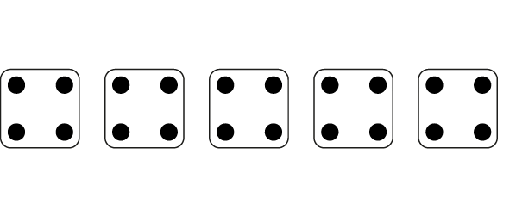
2.7 The 2, 4 and 8 times tables Step 1:8
5 × 4 =
20
4 × 5 =
20
Notes:
Complete the equations to show how many dots there are altogether.

Slide 14
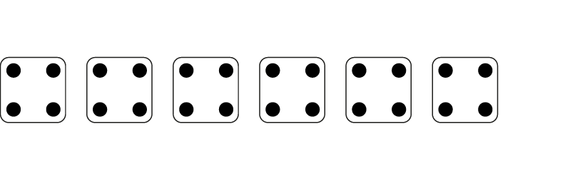
2.7 The 2, 4 and 8 times tables Step 1:8
6
× 4 =
24
4 ×
6
=
24
Notes:
Complete the equations to show how many dots there are altogether.

Slide 15
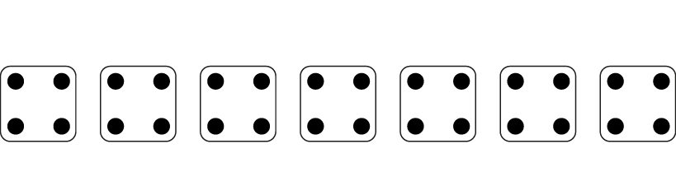
2.7 The 2, 4 and 8 times tables Step 1:8
7
×
4
=
28
4
×
7
=
28
Notes:
Complete the equations to show how many dots there are altogether.

Slide 16

2.7 The 2, 4 and 8 times tables Step 1:8
Eloise wrote this.
This shows 4 x 3 = 12.
Draw a picture like this to show 4 × 6 = 24.

Slide 17
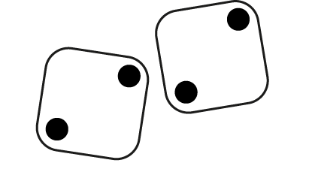

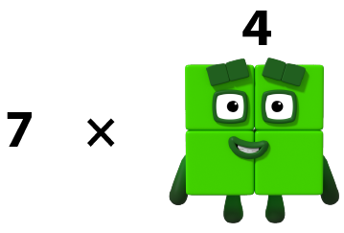
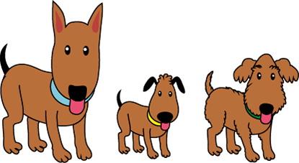
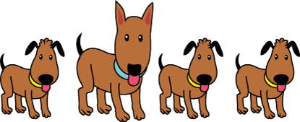
2.7 The 2, 4 and 8 times tables Step 1:8
Represents groups of 4?
© 2017 Alphablocks Ltd. All rights reserved.
Notes:
Two dice each showing two dots: does not show groups of four.
Numberblocks: does show groups of four.
4 × 7 = 28 7 × 4 = 28
Four dogs: does show groups of four.
Four groups of four legs.
4 × 4 = 16
Or one group of four dogs.
1 × 4 = 4 4 × 1 = 4
Four five-pointed stars: could show groups of four.
Four groups of five points: does not show groups of four.
One group of four stars: does show groups of four.
1 × 4 = 4 4 × 1 = 4
Three dogs: could show groups of four.
Three groups of four legs: does show groups of four.
3 × 4 = 12 4 × 3 = 12
One group of three dogs: does not show groups of four.

Slide 18
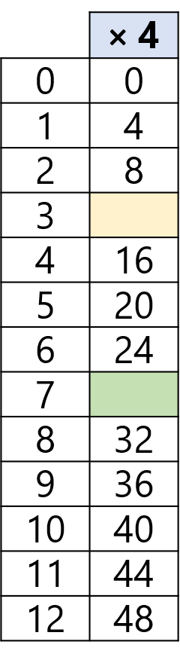
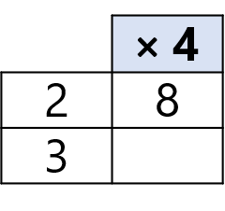
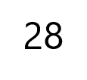
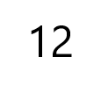
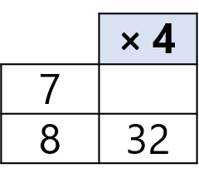
2.7 The 2, 4 and 8 times tables Step 1:9
↓ + 4
3 × 4 = 2 × 4 + 4
↑ − 4
7 × 4 = 8 × 4 − 4
+ 4
− 4
0
4
8
12
16
20
24
28
32
36
40

Slide 19
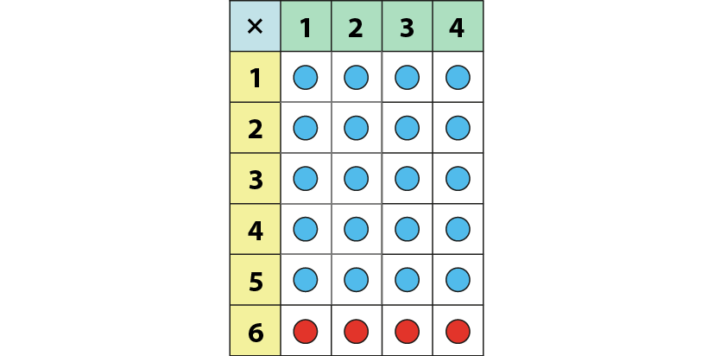
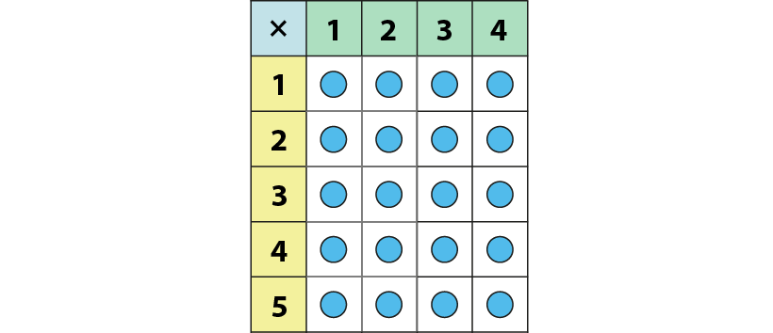
2.7 The 2, 4 and 8 times tables Step 1:9
6 × 4 = 5 × 4 + 4
= 24
5 × 4 = 20

Slide 20
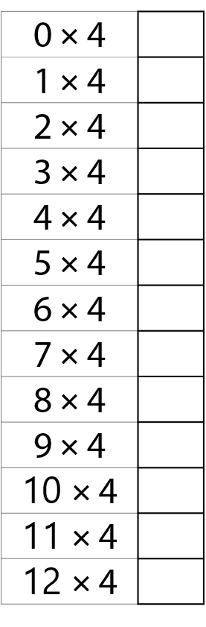



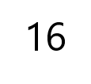
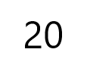
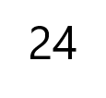
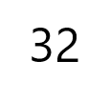
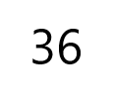
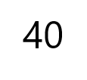
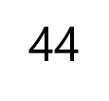
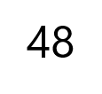
2.7 The 2, 4 and 8 times tables Step 1:9

Slide 21
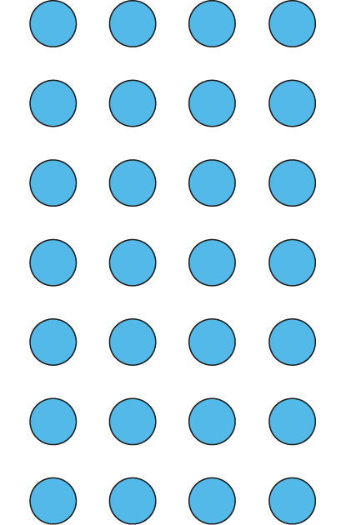
2.7 The 2, 4 and 8 times tables Step 1:11
Circle the groups of 4.
Circle the 4 equal groups.
4 ×
7
=
28
7
× 4 =
28
7
7
There are groups of 4.
There are 4 groups of .

Slide 22
2.7 The 2, 4 and 8 times tables Step 2:1
0
2
4
6
8
10
12
14
16
18
20
22
24

Slide 23
2.7 The 2, 4 and 8 times tables Step 2:1

Slide 24
2.7 The 2, 4 and 8 times tables Step 2:1
Number | 0 | 1 | 2 | 3 | 4 | 5 | 6 | 7 | 8 | 9 | 10 | 11 | 12 | 13 | 14 | 15 | 16 | 17 | 18 | 19 | 20 | 21 | 22 | 23 | 24
Counting in 2s
Counting in 4s
✓
✓
✓
✓
✓
✓
✓
✓
✓
✓
✓
✓
✓
✓
✓
✓
✓
✓
✓
✓

Slide 25
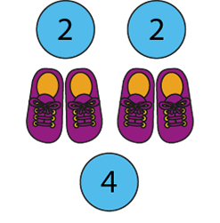
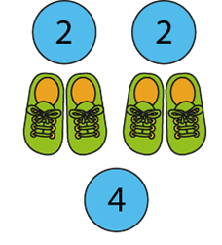
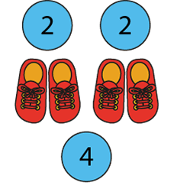
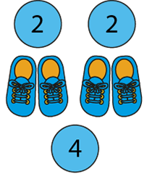
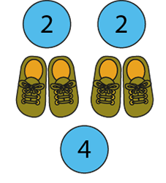
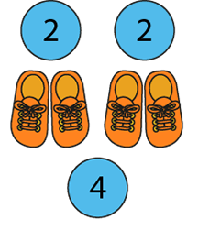
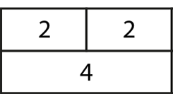
2.7 The 2, 4 and 8 times tables Step 2:2
Notes:
How many groups of two are there?
How many groups of four are there?
For every one group of four, there are two groups of two.

Slide 26
2.7 The 2, 4 and 8 times tables Step 2:3
0 × 2 = 0 | 0 × 4 = 0
1 × 2 = 2 | 1 × 4 = 4
2 × 2 = 4 | 2 × 4 = 8
3 × 2 = 6 | 3 × 4 = 12
4 × 2 = 8 | 4 × 4 = 16
5 × 2 = 10 | 5 × 4 = 20
6 × 2 = 12 | 6 × 4 = 24
7 × 2 = 14 | 7 × 4 = 28
8 × 2 = 16 | 8 × 4 = 32
9 × 2 = 18 | 9 × 4 = 36
10 × 2 = 20 | 10 × 4 = 40
11 × 2 = 22 | 11 × 4 = 44
12 × 2 = 24 | 12 × 4 = 48
Notes:
What’s the same?
What’s different?

Slide 27
2.7 The 2, 4 and 8 times tables Step 2:3
0 | × 2 = | 0 | = 4 × | 0
2 |  | 10 |  | 1
4 |  |  |  | 2
6 |  |  |  | 3
8 |  |  |  | 4
10 |  |  |  | 5
12 |  |  |  | 6
4
8
12
16
20
24

Slide 28
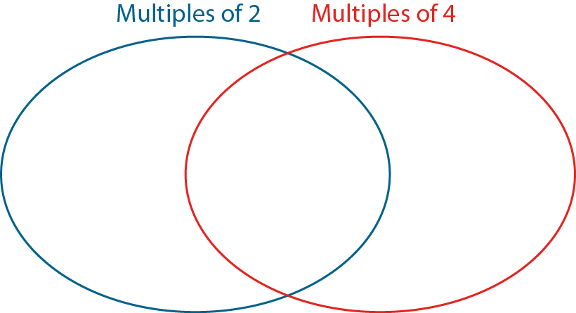
2.7 The 2, 4 and 8 times tables Step 2:3
0
2
4
23
14
31
20
16
40

Slide 29








2.7 The 2, 4 and 8 times tables Step 2:4
6 twos
3 fours
Notes:
Three times four is equal to twelve, so double-three times two is equal to twelve.
Six times two is equal to twelve, so half-of-six times four is equal to twelve.

Slide 30
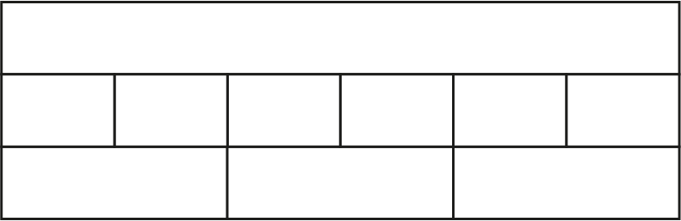
2.7 The 2, 4 and 8 times tables Step 2:4
12
2
2
2
2
2
2
4
4
4

Slide 31
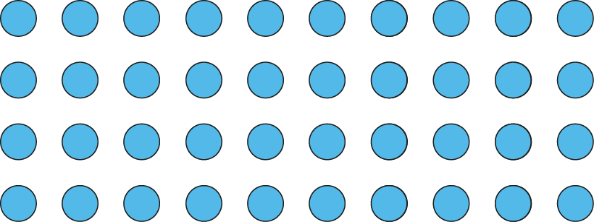
2.7 The 2, 4 and 8 times tables Step 2:5
20
10
× 4 =
40
× 2 =
40

Slide 32
2.7 The 2, 4 and 8 times tables Step 2:5
10
× 4 =
40
10
× 2 =
20

Slide 33







2.7 The 2, 4 and 8 times tables Step 2:6

Slide 34
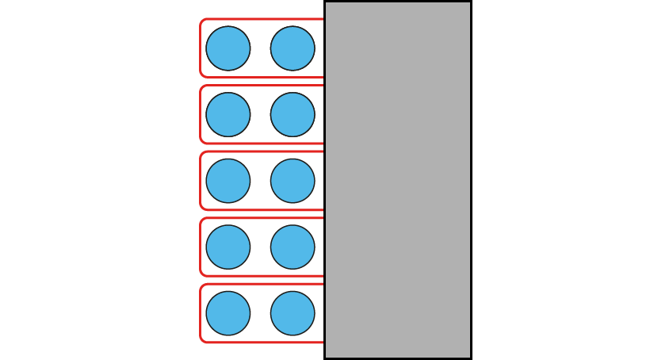
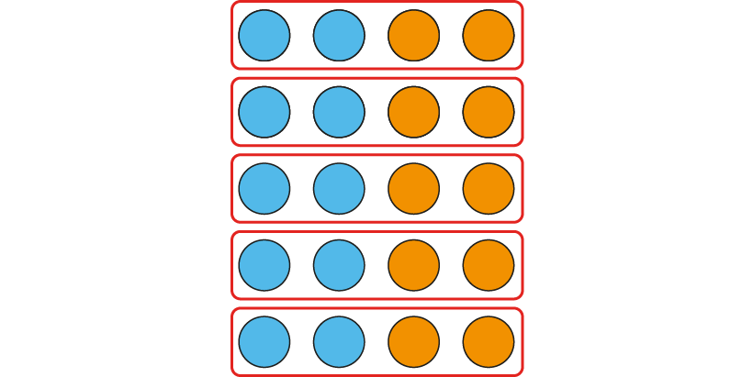
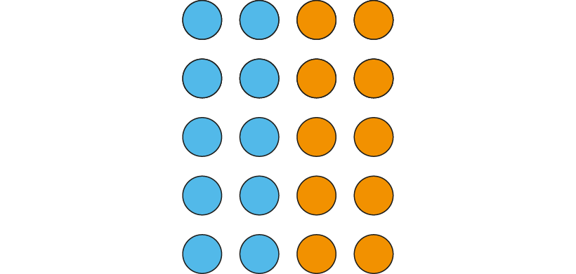
2.7 The 2, 4 and 8 times tables Step 2:7
5 groups of 4
5 groups of 2
5 × 2 = 10 five 2s are 10
5 × 4 = 20 five 4s are 20
2 × 5 = 10 2, five times is 10
4 × 5 = 20 4, five times is 20
Notes:
Four is double two, so five fours is double five-twos.
Two is half of four, so five twos is half of five-fours.

Slide 35
2.7 The 2, 4 and 8 times tables Step 2:7
5 groups of 4
5 groups of 2
5 × 4 = 20 five 4s are 20
5 × 2 = 10 five 2s are 10
4 × 5 = 20 4, five times is 20
2 × 5 = 10 2, five times is 10
Notes:
Four is double two, so five fours is double five-twos.
Two is half of four, so five twos is half of five-fours.

Slide 36
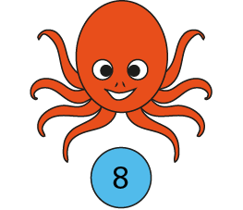
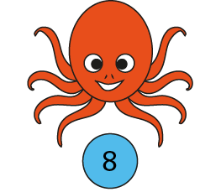
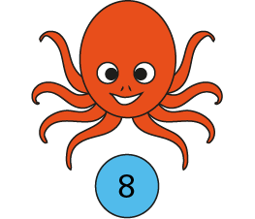



2.7 The 2, 4 and 8 times tables Step 3:1
How many tentacles? Count in groups of 8.
0
8
16
24
There are 24 tentacles.
3 × 8 = 24
8 × 3 = 24
Notes:
There are three groups of eight; there are eight, three times.
There are twenty-four altogether.
Three is a factor. Eight is a factor.
The product of three and eight is twenty-four.
Twenty-four is the product of three and eight.

Slide 37
2.7 The 2, 4 and 8 times tables Step 3:3
0
8
16
24
32
40
48
56
64
72
80
88
96

Slide 38

2.7 The 2, 4 and 8 times tables Step 3:4
Number of octopuses
Total number of tentacles
0
1
2
3
4
5
6
0
8
16
24
32
40
48
0
2 × 8 = 16 8 × 2 = 16
3 × 8 = 24 8 × 3 = 24
6 × 8 = 48 8 × 6 = 48
4 × 8 = 32 8 × 4 = 32
5 × 8 = 40 8 × 5 = 40
0 × 8 = 0 8 × 0 = 0
1 × 8 = 8 8 × 1 = 8

Slide 39
2.7 The 2, 4 and 8 times tables Step 3:5
Number of octopuses | Total number of tentacles
0 | 0
1 | 8
2 | 16
3 | 24
4 | 32
5 | 40
6 | 48
7 | 56
8 | 64
9 | 72
10 | 80
11 | 88
12 | 96
0 × 8 = 0 | 8 × 0 = 0
1 × 8 = 8 | 8 × 1 = 8
2 × 8 = 16 | 8 × 2 = 16
3 × 8 = 24 | 8 × 3 = 24
4 × 8 = 32 | 8 × 4 = 32
5 × 8 = 40 | 8 × 5 = 40
6 × 8 = 48 | 8 × 6 = 48
7 × 8 = 56 | 8 × 7 = 56
8 × 8 = 64 | 8 × 8 = 64
9 × 8 = 72 | 8 × 9 = 72
10 × 8 = 80 | 8 × 10 = 80
11 × 8 = 88 | 8 × 11 = 88
12 × 8 = 96 | 8 × 12 = 96

Slide 40
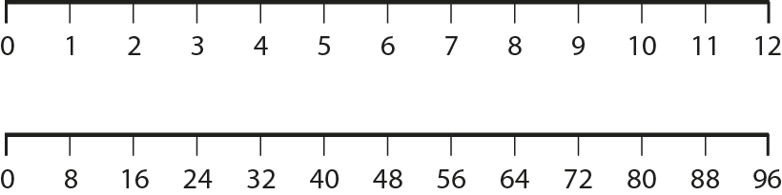
2.7 The 2, 4 and 8 times tables Step 3:6

Slide 41

2.7 The 2, 4 and 8 times tables Step 3:7
How many legs?
5 × 8 =
40
8 × 5 =
40
Notes:
Complete the equations to show how many legs altogether.

Slide 42

2.7 The 2, 4 and 8 times tables Step 3:7
How many legs?
6
× 8 =
48
8 ×
6
=
48
Notes:
Complete the equations to show how many legs altogether.

Slide 43
2.7 The 2, 4 and 8 times tables Step 3:7
How many legs?
7
×
8
=
56
8
×
7
=
56
Notes:
Complete the equations to show how many legs altogether.

Slide 44


2.7 The 2, 4 and 8 times tables Step 3:7
Hari wrote this.
This shows 4 × 8 = 32.
Draw a picture like this to show 7 × 8 = 56.

Slide 45
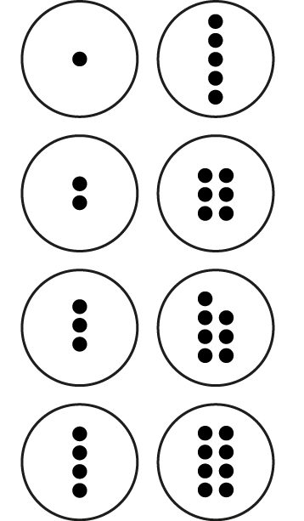

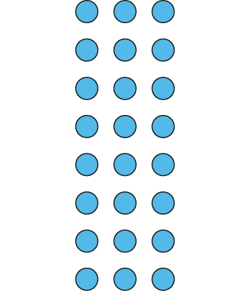


2.7 The 2, 4 and 8 times tables Step 3:7
Represents groups of 8?
© 2017 Alphablocks Ltd. All rights reserved.
Notes:
Eight dice each showing two dots: does not show groups of eight.
Numberblocks: does show groups of eight.
5 × 8 = 40 8 × 5 = 40
Counters with dots: does not show groups of eight.
Array of blue counters: does show groups of eight.
8 × 3 = 24 3 × 8 = 24
Eight triangles: could show groups of eight.
Eight groups of three sides (or eight groups of three corners): does not show groups of eight.
3 × 4 = 12 4 × 3 = 12
One group of eight triangles: does show groups of eight.
1 × 8 = 8 8 × 1 = 8

Slide 46




2.7 The 2, 4 and 8 times tables Step 3:8
↓ + 8
7 × 8 = 8 × 8 − 8
↑ − 8
3 × 8 = 2 × 8 + 8
+ 8
− 8
0
8
16
24
32
40
48
56
64
72
80

Slide 47


2.7 The 2, 4 and 8 times tables Step 3:8
5 × 8
− 8 = 4 × 8
= 32

Slide 48

2.7 The 2, 4 and 8 times tables Step 3:8
0
8
16
24
32
40
48
56
64
72
80
88
96

Slide 49

2.7 The 2, 4 and 8 times tables Step 3:10
Circle the groups of 8.
Circle the 8 equal groups.
8 ×
3
=
24
3
× 8 =
24
3
3
There are groups of 8.
There are 8 groups of .

Slide 50

2.7 The 2, 4 and 8 times tables Step 3:10
8 × 3 = 24 3 × 8 = 24

Slide 51




2.7 The 2, 4 and 8 times tables Step 3:10
12 cupcakes in a pack. 4 chocolate and the rest vanilla.
How many vanilla cupcakes in 3 packs?
packs of 12
8
vanilla cupcakes
4
chocolate cupcakes
8
vanilla cupcakes
4
chocolate cupcakes
Total number of vanilla cupcakes =
3 × 8 = 24

Slide 52
2.7 The 2, 4 and 8 times tables Step 4:1
0
4
8
12
16
20
24
28
32
36
40
44
48

Slide 53
2.7 The 2, 4 and 8 times tables Step 4:1

Slide 54
2.7 The 2, 4 and 8 times tables Step 4:1
Number | 0 | 1 | 2 | 3 | 4 | 5 | 6 | 7 | 8 | 9 | 10 | 11 | 12 | 13 | 14 | 15 | 16 | 17 | 18 | 19 | 20 | 21 | 22 | 23 | 24
Counting in 4s
Counting in 8s
✓
✓
✓
✓
✓
✓
✓
✓
✓
✓
✓

Slide 55

2.7 The 2, 4 and 8 times tables Step 4:2
© 2017 Alphablocks Ltd.
All rights reserved.
Notes:
For every one group of eight there are two groups of four.

Slide 56
2.7 The 2, 4 and 8 times tables Step 4:3
4 × 0 = 0 | 8 × 0 = 0
4 × 1 = 4 | 8 × 1 = 8
4 × 2 = 8 | 8 × 2 = 16
4 × 3 = 12 | 8 × 3 = 24
4 × 4 = 16 | 8 × 4 = 32
4 × 5 = 20 | 8 × 5 = 40
4 × 6 = 24 | 8 × 6 = 48
4 × 7 = 28 | 8 × 7 = 56
4 × 8 = 32 | 8 × 8 = 64
4 × 9 = 36 | 8 × 9 = 72
4 × 10 = 40 | 8 × 10 = 80
4 × 11 = 44 | 8 × 11 = 88
4 × 12 = 48 | 8 × 12 = 96
Notes:
What’s the same?
What’s different?

Slide 57
2.7 The 2, 4 and 8 times tables Step 4:3
0 | × 4 = | 0 | = 8 × | 0
2 |  | 10 |  | 1
4 |  |  |  | 2
6 |  |  |  | 3
8 |  |  |  | 4
10 |  |  |  | 5
12 |  |  |  | 6
8
16
24
32
40
48

Slide 58

2.7 The 2, 4 and 8 times tables Step 4:3
0
4
8
45
12
31
24
44
40

Slide 59




2.7 The 2, 4 and 8 times tables Step 4:4
© 2017 Alphablocks Ltd.
All rights reserved.
6 fours
3 eights
Notes:
Three times eight is equal to twenty-four, so double-three times four is equal to twenty-four.
Six times four is equal to twenty-four, so half-of-six times eight is equal to twenty-four.

Slide 60
2.7 The 2, 4 and 8 times tables Step 4:4
24
4
4
4
4
4
4
8
8
8
Notes:
Three times eight is equal to twenty-four, so double-three times four is equal to twenty-four.
Six times four is equal to twenty-four, so half-of-six times eight is equal to twenty-four.

Slide 61


2.7 The 2, 4 and 8 times tables Step 4:5
Tables can seat 8 or 4 people. Tables of 4: 6 tables needed. Tables of 8: ? tables needed.
6 × 4
= 3 × 8
Notes:
A class of children can sit around tables in eights or in fours.
If they sit around tables in fours, they need six tables.
How many tables will they need if they sit in eights?

Slide 62
2.7 The 2, 4 and 8 times tables Step 4:5
How many tables for 32 to sit in 4s?
8 × 4 = 32
How many tables to sit in 8s?
4 × 8 = 32
Notes:
There are 32 children in a class. How many tables will
be needed if each table can seat four children? How
many tables would be needed if each table can seat 8 children?

Slide 63



2.7 The 2, 4 and 8 times tables Step 4:6

Slide 64



2.7 The 2, 4 and 8 times tables Step 4:7
5 groups of 8
5 groups of 4
5 × 8 = 40 five 8s are 40
5 × 4 = 20 five 4s are 20
8 × 5 = 40 8, five times is 40
4 × 5 = 20 4, five times is 20
Notes:
Eight is double four, so five eights is double five-fours.
Four is half of eight, so five fours is half of five-eights.

Slide 65
2.7 The 2, 4 and 8 times tables Step 4:7
5 groups of 8
5 groups of 4
5 × 8 = 40 five 8s are 40
5 × 4 = 20 five 4s are 20
8 × 5 = 40 8, five times is 40
4 × 5 = 20 4, five times is 20
Notes:
Eight is double four, so five eights is double five-fours.
Four is half of eight, so five fours is half of five-eights.

Slide 66


2.7 The 2, 4 and 8 times tables Step 4:8
The same number of octagons, how many corners?
6 squares, how many corners?
6 × 4 =
24
6 × 8 =
48
Notes:
Felicity has six squares. How many corners does she have altogether?
Hamid has the same number of octagons. How many corners does he have altogether?

Slide 67
2.7 The 2, 4 and 8 times tables Step 4:9

Slide 68
2.7 The 2, 4 and 8 times tables Step 4:9

Slide 69
2.7 The 2, 4 and 8 times tables Step 4:9
Number | 0 | 1 | 2 | 3 | 4 | 5 | 6 | 7 | 8 | 9 | 10 | 11 | 12 | 13 | 14 | 15 | 16 | 17 | 18 | 19 | 20 | 21 | 22 | 23 | 24
Counting in 2s
Counting in 4s
Counting in 8s
✓
✓
✓
✓
✓
✓
✓
✓
✓
✓
✓
✓
✓
✓
✓
✓
✓
✓
✓
✓
✓
✓
✓
✓

Slide 70
2.7 The 2, 4 and 8 times tables Step 4:10
8 × 1 = 8
4 × 2 = 8
2 × 4 = 8
1 × 8 = 8

Slide 71


2.7 The 2, 4 and 8 times tables Step 4:11

Slide 72
2.7 The 2, 4 and 8 times tables Step 4:11
16 × 1 = 16
8 × 2 = 16
4 × 4 = 16
2 × 8 = 16

Slide 73





2.7 The 2, 4 and 8 times tables Step 4:11
9 sticks, how many 2-stick mountains?
9 = 4 × 2 + 1
Notes:
Basil has nine sticks. How many two-stick mountains can he make?

Slide 74


2.7 The 2, 4 and 8 times tables Step 4:11
9 sticks, how many squares?
9 = 2 × 4 + 1
Notes:
How many squares can he make?

Slide 75

2.7 The 2, 4 and 8 times tables Step 4:11
9 sticks, how many octagons?
9 = 1 × 8 + 1
Notes:
How many octagons can he make?

Slide 76





2.7 The 2, 4 and 8 times tables Step 4:11
15 sticks; make as many squares as possible.
2 × 4 + 7
3 × 4 + 3
15 =
✗
Do you agree?
✓
Notes:
Nickolay has fifteen sticks. He makes as many sauares as possible.
Do you agree with his representation and equation?

Slide 77
2.7 The 2, 4 and 8 times tables Step 4:12
5 × 2 =
10
5 × 4 =
20
5 × 8 =
40

Slide 78
2.7 The 2, 4 and 8 times tables Step 4:12
6 spiders, how many legs?
Ben
Ben says, ‘I know that 6 eights are 48.’
6 x 8 = 48
✓
Notes:
Some children are calculating how many
legs there are on six spiders.
Whose method do you like best? Why?

Slide 79
2.7 The 2, 4 and 8 times tables Step 4:12
6 spiders, how many legs?
Akisha
Akisha says, ‘5 times 8 is 40, so 6 times 8 is 40 plus 8.’
6 x 8 = 5 x 8 + 8
= 40 + 8
6 x 8 = 48
✓
Notes:
Some children are calculating how many
legs there are on six spiders.
Whose method do you like best? Why?

Slide 80
2.7 The 2, 4 and 8 times tables Step 4:12
6 spiders, how many legs?
Tasha
6 x 4 = 24
double 24 = double 20 + double 4
= 40 + 8
= 40 + 4
= 48
= 44
✗
6 x 8 = 48
✓
6 x 8 = 44
Notes:
Some children are calculating how many
legs there are on six spiders.
Whose method do you like best? Why?

Slide 81


2.7 The 2, 4 and 8 times tables Step 4:12
6 spiders, how many legs?
Elliot
0
8
16
24
32
40
48
✓
6 x 8 = 48
✗
6 x 8 = 56
Notes:
Some children are calculating how many
legs there are on six spiders.
Whose method do you like best? Why?

Slide 82

2.7 The 2, 4 and 8 times tables Step 4:12
6 spiders, how many legs?
Mandy
✓
Notes:
Some children are calculating how many
legs there are on six spiders.
Whose method do you like best? Why?

Slide 83

2.7 The 2, 4 and 8 times tables Step 4:14
Notes:
A shop sells socks in packs of four pairs.
How many socks are there in one pack?
How many pairs are there in three packs?
How many socks are there in three packs?
If I buy thirty-two socks, how many packs is this?
How many pairs of socks is this?

Slide 84


2.7 The 2, 4 and 8 times tables Step 4:14
8 guests (4 pairs) at each table.
2 guests at the head of each table.
Fill in the missing numbers.
Tables | Guests (× 8) | Pairs of guests (× 4) | Guests at head of tables (× 2)
1 | 8 | 4 | 2
2 | 16 |  | 4
3 | 24 | 12
4 |  | 16 | 8
 | 40 |  | 10
Notes:
Guests at a party sit at tables like this.
There are eight guests at each table.
There are four pairs of guests at each table.
There are two guests at the head of each table.

Slide 85
2.7 The 2, 4 and 8 times tables Step 4:14
8
162
12
72
31
34
480
223
99
5
700
Can be divided by 2 | Can’t be divided by 2

Slide 86

2.7 The 2, 4 and 8 times tables Step 5:2

Slide 87
2.7 The 2, 4 and 8 times tables Step 5:3
Known multiple of 4 | Halve the number; is it even? | Halve the 1s digit; is it even? | Halve the final 2 digits; is it even?
156
288
78
3
28
144
4
44
Divisibility rule works, but we have to halve the 3-digit number
Not a divisibility rule for 4.
For numbers with more than 2 digits: if the final 2 digits are divisible by 4 then the number is divisible by 4.
Notes:
For numbers with more than two digits: if the final two
digits are divisible by four then the number is divisible by four.

Slide 88






2.7 The 2, 4 and 8 times tables Step 5:3

Slide 89
2.7 The 2, 4 and 8 times tables Step 5:4
Circle the numbers that are divisible by 4.
48 | 214 | 96
148 | 224 | 106
948 | 234 | 996

Slide 90

2.7 The 2, 4 and 8 times tables Step 5:5

Slide 91
2.7 The 2, 4 and 8 times tables Step 5:7
Circle the numbers that are divisible by 8.
48 | 52 | 96
148 | 152 | 104
248 | 252 | 114

