Slide 1
Numberblocks
Support Materials
Episode 10
How to Count

Slide 2
Practitioner Notes

Slide 3
Episode Description
Numberblocks One to Four gather for a woodland picnic. Four has brought them a flapjack each. But they are too hot to eat when Three touches them. She counts them incorrectly and claims there are only 3 and the mysterious Flapjack Snaffler, who has 3 blocks, 3 eyes and 3 mouths, has stolen one. Four counts them and everyone is reassured there are 4. Three checks, and again counts 3. Then they hear someone coming, they all run for cover behind a mound. It turns out to be Five, who arrives and teaches Three the rules of counting. Three finally understands and they decide to celebrate with flapjacks, only to discover that they are all missing. In another clearing, a Flapjack Snaffler munches happily!

Slide 4
Maths in the Episode
The key principles of counting
In this episode three of Gelman and Gallistel’s (1978) five key principles of counting are introduced:
One-to-one correspondence: match one number name to each item
Cardinality: understand that the last number in the count is the total size of the group
Stable order: say the number names in the correct order.

Slide 5
Using Mathematical Language
Encourage children to use full sentences to explain their thinking:
One, two, three, four: there are four flapjacks.
I know there are five because I counted them one at a time.
I know there are three because I said the numbers in the correct order.

Slide 6
Talk and Discuss Together

Slide 7
Talk and Discuss Together
Watch the episode of Numberblocks. First ask the children what they noticed and allow them to talk to you and each other. The following slides are designed to stimulate children and adults to talk about the episode and draw out some key aspects of the mathematics.

Slide 8
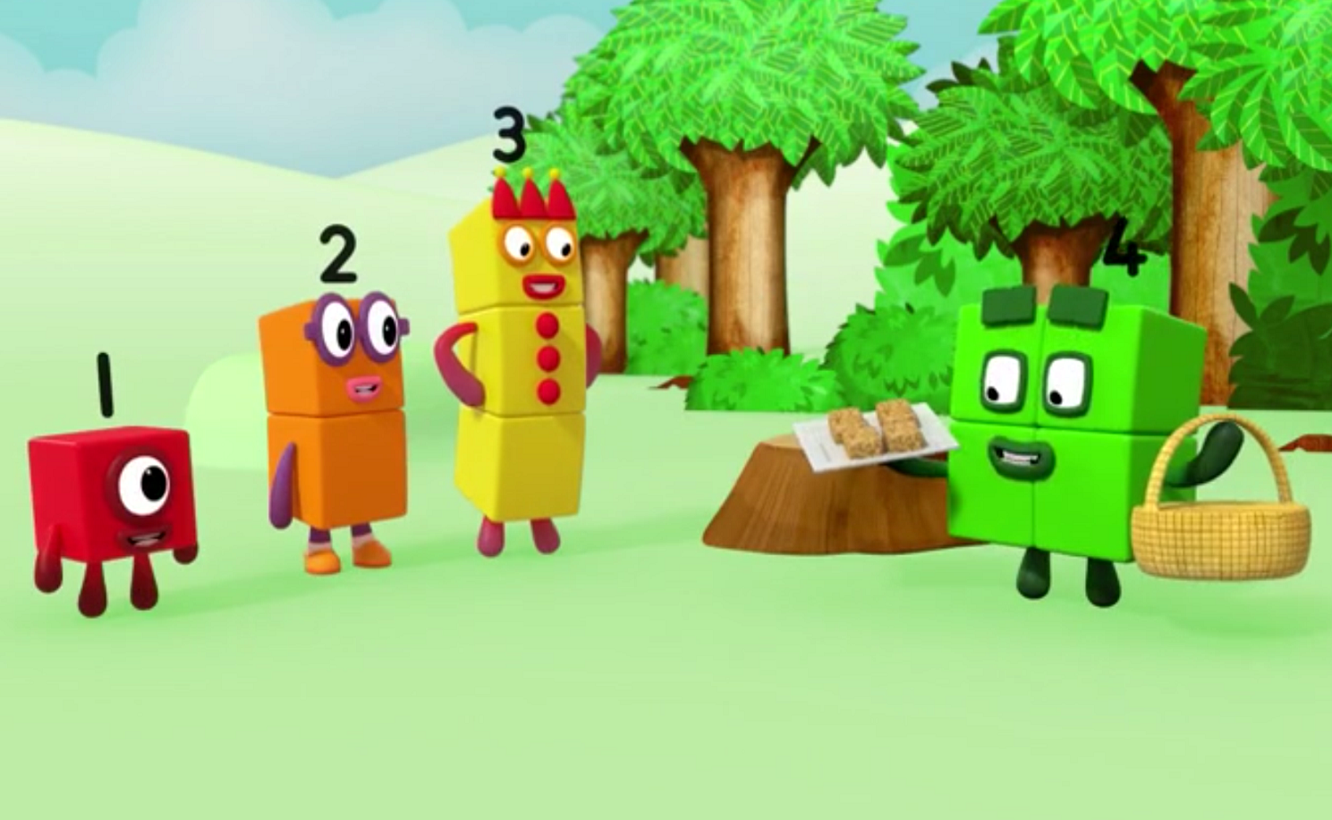
Images © 2017 Alphablocks Ltd. All Rights Reserved.
Notes:
Ask the children to see if they can get themselves into groups of 4 and check by counting. Hand out some hats with an image on that represents the Numberblocks 1-4. Each child puts one on and pretends to be that number. Provide some plates and a basket/box of flapjacks (these could be wooden blocks or something else to represent flapjacks). Ask the children to re-tell the story by acting out what happened.
Gather children back together and discuss what tips Five gave Three to help her count correctly.

Slide 9




Click on each flapjack from top left to right and then bottom left to right.
flapjack
flapjacks
flapjacks
Images © 2017 Alphablocks Ltd. All Rights Reserved.
Notes:
Watch Three counting the flapjacks. Click on each flapjack from top left to right and then bottom left to right.
What do you notice?
Three has counted the last two flapjacks together.
Demonstrate how to do it correctly.
“I know there are 4 because I gave each flapjack one number name.”

Slide 10
Click on each flapjack from top left to right and then bottom left to right.
flapjacks
Images © 2017 Alphablocks Ltd. All Rights Reserved.
Notes:
Watch Three counting the flapjacks. Click on each flapjack from top left to right and then bottom left to right.
What do you notice?
Three has said the number names in an incorrect order – 1, 2, 3, 5.
Demonstrate how to do it correctly.
“I know there are 4 because I gave each flapjack one number name.”

Slide 11


Click on each flapjack from top left to right and then bottom left to right.
flapjacks
Images © 2017 Alphablocks Ltd. All Rights Reserved.
Notes:
Watch Three counting the flapjacks. Click on each flapjack from top left to right and then bottom left to right.
What do you notice?
Three has counted the second flapjack twice.
Demonstrate how to do it correctly.
“I know there are 4 because I gave each flapjack one number name.”

Slide 12
Click on each flapjack from top left to right and then bottom left to right.
flapjacks
Images © 2017 Alphablocks Ltd. All Rights Reserved.
Notes:
Watch Three counting the flapjacks. Click on each flapjack from top left to right and then bottom left to right.
What do you notice?
Count them the correct way and then clap Three.
Provide the children with some clear bags of counters or cubes.
Can you count them without opening the bag?

Slide 13
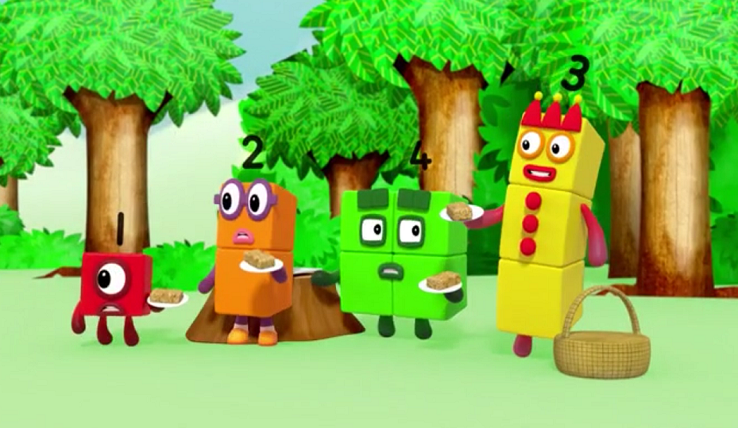
Images © 2017 Alphablocks Ltd. All Rights Reserved.
Notes:
Ask the children if they remember what happened in this scene in the episode.
In this part of the episode, Three counts the flapjacks using the numbers in the wrong sequence. ‘1, 2, 4, 3’.

Slide 14
Images © 2017 Alphablocks Ltd. All Rights Reserved.
Notes:
As the teacher, model counting out 4 objects using the wrong counting sequence. Do the children notice? Do they correct you?
Show this slide and count the flapjacks using the counting sequence in each speech bubble. Which speech bubble is the correct counting?
Use a sentence to describe:
“I know there are four because I counted the numbers in the right order.”

Slide 15
Enabling Environments

Slide 16
Enabling Environments
Playing and Exploring
Leave out a tray of red connecting cubes and a set of Numberblocks pictures. Encourage the children to collect the right number of red cubes (Ones) to make the Numberblocks 2-5.
Active Learning
Notice how consistently children can count: moveable objects, touchable but static objects (e.g. spots on a dice), sounds and movements. Prompt children to realise when counting can help them solve a problem.
Creating and Thinking Critically
Provide an environment where numbers as labels are used consistently alongside visual images so that children can organise and tidy away properly.

Slide 17
Learning Together in Y1

Slide 18
Images © 2017 Alphablocks Ltd. All Rights Reserved.
Notes:
Discuss how the Numberblocks needed to check that there were enough flapjacks for each one.
Ask the children to get into teams of 5.
Send the children on a treasure hunt to look for 5 different things (objects or pictures) so that everyone has one each of each thing, e.g. apple, cup, serviette, plate, flapjack.
Bring the children back together and ask them to lay out all the treasure they have collected, and count to see how many of each item they have. Look for children who rearrange objects into lines to count.

Slide 19
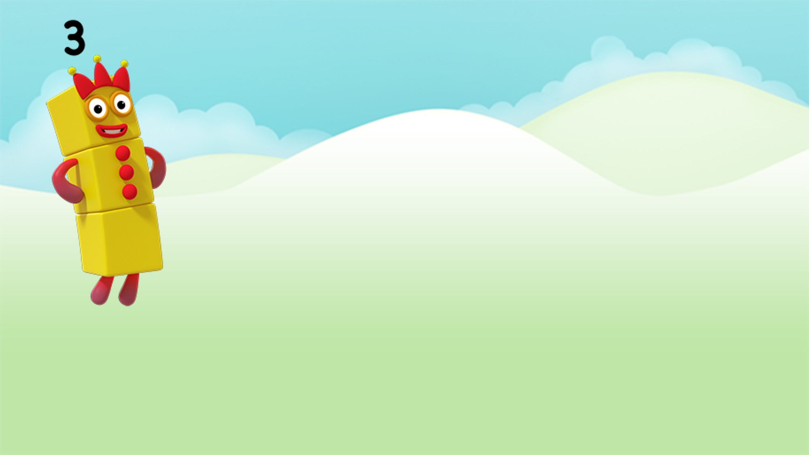
How many?
Images © 2017 Alphablocks Ltd. All Rights Reserved.
Notes:
This slide is animated.
Use this slide to model rearranging in a straight line so that you don’t lose count.
What do the children notice? What has changed? What has stayed the same?
On each click, a flapjack moves to form a line.

Slide 20
How many?
Images © 2017 Alphablocks Ltd. All Rights Reserved.
Notes:
Use this slide to demonstrate how to arrange a random arrangement to help count accurately.
This slide is animated:
On each click, a counter moves to form a line.

Slide 21

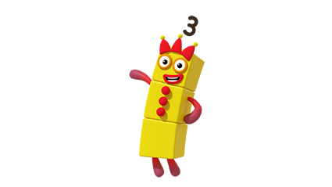
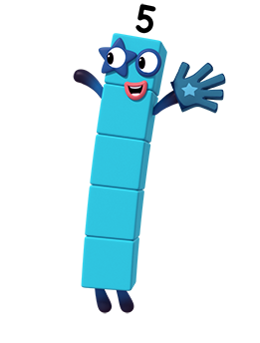
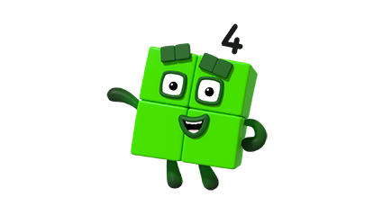
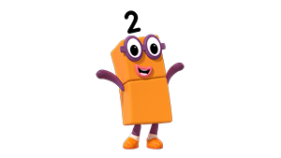
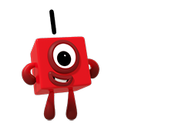
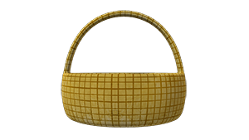


Are there enough?
Images © 2017 Alphablocks Ltd. All Rights Reserved.
Notes:
Use this slide to discuss if there are enough hats, apples, baskets for all the number blocks to have one each?
To find out we must count.
This slide is animated:
Click 1: The apples are rearranged and matched in a line.
Click 2: The baskets are rearranged and matched in a line. There too many.
Click 3: The hats are rearranged and matched to each Numberblock. There are not enough.
As the images move encourage the children to count. Practise speaking in full sentences as suggested in slide 5.

Slide 22
How many?
I can count
I can count
I can count
I can count
I can count
I can count
I can count
I can count
Notes:
Use this slide for individual practice and then follow up to check answers.
Encourage children to place individual cubes/counters over the picture and then rearrange in a line.

Slide 23
Notes:
This slide demonstrates how children might use counters to keep track of their counting. Moving the counters to a tens frame enables them to see the structure of the number as 5 and 1 more.

