Slide 1
Manipulating equations with unknowns on both sides
KS3 Mastery PD Materials: Exemplified Key Ideas
Materials for use in the classroom or to support professional development discussions
(from 2.2 Solving linear equations)
Summer 2021

Slide 2
About this resource
These slides are designed to complement the 2.2 Solving linear equations Core Concept document and its associated Theme Overview document 2 Operating on number, both found in the Secondary Mastery Professional Development pages.
These slides re-present the key examples from the Core Concept document so that the examples can be used either directly in the classroom or with a group of teachers. There are prompt questions alongside the examples, and further clarification in the notes.
These slides do not fully replicate the Core Concept document, so should be used alongside them. Reference to specific page numbers, and to other useful NCETM resources, can be found in the notes for each slide.
This slide deck is not designed to be a complete PD session, rather it is a selection of resources that you can adapt and use as needed when planning a session with a group of teachers.

Slide 3


About this resource
The slides are structured as follows:
  The big picture:
    Where does this fit in?
    What do students need to understand?
    Why is this key idea important?
  Prior learning
  Misconceptions
  Exemplified key ideas
  Reflection questions
  Appendices:
    Key vocabulary
    Representations and structure
    Previous and Future learning
    Useful links
The exemplified key idea slides have the following symbols to indicate how they have been designed to be used:
Into the classroom
The examples are presented on these slides so that they could be used in PD, but also directly in the classroom. The notes feature suggested questions and things teachers might consider when using with students.
PD discussion prompts
These slides look at the examples in more detail, with question prompts to promote discussion among maths teachers. The notes feature reference to further information and guidance within the Core Concepts document.

Slide 4
Where does this fit in?
The NCETM has identified a set of six ‘mathematical themes’ within Key Stage 3 mathematics that bring together a group of ‘core concepts’.
The second of these themes is Operating on number, which covers the following interconnected core concepts:
2.1 Arithmetic procedures
2.2 Solving linear equations
Notes:
Linked on this slide is the Theme Overview document of Operating on Number. This document includes why it is important, the key underpinning knowledge and links to prior and future learning. There is also guidance about how the five big ideas of Teaching for Mastery relate specifically to this theme.

Slide 5
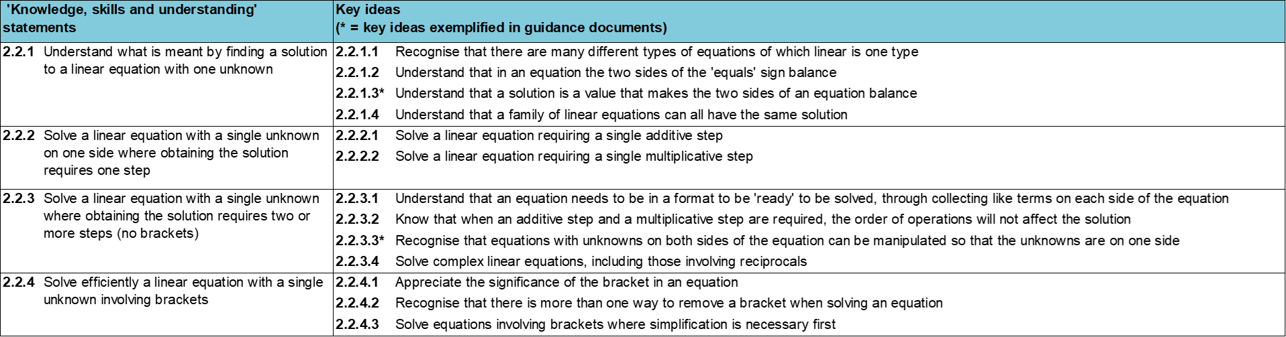
Where does this fit in?
Within this core concept, 2.2 Solving linear equations, there are four statements of knowledge, skills and understanding.
These, in turn, are broken down into thirteen key ideas. The highlighted key idea is exemplified in this slide deck.
Notes:
For key ideas marked with an asterisk, we exemplified the common difficulties and misconceptions that students might have and included elements of what teaching for mastery may look like. We have provided examples of possible student tasks and teaching approaches.
Within these slides are ‘classroom-ready’ versions of the examples for the key idea that has been highlighted. There are also slides that may be useful for discussion in a professional development session

Slide 6
What do students need to understand?
2.2.3.3 Recognise that equations with unknowns on both sides of the equation can be manipulated so that the unknowns are on one side
Understand that an equation can be considered as both a process and an object.
Understand ways in which equations can be manipulated while maintaining equality.
Understand the manipulations that will efficiently work towards solving an equation.
  What prior knowledge might your students already have?
  What language might they use to describe this key idea?
  What questions might you want to ask to assess their prior learning?

Slide 7
Why is this key idea important? (1)
It is important for students to appreciate that number and algebra are connected, and that the solving of equations is essentially concerned with operations on, as yet, unknown numbers..
Understanding the ‘=’ sign as ‘having the same value as’, and the correct use of order of operations, along with inverse operations, are key to the solving of equations. Students also need to understand the difference between an expression and an equation, and the different roles that letters might take.
For example, 3x + 7 is an expression where the variable x, and therefore the expression as a whole, can take an infinite number of values. It also has a duality about it – it is a process and the result of that process. It is a way of describing a set of operations on a variable (i.e. multiply by three and add seven), as well as a way of representing the actual result when x is multiplied by three and seven is added. When some restriction is put on this expression, as in 3x + 7 = 10, the letter x ceases to represent a variable but is now an unknown, the specific value of which will make the equation true. It is important that students experience this sense of the infinite (as in the values an expression can take) and the finite (specific values to satisfy an equation.
Notes:
A more detailed overview of the core concept of Solving linear equations can be found on page 2 of the 2.2 Core Concept document.
The background to each key idea is also explored in more detail on the following pages:
2.2.1 Understand what is meant by finding a solution to a linear equation with one unknown – pages 6-7
2.2.2 Solve a linear equation with a single unknown on one side where obtaining the solution requires one step – page 7
2.2.3 Solve a linear equation with a single unknown where obtaining the solution requires two or more steps (no brackets) – page 7-8
2.2.4 Solve efficiently a linear equation with a single unknown involving brackets – page 8

Slide 8
Why is this key idea important? (2)
In Key Stage 2, students were introduced to the use of symbols and letters to represent variables and unknowns in mathematical situations. Therefore, students should be able to express missing-number problems algebraically and find pairs of numbers that satisfy an equation with two unknowns. Key Stage 3 builds on this experience by providing opportunities for students to understand the concept of a ‘solution’ to a (linear) equation.
Students should appreciate that x = 5 is a linear equation (to which the solution is obvious) and that all other linear equations which are a transformation of this have the same solution. This also links to the awareness that linear equations have only one solution.
It is important that students do not just learn and blindly follow a set of procedural rules for solving equations without this sense of what a solution means. Deep, conceptual understanding allows students to be fluent and flexible problem-solvers.
Much of this learning is new and is built upon in Key Stage 4; therefore, it is essential that students are given time to develop a secure and deep understanding of these important ideas and techniques.
Notes:
A more detailed overview of the core concept of Solving linear equations can be found on page 2 of the 2.2 Core Concept document.
The background to each key idea is also explored in more detail on the following pages:
2.2.1 Understand what is meant by finding a solution to a linear equation with one unknown – pages 7 and 8
2.2.2 Solve a linear equation with a single unknown on one side where obtaining the solution requires one step – page 8
2.2.3 Solve a linear equation with a single unknown where obtaining the solution requires two or more steps (no brackets) – page 9
2.2.4 Solve efficiently a linear equation with a single unknown involving brackets – pages 9 and 10

Slide 9
Prior learning
  What prior knowledge might your students already have?
  What language might they use to describe this key idea?
  What questions might you want to ask to assess their prior learning?
Upper Key Stage 2 Learning Outcome
Express missing number problems algebraically
Find pairs of numbers that satisfy an equation with two unknowns
Enumerate possibilities of combinations of two variables
Notes:
You may find it useful to speak to your partner schools to see how the above has been covered and the language used.
You can find further details regarding prior learning in the following segments of the NCETM primary mastery professional development materials:
• Year 4: 2.10 Connecting multiplication and division, and the distributive law
• Year 5: 1.28 Common structures and the part–part–whole relationship
• Year 5: 1.29 Using equivalence and the compensation property to calculate
• Year 5: 2.18 Using equivalence to calculate
• Year 5: 2.22 Combining multiplication with addition and subtraction
• Year 6: 1.31 Problems with two unknowns
• Year 6: 2.28 Combining division with addition and subtraction
Within the Operating on number Theme Overview document, you can also find a broader description of students’ potential previous learning (page 6), alongside further information about key underpinning knowledge (page 2).

Slide 10
Prior learning
Key Stage 3 Learning Outcome
1.4.1 Understand and use the conventions and vocabulary of algebra including forming and interpreting algebraic expressions and equations
1.4.2 Simplify algebraic expressions by collecting like terms to maintain equivalence
1.4.3 Manipulate algebraic expressions using the distributive law to maintain equivalence
2.1.1 Understand and use the structures that underpin addition and subtraction strategies
2.1.2 Understand and use the structures that underpin multiplication and division strategies
2.1.3 Know, understand and use fluently a range of calculation strategies for addition and subtraction of fractions
2.1.4 Know, understand and use fluently a range of calculation strategies for multiplication and division of fractions
2.1.5 Use the laws and conventions of arithmetic to calculate efficiently
  What representations might your students already be familiar with?
  What language might they use?
  How does this fit in with your curriculum progression?
Notes:
Please note: Numerical codes refer to statements of knowledge, skills and understanding in the NCETM breakdown of Key Stage 3 mathematics.
Within the Operating on number Theme Overview document, you can also find a broader description of students’ potential previous learning (page 4), alongside further information about key underpinning knowledge (page 2).

Slide 11
Checking prior learning
The following slides contain questions for checking prior learning.
  What representations might students use to support their understanding of these questions?
  What variation might you put in place for these questions to fully assess students’ understanding of the concept?
  How might changing the language of each question change the difficulty?
  Why are these such crucial pre-requisites for this key idea?

Slide 12
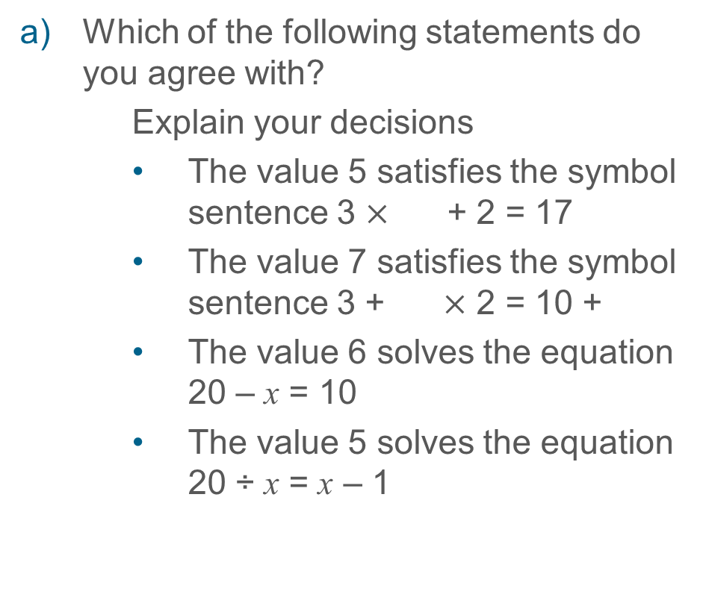
Checking prior learning
Which of the following statements do you agree with?
Explain your decisions
    The value 5 satisfies the symbol sentence 3 $×$ + 2 = 17
    The value 7 satisfies the symbol sentence 3 + $×$ 2 = 10 +
    The value 6 solves the equation 20 – x = 10
    The value 5 solves the equation 20 ÷ x = x – 1
Are these statements, always, sometimes or never true?
  2x + 3 = 2x + 6
  2x + 6 = 2(x + 3)
  2x + 6 = 3x + 2
  2x + 3 > 2x + 6
  3x + 2 < 2x + 6
  Explain why you have decided on each answer and for those that are “sometimes true”, explain when they are true
Notes:
References to the questions (links on final slide):
NCETM Primary assessment materials: year 6, page 29
NCETM Secondary assessment materials, page 15

Slide 13
Common difficulties and misconceptions
What aspects of this key idea might pupils find challenging?
What misconceptions might pupils have?
When teaching this topic, you may find students encounter difficulties with…
Over reliance on a ‘function machine’ strategy for solving
Understanding expressions as an ‘object’ as well as a ‘process’
More information, and some suggestions for overcoming these challenges, can be found on the following slides

Slide 14
Common difficulties and misconceptions (1)
When solving an equation in which the unknown is on one side, students are able to use a ‘doing and undoing’ strategy to think about the equation.
If students are able to interpret 3x − 2 = 10 as ‘I think of a number, multiply by three, then subtract two and the result is ten’, then they may be able to use ‘common sense’ to find the original number.
Function machines are commonly used to sequence the transformations made in equations and to focus on the inverse operations needed to find a solution.
When the unknown is on both sides of the equation, then ‘doing and undoing’ strategies break down. Students’ attention has to shift to maintaining equality as the equation is transformed.

Slide 15
Common difficulties and misconceptions (2)
Some students may find challenging the shift in awareness needed to understand that a process (e.g. 3e means multiply whatever e is by three) is now being manipulated as one object (e.g. in the equation 5 + 3e = 7e – 1, we might start by subtracting 3e).
Gray and Tall (1991)* coined the term ‘procept’ to describe symbolic notation that allows for both interpretations. Attention and thought needs to be given to supporting these students.
As students become familiar with the range of manipulations that will maintain equality, they can then transfer their focus to which of these manipulations are helpful in moving towards a solution.
Here, the intention to transform the equation so that the unknown is on one side should be made explicit.
*E. Gray & D. Tall, 1991, Duality, Ambiguity and Flexibility in Successful Mathematical Thinking, Coventry, University of Warwick

Slide 16
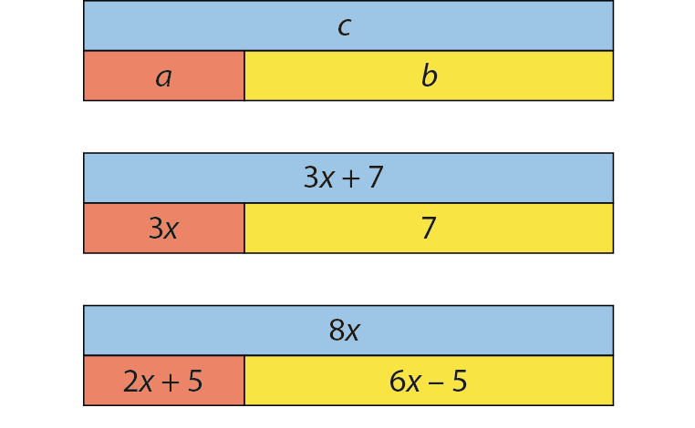
Understand that an equation can be considered as both a process and an object
Example 1
Look at the first bar model. Can you see:
  a + b = c?
  b + a = c?
  c – a = b?
  c – b = a?
Write similar ‘families’, each with four equations for the other two bar models.
Notes:
Suggested questioning:
What symbol connects c with a + b? Why?
How can you use the answers to part a to write a family of equations for parts b and c?
What do you need to be careful of when adding the red bar and the yellow bar in part c?
Things for you to think about:
In Example 1 part a), students’ awareness should be directed to the structure of the addition represented by the bar model. They should be encouraged to describe the connection between the diagram and the symbolic representation.
When working on part b), students’ awareness should then be drawn to the similarity with part a), with a particular focus on the way that 3x or 2x + 5 can be considered as a single object and manipulated in the same way as in the first example.
The expression 6x − 5 in the third diagram has been chosen to raise possible common misconceptions when subtracting a negative value. Consider possible outcomes that are likely to be given by students, including 8x − 6x − 5 = 2x + 5 or 8x − (6x − 5) = 2x + 5, and raise the use of brackets to support the understanding of 6x − 5 as an object.

Slide 17
Understand that an equation can be considered as both a process and an object
Example 1
Look at the first bar model. Can you see:
  a + b = c?
  b + a = c?
  c – a = b?
  c – b = a?
Write similar ‘families’, each with four equations for the other two bar models.
  How might exploring the structure of addition in this way support students to be able to manipulate equations?
  What misconceptions might students encounter, particularly for the third bar model?
Notes:
More detail about the sequencing of this example can be found on page 18 of the 2.2 Core Concept document.

Slide 18
Understand that an equation can be considered as both a process and an object
Example 2
Complete each statement.
  Given that 3e = 7, then 6e = ___.
  Given that 5(3w − 7) = 30, then 3w − 7 = ___.
  Given that 5k = 7, then 5k + 9 = ___.
  Given that 8f + 12 = 23, then 8f + 2 = ___.
  Given that 3t + 6 = 2t + 1, then 3t + 10 = ___.
Notes:
Suggested questioning:
What has happened to __ to transform it into __?
If you know __, what else do you know? What other statements can you write using each equation?
Things for you to think about:
As in Example 1, students’ attention in Example 2 should be directed to the expression as an object, and the way in which this object has been transformed in the second part. The intention here is to encourage familiarity and an awareness of the way in which an expression as a whole can be transformed. For example, a prompt for part d) might be ‘What has happened to 8f + 12 to transform it into 8f + 2?’, encouraging the idea that 8f + 12 is a single object on which a subtraction has been carried out and from which another valid equation can be written.

Slide 19
Understand that an equation can be considered as both a process and an object
Example 2
  How does treating the expression as an object that can be transformed support students in their understanding of manipulating algebra?
  What questions might you ask to ensure students get the most out of this activity?
Complete each statement.
  Given that 3e = 7, then 6e = ___.
  Given that 5(3w − 7) = 30, then 3w − 7 = ___.
  Given that 5k = 7, then 5k + 9 = ___.
  Given that 8f + 12 = 23, then 8f + 2 = ___.
  Given that 3t + 6 = 2t + 1, then 3t + 10 = ___.
Notes:
This example can be found on page 19 of the 2.2 Core Concept document.

Slide 20
Understand that an equation can be considered as both a process and an object
Example 2 (cont’d)
  Consider what responses your KS3 students may have to this task. Then watch the video of this task on Mathematical Prompts for Deeper Thinking videos | NCETM.
  How did the students’ responses compare to your predictions?
  How does the discussion reveal students’ understanding of expressions as both processes and objects?
Complete each statement.
  Given that 3e = 7, then 6e = ___.
  Given that 5(3w − 7) = 30, then 3w − 7 = ___.
  Given that 5k = 7, then 5k + 9 = ___.
  Given that 8f + 12 = 23, then 8f + 2 = ___.
  Given that 3t + 6 = 2t + 1, then 3t + 10 = ___.
Notes:
This example can be found on page 19 of the 2.2 Core Concept document.
A downloadable powerpoint, giving more insight into the video and some links to research, can be found on the Mathematical Prompts for Deeper Thinking videos | NCETM page.

Slide 21
Understand ways in which equations can be manipulated while maintaining equality
Example 3
2x + 12 = 18
5x + 9 = 15 + 3x
Each arm of the spider diagram is constructed using a rule that is repeated at each step moving out from the centre.
Which arm has the rule ‘add one to each side each time’?
Write down the rules for the other arms.
The solution to 2x + 9 = 15 is x = 3. Is this also the solution to the other equations that have been created?
4x + 9 = 15 + 2x
2x + 11 = 17
2x + 10 = 16
3x + 9 = 15 + x
2x + 9 = 15
2x + 8 = 14
x + 9 = 15 - x
9 = 15 – 2x
2x + 7 = 13
9 – x = 15 - 3x
2x + 6 = 12
Notes:
Suggested questioning:
What is the same and different about the equations on each arm?
Will the value of x have changed?
Things for you to think about:
The use of a spider diagram constructed according to given rules can give students an opportunity to understand the impact of making a change to an equation while maintaining the equilibrium. This is not intended to be an efficient strategy for solving equations; rather the intention is to offer insight into the structures that underpin the process of ‘performing the same operation on each side’.
Once students have made sense of this spider diagram, and identified the rules used, you might follow this with a task in which they create their own spider diagram following the same rules but with a different starting point, or offer a starting point that is not the centre of the spider, for example using the task on the next slide.
A blank template of the spider diagram can be found in the appendices.

Slide 22
Understand ways in which equations can be manipulated while maintaining equality
Example 3a
Add 3x to each side each time
Double each side each time
Complete the blanks in this spider diagram.
3x + 5 = 7 + 2x
Subtract 5 from each side each time
Add x to each side each time

Slide 23
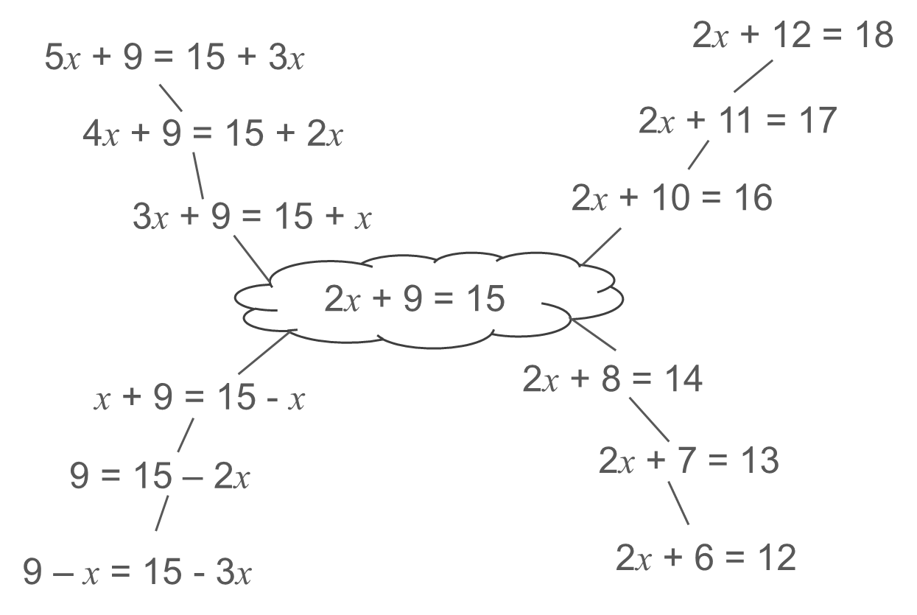
Understand ways in which equations can be manipulated while maintaining equality
Example 3
Each arm of the spider diagram is constructed using a rule that is repeated at each step moving out from the centre.
Which arm has the rule ‘add one to each side each time’?
Write down the rules for the other arms.
The solution to 2x + 9 = 15 is x = 3. Is this also the solution to the other equations that have been created?
  How does this activity offer insight into the structures that underpin the process of ‘performing the same operation on each side’?
  How might you follow this task?
Notes:
More detail about how you might use this example can be found on pages 19-20 of the 2.2 Core Concept document.

Slide 24
Understand ways in which equations can be manipulated while maintaining equality
Example 4
The solution to the equation 24x + 5 = 17x + 61 is x = 8.
Use this to find the value of x when:
the 24 and 17 are doubled to give the equation 48x + 5 = 34x + 61
the 5 and 61 are doubled to give 24x + 10 = 17x + 122
the entire equation is doubled to give 48x + 10 = 34x + 122.
Notes:
Suggested questioning:
What do you predict will happen each time? Why? How could you check?
When is equilibrium maintained? When is it not maintained?
Things for you to think about:
Example 4 is designed to make explicit some of the manipulations that will and will not maintain equilibrium in an equation. Students should be discouraged from rushing in to solve the equation by manipulating it; rather, they should be given the opportunity to reason and make predictions about the impact of making the changes described.
It may be beneficial to offer part a) and discuss this, before then offering part b) and again discussing students’ predictions and reasoning, followed by part c), rather than offering all three as a single exercise.

Slide 25
Understand ways in which equations can be manipulated while maintaining equality
Example 4
  How do you think students will answer each of these questions? Predict the responses that will arise and the reasoning that might accompany them.
  What strategies and structures will you use in your classroom to help students share their reasoning?
The solution to the equation 24x + 5 = 17x + 61 is x = 8.
Use this to find the value of x when:
the 24 and 17 are doubled to give the equation 48x + 5 = 34x + 61
the 5 and 61 are doubled to give 24x + 10 = 17x + 122
the entire equation is doubled to give 48x + 10 = 34x + 122.
Notes:
This example can be found on pages 20-21 of the 2.2 Core Concept document.

Slide 26
Understand ways in which equations can be manipulated while maintaining equality
Example 4a
  A similar task can be created by adding a constant value on to each term. For example, replacing part a) with “two is added onto the 24 and 17 to give the equation 26x + 5 = 19x + 61”.
  This task offers a set of transformations that maintain the equilibrium but may offer less opportunity for students to reason.
  Do you feel that an additive version of the task is worthwhile?
The solution to the equation 24x + 5 = 17x + 61 is x = 8.
Use this to find the value of x when:
the 24 and 17 are doubled to give the equation 48x + 5 = 34x + 61
the 5 and 61 are doubled to give 24x + 10 = 17x + 122
the entire equation is doubled to give 48x + 10 = 34x + 122.
Notes:
This example can be found on page 20-21 of the 2.2 Core Concept document.

Slide 27
Understand ways in which equations can be manipulated while maintaining equality
Example 5
Given that 4x + 12 = 10x + 2, which of these are true and which are false? Explain how you know.
(These questions are sequenced in columns down the page).
4x + 13 = 10x + 3
8x + 24 = 20x + 4
4 + 12 = 10 + 2
3x + 12 = 10x + 2 − x
2x + 6 = 5x + 1
13 = 6x + 3
8x + 12 = 20x + 2
4x = 10x + 2 − 12
Notes:
Suggested questioning:
What happens to the value of x when every term in an equation is multiplied by the same value?
Could you simplify any of these transformations further?
How could you correct the equations that are false?
Which of these transformations gets us closer to solving the equation?
Things for you to think about:
There are only two equations here – parts c) and g) – that are not a correct transformation of the given equation. Some of the transformations offered – parts d) and h) – have not been simplified, and this may be a useful discussion point for students. Although the intention of this task is not to focus on processes for solving an equation, a useful prompt might be to ask which of the valid transformations students think moves closer to a solution and why.

Slide 28
Understand ways in which equations can be manipulated while maintaining equality
Example 5
  What misconceptions are part c) and g) designed to expose?
  Consider other misconceptions that students might have. What non-examples might you add to this set in order to expose these misconceptions?
Given that 4x + 12 = 10x + 2, which of these are true and which are false? Explain how you know.
4x + 13 = 10x + 3
8x + 24 = 20x + 4
4 + 12 = 10 + 2
3x + 12 = 10x + 2 − x
2x + 6 = 5x + 1
13 = 6x + 3
8x + 12 = 20x + 2
4x = 10x + 2 − 12
Notes:
More detail about the this example, including the intended misconceptions, can be found on page 21 of the 2.2 Core Concept document.

Slide 29
Understand the manipulations that will efficiently work towards solving an equation
Example 6
Explain why the two highlighted transformations are useful in finding a solution to the equation 6x + 15 = 2x + 21.
The rule is subtract x from each side each time
3x + 15 = 21 - x
The rule is add x to each side each time
4x + 15 = 21
8x + 15 = 4x + 21
5x + 15 = x + 21
7x + 15 = 3x + 21
6x + 1 = 2x + 21
6x + 10 = 2x + 16
6x + 14 = 2x + 20
6x + 5 = 2x + 11
6x + 13 = 2x + 19
6x = 2x + 6
6x + 12 = 2x + 18
6x – 5 = 2x + 1
The rule is subtract 1 from each side each time
The rule is subtract 5 from each side each time
Notes:
Suggested questioning:
Which of these equations would be easier to solve? Why?
Will the value of x be the same or different in each of these?
Things for you to think about:
From previous use of these spider diagrams (in Example 3), students should know that all of the equations in the diagram have the same solution. The focus for Example 6 is to draw attention to particular transformations that move closer to a solution to the equation. A key understanding here is that removing one of the terms of the equation makes finding a solution more straightforward, and it is this that should be a focus of this task.

Slide 30
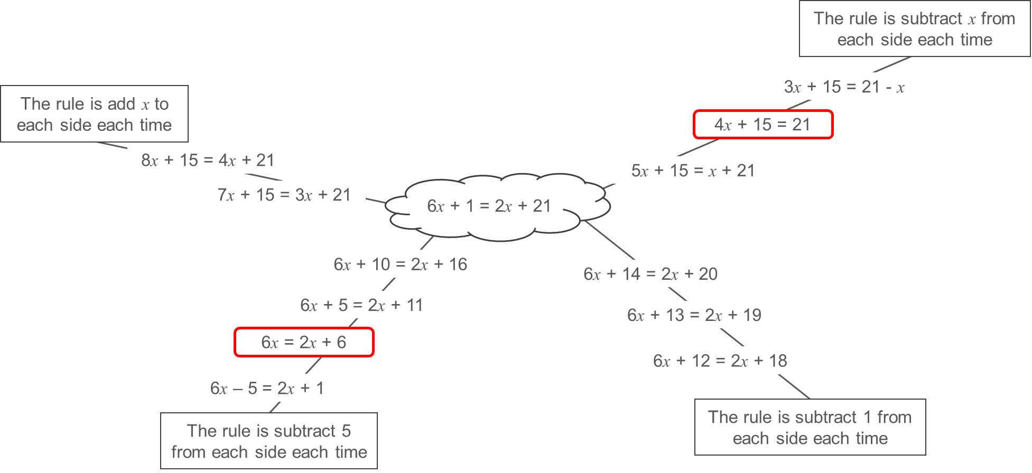
Understand the manipulations that will efficiently work towards solving an equation
Example 6
  Example 6 looks again at transforming equations, now drawing attention to the idea that removing one of the terms makes it easier to find a solution. How does this approach differ from how you have taught this in the past?
  What is the benefit of giving students opportunities to manipulate algebra, without a focus on solving?
Explain why the two highlighted transformations are useful in finding a solution to the equation 6x + 15 = 2x + 21.
Notes:
This example can be found on page 22 of the 2.2 Core Concept document.

Slide 31
Understand the manipulations that will efficiently work towards solving an equation
Example 7
d − 9 = 3 − 3d
−9 = 3 − 4d
11d = 7d + 12
10d − 9 = 6d + 3
4d − 9 = 3
11d − 12 = 7d
0 = 12 − 4d
Parts i–vii are all correct transformations for 11d − 9 = 7d + 3.
Which ones are helpful in finding a solution?
Which would you use to find the value of d? Explain why.
Notes:
Suggested questioning:
What transformation has taken place each time to change the original equation?
Which transformations get us closer to finding the solution to the equation?
Things for you to think about:
In Example 7, students are offered a range of correct manipulations, allowing them to focus on making a decision about which manipulation(s) will move them closer to solving the equation. A useful discussion might be had around what transformation has taken place to change the original equation to each of the examples (with the exception of part (vii), each example is the result of just one change), but the key idea here is that some of these transformations – parts (ii), (iii), (v), (vi) and perhaps (vii) – reduce the number of terms in the equation while maintaining the equality, and so move closer to a solution.

Slide 32
Understand the manipulations that will efficiently work towards solving an equation
Example 7
  Do you have a preference for the order in which equations like this are solved?
  Do you teach students to manipulate the constant terms first – as in parts (iii) and (vi) – or to deal with the unknown first – as in parts (ii) and (v)?
  Do you consider the ‘larger’ term first or the ‘smaller’?
  Why do you teach this particular process?
Parts i–vii are all correct transformations for 11d − 9 = 7d + 3.
d − 9 = 3 − 3d
−9 = 3 − 4d
11d = 7d + 12
10d − 9 = 6d + 3
4d − 9 = 3
11d − 12 = 7d
0 = 12 − 4d
Which ones are helpful in finding a solution?
Which would you use to find the value of d? Explain why.
Notes:
More detail about this example can be found on pages 22-23 of the 2.2 Core Concept document.

Slide 33
Understand the manipulations that will efficiently work towards solving an equation
Example 8
Use the given information to fill in each gap with a number or an expression so that the equations balance.
a)
n = 2
11n + 7 = __
b)
t = __
3t – 1 = 23
11n = __
3t = __
13n + 7 = __
5t – 1 = __
c)
m = __
5m + 6 = __
5m = __
2m + 6 = 61 – 3m
Notes:
Suggested questioning:
What do you know? What has changed between each step?
How can you transform the equation to move backwards and forwards along the arrows?
What information do you need to be able to find the unknown each time? How can you get to that stage?
Things for you to think about:
In Example 8, students are taken through a particular set of steps, and their attention should be drawn to the way in which it is possible to move ‘backwards’ through these by choosing efficient transformations, meaning that the unknown is on one side of the equals sign and the constant term on the other. The focus here is on what has changed from one step to the next, and so undoing this in order to transform the equation into a simpler equivalent equation.

Slide 34
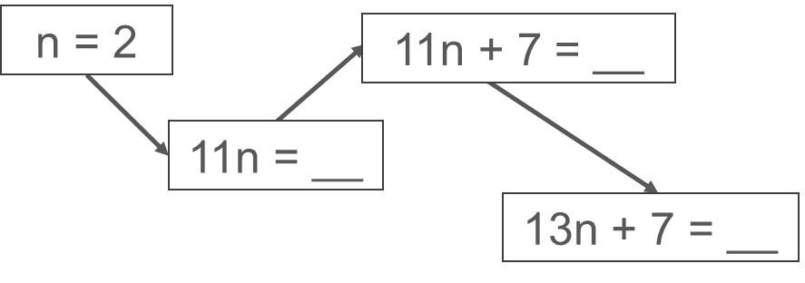
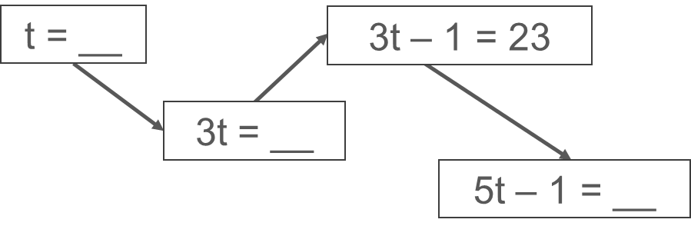
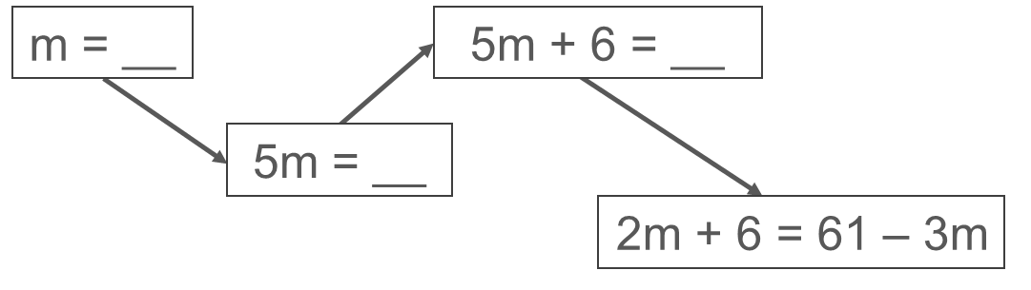
Understand the manipulations that will efficiently work towards solving an equation
Example 8
a)
  How might this activity build students towards understanding that they can transform equations into simpler equivalent equations to solve them?
  What questions might you ask alongside this? What language might you want students to use?
b)
c)
Notes:
This example can be found on page 23 of the 2.2 Core Concept document.

Slide 35
Understand the manipulations that will efficiently work towards solving an equation
Example 9
Solve these equations.
5x + 8 = 43
7x + 8 = 2x + 43
x + 8 = 43 − 4x
2 − x = 3 x − 12
2 − x = 12 − 3 x
x − 2 = −3x − 12
a)
b)
c)
x + 73 = 5x + 5
x + 7.3 = 5x + 0.5
x + 7.3 = 5x + 0.5
Notes:
Suggested questioning:
Can you solve this equation? If not, how can you transform it so that you can?
Is there more than one way to transform the equation?
Things for you to think about:
Example 9 provides an opportunity for students to practise solving equations with the unknown value on each side.
In part a), equations (ii) and (iii) are transformations of equation (i). This may give students a chance to discuss reducing the complexity of an equation by ensuring that the unknown is on just one side.
Part b) offers practice at making decisions about which term of the equation to ‘move’ to make solving quick and efficient (for example, in part (i), students might start by adding x to each side, while in parts (ii) and (iii) they might add 3x to each side). This task may provide different routes to reach a solution for students to discuss and unpick.
Part c) introduces fractional and decimal elements to the equation for students to work with. This may allow them to further generalise the process of solving an equation by working with more complex numbers.

Slide 36
Understand the manipulations that will efficiently work towards solving an equation
Example 9
  What is the same and different in each set of three questions?
  What opportunities for discussion might be created by the sequencing of these questions?
  How will you build on the experience students have built up in examples 1-8 in your approach to this example?
Solve these equations.
2 − x = 3x − 12
2 − x = 12 − 3x
x − 2 = −3x − 12
a)
5x + 8 = 43
7x + 8 = 2x + 43
x + 8 = 43 − 4x
b)
c)
x + 73 = 5x + 5
x + 7.3 = 5x + 0.5
x + 7.3 = 5x + 0.5
Notes:
This example can be found on pages 23-24 of the 2.2 Core Concept document.

Slide 37
Reflection questions
What other mathematical concepts will be supported by students’ stronger understanding of this key idea?
What mathematical language will you continue to use to support pupils to make connections with other areas?
Which representations might you continue to use to further develop students’ understanding?

Slide 39
Appendices
You may choose to use the following slides when planning or delivering a PD session. They cover:
  Key vocabulary
  Representations and structure
  Previous learning
  Future learning
  Blank spider diagram template
  Library of links

Slide 40
Key vocabulary
Term | Definition
coefficient | Often used for the numerical coefficient. More generally, a factor of an algebraic term. Example 1: In the term 4xy, 4 is the numerical coefficient of xy but x is also the coefficient of 4y and y is the coefficient of 4x. Example 2: in the quadratic equation 3x² + 4x – 2, the coefficients of x² and x are 3 and 4 respectively.
equation | A mathematical statement showing that two expressions are equal. The expressions are linked with the symbol = Examples: 7 – 2 = 4 + 1 4x = 3 x² − 2x + 1 = 0
linear | In algebra, describing an expression or equation of degree one. Example: 2x + 3y = 7 is a linear equation. All linear equations can be represented as straight line graphs.
solution | A solution to an equation is a value of the variable that satisfies the equation, i.e. when substituted into the equation, makes it true. A solution set is the set of values that satisfy a given set of equations or inequalities.
unknown | A number that is not known. Example: In the expression 2x − 5, x represents an unknown. When presented with more information, such as in the form of an equation (e.g. 2x – 5 = 6), this unknown can be found.
variable | A quantity that can take on a range of values, often denoted by a letter, x, y, z, t, …, etc.

Slide 41
Representations and structure
There are a number of different representations that you may wish to use to support students’ understanding of this key idea. These might include:
Tables and graphs
  Tables and graphs can be used to draw attention to the continuous nature of variables, as well as the unique points where a variable is a solution to a linear equations. See examples 2-4 in this slide deck.
Bar models
  Bar models can be very useful to support students in representing (literally, re-presenting) problems to reveal additive and multiplicative structures, including those involving unknown values.
Balance models
  The balance model is a classic representation (or metaphor) for equality.
Notes:
More information about the representations and structure involved in this key idea can be found:
On page 11 and 12 of the Theme Overview document.
In the ‘Using mathematical representations at KS3’ documents
Links to all of these can be found on the final slide.

Slide 42
Previous learning (1)
From Upper Key Stage 2, students will bring experience of:
multiplying multi-digit numbers up to four digits by a two-digit whole number using the formal written method of long multiplication
dividing numbers up to four digits by a two-digit whole number using the formal written method of long division, and interpreting remainders as whole number remainders, fractions, or by rounding, as appropriate for the context
dividing numbers up to four digits by a two-digit number using the formal written method of short division where appropriate, and interpreting remainders according to the context
performing mental calculations, including with mixed operations and large numbers
using their knowledge of the order of operations to carry out calculations involving the four operations
solving addition and subtraction multi-step problems in contexts, deciding which operations and methods to use and why
Notes:
Theme 2 Operating on number

Slide 43
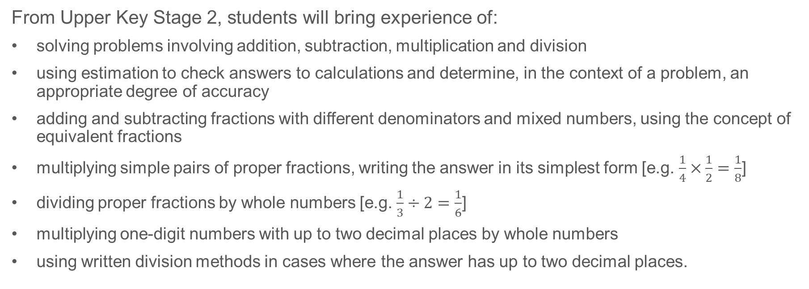
Previous learning (2)
From Upper Key Stage 2, students will bring experience of:
solving problems involving addition, subtraction, multiplication and division
using estimation to check answers to calculations and determine, in the context of a problem, an appropriate degree of accuracy
adding and subtracting fractions with different denominators and mixed numbers, using the concept of equivalent fractions
multiplying simple pairs of proper fractions, writing the answer in its simplest form [e.g. $\frac{1}{4}×\frac{1}{2}=\frac{1}{8}$]
dividing proper fractions by whole numbers [e.g. $\frac{1}{3}÷2=\frac{1}{6}$]
multiplying one-digit numbers with up to two decimal places by whole numbers
using written division methods in cases where the answer has up to two decimal places.
Notes:
Theme 2 Operating on number

Slide 44
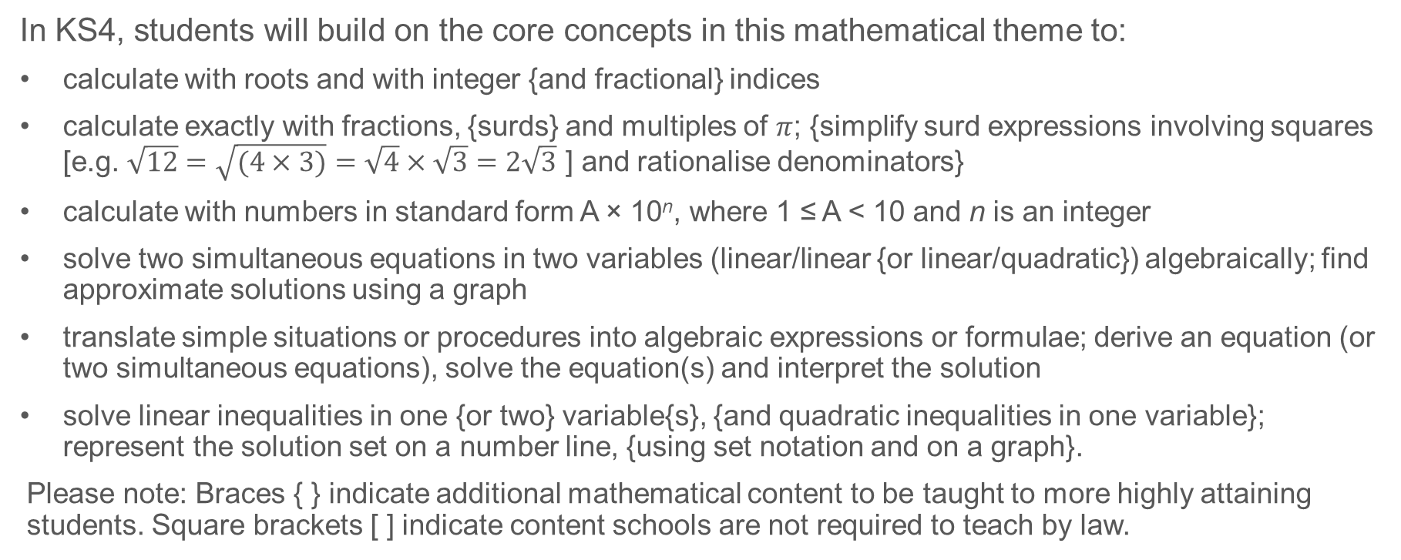
Future learning
In KS4, students will build on the core concepts in this mathematical theme to:
calculate with roots and with integer {and fractional} indices
calculate exactly with fractions, {surds} and multiples of $π$; {simplify surd expressions involving squares [e.g. $\sqrt{12}=\sqrt{(4×3)}=\sqrt{4}×\sqrt{3}=2\sqrt{3}$ ] and rationalise denominators}
calculate with numbers in standard form A × 10^{n}, where 1 ≤ A < 10 and n is an integer
solve two simultaneous equations in two variables (linear/linear {or linear/quadratic}) algebraically; find approximate solutions using a graph
translate simple situations or procedures into algebraic expressions or formulae; derive an equation (or two simultaneous equations), solve the equation(s) and interpret the solution
solve linear inequalities in one {or two} variable{s}, {and quadratic inequalities in one variable}; represent the solution set on a number line, {using set notation and on a graph}.
Please note: Braces { } indicate additional mathematical content to be taught to more highly attaining students. Square brackets [ ] indicate content schools are not required to teach by law.
Notes:
Theme 2 Operating on Number

Slide 45
Understand ways in which equations can be manipulated while maintaining equality
Blank spider diagram template
The rule for this arm is ___ each time
The rule for this arm is ___ each time
The rule for this arm is ___ each time
The rule for this arm is ___ each time
Notes:
Suggested questioning:
Things for you to think about:

Slide 46
Library of links
The following resources from the NCETM website have been referred to within this slide deck:
  NCETM Secondary Mastery Professional Development
    2 Operating on number Theme Overview Document
    2.2 Solving linear equations Core Concept Document
  Using mathematical representations at KS3 | NCETM
  Mathematical Prompts for Deeper Thinking videos | NCETM
  NCETM primary mastery professional development materials
  NCETM primary assessment materials
  NCETM secondary assessment materials

