Slide 1
3.7 Finding equivalent fractions and simplifying fractions
Representations | Year 5
Fractions

Slide 2
How to use this presentation
You can find the teacher guide 3.7 Finding equivalent fractions and simplifying fractions by following the link below.

Slide 3
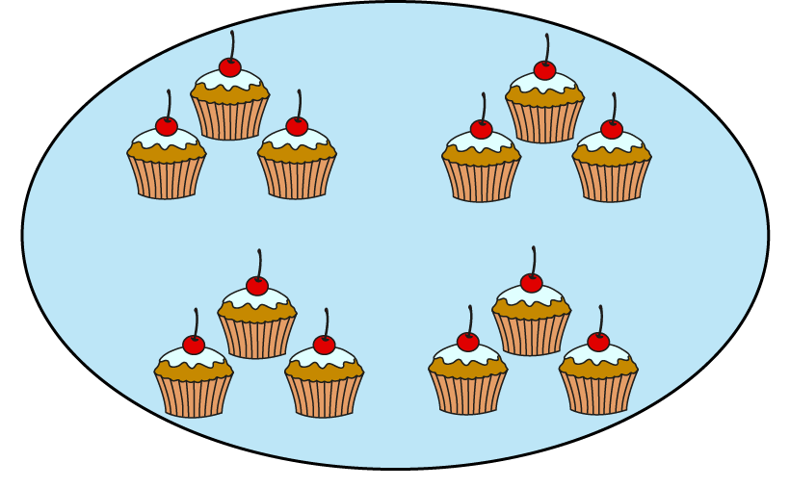
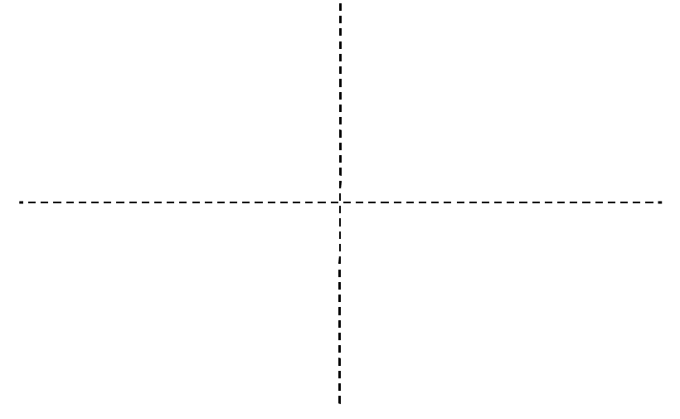
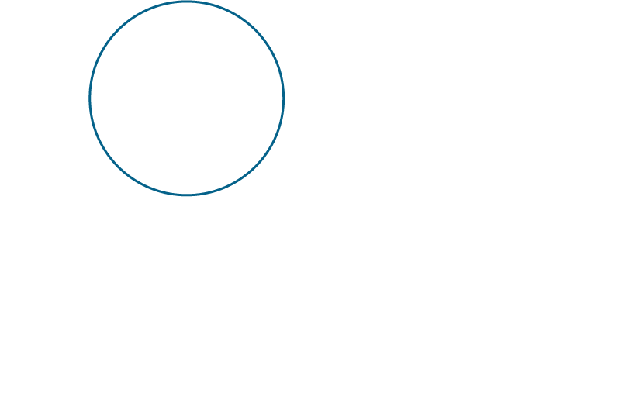
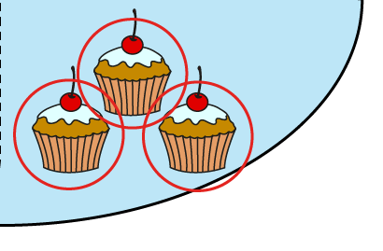
3.7 Equivalent fractions and simplifying
Step 1:1
Notes:
Sabijah and Jess go to the café. They share some cakes. Sabijah eats $\frac{1}{4}$ of the cakes.
The whole is divided into four equal parts and one of the parts is circled. (Sabijah)
Where is the four?
Where is the one?
Jess eats $\frac{3}{12}$ of the cakes.
The whole is divided into twelve equal parts and three of the parts are circled. (Jess)
Where is the twelve?
Where is the three?

Slide 4

3.7 Equivalent fractions and simplifying
Step 1:2

Slide 5
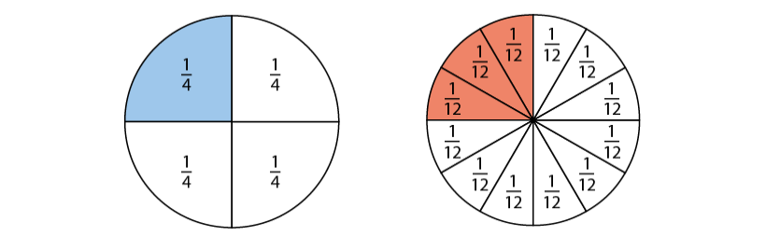
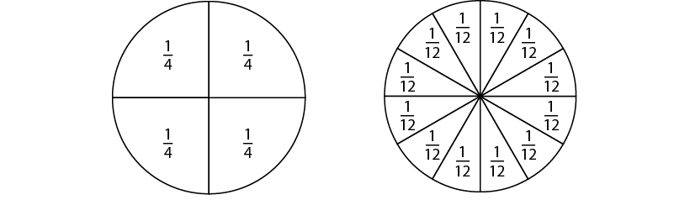

3.7 Equivalent fractions and simplifying
Step 1:3
Notes:
The whole is divided into four equal parts and we have one of those parts.
The whole is divided into twelve equal parts and we have three of those parts.

Slide 6
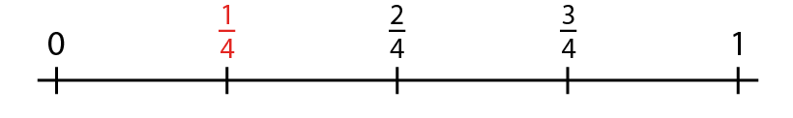
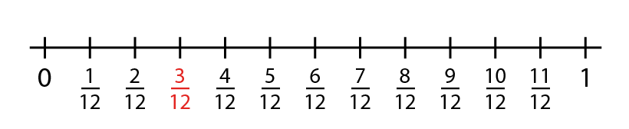

3.7 Equivalent fractions and simplifying
Step 1:4

Slide 7
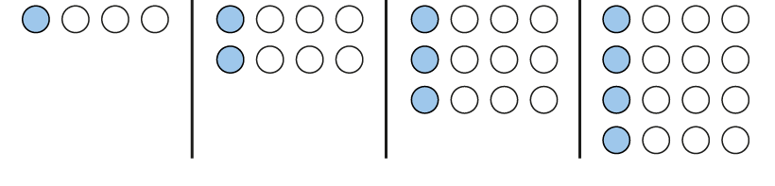
3.7 Equivalent fractions and simplifying
Step 1:5

Slide 8
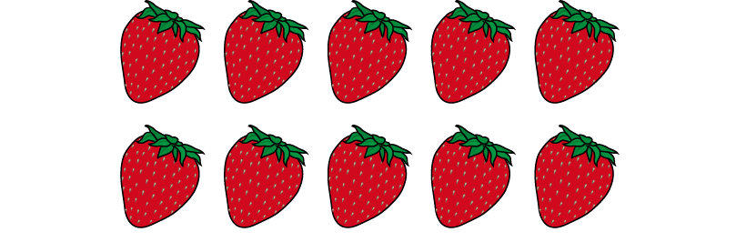
3.7 Equivalent fractions and simplifying
Step 1:6
Notes:
The whole is divided into two equal parts and we have one of those parts.
The whole is divided into ten equal parts and we have five of those parts.

Slide 9
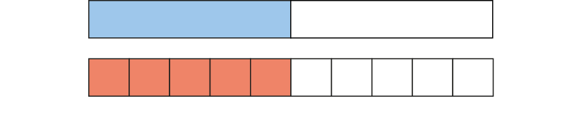
3.7 Equivalent fractions and simplifying
Step 1:6
Notes:
The whole is divided into two equal parts and we have one of those parts.
The whole is divided into ten equal parts and we have five of those parts.

Slide 10
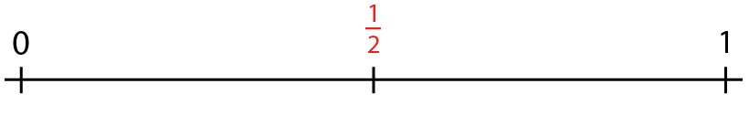
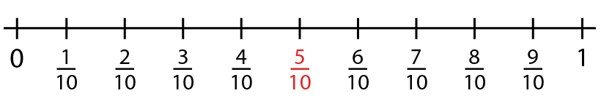

3.7 Equivalent fractions and simplifying
Step 1:6

Slide 11
3.7 Equivalent fractions and simplifying
Step 1:6
Notes:
The whole is divided into two equal parts and we have one of those parts.
The whole is divided into ten equal parts and we have five of those parts.

Slide 12

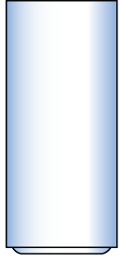




3.7 Equivalent fractions and simplifying
Step 1:7

Slide 13



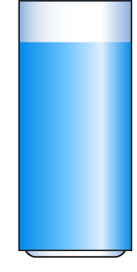


3.7 Equivalent fractions and simplifying
Step 1:8

Slide 14
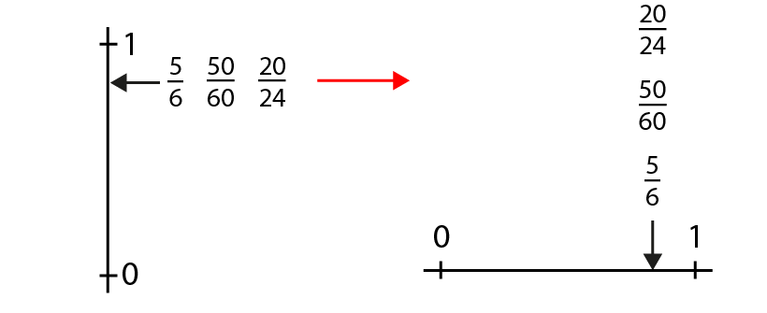
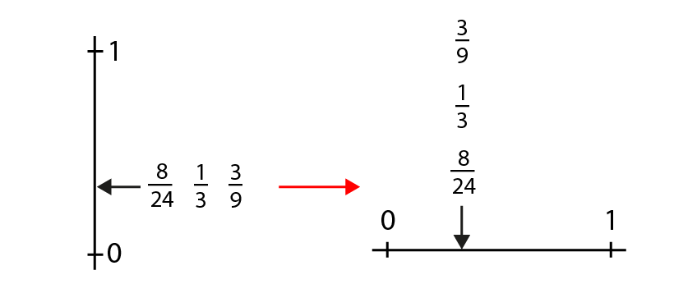
3.7 Equivalent fractions and simplifying
Step 1:8

Slide 15
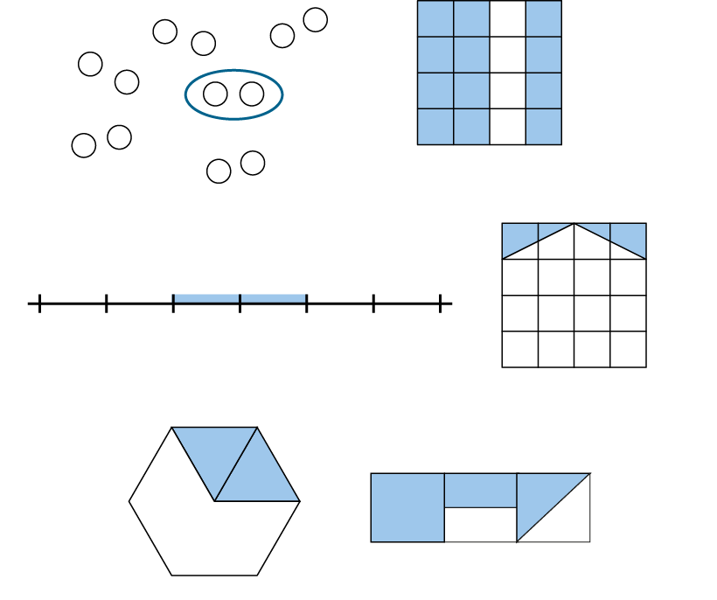
3.7 Equivalent fractions and simplifying
Step 1:10

Slide 16
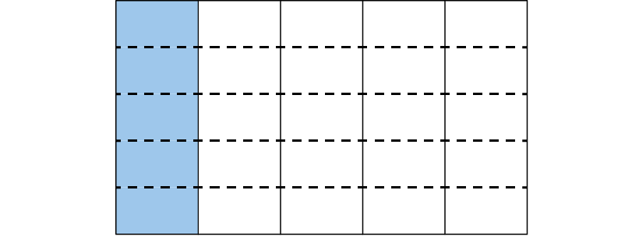
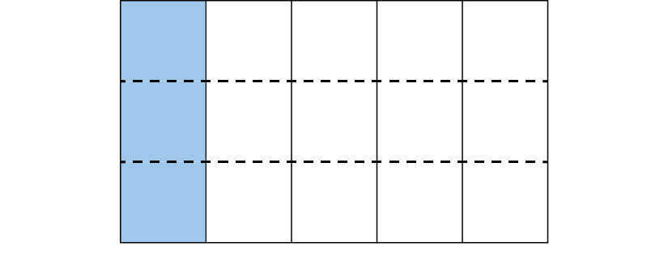

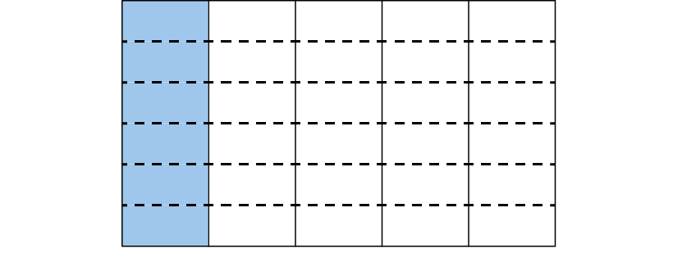
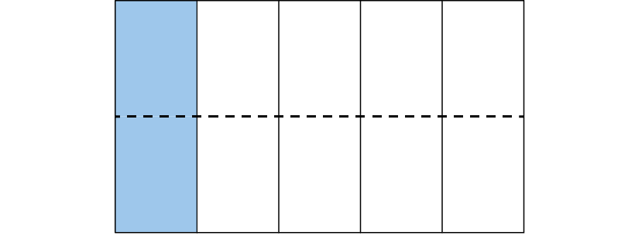
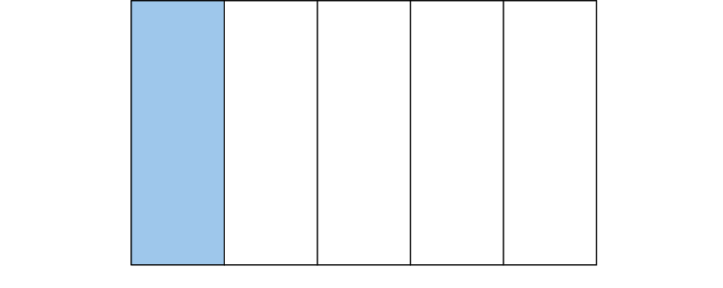
3.7 Equivalent fractions and simplifying
Steps 2:1–2:3
Notes:
Use the stem sentence:
The whole is divided into ___ equal parts, and ___ of these parts is/are shaded.
Where are the five parts?
Where is the one part?
Can you still see the one-fifth?
What other fractions can you see? ($\frac{2}{10}$ $\frac{3}{10}$ , $\frac{4}{20 }$ , $\frac{5}{25}$ and $\frac{6}{30}$)

Slide 17
3.7 Equivalent fractions and simplifying
Step 2:4

Slide 18
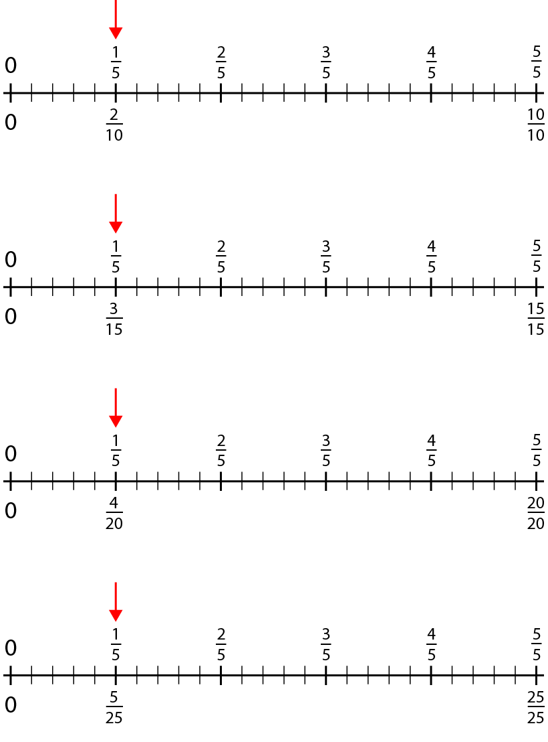
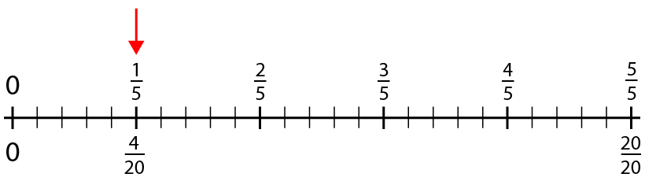
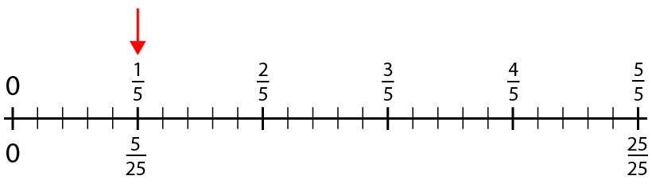
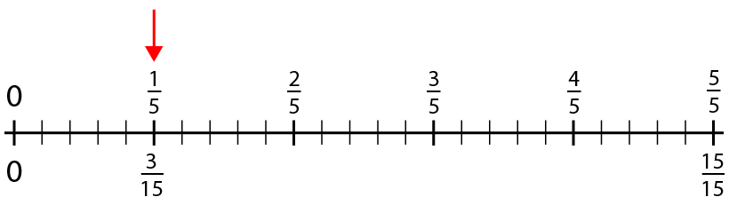
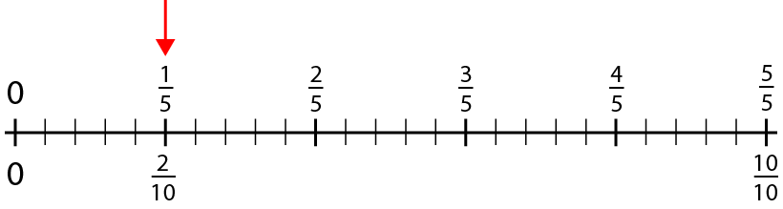
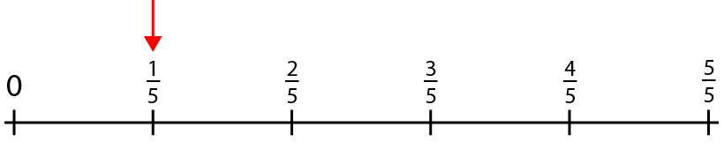
3.7 Equivalent fractions and simplifying
Step 2:5
Notes:
So which number is bigger, one-fifth or two-tenths?

Slide 19
3.7 Equivalent fractions and simplifying
Step 2:6
Notes:
How does the denominator change each time?

Slide 20
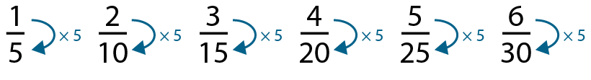
3.7 Equivalent fractions and simplifying
Step 2:7

Slide 21
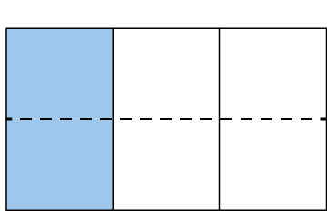
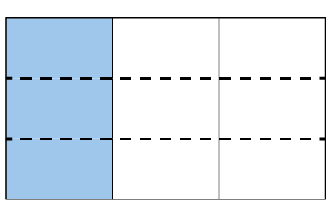
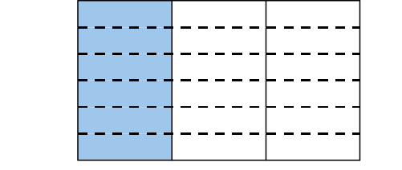
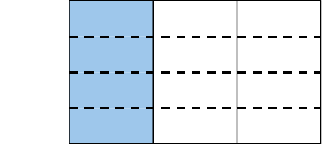
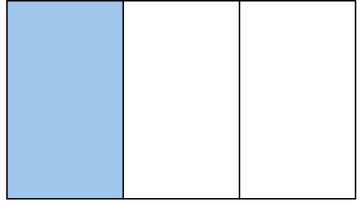
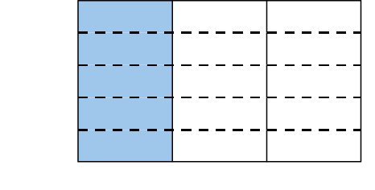

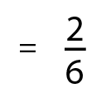
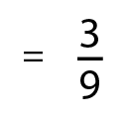
3.7 Equivalent fractions and simplifying
Step 2:9

Slide 22
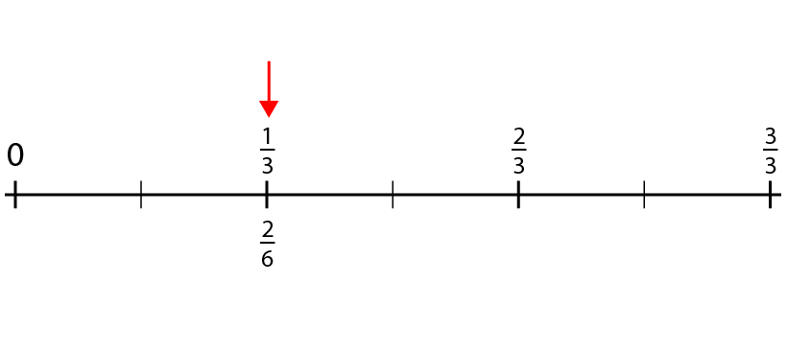
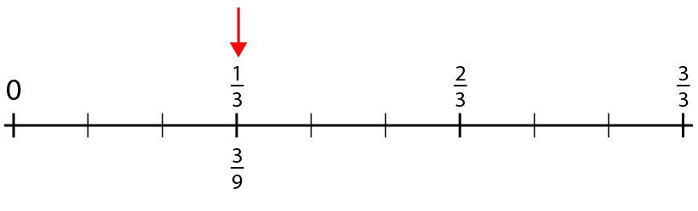
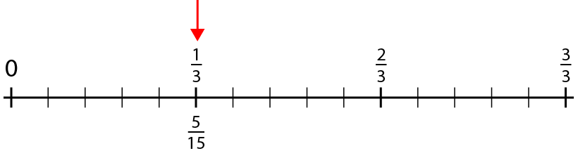
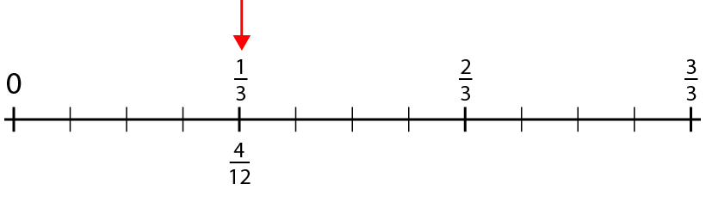
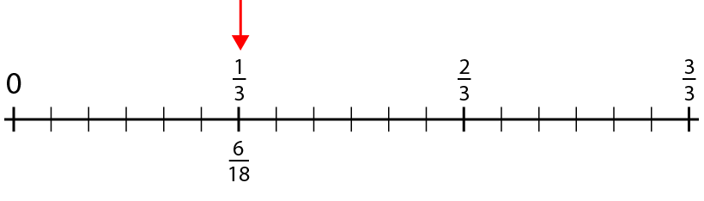
3.7 Equivalent fractions and simplifying
Step 2:9

Slide 23
3.7 Equivalent fractions and simplifying
Step 2:9

Slide 24
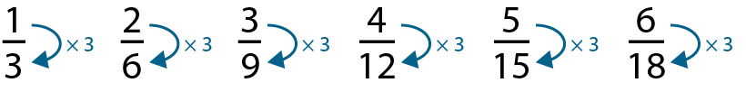
3.7 Equivalent fractions and simplifying
Step 2:9
Notes:
The denominator is always three times the numerator.
The numerator is one-third of the denominator.

Slide 25
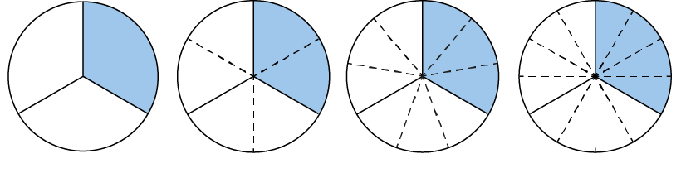
3.7 Equivalent fractions and simplifying
Step 2:11
Write the equivalent fractions to match each image.

Slide 26
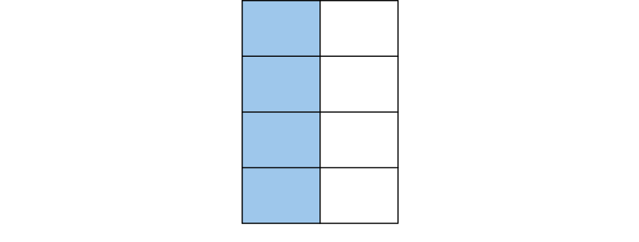
3.7 Equivalent fractions and simplifying
Step 2:11
Write the equivalent fractions to match each image.

Slide 27
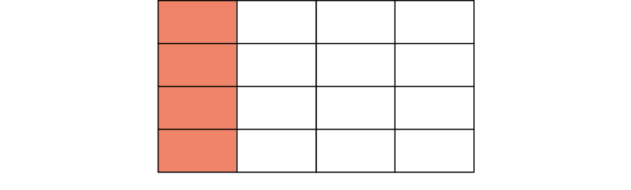
3.7 Equivalent fractions and simplifying
Step 2:11
Write the equivalent fractions to match each image.

Slide 28
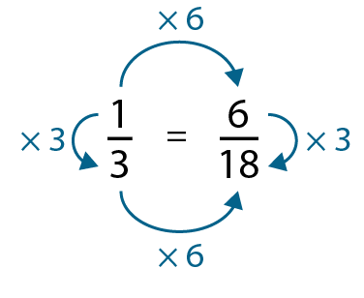
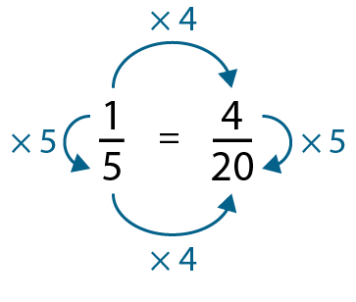
3.7 Equivalent fractions and simplifying
Step 2:12

Slide 29
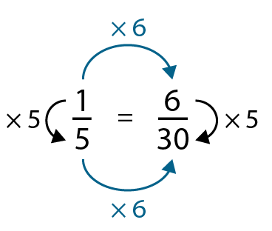




3.7 Equivalent fractions and simplifying
Step 2:13

Slide 30






3.7 Equivalent fractions and simplifying
Step 2:14

Slide 31










3.7 Equivalent fractions and simplifying
3.7 Equivalent fractions and simplifying
Steps 2:15–2:17
Notes:
What fraction is shaded?
Where are the five parts?
Where are the two parts?
What other fractions can you see?

Slide 32
3.7 Equivalent fractions and simplifying
Step 2:18

Slide 33





3.7 Equivalent fractions and simplifying
Step 2:18

Slide 34
3.7 Equivalent fractions and simplifying
Step 2:19

Slide 35


3.7 Equivalent fractions and simplifying
Step 2:20
Notes:
Which of these is the largest number?

Slide 36

3.7 Equivalent fractions and simplifying
Step 2:21

Slide 37

3.7 Equivalent fractions and simplifying
Step 2:21
Notes:
When the numerator and denominator are multiplied or divided by the same number, the value of the fraction remains the same.

Slide 38


3.7 Equivalent fractions and simplifying
Step 2:23

Slide 39

3.7 Equivalent fractions and simplifying
Step 2:23

Slide 40

3.7 Equivalent fractions and simplifying
Step 2:23

Slide 41

3.7 Equivalent fractions and simplifying
Step 3:2
Notes:
The simplest form in this family of fractions is $\frac{1}{4}.$

Slide 42
3.7 Equivalent fractions and simplifying
Step 3:2
Notes:
The simplest form in this family of fractions is $\frac{1}{7}.$

Slide 43

3.7 Equivalent fractions and simplifying
Step 3:2
Notes:
The simplest form in this family of fractions is $\frac{1}{3}.$

Slide 44

3.7 Equivalent fractions and simplifying
Step 3:3
Notes:
The simplest form in this family of fractions is $\frac{3}{4}.$

Slide 45
3.7 Equivalent fractions and simplifying
Step 3:3
Notes:
The simplest form in this family of fractions is $\frac{5}{7}.$

Slide 46

3.7 Equivalent fractions and simplifying
Step 3:3
Notes:
The simplest form in this family of fractions is $\frac{2}{3}.$

Slide 47

3.7 Equivalent fractions and simplifying
Step 3:4

Slide 48

3.7 Equivalent fractions and simplifying
Step 3:4

Slide 49

3.7 Equivalent fractions and simplifying
Step 3:4

Slide 50
3.7 Equivalent fractions and simplifying
Step 3:4
HCF = 4

Slide 51

3.7 Equivalent fractions and simplifying
Step 3:5
HCF = 3

Slide 52


3.7 Equivalent fractions and simplifying
Step 3:5
Notes:
A fraction can be simplified when the numerator and denominator have a common factor other than one.
To write a fraction in its simplest form, divide both the numerator and denominator by their highest common factor.

Slide 53


3.7 Equivalent fractions and simplifying
Step 3:6
Notes:
Simran is simplifying the fraction $\frac{8}{12}$. She divides both the numerator and the denominator by 2 to get $\frac{4}{6}$. Then she divides both the denominator and the numerator by 2 again. Simran has $\frac{2}{3}$ as her simplified fraction.
Sam simplifies the same fraction. He divides both the numerator and the denominator by 4. Sam has $\frac{2}{3}$ as his simplified fraction.
What is the same?
What is different?

Slide 54

3.7 Equivalent fractions and simplifying
Step 3:8

Slide 55

3.7 Equivalent fractions and simplifying
Step 3:10

Slide 56


3.7 Equivalent fractions and simplifying
Step 3:12
Method 1
Method 2
Notes:
Can this answer be simplified?
What is the same?
What is different?

