Slide 1
3.1 Preparing for fractions: the part–whole relationship
Representations | Year 3
Fractions

Slide 2
How to use this presentation
You can find the teacher guide 3.1 Preparing for fractions:
the part–whole relationship by following the link below.

Slide 3
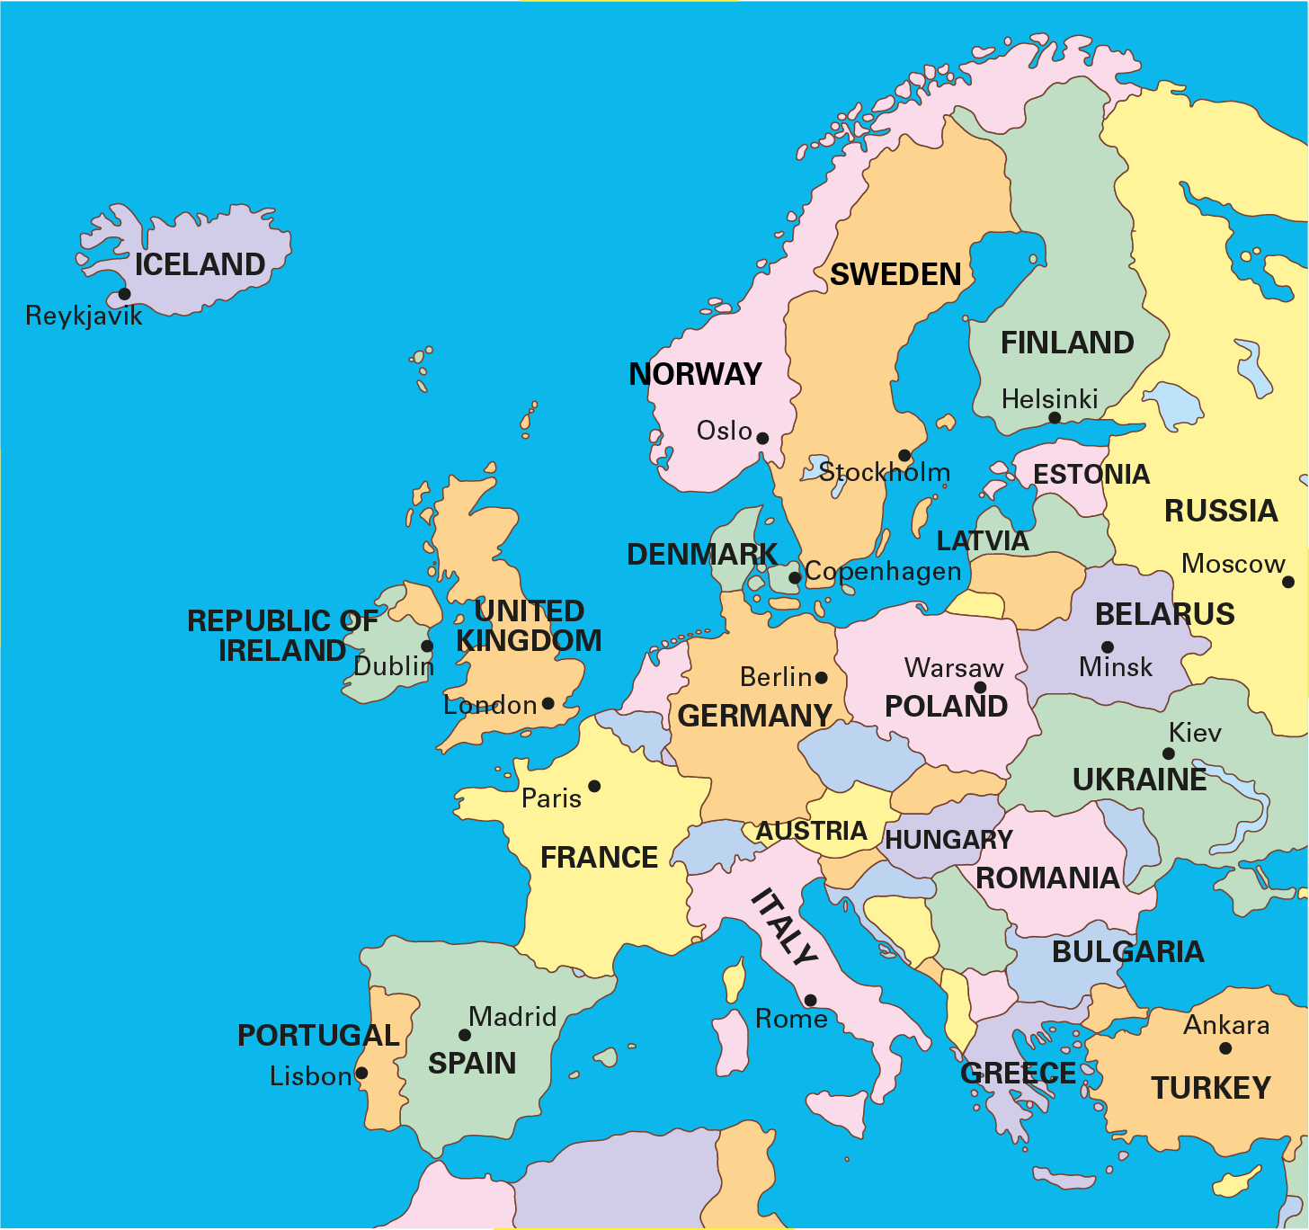
3.1 The part–whole relationship Step 1:1
Notes:
If Europe is the whole, then the United Kingdom is part of the whole.

Slide 4
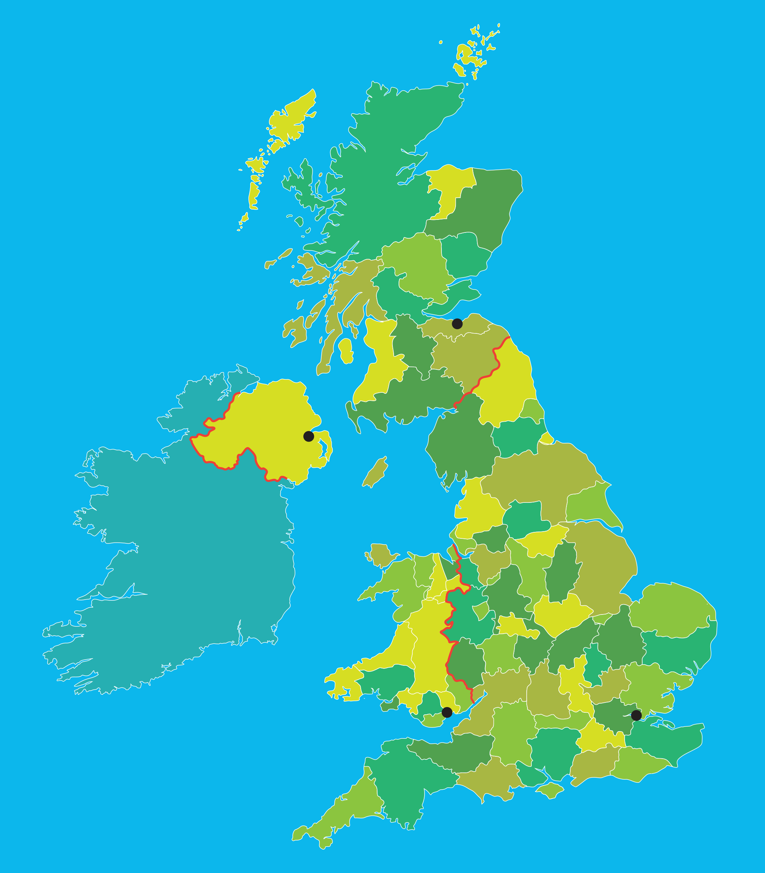
3.1 The part–whole relationship Step 1:2
Scotland
Edinburgh
Northern
Ireland
Belfast
Wales
England
Cardiff
London
Notes:
If the United Kingdom is the whole, then London is part of the whole.

Slide 5
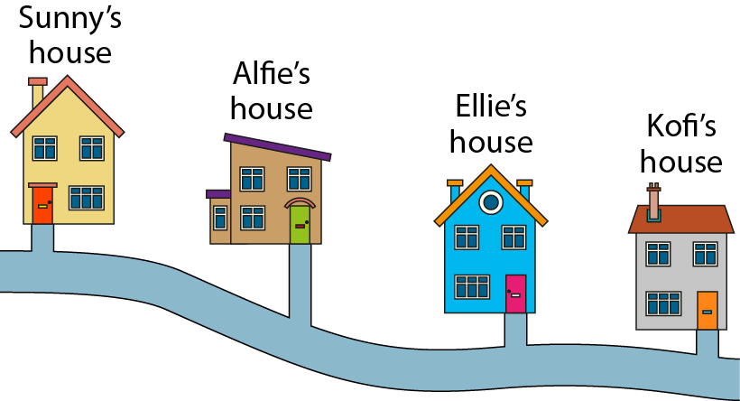
3.1 The part–whole relationship Step 1:4
Notes:
If the journey from Sunny’s house to Kofi’s house is the whole, then the
journey from Sunny’s house to Alfie’s house is part of the whole.

Slide 6
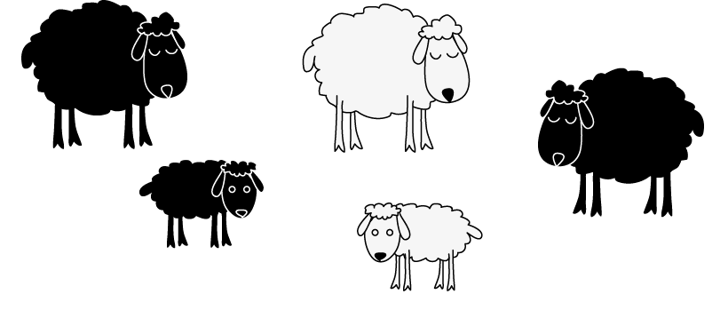
3.1 The part–whole relationship Step 1:4
Notes:
If the group of sheep is the whole, then the black sheep are part of the whole.

Slide 7

3.1 The part–whole relationship Step 1:4
Notes:
If the week is the whole, then Tuesday is part of the whole.

Slide 8


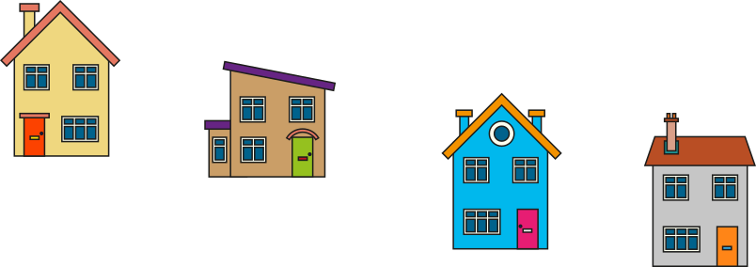


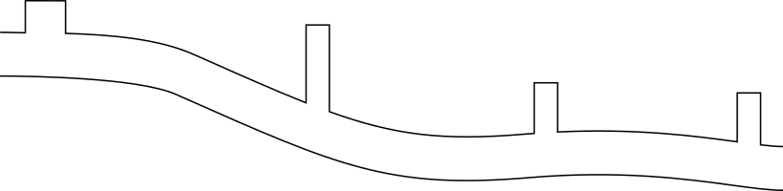





3.1 The part–whole relationship Step 1:5
Notes:
If the journey from Sunny’s house to Kofi’s house is the whole, then the
journey from Sunny’s house to Alfie’s house is part of the whole.
The part is smaller than the whole.

Slide 9
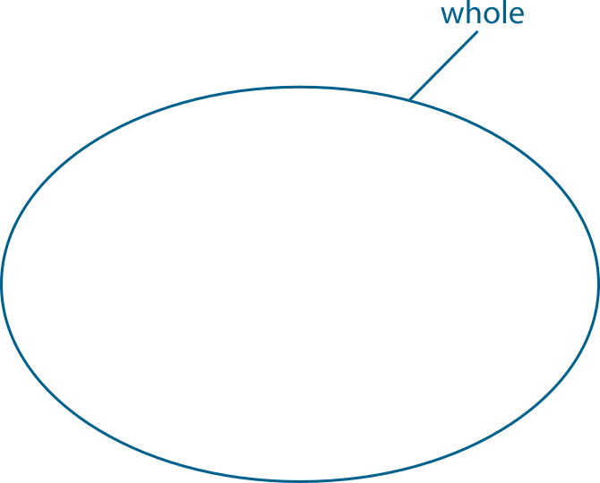
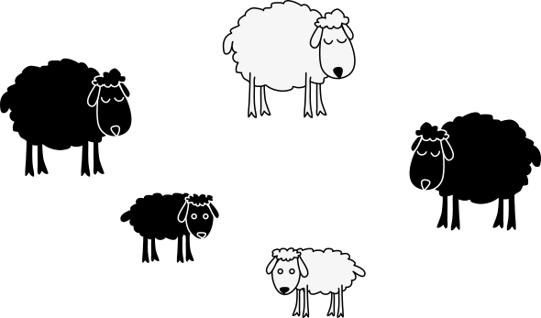
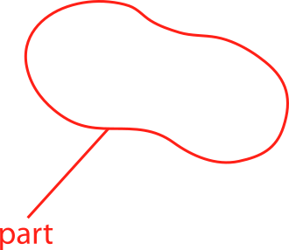
3.1 The part–whole relationship Step 1:5
Notes:
If the group of sheep is the whole, then the lambs are part of the whole.
The part is smaller than the whole.

Slide 10
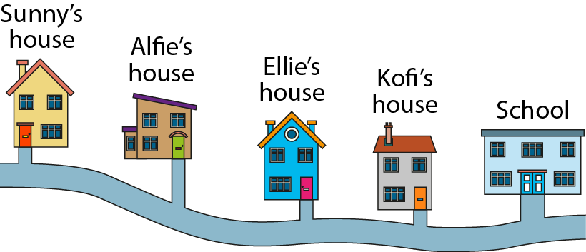
3.1 The part–whole relationship Step 1:6
Notes:
If the journey from Sunny’s house to Kofi’s house is the whole, then the journey from Sunny’s house to Alfie’s house is part of the whole.
If the journey from Sunny’s house to school is the whole, then the journey from Sunny’s house to Kofi’s house is part of the whole.
If the journey from Sunny’s house to school is the whole, then the journey from Sunny’s house to Alfie’s house is part of the whole.

Slide 11
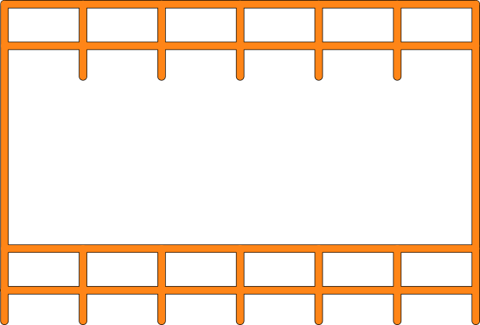
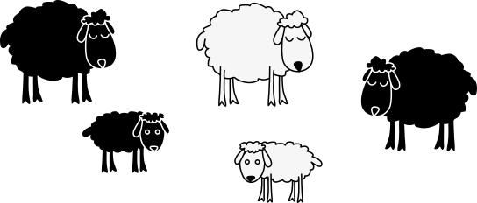
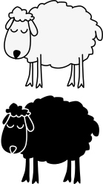
3.1 The part–whole relationship Step 1:6
Notes:
Look at our original group of sheep. Extend the group of sheep.
If all the sheep is the whole, then the sheep in the pen are part of the whole.
If the sheep in the pen are the whole, then the white sheep in the pen are part of the whole.
If the black sheep are the whole, then the black lamb is part of the whole.

Slide 12
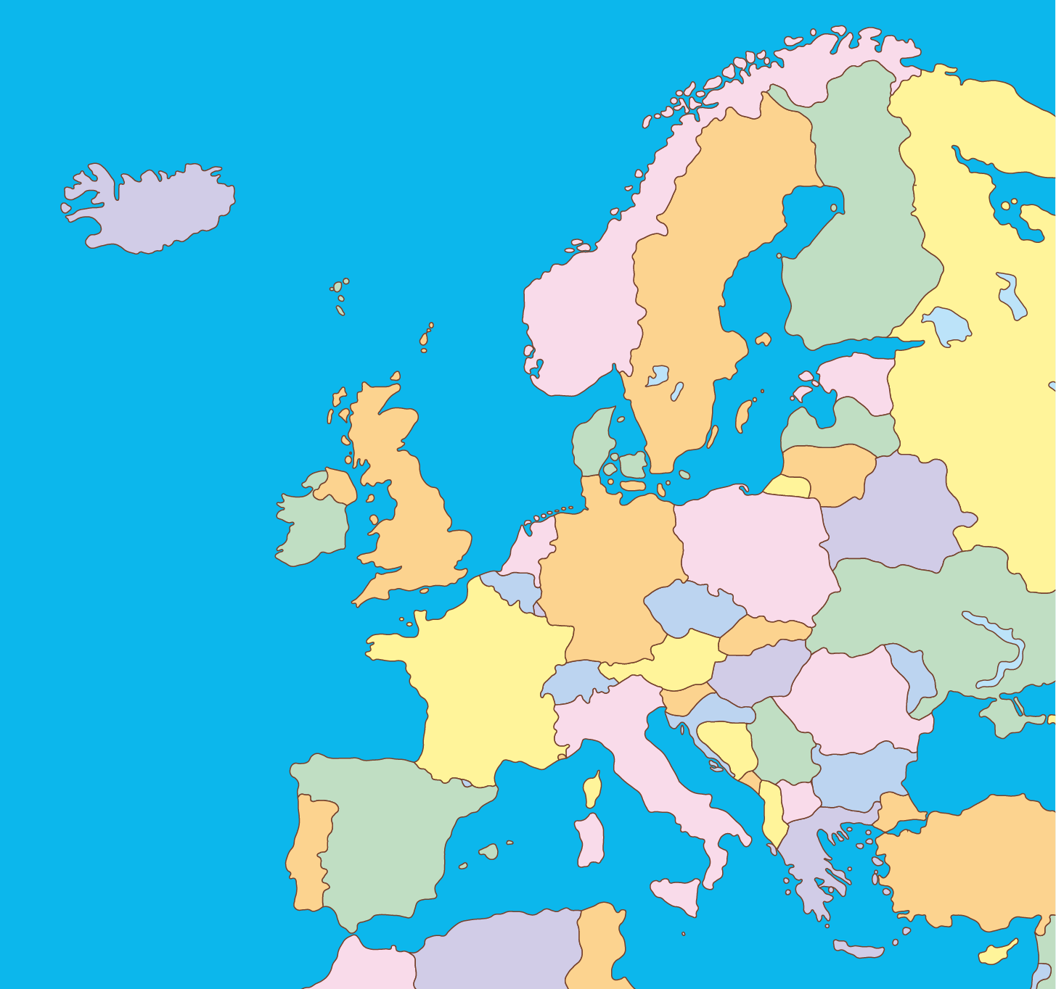
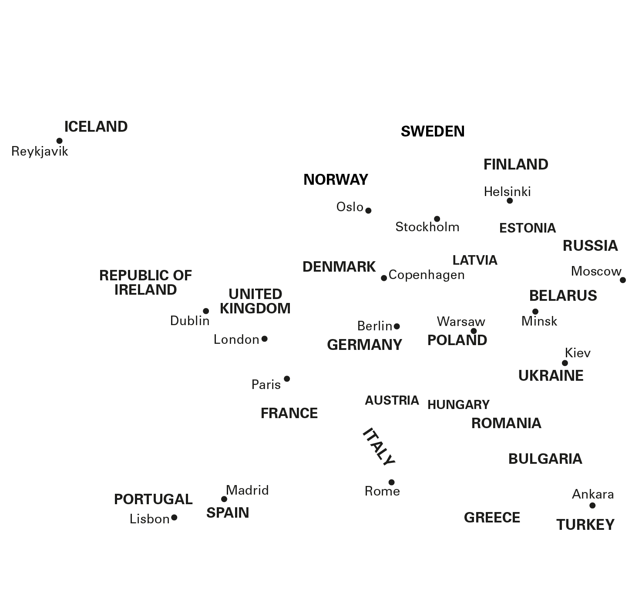
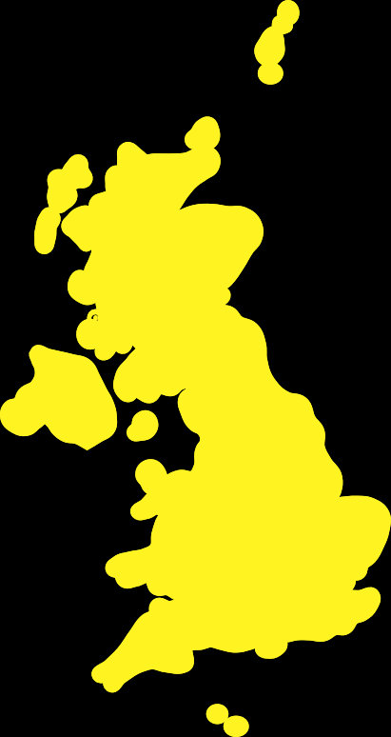

3.1 The part–whole relationship Step 1:7
If the UK is the whole,
then Italy is part of the whole.
✗
✓
then Italy is not part of the whole.

Slide 13
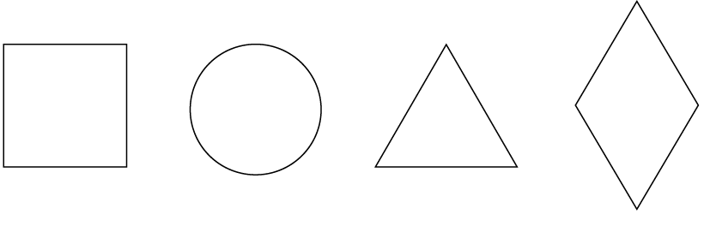
3.1 The part–whole relationship Step 2:1

Slide 14
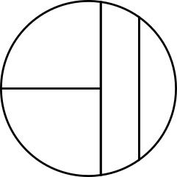
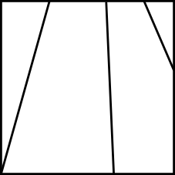

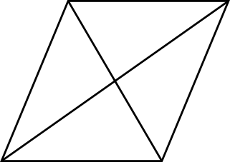
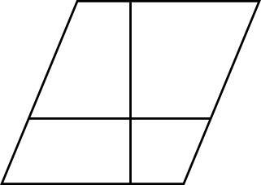
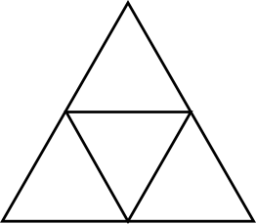
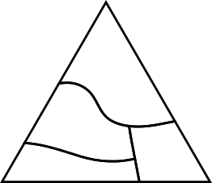
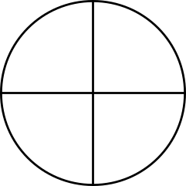
3.1 The part–whole relationship Step 2:2
Equal parts
Unequal parts

Slide 15
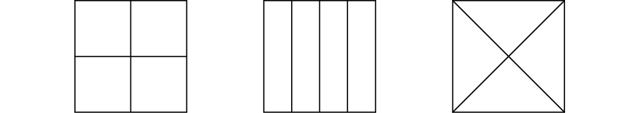
3.1 The part–whole relationship Step 2:2
Equal or unequal parts?
Notes:
Explain to children that these are three equal-sized squares.

Slide 16

3.1 The part–whole relationship Step 2:2
Equal or unequal parts?

Slide 17
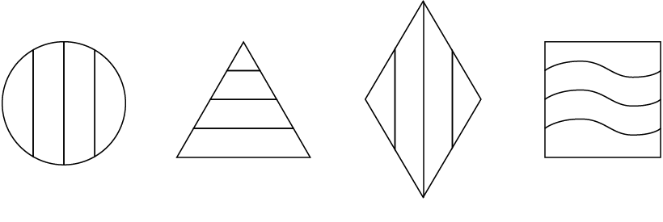
3.1 The part–whole relationship Step 2:2
Equal or unequal parts?

Slide 18
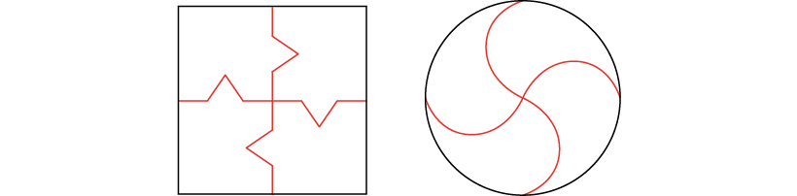
3.1 The part–whole relationship Step 2:3
Notes:
It is only possible to divide a whole into parts using straight lines.
Do you agree with this statement?

Slide 19


3.1 The part–whole relationship Step 2:4
4 equal parts
4 unequal parts

Slide 20
3.1 The part–whole relationship Step 2:4
Are all the parts of equal size?

Slide 21
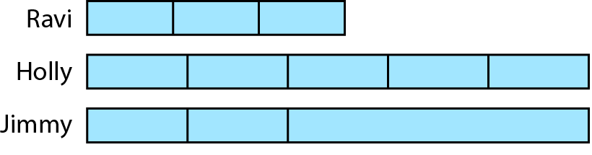
3.1 The part–whole relationship Step 2:4
Odd one out?
Notes:
Three children have folded their paper strips in different ways.
Which strip is the odd one out?
Can you find a way to make each of the strips the odd one out?

Slide 22
3.1 The part–whole relationship Step 2:5

Slide 23
3.1 The part–whole relationship Step 2:5

Slide 24

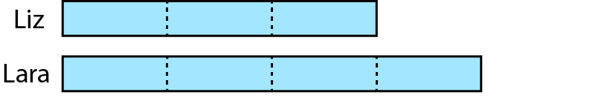
3.1 The part–whole relationship Step 2:5
Equal parts. Which is longer?
Notes:
Liz has folded her paper strip into three equal parts.
Lara has folded her paper strip into four equal parts.
Part of their strips are hidden.
Whose paper strip is longer?

Slide 25
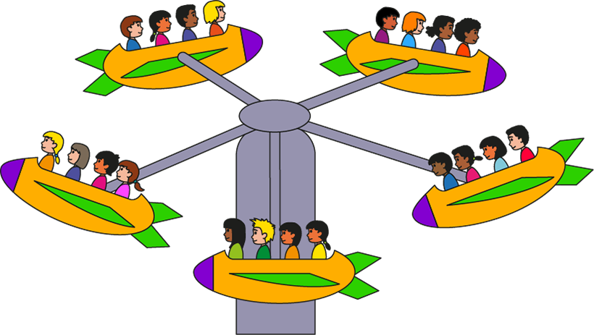
3.1 The part–whole relationship Step 2:6
Notes:
The parts are equal. I know this because the number of people in each part is the same.

Slide 26
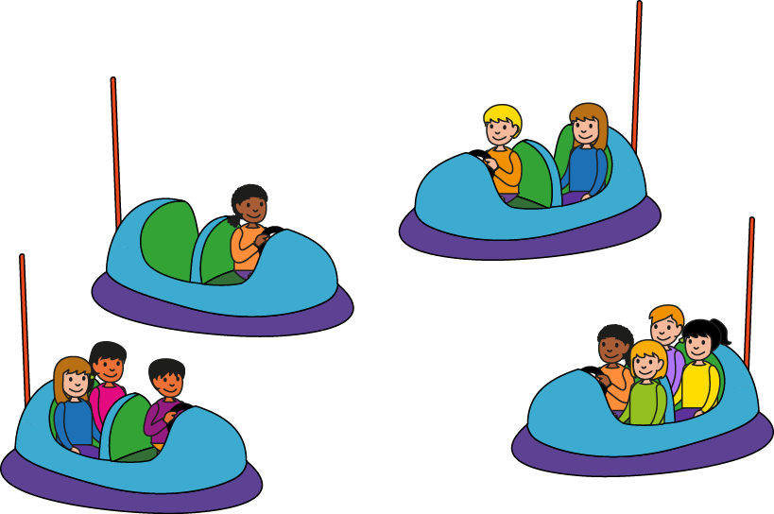
3.1 The part–whole relationship Step 2:6
Notes:
The parts are unequal. I know this because the number of people in each part is not the same.

Slide 27
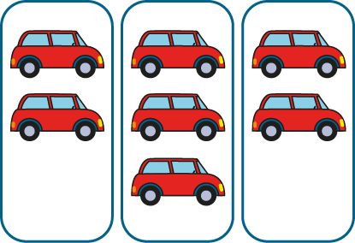
3.1 The part–whole relationship Step 2:6
Notes:
The parts are unequal. I know this because the number of cars in each part is not the same.

Slide 28


3.1 The part–whole relationship Step 2:6
Arrange into equal parts.
Notes:
Can we rearrange the objects so the parts become equal?

Slide 29
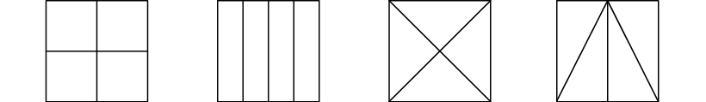
3.1 The part–whole relationship Step 2:7
Equal or unequal parts?

Slide 30
3.1 The part–whole relationship Step 2:7
What is the same about each part? What is different?

Slide 31
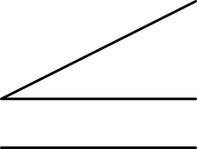


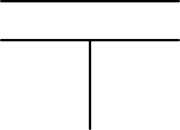
3.1 The part–whole relationship Step 2:7
Equal or unequal parts?
Notes:
Has the square been divided into equal or unequal parts?
What is the same about each part? What is different?

Slide 32
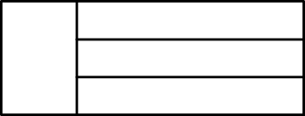
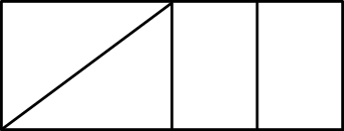

3.1 The part–whole relationship Step 2:7
Equal parts?
✗
✓

Slide 33

3.1 The part–whole relationship Step 3:1
What is the same? What is different?
Notes:
The yellow part is a larger part of the whole circle than the red part.
The red part and the blue part are equally-sized parts of the whole circle.

Slide 34
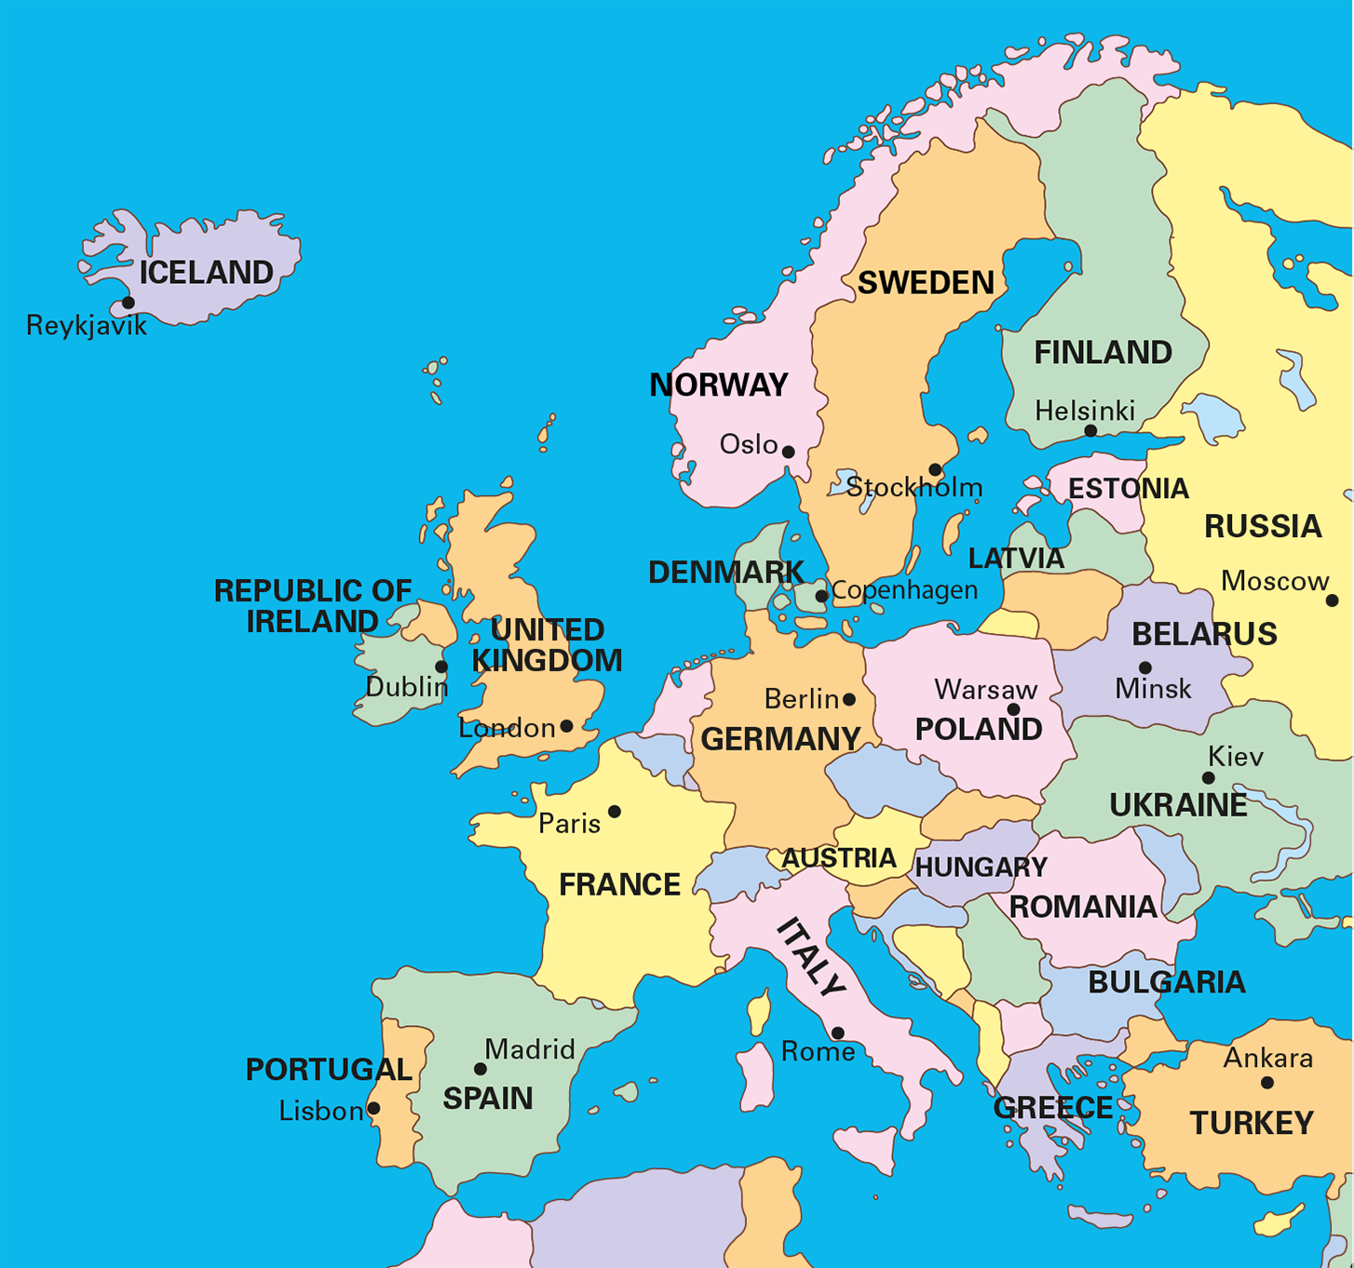
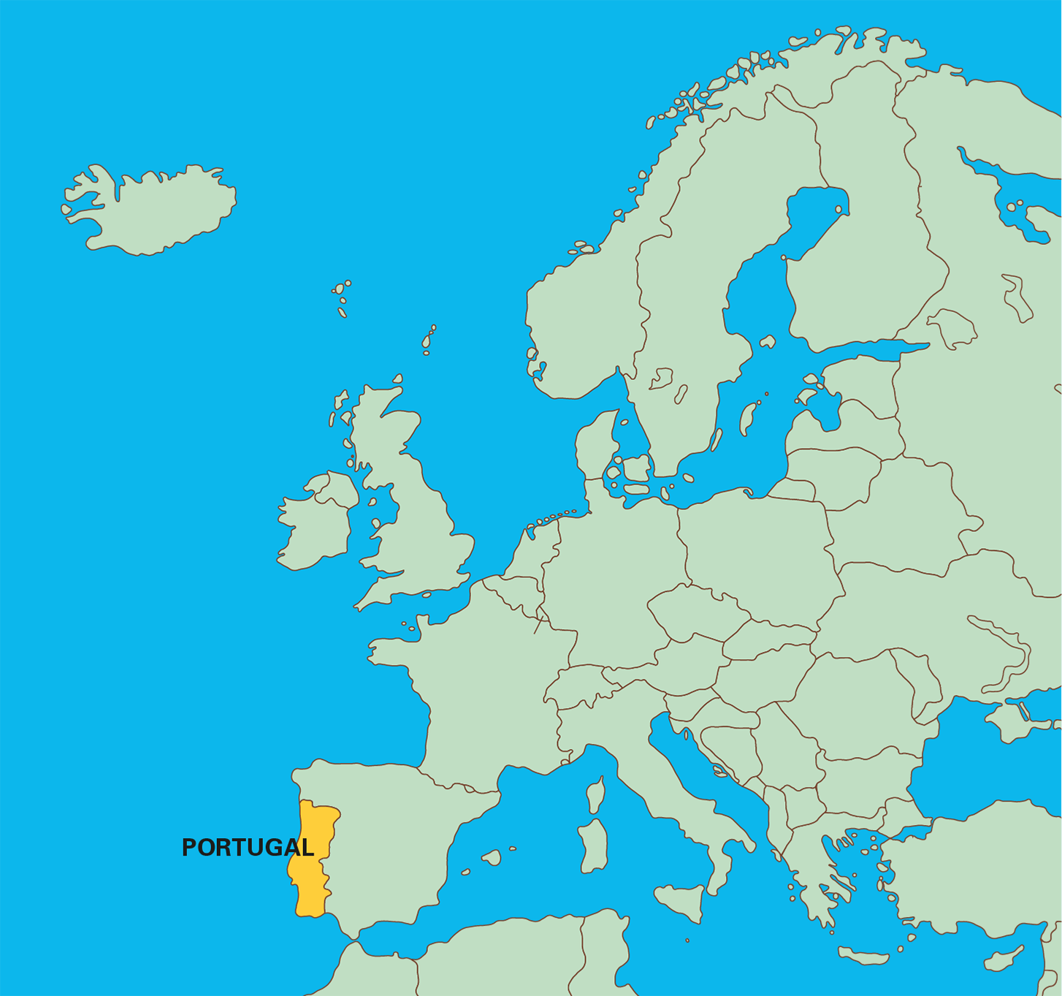
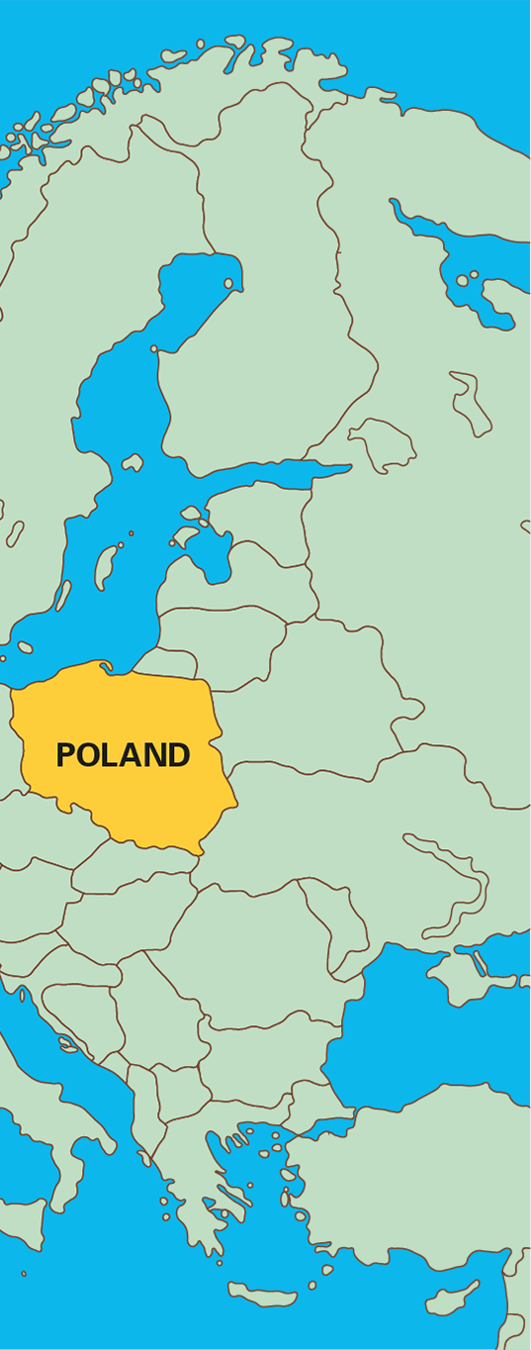
3.1 The part–whole relationship Step 3:2
Notes:
Poland is a bigger part of Europe than Portugal is.

Slide 35
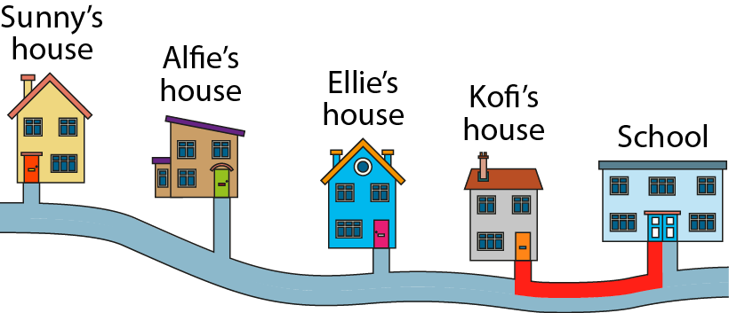
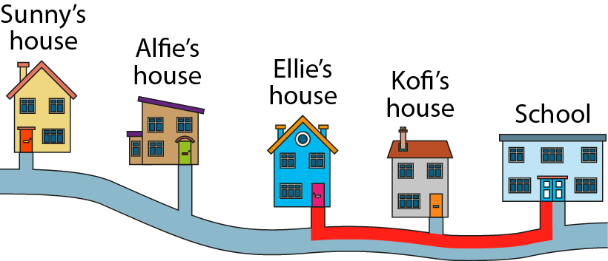
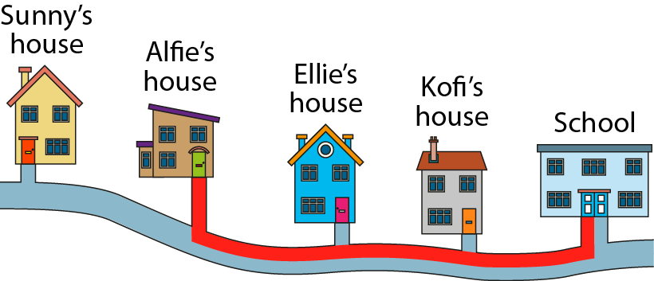
3.1 The part–whole relationship Step 3:2

Slide 36



3.1 The part–whole relationship Step 3:2
Notes:
In the first set of counters, the yellow counters make up a smaller part of the whole than in the second set.

Slide 37
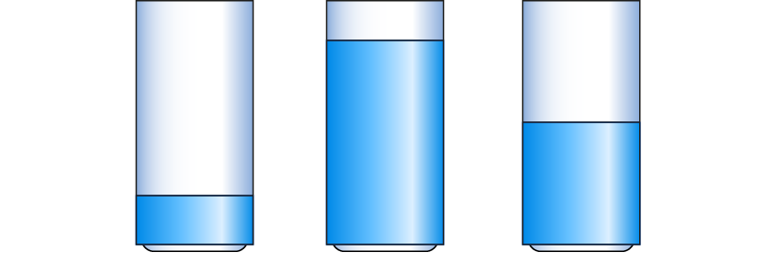
3.1 The part–whole relationship Step 3:2

Slide 38




3.1 The part–whole relationship Step 3:3
What is the same? What is different?
Notes:
• Basil says 'One part is shaded in each image. This means the same amount of each whole is shaded'.
• Jess says 'Each whole is one part larger than the previous whole. Only one part of each whole is shaded. This means that each time a smaller amount of the whole is shaded'.
Who is correct?

Slide 39




3.1 The part–whole relationship Step 3:4
What is the same? What is different?

Slide 40


3.1 The part–whole relationship Step 3:4
What is the same? What is different?

Slide 41




3.1 The part–whole relationship Step 3:4
What is the same? What is different?

Slide 42



3.1 The part–whole relationship Step 3:5
What is the same? What is different?

Slide 43
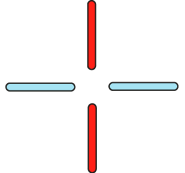


3.1 The part–whole relationship Step 3:5
What is the same? What is different?

Slide 44
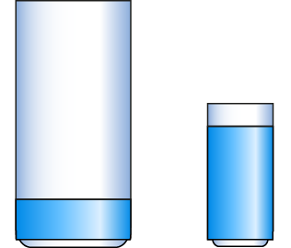
3.1 The part–whole relationship Step 3:6
Notes:
The large glass is nearly empty. A smaller part of the glass has water in it.
The small glass is nearly full. A larger part of the glass has water in it.

Slide 45
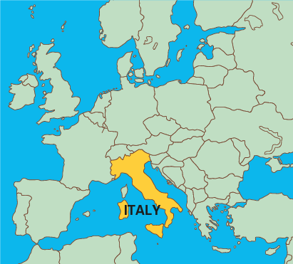
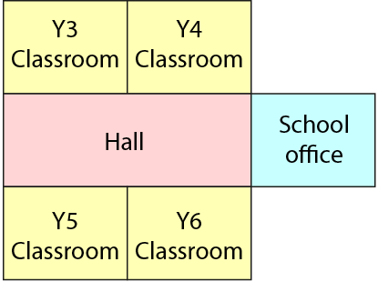
3.1 The part–whole relationship Step 3:6
Notes:
The classrooms make up quite a large part of the whole school building.
Italy is quite a small part of the whole (Europe).

Slide 46
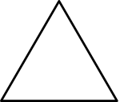
3.1 The part–whole relationship Step 4:1
What is the whole?
one part

Slide 47
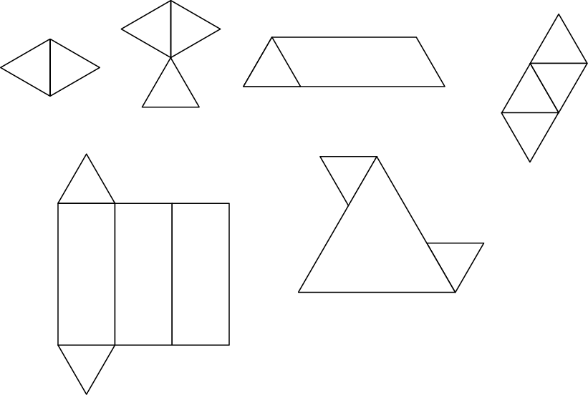
3.1 The part–whole relationship Step 4:1
The wholes might be…

Slide 48



3.1 The part–whole relationship Step 4:2
What is the whole?
Notes:
This triangle is one part of a whole made out of three equal parts.

Slide 49




3.1 The part–whole relationship Step 4:2
What is the whole?
What is the same? What is different?
Notes:
The rhombus is one part of a whole made out of three equal parts.

Slide 50


3.1 The part–whole relationship Step 4:2
Who has drawn the correct shape? Why?
One part of
a whole made out of
three equal parts.
Max
Beth
Ellen
Florent
✗
✓
✓
✗
Notes:
Four children have been given a part of a shape and have been asked to
draw the whole shape. Who has drawn a correct shape? Why?

Slide 51

3.1 The part–whole relationship Step 4:3
What is the whole?
one of 5 parts

Slide 52
3.1 The part–whole relationship Step 4:4
1 part of 5 parts. Draw the whole ribbon.
Notes:
I have cut a ribbon into five equal parts.
Here is one part of my ribbon.
How long was my ribbon to start with?

Slide 53



3.1 The part–whole relationship Step 4:4
1 part of 4 parts. What is the whole rod?
Notes:
Here is a red Cuisenaire® rod. It is one of four equal parts of another rod.
What is the whole rod?

Slide 54

3.1 The part–whole relationship Step 4:4
1 of 4 equal teams in the class. Draw the whole class.
Notes:
The class has been divided into four equal teams. Here is one of the teams.
How many children are in the class? Draw the whole class.

Slide 55

3.1 The part–whole relationship Step 4:5

