Slide 1
Series 3 Episode 24
Eleven

Slide 2
Practitioner Notes

Slide 3
Episode Description
One and Ten bump into each other and make a new Numberblock called Eleven. Eleven likes to play football so she arranges for a match with all 11 Numberblocks. Eleven forgets to arrange an opposing team but the Numberblobs come to the rescue to play against the Numberblocks.

Slide 4
Maths in the Episode
Composition and properties of 11
In this episode 11 is made by combining 10 and 1. 11 can also be partitioned into 1 ten and 1 one. Counting to eleven is also experienced so that it is possible to understand 11’s position in the number system in relation to previous learnt numbers from Numberblocks.

Slide 5
Using Mathematical Language
Use these stem sentences to rehearse the mathematical ideas in the programme:
“11 is made from one ten and one one.”
“Ten add one is eleven.”
“Eleven is 1 more than 10.”

Slide 6
Talk and Discuss Together

Slide 7
Talk and Discuss Together
Watch the episode of Numberblocks. First ask the children what they noticed and allow them to talk to you and each other.
What do you know about Eleven?
The following slides are designed to stimulate children and adults to talk about the episode and draw out some key aspects of the mathematics.

Slide 8
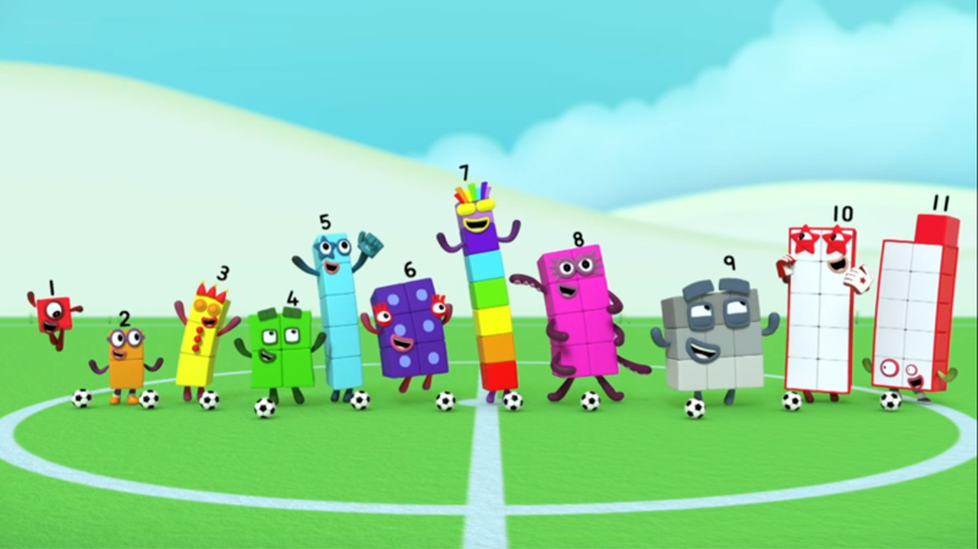
Notes:
Use this slide for talking and discussing together.

Slide 9
Enabling Environments in Reception

Slide 10
Enabling Environments
Playing and Exploring
Set up a ‘small-world’ football game in Subbuteo-style (Lego mini-figures or other small characters). Find 11 characters for each team.
Active Learning
Notice when children count, whether they can count accurately beyond 10. Ensure there are opportunities to say the number words …7, 8, 9, 10 “I wonder what comes next?”.
Creating and Thinking Critically
Explore different places for One to join onto Ten.

Slide 11
Learning Together in Y1

Slide 12
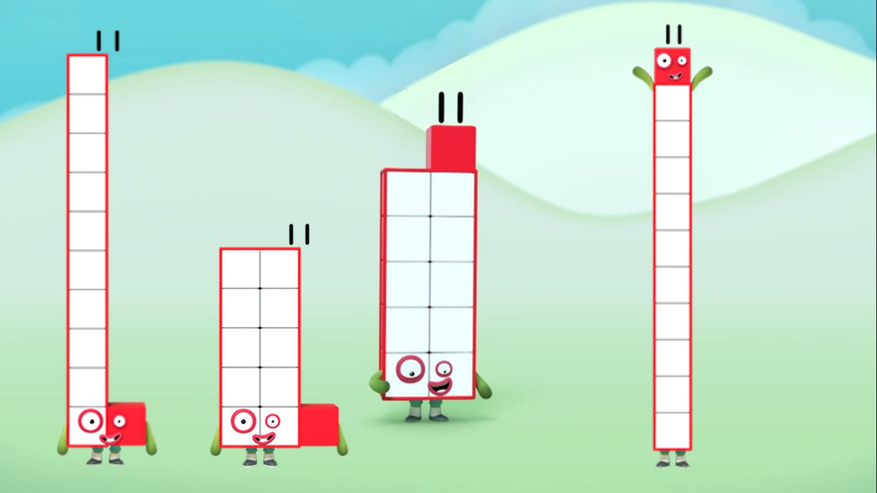
Notes:
Use this slide to emphasise the composition of Eleven.
Compare the Elevens. (The coloured dots are there to help to identify the Eleven the children talk about.)
What is the same? (They all have 11 ones/ they are all made of ten and one.)
What is different? (The shapes are different/ the position of the one is different.)

Slide 13

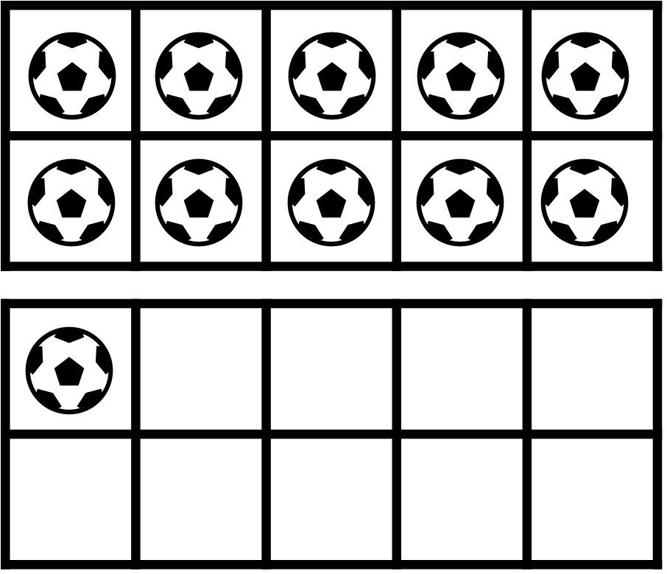
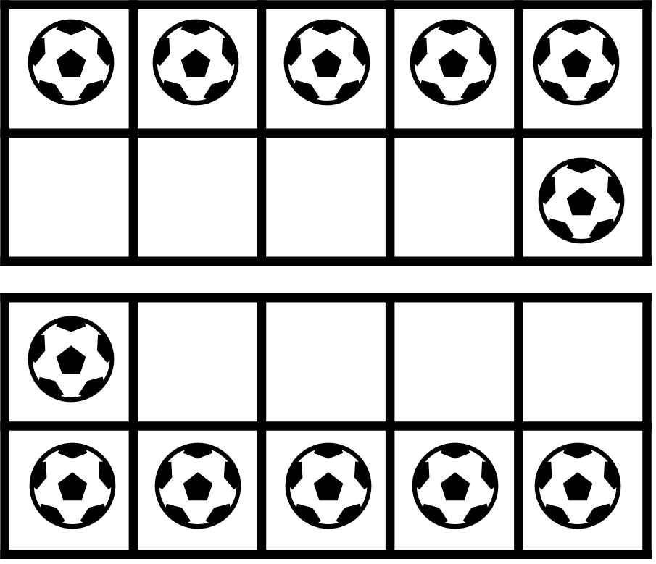
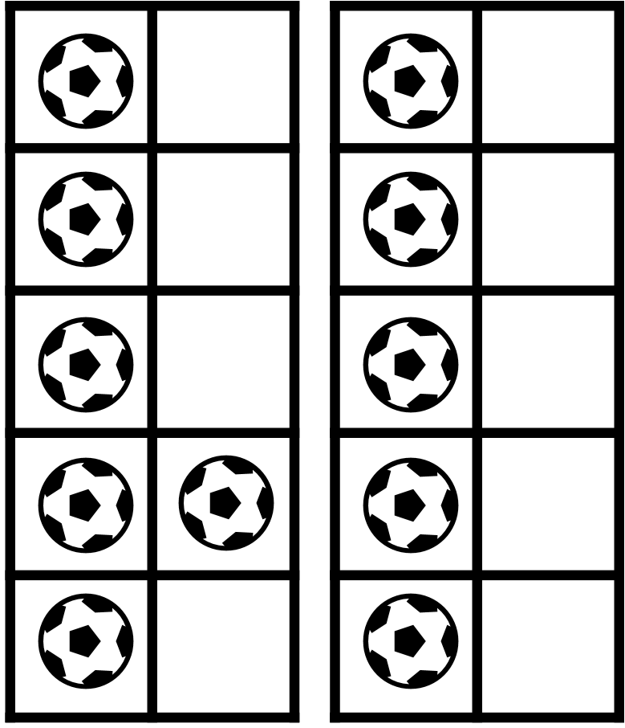

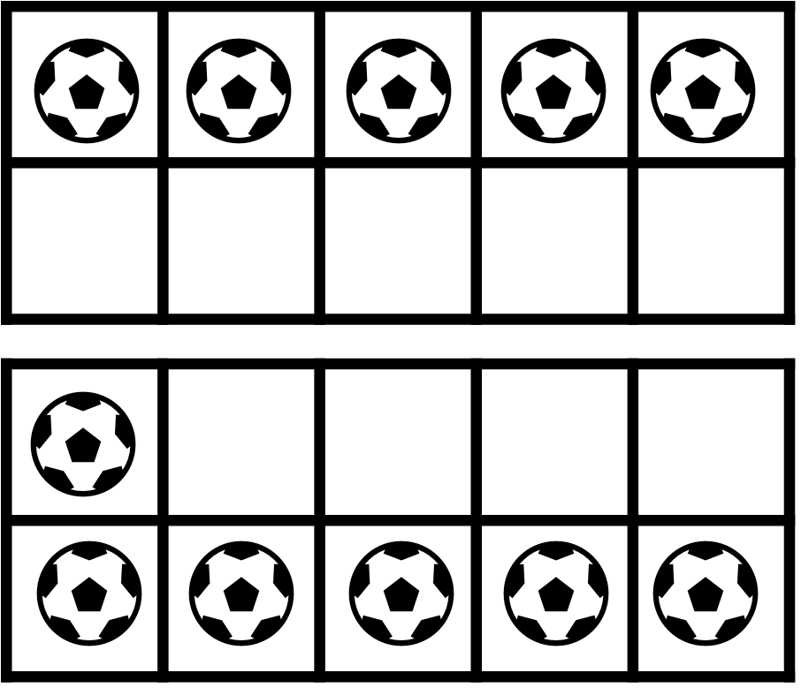
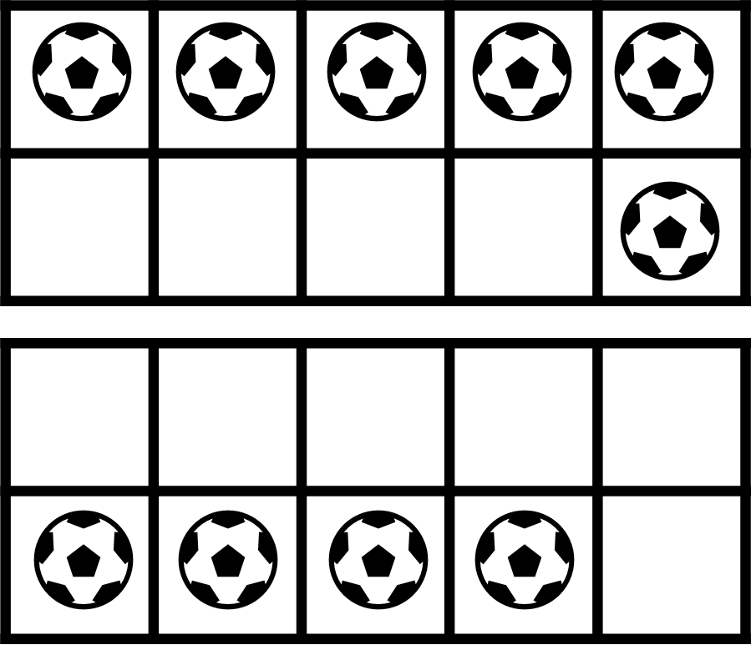
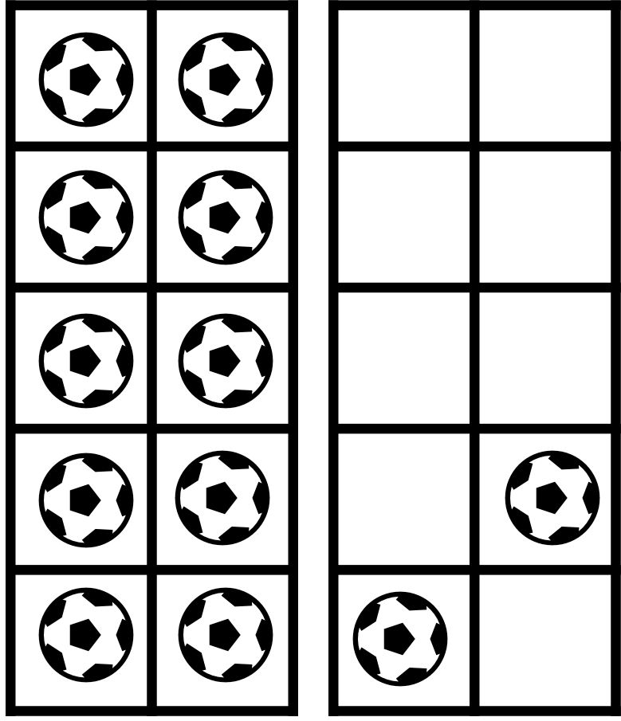
Notes:
Editor note: Football image is from icons menu in PowerPoint.
Use this slide to identify 11/ NOT 11 and use reasoning rather than counting to identify them.
Use the coloured buttons to identify the frame the children are talking about.
Which represent 11? How do you know without counting them? (The red one is 11 because it is 10 and 1. 10 and 1 is 11.)
Which are not 11? How do you know without counting them? (The blue one is not 11 because it is 10 and 2. 11 is 10 and 1.)
Click on each frame in ‘slideshow’ to reveal a tick or a cross when the class have agreed on the frames which have 11 footballs.

Slide 14
Further activities for Y1
Order different (pictorial) representations of quantities up to 11 from 1 to 11. For example, Numberblock images or other arrangements such as tens frames.
Sort images of quantities into two groups: 11 and not 11.
Explore ways to make Eleven from 10 white blocks and 1 red.
Explore ways to represent 11 on 2 blank tens frames.

Slide 15
Learning Together in Y2

Slide 16
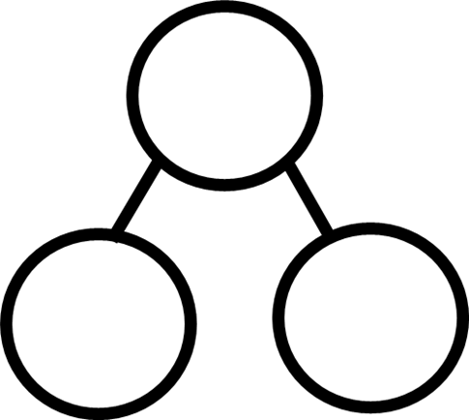





?
?
Images © 2017 Alphablocks Ltd. All Rights Reserved.
Notes:
Use this slide to discuss the place value partitioning/combining using 10 and 1.
Look at the part-part-whole diagram.
What are the missing parts in each diagram? How do you know?
Look at the arrow card and the equation.
What does the 1 in the white part mean? (One ten) What does the 1 in the red part mean? (One one.)
Read the equation together. (10 plus 1 is equal to 11.)
Look at the next arrow card and the start of the equation. (11.)
How can we complete this equation to show how 11 can be partitioned? (Children might need prompting that the equals sign could be in a different position.)
Read the equation together. (11 is equal to 10 plus 1.)

Slide 17
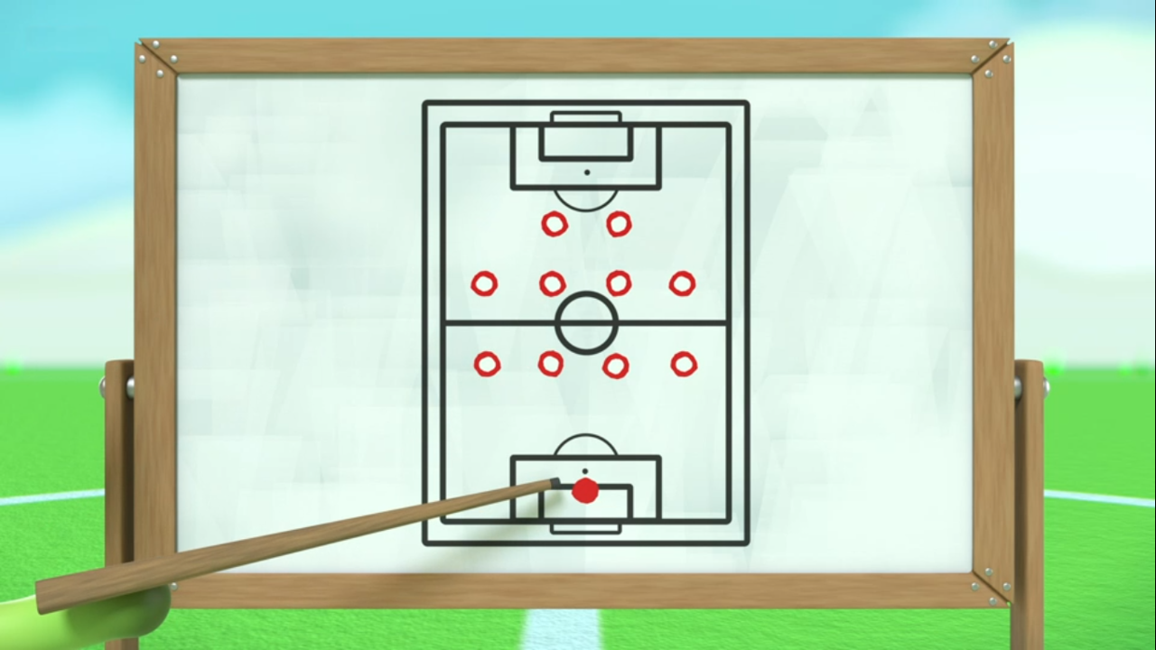
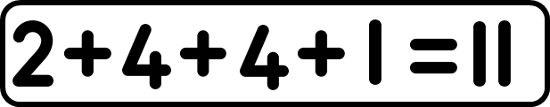
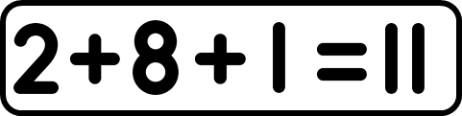
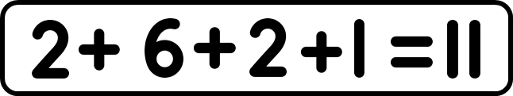
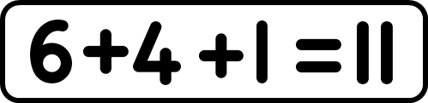
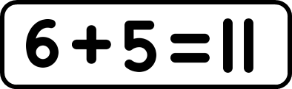
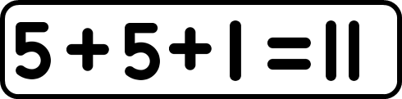
Notes:
Use this picture to explore ways to prove there are 11 players here. Use different ways to calculate how many without counting – that is, 2 + 8 + 1, 2 + 6 + 2 + 1, 6 + 4 + 1, 6 + 5, 5 + 5 + 1
Provide a copy of this picture (Slide 18) printed on A4. Ask the children to work together in small groups to find different ways to find 11. You may need to illustrate with the first animated example; use the remaining animations to compare to children’s own ideas after they have had time to explore.

Slide 18
Notes:
Print this on A4 for the pupils to use to explore the different ways to find 11.

Slide 19
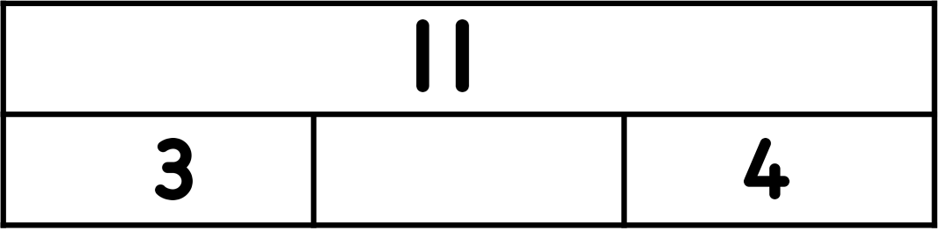
Further activities for Y2
Represent the partitioning of 11 in different contexts. For example, 11 o’clock is 1 hour after 10 o’clock, £11 can be 1 ten pound note and 1 £1 coin, or 11p can be made from a 10p and a 1p coin.
Explore different ways to partition 11 into 3 parts or 4 parts. Build it, draw it (using tens frames then bar model), write it using part-part-whole diagrams and equations.
Given a bar model, where the whole is 11 and 2 parts find the remaining part. For example:
Solve missing number problems involving 11, for example: 8 + o = 7 + 4.

