Slide 1
Year 6, Unit 10
Calculating using knowledge of structures (2)

Slide 2
Year 6, Unit 10
These materials heavily reflect the prioritisation approach of the ready-to-progress criteria in the DfE Primary Mathematics Guidance 2020 and on the PPTs that exemplify them on the NCETM website. They also include other relevant National Curriculum content. Related sections of the NCETM Primary Mastery Professional Development Materials provide small-step teaching guidance.
Ready-to-progress criteria addressed by this unit
Teaching of this unit supports the following criteria from the ‘DfE Mathematics Guidance: key stages 1 & 2’ (the 335-page document available as a download)
6AS/MD-2 Page 302

Slide 3
Contents
The links below take you to the starting slide of each learning outcome.
1 | Pupils explain how to balance equations with addition expressions
2 | Pupils explain how to balance equations with subtraction expressions
3 | Pupils explain how to balance equations with addition or subtraction expressions
4 | Pupils explain how to balance equations with addition and subtraction expressions
5 | Pupils use their knowledge of balancing equations to solve problems
Click the arrow button to return to this Contents slide.

Slide 4
Year 6, Unit 10, Learning Outcome 1
Learning Outcome 1
Pupils explain how to balance equations with addition expressions
The following slides have been collated to support the teaching of this learning outcome.

Slide 5
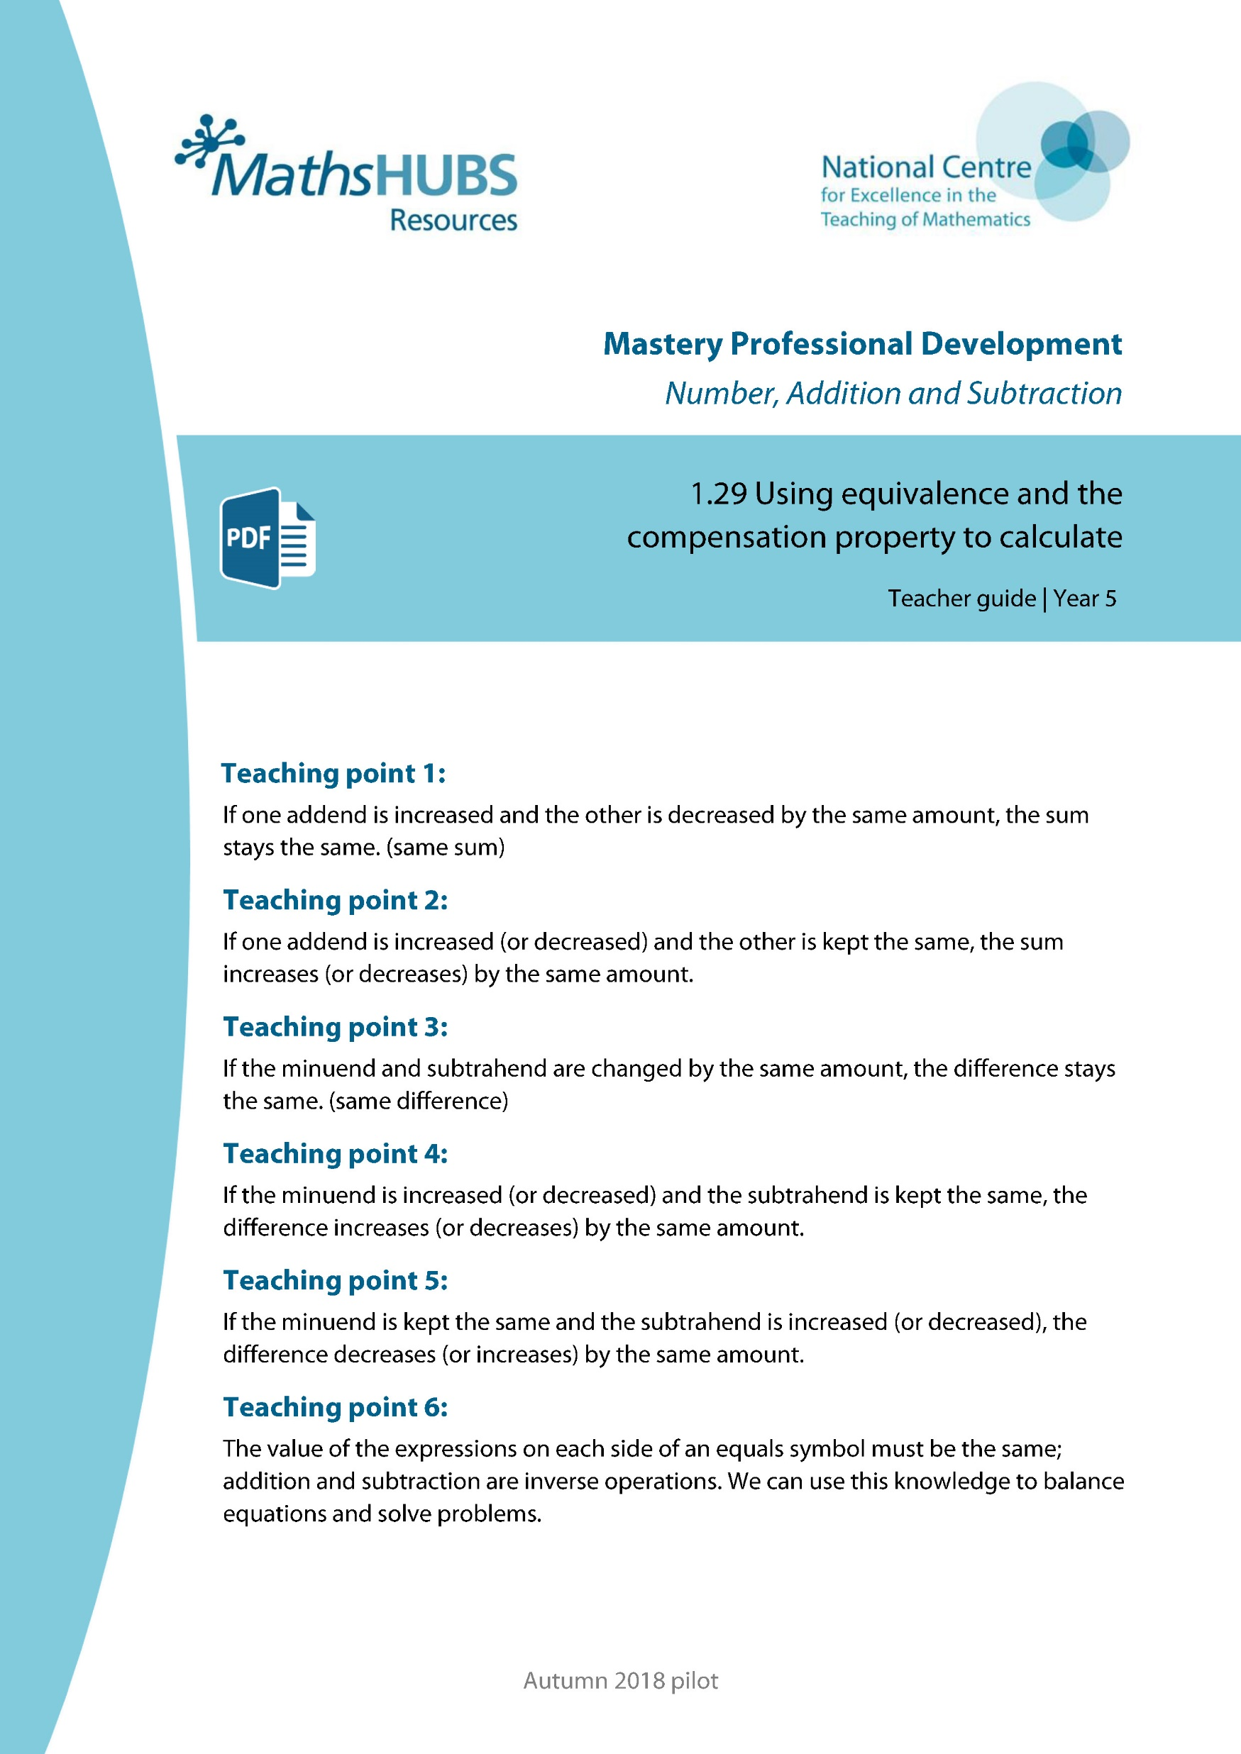
Year 6, Unit 10, Learning Outcome 1
Additional teacher guidance for this outcome should be read first and can be found in this segment of the NCETM Primary Mastery Professional Development Materials:
1.29 Using equivalence and the compensation property to calculate
The spine materials are divided into ‘teaching points’ and ‘steps in learning’.
Teaching point | Steps in learning | Pages
6 | 6:1-6:2 | 48-49

Slide 6

1.29 Equivalence and compensation – step 6:2
34 + 46
72 +
8
80
=

Slide 7
Year 6, Unit 10, Learning Outcome 2
Learning Outcome 2
Pupils explain how to balance equations with subtraction expressions
The following slides have been collated to support the teaching of this learning outcome.

Slide 8
Year 6, Unit 10, Learning Outcome 2
Additional teacher guidance for this outcome should be read first and can be found in this segment of the NCETM Primary Mastery Professional Development Materials:
1.29 Using equivalence and the compensation property to calculate
The spine materials are divided into ‘teaching points’ and ‘steps in learning’.
Teaching point | Steps in learning | Pages
6 | 6:3-6:4 | 49-51

Slide 9

1.29 Equivalence and compensation – step 6:4
427 − 274
538
− 385
153
=
− 385
3
1
 | 1 | 5 | 3
+ | 3 | 8 | 5
 | 4 | 2 | 7
− | 2 | 7 | 4
153
538
1
5
3
5
3
8
+ 385
1

Slide 10
Year 6, Unit 10, Learning Outcome 3
Learning Outcome 3
Pupils explain how to balance equations with addition or subtraction expressions
The following slides have been collated to support the teaching of this learning outcome.

Slide 11
Year 6, Unit 10, Learning Outcome 3
Additional teacher guidance for this outcome should be read first and can be found in this segment of the NCETM Primary Mastery Professional Development Materials:
1.29 Using equivalence and the compensation property to calculate
The spine materials are divided into ‘teaching points’ and ‘steps in learning’.
Teaching point | Steps in learning | Pages
6 | 6:5 | 51-52

Slide 12

1.29 Equivalence and compensation – step 6:5
87.36 m
56.16 m
37.44 m
68.64 m
x
Notes:
Both lawns have the same perimeter.
How long is the side marked x?
How many different ways can you find to calculate the value of x?
Which method do you prefer?

Slide 13
Year 6, Unit 10, Learning Outcome 4
Learning Outcome 4
Pupils explain how to balance equations with addition and subtraction expressions
The following slides have been collated to support the teaching of this learning outcome.

Slide 14
Year 6, Unit 10, Learning Outcome 4
Additional teacher guidance for this outcome should be read first and can be found in this segment of the NCETM Primary Mastery Professional Development Materials:
1.29 Using equivalence and the compensation property to calculate
The spine materials are divided into ‘teaching points’ and ‘steps in learning’.
Teaching point | Steps in learning | Pages
6 | 6:6 | 52-53

Slide 15
1.29 Equivalence and compensation – step 6:7
Month | Rainfall (mm)
Jun | 87
Jul | 67
Aug | 28
Sep | 48
Notes:
True or false? The difference between the amount of rain that fell in July compared to June is the same as the difference between the amount of rain that fell in September compared to August. Write calculations to explain your answer.
Explain which difference shows an increase in rainfall and which shows a decrease.

Slide 16
Year 6, Unit 10, Learning Outcome 5
Learning Outcome 5
Pupils use their knowledge of balancing equations to solve problems
The following slides have been collated to support the teaching of this learning outcome.

Slide 17
Year 6, Unit 10, Learning Outcome 5
Additional teacher guidance for this outcome should be read first and can be found in this segment of the NCETM Primary Mastery Professional Development Materials:
1.29 Using equivalence and the compensation property to calculate
The spine materials are divided into ‘teaching points’ and ‘steps in learning’.
Teaching point | Steps in learning | Pages
6 | 6:7 - 6:8 | 53 - 54

