Slide 1
1.8 Composition of numbers: multiples of 10 up to 100
Representations | Year 1
Number, Addition and Subtraction

Slide 2
How to use this presentation
You can find the teacher guide 1.8 Composition of numbers: multiples of 10 up to 100 by following the link below.

Slide 3
1.8 Composition: multiples of 10 up to 100 – step 1:1

Slide 4
1.8 Composition: multiples of 10 up to 100 – step 1:1

Slide 5
1.8 Composition: multiples of 10 up to 100 – step 1:1

Slide 6
1.8 Composition: multiples of 10 up to 100 – step 1:1

Slide 7
1.8 Composition: multiples of 10 up to 100 – step 1:1

Slide 8
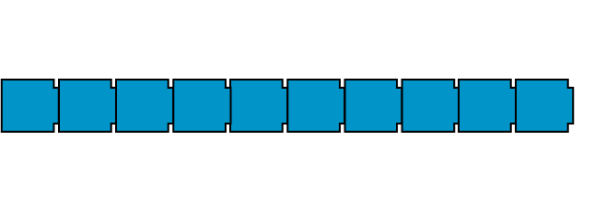
1.8 Composition: multiples of 10 up to 100 – step 1:1

Slide 9
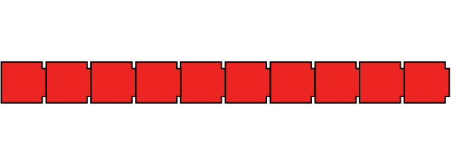
1.8 Composition: multiples of 10 up to 100 – step 1:1

Slide 10
1.8 Composition: multiples of 10 up to 100 – step 1:1

Slide 11
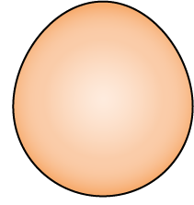
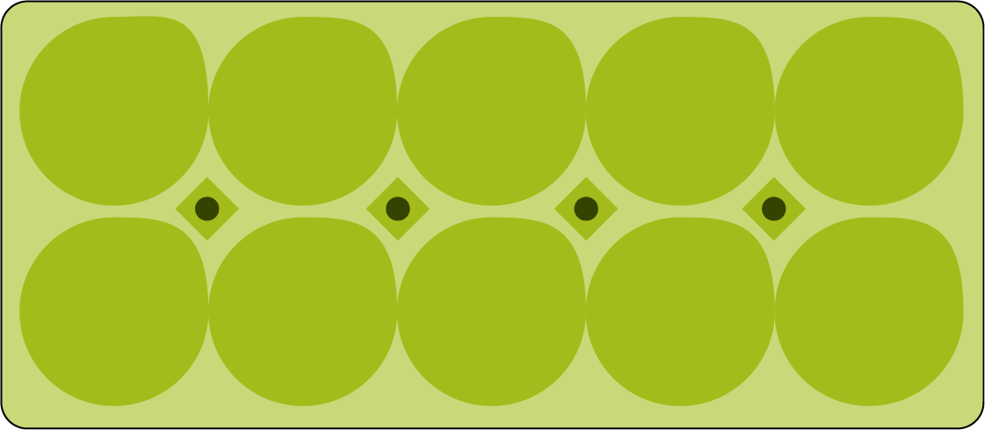
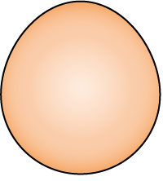
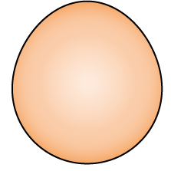
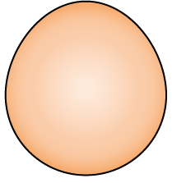
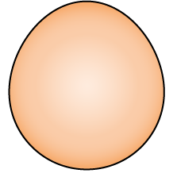
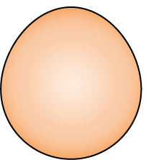
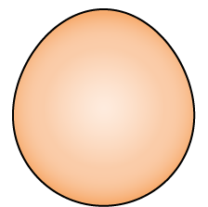
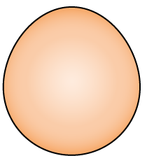
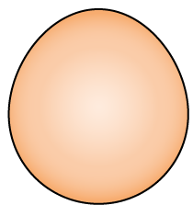
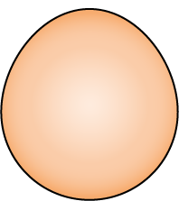
1.8 Composition: multiples of 10 up to 100 – step 1:2

Slide 12
1.8 Composition: multiples of 10 up to 100 – step 1:2

Slide 13
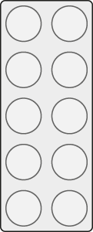
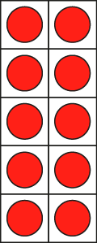
1.8 Composition: multiples of 10 up to 100 – step 1:4

Slide 14
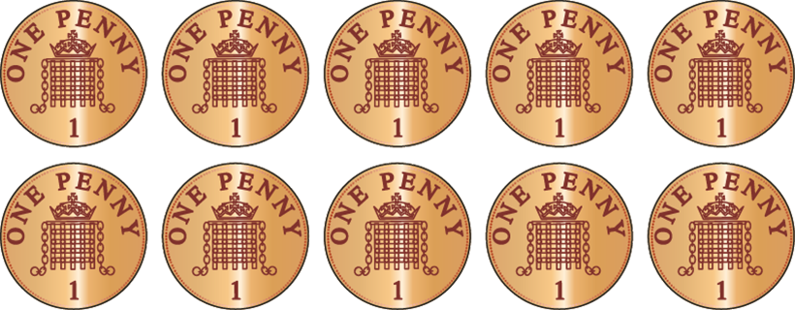
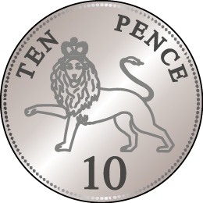
1.8 Composition: multiples of 10 up to 100 – step 1:5

Slide 15
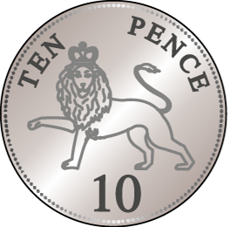
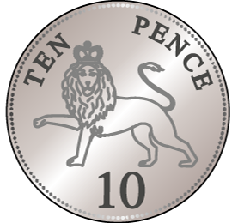
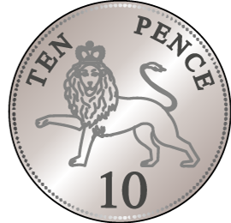
1.8 Composition: multiples of 10 up to 100 – step 2:1

Slide 16
1.8 Composition: multiples of 10 up to 100 – step 2:1

Slide 17
1.8 Composition: multiples of 10 up to 100 – step 2:1

Slide 18
1.8 Composition: multiples of 10 up to 100 – step 2:1

Slide 19
1.8 Composition: multiples of 10 up to 100 – step 2:1

Slide 20
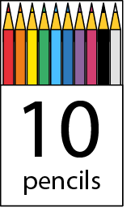
1.8 Composition: multiples of 10 up to 100 – step 2:2
90
70
100
80
20
30
40
50
10
60

Slide 21
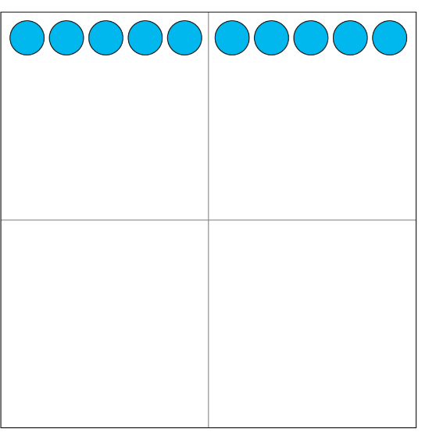
1.8 Composition: multiples of 10 up to 100 – step 2:2
10
20
30
40
50
60
70
80
90
100

Slide 22
1.8 Composition: multiples of 10 up to 100 – step 2:3

Slide 23
1.8 Composition: multiples of 10 up to 100 – step 2:3

Slide 24
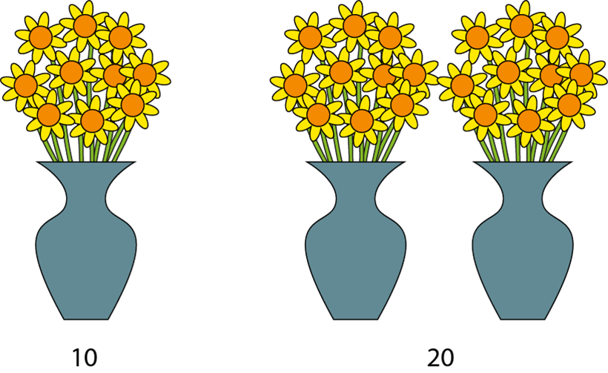
1.8 Composition: multiples of 10 up to 100 – step 2:3

Slide 25
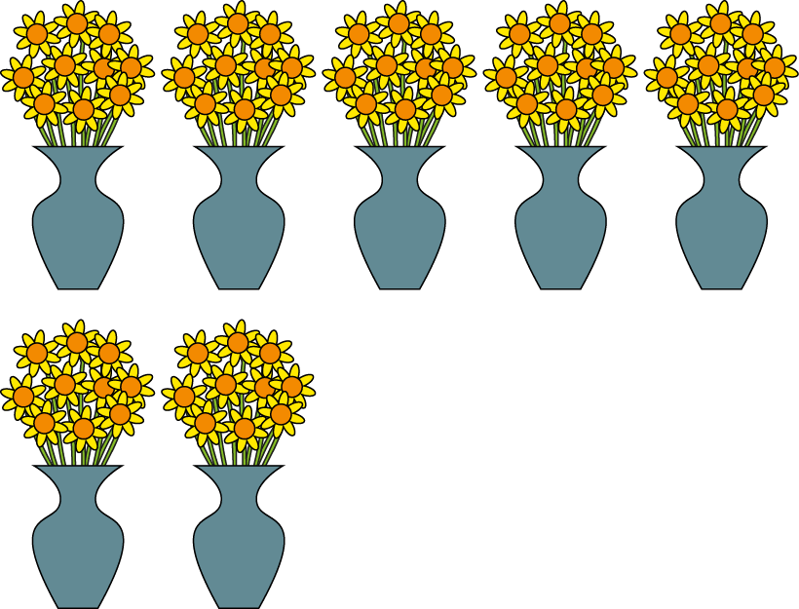
1.8 Composition: multiples of 10 up to 100 – step 2:4
70

Slide 26
1.8 Composition: multiples of 10 up to 100 – step 2:4
10
50
30

Slide 27
1.8 Composition: multiples of 10 up to 100 – step 2:4
10
60
40

Slide 28
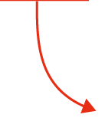
1.8 Composition: multiples of 10 up to 100 – step 2:5

Slide 29
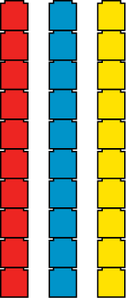
1.8 Composition: multiples of 10 up to 100 – step 2:6
10
30
60

Slide 30
1.8 Composition: multiples of 10 up to 100 – step 2:7
10
+
10
+
10
+
10
+
10
+
10
+
10
=
70

Slide 31
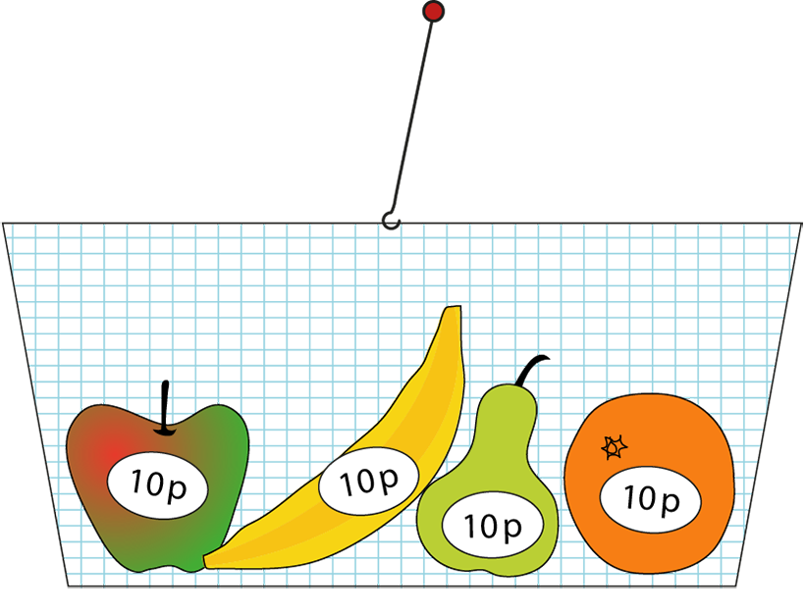
1.8 Composition: multiples of 10 up to 100 – step 2:7
10 p
+
10 p
+
10 p
+
10 p
=
40 p

Slide 32
1.8 Composition: multiples of 10 up to 100 – step 3:1

Slide 33
1.8 Composition: multiples of 10 up to 100 – step 3:1

Slide 34
1.8 Composition: multiples of 10 up to 100 – step 3:2

Slide 35
1.8 Composition: multiples of 10 up to 100 – step 3:2

Slide 36
1.8 Composition: multiples of 10 up to 100 – step 3:2
1000 | 2000 | 3000 | 4000 | 5000 | 6000 | 7000 | 8000 | 9000
100 | 200 | 300 | 400 | 500 | 600 | 700 | 800 | 900
1 | 2 | 3 | 4 | 5 | 6 | 7 | 8 | 9
10
20
30
40
50
60
70
80
90

Slide 37
1.8 Composition: multiples of 10 up to 100 – step 3:3

Slide 38
1.8 Composition: multiples of 10 up to 100 – step 3:3

Slide 39
1.8 Composition: multiples of 10 up to 100 – step 3:3

Slide 40
1.8 Composition: multiples of 10 up to 100 – step 3:4

Slide 41
1.8 Composition: multiples of 10 up to 100 – step 3:4

Slide 42
1.8 Composition: multiples of 10 up to 100 – step 3:5

Slide 43
1.8 Composition: multiples of 10 up to 100 – step 3:5

Slide 44
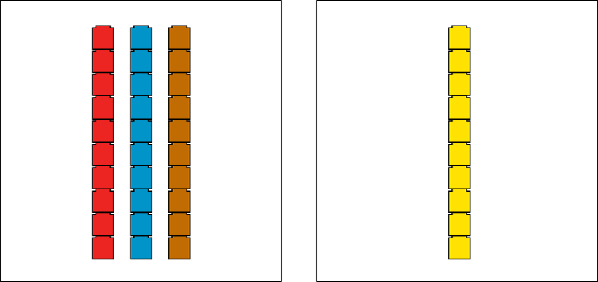
1.8 Composition: multiples of 10 up to 100 – step 3:6

Slide 45
1.8 Composition: multiples of 10 up to 100 – step 3:6
Notes:
Teddy says that forty is less than sixty. Is he right? Convince me.

Slide 46
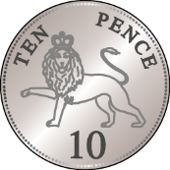
1.8 Composition: multiples of 10 up to 100 – step 3:7
Sarah
Deb
Notes:
Sarah and Deb have some 10 p coins. Sarah has fewer coins than Deb. If Deb has 50 p, how much money might Sarah have?

Slide 47
1.8 Composition: multiples of 10 up to 100 – step 4:1
1 ten
2 tens
3 tens
4 tens
5 tens
6 tens
7 tens
8 tens
9 tens
10 tens

Slide 48
1.8 Composition: multiples of 10 up to 100 – step 4:1
1 ten
2 tens
3 tens
4 tens
5 tens
6 tens
7 tens
8 tens
9 tens
10 tens

Slide 49
1.8 Composition: multiples of 10 up to 100 – step 4:1
ten 10
twenty 20
thirty 30
forty 40
fifty 50
sixty 60
seventy 70
eighty 80
ninety 90
one hundred 100

Slide 50
1.8 Composition: multiples of 10 up to 100 – step 4:1
ten 10
twenty 20
thirty 30
forty 40
fifty 50
sixty 60
seventy 70
eighty 80
ninety 90
one hundred 100

Slide 51
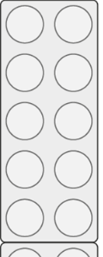
1.8 Composition: multiples of 10 up to 100 – step 4:2
30
40

Slide 52
1.8 Composition: multiples of 10 up to 100 – step 4:2
40
30

Slide 53
1.8 Composition: multiples of 10 up to 100 – step 4:6

Slide 54
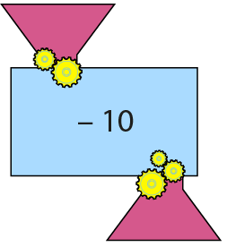
1.8 Composition: multiples of 10 up to 100 – step 4:6

Slide 55
1.8 Composition: multiples of 10 up to 100 – step 4:6

Slide 56
1.8 Composition: multiples of 10 up to 100 – step 4:6

Slide 57
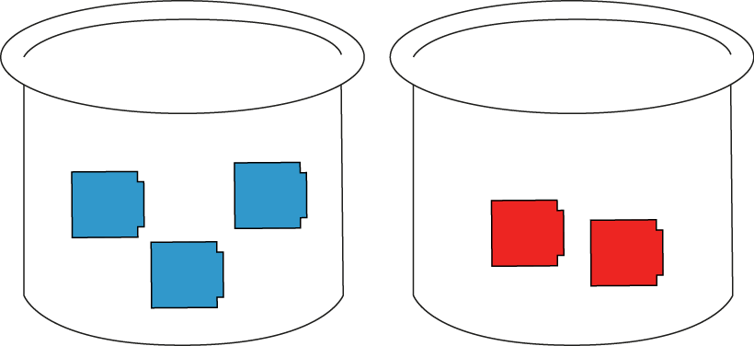
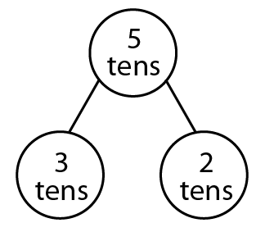
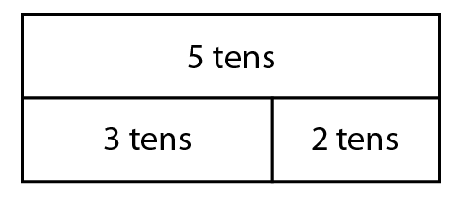
1.8 Composition: multiples of 10 up to 100 – step 5:1

Slide 58
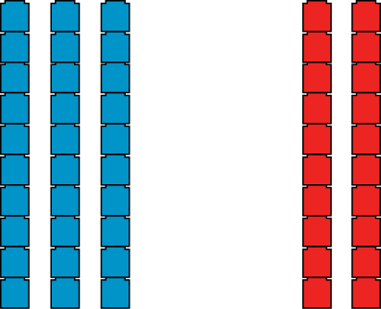
1.8 Composition: multiples of 10 up to 100 – step 5:2

Slide 59
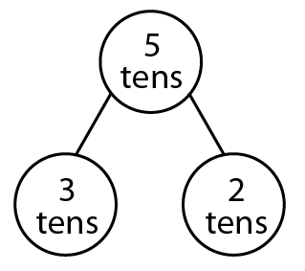
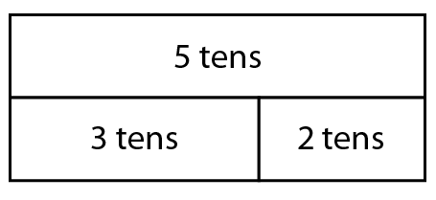
1.8 Composition: multiples of 10 up to 100 – step 5:2

Slide 60
1.8 Composition: multiples of 10 up to 100 – step 5:3

Slide 61
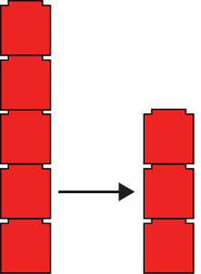
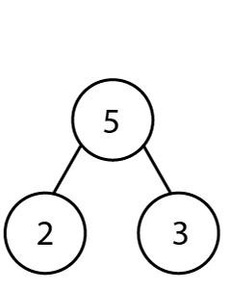
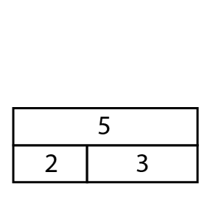
1.8 Composition: multiples of 10 up to 100 – step 5:4
5
− 2
= 3

Slide 62
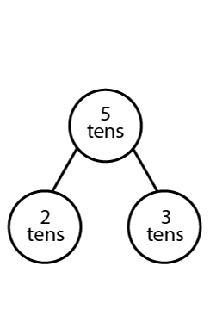
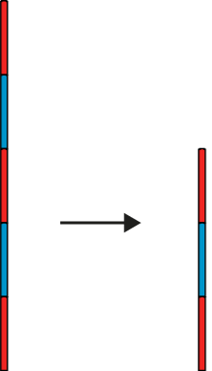
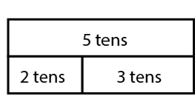
1.8 Composition: multiples of 10 up to 100 – step 5:4
5 tens
− 2 tens
= 3 tens

Slide 63
1.8 Composition: multiples of 10 up to 100 – step 5:6

Slide 64
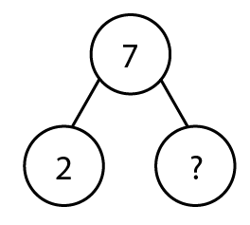
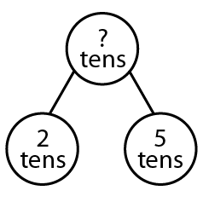
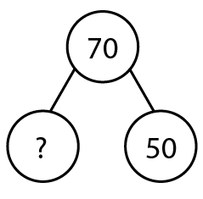
1.8 Composition: multiples of 10 up to 100 – step 5:7

Slide 65
1.8 Composition: multiples of 10 up to 100 – step 5:7

Slide 66
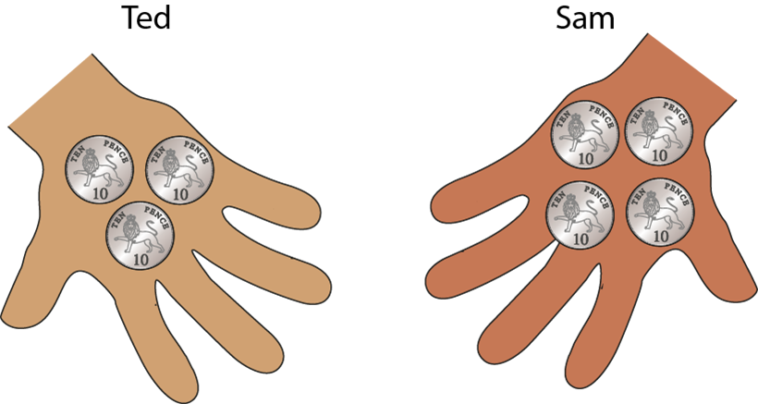
1.8 Composition: multiples of 10 up to 100 – step 5:8

Slide 67
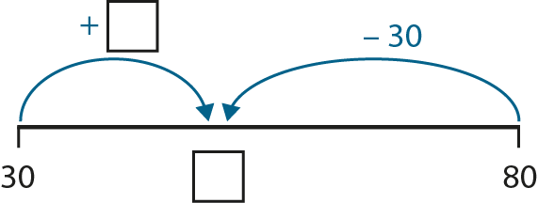
1.8 Composition: multiples of 10 up to 100 – step 5:8

Slide 68
1.8 Composition: multiples of 10 up to 100 – step 5:9

