Slide 1
1.9 Composition of numbers: 20–100
Representations | Year 1
Number, Addition and Subtraction

Slide 2
How to use this presentation
You can find the teacher guide 1.9 Composition of numbers:
20–100 by following the link below.

Slide 3
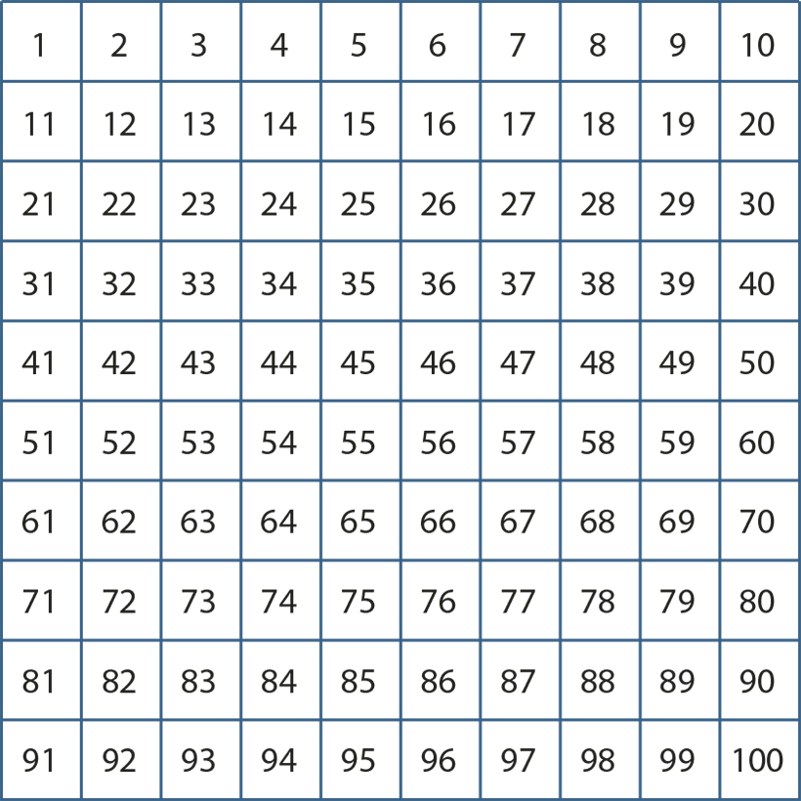
1.9 Composition: 20–100 – step 1:1

Slide 4
1.9 Composition: 20–100 – step 1:1
1000 | 2000 | 3000 | 4000 | 5000 | 6000 | 7000 | 8000 | 9000
100 | 200 | 300 | 400 | 500 | 600 | 700 | 800 | 900
10 | 20 | 30 | 40 | 50 | 60 | 70 | 80 | 90
1 | 2 | 3 | 4 | 5 | 6 | 7 | 8 | 9

Slide 5


1.9 Composition: 20–100 – step 2:1

Slide 6
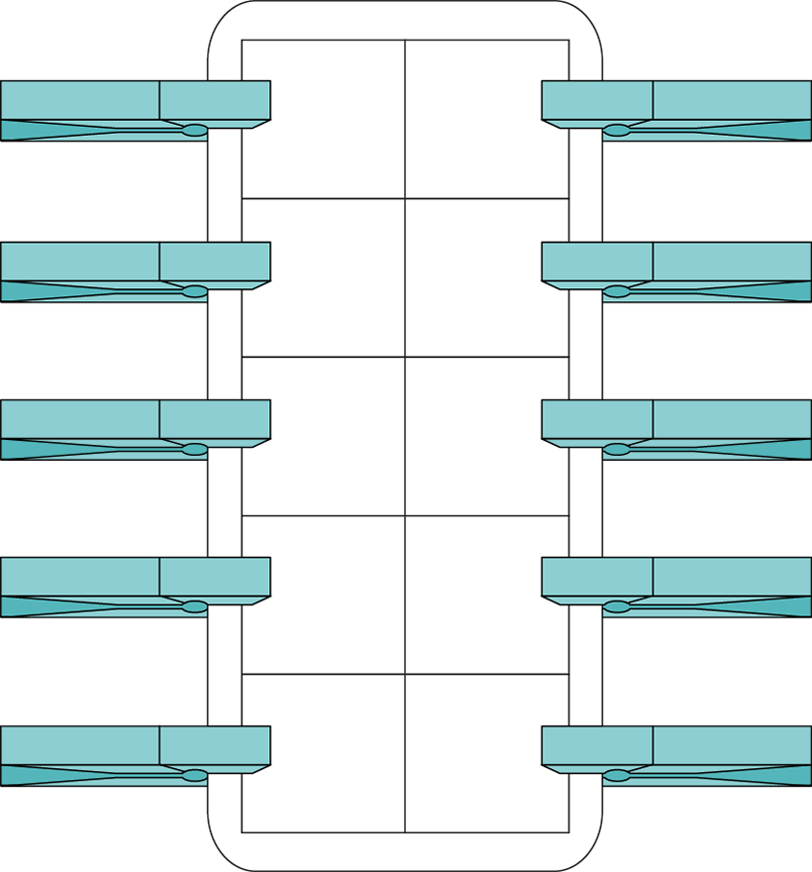
1.9 Composition: 20–100 – step 2:1

Slide 7


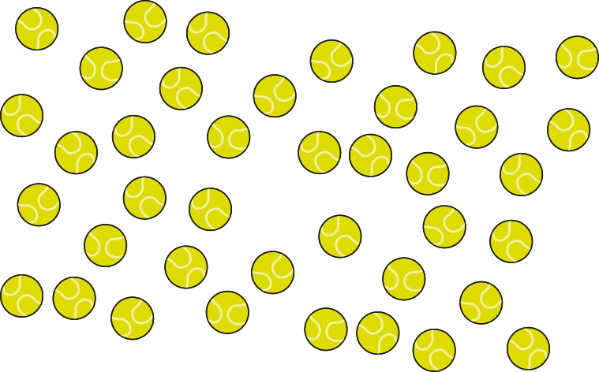



1.9 Composition: 20–100 – step 2:2

Slide 8





1.9 Composition: 20–100 – step 2:4
forty-two

Slide 9
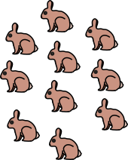
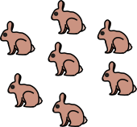
1.9 Composition: 20–100 – step 2:5
10s | 1s
2
7

Slide 10
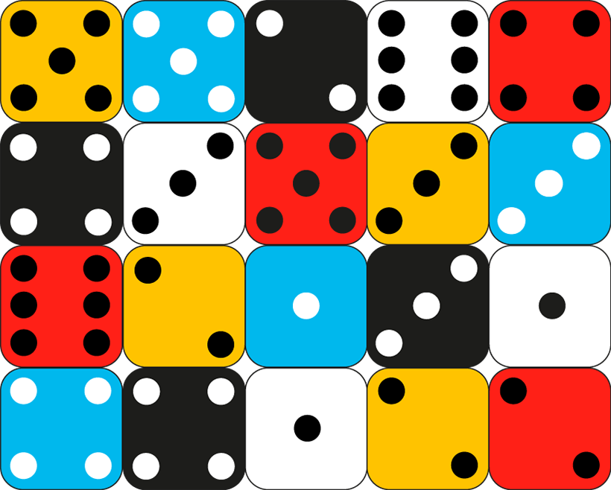
1.9 Composition: 20–100 – step 2:5

Slide 11

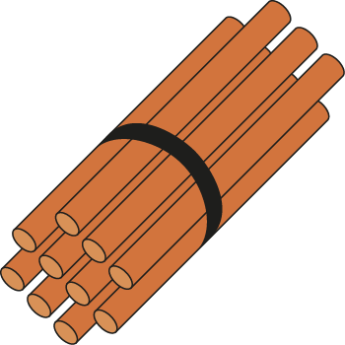
1.9 Composition: 20–100 – step 2:6

Slide 12
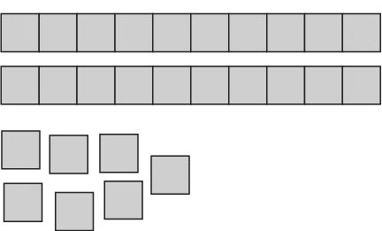





1.9 Composition: 20–100 – step 2:7
10s | 1s
2
7
27

Slide 13
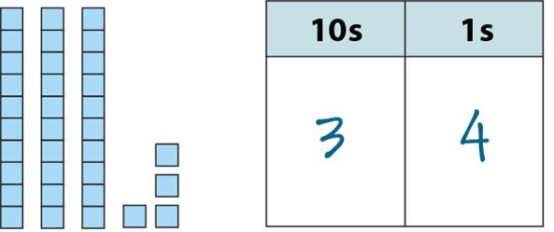



1.9 Composition: 20–100 – step 2:8

Slide 14
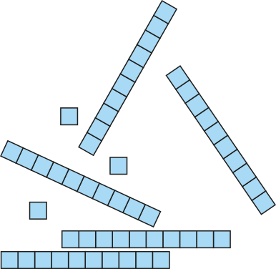
1.9 Composition: 20–100 – step 2:8
53

Slide 15
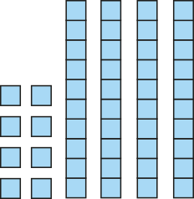
1.9 Composition: 20–100 – step 2:8
48

Slide 16
1.9 Composition: 20–100 – step 2:8
32

Slide 17
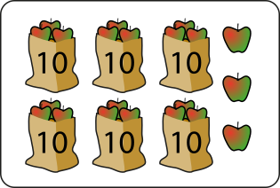

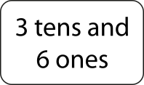


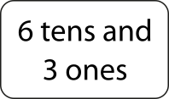
1.9 Composition: 20–100 – step 2:9

Slide 18
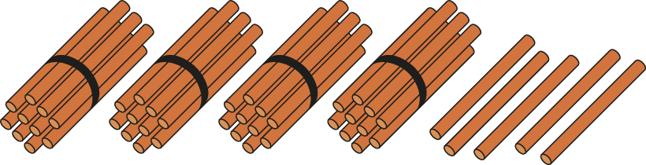
1.9 Composition: 20–100 – step 2:10
45

Slide 19

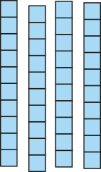

1.9 Composition: 20–100 – step 2:10
45

Slide 20

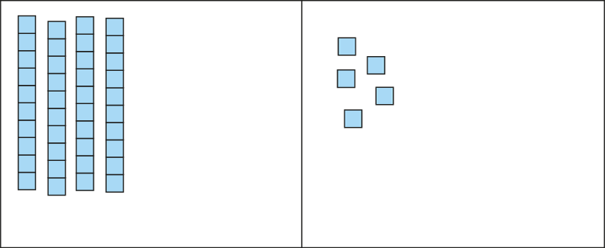
1.9 Composition: 20–100 – step 2:10
45

Slide 21
1.9 Composition: 20–100 – step 2:12
29
twenty-nine
2 tens and 9 ones

Slide 22
1.9 Composition: 20–100 – step 2:12
48
forty-eight
4 tens and 8 ones

Slide 23
1.9 Composition: 20–100 – step 2:12
67
sixty-seven
6 tens and 7 ones

Slide 24
1.9 Composition: 20–100 – step 3:1

Slide 25
1.9 Composition: 20–100 – step 3:1

Slide 26
1.9 Composition: 20–100 – step 3:3
a
b
0
10
20
30
40
50
60
70
80
90
100

Slide 27
1.9 Composition: 20–100 – step 3:3
46
0
10
20
30
40
50
60
70
80
90
100

Slide 28
1.9 Composition: 20–100 – step 3:4
21
35
52
67
84
99
0
10
20
30
40
50
60
70
80
90
100

Slide 29
1.9 Composition: 20–100 – step 3:4
a
57
b
c
d
0
10
20
30
40
50
60
70
80
90
100
Notes:
Which of these numbers has a ones digit which is larger than the tens digit?

Slide 30
1.9 Composition: 20–100 – step 3:4
a
b
73
c
d
0
10
20
30
40
50
60
70
80
90
100
Notes:
Which of these numbers has two digits that add up to ten?

Slide 31
1.9 Composition: 20–100 – step 3:6
32

Slide 32

1.9 Composition: 20–100 – step 3:6
32

Slide 33
1.9 Composition: 20–100 – step 3:7
41

Slide 34
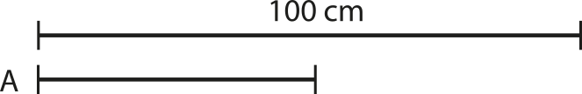
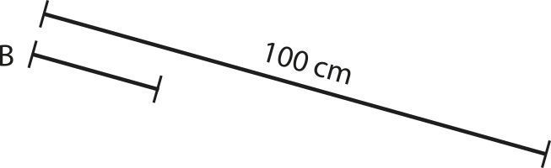
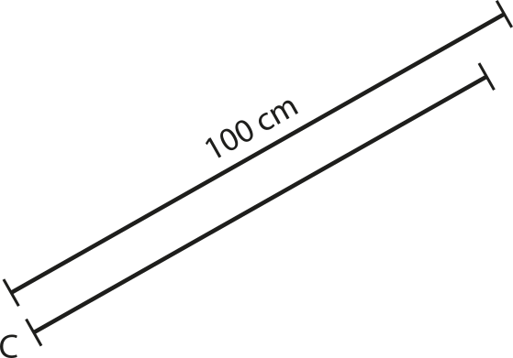
1.9 Composition: 20–100 – step 3:7

Slide 35
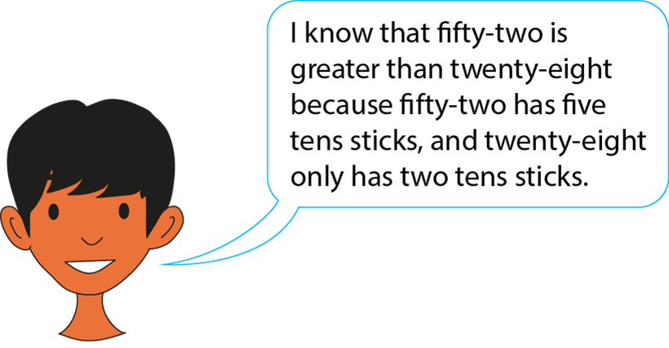
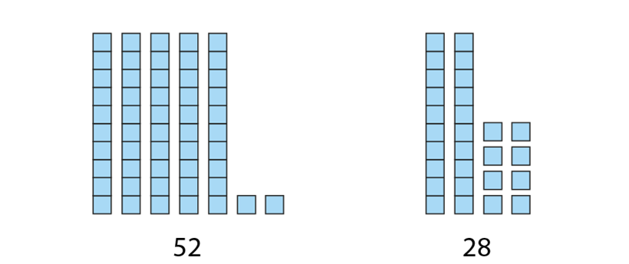
1.9 Composition: 20–100 – step 4:1

Slide 36

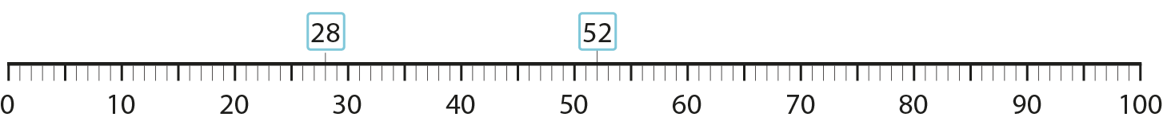
1.9 Composition: 20–100 – step 4:1

Slide 37
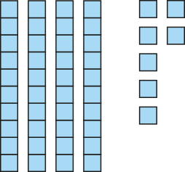
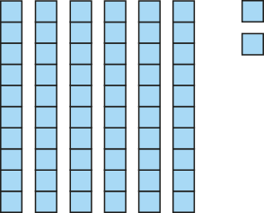
1.9 Composition: 20–100 – step 4:2
47
62
four tens
four tens
seven ones
six tens
two ones
six tens

Slide 38

1.9 Composition: 20–100 – step 4:2
4
7
6
2
0
10
20
30
40
50
60
70
80
90
100

Slide 39
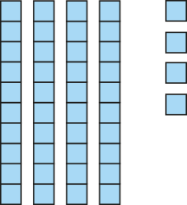
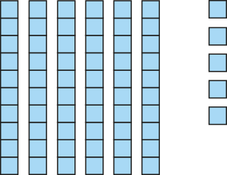
1.9 Composition: 20–100 – step 4:2
44
65
four tens
four tens
four ones
six tens
five ones
six tens

Slide 40
1.9 Composition: 20–100 – step 4:2
4
5
4
6
0
10
20
30
40
50
60
70
80
90
100

Slide 41
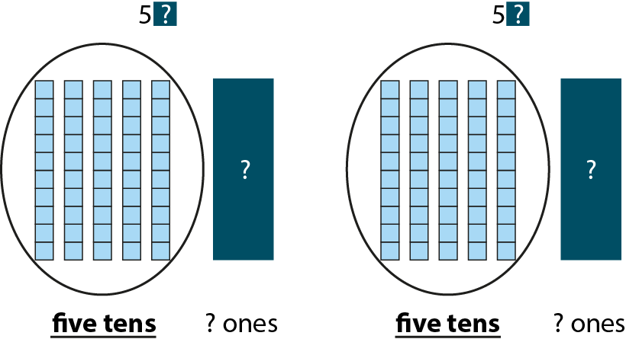
1.9 Composition: 20–100 – step 4:3

Slide 42
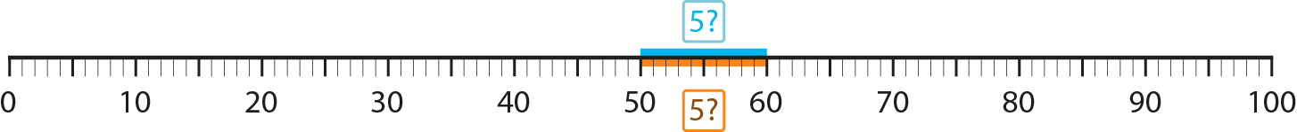
1.9 Composition: 20–100 – step 4:3

Slide 43
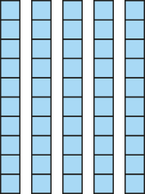

1.9 Composition: 20–100 – step 4:3
57
54
?
?
?
?
five tens
seven ones
?
five tens
four ones
seven ones
?
four ones

Slide 44


1.9 Composition: 20–100 – step 4:3
5?
7
0
10
20
30
40
5?
4
50
60
4
6
70
80
90
100

Slide 45
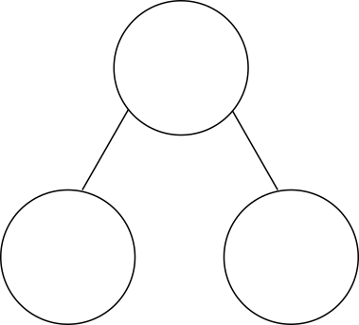


1.9 Composition: 20–100 – step 5:1
34
30
4

Slide 46
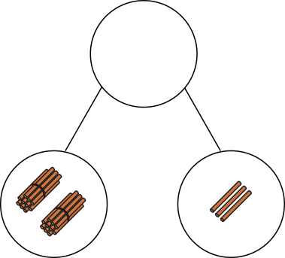
1.9 Composition: 20–100 – step 5:2
23
?

Slide 47
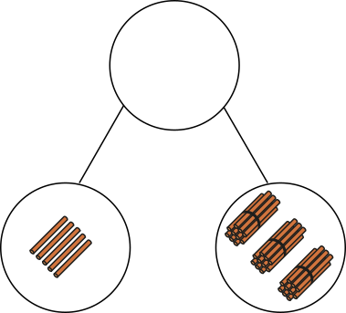
1.9 Composition: 20–100 – step 5:2
35
?

Slide 48
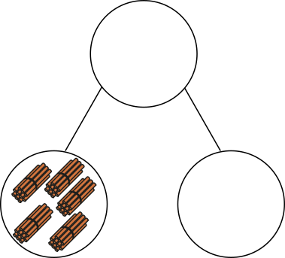

1.9 Composition: 20–100 – step 5:3
57
?

Slide 49
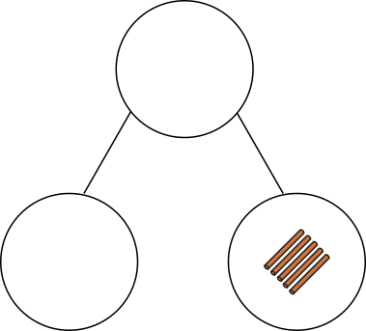

1.9 Composition: 20–100 – step 5:3
35
?

Slide 50
1.9 Composition: 20–100 – step 5:4
42
4
?
2
ones
tens

Slide 51
1.9 Composition: 20–100 – step 5:4
89
9
?
8
tens
ones

Slide 52
1.9 Composition: 20–100 – step 5:4
28
?
2
tens
8
ones

Slide 53
1.9 Composition: 20–100 – step 5:4
25
5
20
?

Slide 54
1.9 Composition: 20–100 – step 5:4
61
60
1
?

Slide 55
1.9 Composition: 20–100 – step 5:4
45
?
40
5

Slide 56
1.9 Composition: 20–100 – step 5:4
61
6
?
1
60
✓
✗

Slide 57
1.9 Composition: 20–100 – step 5:4
39
30
3
?
9
✓
✗

Slide 58
1.9 Composition: 20–100 – step 5:4
27
72
?
✓
✗
2
70

Slide 59
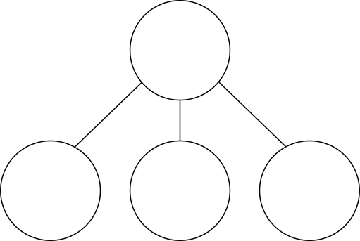
1.9 Composition: 20–100 – step 5:4
25
10
5
10
?

Slide 60
1.9 Composition: 20–100 – step 5:4
56
6
30
20
?

Slide 61
1.9 Composition: 20–100 – step 5:4
67
?
40
20
7

Slide 62
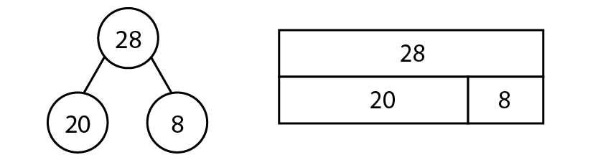
1.9 Composition: 20–100 – step 6:1
20 + 8 = 28
28 – 20 = 8
8 + 20 = 28
28 – 8 = 20
28 = 20 + 8
8 = 28 – 20
28 = 8 + 20
20 = 28 – 8

Slide 63
1.9 Composition: 20–100 – step 6:2
85
?
80
5
85
= 80 + 5

Slide 64
1.9 Composition: 20–100 – step 6:2
29
20
9
?
29 – 9 =
20

Slide 65
1.9 Composition: 20–100 – step 6:3
56
?
6
50
6 + 50 =
56

Slide 66
1.9 Composition: 20–100 – step 6:3
42
2
?
40
42 – 40 =
2

Slide 67
1.9 Composition: 20–100 – step 6:5
49
40
9
49
40
9
Notes:
At first there were forty-nine grapes in a bowl. Then I ate nine of them. Now there are forty grapes left.

Slide 68
1.9 Composition: 20–100 – step 6:5
34
?
30
4
Notes:
I have thirty maths books to mark and four English books to mark. How many books do I need to mark altogether?

Slide 69
1.9 Composition: 20–100 – step 6:5
28
8
?
20
Notes:
I have twenty-eight pencils to sharpen. I have already sharpened twenty. How many more do I need to sharpen?

