Slide 1
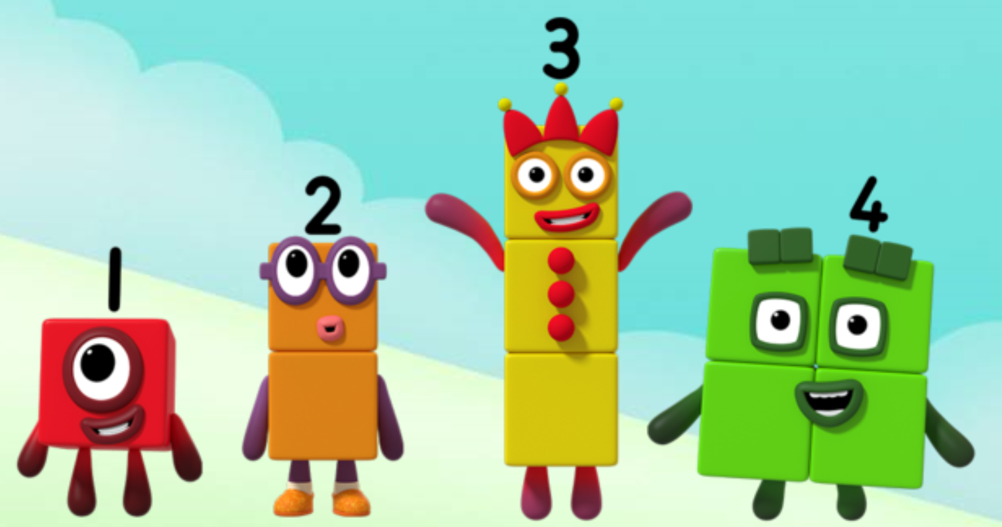
Series 2 Episode 2
Seven

Slide 2
Maths in the Episode
To watch this episode, please go to BBC iPlayer – Numberblocks Look for Series 2: Seven.
Counting to seven
In this episode children hear the Numberblocks counting to seven over and over again and can join in. They see different things in a group of seven. For example, seven ducks on a pond and seven colours in the rainbow.
Seven is one more than six
Children can see that seven is made from six and one more. The staircase pattern made by the Numberblocks shows that seven comes after six.

Slide 3
Talk and discuss together
Watch the episode together.
Ask your child what they noticed and be interested in anything they have to say.
Use the following pictures and activities to explore and talk about the maths involved.

Slide 4
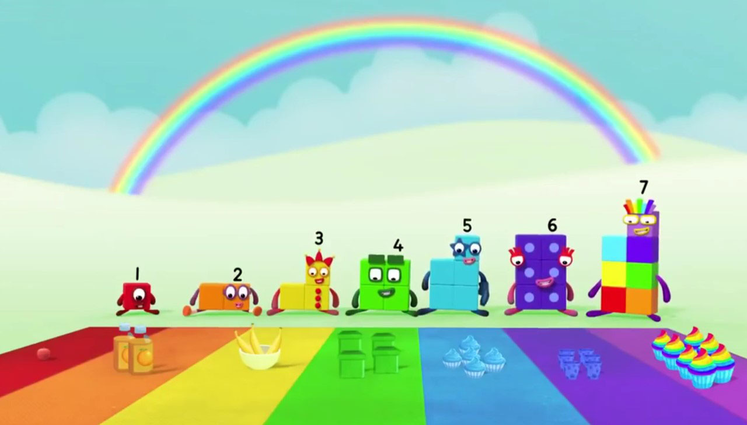
1, 2, 3, 4, 5, 6, 7!
I am after 6!
Images © 2017 Alphablocks Ltd. All Rights Reserved.

Slide 5
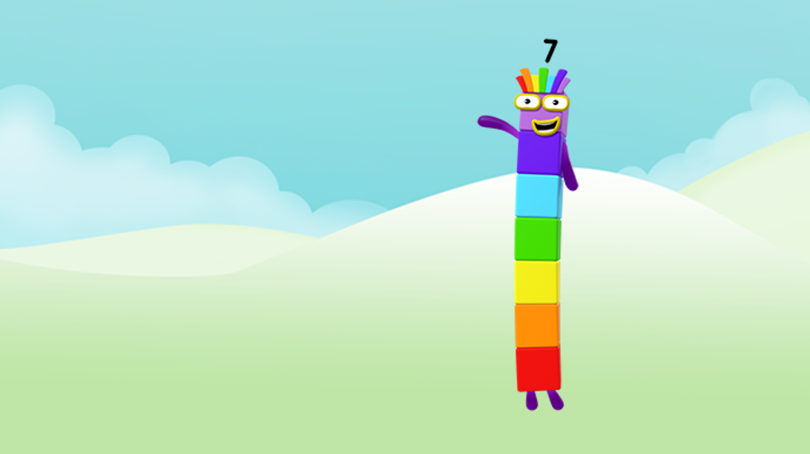
Can you help me find seven things?
Images © 2017 Alphablocks Ltd. All Rights Reserved.

Slide 6
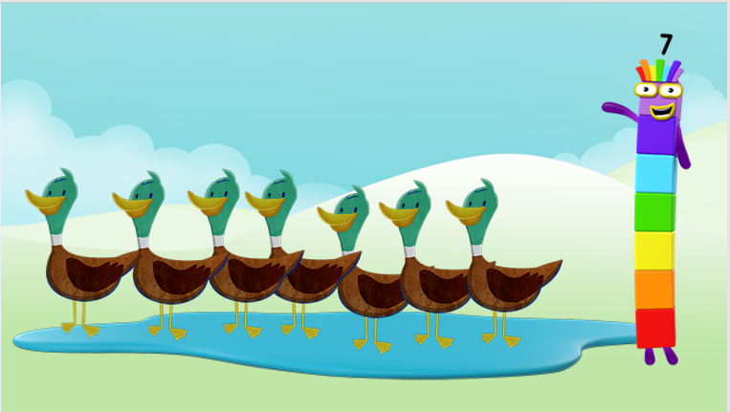
1, 2, 3, 4, 5, 6, 7!
7 ducks in the pond!
Images © 2017 Alphablocks Ltd. All Rights Reserved.

Slide 7
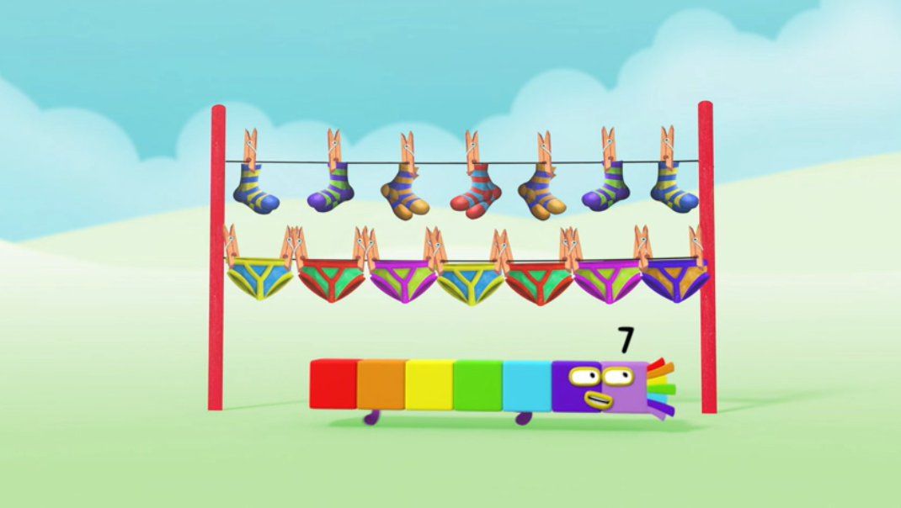
1, 2, 3, 4, 5, 6, 7!
7 pairs of socks for every day of the week!
Images © 2017 Alphablocks Ltd. All Rights Reserved.

Slide 8
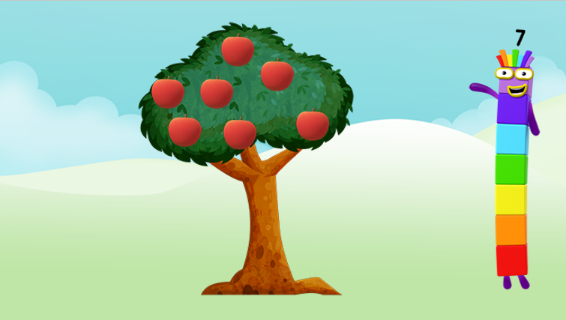
1, 2, 3, 4, 5, 6, 7!
7 apples on the tree!
Images © 2017 Alphablocks Ltd. All Rights Reserved.

Slide 9
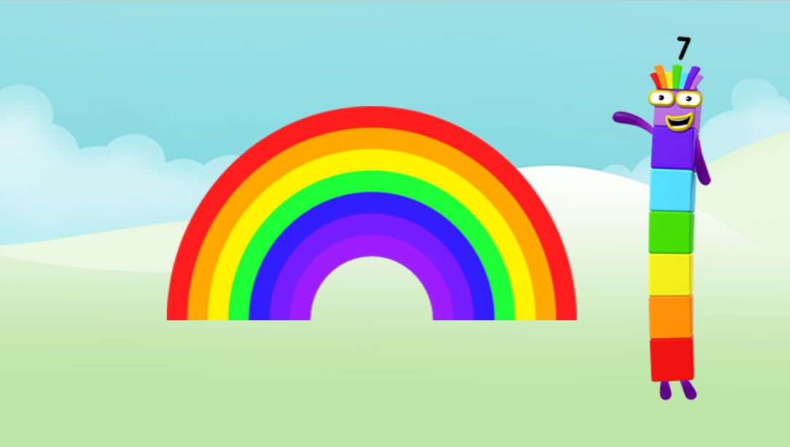
1, 2, 3, 4, 5, 6, 7!
7 colours in the rainbow!
Images © 2017 Alphablocks Ltd. All Rights Reserved.

Slide 10
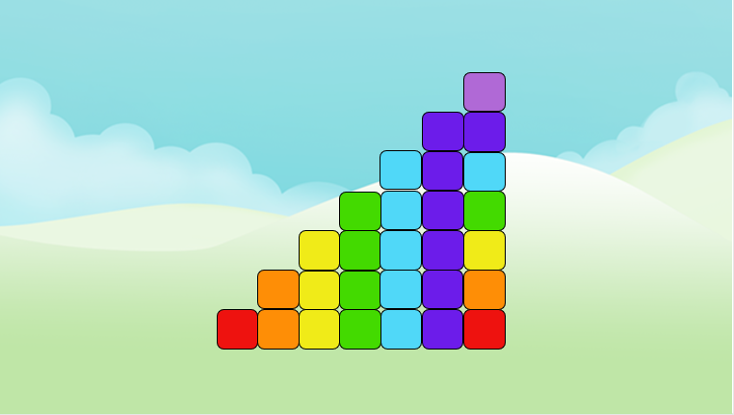
Can you see Seven hiding?
Images © 2017 Alphablocks Ltd. All Rights Reserved.

Slide 11
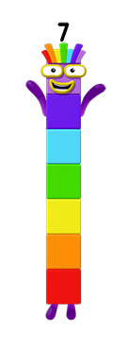
1, 2, 3, 4, 5, 6, 7!
Here I am!
Images © 2017 Alphablocks Ltd. All Rights Reserved.

Slide 12
Around the home
Practise saying the counting numbers in order to seven. Put up one finger for each counting number.
Put up seven fingers from two hands. How many different ways can you do it?
Join in with the Numberblocks as they sing the days of the week song in the episode. Talk about the days of the week and what you do on each day. How many days do we have at the weekend? How many in the week?
Draw a rainbow with seven colours.
Draw seven things that you like and colour them each in a different colour. Can you match the colours to Numberblock Seven?
Find a toy who wants to go on holiday! Pack a bag for your toy – make sure they have seven T-shirts, one for each day!
Count your way upstairs. Can you find the seventh stair? Can you remember where the seventh stair is? Count up the stairs again to check if you are right!

Slide 13
General tips that can make a difference in maths
Provide lots of opportunities to say how many things you can see (up to 5) without counting.
Whenever you talk about a small set of objects, say the number. For example, please pick up those 3 teddies or look at those 2 dogs.
Count up (starting from one) when walking upstairs and count back when walking downstairs.
Count lots of different objects, big and small, and ask ‘How many are there?’ Your child should be able to tell you without going back and re-counting. If they can’t, then tell them: ‘There are 6 altogether’.
Play with fingers, firstly practise counting fingers.
Ask your child to put their fingers down and then say or hold up a number such as 3. Can they do it without counting? Can they do it using different fingers? Can they do it using fingers from two hands?
Play board games with your child which involve moving along numbered tracks, such as ‘Snakes and Ladders’. Check that your child counts along the track correctly, moving one square for each number counted.
Regular use of these simple ideas, whenever the opportunity arises, will improve your child’s maths.

Slide 14
General tips that can make a difference in maths
Notice when there are two amounts and one is more than the other, or they are the same. For example, I have 2 eyes and 2 ears, or I have more chips than peas.
Talk about and describe shapes you can see outside or around your home. For example, count corners, talk about straight/curved edges, flat/curved surfaces. If you have building blocks then talk about and describe the things that are built.
In the bath or at the sink, play with containers, pouring water, counting how many small pots are needed to fill the big container.
Encourage your child to draw a picture of their number work and explain their mark-making to you, for example, how many leaves they find on a walk. This doesn’t necessarily mean writing the numerals (1, 2, 3, 4… etc.).
Sing counting songs and rhymes. You can find some on the internet, but children love it if you join in with them!
Make a deliberate maths mistake from time to time and ask your child to explain why you are wrong. For example, say that 4 is bigger than 5.
Regular use of these simple ideas, whenever the opportunity arises, will improve your child’s maths.

