Slide 1
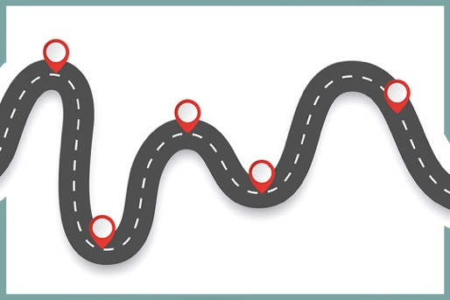
Checkpoints
Year 8 diagnostic mathematics activities
Graphical representations of linear relationships
Fifteen Checkpoint activities
Eight additional activities
Published in 2022/23

Slide 2
About this resource
This resource is designed to be used in the classroom with Year 8 students, although it may be useful for other students.
The Checkpoints are grouped around the key ideas in the core concept document, 4.2 Graphical representations, part of the NCETM Secondary Mastery Professional Development materials.
Before each set of Checkpoints, context is explored, to help secondary teachers to understand where students may have encountered concepts in primary school.
The 10-minute Checkpoint tasks might be used as assessment activities, ahead of introducing concepts, to help teachers explore what students already know and identify gaps and misconceptions.
Each Checkpoint has an optional question marked . This will provide further thinking for those students who have completed the rest of the activities on the slide.
The notes for each Checkpoint give answers (if appropriate), some suggested questions and things to consider.
After each Checkpoint, a guidance slide explores suggested adaptations, potential misconceptions and follow-up tasks. These may include the additional activities at the end of this deck.

Slide 3
Using these Checkpoints
Whilst linear graphs is new learning in Key Stage 3, there is much that students experienced at primary school that will support these ideas. This deck focuses on some of the underpinning understanding that they need.
The notes for each slide make it clear how it is best used, and the guidance at the start of each section gives more detail about students’ experience at primary school. We strongly recommend you read each of these first before attempting any tasks with your students.
All of the Checkpoints are intended to be accessible with primary school knowledge. Where they go beyond what has been explicitly taught at primary school, the intention is to help teachers assess students’ readiness for formal teaching of linear graphs, so that they can plan their approach based on students’ understanding.
If students need more practice of plotting and identifying coordinates, use the Checkpoints from the ‘Plotting coordinates’ deck.
We have tried to build some continuity in representations and structure between different Checkpoints decks: where a Checkpoint uses the word ‘again’ in the title, this indicates a similar task has been used in another deck.

Slide 4
Checkpoints 1–8
Checkpoint | Underpins | Code
1: Ant moves again | Coordinates and linear relationships | 4.2.1 4.2.2
2: Plotting rules
3: Awkward axes again
4: Three in a row | Understand place value in decimals, including recognising exponent and fractional representations of the column headings | 1.1.1.2
5: Thinking of a number
6: Odd coordinate out
7: Subject graphs
8: Inbetweeners again
*This three-digit code refers to the statement of knowledge, skills and understanding in the NCETM’s Sample Key Stage 3 Curriculum Framework (see notes below for more information).
Notes:
In the Sample Key Stage 3 Curriculum Framework, statements of knowledge, skills and understanding are arranged to give an example teaching order. The three-digit code for each statement in the framework is a clickable hyperlink to documents with more detailed information, including the key ideas contained within that statement. These key ideas are also shown on slide 6 in this deck.

Slide 5
Checkpoints 9–15
Checkpoint | Underpins | Code
9: For every… | Gradient and rate | 4.2.2
10: Staircases
11: Buckets
12: Stepping up | Understand place value in decimals, including recognising exponent and fractional representations of the column headings | 1.1.1.2
13: Almost square?
14: Race to the centre
15: Gardeners’ time question
*This three-digit code refers to the statement of knowledge, skills and understanding in the NCETM’s Sample Key Stage 3 Curriculum Framework (see notes below for more information).
Notes:
In the Sample Key Stage 3 Curriculum Framework, statements of knowledge, skills and understanding are arranged to give an example teaching order. The three-digit code for each statement in the framework is a clickable hyperlink to documents with more detailed information, including the key ideas contained within that statement. These key ideas are also shown on slide 6 in this deck.

Slide 6
Key ideas
Connect coordinates, equations and graphs | Code
Know that a set of coordinates, constructed according to a mathematical rule, can be represented algebraically and graphically | 4.2.1.3*
Understand that a graphical representation shows all of the points (within a range) that satisfy a relationship | 4.2.1.4
Explore linear relationships | Code
Recognise that linear relationships have particular algebraic and graphical features as a result of the constant rate of change | 4.2.2.1
Understand that there are two key elements to any linear relationship: rate of change and intercept point | 4.2.2.2
That writing linear equations in the form y = mx + c helps to reveal the structure | 4.2.2.3*
Solve a range of problems involving graphical and algebraic aspects of linear relationships | 4.2.2.4
*There are additional resources exemplifying these key ideas in the Secondary Mastery Professional Development | NCETM.

Slide 7
Coordinates and linear relationships
Checkpoints 1–8

Slide 8
Coordinates and linear relationships
Previous learning
Key Stage 2 curriculum: Year 4: describe positions on a 2D grid as coordinates in the first quadrant Year 5 non-statutory guidance: pupils connect their work on coordinates and scales to their interpretation of time graphs Year 6: connect conversion (for example, from kilometres to miles) to a graphical representation as preparation for understanding linear/proportional graphs Year 6: describe positions on the full coordinate grid (all four quadrants) Year 6: draw and translate simple shapes on the coordinate plane, and reflect them in the axes Year 6 non-statutory guidance: pupils should be introduced to the use of symbols and letters to represent variable and unknowns in mathematical situations that they already understand, such as: missing numbers, lengths, coordinates and angles Further information about how students may have experienced this key idea in Key Stage 2: Teaching mathematics in primary schools 4G–1: Draw polygons, specified by coordinates in the first quadrant, and translate within the first quadrant (pp192–96)¹; 6NPV-3: Reason about the location of any number up to 10 million, including decimal fractions, in the linear number system (pp289–93); 6AS/MD–1: Quantify additive and multiplicative relationships (pp298–301) Key Stage 3 curriculum: 4.2.1.1² Describe and plot coordinates, including non-integer values, in all four quadrants 4.2.1.2 Solve a range of problems involving coordinates ¹ Page numbers reference the complete Years 1–6 document ² This four-digit code refers to the key ideas in Secondary Mastery Professional Development | NCETM; the Key Stage 2 content underpinning these ideas is assessed in the ‘Plotting coordinates’ Checkpoints deck.

Slide 9
Coordinates and linear relationships
In Key Stage 3 students need to
Be fluent at both reading and plotting coordinates involving negative and non-integer x- and y-values in all four quadrants. Be confident in solving problems that require them to be analytical, and be able to go beyond finding an answer to being able to give clear reasons based on the relationships between the coordinates. Understand the relationships between the x- and y-values of pairs of coordinates in linear functions. Plot sets of coordinates where the x- and y-values are connected by a rule, becoming aware of the connection between a rule expressed algebraically and the linear graph created by joining a set of points (including horizontal and vertical straight line graphs). Appreciate that all linear relationships have certain key characteristics: a specific pair of values or points on the graph; for example, where x = 0 (the intercept) a rate of change of one variable in relation to the other variable; for example, how the y-value increases (or decreases) as the x-value increases (the gradient). Become fluent at plotting and identifying straight line graphs and make connections between the equation of the line and the coordinates of points on the corresponding line. Appreciate the important two-way connection, that is: if the x- and y-values of the coordinates fit an arithmetic rule, then they will lie on a straight line if the coordinates lie on a straight line, then their x- and y-values will fit an arithmetic rule. Explore the connections between equations of lines and their corresponding graphs, including those presented in a non-standard form, such as ax + by = c, as well as the more standard y = mx + c.

Slide 10
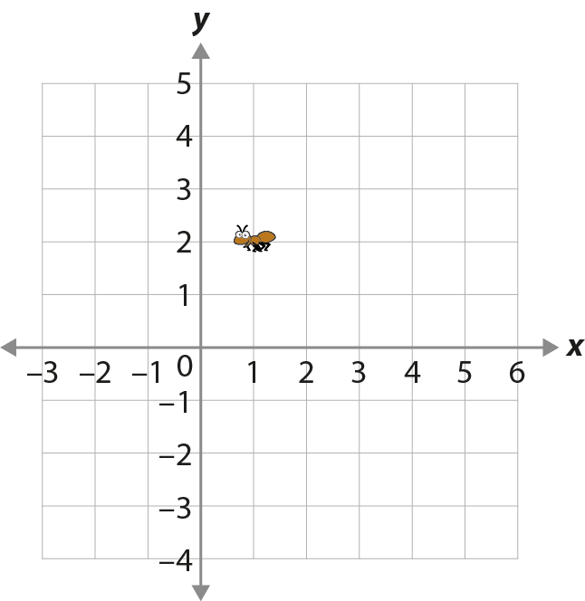
Checkpoint 1: Ant moves again
An ant is on a coordinate grid.
What coordinates is the ant on?
Complete the sentence:
The y-coordinate is __ times the x-coordinate.
The ant moves to another point on the grid. The sentence is still true.
What new coordinates might it be on?
Redo parts a to c using this new sentence:
The y-coordinate is __ more than the x-coordinate.
How have your answers changed?
Notes:
This slide is animated. Each question will appear separately so you can choose the pace at which to work with your class.
Answers
a) (1, 2)
b) The y-coordinate is 2 times the x-coordinate.
c) Any pair of coordinates where the y-coordinate is 2 times the x-coordinate. Examples visible on this grid include (2, 4), (-1, -2) and (-2, -4). You may wish to discuss why answers such as (3, 6), although not appearing on this grid, are still valid. Students may also suggest non-integer coordinates or (0, 0) – see guidance slide.
? a) Unchanged.
b) The sentence would now be: The y-coordinate is 1 more than the x-coordinate.
c) The new coordinates would change to any coordinate pair where the y-coordinate is 1 more than the x-coordinate, including (-3, -2), (-2, -1), (-1, 0), (0, 1), (2, 3), (3, 4) and (4, 5).
Suggested questioning
What is the x-coordinate? What can you do to that number to create the y-coordinate?
What is the relationship between the x- and y-coordinates? Can you think of another pair where the same relationship is true.
What is the same and what is different about the sentences in part b and the further thinking question?
Is there another way that you could phrase the sentence and it still be true?
If I pick any number for the x-coordinate, can you always pick a y-coordinate to make the sentence true?
Things to think about
The ‘Plotting coordinates’ Checkpoints deck has previously explored students’ understanding of the coordinate plane, including plotting and reading coordinates correctly. This first Checkpoint begins similarly, but then starts to explore whether students can talk about the relationship between the x- and y-coordinates. Being able to talk about how one coordinate might be generated from the other using a rule is a key understanding that needs to be established before students start to use representations such as tables of values.

Slide 11
Checkpoint 1: Guidance
Adaptations | Assessing understanding
Support To help students with the multiplicative relationship between coordinates, focus on part b: move the ant vertically, so the x-coordinate remains 1, and ask how the sentence changes. Challenge Reverse the problem: give students a relationship and ask them to pick coordinates that fit that statement. Representations The coordinate grid will be a familiar representation, but considering the relationship between x- and y-coordinates will not. It might be tempting to use other representations such as tables of values, but this will be new teaching rather than being a quick explanation of this task. | The aim of Checkpoint 1 is to check students can identify coordinates. This is explicitly asked in part a but underlies the rest of the task too. Part b asks students to consider the relationship between the x-coordinate and the y-coordinate, which is a key understanding to build on in future work on linear graphs. This will likely be an unfamiliar way of thinking, and so a sentence frame is provided to help structure students’ thinking. Part c asks students to think of pairs of coordinates for which the statement will still be true. They might suggest that there is only one pair of coordinates that works (2, 4) as this is the only other point on the given grid with positive coordinates. If they do not volunteer other answers, prompt students to consider what the y-coordinate might be if the x-coordinate were, for example, -1. Students who are more confident with the infinite nature of the coordinate plane might suggest fractional or decimal coordinates, or pairs of coordinates that are true but not visible on this particular grid (such as (3, 6). You can also discuss the point (0, 0) and why those coordinates can be substituted into the sentence. The further thinking question considers an alternative (additive) relationship between the coordinates.
Additional resources If students need more time to practise reading and plotting coordinates, the ‘Plotting coordinates’ deck from Year 7 Checkpoints contains tasks that go into more depth with this preliminary skill, including the original ‘Ant moves’ Checkpoint.

Slide 12
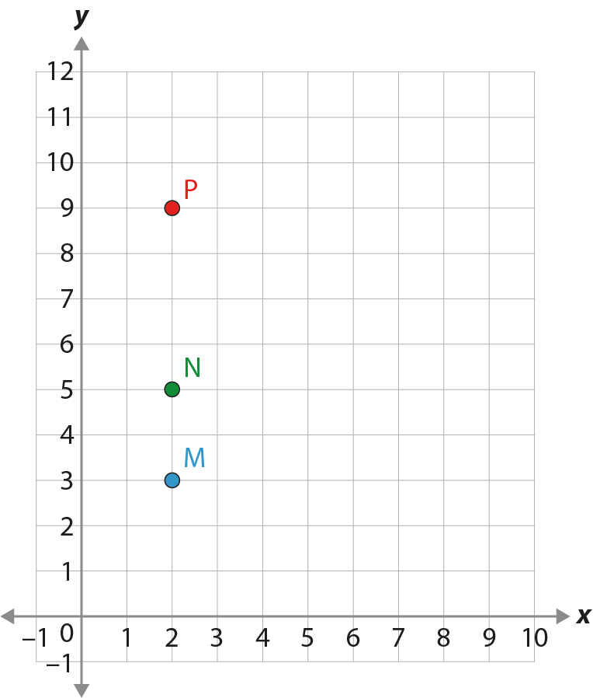
Checkpoint 2: Plotting rules
Four people are given the same number.
Asma trebles the number and adds 3.
Bola halves the number and subtracts 1.
Claire doubles the number and subtracts 1.
Dave doubles the number and adds 1.
Three of them plot some points, using their starting number as the x-coordinate and the outcome of their calculation as the y-coordinate.
Which point belongs to which person?
Whose point was missing? Plot it for them.
S
One person plots a new point, S, using the same rule with a different starting number. Who is it? Plot the other three people's coordinates using this new starting number.
Notes:
This slide is animated. Each question will appear separately so you can choose the pace at which to work with your class.
Answers
a) Asma’s is the red point (P). Claire’s is the blue point (M). Dave’s is the green point (N).
b) Bola’s point is missing. It should be at (2, 0).
? The orange point (S) belongs to Dave: 4 × 2 + 1 = 9. Asma: (4, 15), Bola: (4, 1), Claire: (4, 7).
Suggested questioning
What are the coordinates of point __?
What is the same and what is different about point __ and point __?
If you were given the same number, can you think of a rule that would result in a point above P? How about below R?
Why are P, N and M all lined up vertically?
Things to think about
As with Checkpoint 1, this Checkpoint explores whether students can identify points on a plane but also begin to talk about the relationship between the x- and y-coordinates. As an assessment task, the focus is on individual pairs of coordinates and connecting x and y with a rule, rather than considering lines or sets of points. The intention is to check whether students are comfortable with the idea of connecting the x- and y- coordinates according to a mathematical rule, and so are ready for Key Stage 3 teaching on straight lines. If they are not, spend some time generating one coordinate from another first.

Slide 13
Checkpoint 2: Guidance
Adaptations | Assessing understanding
Support Students might find it challenging to identify the original number given to Asma and her friends. Offering this to those students who find it hard to get started might then give more information about their understanding. For example, if they are able to plot points accurately but working backwards to identify the x coordinate offers too much challenge. Challenge Explore with students the possibility of two of the people plotting the same points. It is clear from the Further thinking question that two rules can have the same outcome (in this case, y = 9). Start by exploring the starting numbers needed to make all of the points fall on that line, then whether there is a value that means that, for example, Asma and Claire plot their points at the same coordinate. Representations Function machines can provide a useful input/output model for coordinates, as can recording values in a table. The coordinates themselves are familiar, but their use as a representation of a relationship maybe less so. | This Checkpoint explores students’ familiarity with the conventions of plotting coordinates, and also whether are aware that coordinates might be connected by a given rule – key when plotting and interpreting linear graphs. Giving the same start number for x means the focus is on the y-coordinate and ensures students focus on how different rules can generate different outputs. The missing coordinate in part b should be plotted at (2, 0) allowing insight into whether students understand the conventions of the origin (note the position of the single 0 at the origin).
Additional resources Additional activity B takes the ideas within this Checkpoint further to explore different coordinates generated from a rule. Additional activity A is a ‘three in a row’ game, exploring coordinates in the context of them forming a line rather than following a rule.

Slide 14
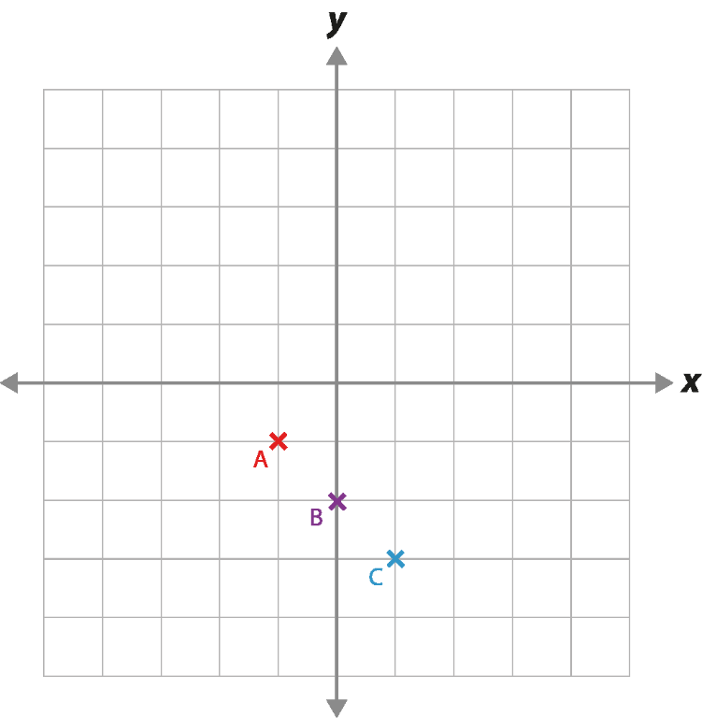
Checkpoint 3: Awkward axes again
Bix plots three coordinates: A, B and C.
What might these coordinates be? Is there more than one answer?
Sam says coordinate A is (-2, -2). Terri says it is (-2, -1). Why could they both be right?
If coordinate C is (1, -1.5), what are the other coordinates?
If coordinate B is (0, -40), what do we know about the other coordinates?
Bix’s coordinates form a straight line. If Sam was correct in part b, what are the coordinates of points B and C? What other coordinates could be on this line?
Notes:
This slide is animated. Each question will appear separately so you can choose the pace at which to work with your class. A printable resource can be found on slide 57.
Answers
a) The most likely set of three coordinates that students choose are (-1, -1), (0, -2), (1, -3). However, as there is no scale, this is not the only possible answer. Students will be correct if they have applied the scale of their choosing consistently. For example, demonstrating that the difference between the x-coordinates for A and B is the same as the difference for B and C; the same must be true of their respective y-coordinates. The scale for their x-axis does not need to be the same as the scale for their y-axis. For example, a valid answer could be: A (-2, -10), B (0, -20), C (2, -30).
b) Sam could be right if both the x- and y-axes are going up in twos, whilst Terri could be right if the x-axis is going up in twos but the y-axis is going up in ones.
c) A (-1, -0.5) and B (0, -1)
d) There is not enough information to know what the x-coordinates would be for A and C. We know that the y-coordinate for A would be -20 and for C it would be -60.
? Note: equations of lines are given to aid teachers in checking suggested coordinates. It is not appropriate to share solutions in the form of equations with students at this stage.
If Sam was correct, other points might include: (-10, 6) (-8, 4), (-6, 2), (-4, 0), (0, -4), (2, -6), (4, -8), (6, -10) and (8, -12). Any other points suggested need to fit the rule y = -x – 4.
If Terri was correct, other points might include: (-10, 3), (-8, 2), (-6, 1), (-4, 0), (0, -2), (2, -3), (6, -5), (8, -6), (10, -7).
Any other points suggested need to fit the rule y =$−\frac{1}{2}x –2$
Suggested questioning
What do you know about the coordinates? What do you not know?
If you know the coordinates of point A, do you know enough to work out the other coordinates? How about B and C?
Why might you use different scales for graphs?
A coordinate is, for example, (-9, 7). Which of the points could it be?
How would your answer to the further thinking question change if Terri was correct?
Things to think about
In the ‘Plotting coordinates’ Checkpoints deck, Checkpoint 4 (‘Awkward axes’) asks students to think about possible coordinates with blank axes, highlighting that the scale of the axes does not have to be 1:1, and that the x- and the y-axes could have different scales. This Checkpoint revisits these basic ideas while also checking whether students are thinking about the relationships between the x- and y-coordinates at the same time.

Slide 15
Checkpoint 3: Guidance
Adaptations | Assessing understanding
Support Provide multiple printed versions of the grid to write on, so that students can see the different possible scales side-by-side. Challenge Ask students to consider what A, B and C are when given information about other points on their line. How many points do they need to know? Representations Students usually expect to see a scale on the axes when working with graphs. It is important that they realise that one square on the coordinate grid doesn’t necessarily represent one unit and that the scaling on the two axes may not be the same. They may be more familiar with this idea from previous work on data, where they adapt the scale to fit the values they need to represent. | Checkpoint 4 from the Year 7 ‘Plotting coordinates’ Checkpoints deck assesses how students work out coordinates in relation to other coordinates when a scale is missing. For example, by counting the spaces between points, or relating each point back to the origin and using the axes. These are useful assessment points here, too. The three given points form a line, and so students might demonstrate thinking that they will need to work on linear relationships at Key Stage 3. Even if they do not know the scale, they can talk about the relationship between points. When working out part d, for example, do they recognise that the y-coordinate for point C is the same distance below the y-coordinate for B as the y-coordinate for A is above it? Do they use this understanding of equidistance to think about the x-coordinates too? Explore what they know or can assume from the information given – knowing the coordinates for A or C is enough information to understand the scale, but knowing them for B is not. Can students explain why?
Additional resources Checkpoint 4 in the ‘Plotting coordinates’ Checkpoints deck offers more exploration of different scales on axes, including the original ‘Awkward axes’ Checkpoint.

Slide 16
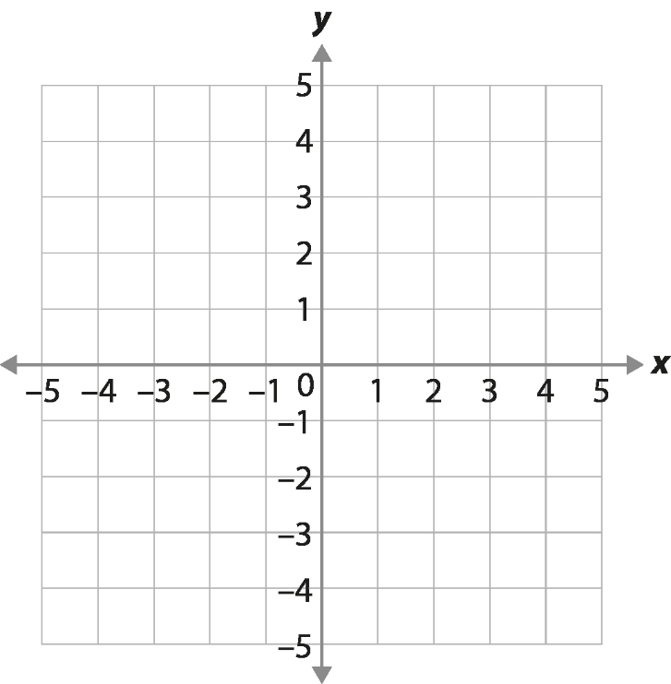
Checkpoint 4: Three in a row
Ian and Alison are playing a game.
The aim is to plot three coordinates in a row, then join them with a straight line so that the line segment does not cross the other player’s line segment.
Alison’s are the red crosses. Ian’s are the blue circles.
Where might Alison plot her third coordinate?
Where might Ian plot his third coordinate?
If the winner is the person with the longest line segment, who had the best strategy? Why?
×
×
If both axes are extended to be from -10 to 10, would any of your answers change?
Notes:
This slide is animated. Each question will appear separately so you can choose the pace at which to work with your class. The circles and crosses will also appear, in order, with the last sentence of the rubric. Students might find it helpful to draw the line segments, so a printable version is provided on slide 58.
Answers
a) Alison might plot her third coordinate anywhere where the x-coordinate is 2. Using the gridlines that are visible: (2, -5), (2, -4), (2, -3), (2, -2), (2, -1), (2, 0), (2, 2), (2, 3), (2, 5).
b) If Ian uses the visible gridlines, there is no place where he could plot the coordinate to create a straight line that connects to his original two coordinates. The next point would be (5, 6), which would cross Alison’s line segment, or (-7, -9), which is off the grid. Students might, rightly, suggest that Ian could plot his points between the gridlines, for example at (-1, -1.5), although they may find it more challenging to identify correct coordinates. See the Guidance slide for more information.
c) Students’ answers to this will depend on the understanding that they showed in part b. If they did not think there was a possible position for Ian’s coordinate in part b, they might argue that Alison had the best strategy as it was easier to identify her next point. Alternatively, students might argue that Ian had the best strategy because a diagonal line has the potential to be longer than a horizontal or vertical line on this grid – although the points he chose limited this possibility.
? Students’ answers to both parts might change to encompass y-coordinates from -10 to 10. Students’ answers to part b are probably most likely to change as they could now include (-7, -9) as a solution. For part c, students might be more likely to think Ian’s strategy was best – although a different angle of diagonal line would still have arguably been better.
Suggested questioning
How could you describe each person’s line?
Whose line is the longest now? Whose line will be longest after their next turn?
Do you think Ian should be allowed to plot a point beyond the grid given? Why or why not?
Things to think about
Take some time considering Checkpoint 4 before using it with students, as there are some deliberate ambiguities that could take the class discussion in different directions. The intention is that students’ arguments will reveal their understanding about the nature of the coordinate plane. Students who understand that the axes continue beyond the grid given might argue that Ian should be able to plot a third coordinate using non-integer coordinates or beyond the axes given. However, those who most deeply understand the infinite nature of the plane might realise that the game becomes pointless points beyond -5 and 5 are allowed, because not posing any limits would mean any line segments could be infinitely long in one or more direction.

Slide 17
Checkpoint 4: Guidance
Adaptations | Assessing understanding
Support If students find it hard to imagine Ian’s line with the coordinates so far apart, moving the coordinate at (1, 1) to (0, -2) would still elicit the same discussion. Challenge Introduce a third line segment; ask students to choose three coordinates that would be longer than both Ian and Alison’s possible lines. Representations This Checkpoint explores the limits of students’ understanding of a Cartesian plane, as Ian’s points either need to be between gridlines or beyond the axes shown. | This ‘three in a row’ game is deliberately ambiguous, and is designed to discussion of coordinates of the Cartesian plane. It could take various directions based on students’ responses and understanding – read the notes, answers and guidance carefully first! The points have been chosen so that Ian cannot win on the grid shown; in fact, to even be able to plot another point on his line, he would need to use a non-integer coordinate. Pay attention to how students explain their answers to part b: do they understand the axes as continuous scales? Or do they only recognise the discrete gridlines that are shown? If students do try to find non-integer coordinates between Ian’s points, look for a general sense of position rather than precision. To check students’ suggested solutions, drawing a line between Ian’s coordinates to see if their coordinates would sit on the line is appropriate at this stage in students’ learning.
Additional resources Additional activity A is an alternative ‘three in a row’ game, that specifically explores coordinates on lines. Key idea 4.2.1.3 from Secondary Mastery Professional Development | NCETM explores ‘Representing sets of coordinates algebraically’ and might give some ideas for where to take this next in Key Stage 3.

Slide 18
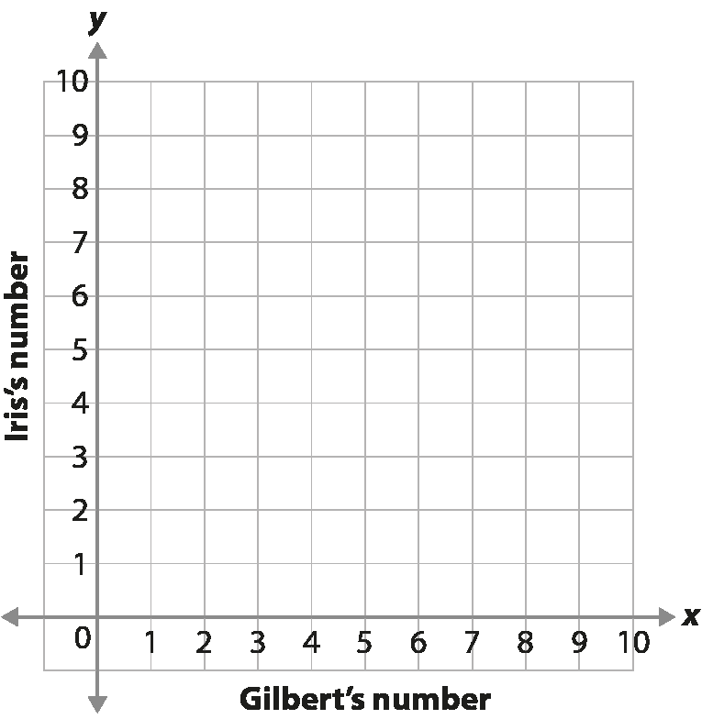
Checkpoint 5: Thinking of a number
Gilbert is thinking of a number.
Iris says that she will add two to whatever number he chooses.
What could their numbers be?
Plot some of your suggestions on the grid.
What do you notice about your suggestions?
How would your graph look different if Iris added five to Gilbert’s numbers?
How about if she subtracted three?
Iris picks a new rule. One of coordinates she plots is (3, 6). What could her rule have been? What other coordinates might she plot using the new rule?
Notes:
This slide is animated. Each question will appear separately so you can choose the pace at which to work with your class. You might wish to use the printable resource on slide 59 for students to complete this task.
Answers
a) For example, (0, 2), (1, 3), (2, 4), (3, 5), (4, 6), (5, 7), (6, 8), (7, 9), (8, 10). If students volunteer non-integer coordinates or coordinates that appear in different quadrants to the one shown, we suggest that this is encouraged.
b) Any correctly plotted pairs of coordinates where the y-coordinate is two more than the x-coordinate (see above).
c) Students should notice that their chosen coordinates form a straight line.
d) The graph would still be a straight line at the same angle, but it would be further ‘up’ the page/slide. Students might comment that less of the line would be visible, or that it goes ‘off the page/slide’ sooner.
e) The graph would still be a straight line at the same angle, but it would be further ‘down’ the page/slide. Students might comment that it goes ‘below’ the line for Gilbert's number.
? Iris’s rule could have been, ‘Add three to Gilbert’s number’, in which case other coordinates would include (1, 4), (2, 5) or (4, 7). Iris’s rule could also have been, ‘Double Gilbert’s number’, in which case other coordinates would include (1, 2), (2, 4) or (4, 8). There are an infinite number of other rules that Iris could have chosen (such as ‘Triple and subtract three’, in which case other coordinates would include (1, 0), (2, 3) or (4, 9). Students may realise that they cannot be sure what Iris’s rule is with only one given coordinate.
Suggested questioning
What do you notice about Iris and Gilbert’s numbers?
Can you think of a pair of numbers that wouldn’t be seen on this grid? Would they be on the line? How do you know?
What is the same and what is different about your answers to parts b, d and e?
What would the rule be if, for example, (0, 0) and (1, 1) were on the line?
Things to think about
The transition to graphical representations of relationships is a big step in students’ mathematical understanding. Students can find it hard to connect the different representations – including equations, tables of values and graphs. The intention of Checkpoint 5 is to find some familiarity in plotting relationships on a grid. The axes are labelled with the two people’s names rather than x and y. Students will have experienced the axes representing different variables within statistics at primary or science in primary and early Key Stage 3). The focus is on the relationship between the two numbers. You might wish to build on this by linking the two names to the variables x and y at a later stage of teaching.

Slide 19
Checkpoint 5: Guidance
Adaptations | Assessing understanding
Support Help students get started with parts a and b by suggesting Gilbert’s starting number, asking for what Iris’s number would be, and then modelling how to plot this. Challenge Introduce a multiplicative relationship for Iris and Gilbert’s numbers – such as, ‘Iris says she will double his number’. For further challenge, add a second step – such as, ‘Iris says she will double his number and add 1’. Representations The grid here is used to represent the relationship between two numbers. Names are used to label the x- and y-axes so the focus is on how students use and understand the representation of a coordinate grid. This probably draws more on their experience of statistics and data at primary school than of algebra. | Checkpoint 5 starts to look at plotting lines from a relationship but, crucially, makes no mention of coordinates. The intention is to see how readily students can translate information onto a graph using the given labels for axes. Parts c, d and e ask students what they notice and to conjecture about what might change if the relationship is different. If students have plotted correctly from parts a and b, then they should notice that the points form a straight line; it is worth confirming this fact before moving on from part c. For parts d and e, do not expect any specific language, as much of the language of graphs is embedded in new learning at Key Stage 3. Instead, investigate whether students have a sense of how the line might be positioned in relation to the original line, or where it might start and finish on the given grid. Students may find it easier to talk about the line from part c ‘moving’. Their language might help you to understand how readily students can interpret and describe graphs, before you teach the vocabulary of gradient and intercept.
Additional resources Additional activity B also looks at plotting ‘rules’ to create coordinates. Key idea 4.2.1.3 from Secondary Mastery Professional Development | NCETM explores ‘Representing sets of coordinates algebraically’ and might give some ideas for where to take this next in Key Stage 3.

Slide 20
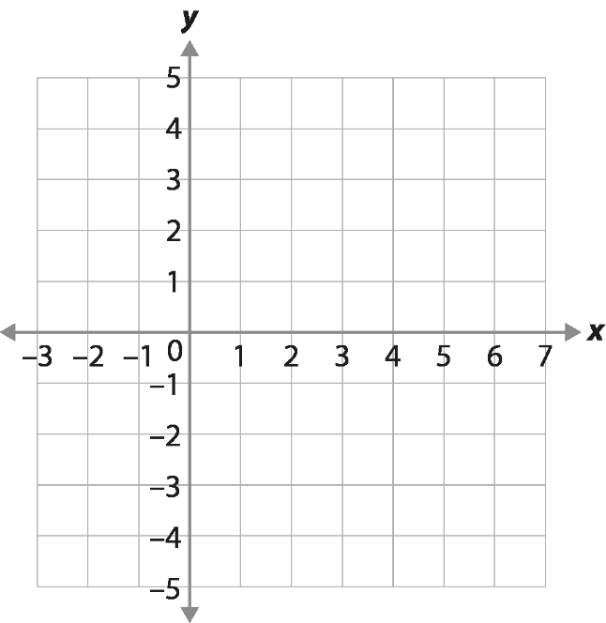
Checkpoint 6: Odd coordinate out
On the right is a set of coordinates.
Which set do you think is the odd one out?
Plot the coordinates on the grid.
What do you notice? Do you want to change your answer to part a?
Repeat parts a to c for the two sets of coordinates below.
(0, 2)
(5, 6)
(3, 5)
(1, 3)
(-1, 1)
(0, 0)
(4, 8)
(2, 4)
(-3, -6)
(-1, 1)
(0, 0)
(-2, -4)
(1, -1)
(-1, -3)
(2, 0)
For each of the three sets of coordinates, change the odd one out so that they fit into the group.
Notes:
This slide is animated. Each question, and the grid, will appear separately so you can choose the pace at which to work with your class. A printable resource, with three grids, is available on slide 60; we suggest that this is given after students have completed part a without access to a grid.
Answers
Note that students might want to change their answer to part a based on their experience of part c. Collect answers to part a for your own assessment purposes, but do not reveal the correct answer until students have tried parts b and c.
a) (5, 6) because all of the other pairs of coordinates have a difference of 2 between the x-coordinate and the y-coordinate.
b) See animated solutions on next slide.
c) Students should notice that all points except (5, 6) form a straight line. If they did not choose (5, 6) as their odd coordinate out, but have plotted all points correctly, they might wish to change their answer to part a.
d) See next slide for animated solutions. The odd one out is (-1, 1) in the set on the left and (0, 0) in the set on the right
? (5, 6) could be changed to (5, 7) or (4, 6); (-1, 1) could be changed to (-1, -2) or (0.5, 1); (0, 0) could be changed to (0, -2) or (2, 0).
Suggested questioning
What do you notice about the x-coordinate compared to the y-coordinate?
Is there more than one way to define ‘odd one out’? Do you still think that after plotting the points?
What do you notice about the way the points are arranged?
Could you think of another pair of coordinates that would fit into the set?
Things to think about
Checkpoint 6 is the first time we explicitly list multiple coordinates that follow the same rule, so it may be a useful precursor to planning for introducing equations of lines. Think about the practicalities of using this task in the classroom. Will you collect students’ answers to part a? Will you ask the whole group to work on one set of coordinates together and compare their thinking? Relationships with a single additive or multiplicative step have been chosen so that the relationship is more easily identifiable from the coordinates alone.

Slide 21
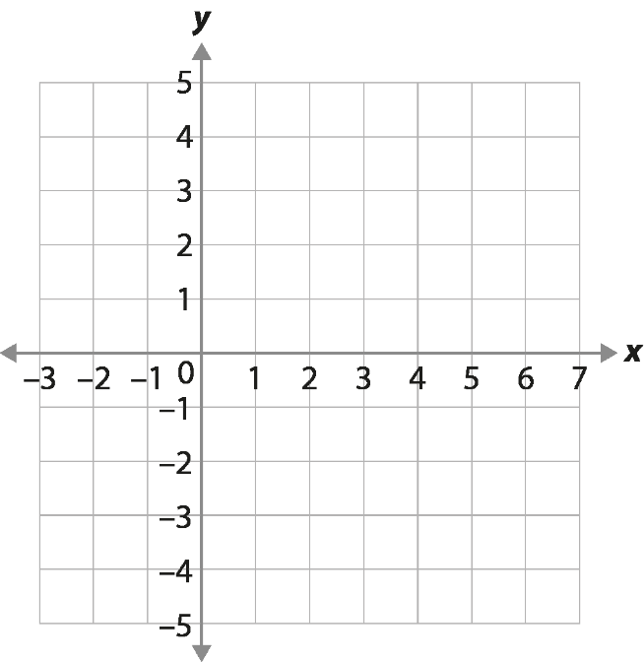
Checkpoint 6: Odd coordinate out (animated solutions)
x
x
x
x
x
x
x
x
x
x
x
x
x
(0, 2)
(2, 3)
(3, 5)
(1, 3)
(-1, 1)
x
(0, 0)
(-2, -4)
(2, 4)
(1, 2)
(-1, 1)
x
(0, 0)
(-2, -4)
(1, -1)
(-1, -3)
(2, 0)
Notes:
This slide is animated. Each point will appear separately, in the order that they appear in the list. The odd coordinate out will the be highlighted red and underlined.

Slide 22
Checkpoint 6: Guidance
Adaptations | Assessing understanding
Support Modelling the relationship between the x- and y-coordinates might help students access the task. For example, draw an arrow from the x- to the y- in each pair in the first set, and label it with the operation: +2, and +1 for (5, 6). Challenge Ask students to create their own sets with a specified coordinate as the odd one out. Representations This Checkpoint assesses the foundations needed for future teaching by asking students to consider a relationship represented two ways: as written coordinates, and then again as coordinates plotted on a grid. Consider how readily students are able to notice relationships in both representations. This may have implications for how readily they cope with new learning on linear graphs. | Checkpoint 6 assesses how readily students spot relationships between coordinates, so that you can plan how to introduce linear graphs. Students first consider the coordinates without plotting, so that they can focus on identifying a consistent relationship between the coordinates. Plotting the line gives an opportunity to see this relationship in a different way. After part a, do students anticipate that there will be a line again for parts b and c? A key feature of this task is that part c allows students to change their answer to part a, once they have seen the points plotted. We suggest that incorrect answers to part a are accepted – perhaps recorded visibly on the board – but not dealt with until parts b and c are complete. The left set from part d might pose some challenges: here, the relationship is multiplicative and so students might incorrectly identify (0, 0) as the odd one out. Listen to how students describe the relationship they have spotted – how easily does this apply to (0, 0)? For example, how happy are they with the idea that 0 is double 0? Seeing the points plotted may help convince students that (0, 0) does belong to the set.
Additional resources Additional Activity C offers a more challenging version of this Checkpoint, with more complex relationships between the two coordinates. The second question on p18 of the Secondary assessment materials builds on this idea, as does Additional activity F.

Slide 23
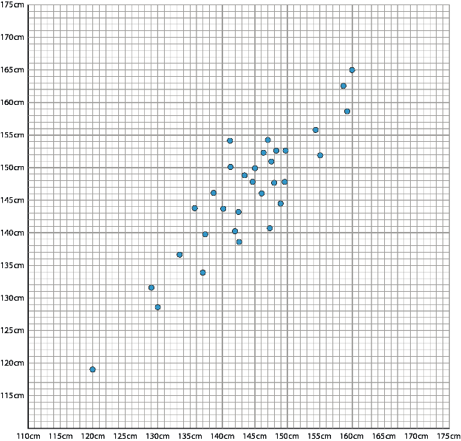
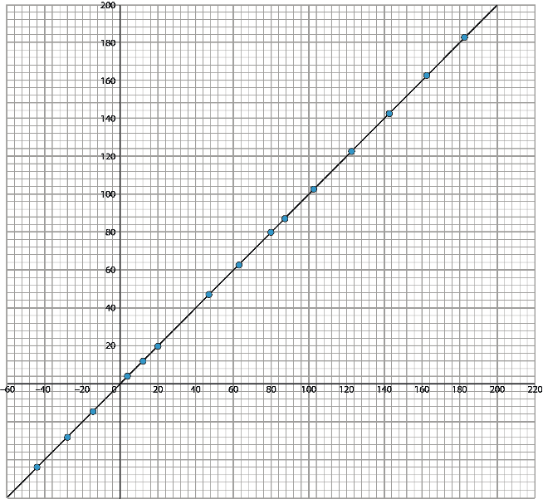
Checkpoint 7: Subject graphs
In science, Tyler measures the height and arm span of people in his class.
In maths, Tyler writes a list of coordinates where the x and y values are equal.
Which graph is which?
What is the same and what is different between Tyler’s two graphs?
Here are three more points: A (151, 150), B (251, 251) and C (151, 151).
Which graph could points A, B and C belong to? Explain how you know.
Notes:
This slide is animated. Each question will appear separately so you can choose the pace at which to work with your class. A printable version is available on slide 61 if you want students to be able to look more closely at the values.
Answers
a) The graph on the left is from the science lesson. The one on the right is from maths
b) Key points to consider are the way that the points plotted in maths must be on the line while the points from science are showing a trend, so will be spread out. In fact, it would be odd if all of the points were precisely on the line. Other points to consider: the science graph can only be within a certain range of measurements, while the maths graph is infinitely long in both the positive and negative directions; the science graph needs units.
? (151, 150) must be on the science graph as the two are not equal; (251, 251) must be on the maths graph because the values are too high; (151, 151) could be on either.
Suggested questioning
The axes on the science graph are not labelled as this would give away the answer to part a. How might they be labelled? Does that mean that a person above the line has long or short arms for their height?
Is it possible that someone's arm span and height fall exactly on the line? How likely do you think this is? Is it possible that no one's arm span and height fall exactly on the line? Is it possible that one of the points on the graph from the maths lesson falls exactly on the line? That one doesn't?
Things to think about
Talk to your science department colleagues about the order of their scheme of learning. It is very likely that students will have encountered lines of best fit in Year 7. If so, when you come to teach equations of lines in Year 8 or 9, this will not be their first experience of straight lines on graphs. Given the similar nature of the representations, there is some potential for misconceptions to be generated. Discuss what is the same and different about a line of best fit and the equation of a line, to pre-empt confusion. The way in which the graph from Tyler’s maths lesson is described means that students can access this Checkpoint before any formal teaching on equations of lines.

Slide 24
Checkpoint 7: Guidance
Adaptations | Assessing understanding
Support For insights into students’ current understanding, draw attention to the negative points plotted in the right-hand graph and ask about the height and arm span of those people. To support students in accessing the graphs more fully, record some students’ height and arm span, and model how they can be added to one graph but not the other (unless their height and arm span are identical!) Students could do this using the printable version). Challenge The length of your femur (measured sitting from your knee to your hip joint) is about one-quarter of your height. What would this look like on a graph? How would it be different to the graph of arm span and height? The length of your head (the vertical distance between the top of your head and your chin) changes from about one-quarter of a person’s height, for a very young child, to about one-eighth of their height for an adult. How would this look on a graph? Which of these two new graphs would be steepest? Representations Plotting a table of coordinates might help to make sense of both sets of axes and the possible relationships. Key to this task is the awareness that the same representation is used in a different way to explore and make explicit a relationship. | Students are very likely to first meet lines of best fit in their year 7 science lessons. This Checkpoint explores whether they can distinguish between a line of best fit (an approximation in which points are plotted to estimate a rule) and a graph of a function (in which a rule is used to plot points). Other than the certainty offered by plotting points according to a rule, explore other differences: the use of units on axes; the range of possible coordinates, for example, if (251, 251) could be on both graphs; and, connected to this, the continuation of the axes to include negative values.
Additional resources The line graph question on p29 of the Year 5 Primary Assessment Materials | NCETM gives another idea of how students may have seen data represented graphically in the past. Consider what misconceptions might arise from the similarities and differences between line graphs, scatter graphs and graphical representations of equations of straight lines.

Slide 25
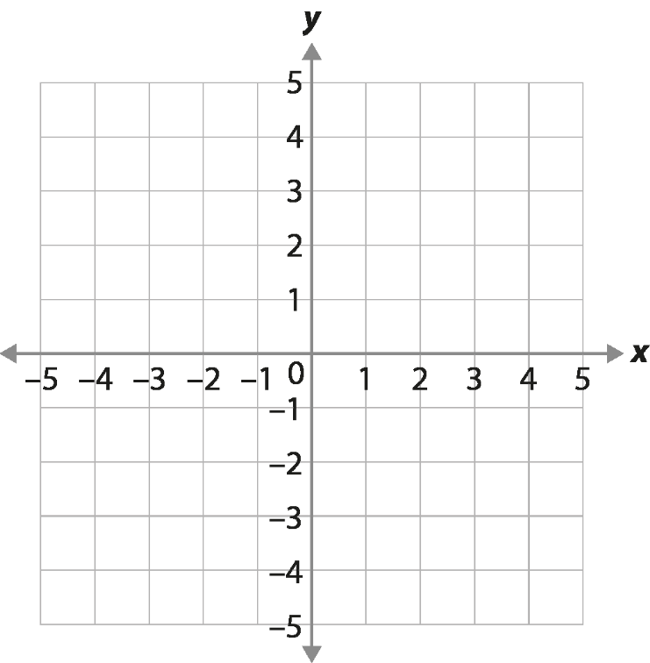
Checkpoint 8: Inbetweeners again
Think of a pair of coordinates that would be on the line between A and B.
Think of two more pairs.
Can you think of another one that no one else has yet?
Think of a pair of coordinates between C and D that is not on the line between A and B.
C
×
A
×
×
B
D
×
Can you think of a pair of coordinates that might be on the line between B and D?
Notes:
This slide is animated. Each question will appear separately so you can choose the pace at which to work with your class.
Answers
a), b), and c) Any coordinate where the x-coordinate is between -1 and 2 and the y-coordinate is 2. The questions have been structured to ensure that students think beyond integer coordinates, so they are likely to select (0, 2) and (1, 2) for either part a or b, and then start considering non-integers for their x-coordinate.
d) Any coordinate where the x-coordinate is 1 and the y-coordinate is between 1 and 2 or between 2 and 3 (but not including 2).
? Any coordinate where the x- and y-coordinates are equal, and between (but not including) 1 and 2.
Suggested questioning
Can you think of a pair of coordinates that no one else has?
Is there always another coordinate pair that you can think of?
How many possible answers do you think there are?
Things to think about
Many of the Checkpoints in this deck deal with integer coordinate pairs, or coordinates that sit on gridlines. This is necessary to assess how readily students spot relationships between the x- and y- coordinates or notice straight lines being formed on the grid, which is arguably easier with integers. This Checkpoint checks that students know, or remember, that there are an infinite number points in between these integers. This is a crucial concept, to fully understand that a line on a graph represents the infinite points that fit a mathematical rule. Note whether students tend towards decimals or fractions to describe these non-integer coordinates.

Slide 26
Checkpoint 8: Guidance
Adaptations | Assessing understanding
Support Precede the task with an exploration of numbers between integers on a single axis or number line. For example, ask students to give a number between 2 and 5, and another, and another. Challenge Take the further thinking question on by asking students for points between A and C. Representations This Checkpoint explores whether students understand the infinite number of points between the gridlines in a graphical representation. Provide students with graph paper with minor gridlines, to help them think about coordinate between the major grid lines – but be aware that students still need to understand that there are still infinite points between these minor gridlines, too. | Many of the Checkpoints in this deck assess whether students notice relationships between coordinates, and how readily they connect these to other coordinates with the same relationship. This, naturally, leads to an emphasis on coordinates that exist along the gridlines (that is, primarily integers). Checkpoint 8 offers an opportunity to check whether students understand that there are points between these integer coordinates. Use it alongside Checkpoints 4–6, to check students understand the infinite nature of the coordinate plane and that, between any two points on a line, there will always be another point between them. Horizontal and vertical lines are chosen here partly as they are easier for students to identify the coordinates on the line between two points, but also to offer an additional assessment opportunity. Do students understand terms like horizontal and vertical? Do they use them readily in explanations or need to be prompted? Do they notice that, for example, the y-coordinates of points on a horizontal line are the same? This information will help in planning lessons exploring the equations of horizontal and vertical lines.
Additional resources Additional activities G and H also explore non-integer coordinates and the concept that there are an infinite number of points between two given coordinates.

Slide 27
Gradient and rate
Checkpoints 9–15

Slide 28
Gradient and rate
Previous learning | In Key Stage 3 students need to
Key Stage 2 curriculum: Year 5: solve problems involving multiplication and division, including scaling by simple fractions and problems involving simple rates Year 5: solve comparison, sum and difference problems using information presented in a line graph Year 6: interpret and construct pie charts and line graphs and use these to solve problems Further information about how students may have experienced this key idea in Key Stage 2 is not available. These ideas are not explicitly referenced in either Teaching mathematics in primary schools or Primary Mastery Professional Development. Note the word ‘gradient’ is not referred to within the primary curriculum. Key Stage 3 curriculum: 3.1.1.1¹ Appreciate that any two numbers can be connected via a multiplicative relationship 3.1.1.4 Appreciate that there are an infinite number of pairs of numbers for any given multiplicative relationship (equivalence) 3.1.4.4 Use ratio to describe rates (e.g. exchange rates, conversions, cogs, etc.) ¹ This four-digit code refers to the key ideas in Secondary Mastery Professional Development | NCETM; the Key Stage 2 content underpinning these ideas is assessed in the ‘Understanding multiplicative relationships: fractions and ratio’ Checkpoints deck. | Understand gradient as a rate of change of one variable in relation to the other variable; for example, how the y-value increases (or decreases) as the x-value increases. Connect the concepts of gradient and intercept to their work on graphs and linear functions. Be aware that the two significant features of any straight line which enable it to be drawn uniquely – the rate at which x changes with respect to y (the gradient) and where the line is positioned in the plane (the intercept) – can be inferred by looking at the equation of the line.

Slide 29
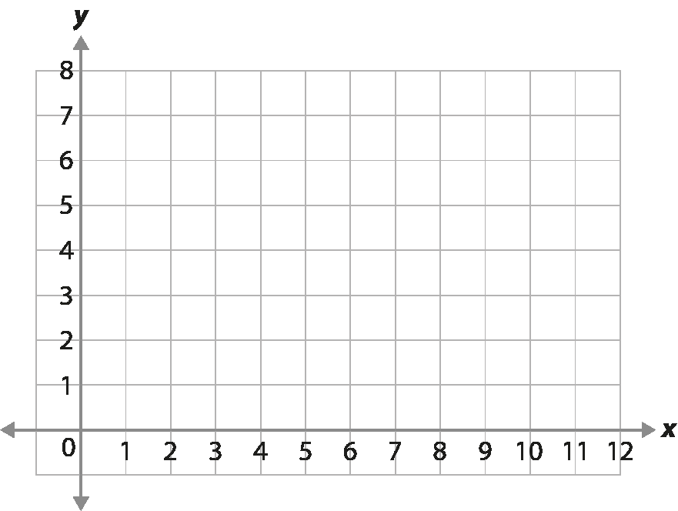
Checkpoint 9: For every…
On Monday, Ali and Darren are unpacking boxes.
For every two boxes Ali unpacks, Darren unpacks one.
One person has unpacked five boxes. How many has other unpacked?
Ali records how many boxes they unpack on a graph.
She plots one point (G).
Which axis is for Ali and which is for Darren?
What other points could be plotted?
On Tuesday, they unpack at different rates.
The coordinate H shows this.
Complete the sentence: For every four boxes Ali unpacks, Darren unpacks __.
x
H
x
G
Each day, they need to unpack 100 boxes in total. On which day do they do this faster? How do you know?
Notes:
This slide is animated. Each question, and the grid and each point, will appear separately so you can choose the pace at which to work with your class.
Answers
a) If Darren has unpacked five boxes, Ali has unpacked ten. If Ali has unpacked five boxes, Darren has unpacked two and a half.
b) The x-axis is for Ali and the y-axis is for Darren.
c) Any other point where the x-coordinate is twice the y-coordinate. For example, (2, 1), (4, 2), (8, 4) or (10, 5). Students might suggest that only integer coordinates can be chosen, so you might have a useful conversation about non-integer coordinate pairs and the part-boxes they would represent, such as the two and a half example from part a.
d) For every four boxes Ali unpacks, Darren unpacks three.
? Students could argue that they do this quicker on Tuesday because, for every two boxes Ali unpacks, Darren unpacks one and a half, compared to one on Monday. This might suggest they are unpacking three and a half boxes at the same rate that they unpacked three previously. However, there is no mention of Darren unpacking faster in the information given; it could be that Ali is unpacking slower. Therefore, students could also argue that they do not know which day they are unpacking faster.
Suggested questioning
Complete the sentence: For every __ boxes Ali unpacks, Darren unpacks ___.
How do you know which axis is which?
How would the graph look different if the axes were the other way around?
On Tuesday, is Darren unpacking faster? Can you tell?
Things to think about
Checkpoint 9 revisits a context explored in the Year 7 Checkpoints deck ‘Understanding multiplicative relationships: fractions and ratio’, that of ratio and rate. The language of ‘for every’ is a common structure for exploring multiplicative relationships win primary; check how readily students connect that understanding to a graphical representation. Starting to use a graphical representation for mathematical relationships can be a big leap in students’ understanding. Here, readiness for this leap is checked by not labelling the axes, so students have to show whether they can interpret the relationship/values as represented both graphically and in words.

Slide 30
Checkpoint 9: Guidance
Adaptations | Assessing understanding
Support Ask students for several examples of different numbers of boxes that Ali and Darren have unpacked and record these so that they are visible to students. This will give you something to refer students back to when choosing other points to be plotted in part c. Challenge Extend part d by offering further points and asking students to describe the relationship. Deepen students’ understanding by offering some different points that represent the same relationship. Representations This Checkpoint takes a ‘real-life’ example of a multiplicative relationship and connects it to a graphical representation. Students may not have encountered a relationship like this on a graph, but they will have experienced graphs with different variables for each axis. | Checkpoint 9 explores a common language structure used in primary to describe ratio and rate: that of ‘for every’. Part a checks understanding of a simple multiplicative relationship using this language. If students are not confident with this, offer more values for part a so that students practise using the relationship given. Part b introduces a graphical representation for this relationship. It is possible to access this without any formal teaching on linear graphs. The intention is to explore how readily students can interpret what each axis might represent based on the information given, to help you plan the language and examples you might use for teaching. There is no explicit intention to explore straight lines within this Checkpoint, although this is something that might come out of the other points that students suggest in part c. If this is the case, you may ignore part d and instead see how far students can take their interpretation of part c instead.
Additional resources There are multiple activities that explore this relationship within the ‘Understanding multiplicative relationships – fractions and ratio’ Checkpoints deck, which might be interesting to revisit and represent graphically as a next step.

Slide 31
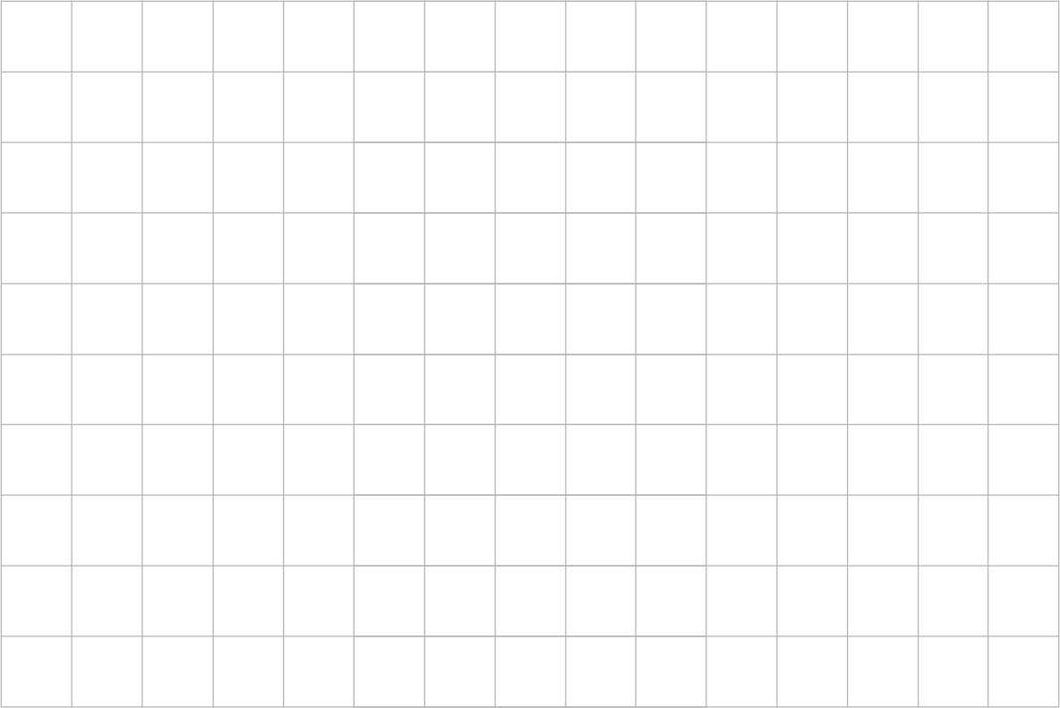
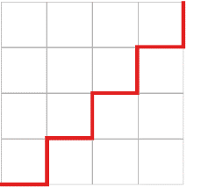
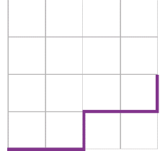
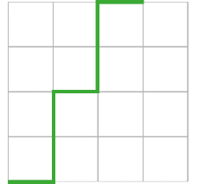
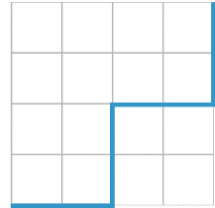

Checkpoint 10: Staircases
Some students are drawing staircase patterns across this piece of squared paper.
Below are the beginnings of their patterns.
Abdul
Benny
Cara
Denis
Whose pattern will reach the top of the page first? How do you know?
Who will reach the top of the page next?
Elsa
Elsa starts her staircase pattern at the top left of the page. How could you complete it so that it is the same steepness as each of the other patterns?
Notes:
This slide is animated. Each question will appear separately so you can choose the pace at which to work with your class. A printable resource is available on slide 62.
Answers
a) Cara will reach the top of the page first, as her staircase gains two squares of height for every one square across.
b) Abdul and Denis will both reach the top of the page next, as their staircases both gain two squares of height for every two squares across.
? To make Elsa’s staircase the same as Abdul and Denis’s staircases, you need to draw a vertical line that is three squares long, and then continue this pattern (three across, three down or equivalent).
To make Elsa’s staircase the same as Benny’s, you need to draw a vertical line that is one and a half squares long, and then continue the pattern (three across, one and a half down or equivalent). To avoid steps that are part-squares in height, students might suggest continuing the horizontal line for one more square and then drawing a vertical line that is two squares long (four across, two down).
To make Elsa’s staircase the same as Cara’s, you need to draw a vertical line that is six squares long, and then continue the pattern (three across, six down or equivalent).
Suggested questioning
What is the same and what is different about each of their staircases?
Which staircase would be most difficult to walk up if it was real?
What language might you use to compare different staircases?
Which staircase is the steepest?
Things to think about
Staircases are a common representation used to help students interpret the gradient of a line. When teaching graphs at Key Stage 3, teachers often start with the line and then model drawing the vertical and horizontal ‘steps’ underneath as a way of accessing the idea of gradient. This Checkpoint reverses the order, checking whether students understand the concept of steepness using steps before they are expected to use them to consider gradient more formally.

Slide 32
Checkpoint 10: Guidance
Adaptations | Assessing understanding
Support Give students a print out of the grid and different coloured pens so that they can model the different staircases. Challenge Build on the further thinking question by asking students to create staircases that would be in between the other staircases in order of steepness. Representations Staircases are used here as a visual representation of gradient. You might also encourage students to consider the real, physical staircases around school to help them consider and compare different gradients. See the comment about potential misconceptions in Assessing understanding. | Checkpoint 10 is a precursor to work on gradient, offering a context for students to compare the steepness of different staircase patterns. The word ‘steepness’ is not used until the further thinking question, so that you can see whether students volunteer it or need to be taught this vocabulary explicitly. Using this Checkpoint ahead of teaching on gradient of lines may also offer something to refer back to if you choose to model gradient by sketching out the ‘staircase’ of horizontal and vertical steps underneath a slope. Students often connect the idea of steepness with effort, so you may need to be prepared to respond to misconceptions about more steps meaning greater effort. In particular, this might be the case for Abdul and Denis’s steps; whilst Abdul has more steps, and Denis’s are bigger, both have the same steepness. The further thinking question considers a negative gradient, and how this can have the same magnitude even when it is in a different direction.
Additional resources Key idea 4.2.2.3 from Secondary Mastery Professional Development | NCETM explores ‘Writing linear equations in the form y = mx + c’ and might give some ideas for where to take this next in Key Stage 3. Examples 3–5 explore gradient.

Slide 33
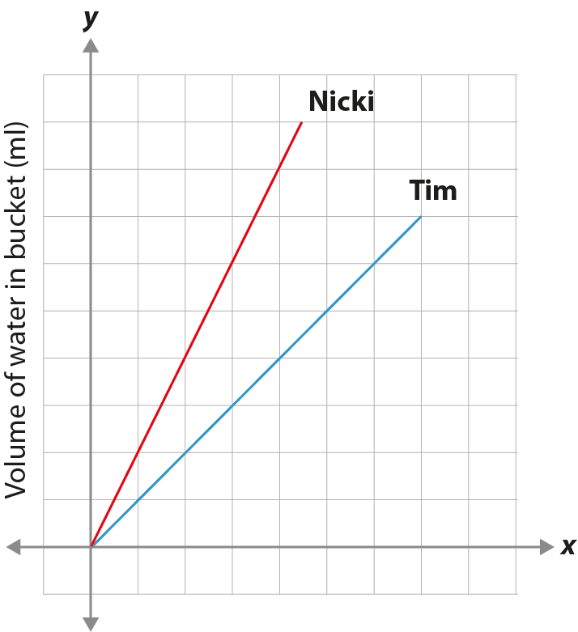
Checkpoint 11: Buckets
Nicki and Tim each fill a bucket.
Whose bucket was filled faster? How do you know?
Whose bucket was smaller?
Where on the graph shows when Nicki’s bucket was half full?
Where on the graph shows when Tim’s bucket was half full?
Where on the graph shows when Nicki had twice as much water in her bucket as Tim?
Volume of water in bucket (ml)
The capacity of Tim’s bucket was four litres. Nicki filled her bucket in 45 seconds.
Now you know this, what else do you know?
Time (seconds)
Notes:
This slide is animated. Each question will appear separately so you can choose the pace at which to work with your class. A printable version of the grid can be found on slide 63.
Answers
a) Nicki’s, because her line stops after the shortest time.
b) Tim’s, because his line stops at the lower capacity.
c), d) and e) See animated solutions on the next slide.
? We now know that the scale of the x-axis is that each square represents 10 seconds and that the scale for the y-axis is that each square represents 0.5 litres. We also know that Nicki’s bucket has a capacity of 4.5 litres and that Tim’s bucket took 80 seconds to fill.
Suggested questioning
What is the same and what is different about Nicki and Tim’s lines?
What does this tell you about their buckets, or how they filled them?
Whose line is shorter? Whose line is steeper? Whose line stops sooner?
How much bigger is Nicki’s bucket than Tim’s bucket?
How much quicker did Nicki get to the ___ litres than Tim?
Things to think about
Checkpoint 11 asks students to compare two lines with different gradients, to check their sense of real-life applications of gradient. Listen for the language students use: do they volunteer terms like ‘steeper’ to compare? If students find this hard, you might want to consider exposing them to simpler contexts to help build their understanding of a steeper line representing a faster rate. There are no values on the axes, so students focus on making comparisons between the gradient and position of the lines, rather than comparing values.

Slide 34
Checkpoint 11: Buckets (animated solutions for c-e)
Nicki and Tim each fill a bucket.
Whose bucket was filled faster? How do you know?
Whose bucket was smaller?
Where on the graph shows when Nicki’s bucket was half full?
Where on the graph shows when Tim’s bucket was half full?
Where on the graph shows when Nicki had twice as much water in her bucket as Tim?
Volume of water in bucket (ml)
X
X
The capacity of Tim’s bucket was four litres. Nicki filled her bucket in 45 seconds.
Now you know this, what else do you know?
Time (seconds)
Notes:
This slide is animated. The solutions for parts c, d and e will appear with each click.

Slide 35
Checkpoint 11: Guidance
Adaptations | Assessing understanding
Support Model plotting two comparable points on a graph. For example, compare pouring water into containers at different rates over 10 seconds. Show how the faster rate results in more liquid, and so a point that is ‘higher’ than the slower rate. Challenge Offer students different situations and ask them to draw a line that represents them. For example, draw a line that shows a bucket that is half the capacity of Tim’s being filled. Can you draw a line that shows it being filled quicker than Tim’s? How about slower? Representations Line graphs, with time as a variable, are used as a graphical representation that students may be familiar with from statistics and data at Key Stage 2. Consider what transferable knowledge there is between this representation and the graphical representation of linear equations that students will learn in Key Stage 3. | Checkpoint 11 offers a context for comparing lines and how students can interpret graphs before the formal teaching that comes at Key Stage 3. There is no scale until you use the information given in the further thinking question, so that students focus less on reading specific points and more on comparing the two lines. Students may find it hard to recognise which line represents a quicker fill rate and which represents a smaller bucket. Holding a metre stick to the board or drawing a line across/down from the end of the line to the axes may help this understanding. Students are unlikely to connect the concepts of steepness with rate, but listen for the language they use to try and compare the lines. This may help you plan the language to use when introducing linear graphs, and to think about what vocabulary might need to be taught or clarified first.
Additional resources The first question on p19 of the Secondary assessment materials also considers a real-life context for a graph, and comparing different gradients. Key idea 4.2.2.3 from Secondary Mastery Professional Development | NCETM explores ‘Writing linear equations in the form y = mx + c’ and might give some ideas for where to take this next in Key Stage 3. In particular, examples 3–5 explore gradient.

Slide 36
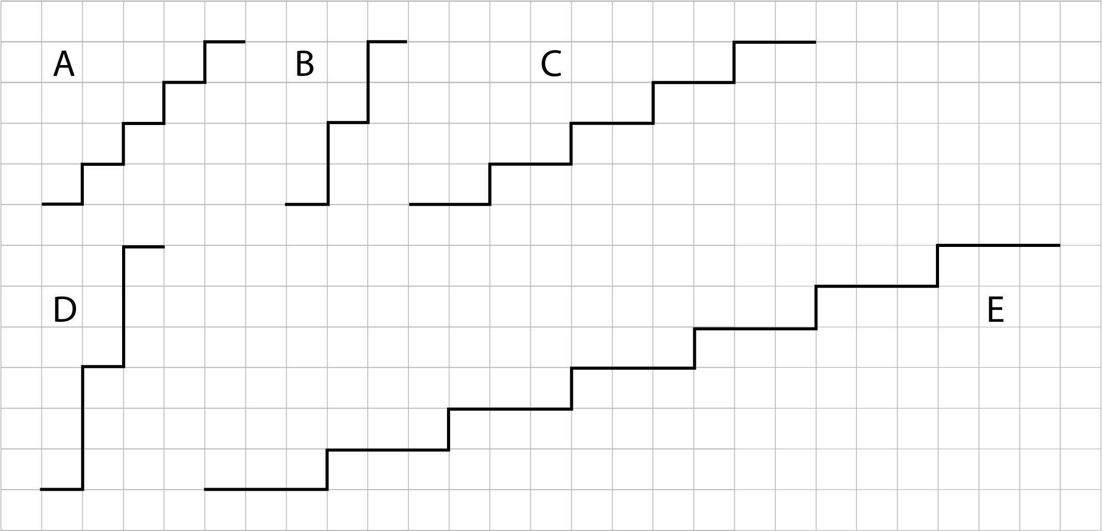
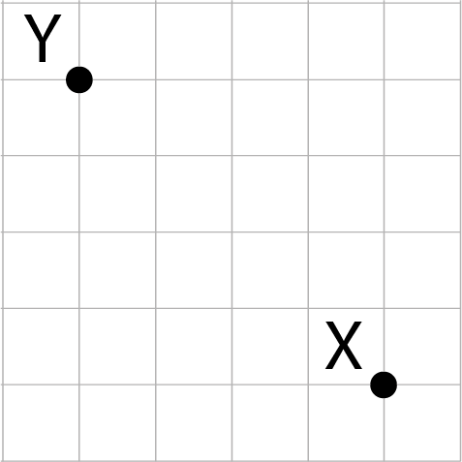
Checkpoint 12: Stepping up
Put these steps in order from steepest to least steep. How do you know?
Another set of steps join point X to point Y. Where would these steps go in your order of steepness?
Draw some sets of steps that are steeper than E but not as steep as C.
Notes:
This slide is animated. Each question will appear separately so you can choose the pace at which to work with your class. A printable resource is available on slide 64.
Answers
a) D, B, A, C, E
b) They will be the same steepness as A (but in a different direction).
? All of the steps considered so far have either a height or length of 1. This won't be possible if our steps are to be steeper than E but not as steep as C so options such as across 5 up 2, or across 7 up 3 will work.
Suggested questioning
What are you looking at to consider how steep the steps are? Is it just how high each step is? in which case, are C and E the same steepness since each step is 1 high?
What would happen to the steepness if the size of the steps was doubled? For example, if set B went along 2 and up 4?
Things to think about
Checkpoint 12 explores and compares different sets of steps in order to assess students’ understanding of gradient. Unlike Checkpoint 10, it uses the term steep as a different way of assessing whether students are familiar with this vocabulary.

Slide 37
Checkpoint 12: Guidance
Adaptations | Assessing understanding
Support Ask students how they might draw a line through the steps to show how steep they are – do they draw an accurate line through the vertices, or do they estimate through the centre of each step? Students could physically model this using the printable version. Explore with students what ‘steepness’ means to them and how it might be described. Challenge Given a start and an end point (as in part b), is it possible to create sets of steps with different gradient? Does the number of steps impact on the steepness? Which is steeper – a slope that goes along 3 m and up 4 m, or a slope that goes along 4 m and up 5 m. How do you know? Representations A verbal or written description can be a very helpful representation. Particularly helpful is the use of ‘for every’ as it connects the idea of slope and rate. | ‘Stepping up’ assesses students’ understanding of steepness and whether they are able to use a numerical value to describe it. The way that students choose to describe the way the steps are growing is key. Look for students who use ‘for every’ (for example, for every one it goes up, it goes right three) as this is an indicator that they have an understanding of rate. In preparation for teaching gradient, move towards refining and agreeing on a way to describe steepness: For every one across, it goes up/down__. Part b offers an opportunity to discuss how steps may have the same gradient but go in different directions. This is a useful idea to have discussed ahead of teaching graphs with negative gradients.
Additional resources Key idea 4.2.2.3 from Secondary Mastery Professional Development | NCETM explores ‘Writing linear equations in the form y = mx + c’ and might give some ideas for where to take this next in Key Stage 3. In particular, examples 3–5 explore gradient.

Slide 38
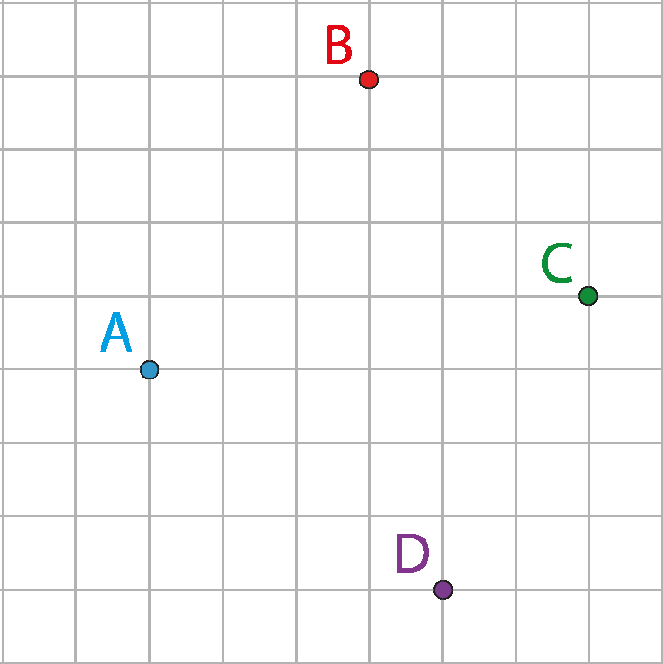
Checkpoint 13: Almost square?
Which is steeper?
B to D or A to D?
A to B or D to C?
A to D or B to C?
A to D or C to B?
The shape ABCD is nearly square. Move one point so that it becomes square. How can you be certain that it’s square?
Notes:
This slide is animated. Each question will appear separately so you can choose the pace at which to work with your class. Students may find this easier to interact with the image on paper, so a printable version is provided on slide 65.
Answers
a) B to D
b) D to C
c) B to C
d) C to B (Note – part d is a rephrasing of part c, to assess whether students think that direction is a part of steepness.)
? Moving point C one grid square to the right will make ABCD square.
Suggested questioning
Are any of the lines parallel? What would you look for to find out?
Are any of the lines perpendicular? What would you look for to find out?
Is there only one possible answer to the further thinking question? How about if you're asked to move two points to make a square?
Things to think about
Checkpoint 13 asks students to think about the steepness of lines without lines being visible. Watch what strategies students use: do they draw the lines? Draw staircases? Count squares? Their approach may help you to plan for teaching gradient more formally at Key Stage 3.

Slide 39
Checkpoint 13: Guidance
Adaptations | Assessing understanding
Support Invite students to draw points ABCD on squared paper. They are likely to need to count the squares between different points. This may offer the information they need to consider the relative steepness of each line. Alternatively, offer the printable version to annotate. Challenge Ask students to think about other squares that might be constructed off the grid, and to describe the position of the other vertices. For example, if AB forms the bottom right-hand edge of a square, where would the other two vertices be? How about if AC forms the bottom right-hand edge? Representations The representation here is given without axes. This focuses students on a particular approach to comparing gradients (counting squares). Relating to the properties of a square may help you to make links with relevant areas of geometry, a helpful connection as students are working with familiar properties. | ‘Almost square’ explores students’ understanding of gradient by considering steepness. The steepness is not, however, broken into steps, but is used to think about and describe whether lines are parallel or not. The lines are close to being parallel, so students will need to justify their decisions. The use of the grid to quantify steepness is key – look for students who consider a change per unit, maybe using the words ‘for every’. Also, those who are aware that the same steepness implies that the lines are parallel, and who are able to count squares to measure the distance between points to see if they are equidistant. Parts c and d invite discussion about whether the direction impacts on the steepness, and offers useful information about students’ understanding. The switch in direction (from C to B) is deliberate to provoke discussion.
Additional resources Key idea 4.2.2.3 from Secondary Mastery Professional Development | NCETM explores ‘Writing linear equations in the form y = mx + c’ and might give some ideas for where to take this next in Key Stage 3. In particular, examples 3–5 explore gradient.

Slide 40

Checkpoint 14: Race to the centre
Jane starts here
Jane and Ross are playing a game.
What are their starting coordinates?
Their teacher writes some different rules for how to move from a starting coordinate to the next coordinate. They each pick a rule and plot their next two coordinates.
What might Jane’s rule be?
What might Ross’s rule be?
The aim of the game is to reach the origin first. Who will win?
How could you change the other person’s start coordinate so that they win?
x
x
x
x
x
x
Ross starts here
Dahlia picks a rule: ‘right two, down one’. Where could she plot her starting coordinate to be sure she gets to the origin? Is there more than one answer?
Notes:
This slide is animated. Each question will appear separately so you can choose the pace at which to work with your class. A printable version is provided on slide 66.
Answers
a) Jane: (-3, 5); Ross (-5, -5)
b) Jane’s rule might be go right 1 and down 2.
c) Ross’s rule might be go right 1 and up 1.
d) Ross will win. Although he will take more moves to get to the middle area of the grid, one of his coordinates would actually be (0, 0). Jane’s line does not pass through the origin.
e) Jane could change her starting coordinate to (-2, 4) or (-1, 2) to ensure one of her coordinates is (0, 0).
? On this grid, Dahlia could plot her coordinate at (-2, 1) or (-4, 2).
Suggested questioning
If you put your finger on Jane or Ross’s first coordinate, how would you describe the movement you need to do to get to their second coordinate?
How do Jane and Ross move horizontally and vertically between their second and third coordinates?
What might be the best first coordinate if the rule is…?
Is a coordinate near the centre always going to be best? Why or why not?
Things to think about
The animation, revealing a little more each time, is key for this Checkpoint. Part a simply checks whether students read coordinates correctly; parts b and c step up quite quickly to consider relationships between points. Listen to students’ language: this Checkpoint uses the idea of movement between coordinates, so see if students connect this to their work on translation.

Slide 41
Checkpoint 14: Guidance
Adaptations | Assessing understanding
Support Focus less on the idea of winning the game by aiming for the origin, and more on the points generated by the rules. For example, after part c, ask students to plot more points with Jane and Ross’s rules; then a completely different set of points with the same rules; and then another set that includes a specific point such as the origin. Challenge Ask students to play the game. Write different rules and ask them to pick one, as well as a starting coordinate, and see who reaches the origin. If they both reach the origin, who reaches it first? Representations This Checkpoint focuses on one aspect of graphical representations: using the idea of movement across the plan to understand gradient. You could mark on the horizontal and vertical movements between each consecutive point; students might find it helpful to interact with the printable version. | ‘Race to the centre’ uses the premise of a coordinate game to explore students’ readiness for learning about linear relationships – particularly gradient. The phrasing of the rule being ‘how to move from a starting coordinate to the next coordinate’ focuses them on steps between coordinates, rather than on the relationship between x- and y-coordinates within a rule. This will help you to assess how students work with the coordinate grid, particularly with using the concept of translation to describe a trend in sets of coordinates, to prepare for teaching on gradient. Students responses to part b and c, and the language they naturally reach for to describe this movement between coordinates, may help you to plan how to introduce this concept. For part d, students may think that Jane has won as her coordinate will go past the origin before Ross’s. Discuss what it means for a line to go through the origin.
Additional resources Additional activity F also asks students to predict coordinates that follow a pattern, this time explicitly on a line.

Slide 42
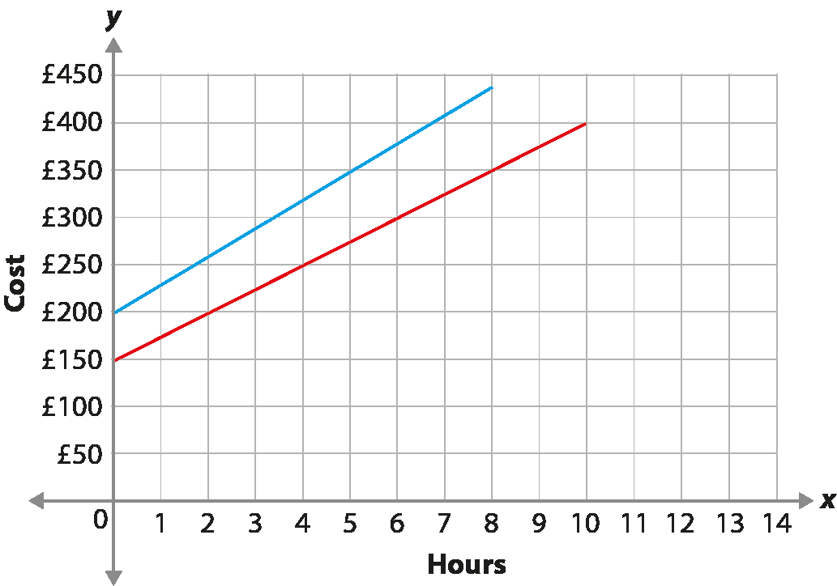
Checkpoint 15: Gardeners’ time question
Gardener A
Two different gardeners work in the local park. They each buy some trees and flowers and then charge a set amount for each hour it takes to plant them all.
Explain how you could use this graph to find out how much each gardener spent on plants.
How could you use it to find out about their hourly rate?
Gardener B
One of the gardeners says that the job will take 10 hours, the other says eight hours. How much would each gardener charge to complete the job?
Notes:
This slide is animated. Each question will appear separately so you can choose the pace at which to work with your class. Printable versions of the grids are available on slide 67.
Answers
a) The starting point of each graph, when the time = 0, will be the cost of the plants. Gardener B (red line) spent £150 and gardener A (blue line) spent £200.
b) The hourly rate is by how much each line increases for every hour worked. It's possible to estimate this by looking at a one-hour interval. It can be calculated exactly by looking for points where the line goes through an integer coordinate point. For example, the red (Gardener B) line goes up £50 for every two hour interval, so the hourly rate is £25. The blue (Gardener A) line goes up £150 for every five hour interval, so the hourly rate is £30.
? Gardener A (blue): £440 for 8 hours; Gardener B (red): £400 for 10 hours.
Suggested questioning
When introducing the graph, ask ‘What do you notice, what do you wonder?’
How can you tell by looking at the graph that the gardeners charge different hourly rates? Which gardener charges the higher rate?
Which gardener takes the longest to do the job? How do you know?
If the park committee can only choose one gardener in future, which should they choose? Explain your reasons.
Things to think about
This last Checkpoint offers a real-life context for graphs. No understanding from Key Stage 3 is needed to access the task. Instead, the questions are phrased to help you to gauge the pitch and content for your own teaching of real-life graphs. How readily can students identify how the information is represented graphically?

Slide 43
Checkpoint 15: Guidance
Adaptations | Assessing understanding
Support Work with students to identify some key points on the graph; giving the printable version to interact with may be useful. Ask: ‘How much have the gardeners each charged before starting to plant? Roughly how much does each gardener charge after one hour? Can you be more precise than that estimate by choosing a different length of time?’ Challenge Consider how changes to the situation would impact the way that the graphs look. Use prompts such as: ‘If each gardener spent £50 more on plants, what would change on the graphs? If each gardener reduces their rate by £5 per hour, what would change on the graph?’ to challenge students to work between the two representations of the situation. Representations The context and graph can both be considered representations here. It is important that students are able to connect the two and understand how a change in the relationship might impact on each representation. | This Checkpoint reveals how students connect graphical representations to real contexts, identifying the key features of the graphs and using them to make sense of situations. The prompts used in parts a and b and the further thinking question all relate to features of the graph: the intercept, the gradient, and the end point of the line segment respectively. Students who are able to make these connections are likely to have a good understanding of these features of the graph, although they are unlikely to have language such as gradient and intercept to make their understanding clear.
Additional resources Additional activities D and E offer other contexts to explore to assess students’ initial instincts for interpreting graphical representations of real-life situations. The question on p39 of the Year 6 Primary Assessment Materials | NCETM gives an example of how students may have interpreted graphs of real-life contexts in primary.

Slide 44
Additional activities
Activities A–H

Slide 45
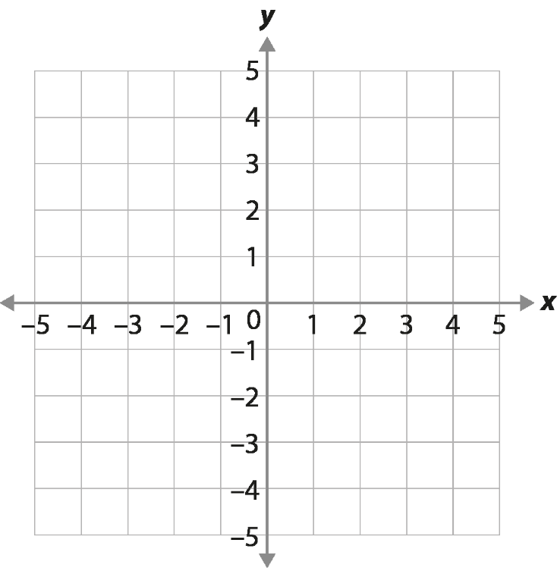
Activity A: Four in a row
Franca and Mark are playing a game.
The aim is to plot four coordinates in a row.
What are Franca and Mark’s first coordinates?
The coordinate marked ? is the next coordinate plotted.
If it is Franca’s, what other coordinates might she be planning to plot? What do you notice about her coordinates?
If it is Mark’s, what other coordinates might he be planning to plot? What do you notice about his coordinates?
Franca
x
x
?
x
Mark
The third coordinate was Franca’s. Is it possible for Mark to win? Continue playing the game with a partner and see if you can find a way for either Franca or Mark to win.
Notes:
This slide is animated. Each question, and the coordinates they refer to, will appear separately so you can choose the pace at which to work with your class. Printable versions of the grid are available on slide 68.
Answers
All of the answers below suppose that Franca and Mark have to give integer coordinates; you may or may not choose to specify that this is the case. For parts b and c below, there are infinite possible solutions if non-integer coordinates are allowed, as long as the final statement given remains true.
a) Franca: (-1, 1), Mark: (-1, -1)
b) Franca might be planning to plot (0, 1) and either (-2, 1) or (2, 1). All of her coordinates have a y-coordinate of 1.
c) Mark might be planning to plot (0, 0) and either (2, 2) or (-2, -2). All of his coordinates have an x-coordinate that is equal to the y-coordinate.
? It is possible for Mark to win – if he blocks Franca by plotting one of his points with a y-coordinate of 1. It is possible for either person to win, depending on the sequence of steps. Encourage students to try some different ideas to get different outcomes.
Suggested questioning
What should Franca do to ensure she wins? How about Mark?
Are there any other points on both lines? Why or why not?
What do you notice about all of Mark’s coordinates? Is it possible to get a diagonal four in a row where the x- and y-coordinates are not the same as each other?
What do you notice about all of Franca’s coordinates? What would be the same and what would be different if her line was vertical rather than horizontal?
Things to think about
Additional activity A uses the context of a game to consider how coordinates might form lines. It offers a slightly different direction ‘in’ to graphs compared with Checkpoints such as 1, 2, 5 and 6. In these Checkpoints, the focus is on checking whether students notice the relationship between coordinates first, and the idea that these coordinates form a line is a less crucial assessment point. Instead, here, students generate the coordinates according to the visual pattern/line and then look to see what they notice. Consider your own scheme of learning and how you introduce coordinates. Which approach will give you the most useful information about how to pitch your lessons appropriately for students’ prior learning? This game is also something that you might consider letting students play, to practise plotting coordinates and starting to think about some lines.

Slide 46
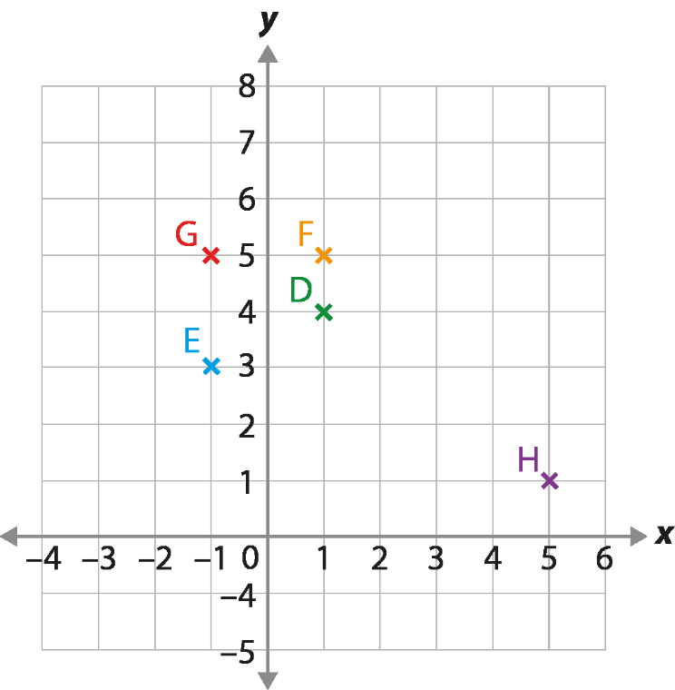
Activity B: Plotting rules
Esme is given a starting number and adds four to it.
She uses her starting number as an x-coordinate and her new number as a y-coordinate.
Which of the coordinates given could be Esme’s?
Where else on the grid can Esme mark her position?
What might be a coordinate that follows Esme’s rule, but isn’t on this grid?
For the coordinates that weren’t Esme’s, how might the y-coordinate have been calculated?
Notes:
This slide is animated. Each question will appear separately so you can choose the pace at which to work with your class.
Answers
a) E and F
b) Esme could mark coordinates at (-4, 2), (-3, 1), (-2, 2), (0, 4), (2, 6), (3, 7) and (4, 8). Students might also suggest some coordinates between the grid lines, for example (0.5, 4.5), which suggests a deeper understanding of the infinite number of points between those given.
c) Any coordinate where the y-coordinate is 4 more than the x-coordinate, and x is greater than 6 or less than -4.
? There are an infinite number of solutions to this, as students could use more than one calculation in their rule. A single additive or single multiplicative step are the most likely for students to choose at this stage:
G: add 6 to the starting number or multiply the starting number by -5.
D: add 3 to the starting number or multiply the starting number by 4.
E: add 4 to the starting number or multiply the starting number by -3.
Suggested questioning
How do you know whether one of these coordinates follows Esme’s rule?
Does writing the coordinates down help?
What do you notice about the coordinates that follow Esme’s rule? Can you predict where another one might be?
Complete the sentence: the value of the y-coordinate is the x-coordinate _____.
Things to think about
Additional activity B is an alternative way of exploring the ideas from Checkpoint 2. The guidance slide for Checkpoint 2 offers insight into the key assessment points.

Slide 47
Activity C: More odd coordinates out
On the right is a set of coordinates.
Which one do you think is the odd one out?
Plot the coordinates on the grid.
What do you notice? Do you want to change your answer to part a?
Repeat parts a to c for the three sets of coordinates below.
(0, 0)
(-1, 1)
(2, -2)
(-3, -3)
(4, -4)
(0, 0)
(2, 5)
(1, 3)
(-1, -1)
(-2, -3)
(0, 0)
(-2, 4)
(1, 1)
(-1, 3)
(2, 0)
(0, 0)
(-2, -1)
(1, 2)
(4, 2)
(6, 3)
Change the odd ones out in each set of coordinates so that they fit into the group.
Notes:
This slide is animated. Each question, and the grid, will appear separately so you can choose the pace at which to work with your class. A printable resource, with four grids, is available on slide 69; we suggest that this is given after students have completed part a without access to a grid.
Answers
Students might want to change their answer to part a based on their experience of part c. Collect answers to part a for your own assessment purposes, but do not reveal the correct answer until students have had a chance to try parts b and c.
a) (-3, -3). Students might notice that in every other pair except (0, 0) there is one negative and one positive. Another way of describing this is that one coordinate is the product of the other coordinate and -1.
b) See the animated solutions on the next slide.
c) Students should notice that all points except (-3, -3) form a straight line. If they did not choose (-3, -3) as their odd coordinate out, but have plotted all points correctly, they might wish to change their answer to part a.
d) See the animated solutions on the next slide. The odd one out is (0, 0) in the first (lightest) set, (0, 0) in the middle set and (1, 2) in the third (darkest) set.
? (-3,-3) could be changed to (1, -1) or (3,-3); (0,0) could be changed to (0,1) or (-3, -5); (0,0) could be changed to (0,2) or (-3,-1); (1,2) could be changed to (2,1).
Suggested questioning
What do you notice about the x-coordinate compared to the y-coordinate?
Is there more than one way to define the odd one out? Do you still think that after plotting the points?
What do you notice about the way the points are arranged?
Could you think of another pair of coordinates that would fit into the set?
Things to think about
Additional activity C is a version of Checkpoint 6 that offers some slightly more complex relationships, where there is both an additive and a multiplicative step. This may make it more challenging for students to spot the odd one out from the coordinates alone. See the Guidance for Checkpoint 6 for more information about assessment.

Slide 48

Activity C: More odd coordinates out (animated solutions)
x
x
x
x
x
x
x
x
x
x
x
x
x
x
x
x
x
x
x
x
(0, 0)
(-1, 1)
(2, -2)
(-3, -3)
(4, -4)
(0, 0)
(2, 5)
(1, 3)
(-1, -1)
(-2, -3)
(0, 0)
(-2, 4)
(1, 1)
(-1, 3)
(2, 0)
(0, 0)
(-2, -1)
(1, 2)
(4, 2)
(6, 3)
Notes:
This slide is animated. Each point will appear separately, in the order that they appear in the list. The odd coordinate out will the be highlighted red and underlined.

Slide 49
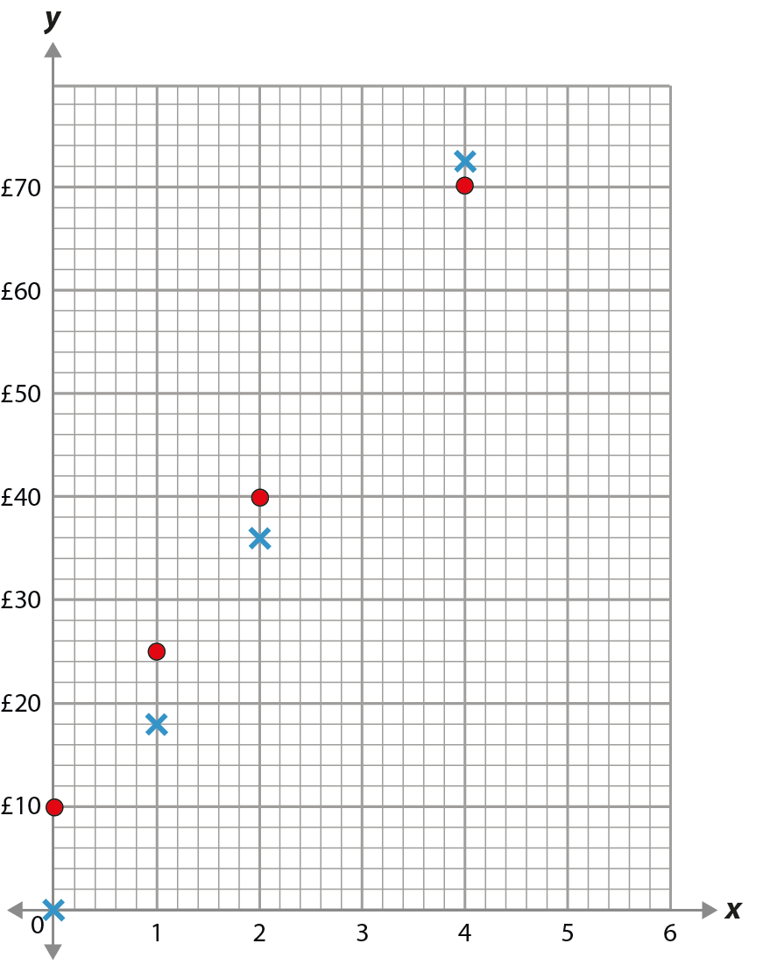
Activity D: Plumbers
Key: Plumber A Plumber B
Julia is choosing between two plumbers. They each use a different rule to work out their pay.
She plots the two rules on a graph.
What is the same and what is different about the two rules?
Which plumber do you think charges for their travel time?
Which plumber costs more for three hours? How can you tell?
Cost
Create your own rule that would be more expensive than both plumbers before five hours, but cheaper after.
Hours worked
Notes:
This slide is animated. Each question will appear separately so you can choose the pace at which to work with your class. You may wish to give printed copies of the grids (see slide 70) to students, to see how they choose to interact with the information to answer the questions.
Answers
a) The same: both increase every hour.
Different: Plumber A’s rule starts at 0, but Plumber B’s starts at 10; Plumber A’s rule goes up by £18 every hour, Plumber B’s goes up by £15.
b) Plumber B, as their first point is at £10 even after 0 hours.
c) Plumber B (£55, versus Plumber A £54). Students might work this out by plotting the missing points on the graph; by adding £15 and £18 to the respective values for each plumber at hour two; or by subtracting £15 and £18 from the respective values for each plumber at hour four.
? Any valid rule where the outcome for four hours is greater than £72, but the outcome for five hours is less than £85. For example, charge £33 for travel time and then charge £10 per hour.
Suggested questioning
What do you notice about the graph? What do you wonder?
If you connected the points with a line, which would be steeper? Where would the lines cross?
Who charges most per hour?
How would Plumber A’s graph change if they changed their rule to include £20 for travel time?
Things to think about
‘Plumbers’ assesses whether students are able to connect a real-life situation with a mathematical representation – in this case the rules that plumbers use to work out their pay. Unlike the contexts in Checkpoint 15 and Additional activity E, here one graph starts at 0 and the other doesn’t – discuss what is the same and what is different, and why this might be. The points are not connected by lines, so that you can see how students choose to interact with the graph to answer the questions. For part c, notice how they use the information they have to work out what the values might be for three hours. Do they take values from the graph and work numerically? Do they connect the existing points with a line? Do they ‘step up’ horizontally and vertically from the points at two hours? Their approach might help you understand more about how comfortable they are with interpreting graphs.

Slide 50
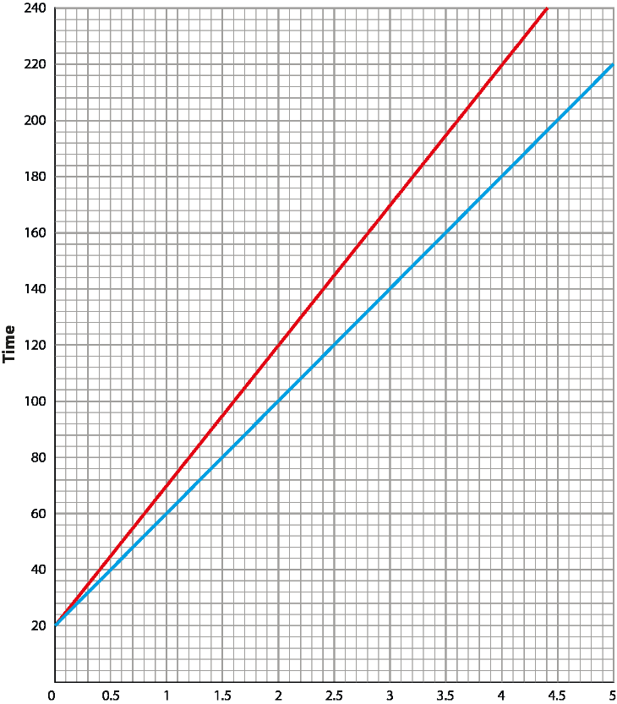
Activity E: Roast dinners
Sam is roasting a lamb joint. His recipe book gives two options for the cooking times, in minutes.
Medium:
40 × weight (in kg) + 20
Well done:
50 × weight (in kg) + 20
On the graph, what does the x-axis represent?
What are the units for the two axes?
What is the same and what is different about the two lines?
How much longer would it take to cook a 4 kg lamb joint so that it is well done rather than medium?
Sam wants to cook a 6 kg lamb joint. How could he use the graph to work out the cooking times?
Notes:
This slide is animated. Each question will appear separately so you can choose the pace at which to work with your class. There is a printable copy of the graph on slide 71.
Answers
a) The weight of the lamb in kilograms.
b) The x-axis unit is kilograms; the y-axis unit is minutes.
c) The same: both lines start at 20 (because both formulae involve + 20).
Different: the red (top) line is steeper than the blue (bottom) line. Students might suggest that this is because the red line represents the well done formula, which has a bigger multiplier.
d) 40 more minutes.
? What students suggest may offer insight into how confident they are with interpreting graphical data and with multiplicative reasoning. For example, they might suggest extending the graphs until the x-axis includes 6. Alternatively, they might read the value for 3 kg and double it, or the value for 2 kg and triple it, or the value for 1 kg and multiply it by 6. Some students might read the value for 5 kg and 1 kg and add them; this might suggest they are still more comfortable with additive than multiplicative reasoning.
Suggested questioning
Which line is which?
Why do both lines start at 20?
How long would a __ kg lamb joint take to cook? What if it weighed one more kilogram?
Which do you find easer to use for part d, the graph or the formula?
Can you write your own set of instructions? What would the graph look like?
Things to think about
‘Roast dinners’ assesses whether students are able to connect a real-life situation with a mathematical representation – in this case, a recipe. The formulae and the graphs can both be considered representations here. The formulae previously featured, without the graph, in the ‘Expressions and equations’ Checkpoints deck. It is important to know if students are already able to connect the two representations to the context, as this will impact upon how much support they might need when they are more formally introduced to graphical representations. Students are likely to consider which line relates to which formula, and it is this awareness that can give insight into their preliminary understanding. Do they know, or can they reason, that the greater multiplier will lead to a steeper graph? Informal language is probably more likely to be used, such as describing one line as ‘going up quicker’ than the other. In part d, notice whether students can work between the representations, using the most appropriate representation to answer the question efficiently. Probe if students can predict how a change in the relationship might impact on each representation.

Slide 51
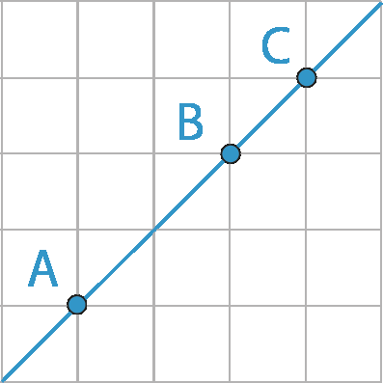
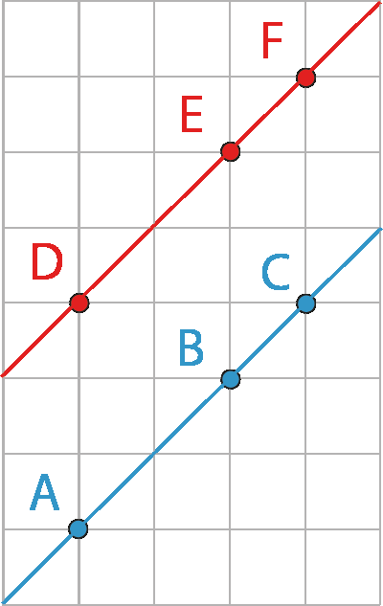
Activity F: On the line
The coordinates of point A are (37, 37), B (39, 39) and C (40, 40). The three points form a line.
Write three more coordinates that will be on the same line.
Points D, E and F also form a line.
Write down three more coordinates that will be on this line. How do you know?
Is it possible to answer part b so that one of the coordinate values is negative and one is positive? How do you know?
Imagine a line drawn through A and E. Write down the coordinates of three points that will be on this line.
Notes:
This slide is animated. Each question will appear separately so you can choose the pace at which to work with your class.
Answers
a) Any points where the x and y coordinates are equal.
b) Any points where the y coordinate is three more than the x coordinate.
c) It is possible to have a negative x value with a positive y value, but it is not possible to have a positive x value with a negative y value
? A to E is 'across 2 and up 5'. Students are likely to continue this pattern, so if E is (39, 42), another point might be (41, 47) or (43, 52).
Suggested questioning
Can you tell me a point on the line which is really far away from the origin? Which is really far away in a different direction?
How would you convince someone that the point (168, 171) is on the line with points DEF?
What's the relationship between line with points DEF and the line with points ABC?
Things to think about
Additional activity F takes some of the ideas explored in Checkpoints 6 and 14 but asks students to think beyond the -10 to 10 range for the axes that they are likely to be most familiar with. Check the depth of their understanding: are they able to continue patterns and rules without the axes being visible, and into values of coordinates that they may have worked less with? Part b might be a particularly ahead of teaching on the y-intercept and what this means.

Slide 52
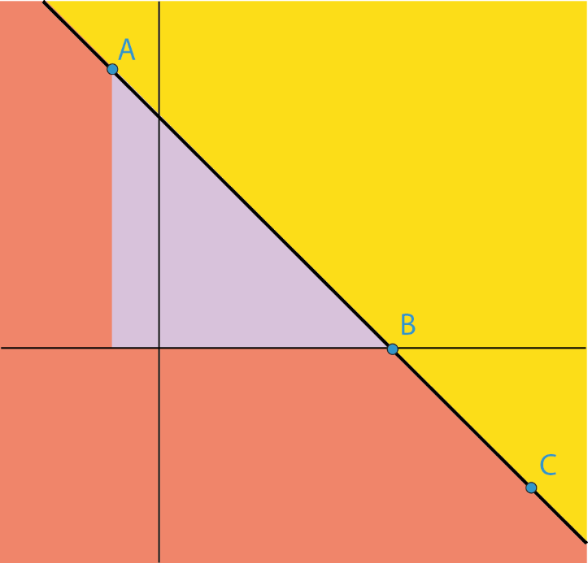
Activity G: Mark the points
Three points are marked on a set of axes.
A (-2, 12)
B (10, 0)
C (16, -6)
Write down the coordinates of a point:
in the yellow (right-hand) section
in the orange (left-hand) section
in the purple (middle) section
on the line formed by A, B and C.
yellow
purple
orange
Write down some other points on the line. How do you know that your points must be on the line?
Notes:
This slide is animated. Each question will appear separately so you can choose the pace at which to work with your class.
Answers
a) Students are likely to choose one of the given points, A, B or C, and add to the y-coordinate of that point. For example, using A as a starting point, a coordinate pair of (-2, y) where y is any number greater than 12 will be a solution. A general rule to check solutions is that x + y >10.
b) As with part a, students are likely to use the given points as a reference. A general rule is that x + y <10 but that the x-coordinate cannot be between –2 and 10 if the y-coordinate is positive.
c) The purple section is bounded by x + y =10, x = -2 and y = 0. Any points within this are valid. The next slide shows the grid to make it easier to identify solutions.
d) The line is x + y =10, so any points where the x- and y-coordinates sum to 10 is valid.
? The line is x + y = 10, so any values that obey this rule will be correct.
Suggested questioning
If the value of the x-coordinate is really big, will the point be in a yellow, orange or purple section? How do you know? What information might help?
Mark a point that is either directly above or directly beside on of the given points: what can you tell about the x- or y-value of its coordinate?
Point to the bottom left corner of the purple triangle and identify the coordinates. How do you know?
Things to think about
Students will not encounter representing inequalities and regions on graphs until Key Stage 4. However, the ideas that sit behind these concepts can be explored to check students’ understanding of coordinates on the plane using Key Stage 2/3 knowledge and understanding. How strategically students think will give an insight to their understanding and how well they estimate in the context of coordinates. Do they realise, for example, that if they pick an x-coordinate of 8 for part a, that their y-coordinate will need to be more than 2? Do they pick a ‘big’ y-coordinate (like 12, in line with point A) to be on the safe side, or do they have a sense of how close to the line they can get?

Slide 53
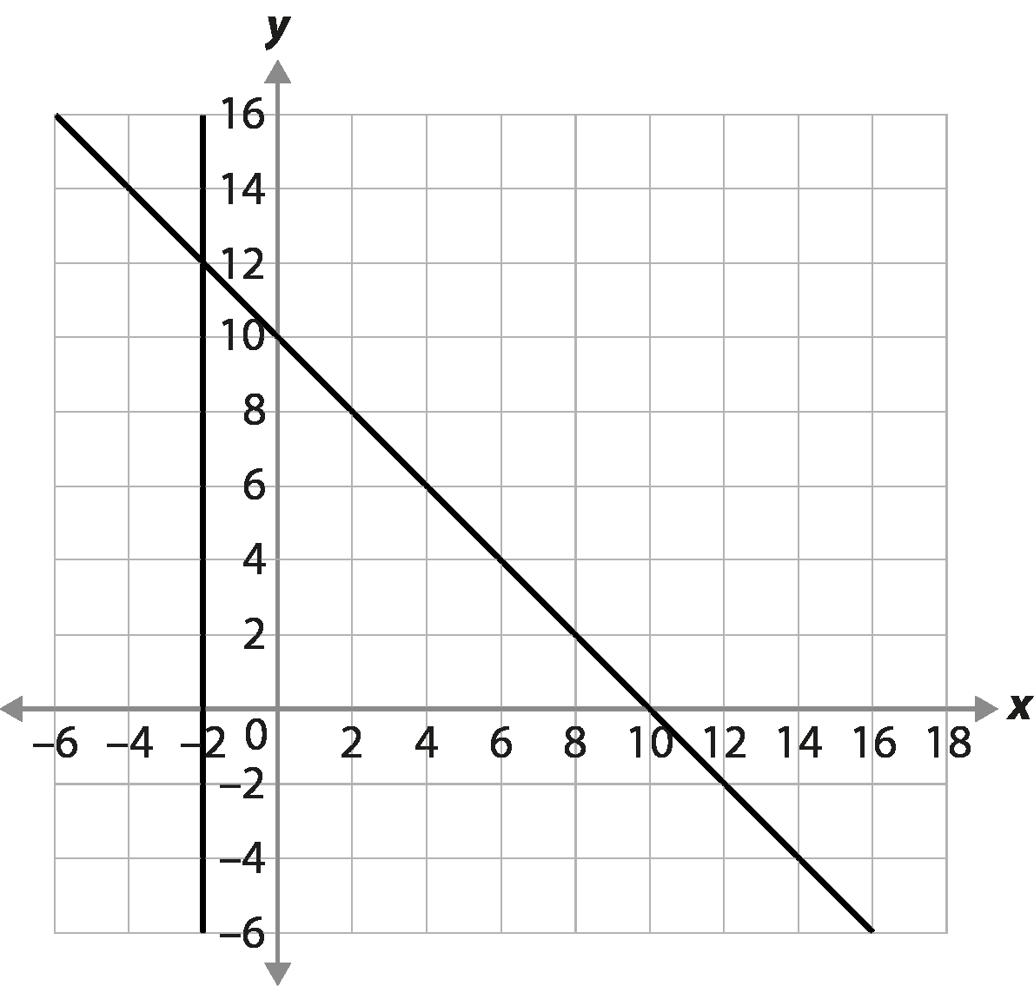
Activity G: Mark the points (solutions to part c)
Notes:
Additional Activity G: integer solutions to part c can be easily tested using this slide.

Slide 54
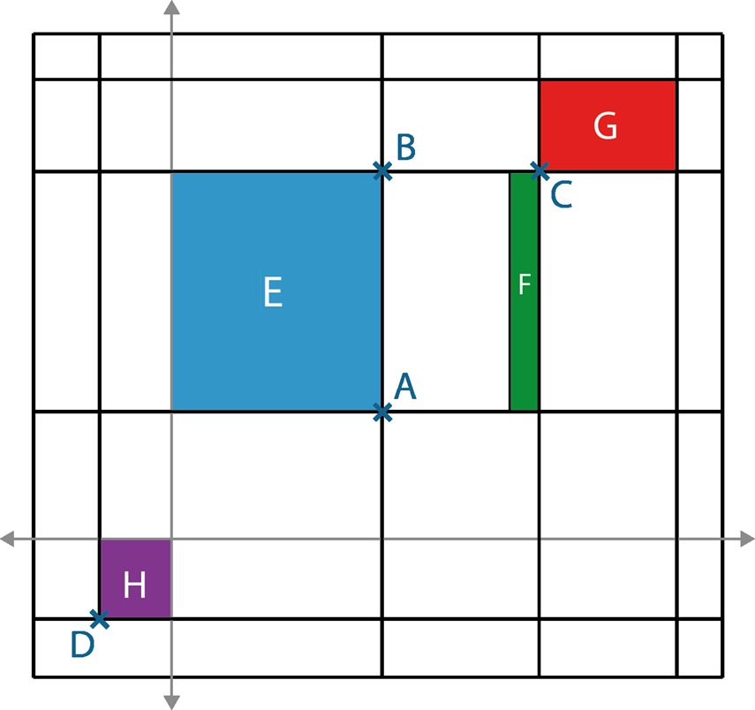
Activity H: Mathematical Mondrian
Piet draws some lines on a set of axes. All the lines are vertical or horizontal.
The coordinates of the points marked are:
G
A (4.5, 2.8)
C (8, 8)
B (4.5, 8)
D (-1.6, -1.7)
E
F
Write down the coordinates of a point in each of the blue (E), green (F), red (G) and purple (H) sections.
Are you able to give the coordinates of any of the other vertices of the coloured sections?
H
If you know these points, what other points do you know? Can you identify the coordinates (either complete or partial) of any other intersecting lines?
Notes:
This slide is animated. Each question will appear separately so you can choose the pace at which to work with your class. A printable copy is provided on slide 72.
Answers
The next slide shows the picture with the gridlines and axes marked, to allow for checking solutions.
? You can give the x-coordinate for any point that is on a vertical line with a known coordinate (for example, all the points on the same vertical line as A will start (4.5, y). Similarly, you can give the y-coordinate for any point that is on a horizontal line with a known coordinate (for example, all the points on the same horizontal line as A will end (x, 2.8). Where two lines intersect with known coordinates on both lines, the full coordinates can be given. For example (-1.6, 2.8) is the intersection of the vertical line with point D on and the horizontal line with point A on.
Suggested questioning
Pointing to a vertical line: what can you tell about all the x-coordinates along this line? What about all the y-coordinates?
Pointing to a horizontal line: what can you tell about all the y-coordinates along this line? What about all the x-coordinates?
Pointing to an intersection: which coordinates can you be sure of? Which do you have to guess?
Things to think about
Additional activity H explores similar ideas to Additional activity G. While it doesn’t involve any diagonal lines (which removes some challenge), the number of lines and the fact that some coordinates are not integers brings different complexities. Finding coordinates in the blue (E) and purple (H) sections will be the most straightforward, as the axes provide students with information about the maximum and minimum values in all directions. Check whether students come to this realisation independently, and if they know what this means for the maximum/minimum values for the possible coordinates. The green (F) and red (G) sections will involve some estimation. Encourage students to explain how they decide what coordinates to choose, as this will offer insight into the depth of their understanding when they ‘read’ graphical situations. Do students reason, for example, that since the x-coordinate of B is 4.5 and of C is 8, then the x-coordinates of points in F must be much closer to 8 than 4.5? Do they approximate what fraction of the line between B and C is taken up by rectangle F? Give students time to grapple with this, offering prompts if they have no point of access to the task, and listen closely to their interpretation and reasoning.

Slide 55
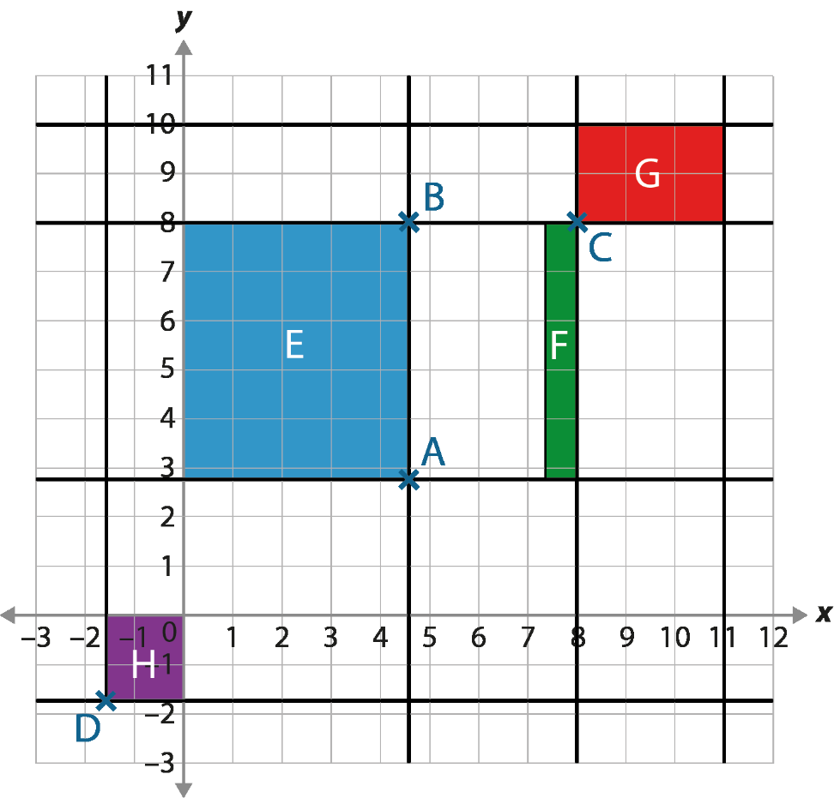
Activity H: Mathematical Mondrian (solutions)

Slide 56
Printable resources

Slide 57

Notes:
This printable resource may be used with Checkpoint 3 (two to a page).

Slide 58
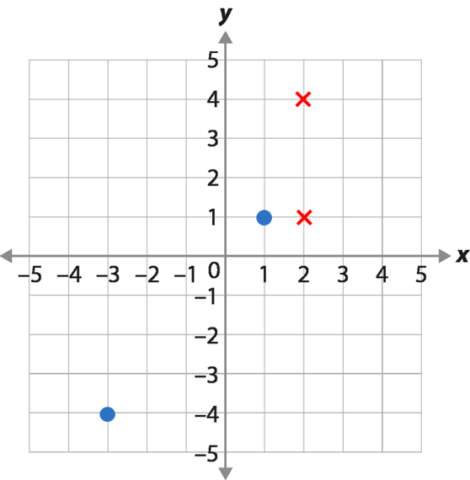
Notes:
This printable resource may be used with Checkpoint 4 (six to a page).

Slide 59
Notes:
This printable resource may be used with Checkpoint 5 (six to a page).

Slide 60
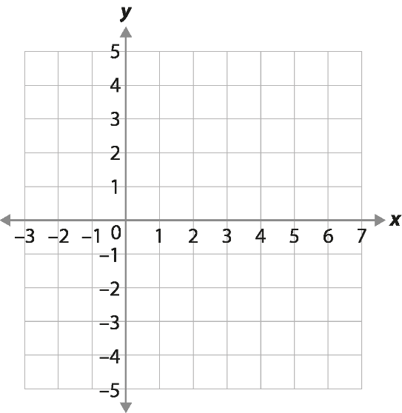
Notes:
This printable resource may be used with Checkpoint 6 (three to a page).

Slide 61
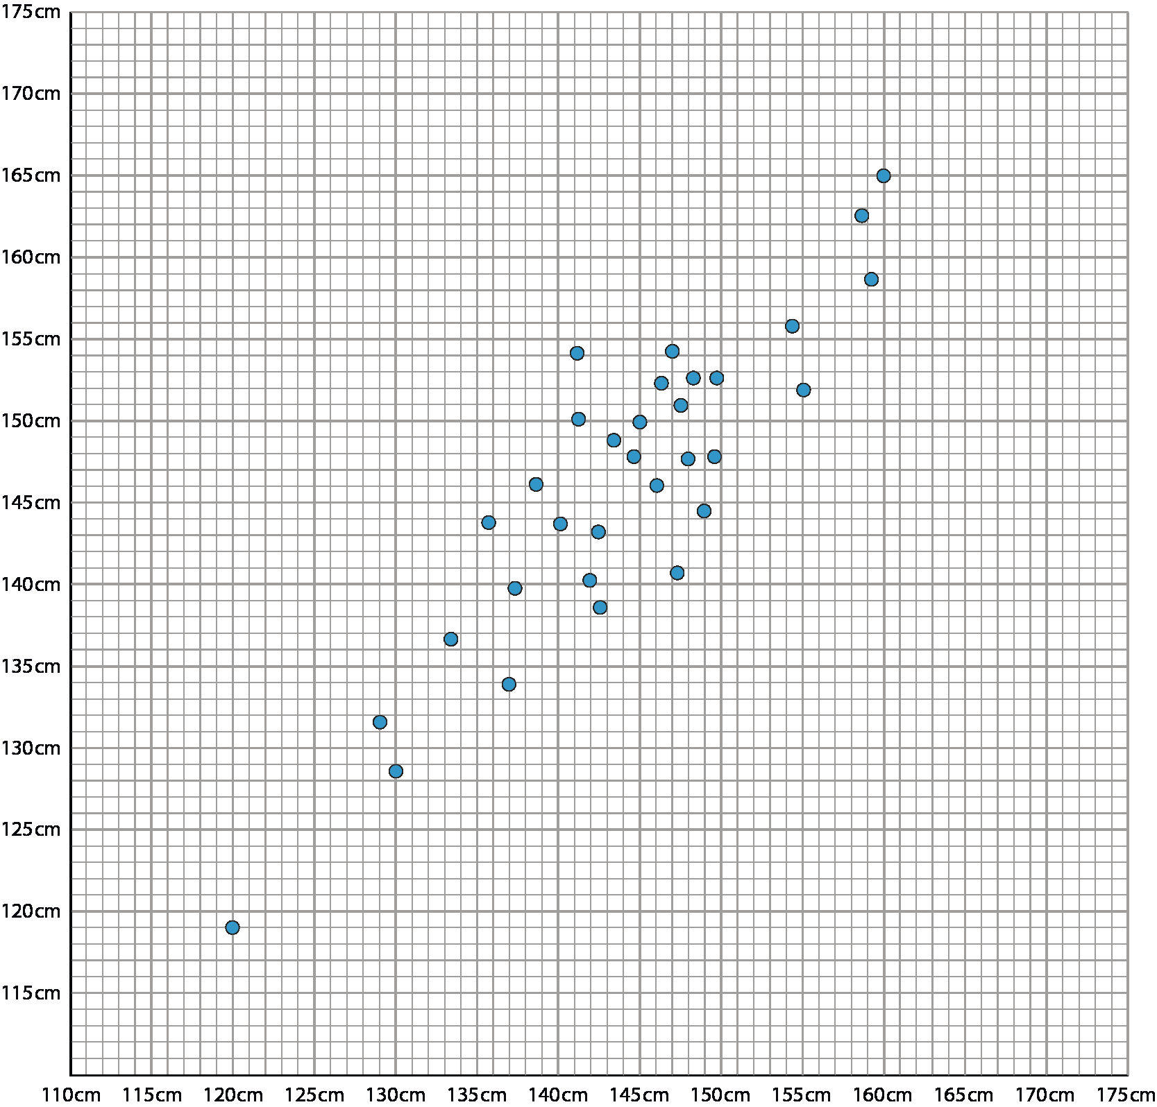
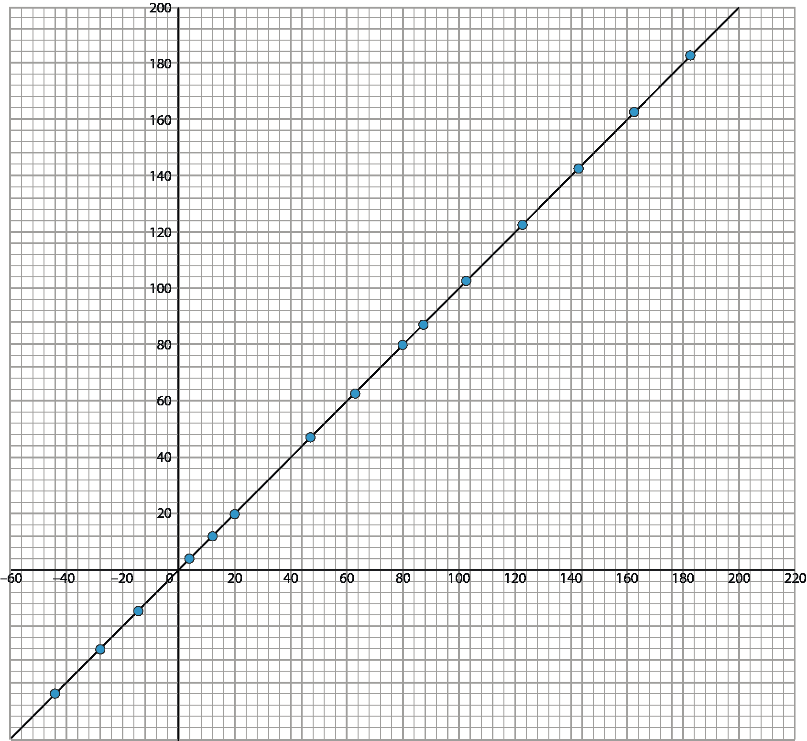
Notes:
These enlarged versions of the graphs in Checkpoint 7 may help students to look more closely at the values.

Slide 62
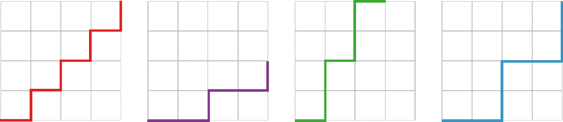
Abdul
Benny
Cara
Denis
Elsa
Elsa starts her staircase pattern at the top left of the page. How could you complete it so that it is the same steepness as each of the other patterns?
Abdul
Benny
Cara
Denis
Elsa
Elsa starts her staircase pattern at the top left of the page. How could you complete it so that it is the same steepness as each of the other patterns?
Notes:
Students might find it helpful to have this printable version of Checkpoint 10 (two to a page).

Slide 63
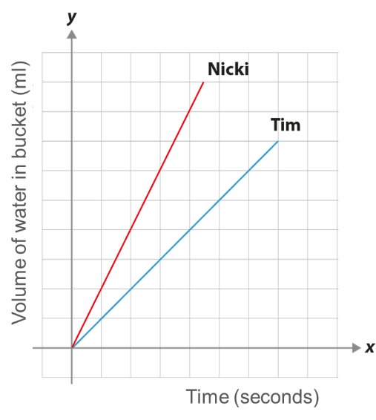
Notes:
Students may like to record their answers to Checkpoint 11 on these printable grids (six to a page).

Slide 64
Notes:
This printable resource may be used with Checkpoint 12 (two to a page).

Slide 65

Notes:
This printable resource may be used with Checkpoint 13 (six to a page).

Slide 66
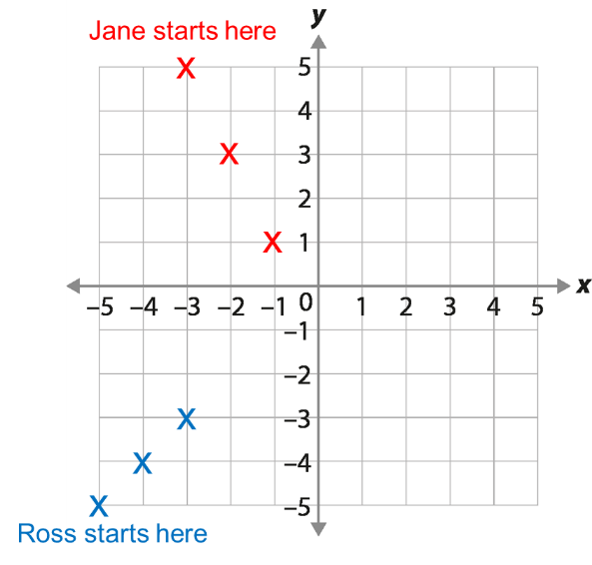
Notes:
This printable resource may be used with Checkpoint 14 (six to a page).

Slide 67
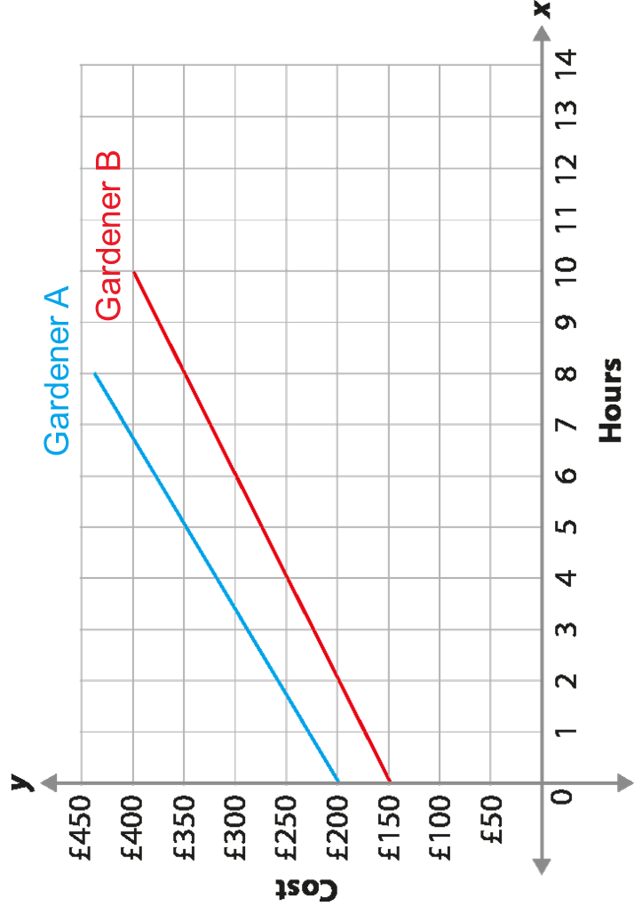
Notes:
This is a printable resource may be used with Checkpoint 15 (two to a page).

Slide 68
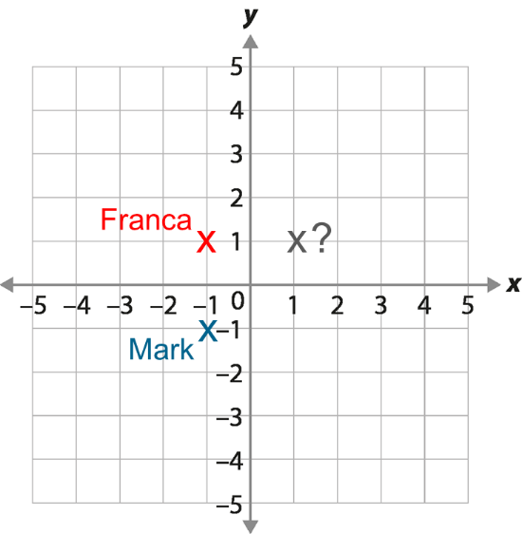
Notes:
This printable resource may be used with Additional activity A (six to a page).

Slide 69

Notes:
These grids may be used with Additional activity C (two sets of four to a page) .

Slide 70
Key: Plumber A Plumber B
Key: Plumber A Plumber B
Cost
Cost
Hours worked
Hours worked
Notes:
This printable resource may be used with Additional activity D (two to a page).

Slide 71
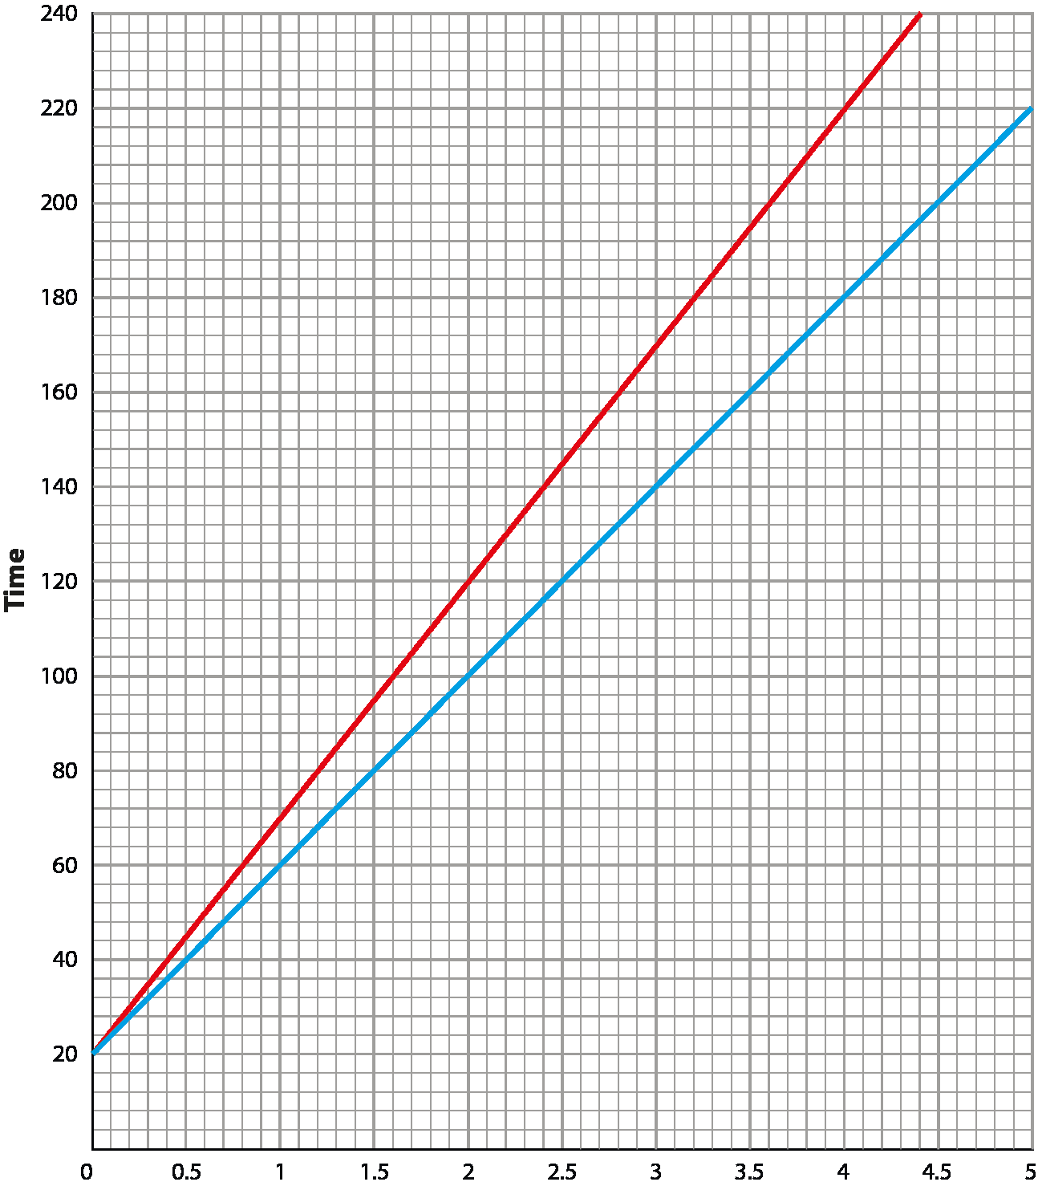
Notes:
This printable resource may be used with Additional activity E (two to a page).

Slide 72

Notes:
This printable resource may be used with Additional activity H (six to a page).

