Slide 1
Interpreting the intersection of two linear graphs
KS3 Mastery PD Materials: Exemplified Key Ideas
Materials for use in the classroom or to support professional development discussions
(from 4.2 Graphical representations)
Summer 2021

Slide 2
About this resource
These slides are designed to complement the 4.2 Graphical representations Core Concept document and its associated Theme Overview document 4 Sequences and Graphs, both found in the Secondary Mastery Professional Development pages.
These slides re-present the key examples from the Core Concept document so that the examples can be used either directly in the classroom or with a group of teachers. There are prompt questions alongside the examples, and further clarification in the notes.
These slides do not fully replicate the Core Concept document, so should be used alongside it. Reference to specific page numbers, and to other useful NCETM resources, can be found in the notes for each slide.
This slide deck is not designed to be a complete PD session, rather it is a selection of resources that you can adapt and use as needed when planning a session with a group of teachers.

Slide 3
About this resource
The slides are structured as follows:
The big picture:
Where does this fit in?
What do students need to understand?
Why is this key idea important?
Prior learning
Misconceptions
Exemplified key ideas
Reflection questions
Appendices:
Key vocabulary
Representations and structure
Previous and Future learning
Useful links
The exemplified key idea slides have the following symbols to indicate how they have been designed to be used:
Into the classroom
The examples are presented on these slides so that they could be used in PD, but also directly in the classroom. The notes feature suggested questions and things teachers might consider when using with students.
PD discussion prompts
These slides look at the examples in more detail, with question prompts to promote discussion among maths teachers. The notes feature reference to further information and guidance within the Core Concepts document.

Slide 4
Where does this fit in?
The NCETM has identified a set of six ‘mathematical themes’ within Key Stage 3 mathematics that bring together a group of ‘core concepts’.
The fourth of these themes is Sequences and graphs, which covers the following interconnected core concepts:
4.1 Sequences
4.2 Graphical representations
Notes:
Linked on this slide is the Theme Overview document of Sequences and graphs. This document includes why it is important, the key underpinning knowledge and links to prior and future learning. There is also guidance about how the five big ideas of Teaching for Mastery relate specifically to this theme.

Slide 5
Where does this fit in?
Within this core concept, 4.2 Graphical representations, there are three statements of knowledge, skills and understanding.
These, in turn, are broken down into twelve key ideas. The highlighted key idea is exemplified in this slide deck.
Notes:
For key ideas marked with an asterisk, we exemplified the common difficulties and misconceptions that students might have and included elements of what teaching for mastery may look like. We have provided examples of possible student tasks and teaching approaches.
Within these slides are ‘classroom-ready’ versions of the examples for the key idea that has been highlighted. There are also slides that may be useful for discussion in a professional development session.

Slide 6
What do students need to understand?
4.2.3.4 Recognise that the point of intersection of two linear graphs satisfies both relationships and hence represents the solution to both those equations
Identify regions on the plane
Understand that the point of intersection is a solution to both equations
What prior knowledge might your students already have?
What language might they use to describe this key idea?
What questions might you want to ask to assess their prior learning?

Slide 7
Why is this key idea important?
In Key Stage 3, a key focus will be thinking about x- and y-coordinates as the input and output respectively of a function or rule, and appreciating that the set of coordinates generated and the line joining them can be thought of as a graphical representation of that function.
The move from seeing a graph as a finite collection of coordinates that satisfy a relationship to a single mathematical object which encapsulates an infinite set of points, is an important one.
Students should also begin to explore the idea of two linear graphs intersecting and recognise that the point of intersection is the solution to a pair of simultaneous equations. This will help prepare students for future learning in Key Stage 4 when solving two linear simultaneous equations algebraically.
In order to gain a deep understanding of this concept, students must also experience scenarios where there is no point of intersection and be able to explain why this is so by making reference to the gradients.
Notes:
A more detailed overview of the core concept 4.2 Connect coordinates, equations and graphs can be found on pages 7-8 of the 4.2 Core Concept document.
The background to each key idea is also explored in more detail on the following pages:
4.2.1 Connect coordinates, equations and graphs – pages 7 and 8
4.2.2 Explore linear relationships – pages 8 and 9
4.2.3 Model and interpret a range of situations graphically – page 9

Slide 8
Prior learning
What prior knowledge might your students already have?
What language or representations might they use for this key idea?
What questions might you want to ask to assess their prior learning?
How does this fit in with your curriculum progression?
Upper Key Stage 2 Learning Outcome
Describe positions on the full coordinate grid (all four quadrants)
Find pairs of numbers that satisfy an equation with two unknowns
Enumerate possibilities of combinations of two variables
Key Stage 3 Learning Outcome
1.4.1 Understand and use the conventions and vocabulary of algebra, including forming and interpreting algebraic expressions and equations
1.4.5 Rearrange formulae to change the subject
Please note: Numerical codes refer to statements of knowledge, skills and understanding in the NCETM breakdown of Key Stage 3 mathematics.
Notes:
You may find it useful to speak to your partner schools to see how the above has been covered and the language used.
You can find further details regarding prior learning in the following segments of the NCETM primary mastery professional development materials (linked on final slide):
Year 5: 1.27 Negative numbers: counting, comparing and calculating
Year 5: 1.28 Common structures and the part–part–whole relationship
Within the 4 Sequences and graphs Theme Overview document, you can also find a broader description of students’ potential previous learning (page 2), alongside further information about key underpinning knowledge (page 3).

Slide 9
Checking prior learning
The following slides contain questions for checking prior learning.
What representations might students use to support their understanding of these questions?
What variation might you put in place for these questions to fully assess students’ understanding of the concept?
How might changing the language of each question change the difficulty?
Why are these such crucial pre-requisites for this key idea?

Slide 10
Checking prior learning (1)
Which of the following points lie on the line 2x + y = 7:
(1,5) (5,1) (3,1) (4,1) (5,3) (5,-3)
Can you explain why or why not?
Can you show this with a calculation as well as drawing?
Which of these equations represent the same straight line:
Explain your answers using words and calculations as well as graphs.
2x + y = 8
y = 2x + 8
y + 8 = 2x
y = 2x – 8
x = ½y – 8
y = -2x + 8
Notes:
References to the questions (links on final slide):
a) NCETM Secondary assessment materials, Page 18
b) NCETM Secondary assessment materials, Page 20

Slide 11
Common difficulties and misconceptions
What aspects of this key idea might students find challenging?
What misconceptions might students have?
When teaching this topic, you may find students encounter difficulties with…
Understanding that a line splits the plane into three parts
More information, and some suggestions for overcoming these challenges, can be found on the following slides.

Slide 12
Common difficulties and misconceptions (1)
This Key Idea builds on the exemplified Key Idea 2.2.1.3 which states that students should understand a solution is a value that makes the two sides of an equation balance. This idea is explored in here in 4.2.3.4 with explicit reference to Cartesian graphs.
A key understanding here is that a line such as y = 3x + 5 splits the plane into three parts. The region where y > 3x + 5, the region where y < 3x + 5 and the line itself which contains all possible points where y = 3x + 5.
The focus of this Key Idea is on the graphical representation and so algebraic manipulation is not a feature of the examples offered. Rather, the focus here is on the different ways in which the lines and any crossing points might be understood.
Notes:
More detail can be found on page 30 of the 4.2 Core Concept document.

Slide 13
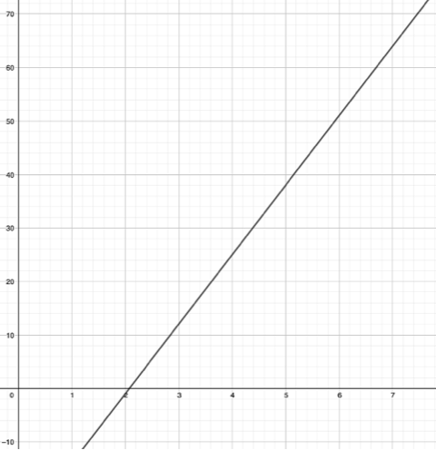
Identify regions on the plane
Example 1
This graph shows the line y = 13x − 27.
Use the graph to write down the answer to 13 × 7 − 27.
Use the graph to estimate 13 × 3.5 − 27.
Notes:
A larger, printable version of this graph is available in the appendices.
Suggested questioning:
What other calculations could you estimate from the graph?
How many solutions are represented by this line?
Things for you to think about:
In Example 1 students use a graph in an unfamiliar context (to complete a calculation). The equation is intended to be challenging enough that students will be discouraged from calculating and will instead use the graph. It is likely that students will be familiar with using graphs to find values and this question might commonly be phrased as ‘Find the value of y when x = 8 ‘. However, it may be that they have not connected the graphical representation and its equation with the calculation. Part b) asks students to estimate the solution to a calculation that can be quite accurately seen on the graph. The intention here is to encourage them to see that all points on the line fit the given equation. You might ask students to write more calculations and approximate solutions, for example asking how many ways they can complete a frame such 13 × ___ – 27 = __ (or maybe 13 × ___ – 27 ≈ __).

Slide 14
Identify regions on the plane
Example 1
How might asking students to estimate develop their understanding of the line as a representation of an infinite number of solutions to the equation?
You might ask students to write more calculations and approximate solutions; what would be the purpose of this?
This graph shows the line y = 13x − 27.
Use the graph to write down the answer to 13 × 7 − 27.
Use the graph to estimate 13 × 3.5 − 27.
Notes:
Due to space constraints, the image on this PD discussion slide is very small. PD Leads might like to use or print the ‘in the classroom’ version of this slide for teachers to access during discussions.
This example can be found on page 30 of the 4.2 Core Concept document.

Slide 15
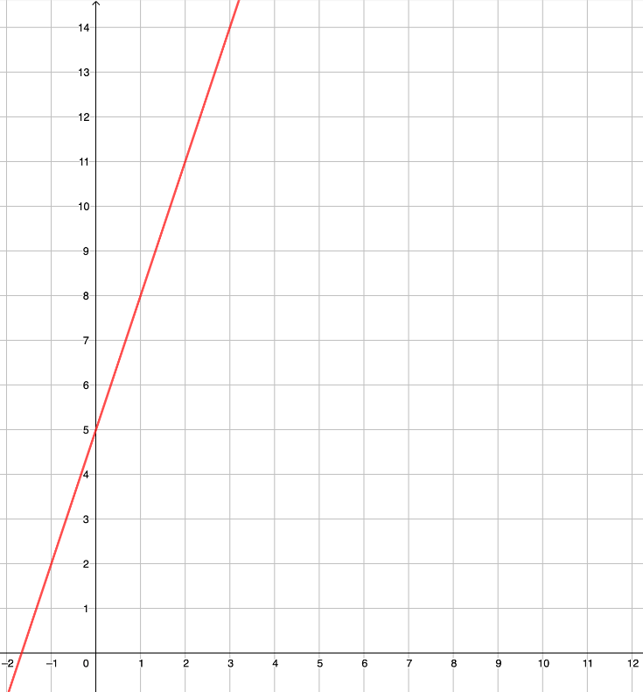
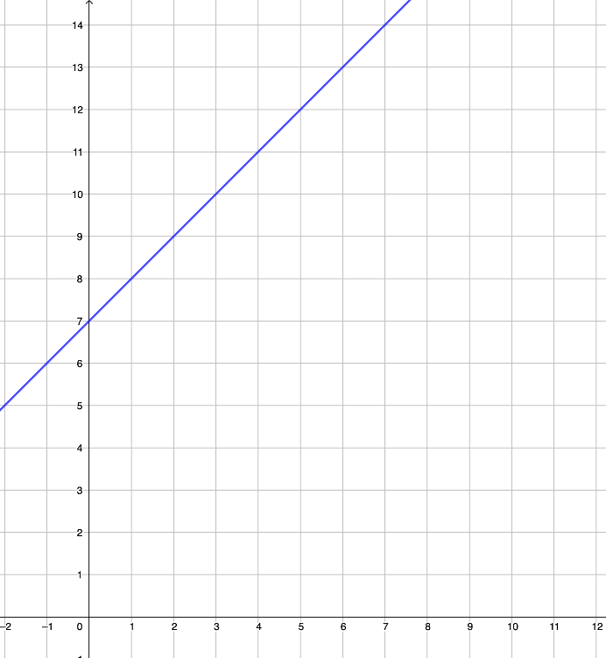
Identify regions on the plane
Example 2
1. This graph shows the line y = 3x + 5.
2. This graph shows the line y = x + 7.
Mark three points where y > 3x + 5.
Mark three points where y < 3x + 5.
Mark three points where y = 3x + 5.
Mark three points where y > x + 7.
Mark three points where y < x + 7.
Mark three points where y = x + 7.
Notes:
If the images for Example 2 are too small for use with your class, each part is repeated separately on the next two slides. A larger, printable version of these graphs is also available in the appendices.
Suggested questioning:
What do you notice about all your points for part a? How about part b? And part c?
What could you say about all the points in the region above the line? How about below the line?
What could you say about all the points on the line?
Things for you to think about:
Examples 2 and 3 are designed to be used together, to give students a context in which they can identify the different regions of the plane and their meanings. By identifying three positions for each region, students build a range of their own examples. These can be further developed through teacher questioning (for example, you might introduce some further constraints such as marking three points where y > 3x + 5 and x = 1, or where y > 3x + 5 and y = 1). These constraints might challenge students to go beyond the range of the given graph (such as write down three coordinates so that y > 3x + 5 and x > 100, or y = 3x + 5 and x > 100). The key awareness here is that all points on the line are connected by one relationship. Part 2 of Example 2 uses the same prompts as part 1 and students might be encouraged to describe what’s the same and what’s different about the two examples.

Slide 16
Identify regions on the plane
Example 2 (part 1)
This graph shows the line y = 3x + 5.
Mark three points where y > 3x + 5.
Mark three points where y < 3x + 5.
Mark three points where y = 3x + 5.
Notes:
This is an enlarged version of the first graph from Example 2. For ‘suggested questioning’ and ‘things to think about’, see slide 15.

Slide 17
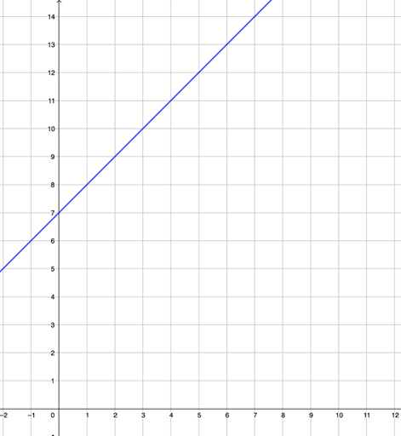
Identify regions on the plane
Example 2 (part 2)
This graph shows the line y = x + 7.
Mark three points where y > x + 7.
Mark three points where y < x + 7.
Mark three points where y = x + 7.
Notes:
This is an enlarged version of the second graph from Example 2. For ‘suggested questioning’ and ‘things to think about’, see slide 15.

Slide 18
Identify regions on the plane
Example 2
In this set of examples, inequalities are used to help students make sense of the graphical representation. Do you feel that this a useful connection to make?
How explicitly are graphical inequalities linked to initial work on graphs in your scheme of work? What’s the thinking behind your decision?
1. This graph shows the line y = 3x + 5.
2. This graph shows the line y = x + 7.
Mark three points where y > 3x + 5.
Mark three points where y < 3x + 5.
Mark three points where y = 3x + 5.
Mark three points where y > x + 7.
Mark three points where y < x + 7.
Mark three points where y = x + 7.
Notes:
Due to space constraints, the image on this PD discussion slide is very small. PD Leads might like to use or print the ‘in the classroom’ version of this slide for teachers to access during discussions.
This example can be found on page 31 of the 4.2 Core Concept document.

Slide 19
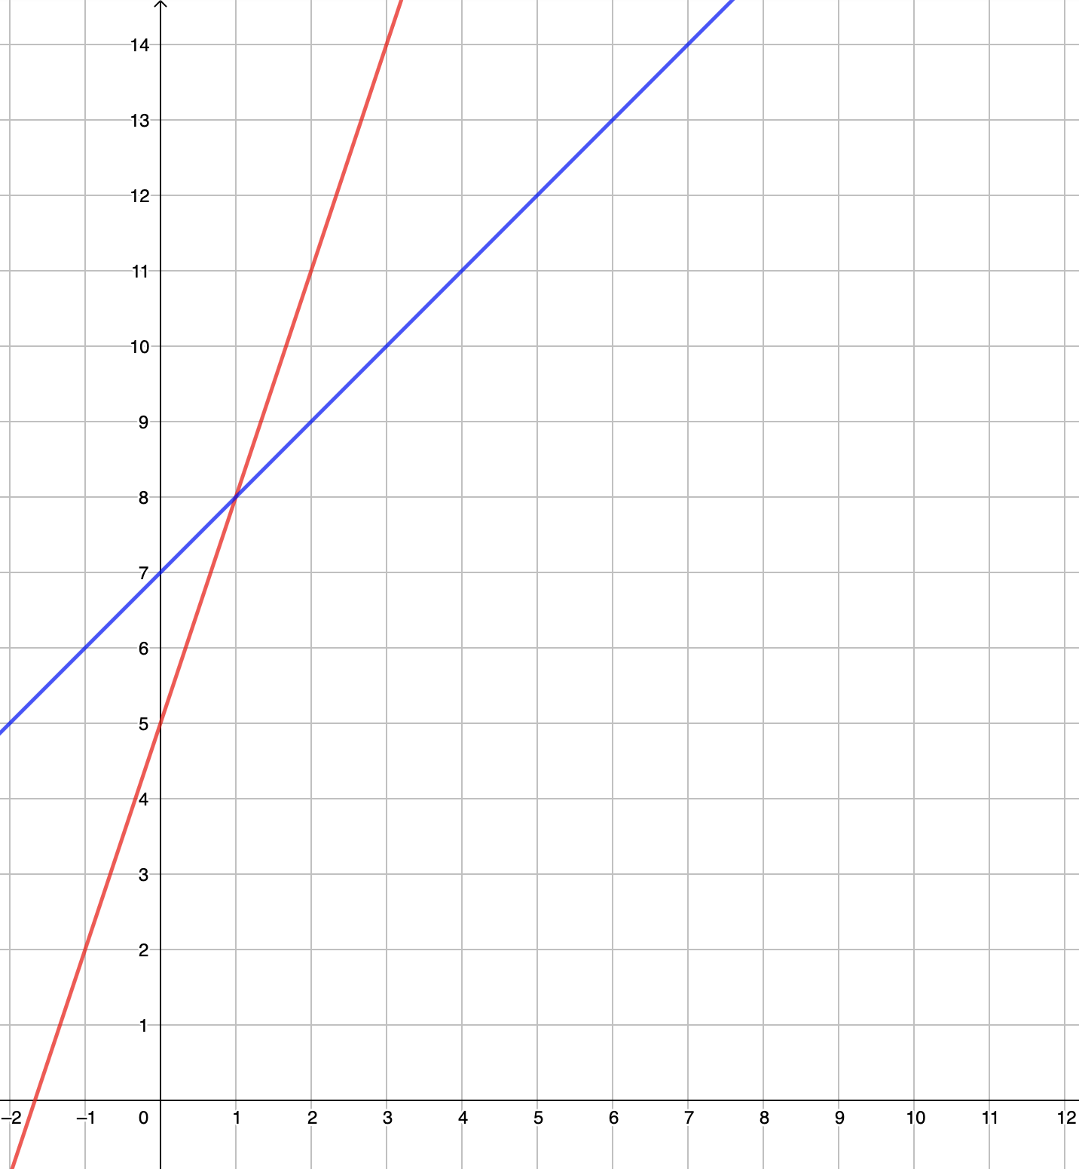
Identify regions on the plane
Example 3
This graph shows the lines y = 3x + 5 and y = x + 7
On the diagram
Mark three points where y > 3x + 5 and y = x + 7
Mark three points where y < 3x + 5 and y = x + 7
Mark one point where y = 3x + 5 and y = x + 7
Notes:
A larger, printable version of this graph is available in the appendices.
Suggested questioning:
What do you notice about your points for part a? How about part b?
When can your points be found within a region? When can the be found on a line?
Why does part c only ask for one point?
Things for you to think about:
Examples 2 and 3 are designed to be used together, to give students a context in which they can identify the different regions of the plane and their meanings. Example 3 builds on Example 2 and shows the two lines used on the same axis. Before showing Example 3, ask students to consider the two lines used in Example 2, whether there is a point where the two lines cross, and what value x and y might have at that point. Similar prompts are used to those in Example 2, and only the constraints around y = 3x + 5 change in each question. The intention here is that students again focus on the fact that all points on the line y = x + 7 are connected by that relationship. Asking students why part c only asks for one point while all other prompts in Example 2 and 3 have asked for three points may be productive in supporting students’ reasoning around straight line graphs and the uniqueness of the crossing point.

Slide 20
Identify regions on the plane
Example 3
How might you use examples 2 and 3 alongside each other?
What similarities and differences might you want to draw attention to?
What are the benefits of using the same two equations in each example?
This graph shows the lines y = 3x + 5 and y = x + 7
On the diagram
Mark three points where y > 3x + 5 and y = x + 7
Mark three points where y < 3x + 5 and y = x + 7
Mark one point where
y = 3x + 5 and y = x + 7
Notes:
Due to space constraints, the image on this PD discussion slide is very small. PD Leads might like to use or print the ‘in the classroom’ version of this slide for teachers to access during discussions.
This example can be found on page 32 of the 4.2 Core Concept document.

Slide 21
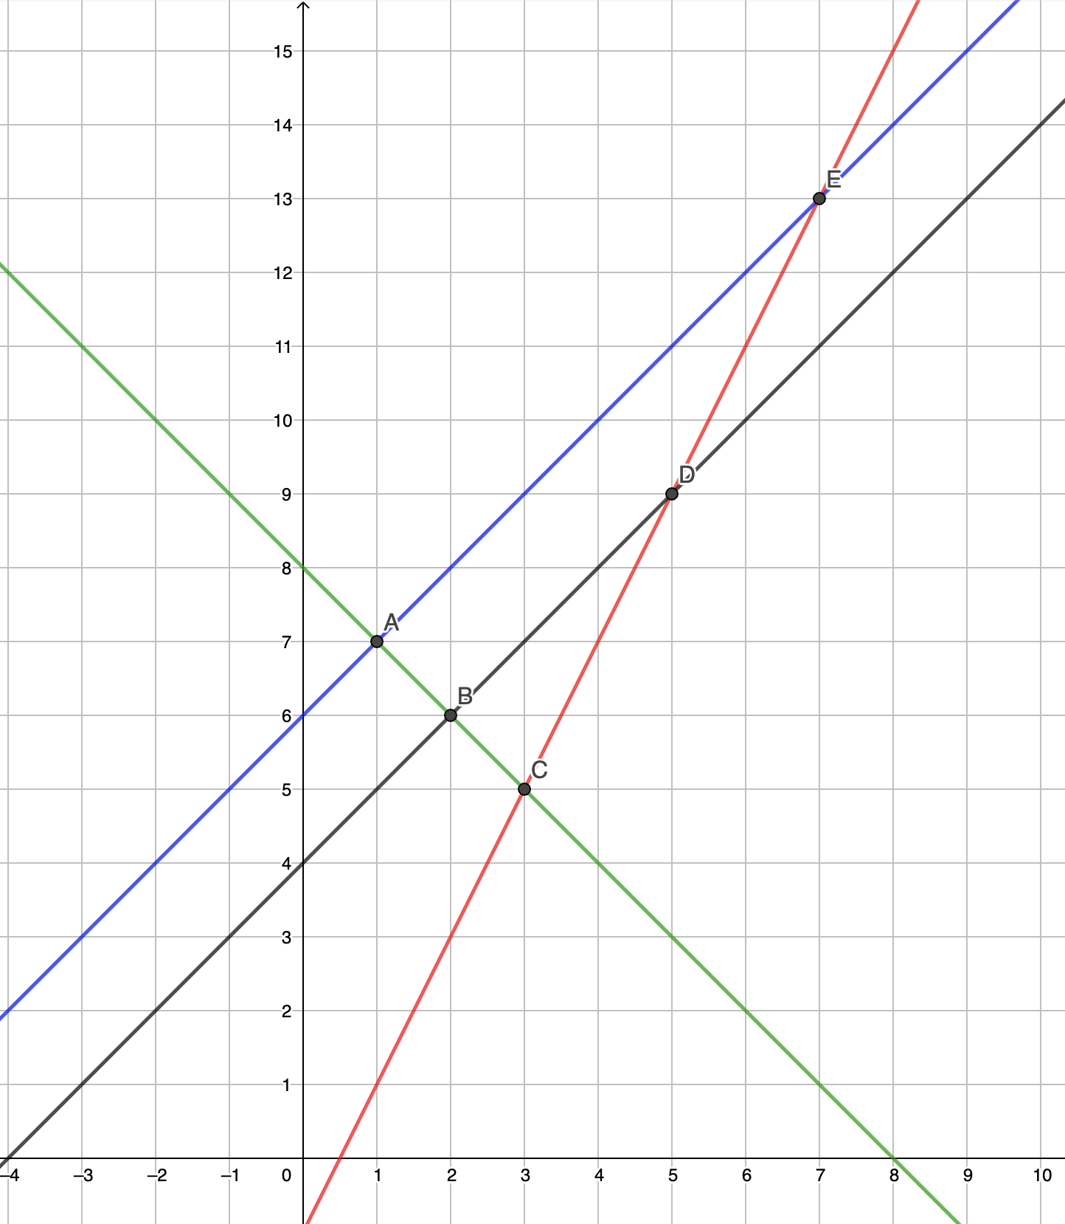
Understand that the point of intersection is a solution to both equations
Example 4
The graph shows the lines of these equations:
y = x + 4
y = x + 6
y = 2x – 1
y = 8 – x
When x = 1, y = 7 is a solution to two of the equations. Which two?
Two equations have the same value for y when x = 5. Which two equations?
Write down the values of x and y that are a solution to both y = 8 – x and y = 2x – 1.
Notes:
A larger, printable version of this graph is available in the appendices.
Suggested questioning:
What co-ordinate does part a) refer to?
How could you write question a) as an algebraic statement?
What points have you not been asked to find? What pairs of lines share these solutions?
Things for you to think about:
The variation in the way that parts a), b) and c) ask similar questions with different wording is designed to draw attention to different awarenesses that students must have to make sense of solving simultaneous equations.
Part a) introduces that the crossing point is a ‘solution’ to two equations
Part b) draws attention to the equality of the values at the solution
Part c) then builds on this to identify the crossing point as a solution to both equations.
Points B and E on the graph are not used in the three questions. You could ask students to write a question in the style of a), b) or c) for which B or E is the answer.
You might usefully explore whether all the pairs of lines in Example 4 will have a solution, and if not what that might tell us about those pairs of lines.

Slide 22
Understand that the point of intersection is a solution to both equations
Example 4
The graph shows the lines of these equations:
y = x + 4
y = x + 6
y = 2x – 1
y = 8 – x
When x = 1, y = 7 is a solution to two of the equations. Which two?
Two equations have the same value for y when x = 5. Which two equations?
Write down the values of x and y that are a solution to both
y = 8 – x and y = 2x – 1.
What is the effect of asking the same type of question in three different ways?
Do you think your students would find any one of these questions ‘easier’ than the others? Why or why not?
Notes:
Due to space constraints, the image on this PD discussion slide is very small. PD Leads might like to use or print the ‘in the classroom’ version of this slide for teachers to access during discussions.
This example can be found on page 33 of the 4.2 Core Concept document.

Slide 23
Reflection questions
What other mathematical concepts will be supported by students’ stronger understanding of this key idea?
What mathematical language will you continue to use to support pupils to make connections with other areas?
Which representations might you continue to use to further develop students’ understanding?

Slide 25
Appendices
You may choose to use the following slides when planning or delivering a PD session. They cover:
Printable versions of images
Key vocabulary
Representations and structure
Previous learning
Future learning
Library of links

Slide 26
Notes:
This is a larger, printable version of the graph used in Example 1.

Slide 27
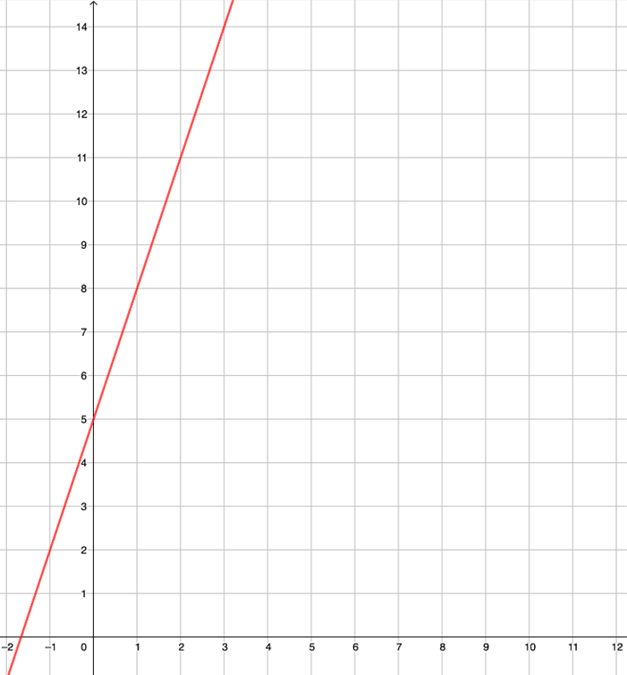
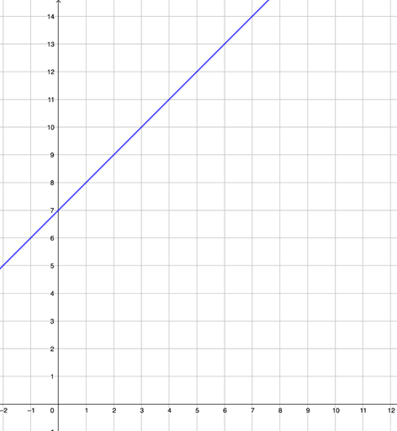
Notes:
This is a larger, printable version of the graphs used in Example 2.

Slide 28
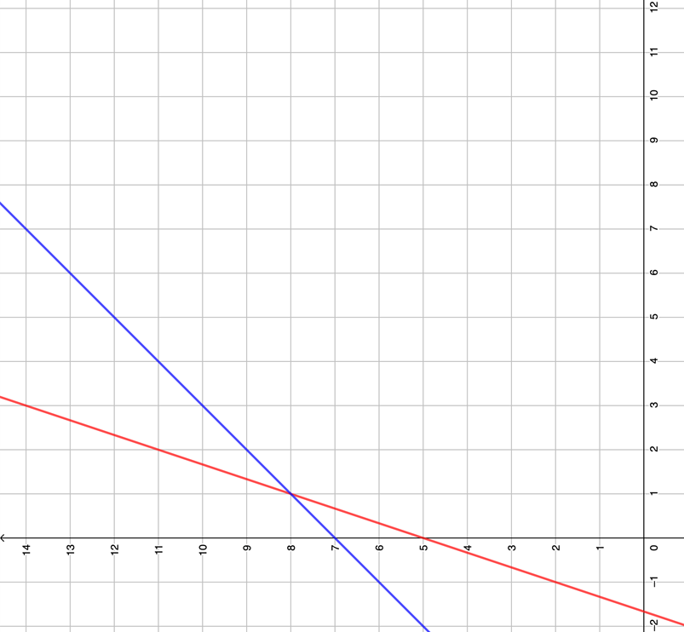
Notes:
This is a larger, printable version of the graph used in Example 3.

Slide 29
Notes:
This is a larger, printable version of the graph used in Example 4.

Slide 30
Key vocabulary (1)
Term | Definition
Cartesian coordinate system | A system used to define the position of a point in 2- or 3-dimensional space: Two axes at right angles to each other are used to define the position of a point in a plane. The usual conventions are to label the horizontal axis as the x-axis and the vertical axis as the y-axis, with the origin at the intersection of the axes. The ordered pair of numbers (x, y) that defines the position of a point is the coordinate pair. The origin is the point (0, 0); positive values of x are to the right of the origin and negative values are to the left of the origin; positive values of y are above the origin and negative values below the origin. Each of the numbers is a coordinate. The numbers are also known as ‘Cartesian coordinates’, after the French mathematician, René Descartes (1596–1650). Three mutually perpendicular axes, conventionally labelled x, y and z, and coordinates (x, y, z) can be used to define the position of a point in space.

Slide 31
Key vocabulary (2)
Term | Definition
gradient | A measure of the slope of a line. On a coordinate plane, the gradient of the line through the points (x₁, y₁) and (x₂, y₂) is defined as $\frac{(y_{2}−y_{1})}{(x_{2}−x_{1})}$. The gradient may be positive, negative or zero depending on the values of the coordinates.
intercept | To cut a line, curve or surface with another. In the Cartesian coordinate system, the positive or negative distance from the origin to the point where a line, curve or surface cuts a given axis. OR On a graph, the value of the non-zero coordinate of the point where a line cuts an axis.
linear | In algebra, describing an expression or equation of degree one. Example: 2x + 3y = 7 is a linear equation. All linear equations can be represented as straight line graphs.

Slide 32
Key vocabulary (3)
Term | Definition
quadratic | Describing an expression of the form ax² + bx + c where a, b and c are real numbers. The function y = ax² + bx + c is a quadratic function; its graph is a parabola.
simultaneous equations | Two linear equations that apply simultaneously to given variables. The solution to the simultaneous equations is the pair of values for the variables that satisfies both equations. The graphical solution to simultaneous equations is a point where the lines representing the equations intersect. Example: x + y = 6 and y = 2x is a set of simultaneous equations. The solution is the value of x and y which satisfies both simultaneously – i.e. x = 2 and y = 4.

Slide 33
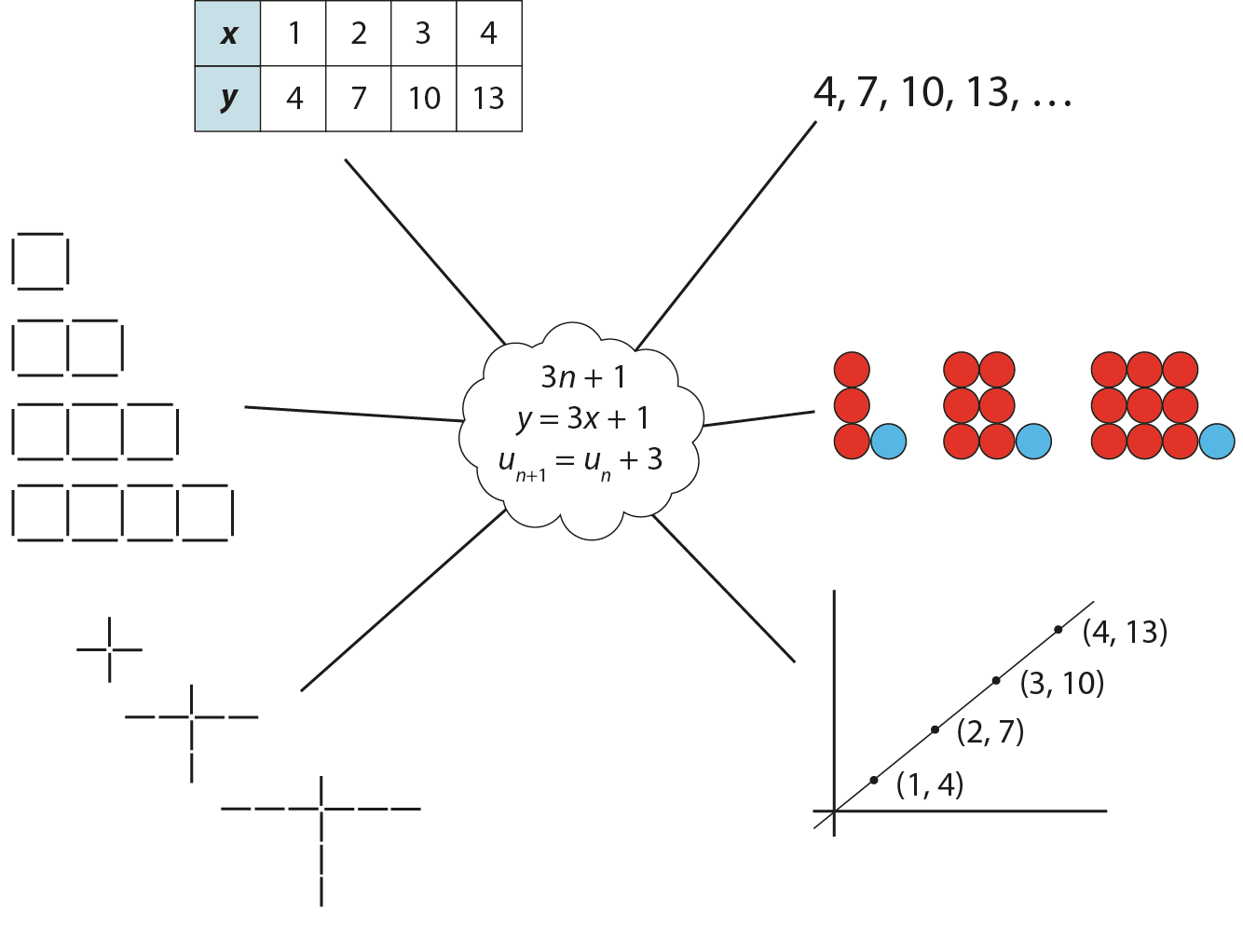
Representations and structure
There are a number of different representations that you may wish to use to support students’ understanding of this key idea. These might include:
Tables of values, graphs, sequences and structured pictorial arrangements
It is important for students to see multiple representations of the same structure, as in the diagram, and to connect them. Prompts such as ‘Where is the 3 in this representation?’ and ‘Where is the 1?’ can support students in making these connections and understanding that each representation has the same underpinning structure.
Notes:
More information about the representations and structure involved in this key idea can be found:
On page 5 of the 4 Sequences and graphs Theme Overview document
Links to all of these can be found on the final slide.

Slide 34
Previous learning
From Upper Key Stage 2, students will bring experience of:
using simple formulae
generating and describing linear number sequences
describing positions on the full coordinate grid (all four quadrants).
Notes:
Theme 4 Sequences and graphs

Slide 35
Future learning
In KS4, students will build on the core concepts in this mathematical theme to:
recognise and use sequences of triangular, square and cube numbers, simple arithmetic progressions, Fibonacci-type sequences, quadratic sequences, and simple geometric progressions ($r^{n}$ where $n$ is an integer, and $r$ is a positive rational number {or a surd}) {and other sequences}
deduce expressions to calculate the nth term of linear {and quadratic} sequences
use the form $y=mx+c$to identify parallel {and perpendicular} lines; find the equation of the line through two given points, or through one point with a given gradient
recognise, sketch and interpret graphs of linear functions, quadratic functions, simple cubic functions, the reciprocal function 𝑦=1/𝑥 with 𝑥 ≠ 0, {the exponential function 𝑦=𝑘𝑥 for positive values of k, and the trigonometric functions (with arguments in degrees) 𝑦=sin𝑥, 𝑦=cos𝑥, 𝑦= tan𝑥 for angles of any size}
{sketch translations and reflections of the graph of a given function}
plot and interpret graphs (including reciprocal graphs {and exponential graphs}) and graphs of non-standard functions in real contexts, to find approximate solutions to problems such as simple kinematic problems involving distance, speed and acceleration.
Please note: Braces { } indicate additional mathematical content to be taught to more highly attaining students.
Notes:
Theme 4 Sequences and graphs

Slide 36
Library of links
The following resources from the NCETM website have been referred to within this slide deck:
NCETM Secondary Mastery Professional Development
4 Sequences and Graphs Theme Overview Document
4.2 Graphical representations Core Concept Document
1.4 Simplifying and manipulating expressions, equations and formulae Core Concept Document
Using mathematical representations at KS3 | NCETM
Insights from experienced teachers | NCETM
NCETM primary mastery professional development materials
NCETM primary assessment materials
NCETM secondary assessment materials

