Slide 1
2.14 Multiplication: partitioning leading to short multiplication
Representations | Year 4
Multiplication and Division

Slide 2
How to use this presentation
You can find the teacher guide Multiplication: partitioning leading to short multiplication by following the link below.

Slide 3
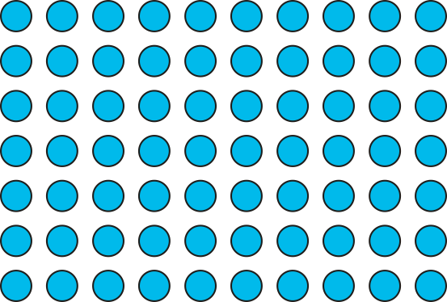

2.14 Short multiplication Step 1:1
7 × 13
= 91
10
3
7
70
21
7 × 13 = 7 × 10 + 7 × 3
= 70
+
21
= 91

Slide 4

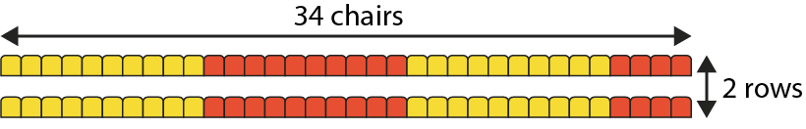
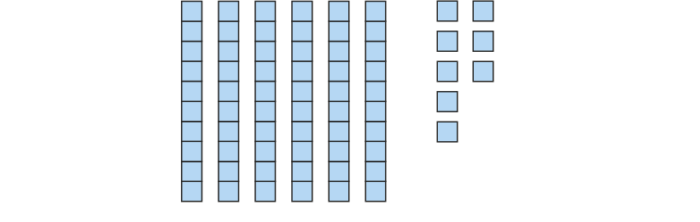
2.14 Short multiplication Step 1:2
2 rows, each with 34 chairs. How many chairs altogether?
34 = 30 + 4
34 × 2 = 30 × 2 + 4 × 2
= 60 + 8
= 68
Notes:
Thirty-four is equal to three tens and four ones.
Gather thirty-four and multiply by two.
Three-tens-and-four-ones multiplied by two.
Three-tens-and-four-ones multiplied by two is equal
to three tens multiplied by two and four ones multiplied by two.
3 tens × 2 = 6 tens
4 ones × 2 = 8 ones

Slide 5

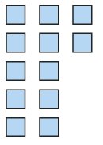



2.14 Short multiplication Step 1:3
3 rows, each with 24 chairs. How many chairs altogether?
24 × 3 = 20 × 3 + 4 × 3
= 60 + 12
= 70 + 2
= 72
Notes:
Two-tens-and-four-ones multiplied by three is equal to
two tens multiplied by three and four ones multiplied by three.
2 tens × 3 = 6 tens
4 ones × 3 = 12 ones
Regroup the ones into tens and ones.
Twelve ones is equal to one ten and two ones.
12 ones = 1 ten + 2 ones

Slide 6
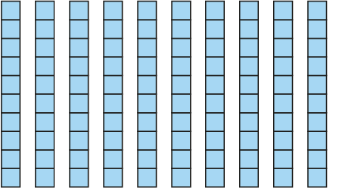
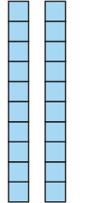
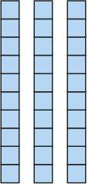


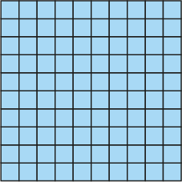
2.14 Short multiplication Step 1:4
4 rows, each with 32 chairs. How many chairs altogether?
32 × 4 = 30 × 4 + 2 × 4
= 120 + 8
= 128
Notes:
Three-tens-and-two-ones multiplied by four is equal to
three tens multiplied by four and two ones multiplied by four.
3 tens × 4 = 12 tens
2 ones × 4 = 8 ones
Regroup the tens into hundreds and tens.
Twelve tens is equal to one hundred and two tens.
12 tens = 1 hundred + 2 tens

Slide 7
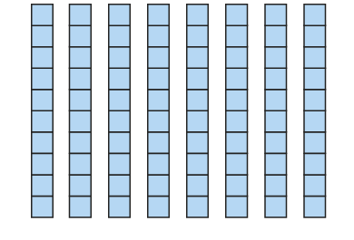
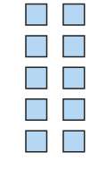





2.14 Short multiplication Step 1:5
4 rows, each with 26 chairs. How many chairs altogether?
26 × 4 = 20 × 4 + 6 × 4
= 80 + 24
= 100 + 4
= 104
Notes:
Two-tens-and-six-ones multiplied by four is equal to
two tens multiplied by four and six ones multiplied by four.
2 tens × 4 = 8 tens
6 ones × 4 = 24 ones
Twenty-four ones is equal to two tens and four ones
24 ones = 2 tens + 4 ones
Ten tens is equal to one hundred.
10 tens = 1 hundred

Slide 8
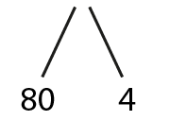
2.14 Short multiplication Step 1:6
1 pack of biscuits costs 84 p. How much do 6 packs cost?
84 × 6 =
504
80 × 6 = 480
4 × 6 = 24
480 + 24
= 504
6 packs cost 504 p.

Slide 9
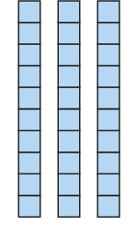

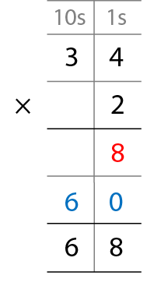
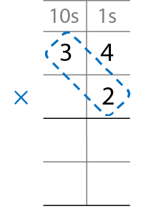
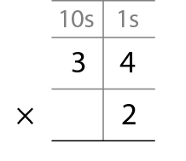
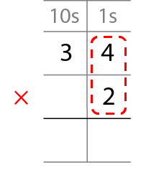
2.14 Short multiplication Step 2:1
2 rows, each with 34 chairs. How many chairs altogether?
8
2 × 4 ones = 8 ones
6
0
2 × 3 tens = 6 tens
Notes:
Step 1 – write the factors.
Step 2 – multiply the one-digit number by the ones.
Step 3 – multiply the one-digit number by the tens.
Step 4 – add the partial products.

Slide 10
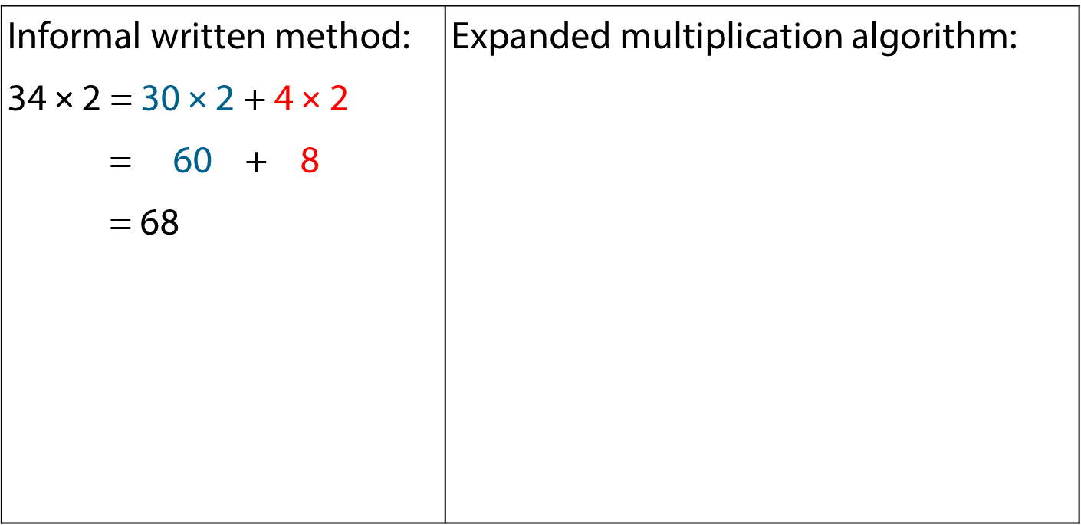
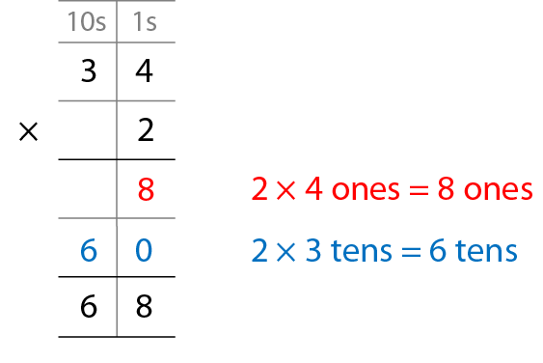
2.14 Short multiplication Step 2:2
Notes:
What’s the same?
What’s different?

Slide 11
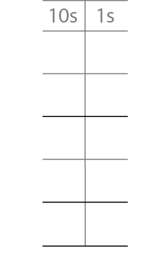
2.14 Short multiplication Step 2:3
3 × 32 =
96
3
2
×
3
6
3 × 2 ones = 6 ones
9
0
3 × 3 tens = 9 tens
9
6

Slide 12
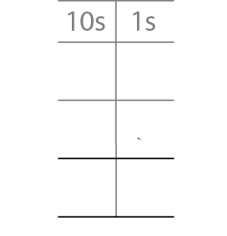
2.14 Short multiplication Step 2:3
3 × 32 =
96
3
2
×
3
9
6
3 × 2 ones = 6 ones
Write “6” in the ones column.
3 × 3 tens = 9 tens
Write “9” in the tens column.

Slide 13
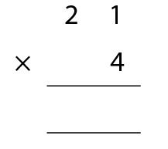
2.14 Short multiplication Step 2:4
21 × 4 =
84
8
4
Notes:
4 × 1 one = 4 ones
Write “4” in the ones column.
4 × 2 tens = 8 tens
Write “8” in the tens column.

Slide 14
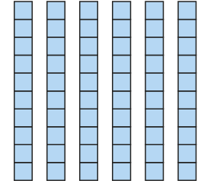

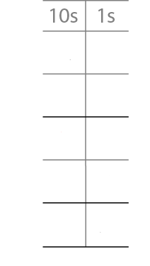


2.14 Short multiplication Step 2:6
3 rows, each with 24 chairs. How many chairs altogether?
2
4
×
3
3 × 4 ones = 12 ones
1
2
= 1 ten + 2 ones
6
0
3 × 2 tens = 6 tens
7
2

Slide 15
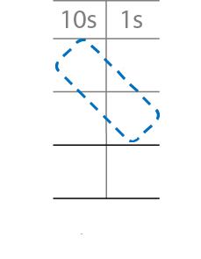
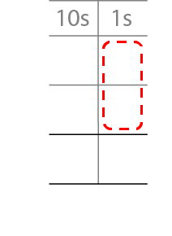
2.14 Short multiplication Step 2:7
2
4
×
3
3 × 4 ones = 12 ones
3 × 2 tens = 6 tens
7
2
6 tens + 1 ten = 7 tens
= 1 ten + 2 ones
1
Write “7” in the tens column.
Write “1” below the tens column and “2” in the ones column.
Notes:
Step 1 – write the factors.
Step 2 – multiply the one-digit number by the ones and regroup.
Step 3 – multiply the one-digit number by the tens and add
the tens from regrouping

Slide 16
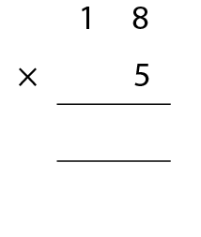
2.14 Short multiplication Step 2:7
18 × 5 =
90
9
0
4
Notes:
5 × 8 ones = 40 ones; 40 ones = 4 tens and 0 ones
Write “4” below the tens column and “0” in the ones column.
5 × 1 ten = 5 tens
5 × 1 ten + 4 tens = 9 tens
Write “9’” in the tens column

Slide 17
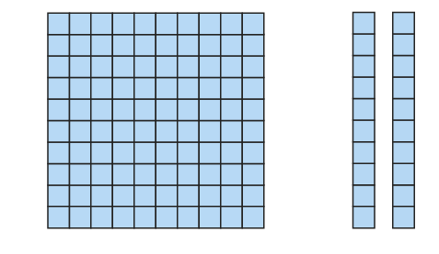
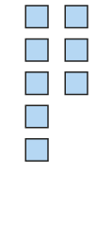
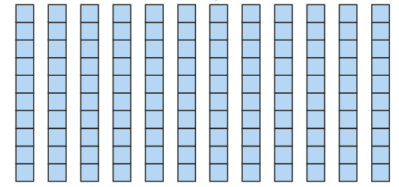
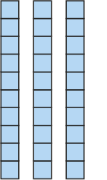

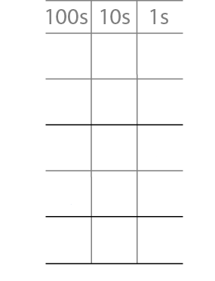
2.14 Short multiplication Step 2:9
4 rows, each with 32 chairs. How many chairs altogether?
3
2
×
4
8
4 × 2 ones = 8 ones
1
2
0
4 × 3 tens = 12 tens
1
2
8
= 1 hundred + 2 tens

Slide 18
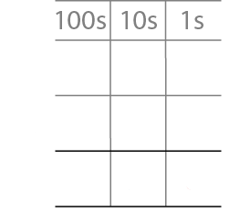
2.14 Short multiplication Step 2:10
32 × 4 =
128
3
2
×
4
4 × 3 tens = 12 tens
= 1 hundred + 2 tens
1
2
8
4 × 2 ones = 8 ones
Write “8” in the ones column.
Write “1” in the hundreds column and “2” in the tens column.

Slide 19
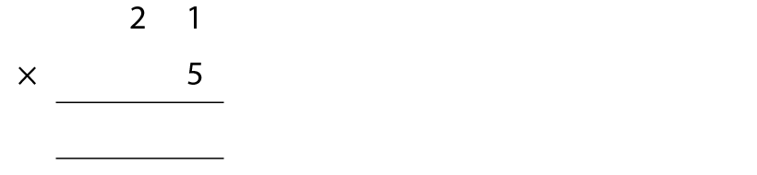
2.14 Short multiplication Step 2:10
21 × 5 =
105
1
0
5
Notes:
5 × 1 one = 5 ones
Write “5” in the ones column.
5 × 2 tens = 10 tens = 1 hundred and 0 tens
Write “1” in the hundreds column and “0” in the tens column.

Slide 20
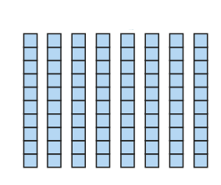



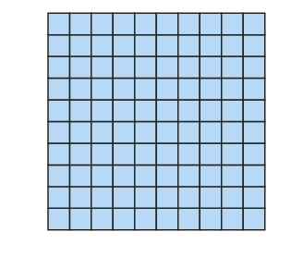

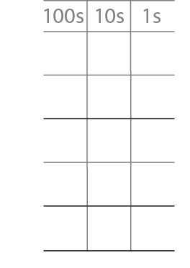

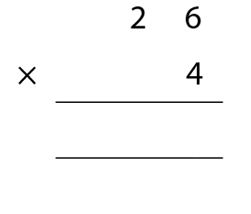
2.14 Short multiplication Step 2:13
4 rows, each with 26 chairs. How many chairs altogether?
2
6
×
4
2
4
1
0
4
8
0
2
1
0
4
Notes:
4 × 6 ones = 24 ones = 2 tens + 4 ones
4 × 2 tens = 8 tens
8 tens + 2 tens + 4 ones = 10 tens + 4 ones = one hundred + 4 ones

Slide 21
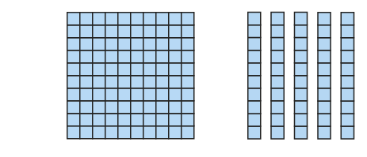

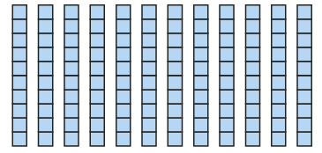
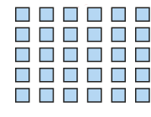


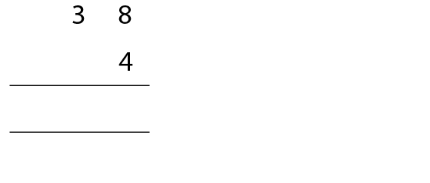

2.14 Short multiplication Step 2:13
4 rows of 38 carrot plants. How many carrot plants altogether?
3
8
×
4
×
3
2
1
5
2
1
2
0
3
1
5
2
Notes:
4 × 8 ones = 32 ones = 3 tens + 2 ones
4 × 3 tens = 12 tens = 1 hundred + 2 tens
1 hundred + 2 tens + 3 tens + 2 ones = 1 hundred + 5 tens + 2 ones

Slide 22
2.14 Short multiplication Step 2:15
24 × 3
24 is between 20 and 30.
20 × 3 = 60
30 × 3 = 90
So, 24 × 3 must be between 60 and 90.

Slide 23
2.14 Short multiplication Step 2:15
4 × 38
30
<
38
<
40
4 × 30
<
4 × 38
<
4 × 40
120
<
4 × 38
<
160

Slide 24
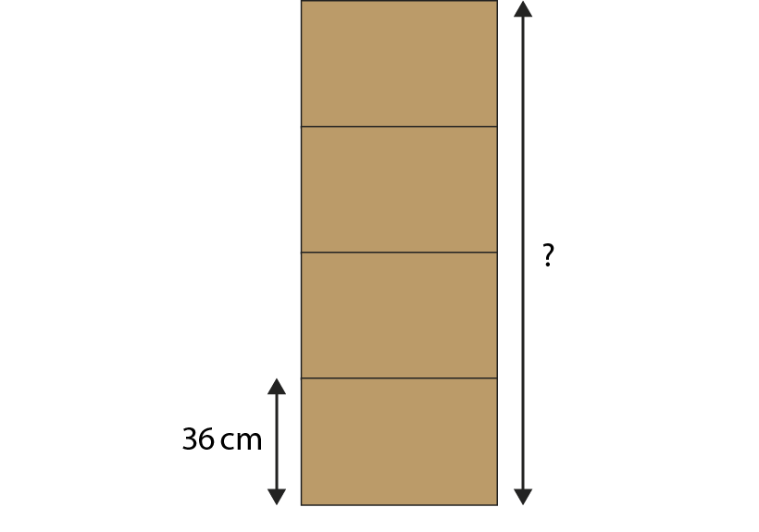
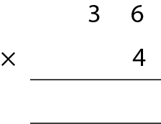
2.14 Short multiplication Step 2:16
If all boxes are the same height, how tall is the stack of boxes?
144 cm
1
4
4
2

Slide 25
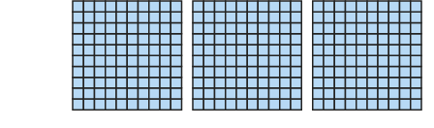

2.14 Short multiplication Step 3:1
321 × 3 =
963
321 = 300 + 20 + 1
321 × 3 = 300 × 3 + 20 × 3 + 1 × 3
= 900 + 60 + 3
= 963
Notes:
Step 1 – partition 321.
Steps 2 and 3 – gather three sets of 321, multiply the
hundreds, tens and ones and recombine.

Slide 26
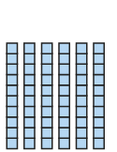

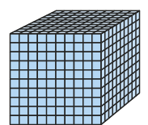
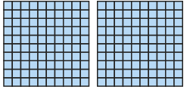
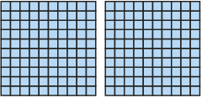

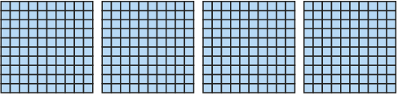
2.14 Short multiplication Step 3:2
423 × 3 =
1,269
423 = 400 + 20 + 3
423 × 3 = 400 × 3 + 20 × 3 + 3 × 3
= 1,200 + 60 + 9
= 1,000 + 200 + 60 + 9
= 1,269
Notes:
Step 1 – partition 423.
Steps 2 and 3 – take three sets of 423, multiply the
Hundreds, tens and ones and recombine.
Step 4 – regroup the hundreds into thousands and hundreds.

Slide 27

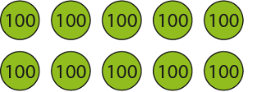



2.14 Short multiplication Step 3:2
521 × 3 =
1,563
521 = 500 + 20 + 1
521 × 3 = 500 × 3 + 20 × 3 + 1 × 3
= 1,500 + 60 + 3
= 1,000 + 500 + 60 + 3
= 1,563
Notes:
Step 1 – partition 521.
Steps 2 and 3 – gather three sets of 521, multiply the
Hundreds, tens and ones and recombine.
Step 4 – regroup the hundreds into thousands and hundreds.

Slide 28


2.14 Short multiplication Step 3:3
201 × 4 =
804
804
200 × 4 = 800
1 × 4 = 4
800 + 4 = 804

Slide 29
2.14 Short multiplication Step 3:3
427 × 3 =
1,281
= 400 × 3 + 20 × 3 + 7 × 3
= 1,200 + 60 + 21
= 1,281

Slide 30



2. 2.14 Short multiplication Step 4:1
321 × 3 =
963
3
2
1
×
3
3
3 × 1 ones = 3 ones
6
0
3 × 2 tens = 6 tens
9
0
0
3 × 3 hundreds =
9 hundreds
9
6
3
9
6
3

Slide 31

2.14 Short multiplication Step 4:3
521 × 3 =
1,563
5
2
1
×
3
3 × 1 ones = 3 ones
3
3 × 2 tens = 6 tens
6
0
3 × 5 hundreds = 15 hundreds
1
5
0
0
= 1 thousand + 5 hundreds
1
5
6
3

Slide 32

2.14 Short multiplication Step 4:3

Slide 33





2.14 Short Multiplication Step 4:4
367 × 4 =
1,468
3
6
7
×
4
4 × 7 ones = 28 ones
2
8
= 2 tens + 8 ones
4 × 6 tens = 24 tens
2
4
0
= 2 hundreds + 4 tens
4 × 3 hundreds = 12 hundreds
1
2
0
0
= 1 thousand + 2 hundreds
1
4
6
8

Slide 34

2.14 Short Multiplication Step 4:4
367 × 4 =
1,468
1
4
6
8
2
2
Notes:
First write the largest factor: “367”
Then write the smallest factor below, lining up the digits: “4”
Now multiply, starting with the ones: four times seven ones is equal to twenty-eight ones…
… and regroup: twenty-eight ones is equal to two tens and eight ones;
write “8” in the ones column and “2” below the tens column.
Then move to the tens: four times six tens is equal to twenty-four tens…
… and regroup: twenty-four tens is equal to two hundreds and four tens…
… and add the two tens from regrouping to give two hundreds and six tens:
write “6” in the tens column and “2” below the hundreds column.
Then move to the hundreds: four times three hundreds is equal to twelve hundreds…
… and regroup: twelve hundreds is equal to one thousand and two hundreds…
… and add the two hundreds from regrouping to give one thousand and
four hundreds; write “1” in the thousands column and “4” in the hundreds column.

Slide 35
2.14 Short Multiplication Step 4:6
242 × 3
200
<
242
<
300
200 × 3
<
242 × 3
<
300 × 3
600
<
242 × 3
<
900

Slide 36
2.14 Short Multiplication Step 4:6
4 × 383
300
<
383
<
400
4 × 300
<
4 × 383
<
4 × 400
1,200
<
4 × 383
<
1,600

