Slide 1
Using and applying Pythagoras' theorem
KS3 Mastery PD Materials: Exemplified Key Ideas
Materials for use in the classroom or to support professional development discussions
(from 6.1 Geometrical properties)
Summer 2021

Slide 2
About this resource
These slides are designed to complement the 6.1 Geometrical properties Core Concept document and its associated Theme Overview document 6 Geometry, both found in the Secondary Mastery Professional Development pages.
These slides re-present the key examples from the Core Concept document so that the examples can be used either directly in the classroom or with a group of teachers. There are prompt questions alongside the examples, and further clarification in the notes.
These slides do not fully replicate the Core Concept document, so should be used alongside it. Reference to specific page numbers, and to other useful NCETM resources, can be found in the notes for each slide.
This slide deck is not designed to be a complete PD session, rather it is a selection of resources that you can adapt and use as needed when planning a session with a group of teachers.

Slide 3
About this resource
The slides are structured as follows:
The big picture:
Where does this fit in?
What do students need to understand?
Why is this key idea important?
Prior learning
Misconceptions
Exemplified key ideas
Reflection questions
Appendices:
Key vocabulary
Representations and structure
Previous and Future learning
Useful links
The exemplified key idea slides have the following symbols to indicate how they have been designed to be used:
Into the classroom
The examples are presented on these slides so that they could be used in PD, but also directly in the classroom. The notes feature suggested questions and things teachers might consider when using with students.
PD discussion prompts
These slides look at the examples in more detail, with question prompts to promote discussion among maths teachers. The notes feature reference to further information and guidance within the Core Concepts document.

Slide 4
Where does this fit in?
The NCETM has identified a set of six ‘mathematical themes’ within Key Stage 3 mathematics that bring together a group of ‘core concepts’.
The sixth of these themes is Geometry, which covers the following interconnected core concepts:
6.1 Geometrical properties
6.2 Perimeter, area and volume
6.3 Transforming shapes
6.4 Constructions
Notes:
Linked on this slide is the Theme Overview document of Geometry. This document includes why it is important, the key underpinning knowledge and links to prior and future learning. There is also guidance about how the five big ideas of Teaching for Mastery relate specifically to this theme.

Slide 5
Where does this fit in?
Within this core concept, 6.1 Geometrical properties, there are three statements of knowledge, skills and understanding.
These, in turn, are broken down into ten key ideas. The highlighted key idea is exemplified in this slide deck.
Notes:
For key ideas marked with an asterisk, we exemplified the common difficulties and misconceptions that students might have and included elements of what teaching for mastery may look like. We have provided examples of possible student tasks and teaching approaches.
Within these slides are ‘classroom-ready’ versions of the examples for the key idea that has been highlighted. There are also slides that may be useful for discussion in a professional development session

Slide 6
What do students need to understand?
6.1.3.2 Use and apply Pythagoras’ theorem to solve problems in a range of contexts
Identify when Pythagoras’ theorem can be applied.
Solve problems using Pythagoras’ theorem to calculate lengths.
Solve problems using Pythagoras’ theorem to make statements about angles.
What prior knowledge might your students already have?
What language might they use to describe this key idea?
What questions might you want to ask to assess their prior learning?

Slide 7
Why is this key idea important? (1)
A 2001 report* about the teaching and learning of geometry from 11–19 set out a number of objectives for a well-taught geometry curriculum, notably:
to develop spatial awareness, geometrical intuition and the ability to visualise
to encourage the development and use of conjecture, deductive reasoning and proof.
The geometry of intersecting lines and the connections and deductions that can be made from diagrams, provide rich opportunities in which students can be encouraged to build logical, deductive arguments. Students develop a narrative, connecting and combining known facts in order to generate further mathematical truths.
*The Royal Society / Joint Mathematical Council working group, 2001: xii, 7
Notes:
A more detailed overview of the core concept of Geometrical properties can be found on pages 2 and 3 of the 6.1 Core Concept document.
The background to each key idea is also explored in more detail on the following pages:
6.1.1 Understand and use angle properties – pages XX
6.1.2 Understand and use similarity and congruence – XX
6.1.3 Understand and use Pythagoras’ theorem – pages XX

Slide 8
Why is this key idea important? (2)
In Key Stage 2, students should have studied that vertically opposite angles are equal.
In Key Stage 3, students will use this fact to deduce that a translation of one of the lines will create a second, equivalent pair of vertically opposite angles.
They will then be able to identify pairs of equal angles (some of which are named alternate or corresponding) and other relationships, such as pairs of supplementary angles (i.e. with a sum of 180°).
Throughout Key Stage 3, students are encouraged to use what they know to construct a logical argument and deduce other facts. By offering carefully selected contexts that encourage reasoning, students can construct and understand proofs, such as the angles in a triangle always sum to 180° (see exemplified key idea 6.1.1.2).
Notes:
A more detailed overview of the core concept of Geometrical properties can be found on pages 2 and 3 of the 6.1 Core Concept document.
The background to each key idea is also explored in more detail on the following pages:
6.1.1 Understand and use angle properties – pages XX
6.1.2 Understand and use similarity and congruence – XX
6.1.3 Understand and use Pythagoras’ theorem – pages XX

Slide 9
Prior learning
Upper Key Stage 2 Learning Outcome
Solve problems involving similar shapes where the scale factor is known or can be found
What prior knowledge might your students already have?
What language might they use to describe this key idea?
What questions might you want to ask to assess their prior learning?
Notes:
You may find it useful to speak to your partner schools to see how the above has been covered and the language used.
You can find further details regarding prior learning in the following segments of the NCETM primary mastery professional development materials (linked on final slide):
Year 6: 2.27 Scale factors, ratio and proportional reasoning
Within the Geometry Theme Overview document, you can also find a broader description of students’ potential previous learning (page 3), alongside further information about key underpinning knowledge (page 2).

Slide 10
Prior learning
Key Stage 3 Learning Outcome
1.4.1 Understand and use the conventions and vocabulary of algebra
1.4.5 Rearrange formulae to change the subject
What representations might your students already be familiar with?
What language might they use?
How does this fit in with your curriculum progression?
Notes:
You may find it useful to speak to your partner schools to see how the above has been covered and the language used.

Slide 11
Checking prior learning
The following slides contain questions for checking prior learning.
What representations might students use to support their understanding of these questions?
What variation might you put in place for these questions to fully assess students’ understanding of the concept?
How might changing the language of each question change the difficulty?
Why are these such crucial pre-requisites for this key idea?

Slide 12
Checking prior learning
a)
Here are two similar right-angled triangles.
Write the ratio of side a to side b.
Notes:
References to the questions (links on final slide):
2017 Key Stage 2 Mathematics Paper 2: reasoning Question 22

Slide 13
Common difficulties and misconceptions
What aspects of this key idea might students find challenging?
What misconceptions might students have?
When teaching this topic, you may find students encounter difficulties with…
Identifying where Pythagoras’ theorem can be used within a problem where the triangle is not explicit
More information, and some suggestions for overcoming these challenges, can be found on the following slides

Slide 14
Common difficulties and misconceptions
Students may know the formula a² + b² = c² and be able to use it to calculate the hypotenuse in a given triangle. However, identifying where Pythagoras’ theorem can be used within a problem where the triangle is not explicit, can be a challenge.
As students are introduced to trigonometric ratios and how to use these to calculate missing sides, there is a danger that this becomes the sole strategy for solving problems involving right-angled triangles and that Pythagoras’ theorem might be an under-used strategy.
To address both of these issues, it is important that students experience Pythagoras’ theorem problems in many different forms, so that they are able to identify where it is an appropriate technique when solving a problem, and to deepen their understanding of the relationship that it describes.
Notes:
More detail can be found on page XX of the 6.1 Core Concept document.

Slide 15
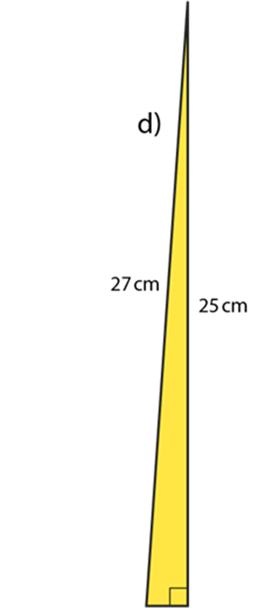
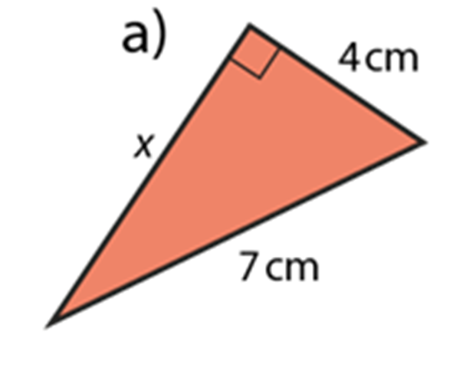
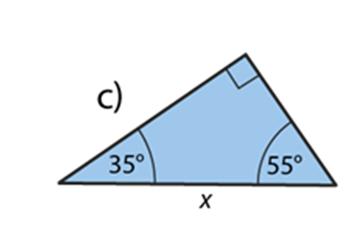
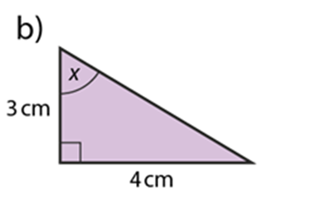
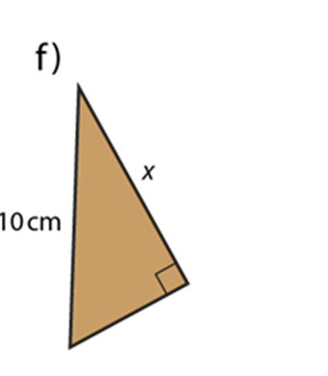
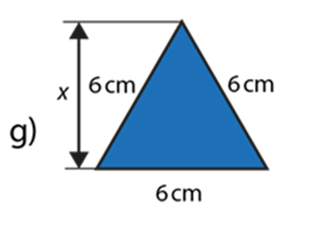
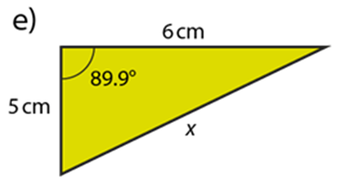
Identify when Pythagoras’ theorem can be applied
Example 1
In which of these diagrams could Pythagoras’ theorem be used to calculate x?
Notes:
Suggested questioning:
How do you know if Pythagoras Theorem can be used?
How could you redraw part g) to show a right angled triangle?
Things for you to think about:
Example 1 offers different examples and non-examples of triangles in which Pythagoras’ theorem might be used to find a missing value.
Students should identify which values of x can and cannot be found using Pythagoras’ theorem, and should be asked to explain how they know for each example.

Slide 16
Identify when Pythagoras’ theorem can be applied
Example 1
In which of these diagrams could Pythagoras’ theorem be used to calculate x?
Why do you think these triangles are in orientation that they are?
Why is it important for students to see non-examples (when Pythagoras doesn’t apply)?
Notes:
Due to space constraints, the image on this PD discussion slide is very small. PD Leads might like to use or print the ‘in the classroom’ version of this slide for teachers to access during discussions.
This example can be found on page 23 of the 6.1 Core Concept document.

Slide 17
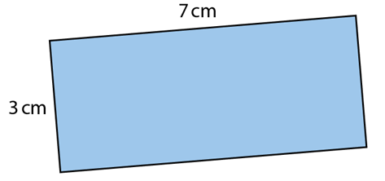
Solve problems using Pythagoras’ theorem to calculate lengths
Example 2a
Can a straight line that is 8 cm long be drawn inside this rectangle?
Notes:
Suggested questioning:
How long is the longest side of this rectangle?
If you had to draw the longest line possible inside the rectangle, where would you draw it?
Things for you to think about:
Example 2a uses Pythagoras’ theorem to find a missing length.
A key understanding here is that Pythagoras’ theorem can only be used to find a missing length where the triangle contains a right angle. Identifying the right angle (where it is not obvious) and/or the triangle is a key part of solving these problems. Students should be encouraged to reflect on the similarities and differences across these questions. A prompt, such as, ‘How did you know that you could use Pythagoras’ theorem to solve this problem?’, may be helpful.

Slide 18
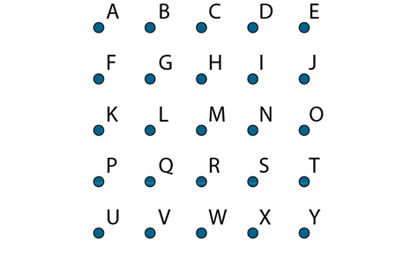
Solve problems using Pythagoras’ theorem to calculate lengths
Example 2b
This is a 1cm grid.
Which two points should be joined to make a straight line that is exactly 5cm long?
Notes:
Suggested questioning:
How far is it from A to B
How far is it from A to E? (students can get confused with number of dots rather than distance between them)
How far is it from A to G? How do you know?
Things for you to think about:
Example 2b uses Pythagoras’ theorem to find a missing length.
Changing the context in which a concept is practised can help students identify the key features of that concept. In this instance, students are asked to calculate a length in problems where a right angle is evident, but no other angles are offered or required.
A key understanding here is that Pythagoras’ theorem can only be used to find a missing length where the triangle contains a right angle. Identifying the right angle (where it is not obvious) and/or the triangle is a key part of solving these problems. Students should be encouraged to reflect on the similarities and differences across these questions. A prompt, such as, ‘How did you know that you could use Pythagoras’ theorem to solve this problem?’, may be helpful.

Slide 19
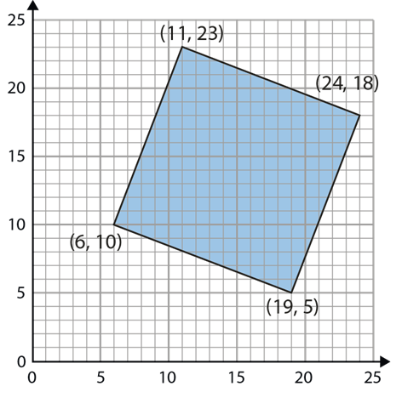
Solve problems using Pythagoras’ theorem to calculate lengths
Example 2c
Find the perimeter of this square.
Notes:
Suggested questioning:
How much higher is the top vertex than the bottom one? How do you know?
What is the difference in the x co-ordinates for the bottom two vertices? Where would you show this on the diagram?
Things for you to think about:
Example 2c uses Pythagoras’ theorem to find a missing length.
Changing the context in which a concept is practised can help students identify the key features of that concept. In this instance, students are asked to calculate a length in problems where a right angle is evident, but no other angles are offered or required.
A key understanding here is that Pythagoras’ theorem can only be used to find a missing length where the triangle contains a right angle. Identifying the right angle (where it is not obvious) and/or the triangle is a key part of solving these problems. Students should be encouraged to reflect on the similarities and differences across these questions. A prompt, such as, ‘How did you know that you could use Pythagoras’ theorem to solve this problem?’, may be helpful.

Slide 20
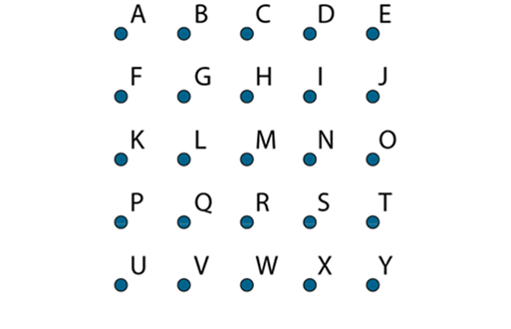
Solve problems using Pythagoras’ theorem to calculate lengths
Example 2a
Example 2b
Example 2c
Can a straight line that is 8cm long be drawn inside this rectangle?
This is a 1cm grid.
Which two points should be joined to make a straight line that is exactly 5cm long?
Find the perimeter of this square.
What teaching techniques do you use in your classroom to draw out and make explicit the strategies that students use to identify what mathematical knowledge is appropriate in solving a problem?
How can you support your students to identify them (and other problems they have not yet met) as examples of Pythagoras’ theorem?
PD questions…
Notes:
Due to space constraints, the images on this PD discussion slide are very small. PD Leads might like to use or print the ‘in the classroom’ version of this slide for teachers to access during discussions.
More detail about the sequencing of this example can be found on page 24 of the 6.1 Core Concept document.

Slide 21
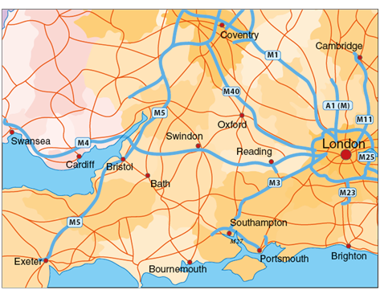
Solve problems using Pythagoras’ theorem to calculate lengths
Example 2d
Brighton is 48 miles south of London.
Cardiff is 130 miles west of London.
What is the direct distance between Brighton and Cardiff?
Can you identify three different cities that might be able to replace London, Brighton and Cardiff in this question?
What is it about them that makes them suitable?
Notes:
Suggested questioning:
Which way is North on this map? How do you know?
What does it mean when it says direct distance? Would this be possible to drive? Which would be the quickest way for a bird to fly?
Things for you to think about:
Example 2d uses Pythagoras’ theorem to find a missing length.
Changing the context in which a concept is practised can help students identify the key features of that concept. In this instance, students are asked to calculate a length in problems where a right angle is evident, but no other angles are offered or required.
A key understanding here is that Pythagoras’ theorem can only be used to find a missing length where the triangle contains a right angle. Identifying the right angle (where it is not obvious) and/or the triangle is a key part of solving these problems. Students should be encouraged to reflect on the similarities and differences across these questions. A prompt, such as, ‘How did you know that you could use Pythagoras’ theorem to solve this problem?’, may be helpful.

Slide 22
Solve problems using Pythagoras’ theorem to calculate lengths.
Example 2e
When using a ladder, it is recommended to use the four-to-one rule:
for every four feet the ladder goes up the wall, move the base away from the wall by one foot.
Using this rule, how high up a wall should a
24-foot ladder reach?
Notes:
Suggested questioning:
How would you represent this information in a diagram?
What if you moved the ladder 8 feet up the wall? How far would the base need to be away from the wall?
Things for you to think about:
Example 2e uses Pythagoras’ theorem to find a missing length.
Changing the context in which a concept is practised can help students identify the key features of that concept. In this instance, students are asked to calculate a length in problems where a right angle is evident, but no other angles are offered or required.
A key understanding here is that Pythagoras’ theorem can only be used to find a missing length where the triangle contains a right angle. Identifying the right angle (where it is not obvious) and/or the triangle is a key part of solving these problems. Students should be encouraged to reflect on the similarities and differences across these questions. A prompt, such as, ‘How did you know that you could use Pythagoras’ theorem to solve this problem?’, may be helpful.

Slide 23
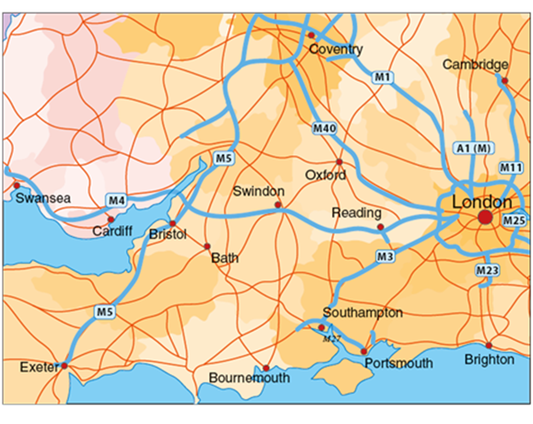
Solve problems using Pythagoras’ theorem to calculate lengths
Example 2d
Example 2e
Brighton is 48 miles south of London.
Cardiff is 130 miles west of London.
When using a ladder, it is recommended to use the four-to-one rule:
for every four feet the ladder goes up the wall, move the base away from the wall by one foot.
Using this rule, how high up a wall should a 24-foot ladder reach?
What is the direct distance between Brighton and Cardiff?
Can you identify three different cities that might be able to replace London, Brighton and Cardiff in this question?
What is it about them that makes them suitable?
What other contexts could be shared with students in which Pythagoras theorem could be applied?
How can you encourage students to draw suitable diagrams?
Notes:
Due to space constraints, the images on this PD discussion slide are very small. PD Leads might like to use or print the ‘in the classroom’ version of this slide for teachers to access during discussions.
This example can be found on page 25 of the 6.1 Core Concept document.

Slide 24
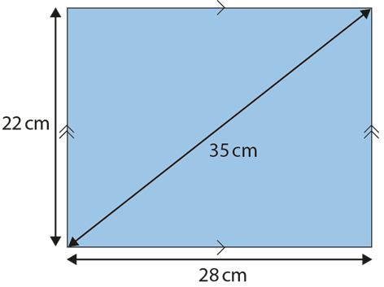
Solve problems using Pythagoras’ theorem to make statements about angles
Example 3a
The shape below shows a parallelogram.
Is it also a rectangle?
Notes:
Suggested questioning:
How do we know that this shape is a parallelogram?
What are the properties of a rectangle? Which one needs to be checked for this diagram?
Things for you to think about:
Each of the problems in Example 3 asks students to make a decision about a shape.
The use of Pythagoras’ theorem as a strategy is perhaps less obvious than when the length of a side is being found, but the focus here is on the angles within the triangle, and the use of the right angle.
In parts a) students use Pythagoras’ theorem to identify whether or not an angle is 90 degrees.
Further prompts might be used to encourage students to further explore a situation.
In part a), (which is not currently a rectangle) you might ask students to consider what the diagonal should be if the height and width are measured correctly, or what the height should be if the base and diagonal are measured correctly, etc.
You might also ask students to visualise and sketch what the shape looks like given its current dimensions. How far is it from being a rectangle?
In each of these problems, Pythagoras’ theorem is being used to give a snapshot of a situation with a right angle, which can then be explored as one or more of the dimensions changes.

Slide 25
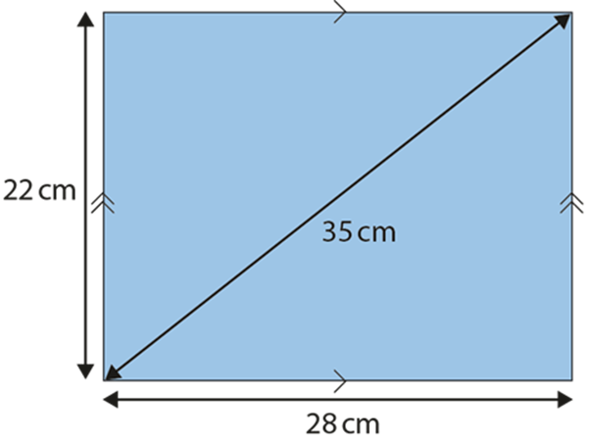
Solve problems using Pythagoras’ theorem to make statements about angles
Example 3a
The shape below shows a parallelogram.
Is it also a rectangle?
How do you sequence your curriculum so prior skills can be revisited without causing cognitive overload?
Can you design additional questions of this type for other quadrilaterals?
Notes:
This example can be found on page 25 of the 6.1 Core Concept document.

Slide 26
Solve problems using Pythagoras’ theorem to make statements about angles
Example 3b
Using three of these rods, is it possible to make a triangle that contains an obtuse angle? If so, which three rods? Is there more than one set?
Using three of these rods, is it possible to make a triangle that contains a right angle? If so, which three rods? Is there more than one set?
Using three of these rods, is it possible to make a triangle that contains all acute angles? If so, which three rods? Is there more than one set?
Notes:
Suggested questioning:
Is it possible to make a triangle using any three of these rods?
Tell me three rod lengths that would not make a triangle? Justify your reasoning.
How do we know if an angle is obtuse / acute?
Things for you to think about:
Each of the problems in Example 3 asks students to make a decision about a shape.
The use of Pythagoras’ theorem as a strategy is perhaps less obvious than when the length of a side is being found, but the focus here is on the angles within the triangle, and the use of the right angle.
Students use Pythagoras’ theorem to identify whether or not an angle is 90 degrees.
Students can be asked to visualise the impact of the changes before going on to calculate to test their predictions.
Further prompts might be used to encourage students to further explore a situation.
Students might consider the minimum number of rods needed to allow all three types of triangle to be made – can they find a set of four rods which can be combined in different ways to make three different types of triangle?
Pythagoras’ theorem is being used to give a snapshot of a situation with a right angle, which can then be explored as one or more of the dimensions changes.

Slide 27
Solve problems using Pythagoras’ theorem to make statements about angles
Example 3b
Using three of these rods, is it possible to make a triangle that contains an obtuse angle? If so, which three rods? Is there more than one set?
Using three of these rods, is it possible to make a triangle that contains a right angle? If so, which three rods? Is there more than one set?
Using three of these rods, is it possible to make a triangle that contains all acute angles? If so, which three rods? Is there more than one set?
How would you manage an exploratory task like this in the classroom to ensure the key learning point is drawn out?
How can you check that all pupils have understood the key idea?
Notes:
Due to space constraints, the image on this PD discussion slide is very small. PD Leads might like to use or print the ‘in the classroom’ version of this slide for teachers to access during discussions.
This example can be found on page 26 of the 6.1 Core Concept document.

Slide 28
Solve problems using Pythagoras’ theorem to make statements about angles
Example 3c
Darcy draws a right-angled triangle.
Emil says, ‘I’m going to draw a bigger right-angled triangle by making each side of your triangle 10cm longer.’
Will Emil’s triangle be a right-angled triangle?
Will it have an obtuse angle?
Notes:
Suggested questioning:
Can you give me an example of triangle that Darcy could have drawn? What about a different example?
How would the dimensions change for that example you have chosen?
Things for you to think about:
Each of the problems in Example 3 asks students to make a decision about a shape.
The use of Pythagoras’ theorem as a strategy is perhaps less obvious than when the length of a side is being found, but the focus here is on the angles within the triangle, and the use of the right angle.
Students can be asked to visualise the impact of the changes before going on to calculate to test their predictions.
Further prompts might be used to encourage students to further explore a situation.
Students can use what they know about similar shapes to see that adding the same amount to each length cannot create a similar shape, but might then be encouraged to use similarity to find Pythagorean triples.
Pythagoras’ theorem is being used to give a snapshot of a situation with a right angle, which can then be explored as one or more of the dimensions changes.

Slide 29
Solve problems using Pythagoras’ theorem to make statements about angles
Example 3c
Darcy draws a right-angled triangle.
Emil says, ‘I’m going to draw a bigger right-angled triangle by making each side of your triangle 10 cm longer.’
Will Emil’s triangle be a right-angled triangle?
Will it have an obtuse angle?
Are there particular triangles that you expect students to know are right angled without checking using the theorem?
What script would you use to turn this into a mental imagery task for students to visualise?
Notes:
This example can be found on page 26 of the 6.1 Core Concept document.

Slide 30
Reflection questions
What other mathematical concepts will be supported by students’ stronger understanding of this key idea?
What mathematical language will you continue to use to support pupils to make connections with other areas?
Which representations might you continue to use to further develop students’ understanding?

Slide 32
Appendices
You may choose to use the following slides when planning or delivering a PD session. They cover:
Key vocabulary
Representations and structure
Previous learning
Future learning
Library of links

Slide 33
Key vocabulary
Term | Definition
hypotenuse | In trigonometry, the longest side of a right-angled triangle. The side opposite the right-angle.
Pythagoras’ theorem | In a right-angled triangle, the square of the length of the hypotenuse is equal to the sum of the squares of the lengths of the other sides, i.e. the sides that bound the right angle. Example: When ∠DEF is a right angle, a² + b² = h².
similar | Two geometrical objects are said to be similar if they both have the same shape. More precisely, one can be obtained from the other by uniformly scaling (enlarging or reducing), possibly with additional translation, rotation and reflection. Similar shapes have corresponding sides proportional and corresponding angles equal.

Slide 34
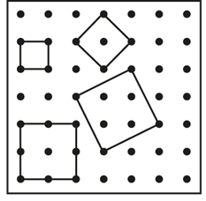
Representations and structure
There are a number of different representations that you may wish to use to support students’ understanding of this key idea. These might include:
Geoboards
Thinking about how many different squares can be made on a pin board, and calculating their areas, can provide an engaging introduction to Pythagoras’ theorem.
Dynamic geometry software
The guided use of dynamic geometry software can provide an environment in which students are able to make and test conjectures. By dragging and changing features, they are able to identify variant and invariant properties, leading to a deeper understanding of generalisations.
Notes:
More information about the representations and structure involved in this key idea can be found:
On page 6 of the Theme Overview document
Links to all this can be found on the final slide.

Slide 35
Previous learning
From Upper Key Stage 2, students will bring experience of:
drawing 2D shapes using given dimensions and angles
recognising, describing and building simple 3D shapes, including making nets
comparing and classifying geometric shapes based on their properties and sizes, and finding unknown angles in any triangles, quadrilaterals and regular polygons
illustrating and naming parts of circles, including radius, diameter and circumference, and knowing that the diameter is twice the radius
recognising angles where they meet at a point, are on a straight line or are vertically opposite, and finding missing angles
drawing and translating simple shapes on the coordinate plane and reflecting them in the axes.

Slide 36
Future learning (1)
In KS4, students will build on the core concepts in this mathematical theme to:
interpret and use fractional {and negative} scale factors for enlargements
{describe the changes and invariance achieved by combinations of rotations, reflections and translations}
identify and apply circle definitions and properties, including: centre, radius, chord, diameter, circumference, tangent, arc, sector and segment
{apply and prove the standard circle theorems concerning angles, radii, tangents and chords, and use them to prove related results}
construct and interpret plans and elevations of 3D shapes
interpret and use bearings
calculate arc lengths, angles and areas of sectors of circles
calculate surface areas and volumes of spheres, pyramids, cones and composite solids
apply the concepts of congruence and similarity, including the relationships between lengths, {areas and volumes} in similar figures

Slide 37
Future learning (2)
In KS4, students will build on the core concepts in this mathematical theme to:
apply the concepts of congruence and similarity, including the relationships between lengths, {areas and volumes} in similar figures
apply Pythagoras’ theorem and trigonometric ratios to find angles and lengths in right-angled triangles {and, where possible, general triangles} in two {and three} dimensional figures
know the exact values of sin θ and cos θ for θ = 30°, 45°, 60° and 90°; know the exact value of tan θ for θ = 30°, 45°, 60°
{know and apply the sine rule, $\frac{a}{SinA}=\frac{b}{SinB}=\frac{c}{SinC}$ , and cosine rule, $a^{2}=b^{2}+c^{2}– 2bc cos⁡A$, to find unknown lengths and angles}
{know and apply Area =$\frac{1}{2}ab\sin{C}$ to calculate the area, sides or angles of any triangle}
describe translations as 2D vectors
apply addition and subtraction of vectors, multiplication of vectors by a scalar, and diagrammatic and column representations of vectors; {use vectors to construct geometric arguments and proofs}.
Please note: Braces { } indicate additional mathematical content to be taught to more highly attaining students.
Notes:
Theme 6 Geometry

Slide 38
Library of links
The following resources from the NCETM website have been referred to within this slide deck:
NCETM Secondary Mastery Professional Development
6 Geometry Theme Overview Document
6.1 Geometrical properties Core Concept Document
Using mathematical representations at KS3 | NCETM
NCETM primary mastery professional development materials
There are also references to:
Standards & Testing Agency’s past mathematics papers

