Slide 1
Understanding simplification of fractions
KS3 Mastery PD Materials: Exemplified Key Ideas
Materials for use in the classroom or to support professional development discussions
(from 1.3 Ordering and comparing)
Summer 2021

Slide 2
About this resource
These slides are designed to complement the 1.3 Ordering and comparing Core Concept document and its associated Theme Overview document 1 The Structure of the number system, both found in the Secondary Mastery Professional Development pages.
These slides re-present the key examples from the Core Concept document so that the examples can be used either directly in the classroom or with a group of teachers. There are prompt questions alongside the examples, and further clarification in the notes.
These slides do not fully replicate the Core Concept document, so should be used alongside it. Reference to specific page numbers, and to other useful NCETM resources, can be found in the notes for each slide.
This slide deck is not designed to be a complete PD session, rather it is a selection of resources that you can adapt and use as needed when planning a session with a group of teachers.

Slide 3


About this resource
The slides are structured as follows:
  The big picture:
    Where does this fit in?
    What do students need to understand?
    Why is this key idea important?
  Prior learning
  Misconceptions
  Exemplified key ideas
  Reflection questions
  Appendices:
    Key vocabulary
    Representations and structure
    Previous and Future learning
    Useful links
The exemplified key idea slides have the following symbols to indicate how they have been designed to be used:
Into the classroom
The examples are presented on these slides so that they could be used in PD, but also directly in the classroom. The notes feature suggested questions and things teachers might consider when using with students.
PD discussion prompts
These slides look at the examples in more detail, with question prompts to promote discussion among maths teachers. The notes feature reference to further information and guidance within the Core Concepts document.

Slide 4
Where does this fit in?
The NCETM has identified a set of six ‘mathematical themes’ within Key Stage 3 mathematics that bring together a group of ‘core concepts’.
The first of these themes is The structure of the number system, which covers the following interconnected core concepts:
    1.1 Place value, estimation and rounding
    1.2 Properties of number
    1.3 Ordering and comparing
    1.4 Simplifying and manipulating expressions, equations and formulae
Notes:
Linked on this slide is the Theme Overview document of The structure of the number system. This document includes why it is important, the key underpinning knowledge and links to prior and future learning. There is also guidance about how the five big ideas of Teaching for Mastery relate specifically to this theme.

Slide 5
Where does this fit in?
Within this core concept, 1.3 Ordering and comparing, there are three statements of knowledge, skills and understanding.
These, in turn, are broken down into sixteen key ideas. The highlighted key idea is exemplified in this slide deck.
Notes:
For key ideas marked with an asterisk, we exemplified the common difficulties and misconceptions that students might have and included elements of what teaching for mastery may look like. We have provided examples of possible student tasks and teaching approaches.
Within these slides are ‘classroom-ready’ versions of the examples for the key idea that has been highlighted. There are also slides that may be useful for discussion in a professional development session.

Slide 6
What do students need to understand?
1.3.1.5 Understand the process of simplifying fractions through dividing both numerator and denominator by common factors
Understand how the numerator and the denominator are linked in a family of equivalent fractions.
Recognise fractions in their simplest form.
Find a common factor and convert a fraction to its simplest form.
Connect fractions with division and appreciate that the concept of equivalent fractions can be used to generate equivalent divisions.
  What prior knowledge might your students already have?
  What language might they use to describe this key idea?
  What questions might you want to ask to assess their prior learning?

Slide 7
Why is this key idea important? (1)
At Key Stage 2, students should have developed an awareness that any number can be expressed in a variety of ways that reveal the base-ten structure. Students should not simply name the place-value column headings. Rather, they should recognise that, for example, the number 2 437 consists of 24 hundreds or 243 tens.
At Key Stage 3, students will further develop their understanding of the different ways that numbers can be expressed and will become more proficient in changing from one form to another. This will develop their awareness that different representations of the same number can reveal something of its structure and so can be used to compare and order numbers with ease.
Students should develop their understanding of the infinite nature of the number system and work confidently with a wide range of real numbers. For example, they should recognise that for any given pair of numbers, a third that is greater than both, smaller than both or in between the two can always be found. The process of comparing and ordering these numbers becomes easier by considering numbers expressed as decimals and fractions.
Notes:
A more detailed overview of the core concept 1.3 Ordering and comparing can be found on page 2 of the 1.3 Core Concept document.
The background to each key idea is also explored in more detail on the following pages:
1.3.1 Work interchangeably with terminating decimals and their corresponding fractions – page 6
1.3.2 Compare and order positive and negative integers, decimals and fractions – page 7
1.3.3 Interpret and compare numbers in standard form A × 10^{n}, 1 ≤ A < 10 – pages 8 and 9

Slide 8
Why is this key idea important? (2)
At Key Stage 3, students begin to recognise decimals such as 0.13 not just as one tenth and three hundredths, but also as 13 hundredths, which leads to its expression as a single fraction.
An awareness that a fraction represents a division is crucial at this stage, as this will allow a deep understanding of the process of changing fractions to decimals.
It is important during Key Stage 3 that students become increasingly fluent when converting between fractions and decimals. This will contribute to a strong sense of number, support flexibility in calculation and students’ ability to make sensible choices as to when to work mentally, use a written method or use a calculator.
Notes:
A more detailed overview of the core concept 1.3 Ordering and comparing can be found on page 2 of the 1.3 Core Concept document.
The background to each key idea is also explored in more detail on the following pages:
1.3.1 Work interchangeably with terminating decimals and their corresponding fractions
1.3.2 Compare and order positive and negative integers, decimals and fractions
1.3.3 Interpret and compare numbers in standard form A × 10^{n}, 1 ≤ A < 10

Slide 9
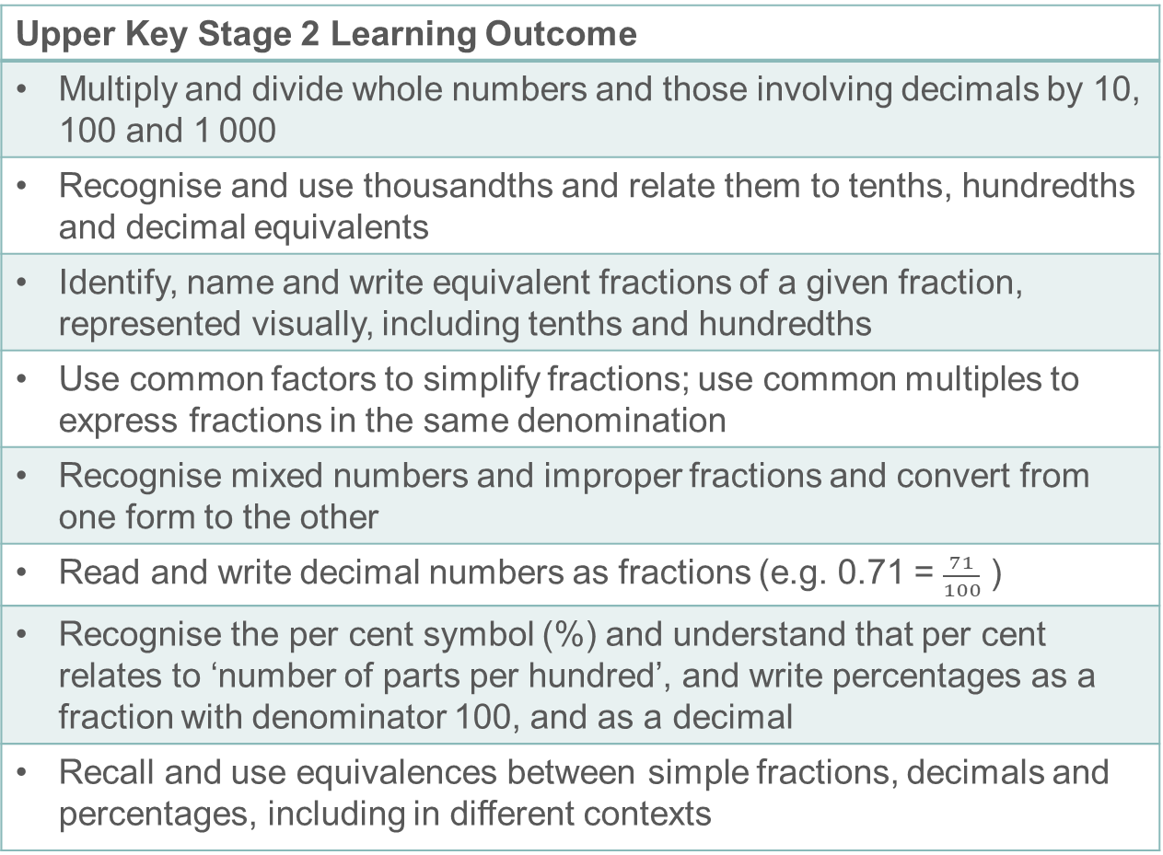
Prior learning
Upper Key Stage 2 Learning Outcome
Multiply and divide whole numbers and those involving decimals by 10, 100 and 1 000
Recognise and use thousandths and relate them to tenths, hundredths and decimal equivalents
Identify, name and write equivalent fractions of a given fraction, represented visually, including tenths and hundredths
Use common factors to simplify fractions; use common multiples to express fractions in the same denomination
Recognise mixed numbers and improper fractions and convert from one form to the other
Read and write decimal numbers as fractions (e.g. 0.71 = $\frac{71}{100}$ )
Recognise the per cent symbol (%) and understand that per cent relates to ‘number of parts per hundred’, and write percentages as a fraction with denominator 100, and as a decimal
Recall and use equivalences between simple fractions, decimals and percentages, including in different contexts
  What prior knowledge might your students already have?
  What language might they use to describe this key idea?
  What questions might you want to ask to assess their prior learning?
Notes:
You may find it useful to speak to your partner schools to see how the above has been covered and the language used.
You can find further details regarding prior learning in the following segments of the NCETM primary mastery professional development materials (linked on final slide):
Year 4: 1.23 Composition and calculation: tenths
Year 4: 1.24 Composition and calculation: hundredths and thousandths
Year 4: 2.13 Calculation: multiplying and dividing by 10 or 100
Year 5: 1.27 Negative numbers: counting, comparing and calculating
Year 5: 2.18 Using equivalence to calculate
Year 5: 3.7 Finding equivalent fractions and simplifying fractions
Year 6: 3.10 Linking fractions, decimals and percentages
Within The structure of the number system Theme Overview document, you can also find a broader description of students’ potential previous learning (page 4), alongside further information about key underpinning knowledge (page 2).

Slide 10
Prior learning
Key Stage 3 Learning Outcome
1.1.1 Understand the value of digits in decimals, measure and integers
1.2.2 Understand integer exponents and roots
1.3.2 Compare and order positive and negative integers, decimals and fractions
Please note: Numerical codes refer to statements of knowledge, skills and understanding in the NCETM breakdown of Key Stage 3 mathematics.
  What representations might your students already be familiar with?
  What language might they use?
  How does this fit in with your curriculum progression?

Slide 11
Checking prior learning
The following slides contain questions for checking prior learning.
  What representations might students use to support their understanding of these questions?
  What variation might you put in place for these questions to fully assess students’ understanding of the concept?
  How might changing the language of each question change the difficulty?
  Why are these such crucial pre-requisites for this key idea?

Slide 12
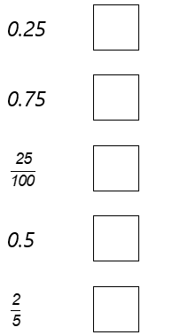
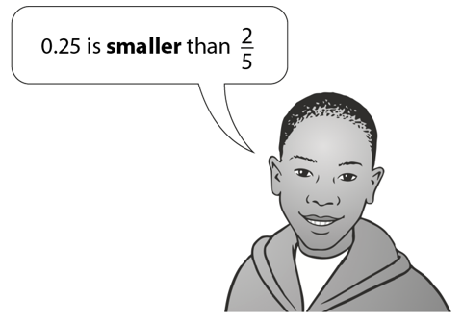
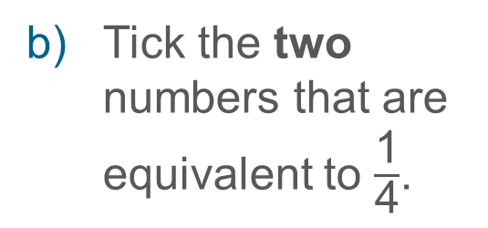
Checking prior learning (1)
Adam says,
Tick the two numbers that are equivalent to $\frac{\text{1}}{\text{4}}$.
Explain why he is correct.
Notes:
References to the questions (links on final slide):
a) 2017 Key Stage 2 Mathematics Paper 2: reasoning, Question 20
b) 2018 Key Stage 2 Mathematics Paper 2: reasoning Question 7

Slide 13
Checking prior learning (2)
In each number sentence, replace the boxes with different whole numbers less than 20 so that the number sentence is true:
1
3
=
=
=
3
12
30
45
=
÷
=
Notes:
References to the questions (links on final slide):
c) NCETM Primary assessment materials: Year 6, page 19

Slide 14
Common difficulties and misconceptions
What aspects of this key idea might pupils find challenging?
What misconceptions might pupils have?
When teaching this topic, you may find students encounter difficulties with…
Thinking the size of the fraction has changed
Memorising the procedure without understanding
Not finding the simplest form of a fraction
More information, and some suggestions for overcoming these challenges, can be found on the following slides.

Slide 15
Common difficulties and misconceptions (1)
When simplifying, or ‘cancelling’, fractions, students may know to look for a common factor by which to divide both the numerator and denominator. However, if this has been learnt as a procedure, with no understanding of the reason behind it, a number of misconceptions may arise.
Students may, for example, think that since a division has occurred, the size of the fraction has changed.
Students may also think that a ‘cancelled down’ fraction can be obtained by subtracting from both the numerator and the denominator, rather than by dividing.
Students should understand that the process of cancelling is the inverse of the process for obtaining equivalent fractions. It involves the scaling down of both the numerator and the denominator and, therefore, maintaining the same (multiplicative) relationship between them.
Notes:
More detail can be found on pages 13 and 14 of the 1.3 Core Concept document.

Slide 16
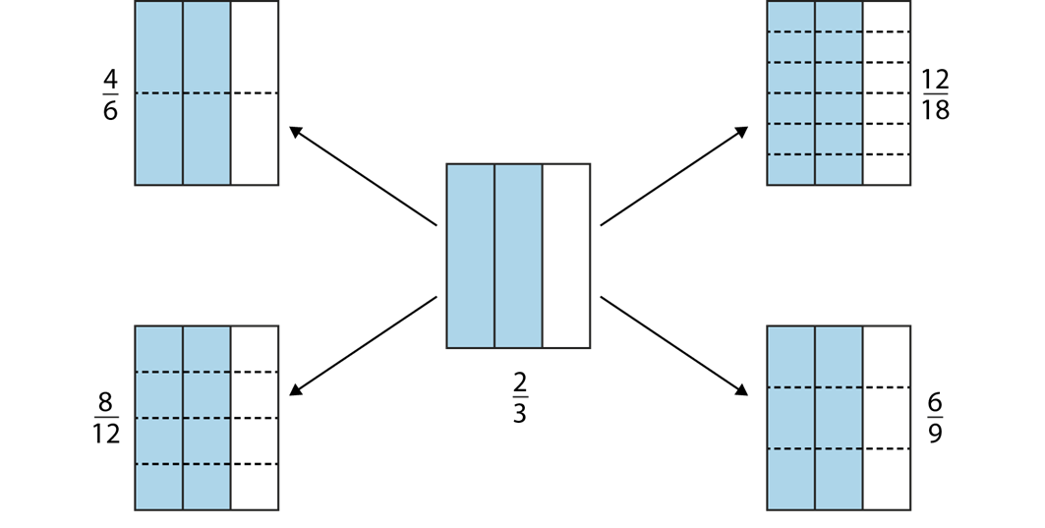
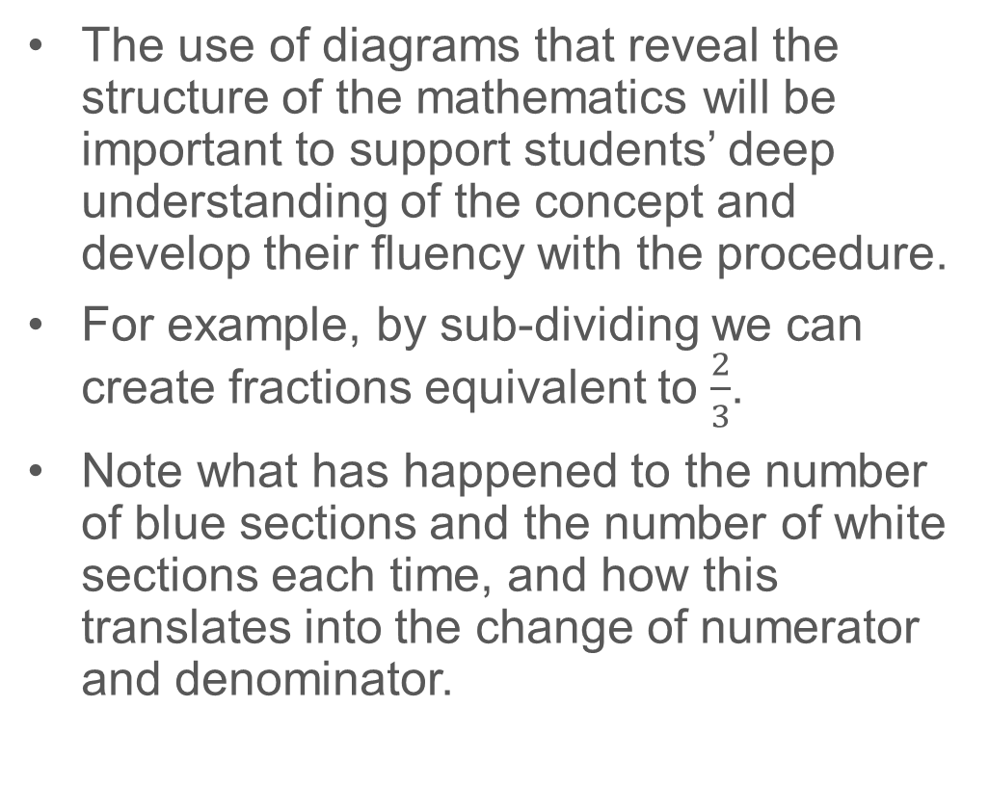
Common difficulties and misconceptions (2)
The use of diagrams that reveal the structure of the mathematics will be important to support students’ deep understanding of the concept and develop their fluency with the procedure.
For example, by sub-dividing we can create fractions equivalent to $\frac{2}{3}$.
Note what has happened to the number of blue sections and the number of white sections each time, and how this translates into the change of numerator and denominator.
Notes:
More detail can be found on pages 13 and 14 of the 1.3 Core Concept document.
This also features an example of a diagram where the central fraction is 12/18, and equivalent fractions are found by removing sub-divisions.

Slide 17
Common difficulties and misconceptions (2 cont.)
Diagrams such as the one on the previous slide will help students to appreciate that, as the denominator is halved (or divided by three, four, five, etc.) then the numerator must also be halved (or divided by three, four, five, etc.) to retain equality.
However, it is important not to create the misconception that one always has to multiply by two, then by three, then by four, etc. Students need to appreciate that multiplying the numerator and denominator by the same integer yields a fraction equivalent to the original. Conversely, dividing the numerator and the denominator by the same common factor obtains an equivalent fraction.
Students will have been introduced to fractions in several ways, so illustrating fractions as representations is important. When students’ experience of fractions is solely through the symbolic representation, then the language of ‘two over three’ can dominate. This does not support students’ understanding. Using diagrams, such as the one on the previous slide, can support and encourage use of the term ‘out of’, as in ‘two out of three’.
Notes:
More detail can be found on pages 13 and 14 of the 1.3 Core Concept document.

Slide 18

Common difficulties and misconceptions (3)
As students work more symbolically, they may recognise common factors such as two, five and ten within fractions but may not check rigorously enough to arrive at a fraction in its simplest form. For example, students may simplify $\frac{12}{42}$to $\frac{6}{21}$ but not cancel further by three to arrive at $\frac{2}{7}$.
Notes:
More detail can be found on pages 13 and 14 of the 1.3 Core Concept document.

Slide 19
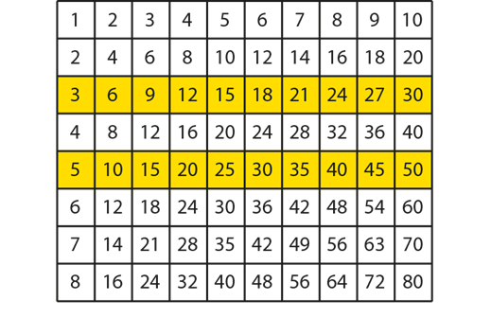
Understand how the numerator and the denominator are linked in a family of equivalent fractions.
Example 1a & 1b
Two lines on this multiplication grid have been highlighted.
Discuss the patterns you see in the numbers on these two highlighted lines.
What do you notice about the two sets of numbers; how are they related?
What can you say about the fractions that are formed by taking a number on the upper highlighted line as the numerator and the number below it on the lower highlighted line as the denominator?
Notes:
Suggested questioning:
What is the relationship along each row?
What is the relationship between the numerator and the denominator?
Can you find a fraction with the same relationship on the grid? How about off the grid?
Things for you to think about:
Students should be familiar with finding equivalent fractions using a fraction wall like the one on page 15 of the 1.3 Core Concept Document. For example, they should be able to use the fraction wall to find equivalent fractions to 1/2, 1/3, 1/4, etc. However, such activities may not allow students to see the multiplicative connection between the numerator and the denominator and appreciate that this will necessarily be the same for any other equivalent fraction.
For example, in the multiplication grid in Example 1, 3/5 is equivalent to 6/10, 9/15, 12/20, 15/25, … Draw students’ attention to the fact that, in each case, the numerator is three-fifths of the denominator.
Use of the grid in this way will support students in seeing, for example, 18/30 as (3x6)/(5x6), and therefore equivalent to 3/5.
Where appropriate, draw students’ attention to non-integer examples, such as 2.5/10. They should recognise that these can be expressed as proper fractions through multiplying by a convenient number. Note, multiplying a terminating decimal by ten or a power of ten will always produce integers, but not necessarily a fraction in its simplest form, e.g. 12.5/20 = 125/200).

Slide 20
Understand how the numerator and the denominator are linked in a family of equivalent fractions.
Example 1c
Two lines on this multiplication grid have been highlighted.
Highlight two different lines on the multiplication grid. What fractions are revealed and what do you know about them?
Notes:
Suggested questioning:
What is the relationship along each row?
What is the relationship between the numerator and the denominator?
Can you find a fraction with the same relationship on the grid? How about off the grid?
Things for you to think about:
Students should be familiar with finding equivalent fractions using a fraction wall like the one on page 15 of the 1.3 Core Concept Document. For example, they should be able to use the fraction wall to find equivalent fractions to 1/2, 1/3, 1/4, etc. However, such activities may not allow students to see the multiplicative connection between the numerator and the denominator and appreciate that this will necessarily be the same for any other equivalent fraction.
For example, in the multiplication grid in Example 1, 3/5 is equivalent to 6/10, 9/15, 12/20, 15/25, … Draw students’ attention to the fact that, in each case, the numerator is three-fifths of the denominator.
Use of the grid in this way will support students in seeing, for example, 18/30 as (3x6)/(5x6), and therefore equivalent to 3/5.
Where appropriate, draw students’ attention to non-integer examples, such as 2.5/10. Students should recognise that these can be expressed as proper fractions through multiplying by a convenient number. Note, multiplying a terminating decimal by ten or a power of ten will always produce integers, but not necessarily a fraction in its simplest form, e.g. 12.5/20 = 125/200).

Slide 21
Understand how the numerator and the denominator are linked in a family of equivalent fractions.
Example 1
Two lines on this multiplication grid have been highlighted.
Discuss the patterns you see in the numbers on these two highlighted lines.
What do you notice about the two sets of numbers; how are they related?
What can you say about the fractions that are formed by taking a number on the upper highlighted line as the numerator and the number below it on the lower highlighted line as the denominator?
Highlight two different lines on the multiplication grid. What fractions are revealed and what do you know about them?
  Have you used the multiplication grid to explore this topic before? What possibilities are offered by this representation?
  What does an activity like this add to students’ understanding of simplifying fractions?
Notes:
Due to space constraints, the image on this PD discussion slide is very small. PD Leads might like to use or print the ‘in the classroom’ version of this slide for teachers to access during discussions.
More detail about this example can be found on page 15 of the 1.3 Core Concept document.

Slide 22

Recognise fractions in their simplest form.
Example 2
Is each fraction in its simplest form?
Explain your reasoning.
(These questions are sequenced vertically, down the page).
$\frac{8}{18}$
$\frac{9}{18}$
$\frac{10}{18}$
$\frac{11}{18}$
$\frac{12}{18}$
$\frac{13}{18}$
$\frac{14}{18}$
$\frac{15}{18}$
Notes:
Suggested questioning:
What are the factors of the denominator? Are any of these also factors of the numerator?
How do you know if a fraction is in its simplest form?
What do you notice about the fractions that are in the simplest form? Is this the case for all fractions in the simplest form?
It will be important for students to articulate how they know when a fraction is in its simplest form. Your questioning should encourage the use of some standard language, such as ‘because the numerator and the denominator have no common factors (other than one)’.
Things for you to think about:
Once students are fluent with generating equivalent fractions by multiplying both numerator and denominator by any integer, their attention can be shifted to noticing whether any common factors can be removed from certain fractions, as in Example 2.
Notice how the denominator is kept constant so that students can more easily focus on the idea of a common factor without being distracted by having to find all the factors of a different denominator each time.

Slide 23

Recognise fractions in their simplest form.
Example 2
Is each fraction in its simplest form?
Explain your reasoning.
  Why might the denominator be the same for all of the parts to this example? What are the benefits of keeping this aspect the same?
  What language would you want your students to use to explain their reasoning? How will this support their understanding?
$\frac{8}{18}$
$\frac{9}{18}$
$\frac{10}{18}$
$\frac{11}{18}$
$\frac{12}{18}$
$\frac{13}{18}$
$\frac{14}{18}$
$\frac{15}{18}$
Notes:
Due to space constraints, the image on this PD discussion slide is very small. PD Leads might like to use or print the ‘in the classroom’ version of this slide for teachers to access during discussions.
More detail about this example can be found on page 16 of the 1.3 Core Concept document.

Slide 24
Find a common factor and convert a fraction to its simplest form.
Example 3
75
3 x
3
Complete these equivalent fractions.
=
=
4 x 25
12
2
Complete these equivalent fractions.
=
=
18
9
Simplify this fraction.
24
=
36
Notes:
Suggested questioning:
Which missing number will you find first? Why?
What is a common factor of both the numerator and denominator? What is the highest common factor?
Is the fraction in its simplest form? How do you know?
Things for you to think about:
Students can be given clues to help them find common factors. They can either be told to express the numerator and denominator in a certain way before dividing or they can be given one of the resulting answers so they can more easily spot the dividing factor. Additionally, exercises where students have to fill in the gaps can give a scaffold, as well as draw attention to the fact that there are many equivalent fractions and not just the simplest form.
In Example 3:
Part a) has been designed to highlight the highest common factor of the numerator and denominator (25). It is important to draw students’ attention to this so they understand that dividing by the highest common factor results in a fraction in its simplest form.
Part b) can be used to prompt discussion about what the highest common factor of 12 and 18 is, and how this is related to the interim divisions that were made.
Part c) provides an opportunity to discuss different methods for reducing the fraction to its simplest form. It will be important to compare and contrast multiple solutions in order to arrive at a conclusion about what the most efficient method is (i.e. identifying that 12 is the highest common factor).

Slide 25
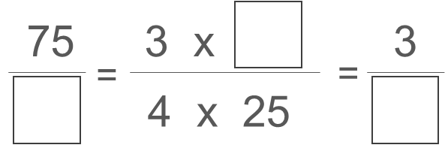
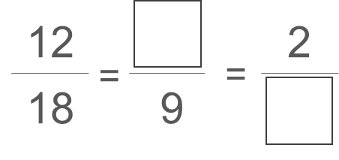
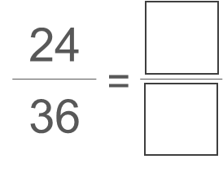
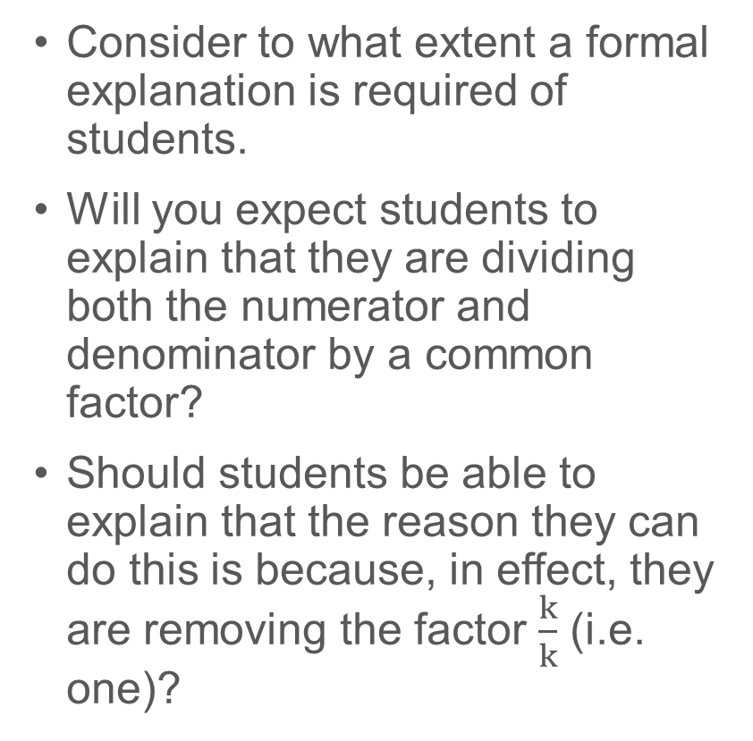
Find a common factor and convert a fraction to its simplest form.
Example 3
  Consider to what extent a formal explanation is required of students.
  Will you expect students to explain that they are dividing both the numerator and denominator by a common factor?
  Should students be able to explain that the reason they can do this is because, in effect, they are removing the factor $\frac{k}{k}$ (i.e. one)?
Complete these equivalent fractions.
Complete these equivalent fractions.
Simplify this fraction.
Notes:
Due to space constraints, the image on this PD discussion slide is very small. PD Leads might like to use or print the ‘in the classroom’ version of this slide for teachers to access during discussions.
More detail about this example can be found on pages 16 and 17 of the 1.3 Core Concept document.

Slide 26
Connect fractions with division and appreciate that the concept of equivalent fractions can be used to generate equivalent divisions.
Example 4
Explain why 8 ÷ 2, 80 ÷ 20 and 800 ÷ 200 all give the same result.
Notes:
Suggested questioning:
How could I write each of these as a fraction?
What is the same? What is different?
What has happened to both values each time? What does this mean for the quotient? How would it be different if one had stayed the same?
Things for you to think about:
A significant idea, which is not always grasped in the study of fractions at Key Stage 2, and which is crucial to developments at Key Stage 3, is to conceptualise fractions as a division, i.e. 3/4 = 3 ÷ 4. Working with integers offers a more familiar context to begin this work. You could ask students to give several reasons (including drawing diagrams) to explain why the answers to Example 4 are all four.

Slide 27
Connect fractions with division and appreciate that the concept of equivalent fractions can be used to generate equivalent divisions.
Example 4
  How explicitly do you conceptualise fractions as divisions in your current scheme of learning?
  What different explanations might your students give here? Are any explanations preferrable to others?
Explain why 8 ÷ 2, 80 ÷ 20 and 800 ÷ 200 all give the same result.
Notes:
More detail about this example can be found on page 17 of the 1.3 Core Concept document.

Slide 28
Connect fractions with division and appreciate that the concept of equivalent fractions can be used to generate equivalent divisions.
Example 5
Express the calculation 1 300 ÷ 70 as an equivalent but simpler calculation.
Notes:
Suggested questioning:
How else could I write this?
How is this the same as simplifying fractions?
What is the relationships between the original calculation and your simpler calculation?
Things for you to think about:
You could challenge students to explain why the procedure of ‘cancelling zeros’ in fractions works.

Slide 29
Connect fractions with division and appreciate that the concept of equivalent fractions can be used to generate equivalent divisions.
Example 5
  Many students might use the phrase ‘take off the zeros’ here. Will you accept this language? Why or why not?
  Think about how you think about this problem, and how you would plan to explain this problem to students. Is there a difference?
Express the calculation 1 300 ÷ 70 as an equivalent but simpler calculation.
Notes:
More detail about this example can be found on page 17 of the 1.3 Core Concept document.

Slide 30
Connect fractions with division and appreciate that the concept of equivalent fractions can be used to generate equivalent divisions.
Example 6
Find:
(These questions are sequenced vertically, down the page).
320 ÷ 8
320 ÷ 80
32 000 ÷ 80
32 ÷ 8
32 ÷ 0.8
320 ÷ 0.8
3 200 ÷ 8
0.32 ÷ 0.08
0.32 ÷ 80
What is the same and what is different in each of these calculations?
Notes:
Suggested questioning:
What is the same/different about __?
Which will have the biggest/smallest quotient? Why?
How can you use the answer to i) to find the other answers?
Ben says ‘The answer to ii must be bigger than the answer to i because 80 is bigger than 8.’ Do you agree? Why or why not?
Things for you to think about:
Example 6 enables students to explore multiplying or dividing both the divisor and the dividend by powers of ten.
Draw attention to the connections between parts (i), (ii) and (iii):
For example, parts (i) and (ii): the divisor has been multiplied by ten; note what happens to the answer. (Similarly, in parts (iv) and (v), the divisor has been divided by 10.)
Part (ii) and (iii): the dividend has been multiplied by 100.
Parts (vi) and (vii): both the dividend and the divisor have been multiplied by ten. How does this affect the answer?
Use what has been learnt to find equivalent divisions to solve parts (viii) and (ix) more easily.
Example 6 might also provide a useful opportunity to ask students to think about when dividing and multiplying by ten results in a zero being removed or added, and when this cannot be done. This will prompt students to recognise that it is the digits that move under such operations.

Slide 31
Connect fractions with division and appreciate that the concept of equivalent fractions can be used to generate equivalent divisions.
Example 6
  Which particular relationships might you want to draw attention to in this example?
  Will you have a routine/structure for the language students use? Why or why not?
  How might you use Example 6 as a basis for discussion of strategies for calculating (by hand) divisions where the divisor is a decimal?
Find:
320 ÷ 8
320 ÷ 80
32 000 ÷ 80
32 ÷ 8
32 ÷ 0.8
320 ÷ 0.8
3 200 ÷ 8
0.32 ÷ 0.08
0.32 ÷ 80
What is the same and what is different in each of these calculations?
Notes:
Due to space constraints, the image on this PD discussion slide is very small. PD Leads might like to use or print the ‘in the classroom’ version of this slide for teachers to access during discussions.
More detail about this example can be found on page 18 of the 1.3 Core Concept document.

Slide 32
Connect fractions with division and appreciate that the concept of equivalent fractions can be used to generate equivalent divisions.
Example 6 (cont.)
  Think about some of your KS3 students. What responses might you expect from them?
  Watch the video of a teacher working through this task with a small group of students in Mathematical Prompts for Deeper Thinking videos | NCETM.
  How do the students’ comments compare with what you expected?
  What does the language each student uses reveal about their understanding?
Find:
(These questions are sequenced vertically, down the page).
320 ÷ 8
320 ÷ 80
32 000 ÷ 80
32 ÷ 8
32 ÷ 0.8
320 ÷ 0.8
3 200 ÷ 8
0.32 ÷ 0.08
0.32 ÷ 80
What is the same and what is different in each of these calculations?
Notes:
Due to space constraints, the image on this PD discussion slide is very small. PD Leads might like to use or print the ‘in the classroom’ version of this slide for teachers to access during discussions.
More detail about this example can be found on page 18 of the 1.3 Core Concept document.
On the Mathematical Prompts for Deeper Thinking videos | NCETM page, there is also a downloadable PowerPoint file with further prompts for reflection and links to research.

Slide 33
Reflection questions
What other mathematical concepts will be supported by students’ stronger understanding of this key idea?
What mathematical language will you continue to use to support pupils to make connections with other areas?
Which representations might you continue to use to further develop students’ understanding?

Slide 35
Appendices
You may choose to use the following slides when planning or delivering a PD session. They cover:
  Key vocabulary
  Representations and structure
  Previous learning
  Future learning
  Library of links

Slide 36
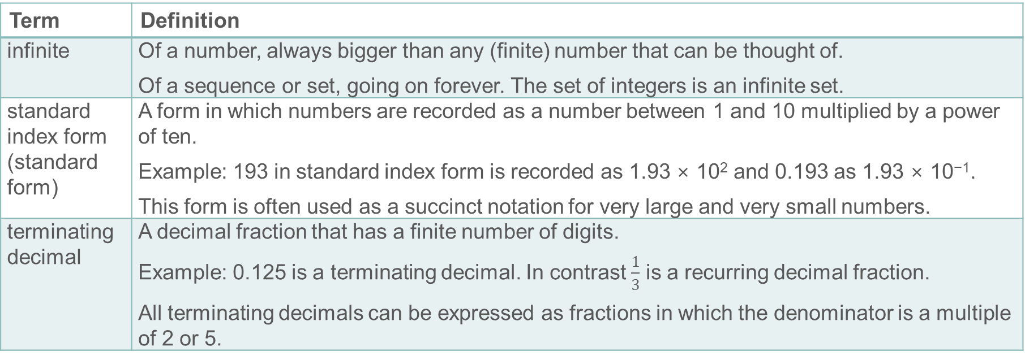
Key Vocabulary
Term | Definition
infinite | Of a number, always bigger than any (finite) number that can be thought of. Of a sequence or set, going on forever. The set of integers is an infinite set.
standard index form (standard form) | A form in which numbers are recorded as a number between 1 and 10 multiplied by a power of ten. Example: 193 in standard index form is recorded as 1.93 × 10² and 0.193 as 1.93 × 10⁻¹. This form is often used as a succinct notation for very large and very small numbers.
terminating decimal | A decimal fraction that has a finite number of digits. Example: 0.125 is a terminating decimal. In contrast $\frac{1}{3}$ is a recurring decimal fraction. All terminating decimals can be expressed as fractions in which the denominator is a multiple of 2 or 5.

Slide 37
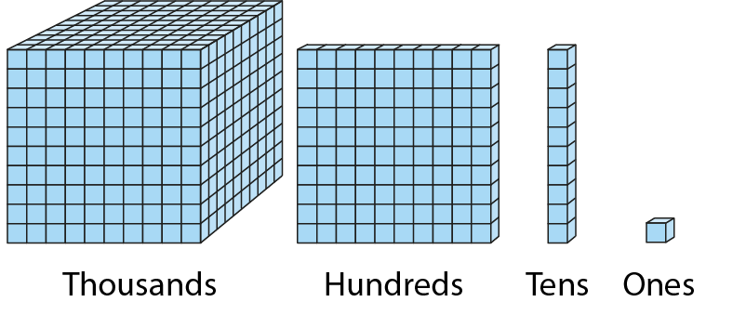
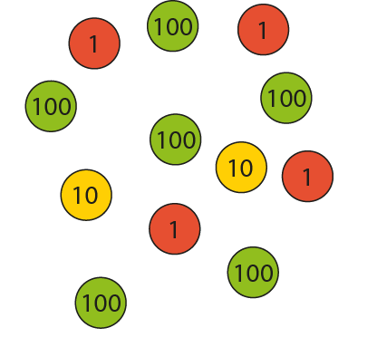
Representations and structure (1)
There are a number of different representations that you may wish to use to support students’ understanding of this key idea. These might include:
Diene base-ten blocks and place value counters
  Dienes apparatus and place-value counters will probably have been an important representation used in Key Stage 2 to support students’ understanding of the base-ten structure of numbers (both integers and decimals). In Key Stage 3, students are required to generalise this structure and to become as fluent with the base-ten structure of decimals as they are with integers. Revisiting these familiar manipulatives with an emphasis on tenths, hundredths, and so on, will support this generalisation.
Notes:
More information about the representations and structure involved in this key idea can be found:
On pages 6 and 7 of the 1 The Structure of the number system Theme Overview document
Within the ‘Using mathematical representations at KS3’ guidance on the NCTEM website
Links to all of these can be found on the final slide.

Slide 38
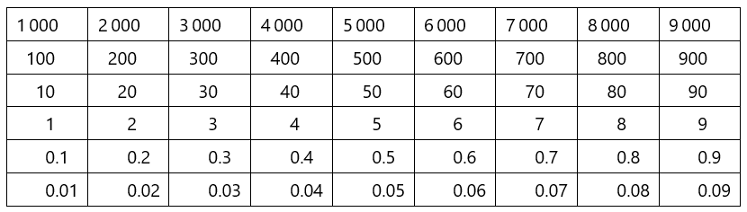
Representations and structure (2)
There are a number of different representations that you may wish to use to support students’ understanding of this key idea. These might include:
Gattegno chart
  Moving (up or down) from one row to another to represent multiplying and dividing by powers of ten helps students to understand these operations and their results.
Arrays and other area models
  The array is a useful image for revealing the commutative and distributive properties of multiplication. When the rectangle has continuous measures for the dimensions, it becomes a useful way of thinking about the product of any two numbers including decimals and fractions.
Notes:
More information about the representations and structure involved in this key idea can be found:
On page 7 of the 1 The Structure of the number system Theme Overview document
Within the ‘Using mathematical representations at KS3’ guidance on the NCTEM website
Links to all of these can be found on the final slide.

Slide 39
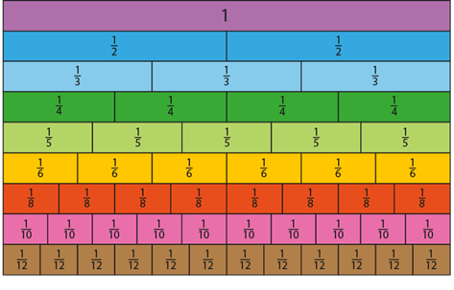
Representations and structure (3)
There are a number of different representations that you may wish to use to support students’ understanding of this key idea. These might include:
Fraction wall
  Students should be familiar with finding equivalent fractions using a fraction wall like this. However, such activities may not allow students to see the multiplicative connection between the numerator and the denominator and appreciate that this will necessarily be the same for any other equivalent fraction.
Notes:
More information about the representations and structure involved in this key idea can be found:
On page 15 of the 1.3 Core Concept document
Within the ‘Using mathematical representations at KS3’ guidance on the NCTEM website
Links to all of these can be found on the final slide.

Slide 40
Previous Learning
From Upper Key Stage 2, students will bring experience of:
reading, writing, ordering and comparing numbers up to 10 000 000 and determining the value of each digit
rounding any whole number to a required degree of accuracy
using negative numbers in context
identifying the value of each digit in numbers given to three decimal places and multiplying and dividing numbers by 10, 100 and 1 000, giving answers up to three decimal places
using, reading, writing and converting between standard units, converting measurements of length, mass, volume and time from a smaller unit of measure to a larger unit and vice versa, using decimal notation up to three decimal places
using symbols and letters to represent variables and unknowns in mathematical situations that they already understand, such as:
  missing numbers, lengths, coordinates and angles
  formulae in mathematics and science
Notes:
Theme 1 The structure of the number system

Slide 41
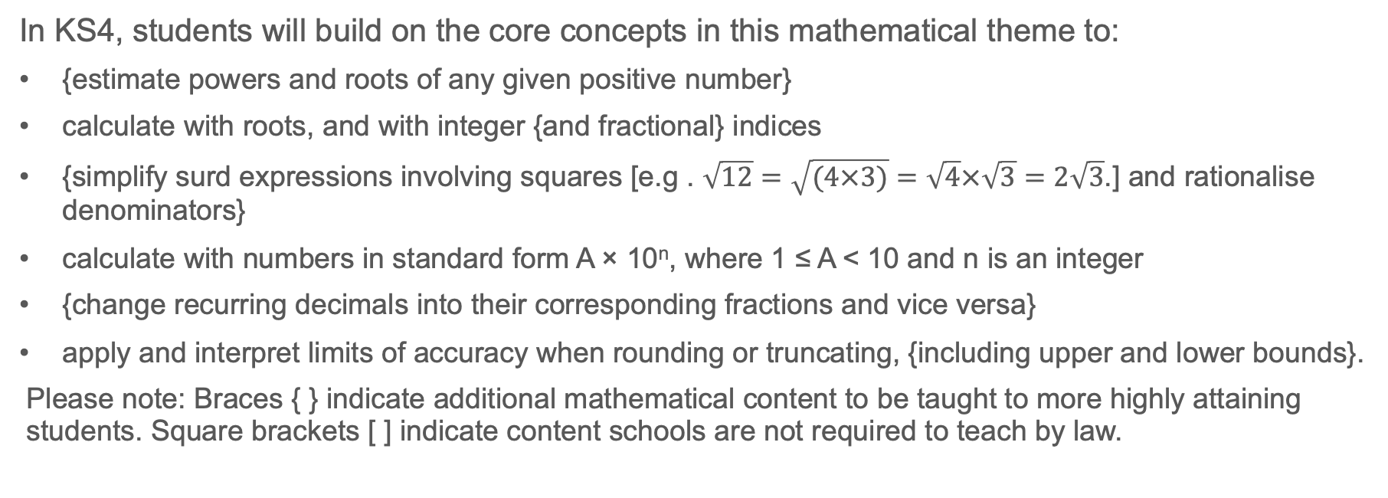
Future Learning
In KS4, students will build on the core concepts in this mathematical theme to:
{estimate powers and roots of any given positive number}
calculate with roots, and with integer {and fractional} indices
{simplify surd expressions involving squares [e.g . $\sqrt{12}=\sqrt{(4×3)}=\sqrt{4}×\sqrt{3}=2\sqrt{3}$.] and rationalise denominators}
calculate with numbers in standard form A × 10^{n}, where 1 ≤ A < 10 and n is an integer
{change recurring decimals into their corresponding fractions and vice versa}
apply and interpret limits of accuracy when rounding or truncating, {including upper and lower bounds}.
Please note: Braces { } indicate additional mathematical content to be taught to more highly attaining students. Square brackets [ ] indicate content schools are not required to teach by law.
Notes:
Theme 1 The structure of the number system

Slide 42
Library of Links
The following resources from the NCETM website have been referred to within this slide deck:
  NCETM Secondary Mastery Professional Development
    1 The Structure of the number system Theme Overview Document
    1.3 Ordering and comparing Core Concept Document
  Using mathematical representations at KS3 | NCETM
  Mathematical Prompts for Deeper Thinking videos | NCETM
  NCETM primary mastery professional development materials
  NCETM primary assessment materials
There are also references to:
  Standards & Testing Agency’s past mathematics papers

