Slide 1
2.21 Factors, multiples, prime numbers and composite numbers
Representations | Year 5
Multiplication and Division

Slide 2
How to use this presentation
You can find the teacher guide 2.21 Factors, multiples, prime numbers and composite numbers by following the link below.

Slide 3


2.21 Properties of factors and multiples Step 1:1
Notes:
How many different ways can you arrange ‘12‘ tiles into a rectangle?

Slide 4
2.21 Properties of factors and multiples Step 1:1
12
1
Notes:
There are ‘12‘ tiles. There is ‘1‘ row and ‘12‘ columns.
So ‘12‘ and ‘1‘ are factors of ‘12‘.

Slide 5
2.21 Properties of factors and multiples Step 1:1
1
12
1
12
Notes:
There are ‘12‘ tiles. There are ‘12‘ rows and ‘1‘ column.
So ‘12‘ and ‘1‘ are factors of ‘12‘.

Slide 6
2.21 Properties of factors and multiples Step 1:1
1
2
6
12
Notes:
There are ‘12‘ tiles. There are ‘6‘ rows and ‘2‘ columns.
So ‘6‘ and ‘2‘ are factors of ‘12‘.

Slide 7
2.21 Properties of factors and multiples Step 1:1
2
6
2
6
Notes:
There are ‘12‘ tiles. There are ‘2‘ rows and ‘6‘ columns.
So ‘6‘ and ‘2‘ are factors of ‘12‘.

Slide 8
2.21 Properties of factors and multiples Step 1:1
3
6
2
4
Notes:
There are ‘12‘ tiles. There are ‘4‘ rows and ‘3‘ columns.
So ‘4‘ and ‘3‘ are factors of ‘12‘.

Slide 9
2.21 Properties of factors and multiples Step 1:1
3
4
3
4
Notes:
There are ‘12‘ tiles. There are ‘3‘ rows and ‘4‘ columns.
So ‘4‘ and ‘3‘ are factors of ‘12‘.

Slide 10
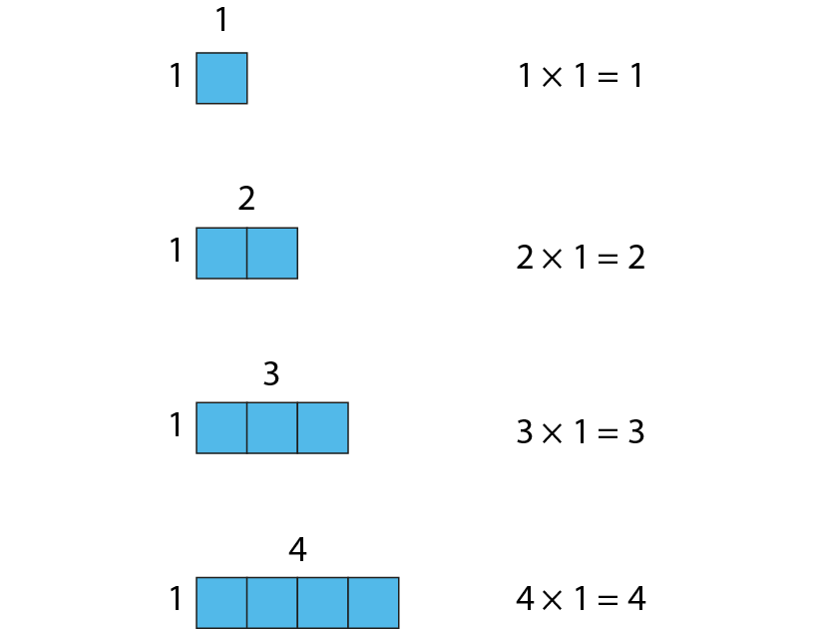
2.21 Properties of factors and multiples Step 1:3
Notes:
When ‘1‘ is a factor, the product is equal to the other factor.

Slide 11


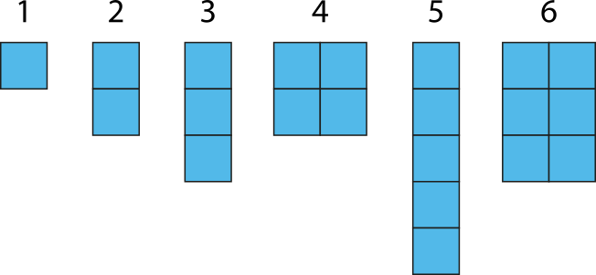
2.21 Properties of factors and multiples Step 1:4
Notes:
Which of these are square numbers?

Slide 12
2.21 Properties of factors and multiples Step 1:5
× | 0 | 1 | 2 | 3 | 4 | 5 | 6 | 7 | 8 | 9 | 10 | 11 | 12
0 | 0 | 0 | 0 | 0 | 0 | 0 | 0 | 0 | 0 | 0 | 0 | 0 | 0
1 | 0 | 1 | 2 | 3 | 4 | 5 | 6 | 7 | 8 | 9 | 10 | 11 | 12
2 | 0 | 2 | 4 | 6 | 8 | 10 | 12 | 14 | 16 | 18 | 20 | 22 | 24
3 | 0 | 3 | 6 | 9 | 12 | 15 | 18 | 21 | 24 | 27 | 30 | 33 | 36
4 | 0 | 4 | 8 | 12 | 16 | 20 | 24 | 28 | 32 | 36 | 40 | 44 | 48
5 | 0 | 5 | 10 | 15 | 20 | 25 | 30 | 35 | 40 | 45 | 50 | 55 | 60
6 | 0 | 6 | 12 | 18 | 24 | 30 | 36 | 42 | 48 | 54 | 60 | 66 | 72
7 | 0 | 7 | 14 | 21 | 28 | 35 | 42 | 49 | 56 | 63 | 70 | 77 | 84
8 | 0 | 8 | 16 | 24 | 32 | 40 | 48 | 56 | 64 | 72 | 80 | 88 | 96
9 | 0 | 9 | 18 | 27 | 36 | 45 | 54 | 63 | 72 | 81 | 90 | 99 | 108
10 | 0 | 10 | 20 | 30 | 40 | 50 | 60 | 70 | 80 | 90 | 100 | 110 | 120
11 | 0 | 11 | 22 | 33 | 44 | 55 | 66 | 77 | 88 | 99 | 110 | 121 | 132
12 | 0 | 12 | 24 | 36 | 48 | 60 | 72 | 84 | 96 | 108 | 120 | 132 | 144
Notes:
‘7‘ is a factor of ‘42‘ because ‘42‘ is in the‘ 7‘ times table.
42 ÷ 7 = 6 so I can make a rectangular array that is 6 × 7
‘6‘ and ‘7‘ are factors of ‘42‘.

Slide 13





2.21 Properties of factors and multiples Step 2:1
and
and
Factors of 6 are 1, 2, 3 and 6.

Slide 14
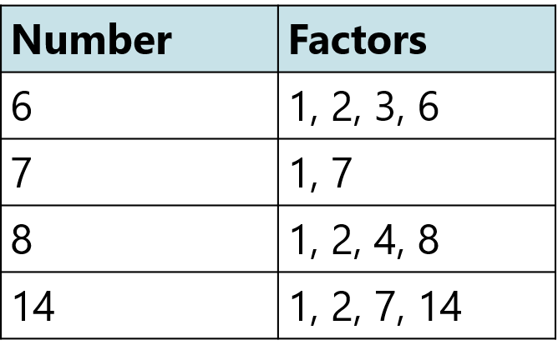
2.21 Properties of factors and multiples Step 2:1
Notes:
What‘s the same?
All numbers have ‘1‘ and themselves as factors.
‘6‘, ‘8‘ and ‘14‘ have ‘2‘ as a factor.
‘7‘ has only two factors.
What‘s different?
Some factors only appear in one list.
‘7‘ has two factors.
‘6‘, ‘8‘ and ‘14‘ have four factors.

Slide 15
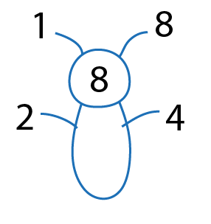
2.21 Properties of factors and multiples Step 2:2

Slide 16
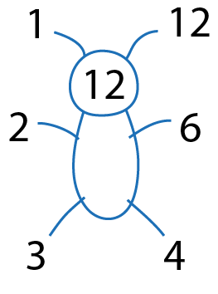
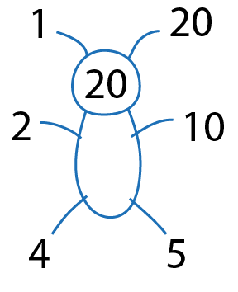
2.21 Properties of factors and multiples Step 2:3

Slide 17
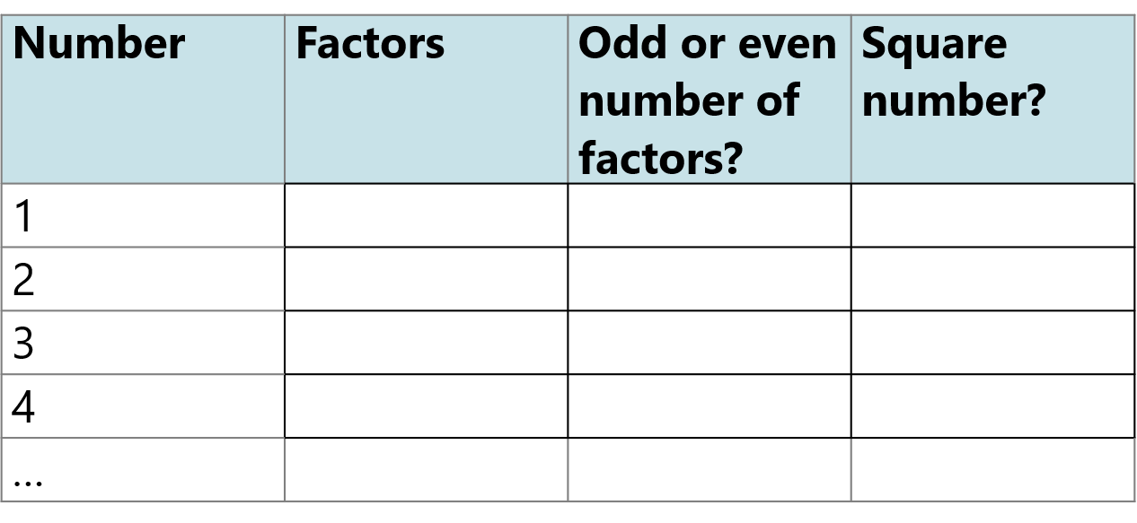

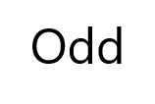

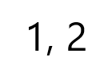
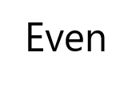

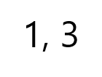
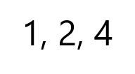
2.21 Properties of factors and multiples Step 2:5
Notes:
Complete the table to identify factors and square numbers.

Slide 18



2.21 Properties of factors and multiples Step 3:1
Notes:
Which of these are prime numbers?

Slide 19

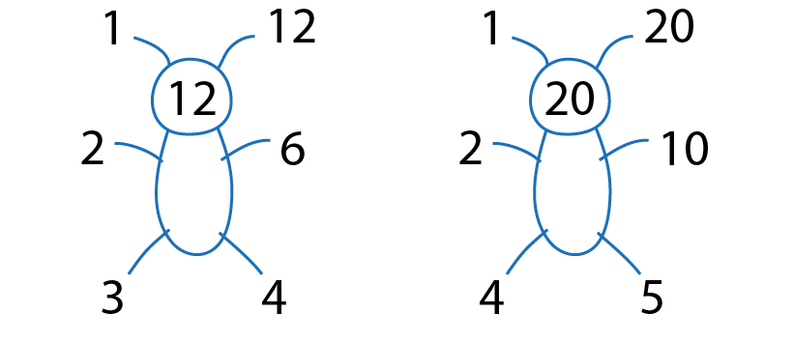
2.21 Properties of factors and multiples Step 4:1
Notes:
What are the common factors of ‘12‘ and ‘20‘?
The common factors of ‘12‘ and ‘20‘ are ‘1‘, ‘2‘, and ‘4‘.

Slide 20
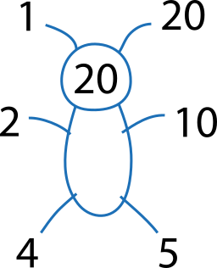
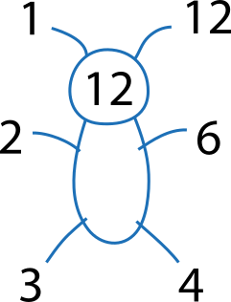
2.21 Properties of factors and multiples Step 4:2
Notes:
Factors that are prime numbers are called prime factors.
What are the prime factors of ‘12‘ and ‘20‘?
The prime factors of ‘12‘ are ‘2‘ and ‘3‘.
The prime factors of ‘20‘ are ‘2‘ and ‘5‘.

Slide 21
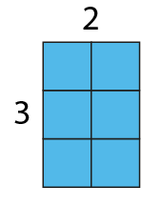
2.21 Properties of factors and multiples Step 5:1
Notes:
‘2‘ is a factor of ‘6‘ because 2 × 3 = 6
‘6‘ is a multiple of ‘2‘ because 2 × 3 = 6
‘2‘ is a factor of ‘6‘ because 6 ÷ 3 = 2
‘6‘ is a multiple of ‘2‘ because 6 ÷ 3 = 2

Slide 22
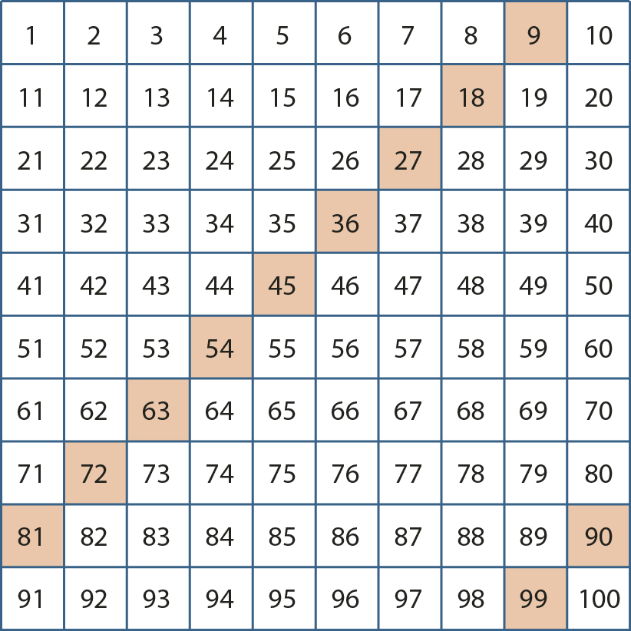
2.21 Properties of factors and multiples Step 5:3
Notes:
Some multiples have been highlighted in this hundred square.
Which number is a factor of all of these multiples?
Is there more than one number that is a factor of all of these multiples?

Slide 23

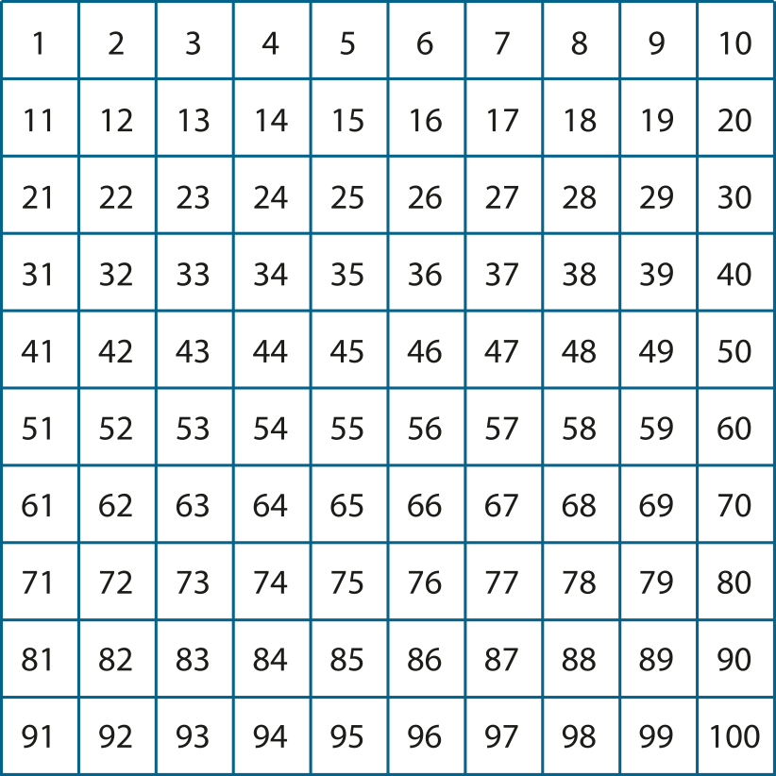

2.21 Properties of factors and multiples Step 5:4
Notes:
Use a hundred square to find the common multiples of ‘3‘ and ‘5‘.

Slide 24
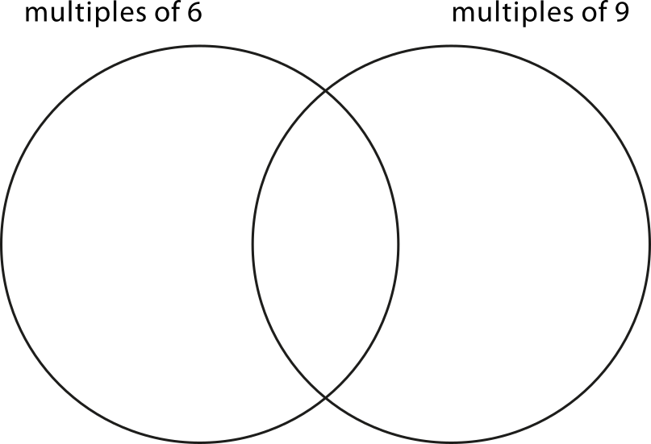
2.21 Properties of factors and multiples Step 5:6
12
9
25
18
42
36
54
64
360
48
63
45
24
630
72
480
27
63
25
12
72
27
18
630
9
24
64
48
54
42
45
480
360
36
Notes:
Sort the numbers into multiples of ‘6‘, multiples of ‘9‘, both or neither.
What do you notice about numbers in the intersection? Are they odd or even?

Slide 25
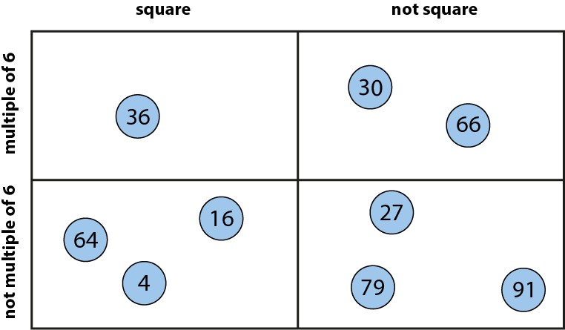

2.21 Properties of factors and multiples Step 5:6
Notes:
The numbers are sorted so that they are in the sections with the correct labels.
One number is in the wrong place. Which number is it and why?

Slide 26
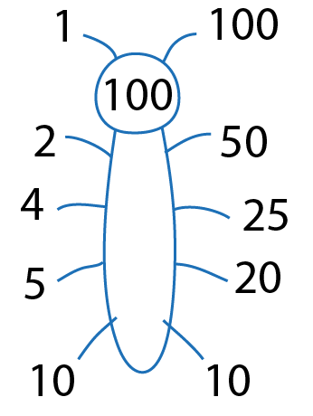
2.21 Properties of factors and multiples Step 6:1
Notes:
List the factor pairs of ‘100‘.

Slide 27
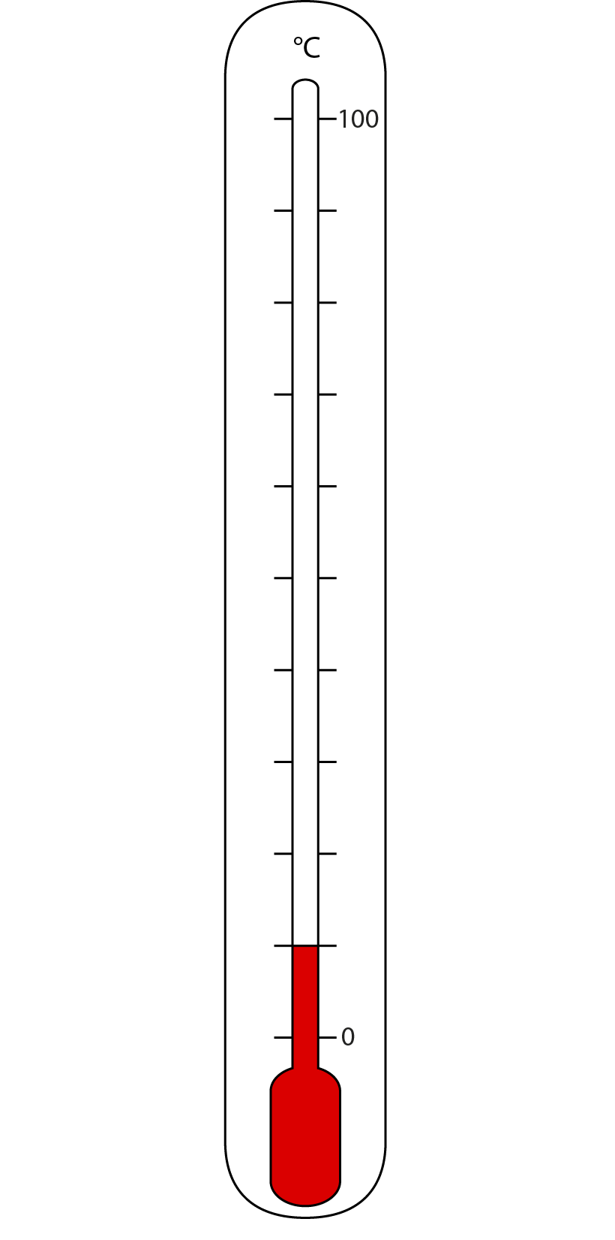
2.21 Properties of factors and multiples Step 6:1
Notes:
What is the temperature shown on this thermometer?
There are ’10’ intervals on the thermometer.
We know that ‘10‘ and ‘10‘ are factor pairs of ‘100‘, so there are ’10’ intervals of ‘10‘.
The temperature is 10˚C.

Slide 28
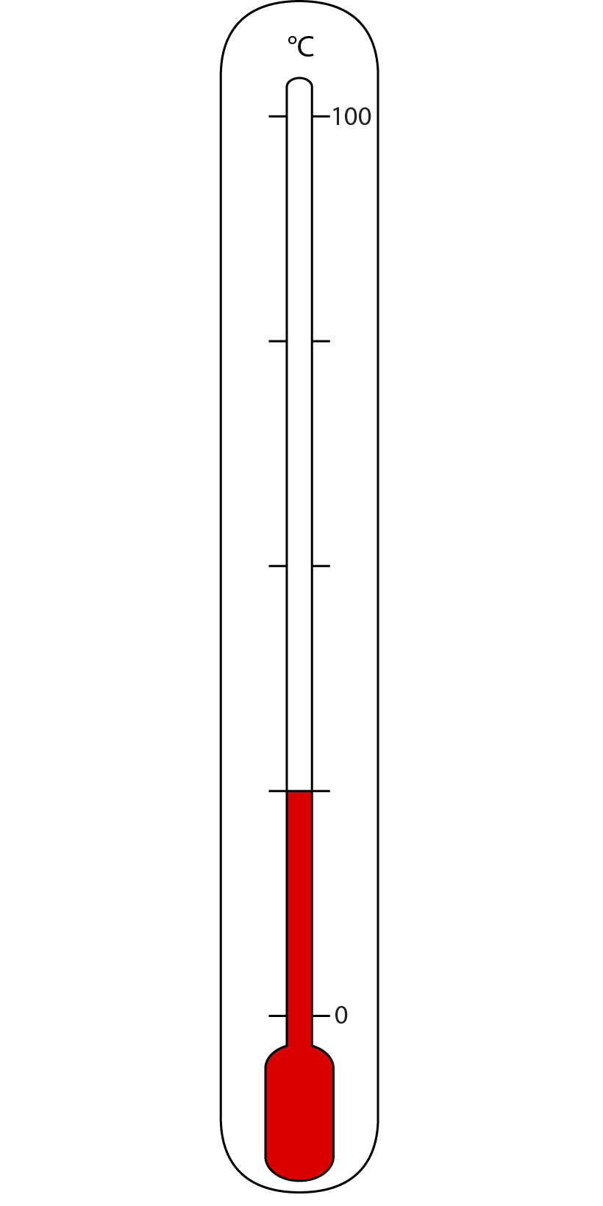
2.21 Properties of factors and multiples Step 6:1
Notes:
What is the temperature shown on this thermometer?
There are ‘4’ intervals on the thermometer.
We know that ‘4‘ and ‘25‘ are factor pairs of ‘100‘, so there are ‘4’ intervals of ‘25‘.
The temperature is 25˚C.

