Slide 1
Checkpoints
Year 8 diagnostic mathematics activities
Constructions
22 Checkpoint activities
16 additional activities
Published in 2022/23

Slide 2
About this resource
This resource is designed to be used in the classroom with Year 8 students, although it may be useful for other students.
The Checkpoints are grouped around the key ideas in the core concept documents, 6.4 Constructions, part of the NCETM Secondary Mastery Professional Development materials.
Before each set of Checkpoints, context is explored, to help secondary teachers to understand where students may have encountered concepts in primary school.
The 10-minute Checkpoint tasks might be used as assessment activities, ahead of introducing concepts, to help teachers explore what students already know and identify gaps and misconceptions.
Each Checkpoint has an optional question marked . This will provide further thinking for those students who have completed the rest of the activities on the slide.
The notes for each Checkpoint give answers (if appropriate), some suggested questions and things to consider.
After each Checkpoint, a guidance slide explores suggested adaptations, potential misconceptions and follow-up tasks. These may include the additional activities at the end of this deck.

Slide 3
Using these Checkpoints
This deck is split into two sections. The first two sections explore properties of shapes, which are in the Key Stage 2 curriculum, from the perspective of the prior knowledge that is most necessary to understand the constructions content at Key Stage 3.
Towards the end of the first section, there are Checkpoints exploring how effectively students are able to visualise paths and regions using the properties of circles, as a precursor for thinking about constructions as a means to represent loci. There is one Checkpoint at the end of the second section that serves the same purpose, but thinking about the properties of a rhombus in loci problems.
The notes for each slide make it clear how it is best used, and the guidance at the start of each section gives more detail about students’ experience at primary school. We strongly recommend you read each of these first before using any tasks with your students.
If students need more practice of the properties of shapes, including angles, use the Checkpoints from the ‘Angles’, ‘Perimeter and area 1’ or ‘Perimeter, area and volume 2’ decks.

Slide 4
Checkpoints 1–8 1
Checkpoint | Underpins | Code
1: Circle? | Using properties of circles in construction | 6.4.1
2: Perfect circle?
3: Three circles
4: Too many circles | Understand place value in decimals, including recognising exponent and fractional representations of the column headings | 1.1.1.2
5: Arcs
6: Making triangles
7: Ripples
8: Matching circles
*This three-digit code refers to the statement of knowledge, skills and understanding in the NCETM’s Sample Key Stage 3 Curriculum Framework (see notes below for more information).
Notes:
In the Sample Key Stage 3 Curriculum Framework, statements of knowledge, skills and understanding are arranged to give an example teaching order. The three-digit code for each statement in the framework is a clickable hyperlink to documents with more detailed information, including the key ideas contained within that statement. These key ideas are also shown on slide 7 in this deck.

Slide 5
Checkpoints 9–16
Checkpoint | Underpins | Code
9: Dangerous distances | Using properties of circles in construction | 6.4.1
10: Bungling burglars
11: Relocation
12: Celia saw
13: Fireworks
14: Making shapes | Using properties of polygons in construction | 6.4.2
15: Impossible triangles
16: Diagonally
*This three-digit code refers to the statement of knowledge, skills and understanding in the NCETM’s Sample Key Stage 3 Curriculum Framework (see notes below for more information).
Notes:
In the Sample Key Stage 3 Curriculum Framework, statements of knowledge, skills and understanding are arranged to give an example teaching order. The three-digit code for each statement in the framework is a clickable hyperlink to documents with more detailed information, including the key ideas contained within that statement. These key ideas are also shown on slides 7–8 in this deck.

Slide 6
Checkpoints 17–22
Checkpoint | Underpins | Code
17: Tree branches | Using properties of polygons in construction | 6.4.2
18: More ripples
19: Two sides and a diagonal
20: Rhombus
21: Shortest distance
22: Where do you stand?
*This three-digit code refers to the statement of knowledge, skills and understanding in the NCETM’s Sample Key Stage 3 Curriculum Framework (see notes below for more information).
Notes:
In the Sample Key Stage 3 Curriculum Framework, statements of knowledge, skills and understanding are arranged to give an example teaching order. The three-digit code for each statement in the framework is a clickable hyperlink to documents with more detailed information, including the key ideas contained within that statement. These key ideas are also shown on slides 7–8 in this deck.

Slide 7
Key ideas
Use the properties of a circle in constructions | Code
Understand a circle as the locus of a point equidistant from a fixed point | 6.4.1.1
Use intersecting circles to construct triangles and rhombuses from given lengths | 6.4.1.2
Use the properties of a rhombus in constructions
Be aware that the diagonals of a rhombus bisect one another at right angles | 6.4.2.1
Be aware that the diagonals of a rhombus bisect the angles | 6.4.2.2
Use the properties of a rhombus to construct a perpendicular bisector of a line segment | 6.4.2.3*
Use the properties of a rhombus to construct a perpendicular to a given line through a given point | 6.4.2.4
Use the properties of a rhombus to construct an angle bisector | 6.4.2.5
*‘There are additional resources exemplifying these key ideas in the Secondary Mastery Professional Development | NCETM.

Slide 8
Using properties of circles in construction
Checkpoints 1–13

Slide 9
Using properties of circles in construction
Previous learning | In Key Stage 3 students need to
Key Stage 2 curriculum: Year 6: illustrate and name parts of circles, including radius, diameter and circumference and know that the diameter is twice the radius There are no explicit references to properties of a circle in either Teaching mathematics in primary schools or Primary Mastery Professional Development. Note that, if primary schools are using the Curriculum prioritisation in primary maths | NCETM to support curriculum planning, then this may mean that they have not spent a long time exploring the properties of a circle in depth. Key Stage 3 curriculum: 6.2.1.2¹ Recognise that there is constant multiplicative relationship (π) between the diameter and circumference of a circle 6.2.1.3 Use the relationship C = πd to calculate unknown lengths in contexts involving the circumference of circles 6.2.2.3 Understand the derivation of, and use the formula for, the area of a circle 6.2.2.4 Solve area problems of composite shapes involving whole and/or part circles, including finding the radius or diameter given the area ¹ This four-digit code refers to the key ideas in Secondary Mastery Professional Development | NCETM | Understand a circle as the locus of a point equidistant from a fixed point. Use a pair of compasses to construct circles and arcs. Use their understanding of the geometrical properties of circles to learn the ruler and compass constructions of triangles of given lengths. Reason deductively in geometry, including using geometrical constructions.

Slide 10
Checkpoint 1: Circle?
Anne says, “The circle is black.”
John says, “The circle is grey.”
Who is correct:
A Anne
B John
C both Anne and John
D neither Anne nor John?
Dan says that the answer is ‘D’ because you need more information about the circle to recreate it accurately. What information might you give?
Notes:
This slide is animated. The further thinking question will appear separately so you can choose the pace at which to work with your class.
Answers
This question is ambiguous, and students could argue that either A or C is true. A circle is the locus of points that are equidistant from a given point, as per Anne’s statement, and the grey shaded area is a disc (i.e. the space contained by these points rather than comprising the circle itself). An alternative argument is that both are true: the circle is both the locus of points and the area contained within them.
? You would need to give some information about the measurements needed to create it, such as radius or diameter.
Suggested questioning
What is a circle?
How do you draw a _ cm circle? Which part of the circle do you ‘measure’? How about a _ cm square?
Things to think about
Students might not be used to questions in mathematics that are ambiguous, and for which you might argue different solutions. Think about how to structure the discussion. For example, you might want to assign students a particular option and say that they need to argue the case for that option, following up by asking which was the hardest option to justify. This question has been posed on Twitter and resulted in much debate – and disagreement! Before using with students, try posing the question within your department and seeing where the discussion goes.

Slide 11
Checkpoint 1: Guidance
Adaptations | Assessing understanding
Support Presented as a multiple choice question, this task is accessible to all, but students might need some support to articulate their reasoning. Prepare some reasons for each answer and ask students to choose the one they agree with most, or to order them in terms of how much they agree. Challenge Ask students to think about the information needed to draw different 2D shapes. Is side length always key, or are there other shapes where a spatial relationship (like distance from centre to circumference) is needed? Representations You could create this ‘live’ by drawing a circle on the board. Can you draw just the black circle? How about the grey circle? | Students’ first experiences of circles are highly likely to pre-date even primary school – some of their very earliest toys may have involved naming or matching shapes. They will have identified circles throughout primary school, and classified shapes according to their properties – often resulting in circles being the ‘odd one out’. However, students can reach Key Stage 3 without appreciating that all of the points on the circumference are equidistant from the centre – this is the key understanding needed to use the properties of a circle in construction. In this ambiguous question, you are less interested in the answer than in students’ reasoning. See whether students have an appreciation that the circumference is what forms the circle. It may be that they see no reason to just argue for option A, or not appreciate that anyone might contest option C. In this case, spend a bit more time exploring what a circle is in your future lessons, so that students are fully prepared to use its properties in construction. The further thinking question offers a contrast which might help to distil students’ thinking – do they see a difference between how we define squares and circles? Asking students which measurement they would need to draw or describe them might help here – this is explored further in Additional activity A.
Additional resources Additional activity A offers another way to explore the properties of circles and how they contrast to other 2D shapes.

Slide 12
Checkpoint 2: Perfect circle?
×
A teacher asks her class of students to each draw a cross that is 5 cm from the dot.
Did they all do this correctly? How do you know?
What do you think would happen if the teacher asked more students to draw crosses 5 cm from the dot?
×
×
×
×
×
×
×
×
×
×
×
×
×
×
×
×
×
How would the students’ responses be different if they were asked to draw 5 inches from the dot? How about 5 mm?
Notes:
This slide is animated. Each question will appear separately so you can choose the pace at which to work with your class.
Answers
a) They did not all do this correctly; we know this because not all of the crosses form a circle around the dot. The next slide shows these, circled in yellow.
b) The more students who draw crosses, the more complete the circle that is formed. Eventually, with enough crosses, it would form a circular line around the point.
? If 5 inches, the circle formed would be approximately 2.5 times bigger. If 5 mm, the circle formed would be exactly 10 times smaller.
Suggested questioning
Which crosses are the odd ones out? How do you know?
How could you predict the shape formed? How could you draw it accurately?
What equipment would be useful for this task?
What is a circle?
Things to think about
Ask students to recreate this task on the board, using their rulers. A distance of 20–30 cm would be appropriate. Can students anticipate what shape would be formed? Can you model the ruler ‘swinging’ round from the centre to form each point. This might be a useful way to explain why a pair of compasses are a useful piece of mathematical equipment, as students’ experience of compasses before Key Stage 3 is likely to be extremely limited.

Slide 13
Checkpoint 2: Perfect circle? (solutions)
×
×
×
×
×
×
×
×
×
×
×
×
×
×
×
×
×
×
×
×
×
×
×
×
×
×
×
×
×
×
×
×
×
×
×
A teacher asks her class of students to each draw a cross that is 5 cm from the dot.
Did they all do this correctly? How do you know?
What do you think would happen if the teacher asked more students to draw crosses 5 cm from the dot?
×
×
×
×
×
×
×
×
×
×
×
×
×
×
×
×
×
×
×
×
×
×
×
×
×
×
×
×
×
×
×
×
×
×
×
×
×
×
×
×
×
×
×
×
×
×
×
×
×
×
×
×
×
×
×
×
×
×
×
×
×
×
×
×
×
×
×
×
×
×
×
×
×
×
×
×
×
×
×
×
×
×
×
×
×
×
×
×
×
×
×
×
×
×
×
×
×
×
×
×
×
×
×
×
×
×
×
×
×
×
×
×
×
×
×
×
×
×
×
×
×
×
×
×
×
×
×
×
×
×
×
×
×
×
×
×
×
×
×
×
×
×
×
×
×
×
×
×
×
×
×
×
×
×
×
×
×
×
×
×
×
×
×
×
×
×
×
×
×
×
×
×
×
×
×
×
×
×
×
×
×
×
×
×
×
×
×
×
×
×
×
×
×
×
×
×
×
×
×
×
×
×
×
×
×
×
×
×
×
×
×
×
×
×
×
×
×
×
×
×
×
×
×
×
×
Notes:
This slide is animated. Each incorrect dot will be highlighted in turn, so you can choose the pace at which you work with your class. After this, the complete circle for part b appears. Click once for each cross to appear quickly in turn (there are nearly 300 crosses in total!)

Slide 14
Checkpoint 2: Guidance
Adaptations | Assessing understanding
Support Close the task slightly by telling students that they are looking for three incorrect points. Challenge Ask students to think in 3D, and imagine straws of equal length being placed into a ball of plasticine. What shape would be formed? How about if the plasticine was a different shape? Representations Representing the circumference using crosses rather than a continuous line may help students to appreciate a circle as a locus of points. | As with Checkpoint 1, a key point is whether students understand a circle as the locus of points equidistant from a given point. (With the exception of one example in Checkpoint 9 and the suggested challenge on this slide, we are working in 2D space for this definition.) Properties of a circle were explored in the ‘Perimeter, area and volume 2’ deck. There, tasks focused on whether students remembered the key terminology and understood the relationship between radius and diameter, in preparation for new learning on area and circumference. Here, the focus is on whether students understand what a circle is, a key understanding that underpins all work on constructions and loci. Students are likely to be able to identify the incorrect points, but may struggle to articulate why they are incorrect and the others are not. Listen for students who appreciate that they should ‘form a circle’: do they offer explanations as to why? Use questioning to probe students’ reasoning – do they use the distance between the points and the centre in their explanation? Note that, as there is no scale, students could argue that one of the three identified crosses is correct and all of the others are wrong! If students offer this argument, ask where other correct points would be to check they know they should form a circle. The further thinking question checks students’ understanding of units of measure – push them to articulate how many times bigger or smaller the circles will be.
Additional resources For more activities on circles (which predominantly explore the relationships between radius and diameter in a circle) see the ‘Perimeter, area and volume 2’ Checkpoints | NCETM deck. Additional activities B, C and D all explore circles as loci in different ways, and could be used as alternative tasks or to revisit the concept at another time.

Slide 15
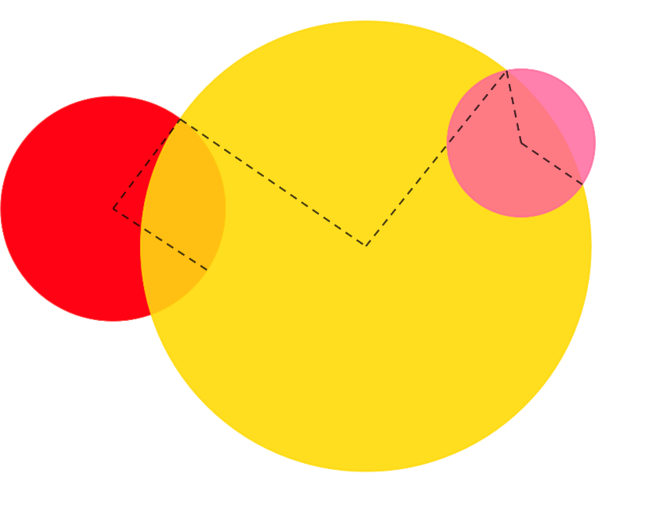
Checkpoint 3: Three circles
The biggest (yellow) circle has a radius of 6 cm.
The next biggest (red) circle has a diameter of 6 cm.
The smallest (pink) circle has a radius of 2 cm.
The dotted path goes through each circle’s centre.
How long is the dotted path in total?
The dotted path is made from six straight lines.
Is it possible to draw a path on the diagram that’s the same length in total, but uses five straight lines? How about four?
Draw your own 20 cm path using four circles of different radii. How many ways can you do this?
Notes:
This slide is animated. Each question will appear separately so you can choose the pace at which to work with your class. A printable version of the image (not to scale) can be found on slide 83.
Answers
a) 22 cm.
b) You could draw a path with five straight lines if either the first or the last line changed angle to create a single line across the whole circle. This would mean that the diameter was used rather than two radii for either the red or pink circles. You could draw a path with four straight lines if both the first and last lines were diameters rather than two radii. This would mean that the diameter was used for both the red and pink circles.
? Students’ answers will vary; check each individually.
Suggested questioning
What do you know about the length of each line?
Where does each line start/end?
What other paths could you make?
What is the most important information in the question?
How would this question change if you did not know the dotted path goes through the centre of each circle?
Things to think about
Checkpoint has some overlap with the circles task in the ‘Perimeter, area and volume 2’ deck, in that it explores understanding of the properties of circles, in particular, the radius. It is included here as understanding radius is key to an appreciation of circles as a locus from a point, which underpins all ruler and compass constructions.

Slide 16
Checkpoint 3: Guidance
Adaptations | Assessing understanding
Support Ask students to colour the lines that are the same length using the printable version. Model adding the information from the rubric to these lines. See if students can bring this information together. Challenge Changing the angle of the radii might lend a deeper appreciation of the essential features of this task. Ask students which radii can move and which cannot (the end ones can, but the middle ones need to meet the next circle at its circumference). Representations This task lends itself to dynamic geometry software, especially if you are using the ‘Challenge’ suggestion and want to model when the angle of the radii can change. | A small number of circles tasks are included in the ‘Perimeter, area and volume 2’ deck. These focus more on the precursory knowledge needed for new learning on area and circumference: being able to identify the radius and diameter, and understand the relationship between them. This task uses similar knowledge and checks that students can use this to solve more complex problems about paths. Students should be able to use the information given and recognise that it is significant that the paths go from the centre to the circumference each time. If we did not know they go through the centre, the task would be impossible. Those who are more secure might not need to add each radius individually, and notice that there are two radii in each circle. Part b gives an opportunity for deeper reasoning. Less secure students might try to create new paths, rather than recognising that the total length created by two radii is equivalent to a single diameter.
Additional resources For more activities on circles (which predominantly explore the relationships between radius and diameter in a circle) see the ‘Perimeter, area and volume 2’ Checkpoints | NCETM deck. Page 38 of Secondary Assessment Materials | NCETM also uses overlapping circles to explore students’ understanding of distance.

Slide 17
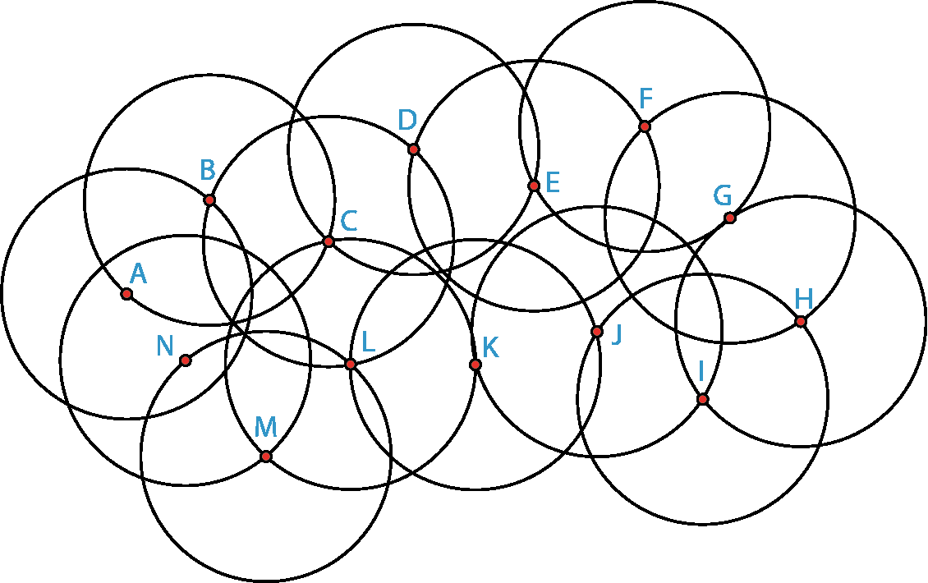
Checkpoint 4: Too many circles
All these circles have a radius of 3 cm.
For parts a to f, decide whether the points are more than 3 cm apart, less than 3 cm apart or exactly 3 cm apart.
A and B
A and N
N and M
C and K
K and L
F and H
Are the paths on the right more than 6 cm long, less than 6 cm long or exactly 6 cm long?
A to N to M
M to L to C
C to L to K
I to H to G
N to L to K
L to N to A
Notes:
This slide is animated. Each question will appear separately so you can choose the pace at which to work with your class. A printable version is available on slide 84.
Answers
a) A and B: exactly 3 cm apart.
b) A and N: less than 3 cm apart.
c) N and M: exactly 3 cm apart.
d) C and K: more than 3 cm apart.
e) K and L: exactly 3 cm apart.
f) F and H: more than 3 cm apart.
? A to N to M: less than 6 cm long.
M to L to C: exactly 6 cm long.
C to L to K: exactly 6 cm long.
I to H to G: exactly 6 cm long.
N to L to K: more than 6 cm long.
L to N to A: not possible to know (L to N is greater than 3 and N to A is less than 3, but we do not know by how much).
Suggested questioning
What distances do you know?
What do you know about the point where two circles intersect?
Where is the centre of each circle? How do you know?
Are there any that you are not sure of? Why?
Things to think about
Checkpoint 4 explores the relationship between centre, radius and circumference. There are two versions of this task (see also Additional activity E on slide 66). Think in advance about which is most suited to your class. Is there value in giving the more complex diagram first, and letting students experience some productive struggle?

Slide 18
Checkpoint 4: Guidance
Adaptations | Assessing understanding
Support Use Additional activity E which assesses similar understanding using a less complex diagram. Or use the printable version of the diagram, allowing students to sketch and mark known distances. Challenge Ask students to identify points that obey particular constraints, for example, those that are less than 3 cm from A and exactly 3 cm from B. Or ask them to consider the three points B, D and L and decide whether or not these form an equilateral triangle, justifying their reasoning. Representations Presenting students with such a complex image means that they need to draw their attention to the essential features of a circle – the centres, the circumference and where these align. | Checkpoint 4 checks very similar understanding to Checkpoints 2 and 3, but goes deeper in reasoning around radius. In this task, the significance of the point where two circles intersect is much more explicit. Listen out for whether students notice this significance, perhaps by saying that this point is the same distance from both of the respective centres. This is key understanding on which the use of a pair of compasses in constructions is built. Look for students with a sound understanding that the circumference of a circle is a fixed distance from the centre (the radius), and who are able to use this knowledge to construct chains of reasoning about the distances of points. The image is intended to be complex enough so that the circles are not obvious. This ensures that the task does not become trivial, and that students need to work to identify the relevant circles and which circle belongs to which centre. The complexity of the diagram means that students might identify different chains of reasoning. Comparing their different ideas may offer a deeper insight into the group's understanding.
Additional resources For more activities on circles (which predominantly explore the relationships between radius and diameter in a circle) see the ‘Perimeter, area and volume 2’ Checkpoints | NCETM deck. Additional activity E offers a similar task with a simpler image. Page 38 of Secondary Assessment Materials | NCETM also uses overlapping circles to explore understanding of distance.

Slide 19
Checkpoint 5: Arcs
W, X, Y and Z are arcs from four circles with a radius of 5 cm.
A, B, C and D are four possible centres for these circles.
Match the arcs to their centres. What is your strategy?
W
X
B
A
C
V
D
A fifth arc, V, is drawn. It shares its centre with one of the other arcs but has a different diameter.
Which point is the centre?
Is the radius greater or less than 5 cm?
Z
Y
Notes:
This slide is animated. The further thinking question will appear separately so you can choose the pace at which to work with your class. A printable version (featuring arcs W, X, Y and Z) can be found on slide 85.
Answers
A is the centre for arc X.
B is the centre for arc W.
C is the centre for arc Y.
D is the centre for arc Z.
? The centre for arc V is point B. The radius is greater than 5 cm as it is a more ‘gentle’ curve than W, X, Y and Z.
Suggested questioning
Which centre ‘looks about right’? How could you check?
How far should the end of the arc be from the centre? How about the other end? The middle?
Things to think about
How you organise this task may have an impact on students’ approaches to it. Depending on how readily students access equipment, you may like to offer it without anything and wait for them to ask for a particular piece of equipment. Or offer a range of equipment (ruler, pair of compasses, tracing paper, string) and direct students to use them if they wish. Consider how led students might be by your choices, and whether that affects the quality of the assessment offered by the task.

Slide 20
Checkpoint 5: Guidance
Adaptations | Assessing understanding
Support Show one arc at a time and ask which point is its centre each time. Challenge Challenge students’ visual manipulation by asking them to imagine where different arcs would intersect. For example, ‘Would a circle of radius __ cm drawn with a centre at __ intersect with __?’ Representations Presenting this task on the board, or giving students printed physical copies to manipulate will change the assessment point. If you do not give students print-outs, you can assess their visual reasoning, but might not find out whether they understand that all points on the circumference are equidistant from the centre. | Checkpoint 5 is an opportunity to see how students can reason with the properties of a circle explored in Checkpoints 1–4. We suggest that the task is initially offered without any equipment, so that you can see what students reach for in trying to solve the problem. If students understand that every point on the circumference is a radius’s distance from the point at the centre, then they are likely to use a ruler to measure the distance from the centre to each arc. They should realise that, if the centre matches, it doesn’t matter where on the arc they measure from, the distance will be the same. You might like to offer a pair of compasses and see if they have a sense of how it might help them in this task, but they are not likely to have used these at primary school. It is not intended that this task is used to teach compass skills, but other tasks are available to support this (see ‘Additional resources’). Some students might be able to reason visually, perhaps by eliminating centre points because they cannot be the centre for a particular arc. Point B, for example, is far too close to arc X for the curve to be a circle centred on this point. Ask them how they could check this: what would they expect from the distances at the end of the arc? Listen to whether students understand that the end points of this arc are further from B than other points on the arc.
Additional resources Additional activities G and H also explore the relationship between the arc/circumference and the centre. Additional activities I and J might be used to explore compass skills further.

Slide 21
Checkpoint 6: Making triangles
On the right are six line segments. They need to be arranged into two triangles.
Is this possible? Why or why not?
If it is not possible, what would you change to make it possible?
1 cm
3 cm
3 cm
3 cm
4 cm
7 cm
Draw your two triangles. How can you do this accurately?
Notes:
This slide is animated. Each question will appear separately so you can choose the pace at which to work with your class.
Answers
a) No, it is not possible. Any combination of side lengths that ‘works’ for one triangle, leaves an impossible triangle with the remaining sides:
1 cm, 3 cm, 3 cm is possible but 3 cm + 4 cm = 7 cm so the remaining sides form a line.
3 cm, 3 cm, 3 cm is possible but 1 cm + 4 cm < 7 cm so the remaining sides do not meet.
3 cm, 3 cm, 4 cm is possible but 1 cm + 3 cm < 7 cm so the remaining sides do not meet.
b) To make it possible, either the 7 cm line needs to be shorter (even by a fraction of a centimetre) or one (or both) of the remaining sides needs to be longer (until the sum of the two shorter sides > 7 cm).
? Students are likely to attempt to do this using a ruler. They might find that using two rulers or drawing possible different points until an intersecting point is found helps them to angle their sides appropriately. Based on their learning at Key Stage 2, it is unlikely that they have enough experience of a pair of compasses to suggest this as a tool, but you should be prepared to provide students with one if they ask.
Suggested questioning
Can you sketch your possible triangles?
Can you show why the impossible triangles in part a do not work?
What equipment could you use to help you with this task?
Things to think about
Checkpoint 6 and Additional activity K offer a similar premise (working out which side lengths can make triangles) but with different visual representations. Think about which might work best for your students. Consider whether a physical ‘length’ that can be manipulated is more accessible than a visual one. Will a 3D representation of a 2D line add confusion, and if so, do the benefits outweigh this challenge? Discuss with your colleagues; what is the consensus?

Slide 22
Checkpoint 6: Guidance
Adaptations | Assessing understanding
Support Remove one 3 cm and the 7 cm lengths from the options and make them the bases of the triangles. Can students think about how to arrange the remaining four lengths? See also ‘Representations’ below. Challenge Ask students to create their own sets of six lengths. Can they create a set where there are two possible triangles? How about one possible and one not? Is it possible to create a set of six lengths with no possible triangles? Representations Having physical sticks to manipulate may help students appreciate the idea of rotating of the sides until you find the is one position where the lengths meet. This might help with moving from this task towards teaching how to use a pair of compasses to draw arcs for the side lengths. Additional activity K uses Cuisenaire in this way. | Up until this point, the checkpoints in in this deck have made the connection to the properties of circles explicit. Here, we assess the understanding of triangles that is needed. The first assessment point is whether students can recognise that the lengths of the two shorter sides of triangle need to sum to a value that is greater than the length of the longest side. If they do not appreciate this, pull out three lengths (for example, 3 cm, 4 cm and 7 cm) and ask why these don’t make a triangle. Once students have established which lengths they want to use, see if they can visualise what the triangles might look like. Can they sketch the triangles? How about draw them accurately? Seeing how students cope with this might give you some ideas about how to introduce formal constructions of triangles, particularly how to explain the necessity of drawing arcs with a pair of compasses to find the point at which the two lengths meet.
Additional resources Additional activity K offers a similar premise with physical manipulatives.

Slide 23
Checkpoint 7: Ripples
Circles are drawn around points X and Y.
The smallest circle around each has a radius of 1 cm. Each radius increases by 1 cm for each new circle.
X is joined to Y with a line segment, and then both are joined to one other point to make a triangle.
Which of the points A to F would make:
an isosceles triangle
a triangle with an obtuse angle
a triangle with one length of 3 cm?
× F
× C
× B
X
× A
Y
× D
× E
A triangle is made from X, Y and a new point G. One length is 5 cm, and one length is 2 cm. Where could its point be? Is there more than one answer?
Notes:
This slide is animated. Each relevant part of the diagram will appear automatically with the relevant part of the rubric; each question will also appear separately so you can choose the pace at which to work with your class. A printable version of the image can be found on slide 86.
Answers
a) A or D
b) F or E
c) C or E
? Its point needs to be where one of the 2 cm circles meets one of the 5 cm circles. There are four possible locations for point G (see the next slide).
Suggested questioning
What do you notice about the circles?
Show me a point that is closer to X than Y/further from X than Y/the same distance from X and Y.
Is there more than one answer to any of these questions?
Can you write a question that would have more than two answers?
Can you write an impossible question?
Things to think about
The overlapping concentric circle image is used repeatedly throughout this deck: see also Checkpoint 18 and Additional activity F. While the diagram may at first appear overwhelming, the intention is to emphasise the structure that underpins ruler and compass constructions by making the circles visible. In this case, the focus is constructing triangles. Can you think of any other questions you could ask using this structure? This could be a useful thing to explore as a department, to help deepen subject knowledge around constructions, angles and properties of 2D shapes.

Slide 24
Checkpoint 7: Ripples (solutions to further thinking question)
A triangle is made from X, Y and a new point G. One length is 5 cm, and one length is 2 cm. Where could its point be? Is there more than one answer?
× F
× C
× B
× G
X
× G
× A
× G
Y
× G
× D
× E
Notes:
This slide is animated. The four possible positions of point G will appear separately.

Slide 25
Checkpoint 7: Guidance
Adaptations | Assessing understanding
Support The animation is designed to build up the complex image gradually to support interpretation of the situation. Students may nonetheless find the number of circles distracting. Removing the outer two circles from X (and points D and F) would leave sufficient points to answer each question, but be less visually stimulating. Challenge There are two possible answers for each question. Challenge students to identify any other possible solutions that are not marked. Can they find all the possible answers each time? Representations When constructing, it is common to draw just short arcs near the intersection point, rather than the full circles given here. Consider whether, at least in the early stages of learning how to construct triangles, it is helpful to see the whole circle to reinforce the conceptual understanding of distance from the given points. | Checkpoint 7 looks at whether students’ understanding of circles will support their understanding of constructing triangles with a ruler and compass. When they learn to construct triangles, they will draw arcs with the same radius as the missing side lengths, with the point that these two arcs cross representing the third vertex of the triangle. To understand this, they need to understand that each arc represents all the points that are the given distance from the end of the line, and the crossing point of two arcs represents the only point that is both distances. The diagram here shows complete circles rather than arcs. If students cannot answer part a immediately, check their understanding of the situation by pointing to any point on any circle and asking how far it is from the point at the centre. Once they can confidently state the distance from one centre point, they should be able to consider the distance from two and therefore access the questions. If not, they may need more input to understand a circle as the locus of points equidistant from the centre. There are two possible answers for each question, so that you can compare and discuss students’ responses. Do they all identify both answers each time?
Additional resources This overlapping concentric circle diagram is also used in Checkpoint 18 and Additional activity F.

Slide 26
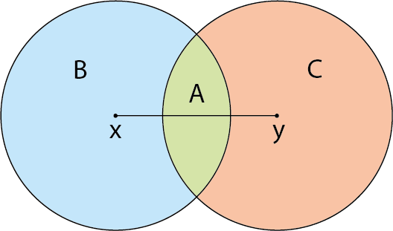
Checkpoint 8: Matching circles
Two circles, with centres X and Y respectively, have the same radius.
Are all points in region B closer to point X or point Y?
How about the points in region C?
How about the points in region A?
X
Y
Both the circles have a radius 3 cm.
Where on the diagram is exactly 3 cm from both X and Y? How do you know?
Notes:
This slide is animated. Each question will appear separately so you can choose the pace at which to work with your class. A printable version can be found on slide 87.
Answers
a) All points in region B are closer to point X than point Y.
b) All points in region C are closer to point Y than point X.
c) It depends where the points are within region A. If a line were drawn to connect the two points where the circles intersect, the points to the left of this line are closer to X than Y, and the points to the right of this line are closer to Y than X. The points along the line are equidistant from X and Y.
? The two points where the circles intersect are exactly 3 cm from both X and Y. This is because every point on each circumference is exactly 3 cm from the centre, so the points where two circles intersect are 3 cm from both centres.
Suggested questioning
What do you know about all the points on the circumference of a circle?
What do you know about all the points within the area of a circle?
What do you notice about the region that is within both circles?
Things to think about
Checkpoint 8 is the first in a series of Checkpoints that considers not just the construction of circles, but the regions that they encompass. Although loci are no longer explicitly on the Key Stage 3 curriculum, at both Key Stages 3 and 4 students are expected to ‘reason deductively in geometry, number and algebra, including using geometrical constructions’. It is therefore important that such reasoning is not seen as an add-on for Key Stage 4, and that the foundations for such reasoning are laid within Key Stage 3. Consider your own scheme of work: are there opportunities for geometric reasoning embedded within it?

Slide 27
Checkpoint 8: Guidance
Adaptations | Assessing understanding
Support Scaffold some of the thinking while still checking whether students understand the properties of points in a region. For example, precede the task by using the diagram to ask students to mark five points that are closer to X than Y, and then another five, and another five. Ask students to identify a point that they know is the same distance from X as Y, and then another, and another. Challenge Ask students to consider the triangle formed by points X, Y and one of the points where the two circle intersect. Is that triangle isosceles? Equilateral? Scalene? How do they know? How might they redraw the diagram to make the triangle equilateral? Representations A printed copy of the diagram might be useful. Ask students to use a ruler and compass to construct the diagram, and check whether they are able to identify that the circles have the same radius and what this means for the pair of compasses when drawing. | Checkpoint 8 explores whether students understand that every point on the circumference of the circle is the same distance from the centre. It also gives a sense of their initial understanding of loci and regions, as they are asked to categorise points that are within the given distances. The intention is help assess whether students are already starting to reason using their understanding of geometrical properties (see ‘Things to think about’ in the notes for the Checkpoint). Key here is the understanding that there is a straightforward answer for parts a and b, but that the answer for part c depends on where in the regions the points fall. Students need to have an appreciation of the ‘invisible’ line between the two circle intersections – look out for students that notice this. If you do this task after teaching triangle constructions, you should expect students to connect their answers to that understanding.
Additional resources Page 38 of Secondary Assessment Materials | NCETM also uses overlapping circles to explore students’ understanding of distance.

Slide 28
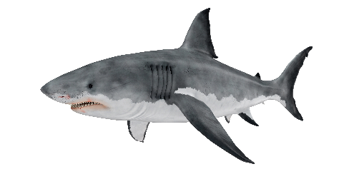
Checkpoint 9: Dangerous distances
In 2021, an unexploded World War II bomb was uncovered in Exeter.
A 400 m cordon was put in place around the bomb site, while a controlled explosion was carried out.
How might you describe the shape of the boundary of the ‘safe’ region around the bomb site? How accurate can you be?
Some sharks can smell blood from up to 400 m away.
How might you describe the shape of the boundary of the ‘safe’ region around a shark in the ocean? How accurate can you be?
How is this the same and how is it different from the 400 m safe zone around the bomb site?
Can you think of some other examples of ‘safe zone’ boundaries that would have similar shapes? How about different shapes?
Notes:
This slide is animated. Each question will appear separately so you can choose the pace at which to work with your class.
Answers
a) The boundary would be circular. Although the explosion would also detonate into the air, the ‘safe zone’ created by the cordon would be 2D. A circle of radius 400 m would be marked out on the ground around the explosion point, with the safe region being the space outside of this circle
b) The boundary would be spherical. The shark could swim up and down as well as at the same level in the ocean, and so the ‘safe region’ would need to be in 3D. This results in a sphere of radius 400 m around the shark, with the safe region being everywhere else in the ocean that is not contained in this sphere – the further away the better!
? Students’ responses will vary but might include examples where barriers are formed for crowds.
Suggested questioning
What shape would the boundary make? Is there more than one possible answer?
If your class all stood __ m from a point, what shape would you form?
Is your shape 2D or 3D?
Things to think about
Students should understand constructions in real-life contexts, such as those in Checkpoints 9–13. In all of these examples, situations are explored where a path or region can be represented by circles or part circles. Discuss with your department: are there any other situations that could be modelled using these shapes? Discuss also with your students, prompting them to draw on their own experiences. For example, when social distancing rules are in place for a queue, what is the shape of the boundary around each person? What does this look like in practice?

Slide 29
Checkpoint 9: Guidance
Adaptations | Assessing understanding
Support Ask students to draw a 'map' of the safe spaces. They should mark the bomb and then identify the boundary of the safe spaces. Imagining people walking towards the central point, then stopping at a 400 m distance may feel more natural to students than imagining people leaving a central region. Challenge Extend each situation by including a second ‘danger’. For example, imagine a second shark swimming exactly 400 m away from the first shark. What would this do to the unsafe region? Will it double in size? What shape might it be? Representations Sketching out diagrams will be very helpful, or some students may want to explore with a pair of compasses. It might also be useful to do some ‘people maths’. In a large space, tell students they all need to stand the same distance from the ‘bomb’ in the centre: what do they notice about the shape they form? | Although loci are not explicitly in the Key Stage 3 curriculum, students are expected to know standard ruler and compass constructions and to, ‘reason deductively in geometry, including using geometrical constructions’. It is important that they experience contextual problems where a circle is formed – such as the two situations described here. Look for understanding that the shape formed of points that are an equal distance from a given object will be circular, if not a mathematically correct 'circle’. (This task gives an opportunity to explore similarities and differences in the meanings of colloquial and mathematical words, continuing the discussion started in Checkpoint 1). Ensure that students are able to explain why a cordon like this should be circular. This understanding may be more apparent as students move to the 3D context offered in part b of the task.
Additional resources Part a refers to a real event. You can find news articles about the unexploded bomb by searching ‘unexploded bomb Exeter 2021’ online. Other examples of regions in real-life contexts can be found in Checkpoints 10, 11 and 13 as well as Additional activities M and N.

Slide 30
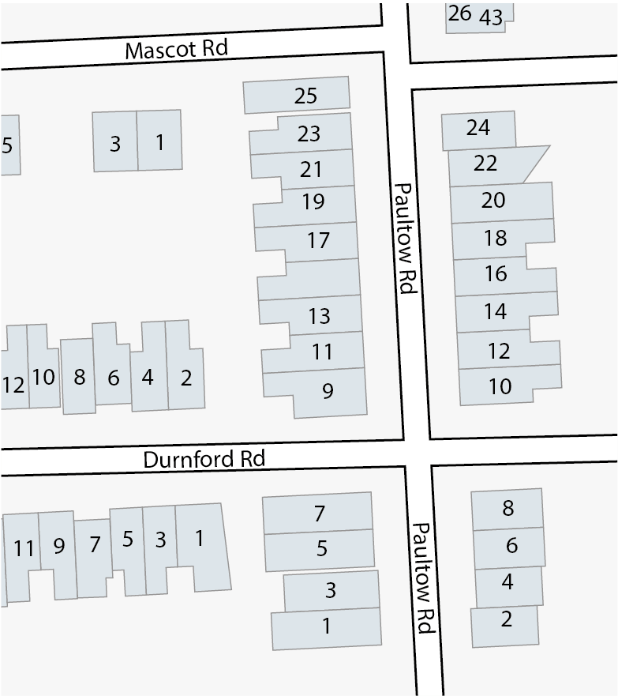
Checkpoint 10: Bungling burglars
A burglar sets off the alarm at 17 Paultow Road. It is heard by everyone in a radius of 20 m (shown by the circle around the house).
In which houses do people hear the alarm?
In which houses do people hear the alarm most loudly?
The burglar then sets off another alarm at 8 Paultow Road (shown by a second circle).
In which houses do people hear both alarms?
Which alarm is heard in the most houses? Why?
A third alarm can be heard in all the houses on Durnford Road but none of the houses on Paultow road. Where might this alarm be?
Notes:
This slide is animated. Each question will appear separately so you can choose the pace at which to work with your class.
Answers
a) People in the odd numbers 9–25 on Paultow Road can hear the alarm from anywhere in their houses, as can number 2 Durnford Road. There are some properties where the alarm can only be heard in part of the building: even numbers 12–24 Paultow Road; 4 and 6 Durnford Road; and 1 and 3 Mascot Road.
b) Those nearest the centre of the circle can hear the alarm most loudly: it will be loudest at number 17 Paultow Road, and then pretty loud at numbers 15 and 19.
c) Both alarms can be heard in all of 9 Paultow Road; most parts of 11 and 12 Paultow Road; and some parts of 12, 14, 15, 16 and 18 Paultow Road.
d) Students could interpret this question two ways, so make sure you listen to their reasoning to check understanding. The alarm at number 17 can be heard by more houses, as there are more buildings within the circle. However, the radius of the alarm at number 8 is greater, which means that the sound covers a greater area and so could arguably be heard by more people as it includes more people walking on the street etc.
? The alarm could be at number 11 or 12 Durnford Road (or off the map to the left) so long as the circumference of the circle that represents it doesn’t go beyond numbers 1 or 2.
Suggested questioning
Where is each alarm loudest/quietest?
What do you think the radius of the second alarm might be? Why?
Is this a realistic way to show where people might be able to hear the alarms?
Things to think about
Students should understand constructions in real-life contexts, such as those in Checkpoints 9–13. In all of these examples, we have explored situations where a path or region can be represented by circles or part circles. In this case, two alarms of different volumes are represented by two circles of different radii. Discuss with your department: are there any other situations that could be modelled using these shapes? Discuss also with your students: prompt them to think of any further examples from their own experiences.

Slide 31
Checkpoint 10: Guidance
Adaptations | Assessing understanding
Support Explore the first circle thoroughly before introducing parts c and d. Use counters to represent people and move them around and outside the circle, asking who will hear the alarm most loudly etc. Challenge Ask students to construct their own diagrams using information you give them. Add constraints such as, ‘No one can hear both alarms at the same time’, or, ‘One alarm can be heard everywhere that the other alarm can be heard’, to see if they can interpret different intersections and overlaps. Representations The map is an oversimplification of the range an alarm will have – other factors, such as the hearing of the people, and the soundproofing of the buildings will play a part. Students may or may not pick up on this – if they do, encourage them to critique the representation and discuss ways in which it is realistic or not. Sometimes, mathematical models of situations make compromises, and it is important that students are aware of this. | As with Checkpoint 9, Checkpoint 10 checks the prerequisite knowledge and understanding for reasoning and problem solving with Key Stage 3 geometry. Here, rather than asking students to identify the shape of the space described, the circular loci are given. Assess if they understand what these circles mean in the given context. There is room for some interpretation within the questions, which is intentional – asking students to justify their answers will give you more information about their understanding. So, students might disagree about whether the even numbers of Paultow Road count for part a, as only part of the houses are within the circle. Of particular interest is their solutions to part c, as this considers where two regions intersect. Can students identify what it means to be standing on the points where the two circles intersect? This has implications for their understanding of the construction of triangles.
Additional resources Other examples of regions in real-life contexts can be found in Checkpoints 10, 11 and 13 as well as Additional activities M and N.

Slide 32
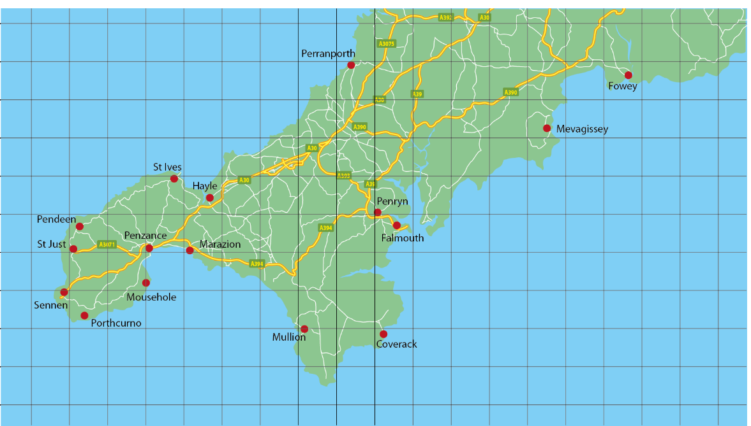
Checkpoint 11: Relocation
This is a map of Cornwall. The grid shows 5 km squares.
Darren wants to live within 5 km of Penzance.
Where could Darren live?
He widens his search to within 15 km of Penzance.
Where could he live now?
Is it possible to also live within 15 km of Penryn?
X
X
Darren buys a house exactly 10 km from Penzance. He drives from his new house to Penzance. What do you estimate the distance he travels to be? Why?
Notes:
This slide is animated. Each question will appear separately so you can choose the pace at which to work with your class. A printable version of the map, for students to annotate, can be found on slide 88.
Answers
For a) and b) see the next slide for animated solutions. Darren could live anywhere on land within the circles shown.
c) No, it is not possible to also live within 15 km of Penryn; if you drew a circle of radius 15 km from each place, the two circles would not touch or overlap.
? The distance ‘as the crow flies’ from one place to another will almost always be shorter than the actual distance by road, as roads are not straight over that distance. Darren will have travelled further than 10 km, so an estimate of around 12 km to 15 km would be sensible.
Suggested questioning
What shape is Darren’s search area? Could he live anywhere within that shape?
Does living 5 km from Penzance mean he will have to travel a distance of 5 km to get there? Why or why not?
Things to think about
Students should understand constructions in real-life contexts, such as those in Checkpoints 9–13. All these examples explore situations where a path or region can be represented by circles or part circles. In this case, thinking about regions around a specific place. The wording is deliberately ambiguous to allow you to discuss with students whether, realistically, Darren would be considering a circular region ‘as the crow flies’ or thinking about travel times by road. The context of, for example, a house located on the coast might be helpful to exemplify this: houses that might be 5 km away as the crow flies will be further than that once the bays and inlets of the Cornish coast have been taken into account. Discuss with your department: are there any other situations that could be modelled using these shapes? Discuss also with your students: prompt for further examples from their own experiences.

Slide 33
Checkpoint 11: Relocation (solutions to parts a and b)
This is a map of Cornwall. The grid shows 5 km squares.
Darren wants to live within 5 km of Penzance.
Where could Darren live?
He widens his search to within 15 km of Penzance.
Where could he live now?
X
Darren could live anywhere on land within the circles shown.
Notes:
This slide is animated. The two circles for part a and b will appear separately.

Slide 34
Checkpoint 11: Guidance
Adaptations | Assessing understanding
Support The use of a printed map to sketch on might be helpful – encourage students to mark on possible places where Darren could live. Can they add another? And another? What shape do these points form? Challenge Challenge students to consider how different factors will impact on the shape defined by the locus, and what a more realistically-shaped locus might look like. For example, if the road to the north-west of Penzance has a slower speed limit than the road to the north-east, what might this mean for the travel time and therefore the region where Darren could possibly live? Representations As in Checkpoint 11, the solutions represented by the circular loci are a simplification of how someone might search for a location in real life. Travel time is more likely to be considered than physical distance. Students may or may not pick up on this – if they do, encourage them to critique the representation and discuss ways in which it is realistic or not. Sometimes, mathematical models of situations make compromises, and it is important that students are aware of this. | As with the two previous Checkpoints, ‘Relocation’ offers a context to explore a circle as a set of points that are a fixed distance from a central point. Explore students' differing understanding of the circle as the locus of points either at or within a fixed distance of that point. Working on and discussing these details and 'boundary cases’ should support deeper understanding. A discussion about the usefulness of the gridlines on the map might also give insight into students' understanding of distances from points. Look for students who use the square grid, but might assume that the shape has to be defined by these straight lines. Some students may work using the assumption that the distance diagonally across a grid square is the same as the length of the sides – a common misconception. You could check whether students hold this misconception by pointing to the corner of the grid square diagonally opposite Penzance and stating, ‘Darren could live here’, to see if students disagree.
Additional resources Additional activity M offers an alternative premise to explore a map in the context of circular loci.

Slide 35
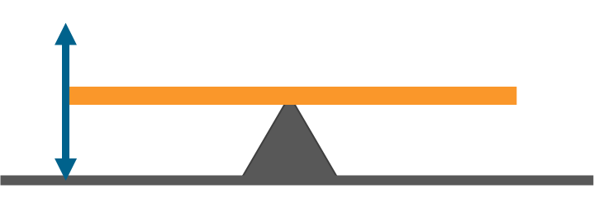
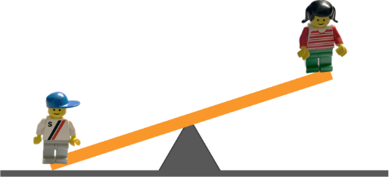
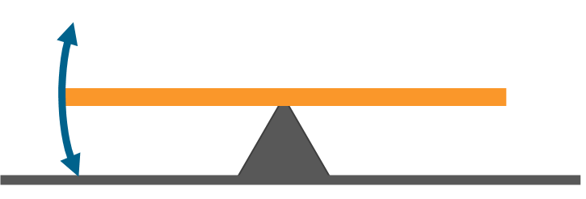
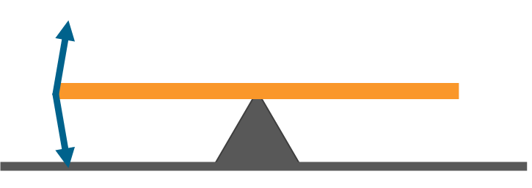
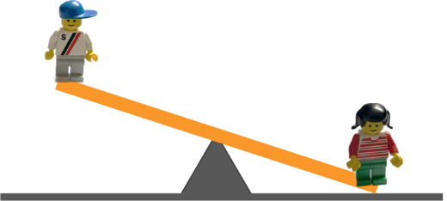
Checkpoint 12: Celia saw
Celia is watching Rom and Sam play on a see-saw.
Which of the lines A to D shows the path that Rom moves? How do you know?
A
B
C
D
In the playground, there is also a zip wire, swing and slide. Draw the path that Rom would take on one of these.
Notes:
This slide is animated. The further thinking question will appear separately so you can choose the pace at which to work with your class.
Answers
The correct path is shown by C, as it represents the curve of a circle created when the see-saw pivots on the centre. In effect, the seat of the see-saw is the diameter of this circle). A is just vertical, which would require the seesaw to change length as it moved up and down. The curve in B is too extreme, while the lines in D are too straight.
? Students’ answers will vary. One suggestion is offered in additional activity L.
Suggested questioning
What is the same and what is different about each of the paths offered?
What is the length between the pivot and the top/middle/bottom of the suggested path? Why does this need to stay the same?
Imagine the see-saw was not stopped by the ground. What would the rest of the path look like?
Things to think about
Students should understand constructions in real-life contexts, such as those in Checkpoints 9–13. All these examples explore situations where a path or region can be represented by circles or part circles. Discuss with your department: are there any other situations that could be modelled using these shapes? Discuss also with your students: prompt for any further examples from their own experiences.

Slide 36
Checkpoint 12: Guidance
Adaptations | Assessing understanding
Support Draw the paths on the board to help students visualise. To model the correct answer (C), tape a board pen to either end of a metre stick and pivot it about the centre so that the pens mark arcs on the board. Challenge Building on the further thinking activity, draw the path that Rom takes on a different piece of playground equipment and ask them to identify what equipment it might be and why. Alternatively, use the representation described in ‘Support’ and ask students how the paths would change if the pivot was not in the centre of the stick. Representations The see-saw is a common piece of playground equipment and students are likely to be familiar with it. However, it might be hard for them to imagine the path that it would take were the ground not there. Using a metre stick (as suggested in ‘Support’) can help to complete the circle and model the behaviour of the straight line as it turns about a point. | Students may never have thought about the path they take when sitting on a see-saw, and are highly likely to have assumed that the movement is up-and-down in a straight line. See if students can recognise a real-life example of where a path is represented by a circle, in preparation for using constructions in geometrical problem-solving. Ask students to explain the reasons for their choice. If students do not offer anything other than A, state that this is not correct and ask if they can explain why, before exploring other options. It is likely that some kind of physical recreation of the movement will be needed to support students’ reasoning. Some suggestions are given in ‘Support’ and ‘Representations’. Something as simple as tilting a pencil on their finger might help them to visualise the circular path that each end of the see-saw takes. Those that can recognise the see-saw seat as the diameter of a circle with the pivot at the centre are likely to have the most secure understanding.
Additional resources Additional activities L, N, O and P also explore real-life contexts that could be modelled with part-circles.

Slide 37
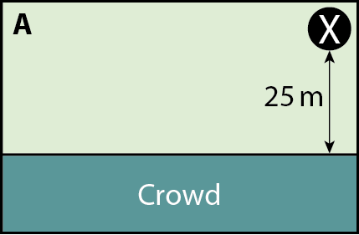
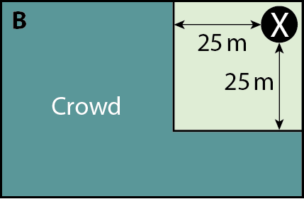
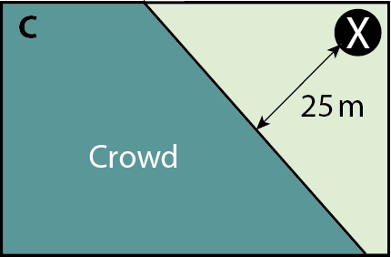
Checkpoint 13: Fireworks
At a fireworks display, the crowd needs to be at least 25 m from the fireworks.
The fireworks are positioned in the circular area around X. There are three options for the position of the safety fence and the crowd.
Which is the best option for the position of the fence? Why?
Could you create a better fence position?
What would be the optimal position of the fence if the fireworks were set off from a different position?
How about if the fireworks area looked like this?
X
Notes:
This slide is animated. Each image, and then each question, will appear separately so you can choose the pace at which to work with your class.
Answers
a) Students’ answers may vary. See whether they can reason about where the space has most effectively been used. In option A the edge of the crowd ends up significantly further away from the fireworks than 25 m, and a lot of field space is wasted. Option B offers the biggest crowd space, but in both options B and C there are still some ‘front row’ spaces that are more than 25 m from the fireworks.
b) A better position for the fence would be an arc with a radius of 25 m and centre at X (see the next slide).
? If the fireworks were set off from a different position, the fence might be a longer or shorter portion of the arc of the circle centred on X. For example, X were in the middle of the longest side, then the fence would be semi-circular.
If the fireworks area was rectangular, there would be some straight fencing 25 m from, but parallel to, the sides and an arc 25 m from the vertices (see the next slide).
Suggested questioning
What do you notice about each fence? Are there positions on the fence that are further than 25 m from the fireworks?
What shape would enable more people to watch the fireworks?
Things to think about
Students should understand constructions in real-life contexts, such as those in Checkpoints 9–13. In all these examples, we have explored situations where a path or region can be represented by circles or part circles. Discuss with your department: are there any other situations that could be modelled using these shapes? Discuss also with your students: prompt them to think of further examples from their own experiences.

Slide 38
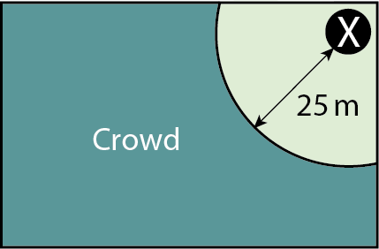
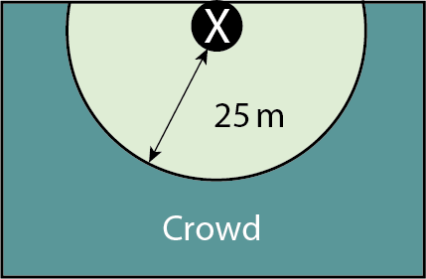
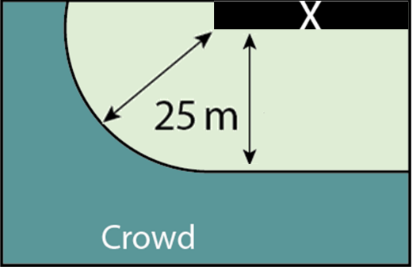
Checkpoint 13: Fireworks (solution to part b and further thinking question)
Could you create a better fence position?
How would the position of the fence need to change if the fireworks were set off from a different position?
How about if the fireworks area looked like this?
Notes:
This slide is animated. The solutions to the further thinking question will appear separately.

Slide 39
Checkpoint 13: Guidance
Adaptations | Assessing understanding
Support Show the images one at a time, or in pairs, and ask specific questions to support students to interpret them. For example, ‘Which could fit more people?’ or, ‘Where is the fence more than 25 m from the fireworks?’ Challenge Take the further thinking question further by suggesting different shapes and positions for the firework area, and asking students to predict how the shape of the safety fence would need to change. Representations There are a number of scenarios where a locus might be needed in real life. The representations used here will hopefully be familiar or at least accessible to students. You could physically recreate the situation – for example, by using the school hall or playground and asking students to position themselves around an object or objects representing the fireworks area. | Checkpoint 13 is the last in a sequence of tasks that check how readily students can think about circles in context. It is intended for assessment ahead of teaching and so the three options do not include any arcs. See if students recognise that, along each of the lines, there are points that are further than 25 m from the fireworks area. From this, you can see whether they have an initial sense that an arc or part-circle might be an appropriate shape. There is no single correct answer for part a so, as with many tasks within Checkpoints, structure the discussion to give students space to disagree and explain their reasoning. Ask them to list what they think the criteria are for choosing the best fence first. If students do not suggest an arc or curve for part b, then this task could pivot to a teaching task. Ask students if there are any places where the fence could be moved, and pick a few points along the fence to ‘move’. Mark the new positions on the board; what do students notice about these positions?
Additional resources Additional activities L, N, O and P also explore real life contexts that could be modelled with part-circles.

Slide 40
Using properties of polygons in construction
Checkpoints 14–22

Slide 41
Using properties of polygons in construction
Previous learning | In Key Stage 3 students need to
Key Stage 2 curriculum: Year 5 (non-statutory): pupils use the term diagonal and make conjectures about the angles formed between sides, and between diagonals and parallel sides, and other properties of quadrilaterals, for example using dynamic geometry ICT tools Year 6: draw 2D shapes using given dimensions and angles Year 6: compare and classify geometric shapes based on their properties and sizes and find unknown angles in any triangles, quadrilaterals, and regular polygons Further information about how students may have experienced this key idea in Key Stage 2: Teaching mathematics in primary schools 3G–2 Draw polygons by joining marked points, and identify parallel and perpendicular (pp 137-139¹); 6G–1 Draw, compose and decompose shapes according to given properties, including dimensions angles and area, and solve related problems (pp 322–26) Key Stage 3 curriculum: 6.1.1.4² Solve problems that require use of a combination of angle facts to identify values of missing angles, providing explanations of reasoning and logic used ¹ Page numbers reference the complete Years 1–6 document ² This four-digit code refers to the key ideas in Secondary Mastery Professional Development | NCETM; | Be aware that the diagonals of a rhombus bisect one another at right angles. Be aware that the diagonals of a rhombus bisect the angles. Use this understanding of the geometrical properties of rhombuses to learn the ruler and compass constructions of: A perpendicular bisector of a line segment A perpendicular to a given line through a given point An angle bisector Reason deductively in geometry, including using geometrical constructions.

Slide 42
Checkpoint 14: Making shapes
Use a ruler and protractor to construct these shapes.
A square with side length 4.5 cm
A rhombus with an angle of 35°
An isosceles triangle with an angle of 50° and a side length of 60 mm
Did you have enough information to do this? Is there more than one way to do any of them?
What additional information would you need each time to ensure there was only one possible shape for each instruction?
Notes:
This slide is animated. Part b and the further thinking question will appear separately so you can choose the pace at which to work with your class.
Answers
a) Students’ answers will need to be checked individually. You might do this yourself or by structuring self/peer assessment through questioning. You might find it helpful to construct the shapes accurately on some tracing paper and then place this over students’ answers for speedy checking. Where there are multiple possible answers (i.e. the rhombus), just construct the angle and then check the sides with a ruler.
b) There was enough information for the square; all students’ answers should look identical.
There are four possible isosceles triangles (shown on next slide):
50°, 50°, 80°, with a side of 60 mm between the two 50° angles.
50°, 50°, 80°, with sides of 60 mm between the 50° and 80° angles.
50°, 65°, 65°, with a side of 60 mm between the two 65° angles.
50°, 65°, 65°, with sides of 60 mm between the 50° and 65° angles.
There are infinite possible rhombuses. All students should have two opposite angles of 35° and two opposite angles of 145°, as well as four equal sides. However, as these side lengths are not specified they could be any length.
? For the isosceles triangles, you need to specify the relationship between the side and the angle, as well as whether there is more than one of that angle. For the rhombuses, you need to specify the side lengths.
Suggested questioning
What is special about the angles in a square/rhombus/isosceles triangle?
What is special about the lengths in a square/rhombus/isosceles triangle?
Draw me another…and another. What is the same and what is different about your shapes?
Things to think about
As described in the Guidance slide, it is possible that students’ recent experience with protractor and ruler constructions is minimal. Consider how you will manage this task in the classroom and at what stage you will intervene. What might students’ ‘productive struggle’ tell you about their understanding of how to use the equipment? Do you need them to do all three shapes to help you understand what the challenges are? If you wanted to minimise the time spent, which shape would be the most useful to ask them to construct? (See ‘Support’ on the Guidance slide for our suggestion).

Slide 43
Checkpoint 14: Guidance
Adaptations | Assessing understanding
Support Work on one shape at a time. The triangle offers the most scope for ruler and protractor work. Challenge Give students an angle and a length. How many different quadrilaterals can they make with this starting point? Representations Students are likely to begin with a horizontal line for their construction, meaning all of their shapes will be represented the same way. Note whether they turn the page so that they always work with a horizontal line, or turn their protractor instead. | Students should have used protractors and rulers but not a pair of compasses at primary school. This Checkpoint assesses how accurately they can use such equipment to construct shapes. Rulers are used from as early as Year 1, but protractors are not used until Year 5. Depending on where in your Key Stage 3 curriculum you use this task, and how much time their primary school was able to spend on working with protractors, you may find students’ experience is not very recent. If students are struggling with using a protractor it might be that more significant lesson time is needed to address the issues with protractor skills. For the purposes of this brief Checkpoint, you might therefore need skip through part a and focus on part b and then plan a more extended sequence of learning to deal with protractor skills. Part b offers a subsidiary assessment point which explores whether students recognise that the information given will not always result in the same shape. Students should be able to reason that they need information about both side length and angles to ensure all of their constructions are the same. They have this for the square (as all angles are right angles) but not the rhombus. Where sides are different lengths, they also need information about the relationship between the sides and the angles.
Additional resources Checkpoint 12 from the ‘Geometrical properties - polygons’ Checkpoints | NCETM deck explores some common misconceptions around protractor use. Unit 10 from the Year 5 Curriculum prioritisation in primary maths | NCETM explores angles, including protractors. Examples of Key Stage 2 assessment questions involving accurate drawing can be found in the Key Stage 2 SATs papers (Question 13 from 2019 Paper 2 reasoning) and Primary Assessment Materials | NCETM (Year 6 p35).

Slide 44
Checkpoint 15: Impossible triangles
Priya uses a ruler to draw the triangle on the right. She then measures the angles with a protractor.
Paani says that Priya’s angle measurements are not possible.
Who is correct?
Paani measures and re-labels the incorrect angle.
Use a ruler and a protractor to draw the triangle accurately.
What are the missing measurements?
8 cm
100°
40°
9 cm
8 cm
100°
25°
9 cm
Make a different triangle using 8 cm, 9 cm and 100°. Is one of the missing angles still 25°?
Notes:
This slide is animated. Each question will appear separately so you can choose the pace at which to work with your class.
Answers
a) Paani is correct. If the angles are correct, then the missing angle will also be 40° and so the missing length must also be 8 cm, when in the diagram it is clearly shorter than the other 8 cm length. At least one of Paani’s angles must be incorrect.
b) Students’ answers should be checked individually: construct the shapes accurately on some tracing paper and then place this over students’ answers for speedy checking.
c) The missing angle should be 55° and the missing side should be 3.86 cm (2 d.p.). Accept answers within 2° or 2 mm of those given.
? If the 100° angle is between the 8 cm and 9 cm sides, then there is one possible triangle and neither of the remaining angles are 25°. If the 100° angle is just at the end of the 9 cm side, then infinite different triangles can be made, one of which could have an angle of 25°. If the 100° angle is just at the end of the 8 cm side, then, again, infinite different triangles can be made, one of which could have an angle of 25° - but would be the same as the triangle given here.
Suggested questioning
What do you know about the triangle? What else can you find out?
Why is this triangle (as shown in the image for part a) definitely not isosceles? Why are the angles (as described in part a) definitely from an isosceles triangle?
Things to think about
Students will become accustomed to the phrase ‘diagram not drawn accurately’ as they experience more examination papers. This Checkpoint offers an opportunity to discuss what accurate drawing means. You could ask students to sketch Priya’s triangle more appropriately; even without a protractor, it is possible to draw a more appropriate representation of an isosceles triangle. This might be a good opportunity to also remind students of the common notation used to denote equal lengths and angles.

Slide 45
Checkpoint 15: Guidance
Adaptations | Assessing understanding
Support In part a, tell students that one of the measurements is wrong and see if they can identify which one and why. In part b, you could give a 9 cm line as a starting point. Challenge The further thinking question could extend into thinking about possible combinations of sides and angles. Ask students how many different possible relationships there could be between the 8 cm, 9 cm and the 100° angle. How many different possible triangles would these produce? Representations Discuss the assumptions we can and cannot make when angles are represented on a diagram. Here, the shape used in part a cannot be accurate based on the angles given. Ask students what a better representation of those angles would look like. | Like Checkpoint 14, Checkpoint 15 has dual assessment points: can students reason with their knowledge about properties of shapes, and can they accurately construct them with this information. Part a asks students to use their knowledge of angles in isosceles triangles to reason that Priya’s measurements cannot be true. This requires more than one step. Students first need to recognise that the missing angle is also 40°, and that this implies that the triangle is isosceles. Some students might immediately reject this possibility as the triangle doesn’t ‘look’ isosceles. Probe further to see if students can identify that the missing side would also be 8 cm and that, for two sides of 8 cm to be drawn from a side of 9 cm, the given angles would not work. Assess not only their reasoning with properties of shape but also how readily they can visualise/estimate length and angle. Part b asks students to construct the triangle accurately; see the guidance slide to Checkpoint 14 for suggestions about students’ experience with protractors. They are also asked, in part c, to measure the missing measurements. This enables you to check their confidence and accuracy with both measurement and construction.
Additional resources Another example of a question that asks students to use properties of possible/impossible triangles can be found on p40 of Secondary Assessment Materials | NCETM. Checkpoint 12 from the ‘Geometrical properties - polygons’ Checkpoints | NCETM deck explores protractor use.

Slide 46
Checkpoint 16: Diagonally
Ms Astley asks her class to draw a square and its diagonals.
On the right are two students’ responses.
Who is correct? Why?
What do you notice about the two correct diagonals?
Do any other shapes have diagonals like this?
Greta
Felix
In another shape, two diagonals are of equal length and meet at right angles. What other property would they need to form a kite but not a square?
Notes:
This slide is animated. Each question will appear separately so you can choose the pace at which to work with your class.
Answers
a) Greta is correct, because the diagonals are drawn from and to the vertices of her shape. Felix’s lines are diagonal (using the common usage of the term) but are not mathematical diagonals.
b) The correct diagonals are the same length and perpendicular to each other. They also bisect each other. (However, students are more likely to refer to ‘cutting in half’ rather than using the term bisect.)
c) No other shapes have diagonals that are perpendicular bisectors of each other AND equal in length; this is a property that is unique to squares. A rhombus has diagonals that are perpendicular bisectors of each other, but they do not have to be equal in length. A kite has diagonals that are perpendicular, and they can in some cases be equal in length, but they do not bisect each other. Rectangles have diagonals that are equal in length and bisect each other, but they are not perpendicular.
? To form a kite, only one of the diagonals should bisect the other.
Suggested questioning
What does diagonal mean in non-mathematical contexts?
What is the mathematical definition of a diagonal?
In what context might Felix’s answer be appropriate?
Things to think about
Students need to be aware of terms that have a specific mathematical meaning, even if their colloquial use is different. Diagonal is a particularly slippery term in the mathematics classroom, as it is very easy to use it in different ways. For example, it is likely that students have heard a maths teacher refer to a diagonal line to identify a non-horizontal/vertical line. This task offers a chance to ‘myth-bust’ around the term and check that students are confident with its use when referring to properties of polygons. This is particularly crucial in relation to ruler and compass constructions, as the properties of the diagonals of a rhombus are so key.

Slide 47
Checkpoint 16: Guidance
Adaptations | Assessing understanding
Support Create a definitions board showing ‘Maths usage’ and ‘Common usage’, with visual examples. Add other words to this board when you encounter vocabulary that has different usage within the context of mathematics. Challenge Ask students to discuss the triangles formed by the diagonals and sides: how many different triangles are formed? How would your answer change with different quadrilaterals? Representations It is important that students see different orientations of shapes in order to build up their own definitions and fully understand their properties. Here, a square is presented with horizontal/vertical sides and also rotated by 45°. Check students still acknowledge that this is a square. Discussion might arise about the overlap between squares and rhombuses. A common misconception might be to call Greta’s square a ‘diamond’. | Checkpoint 16 plays with the term ‘diagonal’ and checks that students appreciate the difference between its common and mathematical usage. Students might argue that Greta’s lines are horizontal and vertical, rather than diagonal. It is important that students appreciate that the key feature of a mathematical diagonal is not the angle of the line, but that the line extends from one vertex of a polygon to another. Parts b and c check students understand properties of a square – here, that the diagonals bisect each other at right angles – and whether they know which other shapes share these properties. The diagonals of both kites and rhombuses meet at right angles; in a kite, one diagonal bisects the other, whereas in a rhombus both diagonals are bisectors. This is an important property for the constructions taught within Key Stages 3 and 4; the methods for bisecting both lines and angles rely on the diagonal properties of a rhombus. Students who understand this have a better chance of understanding how constructions work rather than just trying to remember a set of disconnected steps.
Additional resources For more Checkpoints | NCETM that explore the mathematical definition of diagonals, see the ‘Geometrical properties - polygons’ deck.

Slide 48
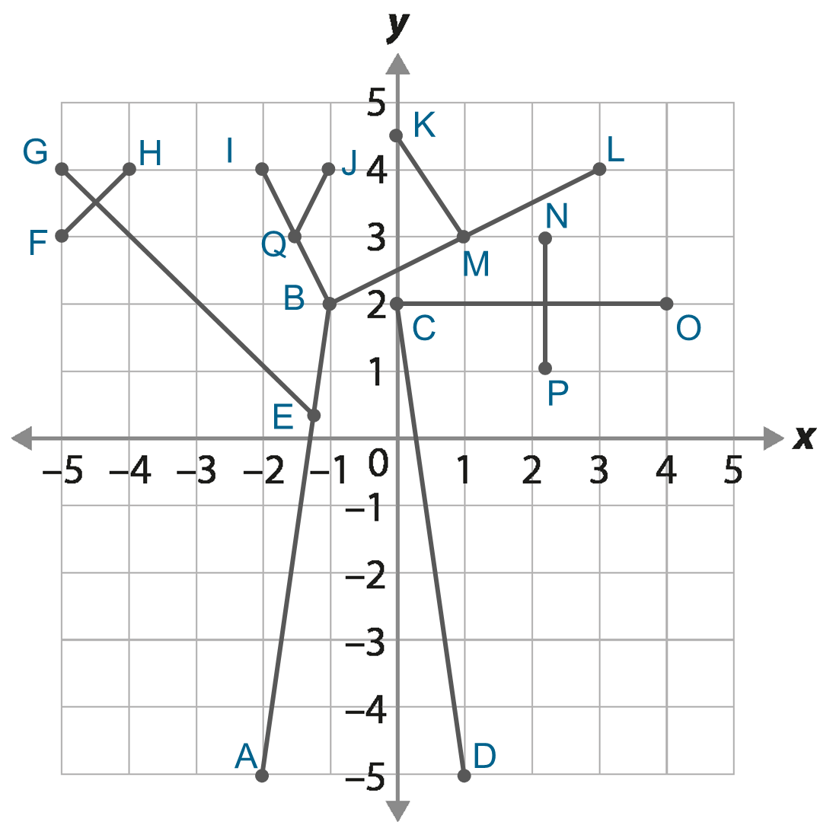
Checkpoint 17: Tree branches
Find:
a pair of perpendicular line segments
a pair of line segments where one cuts the other in half
a pair of perpendicular line segments where one cuts the other in half.
Add one line segment so that there is another solution to each of parts a–c. How many ways is it possible to do this?
Notes:
This slide is animated. Each question will appear separately so you can choose the pace at which to work with your class. An editable, printable version can be found on slide 89.
Answers
a) Pair of perpendicular line segments: CO and NP; EG and FH; BI and BM/BL
b) Pair of line segments where one cuts the other in half: EG bisects HF; CO bisects NP; KM bisects BL; JQ bisects BI.
c) Pair of perpendicular line segments where one cuts the other in half: EG is a perpendicular bisector of HF; CO is a perpendicular bisector of NP.
? Check students’ answers individually. It is possible to draw a perpendicular bisector of infinitely different lengths for every line.
Suggested questioning
What does perpendicular mean?
How do you know if two diagonal lines are perpendicular?
What is the midpoint of this line? How do you know?
How can you use the coordinate grid to help you?
Things to think about
Checkpoint 17 uses a coordinate grid to explore relationships between line segments. Depending on the order of your scheme of work, you could connect this task to the gradients that students study as part of their work on graphs of linear equations.

Slide 49
Checkpoint 17: Guidance
Adaptations | Assessing understanding
Support Use the editable, printable version to remove some of the line segments to simplify the diagram. For example, taking out AB and CD still leaves plenty of line segments to discuss. Challenge Ask students to create their own image, giving constraints such as, ‘Must have four pairs of perpendicular lines but only one horizontal line’. Representations As with Checkpoint 16, consider whether students have seen enough variation in the examples they associate with certain terms. Here, a variety of examples and non-examples are used to build a definition of perpendicular lines. The coordinate grid further supports understanding. | Checkpoints 18–20 look at the properties of rhombuses in preparation for standard ruler and compass constructions. Checkpoint 17 instead focuses on the terminology used and whether students can recognise examples of these terms in practice. The expression ‘a pair of lines’ is used, but there are multiple answers to each question. Choose whether to prompt students by asking for another, and another, or by selecting and comparing the different responses that students offer. Students should have an awareness that perpendicular means ‘at right angles to’ and so should be able to identify a number of pairs of lines for part a. Look out for those that identify KM and LB as perpendicular because they look ‘nearly’ right angled. Ask them to prove it and offer out to the class to prove otherwise. Part b does not use the word ‘bisect’ as it is not explicitly in the primary mathematics curriculum. Instead, it checks if students can identify lines that have been cut exactly in half. Students should use the scales on the axes to help them. Visually, it may be easier for students to identify those that bisect at right angles, but identifying pairs of lines that have both properties is checked in part c. Decide whether to introduce the term ‘perpendicular bisector’ at this stage – depending on students’ experience of the language, they may need more explicit teaching with examples and non-examples to fully understand the terminology.
Additional resources For more activities exploring perpendicular lines, see the ‘Geometrical properties - polygons’ Checkpoints | NCETM deck.

Slide 50
Checkpoint 18: More ripples
Circles are drawn around points X and Y.
The smallest circle around each has a radius of 1 cm. Each radius increases by 1 cm for each new circle.
X is joined to Y with a line segment to form one diagonal for a quadrilateral.
Two points from A, B, C and D will be connected to make the other diagonal.
Is it possible to make a kite? Why or why not?
How about a rhombus? Why or why not?
× F
× C
× B
X
× A
Y
× D
× E
Where would you plot one more point to create a kite? What about a rhombus?
Is there more than one way to do this for each shape?
Notes:
This slide is animated. Each relevant part of the diagram will appear automatically with the relevant part of the rubric; each question will also appear separately so you can choose the pace at which to work with your class. A printable version of the image can be found on slide 86.
Answers
a) Yes, joining A and D would make a kite. This is because the line from A to D splits the line from X to Y exactly in half, as the circles that create those points are the same radius.
b) There are no points that currently form a rhombus. The diagonals of a rhombus are perpendicular bisectors of each other, so the two points need to both be at the overlap of two circles with the same radius.
? You could create a kite with:
Point B if the new point was placed at the intersection of the 5th blue circle (round point X) and 4th orange circle (round point Y).
Point C if the new point was placed at the intersection of the 3rd blue circle (round point X) and 5th orange circle (round point Y).
Point A/D if the new point was placed anywhere along the line where the same number circle overlaps (for example, both the 3rd circles).
It is not possible to accurately create a kite with point E and F using this diagram as you cannot ensure that it is at the correct point on the circumference to create a symmetrical arrowhead.
You could create a rhombus with:
Point A if the new point was placed at the other intersection of the 1st circles.
Point D if the new point was placed at the other intersection of the 5th circles.
Suggested questioning
What do you notice about the circles?
Show me a point that is closer to X than Y/further from X than Y/the same distance from X and Y.
Is there more than one answer to any of these questions?
Can you write a question that would have more than two answers?
Can you write an impossible question?
Things to think about
The overlapping concentric circle image is used repeatedly throughout this deck: see also Checkpoint 7 and Additional activity F. The diagram may at first appear overwhelming, but the intention is to emphasise the structure that underpins ruler and compass constructions by making the circles visible. In this case, kites and rhombuses as a precursor for constructing perpendicular bisectors. Can you think of any other questions you could ask using this structure? This could be a useful thing to explore as a department, to help deepen subject knowledge around constructions, angles and properties of 2D shapes.

Slide 51
Checkpoint 18: Guidance
Adaptations | Assessing understanding
Support Remove points E and F. Say, ‘Point D is connected to another point. Which point would form the diagonals of a kite?’ Challenge Ask students to find all possible rhombuses and kites using the circles. Representations The overlapping sets of concentric circles image is used throughout this deck, so that a familiar representation supports students to see the connections between different constructions, rather than seeing them as distinct and disconnected. See the guidance slide for Checkpoint 7 for some further points to consider about using full circles or arcs in construction. | Checkpoint 18 checks if students connect their understanding of circles to properties of quadrilaterals, to support future work on construction. When they learn to construct perpendicular bisectors, they will draw on understanding used when constructing triangles. In effect, they construct an isosceles triangle above and below the two points, creating a rhombus. To appreciate that the line connecting their two new points is a perpendicular bisector, they must understand that the diagonals of a rhombus bisect each other at right angles. Remind students that they are creating the diagonals not the sides. Use one colour to draw in the diagonals and another to join up the sides to check answers. Part a asks students to identify a kite before a rhombus, focusing on what is the same (that their diagonals cross at right angles) and what is different (that both diagonals bisect each other in rhombuses). Part b is not possible so the focus is on students’ reasoning: they might not talk about quadrilateral properties and instead focus on where they would move one point so that it is the same distance above/below the line as A or D. It is possible that students’ work with the properties of 2D shapes was not recent or deep enough to have established this understanding about the diagonals of rhombuses. If so, plan this into your teaching of constructions so that the process has purpose and meaning, rather than just being a series of disconnected steps.
Additional resources To think about how to use this at Key Stage 3, Key idea 6.4.2.3 from Secondary Mastery Professional Development | NCETM explores ‘Constructing perpendicular bisectors using properties of rhombuses. This overlapping concentric circle diagram is used further in Checkpoint 7 and Additional activity F.

Slide 52
Checkpoint 19: Two sides and a diagonal
Some of diagrams A to E show two sides and a diagonal of a rhombus.
Which ones do you think they are?
How could you be sure?
E
A
C
B
D
Draw your own diagram that shows two sides and a diagonal of a rhombus. What properties do your lines need to have?
Notes:
This slide is animated. Each question will appear separately so you can choose the pace at which to work with your class.
Answers
a) A and E
b) We can be sure if the diagonal cuts the angle exactly in half, and the two sides (as well as the two missing sides) are the same length. So, we could measure the two angles to check they are the same
Suggested questioning
What is the same and what is different about each image?
Which angles/lengths are the same? How do you know? How could you check?
What is special about the diagonals of a rhombus? Do any other quadrilaterals share these properties?
Things to think about
This and the following Checkpoint explore the properties of a rhombus as preparation for standard ruler and compass construction. The Guidance slide suggests how this relates to the method for bisecting an angle, but the same properties are essential for bisecting lines too. When learning to construct a perpendicular bisector at Key Stage 3, students will draw arcs of equal radii above and below a line. The reason that this works is that the point where these arcs cross become the opposite points of a rhombus, with the original line and the new bisector acting as diagonals. However, these constructions are often taught as a set of steps without these connections to properties of shapes being made explicit. Chat to your department; how much of an appreciation is there of the importance of the rhombus in construction?

Slide 53
Checkpoint 19: Guidance
Adaptations | Assessing understanding
Support Just show two examples (one a rhombus, one not) and ask, ‘What is the same and what is different?’ If students are distracted by differences in side length, copy E onto another slide twice, but alter the angle of the diagonal on one image for a direct comparison. Challenge Extend the further thinking question by asking students to create ‘two sides and a diagonal’ images for other quadrilaterals. Are there any that are ambiguous, or do they all have a unique diagonal/side property? Representations A dynamic image could be a useful representation: keeping the sides fixed, rotate one end of a diagonal so that the two angles created vary in size. Model the point where the two angles are equal and show that this is when a rhombus is formed. | When students learn how to bisect an angle at Key Stage 3, they will be using the properties of a rhombus: namely, that the diagonals bisect the angles. When they mark arcs on the line segments, and then use these arcs to create a point that is equidistant to them both, they create a rhombus: the line that connects the original angle to this new point is a diagonal that bisects the angle. This Checkpoint uses one angle and its diagonal to check that students can identify this useful property. No angles or measurements are given, so expect students to consider part a ‘by eye’. The diagrams are drawn to scale so, as part of their justifications for part b, they could use a ruler and protractor to check their answers. Listen for students who are able to identify that the angle must be bisected by the diagonal. Some may have an appreciation of which diagrams are correct without articulating it in this way. They might, for example, look for two equal angles rather than considering the whole angle as bisected. This will help you know how explicitly you need to teach certain terminology and properties.
Additional resources Further tasks exploring understanding of diagonals are in the Geometrical properties - polygons’ Checkpoints deck. Diagonals in quadrilaterals are assessed in question 18 of Paper 3 reasoning from the Key Stage 2 SATs. Past papers can be found online.

Slide 54
Checkpoint 20: Rhombus
On the left is a rhombus with its diagonals drawn on.
The angle between one diagonal and one side is labelled.
What other angles do you know?
75°
On the right is another rhombus with just one diagonal drawn on.
One angle is labelled.
What is the missing angle r? How do you know?
r
88°
How many facts can you write about the relationship between the angles and diagonals in a rhombus?
Notes:
This slide is animated. Each question will appear separately so you can choose the pace at which to work with your class.
Answers
a) We know all the angles in the rhombus. If the angle marked is 75°, then the whole obtuse angle at that vertex is 150°. The angle opposite is also 150°. 360° − (150° × 2) = 60°; 60° ÷ 2 = 30°, so both of the acute angles are 30°.
b) The missing angle r is 46°. We know this because co-interior angles in a rhombus add to 180°, so r + the other missing part = 180°. 180°− 88° = 92°. The diagonals of a rhombus bisect the angles, so r = 92° ÷ 2 = 46°. Students might also consider the full quadrilateral (i.e. 360°− (88° × 2) = 184°; 184° ÷ 4 = 46°) or bisect the given angle, and then use the angle sum of triangles and the right angle at the centre of the rhombus (i.e. 88° ÷ 2 = 44°; 180° − (44° + 90°) = 46°; the symmetry of the rhombus allows us to deduce that r is also 46°.)
? Students’ responses will vary but could include:
The diagonals of a rhombus are perpendicular bisectors of each other. (Students might use terms like ‘cut in half’ or ‘right angles’.)
The diagonals of a rhombus bisect the angles.
Opposite angles in a rhombus are the same.
The angles of a rhombus sum to 360°.
Co-interior angles of a rhombus sum to 180°. (Depending on when you teach co-interior angles in Key Stage 3, students may not know this term but may be aware of the angle relationship.)
Suggested questioning
What angles are the same? What angles are different?
If we know __, what else do we know?
What is the angle sum in a triangle/quadrilateral?
How would this question be different if it were a kite not a rhombus? How about a parallelogram?
Things to think about
It might seem like this task belongs with the angles Checkpoints in the ‘Geometrical properties’ deck. However, the intention is to check students are aware of the special properties of a rhombus. These properties underpin why the ruler and compass constructions for both line and angle bisectors work, and so it is essential that students understand them in order to be able to understand the constructions deeply, rather than as a set of unconnected steps. Talk to your colleagues: is this a connection that they are familiar with? How does it to relate to how you have taught constructions previously?

Slide 55
Checkpoint 20: Guidance
Adaptations | Assessing understanding
Support Give students colours to mark on the angles that are the same as each other. Can they now see four identical triangles to work with? Challenge Ask students to consider how the task would work with different quadrilaterals. Would they still be able to find the other angles if they knew the angle between one diagonal and a side? Representations As with Checkpoint 15, this is an opportunity to discuss the assumptions we can and cannot make when angles are represented on a diagram. For example, in this case right angles are not shown but are known because of the properties of a rhombus. | Checkpoint 20 looks again at the properties of a rhombus. Check how deeply students understand these ahead of teaching standard ruler and compass constructions. Part a is unstructured to enable an open discussion with students to glean as much information as possible about their understanding of angles in rhombuses, particularly in relation to the diagonals. They might use other mathematical knowledge and not connect it to the diagonals. For example, they might use terms such as ‘symmetrical’ to justify other 75° angles in the shape, rather than referring to the diagonal cutting the obtuse angle in half. They are unlikely to have encountered the term ‘bisect’ unless it has been previously taught at Key Stage 3. Part b asks for a specific angle. Again, listen for how students get there. If they have decent angle knowledge but not specifically in relation to the diagonals of a rhombus, pause between parts a and b to clarify the angle bisection property. Then ask them to use the diagonal properties of rhombuses in their explanation. If students do not seem ready for this, spend some time looking at the properties of diagonals in quadrilaterals before teaching construction.
Additional resources Examples of missing angles problems can be found in the Key Stage 2 SATs papers, for example question 24 from 2022 Paper 2 reasoning or question 17 from 2016 Paper 3 reasoning. Past papers can readily be found online. To think about how to use this at Key Stage 3, Key idea 6.4.2.3 from Secondary Mastery Professional Development | NCETM explores ‘Constructing perpendicular bisectors using properties of rhombuses’.

Slide 56
Checkpoint 21: Shortest distance
A
Road A and road B are parallel.
The council are planning to build a straight road to connect the roads. Four possible routes are shown as black lines.
Which possible route will be the shortest when it reaches road B?
Could they make an even shorter route? How?
76°
111°
84.5°
99.2°
1
2
3
4
B
Imagine the lines for the possible routes are extended above and below roads A and B. Which pairs of lines will cross above road A? Which will cross furthest from the road?
Notes:
This slide is animated. Each question will appear separately so you can choose the pace at which to work with your class.
Answers
a) Route 3, at an angle of 84.5°, will be the shortest.
b) They could make an even shorter route by making the angle between the new and original roads closer to 90°. The shortest possible route would be at an angle of exactly 90°.
? Crossing above A (in increasing order of distance from A): 2 and 3; 2 and 4; 3 and 4. So, lines 3 and 4 will cross furthest from the road.
Suggested questioning
What is the same and what is different about each line?
How realistic is this context?
How do you know which is the shortest line?
Things to think about
Checkpoint 21 checks students are aware that perpendicular distance is the shortest between two points. This might be something that they are instinctively aware of rather than something that they have memorised or formalised as a statement. This is a very specific assessment point, which we have drawn out as it is a key piece of knowledge embedded within constructions at Key Stage 3 that might often be assumed rather than explicitly checked.

Slide 57
Checkpoint 21: Guidance
Adaptations | Assessing understanding
Support Just show the middle two lines at first: compare them and ask which will be shorter. Then ask how they could change this to be shorter still. Challenge The further thinking question ask students to imagine when the lines will cross. Connect this to learning on angles between parallel lines and their transversals. Ask them to sketch the extended lines and work out what angles they can calculate. Representations If students are unconvinced about the respective lengths of the lines, this could be modelled physically using pieces of string. Draw two lines on the board and attach string at the various angles. Cut and measure the string to show that the shortest string is closest to perpendicular. | The national curriculum for Key Stage 3 states that students should be taught to ‘recognise and use the perpendicular distance from a point to a line as the shortest distance to the line’. This Checkpoint offers an opportunity to see whether students already have an instinctive sense of this. It is not explicitly taught in the Key Stage 2 curriculum. This is likely to be a relatively quick Checkpoint: it should be revealed very quickly if students have a sense that the shortest route will be nearest to perpendicular). You might usefully ask students to agree/disagree with some statements (provided by you or the students) so that you can listen in to their reasoning. Both Checkpoints 21 and 22, much like Checkpoints 9–13, attempt to find a real-life situation that the mathematical construction could plausibly represent. As with the circular loci to represent burglar alarms in Checkpoint 10, you might like to discuss with students how realistic such modelling is.
Additional resources A similar task can be found on p39 of the Secondary Assessment Materials | NCETM

Slide 58
Checkpoint 22: Where do you stand?
x Flo
Two stink bombs, A and B, are set off in the school hall. Five students stand so that they are equidistant from both stink bombs.
What do you notice about the positions of the students?
Who is closest to the smells?
Who is furthest from the smells?
Flo enters the room. Which smell is she closest to?
If you were also in the hall, where would you stand to be least affected by the smells?
x Abi
x Bix
B
x Cam
A
x Dev
x Eli
Draw this image as accurately as you can. What equipment will you need to do this?
Notes:
This slide is animated. Each question will appear separately so you can choose the pace at which to work with your class.
Answers
a) The students have formed a straight line.
b) Cam is closest to the smells.
c) Eli is furthest from the smells.
d) Flo is closer to smell A than smell B.
e) Students’ answers will vary. It is likely that they might select the space beyond either Abi or Eli, or either the top left or bottom right corner. The bottom right corner is furthest from both stink bombs.
? Students’ answers will vary. They will need a pair of compasses and ruler.
Suggested questioning
What does equidistant mean?
When all six people are in the hall, which person is the ‘odd one out’? Why?
Which smell would be stronger if you stood to the left/right of the line?
Things to think about
As with many attempts to provide a real-life scenario for mathematical constructs, the stink bombs in the school hall may seem like a relatively tenuous context! If you think this context will be too silly for your students, then change points A and B to something different like sounds or lights.

Slide 59
Checkpoint 22: Guidance
Adaptations | Assessing understanding
Support For parts b and c, you may find it helpful to connect each ‘student’ to the ‘stink bomb’ using string, and then measure or compare the string to help students to see who is closest and furthest away. Challenge The further thinking question asks students to recreate the situation. Add further challenge by introducing relationships between the points (for example, Eli is twice as far from the smells as Cam). Representations As with Checkpoint 21, string may be a helpful manipulative to model distance between points (see ‘Support’) or to mimic a pair of compasses in creating a locus around each point. It may also help if you physically recreate the situation – for example, by using the school hall or playground and asking students to position themselves with markers for the ‘stink bombs’. | Checkpoint 22 attempts to find a real-life situation that the mathematical construction could plausibly represent – in this case, the students avoiding the stink bomb smells provide a context for perpendicular bisectors. The main assessment point is whether students notice that the students form a line, and can then reason about the points on and either side of this line. You may need to clarify the term ‘equidistant’ before using this task as it is important that students appreciate that each person is the same distance from both points. Model this by annotating the diagram. Ask students what shapes would be formed if you connected each person to both points A and B.
Additional resources To think about how to take this further at Key Stage 3, Key idea 6.4.2.3 from Secondary Mastery Professional Development | NCETM explores ‘Constructing perpendicular bisectors using properties of rhombuses’.

Slide 60
Additional activities
Activities A–P

Slide 61
Activity A: Square and circle
Draw a 3 cm square.
Draw a 3 cm circle.
What is the same and what is different about how you followed these instructions?
Think about some different shapes. What are the key measurements you need to give so that someone could draw them? How do these measurements compare to what you need to give to describe a circle?
Notes:
This slide is animated. Each question will appear separately so you can choose the pace at which to work with your class.
Answers
a) Students should draw a square with 3 cm sides.
b) Students should draw a circle with a radius of 3 cm. They might also interpret this as a circle with a diameter of 3 cm, which for the purposes of this Checkpoint is acceptable – if so, use 1.5 cm for the radius when discussing part c.
c) The same: both use the measurement 3 cm. Different: for the square, the 3 cm refers to the side lengths so students would have used a ruler to measure each side as 3 cm. For the circle the 3 cm refers to the radius, which is an internal dimension and therefore the side of the shape is not the key measurement here.
? Students should recognise that, when asking someone to draw any other shape, they would need to give side lengths and angles. A circle is the only shape where the distinguishing feature is not the side length, but the relationship between ‘side’ (or the points that form it) and another point.
Suggested questioning
What is a circle?
How do you draw a _ cm circle? Which part of the circle do you ‘measure’? How about a _ cm square?
Things to think about
Additional activity A might be used alongside Checkpoint 1, as another means of exploring what a circle is. A circle is unique among the 2D shapes that students will be used to working with. It is the only one that is defined as a locus. Students will not have met the word locus, so this task is an opportunity to explore some of the ideas within the topic of loci without needing the terminology. In contrasting the drawing of a circle with the drawing of a square, students’ attention is drawn to the fact that the key property of a circle is not side length but the relationship between its one, curved side and the point at the centre.

Slide 62
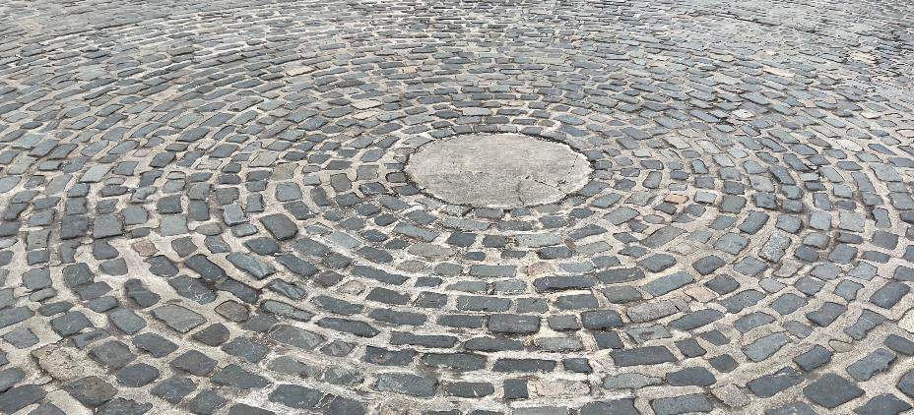
Activity B: Quay points
Put the bricks A, B and C in order of their distance from the central stone, the closest first.
How do you know which points are further away?
C
B
A
How might this pattern of bricks have been laid? How would you arrange bricks to be sure they would form a circle?
Notes:
This slide is animated. Each question will appear separately so you can choose the pace at which to work with your class.
Answers
C, B, A.
? It is likely that they were laid outwards from a central brick.
Students’ responses for their own arrangement may vary. They might agree with working out from a central brick as a strategy, or alternatives such as measuring equidistant points from the centre or using string to form a circle.
Suggested questioning
How many stones from the centre is A/B/C’s circle?
How would you know if A/B/C were furthest from the centre?
Are any of the points given equidistant from the centre? How do you know?
Things to think about
Additional activity B offers another ‘way in’ to checking understanding of a circle as a locus, by using a real-life example of concentric circles and asking students to consider the stones as points on the circles. It might be used as an alternative to Checkpoints 2–4. Listen for whether students reason that all the stones in each circle are equidistant from the central stone. The image is challenging to work with due to the perspective, but it is hoped that this challenge might promote discussion and reasoning. Students will not be able to intuitively work with what ‘looks right’, they will need to count the number of circles from the centre. Prompt for this by asking, for example, ‘If it is hard to see whether A or B is closer to the centre, what might you be looking for?’

Slide 63
Activity C: Target
The smallest circle (A) has a radius of 1 cm. Each circle has a radius that is 1cm bigger than the one before.
Complete the sentences below. Is there more than one way to do this?
Circle __ has a diameter of 4 cm.
Circle __ has a radius of 4 cm.
Circle __ has a radius of __.
Circle __ has a diameter of __.
Find a point that is more than 3 cm but less than 4 cm from the centre. And another. And another.
Mark all the places that are more than 2cm but less than 4 cm from the centre.
A
B
C
D
E
How would your answers to b and c change if the shapes were concentric squares rather than circles?
Notes:
This slide is animated. Each question will appear separately so you can choose the pace at which to work with your class.
Answers
Circle B has a diameter of 4 cm.
Circle D has a radius of 4 cm.
Circle A/B/C/E has a radius of 1 cm/2 cm/3 cm/5 cm respectively.
Circle A/C/D/E has a diameter of 2 cm/6 cm/8 cm/10 cm respectively.
b) Any point in the space between circles C and D.
c) A shaded region between circles B and D.
? Regardless of the shapes that are drawn, the answers to parts b and c would be the same: the region where possible points could be found would be circular. Whilst the answers would not change, it would be more challenging to place the points accurately if the diagram used concentric squares, as the distances to different parts of the squares would be different. For example, the distance from the vertices would be greater than the distance at other points along the sides; only the midpoints of the lengths would be the same distance from the centre as the original circles.
Suggested questioning
What is the relationship between the radius and diameter?
Where is further than __ from the centre?
Where is exactly __ from the centre?
Things to think about
Additional activity C offers another way to explore the relationship between diameter and radius, while also looking at the beginnings of thinking about regions. It combines the underpinning understanding about the key circle terms (covered in more depth in the ‘Perimeter, area and volume 2’ Checkpoints) with some of the understanding more focused on locus checked elsewhere in this deck.

Slide 64
Activity D: Sorting distance
The larger circle has a radius of 4 cm.
The smaller circle has a diameter of 4 cm.
The dot is the centre of both circles.
Organise the letters into the following table:
× D
× A
× K
× C
Less than 2 cm from the dot | Between 2 and 4 cm from the dot | More than 4 cm from the dot
× J
× M
× G
× L
× F
× E
× B
Which letters could you not organise? Why?
× H
Imagine a circle of radius 2 cm drawn with a centre at L. Which points would also be within or on this circle?
Notes:
This slide is animated. Each question will appear separately so you can choose the pace at which to work with your class.
Answers
a) Less than 2 cm from the dot: C, M
Between 2 and 4 cm from the dot: K, E
More than 4 cm from the dot: A, D, G, H
b) J could not be organised as it is exactly 2 cm from the dot. Similarly, F and B could not be organised as they are exactly 4 cm from the dot.
? Points M, L and E would be within this circle. The centre dot would be on the circumference. Point B would be close but not within or on the circle, as the centre, L and B do not form a straight line.
Suggested questioning
What is a circle?
How do you know that (for example, C/M) is less than 2 cm from the dot?
How far do you estimate (for example, A/D/G/H) to be from the dot?
Is K or E closer to the dot? How do you know?
Things to think about
Activity D offers an alternative to Checkpoint 2, and assesses understanding a circle as a locus of points equidistant from a central point. Students should notice that they cannot categorise any of the points that are on the lines as there is no option for ‘Equal to’ 2 or 4 cm. Listen to their justifications. Can they explain that any point on the circumference will be equidistant from the centre? Do they use terminology such as ‘circumference’ without prompting. Can they use it accurately once prompted?

Slide 65
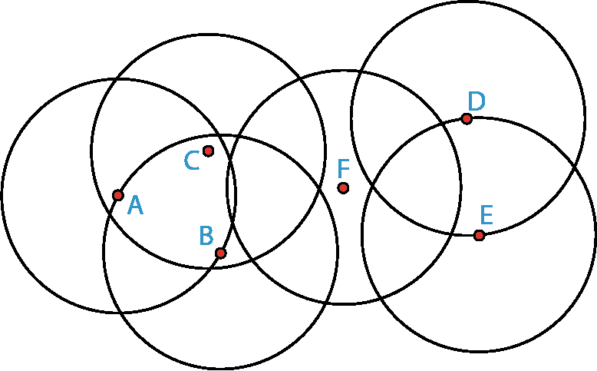
Activity E: Just the right number of circles
All these circles have a radius of 3 cm.
For parts a to f, decide whether these points are more than 3 cm apart, less than 3 cm apart or exactly 3 cm apart.
A and B
B and C
C and F
D and F
E and D
F and E
Point P is exactly 3 cm from D and exactly 3 cm from E.
Where could P be if it is also less that 3 cm from F?
How would your answer change if it was more than 3 cm from F?
Notes:
This slide is animated. Each question will appear separately so you can choose the pace at which to work with your class. A printable version can be found on slide 90.
Answers
a) A and B: exactly 3 cm apart
b) B and C: less than 3 cm apart
c) C and F: more than 3 cm apart
d) D and F: more than 3 cm apart
e) E and D: exactly 3 cm apart
f) F and E: more than 3 cm apart
? See the next slide for solutions.
Suggested questioning
What distances do you know?
What do you know about the point where two circles intersect?
Where is the centre of each circle? How do you know?
Are there any that you are not sure of? Why?
Things to think about
Much like Checkpoint 4, Activity E explores the relationship between centre, radius and circumference – this time, with a less visually overwhelming diagram. See the guidance slide for Checkpoint 4 for more information about assessment points.

Slide 66
Activity E: Just the right number of circles (solutions to further thinking question)
Point P is exactly 3 cm from D and exactly 3 cm from E.
x P
x P
How would your answer change if it was more than 3 cm from F?
Where could P be if it is also less than 3cm from F?

Slide 67
Activity F: Even more ripples
Circles are drawn around points X and Y. The smallest circle has a radius of 1 cm. Each new circle has a radius that is 1 cm bigger than the previous one.
For each of the points in parts a to f, state how far it is from points X and Y:
× F
× C
× B
X
× A
A
B
C
D
E
F
Y
× D
× E
Mark all the points where circles with the same radius intersect. What do you notice?
Notes:
This slide is animated. Each relevant part of the diagram will appear automatically with the relevant part of the rubric; each question will also appear separately so you can choose the pace at which to work with your class. A printable version of the image can be found on slide 86.
Answers
a) A is 3 cm from both X and Y.
b) B is 5 cm from X and 4 cm from Y.
c) C is 3 cm from X and 5 cm from Y.
d) D is 5 cm from both X and Y.
e) E is 3 cm from Y and more than 5 cm from X, but we do not know exactly how much.
f) F is 4 cm from X and more than 5 cm from Y, but we do not know exactly how much
? All the points form a straight line. This line is half way between X and Y and at right angles to the line that connects them. (Note that students are unlikely to know the term ‘perpendicular bisector’ unless it has been taught at Key Stage 3.)
Suggested questioning
What do you notice about the circles?
Show me a point that is closer to X than Y/further from X than Y/the same distance from X and Y.
Imagine a shape created using X, Y and two other points. What can you say about this shape?
Things to think about
The overlapping concentric circle image is used repeatedly throughout this deck: see also Checkpoints 7 and 18. While the diagram may at first appear overwhelming, the intention is to emphasise the structure that underpins ruler and compass constructions by making the circles visible. In this case, the focus is constructing perpendicular bisectors. Can you think of any other questions you could ask using this structure? This could be a useful thing to explore as a department, to help deepen subject knowledge around constructions, angles and properties of 2D.

Slide 68
Activity G: Circles
The line on the left is the radius of a circle.
Where is the centre of the circle? Where is the circumference?
How would your answers to part a change if the line was the diameter of the circle?
The line on the left is the arc of a circle.
Which of points A to D is the centre for the arc on the left? How can you check?
C
D
A
B
How might you find the centre of a circle if there was not one marked?
Notes:
This slide is animated. Each question will appear separately so you can choose the pace at which to work with your class.
Answers
a) The centre could be either end of the line. The circumference would be around the line with one point at the opposite end of the line.
b) The centre would be the middle of the line. The circumference would be around the line with a point at each end of the line.
c) C is the centre for the arc. You could check by measuring the distance from C to either end of the arc, as well as some points along the arc, and checking the distances are the same. You could also use a pair of compasses to draw the arc from C.
? Students’ strategies may vary but should demonstrate some understanding that they would need at least two lines that they were sure were diameters (i.e. the longest possible line they could draw within the circumference of the circle), and that the centre would be where these two lines intersect.
Suggested questioning
What is the difference between radius and diameter?
What is the relationship between the centre of the circle and radius/diameter?
Things to think about
Activity G checks basic understanding of the key features of a circle in preparation for understanding circles as loci. Radius, diameter and circumference should be familiar terms from primary school. Arc is a term that students might not have been experienced earlier in their education. Alternative tasks can also be found in the ‘Perimeter, area and volume 2’ deck.

Slide 69
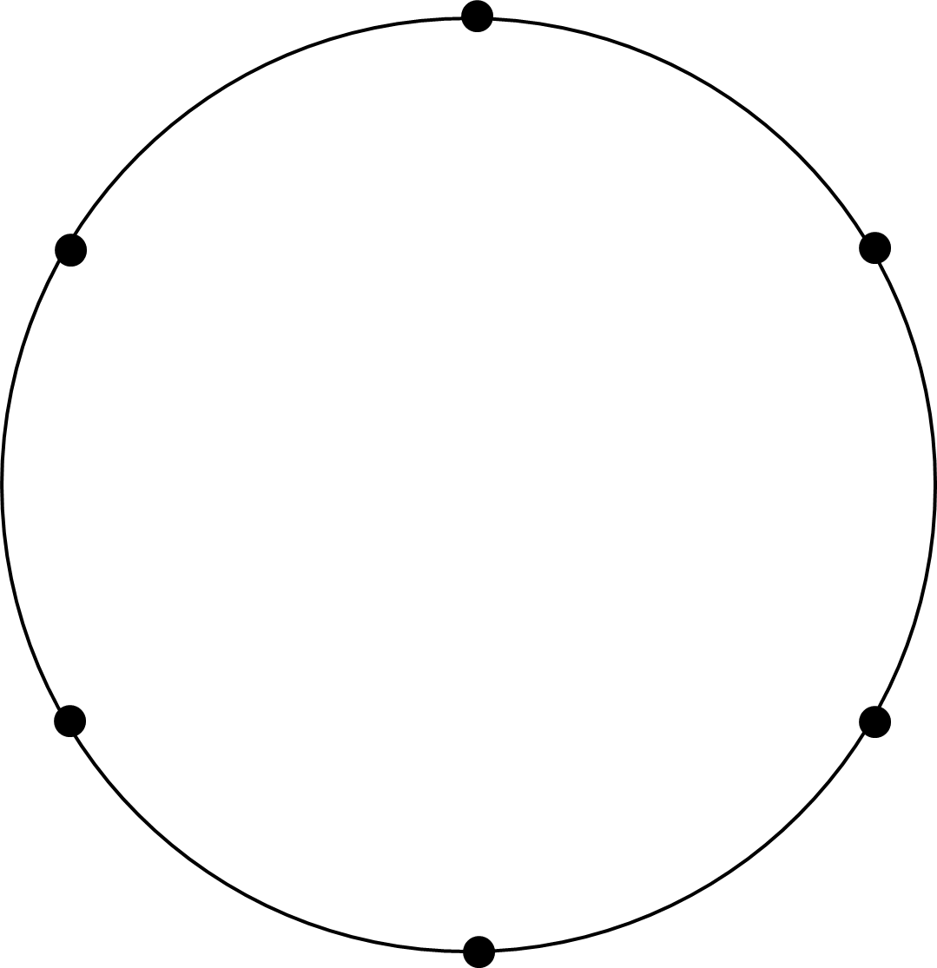
Activity H: Flower power
A
Six dots are equally spaced around the circle.
Polly uses one of the dots to draw this arc with a pair of compasses.
Which dot did she use? How do you know?
Polly uses another dot to draw a second arc. It touches but does not cross the first arc.
What does this tell you about the circles in the diagram?
What will happen if Polly draws an arc from every dot?
F
B
E
C
D
Use a pair of compasses and a six dotted circle to create your own ‘flower’. How will the image change if your arcs have a bigger radius than the main circle?
Notes:
This slide is animated. Each question and arc will appear separately so you can choose the pace at which to work with your class.
Answers
a) Dot E. We know this because all the other points are either on or outside the arc.
b) This tells us that all the arcs and circles have the same radius. If the radii of the arcs from B or E were bigger than the radius of the original circle, then they would cross rather than meeting at the centre.
c) A ‘flower’ would be formed, with six ‘petals’ formed by the overlapping arcs, all meeting at the centre.
? If your arcs have a bigger radius than the main circle, then it might be more challenging to get them to pass through adjacent points. They would also form a shape at the centre, rather than meeting at a point.
Suggested questioning
What do you know about the radius of the circle from E? How do you know this?
Could an arc with a larger radius go through both F and D? How about a smaller one?
Things to think about
Drawing flowers on a dotted circle is a common activity to practise ruler and compass skills. Activity H looks more deeply at what is going on to check students’ understanding of radius. It might be used alongside Checkpoint 5 or Activity G to draw out similar understanding.

Slide 70
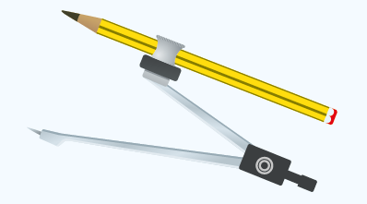
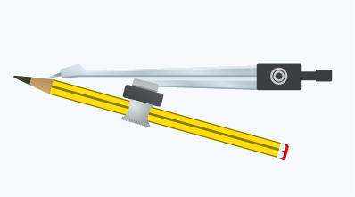
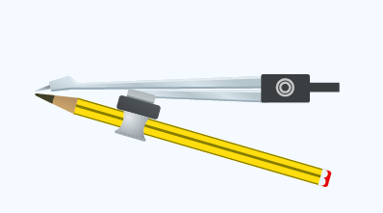
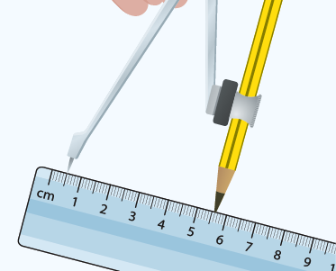
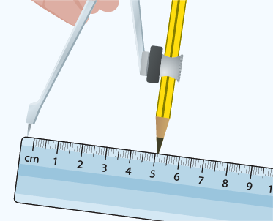
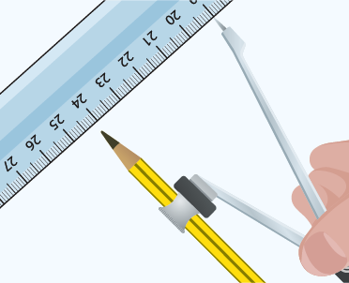
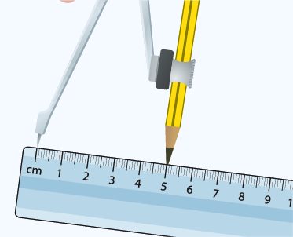
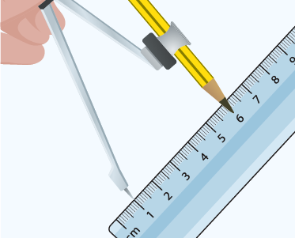
Activity I: Compass, pencil, ruler
Five students insert their pencils into a pair of compasses.
Danny
Jo
Scott
Emma
Owain
Which student is likely to be the most successful using their equipment? Why?
The students need to draw a circle with a diameter of 10.2cm.
Which students have set their equipment up most accurately?
Use a pair of compasses and pencil to draw some arcs and circles. What advice would you give to someone using them for the first time?
Notes:
This slide is animated. Each image, and then each question, will appear separately so you can choose the pace at which to work with your class. The names refer to the images in both parts a and b, so the image furthest to the left belongs to Danny and the image furthest right to Owain.
Answers
a) Scott will be most accurate, as he has aligned his compass point with a sharp pencil.
b) Danny has set his equipment up most accurately, although it would have been simpler to place the point on 0 cm; although Emma has done this, her compass is set to 5 cm rather than 5.1 cm. This might be a good opportunity to talk about accuracy in construction and how some leeway is given.
? Students’ advice may vary but might include not pressing too hard, or holding the compass in a way that doesn’t push the pencil out of the socket.
Suggested questioning
How does a pair of compasses work?
Why is it important to ensure the point of the compass and the pencil meet?
Why is it important for the pencil to be sharp?
Things to think about
The pair of compasses is a piece of equipment that students are unlikely to have used before Key Stage 3 as its use is not stated in the national curriculum for primary. Prior iterations of the national curriculum did include some compass use at Key Stage 2, so some primary schools may still have equipment available to students or have explored them in some way. This task is quite specific – it uses examples of common errors in setting up their equipment to check whether students have a sense of how to accurately prepare a compass for use. You might choose to use it to support new teaching on using a pair of compasses, potentially linked to Checkpoint 5 or Additional activities G or H.

Slide 71
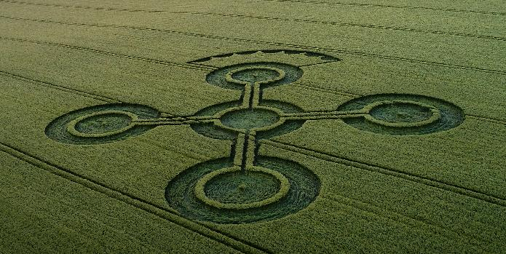
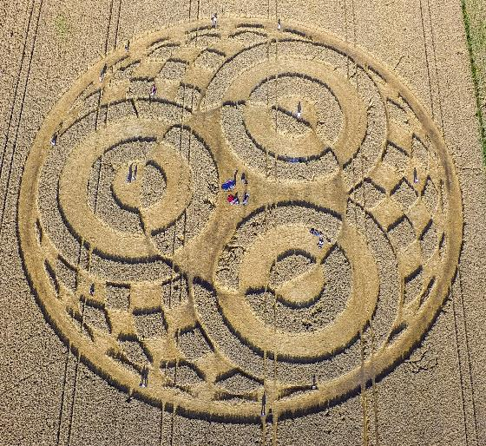
Activity J: Crop circles
a)
On the left are two different patterns of crop circles.
Use a pair of compasses and ruler to recreate each design as accurately as possible.
b)
Create your own crop circle design using only straight lines and arcs from a circle
Notes:
This slide is animated. The further thinking question will appear separately so you can choose the pace at which to work with your class.
Answers
a) and b) Students’ answers will vary and should be compared with the original image for accuracy.
? Students’ answers will vary in both creativity and accuracy!
Suggested questioning
Which circle will you draw first?
How many different radii/diameters can you see?
Approximately how many times bigger is the radius of __ circle compared with __ circle?
How will you draw the arcs that connect the four big corner circles? What might the radius/centre need to be?
Things to think about
Students need time to build confidence and accuracy with a pair of compasses. Additional activity J offers an opportunity to observe them doing this. Recreating the image will likely take more than the ten minutes usually suggested for main Checkpoint tasks. However, within ten minutes of watching students’ attempts you will gain a lot of assessment information about how well they use a pair of compasses and what further support they might need. Although this task is designed to be used at the beginning of their work with compasses, there also is value to offering such challenges once students have been taught formal ruler and compass constructions, such as angle and line bisection. Asking students to create specific angles without a protractor can be a way of stimulating some deeper thinking around construction. For example, ask students if, using only a straight edge and a pair of compasses, it is possible to create an accurate square.

Slide 72
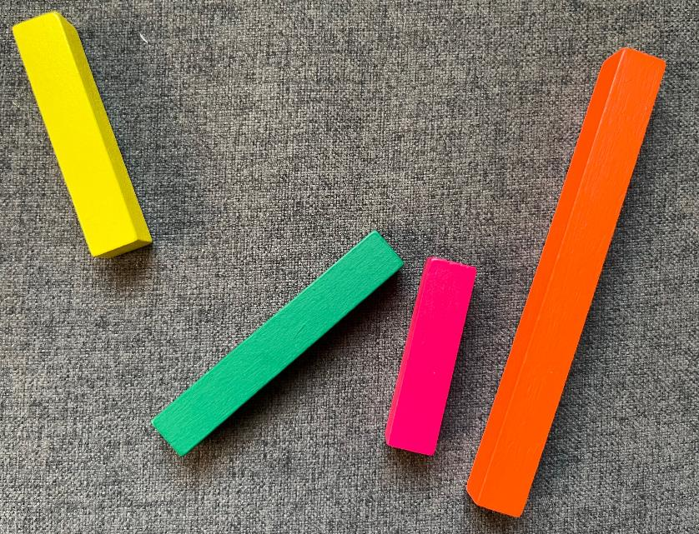
Activity K: Making triangles
Caleb has some coloured rods.
The yellow rod (Y) is half the length of the orange rod (O).
Caleb uses the rods to make triangles.
How many different triangles can Caleb make? How do you know?
Y
O
G
P
Madeleine swaps the pink rod (P) for a second orange rod (O) which is the same length as the first orange rod. How many more or fewer triangles can Madeleine make than Caleb?
Notes:
This slide is animated. Each paragraph, and then the further thinking question, will appear separately so you can choose the pace at which to work with your class.
Answers
Caleb can make two different triangles: pink, green, yellow; and green, yellow, orange. This is because the yellow rod can only be used with the orange rod when the other rod is greater than half the length of the orange rod.
? Madeleine can now make a total of four triangles: orange, orange, green; orange, orange, yellow; pink, green, yellow. So Madelaine can make one more than Caleb.
Suggested questioning
Is the __ rod longer or shorter than the yellow rod?
If the yellow rod is only half the length of the orange rod, when can it be used to make a triangle with the orange rod?
Things to think about
Additional activity K uses a common classroom manipulative – Cuisenaire rods – to explore the same ideas as Checkpoint 6. Students may benefit from being able to physically arrange rods, as it will help them to visualise the lengths that can create triangles, particularly where one length is less than or equal to half of the longest length. The act of placing two ends together and rotating them to meet the third rod also mimics the motion of a pair of compasses drawing an arc that will be used in formal construction. However, there is a challenge to using a 3D representation (the rod) of a 1D thing (the line). If you choose to use this representation, you need to be sure that it will not cause more confusion than support. Pre-empt some issues by being clear that the vertices of the rods must meet without overlap, and that the triangle formed is on the ‘inside’ of the touching rods, not the ‘outside’.

Slide 73
Activity L: Zipline
At the park, there is a zipline. At either end of the zipline, there is a ball that stops the seat from sliding any further.
A child rides on the zipline.
Which of paths A to D shows what happens to the seat at the end of the zipline?
A
B
C
D
Draw the whole path of the seat on the zipline, from start to finish.
In the park, there is also a swing, slide and roundabout. Draw the path that the child would take on one of these.
Notes:
This slide is animated. Each question will appear separately so you can choose the pace at which to work with your class.
Answers
a) Path C.
b) A path similar to C, but with an arc at the start as well. The path might not be symmetrical. Students might reasonably argue that one or other end of the zipline ride is higher.
? Students’ answers will vary and should be checked individually.
Suggested questioning
What is the same and different about each possible path?
Which are impossible? Which are unlikely?
When you are on a zipline, which path does it feel most like? Should we change any of the paths to be more realistic?
Things to think about
Additional activity L builds on the potentially counter-intuitive Checkpoint 12, and offers another familiar situation which takes a part-circular path. Unlike the paths for the see-saw, those for the zipline are simplified. The child will not travel entirely horizontally, as the zipline wire is not rigid, so there should also be a slight arc towards the ground across the middle of the zipline. An alternative to the further thinking question might be to ask students to draw a more accurate path for the zipline.

Slide 74
Activity M: Mastery
This is a map of Cornwall. The grid shows 5 km squares.
A mobile phone mast sends a good signal 10 km in every direction.
Where would you position masts to ensure that as much of Cornwall as possible has a good signal?
Is there another way to position masts?
What is the smallest number of masts needed?
Notes:
This slide is animated. Each paragraph, and then the further thinking question, will appear separately so you can choose the pace at which to work with your class. A printable version of the map, for students to annotate, can be found on slide 88.
Answers
Students should position masts so that there are as few gaps as possible. See next slide for one possible solution.
? There are multiple possible ways to complete this task. Ten masts is the minimum for no gaps (see slide 75 for an example with nine masts).
Suggested questioning
Where will you place your first mast? Why?
Where is the most efficient place to place a mast to cover (for example, Lizard or Porthcurno)?
Is it possible to place the masts so that there is no overlap in signal and no gaps? Why not?
Things to think about
Activity M, like Checkpoint 11, asks students to consider the regions within a certain radius of a point. Ask students to articulate their thinking as they position their masts. Is it possible to arrange the masts with no overlap? Why might we want to minimise the overlap? As for other real-life situations, there is a degree of simplification here. The geography of the landscape and whether points are an appropriate elevation for a phone mast are not considered. If you use both contexts with students, discuss which is a more realistic representation of real life.

Slide 75
Activity M: Mastery (possible solution with 10 masts)
This is a map of Cornwall. The grid shows 5 km squares.
A mobile phone mast sends a good signal 10 km in every direction.
Where would you position masts to ensure that as much of Cornwall as possible has a good signal?
Notes:
This shows a solution with complete coverage, using the minimum of 10 masts.

Slide 76
Activity M: Mastery (solution with nine masts)
This is a map of Cornwall. The grid shows 5 km squares.
A mobile phone mast sends a good signal 10 km in every direction.
Where would you position masts to ensure that as much of Cornwall as possible has a good signal?
Notes:
This shows a possible near-solution, demonstrating the gaps that are formed when only nine masts are used.

Slide 77
Activity N: Race to the middle
Mr Locke’s class are taking part in an unusual race. The winner is the first to stand in the circle in the middle of the playground.
The students line up to start the race along one edge of the playground.
Is this race fair? Why or why not?
How could you make this race fairer?
How would your answer to part b change if the finish shape looked like the shape on the right instead of a circle?
Notes:
This slide is animated. Each question will appear separately so you can choose the pace at which to work with your class.
Answers
a) No, the race is not fair as those towards the corners of the playground have further to run than those in the middle of the starting line along the edge.
b) The race could be fairer by making the finish line parallel to and the same length as the starting line. Alternatively, students could start in a circle of fixed radius from the finish circle.
? If the finish looked like the shape given, then the race would need to be made fairer by changing the start arrangements. For the rectangle, students could line up equidistant and parallel to one of the sides, or in a quarter-circle arc around one of the vertices.
Suggested questioning
Why is this race unfair?
Where on the starting line would be furthest from the finish? Where would be closest?
Can you think of a better shape for the finish?
Things to think about
Additional activity N has a similar premise to Checkpoint 13, and could either be used as an alternative task or to revisit the concept. See the guidance on slide 39 for information about the key assessment points and what prior knowledge students may have. You might like to link this to a real-life athletics track and demonstrate how, over distances that use the curve of the track, the athletes starting points are staggered to ensure they all race over the same distance.

Slide 78
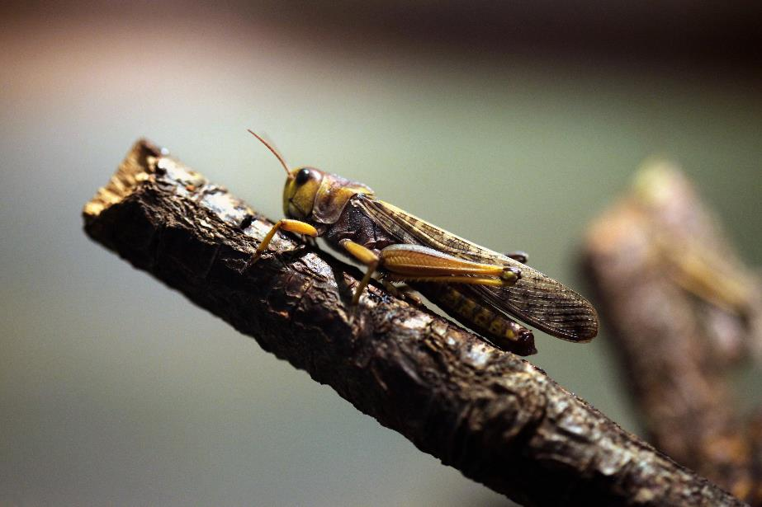
Activity O: Locust
A locust walks along a twig.
Sketch a diagram to show its path.
At the end of the twig, the locust climbs over the end so that it is upside down and then crawls along the other side of the twig.
Sketch a diagram to show its path.
What assumptions have you made?
Imagine the locust jumped from the end of the stick to the ground. What might that path look like? How would your answer change if it jumped to another stick?
Notes:
This slide is animated. Each question will appear separately so you can choose the pace at which to work with your class.
Answers
a) Students’ responses may vary slightly, but should include some kind of representation for the stick (for example, a line) and a representation for the path of the locust (for example, a line parallel to the original line).
b) The parallel line for part b should show the line from part a continuing to the end of the line representing the stick. At this point, an arc should be drawn around the point and another, parallel line drawn underneath.
c) Using the descriptions above, we have assumed that the locust can be modelled as a single point (perhaps referring to one part of the locust, such as the eye) and that there are no up-and-down motions as the locust walks. Students may have made further assumptions based on their own diagrams.
? Students’ responses will vary but should demonstrate an understanding that the path will be curved and likely involve some upwards movement first, rather than straight down to the ground. For the second part of the question, students should show that they have thought about how the arc might change based on the height of the second stick.
Suggested questioning
Is there more than one possible answer?
What is the simplest way to represent the movement? What is the most accurate?
What happens at the end of the twig? What shape is formed around the end?
Things to think about
Additional activities N, O and P are similar to those Checkpoints and activities that try to explore a simple context to see if students can recognise the shapes that might be created. Like Checkpoint 12 and Additional activities L and P, the added challenge here is that students are not imagining a static situation but the path of an object in motion. The intention here is not that students will be able to answer correctly at this stage – indeed, they are unlikely to reach for a pair of compasses to draw an arc without some teaching at Key Stage 3 – but to see how instinctively they can think about the path that is created when an object moves. Students may come up with different answers based on how they think the locust will move. Compare their solutions: which is the most realistic? Which is the simplest to construct?

Slide 79
Activity P: Blue stick
A blue stick is leaning against a wall, as shown in the diagram to the left.
The centre of the stick is marked by the orange dot A.
As the blue stick slides down the wall, what path does the orange dot A follow?
How about the red dot B between the middle and the top of the stick?
How about the yellow dot C between the middle and the bottom of the stick?
B
A
C
Is there any point on the stick that takes a straight path? How do you know?
Notes:
This slide is animated. Each question will appear separately so you can choose the pace at which to work with your class.
Answers
a), b) and c) See solutions on the next two slides – slide 80 is static and 81 is animated to show the moving paths.
? The top of the stick takes a straight, vertical path down the wall and the bottom of the stick takes a straight, horizontal path along the floor.
Suggested questioning
What is the same and what is different about how each point moves?
Which point moves most like the arc of a circle? How do you know?
Things to think about
Like Additional activity O, activity P looks at whether students can visualise a path in motion. The situation here could easily be recreated in a classroom using a metre stick and some pens. Can students draw on the board what the path will look like? Can you check using a metre stick with the points marked on?

Slide 80
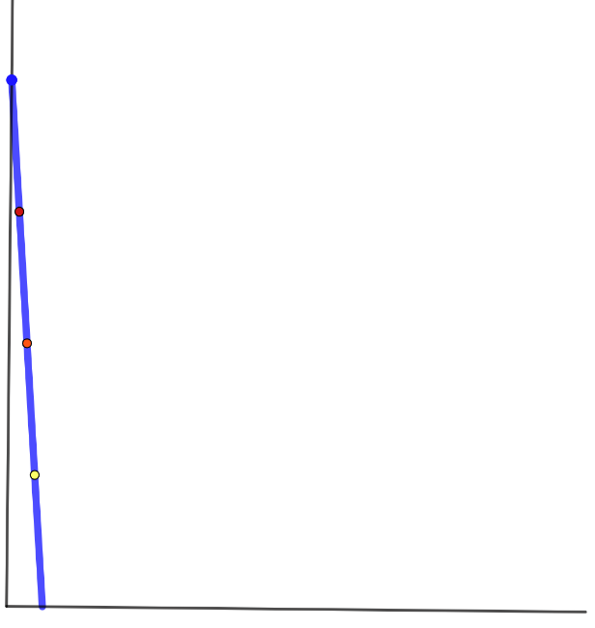
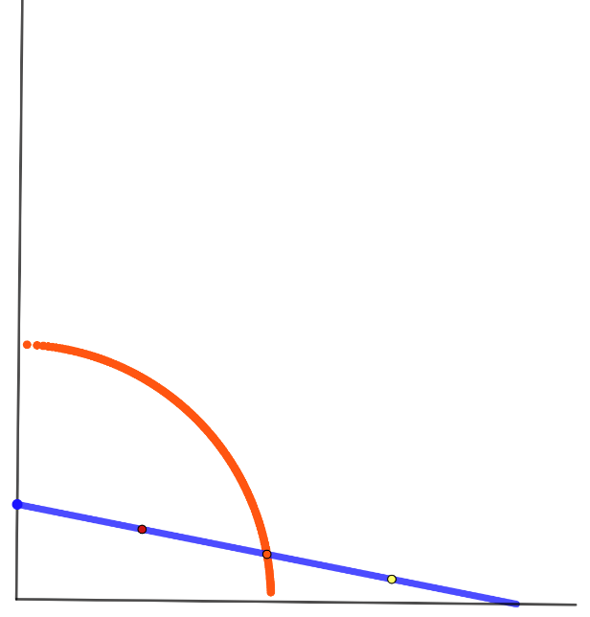
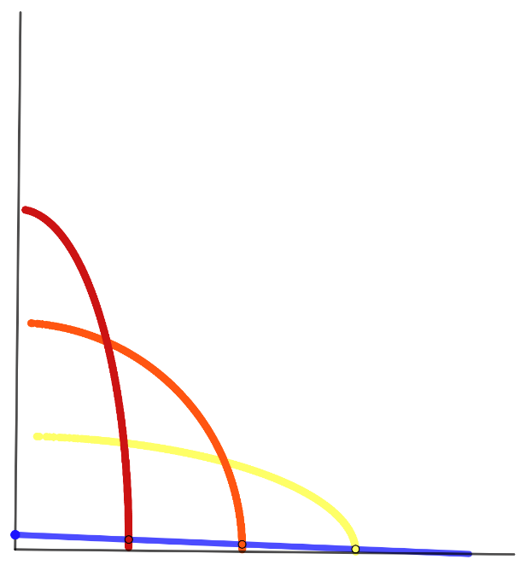
Activity P: Blue stick (solutions)
Path of the orange dot A.
Path of the red dot B.
Path of the yellow dot C.
B
A
C
B
A
C
B
A
C
Notes:
This slide is animated. The solution to part a appears first, and then the solution to parts b and c.

Slide 81
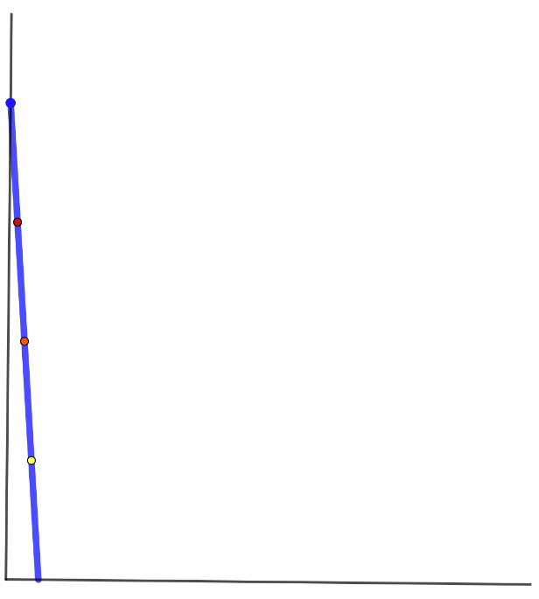
Activity P: Blue stick (animated solutions)
B
A
C
Notes:
This slide is animated. The image to the right is a video that can be played to show the stick in motion, leaving the paths visible.

Slide 82
Printable resources

Slide 83
Notes:
This image (three on a page) can be used with Checkpoint 3.

Slide 84
Notes:
This image (two on a page) might help students to unravel Checkpoint 4.

Slide 85
W
W
X
X
B
B
A
A
C
C
D
D
Z
Y
Z
Y
Notes:
This is a printable version of Checkpoint 5 (two on a page). The arcs are drawn accurately (5 cm radius) so be careful to amend the radii given in the task if you choose to print to a different scale.

Slide 86
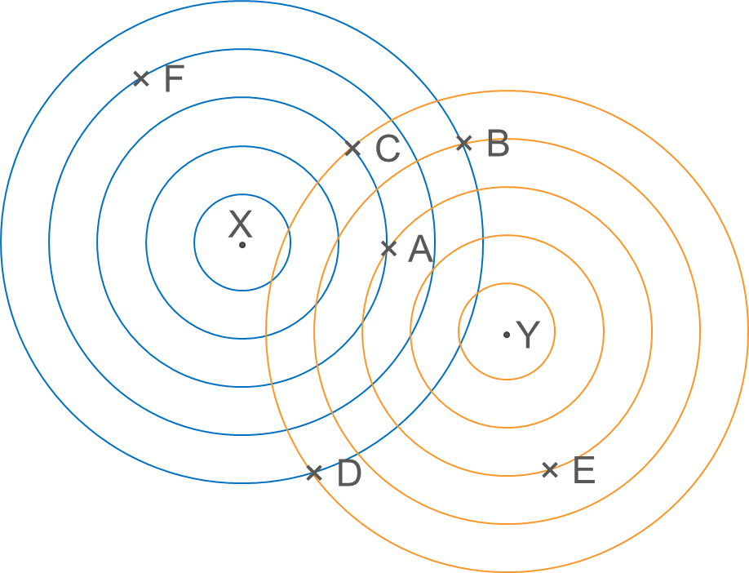
Notes:
This image (two on a page) is for use with Checkpoints 7 and 18, as well as Additional activity F. For Checkpoints 7 and 18, students will need to join points X and Y with a straight line.

Slide 87
X
Y
X
Y
X
Y
X
Y
Notes:
This image (four on a page) is from Checkpoint 8.

Slide 88
Notes:
This map (two on a page) can be used with Checkpoint 11 and Additional activity M.

Slide 89
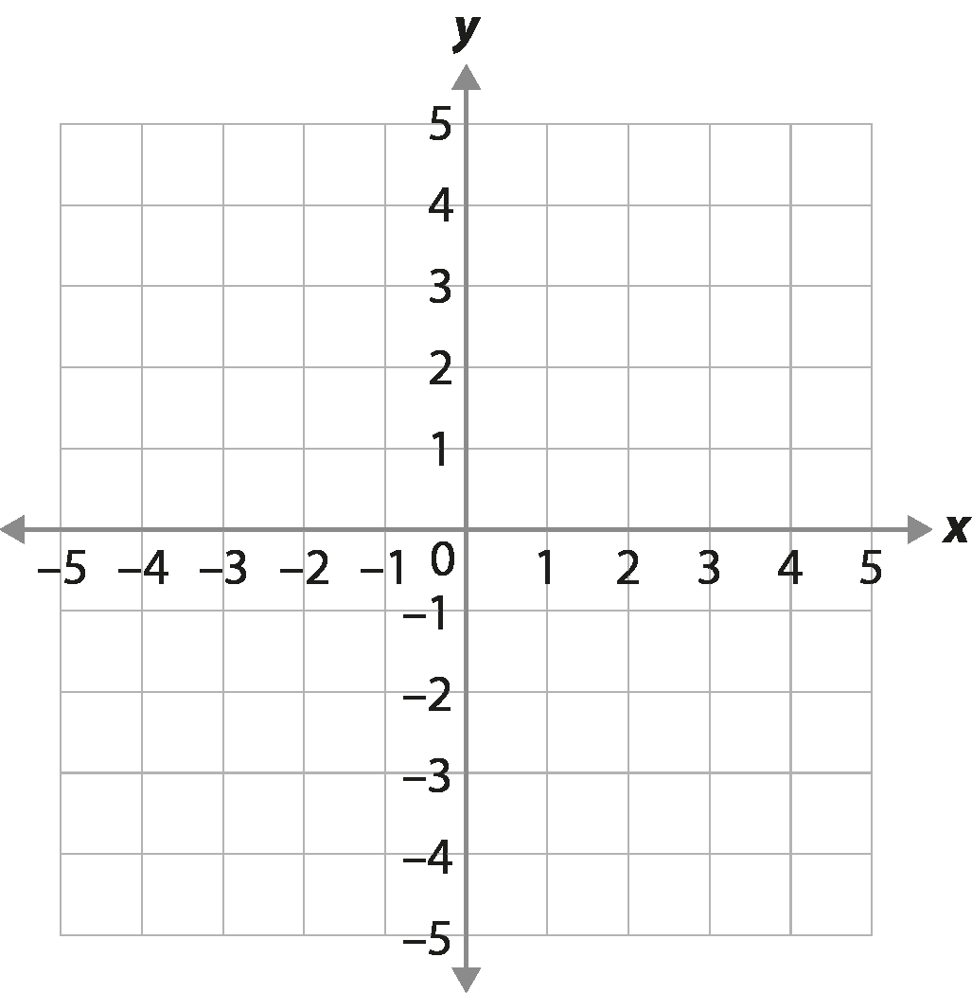
K
G
H
I
J
L
N
F
Q
M
B
C
O
P
E
A
D
Notes:
This version of the image in Checkpoint 17 is editable, so you can remove some branches for Support if you choose to.

Slide 90
Notes:
This is a printable version (two on a page) of the image in Additional activity E.

Slide 91
Image acknowledgements
Images on slides 17, 26, 30, 32, 33, 37, 38, 48 (grid only), 65, 66, 70, 74, 75, 76, 84, 87, 88, 89 (grid only) and 90: credit – Steve Evans.
Images on slides 28, 71 and 78: credit – Shutterstock.
All other images taken or created by Richard Perring and Becky Donaldson.

