Slide 1
Numberblocks
Support Materials
Episode 14
Holes

Slide 2
Practitioner Notes

Slide 3
Episode Description
Five is going for a walk (five birds are also flying behind her) and a large boulder blocks her path. The birds settle in the tree. Next to the boulder a sparkly hole can be seen. As Five leans over to peer in, One falls off and down the hole. As One falls off Five we see the calculation 5 – 1 = 4. Four is now shown and is concerned as to where Five has gone. One bird also flies from the tree on the left, over the boulder to the tree on the right. Four peers down the hole and One falls off. This pattern is repeated throughout the episode. As the number on the right-hand side of the boulder increases we see the addition calculation to show the mathematics. At the end a generalisation is made – every time we get 1 smaller someone else is getting taller.

Slide 4
Maths in the Episode
Quantities can be changed by adding or taking away
In this episode we see the same amount being decomposed into different amounts by taking one away each time.
Adding 1
In this episode children will see how adding 1 to a quantity produces an amount that is the next number in the counting sequence. This is an important step in developing understanding of the relationship between consecutive counting numbers.
Number Bonds to 5
This episode will help children to understand the composition of 5 and develop fluency in all the bonds that form 5, i.e. 1 and 4, 2 and 3, 3 and 2 , 4 and 1.

Slide 5
Using Mathematical Language
Encourage children to use this phrase to explain their thinking:
“First there was ______. Then _____ . Now _______”
e.g. “First there was a tower of five cubes. Then one cube fell into the hole. Now there is a tower of four cubes.”
Encourage children to describe the composition of 5 using more generalised language:
“Five is made of four and one.”
“Four and one is five.”
“Five subtract one is four.”

Slide 6
Talk and Discuss Together

Slide 7
Talk and Discuss Together
Watch the episode of Numberblocks. First ask the children what they noticed and allow them to talk to you and each other. The following slides are designed to stimulate children and adults to talk about the episode and draw out some key aspects of the mathematics.

Slide 8
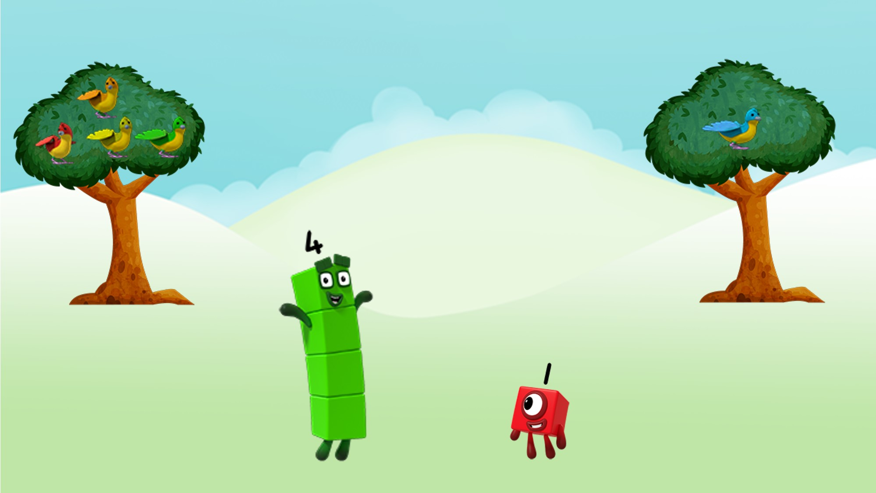
Where, oh where is Five?
Images © 2017 Alphablocks Ltd. All Rights Reserved.
Notes:
Chant “Where, oh where is Five?”
Look at the picture.
Where is Five?
Notice there are 4 birds in the left-hand tree and 1 bird in the right-hand tree.
Separate 5 children to represent the birds in the trees.
“5 is made of 4 and 1 “
“4 and 1 is 5”
Focus on the two Numberblock characters.
Ask what would happen if these two Numberblocks were to combine.
“Four and One together make Five.”
“Four and One is Five.”
Ask children to show you using linking cubes.

Slide 9
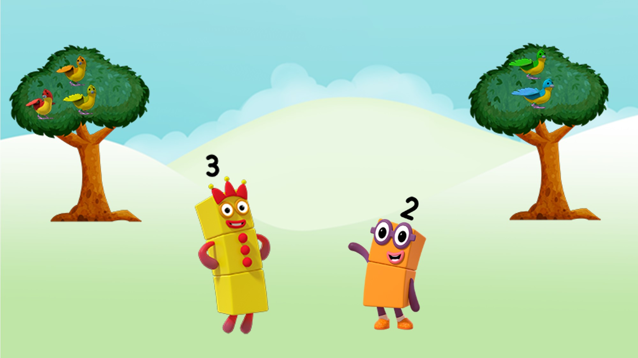
Where, oh where is Five?
Images © 2017 Alphablocks Ltd. All Rights Reserved.
Notes:
Chant “Where, oh where is Five?”
Look at the picture.
Where is 5?
Notice there are 3 birds in the left-hand tree and 2 birds right-hand tree.
Separate 5 children to represent the birds in the trees.
“5 is made of 3 and 2”
“3 and 2 is 5”
Focus on the two Numberblock characters.
Ask what would happen if these two Numberblocks were to combine?
“Three and Two together make Five.”
“Three and Two is Five.“
Ask children to show you using linking cubes.

Slide 10
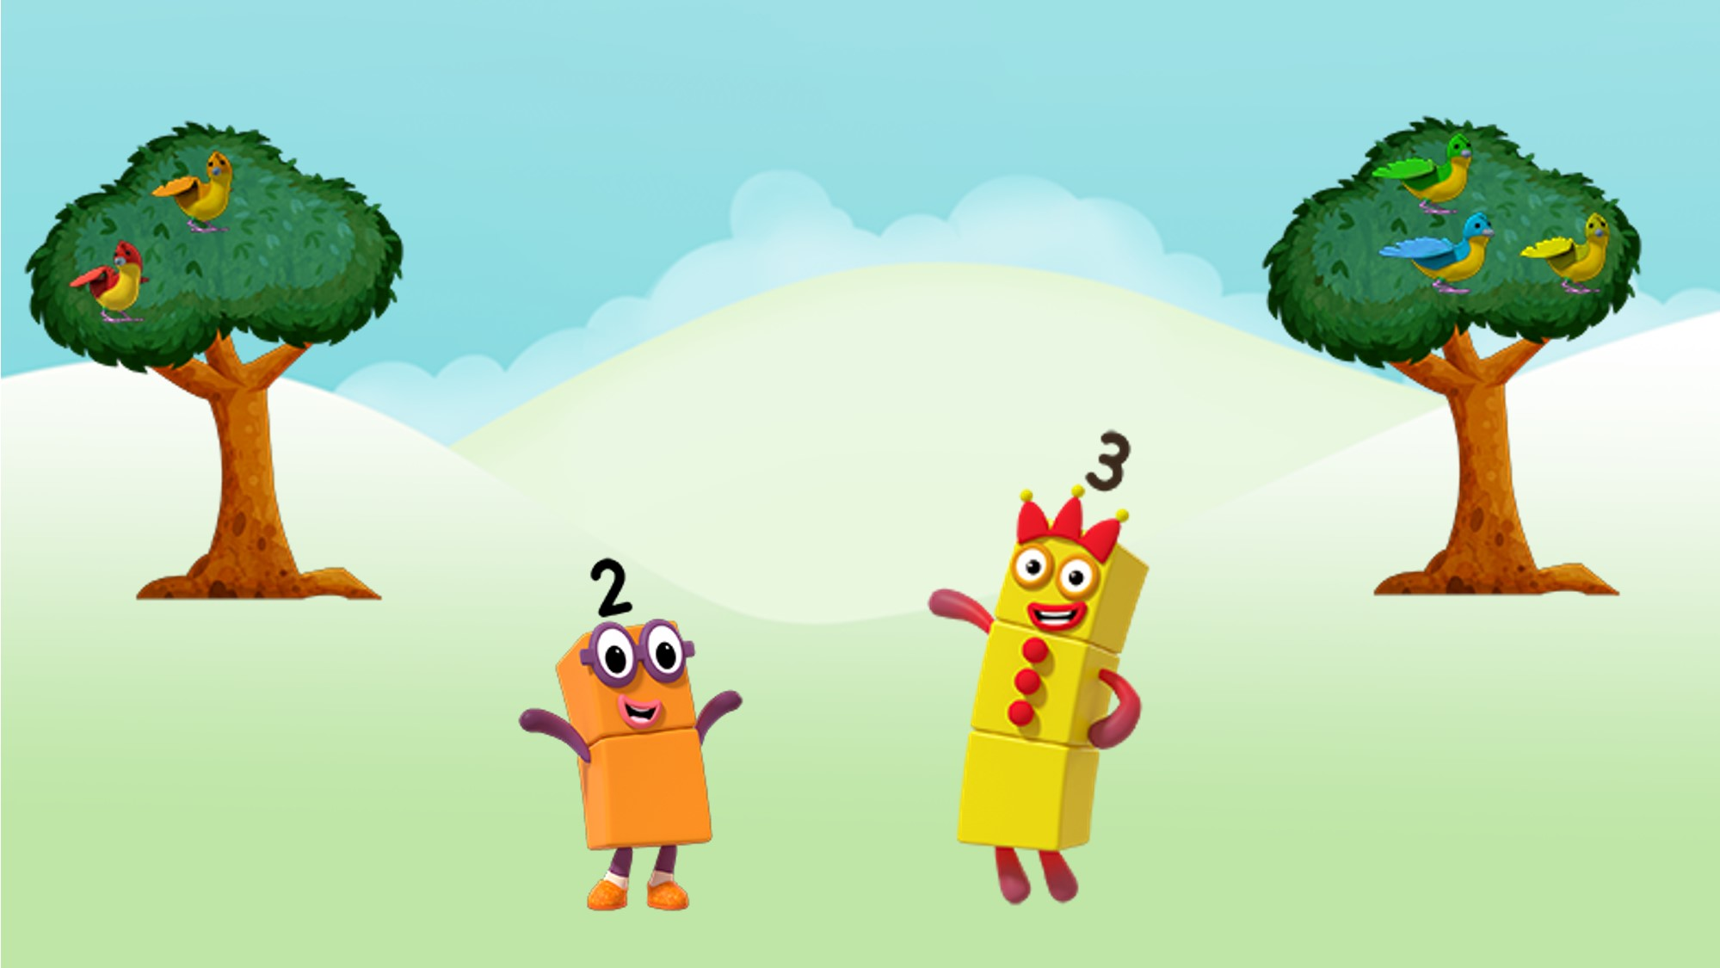
Where, oh where is Five?
Images © 2017 Alphablocks Ltd. All Rights Reserved.
Notes:
Chant “Where, oh where is Five?”
Look at the picture.
Where is 5?
Notice there are 2 birds in the left-hand tree and 3 birds right-hand tree.
Separate 5 children to represent the birds in the trees.
“5 is made of 2 and 3“
“2 and 3 is 5”
Some children may notice that the combination is the same as the previous. Respond with ‘That’s interesting, I wonder if that can happen with other parts of 5?’
Focus on the two Numberblock characters.
Ask what would happen if these two Numberblocks were to combine?
“Two and Three together make Five.”
“Two and Three is Five.”
Ask children to show you using linking cubes.

Slide 11
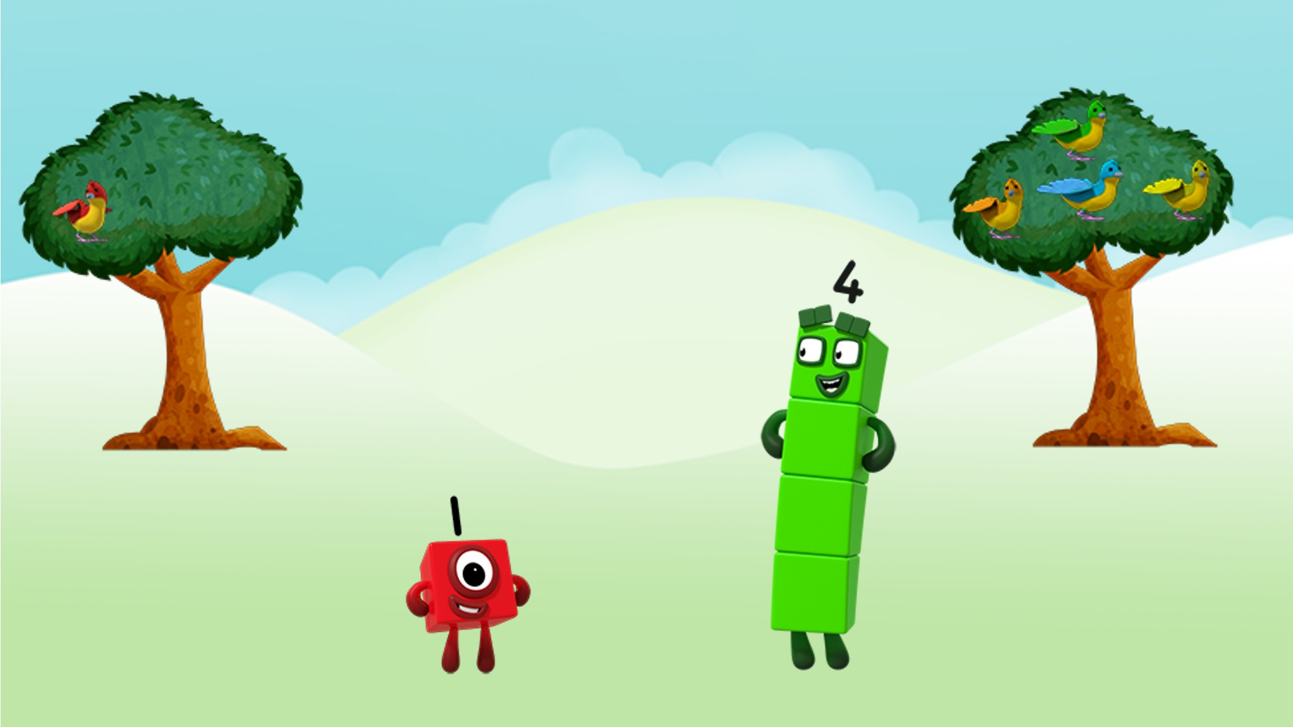
Where, oh where is Five?
Images © 2017 Alphablocks Ltd. All Rights Reserved.
Notes:
Chant “Where, oh where is Five?”
Look at the picture.
Where is 5?
Notice there is 1 bird in the left-hand tree and 4 birds right-hand tree.
Separate 5 children to represent the birds in the trees.
“5 is made of 1 and 4“
“1 and 4 is 5”
Some children may notice that the combination is the same as 4 and 1. Respond with ‘That’s interesting, I wonder if that can happen with other parts of 5?’
Focus on the two Numberblock characters.
Ask what would happen if these two Numberblocks were to combine?
“One and Four together make Five.”
“One and Four is Five.“
Ask children to show you using linking cubes.

Slide 12
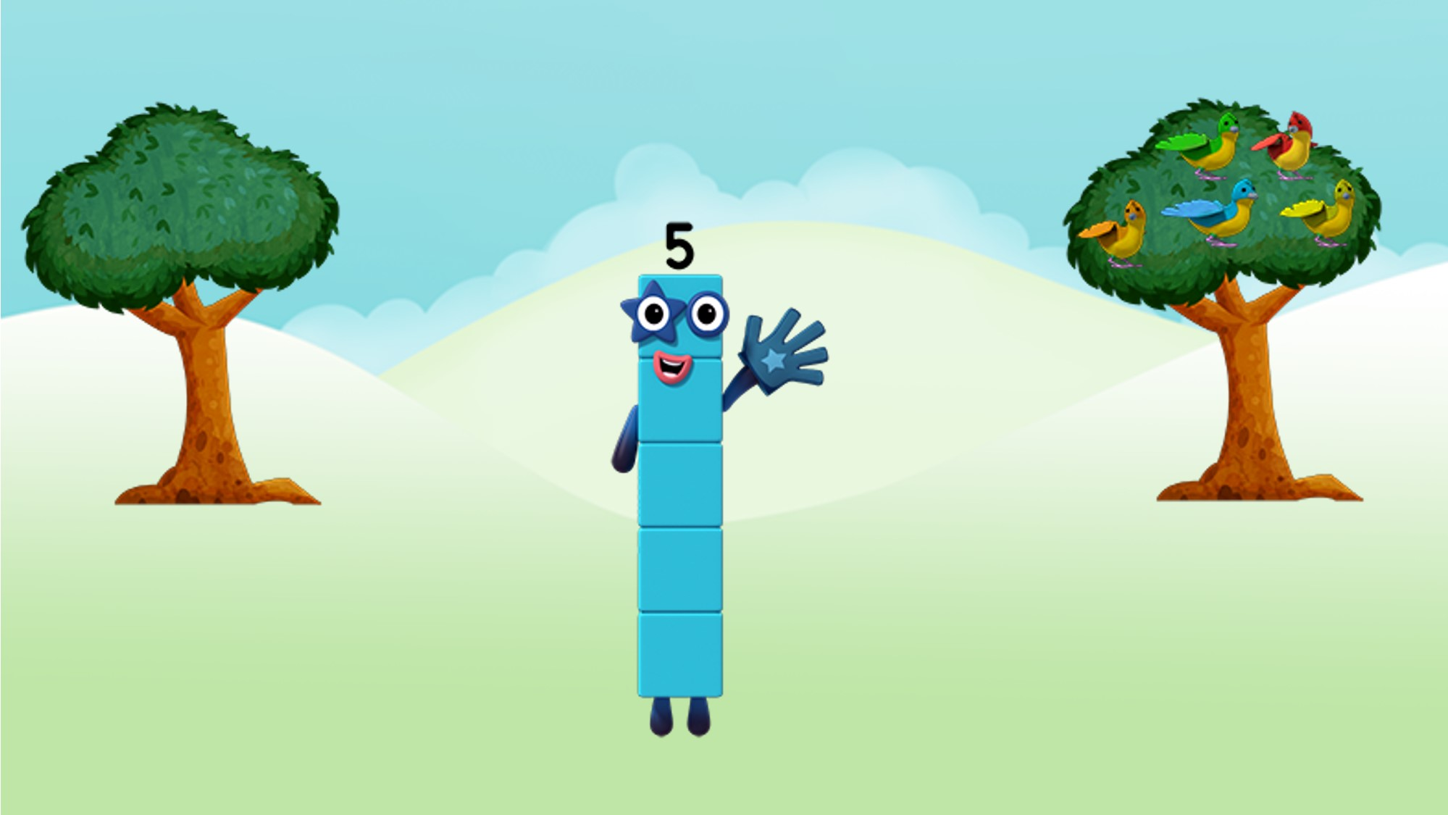
Where, oh where is Five?
Images © 2017 Alphablocks Ltd. All Rights Reserved.
Notes:
Chant “Where, oh where is Five?”
Look at the picture.
Where is 5?
Notice there are no birds in the left-hand tree and 5 birds in the right-hand tree.
Separate 5 children to represent the birds in the trees.
“Five is made of Zero and Five“
“Zero and Five is Five“
Focus on the Numberblock character – only one Numberblock character this time to represent 5.

Slide 13
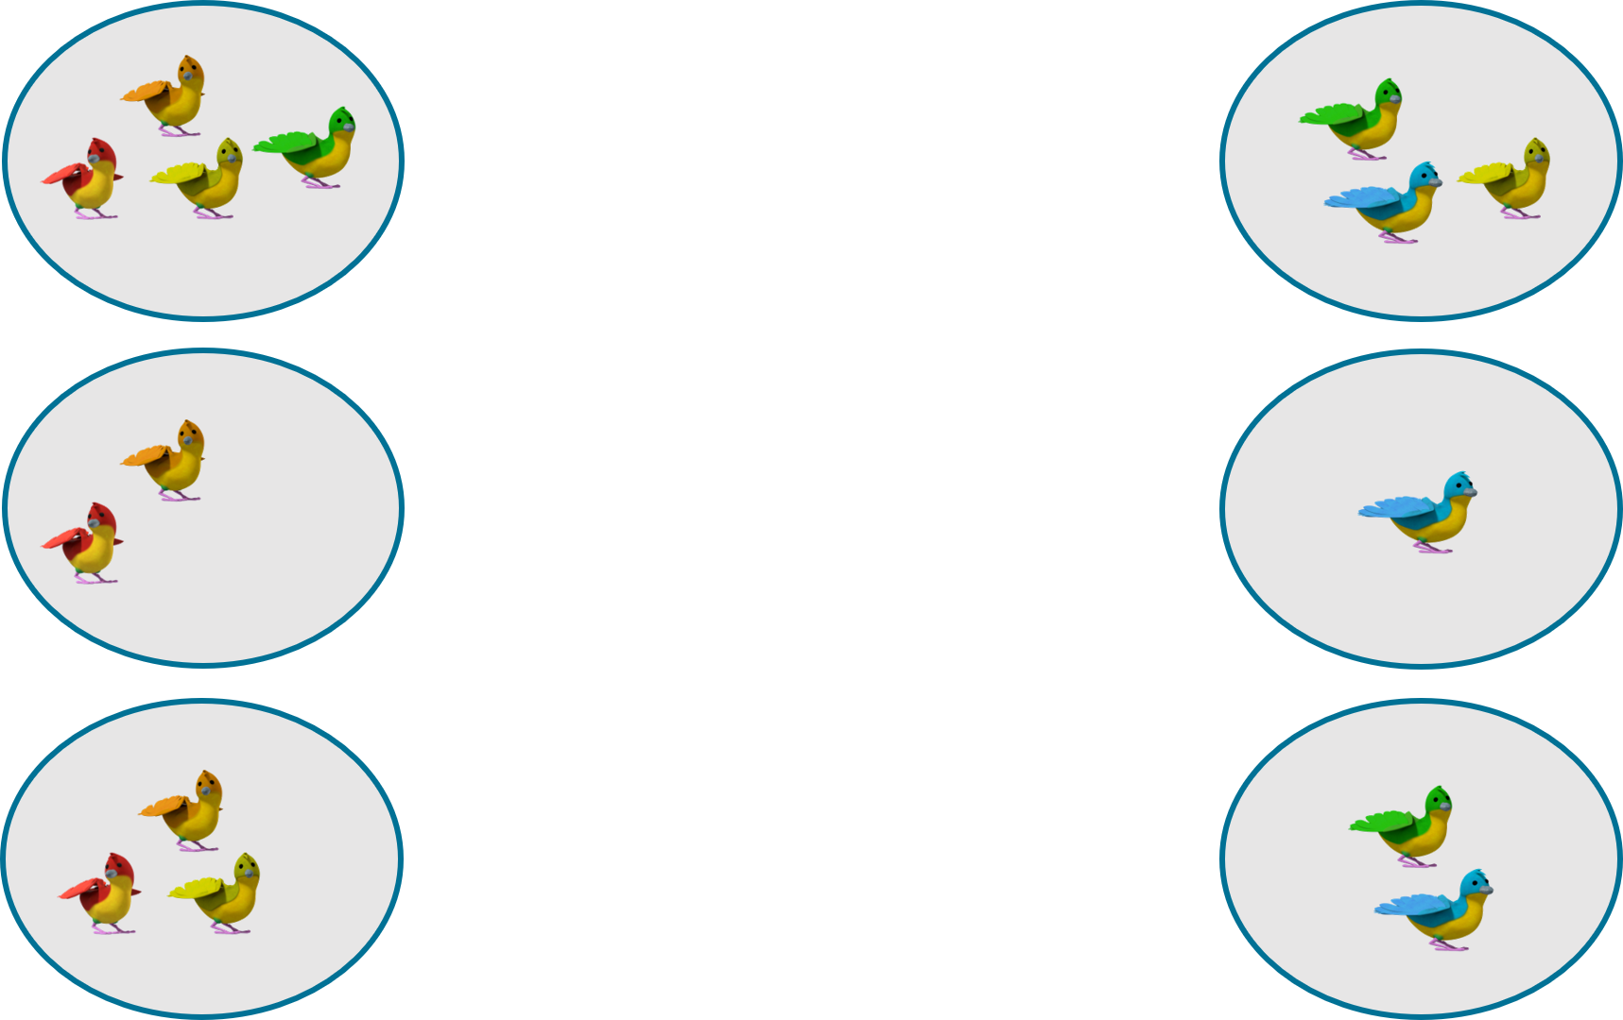
Where, oh where is Five?
Images © 2017 Alphablocks Ltd. All Rights Reserved.
Notes:
This slide is animated:
Ask the children “What do you notice?”
Ask the children to discuss how each picture on the left has a partner on the right.

Slide 14
Enabling Environments

Slide 15
Enabling Environments
Playing and Exploring
Fill a bag of Numberblocks made with linking cubes. Play a game to take out two Numberblocks and combine the two Numberblocks to make 5. If they make 5 the children keep it. First player to make 3 5s is the winner.
Active Learning
Notice how the children partition 5 and other numbers into two sets during their play when they identify a purpose for it.
Creating and Thinking Critically
Collect groups of 5 objects to separate into two parts. Find all the ways to partition 5 using different combinations

Slide 16
Learning Together in Y1

Slide 17
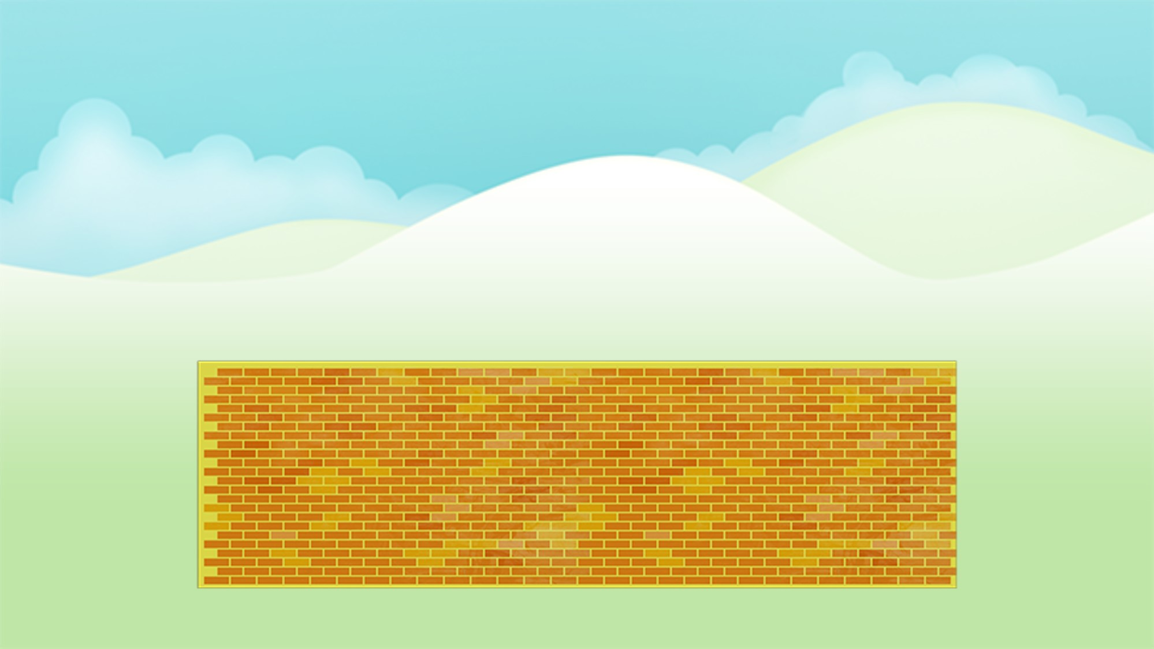
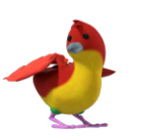
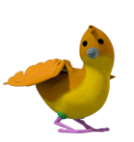
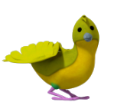
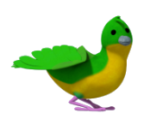
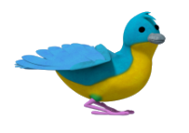
Images © 2017 Alphablocks Ltd. All Rights Reserved.
Notes:
This slide shows 5 birds sitting on a wall. Identify how many birds can be seen.
This and the following slides are animated, with birds flying on and off the wall. Children should describe:
How many birds are on the wall?
How many birds are off the wall?
How many birds are there all together?

Slide 18
Images © 2017 Alphablocks Ltd. All Rights Reserved.

Slide 19
Images © 2017 Alphablocks Ltd. All Rights Reserved.

Slide 20
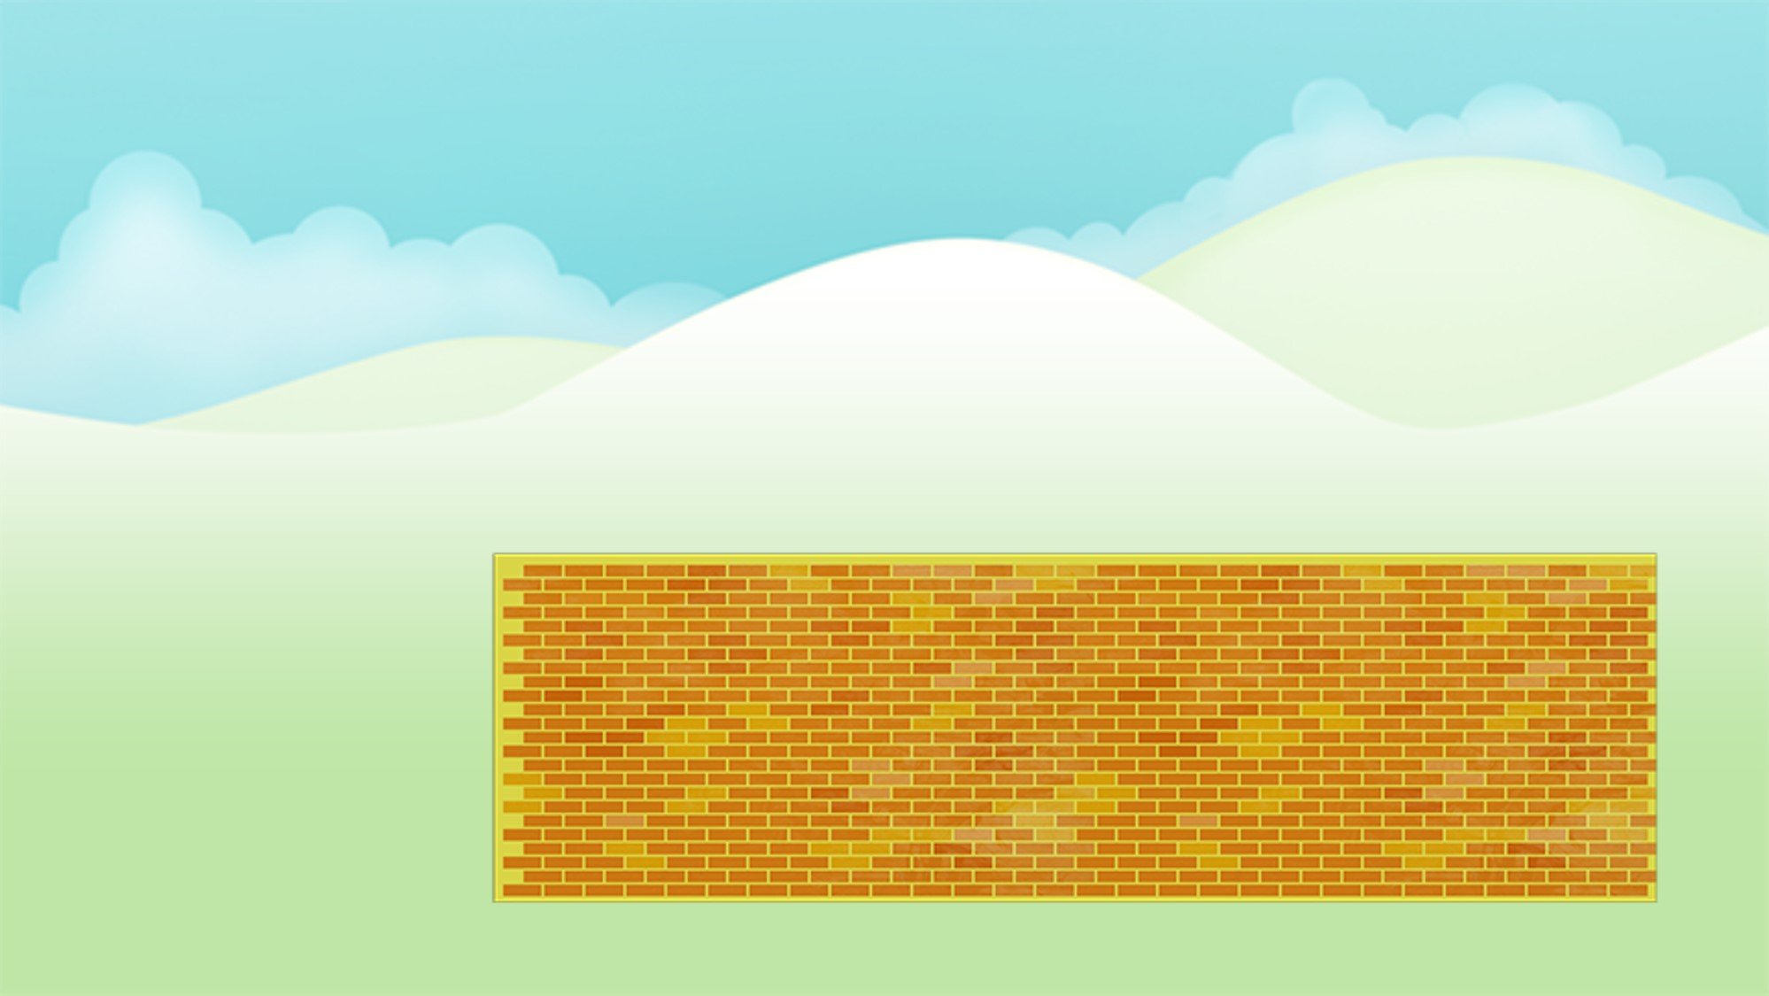





First there were 5 birds on the wall.
Then ____ bird flew off the wall.
Now there are _____ birds on the wall.
Images © 2017 Alphablocks Ltd. All Rights Reserved.
Notes:
This slide shows 5 birds sitting on a wall. Identify how many birds can be seen.
This and the following slides are animated as birds fly on and off the world.
Stem sentences describe each situation and support the construction of an equation.
Ask children to explain what each number represents in each equation.

Slide 21


First there were 5 birds on the wall.
Then ____ birds flew off the wall.
Now there are _____ birds on the wall.
Images © 2017 Alphablocks Ltd. All Rights Reserved.

Slide 22
First there were 5 birds on the wall.
Then ____ birds flew off the wall.
Now there are _____ birds on the wall.
Images © 2017 Alphablocks Ltd. All Rights Reserved.

Slide 23
First there were 5 birds on the wall.
Then ____ birds flew off the wall.
Now there is ____ bird on the wall.
Images © 2017 Alphablocks Ltd. All Rights Reserved.

Slide 24
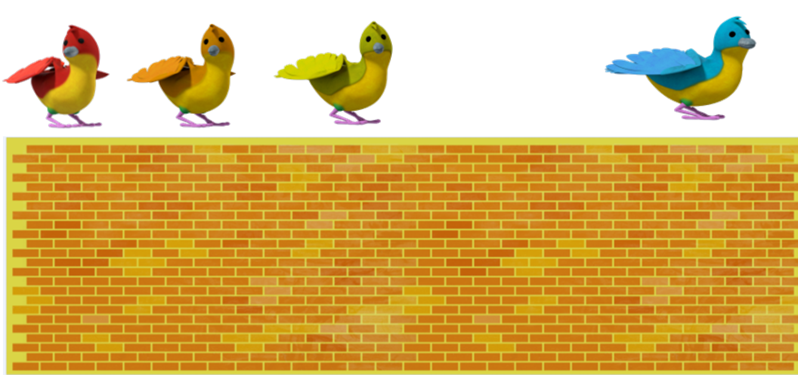
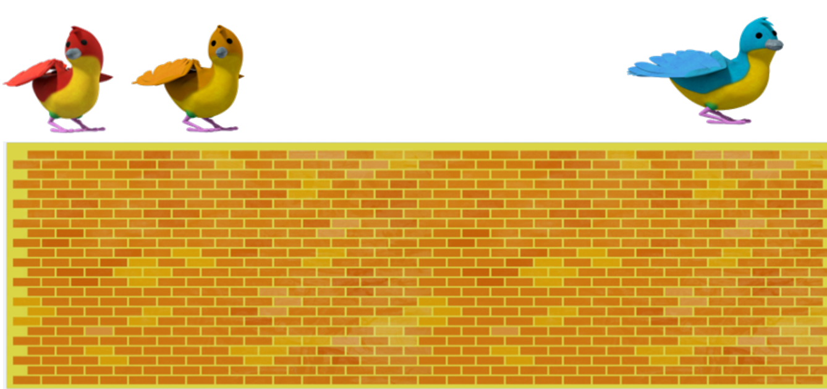
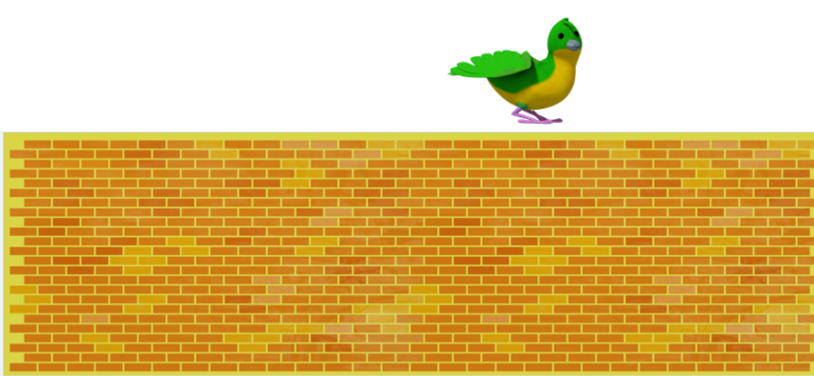
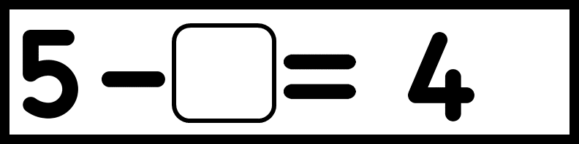


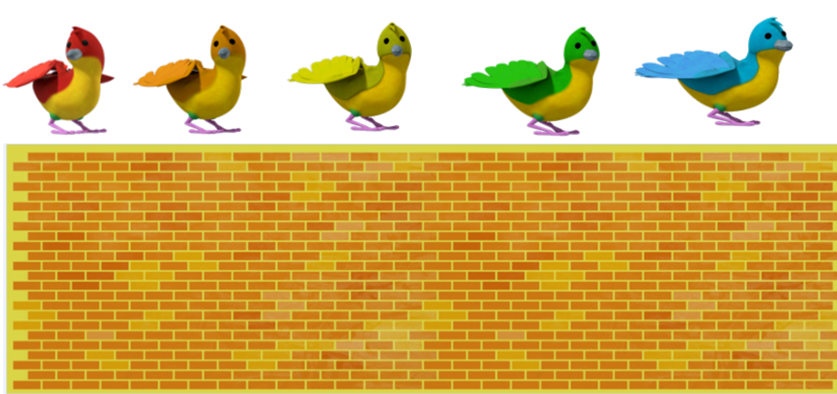
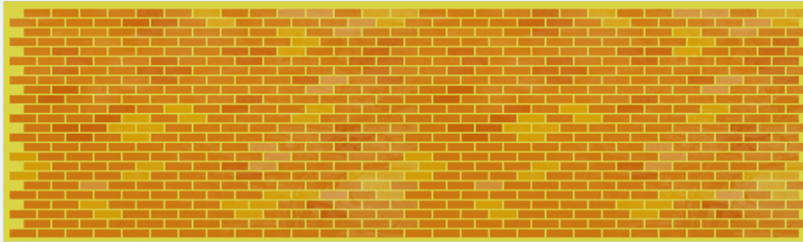

5 birds on a wall. How many flew away?
Notes:
Use this as an activity for individual work.

Slide 25
Click on each cube from the top downwards.
Every time we get one smaller, someone else is getting taller.
If I take 1 cube away, the blue tower gets 1
cube smaller.
Notes:
This slide is animated:
Click on each cube from the top downwards.
Ask the children what they notice. One tower is getting smaller the other tower is getting taller.
Click 1: Reveals the words to describe what is happening. Read together.
Click 2: Reveals the speech bubble. Read together.
Children work in pairs. 1 child has a tower of 5. Child 1 breaks one off the top and gives to child 2.
Say together: “Every time we get one smaller, someone else is getting taller”. Repeat until the first child has no cubes left.

Slide 26
Every time we get one smaller…
If I slide one bead to the right…
What stays the same?
What changes?
Notes:
This slide is animated.
Provide beadstrings with 5 beads on.
Children move their beads in conjunction with the animation.
Discuss:
How many beads on one side?
How many beads on the other side?
How many beads altogether?

