Slide 1
Numberblocks
Support Materials
Series 2, Episode 4
Nine

Slide 2
Practitioner Notes

Slide 3
Episode Description
Four excitedly tells Eight he’s the only square in the world, then realises he’s lonely, so Eight tries to make a square - but he has a hole, which Four sadly says doesn’t count. One arrives and hops into the hole, making new Numberblock Nine. Four is super-excited to meet a bigger square and curious to know all about him. Nine sings a song about how they are both squares because they are the same number of blocks tall and wide. They sing and dance together - Square Like You - in the grass, on blueprint paper and a disco floor. As a running gag, Nine keeps sneezing, sending his middle block (One) flying out of his nose to leave Eight with a hole – and they quickly reform to make Nine again.

Slide 4
Maths in the Episode
Saying the counting numbers up to 9
This episode introduces the counting numbers up to 9. Children should recognise the cardinal principle of counting that the last number counted represents the entire set of objects counted.
Partitioning and combining to 9
At the beginning of the episode Nine is formed from combining One and Eight and then partitioned again.
9 and 4 are square numbers
Although children are not formally introduced to square numbers until much later, this episode provides an opportunity to look at both the structure of squares with 4 equal sides and 4 corners, and square numbers that make a shape with the same number of blocks down as across. Identifying pattern and seeing structure in number is important to early maths development.

Slide 5
Using Mathematical Language
Use these stem sentences to rehearse the cardinal principle:
“I can see 1, 2, 3, 4, 5, 6, 7, 8, 9 (while pointing), nine flowers.”
As children begin to experience numbers partitioned, they can use stem sentences of the form:
“8 and one more is 9.”
Children may also experience the commutativity of 1 and 8 to make 9:
“When 1 and 8 combine in any order they make 9.”
Draw attention to the structure of 9 in his square arrangement:
“9 is three groups of 3.”

Slide 6
Talk and Discuss Together

Slide 7
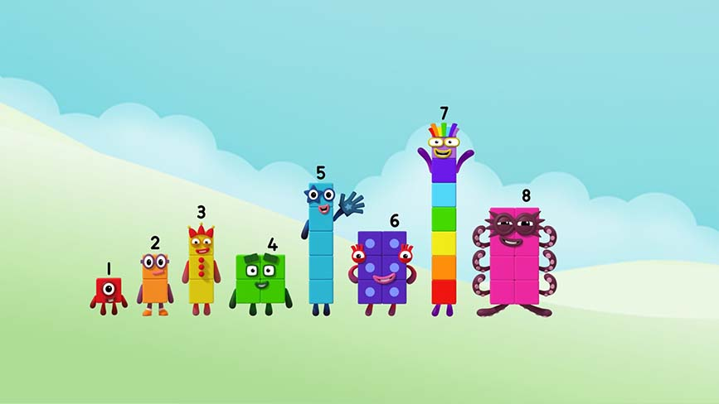
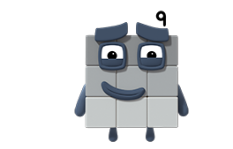
Images © 2017 Alphablocks Ltd. All Rights Reserved.
Notes:
Use this slide to count to 9.
The slide is animated and 9 will bounce in on click 1.
Count to 8 and then ask children what comes next. Then click for 9 to appear.

Slide 8
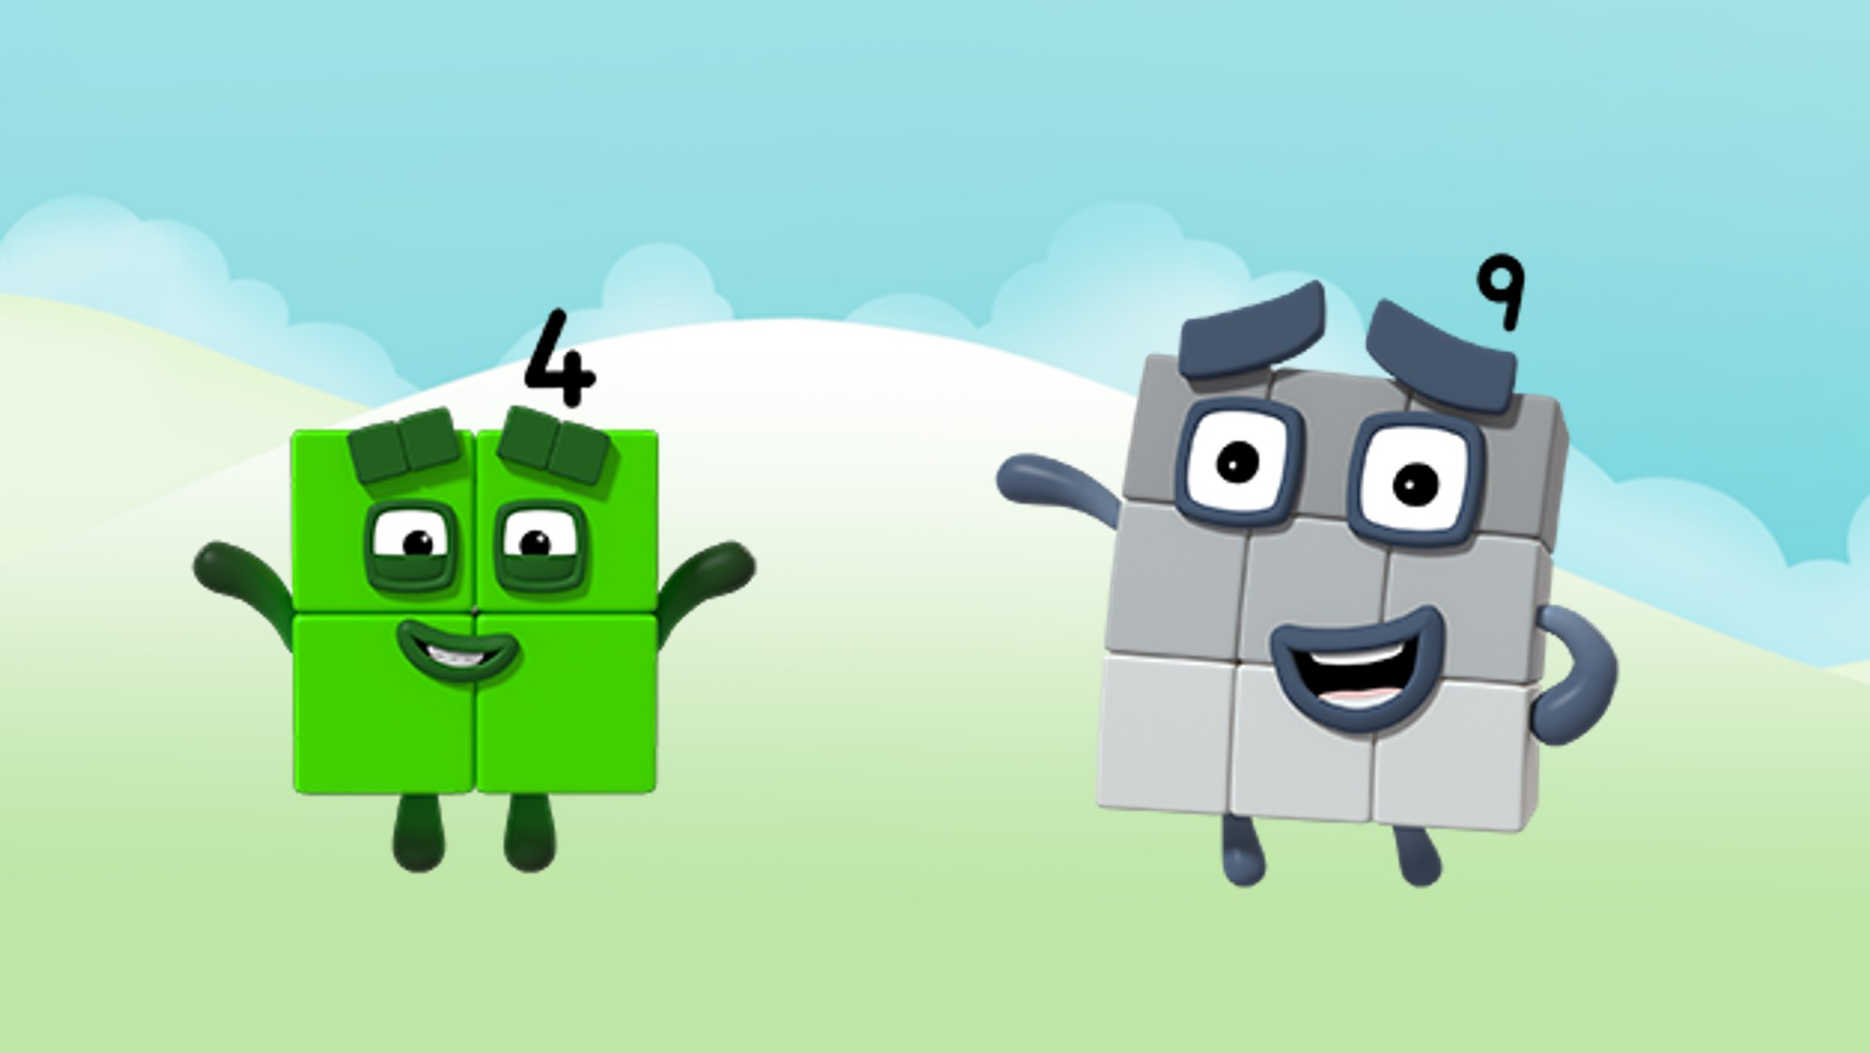
Images © 2017 Alphablocks Ltd. All Rights Reserved.
Notes:
What did you see in the episode? What was it about?
Ask the children to build Four and Nine using cubes of the same colour (green and black/grey respectively).
What is the same and different about these two Numberblocks?
They both have four corners and four sides.
They are both as tall as they are wide.
Show this by holding a Four in each hand. Lay one in front of the other and then rotate the one in front by a quarter turn and show how it still fits exactly over.
Repeat this with Nine.

Slide 9


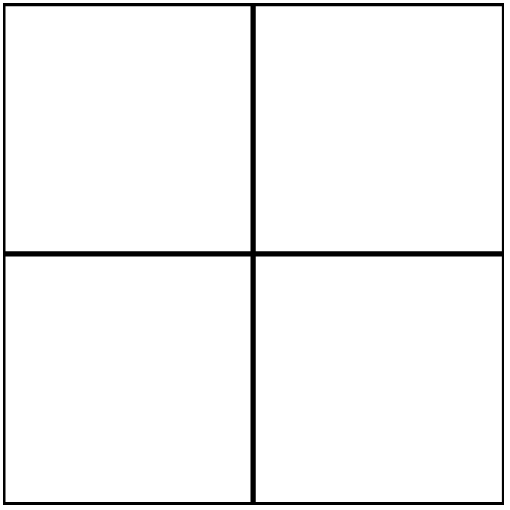
Images © 2017 Alphablocks Ltd. All Rights Reserved.
Notes:
Use this slide to see how to group into two 2s.
Animate the first grid and ask what children notice?
The two yellow ducks are in a row and the two green ducks are in a row.
Ask if there is another way to arrange the ducks.
Animate the second grid and compare the two grids – introduce the word ‘column’.
Seeing the yellow ducks and the green ducks as units of 2 introduces the concept of ‘unitising’, an important idea in mathematics.

Slide 10

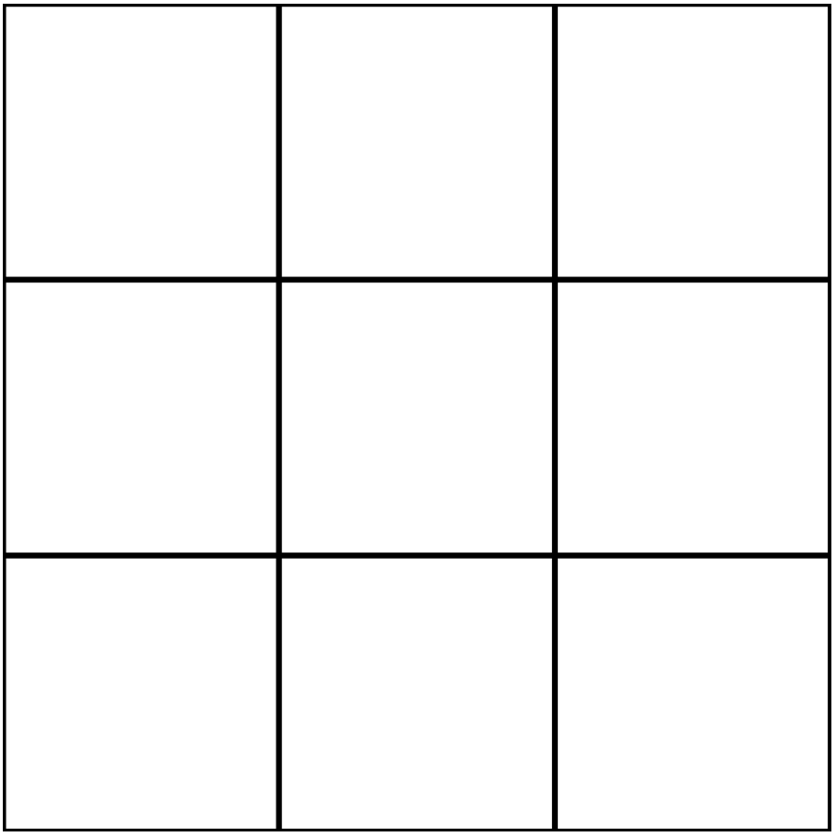
Images © 2017 Alphablocks Ltd. All Rights Reserved.
Notes:
How many ducks now?
Click to animate the ducks on to the grid.
What do you notice (the ducks are in 3 rows of 3)?
How could we arrange the ducks in a different way?
Children could work with their own grids and counters to show a different way.
Draw attention to arrangements in columns and the fact that we still have three groups of 3.
9 is three groups of 3.

Slide 11
Enabling Environments

Slide 12
Enabling Environments
Playing and Exploring
Leave out 3 x 3 grids with dice and counters, and let the children invent games to get three in a row. Go on a square hunt and sort squares and non-squares.
Active Learning
Notice how the children line arrays by matching one to another. Model the language: I wonder if they can be arranged in 2 twos to make a square? I wonder if they can be arranged in 3 threes to make a square?
Creating and Thinking Critically
Explore how to make squares from smaller squares using carpet tiles, square sticky notes, 2 x 2 building bricks.

Slide 13
Learning Together in Y1

Slide 14
Images © 2017 Alphablocks Ltd. All Rights Reserved.
Notes:
What did you see in the episode? What was it about?
Ask the children to build Four and Nine using linking cubes of the same colour (green and grey/black respectively).
What is the same and different about these two Numberblocks?
They both have four corners and four sides.
They are both as tall as they are wide.
Show this by holding a Four in each hand. Lay one in front of the other and then rotate the one in front by a quarter turn and show how it still fits exactly over.
Repeat this with Nine.

Slide 15
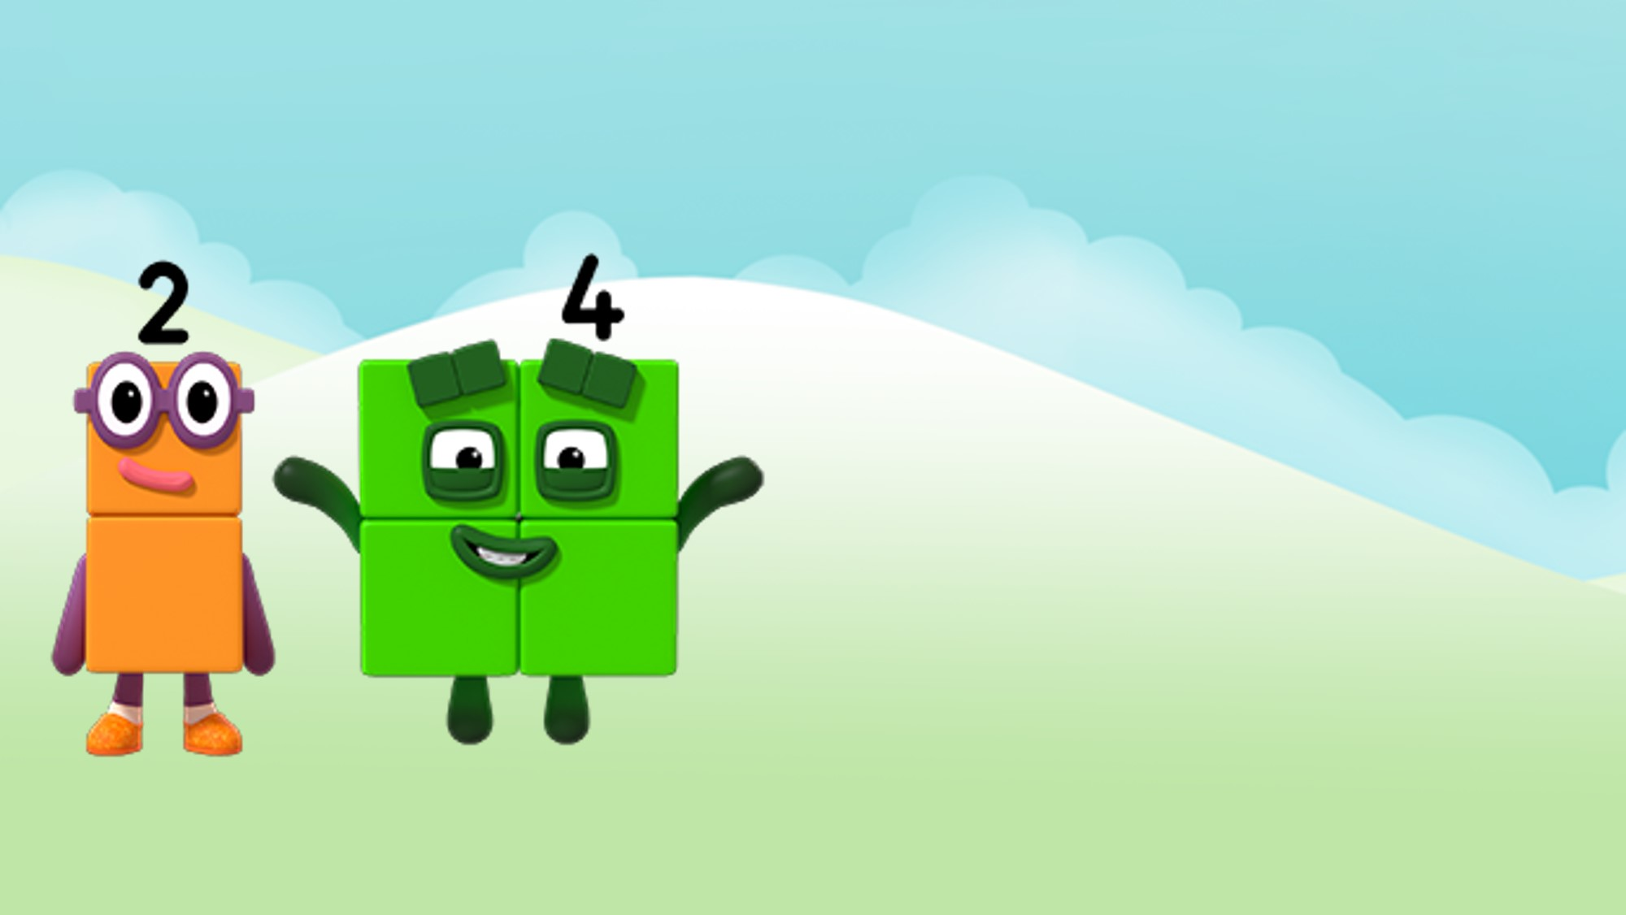
I am 2 blocks tall.
Images © 2017 Alphablocks Ltd. All Rights Reserved.
Notes:
Use slides 15-20 to discuss the similarities between Four and Nine, and how they are both as tall as they are wide.

Slide 16
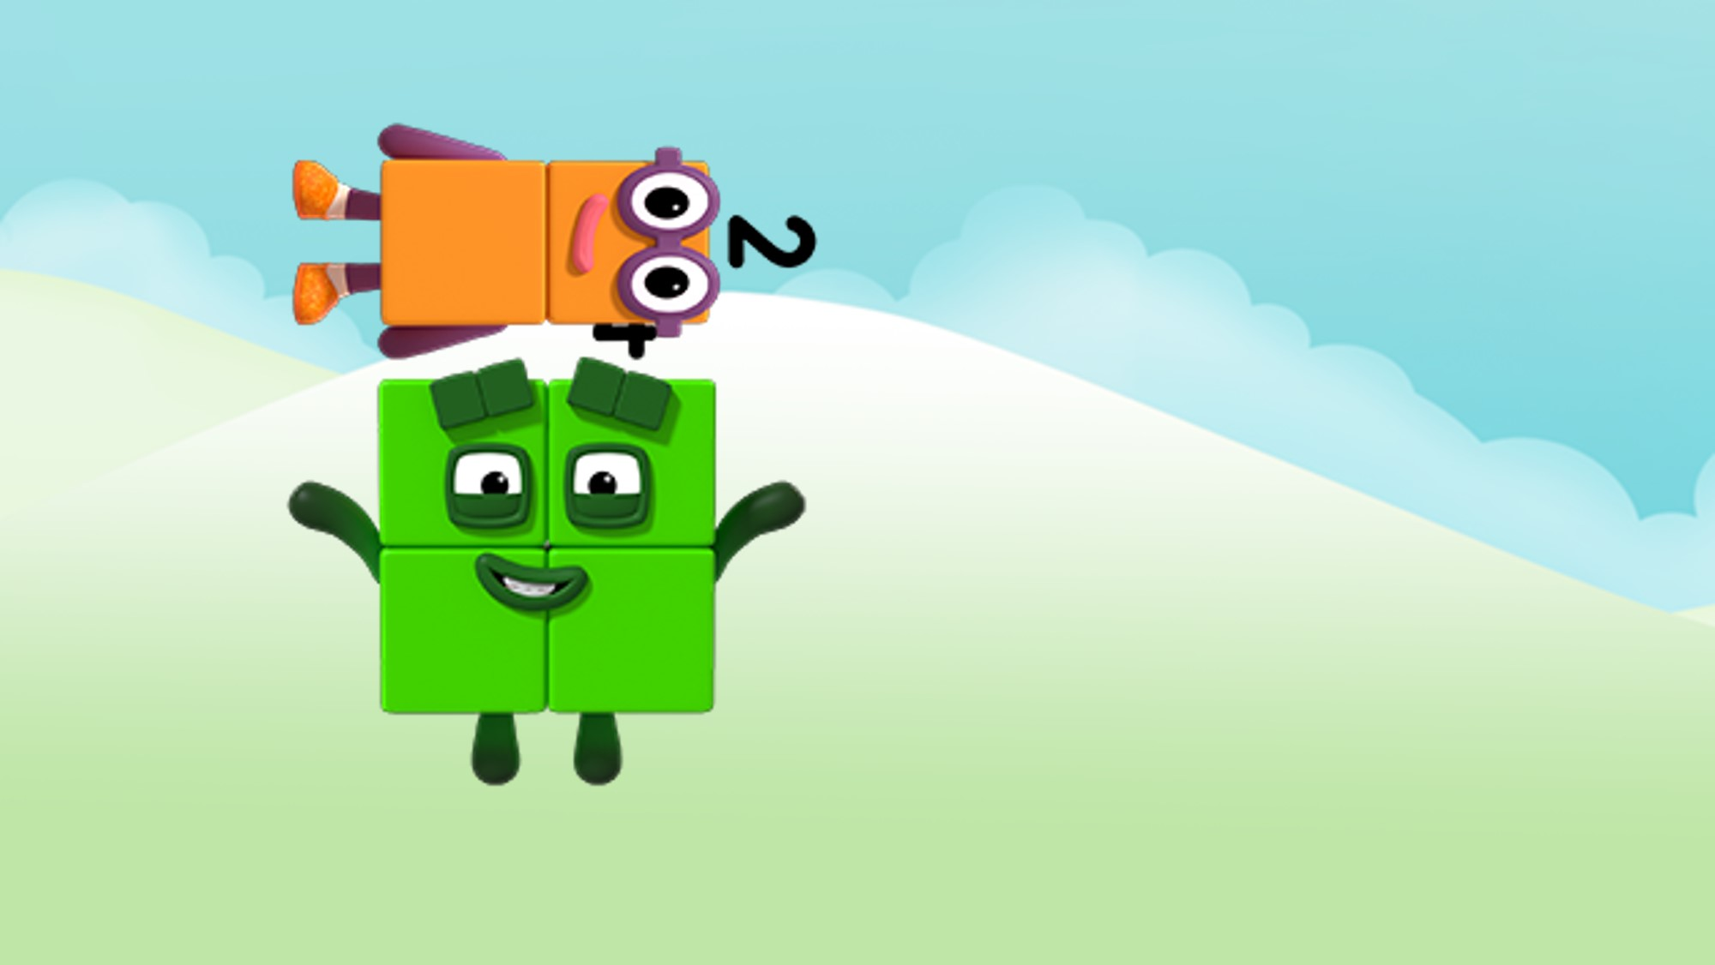
I am 2 blocks wide.
Images © 2017 Alphablocks Ltd. All Rights Reserved.

Slide 17
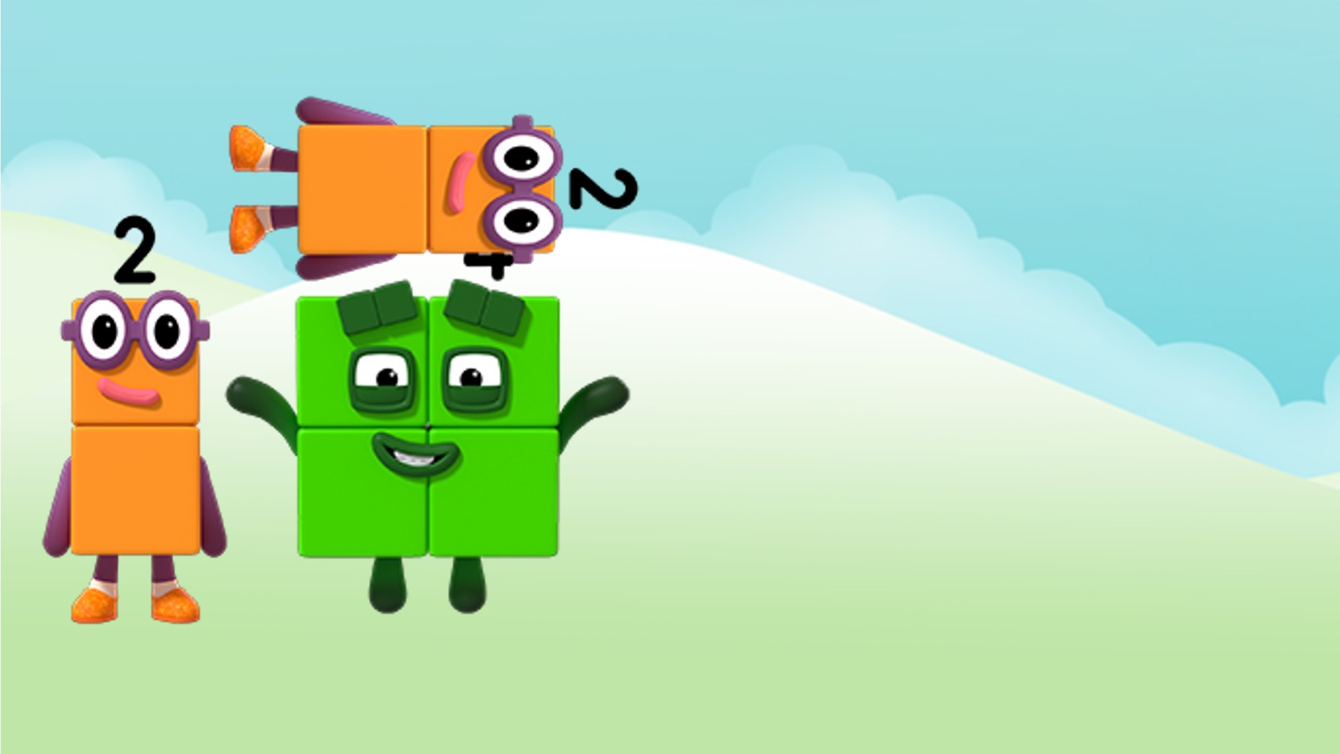
I am as tall as I am wide.
Images © 2017 Alphablocks Ltd. All Rights Reserved.

Slide 18
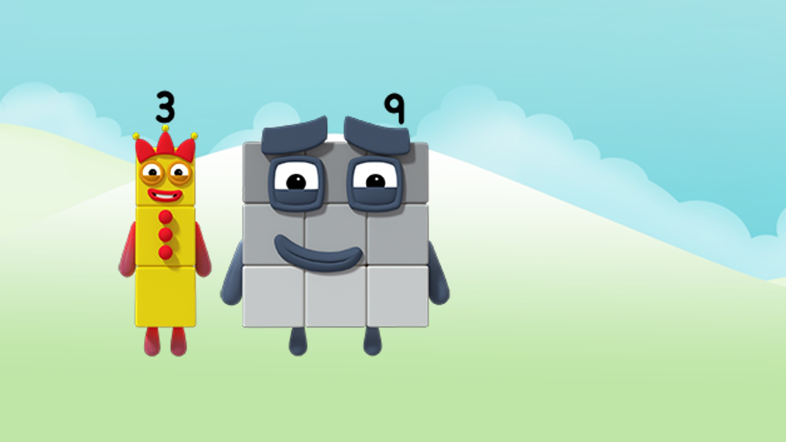
I am 3 blocks tall.
Images © 2017 Alphablocks Ltd. All Rights Reserved.

Slide 19
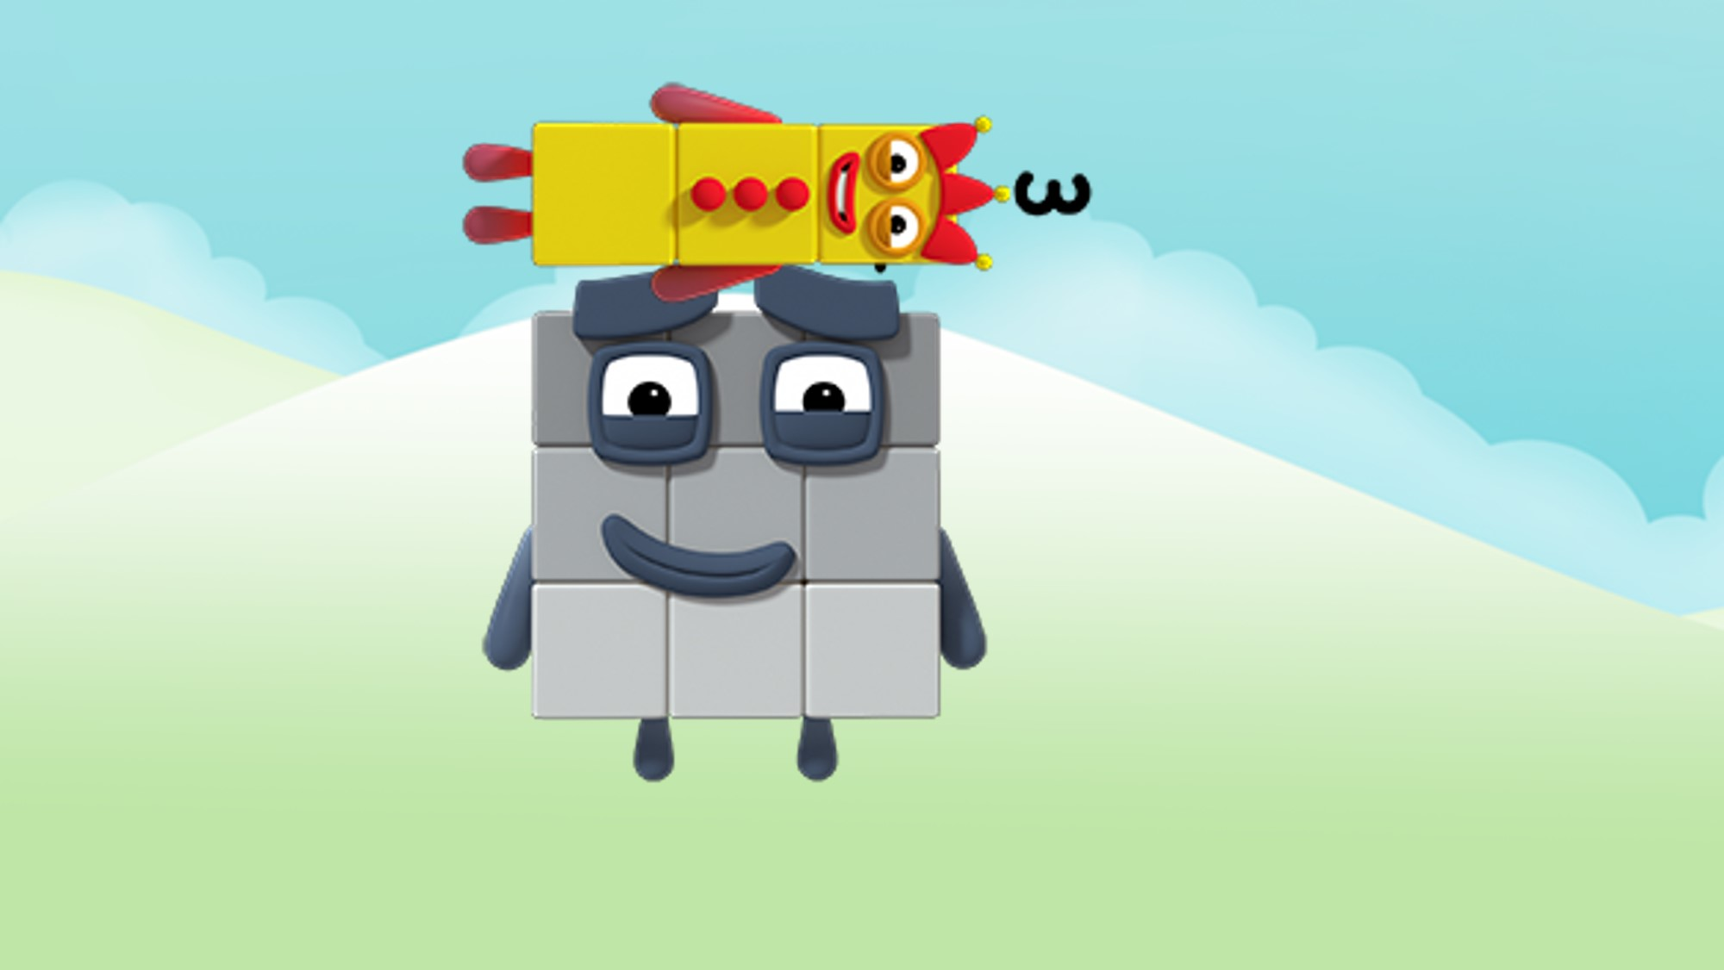
I am 3 blocks wide.
Images © 2017 Alphablocks Ltd. All Rights Reserved.

Slide 20
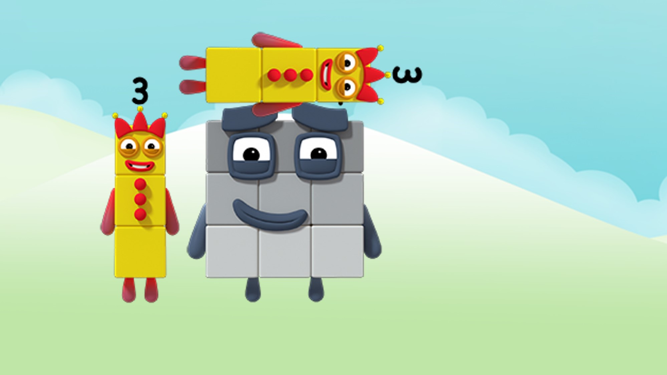
I am as tall as I am wide.
Images © 2017 Alphablocks Ltd. All Rights Reserved.

Slide 21







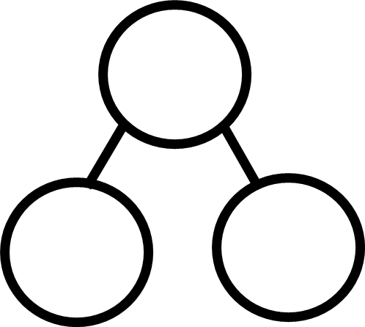
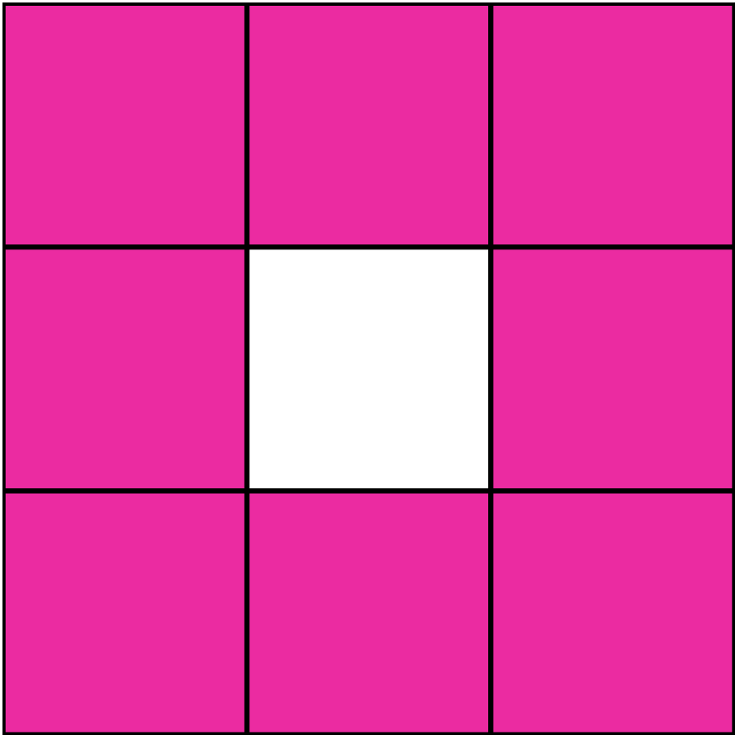
8 and 1 more is 9.
Images © 2017 Alphablocks Ltd. All Rights Reserved.
Notes:
This slide is animated.
Use this slide to discuss how 9 can be partitioned into 8 and 1. This is illustrated using the square blocks and the part-part-whole model; discuss how these two representations are connected. Draw out the fact that ‘8 and 1 more is 9’.
Before revealing the equation ask children to represent the relationship using an equation/number sentence.

Slide 22
1 and 8 more is 9.
Images © 2017 Alphablocks Ltd. All Rights Reserved.
Notes:
This slide is animated.
Use this slide to discuss how 9 can be partitioned into 1 and 8. This is illustrated using the square blocks and the part-part-whole model; discuss how these two representations are connected. Draw out the fact that ‘1 and 8 more is 9’.
Before revealing the equation ask children to represent the relationship using an equation/number sentence.
Discuss what is the same and what is different between this and the previous slide.

Slide 23

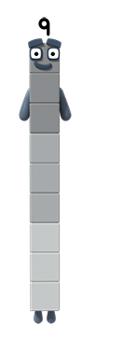
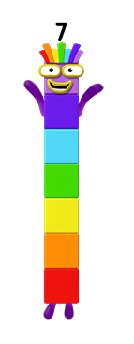
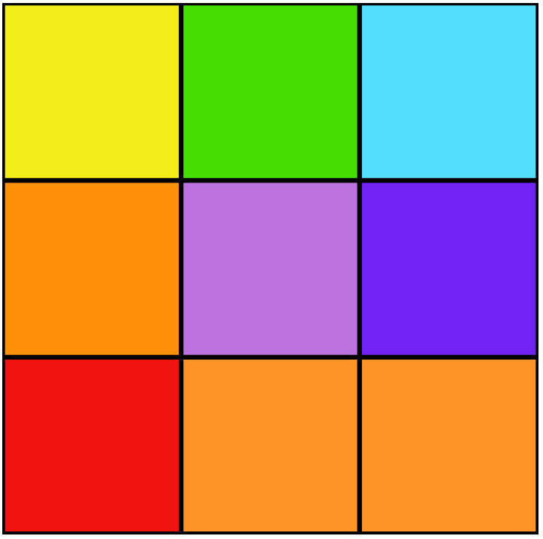
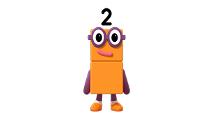
Images © 2017 Alphablocks Ltd. All Rights Reserved.
Notes:
Slides 23 to 25 provide opportunity to explore 9, partitioned and combined in different ways, and to record this in part-part-whole models and equations. Children should have their own cubes to partition, and pens and whiteboards to record and work alongside the slides. Ensure children discuss and give their responses before revealing answers on the slides.

Slide 24


7 and 2 more is 9.
Images © 2017 Alphablocks Ltd. All Rights Reserved.

Slide 25


6 and 3 more is 9.
Images © 2017 Alphablocks Ltd. All Rights Reserved.

Slide 26
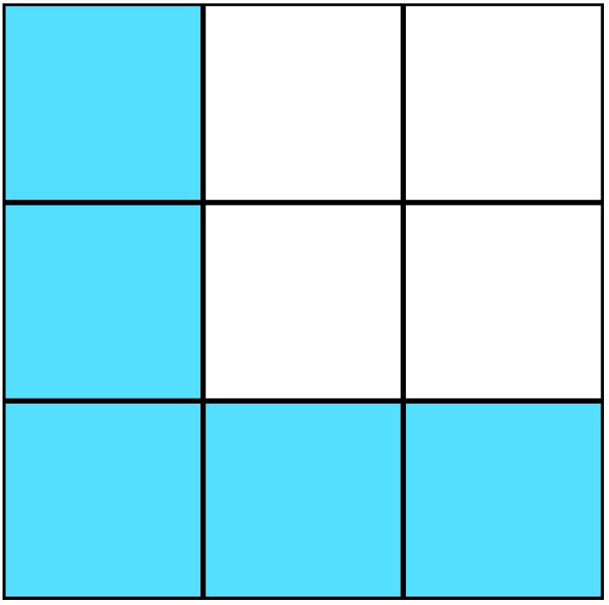
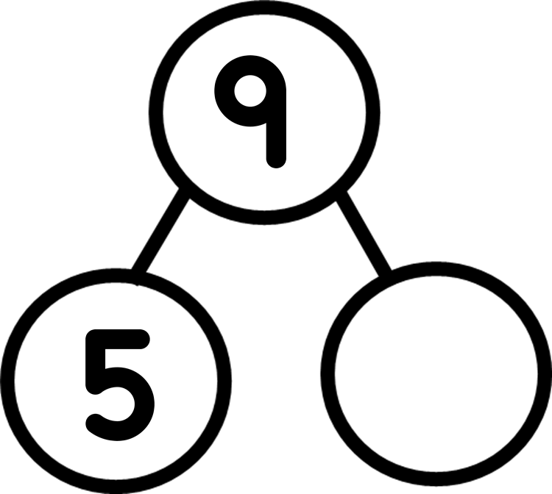
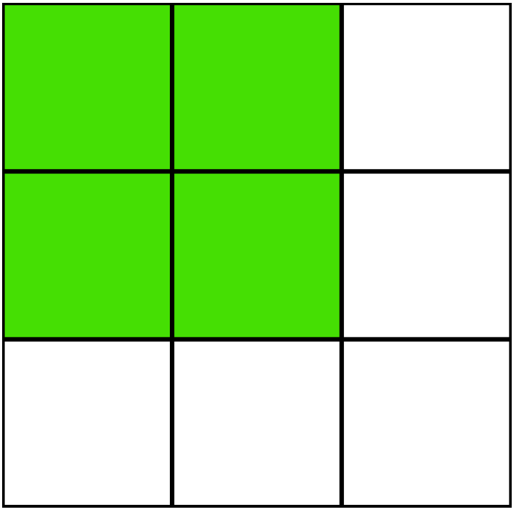
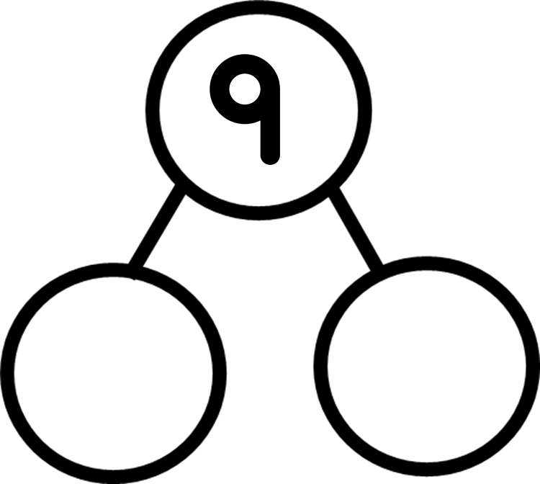
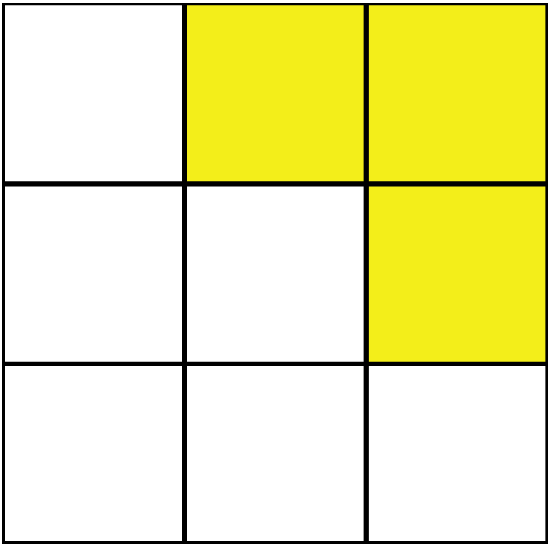


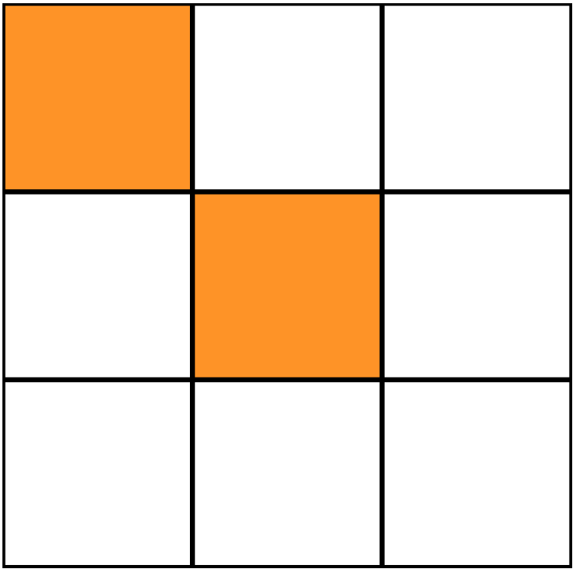

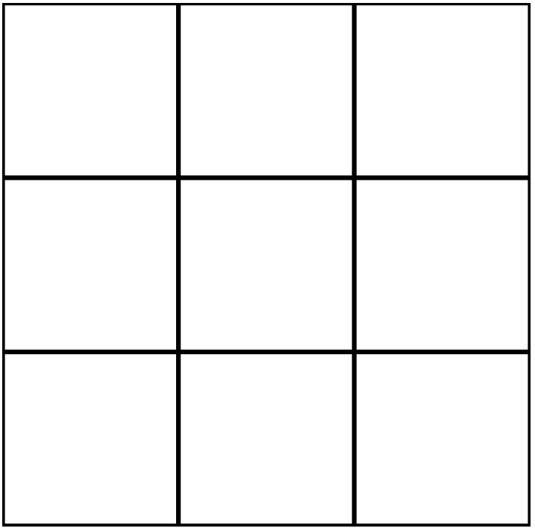

Images © 2017 Alphablocks Ltd. All Rights Reserved.
Notes:
Use this slide for individual work. Pupils complete missing information.
Go through the answers during the class.

Slide 27
Images © 2017 Alphablocks Ltd. All Rights Reserved.
Notes:
Use this as a challenge to consolidate complements to 9.
What do you notice?
The blue pencil is nine blocks long.
Compare the green, red and yellow pencils to the blue pencil.
E.g. “The blue pencil is nine blocks long; the green pencil is seven blocks long. The blue pencil is two blocks longer than the green pencil. The green pencil is two blocks shorter than the blue pencil.”

