Slide 1
Numberblocks
Support Materials
Episode 15
Hide and Seek

Slide 2
Practitioner Notes

Slide 3
Episode Description
One to Four arrive excitedly to find Five reading a book, and ask her to join in a game of Hide and Seek. She agrees but seems content to go on reading her book, which puzzles the others. She claims she can do both and she’ll point them out when she finds them. One and Four try hiding behind each other, then jump when they hear a noise, turning into Five. Five leaves magic pointing handprints and splits back into One and Four - who see pointing handprints with their numbers on and realise they’ve been caught. Next, Three disguises herself but bumps into Two, again forming Five, who leaves more handprints and splits, so Two and Three are caught. Everyone runs back to find Five still sitting and reading. Now it’s her turn to hide, and the others run off looking for her, but she sits reading. The others run and trip up in various combinations to make Five, so the others find her. At the end they all ask Five her secret and she shows them how to stand tall and hide behind a tree.

Slide 4
Maths in the Episode
Number bonds to 5
In this episode we see that One and Four combine to make Five; and Two and Three combine to make Five. We also observe how Five can partition into One and Four, or Two and Three.
Addition and subtraction facts for 5
In addition to experiencing how One, Two, Three and Four combine to make (find) Five, children will see how this can be represented using number sentences (or equations). The number triples of 2,3,5 and 1,4,5 are explored. Children are not required to write equations in the Early Years, but they may see them written down and begin to gain familiarity with their meaning, particularly when they are shown alongside a context.

Slide 5
Using Mathematical Language
Use these stem sentences to describe the combining of the parts to make 5:
“One and Four together make Five.”
“Two and Three together make Five”.
Use these stem sentences to describe the partitioning of 5, relating to the known parts.
“5 is made from 1 and 4 so 5 subtract 4 is 1”.

Slide 6
Talk and Discuss Together

Slide 7
Talk and Discuss Together
Watch the episode of Numberblocks. First ask the children what they noticed and allow them to talk to you and each other. The following slides are designed to stimulate children and adults to talk about the episode and draw out some key aspects of the mathematics.

Slide 8
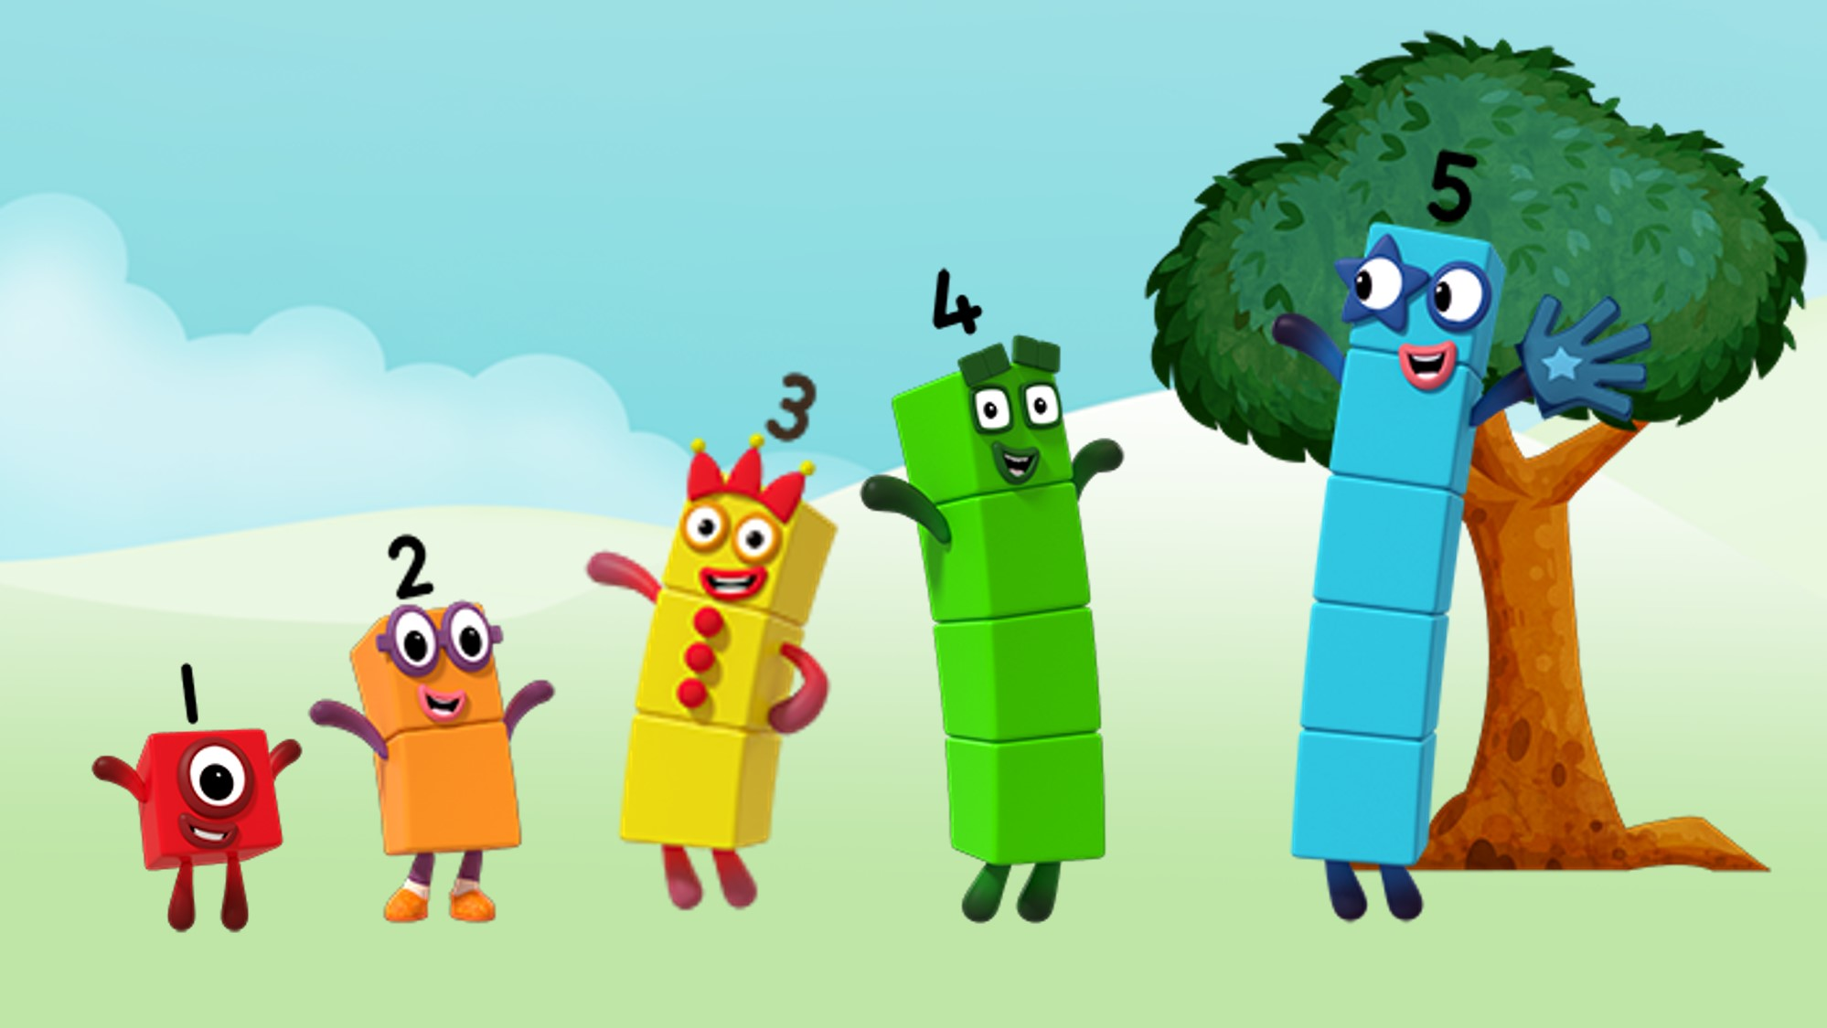
Images © 2017 Alphablocks Ltd. All Rights Reserved.
Notes:
Before watching the episode discuss who has played Hide and Seek.
What normally happens in the game?
Discuss the episode.
What did you notice?
Ask the children to make a set of Numberblocks with linking cubes for One, Two, Three and Four, using the correct colours.
After a count of 5 send the children off to lay their Numberblocks in different places around the setting (either indoors or outdoors) then come back to the adult.
Move to the next slide.

Slide 9

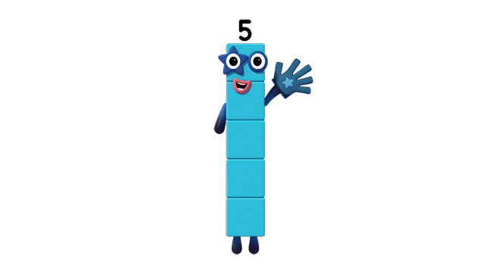
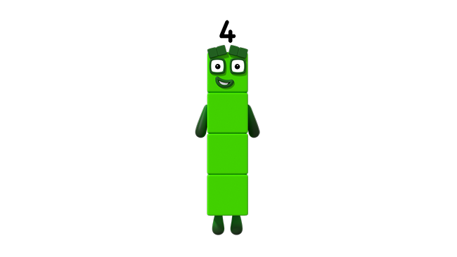

Images © 2017 Alphablocks Ltd. All Rights Reserved.
Notes:
Use this slide to reproduce the combining of 1 and 4 to make 5.
Watch the slide.
This slide is animated:
Click 1: One jumps on top of Four, and Five appears.
What did you notice?
Use the stem sentence:
“One and Four together make Five.”
Send the children off to search for a different One and Four (left out earlier by the children in slide 8) to make Five and bring them back to the adult.
How do we know that this is Five?
Can the children suggest different strategies? For example, count all, count on from 4, compare to a Five the teacher has. Compare to others.
Act out with the cubes: One and Four together make Five.
Ask the children to go and return One and Four to a new place.

Slide 10
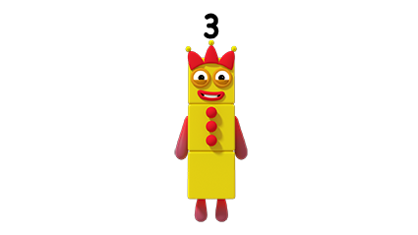
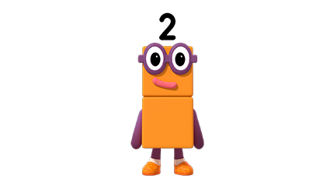
Images © 2017 Alphablocks Ltd. All Rights Reserved.
Notes:
Use this slide to reproduce the combining of Two and Three to make Five.
Watch the slide.
This slide is animated:
Click 1: Two jumps on top of Three and Five appears.
What did you notice?
Use the stem sentence:
“Two and Three together make Five.”
Send the children off to search for a different Two and Three (left out earlier by the children) to make Five and bring them back to the adult.
How do we know that this is Five?
Can the children suggest different strategies? For example, count all, count on from 3 or 2, compare to a Five you already have, compare to someone else’s.
Send the children away to leave Two and Three in a new place.

Slide 11





Click each circle in the top row.
Images © 2017 Alphablocks Ltd. All Rights Reserved.
Notes:
Use this slide to match the ponds that have 5 fish altogether
This slide is animated:
Click at the bottom edge of each circle in the top row.

Slide 12
Enabling Environments

Slide 13
Enabling Environments
Playing and Exploring
In the sand or water area explore containers that can hold 5 cups of water or sand. Explore different ways to fill the container with cups of the same size but different colour, e.g. 1 red, 4 blue.
Active Learning
Notice whether children are using counting all, counting on, subitising or recalled number bonds for 5 when working with small quantities. Encourage the children to notice 1 and 4 or 2 and 3 in groups when counting.
Creating and Thinking Critically
Suggest the children make collections of 5 objects by combining 1 and 4 or 2 and 3 of the objects. Take photos of the 2 parts and print. Then ask the children to leave the pictures in different parts of the setting. Play ‘hide and seek 5’: children look for 2 pictures of quantities that together make 5.

Slide 14
Learning Together in Y1

Slide 15
Images © 2017 Alphablocks Ltd. All Rights Reserved.
Notes:
Before watching the episode discuss who has played Hide and Seek. What normally happens in the game?
Discuss the episode. What did you notice?

Slide 16
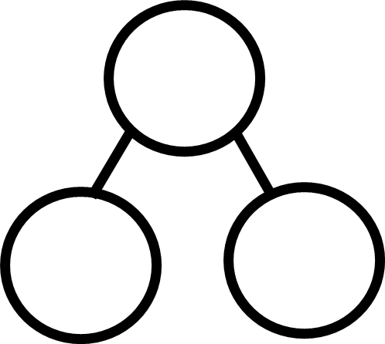






Five is made from One and Four.
Notes:
Use this slide to reproduce the combining of 1 and 4 to make 5. Children should be asked to build with their own blocks to replicate the animations.
Watch the slide.
This slide is animated:
Click 1: One jumps on to Four. Five appears and then jumps to the right.
What did you notice?
Use the stem sentence:
“One and Four together make Five.”
Click 2: Part-part-whole bar model appears.
What’s the same? What’s different about the representations? (Arrangement is different but the story is the same.)
Click 3: Speech bubble appears. Read together.
Click 4: Part-part-whole model appears. Explain that the top represents the whole, the circles below represent the parts to make the whole.
In this story of Five: what is the whole? What are the parts?
Click 5: Numbers appear in the p-p-w model.
What does the 5 mean?
What does the 1 mean?
What does the 4 mean?
How could we write this as a number sentence? As an equation?
Click 6: Equation appears.

Slide 17
Five is made from Four and One.
Notes:
Use this slide to reproduce the combining of 1 and 4 to make 5. Children should be asked to build with their own blocks to replicate the animations.
Watch the slide.
This slide is animated:
Click 1: One jumps on to Four. Five appears and then jumps to the right.
What did you notice?
Use the stem sentence:
“Four and One together make Five.”
Click 2: Part-part-whole bar model appears. What’s the same? What’s different about the representations? (Arrangement is different but the story is the same.)
Click 3: Speech bubble appears. Read aloud together.
Click 4: Part-part-whole model appears. Explain that the top represents the whole, the circles below represent the parts to make the whole.
In this story of Five: what is the whole? What are the parts?
Click 5: Numbers appear in the p-p-w model.
What does the 5 mean?
What does the 4 mean?
What does the 1 mean?
How could we write this as a number sentence? As an equation?
Click 6: Equation appears.

Slide 18
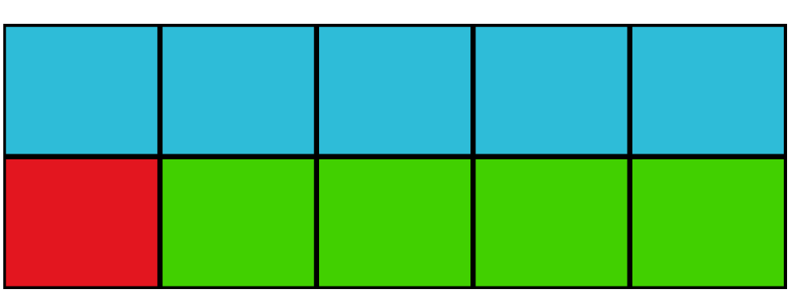
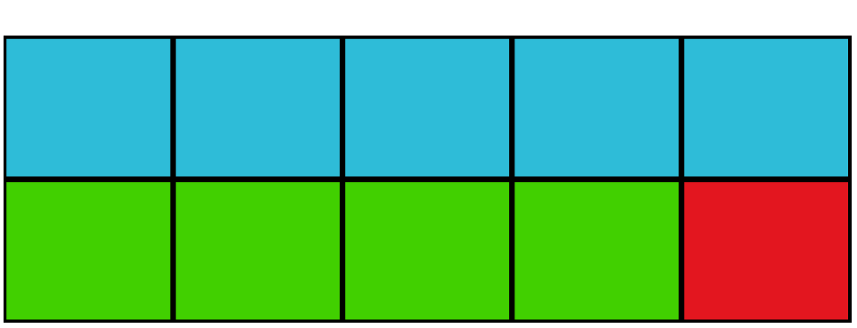
Images © 2017 Alphablocks Ltd. All Rights Reserved.
Notes:
What’s the same and what’s different about the two number stories?
Both 5.
Both 4 and 1.
Order is different but doesn’t change the sum.

Slide 19


Five is made from One and Four.
So Five subtract Four is One.
Images © 2017 Alphablocks Ltd. All Rights Reserved.
Notes:
Use this slide to watch the partitioning of 5 into 1 and 4. Children should be asked to build with their own blocks to replicate the animations.
What do you notice?
Watch the slide.
This slide is animated:
Click 1: Four jumps off One to the left.
What did you notice?
Use the stem sentence:
“Five is made from One and Four so Five subtract Four is One.”
Click 2: Part-part-whole bar model appears for 5. 4 green blocks slide down leaving 1 red block and a grey outline (with dashed borders).
What’s the same? What’s different about the representations?
Orientation is different, but they still tell the same story.
They both show
“5 is made from 1 and 4 so 5 subtract 4 is 1.”
Click 3: Stem sentence appears.
Click 4: Part-part-whole model appears with 5, 4, 1. Ask what the number on the top means (the whole). Ask what the circles below mean (the parts to make the whole).
In this story of Five: what is the whole? What are the parts?
How could we write this as a number sentence/equation?
Click 5: Equation appears.
What does the 5 mean?
What does the 4 mean?
What does the 1 mean?

Slide 20
Five is made from Four and One.
So Five subtract One is Four.
Images © 2017 Alphablocks Ltd. All Rights Reserved.
Notes:
Use this slide to watch the partitioning of 5 into 4 and 1. Children should be asked to build with their own blocks to replicate the animations.
What do you notice?
Watch the slide.
This slide is animated:
Click 1: One jumps off Four to the left.
What did you notice?
Use the stem sentence:
“Five is made from 4 and 1 so 5 subtract 1 is 4.”
Click 2: Part-part-whole bar model appears for 5. 1 red block slides down leaving 4 green blocks and a grey outline (with dashed borders).
What’s the same? What’s different about the representations?
Orientation is different but they still tell the same story.
The both show “5 is made from 4 and 1 so 5 subtract 1 is 4.”
Click 3: Stem sentence appears.
Click 4: Part-part-whole model appears with 5,4,1. Ask what the number on the top means(the whole). Ask what the circles below mean (the parts to make the whole).
In this story of Five: what is the whole? What are the parts?
How could we write this as a number sentence/equation?
Click 5: Equation appears.
What does the 5 mean?
What does the 1 mean?
What does the 4 mean?

Slide 21
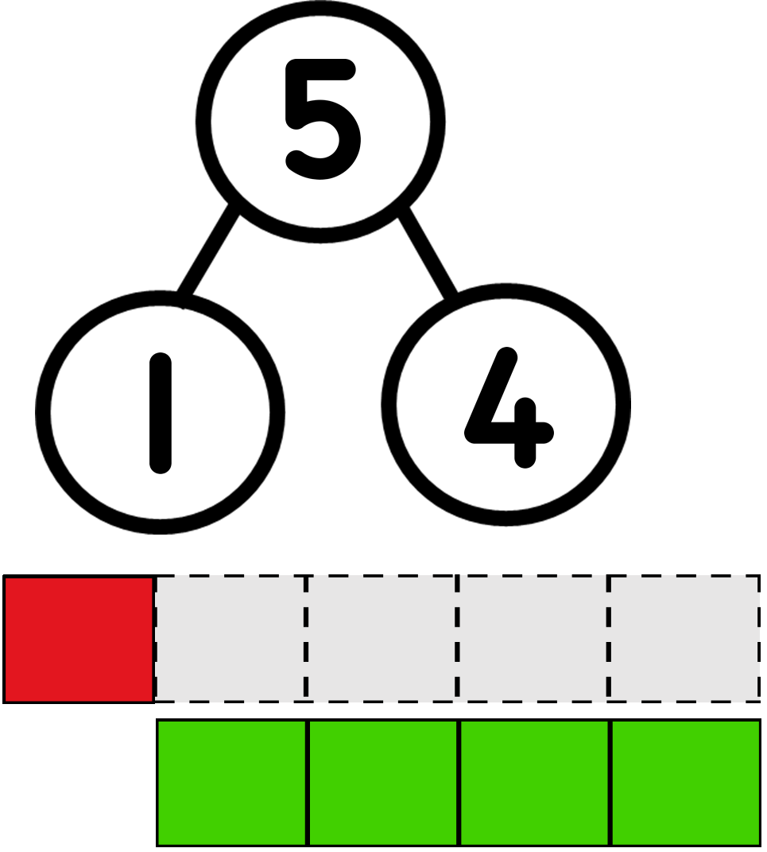
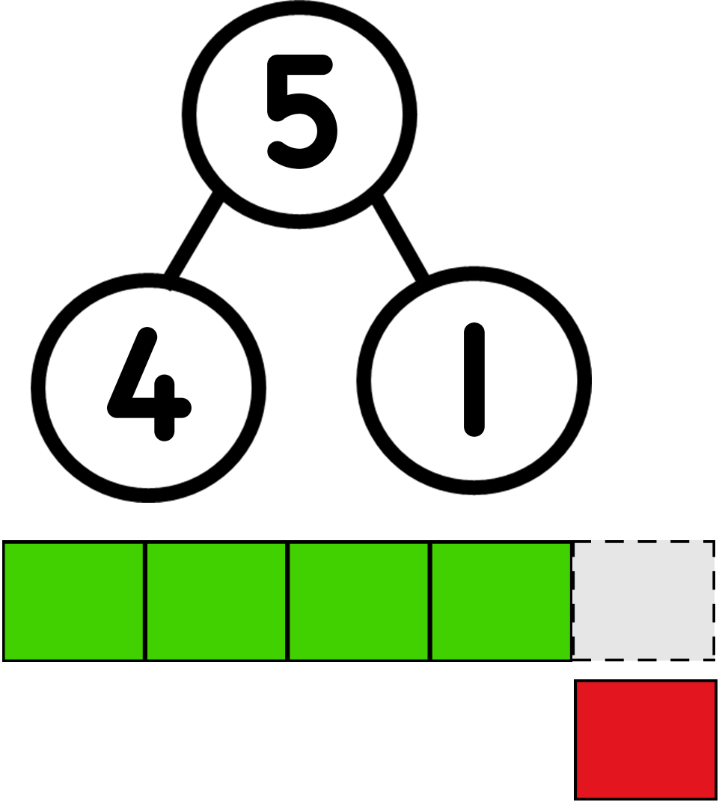
Images © 2017 Alphablocks Ltd. All Rights Reserved.
Notes:
What’s the same and what’s different about the two number stories?
Both start with 5 (minuend).
When 4 is subtracted 1 remains (4 is the subtrahend and 1 is the difference).
When 1 is subtracted 4 remains (1 is the subtrahend and 4 is the difference).

Slide 22
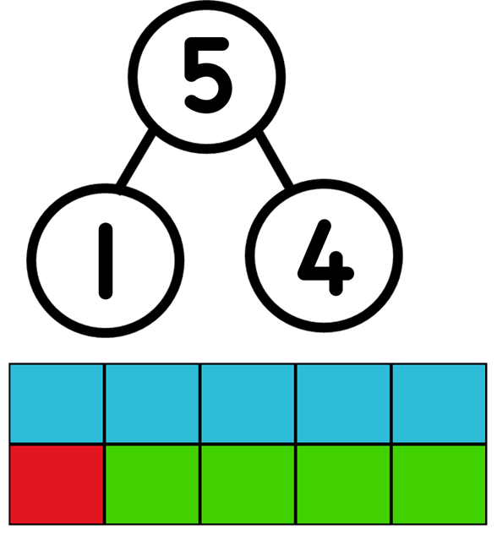
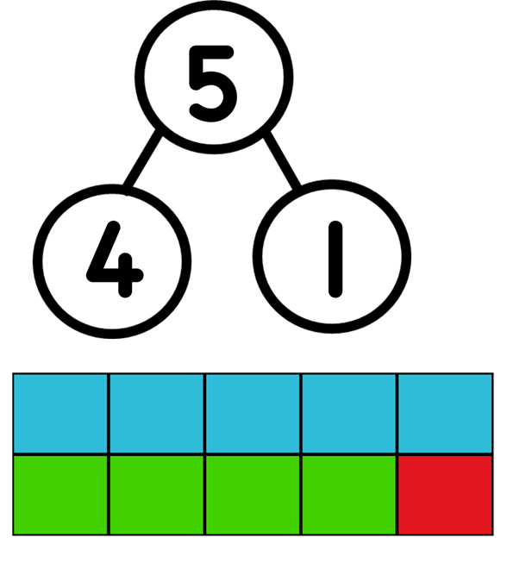
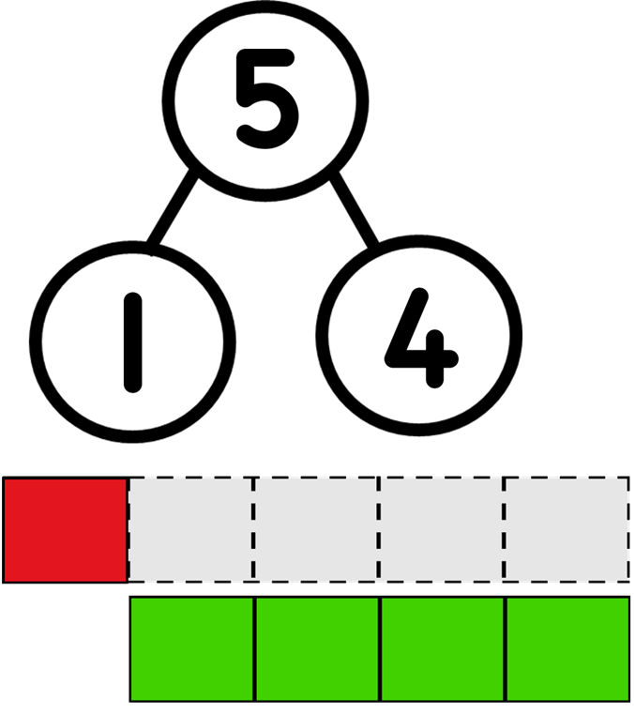
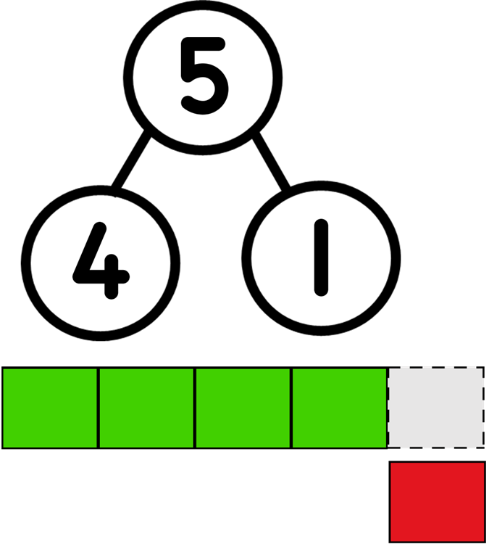
Images © 2017 Alphablocks Ltd. All Rights Reserved.
Notes:
Use this slide to draw out how knowing that 4 and 1 are bonds for 5 means that we can also solve subtraction.
What’s the same?
What’s different?
Ask the children to check each image with their own blocks.

Slide 23
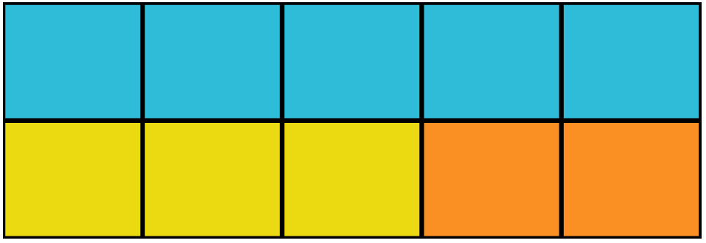
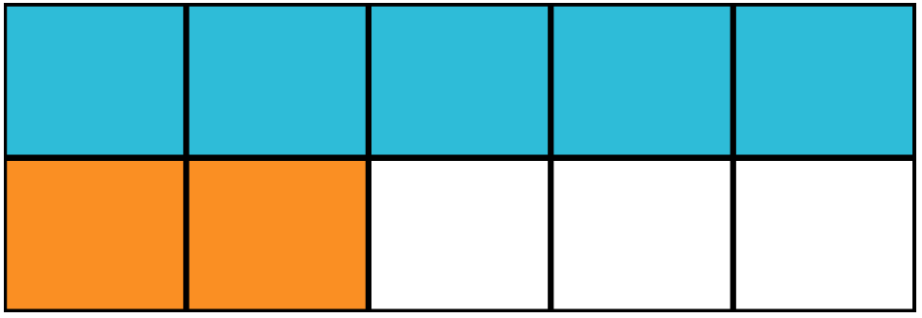








Five is made from ______ and ______ .
Five is made from ______ and ______.
So Five subtract ________ is three.
So Five subtract _______ is ________.
Notes:
Ask the children to work independently on this task. Ask children to share their work with the class and confirm their answers and ideas.

Slide 24
Notes:
Use this slide to review understanding of number bonds for 5.
How can we find the value of the empty circles? How can we check?

