Slide 1
Numberblocks
Support Materials
Episode 13
The Terrible Twos

Slide 2
Practitioner Notes

Slide 3
Episode Description
Everyone is going to bed but Four can't decide whether to sleep or stay up. He
splits into 2 Twos, who don masks and become the Terrible Twos, intent on
cheeky mischief. They tickle the others in turn with feathers, making Two and Three split into Ones, who gleefully bounce on their beds. The Terrible Twos run away, the Ones catch up with them and to everyone's surprise, the Terrible Twos split into four Ones. As everyone else rebuilds themselves, the four Ones turn back into Four. So what happened to the Terrible Twos? Four tells the others that he is the Terrible Twos, but they think he is joking.

Slide 4
Maths in the Episode
Recognising two 2s
In this episode Four is represented as 2 Twos. Describing Four in this way is the early stages of developing a concept known as ‘unitising’. This is the process of handling a quantity (in this case 2) as a single object. When a child is mastering the concept of ‘unitising’ they are able to count the units (of the quantity e.g. 2) rather than the single items, thus using one-to-many correspondence. This will then eventually lead on to developing an understanding of multiplication.
Partitioning numbers to four
In this episode the children will also see how Two, Three and Four can be partitioned into Ones as well as how Four can also partition into two Twos.

Slide 5
Using Mathematical Language
Use these stem sentences to describe 2 groups of 2.
“I see 2 pairs of socks”.
“I see 2 lots of 2 feathers”.
“I see 2 twos”.
Use these stem sentences to describe the partitioning
e.g.
”Two is 2 ones”.
“Four is 2 twos”.

Slide 6
Talk and Discuss Together

Slide 7
Talk and Discuss Together
Watch the episode of Numberblocks. First ask the children what they noticed and allow them to talk to you and each other. The following slides are designed to stimulate children and adults to talk about the episode and draw out some key aspects of the mathematics.

Slide 8
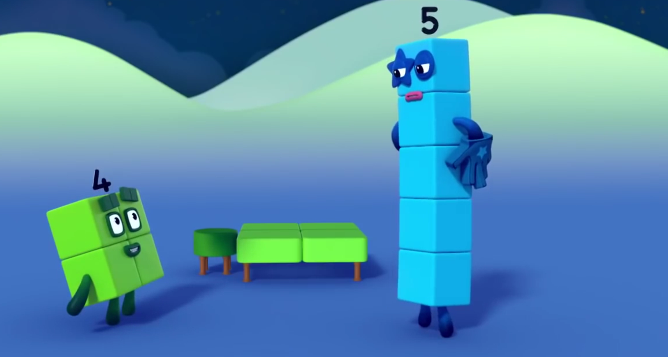
Images © 2017 Alphablocks Ltd. All Rights Reserved.
Notes:
Discuss the video. How do you feel when it’s bed time? What does it feel like to be tired?

Slide 9
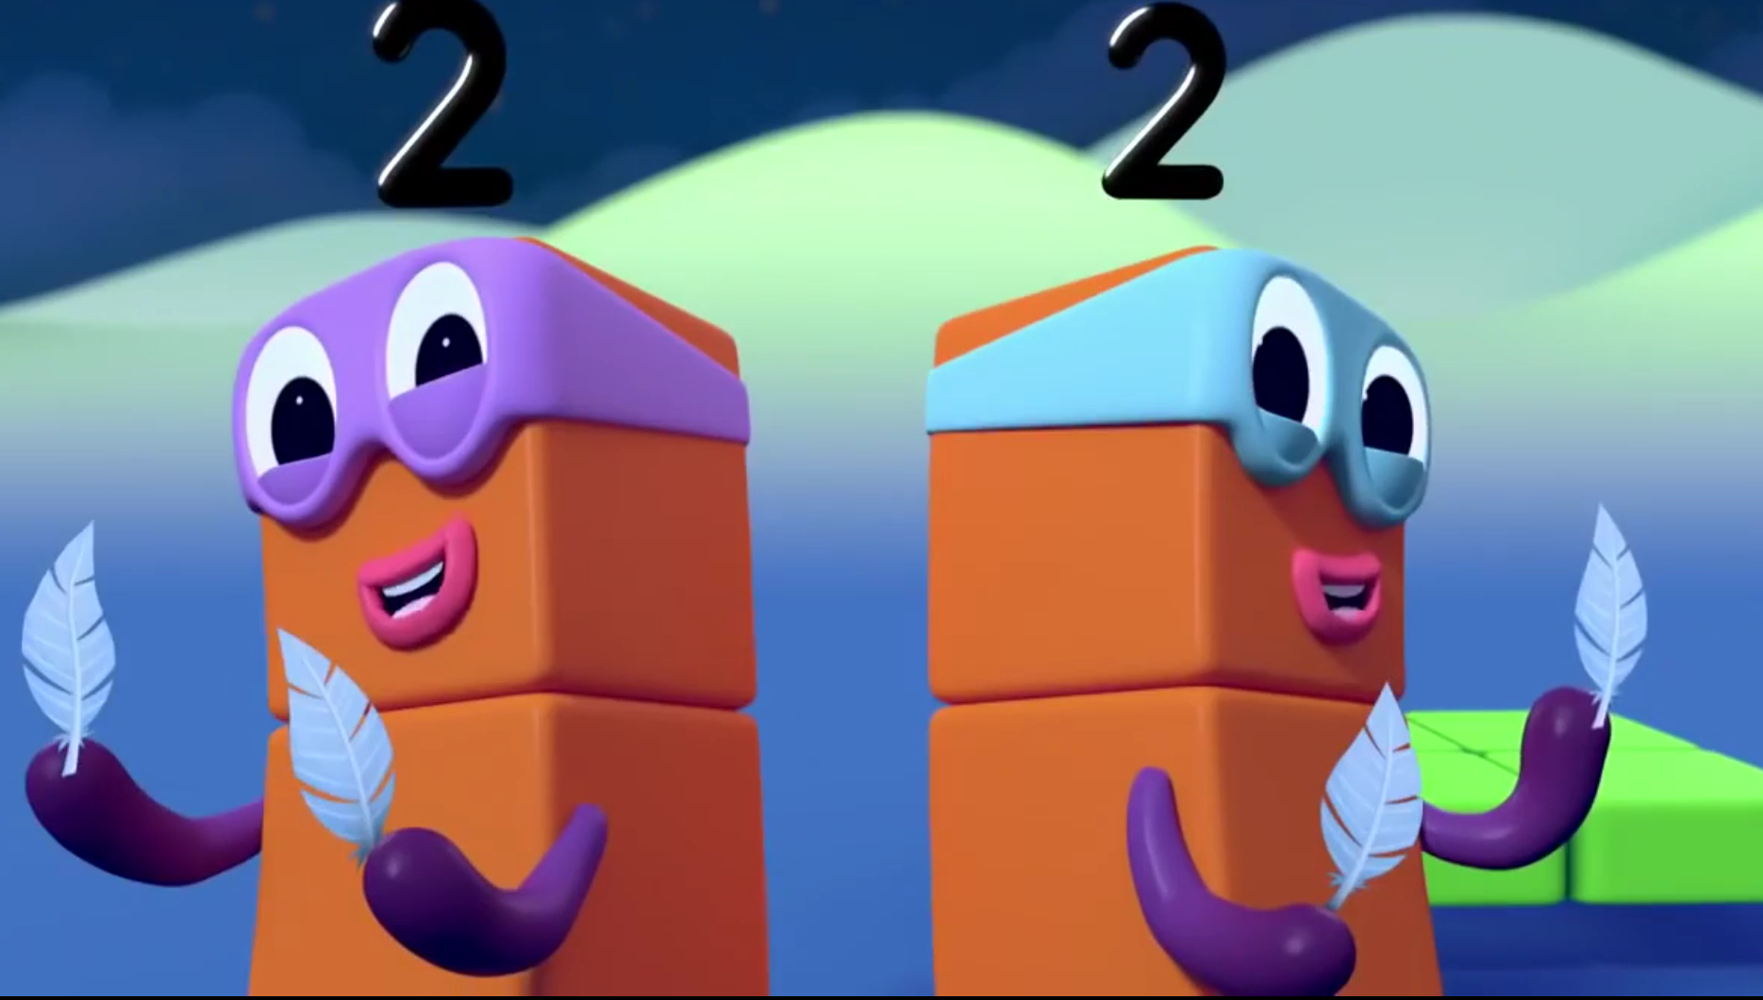
Images © 2017 Alphablocks Ltd. All Rights Reserved.
Notes:
Give out some craft feathers – one for each hand.
Find a partner and go around together to tickle other pairs’ cheeks or necks or hands.
How many feathers do you and your partner have?
“We have 2 lots of 2 feathers.”

Slide 10
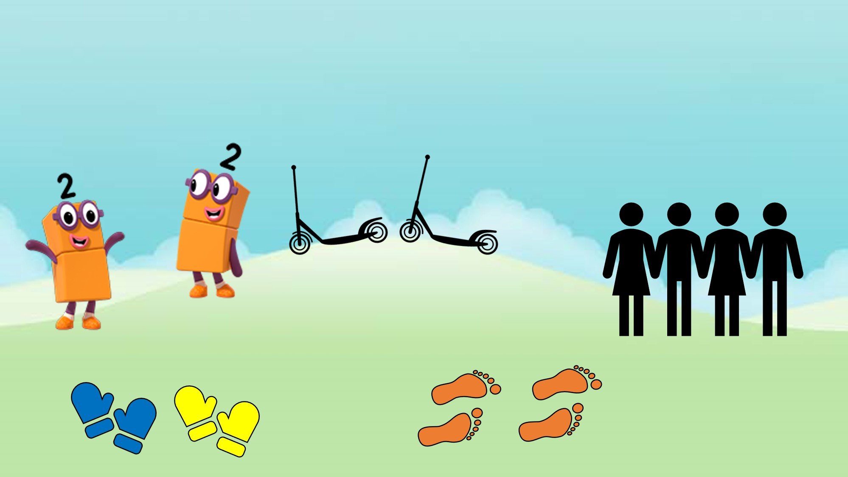
Images © 2017 Alphablocks Ltd. All Rights Reserved.
Notes:
What do you see?
“I see 2 pairs of mittens.”
“I see 2 pairs of footprints.”
“I see 2 scooters with 2 wheels.”
“I see 2 sets of partners.”
Children get into pairs, then look at each other and see how many 2 lots of 2 they can find on their bodies, e.g. eyes, ears, arms.
Use this as an opportunity to learn the vocabulary of body parts that are less familiar e.g. shoulders, nostrils.

Slide 11
Enabling Environments

Slide 12
Enabling Environments
Playing and Exploring
Leave out pairs of identical containers (transparent and opaque) and collections of things. Suggest the children fill the containers with the same number of the same things e.g. 2 containers of 2 buttons.
Active Learning
Notice how children use their own mark-making to represent units of quantities, e.g. how they make marks to represent the amount inside.
Creating and Thinking Critically
Provide opportunities to explore and discover 2 twos in lots of different contexts, e.g. money, 2 people with drums beating with 2 sticks. Also, dance routines that involve 2 moves of 2, e.g. jump-jump-pause, jump-jump-pause.

Slide 13
Learning Together in Y1

Slide 14
Images © 2017 Alphablocks Ltd. All Rights Reserved.
Notes:
Discuss the episode.
What did you notice?
What do you do when it’s time for bed? Do you stay awake, play, make mischief, or go to bed?

Slide 15
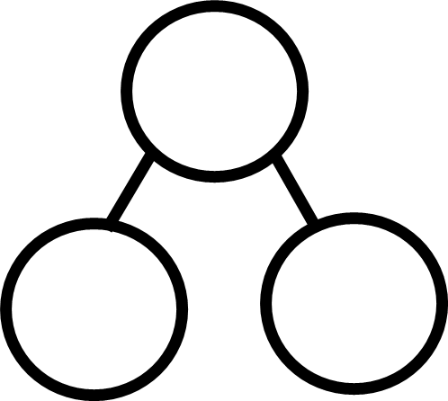
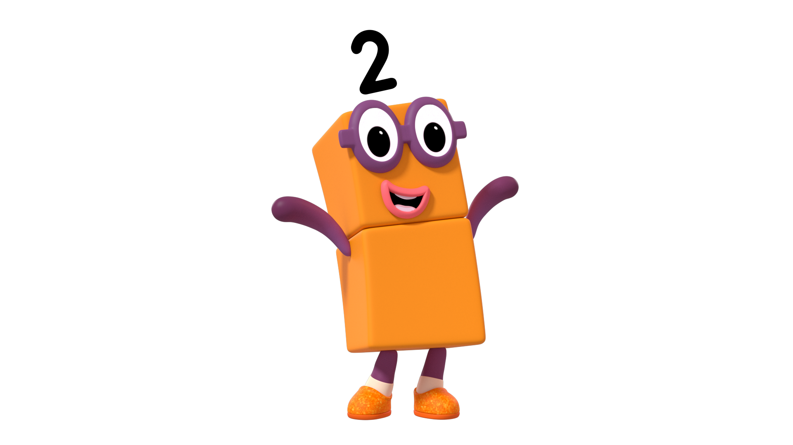
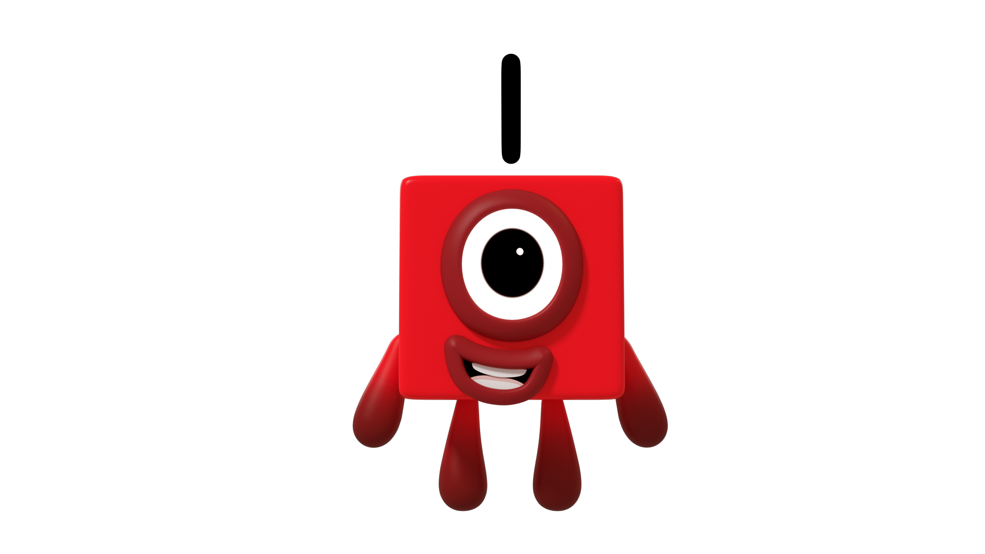
Two is the same as 2 Ones.
Images © 2017 Alphablocks Ltd. All Rights Reserved.
Notes:
This slide is animated.
Watch the first animation.
Click 1: Two jumps to the right, 2 Ones appear overlaid. Two disappears.
What do you notice?
Two is the same as 2 Ones
Use the next animation to understand the representation using the part-part-whole model.
Click 2: Part-part-whole model appears. Describe this by its name: ‘part-part-whole model’.
How could we use this to tell the story of ‘Two is the same as 2 Ones’? Discuss this.
Click 3: Two cubes appear in the whole of part-part-whole model and move to the parts. What did you notice?
Encourage language such as
“Two was in the whole; it partitioned into 2 ones; the ones moved to the 2 parts”
Click 4: Stem sentence appears.
How could we write this as a number sentence/equation?
Click 5: Equation box with ‘2 = ‘ appears. What is missing?
Click 6: ‘1 + 1’ appears.
Read the number sentence together.

Slide 16
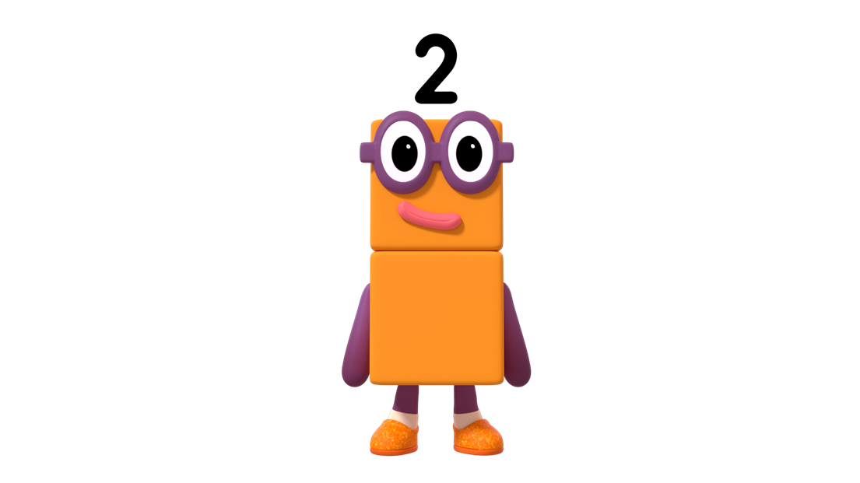
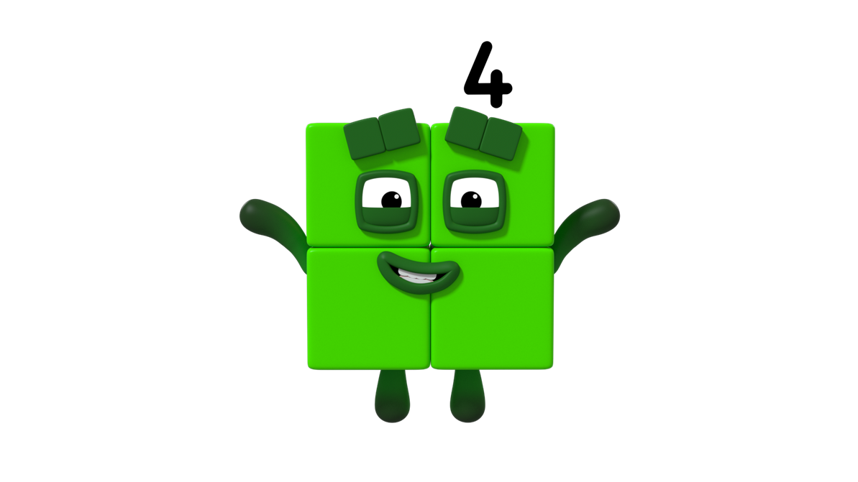
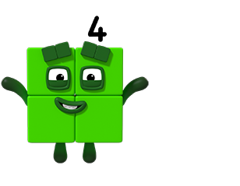
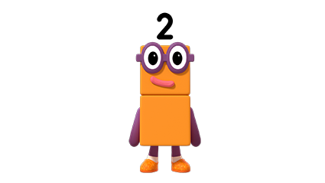
Four is the same as 2 Twos.
Images © 2017 Alphablocks Ltd. All Rights Reserved.
Notes:
This slide is animated.
Watch the first animation.
Click 1: Four jumps to the right, 2 Twos appear overlaid. Four disappears.
What do you notice?
Four is the same as 2 Twos
Use the next animation to understand the representation using the part-part-whole model.
Click 2: Part-part-whole model appears. Describe this by its name: ‘part-part-whole model’.
How could we use this to tell the story of ‘Four is the same as 2 Twos’? Discuss this.
Click 3: Four appears in the whole of part-part-whole model. 2 Twos appear and move to the parts. What did you notice?
Encourage language such as
“Four was in the whole; it partitioned into 2 Twos; the Twos moved to the 2 parts”
Click 4: Stem sentence appears.
How could we write this as a number sentence/equation?
Click 5: Equation box with ‘4 = ‘ appears. What is missing?
Click 6: ‘2 + 2’ appears.
Read the number sentence.
What’s the same? What’s different about the story of Four and the story of Two (on the previous slide)?

Slide 17
Four is the same as 2 twos.
Images © 2017 Alphablocks Ltd. All Rights Reserved.
Notes:
What do you see?
This slide is animated.
Watch the first animation.
Click 1: Four gloves separated in pairs to the left and right.
What do you notice? What’s the same and what’s different about what Four did in the last slide?
“Four is the same as 2 twos”
Use the next animation to understand the representation using the part-part-whole model.
Click 2: Part-part-whole model appears. Describe this by its name: ‘part-part-whole model’.
How could we use this to tell the story of ‘The 4 gloves are the same as 2 pairs of gloves’? Discuss this.
Click 3: Four gloves appear in the whole of part-part-whole model. 2 pairs of gloves move to the parts. What did you notice?
Encourage language such as
“Four gloves were in the whole; they partitioned into 2 pairs of gloves; the pairs moved to the 2 parts”
Click 4: Stem sentence appears.
How could we write this as a number sentence/equation?
Click 5: Equation box with ‘4 = ‘ appears. What is missing?
Click 6: ‘2 + 2’ appears.
Read the number sentence.
What do you notice about this number sentence? (refer back to the previous slide).

Slide 18
Four is the same as 2 twos.
Images © 2017 Alphablocks Ltd. All Rights Reserved.
Notes:
What do you see?
This slide is animated.
Watch the first animation.
Click 1: 4 separated blocks combine in pairs.
What do you notice? What’s the same and what’s different about what Four did in the first slide?
“4 is the same as two 2s”
This slide is used to generalise that whatever we are counting 4 is the same as two 2s. Ask the children to suggest what the 4 blocks could represent (4 of the same thing that is grouped into 2s)
Use the next animation to understand the representation using the part-part-whole model.
Click 2: Part-part-whole model appears. Describe this by its name: ‘part-part-whole model’. How could we use this to tell the story of ‘The 4 blocks are the same as 2 lots of 2 blocks’? Discuss this.
Click 3: Four blocks appear in the whole of part-part-whole model. 2 lots of 2 blocks move to the parts. What did you notice?
Encourage language such as
“4 blocks were in the whole; they partitioned into 2 lots of 2 blocks; the blocks moved to the 2 parts.”
Click 4: Stem sentence appears.
How could we write this as a number sentence/equation?
Click 5: Equation box with ‘4 = ‘ appears. What is missing?
Click 6: ‘2 + 2’ appears.
Read the number sentence.
What do you notice about this number sentence? (refer back to the previous slides).
It doesn’t matter what there are 4 of, 4 is the same as two 2s.

Slide 19
Images © 2017 Alphablocks Ltd. All Rights Reserved.
Notes:
What do you see?
Which things can be used to show that 4 is the same as two 2s?
Use this slide as stimulus for individual activity.
The images on the next 3 slides can be printed out and cut into sets of cards for the children to work in groups to explore using a large part-part-whole model.
The images vary in the concept of how 4 is represented using 2 and 2.
Rocket – can’t be used on its own.
Socks – 4 identical socks = 2 identical pairs.
Balloons – 4 balloons – 2 identical, 2 are not.
Trousers – 2 pairs of trousers but 4 legs.
Scooters – Only 2 of the scooters can be used to represent 4 is the same as 2 and 2.
Ask the children to justify their reasons for each of the items using the stem sentences:
“4 socks is the same as 2 pairs of socks.”
“4 is the same as two 2s.”
The children could also hunt down other things in the classroom that there are four of or that there are 2 pairs of.

Slide 23
Notes:
Print this on A4 and enlarge to A3 for the children to explore.
This page could also be used for the children to draw and record, say and write the story of 4 is the same as two 2s.

