Slide 1
Subtraction:
Developing the concept of difference
Year 1

Slide 2
Introduction
This document contains:
an introduction to the lesson
points to consider as you watch each video clip.

Slide 3
The journey through the lesson
Counting in odd and even numbers, drawing attention to the difference of two.
Representing subtraction as take away.
Representing subtraction as difference.
Connecting to the part part whole model.
Extending the concept of difference to larger numbers.

Slide 4
Developing the concept of difference
Counting in odd and
even numbers
Year 1 Lesson Clip 1

Slide 5
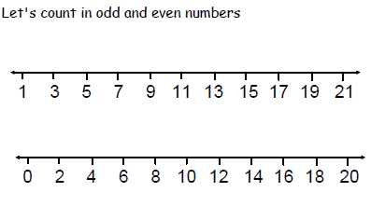
Warm up and review
This familiar activity provides the opportunity to think about the newly introduced concept of difference.

Slide 6
Developing the concept of difference
Representing subtraction
Year 1 Lesson Clip 2

Slide 7
Partner 1 and Partner 2
This is an organisational device which the
Children are practiced in and ensures that
the children work together and take it in
turn to lead.

Slide 8
Representing subtraction
Consider how the counters provide a bridge between the concrete and the abstract. They are not actual cars, they represent cars and draw attention to the mathematics: the number of cars.

Slide 9
What does one counter represent?
This is a key question.
One counter could represent anything, but in this context it represents one car.
Tomorrow it might represent a glass of orange juice or a spider. This flexibility in thinking is important in children’s mathematical development.

Slide 10
Three cars drive away
The children represent the cars that have driven away in their own way, showing that they have made sense of the structure of the mathematics.
Consider how the representations demonstrate different levels of abstraction. Some children move the counters, others just turn them over to demonstrate partitioning of the set.

Slide 11
Developing the concept of difference
Connecting to the
part part whole model
Year 1 Lesson Clip 3

Slide 12
Part Part Whole Model
3 + 2 = 5 5 = 3 + 2
2 + 3 = 5 5 = 2 + 3 5 – 3 = 2 2 = 5 - 3
5 – 2 = 3 3 = 5 - 2
5
3
2
The children are familiar with the part part whole model.
It is a powerful model for understanding additive relationships, including inverse and commutative relationships.
Consider whether all children in your class able to derive all eight relationships, given one relationship. Spending a longer time, working with smaller numbers can provide the time to embed key number relationships.

Slide 13
Perseverance where the number sentence is incorrect
Notice the two girls who create this incorrect number sentence. They recognise it is incorrect and work together with the counters to make sense of the mathematics and correct their error.
5 = 2 – 3

Slide 14
Stem Sentence
Subtraction can tell us about take away
One purpose of stem sentences is to highlight key points and remind children of important information.
“Take away” is just one subtraction structure, another is difference. The teacher is preparing the children for the introduction of another subtraction structure, that of difference.

Slide 15
Developing the concept of difference
Subtraction as difference
Year 1 Lesson Clip 4

Slide 16
There are 5 red cars and
3 blue cars
Can we use a yellow counter to represent a blue car?
A counter can represent anything we choose to represent.

Slide 17
The cars in the car park
Consider why the teacher asks the children to arrange their counters into the above structure?
How does the arrangement expose the structure of difference?

Slide 18
Connecting difference to the part part whole model
2
Consider how a focus on difference leads us to look at the model in a different way?
The model can be used as a comparative structure, comparing the number of red cars with the number of blue cars.

Slide 19
Developing the concept of difference
Independent work
Year 1 Lesson Clip 5

Slide 20
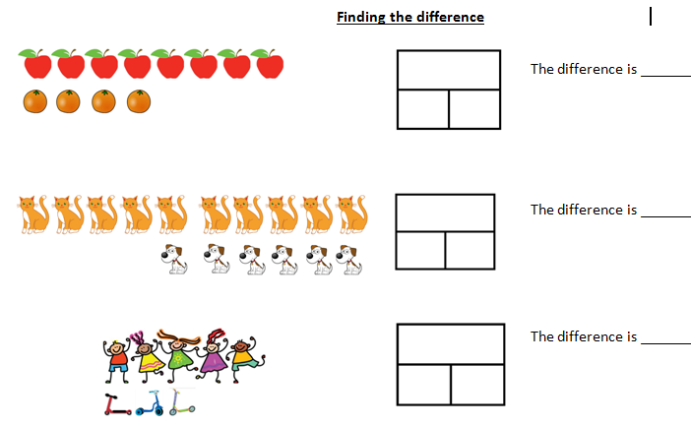
Independent work
Notice the variation

Slide 21
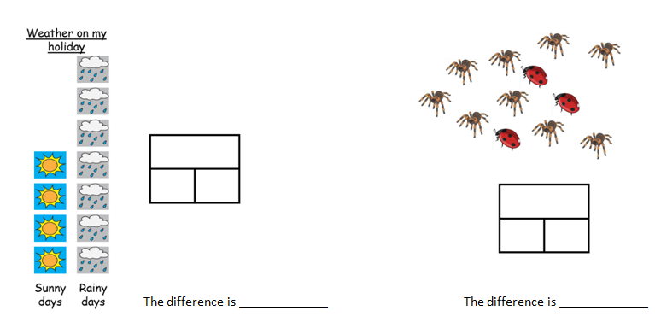
Consider how the above activities help to embed the learning and extend children’s thinking.

Slide 22
The Difficult Points
The teacher says:
I have already got straight in my head what the difficult points are and am looking out for those and ready to address them.
Identification by the teacher of the difficult points is an important aspect of lesson design.

Slide 23
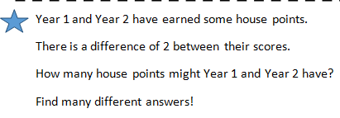
The Star Challenge
Throughout the lesson the children have worked with small numbers. This was deliberate so that they could focus on the new concept of difference. Having generalised the concept the children demonstrate that they are able to apply it to much larger number.

Slide 24
A difference of 2
If Year 2 have 600 house points
Year 1 could have 598 house points
Notice how the child has fully generalised the concept of difference and is able to work with numbers which cross the hundreds’ boundary.

Slide 25
Developing the concept of difference
Exploring number bonds with a
Difference of 2
Year 1 Lesson Clip 6

Slide 26
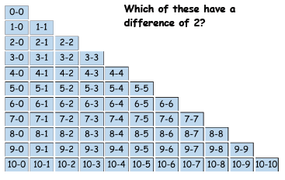
Subtraction facts with a difference of 2
Memorising number bonds is an important component in developing mastery. The opportunity is taken at the end of the lesson to explore subtraction facts with a difference of 2,

