Slide 1
Representing multiplicative relationships using double number lines
KS3 Mastery PD Materials: Exemplified Key Ideas
Materials for use in the classroom or to support professional development discussions
(from 3.1 Understanding multiplicative relationships)
Summer 2021

Slide 2
About this resource
These slides are designed to complement the 3.1 Understanding Multiplicative Relationships Core Concept document and its associated Theme Overview document 3 Multiplicative Reasoning, both found in the Secondary Mastery Professional Development pages.
These slides re-present the key examples from the Core Concept document so that the examples can be used either directly in the classroom or with a group of teachers. There are prompt questions alongside the examples, and further clarification in the notes.
These slides do not fully replicate the Core Concept document, so should be used alongside it. Reference to specific page numbers, and to other useful NCETM resources, can be found in the notes for each slide.
This slide deck is not designed to be a complete PD session, rather it is a selection of resources that you can adapt and use as needed when planning a session with a group of teachers.

Slide 3


About this resource
The slides are structured as follows:
  The big picture:
    Where does this fit in?
    What do students need to understand?
    Why is this key idea important?
  Prior learning
  Misconceptions
  Exemplified key ideas
  Reflection questions
  Appendices:
    Key vocabulary
    Representations and structure
    Previous and Future learning
    Useful links
The exemplified key idea slides have the following symbols to indicate how they have been designed to be used:
Into the classroom
The examples are presented on these slides so that they could be used in PD, but also directly in the classroom. The notes feature suggested questions and things teachers might consider when using with students.
PD discussion prompts
These slides look at the examples in more detail, with question prompts to promote discussion among maths teachers. The notes feature reference to further information and guidance within the Core Concepts document.

Slide 4
Where does this fit in?
The NCETM has identified a set of six ‘mathematical themes’ within Key Stage 3 mathematics that bring together a group of ‘core concepts’.
The third of these themes is Multiplicative reasoning, which covers the following interconnected core concepts:
    3.1 Understanding multiplicative relationships
    3.2 Trigonometry
Notes:
Linked on this slide is the Theme Overview document of Multiplicative reasoning. This document includes why it is important, the key underpinning knowledge and links to prior and future learning. There is also guidance about how the five big ideas of Teaching for Mastery relate specifically to this theme.

Slide 5
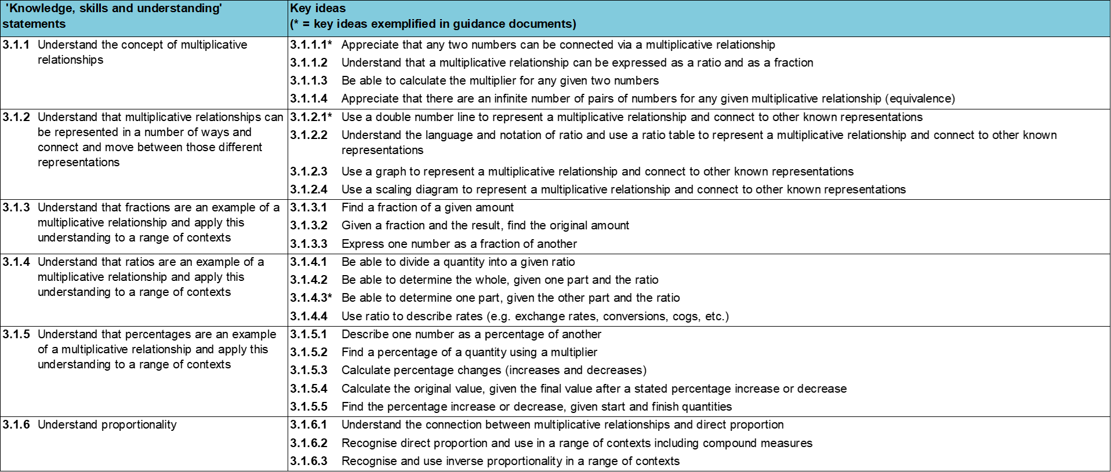
Where does this fit in?
Within this core concept, 3.1 Understanding multiplicative relationships, there are six statements of knowledge, skills and understanding.
These, in turn, are broken down into twenty three key ideas. The highlighted key idea is exemplified in this slide deck.
Notes:
For key ideas marked with an asterisk, we exemplified the common difficulties and misconceptions that students might have and included elements of what teaching for mastery may look like. We have provided examples of possible student tasks and teaching approaches.
Within these slides are ‘classroom-ready’ versions of the examples for the key idea that has been highlighted. There are also slides that may be useful for discussion in a professional development session.

Slide 6
What do students need to understand?
3.1.2.1 Use a double number line to represent a multiplicative relationship and connect to other known representations
Use the multiplicative nature of the double number line to find pairs of values using scalar (along the line) multipliers.
Use the multiplicative nature of the double number line to find pairs of values.
Use the double number line to represent multiplicative relationships, efficiently using both scalar and functional multipliers.
Use the multiplicative nature of the double number line to solve problems efficiently.
  What prior knowledge might your students already have?
  What language might they use to describe this key idea?
  What questions might you want to ask to assess their prior learning?

Slide 7
Why is this key idea important?
Students may have previously met the idea of multiplication by thinking about equal groupings of objects and counting on in equal amounts from zero.
As the numbers with which students work with extend beyond integers to include fractions and decimals, the scaling view of multiplication becomes increasingly important.
This key idea explores some of the images and representations (for example, double number track, ratio table, double number line (also known as a stacked number line), scaling diagram, graphs, algebraic symbolism and other notation) that can be used to build an understanding of the different interpretations of multiplicative structures and so make the connections between seemingly distinct topics explicit.
It is important to keep in mind that the purpose of these different representations is to reveal the underpinning mathematical structure, rather than to provide a method to achieve an answer.
Multiplicative transformations give rise to ideas of ratio, proportionality, percentage increase and decrease, rates of change, enlargement and similarity, and trigonometric ratios.
Notes:
A more detailed overview of the core concept of Multiplicative reasoning can be found on page 2 of the 3.1 Core Concept document.
The background to each key idea is also explored in more detail on the following pages:
3.1.1 Understand the concept of multiplicative relationships – page 5
3.1.2 Understand that multiplicative relationships can be represented in a number of ways and connect and move between those different representations – page 5
3.1.3 Understand that fractions are an example of a multiplicative relationship and apply this understanding to a range of contexts – pages 5 and 6
3.1.4 Understand that ratios are an example of a multiplicative relationship and apply this understanding to a range of contexts – page 6
3.1.5 Understand that percentages are an example of a multiplicative relationship and apply this understanding to a range of contexts – pages 6 and 7
3.1.6 Understand proportionality – page 7

Slide 8
Prior learning
Upper Key Stage 2 Learning Outcome
Multiply proper fractions and mixed numbers by whole numbers, supported by materials and diagrams
Use all four operations to solve problems involving measure (for example, length, mass, volume, money) using decimal notation, including scaling
Solve problems involving the relative sizes of two quantities where missing values can be found by using integer multiplication and division facts
Solve problems involving the calculation of percentages (for example, of measures, and such as 15% of 360) and the use of percentages for comparison
Solve problems involving similar shapes where the scale factor is known or can be found
Solve problems involving unequal sharing and grouping, using knowledge of fractions and multiples
  What prior knowledge might your students already have?
  What language might they use to describe this key idea?
  What questions might you want to ask to assess their prior learning?
Notes:
You may find it useful to speak to your partner schools to see how the above has been covered and the language used.
You can find further details regarding prior learning in the following segments of the NCETM primary mastery professional development materials (linked on final slide):
Year 4: 2.17 Structures: using measures and comparison to understand scaling
Year 6: 2.27 Scale factors, ratio and proportional reasoning
Year 6: 3.10 Linking fractions, decimals and percentages
Within the Multiplicative Reasoning Theme Overview document, you can also find a broader description of students’ potential previous learning (page 3), alongside further information about key underpinning knowledge (page 2).

Slide 9
Checking prior learning
The following slides contain questions for checking prior learning.
  What representations might students use to support their understanding of these questions?
  What variation might you put in place for these questions to fully assess students’ understanding of the concept?
  How might changing the language of each question change the difficulty?
  Why are these such crucial pre-requisites for this key idea?

Slide 10
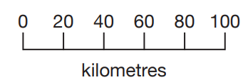
Checking prior learning
a)
Amina planted some seeds.
For every 3 seeds Amina planted, only 2 seeds grew.
Altogether 12 seeds grew.
How many seeds did Amina plant?
b)
On a map, 1cm represents 20km.
The distance between two cities is 250km.
On the map, what is the distance between the two cities?
Notes:
References to the questions (links on final slide):
a) 2017 Key Stage 2 Mathematics Paper 2: reasoning, question 14
b) 2017 Key Stage 2 Mathematics Paper 2: reasoning, question 21

Slide 11
Common difficulties and misconceptions
What aspects of this key idea might students find challenging?
What misconceptions might students have?
When teaching this topic, you may find students encounter difficulties with…
Understanding how a double number line represents the underlying mathematical structure of a multiplicative relationship
More information, and some suggestions for overcoming these challenges, can be found on the following slides.

Slide 12
Common difficulties and misconceptions (1)
Students may not understand that both lines in a double number line must start at zero, and that these zero marks must be aligned.
The double number line can be a useful image to support students in their understanding of the underlying mathematical structure of a multiplicative relationship. It may not always be an efficient representation with which to calculate an answer, but it is an important representation to think with.
A ratio table, which can be considered to be a compressed version of the double number line, is likely to be more efficient, but in the compression, some of the structure is lost and this may need to be made clear to students who are keen to rush to an answer without thinking.
Notes:
More detail can be found on page 16 of the 3.1 Core Concept document.

Slide 13
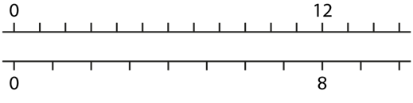
Use the multiplicative nature of the double number line to find pairs of values using scalar (along the line) multipliers
Example 1
Ellie and her dad walk side by side along a straight path. The number of steps they take is represented here:
Which line represents Ellie’s steps and which represents her dad’s? Explain how you know.
When Ellie had taken 12 steps, her dad had taken 8 steps. When else were Ellie and her dad stepping at precisely the same time?
If they continued walking like this, find more points when they would be stepping at the same time. What is the connection between the number of Ellie’s steps and the number of her dad’s steps?
Notes:
Suggested questioning:
Why do Ellie and her Dad take a different number of steps? Who will take more?
If Ellie walks _ steps, how many steps will her Dad take?
If her Dad walks _ steps, how many steps will Ellie take?
When will they be stepping at the same time? How do you know?
Things for you to think about:
In Examples 1–3, the same representation is used to focus attention on different contexts in which the same multiplicative relationship is used, and to give students opportunities to work on the double number line in different ways. In Example 1, the marks represent steps (a discrete measure) and so the question ‘How many steps has Ellie taken when her dad has taken three?’ does not make intuitive sense.
Students should begin to understand how the double number line represents multiplicative relationships. The numbers in Examples 1– 3 have been chosen so that the functional relationship is relatively straightforward. The advantage of the double number line over other representations is that it offers a sense of scale. You could use this by encouraging students to estimate values before going on to calculate accurately.

Slide 14
Use the multiplicative nature of the double number line to find pairs of values using scalar (along the line) multipliers
Example 1
Ellie and her dad walk side by side along a straight path. The number of steps they take is represented here:
  Discuss what students might do in order to find some pairs. What prompts might you use to facilitate further pairs to be found?
Which line represents Ellie’s steps and which represents her dad’s? Explain how you know.
When Ellie had taken 12 steps, her dad had taken 8 steps. When else were Ellie and her dad stepping at precisely the same time?
If they continued walking like this, find more points when they would be stepping at the same time. What is the connection between the number of Ellie’s steps and the number of her dad’s steps?
Notes:
Due to space constraints, the image on this PD discussion slide is very small. PD Leads might like to use or print the ‘in the classroom’ version of this slide for teachers to access during discussions.
More detail about the sequencing of this example can be found on page 16 of the 3.1 Core Concept document.

Slide 15
Use the multiplicative nature of the double number line to find pairs of values using scalar (along the line) multipliers
Example 2
Ali buys eight identical packets of cakes for a birthday party. The total cost is £12.
Which line in this double number line represents the number of packets of cakes Ali buys and which represents the total cost? Explain how you know.
Use this diagram to write down the cost of some other quantities of packets of cakes.
Can you write down roughly how much nine packets of cakes would cost? Can you be precise? Explain how.
Notes:
Suggested questioning:
Did you work by scaling along the lines, or by identifying the relationship between them?
What is the same and different about this example and example 1?
Which line represents cakes? Which line represents cost?
How much would _ cakes cost? How do you know?
How many cakes could I buy for _? How do you know?
Things for you to think about:
In Examples 1–3, the same representation is used to focus attention on different contexts in which the same multiplicative relationship is used, and to give students opportunities to work on the double number line in different ways. Example 2 allows the question of ‘How much would three packets of cakes cost?’, permitting students to use the representation to make an estimate that they can then go on to justify.
It is important that students make connections between the double number line and other familiar representations in order to see the relationships between them. You could ask students to construct a ratio table or graph, using the information presented in a double number line, to solve a problem. For example, Example 2 could be constructed as a ratio table or as a line graph (see slide 17 for a comparison of these representations). By comparing the double number line and the line graph, students will see that every pair of numbers that align on the double number line are represented by coordinates on the graph. It may be helpful to draw students’ attention to the fact that, if the top number line is rotated through 90° anticlockwise the graph is obtained.

Slide 16
Use the multiplicative nature of the double number line to find pairs of values using scalar (along the line) multipliers
Example 2
  What questions might you ask to assess students’ comprehension of this representation?
  How will you support them to reflect on and articulate what they have done?
Ali buys eight identical packets of cakes for a birthday party. The total cost is £12.
Which line in this double number line represents the number of packets of cakes Ali buys and which represents the total cost? Explain how you know.
Use this diagram to write down the cost of some other quantities of packets of cakes.
Can you write down roughly how much nine packets of cakes would cost? Can you be precise? Explain how.
Notes:
Due to space constraints, the image on this PD discussion slide is very small. PD Leads might like to use or print the ‘in the classroom’ version of this slide for teachers to access during discussions.
More detail about the sequencing of this example can be found on pages 17 and 18 of the 3.1 Core Concept document.

Slide 17
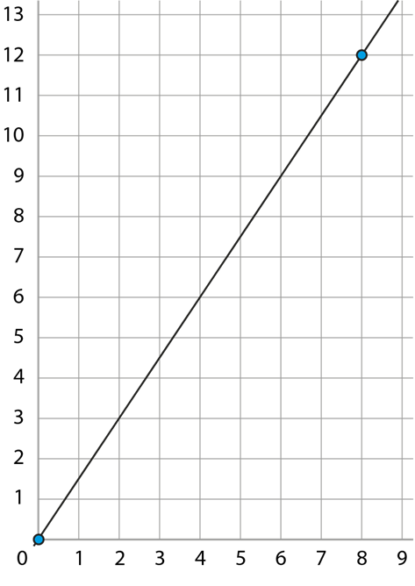
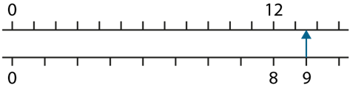
Use the multiplicative nature of the double number line to find pairs of values using scalar (along the line) multipliers
Example 2c
Ali buys eight identical packets of cakes for a birthday party. The total cost is £12.
c) Can you write down roughly how much nine packets of cakes would cost? Can you be precise? Explain how.
12
8 | 9
Which of these representations do you find most useful to answer this question? Why?
Notes:
This slide offers some representations to support part c of Example 2. For ‘suggested questioning’ and ‘things to think about’, see slide 15.

Slide 18
Use the multiplicative nature of the double number line to find pairs of values using scalar (along the line) multipliers
Example 2a
  Which of these representations have you explored with your students in the past?
  What benefits does each representation offer? What are its limitations?
Ali buys eight identical packets of cakes for a birthday party. The total cost is £12.
c) Can you write down roughly how much nine packets of cakes would cost? Can you be precise? Explain how.
12
8 | 9
Which of these representations do you find most useful to answer this question? Why?
Notes:
Due to space constraints, the image on this PD discussion slide is very small. PD Leads might like to use or print the ‘in the classroom’ version of this slide for teachers to access during discussions.
More detail about the sequencing of this example can be found on pages 17 and 18 of the 3.1 Core Concept document.

Slide 19
Use the multiplicative nature of the double number line to find pairs of values using scalar (along the line) multipliers
Example 3
Jodie is travelling from America to New Zealand.
At the time of travelling US$8 is worth about NZ$12.
Which line in this double number line represents US$ and which represents NZ$?
Use this diagram to write down some other conversions for Jodie.
  How many NZ$ is US$9 worth?
  How many US$ is NZ$9 worth?
Can you continue the lines? What rule are you using?
Notes:
Suggested questioning:
Did you work by scaling along the lines, or by identifying the relationship between them?
What is the same and different about this example and examples 1 and 2?
Which line represents US? Which line represents NZ?
How much would _ NZ dollars be worth? How do you know?
How many US dollars could I buy for _? How do you know?
Things for you to think about:
In Examples 1–3, the same representation is used to focus attention on different contexts in which the same multiplicative relationship is used, and to give students opportunities to work on the double number line in different ways. Example 3 allows students to work sensibly by moving up and down both lines, and working between them, to convert amounts given in US$ to NZ$ and amounts given in NZ$ to US$.

Slide 20
Use the multiplicative nature of the double number line to find pairs of values using scalar (along the line) multipliers
Example 3
Jodie is travelling from America to New Zealand.
At the time of travelling US$8 is worth about NZ$12.
  What further questions might you ask for this example?
  Where might you take this next?
Which line in this double number line represents US$ and which represents NZ$?
Use this diagram to write down some other conversions for Jodie.
  How many NZ$ is US$9 worth?
  How many US$ is NZ$9 worth?
Can you continue the lines? What rule are you using?
Notes:
Due to space constraints, the image on this PD discussion slide is very small. PD Leads might like to use or print the ‘in the classroom’ version of this slide for teachers to access during discussions.
More detail about the sequencing of this example can be found on page 18 of the 3.1 Core Concept document.

Slide 21
Use the multiplicative nature of the double number line to find pairs of values using scalar (along the line) multipliers
Examples 1, 2 and 3
  What is the potential benefit of offering students the same double number line in different contexts (as in Examples 1, 2 and 3)?
  What might be drawn out by the differences in each example?
  What other multiplicative relationships might you be able to represent using this example?
Ellie and her dad walk side by side along a straight path. The number of steps they take is represented here.
Ali buys eight identical packets of cakes for a birthday party. The total cost is £12.
Jodie is travelling from America to New Zealand. At the time of travelling US$8 is worth about NZ$12.
Notes:
In Examples 1–3, the same representation is used to focus attention on different contexts in which the same multiplicative relationship is used, and to give students opportunities to work on the double number line in different ways. In Example 1, the marks represent steps (a discrete measure) and so the question ‘How many steps has Ellie taken when her dad has taken three?’ does not make intuitive sense. However, Example 2 allows the question of ‘How much would three packets of cakes cost?’, permitting students to use the representation to make an estimate that they can then go on to justify. Example 3 allows students to work sensibly by moving up and down both lines, and working between them, to convert amounts given in US$ to NZ$ and amounts given in NZ$ to US$.

Slide 22
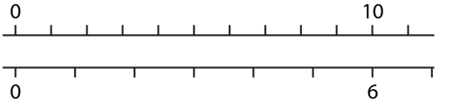
Use the multiplicative nature of the double number line to find pairs of values
Example 4
On this double number line, the 10 and 6 line up
What other pairs of numbers will also line up in the same way?
Notes:
Suggested questioning:
If 10 and 6 line up, what other pairs of numbers will line up?
What else can you tell me about the double number line?
Things for you to think about:
One aspect of variation is exploring the efficiency of different methods that can be used to solve a problem. In Examples 4 and 5, students may use different strategies to reach a solution. It will be important for you to gather these solutions and, if necessary, suggest the strategy of using the functional multiplier of 0.6 if this is not suggested by students.
As an alternative example, you could consider conversions between miles and kilometres. We know that 5 miles is 8 kilometres, and that, for every mile travelled, 1.6 kilometres is travelled.
It is likely that, when converting between the two units, we will use different strategies according to the distances being worked on.
Are there certain distances in which the multiplier of 1.6 is more likely to be used than scaling?

Slide 23
Use the multiplicative nature of the double number line to find pairs of values
Example 4
  What questions will you ask to support students’ to access this representation?
  What questions will you ask to deepen students’ understanding further?
  What different contexts might you use for this example?
On this double number line, the 10 and 6 line up
What other pairs of numbers will also line up in the same way?
Notes:
More detail about the sequencing of this example can be found on pages 18 and 19 of the 3.1 Core Concept document.

Slide 24
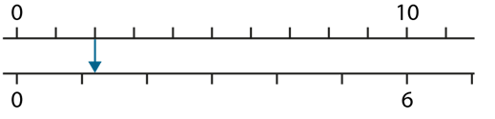
Use the multiplicative nature of the double number line to find pairs of values
Example 5
Estimate the number that the arrow is pointing to.
Calculate the number that the arrow is pointing to.
Describe your calculation – what did you do?
Notes:
Suggested questioning:
If 10 and 6 line up, what other pairs of numbers will line up?
What else can you tell me about the double number line?
How accurate was your estimation?
How did you know what to multiply by? How else could you have done this?
Things for you to think about:
In Examples 4 and 5, students may use different strategies to reach a solution. It will be important for you to gather these solutions and, if necessary, suggest the strategy of using the functional multiplier of 0.6 if this is not suggested by students. For example, in Example 5 the arrow is directly below the 2 on the top line and 2 × 0.6 = 1.2. It will be important for students to realise that this functional multiplier of 0.6 will always change a number on the top line into the corresponding number on the bottom line.

Slide 25
Use the multiplicative nature of the double number line to find pairs of values
Example 5
  Consider what how you might expect students to respond to this task, and then watch video 4 of Mathematical Prompts for Deeper Thinking videos | NCETM. This is the first time these students encountered this representation.
  Do these students show the same thinking that you expected?
  What strikes you about the responses and reasoning from these students?
Estimate the number that the arrow is pointing to.
Calculate the number that the arrow is pointing to.
Describe your calculation – what did you do?
Notes:
Due to space constraints, the image on this PD discussion slide is very small. PD Leads might like to use or print the ‘in the classroom’ version of this slide for teachers to access during discussions.
More detail about the sequencing of this example can be found on page 19 of the 3.1 Core Concept document.
There is a downloadable PowerPoint on the Mathematical Prompts for Deeper Thinking videos | NCETM, which looks more deeply at the students’ misconceptions.

Slide 26
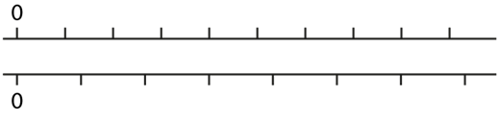
Use the double number line to represent multiplicative relationships, efficiently using both scalar and functional multipliers
Example 6
Each number line is marked in ones.
Fill in the labels on this double number line.
List some pairs of numbers that align perfectly. Could you list them all?
Which number is on the bottom line, directly under 2?
Which number is on the top line, directly above 2?
Which of these answers are you most sure of? How can you check?
Notes:
Suggested questioning:
Give an example of a pair of numbers that align perfectly.
How much has the bottom number line been stretched by? What is the scale factor?
How would your answer change if the bottom line had stayed fixed and the top line had been compressed?
Will 30 and 40 align? How do you know?
Things for you to think about:
The double number line allows students to calculate accurately and estimate. Examples 6 to 8 provide students with an opportunity to do both. Drawing students’ attention to occasions when they use scaling along the line and when they use a multiplier between the lines is crucial. It is likely that students will prefer to work along the lines, and so may need greater experience with simple ‘between the lines’ (functional) multipliers to ensure that they are aware that this is also an option when calculating.

Slide 27
Use the double number line to represent multiplicative relationships, efficiently using both scalar and functional multipliers
Example 6
  It is likely that students will need further experience of working with double number lines in which the scales are removed. Which numbers will you use in order to draw students’ attention to the relationship between the lines?
  How will you ensure that students are aware of both multiplicative relationships?
Each number line is marked in ones.
Fill in the labels on this double number line.
List some pairs of numbers that align perfectly. Could you list them all?
Which number is on the bottom line, directly under 2?
Which number is on the top line, directly above 2?
Which of these answers are you most sure of? How can you check?
Notes:
Due to space constraints, the image on this PD discussion slide is very small. PD Leads might like to use or print the ‘in the classroom’ version of this slide for teachers to access during discussions.
More detail about the sequencing of this example can be found on page 19 of the 3.1 Core Concept document.

Slide 28
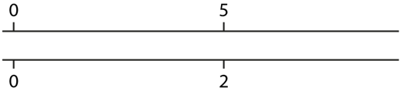
Use the double number line to represent multiplicative relationships, efficiently using both scalar and functional multipliers
Example 7
Here is another double number line. Mark on the positions of some more numbers as accurately as you can.
List more pairs of numbers that align perfectly.
Which number is on the top line, directly above 3?
Which number is on the bottom line, directly below 3?
Which of these answers are you most sure of? How can you check?
Notes:
Suggested questioning:
Which number is on the top line, directly above 1?
Which number is on the top line, directly above 10?
Which number is on the bottom line, directly below 10?
Which number is on the bottom line, directly below 1?
Which of these questions was harder or easier to answer? Why?
What might this look like as a graph?
Things for you to think about:
Making connections between the double number line and other representations of multiplicative relationships can be challenging. You could ask students to consider the double number lines used in Examples 7 and 8 and imagine that they are represented as a graph. Then, ask a question such as ‘Which of the graphs will be the steepest? Make the connection between the graph and the double number line explicit to yourself.’

Slide 29
Use the double number line to represent multiplicative relationships, efficiently using both scalar and functional multipliers
Example 7
Here is another double number line. Mark on the positions of some more numbers as accurately as you can.
  What questions might you want to ask to support your students to understand this representation?
  What questions might you want to ask to challenge your students to think more deeply?
List more pairs of numbers that align perfectly.
Which number is on the top line, directly above 3?
Which number is on the bottom line, directly below 3?
Which of these answers are you most sure of? How can you check?
Notes:
Due to space constraints, the image on this PD discussion slide is very small. PD Leads might like to use or print the ‘in the classroom’ version of this slide for teachers to access during discussions.
More detail about the sequencing of this example can be found on page 20 of the 3.1 Core Concept document.

Slide 30
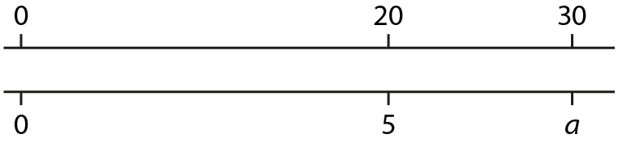
Use the double number line to represent multiplicative relationships, efficiently using both scalar and functional multipliers
Example 8
Here is another double number line.
Steve says that, to find the value of a, he is going to calculate 5 x 1.5.
Mia says that she is going to find one quarter of 30.
Do you agree with Steve or Mia?
Explain how you know.
Notes:
Suggested questioning:
What would you do? Is it the same or different to the methods that Steve and Mia offer?
What relationship is Steve using? What relationship is Mia using?
When might Steve’s method be easier? When might Mia’s method be easier?
Things for you to think about:
In Example 8 students will decide whether the functional or scalar multiplier is appropriate. The methods offered by Steve and Mia are both equally correct and may offer a catalyst for students to think about which multiplier they find easier to work with in each case. Students need to understand that they have a choice to make about which multiplier to use in a given context. You could ask students to replace one of the values given so that the functional multiplier is easier, and then to change it again so that the scalar multiplier would be the preference.

Slide 31
Use the double number line to represent multiplicative relationships, efficiently using both scalar and functional multipliers
Example 8
Here is another double number line.
  Do you use the functional or scalar multiplier when approaching this problem? Why?
  Students need to understand that they have a choice to make about which multiplier to use in a given context. What other examples might you give to help them see this?
Steve says that, to find the value of a, he is going to calculate 5 x 1.5.
Mia says that she is going to find one quarter of 30.
Do you agree with Steve or Mia?
Explain how you know.
Notes:
Due to space constraints, the image on this PD discussion slide is very small. PD Leads might like to use or print the ‘in the classroom’ version of this slide for teachers to access during discussions.
More detail about the sequencing of this example can be found on page 20 of the 3.1 Core Concept document.

Slide 32
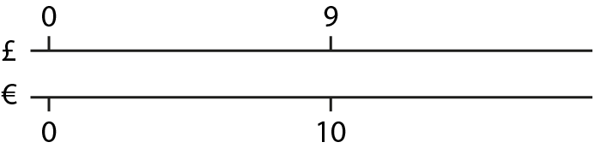
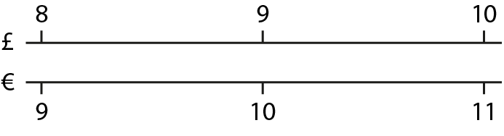
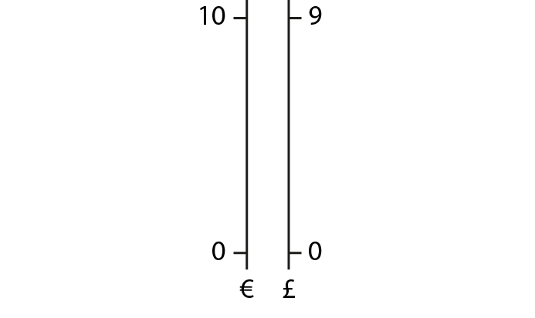
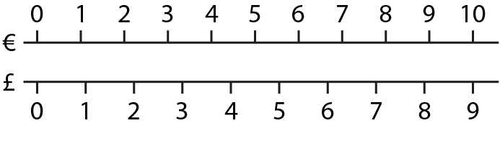
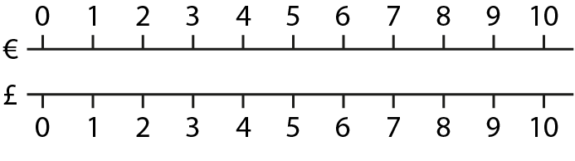
Use the multiplicative nature of the double number line to solve problems efficiently
Example 9a
£9 is worth about €10.
Which of the following double number lines shows this information correctly?
i)
ii)
iii)
iv)
v)
Notes:
Suggested questioning:
Which are correct? Which are not?
What relationship do the incorrect ones show? Why is this not a correct way to model this situation?
Which is most useful for answering this problem? Why?
Things for you to think about:
Examples and non-examples of double number lines are used in Example 9 as discussion points to ensure that students see the multiplicative, rather than additive, nature of double number lines.

Slide 33
Use the multiplicative nature of the double number line to solve problems efficiently
Example 9b
£9 is worth about €10.
Use one of the correct double number lines to:
  (i) Estimate how many pounds €7 is worth.
(ii) Calculate accurately how many pounds €7 is worth.
i)
ii)
iii)
iv)
v)
Notes:
Suggested questioning:
Which are correct? Which are not?
What relationship do the incorrect ones show? Why is this not a correct way to model this situation?
Which is most useful for answering this problem? Why?
Things for you to think about:
Examples and non-examples of double number lines are used in Example 9 as discussion points to ensure that students see the multiplicative, rather than additive, nature of double number lines.

Slide 34
Use the multiplicative nature of the double number line to solve problems efficiently
Example 9
  How might you address the misconceptions posed by double number line ii) ?
  Are there any other non-examples you might want students to consider here?
£9 is worth about €10.
Which of the following double number lines shows this information correctly?
Use one of the correct double number lines to:
  (i) Estimate how many pounds €7 is worth.
(ii) Calculate accurately how many pounds €7 is worth.
iii)
i)
ii)
iv)
v)
Notes:
Due to space constraints, the image on this PD discussion slide is very small. PD Leads might like to use or print the ‘in the classroom’ version of this slide for teachers to access during discussions.
More detail about the sequencing of this example can be found on pages 20 and 21 of the 3.1 Core Concept document.

Slide 35
Use the multiplicative nature of the double number line to solve problems efficiently
Example 10
100ml of orange drink is made with 80ml water and 20ml squash.
Show this information on a double number line.
Use your double number line to:
  Estimate the amount of water needed for 51ml of squash.
  Calculate accurately the amount of water needed for 51ml of squash.
Notes:
Suggested questioning:
Where will both of your number lines start? Why?
What will your top line represent? What will your bottom line represent?
What is the functional (between the lines) multiplier? What is the scalar (along the lines) multiplier?
Things for you to think about:
Examples 10 to 12 use a double number line in different contexts. Students should understand that the same representation can be used because the situations all share the same mathematical structure. You could ask students to offer another context in which the same double number line could be used.

Slide 36
Use the multiplicative nature of the double number line to solve problems efficiently
Example 11
In a sale all items are reduced by 25%, so a shirt that usually costs £40 will be reduced by £10.
Show this information on a double number line.
Use your double number line to:
  Estimate the amount to be taken off a jacket that usually costs £55.
  Calculate accurately the amount to be taken off a jacket that usually costs £55.
Notes:
Suggested questioning:
Where will both of your number lines start? Why?
What will your top line represent? What will your bottom line represent?
What is the functional (between the lines) multiplier? What is the scalar (along the lines) multiplier?
Things for you to think about:
Examples 10 to 12 use a double number line in different contexts. Students should understand that the same representation can be used because the situations all share the same mathematical structure. You could ask students to offer another context in which the same double number line could be used.

Slide 37
Use the multiplicative nature of the double number line to solve problems efficiently
Example 10
Example 11
100 ml of orange drink is made with 80 ml water and 20 ml squash.
Show this information on a double number line.
Use your double number line to:
  Estimate the amount of water needed for 51 ml of squash.
  Calculate accurately the amount of water needed for 51 ml of squash.
In a sale all items are reduced by 25%, so a shirt that usually costs £40 will be reduced by £10.
Show this information on a double number line.
Use your double number line to:
  Estimate the amount to be taken off a jacket that usually costs £55.
  Calculate accurately the amount to be taken off a jacket that usually costs £55.
  What is the same/different about these examples?
  How might the double number line representation change how students approach each question?
Notes:
Due to space constraints, the image on this PD discussion slide is very small. PD Leads might like to use or print the ‘in the classroom’ version of this slide for teachers to access during discussions.
More detail about the sequencing of this example can be found on pages 21 and 22 of the 3.1 Core Concept document.

Slide 38

Use the multiplicative nature of the double number line to solve problems efficiently
Example 12
This rectangle is four times as tall as it is long.
The rectangle can be made bigger or smaller on a screen, but its height is always four times the base.
When the base of the rectangle is 13cm long, the rectangle is 42cm high.
Show this information on a double number line.
Use your double number line to:
  Estimate the length of the base when the height is 13cm.
  Calculate accurately the length of the base when the height is 13cm.
Notes:
Suggested questioning:
Where will both of your number lines start? Why?
What will your top line represent? What will your bottom line represent?
What is the functional (between the lines) multiplier? What is the scalar (along the lines) multiplier?
Things for you to think about:
Examples 10 to 12 use a double number line in different contexts. Students should understand that the same representation can be used because the situations all share the same mathematical structure. You could ask students to offer another context in which the same double number line could be used.

Slide 39
Use the multiplicative nature of the double number line to solve problems efficiently
  Consider the ‘ratio, proportion and rates of change’ section of the Key Stage 3 mathematics programme of study, the chapter index of your Key Stage 3 textbook or your Key Stage 3 schemes of work.
  In which elements of these could a double number line be a productive representation?
Example 12
This rectangle is four times as tall as it is long.
The rectangle can be made bigger or smaller on a screen, but its height is always four times the base.
When the base of the rectangle is 13cm long, the rectangle is 42cm high.
Show this information on a double number line.
Use your double number line to:
  Estimate the length of the base when the height is 13cm.
  Calculate accurately the length of the base when the height is 13cm.
Public sector information licensed under the Open Government Licence v3.0.
Notes:
Due to space constraints, the image on this PD discussion slide is very small. PD Leads might like to use or print the ‘in the classroom’ version of this slide for teachers to access during discussions.
More detail about the sequencing of this example can be found on page 22 of the 3.1 Core Concept document.

Slide 40
Reflection questions
What other mathematical concepts will be supported by students’ stronger understanding of this key idea?
What mathematical language will you continue to use to support pupils to make connections with other areas?
Which representations might you continue to use to further develop students’ understanding?

Slide 42
Appendices
You may choose to use the following slides when planning or delivering a PD session. They cover:
  Key vocabulary
  Representations and structure
  Previous learning
  Future learning
  Library of links

Slide 43
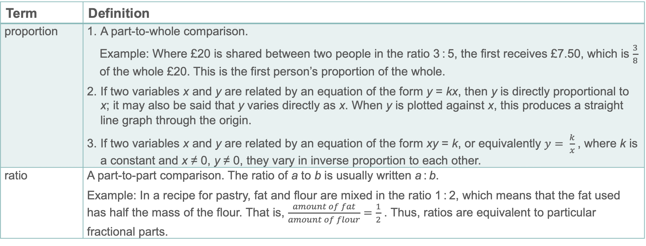
Key vocabulary
Term | Definition
proportion | A part-to-whole comparison. Example: Where £20 is shared between two people in the ratio 3 : 5, the first receives £7.50, which is $\frac{3}{8}$ of the whole £20. This is the first person’s proportion of the whole. If two variables x and y are related by an equation of the form y = kx, then y is directly proportional to x; it may also be said that y varies directly as x. When y is plotted against x, this produces a straight line graph through the origin. If two variables x and y are related by an equation of the form xy = k, or equivalently $y= \frac{k}{x}$, where k is a constant and x ≠ 0, y ≠ 0, they vary in inverse proportion to each other.
ratio | A part-to-part comparison. The ratio of a to b is usually written a : b. Example: In a recipe for pastry, fat and flour are mixed in the ratio 1 : 2, which means that the fat used has half the mass of the flour. That is, $\frac{amount of fat}{amount of flour}=\frac{1}{2}$ . Thus, ratios are equivalent to particular fractional parts.

Slide 44
Representations and structure
There are a number of different representations that you may wish to use to support students’ understanding of this key idea. These might include:
Ratio tables and double number lines (also known as ‘stacked number lines’)
  The comparison of corresponding entries in two different sets of multiples, such as from a multiplication table, can be a useful context in which to explore multiplicative relationships.
12
8 | 9
Notes:
More information about the representations and structure involved in this key idea can be found:
On page 7 of the Multiplicative Reasoning Theme Overview document
Links to all of these can be found on the final slide.

Slide 45
Previous learning
From Upper Key Stage 2, students will bring experience of:
multiplying proper fractions and mixed numbers by whole numbers, supported by materials and diagrams
recognising the per cent symbol (%) and understanding that per cent relates to ‘number of parts per hundred’, and writing percentages as a fraction with denominator 100, and as a decimal
using all four operations to solve problems involving measure (for example, length, mass, volume, money) using decimal notation, including scaling
solving problems involving the relative sizes of two quantities where missing values can be found by using integer multiplication and division facts
solving problems involving the calculation of percentages (for example, of measures, and such as 15% of 360) and the use of percentages for comparison
solving problems involving similar shapes where the scale factor is known or can be found
solving problems involving unequal sharing and grouping, using knowledge of fractions and multiples.
Notes:
Theme 3 Multiplicative reasoning

Slide 46
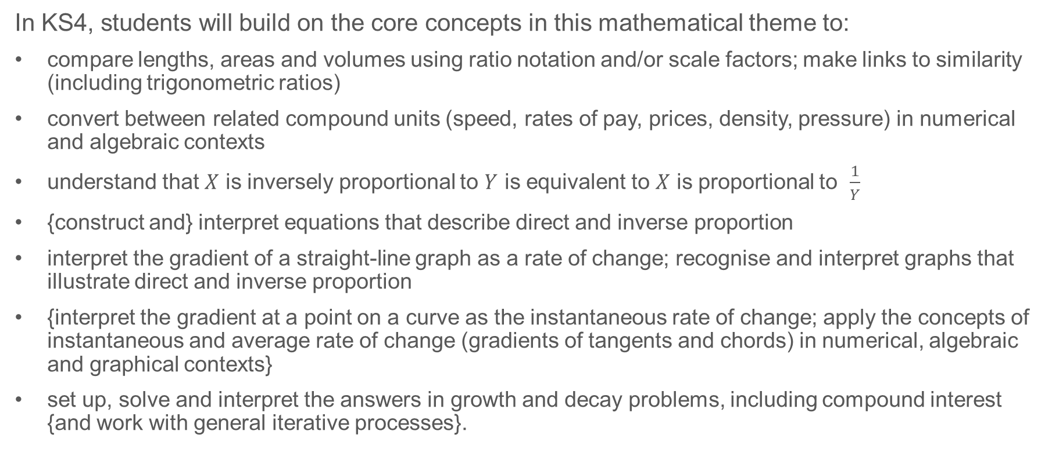
Future learning
In KS4, students will build on the core concepts in this mathematical theme to:
compare lengths, areas and volumes using ratio notation and/or scale factors; make links to similarity (including trigonometric ratios)
convert between related compound units (speed, rates of pay, prices, density, pressure) in numerical and algebraic contexts
understand that $X$ is inversely proportional to $Y$ is equivalent to $X$ is proportional to $\frac{1}{Y}$
{construct and} interpret equations that describe direct and inverse proportion
interpret the gradient of a straight-line graph as a rate of change; recognise and interpret graphs that illustrate direct and inverse proportion
{interpret the gradient at a point on a curve as the instantaneous rate of change; apply the concepts of instantaneous and average rate of change (gradients of tangents and chords) in numerical, algebraic and graphical contexts}
set up, solve and interpret the answers in growth and decay problems, including compound interest {and work with general iterative processes}.
Please note: Braces { } indicate additional mathematical content to be taught to more highly attaining students.
Notes:
Theme 3 Multiplicative reasoning

Slide 47
Library of links
The following resources from the NCETM website have been referred to within this slide deck:
  NCETM Secondary Mastery Professional Development
    3 Multiplicative Reasoning Theme Overview Document
    3.1 Understanding Multiplicative Relationships Core Concept Document
  Using mathematical representations at KS3 | NCETM
  Mathematical Prompts for Deeper Thinking videos | NCETM
  NCETM primary mastery professional development materials
There are also references to:
  Standards & Testing Agency’s past mathematics papers
  National curriculum in England: mathematics programmes of study - GOV.UK (www.gov.uk)

