Slide 1
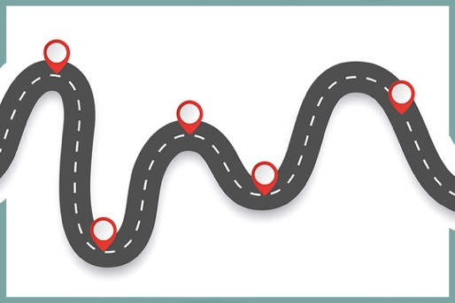
Checkpoints
Year 8 diagnostic mathematics activities
Estimation and rounding
Twenty-two Checkpoint activities
Eleven additional activities
Published in 2022/23

Slide 2
About this resource
This resource is designed to be used in the classroom with Year 8 students, although it may be useful for other students.
The Checkpoints are grouped around the key ideas in the core concept document, 1.1 Place value, estimation and rounding, part of the NCETM Secondary Mastery Professional Development materials.
Before each set of Checkpoints, context is explored, to help secondary teachers to understand where students may have encountered concepts in primary school.
The 10-minute Checkpoint tasks might be used as assessment activities, ahead of introducing concepts, to help teachers explore what students already know and identify gaps and misconceptions.
Each Checkpoint has an optional question marked . This will provide further thinking for those students who have completed the rest of the activities on the slide.
The notes for each Checkpoint give answers (if appropriate), some suggested questions and things to consider.
After each Checkpoint, a guidance slide explores suggested adaptations, potential misconceptions and follow-up tasks. These may include the additional activities at the end of this deck.

Slide 3
Checkpoints 1–8
Checkpoint | Underpins | Code
1: Chairs | Estimation | 1.1.4
2: Animal facts
3: Classroom maths
4: Dolls’ house | Understand place value in decimals, including recognising exponent and fractional representations of the column headings | 1.1.1.2
5: Check pints
6: Lift off!
7: Greater in value
8: Same number
*This three-digit code refers to the statement of knowledge, skills and understanding in the NCETM’s Sample Key Stage 3 Curriculum Framework (see notes below for more information).
Notes:
In the Sample Key Stage 3 Curriculum Framework, statements of knowledge, skills and understanding are arranged to give an example teaching order. The three-digit code for each statement in the framework is a clickable hyperlink to documents with more detailed information, including the key ideas in that statement. These key ideas are also shown on slides 6–7 in this deck.

Slide 4
Checkpoints 9–15
Checkpoint | Underpins | Code
9a: What’s it about? 9b: About a holiday 9c: About a shelf | Estimation | 1.1.4
10: Little more, little less
11: Choices, choices
12: Four or not?
13: In the red | Rounding | 1.1.2 1.1.3
14: Who’s correct?
15: Midpoint muddle
*This three-digit code refers to the statement of knowledge, skills and understanding in the NCETM’s Sample Key Stage 3 Curriculum Framework (see notes below for more information).
Notes:
In the Sample Key Stage 3 Curriculum Framework, statements of knowledge, skills and understanding are arranged to give an example teaching order. The three-digit code for each statement in the framework is a clickable hyperlink to documents with more detailed information, including the key ideas in that statement. These key ideas are also shown on slides 6–7 in this deck.

Slide 5
Checkpoints 16–22
Checkpoint | Underpins | Code
16: Missing numbers | Rounding | 1.1.2 1.1.3
17: Always, sometimes, never? | Rounding | 1.1.2 1.1.3
18: Thinking of a number
19: The dog ate my homework
20: 1997 | Understand place value in decimals, including recognising exponent and fractional representations of the column headings | 1.1.1.2
21: Digit cards
22: Zeros
*This three-digit code refers to the statement of knowledge, skills and understanding in the NCETM’s Sample Key Stage 3 Curriculum Framework (see notes below for more information).
Notes:
In the Sample Key Stage 3 Curriculum Framework, statements of knowledge, skills and understanding are arranged to give an example teaching order. The three-digit code for each statement in the framework is a clickable hyperlink to documents with more detailed information, including the key ideas in that statement. These key ideas are also shown on slides 6–7 in this deck.

Slide 6
Key ideas
Round numbers to a required number of decimal places | Code
Round numbers to up to three decimal places | 1.1.2.1
Round numbers to any number of decimal places | 1.1.2.2
Round numbers to a required number of significant figures | Code
Understand the concept of significant figures | 1.1.3.1
Round integers to a required number of significant figures | 1.1.3.2*
Round decimals to a required number of significant figures | 1.1.3.3
*‘There are additional resources exemplifying these key ideas in the Secondary Mastery Professional Development | NCETM.

Slide 7
Key ideas
Estimate calculations by rounding | Code
Understand what is meant by a sensible degree of accuracy | 1.1.4.1
Estimate numerical calculations | 1.1.4.2*
Estimate and check if solutions to problems are of the correct magnitude | 1.1.4.3
Determine whether calculations using rounding will give an underestimate or overestimate | 1.1.4.4
Understand the impact of rounding errors when using a calculator, and the way that these can be compounded to result in large inaccuracies | 1.1.4.5
Calculate possible errors expressed using inequality notation a < x ≤ b | 1.1.4.6
*‘There are additional resources exemplifying these key ideas in the Secondary Mastery Professional Development | NCETM.

Slide 8
Estimation
Checkpoints 1–12

Slide 9
Estimation
Previous learning | In Key Stage 3 students need to
Key Stage 2 curriculum: Year 3: identify, represent and estimate numbers using different representations (Note this is first mentioned in Key Stage1.) Year 4: estimate, compare and calculate different measures, including money in pounds and pence (Note estimating measures is first mentioned in Key Stage 1.) Year 5: estimate the area of irregular shapes; estimate volume; estimate and compare acute, obtuse and reflex angles Year 6: use estimation to check answers to calculations and determine, in the context of a problem, an appropriate degree of accuracy. Further information about how students may have experienced this key idea in Key Stage 2: Teaching mathematics in primary schools 5G–1: compare angles, estimate and measure angles in degrees and draw angles of a given size (pp265–68)*; 5NPV–3: Reason about the location of any number with up to 2 decimal places in the linear number system, including identifying the previous and next multiple of 1 and 0.1 and rounding to the nearest of each (pp219–24). (Note that, throughout the NPV section of the guidance, pupils are expected to estimate the position of numbers in the linear number system.) Primary Mastery Professional Development, Spine 1 Number, Addition and Subtraction, Year 6 Segment 1.30 Composition and calculation: numbers up to 10,000,000 * Page numbers reference the complete Years 1–6 document | Have a strong sense of the relative size of numbers Use estimation strategies to check the validity of their answers in calculation Use and estimate measures in real-life contexts Understand that measuring is always to a certain degree of accuracy Estimate values using rounding, including working with real-life situations involving contextualised data.

Slide 10
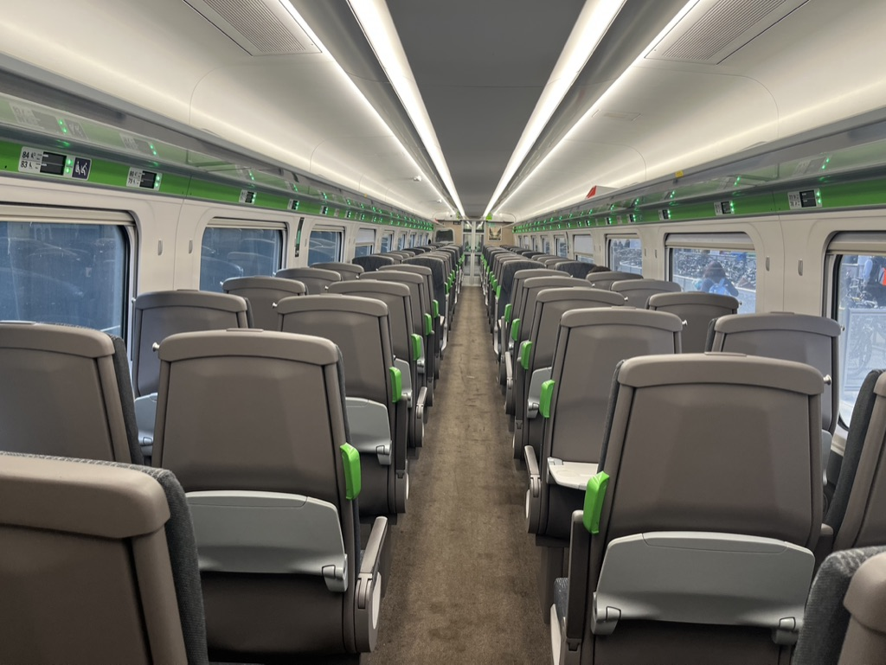
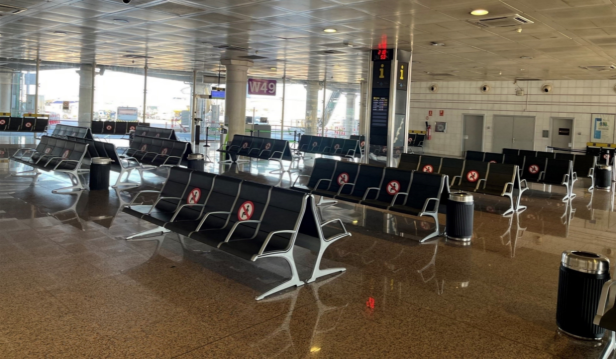
Checkpoint 1: Chairs
How many seats do you think there are in the train carriage on the right? Explain how you estimated your answer.
How many seats do you think there are in the waiting room on the left? Explain how you estimated your answer.
Estimate how many people could stand in your classroom. Explain how you estimated your answer. How would your answer change if they were sitting on chairs?
Notes:
This slide is animated. Each question will appear separately so you can choose the pace at which to work with your class.
Answers
a) There are 92 seats in the train carriage. Any estimate close to this is acceptable (for example, in the range 80–100). You might expect students to talk about counting in twos, or counting the number of rows of chairs that they could see and then multiplying by the four seats across the carriage.
b) There are 205 seats in the waiting room. Any estimate close to this is acceptable (for example, in the range 180–220). You might expect students to count the groups of 10 chairs and then multiply the number of sets of chairs they count by 10. Some students might notice that there is the edge of some chairs next to the bin in the bottom right hand corner of the photo, and so add on an estimate for how many groups of five chairs might be along that wall.
? Students’ answers to this will vary, depending on the size of the classroom. You should expect students to be able to recognise that their estimate will reduce if people are sitting on rows if chairs, and reduce further if those chairs are arranged around tables as in their normal classroom, rather than in rows .
Suggested questioning
Can the way the seats are arranged help?
Are there more or less than 100 seats in the carriage? More or less than 200 seats? Or 50 seats?
How about in the waiting room?
Could there be 51 seats in the carriage? Explain why/why not.
Things to think about
The two images in Checkpoint 1 offer a context for students to estimate. The grouping of the seats in the images offers a natural structure to support students to make a reasoned estimate – are there other images of chairs that lend themselves less to this strategy? For example, you could show students an image of a football stadium and ask how their strategies for estimation would be different. It is worth thinking in advance about how you will manage the class discussion and capture students’ thinking.

Slide 11
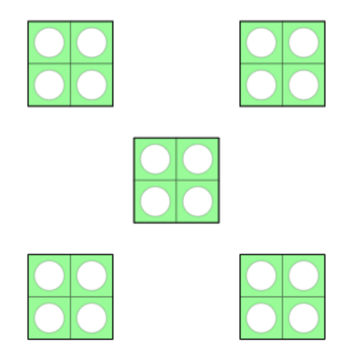
Checkpoint 1: Guidance
Adaptations | Assessing understanding
Support It may help some students to consider the structure of an estimation if they are encouraged to describe how the seats are arranged. If they notice there are rows of seats, then ask, ‘How many rows are there?’; if they notice the seats are in clusters, then ask, ‘How many seats are there in a cluster?’. The intent is to see whether they can use these values, and the mathematical structures within the image, to calculate a reasonable estimate. Challenge Ask students to consider the limits of their estimation. Is there an upper number of seats that they wouldn’t go beyond? Or a lower number that they wouldn’t go below? Particularly, ask them to justify how they know that their limits are accurate and to state any assumptions that they are making. Representations Use number tiles in familiar arrangements, paying attention to which value is the ‘unit’. For example, the tiles on the left are a way to see 4 five times (as in the train carriage; you would use tiles representing 5 or 10 for the waiting room chairs). Such arrangements may support students in looking for easily known numbers in complex situations. | Assess whether students understand that making an estimate is not necessarily the same as making a guess. Estimation is likely to have a structure to it, or to draw on some assumptions or known information. In the case of the train carriage, students can see that the seats are arranged in rows of four seats, so it is likely that multiplying by four will feature in their estimate. They might then assume that there are around 20 or 30 rows of seats, maybe offering an upper and lower estimate of 80 to 120 seats. Similarly, the waiting room chairs are in clusters of 10 (two rows of five back-to-back). It is this reasoning, rather than the accuracy of the answer, that is being assessed. Encouraging students to verbalise and answer the question, ‘How do you know?’ is crucial.
Additional resources If students struggle to use a structure to support their estimation, then it is worth showing them more images of large quantities (for example rows of houses or items on shop shelves) and asking how they estimate the total. These can be readily found online using a search engine and search terms such as “large quantities (of __)”, “how many” or “estimation”.

Slide 12
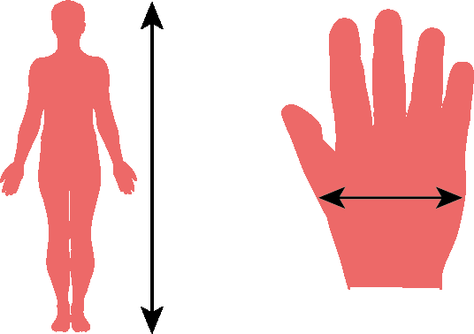
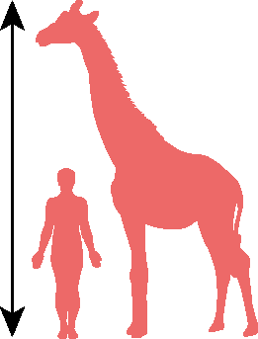
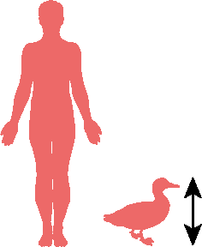
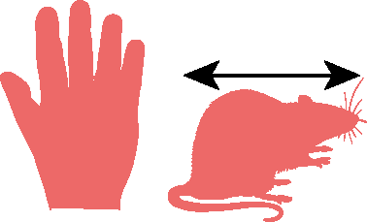
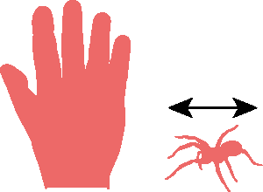
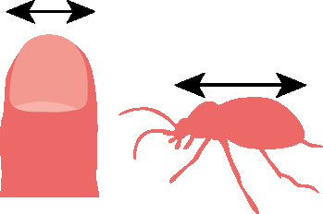
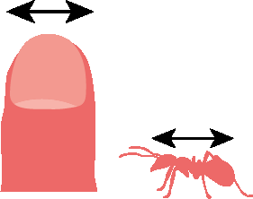

Checkpoint 2: Animal facts
A science textbook uses comparisons with humans to show the sizes of different animals.
Which of these is a good estimate for the height of the person?
1.4 m 1.7 m 2 m
Which of these is a good estimate for the width of the hand?
10 cm 15 cm 20 cm
Use your answers to parts a and b to estimate the size of each of the animals below.
Some other animals are compared to the width of a fingernail. What might be a good estimate for these animals?
Notes:
This slide is animated. Each question will appear separately so you can choose the pace at which to work with your class.
Answers
a) 1.7 m
b) 10 cm
c) These are approximate answers; accept responses within a reasonable range of the given values, particularly if the justification is sound (suggested reasoning is indicated in brackets).
Giraffe: approximately 3.4 m (the giraffe is approximately twice the height of the person).
Duck: approximately 0.42 m or 42 cm (the duck is approximately one-quarter of the height of the person).
Rodent: approximately 22 cm (the rat is approximately one-and-a-half times the width of the hand).
Spider: approximately 5 cm (the spider is approximately one-third of the width of the hand).
? Follow through from students’ estimates for the width of a fingernail, as long as this itself is a reasonable estimate (i.e. 1-1.5 cm). Working left to right, the first insect is approximately 1.5 times the width of the fingernail and the second insect is approximately $\frac{2}{3}$the width of the fingernail. So, for example, if the students started with an estimate of 1.2 cm, reasonable estimates would be 1.8 cm for the first insect and 0.8 cm for the second.
Suggested questioning
How tall are you? Are you taller or shorter than an average adult?
How wide is your hand? Is it wider or narrower than an average adult’s hand?
Why might a textbook use images like these next to pictures of animals?
Which image is easiest to estimate from? Why?
Things to think about
Checkpoint 2 looks at estimating length, and how body measurements can be used to support the estimation of length. Images such as these are often used to show scale. If possible, have some real examples of these in textbooks and encyclopaedias to show students.

Slide 13
Checkpoint 2: Guidance
Adaptations | Assessing understanding
Support Encourage students to measure some lengths or heights around the classroom to give them some necessary reference points for parts a and b, and for other estimation tasks. Challenge Ask students to stay in their seats (so they can’t measure) and to estimate some measurements of items in the classroom. For example, the height of the ceiling, or the dimensions of the whiteboard or a window. Choose objects that could reasonably be compared with the human measurements used in the science textbook examples (i.e. height, hand width, fingernail width). Representations Representations, in this context, can be considered as some familiar objects that are approximately a standard unit of length. Knowing that a metre is roughly one large step, or that a centimetre is a finger nail gives students a reference point to work with when estimating unknown lengths. | An awareness of some key ‘anchor’ points is useful when estimating height, weight or length. See whether students are aware of some of these key values, and then whether they are able to apply this knowledge along with an understanding of reason proportion, to estimate some lengths. Multiple choice answers are offered to help guide students’ thinking, but this should be followed up by prompt questions that ask them to justify why they made that selection. Do they make reference to other known lengths or familiar objects? Asking students to justify their estimations using the language of proportion may support them in understanding the process more clearly. The giraffe is ‘a bit’ bigger than a person does not offer a structure for estimation, while the fact that the bird is twice the height of the person gives a purpose to the comparison. Listen out for students who use the language of scaling (for example “the rat is approximately one-and-a-half times the width of the hand” or “the spider is approximately one-third of the width of the hand”), as this indicates a more secure understanding of multiplicative relationships.
Additional resources Additional activity E explores more body measurements for estimation, specifically the use of hands to measure horses.

Slide 14
Checkpoint 3: Classroom maths
Look around your classroom. Can you find something that is about as long as each of the measurements below?
2 m
20 cm
2 cm
2 mm
1 m
0.5 m
50 mm
0.01 km
Can you think of an object that would be a similar length that is not in your classroom?
Notes:
This slide is animated. Each measurement will appear separately so you can choose the pace at which to work with your class.
Answers
The following are suggestions from a ‘typical’ classroom.
2 m: the width of the whiteboard; the height of the door
20 cm: the width of an A4 exercise book
2 cm: the depth of a textbook
2 mm: the width of a felt-tip mark; the length of a pencil lead
1 m: the length of a table
0.5 m: the width of a table
50 mm: the depth of an in-tray/classroom drawer; the diameter of a drink bottle
0.0 1 km: nothing in the classroom. This is 10 m, so a tenth of the length of the straight on a running track. It may be the length of a larger room in the school.
Check or create your own bank of answers by measuring some items in your own classroom.
? Students’ answers will vary.
Suggested questioning
What is the biggest length on the slide? Why is it not the biggest number?
What is the smallest length on the slide?
Which of these lengths is closest to your height/your arm span/the length of your finger?
Things to think about
Having a sense of the size of everyday objects is a very useful skill to support students’ estimation. Checkpoint 3 uses a simple premise – identifying objects that are visible in the classroom – to assess how accurately students can do this. Follow the lead of students and their responses to the prompts given. You may find it helpful to have measured a few classroom items in advance as reference points.

Slide 15
Checkpoint 3: Guidance
Adaptations | Assessing understanding
Support Encourage students to measure some lengths or heights around the classroom to give them some necessary reference points for this, and for other estimation tasks. Challenge Challenge students to work between the different units, using the structure of the base 10 system. Ask questions like, ‘How many 2 mm objects would be needed to make the same length as a 20 cm object or a 2 m object?’ or ‘How many 2 cm objects would be the same length as a 20 cm object?’ Representations Representations, in this context, can be considered as some familiar objects that are approximately a standard unit of length. Knowing that a metre is roughly one large step, or that a centimetre is roughly a finger nail gives students a reference point to work with when estimating unknown lengths. | This Checkpoint enables students to show their familiarity with different units of length, and the relationships between them. Identifying some lengths may prove more straightforward than others – a door is around 2 m high, but finding an object that is 2 mm may prove challenging in a classroom setting. The first row uses predominantly the same values so that the focus is on the relative size of different units. When working ‘between’ units, as in the second row of the task, look for students who are able to convert to familiar units. For example, identifying that 50 mm is 5 cm may support their estimation. Those less secure with conversion might falsely equate 1 m and 0.01 km or 0.5 m and 50 mm. You could do some further work on units of measurement with these students. Students may be particularly thrown by the fact that 0.01 km is equivalent to 100 m.
Additional resources Additional activity D uses world records as another context for thinking about units of measurement and estimating length/mass; additional activity C might also be helpful. The focus of 5NPV-5 in the Exemplification of ready-to-progress criteria NCETM is on the relationship of powers of 10 between units. Download as part of the Year 5 deck or the complete Number and Place Value deck.

Slide 16
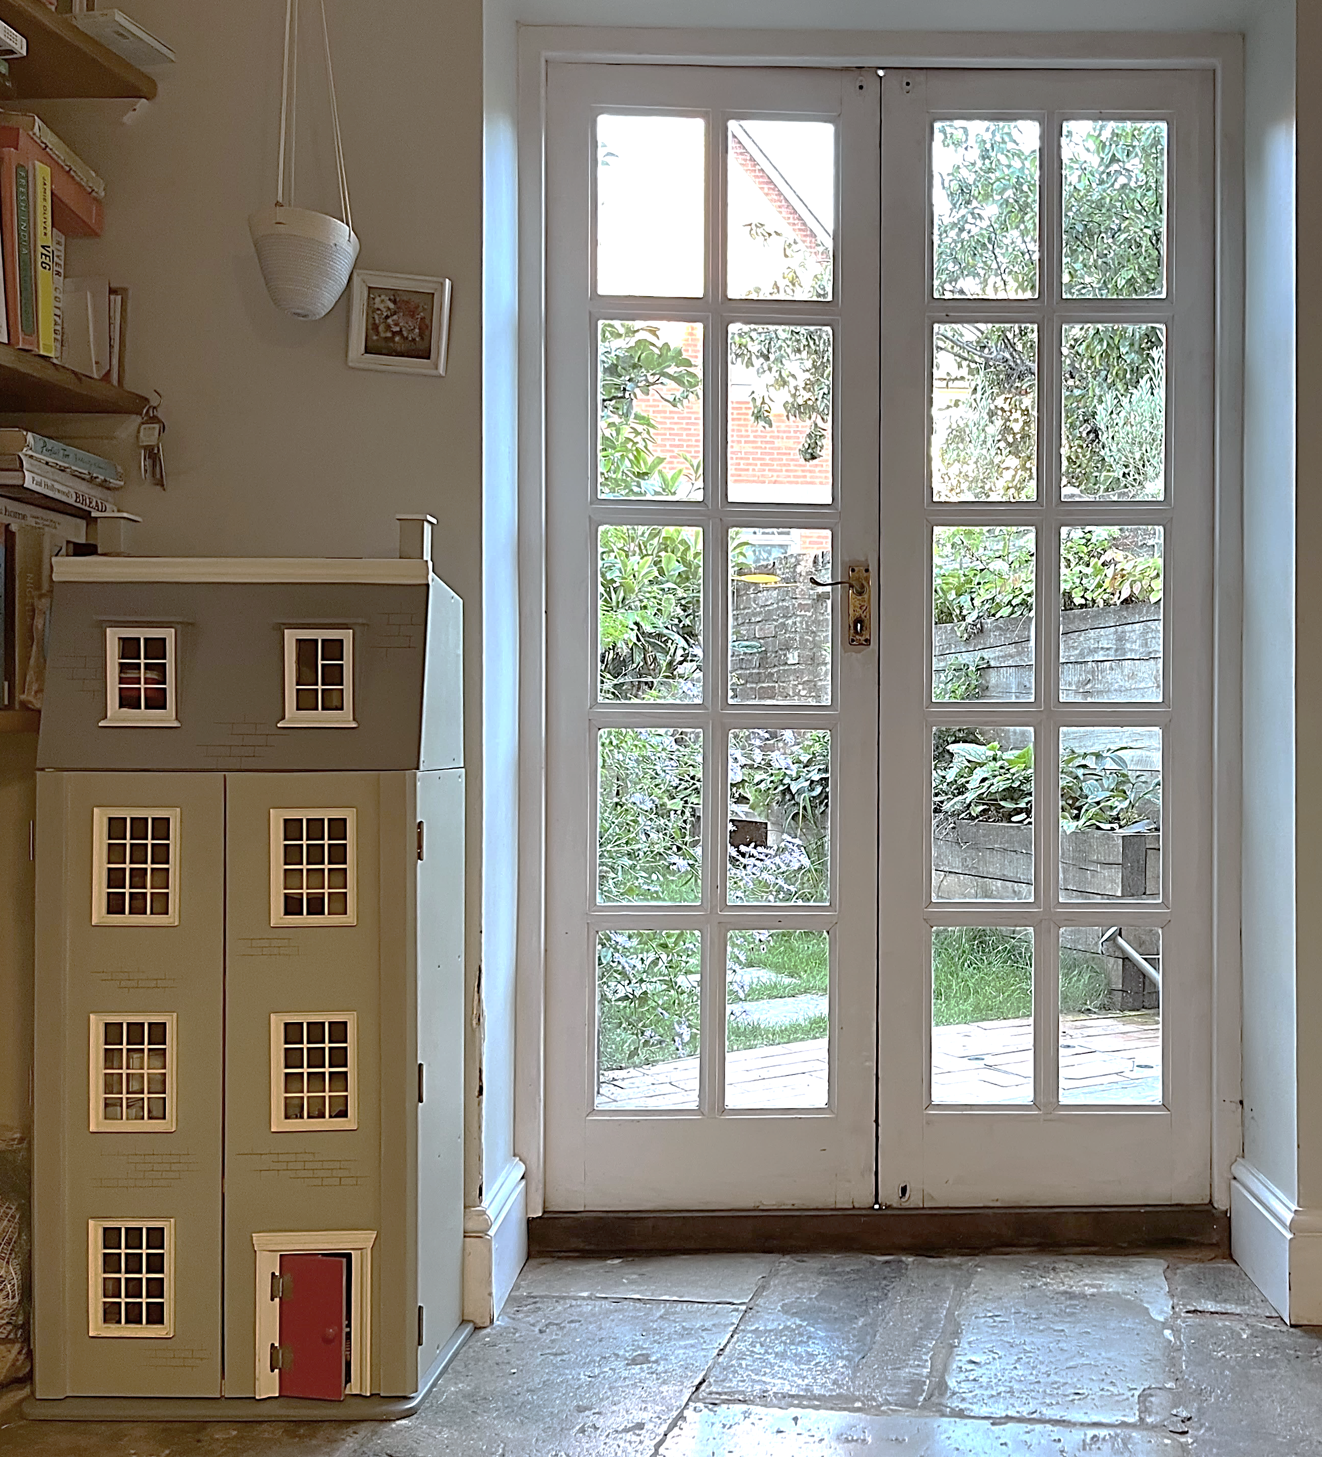
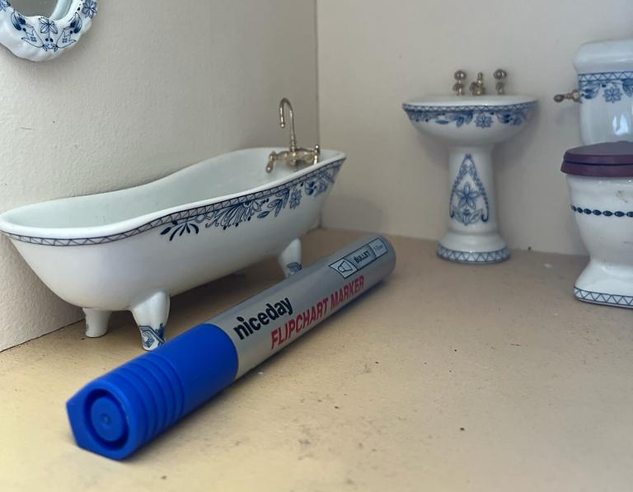
Checkpoint 4: Dolls’ house
How tall is Matilda’s dolls’ house, left?
If it were a real house, how tall would it be?
How long is the bath in the dolls’ house, left?
If it were a real bath, how long would it be?
A piece of furniture from Matilda’s doll’s house is 2 cm tall. What might it be?
Notes:
This slide is animated. Each question will appear separately so you can choose the pace at which to work with your class.
Answers
The doll’s house is 110 cm tall. Any estimate close to this is acceptable (for example, in the range 100–120 cm).
It would be approximately 12 m. Any estimate close to this is acceptable (for example, in the range 10–14 m).
The bath is 13.5 cm long. Any estimate close to this is acceptable (for example, in the range 11–14 cm).
It would be approximately 160 cm. Any estimate close to this is acceptable (for example, in the range 150–170 cm).
Suggested questioning
What clues in the picture might help you to get a sense of how tall the dolls’ house is?
How tall do you think one of the glass panels in the real door might be? How do you know? What calculations did you do to get your estimate?
Do you think the dolls’ house is more or less than half the height of the door? Can you give a more accurate fraction?
Do you think the dolls’ bath is more or less than half the length of the pen? Can you give a more accurate fraction?
Things to think about
Familiar objects are used to help students estimate the size of less familiar objects – items that are not their ‘normal’ size. Students may not readily have an estimate for the height of a door so may need some prompting to help them decide a sensible value to use. Talk about scale. Can students use the height of the real door to estimate the height of a real four-storey house? Can they use this to work out what scale might have been used to create the dolls’ house?

Slide 17
Checkpoint 4: Guidance
Adaptations | Assessing understanding
Support The familiar objects used in the task as reference points are readily available in classrooms. Using your classroom door or a board pen and estimating or measuring their size may support students in then using this now-familiar measure to estimate an unknown length. Challenge Take the opportunity for students to ‘mathematise’ their multiplicative thinking. For example, if they identify that the dolls’ house is two-thirds the height of the door, ask them to write this mathematically. Can they write it as a ratio? As a multiplication? How many times the height is the real door compared to the dolls' house door? Representations Support students to get a sense of one size referenced to another by sketching the door on squared paper and asking them to sketch the dolls’ house. Then use the squares to estimate the fraction of the height reached. A similar scaffold could be achieved using Cuisenaire® rods | See how readily students use known information to make an estimate. In part a, students are likely to use the height of the real door to estimate the height of the dolls’ house, while in part c they will use the length of the board pen to determine the length of the miniature bath. Look for students’ understanding and use of units for both the familiar object (the door, the pen) and the unknown object. Do they work within the same units (for example, assuming that the door is 250 cm high and so the doll house is maybe 150 cm), or do they switch between units, working in metres and centimetres? Look also for students’ familiarity with common units and objects – are they able to estimate the height of the door or the length of the board pen to a reasonable degree of accuracy?
Additional resources If students need more practice in using familiar lengths to estimate, Checkpoint 3 offers more estimation with classroom objects. Checkpoints 2 and 5, and additional activities C and D, might also be helpful.

Slide 18
Checkpoint 5: Check pints
Fill in each gap in the statements with the most sensible metric unit.
  A pint of milk is 568 ___.
  An apple weighs approximately 140 ___.
  A person’s stride is approximately 62 ___.
Use the statements above to complete the estimations.
  Estimate how many pints are in a three-litre bottle.
  Estimate how many apples are in a 10-kilogram bag.
  Estimate how many steps are taken to walk 0.5 kilometres.
Choose two different units that could be used to describe:
the width of a strand of hair
the length of a pencil
how tall you are
the distance you travel to school
the distance from London to New York
the distance from Earth to the Sun.
Notes:
This slide is animated. Each question will appear separately so you can choose the pace at which to work with your class.
Answers
a) millilitres; grams; centimetres
b) approximately 5.5 pints (answers may be in the range 5-6); approximately 70 apples (answers may be in the range 70-100); approximately 800 steps (answers may be in the range 500–1000)
?
Students may choose any two of the given units. Discuss the difference between metric and imperial and when it is appropriate or usual to use each.
The width of a strand of hair: millimetres, nanometres, fractions of an inch.
The length of a pencil: millimetres, centimetres, inches.
How tall you are: centimetres, metres, feet.
The distance you travel to school: metres, kilometres, yards, miles.
The distance from London to New York: kilometres, miles.
The distance from Earth to the sun: kilometres, miles, light years.
Suggested questioning
Is a can of drink more or less volume than a pint of milk? How about a drink bottle?
What feels similar in weight to an apple? What feels a bit heavier? A bit lighter?
Is a classroom table longer or shorter than a person’s stride? How about a different table?
What might you need to do to your value to estimate? Will you calculate as it is?
Things to think about
Assess students’ concept of the volume/mass/length of everyday objects, and whether they can choose appropriate units of measurement. For each type of measurement, there is also an opportunity to estimate and reason further. This Checkpoint does not go into great depth with any particular measurement, and so there are specific additional activities later in this deck for each type of measurement. Use these if any gaps in knowledge are revealed by this task.

Slide 19
Checkpoint 5: Guidance
Adaptations | Assessing understanding
Support Key to accessing the first part of this task is an awareness of common units. Offer situations in which these units are familiar to encourage students to reason: for example, students may know that a can of drink is 330 ml while a large bottle is 2 l, and reason that a standard drink can is smaller than a pint. Challenge Challenge students to estimate between the different situations in the further thinking question. For example, ask approximately how many hair widths would make the length of a pencil, or how many pencils would make their own height. Representations Units of volume and mass can be particularly challenging to estimate. Use some familiar objects (for example, water bottles of different sizes, tins of baked beans and bags of flour) as anchor points for students in developing a ‘feel’ for the units. | Assess students’ familiarity with some common units of measure, and how well they are able to use these units to calculate and make assumptions around different situations. Assess what units are familiar to students to help inform future teaching – they might not necessarily all be metric, or all be consistently from one measurement system. For example, students might suggest grams for the apple but inches for the stride. Students might also conflate capacity and weight, by offering grams for the milk. When assessing appropriate reasoning, it is important to hear students’ explanations and justifications. Look for students who adapt the values appropriately and simplify to work fluently between different units. For example, students might reason that an apple weighs around 150 g, so six apples will weigh 900 g and so one kilogram of apples is around seven apples and around seventy apples would fill a 10 kg bag.
Additional resources Pages 21–24 of the Year 5 Primary Assessment Materials | NCETM give some examples of measures questions. Additional activities A, B and C each focus on a different unit of measurement (volume, mass and length respectively) and can be used to address any gaps identified by this Checkpoint. The focus of 5NPV-5 in the Exemplification of ready-to-progress criteria NCETM is on the relationship of powers of 10 between units. Download as part of the Year 5 deck or the complete Number and Place Value deck.

Slide 20
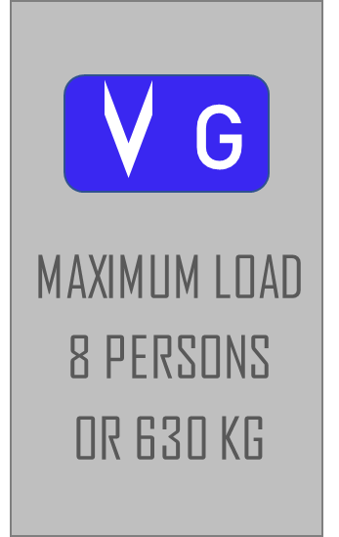
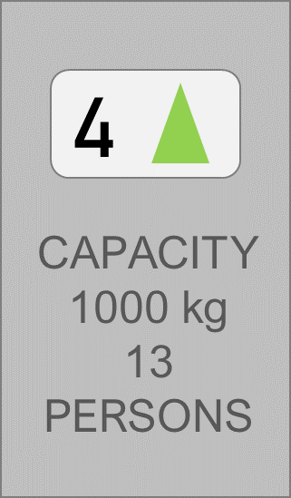
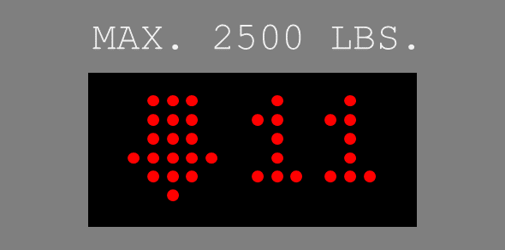
Checkpoint 6: Lift off!
Lift A
Lift B
The two signs on the left are from different lifts. Each lift can carry a different number of people.
Which lift assumes that people are heavier?
Which lift is easier to estimate? Why?
Nine identical boxes are under the weight limit for one lift, but over it for the other lift. What do you know about the weight of the boxes?
Five boxes weighing 23 kg each are put into each lift. Approximately how many people can safely get in the lifts with them?
Lift C
Lift C has the sign on the right. If 1 kg is approximately 2.2 lbs, how many people would you recommend fit in that lift? Why?
Notes:
This slide is animated. Each question will appear separately so you can choose the pace at which to work with your class.
Answers
a) The first lift assumes people are heavier. Students should round the values given to estimate and then reason about their answers. A likely estimation might be 640 $÷$ 80 = 80 kg for the lift on the left, and 1040 $÷$ 13 = 80 kg for that on the right. As these give the same answer, students would need to reason that the total weight for the first lift was changed by less than the second lift when rounding, so the actual weight is closer to 80 for the first lift than it is for the second. The actual assumed weights are 78.75 kg and 76.92 kg (to 2 d.p.) respectively.
b) Students’ answers to this will vary. Some may argue that the first lift is easiest, as 630 is close to 640, which is a multiple of 8, so 640 $÷$ 80 is a straightforward calculation. Students who find the second lift easier may also use the strategy of finding a ‘nearby’ multiplication fact such as 960 $÷$ 12 or 1040 $÷$ 13.
c) The boxes must weigh between 70 kg and approximately 111 kg.
d) Students’ answers will depend on how they estimate or calculate with 23. They might take the total weight of the boxes to be 100 (rounding 23 to 20), 115 (using 23) or 135 (rounding 23 to 25). Approximately six people can get into the first lift with the boxes; approximately 11 people can get into the second lift with the boxes.
? Probably the most likely answer is 15. If students round 2.2 down to 2, then 2500 ÷ 2 = 1250. Both lift A and lift B had a weight limit of approximately 80 kg person, and 80 $×$ 15 is under 1250 but 80 $×$ 16 is over 1250. Students might argue that 16 is a more suitable limit as 80 kg was an overestimate of the actual weights in the two lifts. In fact, this is cancelled out by rounding 2.2 to 2 for the conversion from pounds to kilograms.
The actual safe load is 14 people (using Lift A’s load: 2500 ÷ 2.2 ÷ 78.75 = 14.43 (2 d.p.); using Lift B’s load 2500 ÷ 2.2 ÷ 78.75= 14.77 (2 d.p.) Discuss why you would always truncate your answer rather than using conventional rounding rules.
Suggested questioning
What is the same and what is different about the information given for each lift?
What calculation might you do to approximate the weight of a person?
Do you think the lift manufacturer would have over- or under-estimated the average weight of a person? Why?
Things to think about
Checkpoint 6 features a use of estimation in real life that students are likely to have seen, if not thought about. Parts a and b are more open and could lead to a lot of discussion and comparison of strategies. These two questions alone could last ten minutes and provide sufficient assessment opportunity. Use your judgement about whether to stop there, or continue to see whether students can use their estimates to reason through parts c, d and the further thinking question. If you do stop but want to revisit these later questions on another day, students will need their answers to part a to be refreshed in their minds.

Slide 21
Checkpoint 6: Guidance
Adaptations | Assessing understanding
Support Rather than change the numbers, explore how confidently students can manipulate awkward numbers to make them easier to work with. Use representations (see below) to support access. Challenge A useful link could be made to averages: explore how one of the people being a small child would affect what the maximum weight of the remaining people could be. Weight can be an emotive subject: you could use boxes of different weights rather than people. Representations Bar models could be helpful. Draw a bar model representing 630, which is approximately to scale with a model representing 1000, and show how they can both be divided into eight and 13 parts respectively. | Checkpoint 6 uses a context that students may have seen in everyday life without particularly paying attention to it: that of weight limits in lifts. For part a, the actual answer matters much less than how students approach the problem. Do they have a reasonable strategy for estimating, and do they adapt this strategy based on the values given? Students’ knowledge of multiplication facts will play a part. For example, for the first lift, students who follow a rigid approach of rounding either or both values to the nearest 10 will give a less valid estimate than those who notice that 630 is nearly 640, which is a multiple of eight. Part c poses a problem that works within the weight limits, but does not have a set answer. See first whether students can use estimation to solve a problem. Then assess whether they can think about a possible range of answers. Can they reason about what the maximum and minimum values might be? Part d asks students to calculate and estimate further. Again, the emphasis is less on the answer and more on how they reason about the choices they make
Additional resources If students struggle with how to deal with the remainder in the division calculations of this task, you might find some supportive materials in Segment 2.12 Division with remainders from Primary Mastery Professional Development | NCETM. Checkpoint 5 and Additional activity B explore units of mass further.

Slide 22
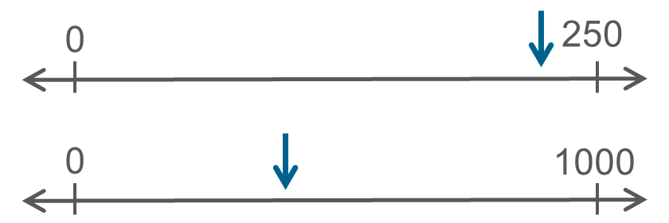
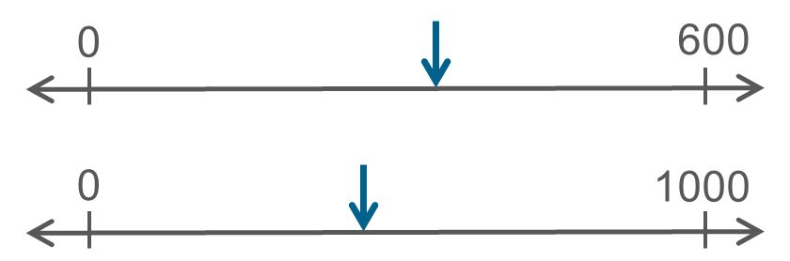
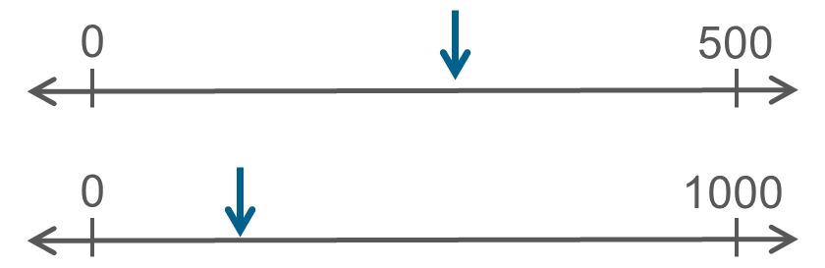
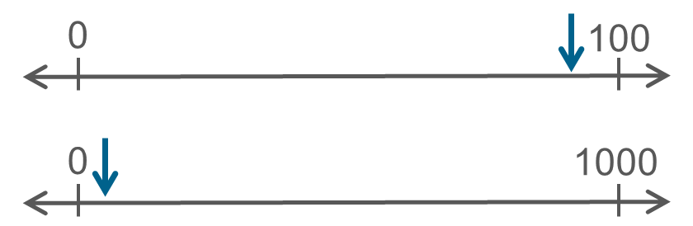
Checkpoint 7: Greater in value
In each pair of number lines, which arrow is pointing to the number that is greater in value?
a)
b)
d)
c)
What values could replace the right-hand numbers on each pair of number lines for both arrows to be pointing to the same number?
Notes:
This slide is animated. Each question will appear separately so you can choose the pace at which to work with your class.
Answers
a) The bottom arrow
b) The bottom arrow
c) The top arrow
d) The top arrow
? a) Change the top number to be approximately 800, or the bottom number to be approximately1200.
b) Change the top number to be approximately 800, or the bottom number to be approximately 750.
c) Change each number slightly as these are almost the same. Make the top number a little smaller or the bottom number a little bigger.
d) Change each number slightly as these are almost the same. Make the top number a little smaller or the bottom number a little bigger.
Suggested questioning
What is the same and what is different about each pair of number lines?
Is the arrow furthest along the number line always the bigger number? Why or why not?
What is your strategy for comparing the number lines?
Are there any other points on the line that you can imagine to help you?
How could the scales change so that the bigger number is the other arrow? Is there more than one way to do this?
Things to think about
Underlying rounding and estimation is a strong sense of number. Students need to be able to say correctly any number and understand where it fits in the number system, i.e. in an ordered list of numbers and on a number line. Checkpoints 7 and 8 both use number lines but, rather than focusing on their use for rounding (covered more explicitly in the second section of this deck), explore how well students can use a number line to estimate.

Slide 23
Checkpoint 7: Guidance
Adaptations | Assessing understanding
Support Look at different examples with the same two number lines, before moving on to a different pair. Challenge All the examples given use whole numbers. Consider varying the scales to involve fractions, decimals and negative numbers. Representations Here, the number line is explored as a representation of the infinite nature of number. See how readily students are able to interact with this as a model of the number system to help you to understand how easily students will be able to use this representation in more specific contexts, such as rounding. | Understanding of the number system underpins a great deal of future learning, so Checkpoint 7 explores students’ sense of estimation with the number line. Students need to consider two different scales simultaneously; check that their judgement about the bigger value is based on a reasonable estimate. This may also help you to understand how readily they can access the number line as a representation for rounding. Students’ strategies offer insight into their thinking and their confidence with the number line as a representation. Are they happy, for example, with considering two different scales? Do they use the midpoint of the number line and consider whether the arrow is greater or less than this? Do they think in terms of fractions or percentages? Some students might think about scaling between the two lines – for example, noticing that, for the first pair of lines, 250 is quarter of 1000, and so using this to scale the position of the arrow to compare it.
Additional resources In Teaching mathematics in primary schools, you can explore students’ experience of reasoning about the location of numbers in the linear number system, from 1NPV–2 (numbers to 20) through to 6NPV–3 (any number up to 10 million including decimal fractions). There is useful guidance about estimating using number lines in 2NPV–2. Use the hyperlinks on p9 of the complete Years 1 to 6 document to navigate.

Slide 24
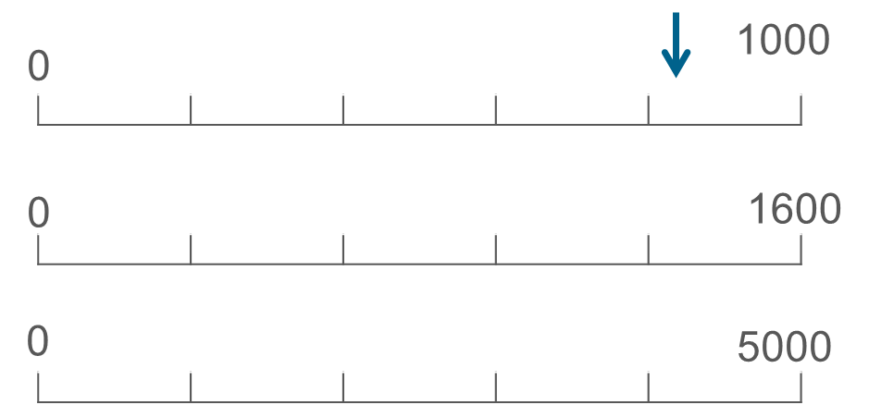
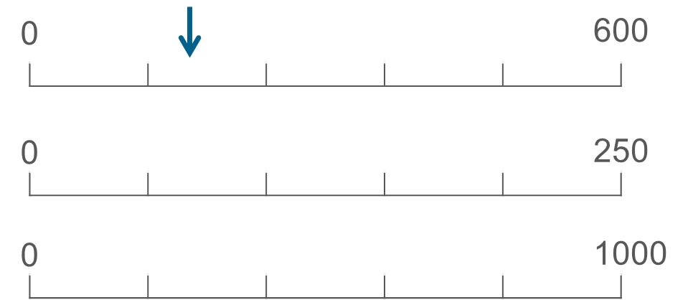
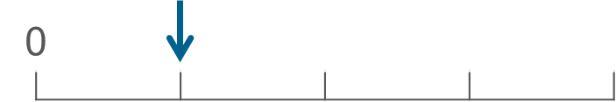
Checkpoint 8: Same number
A number is marked on the first number line in each set with a down arrow. Mark the same number on the other number lines in that set.
a)
b)
If this arrow shows the same number as in part a, what number would go at the end of the line? How about if the number was from part b?
Notes:
This slide is animated. Each question will appear separately so you can choose the pace at which to work with your class. A printable resource can be found on slide 73.
Answers
a) and b) See animated solutions on the following slide.
? For part a, it would be just over 3200, so estimates in the region of 3250–3450 would be appropriate. For part b, it would be approximately 600–700.
Suggested questioning
What is the same and what is different about each set of number lines?
For the second and third number lines, is the arrow going to be further along the line or closer to 0? How do you know?
What is your strategy for comparing the number lines?
Are there any other points on the line that you can imagine to help you?
Things to think about
Underlying rounding and estimation is a strong sense of number. Students need to be able to say any number and understand correctly where it fits in the number system (i.e. in an ordered list of numbers and on a number line). Checkpoints 7 and 8 both use number lines but, rather than focusing on their use for rounding (covered more explicitly in the second section of this deck), explore how well students can use a number line to estimate.

Slide 25
Checkpoint 8: Same number (animated solutions)
A number is marked on the first number line in each set with a down arrow. Mark the same number on the other number lines in that set.
a)
b)
Notes:
This slide is animated. The red arrow indicating the answer to each question will appear separately so you can choose the pace at which to work with your class.

Slide 26
Checkpoint 8: Guidance
Adaptations | Assessing understanding
Support Try not to guide students too much with your own thinking initially. Some ‘productive struggle’ offers the opportunity to listen and understand how they view the problem. If they are struggling to get started, you could ask them to mark the same number on all three lines (for example, 1000 for part a, or 250 for part b) to give a common reference point. Challenge A blank version is provided in printable resources, for to create your different versions to best challenge students. Representations As with Checkpoint 7, the number line is used to represent the continuum of number. Consider the differences in the representation. Including markings on the scale may make students more likely to refer to these points, and less likely to reason informally using their own choice of reference points. A printable resource is provided so that students do not need to sketch out the lines. | Checkpoint 8 is a companion task to Checkpoint 7. It also assesses students’ sense of estimation on a number line, but asks students to mark rather than read a given position. This provides a context for ‘structured estimation’. Are students able to use the information available to make a more informed decision than just a ‘guess’. The Guidance slide for Checkpoint 7 offers more detail about potential chains of reasoning. This time, markings are given along the number lines to support students’ reasoning, so they may be more likely to think about the numbers in relation to these markings, or to try and identify the position of the first given value on the other lines. Look out for any students who count the four markings and incorrectly think that the line is divided into quarters rather than fifths, as they may need some additional support with their understanding of both fractions and scales.
Additional resources In Teaching mathematics in primary schools, you can explore students’ experience of reasoning about the location of numbers in the linear number system, from 1NPV–2 (numbers to 20) through to 6NPV–3 (any number up to 10 million including decimal fractions). There is useful guidance about estimating using number lines in 2NPV–2. Use the hyperlinks on p9 of the complete Years 1 to 6 document to navigate.

Slide 27
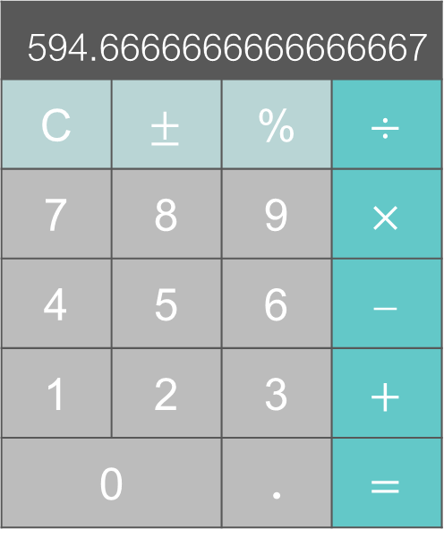
Checkpoint 9a: What’s it about?
The calculator has been used to work out 1784 ÷ 3
Richard thinks of six different ways to describe the answer.
about 600
about 1000
about 590
about 594
about 595
about 594.66
Which of these do you think is correct?
Which do you think is the best way to phrase it?
Is the answer exactly 594.666666666666667?
Would your answer be the same or different if the 1784 was an amount of money?
Notes:
This slide is animated. Each approximate value and then each question will appear separately so you can choose the pace at which to work with your class.
Answers
a) All of these could be considered to be correct, depending on the required degree of accuracy. Students may identify ‘about 594’ and ‘about 594.66’ as being the solutions that are not necessarily mathematically correct, as they would both ‘round up’, but colloquially they are reasonable approximations.
b) Individual students’ responses and justifications will vary. For example, students might suggest that the most decimal places (so 594.66) is the most accurate answer – and some may recognise that this should be rounded to 594.67. Others might prioritise numbers that are easier to work with and suggest the nearest whole number, ten or hundred (i.e. 595, 590 or 600).
c) No. The exact solution is described as, ‘Five hundred and ninety-four point six recurring.’
? Individual student responses and justifications will vary. Students are likely to suggest that the less accurate values are less helpful when dealing with money, as if a group are splitting money then they might end up with too much or too little. They might suggest that two decimal places is therefore most appropriate.
Suggested questioning
Is 594.66 the ‘right’ answer?
Why might Richard say that the answer is about 594 or 595? Does it matter which he chooses? Why?
Is there a time or situation where that sort of precision does matter?
Is there a situation where 594.66 can reasonably be described as ‘about 1000’?
Things to think about
Checkpoints 9a, b and c are a sequence of three to be used together so that direct comparisons can be made. Allow a little longer than 10 minutes to use them, or sequence them over consecutive lessons.
All three feature the same values and ask students to think about different ways to round an answer that is a recurring decimal. Checkpoint 9a is without context, while 9b and 9c feature a context that may influence students’ answers. When thinking about how to structure the task for the classroom, consider how to give allow students to express their choice and justify their reasoning to each other.

Slide 28
Checkpoint 9b: About a holiday
Three friends are going on holiday. The total cost of the holiday is £1784, which they are going to share equally.
Brenda uses a calculator to work out 1784 ÷ 3.
She thinks of six different ways to tell her friends how much they will each pay.
about £600
about £1000
about £590
about £594
about £595
about £594.66
Which of these do you think is correct?
Which do you think is the best way to phrase it?
Would your answer be the same or different if the 1784 was a length?
Notes:
This slide is animated. Each approximate value and then each question will appear separately so you can choose the pace at which to work with your class.
Answers
a) All of these could be considered to be correct, depending on the required degree of accuracy. Students may identify ‘about 594’ and ‘about 594.66’ as being the solutions that are not necessarily mathematically correct, as they would both ‘round up’, but colloquially they are reasonable approximations.
b) Individual students’ responses and justifications will vary. For example, they might suggest that about £595 is best as it doesn’t involve dealing with small coins and doesn’t end up short of the total (as the amount needed from each person is £594). Others might suggest that money is always dealt with to two decimal places and so suggest £594.66 – some may recognise that this should be rounded to 594.67, and that using £594.66 leaves them 2p short. (Regarding coins, some may suggest that the friends could use an online transfer rather than cash!)
? Individual student responses and justifications will vary. Students might question what unit of measurement the length is. If it is metres, then it is possible to measure accurately up to two decimal places and beyond. If it is millimetres, it would be difficult to measure 594.66 mm accurately.
Suggested questioning
Which possible answer would you suggest to your friends if you were in Brenda’s situation? Why?
If you were one of Brenda’s friends, would you be annoyed if you found out she’d approximated the amount? Which of these answers would be so far away from the accurate figure that it would annoy you?
Things to think about
Checkpoints 9a, b and c are a sequence of three to be used together so that direct comparisons can be made. Allow a little longer than 10 minutes to use them, or sequence them over consecutive lessons.
All three feature the same values and ask students to think about different ways to round an answer that is a recurring decimal. Checkpoint 9a is without context, while 9b and 9c feature a context that may influence students’ answers. When thinking about how to structure the task for the classroom, consider how to allow students to express their choice and justify their reasoning to each other.

Slide 29
Checkpoint 9c: About a shelf
Becky is cutting three shelves of equal length out of a plank of wood. The plank is 1784 mm long.
She works out 1784 ÷ 3 using her calculator.
She thinks of six different ways to cut the wood.
about every 600 mm
about every 1000 mm
about every 590 mm
about every 594 mm
about every 595 mm
about every 594.66 mm
Which of these do you think is correct?
Which do you think is the best way to phrase it?
Would your answer be the same or different if the 1784 was the total number of students in a school, split into three house groups?
Notes:
This slide is animated. Each approximate value and then each question will appear separately so you can choose the pace at which to work with your class.
Answers
a) All of these could be considered to be correct, depending on the required degree of accuracy. Students may identify ‘about 594’ and ‘about 594.66’ as being the solutions that are not necessarily mathematically correct, as they would both ‘round up’, but colloquially they are reasonable approximations.
b) Individual student responses and justifications will vary. Some students might recognise that it would be impossible to accurately measure wood to 594.66 mm, or that using a value like 1000 would mean that you only get two, unequal shelves. Most are likely to suggest the nearest mm as the most sensible value – they should recognise that 595 is the correct way to do this.
? Individual student responses and justifications will vary. Students should recognise that, unlike the context-less numbers in 9a, and the contexts in 9b and c, students cannot be split into non-integer groups! They might reason using the idea of remainders, and suggest that every 594 (whilst not the correct way to round) is the most suitable value, leaving two students to add to two of the three groups.
Suggested questioning
If you were Becky, which length would you use? Why?
Are there any that you would definitely not use? Why?
How accurate do you think it’s possible to be when cutting wood? Would you notice a 1 mm difference? Would you notice a 4 or 5 mm difference?
Things to think about
Checkpoints 9a, b and c are a sequence of three to be used together so that direct comparisons can be made. Allow a little longer than 10 minutes to use them, or sequence them over consecutive lessons.
All three feature the same values and ask students to think about different ways to round an answer that is a recurring decimal. Checkpoint 9a is without context, while 9b and 9c feature a context that may influence students’ answers. When thinking about how to structure the task for the classroom, consider how to allow students to express their choice and justify their reasoning to each other.

Slide 30
Checkpoints 9a, b and c: Guidance
Adaptations | Assessing understanding
Support Ordering the tasks so a contextual calculation is first may help students access or eliminate some of the possible solutions. The situation in 9c has some ‘absolute’ answers which cannot be used, while 9b bring in some moral issues which may cloud students’ reasoning. Remember that the students’ reasoning and justifications are the focus of the task and support them with this. You could scaffold reasoning – offer a stem sentence, or encourage them to reason in pairs before feeding back. Challenge Ask students to construct a context in which a chosen estimate is ‘correct’, with others discarded, or in which a chosen estimate is definitely not correct. Is there a context in which ‘about 594.66’ isn’t an appropriate answer? Representations Use bar models to demonstrate whether each estimate would be an under- or over-estimate of the actual answer. Show a bar model splitting 1784 into three, and then compare with bars ‘built up’ of three lots of 600, 1000, 590 etc. | Checkpoint 9 is split into three slides to give opportunities to assess whether students are able to interpret the results of an estimation, and work to a degree of accuracy that is appropriate for a given situation. The same values are used throughout to draw attention to these differences. Although labelled as a, b and c you do not need to use the tasks in this order. You could see how students estimate in a given context, before considering the calculation with no context. The key assessment point is how (or if) the students adapt their estimate according to the context.
Additional resources If students struggle with how to deal with the remainder in the division calculations of this task, you can find supportive materials in Segment 2.12 Division with remainders from Primary Mastery Professional Development | NCETM. Checkpoint 5 and Additional activity C explore units of mass further, if required.

Slide 31
Checkpoint 10: Little more, little less
8 467 × 13.92 = 117 860.64
Write a multiplication that gives a product close to, but a little more than, 117 860.64
Write a multiplication that gives a product close to, but a little less than, 117 860.64
Compare your products with others’ products.
Will your multiplications give a product that is more or less than theirs? How do you know?
Notes:
This slide is animated. Each question will appear separately so you can choose the pace at which to work with your class.
Answers
a) Any values where the multiplier and/or multiplicand have been shifted upwards slightly.
b) Any values where the multiplier and/or multiplicand have been shifted downwards slightly.
? Students’ responses will vary.
Suggested questioning
Would increasing 8467 or 13.92 make the biggest difference to the product? Why?
Is it easier to change one or both factors to change the answer?
If the question was 8466 $×$ 13.92, would the answer be larger or smaller? Can you say by how much?
Things to think about
Checkpoint 10 does not ask students to estimate, but rather to reason about how changing a calculation will affect the answer. It is designed to prompt discussion, so structure the task to encourage students to share responses, in pairs or small groups or with the whole class. This is a useful precursor to talking more formally about over- and under-estimates. Use students’ responses to plan how you will introduce those. Repeat this structure with different calculations, particularly division or subtraction which are not commutative.

Slide 32
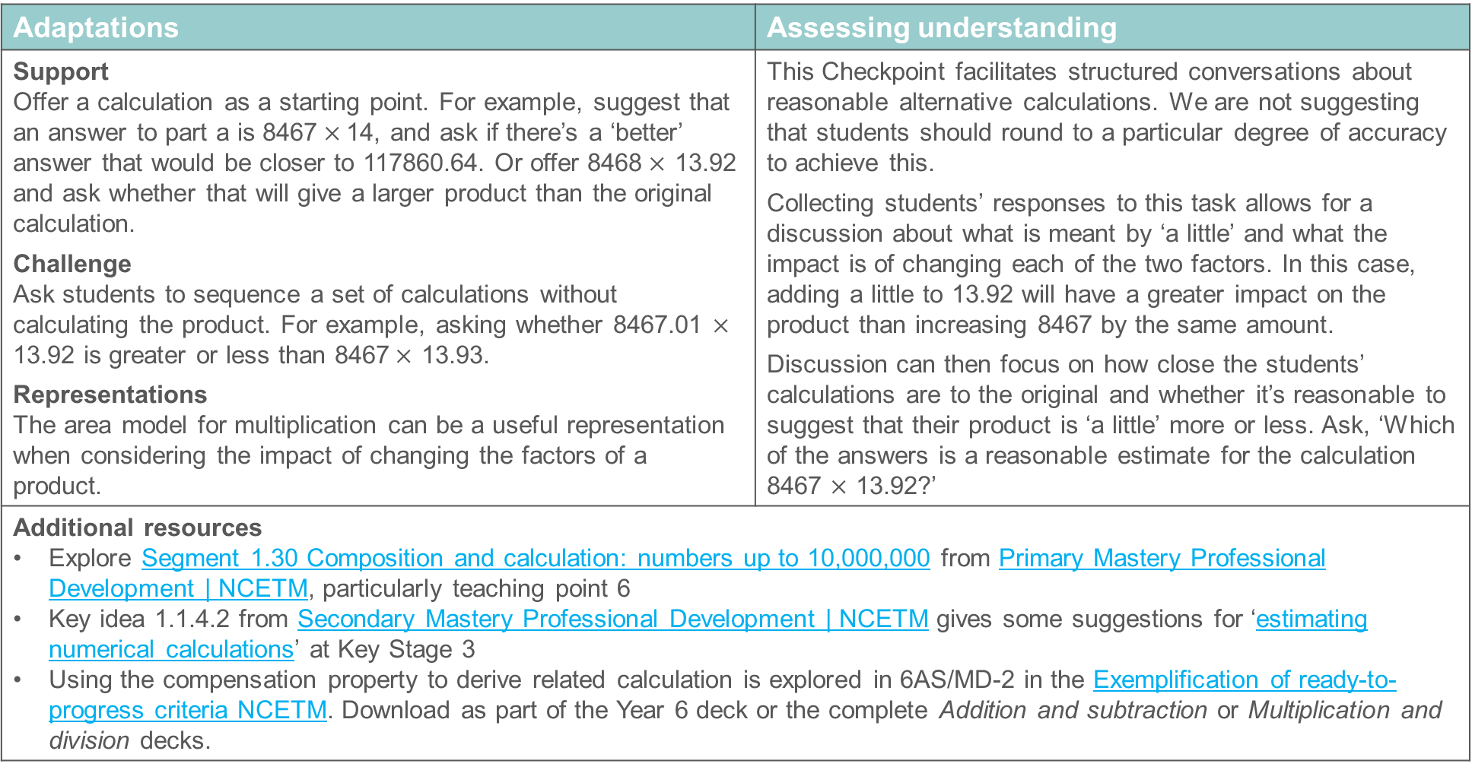
Checkpoint 10: Guidance
Adaptations | Assessing understanding
Support Offer a calculation as a starting point. For example, suggest that an answer to part a is 8467$×$14, and ask if there’s a ‘better’ answer that would be closer to 117860.64. Or offer 8468$×$ 13.92 and ask whether that will give a larger product than the original calculation. Challenge Ask students to sequence a set of calculations without calculating the product. For example, asking whether 8467.01 $×$ 13.92 is greater or less than 8467$×$ 13.93. Representations The area model for multiplication can be a useful representation when considering the impact of changing the factors of a product. | This Checkpoint facilitates structured conversations about reasonable alternative calculations. We are not suggesting that students should round to a particular degree of accuracy to achieve this. Collecting students’ responses to this task allows for a discussion about what is meant by ‘a little’ and what the impact is of changing each of the two factors. In this case, adding a little to 13.92 will have a greater impact on the product than increasing 8467 by the same amount. Discussion can then focus on how close the students’ calculations are to the original and whether it’s reasonable to suggest that their product is ‘a little’ more or less. Ask, ‘Which of the answers is a reasonable estimate for the calculation 8467 $×$ 13.92?’
Additional resources Explore Segment 1.30 Composition and calculation: numbers up to 10,000,000 from Primary Mastery Professional Development | NCETM, particularly teaching point 6 Key idea 1.1.4.2 from Secondary Mastery Professional Development | NCETM gives some suggestions for ‘estimating numerical calculations’ at Key Stage 3 Using the compensation property to derive related calculation is explored in 6AS/MD-2 in the Exemplification of ready-to-progress criteria NCETM. Download as part of the Year 6 deck or the complete Addition and subtraction or Multiplication and division decks.

Slide 33
Checkpoint 11: Choices, choices
19.173 × 338
To estimate this, which of the calculations below would you use?
Explain your choice.
20 × 350
20 × 300
19 × 350
19 × 300
Something else
Which of these gives the closest estimate?
Which gives the estimate that is furthest away?
Notes:
This slide is animated. Each calculation and then the further thinking question will appear separately so you can choose the pace at which to work with your class.
Answers
Individual students’ responses and justifications will vary. See the Guidance slide for more information.
? 19 x 350 gives the closest estimate, since 19.173 is closer to 19 than 20 and 338 is closer to 350 than 300.
20 x 300 gives the estimate that is furthest away, since 20 is further from 19.173 than 19 and 300 is further from 338 than 350.
The exception to both of these is if students choose a calculation for ‘something else’ that is either closer or further away.
Suggested questioning
What is the same and what is different about the options?
If you chose ‘Something else’, what would you do?
Which is easiest? Which is most accurate? Are these the same? Why or why not?
Things to think about
There is no ‘right’ answer to Checkpoint 11. Listen to how students justify the choices that they make. This might lead to insight as to what they think estimation is for. Is it to find the easiest way to answer the calculation, or a more accurate/close answer? Or somewhere in between? Discuss the purpose of estimation, and why you might choose different calculations depending on the reason behind an estimation.

Slide 34
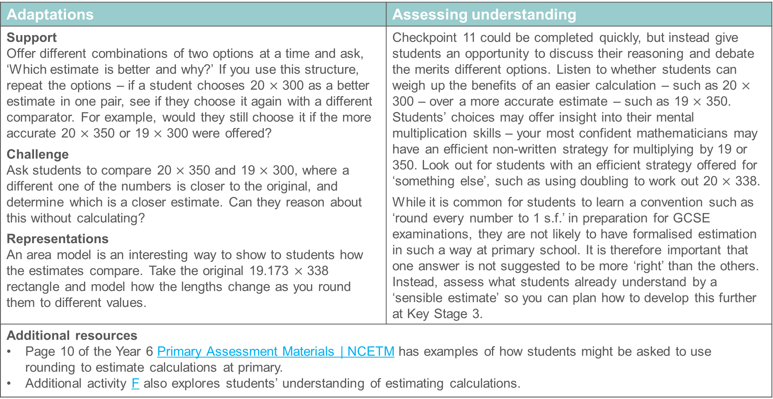
Checkpoint 11: Guidance
Adaptations | Assessing understanding
Support Offer different combinations of two options at a time and ask, ‘Which estimate is better and why?’ If you use this structure, repeat the options – if a student chooses 20 $×$ 300 as a better estimate in one pair, see if they choose it again with a different comparator. For example, would they still choose it if the more accurate 20 $×$ 350 or 19 $×$ 300 were offered? Challenge Ask students to compare 20 $×$ 350 and 19 $×$ 300, where a different one of the numbers is closer to the original, and determine which is a closer estimate. Can they reason about this without calculating? Representations An area model is an interesting way to show to students how the estimates compare. Take the original 19.173 $×$ 338 rectangle and model how the lengths change as you round them to different values. | Checkpoint 11 could be completed quickly, but instead give students an opportunity to discuss their reasoning and debate the merits different options. Listen to whether students can weigh up the benefits of an easier calculation – such as 20 $×$ 300 – over a more accurate estimate – such as 19 $×$ 350. Students’ choices may offer insight into their mental multiplication skills – your most confident mathematicians may have an efficient non-written strategy for multiplying by 19 or 350. Look out for students with an efficient strategy offered for ‘something else’, such as using doubling to work out 20 $×$ 338. While it is common for students to learn a convention such as ‘round every number to 1 s.f.’ in preparation for GCSE examinations, they are not likely to have formalised estimation in such a way at primary school. It is therefore important that one answer is not suggested to be more ‘right’ than the others. Instead, assess what students already understand by a ‘sensible estimate’ so you can plan how to develop this further at Key Stage 3.
Additional resources Page 10 of the Year 6 Primary Assessment Materials | NCETM has examples of how students might be asked to use rounding to estimate calculations at primary. Additional activity F also explores students’ understanding of estimating calculations.

Slide 35
Checkpoint 12: Four or not?
Without calculating, is this a little more than 4, a little less than 4 or exactly 4?
15.99 ÷ 4
16 ÷ 3.99
How about this?
15.99 ÷ 3.99
How about this?
Notes:
This slide is animated. Each question will appear separately so you can choose the pace at which to work with your class.
Answers
a) A little less than 4.
b) A little more than 4.
? A little more than 4.
Suggested questioning
How does knowing that 16$÷$4 = 4 help here?
Is there a ‘story’ that you can think of that helps?
£16 shared between four people means they get £4 each. Does that help with part a? What about with part b?
If a bag of flour weighs 4 kg, then to make 16 kg we’ll need 4 bags. Does that help with part a? With part b?
Things to think about
Checkpoint 12 touches on over- and under-estimation using more informal language. Get students to compare their strategies and reasoning. Collate the different ways they think about this as part of a class discussion, to give insight into the structures and representations they are most comfortable with. You could also discuss this with colleagues – ask them to think about the further thinking question, without parts a and b, and compare the different approaches that people take. The further thinking question has previously been shared on Twitter, where over a hundred people from across the world shared their reasoning – it is worth a look! Using the terms, ‘twitter learningmaths estimating and rounding’ in a search engine should be sufficient to find the thread.

Slide 36
Checkpoint 12: Guidance
Adaptations | Assessing understanding
Support The way in which students understand the division operation is likely to impact on how they access this Checkpoint. Those who understand the partitive model for division may be comfortable that 15.99 ‘shared between’ 4 will be a little less than 4, but may struggle with part b. Those who read part b as, ‘How many 3.99s are there in 16?’, which is a quotitive model, are likely to notice that the answer is a little more than 4. Work with students to expose and share their understanding of division to support them with this task. Challenge Although the task is scaffolded in three parts, you could direct students straight to the further thinking question, with parts a and b reserved as scaffolding to support them if needed. Representations Use counters to model division as both grouping and sharing to scaffold and expose students’ understanding. Bar models might also be helpful. The task is set out using numbers to two decimal places, so students might also find money to be a useful model. | This Checkpoint offers a chance to focus on and reason with the different ways in which adjusting values in a division will impact on the outcome of the calculation. Students will show, and perhaps refine, their understanding of the way the changes they make when estimating will impact on the accuracy of their estimation. The ways that students justify and explain their solutions are likely to offer insight into their understanding of the operation of division. Offer the task in a way that allows students to expose their reasoning – for example, as a ‘think, pair, share’ task – to allow them time to rehearse their justification before sharing with the class.
Additional resources Additional activity H gives a less structured version of this task, focusing on multiplication. In Primary Mastery Professional Development | NCETM, the terms quotitive and partitive are explained more fully in Topic 2.6 Structures: quotitive and partitive division | NCETM.

Slide 37
Rounding
Checkpoints 13–22

Slide 38
Rounding
Previous learning
Key Stage 2 curriculum: Year 3: estimate the answer to a calculation and use inverse operations to check answers Year 3: connect decimals and rounding to drawing and measuring straight lines in centimetres, in a variety of contexts (This expectation to connect estimation and rounding to the use of measuring instruments continues throughout Key Stage 2.) Year 4: round any number to the nearest 10, 100 or 1000 Year 4: round decimals with one decimal place to the nearest whole number Year 5: round any number up to 1 000 000 to the nearest 10, 100, 1000, 10 000 and 100 000 Year 5: use rounding to check answers to calculations and determine, in the context of a problem, levels of accuracy Year 5: round decimals with two decimal places to the nearest whole number and to one decimal place Year 6: round any whole number to a required degree of accuracy Year 6: interpret remainders as whole number remainders, fractions, or by rounding, as appropriate for the context Year 6: solve problems which require answers to be rounded to specified degrees of accuracy Further information about how students may have experienced this key idea in Key Stage 2: Teaching mathematics in primary schools, 6NPV–3: reason about the location of any number up to 10 million, including decimal fractions, in the linear number system and round numbers, as appropriate, including in contexts (pp289–93)*. Note that rounding is also referred to in the Year 4 and year 5 criteria. Primary Mastery Professional Development, Spine 1 Number, Addition and Subtraction, Year 6 Segment 1.30 Composition and calculation: numbers up to 10,000,000. Page numbers reference the complete Years 1–6 document

Slide 39
Rounding
In Key Stage 3 students need to
Continue to develop and utilise a secure understanding of our base-ten place-value system for integers and decimals Understand why rounding is necessary and that it is a valuable tool for estimating number to varying degrees of accuracy Round to any given number of decimal places, using an awareness that, for example, rounding to two decimal places involves choosing between two numbers; one that is just greater than it and one that is just less than it, both of which have two decimal places Appreciate that rounding to decimal places is particularly useful when working with measures in real-life contexts Round numbers to any required number of significant figures Appreciate that rounding to significant figures helps maintain a sense of the size of a number, and that it is particularly useful when estimating.

Slide 40
Checkpoint 13: In the red
The number line has 3.1 at one end, and 3.2 at the other.
The blue (left) section and the red (right) sections are of equal length.
3
.
1
3
.
2
Is it possible to arrange some or all of the digit cards on the right to make a number which is:
0
1
2
3
4
.
in the blue section
in the red section
as close to the centre of the number line as possible?
If you were able to change the values of some digit cards to make the questions easier, which cards would you change and why? What is the smallest number of cards you could change?
Notes:
This slide is animated. Each question will appear separately so you can choose the pace at which to work with your class. A generic printable template for rounding with number lines can be found on slide 74.
A printable version of the number line in this activity is available on slide 75.
Answers
a) Any number starting 3.1 and using these cards will fit in the blue (left) section.
b) It is not possible to create a number in the red (right) section.
c) The centre number is 3.15. The closest it is possible to get with these digits is 3.1420.
Suggested questioning
Tell me any number between 3.1 and 3.2. Is it in the blue (left) or the red (right) section? Where would you mark it on the line?
Would it matter if the 0 card wasn’t there? Would any of your answers change?
Would an extra decimal point card help with any of your answers?
Would an extra 0 card help with any of your answers?
Things to think about
Students will likely use a number line for rounding, as it is the most common and useful representation. This Checkpoint talks about red (right) and blue (left) sections, rather than ‘nearest numbers’, to check students understand the underpinning structures and how the number line is used, before explicitly linking it to the conventions of rounding. The intention is that, by giving only one decimal point card, students deduce that cards can be used more than once – but you may need to make this explicit.

Slide 41
Checkpoint 13: Guidance
Adaptations | Assessing understanding
Support Adjusting the values by a factor of 10, so that the end numbers are 31 and 32, may help students to access the task. It is important that they are then able to explicitly connect this work with the task. Don’t assume that, because a student can place a decimal between 31 and 32, they can also place one between 3.1 and 3.2. Challenge When working with place value, the role of the zero can be challenging. You might like to ask students to use all the cards to make a number as close to 3.14 as possible, or as close to 3.1 as possible, so that the zero card isn’t just relegated to the end of the number. Representations If students are familiar with a place-value chart, or Gattegno chart this may offer a useful way to think about the extreme values of 3.1 and 3.2 and ways to construct numbers between them. | A key understanding needed for rounding a number is to be able to appreciate the size of that number relative to two fixed values. This task uses a number line to explore whether students are able to identify and place numbers of up to three decimal places between two values given to one decimal place. Listen for the ways that students say the numbers when they give their answers – students who offer, for example, ‘three point twelve’ may have less of an understanding of place value than those who say ‘three point one two’. Notice the way students justify that part b is impossible. Are they able to identify that every number in the red section must have at least one digit greater than 4?
Additional resources Year 6 SATs papers contain examples of rounding questions (for example, 2022 Paper 2 (Reasoning) Question 16 looks at rounding to 1 decimal place). Past papers can readily be found online. The focus of 5NPV-3 in the Exemplification of ready-to-progress criteria NCETM is to ‘reason about the location of any number with up to 2 decimals places in the linear number system, including identifying the previous and next multiple of 1 and 0.1 and rounding to the nearest of each’. Download as part of the Year 5 deck or the complete Number and Place Value deck.

Slide 42
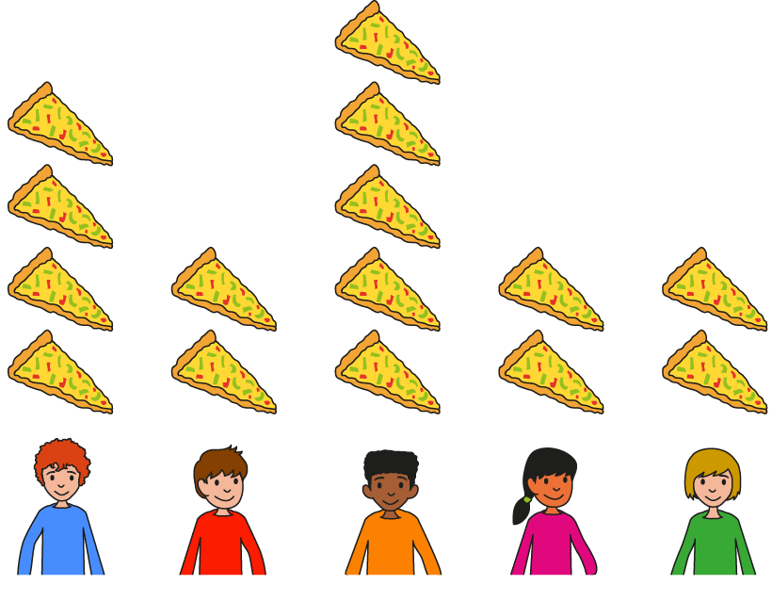
Checkpoint 14: Who’s correct?
In each situation, who do you agree with and why?
Si and Caz are each given a different number to round to the nearest ten.
Si and Caz are each given the same number to round to the nearest hundred.
My 1s digit is more than 5 so I round up to 270.
My 1s digit is less than 5 so I round down to 250.
The tens digit is 5 so we need to round up to 500.
It ends in a 2 so I need to round down to 400.
Si
Caz
Si
Caz
269
264
452
452
Caz and Si round the same number. Caz gets 700 to the nearest hundred. Si gets 680 to the nearest ten. What could the number be?
Notes:
This slide is animated. Each question will appear separately so you can choose the pace at which to work with your class. A generic printable template for rounding with number lines can be found on slide 74.
Answers
a) Si is correct, although the language of ‘round up’ might lead to confusion. (Much like Caz’s confusion that you ‘round down’ to the ten below 260, rather than keeping the tens digit the same. See below for more details).
b) Caz is correct, as she has looked to the digit next to the degree of accuracy that she is rounding to. Si is wrong as he has looked at the last digit, not the digit next to the degree of accuracy he is rounding to. The ones digit is only relevant if rounding to the nearest 10 (or the equivalent significant figures).
? 675, 676, 677, 678, 679, 680, 681, 682, 683 or 684 are the integer answers. Any number greater than or including 675, but less than 685, is valid, including decimals.
Suggested questioning
What is the same and what is different about their answers?
Why might Caz have rounded too far in part a? Is there a better way to think about this?
Which digits are important when you round?
Things to think about
The convention of rounding, and the language that is associated with it, can lead to some misconceptions. Students may have used phrases to help them remember to round up for the number that is midway between the two ‘nearest’ values (such as ‘high 5’). Students often counterpoint this with the language of ‘round down’, which can lead to misconceptions such as the one modelled by Caz in part a. Throughout student-facing material we avoid using the language of rounding up/down as some teachers may use different language structures to prevent these misconceptions. For example, you might just use the word ‘round’, without reference to direction. The exception is this Checkpoint, where the language of up/down is necessary to expose the misconception.

Slide 43
Checkpoint 14: Guidance
Adaptations | Assessing understanding
Support Show just one person at a time, so students consider whether a single statement is true or false, rather than comparing two statements. Challenge Ask students to create their own statements using rounding to the nearest tenth, thousand or ten thousand instead. Students should have covered rounding to the one decimal place and any whole number at primary; you could also ask if they can extend this knowledge to hundredths or other numbers of decimal places. Representations Ask students to suggest their own representations to explain their reasoning, so you can see how they choose visualise their thinking. A number line marked in 10s may support your explanation. | Checkpoint 14 explores some common misconceptions in students’ experience of rounding. Identify where students may have these misconceptions, so that they can be addressed before they are applied to Key Stage 3 learning on decimal places and significant figures. In part a, Si’s use of the words ‘round up’ leads Caz to the misconception that the alternative is to ‘round down’. Students who don’t recognise that Caz is incorrect may have memorised a rule without the conceptual understanding of what the nearest ten is. In part b, Si is incorrect: he looks at the last digit, rather than the digit before the degree of accuracy that he is rounding to. This common misconception likely stems from students’ rounding experience starting with the nearest 10. It is important to establish that there is only one relevant digit – that to the right of the place value that you are rounding to. This is a principle that holds true regardless of whether students are working in terms of place value, decimal places or significant figures.
Additional resources Pages 11–12 of the Year 6 Primary Assessment Materials | NCETM give some examples of the kind of rounding questions students may have experienced at primary.

Slide 44
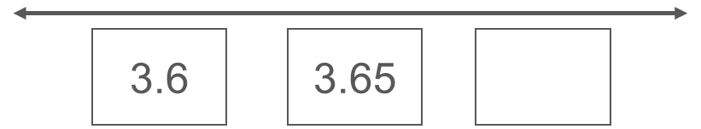
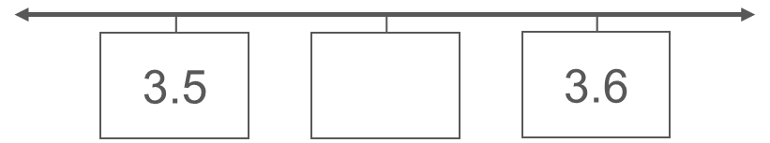
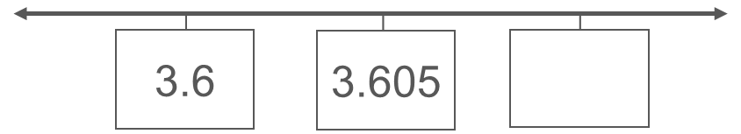
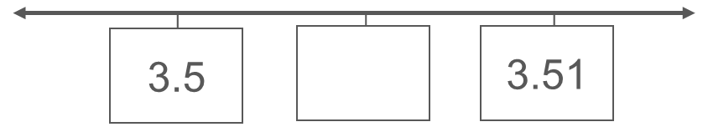
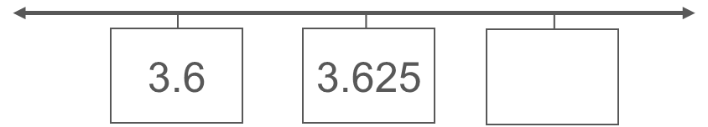
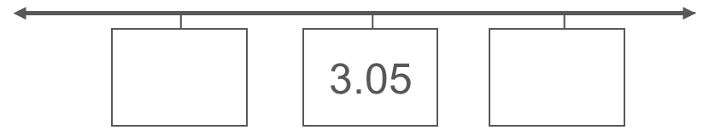
Checkpoint 15: Midpoint muddle
The boxes on these number lines are equally spaced.
What are the missing numbers?
a)
d)
b)
e)
c)
f)
Which of these diagrams might be useful for rounding the number 3.627 to the nearest tenth? How about the nearest hundredth?
Notes:
This slide is animated. Each question will appear separately so you can choose the pace at which to work with your class. A generic printable template for rounding with number lines can be found on slide 74. A printable resource for this activity is available on slide 76.
Answers
a) 3.7
b) 3.61
c) 3.65
d) 3.55
e) 3.505
f) 3 and 3.1 or 3.04 and 3.06 (Although there are infinite solutions, these are the most likely.)
? Diagram c would be useful for rounding 3.627 to the nearest tenth. There isn’t a diagram that would be useful for the nearest hundredth: this would have 3.62, 2.625 and 3.63 marked on.
Suggested questioning
What is the same and what is different about each number line?
What is the number line ‘going up’ in?
How can we find the midpoint?
How many different answers can you think of for part f?
Things to think about
A deep understanding of how the infinite number system can be represented on a number line is essential for using a number line to represent rounding. This Checkpoint looks at this underlying knowledge without explicitly talking about rounding, and is useful to check that students are confident with the number line before delving deeper into using it to round. Consider the strategies you might use to deal with any misconceptions. For example, would you model placing a zero in the hundredths and/or thousands columns? What are the benefits and limitations of rewriting the second question as 3.600, 3.605, 3.610, so that students can see that the numbers all have 3 whole ones and 600/605/610 thousandths?

Slide 45
Checkpoint 15: Guidance
Adaptations | Assessing understanding
Support Focus on the top four questions (a, b, d and e), and repeat the same structure with a different start number to check how secure students’ understanding is. Challenge Use the same structure with different numbers to increase challenge. For example, ask students to find the midpoint of 3.615 and 3.625, and compare how their strategy changes if you change the second number to 3.62 or 3.64. Representations The number line is a key representation for rounding, particularly as it is modelled here with a focus on a relevant ‘segment’ of the number line. This Checkpoint acts as a stand-alone task to assess whether students understand the structure of the representation, without any of the additional complexities of rounding. Model alongside a place-value grid, to help students connect different representations of the same mathematical structure. | Checkpoint 15 isolates a skill that sits ‘underneath’ the use of number lines as a representation for rounding: using place value to identify midpoints between two numbers. It focuses particularly on decimals, as a key development of students’ understanding of rounding at Key Stage 3 is to be able to round to any given number of decimal places. Parts a to c follow the same structure, giving the same start number (3.6) and different midpoints, so that students have to identify the third number in the sequence. Those with a less established sense of place value may find part b hard, and those that follow a pattern of decimal places without understanding may come unstuck at part c. It is intentional that not all of the sets of numbers will be useful for rounding, so that you can discuss which sets are and why. Parts d and e ask students to find the midpoint – they might notice they follow the same structure as parts a and b, with a different start number. Encourage them to find multiple answers to part f.
Additional resources Additional activity G is another task that explores understanding of place value on the number line to support using it as a representation for rounding.

Slide 46
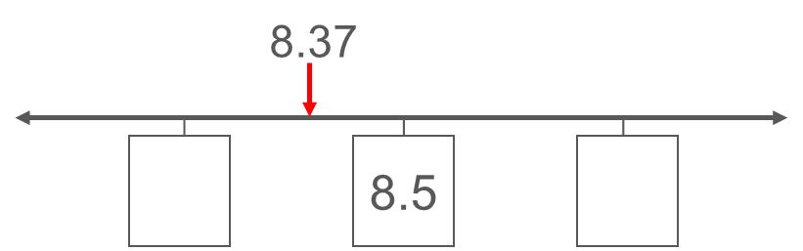
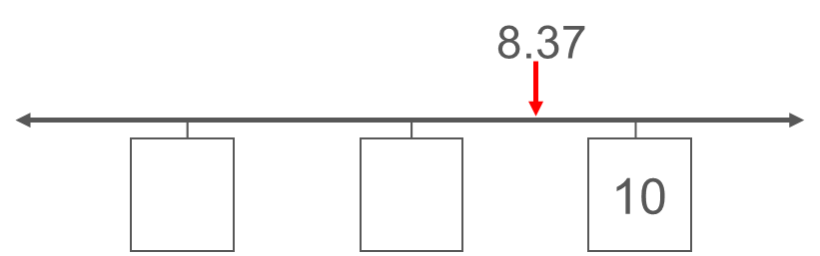
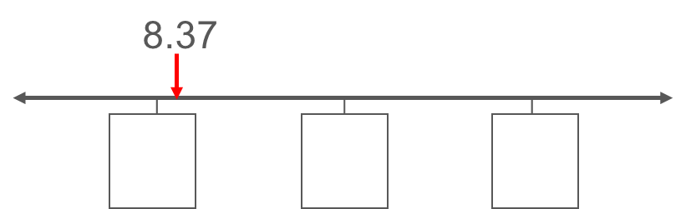
Checkpoint 16: Missing numbers
Kayley and Andy are rounding the number 8.37 in different ways.
They each use a number line to help them.
What numbers might go in the other boxes?
How might they have been asked to round their number?
Kayley
Andy
How might your answers change if Andy’s diagram looked like this?
Notes:
This slide is animated. Each question and each number line will appear separately so you can choose the pace at which to work with your class. A generic template for rounding with number lines can be found on slide 74.
Answers
a) Kayley: 8.0 and 9.0; Andy: 0 and 5.
b) Kayley: to the nearest whole number; Andy: to the nearest 10.
? The numbers might be 0, 50, 100 and Andy was asked to round to the nearest 100; or they were 0, 500, 1000 and it was the nearest 1000; etc.
Suggested questioning
What is the same and what is different about Kayley and Andy’s number lines?
Why is 8.37 in a different place each time?
How do you know what Andy and Kayley are rounding their number to?
Which values on the number line are most important for this?
Things to think about
In the primary curriculum, students are expected to round a whole number to any degree of accuracy and also to round to one decimal place. Students therefore need to be able to apply the structure and convention of rounding, and any representation they use to support this, to different place value. This Checkpoint uses the same value, 8.37, so students can demonstrate their understanding of what is the same and different about rounding to different degrees of accuracy, and how the number line representation is used each time.

Slide 47
Checkpoint 16: Guidance
Adaptations | Assessing understanding
Support If students are not familiar with this representation for rounding, explore just Andy’s with different values before introducing Kayley’s. Challenge Change one digit and ask students whether any of their answers would change. Ask them to generalise about which digits would change and which wouldn’t. For example, can they change the ones digit so that Kayley’s answer would stay the same but Andy’s wouldn’t? How about the other way around? Representations Students are likely to be familiar with seeing a number line to explore rounding, using the midpoint and deciding if the number being rounded lies to the left or right of this. If not, you will find it useful for teaching rounding at Key Stage 3 – and bounds at Key Stage 4 – so take the time to ensure students understand it. Those who find it hard to extrapolate from a small part of a number line may find it helpful to see a dynamic ‘zoomable’ number line – many examples can be found online. | Checkpoint 16 explores how deeply students understand the number line representation for rounding. Rather than asking them to ‘do’ the rounding, it asks them to consider the representation and work out both what the other values on the number line would be, and how the number is being rounded. Look out for students who struggle to find the values either side of Kayley’s 8.5 – they may need more support with place value. A common incorrect response is for students to write 8.6 and 8.7. These students are likely to be familiar with the number line but not with using it to round. Some students may be less familiar with rounding a decimal such as 8.37 to the nearest 10. Encourage them to explain what is the same and what is different about rounding the number 8 to the nearest 10. Those most secure with rounding should be able to identify that the only relevant digit is in the ones column.
Additional resources Checkpoint 15 and Additional activity G explore similar segments of the number line without considering rounding, and so could be used to check understanding of place value on the number line. 5NPV-3 in the Exemplification of ready-to-progress criteria NCETM may be relevant (see Checkpoint 13 Guidance slide).

Slide 48
Checkpoint 17: Always, sometimes, never?
Are these statements always, sometimes or never true?
A number rounded to the nearest 10 will have two digits.
A number rounded to the nearest 10 will be less than 5 away from the original number.
A number rounded to the nearest 10 will end in one zero.
Give some examples that show why.
Write your own ‘always, sometimes, never’ statements for rounding to the nearest hundred.
Notes:
This slide is animated. Each speech bubble, and each question, will appear separately so you can choose the pace at which to work with your class. A generic printable template for rounding with number lines can be found on slide 74.
Answers
a) ‘A number rounded to the nearest 10 will have two digits,’ is sometimes true.
‘A number rounded to the nearest 10 will end in one zero,’ is sometimes true.
‘A number rounded to the nearest 10 will be less than 5 away from the original number’ is sometimes true.
b) ‘A number rounded to the nearest 10 will have two digits,’ is true for -95 $< x<$95. Any number bigger than and including 95 or -95 will have more than two digits when rounded to the nearest 10.
‘A number rounded to the nearest 10 will end in one zero,’ is true most of the time (for example, 587 to the nearest 10 is 580), but it is not true if it rounds to a power of 10 (for example, 597 to the nearest 10 is 600).
‘A number rounded to the nearest 10 will be less than 5 away from the original number,’ is true except for the one example of the number that is exactly 5 less than the ‘nearest’ 10.
? Students’ responses will vary: look out for common misconceptions (see ‘Things to think about’).
Suggested questioning
Can you think of an example when this is true?
Can you think of an example when this is not true?
Why might someone think this is true?
Can you rephrase it so that it is always true?
Things to think about
Some common misconceptions about rounding are tackled using these prompts. Give students all three statements to consider at once, or ask them to discuss one at a time. If the former, support them with some way to structure their thinking (for example, splitting their page or mini whiteboard into three columns) so that they can organise their responses and counterexamples to each prompt. Colloquial terms such as ‘end in one zero’ have been used here to mirror the misconceptions that students might have, but you may seek more accuracy from students if you ask them to rephrase the statements so that they are true. For example, ‘a number rounded to the nearest 10 will have a ones digit of zero’.

Slide 49
Checkpoint 17: Guidance
Adaptations | Assessing understanding
Support Visit this Checkpoint in stages, showing just one of the speech bubbles each time but spending more time on part b, and exploring different examples with students. Challenge The further thinking question could be posed in multiple different ways – such as for numbers to the nearest whole number or thousand. Representations Use a number line to see if students reach for a representation to support their reasoning for part b. Prompt by asking students to ‘show’ why, rather than giving examples. | ‘Always, sometimes, never’ statements are a useful structure for probing students’ understanding. In this case, some common misconceptions and assumptions related to rounding are explored. The first two misconceptions here are relatively common – check if students hold them before delving any deeper into rounding. Students may find the first statement easiest to talk about, as they probably have some experience of rounding three-digit numbers to the nearest ten. Some may realise they can use the same counterexample to disprove both. For the final speech bubble, students might be tempted to say ‘always’ true, as there is only one number that is not less than five away – the number that is exactly five below. Discuss the conventions of rounding, and check students understand that the number five below the nearest ten is treated differently to the number five above.
Additional resources Examples of rounding questions can be found within the Year 6 SATs papers. For example, question 8 of 2022 Paper 2 reasoning and question 14 of 2019 Paper 2 reasoning both explore rounding to different degrees of accuracy, whilst question 14 from 2022 Paper 2 reasoning asks students to consider how far estimates are from the original number. Past papers can readily be found online.

Slide 50
Checkpoint 18: Thinking of a number
Rachel is thinking of a number. She uses rounding to give clues.
After each clue, guess her number and write it down. Does your guess change each time?
Clue 1
Clue 3
Clue 2
It is 4530 to the nearest ten.
It is 5000 to the nearest thousand.
It is 4500 to the nearest hundred.
Clue 4
It is 4528 to the nearest whole number.
Write your own set of clues for a new number using the same pattern.
Notes:
This slide is animated. Each speech bubble will appear separately so that the next clue is not revealed until students have made their guesses. A generic printable template for rounding with number lines can be found on slide 74. A blank template for the further thinking question can be found on slide 93.
Answers
After clue 1: any answer in the range 4500 $≤x<$5500.
After clue 2: any answer in the range 4450 $≤x<$4550.
After clue 3: any answer in the range 4525 $≤x<$ 4530.
After clue 4: any answer in the range 4527.5 $≤x<$ 4528.5
? Students’ responses to this will vary infinitely! Check that all four clues are true for the numbers students choose.
Suggested questioning
What is the biggest your number could be? What is the smallest?
Can you think of an appropriate number that nobody else has thought of?
Did your number need to change? Why or why not?
Which numbers would not need to change? How do you know?
Which clue had the most possible integer answers? Which had the least? (Integer answers are specified here as otherwise all would have infinite answers.)
Things to think about
Using the animations is essential for Checkpoint 18. The ‘reveal’ of the next clue prompts students to think about whether or not to change their answer. It could be completed quite quickly, but there are rich questions to ask at each stage. For example, why there are 1000 possible integer values after part a, but only 100 after part b, and so on. You might talk informally about probability at this stage. Probability is no longer formally in the primary curriculum but students will have experienced it in everyday life. For example, why is it not very likely that someone would guess the right answer after just one clue?

Slide 51
Checkpoint 18: Guidance
Adaptations | Assessing understanding
Support Build up to the ‘four-part’ reveal by practising first with two clues, to the nearest ten and hundred. Additional activity I gives an example of how to explore this in different ways with the same start number. Challenge Students are asked in the further thinking question to create their own sets of clues – add constraints to bring in further challenge. For example, that the number must have two decimal places, or be greater/less than the number it is rounded to at a particular stage. Representations A dynamic number line would be useful here, as you can zoom in with each clue that is given. There are many such tools available on line. | Checkpoint 18 looks at ‘rounding in reverse’ and so checks that students are able to think beyond a process and understand the mathematical structures they are using. Check if students can identify a suitable number in the given range. It is a relatively quick activity, but at each stage ask follow-up questions, such as, ‘What is the biggest/smallest number you could have chosen? You could repeat it with different numbers using the blank version in Additional activity J. For example, you could check that students are still confident if the second clue is over 5000. Using mini whiteboards would allow students to modify their answers as each clue is revealed, and you can check that students do change their answers if needed. Alternatively, ask students to all stand up at the start, and then sit down if their original guess is no longer possible when a new clue is revealed.
Additional resources Additional activity I offers a simplified version for students to begin with. Additional activity J offers a blank version of this for you to adapt. Examples of questions that explore rounding to different degrees of accuracy can be found within the Year 6 SATs papers (such as 2022 Paper 2 (Reasoning) question 8, and 2019 Paper 2 (Reasoning) question 14). Past papers can readily be found online.

Slide 52
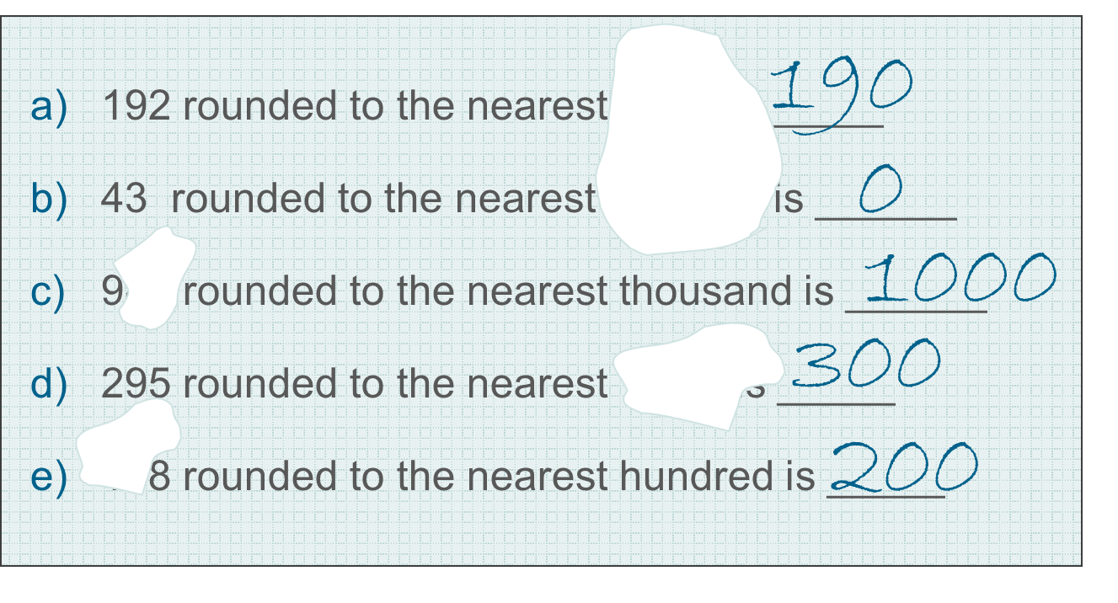
Checkpoint 19: The dog ate my homework
Permbir’s homework has been damaged by her dog!
Her answers are all still there but some numbers are missing from the questions.
What could the missing numbers be?
Which part has the fewest possible answers?
Which has the most?
Notes:
This slide is animated. The further thinking question will appear separately so you can choose the pace at which to work with your class. A generic printable template for rounding with number lines can be found on slide 74.
Answers
a) Ten
b) Hundred (or thousand, ten thousand etc)
c) Any answer in the range 90$≤x<$100 or 900$≤x<$1000
d) Ten or hundred
e) Any number ending in 8 between 150 and 250
? Part a has the fewest possible answers (only 1). The most is arguably part b, as there an infinite range of nearest ‘power of tens’ that would round 43 to 0. However, students are more likely to answer part c, which has 110 integer answers.
Suggested questioning
Which has the fewest?
Which part has the most possible answers?
Are there any parts where you can think of a solution nobody else has thought of?
Things to think about
A key feature of Checkpoint 19 is that there are multiple possible answers for all but part a. If students do not volunteer more than one suggestion, prompt them to think about some other possibilities for part b and see if they can translate this more flexible thinking to later parts of the task.

Slide 53
Checkpoint 19: Guidance
Adaptations | Assessing understanding
Support Offering a set of options for students to choose from may help students to access the task. Challenge Ask students to create their own ‘damaged homework’, but specify how many possible answers you think each question should have. Representations No representations are offered as part of the slide. Instead, watch to see whether students reach for any representations to support their own reasoning. As with the majority of Checkpoints in this deck, you may find a number line is helpful to support your modelling of the solutions. | Checkpoint 19 offers a context for exploring students’ understanding of ‘reverse rounding’ – whether they can identify the possible original values, or the degree of accuracy, from a rounded answer. A key assessment point is whether students recognise that there are multiple possible answers for most parts, indicated by the word ‘could’ in the question. To explore this, ask students to think of a solution that nobody else has thought of, or to think of the greatest number of possible solutions. Look out for students who only think of the most obvious answers (such as values between 950 and 999 for part c). They may need more exposure to non-examples and boundary cases to ensure they have a more complete understanding of rounding before they move on to new rounding concepts at Key Stage 3.
Additional resources Page 6 of the Year 6 Primary Assessment Materials | NCETM and p5 of the Secondary Assessment Materials | NCETM also offer examples of ‘reverse rounding’ type problems. If students find the multiple solutions for part b and d confusing, Checkpoint 20 offers a structure exploration of this concept. Examples of questions that explore rounding to different degrees of accuracy can be found within the Year 6 SATs papers (such as 2022 Paper 2 (Reasoning) question 8 and 2019 Paper 2 (Reasoning) question 14). Past papers can readily be found online.
Examples of finding percentages questions can be found within the Year 6 SATs papers (such as question 18 of 2018 Paper 3 reasoning). Past papers can readily be found online.

Slide 54
Checkpoint 20: 1 997
Round 1 997 to:
the nearest thousand
the nearest hundred
the nearest ten.
What do you notice?
For what other numbers might this happen? Why?
How would your answer to part c change if your number had to round to the same value to the nearest whole number as well?
Notes:
This slide is animated. Each question will appear separately so you can choose the pace at which to work with your class. A generic printable template for rounding with number lines can be found on slide 74.
Answers
a) Nearest thousand: 2000
Nearest hundred: 2000
Nearest ten: 2000
b) All of the rounded answers are the same.
c) This would happen for any other numbers that are up to 5 less or up to 4.4$\dot{9}$ more than a multiple of 1000 (5 $≤$ any multiple of 1000 $<$ 5).
? This would now only include numbers that are up to 0.5 less or up to 0.4$\dot{9}$ more than a multiple of 1000 (i.e. 0.5 $≤$ any multiple of 1000 $<$ 0.5).
Suggested questioning
What is the same/different about your answers?
Why does this happen?
Things to think about
Checkpoint 20 looks in detail at numbers that round to the same value for different degrees of accuracy, which might not be something that students have dwelt on before. It draws on similar ideas to Checkpoint 19, where students had to think about what the missing degree of accuracy could have been. A useful follow up might be to give a sentence such as, ‘199997 rounds to 2000000 to the nearest ___,’ and ask students to complete it. Do they recognise that there are multiple possible answers?

Slide 55
Checkpoint 20: Guidance
Adaptations | Assessing understanding
Support Start by looking at 97 to the nearest 10 and 100 first. Challenge Ask students to extend their generalisations from part c and the further thinking question – what numbers would round to the same value to the nearest 10000, 1000, 100 and 10? Representations A number line is likely to be the most useful representation to model this. Use a number line from 1500–2500, and different colours or patterns to show the range of numbers that round to 2000 to different degrees of accuracy. For example, marking 1500–2500 (nearest 1000) in one colour or pattern, 1950–2050 (nearest 100) in another and 1995–2005 (nearest 10) in another. | Checkpoint 20 focuses on a specific feature of rounding: that numbers within 5 of a multiple of one thousand will round to the same number to the nearest 10, the nearest 100 and the nearest 1000. The premise of part a is simple: to see if students are comfortable with this. They may not be if they have misconceptions, such as thinking that numbers rounded to the nearest 10 must end in one zero, or that if a number has three zeros it has been rounded to the nearest 1000. Part c offers an opportunity for students to generalise. Some may give an example of a value or range of values that work. Listen out for those who are able to define in more general terms as they are likely to have a deeper understanding of the mathematical structure of rounding.
Additional resources The structure of rounding the same number to different degrees of accuracy should be familiar to students. Examples can be found within the Year 6 SATs papers (for example 2022 Paper 3 (Reasoning) Question 8, and 2019 Paper 2 (Reasoning) Question 14). Past papers can readily be found online. Also from the Year 6 SATs papers, 2022 Paper 2 (Reasoning) Question 14 asks students to consider how far estimates are from the original number.

Slide 56
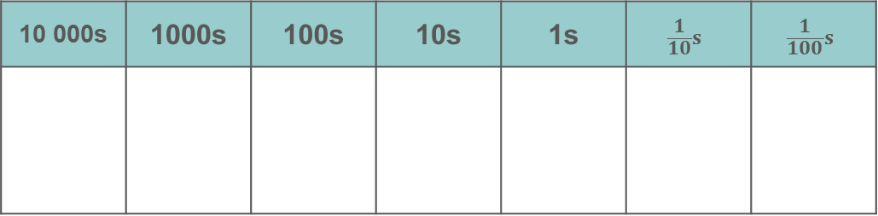
Checkpoint 21: Digit cards
10 000s | 1000s | 100s | 10s | 1s | $$\frac{1}{10}s$$ | $$\frac{1}{100}s$$
3
4
5
6
7
Using all five digits each time, arrange the cards in the place-value grid to create:
A number that rounds to 4 000 to the nearest thousand.
A number that rounds to 300 to the nearest hundred.
A number that rounds to 10 to the nearest ten.
A number that rounds to 10 to the nearest whole number.
A number that rounds to 3.8 to the nearest tenth.
Which of parts a to e has the most possible answers? Which has the fewest?
Notes:
This slide is animated. Each question will appear separately so you can choose the pace at which to work with your class. Printable cards/grids can be found on slides 78–91, with instructions for printing on slide 77. Note that the place-value grids match the grid on the slide. There are not enough columns on the grid for part c onwards, but there is space for students to draw more.
Answers
a) Any arrangement of cards that starts 35_ _ . _, 36 _ _ . _ or 37_ _ . _
b) Any arrangement of cards that starts 34 _ . _ _
c) Any arrangement of cards that starts 5._ _ _ _ , 6._ _ _ _ or 7._ _ _ _
d) There is no possible arrangement of cards, as there is not a 9, 1 or 0.
e) Any arrangement of cards that starts 3.75_ _ or 3.76_ _
? Part c has the most possible answers, as there are three different starting points, each with four cards to arrange different ways. Part d has the least as it is not possible.
Suggested questioning
What is the biggest number you can create each time? What is the smallest?
How can you use all five digits each time?
Which digits are involved in the rounding? Which digits are not?
Things to think about
Checkpoint 21 uses digit cards and a place-value grid to help students create numbers that could have been rounded to a given value. Consider whether it would help your students to have physical cards (available in the printable resources) or if it would be better for them to work on paper. If you do choose to use cards, think about whether you want them to have the prompt of the place-value grid or to work independently of this – in which case, include a decimal point card in the pack.

Slide 57
Checkpoint 21: Guidance
Adaptations | Assessing understanding
Support Simplify the task, while maintaining the focus on mathematical structure: use three digit cards and ask about the nearest 100, 10 and whole number (as in parts b to d). Challenge Encourage students to think more deeply about the structures involved by considering ‘impossible’ questions, as in Additional activity K. Representations A place-value grid is given here as a hint to students that they might need to think ‘beyond’ the decimal point to arrange their five digits. Note that space limitations mean that there are not sufficient decimal places for part c onwards. A number line may support students to think about how to round the digits that they have arranged. | Often, the examples that students work with have only the ‘necessary’ digits for rounding to the given degree of accuracy. For example, they are likely to have most commonly rounded four-digit numbers to the nearest thousand, and three-digit numbers to the nearest hundred. Checkpoint 21 plays with this idea by requiring students to use all five digits in each answer. There are multiple solutions, so it might be helpful to structure this task using mini whiteboards and encourage discussion about whether each student’s suggested number works. Those most confident might be able to generalise about which digit cards must be in certain positions. Use this Checkpoint both to check that students are aware that numbers can be rounded even if they have digits beyond those needed, and as a precursor to teaching rounding to significant figures at Key Stage 3. Discuss which digits are most important for the rounding, and which are necessary to show the size of the number.
Additional resources Additional activity K uses a similar premise but explores more deeply the structures involved in rounding by posing ‘impossible’ questions

Slide 58
Checkpoint 22: Zeros
All of the numbers below have nine zeros.
How many zeros does each number actually need?
0.000000050
50.00000000
50000000.00
0000.000005
0.0005000500
5.000000000
5.0000000005
5.050050005000
50000.050000
50000.000005
What is the smallest number that needs all nine zeros?
What is the biggest?
Notes:
This slide is animated. Each question will appear separately so you can choose the pace at which to work with your class.
Answers
a) 8 (0.00000005)
b) 1 (50)
c) 7 (50 000 000)
d) 6 (0.000005)
e) 7 (0.00050005)
f) 0 (5)
g) 9 (5.0000000005)
h) 6 (5.05005000)
i) 5 (50000.05)
j) 9 (5000.000005)
? The smallest number that needs all nine zeros is 0.000000005.
The biggest is 5 000 000 000.
Suggested questioning
What is the smallest number in this list? What is the biggest?
Why don’t all the numbers need all nine zeros?
When does a zero make a difference to the value of a number? When does it not?
Things to think about
The final Checkpoint in the deck could be used as a precursor to new teaching on significant figures. The assessment point is simple: can students recognise where a zero makes a difference to the place value, and where it doesn’t? Offer some incorrect generalisations for students to argue against, such as, ‘All zeros after the decimal point are unnecessary’. See the Guidance slide for discussion about zeros before the decimal point.

Slide 59
Checkpoint 22: Guidance
Adaptations | Assessing understanding
Support Explore the same premise first with fewer zeros, if students find the longer strings of digits overwhelming. Start with different arrangements of four zeros. Challenge Build on the further thinking question by offering different clues and constraints, such as, ‘I am thinking of a number with eight zeros. More than half of them are needed. What could my number be?’ Representations A place-value grid, with sets of five counters, might be helpful. Most classroom place-value grids do not stretch from ten millions to ten-billionths, so a template is provided in the printable resources. | A key piece of new learning at Key Stage 3 is rounding to significant figures. This relies on an understanding of place value and an appreciation of which digits are ‘significant’ to a number’s size. This Checkpoint checks this before introducing any new terminology, by presenting a set of numbers with the same amount of zeros and asking which are actually needed. Using the same digits throughout may seem a little repetitive – or even silly – but it means that you can easily compare different numbers and ask students if they can explain why some zeros are necessary and some are not. For example, why are they needed for f but not for e? Why are most of the zeros needed in both a and b, even though one is very big and one is very small? We have suggested in the answers that the zero before the decimal point is needed, as this is how decimals are commonly presented – although this does not really have an impact on the place value. You might discuss this convention with students.
Additional resources Pages 5 and 6 of the Secondary Assessment Materials | NCETM offer examples of the kind of questions students might be expected to answer at Key Stage 3. Key idea 1.1.3.2 from the Secondary Assessment Materials | NCETM gives ideas for how you might go on to explore ‘rounding integers to significant figures’ at Key Stage 3

Slide 60
Additional activities
Activities A–K

Slide 61
Activity A: More estimating volume?
What would be a sensible unit of volume to measure each of the items in the table?
drink bottle | pond | swimming pool
petrol tank | cup of tea | dose of medicine
Each of the values below matches one of the six items. Which is which?
375 000 | 5 | 55 | 500 | 1 500 | 300
A drink can has a capacity of approximately 300 ml. How many drink cans would be the equivalent of each of the things in part a?
Notes:
This slide is animated. Each question will appear separately so you can choose the pace at which to work with your class.
Answers
All suggested answers are given in metric units, but this is not stated on the slide so that you can identify which students automatically suggest imperial measures. Students might suggest imperial units such as gallons/pints in place of litres and fluid ounces in place of millilitres. These are also valid.
a) Drink bottle: millilitres or litres; lake: litres; swimming pool: litres: petrol tank: litres; cup of tea: millilitres; dose of medicine: millilitres
b) 375 000 l: swimming pool; 5 ml: dose of medicine; 55 l: petrol tank; 500 ml: drink bottle; 1500 l: pond; 300 ml: cup of tea.
? Drink bottle: approximately 1.5 cans; pond; approximately 5000 cans; swimming pool: approximately 1 250 000 cans; petrol tank: approximately 180 cans; cup of tea: approximately 1 can; dose of medicine: approximately 1/60 can
Suggested questioning
What is the biggest item in the list? What is the smallest?
What is the biggest unit of measure you know? What is the smallest?
Could any of these use two different units of measure?
Why can’t the estimate for __ be __? (Choose an inappropriate unit or value here, for students to argue against.)
Things to think about
Additional activities A, B and C are a set to accompany the ideas assessed in Checkpoint 5, which asks students to estimate the volume, mass or length of a familiar object and then use this to estimate a larger one. Each focuses on one particular measure – in this case volume – so that you can pick up on any misconceptions or gaps. The structure of each is the same: part a asks students to suggest appropriate units for six different items, with some relatively extreme differences between them; part b then gives six possible values to match. For some items in part a, more than one unit might be appropriate, but in part b students will need to use a particular unit to link to the values. Look out for students who suggest imperial measures – probe whether this is just because they are used to them, or because they are unclear of the difference between metric and imperial.

Slide 62
Activity B: More estimating mass
What would be a sensible unit of mass to measure each of the items in the table?
baby | elephant | full suitcase
cargo ship container | newborn puppy | packet of crisps
Each of the values below matches one of the six items. Which is which?
4 000 | 3.2 | 120 | 28 | 19 | 2 797
An orange weighs approximately 120 g. How many oranges do you think would be the equivalent of one of each of the things in part a?
Notes:
This slide is animated. Each question will appear separately so you can choose the pace at which to work with your class.
Answers
All suggested answers are given in metric units, but this is not stated on the slide so that you can identify which students automatically suggest imperial measures. Students might suggest imperial units such as tons in place of tonnes, stones/pounds in place of kilograms and ounces in place of grams. These are also valid.
a) Baby: kilograms; elephant: kilograms or tonnes; full suitcase: kilograms; cargo ship container: tonnes; newborn puppy: grams; packet of crisps: grams
b) 4000 kg: elephant; 3.2 kg: baby; 120 g: newborn puppy; 28 g: packet of crisps; 19 kg: full suitcase; 2797 kg: cargo ship container
? Baby: approximately 25 oranges; elephant: approximately 32 000 oranges; full suitcase: approximately 160 oranges; cargo ship container: approximately 24 000 oranges; newborn puppy: approximately 1 orange; packet of crisps: approximately ¼ orange
Suggested questioning
What is the biggest item in the list? What is the smallest?
What is the biggest unit of measure you know? What is the smallest?
Could any of these use two different units of measure?
Why can’t the estimate for __ be __? (Choose an inappropriate unit or value here, for students to argue against.)
Things to think about
Additional activities A, B and C are a set to accompany the ideas assessed in Checkpoint 5, which asks students to estimate the volume, mass or length of a familiar object and then use this to estimate a larger one. Each focuses on one particular measure – in this case volume – so that you can pick up on any misconceptions or gaps. The structure of each is the same: part a asks students to suggest appropriate units for six different items, with some relatively extreme differences between them; part b then gives six possible values to match. For some items in part a, more than one unit might be appropriate, but in part b students will need to use a particular unit to link to the values. Look out for students who suggest imperial measures – probe whether this is just because they are used to them, or because they are unclear of the difference between metric and imperial.

Slide 63
Activity C: More estimating length
What would be a sensible unit of length to measure each of the items in the table?
journey | river | person
eyelash | tree | building brick
Each of the values below matches one of the six items. Which is which?
0.9 | 40 | 3.1 | 250 | 190 | 1.75
A pencil is approximately 20 cm long. How many pencils would be equivalent of each of the items in part a?
Notes:
This slide is animated. Each question will appear separately so you can choose the pace at which to work with your class.
Answers
All suggested answers are given in metric units, but this is not stated on the slide so that you can identify which students automatically suggest imperial measures. Students might suggest imperial units such miles in place of kilometres, yards/feet in place of metres and inches in place of centimetres/millimetres. These are also valid.
a) Journey: kilometres or metres; river: kilometres; person: centimetres or metres; eyelash: millimetres; tree: metres; building brick: centimetres or metres
b) 0.9 mm: eyelash; 40 km: journey; 3.1 m: tree; 250 km: river; 190 mm: brick; 1.75 m: person. Students might be able to justify some ‘swaps’ (for example, 190 cm: tall person; 175 mm: brick). Bear in mind what is reasonable.
? Eyelash: approximately 1/20 pencil; journey: approximately 200 000 pencils; tree: approximately 15.5 pencils; river: approximately 1 250 000 pencils; brick: approximately 1 pencil; person: approximately 9 pencils
Suggested questioning
What is the biggest item in the list? What is the smallest?
What is the biggest unit of measure you know? What is the smallest?
Could any of these use two different units of measure?
Why can’t the estimate for __ be __? (Choose an inappropriate unit or value here, for students to argue against.)
Things to think about
Additional activities A, B and C are a set to accompany the ideas assessed in Checkpoint 5, which asks students to estimate the volume, mass or length of a familiar object and then use this to estimate a larger one. Each focuses on one particular measure – in this case volume – so that you can pick up on any misconceptions or gaps. The structure of each is the same: part a asks students to suggest appropriate units for six different items, with some relatively extreme differences between them; part b then gives six possible values to match. For some items in part a, more than one unit might be appropriate, but in part b students will need to use a particular unit to link to the values. Look out for students who suggest imperial measures – probe whether this is just because they are used to them, or because they are unclear of the difference between metric and imperial.

Slide 64
Activity D: World records
The following are all values for world records. What might the units be?
narrowest street: 31
heaviest dog: 155.6
longest river: 6992
lightest cat: 0.8
tallest building: 828
longest human nose: 88
heaviest potato: 4980
shortest river: 61
Rewrite all the records using a different unit.
Notes:
This slide is animated. Each question will appear separately so you can choose the pace at which to work with your class.
Answers
All suggested answers are given in metric units, but this is not stated this on the slide so that you can identify which students automatically suggest imperial measures. Miles in place of kilometres, yards/feet in place of metres and inches in place of centimetres/millimetres, stone/pounds in place of kilograms and ounces in place of grams are valid answers.
narrowest street: centimetres (31 cm)
heaviest dog: kilograms (155.6 kg)
longest river: kilometres (6992 km)
lightest cat: kilograms (0.8 kg)
tallest building: metres (828 m)
longest human nose: millimetres (88 mm)
heaviest potato: grams (4980 g)
shortest river: metres (61 m)
? Students’ answers will vary depending on the units chosen.
Suggested questioning
What units could be used for length/mass?
Which unit of mass is most likely for a ‘lightest’ record? Why?
What would you estimate an average measurement to be for each thing? (Gather ideas from the class, to see if they tend towards the same range of values).
Things to think about
World records are an engaging context for exploring measurement and estimation. You could use images to help contextualise each of these items. Records are useful as they offer extreme or ‘boundary’ cases, which offers a helpful comparison to think about what is average in each example. The primary assessment point is to check whether students know their units of measurement and can select appropriate examples. You can also assess whether they can make sensible estimates of length and mass. You could use mini whiteboards or structured discussion to capture their responses.

Slide 65
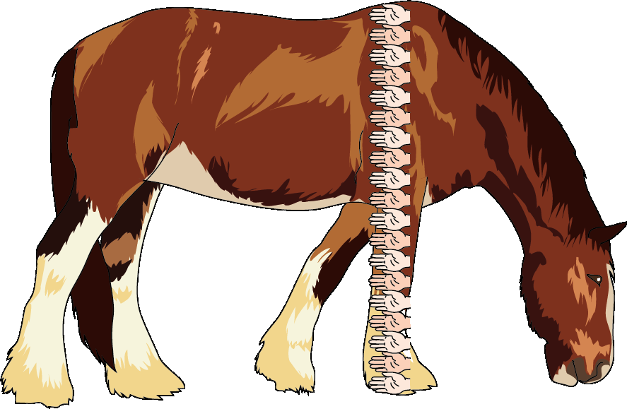
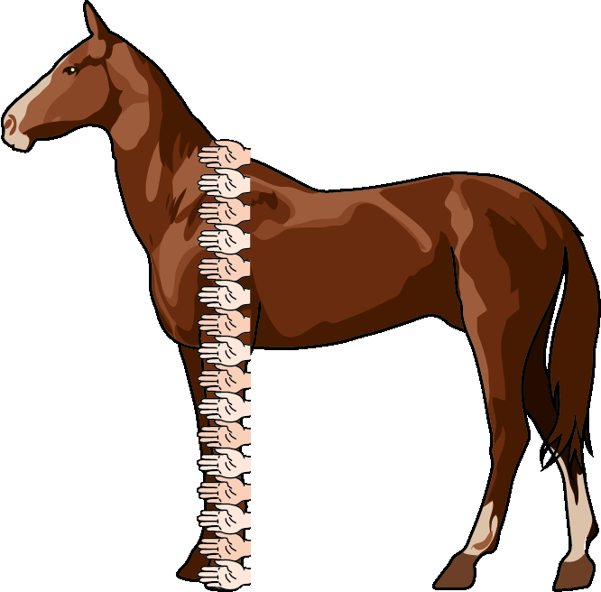
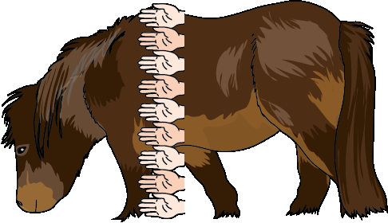
Activity E: Horses and hands
Horses are measured using ‘hands’ as a unit, as shown below.
Estimate the height in centimetres of each of the horses.
The standard metric equivalent for a hand is 10.2 cm. Does this mean your estimate will be too big, too small or just right?
How many hands high are you to the top of your head?
Estimate some other objects using hands as a unit.
Notes:
This slide is animated. Each question will appear separately so you can choose the pace at which to work with your class. If helpful for counting hands, a printable resource is available on slide 92. Students might notice that the hands do not measure to the tallest point on the horse – for consistency, horses are always measured to the same point, their withers, as shown on the diagrams.
Answers
a) Measurement in hands from left to right: 9 hands, 19 hands, 15.5 hands. Students’ answers will vary depending on their own estimate for the width of a hand: 9 $×$ their estimate, 19 $×$ their estimate and 15.5 $×$ their estimate. So, for example, if a student estimates a hand to be 10 cm their answers will be 90 cm, 190 cm and 155 cm.
b) Students’ answers will vary depending on whether they judge the value they used to be more or less than the average hand width of 10.2.
? Students answers to this will vary depending on their own height and which objects they choose.
Suggested questioning
Is the horse taller or shorter than ten hands? How do you know?
What is your strategy for counting/grouping the hands? How does alternating white and grey hands help you to count?
What might this measurement be in centimetres?
Things to think about
Additional activity E offers a real-life context for using a unit of measure derived from a body part, which is an estimation strategy explored in some of the earlier Checkpoints in this deck. As the images here include hand graphics, students do not need any prior knowledge of horses. Notice whether students have an efficient strategy for counting. Do they count one-by-one, or group the hands into twos or larger sets? Students may be interested to know that systems of measurement based on body parts have existed since the time of the Ancient Egyptians, and that many of these have since been standardised using imperial and metric units. Hands, for example, have been standardised at four inches since the 1500s.

Slide 66
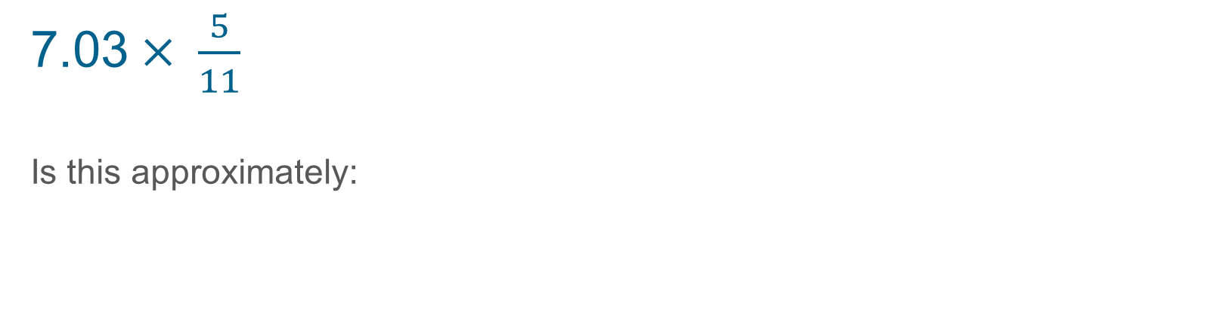




Activity F: Approximately
7.03$× \frac{5}{11}$
Is this approximately:
$$\text{6}$$
$$\text{14}$$
$$\text{3 }$$
$$\text{4}$$
not possible to estimate
Write a calculation that is approximately equal to the other four answers.
Notes:
This slide is animated. Each option, and then the further thinking question, will appear separately so you can choose the pace at which to work with your class.
Answers
Approximately 3 (it is 3.195 to 3 d.p.).
? Students’ responses will vary.
Suggested questioning
What does ‘approximately’ mean? What other word could you use instead?
Which answers are definitely not good approximations? How do you know?
How else could you write each value in this question? How might that help?
Things to think about
Additional activity F offers a similar assessment point to Checkpoint 11, but with a choice of possible answers rather than alternative calculations. The most confident students would round 7.03 to 7, and then recognise that $\frac{5}{11}$ is approximately equal to one-half. Students who answer 3 or 4 might have done this successfully, but not have an effective strategy for dividing by a number between 0 and 1. Encourage students to talk about the steps they took, so you can identify which stage caused a problem. This is not a quick multiple choice question, but a springboard for a wider discussion. Consider classroom strategies that offer students an opportunity to compare and discuss their answers, and plan how to collate them all.

Slide 67
Activity G: Red arrows
The three boxes on the line are equally spaced.
Choose three numbers from the cloud to place in the boxes.
Estimate the value of the numbers shown on the line by the arrows marked X, Y and Z.
Repeat parts a and b for three different numbers from the cloud. What is the same and different about your answers?
X
Y
Z
7
7.05
7.1
7.2
8
Choose two numbers from the cloud that you can’t currently use in a set of three. What would the third number need to be for your choices? What would be the values of X, Y and Z?
7.5
7.25
7.15
Notes:
This slide is animated. Each question, will appear separately so you can choose the pace at which to work with your class. A generic printable template that is the same as the one used in this task can be found on slide 74.
Answers
a) Possible answers include:
7, 7.1, 7.2
7, 7.5, 8
7, 7.05, 7.1
7.1, 7.15, 7.25
7.15, 7.2, 7.25
b) Possible answers include:
7, 7.1, 7.2: X $≈$ 7.06, Y $≈$ 7.12, Z $≈$ 7.18
7, 7.5, 8: X $≈$ 7.3, Y $≈$ 7.6, Z $≈$ 7.85
7, 7.05, 7.1: X $≈$ 7.03, Y $≈$ 7.06, Z $≈$ 7.085
7.1, 7.15, 7.2: X $≈$ 7.13, Y $≈$ 7.16, Z $≈$ 7.185
7.15, 7.2, 7.25: X $≈$ 7.18, Y $≈$ 7.21, Z $≈$ 7.35
c) See above for different potential answers.
? Students’ responses to this will vary. Those seeking the easiest solution might choose 7, 8 and 9 (so X $≈$ 7.6, Y $≈$ 8.2, Z $≈$ 8.7). A more challenging example might be 6.9, 7.2 and 7.5 (X $≈$ 7.08, Y $≈$ 7.28, Z $≈$ 7.42).
Suggested questioning
How can you estimate the values of X, Y and Z?
Which is the easiest set of three numbers to use? Which is the most challenging?
Is X closer to the first or the second number? Is X closer to the midway point between the first and second numbers, or the second number?
Things to think about
Additional activity G explores students’ understanding of the number line using the visual structure most commonly used for rounding, but without specifically asking students to round. There are multiple sets of three that can be found using the numbers given in the box. Students are likely to choose the set they feel most comfortable with first (likely 7, 7.5 and 8), so use part c as an opportunity to push them to challenge themselves, and assess the limits of their understanding.

Slide 68
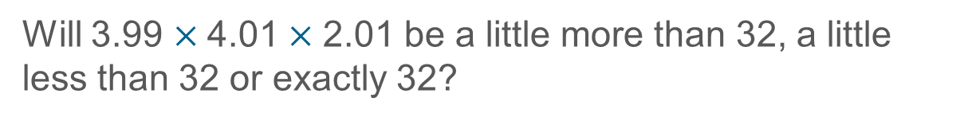
Activity H: Not quite 4 × 4?
3.99 × 4.01
Without calculating, is this a little more than 16, a little less than 16 or exactly 16?
Will 3.99 $×$4.01$×$ 2.01 be a little more than 32, a little less than 32 or exactly 32?
Notes:
This slide is animated. The further thinking question will appear separately so you can choose the pace at which to work with your class.
Answers
A little less than 16.
? A little more than 32.
Suggested questioning
How does this calculation compare to 3 $×$ 4?
Why does ‘adding one-hundredth’ and ‘subtracting one-hundredth’ not cancel each other out?
Could you draw a diagram to explain your reasoning?
Things to think about
Like Checkpoint 12, this activity asks students to reason about a calculation. This time, both the values are adjusted from the nearest integer. You could structure the questions as in Checkpoint 12, and first change just one value at a time. Giving the estimated answer of 16 means that students are not focusing on the process of estimation, but on reasoning about whether the result of an estimation is an over- or under-estimate (albeit using more informal language). A common misconception is that the addition and subtraction of one-hundredth cancel each other out. An area or grid model can be used to represent why this is not the case.

Slide 69
Activity I: Thinking of a number again
Rachel is thinking of some different numbers. She uses rounding to give two clues.
After each clue, guess her number and write it down. Does your guess change each time?
a)
Clue 1
b)
Clue 1
c)
Clue 1
Clue 2
Clue 2
Clue 2
It is 300 to the nearest hundred.
It is 300 to the nearest hundred.
It is 300 to the nearest hundred.
It is 290 to the nearest ten.
It is 250 to the nearest ten.
It is 320 to the nearest ten.
Using the same pattern, write your own pairs of clues for some new numbers.
Notes:
This slide is animated. Each question will appear separately so you can choose the pace at which to work with your class. A generic printable template for rounding with number lines can be found on slide 74.
Answers
a) After clue 1: any answer in the range 250$≤x<\text{350}\text{.}$ After clue 2: any answer in the range 285$≤x<$295.
b) After clue 1: any answer in the range 250$≤x<\text{350}$. After clue 2: any answer in the range 315$≤x<$325.
c) After clue 1: any answer in the range 250$≤x<\text{350.}$ After clue 2: any answer in the range 250$≤x<$ 245.
? Students’ responses to this will vary infinitely!
Suggested questioning
What is the biggest your number could be? What is the smallest?
Can you think of an appropriate number that nobody else has thought of?
Did your number need to change? Why or why not?
Which numbers would not need to change? How do you know?
Which clue had the most possible (integer) answers? Which had the least? (Integer specified here as otherwise all would have infinite answers).
Things to think about
Additional activity I is a more straightforward version of Checkpoint 18, with just two clues so that you can really focus on how the range of possible numbers has changed. The number for clue 1 is kept consistent throughout so that you can focus on what is the same and different when the second clue is given. An interesting point to discuss might be why there are 10 possible integer answers for parts a and c, but only five for part b (as this is at the lower bound for rounding to the nearest hundred). Note that, whilst asking students to consider the range of values that round to a given number is a common question to deepen students’ understanding at Key Stage 2, the language of bounds is not introduced until Key Stage 4. A number line would therefore be the most appropriate way to model this.

Slide 70
Activity J: Thinking of another number
I am thinking of a number. I am going to give rounding to give clues.
After each clue, write a guess down. Does your guess change each time?
Clue 3
Clue 1
It is ____ to the nearest ten.
Clue 2
It is ____ to the nearest thousand.
It is ____ to the nearest hundred.
Clue 4
It is ____ to the nearest whole number.
Write your own set of clues for a new number using the same pattern.
Notes:
This slide is animated. Each question will appear separately so you can choose the pace at which to work with your class. A generic printable template for rounding with number lines can be found on slide 74.
A blank template for the further thinking question can be found on slide 93.
Answers
Not possible to give as it depends on the values selected.
Suggested questioning
What is the biggest your number could be? What is the smallest?
Can you think of an appropriate number that nobody else has thought of?
Did your number need to change? Why or why not?
Which numbers would not need to change? How do you know?
Which clue had the most possible (integer) answers? Which had the least? (Integer specified here as otherwise all would have infinite answers).
Things to think about
Additional activity J is a ‘fill in the blanks’ version of Checkpoint 18, for you to adapt for your own classes. You might use it to extend Checkpoint 18 or to revisit the same concept another time. See the Guidance on slide 50 for more information.

Slide 71
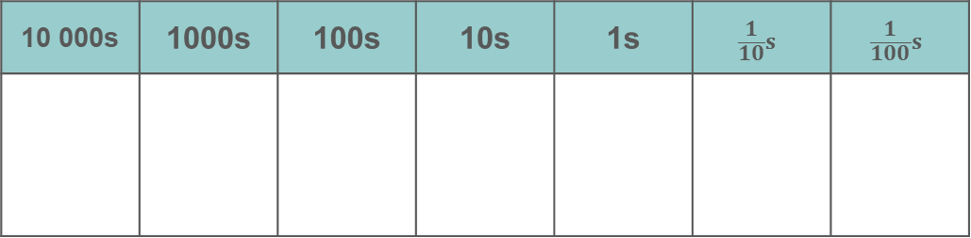
Activity K: Impossible numbers
10 000s | 1000s | 100s | 10s | 1s | $$\frac{1}{10}s$$ | $$\frac{1}{100}s$$
4
5
6
7
Rearranging all four digits on the place-value grid each time, which of these are impossible to create?
A number that rounds to 7 000 to the nearest thousand.
A number that rounds to 7 000 to the nearest hundred.
A number that rounds to 700 to the nearest hundred.
A number that rounds to 700 to the nearest ten.
Change the digits so that all of the statements are possible. What is the minimum number of digits that need to change?
Notes:
This slide is animated. Each question will appear separately so you can choose the pace at which to work with your class. Printable cards/grids can be found on slides 78–91, with instructions for printing on slide 77. Note that the place-value grids match the grid on the slide. There are not enough columns on the grid for part c onwards, but there is space for students to draw more.
Answers
a) Possible with arrangements starting 65_ _, 67_ _ or 74_ _
b) Not possible; would need a 0 or a 9 (e.g. 69_ _ or 70_ _)
c) Possible with arrangements starting 65_._ ,67_._ or 74_._
d) Not possible; would need a 0 or a 9 (e.g. 69_._ or 70_._)
? Just change the 4 or the 5 to a 0 or a 9 and all are now possible.
Suggested questioning
What numbers round to 7000 to the nearest thousand? How about 700 to the nearest hundred?
What is the biggest number you can create each time? What is the smallest?
Why are some of these impossible? What digits would you need?
Things to think about
Additional activity K uses the same premise as Checkpoint 21, but perhaps takes students a little deeper into thinking about the range of values that round to a given number. For example, although there are 7 and 6 digits, students cannot answer part b without a 9 or a 0 to make sure their number is within 50 of 7000. Grappling with this offers students an opportunity to demonstrate their understanding of the structure of rounding and offers insight into how readily they might be able to work with significant figures at Key Stage 3 and, beyond that, to work with bounds at Key Stage 4.

Slide 72
Printable resources

Slide 73
a)
b)
1 000
0
600
0
0
1 600
0
250
0
5 000
0
1 000
a)
b)
1 000
0
600
0
0
1 600
0
250
0
5 000
0
1 000
Notes:
This printable, editable resource (two to a page) is for use with Checkpoint 8.

Slide 74
Notes:
This printable, editable resource of a number-line representation for rounding may be of use throughout the ‘Rounding’ section of this deck.

Slide 75
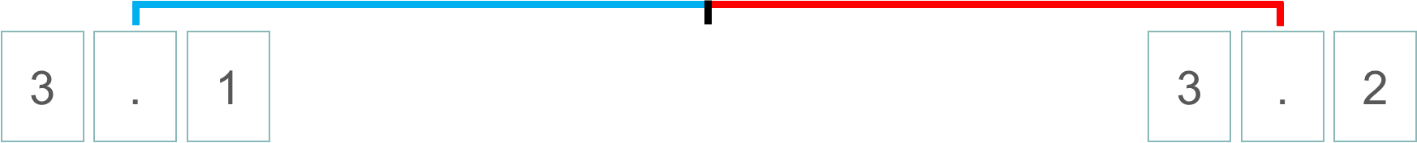
Notes:
These printable number lines (four to a page, with space above and below for labelling) might be useful with Checkpoint 13.

Slide 76
a)
d)
3.6
3.65
3.5
3.6
b)
e)
3.6
3.605
3.5
3.51
c)
f)
3.6
3.625
3.05
a)
d)
3.6
3.65
3.5
3.6
b)
e)
3.6
3.605
3.5
3.51
c)
f)
3.6
3.625
3.05
Notes:
This printable, editable resource (two on a page) is for use with Checkpoint 15.

Slide 77
Printable 0–9 digit cards
You may wish to print slides 78–87 to create sets of 0–9 digit cards. Stack and clip the printed slides and cut along the lines to produce 32 sets of digit cards.
Place-value grids are available on slide 89. If you do not want to give students a place-value grid, you might instead print the decimal point cards on slide 88.
Alternatively, smaller place-value grids that students can draw on are on slides 90 and 91.

Slide 78
0 | 0 | 0 | 0 | 0 | 0 | 0 | 0
0 | 0 | 0 | 0 | 0 | 0 | 0 | 0
0 | 0 | 0 | 0 | 0 | 0 | 0 | 0
0 | 0 | 0 | 0 | 0 | 0 | 0 | 0

Slide 79
1 | 1 | 1 | 1 | 1 | 1 | 1 | 1
1 | 1 | 1 | 1 | 1 | 1 | 1 | 1
1 | 1 | 1 | 1 | 1 | 1 | 1 | 1
1 | 1 | 1 | 1 | 1 | 1 | 1 | 1

Slide 80
2 | 2 | 2 | 2 | 2 | 2 | 2 | 2
2 | 2 | 2 | 2 | 2 | 2 | 2 | 2
2 | 2 | 2 | 2 | 2 | 2 | 2 | 2
2 | 2 | 2 | 2 | 2 | 2 | 2 | 2

Slide 81
3 | 3 | 3 | 3 | 3 | 3 | 3 | 3
3 | 3 | 3 | 3 | 3 | 3 | 3 | 3
3 | 3 | 3 | 3 | 3 | 3 | 3 | 3
3 | 3 | 3 | 3 | 3 | 3 | 3 | 3

Slide 82
4 | 4 | 4 | 4 | 4 | 4 | 4 | 4
4 | 4 | 4 | 4 | 4 | 4 | 4 | 4
4 | 4 | 4 | 4 | 4 | 4 | 4 | 4
4 | 4 | 4 | 4 | 4 | 4 | 4 | 4

Slide 83
5 | 5 | 5 | 5 | 5 | 5 | 5 | 5
5 | 5 | 5 | 5 | 5 | 5 | 5 | 5
5 | 5 | 5 | 5 | 5 | 5 | 5 | 5
5 | 5 | 5 | 5 | 5 | 5 | 5 | 5

Slide 84
6 | 6 | 6 | 6 | 6 | 6 | 6 | 6
6 | 6 | 6 | 6 | 6 | 6 | 6 | 6
6 | 6 | 6 | 6 | 6 | 6 | 6 | 6
6 | 6 | 6 | 6 | 6 | 6 | 6 | 6

Slide 85
7 | 7 | 7 | 7 | 7 | 7 | 7 | 7
7 | 7 | 7 | 7 | 7 | 7 | 7 | 7
7 | 7 | 7 | 7 | 7 | 7 | 7 | 7
7 | 7 | 7 | 7 | 7 | 7 | 7 | 7

Slide 86
8 | 8 | 8 | 8 | 8 | 8 | 8 | 8
8 | 8 | 8 | 8 | 8 | 8 | 8 | 8
8 | 8 | 8 | 8 | 8 | 8 | 8 | 8
8 | 8 | 8 | 8 | 8 | 8 | 8 | 8

Slide 87
9 | 9 | 9 | 9 | 9 | 9 | 9 | 9
9 | 9 | 9 | 9 | 9 | 9 | 9 | 9
9 | 9 | 9 | 9 | 9 | 9 | 9 | 9
9 | 9 | 9 | 9 | 9 | 9 | 9 | 9

Slide 88
. | . | . | . | . | . | . | .
. | . | . | . | . | . | . | .
. | . | . | . | . | . | . | .
. | . | . | . | . | . | . | .

Slide 89
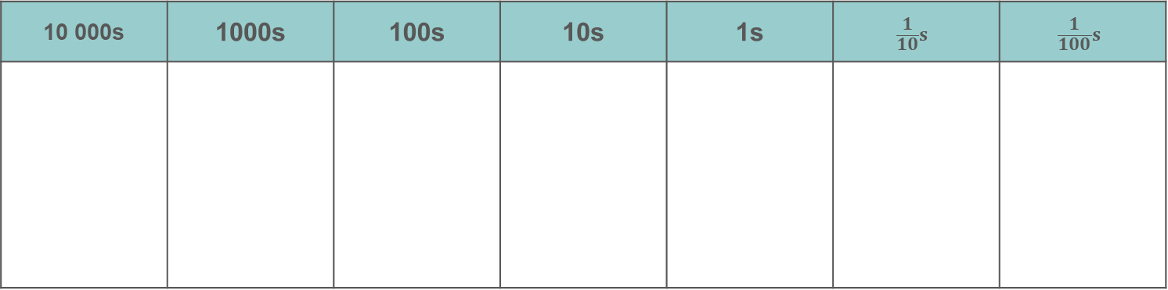

10 000s | 1000s | 100s | 10s | 1s | $$\frac{1}{10}s$$ | $$\frac{1}{100}s$$
10 000s | 1000s | 100s | 10s | 1s | $$\frac{1}{10}s$$ | $$\frac{1}{100}s$$
Notes:
This place-value grid could be used with the number cards to support Checkpoint 21 or Additional activity K

Slide 90

Notes:
These printable place-value grids could be for students to write on rather than using digit cards, particularly to support Checkpoint 21 or Additional activity K.

Slide 91


10 000s | 1000s | 100s | 10s | 1s | $$\frac{1}{10}s$$ | $$\frac{1}{100}s$$
10 000s | 1000s | 100s | 10s | 1s | $$\frac{1}{10}s$$ | $$\frac{1}{100}s$$
Notes:
These printable place-value grids could be for students to write on rather than using digit cards, particularly to support Checkpoint 21 or Additional activity K.

Slide 92
Notes:
This slide (two sets of images per page) may be helpful for students to access Additional activity E.

Slide 93
Clue 1
Clue 2
Clue 3
Clue 4
It is ____ to the nearest thousand.
It is ____ to the nearest hundred.
It is ____ to the nearest whole number.
It is ____ to the nearest ten.
Clue 1
Clue 2
Clue 3
Clue 4
It is ____ to the nearest thousand.
It is ____ to the nearest hundred.
It is ____ to the nearest whole number.
It is ____ to the nearest ten.
Clue 1
Clue 2
Clue 3
Clue 4
It is ____ to the nearest thousand.
It is ____ to the nearest hundred.
It is ____ to the nearest whole number.
It is ____ to the nearest ten.
Notes:
You might wish to print out this template to use for the further thinking question for Checkpoint 18 or Additional activity J.

