Slide 1
Series 3 Episode 20
The Wrong Number

Slide 2
Practitioner Notes

Slide 3
Episode Description
One is a detective wandering around looking for a new case to solve. She bumps into Nine who has come home to his flat to discover that all his furniture has been taken. One agrees to help Nine by asking him questions about the suspicious shape he saw leaving the block of flats when he came home. Can One and Nine identify the shape from the clues they discover?

Slide 4
Maths in the Episode
Properties of numbers
In this episode Six is identified by quantitative visual properties, in particular the ‘even-ness’ represented by having a flat head when 2 blocks wide. Six is also compared to Nine by height when 2 blocks wide and Nine observes Six is shorter so must be a lower value than Nine. Six also disguises herself as partitioned into 2 Threes.
Using deductive reasoning, the clues can help to eliminate the blocks that don’t fit the description.

Slide 5
Using Mathematical Language
Use these stem sentences to rehearse the mathematical ideas in the programme:
“It can’t be < > because it doesn’t have …”
“It can’t be < > because it isn’t …”
“It can’t be < > because it is < >.”
“It must be < > because …”
Notes:
Text in < > indicates what can be changed in the stem sentence.

Slide 6
Talk and Discuss Together

Slide 7
Talk and Discuss Together
Watch the episode of Numberblocks. First ask the children what they noticed and allow them to talk to you and each other.
How did One and Nine work out who the mysterious block was?
The following slides are designed to stimulate children and adults to talk about the episode and draw out some key aspects of the mathematics.

Slide 8
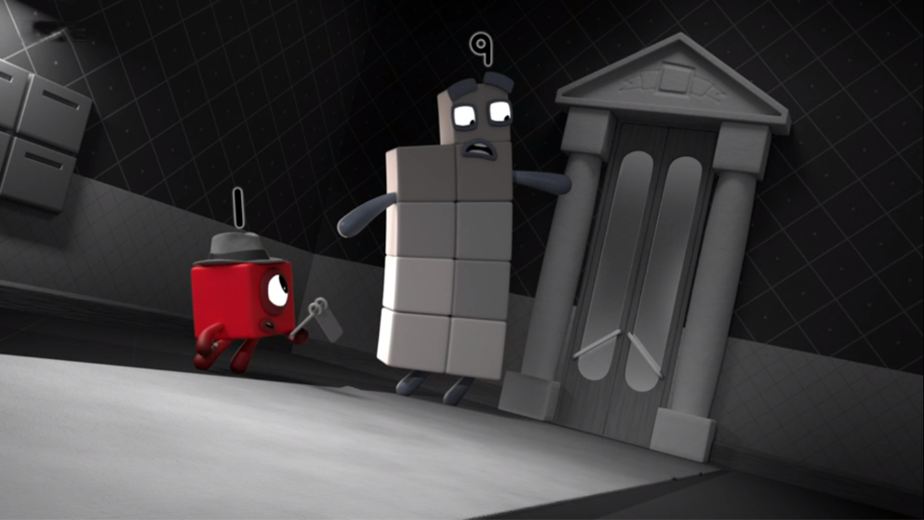

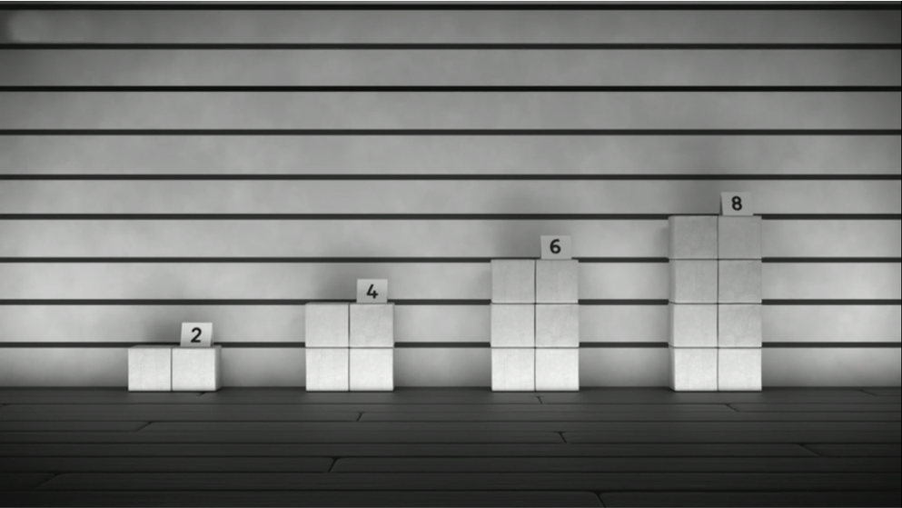
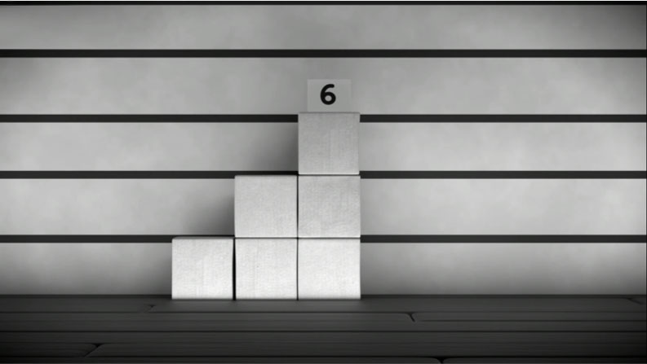
Notes:
Use this slide for talking and discussing together.

Slide 9
Enabling Environments in Reception

Slide 10
Enabling Environments
Playing and Exploring
Explore how to make different Numberblock characters using large carpet tiles reversed (in grey). Which Numberblock could it be?
Active Learning
Notice when children use comparative language to identify quantities: “He has more pieces than me”, “She is shorter than me”. Model comparing quantities. Ask children to notice things that are the same, and things that are different between contrasting items.
Creating and Thinking Critically
Using cubes, match outlines of unusually arranged blocks to a familiar Numberblock shape.

Slide 11
Learning Together in Y1

Slide 12

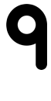
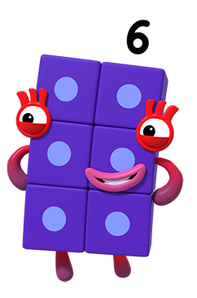


I am 2 blocks wide.
I wonder who it is?
I am smaller than .
I have a flat top.
I am made from two 3s.
Notes:
Use this slide to rehearse the deductive reasoning that One and Nine used to work out that Six was the mysterious block. The slide is animated with a series of clues. Numbers are crossed off before a new clue appears.
Encourage children to explain their thinking for each clue using the stem sentences, for example, It can’t be < > because it isn’t 2 blocks wide/ it is bigger than nine.
Finally read back each clue and check that Six meets all the criteria.

Slide 13
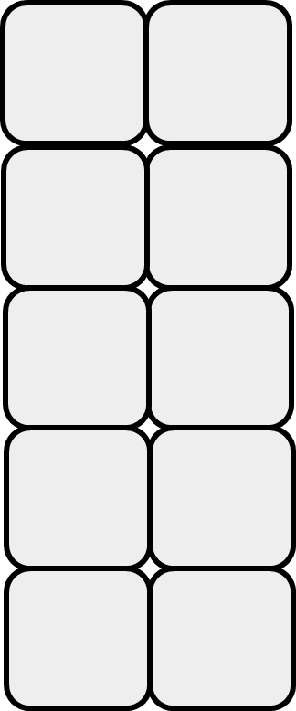
Numberblocks - who is it?
Notes:
Use slide 14 printed out on A4 paper with children working in pairs.
Read aloud the clues and ask the children to place counters on the blocks which the clue eliminates. Use the language “it can’t be < > because … it isn’t …” or “it doesn’t have…”.
Use this slide to check answers after the children have had worked through.
Clue 1: When we all stand in order, I am after Two but before Eight. (Click 1 – eliminate 1, 2, 8, 9, 10).
Clue 2: I don’t have a flat top. (This clue will be challenging because the reasoning requires them to say “It can’t be < > because it DOES have a flat top.” (Click 2 – eliminate 4, 6).
Clue 3: I like baked beans. (This clue is used to show that sometimes information is either irrelevant or unable to be used).
Clue 4: I am made only from One and Two. (It can’t be 5, because 5 is not made from 1 and 2. It can’t be 7 because 7 is not made from 1 and 2). (Click 3: eliminate 5, 7)
Click 4: Circles Three.

Slide 14
Numberblocks - who is it?
Notes:
Use this slide printed out on A4 paper.

Slide 15
Further activities for Y1
Play Numberblocks – Who am I? using different clues
Play Numberblocks – Who am I? by encouraging the children to ask the questions (making clues)
Use different arrangements of Numberblocks, for example, using the “tower” representation instead of the ‘x 2 array’ representation

Slide 16
Learning Together in Y2

Slide 17
Numberblock Guess Who
Play again
Images © 2017 Alphablocks Ltd. All Rights Reserved.
Notes:
Use this slide as a whole class “Guess who” game. The teacher or a pupil chooses a block but does not say which one has been chosen.
Choose pupils to ask questions about the block’s mathematical characteristics (avoiding colour or just guessing the number) and then eliminate the blocks it can’t be, in response to the questions. This is done by clicking on the block in ‘slideshow’ mode.
Click on ‘Play again’ to reset the cards for another game.

Slide 18
Further activities for Y2
Print Slide 19 on two separate sheets. Cut it up into two sets of cards (you could print one set on different coloured paper) and lay out one set in a line. Shuffle the other and place in a pile. Each player picks a card from the top of the pile, keeping it hidden from their opponent. Take turns to ask a question about the opponent’s card where the answer can only be yes or no. Keep playing until each card has been identified by the opponent.
Given 2 clues and 2 sets of eliminations, choose from a selection of 3, one further question that will eliminate all but 1 card.
Choose from a set of given clues, the fewest number of clues needed to find the mystery number.
Write clues to identify a number in 4 sets of eliminations, 3 sets of eliminations.
Play ‘Guess Who’ using numerals rather than blocks.

Slide 19
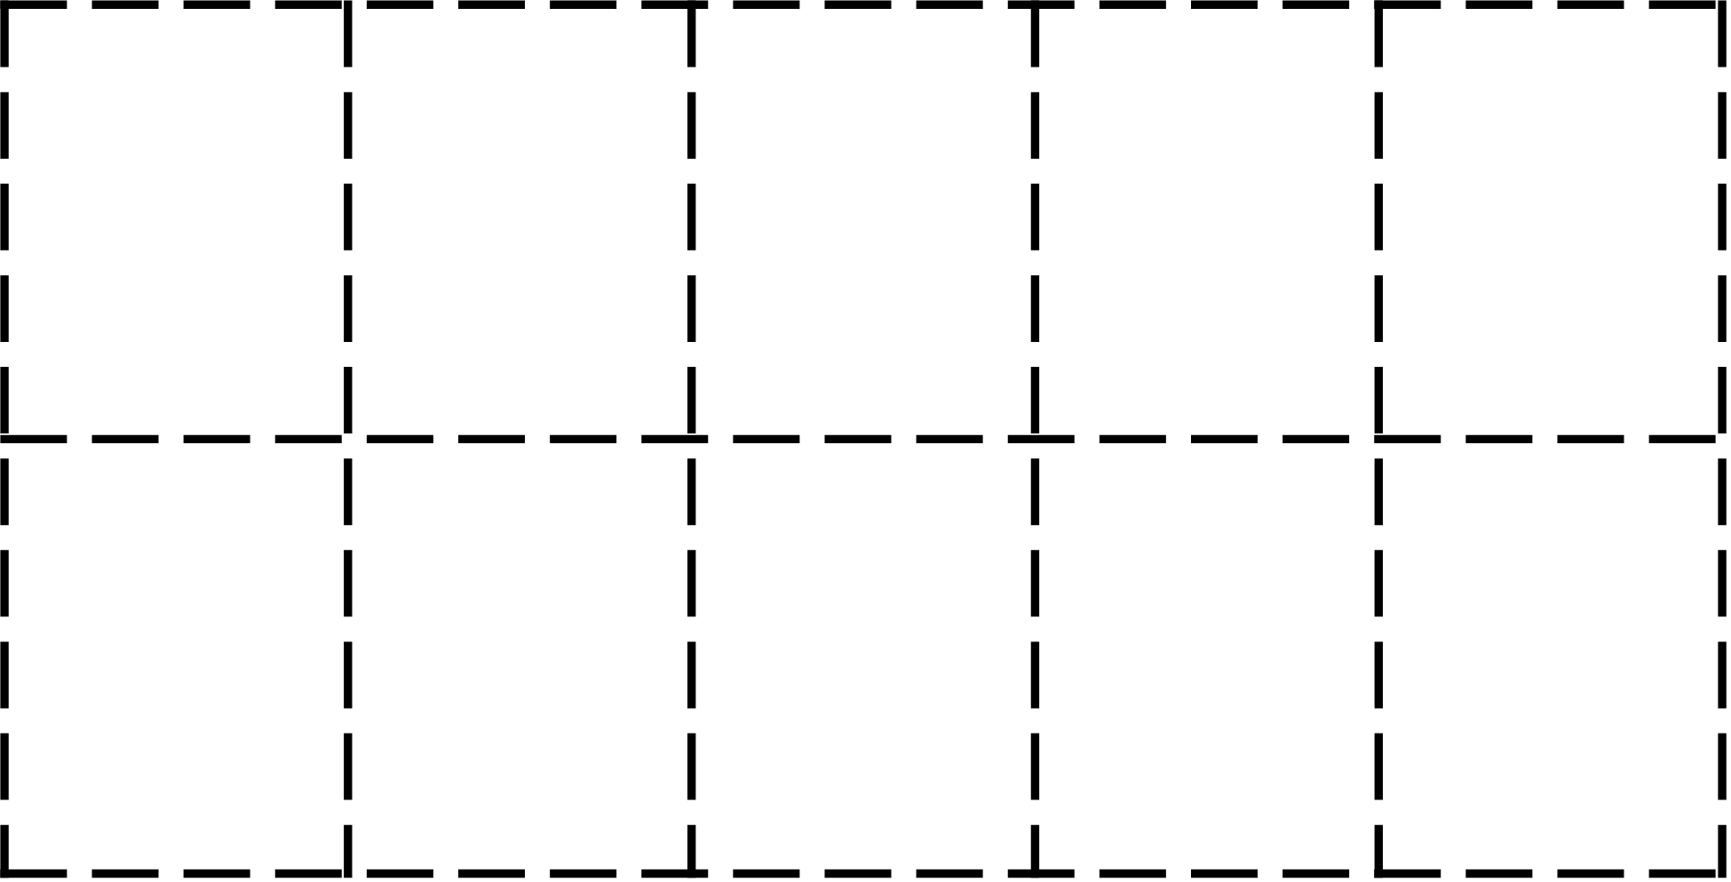
Images © 2017 Alphablocks Ltd. All Rights Reserved.
Notes:
Print off this slide on A4 paper and cut along dotted lines to make playing cards for use in the ‘Guess who’ game described on slide 18.

