Slide 1
Year 4, Unit 12
Division with remainders

Slide 2
Year 4, Unit 12
These materials heavily reflect the prioritisation approach of the ready-to-progress criteria in the DfE Primary Mathematics Guidance 2020 and on the PPTs that exemplify them on the NCETM website. They also include other relevant National Curriculum content. Related sections of the NCETM Primary Mastery Professional Development Materials provide small-step teaching guidance.
Ready-to-progress criteria addressed by this unit
Teaching of this unit supports the following criteria from the ‘DfE Mathematics Guidance: key stages 1 & 2’ (the 335-page document available as a download)
4NF-2 Page 163
Prior learning
There are no specific ready-to-progress criteria supporting the prior learning for this unit.

Slide 3
Contents
The links below take you to the starting slide of each learning outcome.
1 | Pupils interpret a division story when there is a remainder and represent it with an equation (i)
2 | Pupils interpret a division story when there is a remainder and represent it with an equation (ii)
3 | Pupils interpret a division story when there is a remainder and represent it with an equation (iii)
4 | Pupils explain how the remainder relates to the divisor in a division equation
5 | Pupils explain when there will and will not be a remainder in a division equation
6 | Pupils use knowledge of division equations and remainders to solve problems
7 | Pupils interpret the answer to a division calculation to solve a problem (i)
8 | Pupils interpret the answer to a division calculation to solve a problem (ii)
Click the arrow button to return to this Contents slide.

Slide 4
Year 4, Unit 12, Learning Outcome 1
Learning Outcome 1
Pupils interpret a division story when there is a remainder and represent it with an equation (i)
The following slides have been collated to support the teaching of this learning outcome.

Slide 5
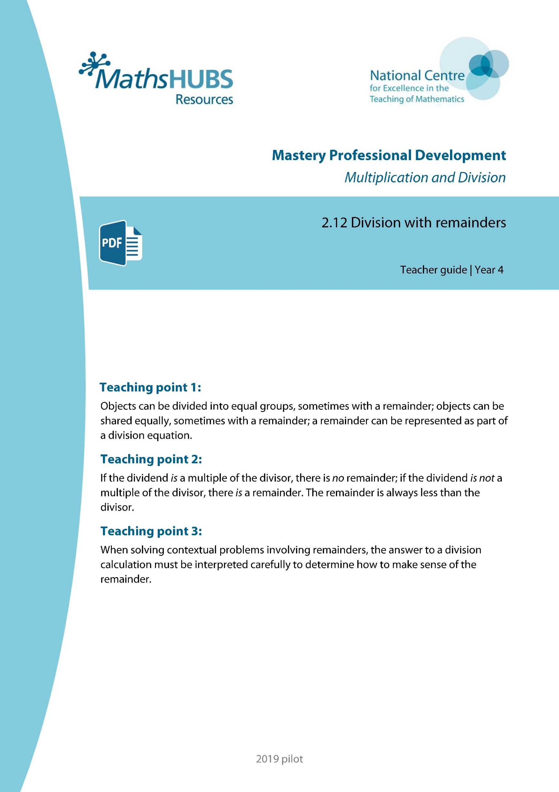
Year 4, Unit 12, Learning Outcome 1
Additional teacher guidance for this outcome should be read first and can be found in this segment of the NCETM Primary Mastery Professional Development Materials:
2.12 Division with remainders
The spine materials are divided into ‘teaching points’ and ‘steps in learning’.
Teaching point | Steps in learning | Pages
1 | 1:1-1:4 | 3-6

Slide 6


2.12 Division with remainders Step 1:1
9 = 4 × 2 + 1
Notes:
Nine is divided into groups of two. There are four groups and a remainder of one.
The “9” represents the total number of counters.
The “4×2” represents the four groups of two.
The “1” represents the remaining one counter.

Slide 7

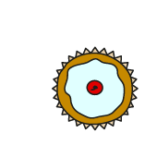
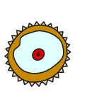



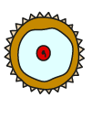







2.12 Division with remainders Step 1:2
12 cakes, in boxes of 4. How can the cakes be boxed?
12 = × 4
3
12 = 4 ×
12 ÷ 4 =
3
3
Notes:
Three boxes of four are twelve.

Slide 8
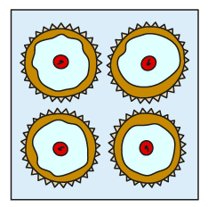
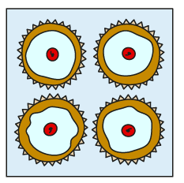
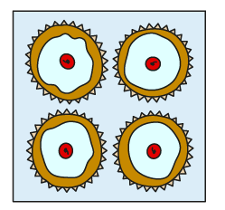
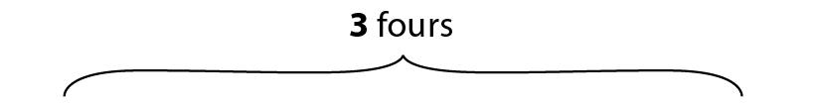
2.12 Division with remainders Step 1:2
– 4
– 4
– 4
12 – 4 – 4 – 4 = 0
12 ÷ 4 = 3
0
1
2
3
4
5
6
7
8
9
10
11
12
Notes:
Twelve divided into groups of four is equal to three.
So, the baker can make three boxes of cakes.

Slide 9

2.12 Division with remainders Step 1:3
14 cakes, in boxes of 4. How can the cakes be boxed?
14 = × 4
3
+ 2
14 = 4 ×
+ 2
14 ÷ 4 =
3
r 2
3
0
1
2
3
4
5
6
7
8
9
10
11
12
13
14
Notes:
Three boxes of four are twelve.
There are two cakes left over.

Slide 10
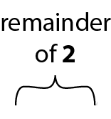
2.12 Division with remainders Step 1:3
– 4
– 4
– 4
0
1
2
3
4
5
6
7
8
9
10
11
12
13
14
14 – 4 – 4 – 4 = 2
14 ÷ 4 = 3 r 2
Notes:
Fourteen divided into groups of four is equal to three, with a remainder of two.
So, the baker can make three boxes of cakes, with two left over.

Slide 11
4NF-2 Division problems with remainders
Can you count in fours?
Can we make another group of 4?
What do you notice?
14 = × 4
3
+ 2
14 = 4 ×
3
+ 2
14 ÷ 4 =
3
r 2
One group of 4 is 4.
Two groups of 4 is 8.
Three groups of 4 are 12.
There are 2 left over.
14 is divided into groups of 4. There are 3 groups and a remainder of 2.
0
1
2
3
4
5
6
7
8
9
10
11
12
13
14
Notes:
Three boxes of four are twelve.
There are two cakes left over.

Slide 12
Year 4, Unit 12, Learning Outcome 2
Learning Outcome 2
Pupils interpret a division story when there is a remainder and represent it with an equation (ii)
The following slides have been collated to support the teaching of this learning outcome.

Slide 13
Year 4, Unit 12, Learning Outcome 2
Additional teacher guidance for this outcome should be read first and can be found in this segment of the NCETM Primary Mastery Professional Development Materials:
2.12 Division with remainders
The spine materials are divided into ‘teaching points’ and ‘steps in learning’.
Teaching point | Steps in learning | Pages
1 | 1:5-1:6 | 6-10

Slide 14



2.12 Division with remainders Step 1:5
18 cars, shared equally between 3 children. How many cars each?
18 = × 3
18 ÷ 3 =
18 = 3 ×
6
6
6
+ 3
+ 3
+ 3
+ 3
+ 3
+ 3
Notes:
Six threes is six each. That’s eighteen

Slide 15

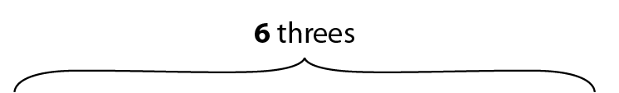
2.12 Division with remainders Step 1:5
– 3
– 3
– 3
– 3
– 3
– 3
18 – 3 – 3 – 3 – 3 – 3 – 3 = 0
18 ÷ 3 = 6
Notes:
Eighteen divided between three is equal to six each.
So the children get six cars each.

Slide 16
2.12 Division with remainders Step 1:6
19 cars, shared equally between 3 children. How many cars each?
19 = 3 ×
+ 1
6
19 = × 3
+ 1
19 ÷ 3 =
r 1
6
6
+ 3
+ 3
+ 3
+ 3
+ 3
+ 3
Notes:
Six threes is six each. That’s eighteen.
There is one car left over.

Slide 17
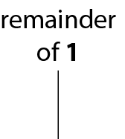
2.12 Division with remainders Step 1:6
– 3
– 3
– 3
– 3
– 3
– 3
0
1
2
3
4
5
6
7
8
9
10
11
12
13
14
15
16
17
18
19
19 – 3 – 3 – 3 – 3 – 3 – 3 = 1
19 ÷ 3 = 6 r 1
Notes:
Nineteen divided between three is equal to six each, with a remainder of one.
So, the children get six cars each; there is one car left over.

Slide 18
Year 4, Unit 12, Learning Outcome 3
Learning Outcome 3
Pupils interpret a division story when there is a remainder and represent it with an equation (iii)
The following slides have been collated to support the teaching of this learning outcome.

Slide 19
Year 4, Unit 12, Learning Outcome 3
Additional teacher guidance for this outcome should be read first and can be found in this segment of the NCETM Primary Mastery Professional Development Materials:
2.12 Division with remainders
The spine materials are divided into ‘teaching points’ and ‘steps in learning’.
Teaching point | Steps in learning | Pages
1 | 1:7-1:8 | 10-12

Slide 20
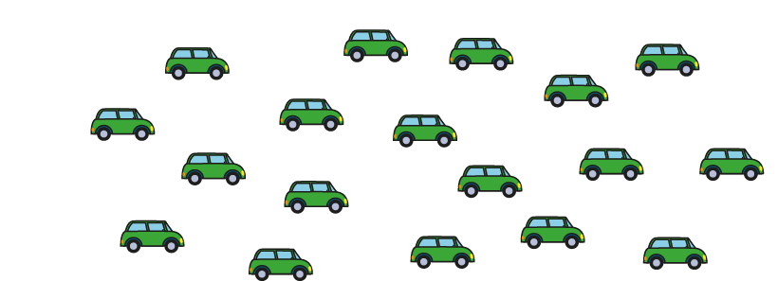
2.12 Division with remainders Step 1:7
19 cars shared equally between 5 children. How many cars each?
19 = 5 ×
19 = × 5
19 ÷ 5 =
0 × 5 = 0 | 5 × 0 = 0
1 × 5 = 5 | 5 × 1 = 5
2 × 5 = 10 | 5 × 2 = 10
3 × 5 = 15 | 5 × 3 = 15
4 × 5 = 20 | 5 × 4 = 20
0 × 5 = 0 | 5 × 0 = 0
1 × 5 = 5 | 5 × 1 = 5
2 × 5 = 10 | 5 × 2 = 10
3 × 5 = 15 | 5 × 3 = 15
4 × 5 = 20 | 5 × 4 = 20
Notes:
The largest multiple of five that is less than or equal to nineteen is fifteen.
Three fives are fifteen.
We can represent this as:
3 x 5 ≤ 19
3 x 5 = 15

Slide 21
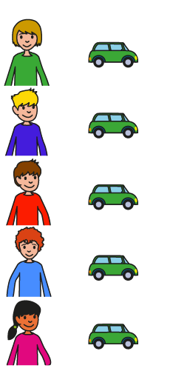

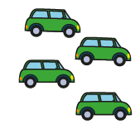
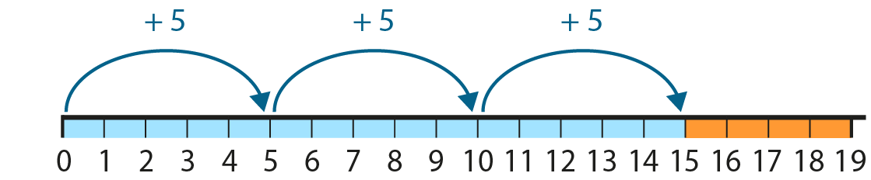
2.12 Division with remainders Step 1:7
19 = 5 ×
+ 4
3
3
19 = × 5
+ 4
19 ÷ 5 =
3
r 4
Notes:
Three fives are fifteen…
and nineteen is four more than fifteen.
So, nineteen divided between five is equal to
three each, with a remainder of four.
So, the children get three cars each; there are four cars left over.

Slide 22
Year 4, Unit 12, Learning Outcome 4
Learning Outcome 4
Pupils explain how the remainder relates to the divisor in a division equation
The following slides have been collated to support the teaching of this learning outcome.

Slide 23
Year 4, Unit 12, Learning Outcome 4
Additional teacher guidance for this outcome should be read first and can be found in this segment of the NCETM Primary Mastery Professional Development Materials:
2.12 Division with remainders
The spine materials are divided into ‘teaching points’ and ‘steps in learning’.
Teaching point | Steps in learning | Pages
2 | 2:1-2:3 | 13-16

Slide 24
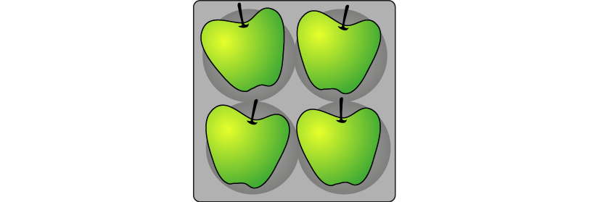


2.12 Division with remainders Step 2:1
Apples in trays of 4. How many trays?
Total number of apples (dividend) | Number of apples in each tray (divisor) | Number of trays (quotient) | Number of apples left over (remainder) | Equation
12
13
14
15
16
17
18
19
20
4
3
0
12 ÷ 4 = 3
3 fours
– 4
– 4
– 4

Slide 25

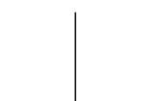
2.12 Division with remainders Step 2:1
Apples in trays of 4. How many trays?
Total number of apples (dividend) | Number of apples in each tray (divisor) | Number of trays (quotient) | Number of apples left over (remainder) | Equation
12
13
14
15
16
17
18
19
20
4
3
0
12 ÷ 4 = 3
4
3
1
13 ÷ 4 = 3 r 1
3 fours
– 4
– 4
– 4

Slide 26
2.12 Division with remainders Step 2:1
Apples in trays of 4. How many trays?
Total number of apples (dividend) | Number of apples in each tray (divisor) | Number of trays (quotient) | Number of apples left over (remainder) | Equation
12
13
14
15
16
17
18
19
20
4
3
0
12 ÷ 4 = 3
4
3
1
13 ÷ 4 = 3 r 1
4
3
2
14 ÷ 4 = 3 r 2
remainder of 2
3 fours
– 4
– 4
– 4

Slide 27
2.12 Division with remainders Step 2:1
Apples in trays of 4. How many trays?
Total number of apples (dividend) | Number of apples in each tray (divisor) | Number of trays (quotient) | Number of apples left over (remainder) | Equation
12
13
14
15
16
17
18
19
20
4
3
0
12 ÷ 4 = 3
4
3
1
13 ÷ 4 = 3 r 1
4
3
2
14 ÷ 4 = 3 r 2
4
3
3
15 ÷ 4 = 3 r 3
remainder of 3
3 fours
– 4
– 4
– 4

Slide 28
2.12 Division with remainders Step 2:1
Apples in trays of 4. How many trays?
Total number of apples (dividend) | Number of apples in each tray (divisor) | Number of trays (quotient) | Number of apples left over (remainder) | Equation
12
13
14
15
16
17
18
19
20
4
3
0
12 ÷ 4 = 3
4
3
1
13 ÷ 4 = 3 r 1
4
3
2
14 ÷ 4 = 3 r 2
4
3
3
15 ÷ 4 = 3 r 3
4
4
0
16 ÷ 4 = 4
4 fours
– 4
– 4
– 4
– 4

Slide 29
2.12 Division with remainders Step 2:1
Apples in trays of 4. How many trays?
Total number of apples (dividend) | Number of apples in each tray (divisor) | Number of trays (quotient) | Number of apples left over (remainder) | Equation
12
13
14
15
16
17
18
19
20
4
3
0
12 ÷ 4 = 3
4
3
1
13 ÷ 4 = 3 r 1
4
3
2
14 ÷ 4 = 3 r 2
4
3
3
15 ÷ 4 = 3 r 3
4
4
0
16 ÷ 4 = 4
4
4
1
17 ÷ 4 = 4 r 1
4 fours
– 4
– 4
– 4
– 4

Slide 30
2.12 Division with remainders Step 2:1
Apples in trays of 4. How many trays?
Total number of apples (dividend) | Number of apples in each tray (divisor) | Number of trays (quotient) | Number of apples left over (remainder) | Equation
12
13
14
15
16
17
18
19
20
4
3
0
12 ÷ 4 = 3
4
3
1
13 ÷ 4 = 3 r 1
4
3
2
14 ÷ 4 = 3 r 2
4
3
3
15 ÷ 4 = 3 r 3
4
4
0
16 ÷ 4 = 4
4
4
1
17 ÷ 4 = 4 r 1
4
4
2
18 ÷ 4 = 4 r 2
remainder of 2
4 fours
– 4
– 4
– 4
– 4

Slide 31
2.12 Division with remainders Step 2:1
Apples in trays of 4. How many trays?
Total number of apples (dividend) | Number of apples in each tray (divisor) | Number of trays (quotient) | Number of apples left over (remainder) | Equation
12
13
14
15
16
17
18
19
20
4
3
0
12 ÷ 4 = 3
4
3
1
13 ÷ 4 = 3 r 1
4
3
2
14 ÷ 4 = 3 r 2
4
3
3
15 ÷ 4 = 3 r 3
4
4
0
16 ÷ 4 = 4
4
4
1
17 ÷ 4 = 4 r 1
4
4
2
18 ÷ 4 = 4 r 2
4
4
3
19 ÷ 4 = 4 r 3
remainder of 3
4 fours
– 4
– 4
– 4
– 4

Slide 32
2.12 Division with remainders Step 2:1
Apples in trays of 4. How many trays?
Total number of apples (dividend) | Number of apples in each tray (divisor) | Number of trays (quotient) | Number of apples left over (remainder) | Equation
12
13
14
15
16
17
18
19
20
4
3
0
12 ÷ 4 = 3
4
3
1
13 ÷ 4 = 3 r 1
4
3
2
14 ÷ 4 = 3 r 2
4
3
3
15 ÷ 4 = 3 r 3
4
4
0
16 ÷ 4 = 4
4
4
1
17 ÷ 4 = 4 r 1
4
4
2
18 ÷ 4 = 4 r 2
4
4
3
19 ÷ 4 = 4 r 3
4
5
0
20 ÷ 4 = 5
5 fours
– 4
– 4
– 4
– 4
– 4

Slide 33
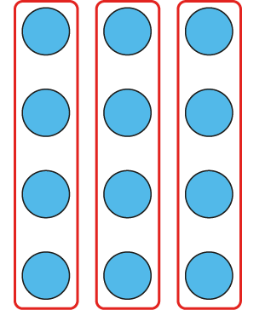
2.12 Division with remainders Step 2:2
Dividend = 12, divisor = 4:
12 ÷ 4 = 3
Notes:
Twelve divided into groups of four is equal to three.

Slide 34
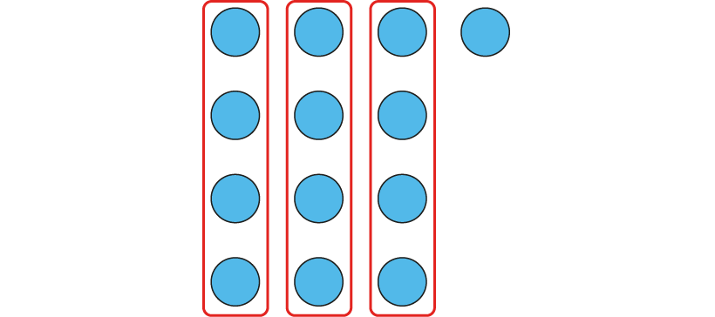
2.12 Division with remainders Step 2:2
Dividend = 13, divisor = 4:
13 ÷ 4 = 3 r 1
Notes:
Thirteen divided into groups of four is equal to three with a remainder of one.

Slide 35
2.12 Division with remainders Step 2:2
Dividend = 14, divisor = 4:
14 ÷ 4 = 3 r 2
Notes:
Fourteen divided into groups of four is equal to three with a remainder of two.

Slide 36
2.12 Division with remainders Step 2:2
Dividend = 15, divisor = 4:
15 ÷ 4 = 3 r 3
Notes:
Fifteen divided into groups of four is equal to three with a remainder of three.

Slide 37
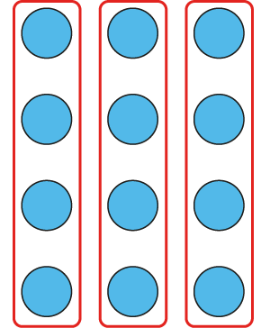
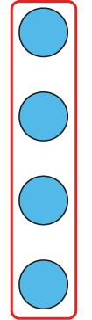
2.12 Division with remainders Step 2:2
Dividend = 16, divisor = 4:
16 ÷ 4 =
3 r 4
4
✓
✗
Notes:
The remainder can’t be equal to four, because we can make another group of four.
Sixteen divided into groups of four is equal to four.

Slide 38

2.12 Division with remainders Step 2:3
Is this correct? 17 ÷ 5 = 2 r 7
✗
Notes:
This is incorrect, because seven is greater than five.
The remainder should be less than the divisor.
We can make another group of five.

Slide 39
2.12 Division with remainders Step 2:3
17 ÷ 5 =
3 r 2
✓
Notes:
This is correct, because two is less than five.
The remainder is less than the divisor.
We can’t make another group of five.

Slide 40
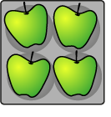
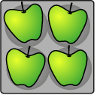



4NF-2 Division problems with remainders
20 ÷ 4 = 5
19 ÷ 4 = 4 r 3
18 ÷ 4 = 4 r 2
17 ÷ 4 = 4 r 1
16 ÷ 4 = 4
15 ÷ 4 = 3 r 3
14 ÷ 4 = 3 r 2
13 ÷ 4 = 3 r 1
12 ÷ 4 = 3
If apples are sold in trays of 4, how many trays can be made if we have __ apples?
Is __ in our 4 times table? Can you count in 4s up to __? Is there a remainder? Can you show this on a number line? Can you write a division equation?
What do you notice about the divisor and the remainder?
The remainder is always less than the divisor.
Notes:
The “23” represents the total number of apples .
The “4” represents the number of apples in each tray.
The “5” represents the number of full trays that can be made.
The “3” represents the number of apples left over.
So, the grocer can make fill full trays of apples; he
will have three apples left over.

Slide 41
4NF-2 Division problems with remainders
Apples in trays of 4. How many trays?
Total number of apples (dividend) | Number of apples in each tray (divisor) | Number of trays (quotient) | Number of apples left over (remainder) | Equation
12
13
14
15
16
17
18
19
20
4
3
0
12 ÷ 4 = 3
4
3
1
13 ÷ 4 = 3 r 1
4
3
2
14 ÷ 4 = 3 r 2
4
3
3
15 ÷ 4 = 3 r 3
4
4
0
16 ÷ 4 = 4
4
4
1
17 ÷ 4 = 4 r 1
4
4
2
18 ÷ 4 = 4 r 2
4
4
3
19 ÷ 4 = 4 r 3
4
5
0
20 ÷ 4 = 5
Use your counters for each dividend, in order, to represent groups of 4. Which of the total number of apples (dividends) are in the 4 times table? Is there a remainder when we divide these by 4? Which dividends have remainders? Can you see a pattern in the table when you look at the remainders?
When we are dividing by 4 can we have a remainder of 5? Why not?
If the dividend is a multiple of the divisor, there is no remainder.
If the dividend is not a multiple of the divisor, there is a remainder.

Slide 42
Year 4, Unit 12, Learning Outcome 5
Learning Outcome 5
Pupils explain when there will and will not be a remainder in a division equation
The following slides have been collated to support the teaching of this learning outcome.

Slide 43
Year 4, Unit 12, Learning Outcome 5
Additional teacher guidance for this outcome should be read first and can be found in this segment of the NCETM Primary Mastery Professional Development Materials:
2.12 Division with remainders
The spine materials are divided into ‘teaching points’ and ‘steps in learning’.
Teaching point | Steps in learning | Pages
2 | 2:4 | 17-18

Slide 44
2.12 Division with remainders Step 2:4
Equation | or | If , write the correct equation
✓
✗
✗
18 ÷ 4 = 3 r 6
✗
18 ÷ 4 = 4 r 2
20 ÷ 5 = 3 r 5
✗
20 ÷ 5 = 4
22 ÷ 6 = 3 r 4
✓
23 ÷ 7 = 3 r 2
✓
31 ÷ 8 = 3 r 7
✓

Slide 45
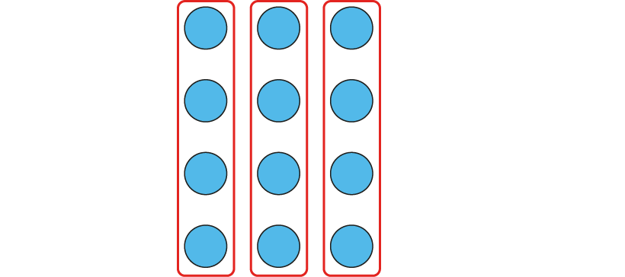

2.12 Division with remainders Step 2:4
Dividend = 12, divisor = 4:
3 fours
+ 4
+ 4
+ 4
multiple of 4
12 = 3 × 4 12 = 4 × 3
12 ÷ 4 = 3
Notes:
Twelve is the largest multiple of four that is
less than or equal to twelve.
Twelve is a multiple of four, so when it is divided into
groups of four there are none left over; there is no remainder.
Twelve divided into groups of four is equal to three.

Slide 46

2.12 Division with remainders Step 2:4
Dividend = 13, divisor = 4:
remainder of 1
3 fours
+ 4
+ 4
+ 4
12 = 3 × 4
13 = 3 × 4 + 1
not a multiple of 4
12 = 4 × 3
13 = 4 × 3 + 1
13 ÷ 4 = 3 r 1
Notes:
Twelve is the largest multiple of four that is
less than or equal to thirteen.
Thirteen is not a multiple of four, so when it
is divided into groups of four there are some
left over; there is a remainder.
Thirteen divided into groups of four is equal
to three with a remainder of one.

Slide 47
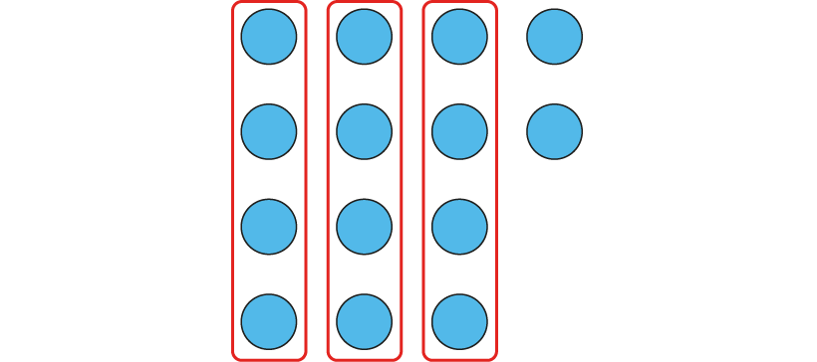
2.12 Division with remainders Step 2:4
Dividend = 14, divisor = 4:
remainder of 2
3 fours
+ 4
+ 4
+ 4
12 = 3 × 4
14 = 3 × 4 + 2
not a multiple of 4
12 = 4 × 3
14 = 4 × 3 + 2
14 ÷ 4 = 3 r 2
Notes:
Twelve is the largest multiple of four that is
less than or equal to fourteen.
Fourteen is not a multiple of four, so when it
is divided into groups of four there are some
left over; there is a remainder.
Fourteen divided into groups of four is equal
to three with a remainder of two.

Slide 48
2.12 Division with remainders Step 2:4
Dividend = 15, divisor = 4:
remainder of 3
3 fours
+ 4
+ 4
+ 4
12 = 3 × 4
15 = 3 × 4 + 3
not a
multiple of 4
12 = 4 × 3
14 = 4 × 3 + 3
15 ÷ 4 = 3 r 3
Notes:
Twelve is the largest multiple of four that is
less than or equal to fifteen.
Fifteen is not a multiple of four, so when it
is divided into groups of four there are some
left over; there is a remainder.
Fifteen divided into groups of four is equal
to three with a remainder of three.

Slide 49
2.12 Division with remainders Step 2:4
Dividend = 16, divisor = 4:
4 fours
+ 4
+ 4
+ 4
+ 4
multiple
of 4
16 = 4 × 4
16 ÷ 4 = 4
Notes:
Sixteen is the largest multiple of four that is
less than or equal to sixteen.
Sixteen is a multiple of four, so when it
is divided into groups of four there are none
left over; there is no remainder.
Sixteen divided into groups of four is equal
to four.

Slide 50

4NF-2 Division problems with remainders
How many groups of 8 are there in 21?
Do you think there will be a remainder? Why? Is 21 a multiple of 8?
Can you show with your counters?
Can you count in 8s to 21?
How many groups of 8 are there? And how many more to make 21?
Repeat for other dividends and divisors both with and without remainders.
21 ÷ 8 = 2 remainder 5
2 groups of 8 are16, 5 more make 21.

Slide 51
Year 4, Unit 12, Learning Outcome 6
Learning Outcome 6
Pupils use knowledge of division equations and remainders to solve problems
The following slides have been collated to support the teaching of this learning outcome.

Slide 52
Year 4, Unit 12, Learning Outcome 6
Additional teacher guidance for this outcome should be read first and can be found in this segment of the NCETM Primary Mastery Professional Development Materials:
2.12 Division with remainders
The spine materials are divided into ‘teaching points’ and ‘steps in learning’.
Teaching point | Steps in learning | Pages
2 | 2:5-2:6 | 19-23

Slide 53
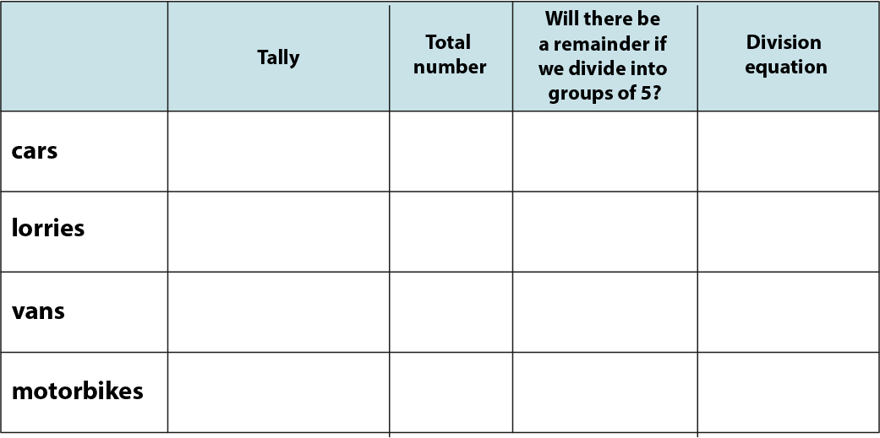

2.12 Division with remainders Step 2:5
Fill in the table.
24
yes
24 ÷ 5 = 4 r 4
12
yes
12 ÷ 5 = 2 r 2
10
no
10 ÷ 5 = 2
6
yes
6 ÷ 5 = 1 r 1
Notes:
Paul records the different numbers of vehicles that drive past the school gate in an hour.
Here are his results. Fill in the rest of the table.

Slide 54
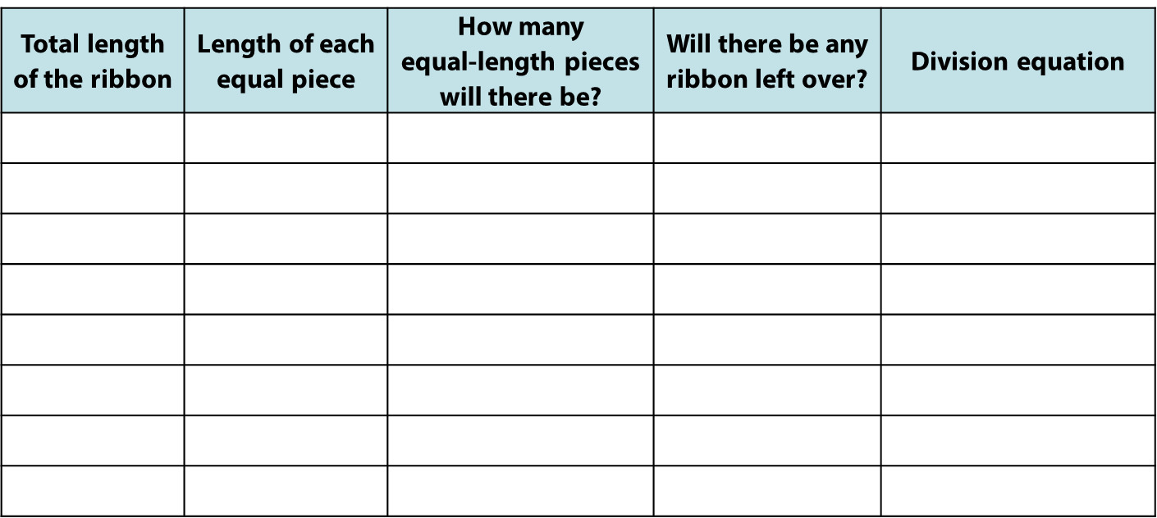
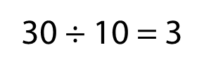
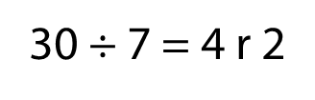
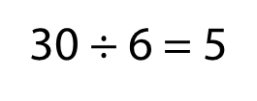
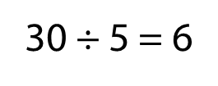
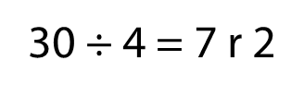
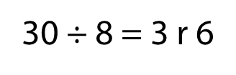
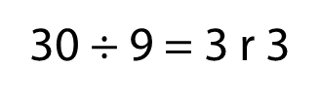
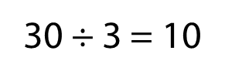
2.12 Division with remainders Step 2:5
30 cm ribbon cut into equal lengths. Fill in the table.
30
3
10
no
30
4
7
yes
30
5
6
no
30
6
5
no
30
7
4
yes
30
8
3
yes
30
9
3
yes
30
10
3
no
Notes:
A dressmaker has a ribbon that is thirty centimetres long.
She wants to cut it into equal lengths. Fill in the table to show how many
lengths she could make and whether there will be any ribbon left over.

Slide 55
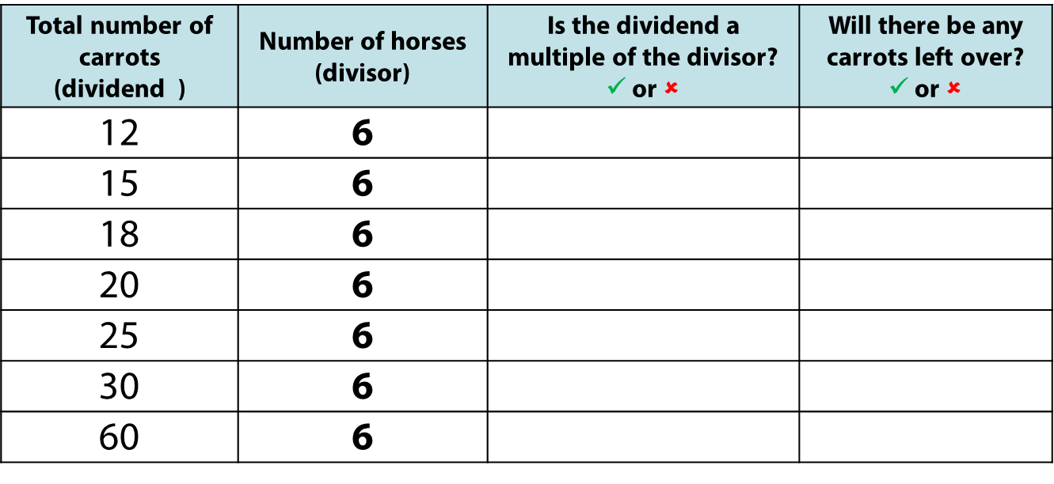
2.12 Division with remainders Step 2:5
Carrots are shared equally between 6 horses. Fill in the table.
✓
✗
✗
✓
✓
✗
✗
✓
✗
✓
✓
✗
✓
✗

Slide 56
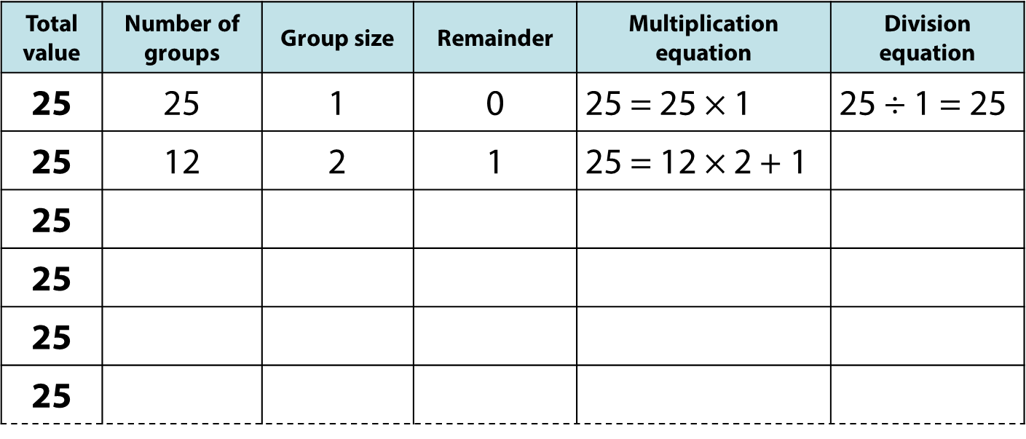
2.12 Division with remainders Step 2:5
Notes:
Find as many ways as you can to divide twenty-five into equal groups.
When will there be a remainder?
Write both a multiplication and a division equation to represent
each of your answers. Use the number line to help you.

Slide 57
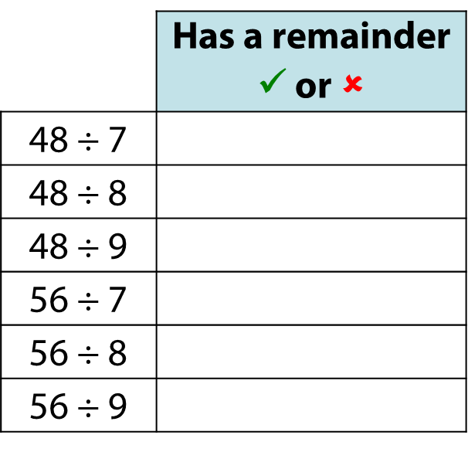
2.12 Division with remainders Step 2:5
✓
✗
✓
✗
✗
✓

Slide 58
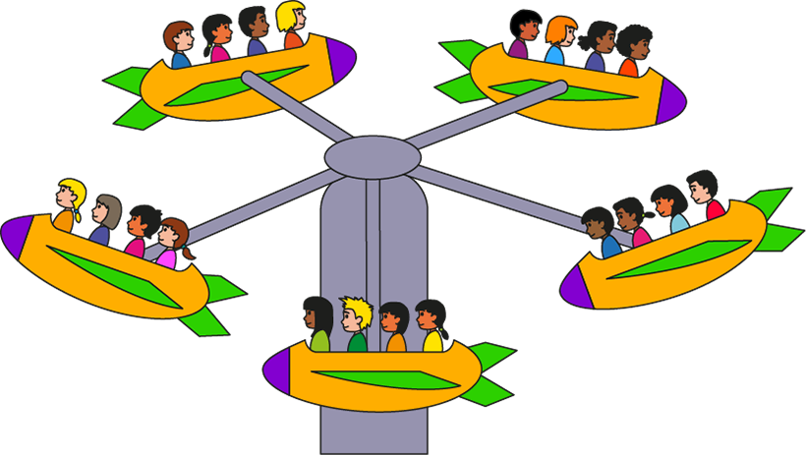
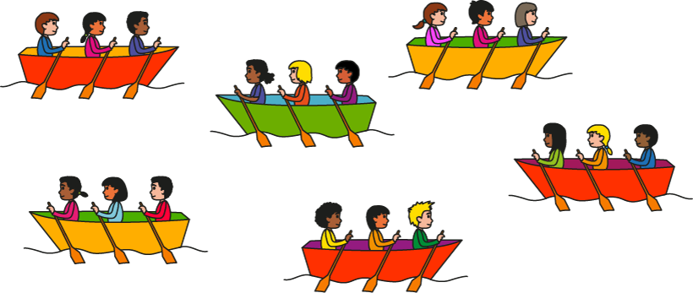
2.12 Division with remainders Step 2:6
Children on the boats swap with children on the ride.
What pair of expressions describe the new situation?
  5 × 3 + 5 and 5 × 3 + 3
  5 × 3 + 3 and 3 × 6 + 2
  6 × 3 + 2 and 4 × 4 + 2
  None of these.
✓
Notes:
If the children on the boats swapped with the children on the ride,
what pair of expressions would describe the new situation?

Slide 59
Year 4, Unit 12, Learning Outcome 7
Learning Outcome 7
Pupils interpret the answer to a division calculation to solve a problem (i)
The following slides have been collated to support the teaching of this learning outcome.

Slide 60
Year 4, Unit 12, Learning Outcome 7
Additional teacher guidance for this outcome should be read first and can be found in this segment of the NCETM Primary Mastery Professional Development Materials:
2.12 Division with remainders
The spine materials are divided into ‘teaching points’ and ‘steps in learning’.
Teaching point | Steps in learning | Pages
3 | 3:1-3:2 | 24-26

Slide 61

2.12 Division with remainders Step 3:1
23 apples, in trays of 4.
How many trays? How many apples left over?
23 ÷ 4 = 5 r 3
5 trays; 3 apples left over
Notes:
The “23” represents the total number of apples .
The “4” represents the number of apples in each tray.
The “5” represents the number of full trays that can be made.
The “3” represents the number of apples left over.
So, the grocer can make fill full trays of apples; he
will have three apples left over.

Slide 62

2.12 Division with remainders Step 3:1
23 apples are shared equally between 4 children.
How many apples does each child get? How many apples are left over?
23 ÷ 4 = 5 r 3
5 apples each; 3 left over
Notes:
The “23” represents the total number of apples.
The “4” represents the number of children the apples are shared between.
The “5” represents the equal number of apples that each child gets.
The “3” represents the number of apples left over.
So, the children get five apples each; there are three apples left over.

Slide 63
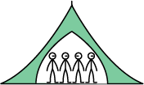
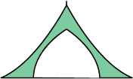
2.12 Division with remainders Step 3:2
4 scouts can fit in each tent. How many tents needed for 30 scouts?
30 ÷ 4 = 7 r 2
8 tents needed
Notes:
Will all of the scouts fit into seven tents? (No)
Why not? (If there are seven tents, there are two scouts left over.)
So how many tents will we need to fit all of the scouts into tents?
(Eight; we need seven tents of four scouts, and another tent for the two left-over scouts.)
The “30” represents the total number of scouts.
The “4” represents the number of scouts in each tent.
The “7” represents the number of full tents.
The “2” represents the number of scouts left over.

Slide 64
4NF-2 Division problems with remainders
The following slides deal with contexts where children are required to round up or down appropriately. Here it is useful to provide a variety of real-life contexts in which children should interpret and practise. For example: 4 scouts can fit in each tent. How many tents needed for 30 scouts?
Can you represent the problem with your counters? How many groups of 4 are there? How many remaining? How many full tents are there? What does the remainder 2 mean? Will all the scouts fit into 7 tents? Why not? So how many tents do we need? What can you tell me about the eighth tent? Can you write a calculation to solve this problem? What does each part of your calculation represent? Why do we have to round up?
The 30 represents the total number of scouts.
The 4 represents the number of scouts in each tent.
The 7 represents the number of full tents.
The 2 represents the number of scouts left over.

Slide 65
4NF-2 Division problems with remainders
4 scouts can fit in each tent. How many tents needed for 30 scouts?
30 ÷ 4 = 7 r 2
8 tents needed
We need another tent for the 2 left over scouts.
Notes:
Will all of the scouts fit into seven tents? (No)
Why not? (If there are seven tents, there are two scouts left over.)
So how many tents will we need to fit all of the scouts into tents?
(Eight; we need seven tents of four scouts, and another tent for the two left-over scouts.)
The “30” represents the total number of scouts.
The “4” represents the number of scouts in each tent.
The “7” represents the number of full tents.
The “2” represents the number of scouts left over.

Slide 66
Year 4, Unit 12, Learning Outcome 8
Learning Outcome 8
Pupils interpret the answer to a division calculation to solve a problem (ii)
The following slides have been collated to support the teaching of this learning outcome.

Slide 67
Year 4, Unit 12, Learning Outcome 8
Additional teacher guidance for this outcome should be read first and can be found in this segment of the NCETM Primary Mastery Professional Development Materials:
2.12 Division with remainders
The spine materials are divided into ‘teaching points’ and ‘steps in learning’.
Teaching point | Steps in learning | Pages
3 | 3:3-3:5 | 26-27

Slide 68


2.12 Division with remainders Step 3:3
34 biscuits, on plates of 6. How many full plates?
34 ÷ 6 = 5 r 4
5 full plates.
Notes:
The “34” represents the total number of biscuits.
The “6” represents the number of biscuits on each plate.
The “5” represents the number of plates of biscuits.
The “4” represents the number of biscuits left over.
So, five full plates of biscuits can be made.

Slide 69
4NF-2 Division problems with remainders
34 biscuits, on plates of 6. How many full plates?
Can you represent the problem with your counters? How many groups of 6 are there? How many remaining? How many full plates of 6 are there? Is the sixth plate full? What does the question ask you this time? Do we need to round up or round down? Can you write a calculation to solve this problem? What does each part of your calculation represent?
Now continue with further contextualised problems where children have to either round up or down. It is important to ask children for their reasoning each time as modelled above.
The 34 represents the total number of biscuits.
The 6 represents the number of biscuits on each plate.
The 5 represents the number of full plates.
The 4 represents the number of biscuits left over.

Slide 70
4NF-2 Division problems with remainders
34 biscuits, on plates of 6. How many full plates?
34 ÷ 6 = 5 r 4
5 full plates.
There are 5 full plates of 6 biscuits. The last plate only has 4 biscuits and it is not full.
Notes:
The “34” represents the total number of biscuits.
The “6” represents the number of biscuits on each plate.
The “5” represents the number of plates of biscuits.
The “4” represents the number of biscuits left over.
So, five full plates of biscuits can be made.

Slide 71
4NF-2 Division problems with remainders
21 ÷ 8
Rounding
down
5
Rounding
up
3

