Slide 1
Fractions Key Stage 3
Video 4.2
Students use fraction walls to add fractions

Slide 2
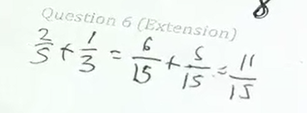
4.2 Students use fraction walls to add fractions
2
1
“We had plus , Pascal,
what did you notice?”
“… that you can’t do it on the graph”
Notice how the choice of an example that couldn’t be done on the graph forced the students to think about the numbers involved and encouraged fluency with the symbols.
5
3

