Slide 1
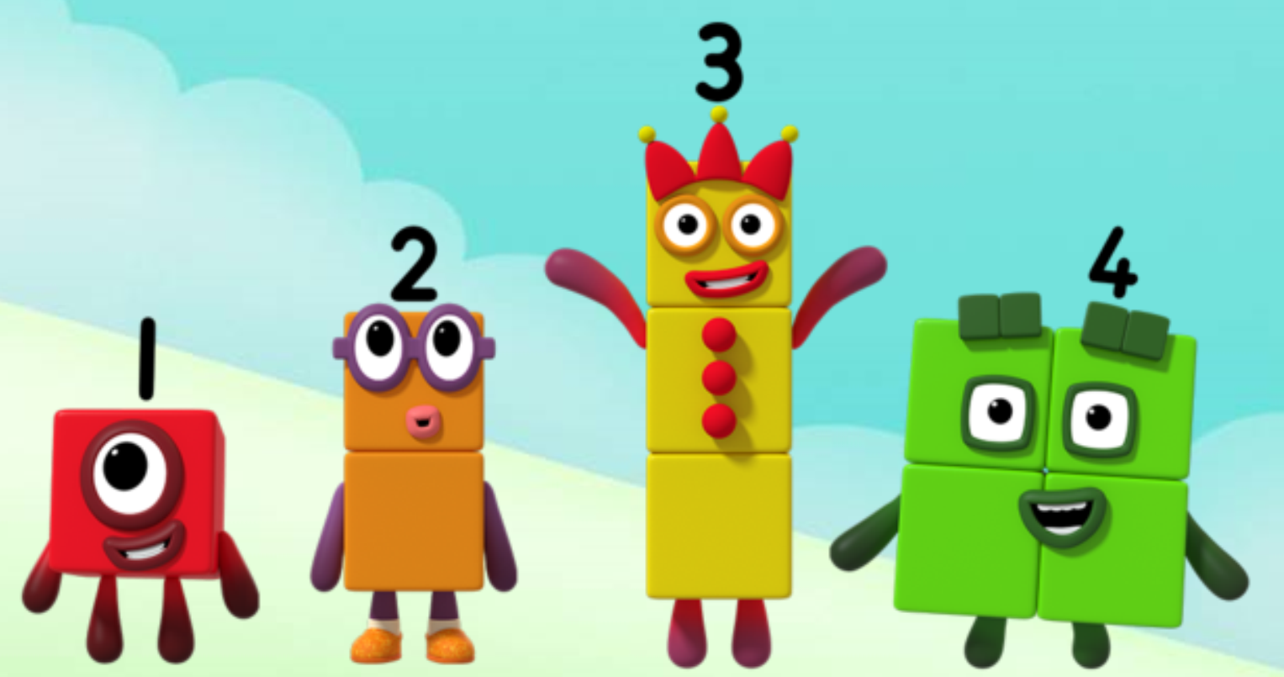
Series 2 Episode 5
Ten

Slide 2
Maths in the Episode
To watch this episode, please go to BBC iPlayer – Numberblocks Look for Series 2: Ten.
Saying the counting numbers to ten
In this episode children see Ten being made when One jumps on top of Nine and they join (combine) together. Children can practise counting to ten with the Numberblocks.
Ten ones is equal to one ten
Children can see that we can describe ‘ten’ as ‘ten ones’ or ‘one ten’.
Ten can be made in different ways
Ten can be made of two fives.
Ten can be made of five twos.
Ten can be made of one and two and three and four – like a staircase.

Slide 3
Talk and discuss together
Watch the episode together.
Ask your child what they noticed and be interested in anything they have to say.
Use the following pictures and activities to explore and talk about the maths involved.

Slide 4
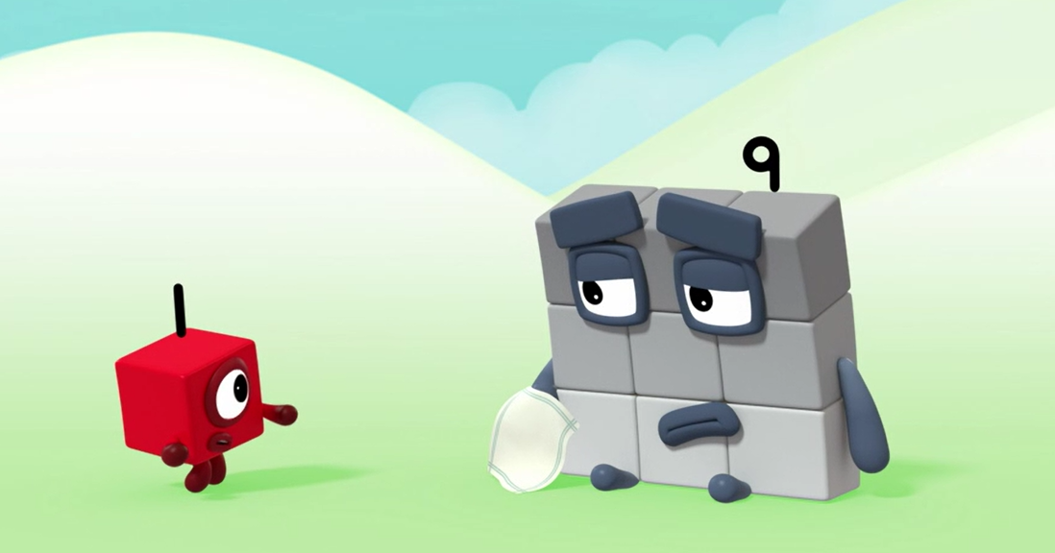
How can I be one bigger?
Images © 2017 Alphablocks Ltd. All Rights Reserved.

Slide 5
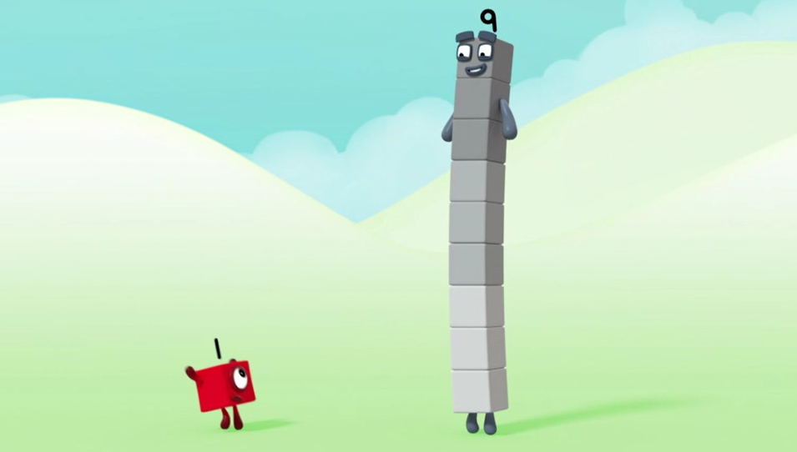
Stand up tall! What will happen if I jump on you?
Images © 2017 Alphablocks Ltd. All Rights Reserved.

Slide 6
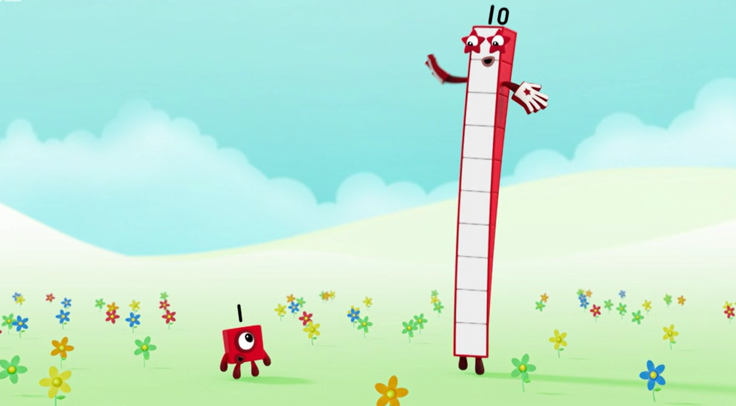
I am Ten!
I am made of nine and one more.
Images © 2017 Alphablocks Ltd. All Rights Reserved.

Slide 7
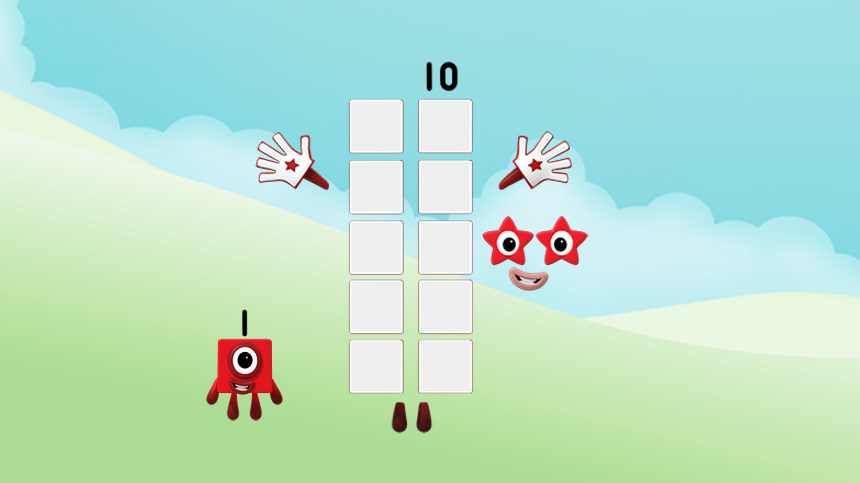
How many ones can you see in me?
Images © 2017 Alphablocks Ltd. All Rights Reserved.

Slide 8
I am made of ten ones!
Images © 2017 Alphablocks Ltd. All Rights Reserved.

Slide 9
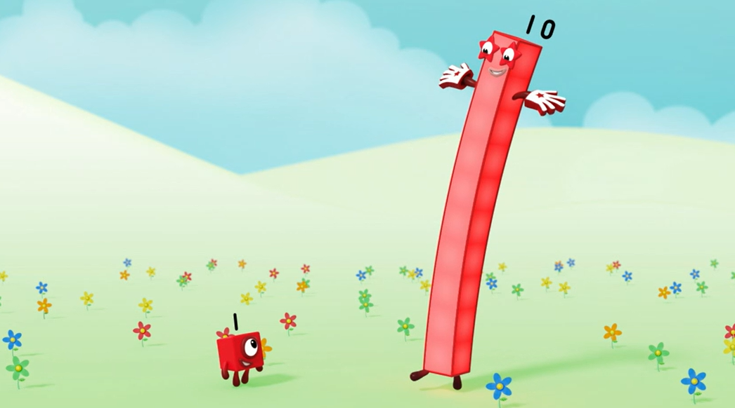
Look at the faces of a dice. Find one in your home or on the internet. What do you notice?
I am one ten!
You are one one!
Images © 2017 Alphablocks Ltd. All Rights Reserved.

Slide 10
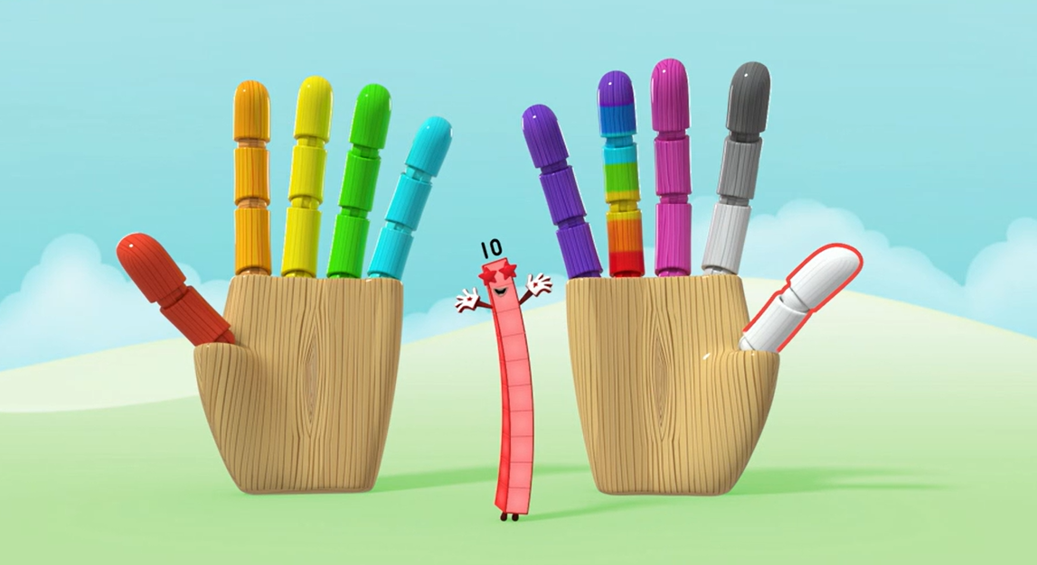
Can you see me on your hands?
Images © 2017 Alphablocks Ltd. All Rights Reserved.

Slide 11
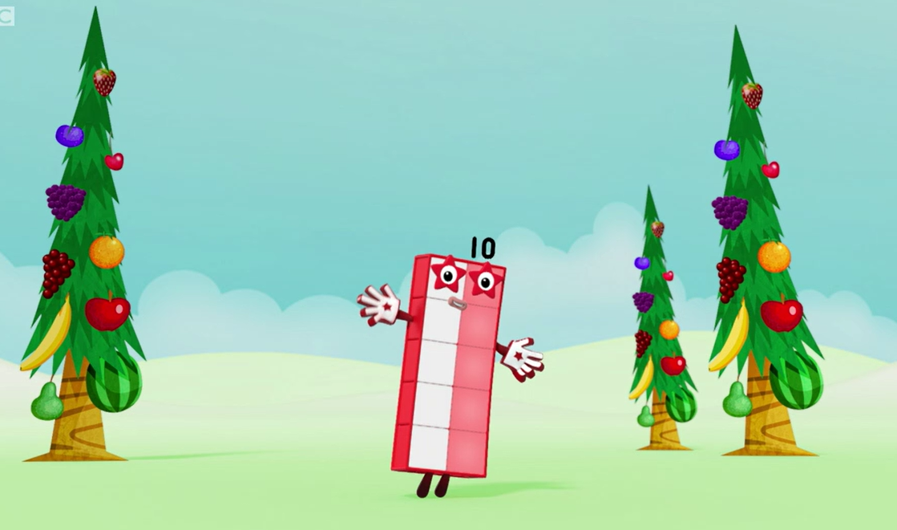
Can you see that I am made of two fives?
Images © 2017 Alphablocks Ltd. All Rights Reserved.

Slide 12
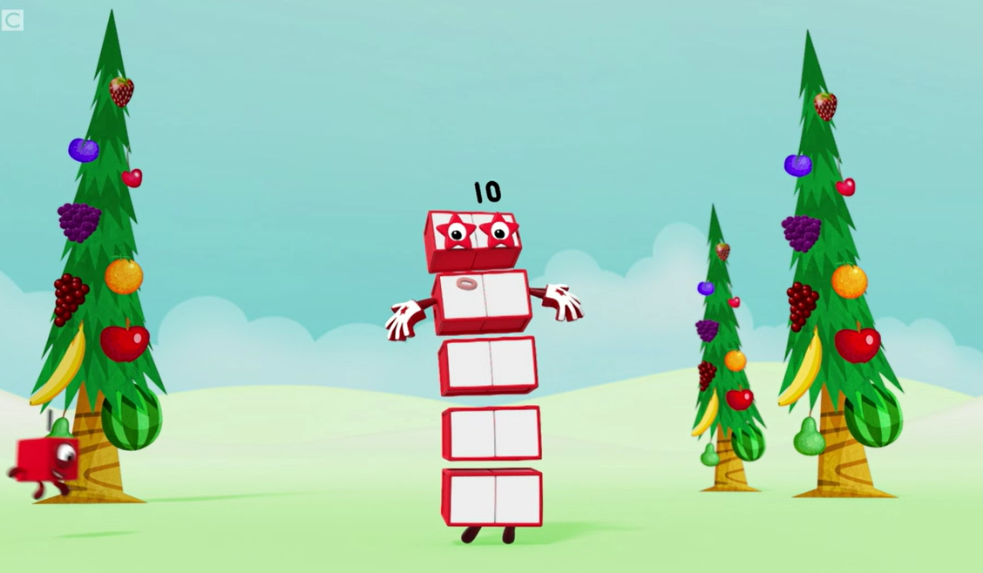
Can you see that I am made of five twos?
Images © 2017 Alphablocks Ltd. All Rights Reserved.

Slide 13
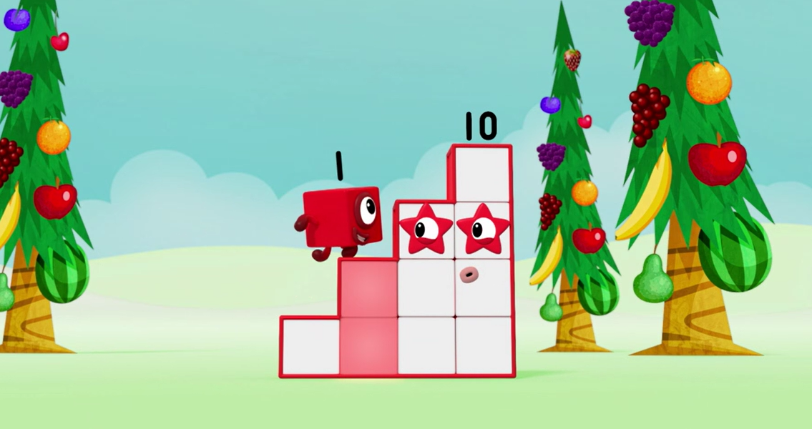
Look at the faces of a dice. Find one in your home or on the internet. What do you notice?
Can you check that I am still ten blocks?
Images © 2017 Alphablocks Ltd. All Rights Reserved.

Slide 14
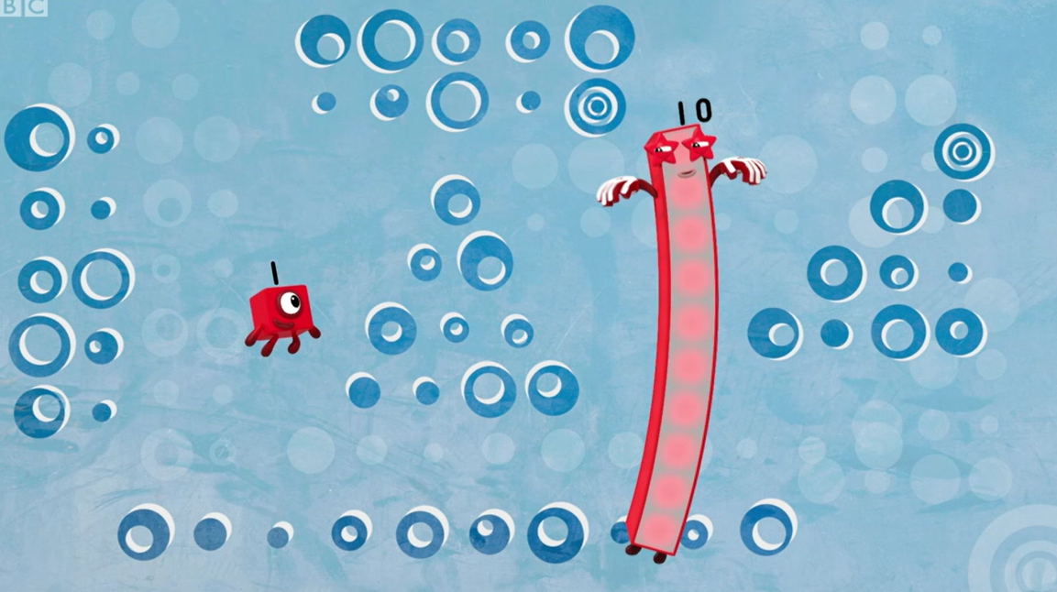
Look at my patterns! Which do you like best?
Look at the faces of a dice. Find one in your home or on the internet. What do you notice?
Images © 2017 Alphablocks Ltd. All Rights Reserved.

Slide 15
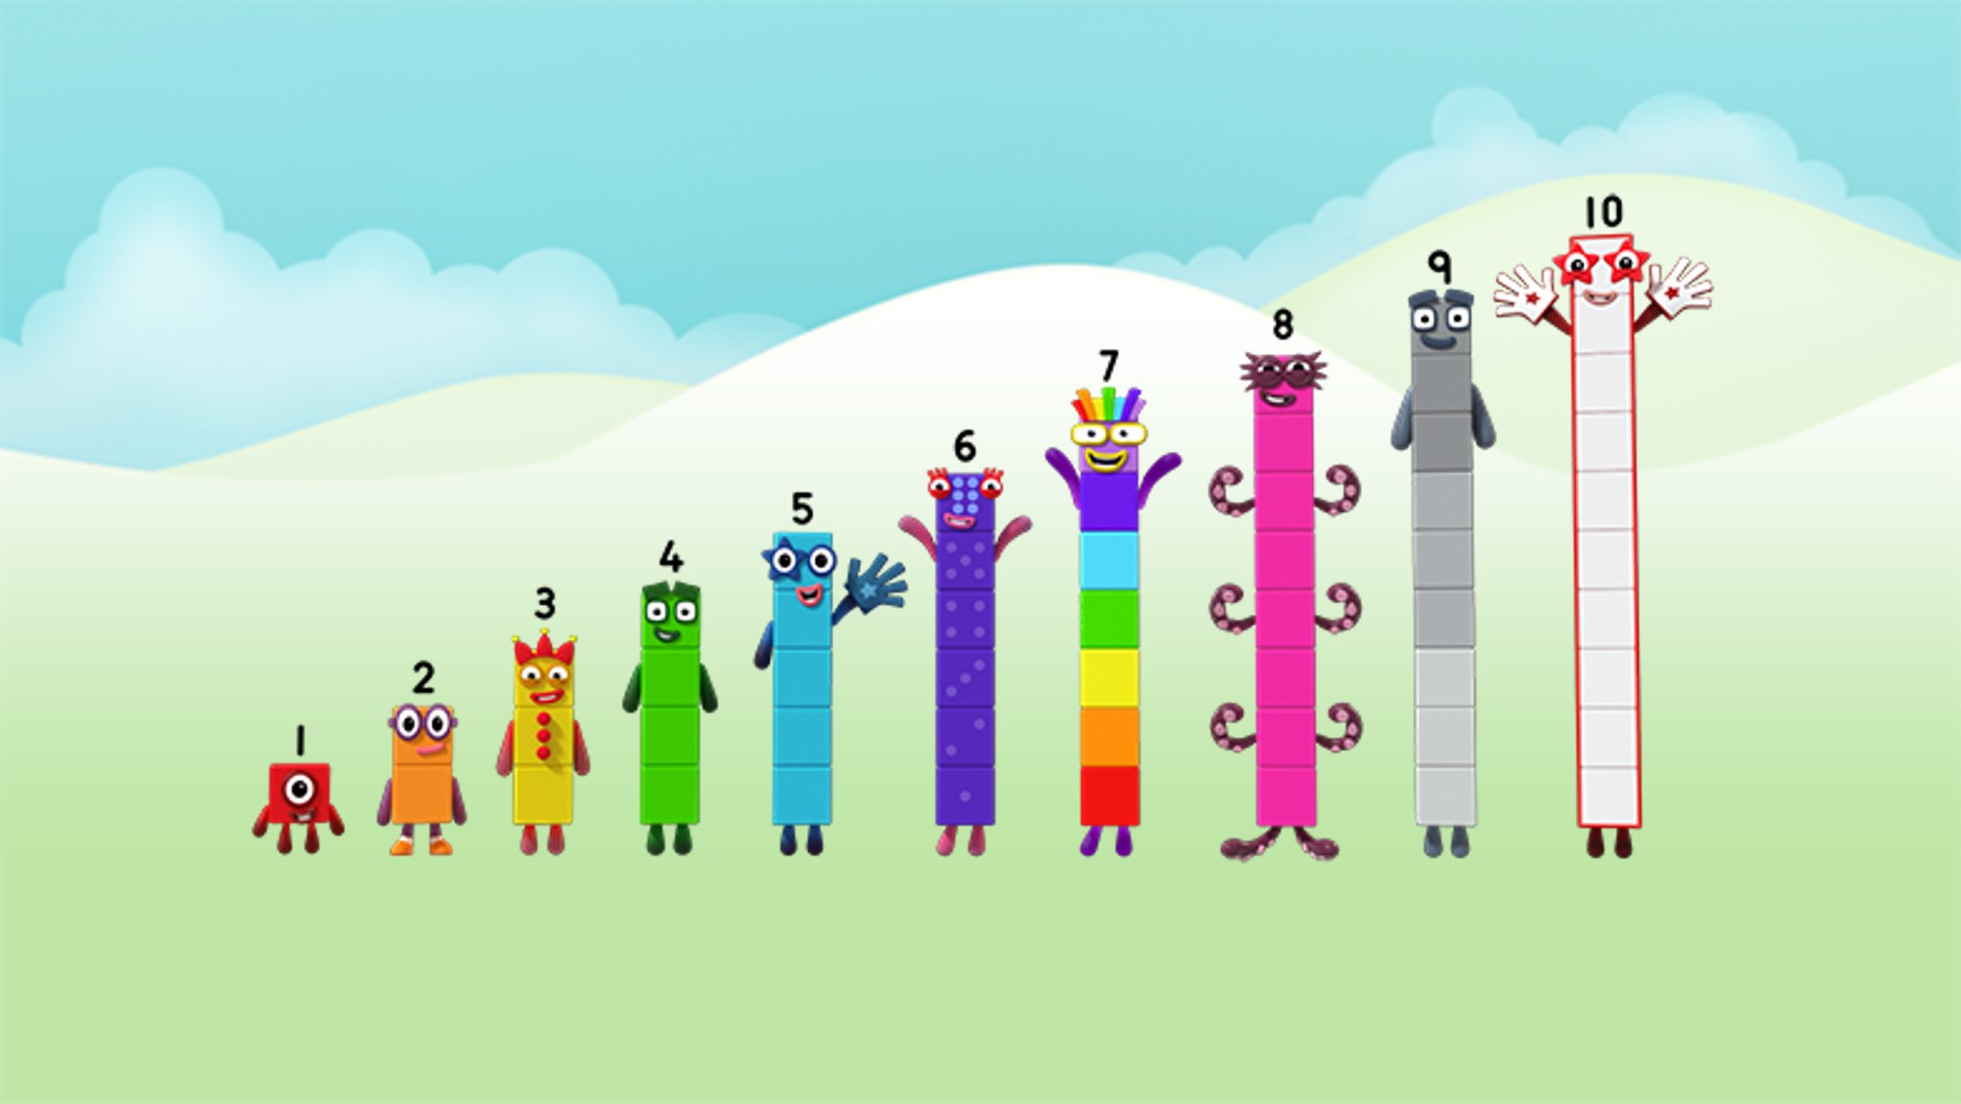
You can stand next to me, Ten!
1, 2, 3, 4, 5, 6, 7, 8, 9, 10!
Images © 2017 Alphablocks Ltd. All Rights Reserved.

Slide 16
Around the home
Practise showing ten fingers all at once.
Practise counting on your fingers by putting up one finger at a time.
Practise counting up the stairs. Are you nearly at the top if you count ten stairs?
Get active! Can you do ten jumps, ten hops, ten claps? Keep track of your movements by counting to ten.
Find some small objects and count out ten from the collection. Remember to stop counting at ten so you have the right number.
Arrange your objects in different ways. Can you put them in a line or row? Can you put them in two rows? Can you make them into a staircase or a triangle shape?
Play a ‘Race to Ten’ game. Collect some objects that you like, and a bag and a dice. Roll the dice and put that number of things into your bag. The winner is the first to put ten things in their bag.
Use ten building blocks to make a staircase for a toy – one and two and three and four.
Draw a suitcase for Ten to go on holiday. Can you draw ten things she will need to take?
Draw ten footprints and cut them out. Put your footprints down to make a path. Can someone follow your path of ten footprints?

Slide 17
General tips that can make a difference in maths
Provide lots of opportunities to say how many things you can see (up to 5) without counting.
Whenever you talk about a small set of objects, say the number. For example, please pick up those 3 teddies or look at those 2 dogs.
Count up (starting from one) when walking upstairs and count back when walking downstairs.
Count lots of different objects, big and small, and ask ‘How many are there?’ Your child should be able to tell you without going back and re-counting. If they can’t, then tell them: ‘There are 6 altogether’.
Play with fingers, firstly practise counting fingers.
Ask your child to put their fingers down and then say or hold up a number such as 3. Can they do it without counting? Can they do it using different fingers? Can they do it using fingers from two hands?
Play board games with your child which involve moving along numbered tracks, such as ‘Snakes and Ladders’. Check that your child counts along the track correctly, moving one square for each number counted.
Regular use of these simple ideas, whenever the opportunity arises, will improve your child’s maths.

Slide 18
General tips that can make a difference in maths
Notice when there are two amounts and one is more than the other, or they are the same. For example, I have 2 eyes and 2 ears, or I have more chips than peas.
Talk about and describe shapes you can see outside or around your home. For example, count corners, talk about straight/curved edges, flat/curved surfaces. If you have building blocks then talk about and describe the things that are built.
In the bath or at the sink, play with containers, pouring water, counting how many small pots are needed to fill the big container.
Encourage your child to draw a picture of their number work and explain their mark-making to you, for example, how many leaves they find on a walk. This doesn’t necessarily mean writing the numerals (1, 2, 3, 4… etc.).
Sing counting songs and rhymes. You can find some on the internet, but children love it if you join in with them!
Make a deliberate maths mistake from time to time and ask your child to explain why you are wrong. For example, say that 4 is bigger than 5.
Regular use of these simple ideas, whenever the opportunity arises, will improve your child’s maths.

