Slide 1
Numberblocks
Support Materials
Series 2, Episode 1
Six

Slide 2
Practitioner Notes

Slide 3
Episode Description
The Numberblocks find a small wooden cube with dots on it, and are surprised to discover that one side has more dots than they can count. It’s time to make a new friend, and so Numberblocks Five and One do number magic to make Six. Six appears and tells her new number friends all about dice and how to play games. She raps - Six is in the Mix - about dice and gets the others playing games. First, they take turns to match the dot patterns on the dice with their blocks, they then roll the dice in turn to decide whose turn it is to dance. They each do a characterful counting dance, before ending with dice games including snakes and ladders.

Slide 4
Maths in the Episode
Subitising Dice Patterns
In this episode children experience recognising the spot patterns on the dice without counting. This is known as ‘subitising’. Being able to subitise small quantities has been shown to be a key skill in developing number sense.
Counting from 1 to 6
This episode provides another opportunity to develop counting skills from 1 to 6. Observe whether children use one-to-one correspondence (match one number name to each object) and, know the number names in order.

Slide 5
Using Mathematical Language
During this episode children will experience recognising dice spot patterns without counting.
Use this stem sentence to support the pupils’ noticing:
“I see 3 spots without counting.”

Slide 6
Talk and Discuss Together

Slide 7
Talk and Discuss Together
Watch the episode of Numberblocks. First ask the children what they noticed and allow them to talk to you and each other. The following slides are designed to stimulate children and adults to talk about the episode and draw out some key aspects of the mathematics.

Slide 8
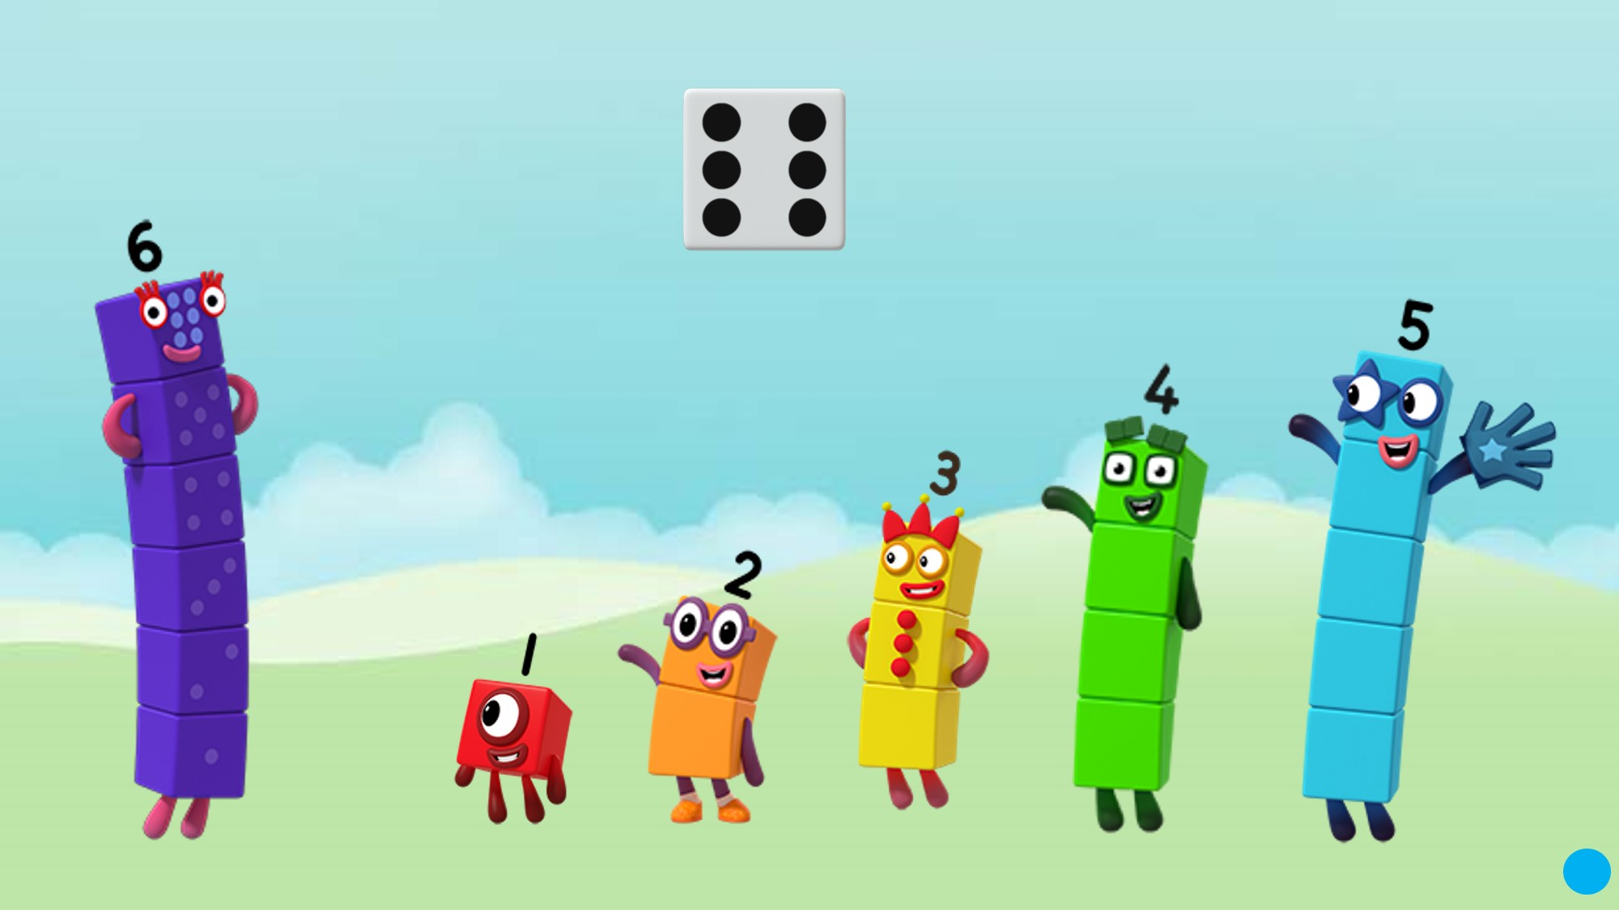
Images © 2017 Alphablocks Ltd. All Rights Reserved.
Notes:
Discuss the episode. What did you notice?
When have you used a dice?

Slide 9

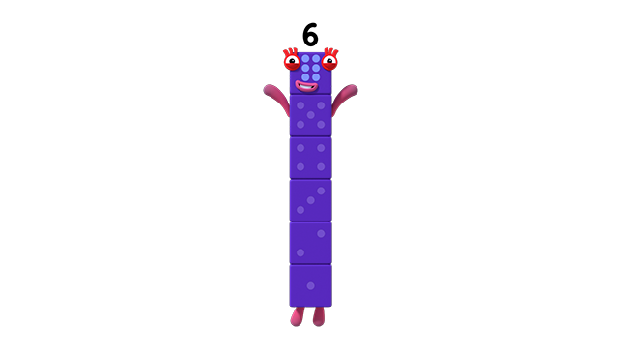

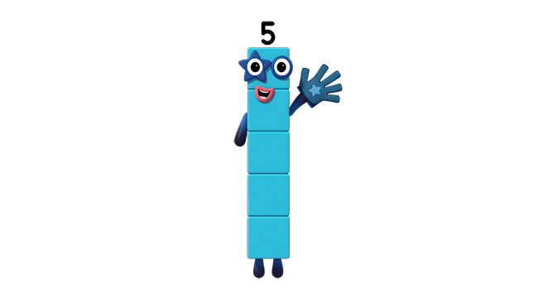
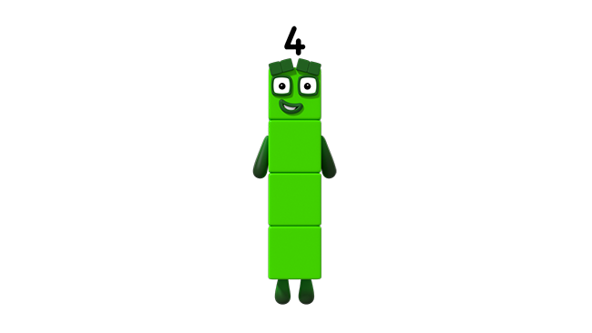

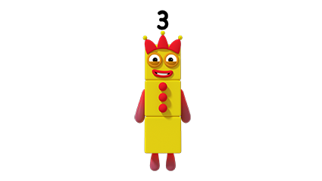

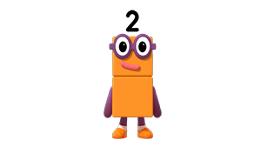

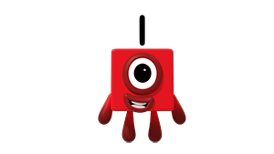


Images © 2017 Alphablocks Ltd. All Rights Reserved.
Notes:
Use this slide to see the relationship between the dice spot pattern and the Numberblock it represents.
Hand out a dice (with the 6 dice patterns on) to pairs of children.
For each Numberblock ask the children to look for the spot pattern on their dice.
This slide is animated:
Starting with One, on each click a Numberblock jumps and the relevant dice pattern appears and moves to create a tower which eventually turns into Numberblock Six.

Slide 10
Images © 2017 Alphablocks Ltd. All Rights Reserved.
Notes:
Use this slide both as an opportunity to practise counting to 6, and as a reminder of the Numberblock and matching spot pattern.
Hand out a collection of Numberblocks (1-6) made from linking cubes, one for each child.
Play musical dice (based on musical bumps).
Play some music to dance to. When the music stops, roll the dice. The children with the matching Numberblock have to sit down.
Start the music again. When the music stops, roll the dice. The children with the matching Numberblock sit down on the floor. Who sat down first with the correct Numberblock?
Swap Numberblocks with another child and play again.

Slide 11
Enabling Environments

Slide 12
Enabling Environments
Playing and Exploring
Leave out a simple lotto game to play. A baseboard with four spaces and a dice. Roll the dice. Pick up the matching Numberblock made from linking cubes and place on an empty space on the baseboard. Keep taking turns until all the children’s boards are filled. Then continue to play by rolling the dice and removing the Numberblock. The first child with an empty board is the winner.
Active Learning
Through providing dice, counters and board games, including dominoes, notice whether the children are counting the spots or are subitising the pattern.
Creating and Thinking Critically
Ask the children to bring in an empty cuboid tissue box to make into a dice. Use sticky dots to make the dice patterns.

Slide 13
Learning Together in Y1

Slide 14
Images © 2017 Alphablocks Ltd. All Rights Reserved.
Images © 2017 Alphablocks Ltd. All Rights Reserved.
Notes:
Discuss the episode. What do you use dice for? Where else have you seen the spot patterns? (dominoes?)
Provide pairs of children with six sticky notes. Ask them to draw on the spots in the correct pattern so that they have a full set.
Send the children off to stick their sticky notes around the classroom and then sit down.
Count up to 6 and backwards to 1, and then send the children off in pairs to collect a full set of dice patterns (but they mustn’t collect ones that they made).
Bring their collection back to show and discuss.

Slide 15
Click on each Numberblock
Images © 2017 Alphablocks Ltd. All Rights Reserved.
Notes:
This slide is animated:
Click on each Numberblock in turn to distribute the dice.
Talk about the total number of spots each of the characters has on their dice.
Set the children the challenge of redistributing the dice so that each character has the same number of dots. Children use their sticky notes of dice patterns to work on the challenge.
The solution is on the next slide.
Opposite sides of a dice add up 7.

Slide 16
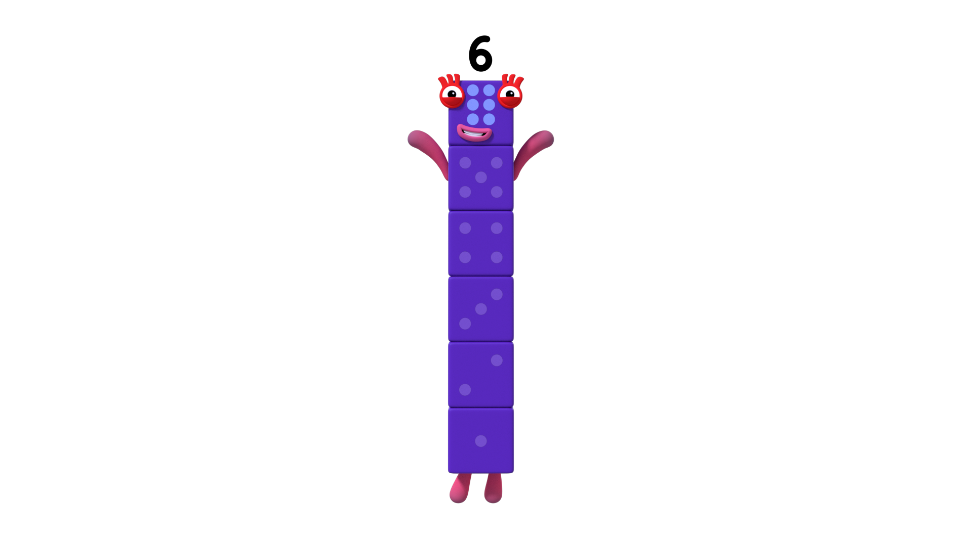
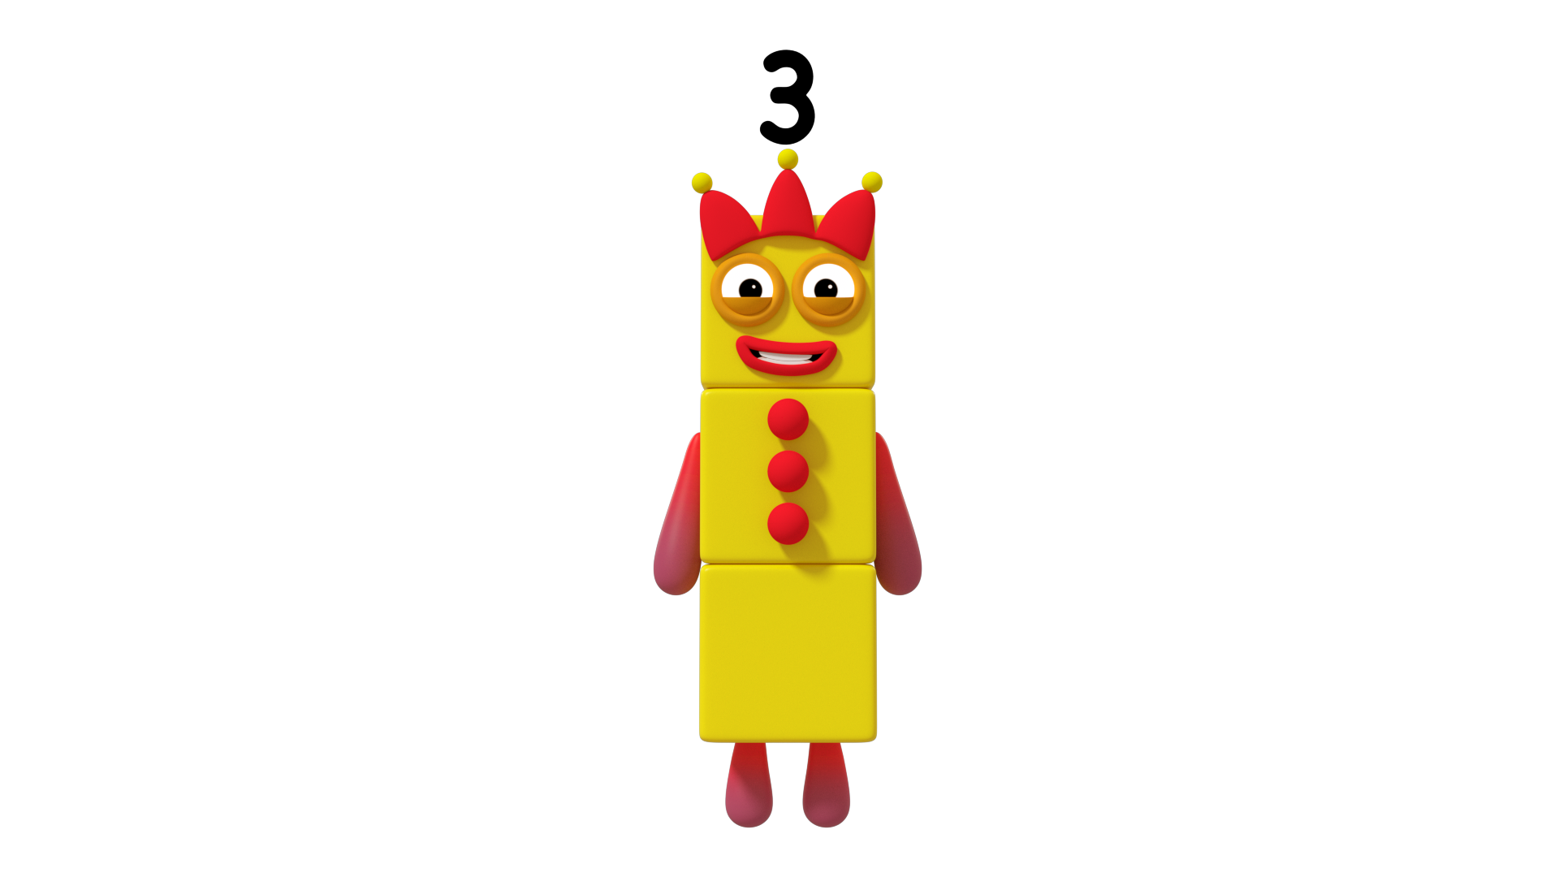
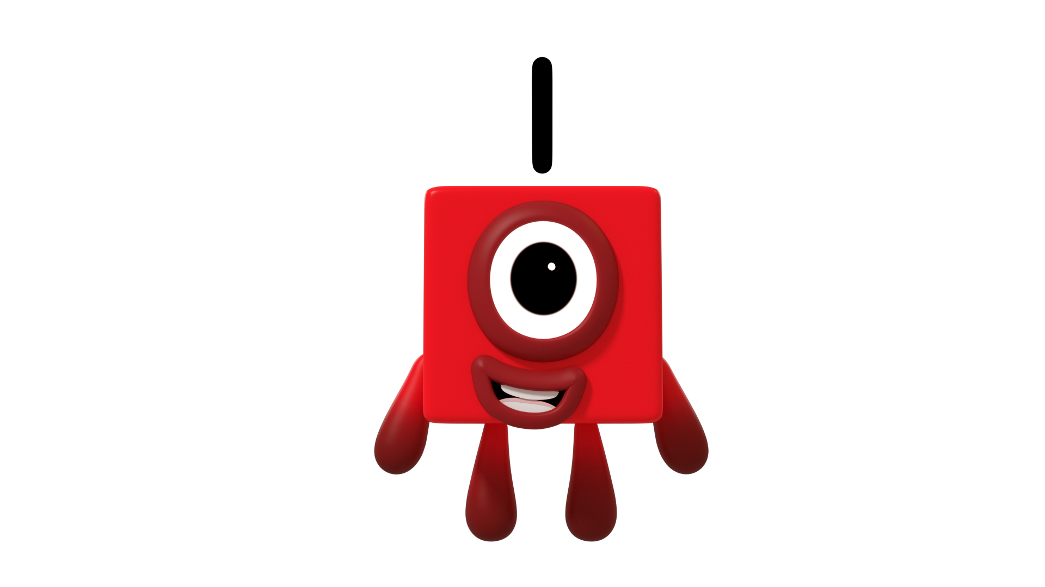
Click on each Numberblock
Images © 2017 Alphablocks Ltd. All Rights Reserved.
Notes:
This slide is animated to show a solution.
Click on each Numberblock to distribute the dice, in pairs that represent opposite sides of a standard dice.
Opposite sides of a dice add up to 7.

Slide 17
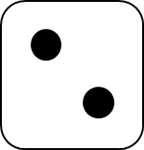
Click on the stars to show a 2 pattern
Images © 2017 Alphablocks Ltd. All Rights Reserved.
Notes:
Use this slide to encourage the children to look for a dice pattern within the arrangement.
Click on two stars that make the dice pattern 2.
Click to the right and the dice pattern 2 appears.

Slide 18
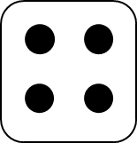
Click on the shapes to show a 4 pattern
Images © 2017 Alphablocks Ltd. All Rights Reserved.
Notes:
Use this slide to encourage the children to look for a dice pattern within the arrangement.
Click on the four triangles that make the dice pattern 4.
Click to the right and the dice pattern 4 appears.

Slide 19
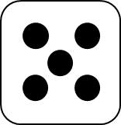
Click on the clouds to show a 5 pattern
Images © 2017 Alphablocks Ltd. All Rights Reserved.
Notes:
Use this slide to encourage the children to look for a dice pattern within the arrangement.
Click on clouds that make the dice pattern 5.
Children may also see the dice pattern 3.
Click to the right and the dice pattern 5 appears.

